Slide 1
Dust plume update
UIOWA model

Slide 2
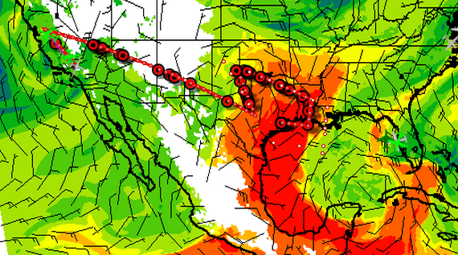

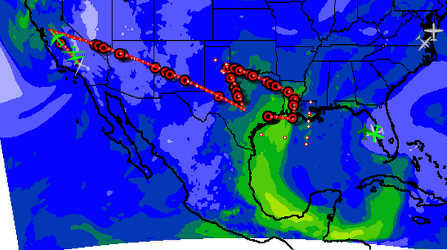
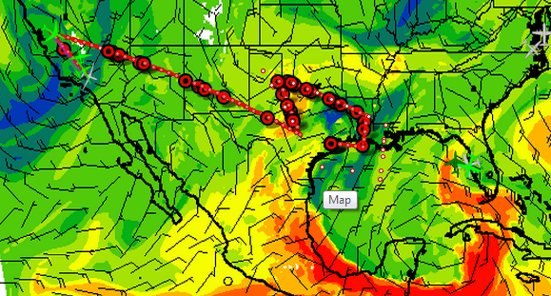

Latest forecast shows the tracks are going to be able to measure the Saharan dust layer pretty well
However, the model is showing the layer closer to the ground now, not seen at 700mb
DUST 850mb 00 UTC, Aug 9th
AOD 00 UTC, Aug 9th
DUST 700mb 00 UTC, Aug 9th

