Slide 1

Weather Briefing for
Monday and Tuesday
Henry Fuelberg
Nick Heath
Tristan Hall

Slide 2
Highlights
Note—These are 4-5 day forecasts that are subject to considerable uncertainty.
Clouds generally will not be present over CA, NV, OR, WA, or ID
Coastal stratus tends to diminish during the day and reform during the night and early morning
Small chance of isolated precipitation over mountain regions during the afternoons.

Slide 3
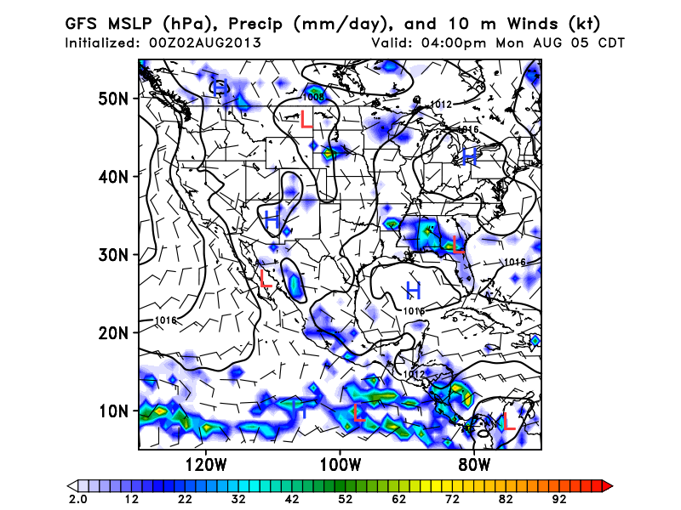
Conditions Monday at 2 PM PDT
→High off Pacific Coast produces flow from NW at surface over Pacific.
Winds become more westerly over Intermountain West
→Isolated Tstorms (~10% PoPs) could occur over the mountainous areas of WA, OR, and northern CA

Slide 4
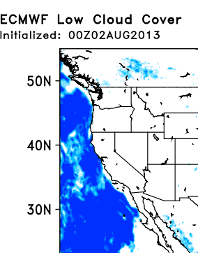
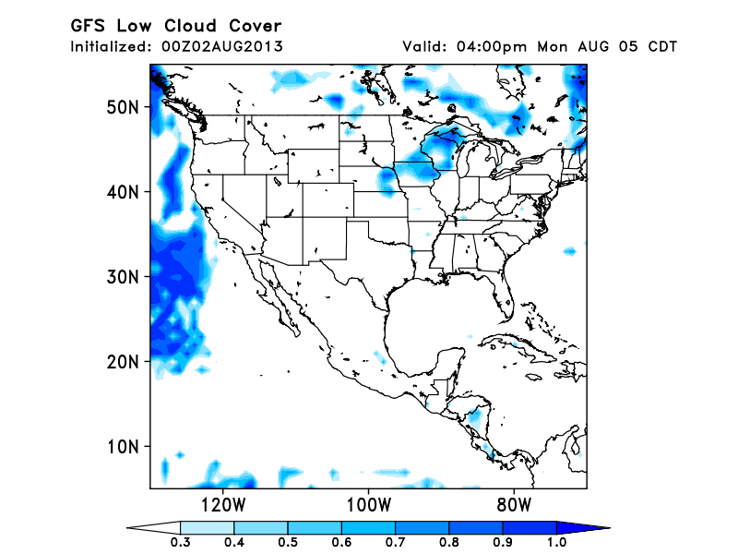
Low Clouds valid at 2 PM PDT Monday
→Low clouds expected off coast of CA. The ECM model is more aggressive with
the clouds than the GFS. Since the ECM model has been verifying better than the GFS,
we accept the ECM results. Over land, no (or only isolated) clouds expected.

Slide 5
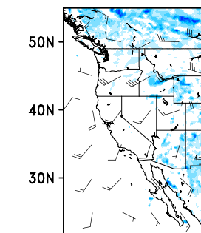
ECMWF Mid Clouds and 500 mb winds (kt) valid at 2 PM PDT Monday
→The only areas of scattered mid level clouds
In the flight areas are portions of WA, OR, and ID.
Clouds not expected to be widespread, just
scattered.
Flow at 500 mb is from SW, associated with
Offshore trough. Speeds are ~ 20 kt

Slide 6
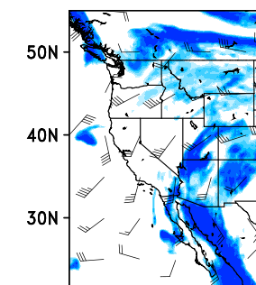
ECMWF High Clouds and 300 mb winds (kt) valid at 2 PM PDT Monday
High clouds become more widespread in the northern portions of the flight area, but most of the area is free of high clouds.
The SW monsoon is becoming more active than previous days. Outflow from the storms passes over AZ and portions of adjacent states.

Slide 7
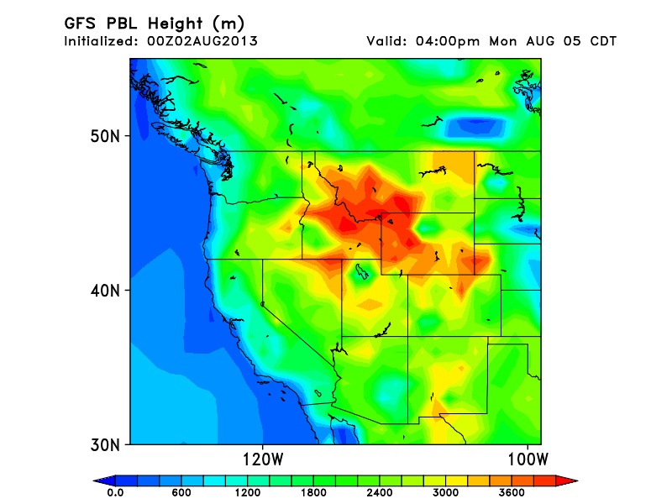
PBL Heights
2 PM PDT Monday
PBL heights (m AGL) generally are about 2000 m.
The exception is the area around ID

Slide 8
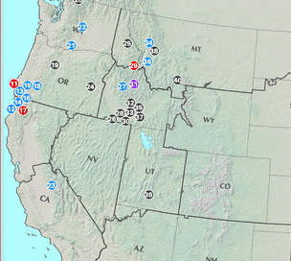
Fires Today on August 2

Slide 9
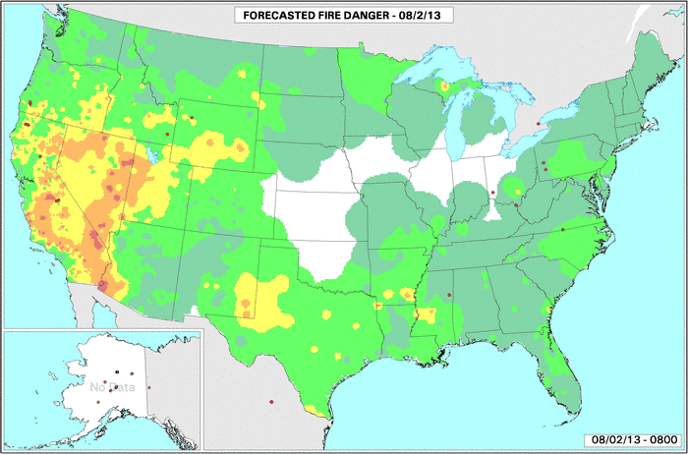
Fire Danger Today

Slide 10
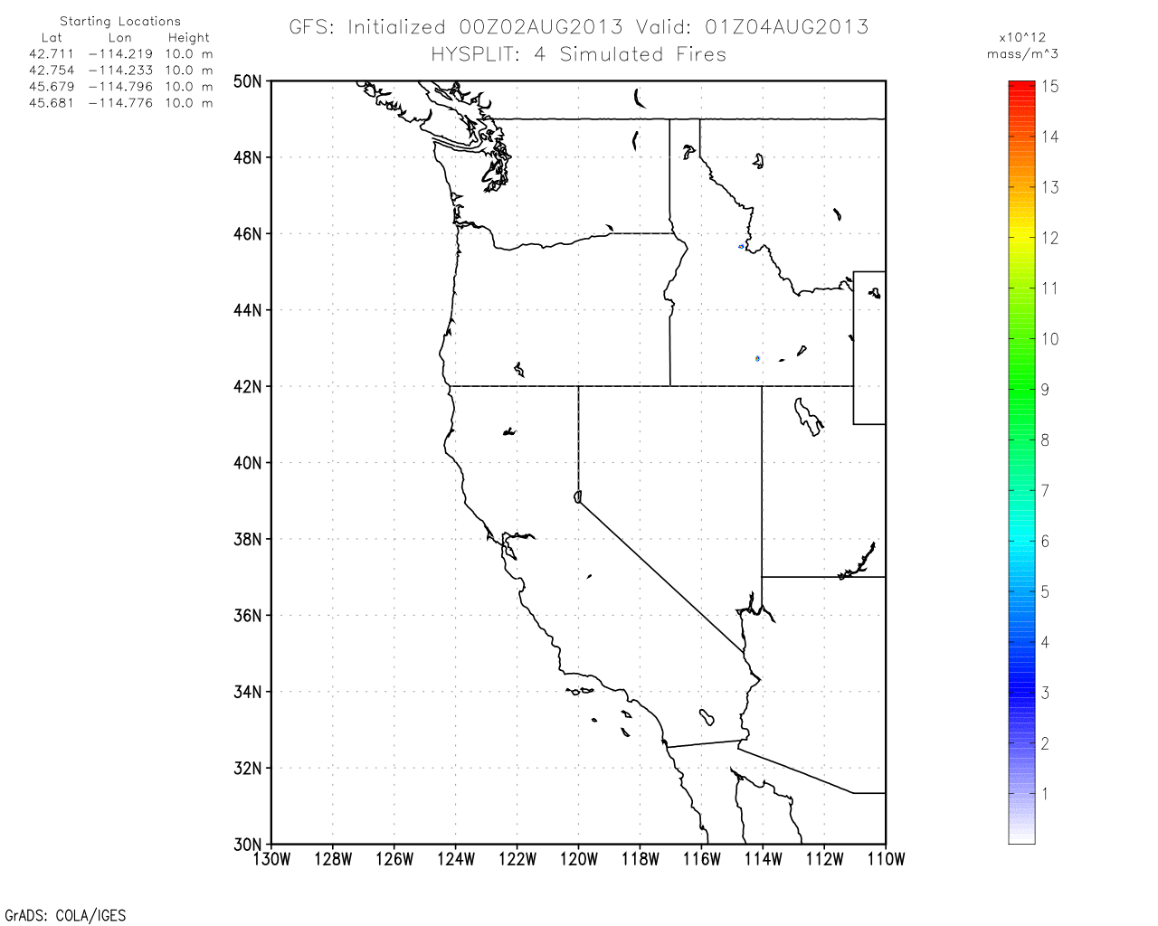
HYSPLIT begin Saturday, ID Fires

Slide 11
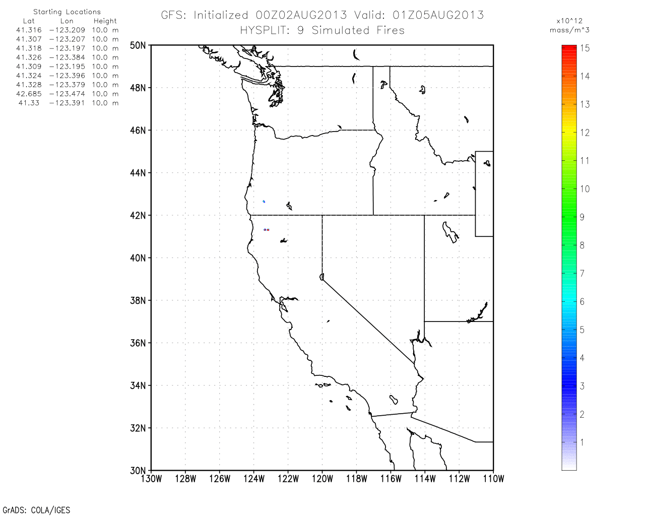
HYSPLIT Begin Saturday Eve. For N CA & OR Fires

Slide 12
Conditions for Tuesday at 2 PM PDT
No major changes in large scale flow
Isolated precip, again in mountain regions similar to Monday
(dependent upon position of upper-level cutoff low)
Cloud locations and amounts virtually unchanged

Slide 13
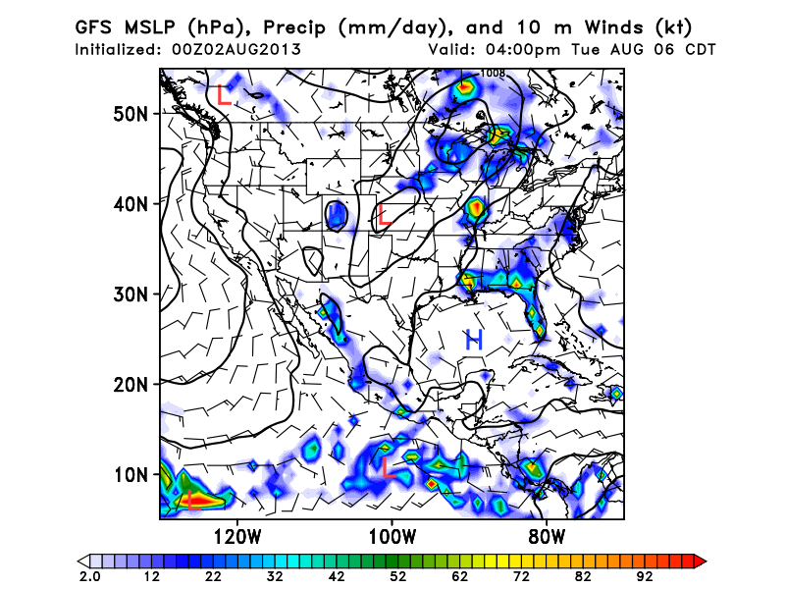
Valid 2 PM PDT Tuesday

Slide 14
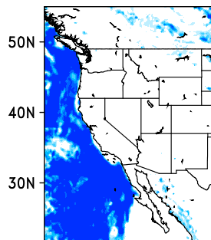
ECMWF Low Clouds valid at 2 PM PDT Tuesday

Slide 15
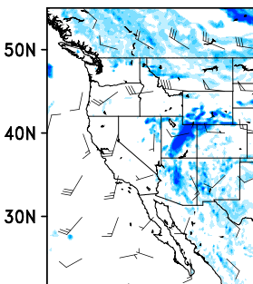
ECMWF Mid Clouds and 500 mb winds (kt) valid at
2 PM PDT Tuesday

Slide 16
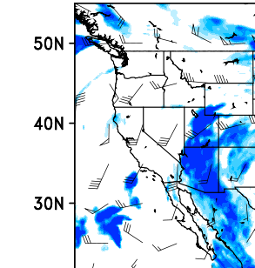
ECMWF High Clouds and 300 mb winds (kt) valid at
2 PM PDT Tuesday

Slide 17
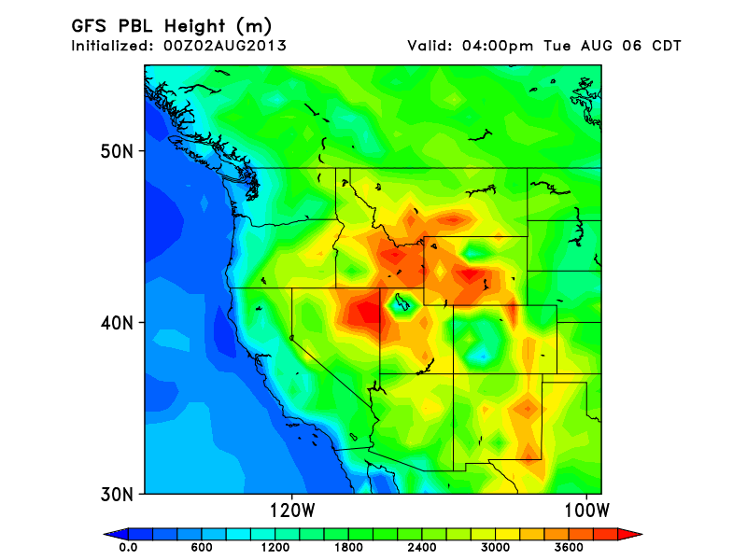
PBL Heights (m AGL)
2 PM PDT Tuesday

Slide 18
Questions ??
Contact Henry, Nick, or Tristan
hfuelberg@fsu.edu
nkh09@my.fsu.edu
tjh10c@my.fsu.edu

