Slide 1
Overview of next week’s weather
09 August 2013
Henry Fuelberg
Nick Heath
Sean Freeman

Slide 2
General
Looking at GFS ensemble because we’re going so far out
Not much confidence in convective forecasts at this point
Synoptic setup, however, does favor wet pattern over SE next week

Slide 3
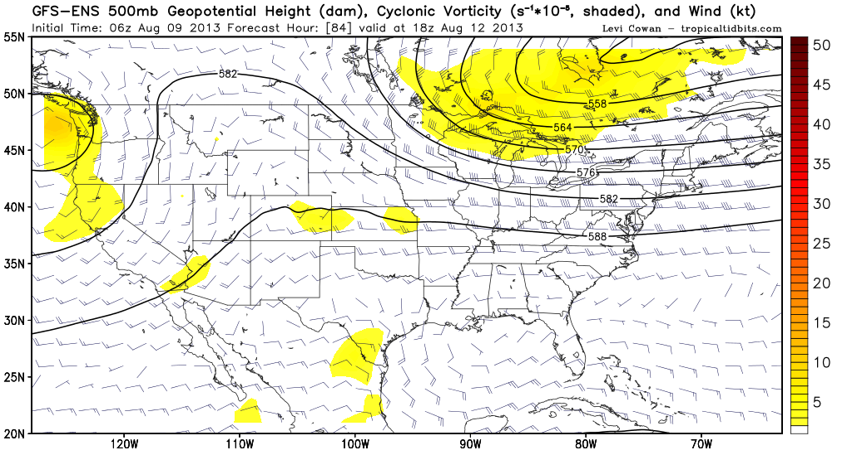
Monday 1 PM CDT
UL disturbance moves through Gulf over the weekend (red arrow)
Ridge builds in from the east, with zonal flow aloft over the SE by Monday
Typically sets up a diurnal convective cycle…afternoon convection probably focused on the front dropping down from the north and seabreeze front

Slide 4
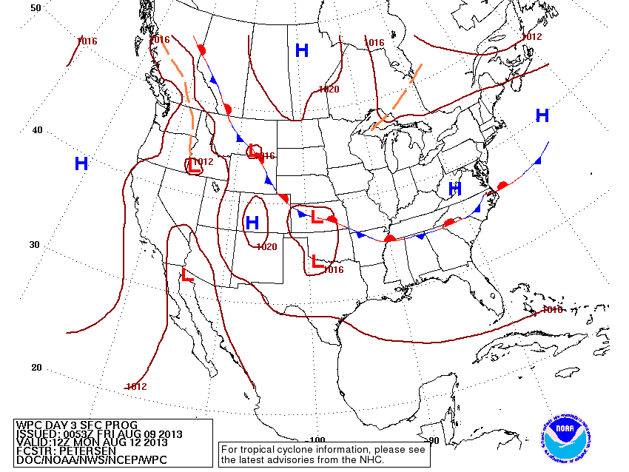
WPC frontal forecast for Monday at 7 AM CDT

Slide 5
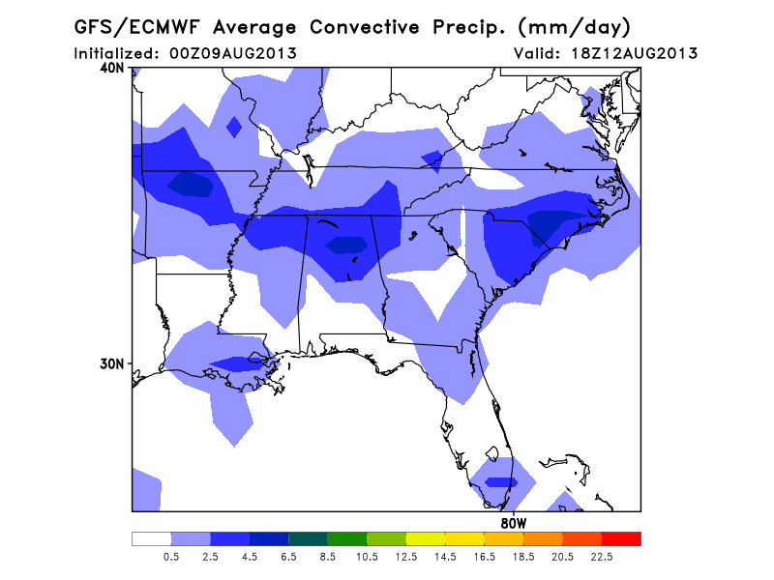
Average of GFS and EC puts convective precip in general region of sfc front on Monday afternoon

Slide 6
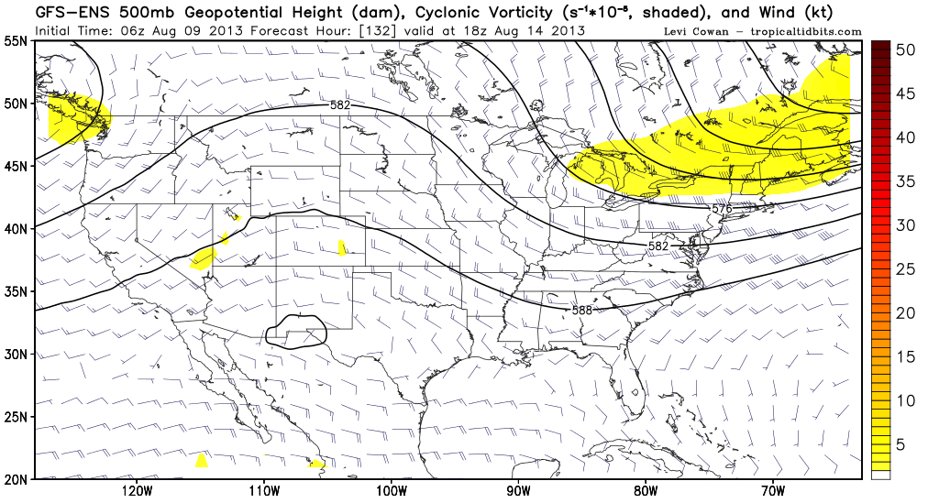
Wednesday 1 PM CDT
Monsoon ridge becomes re-established over midwest
Deep troughing takes over the eastern 1/3 of the CONUS
This typically leads to a much wetter situation over the SE

Slide 7
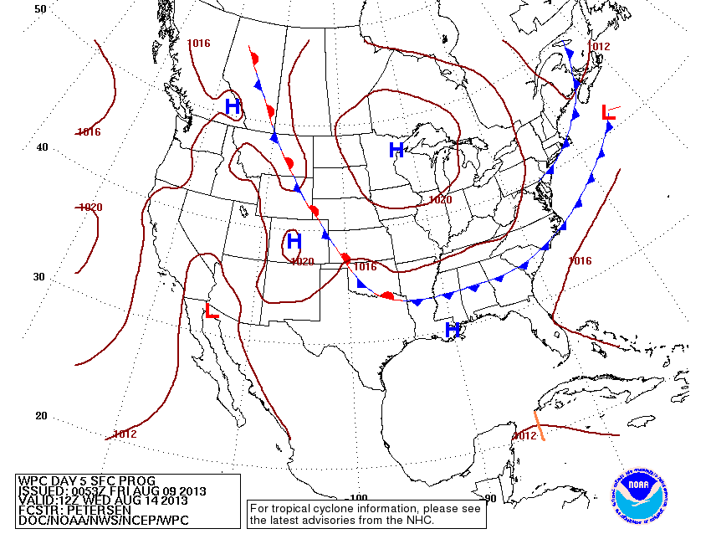
WPC showing sfc front dropping into SE on Wednesday
This, along with UL trough probably lead to an active convective day

Slide 8
Just for fun…

Slide 9
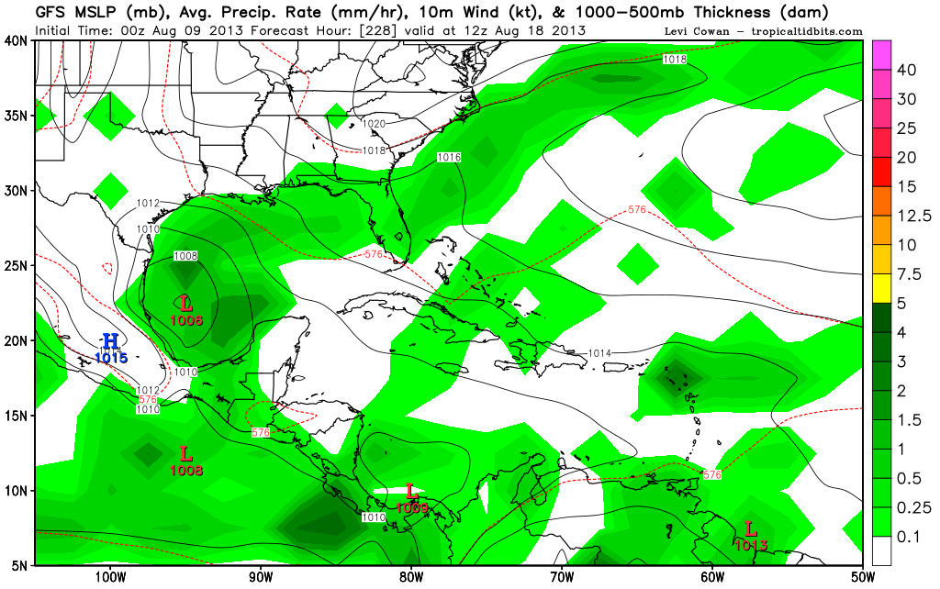
GFS putting a TC in the Gulf on the 18th!

