Slide 1
Today’s Convection -Chance of scattered storms over Texas
08 Aug 2013

Slide 2
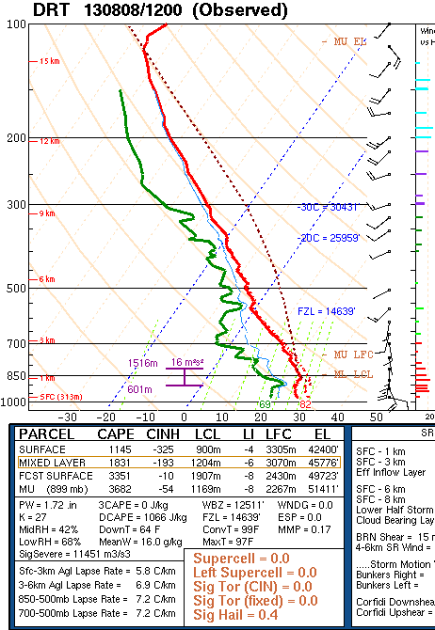
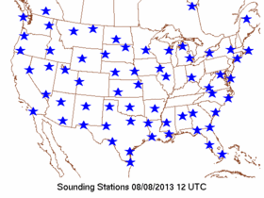
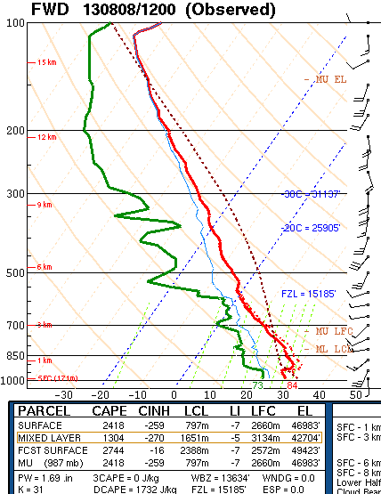

Slide 3
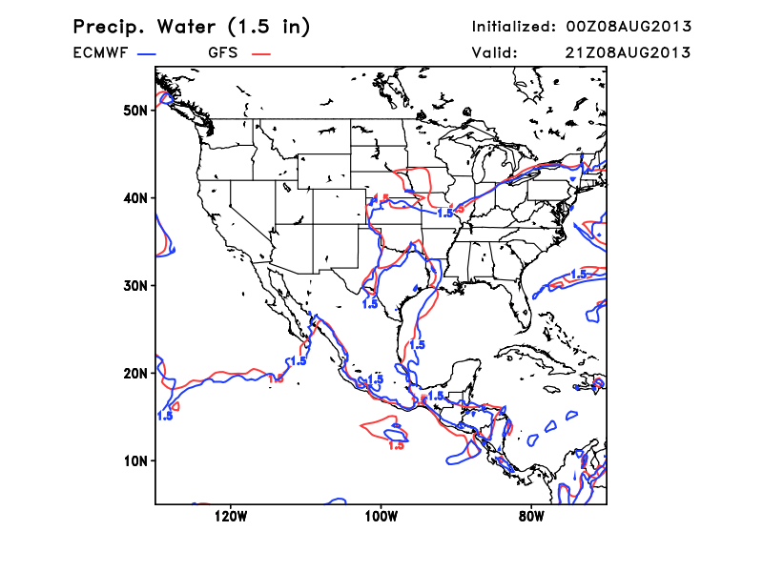
Large scale models agreeing on “pocket” of high precipitable water values

Slide 4
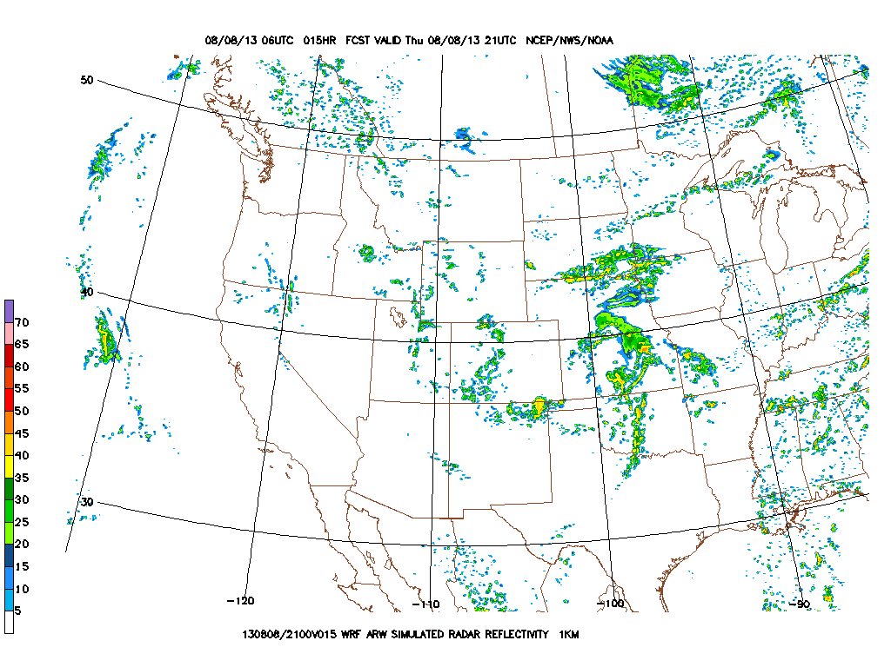
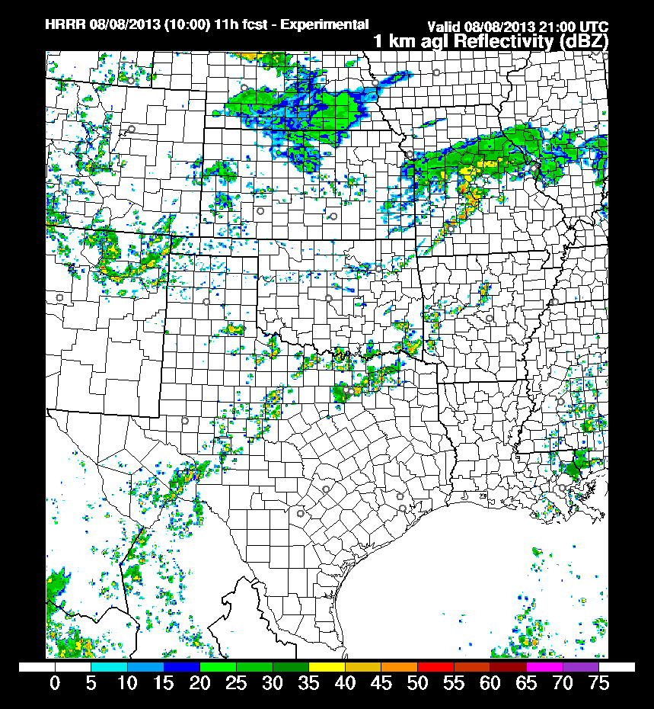
San Angelo NWS office forecasting 20-30 POPS
HRRR and 4 km WRF-ARW hinting at scattered convection in that same region

Slide 5
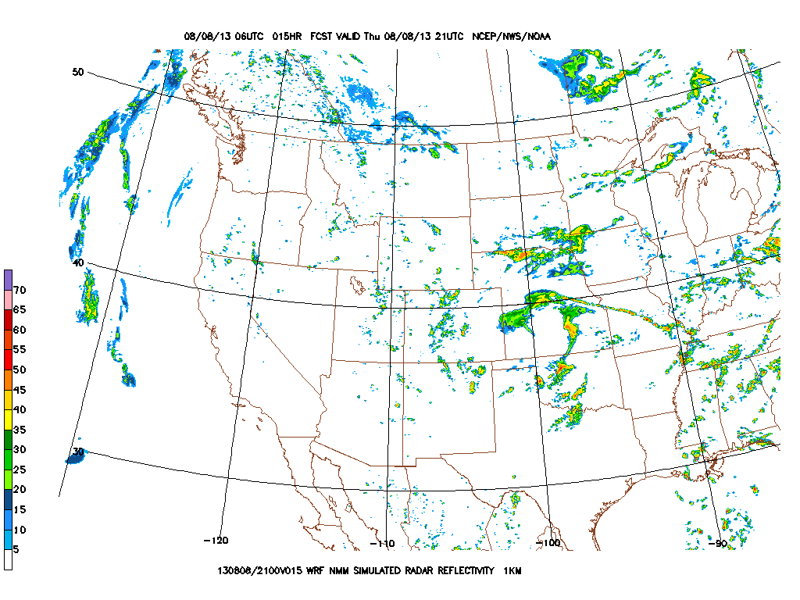
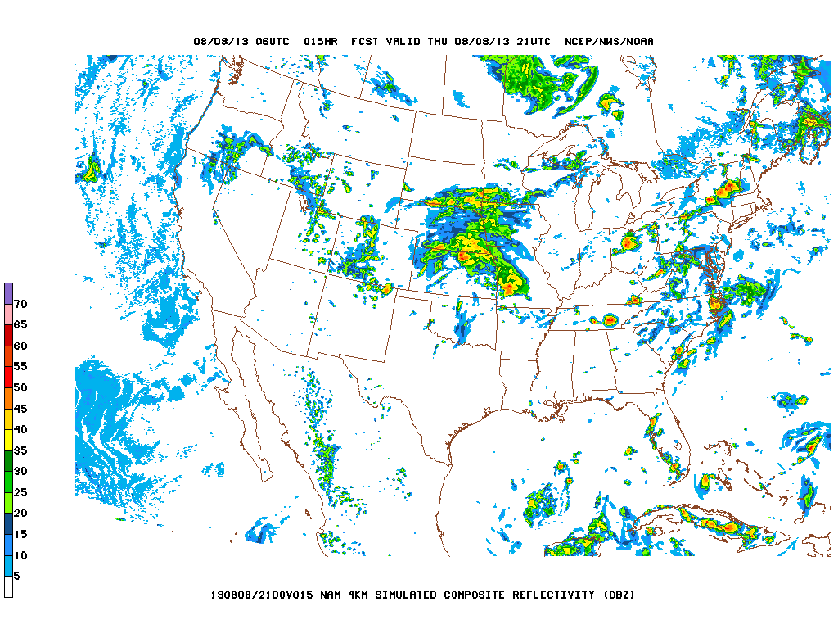
WRF-NMM’s not quite as agressive

