Slide 1
Sunday ASI-Barbados
I think it looks good unless there are delays. Even the easterly waves are staying out of your way!!

Slide 2
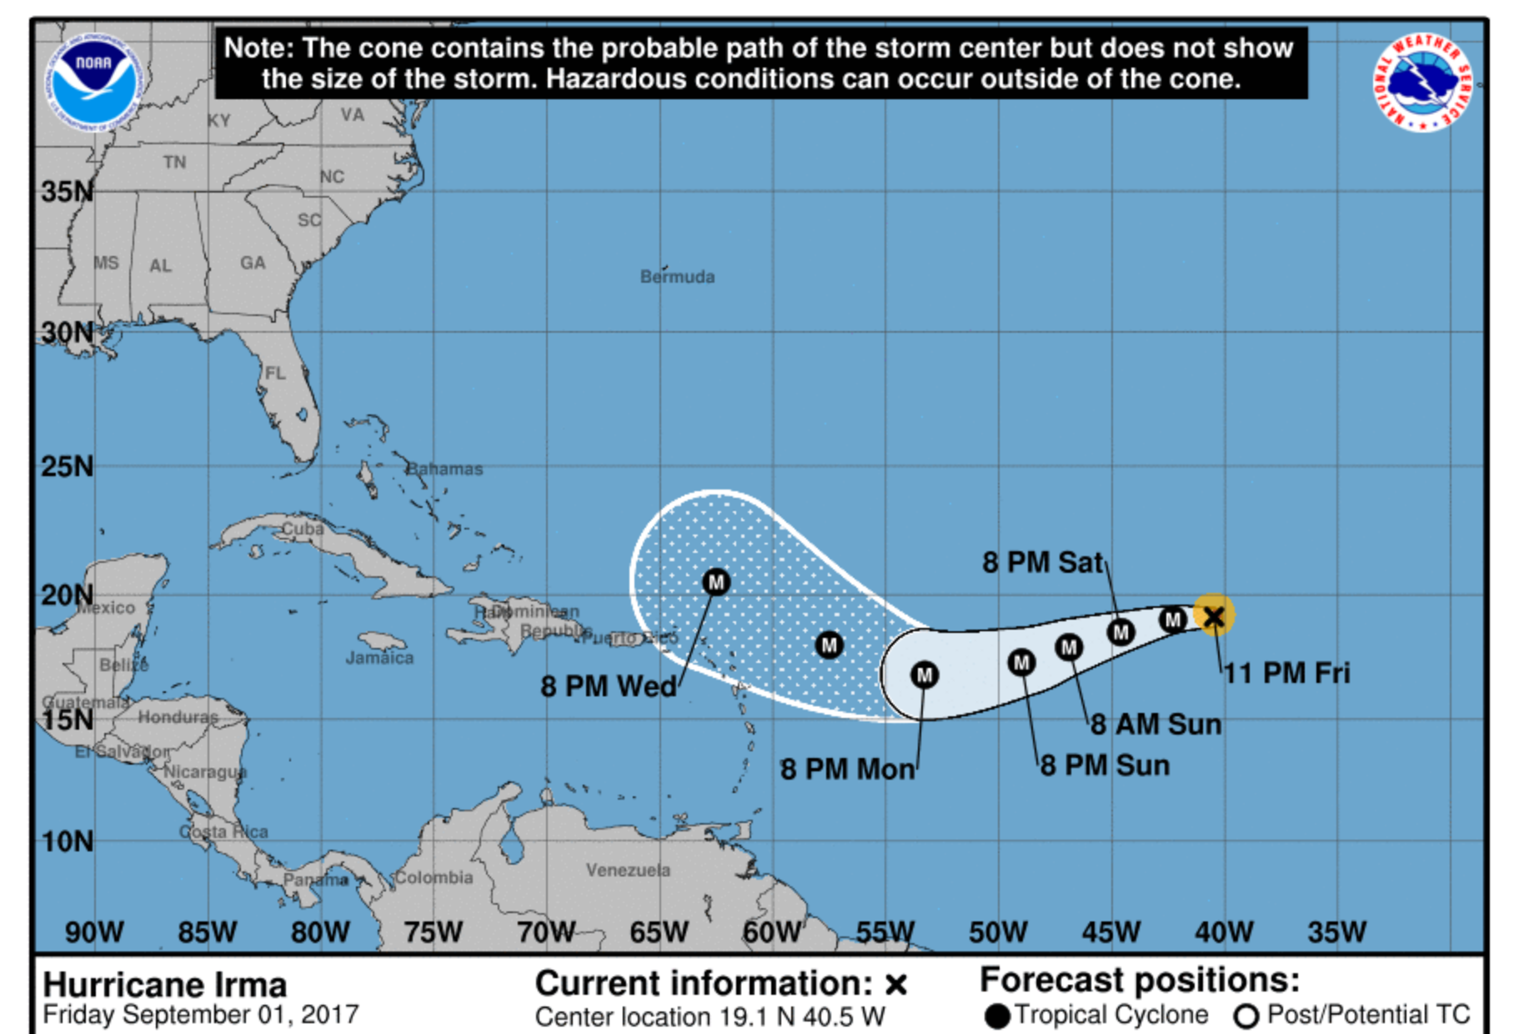
A more northerly track than yesterday’s
forecast. Even a day’s delay (arrival 8 PM
Monday instead of Sunday), should not be
a problem

Slide 3
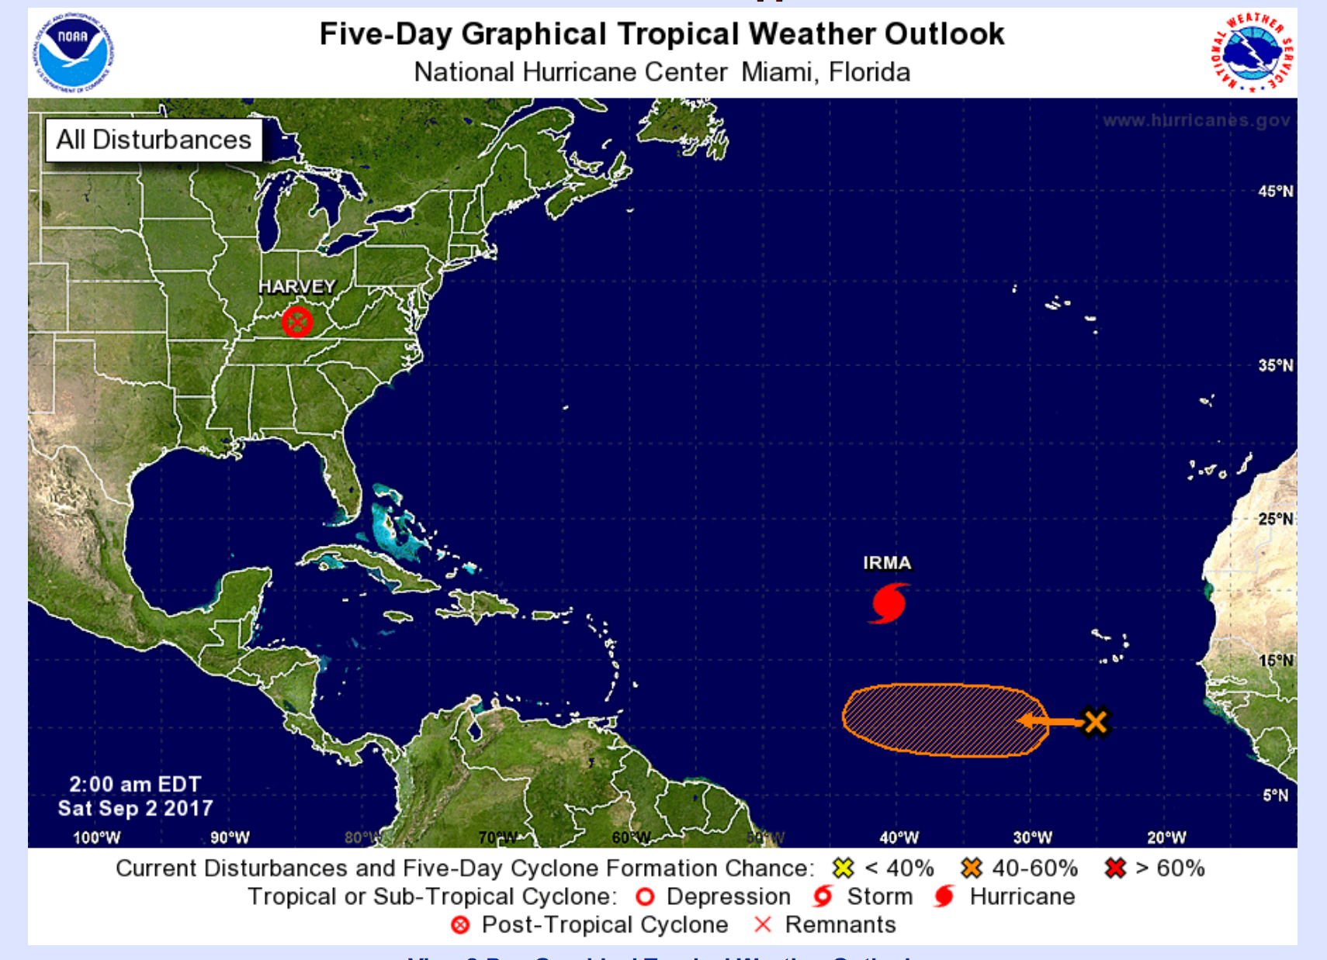
TC formation chance in the orange
region is near 0 in next 48 hours

Slide 4
Winds near cruise altitude
Valid 12Z Sunday, 9/3/2017, 500mb (18kft)

Slide 5
Winds near cruise altitude.
Valid 15Z Sunday, 9/3/2017, 500mb (18kft)

Slide 6
Precipitation, valid 9/3/2017 at 12 UTC

Slide 7
Precipitation, valid 9/3/2017 at 15 UTC

