Slide 1
Der letzte Wettervortrag
02-Sep-2017
Herr Professor Doktor Pfister und Doktor Rei Ueyama

Slide 2
Heute Morgen -- die Bilder vom Satellit und die Prognose der Modelle

Slide 3
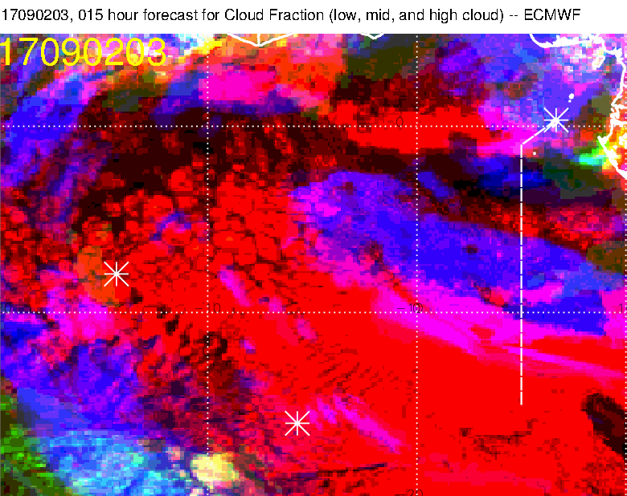
Also, dieses Modell ist aber ganz
verrueckt. Zu viele Wolken in der Hoehe.
Rei: “This appears to be a pretty big forecast bust.”
Low cloud forecast is not bad here.
Onset of middle cloud near TMS is OK. Also near 14W and 2N. Onset near 10S, 5E is missed

Slide 4
Die Englaender sind bloss ein bisschen besser.
Note that the low cloud forecast for this time is actually quite reasonable
Middle cloud is missed as well at 10S.

Slide 5
Middle cloud:
Increasing toward the west, but NOT the south
Moving west at .5 degrees per hour, not decreasing.
High cloud:
Steady, moving west at less than 1 degree per hour
Steady, moving west, previous clouds have dissipated here.
A little risk of high clouds along the northern track but looks OK.
Middle cloud will dissipate some, but not completely (even though UKMO says so).
A middle track, ironically, looks good.

Slide 6
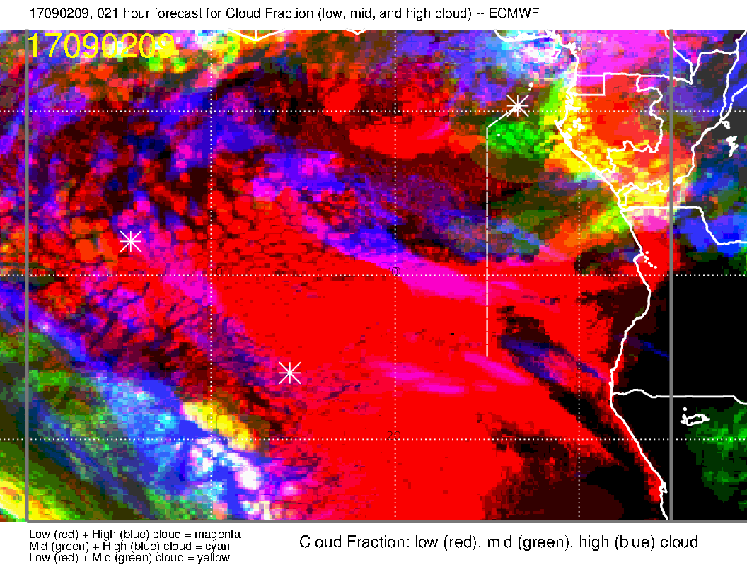
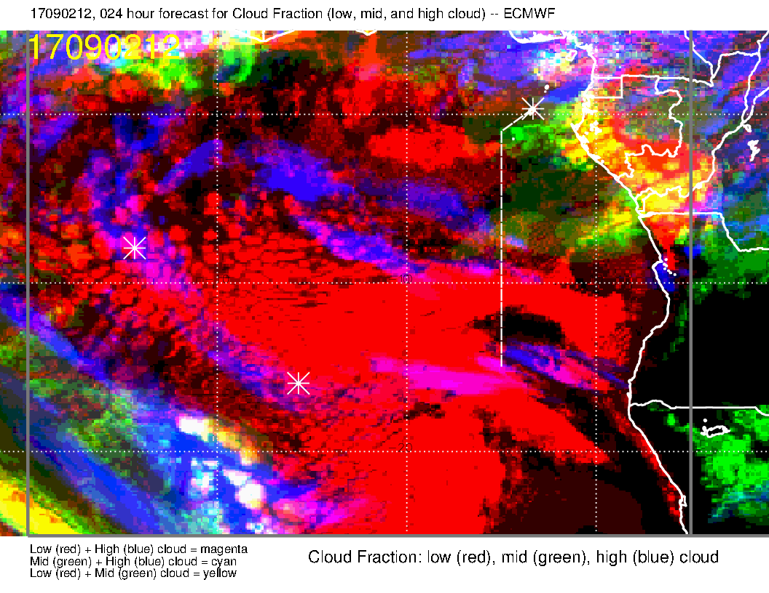
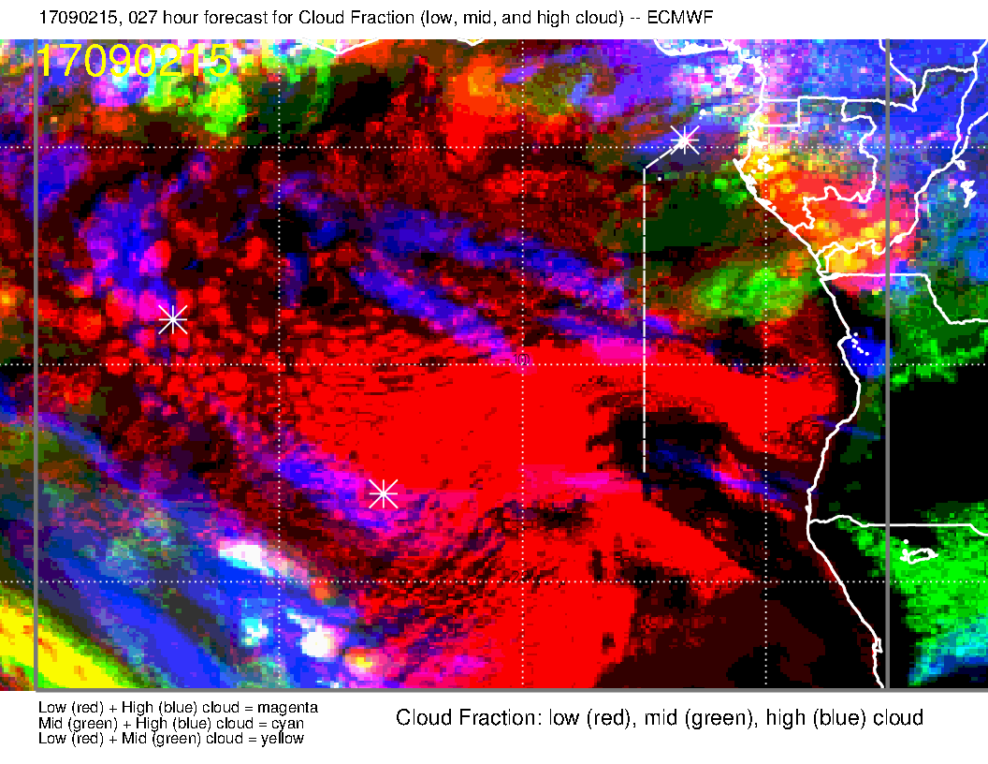
Die Prognose des Eurupaeisches Zentrum
Watch the middle cloud, model does not have the positioning right in latitude – too far north. It will be a problem early in the flight.
I would discount the high clouds in this model.

Slide 7
I would go with this model
For high clouds today.

Slide 10
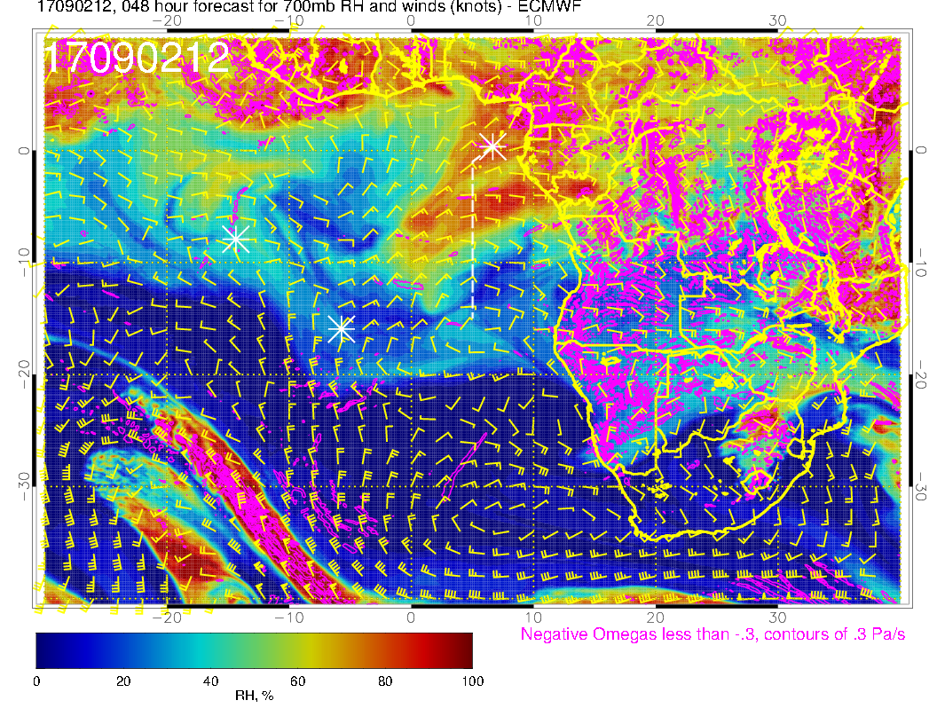
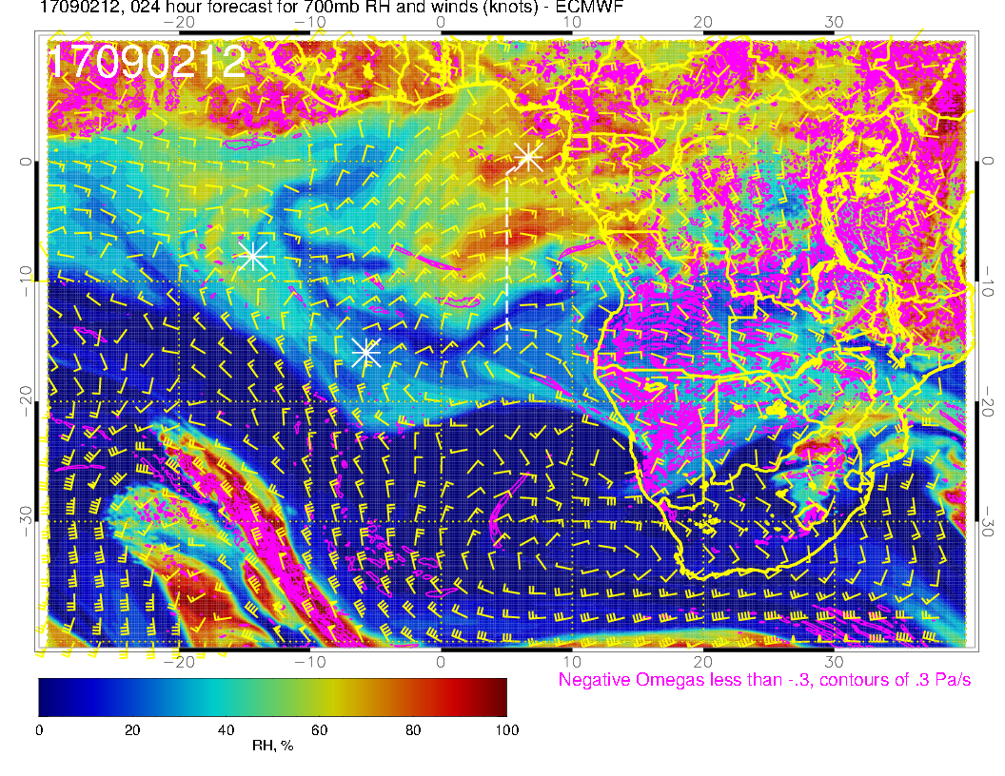
New forecast (right) has backed off some on the intensity of the moisture surge

Slide 11
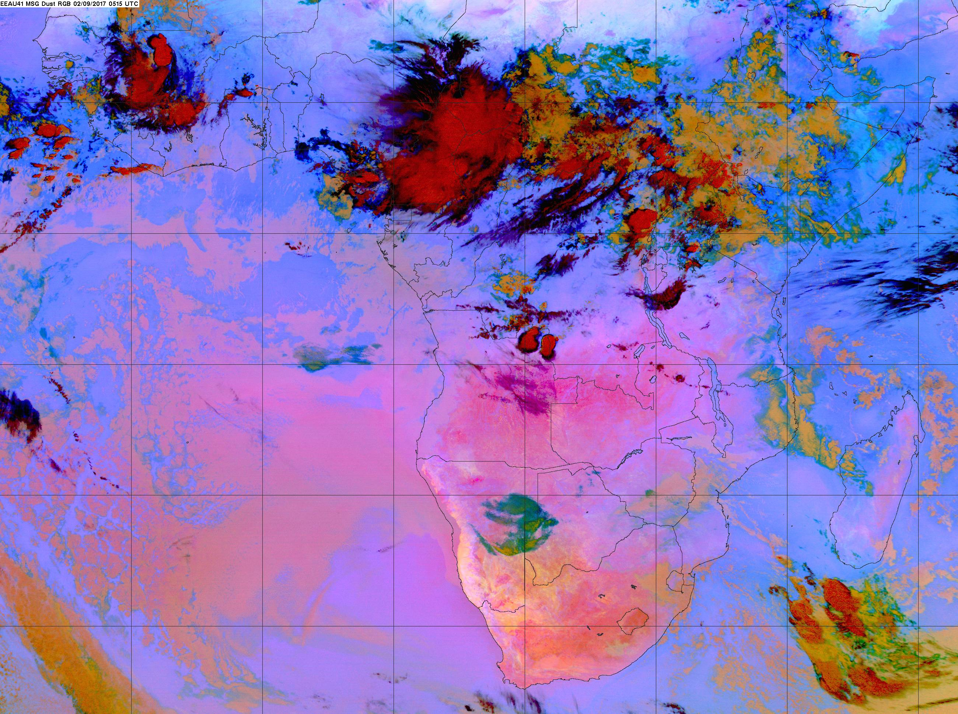
Latest pic

