Slide 1
ORACLES Forecast Briefing
Aerosols
Friday, 01 September 2017

Slide 2
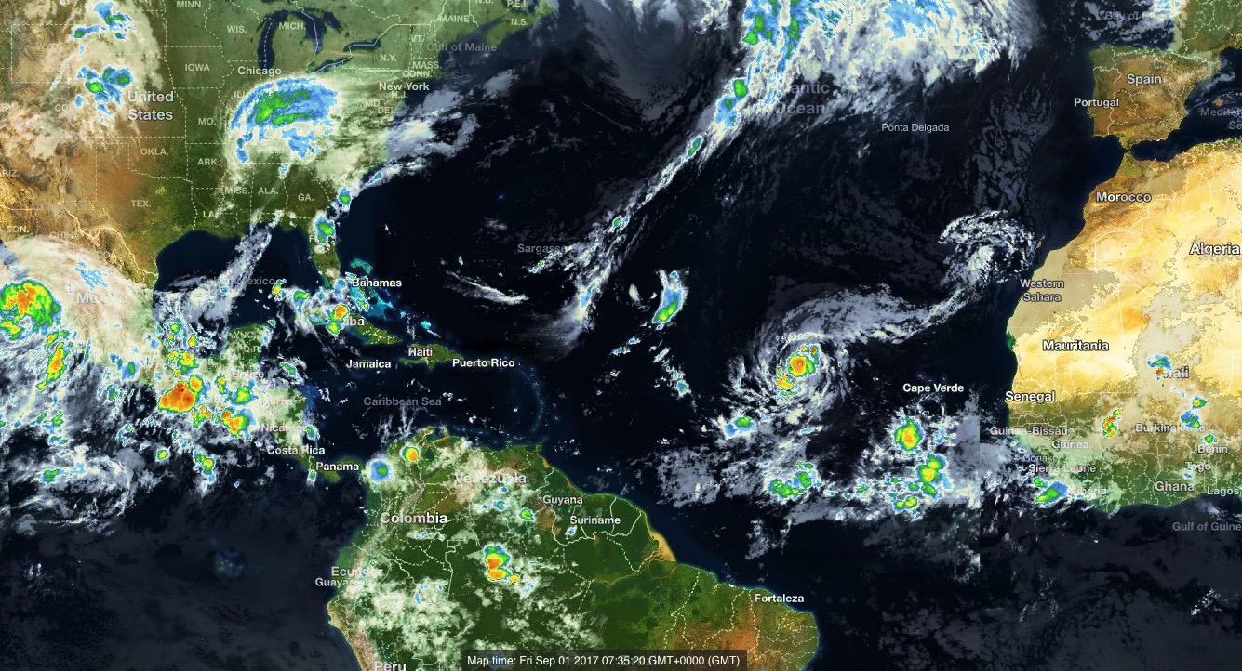
Hurricane Irma (cat. 3)

Slide 3
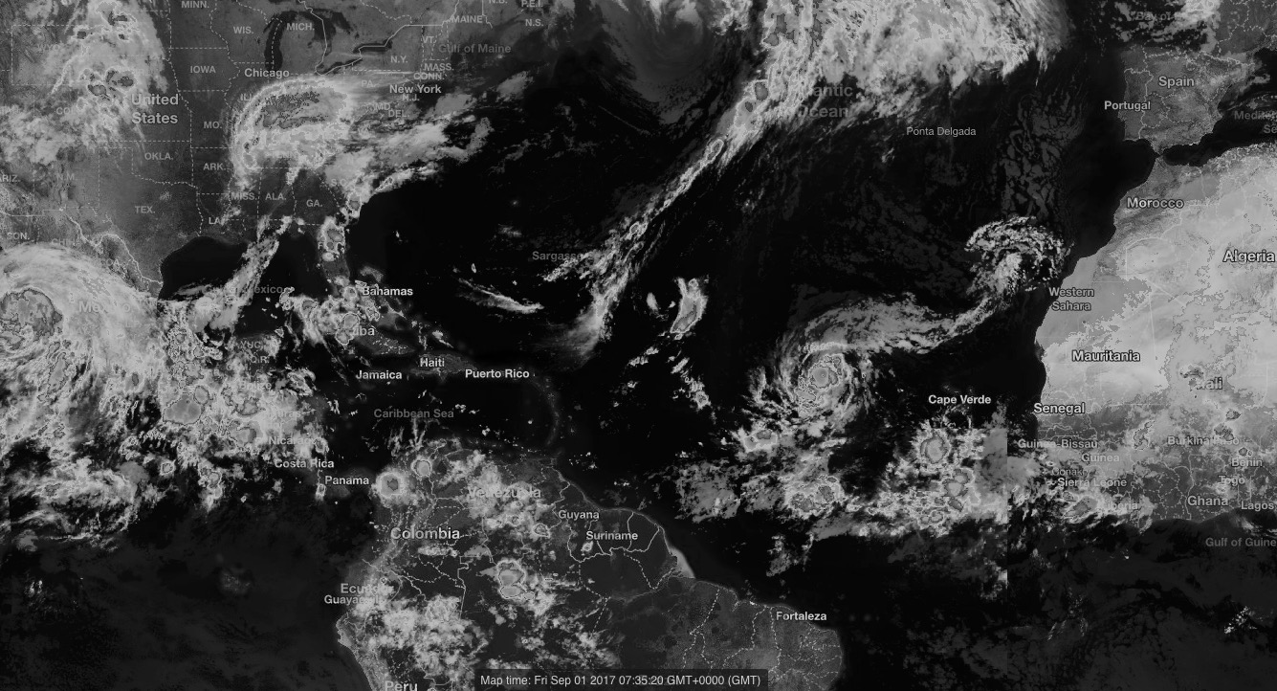
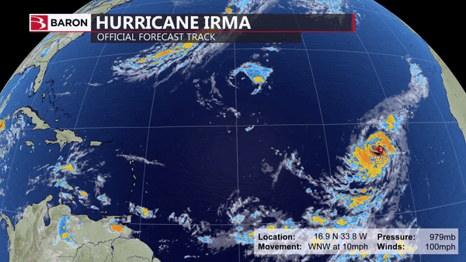
Hurricane Irma (cat. 3)

Slide 4
Friday, 1 September 2017
Packing Day

Slide 7
SATURday, 2 September 2017
Fly Day (Transit to Ascension)

Slide 10
Saturday, 2 September 2017

Slide 11
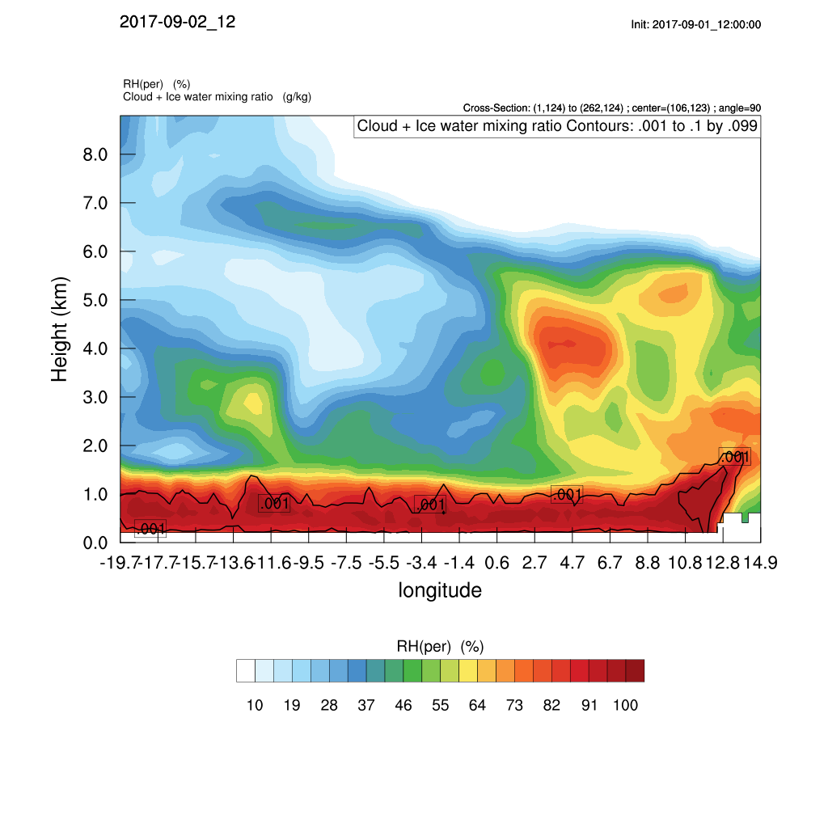
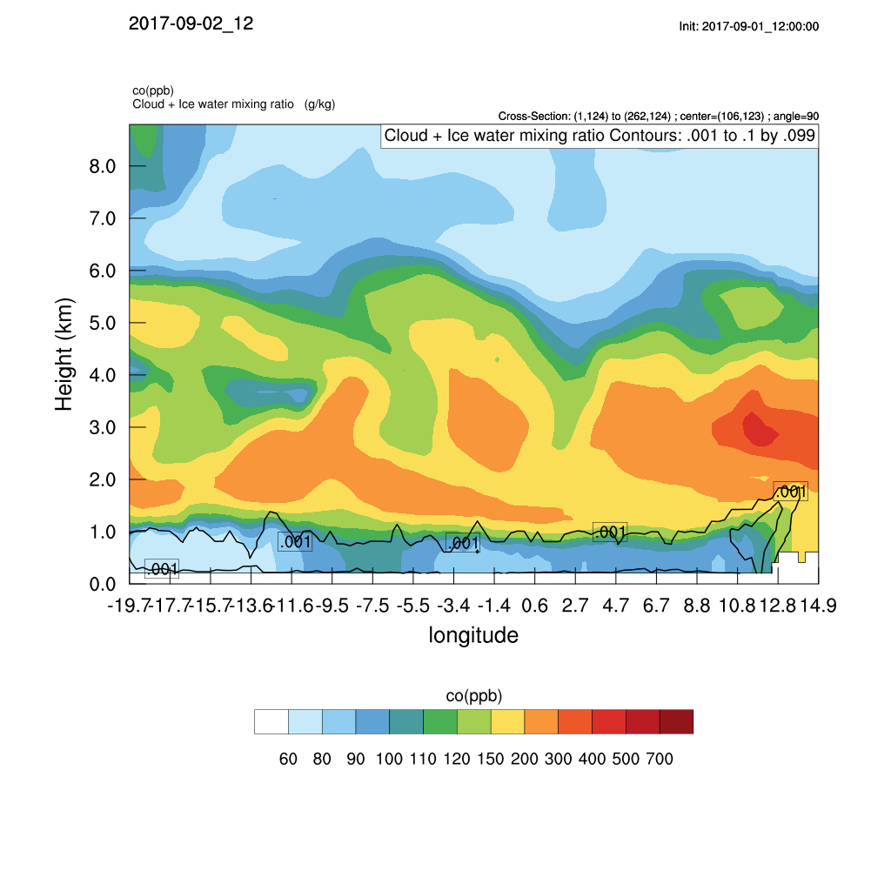
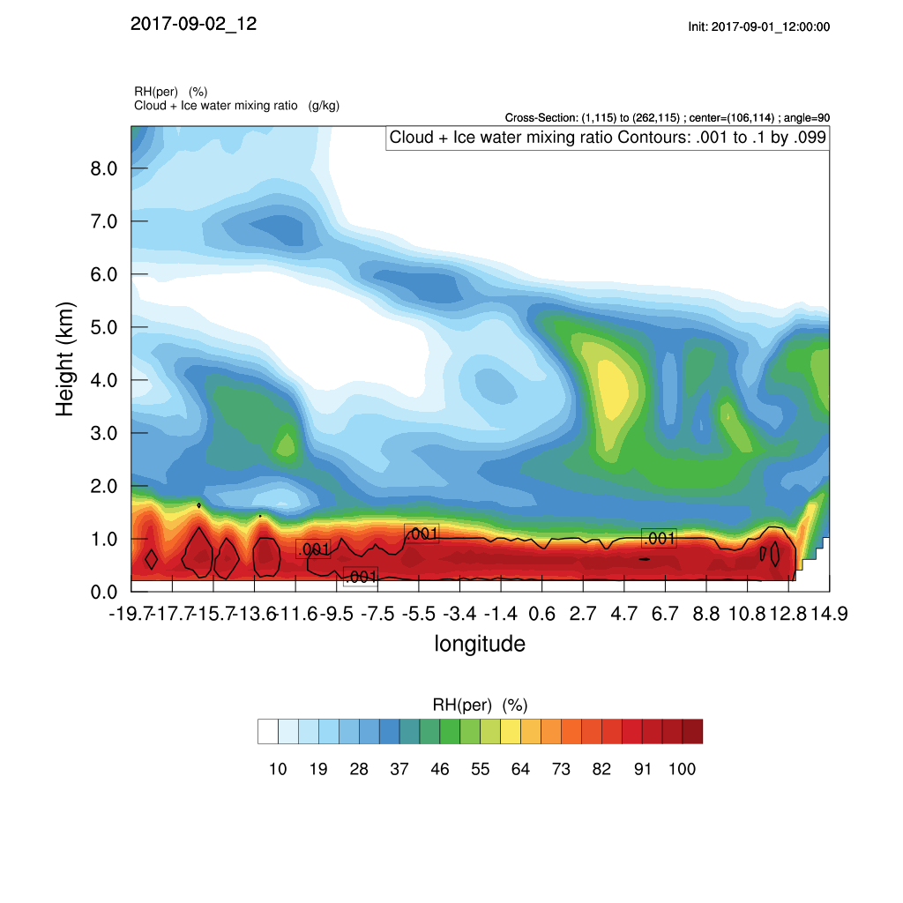
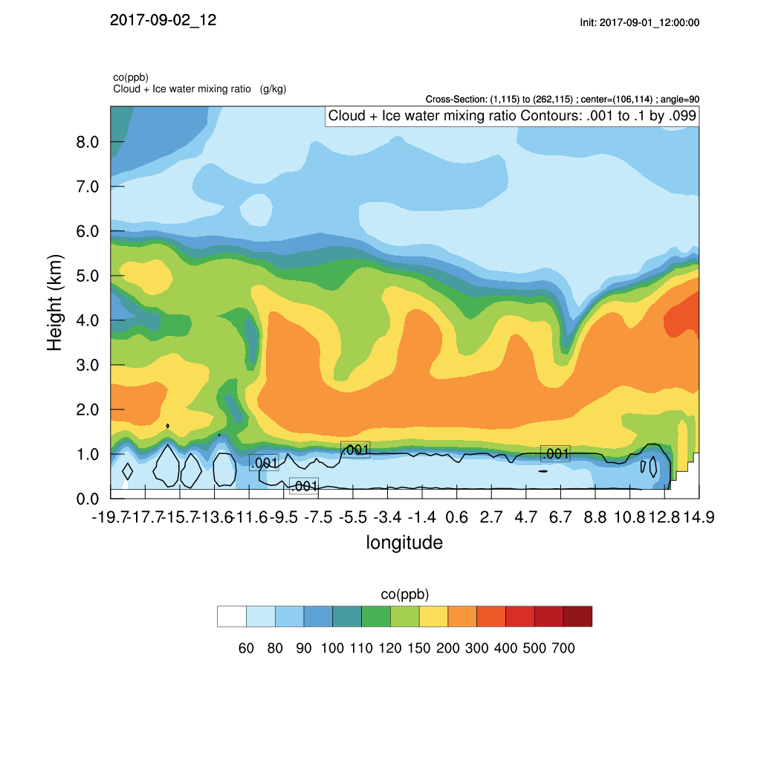
Cross sections at 5 S and 8 S – Sat 02 Sep 12 Z
Relative humidity
CO from BB
5 S
Relative humidity
CO from BB
8 S

Slide 12
Cross sections at 5 S and 8 S – Sat 02 Sep 12 Z

Slide 13
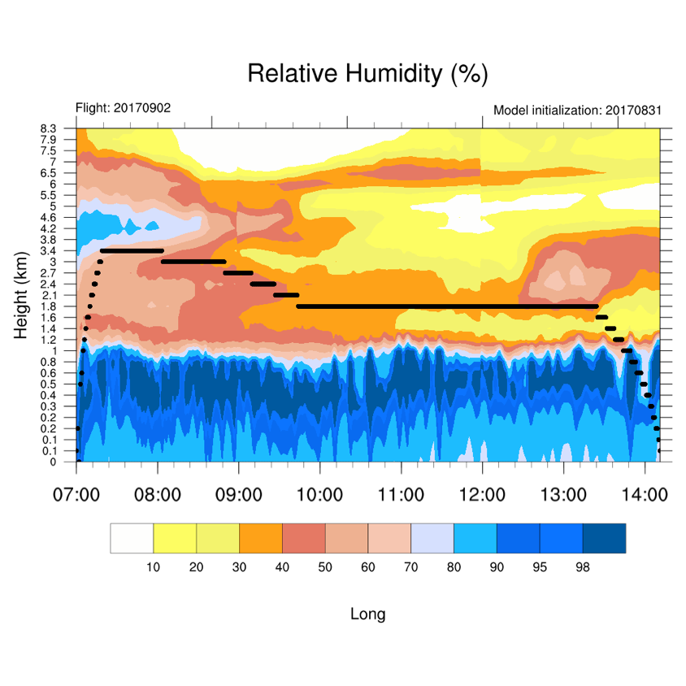
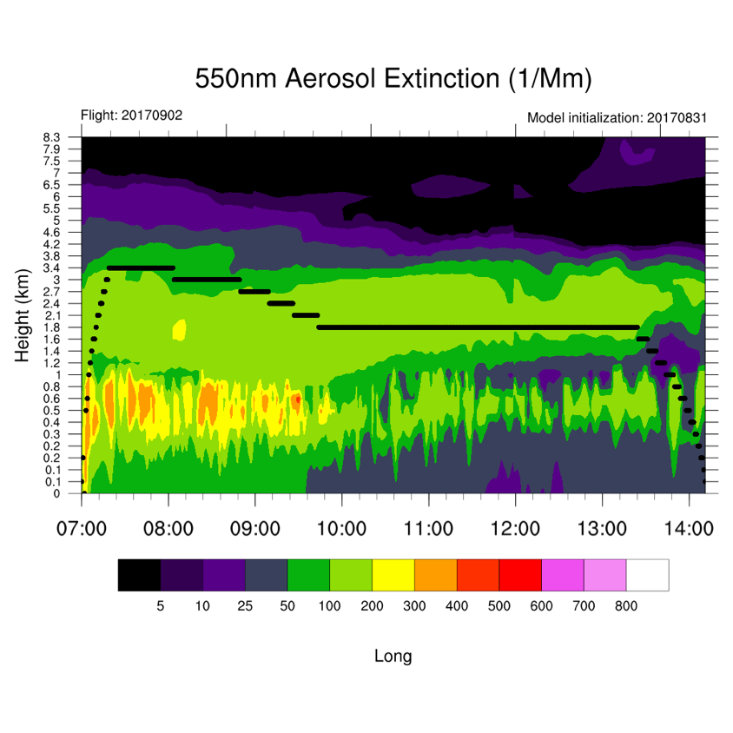
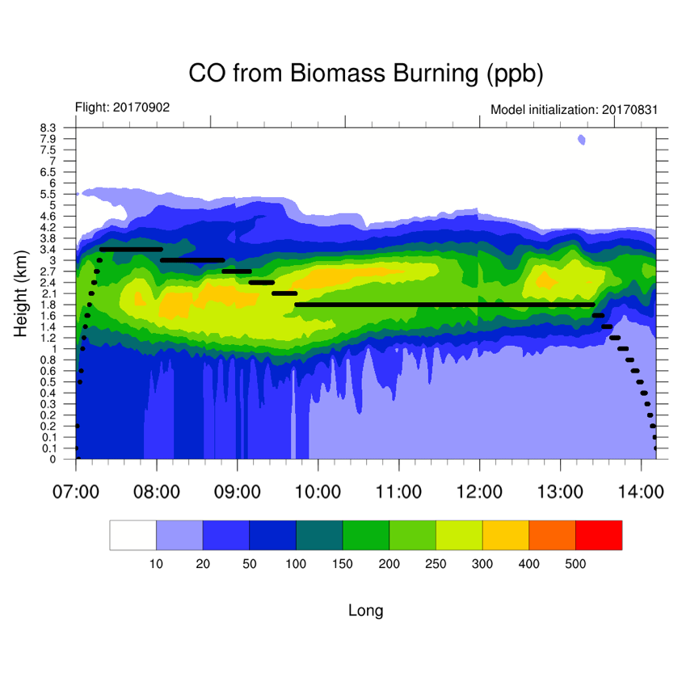
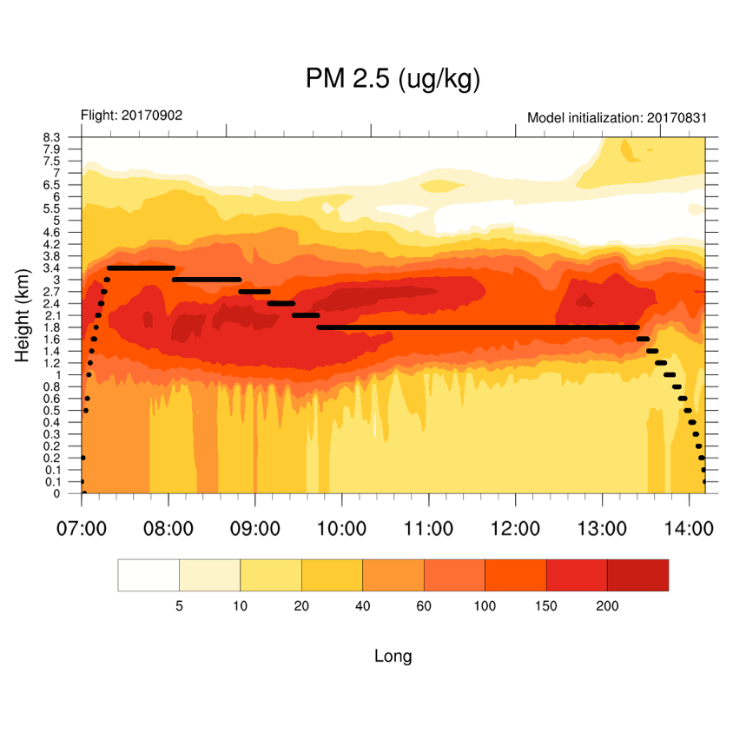
Saturday, 2 September 2017

Slide 14
sunday, 3 September 2017
Fly Day (Transit to Barbados)

Slide 15
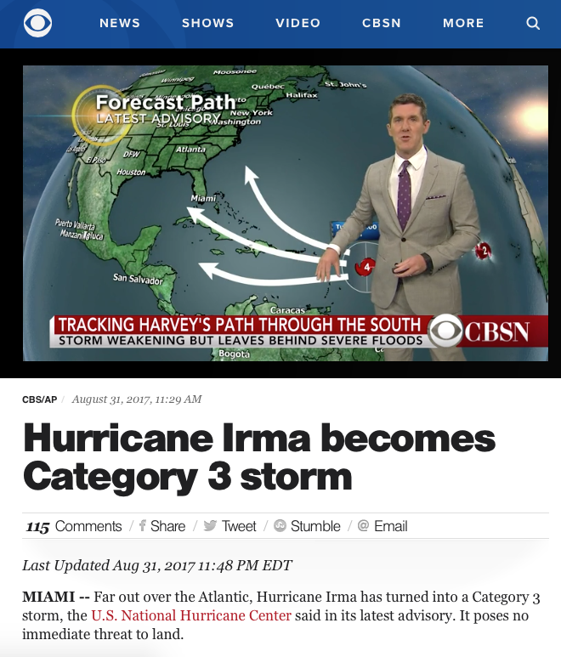
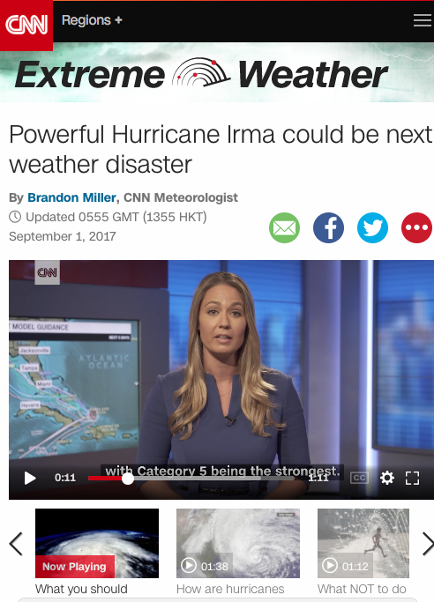
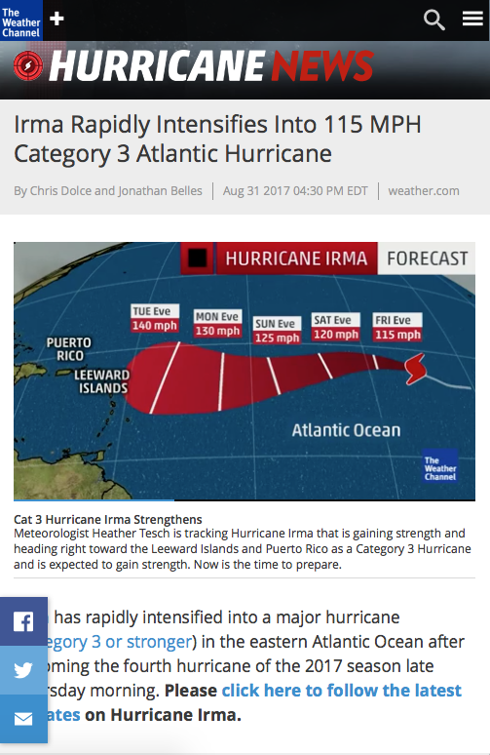
Major hurricane Irma

Slide 16
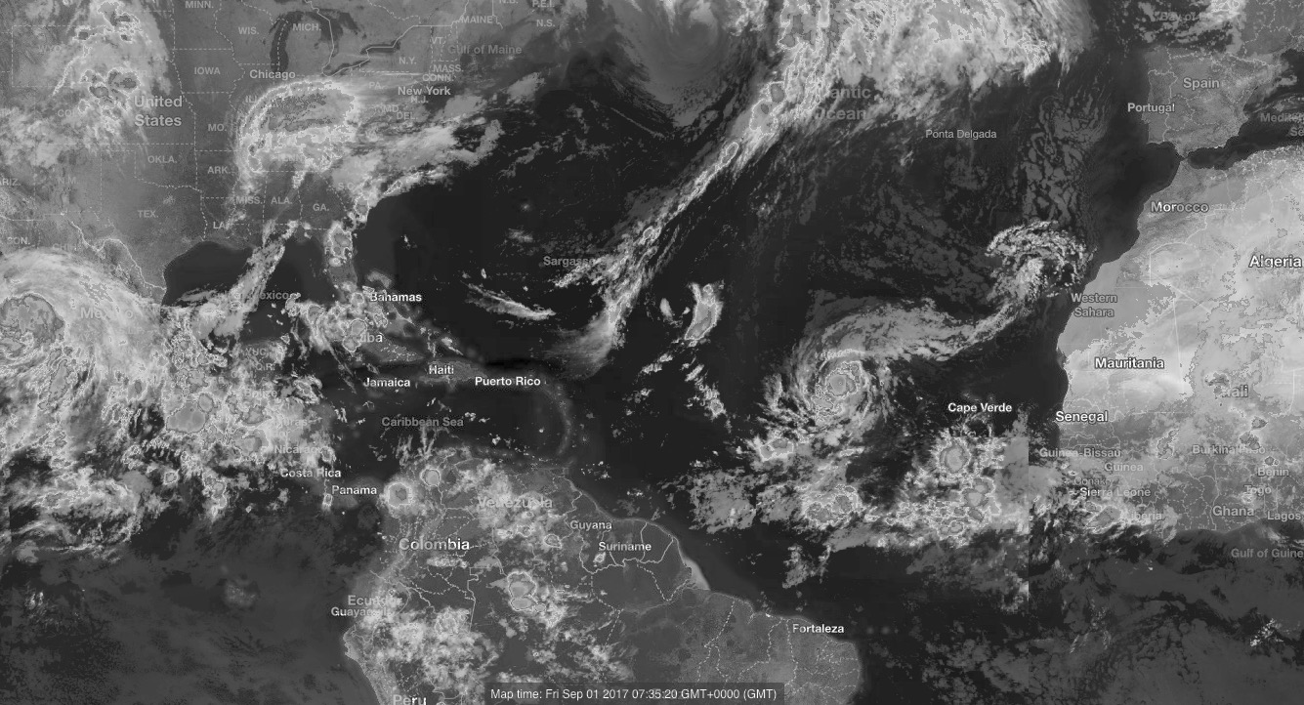
Major hurricane Irma

Slide 17
Major hurricane Irma

Slide 18
Sunday, 3 September 2017

Slide 19
Sunday, 3 September 2017

Slide 20
Monday, 4 September 2017
Fly Day (Transit to Wallops)

Slide 21
Monday, 4 September 2017

Slide 22
Monday, 4 September 2017

