Slide 1
ORACLES forecasting briefing
09-01-2017
Lenny Pfister and Rei Ueyama

Slide 2
Cloud forecast verification for 20170831
There is a substantial difference between 48 and 36 hour forecast skill for both models.
UKMO is overdoing high clouds once skill starts to get “significant” (at 36 hours)
Wind speeds about 20m/s. At 48 hours, depend on modelled convection into central and Eastern Congo into CAR. At 36 hours, more on the Angola region.
Neither model has been great at getting the Congo region precip (though UKMO seems a little better)
As we look to tomorrow’s forecast, we believe that internal dynamics and microphysics of the two models also play a role.

Slide 4
36 hour forecast overdone, but is better

Slide 5
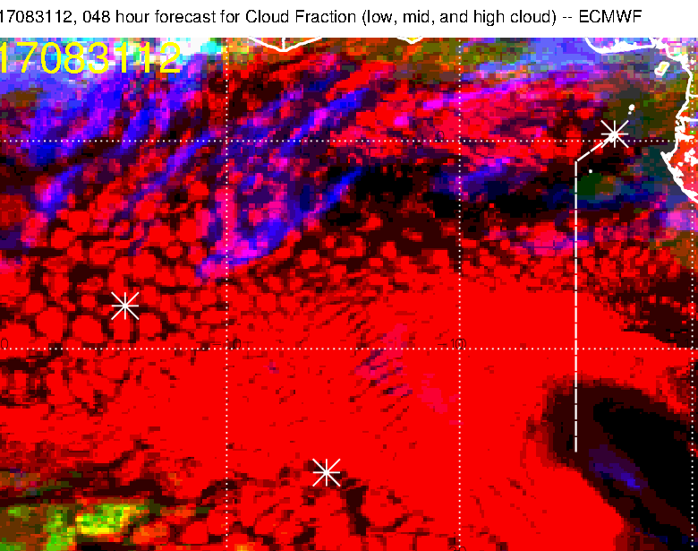
Nothing at all near 0W, 10S

Slide 6
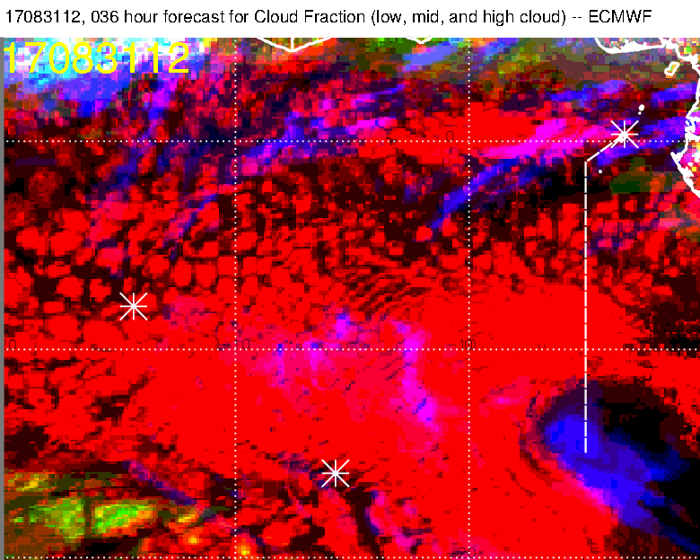
36 hour is substantially improved from 48

Slide 7
Cloud forecast for Tomorrow
Rei did a careful analysis of both UKMO and EC forecast runs yesterday; latest forecasts (12Z 8/31 init) begin to diverge at around 24 hours (when they are forecasting for noon today).
It is clear that differences in internal dynamics and microphysics have a significant impact on the forecast (as well as differences in modelled African convective moisture sources).
EC has consistently developed a closed anticyclone just north of Saint Helena, which is boosting the development of high clouds to the north. UKMO dynamics is subtly different, also consistently.
I find the complete clearing (and going from broad coverage to nothing during the forecast cycle) in the UKMO hard to believe. Would give the edge to the EC forecast.
EC forecasts significant high cloud north of 10S in an irregular line.
Low cloud clearing is further south than typical because of weaker southeasterlies at the surface (SH high is scrunched)

Slide 8
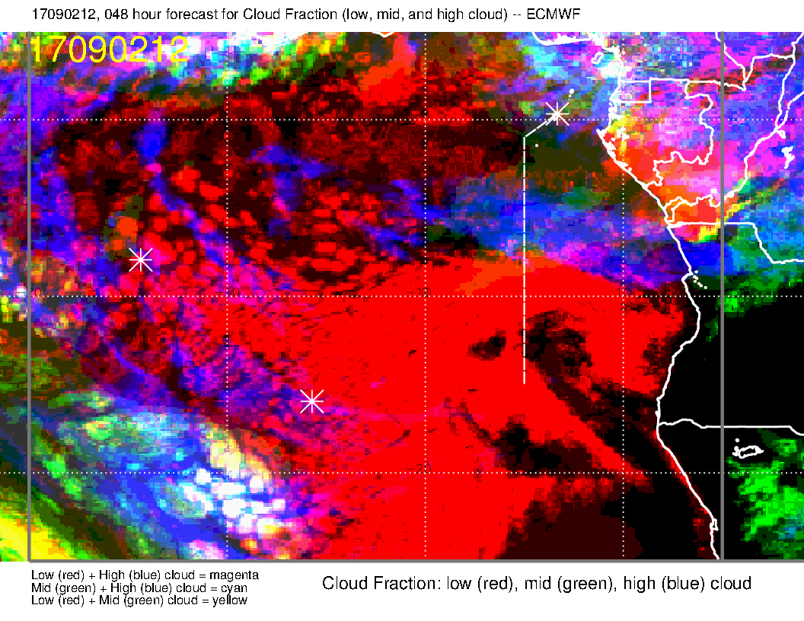
High cloud forecasts are consistent with previous runs for both models, and they do NOT agree. Middle cloud forecasts DO agree.

Slide 9
High cloud forecasts are consistent with previous runs for both models, and they do NOT agree. Middle cloud forecasts do agree.
LATEST UKMO 36 HOUR FORECAST AT LEFT -- SAME

Slide 10
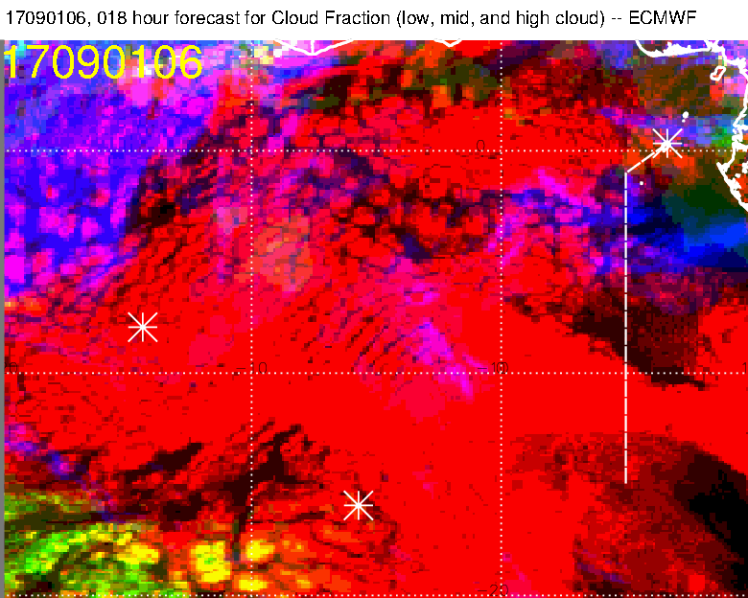
Current picture (verification) this plus next 3 slides. Both models are overforecasting, UKMO more than EC, but basic structure seems in agreement.
Note that low cloud structure is reasonable.

Slide 11
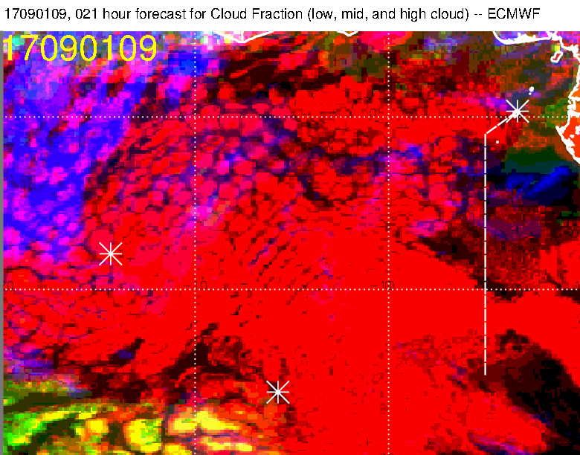
Note dissipation of high cloud in both forecast and reality (near prime meridian).

Slide 12
UKMO forecast also shows dissipation between 6 and 9 Z, but is overforecasting.

Slide 14
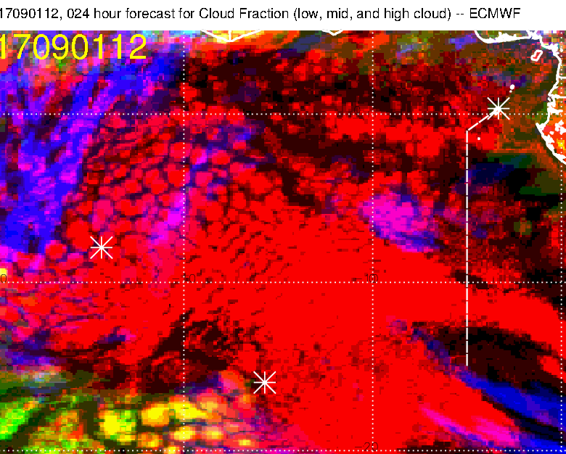
12Z (no satpic available yet): UKMO dissipates previous rounded structure. EC puts a new development, which will amplify, down near [1E, 7S] and completely dissipates rounded structure

Slide 15
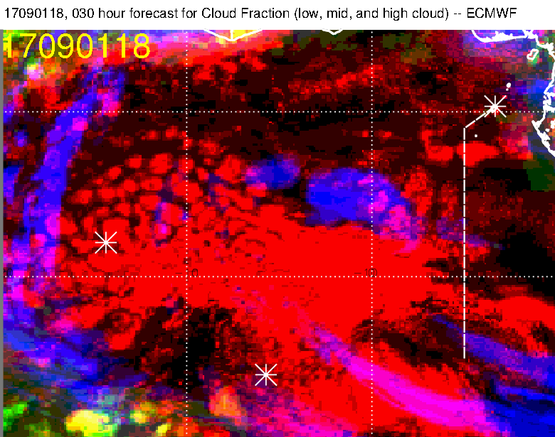
At 18Z, today UKMO continues to dissipate previous structure. EC development expands.

Slide 16
Forecast for 21Z today for 200mb winds. Graphics are different, but consider winds around ASI. Fairly uniform along the streamline (15 m/s) in EC, but showing a lot of decrease in UKMO along that streamline. EC developing a closed anticyclone.

Slide 17
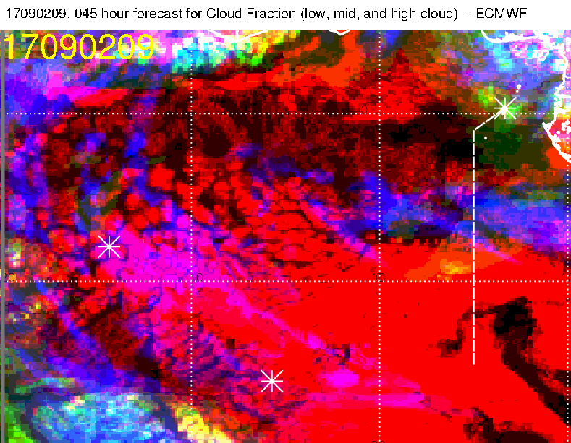
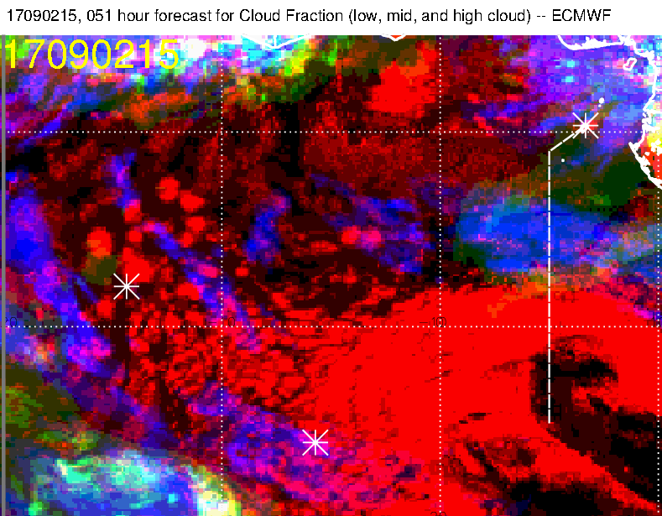
UKMO forecast is “blank” for high clouds tomorrow.
Evolution during the day shows significant high cloud along 5S track. Models underestimate diurnal clearing of middle cloud, but this is a significant large scale development, and I would be concerned about middle cloud along the routine track.

Slide 18
Mid level forecast

Slide 19
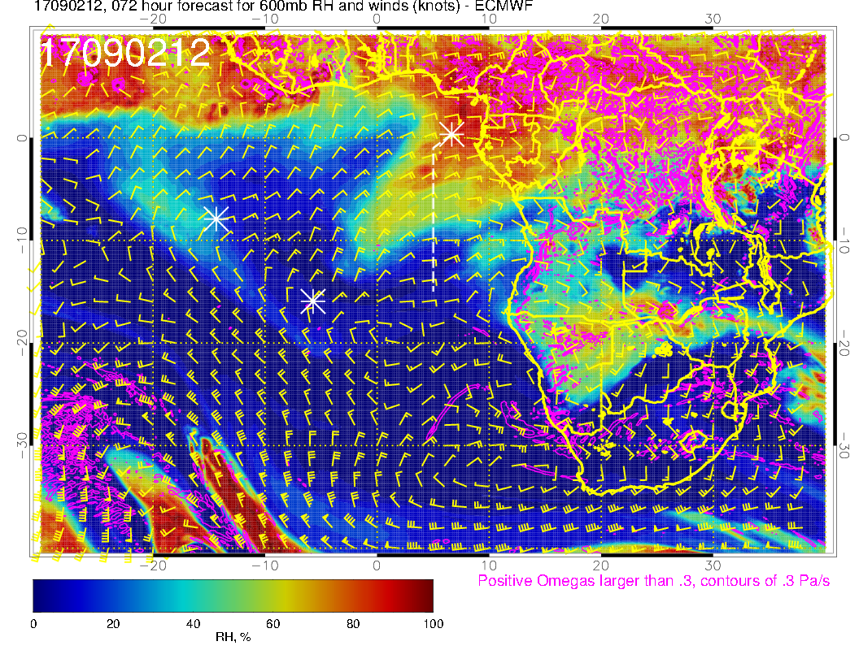
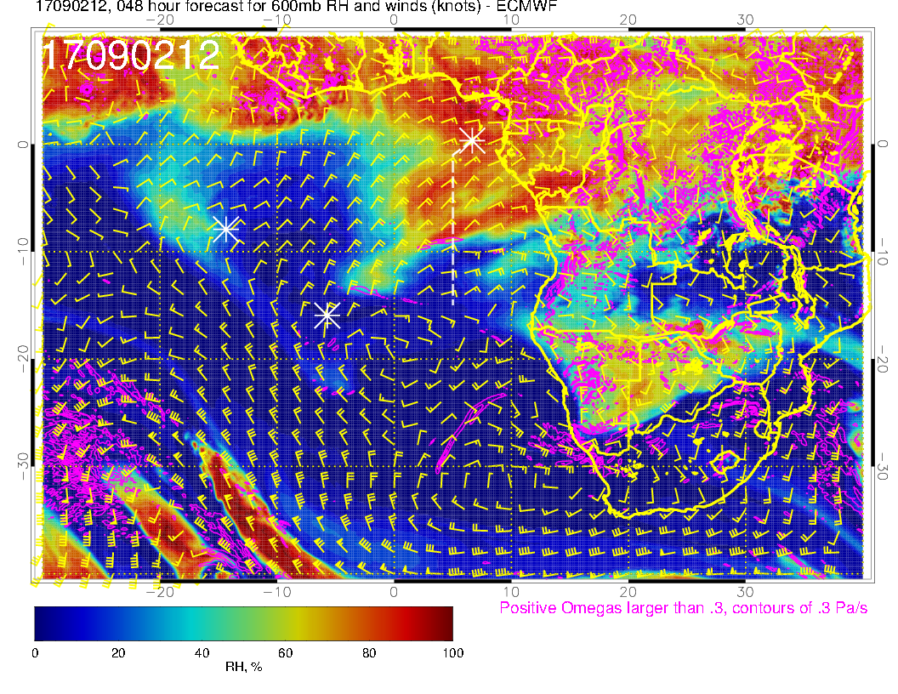
OLD
NEW
Surge of moisture from the northeast is again stronger than yesterday’s fcst

Slide 20
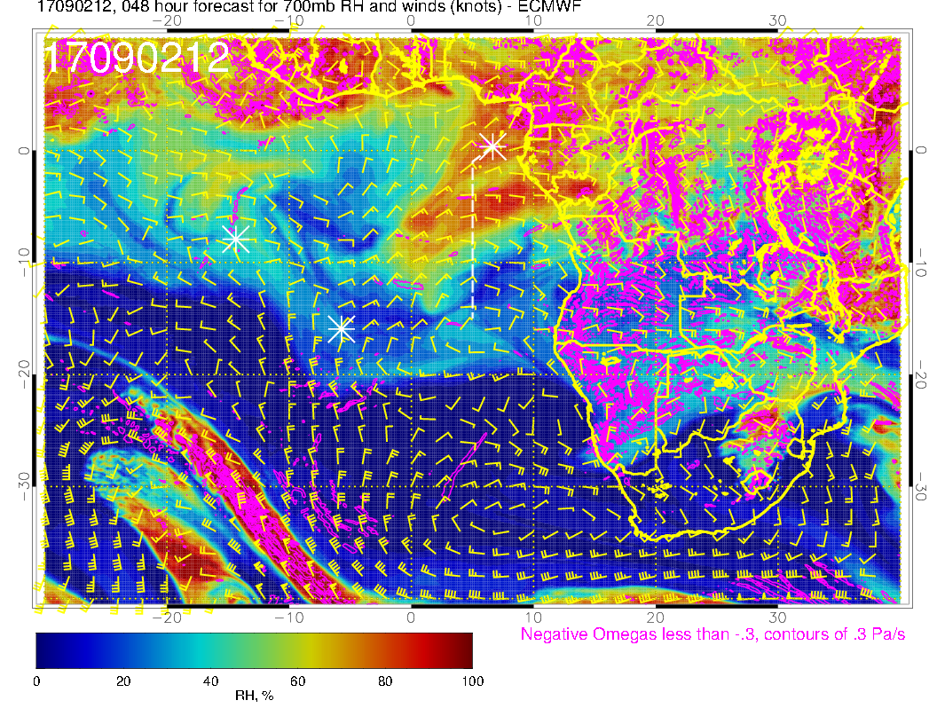
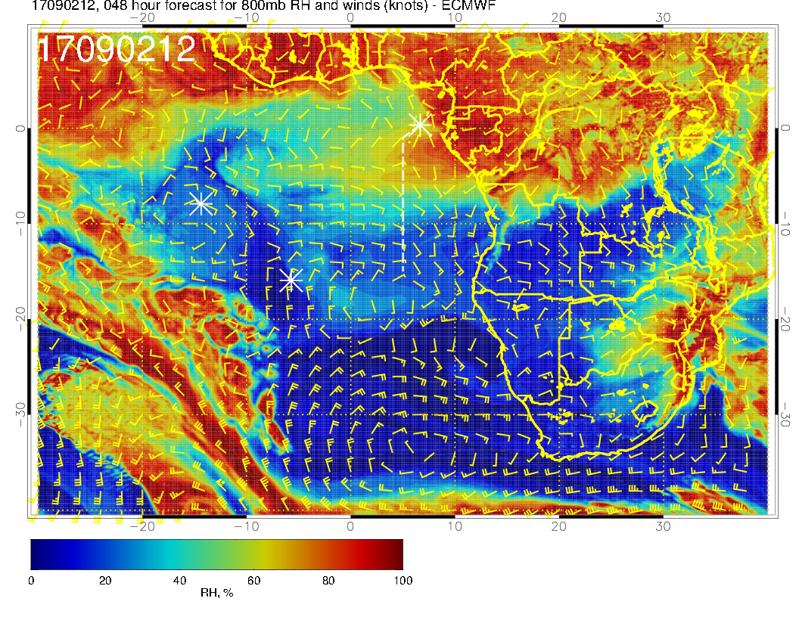
Moisture surge apparent at all levels, consistent with middle cloud forecast in previous slides.

Slide 21
Low Clouds

Slide 22
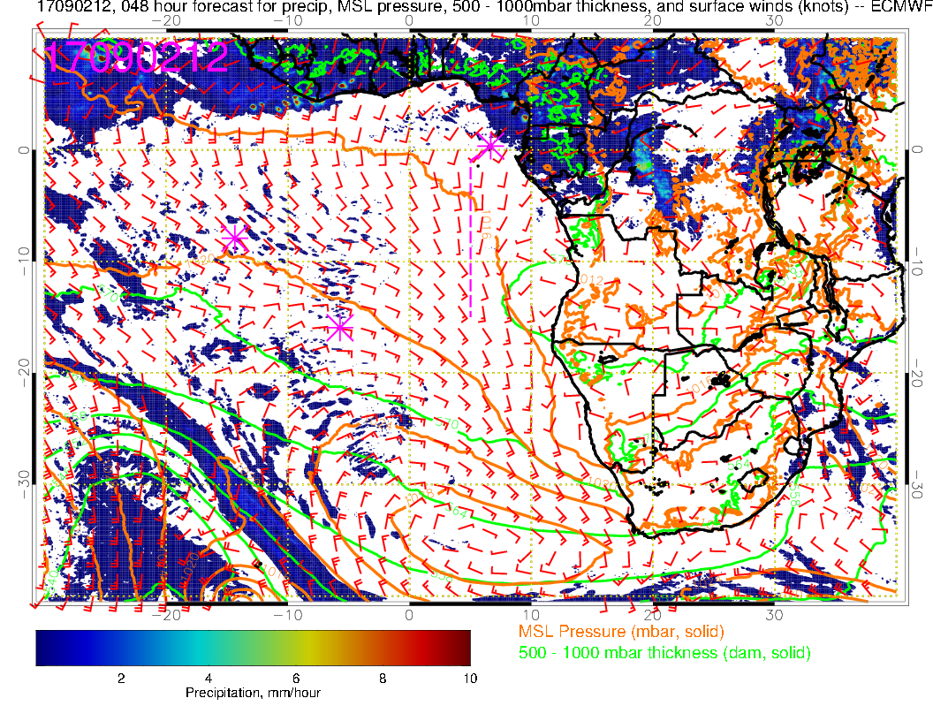
Low level flow. Surface flow is weaker than typical.

Slide 23
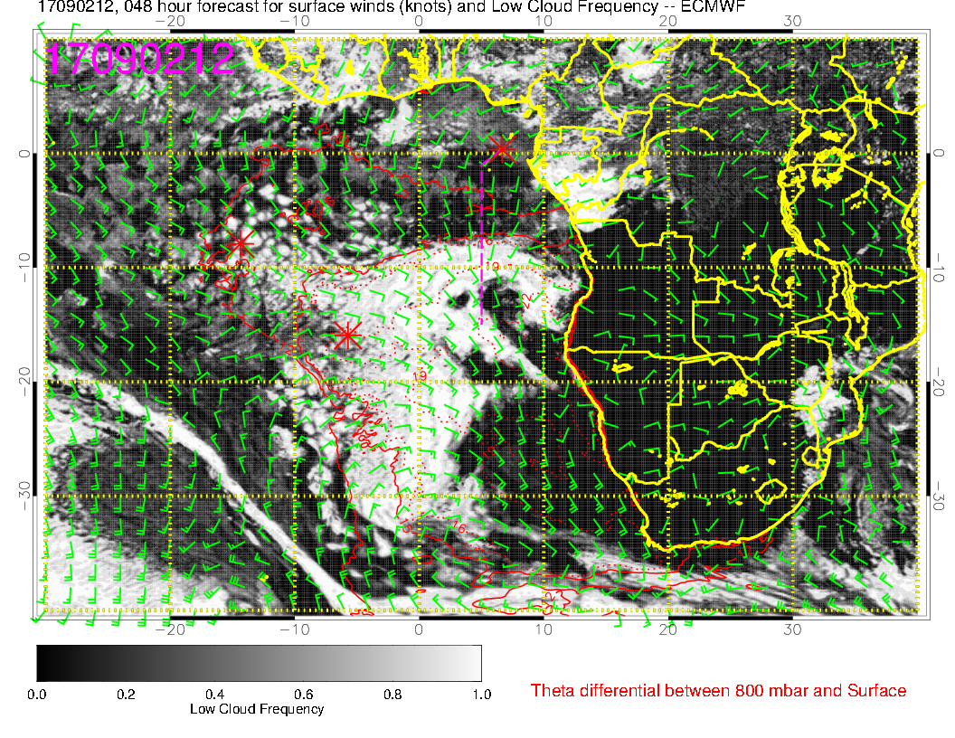
As noted earlier, forecast is verifying earlier in the cycle (6Z, slide 10). Consistent with weaker than normal winds, the beginning of the cloud clearing region in the model is fairly far south. I would think that the situation near ASI would be very broken, even scattered. I think low cloud at 5S will be very limited.

Slide 24
Cross Sections

Slide 25
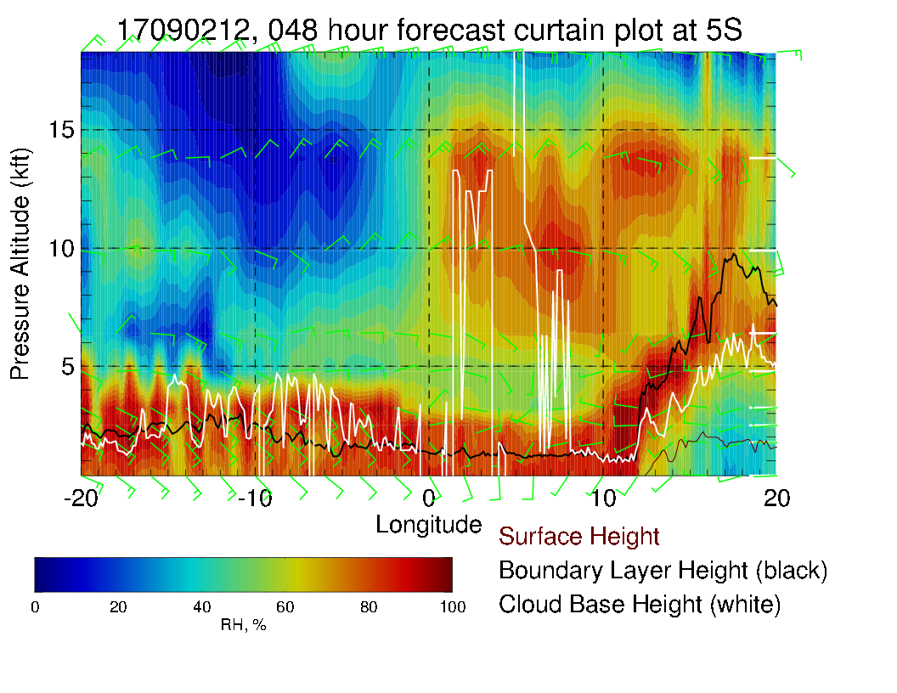
Note significant middle
cloud.

Slide 26
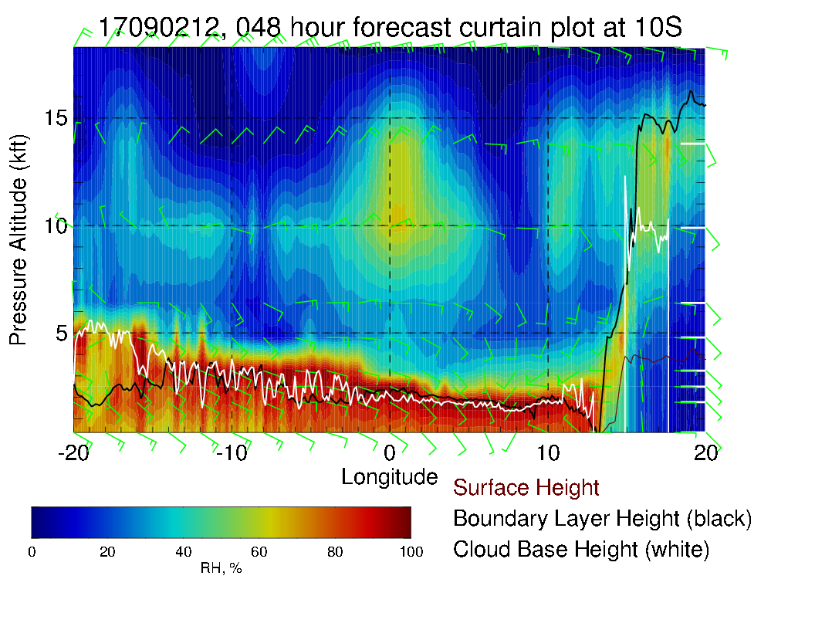

Slide 27
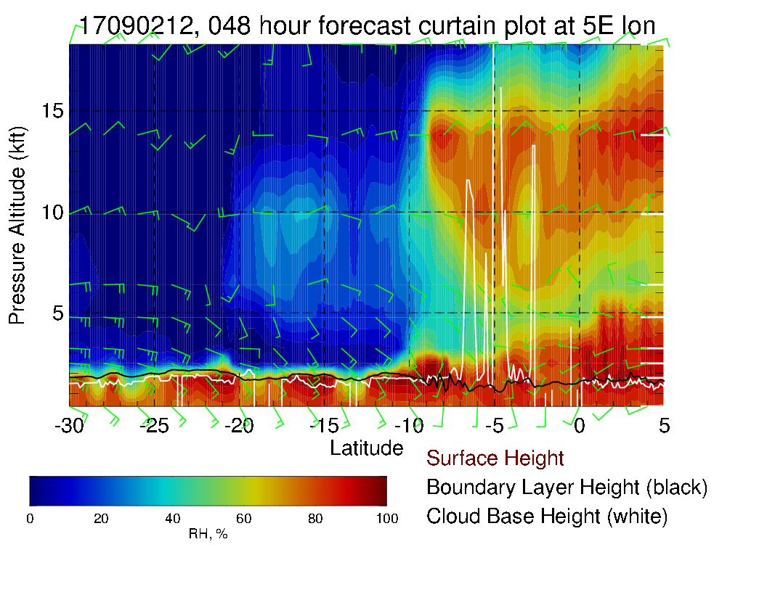
Routine track.

