Slide 1
ORACLES weather briefing
31-Aug-2017
Lenny Pfister and Rei Ueyama

Slide 2
Surface evolution 8/30-9/2

Slide 3
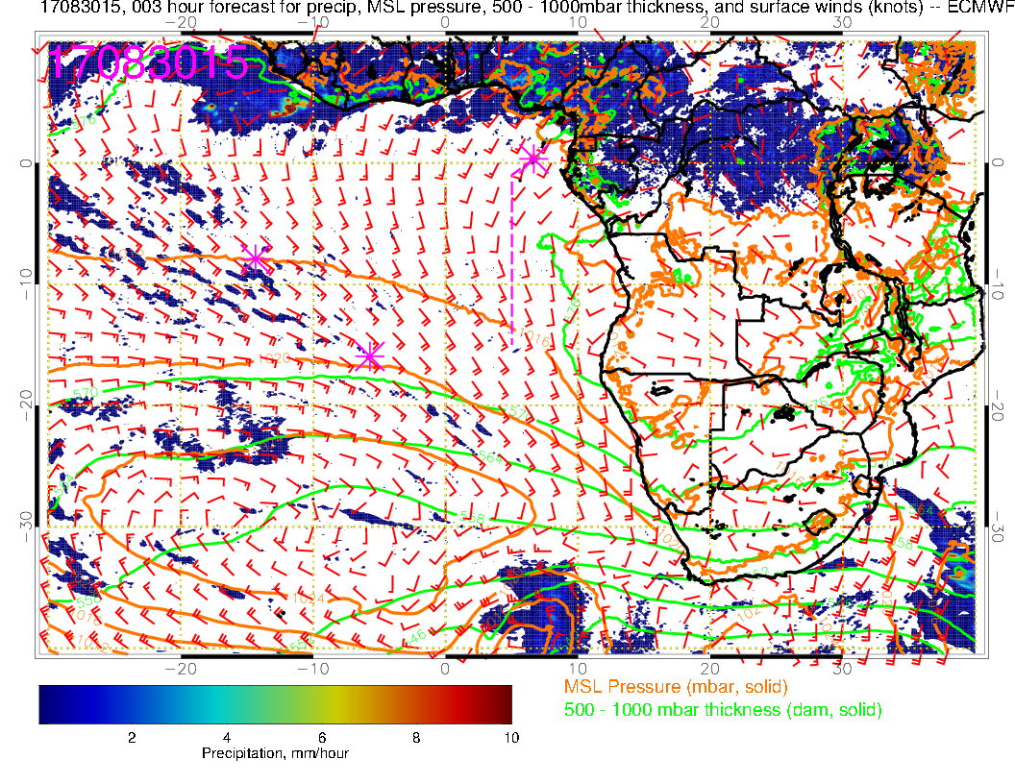
Yesterday (F): Convection developed over Nigeria, off of west African coast (~10W), and northern Congo. Angola Bay eddy starts to redevelop (but not prominent). SH high moves east and winds off of Namibia increase from previous day.

Slide 4
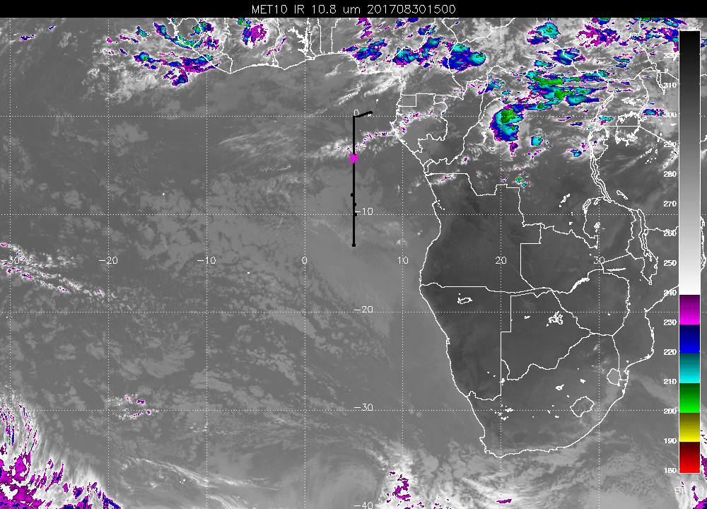
Forecast verification: Reasonable agreement on major features with IR satellite image.

Slide 5
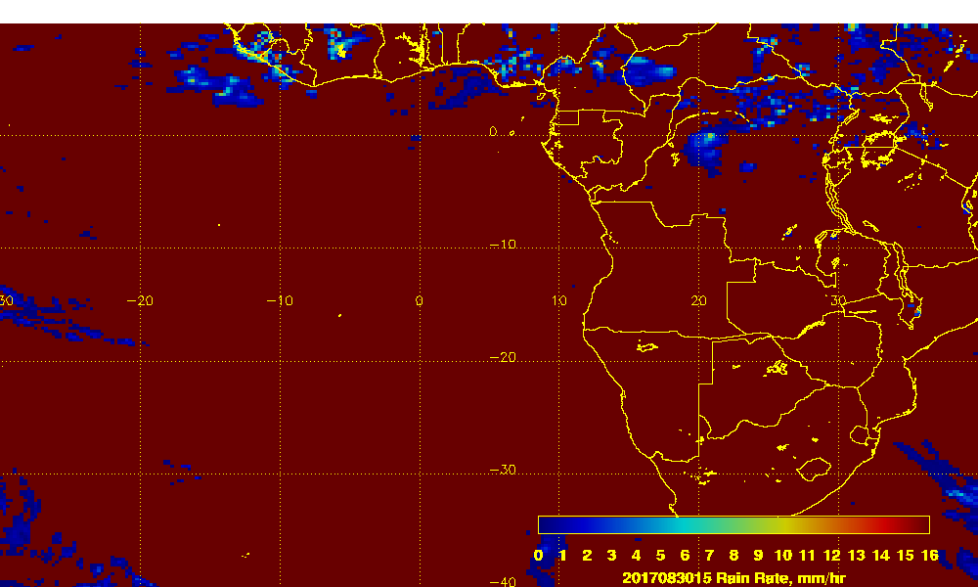
Comparison with multi-satellite rainfall estimate below (3B42RT NASA product – below)
Forecast verification: Reasonable simulation – gets West African convection, misses southern Sudan, gets northern Congo. Patterns are a bit washed out compared with satellite based 3 hourly rainfall estimate at right

Slide 6
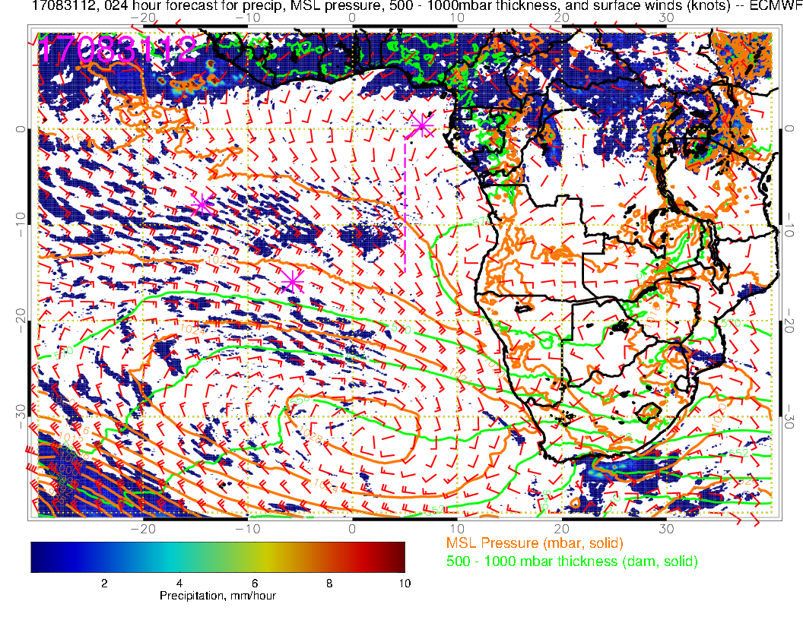
Thursday (F): SH high is in climo position – 25 knots near Namibia. Angola Bay Eddy is well-developed, but a little less extensive than previous forecast. Slightly weaker winds than previous forecast at TMS. Foci of convection are off of WA coast, Nigeria, and African interior north of Congo.

Slide 7
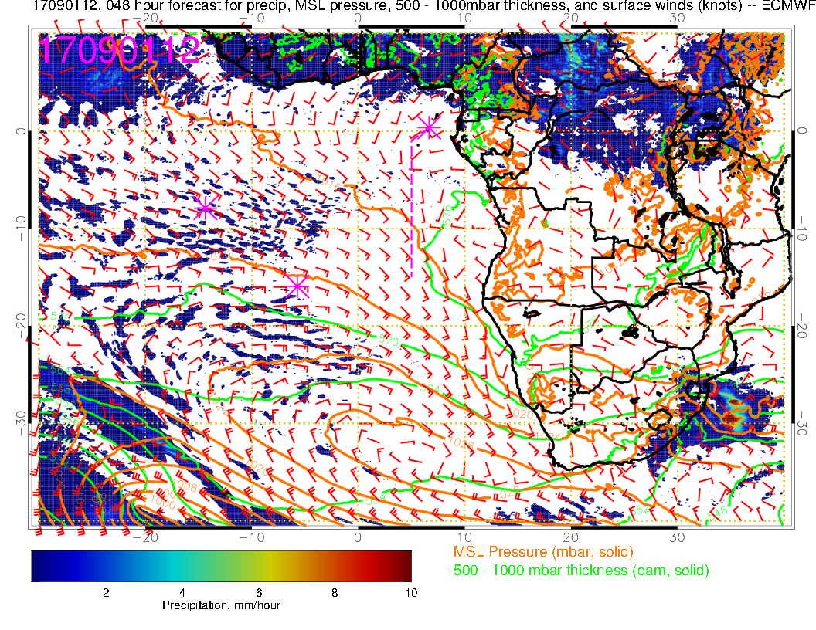
Friday (NF):A new low pressure system moves in, pushing SH high eastward. Winds now really weak in Angola Bay/TMS region, and westerly. Strong convection forecast in interior of Africa (Congo/CAR). Similar to yesterday, but interior Africa convection a bit further north.

Slide 8
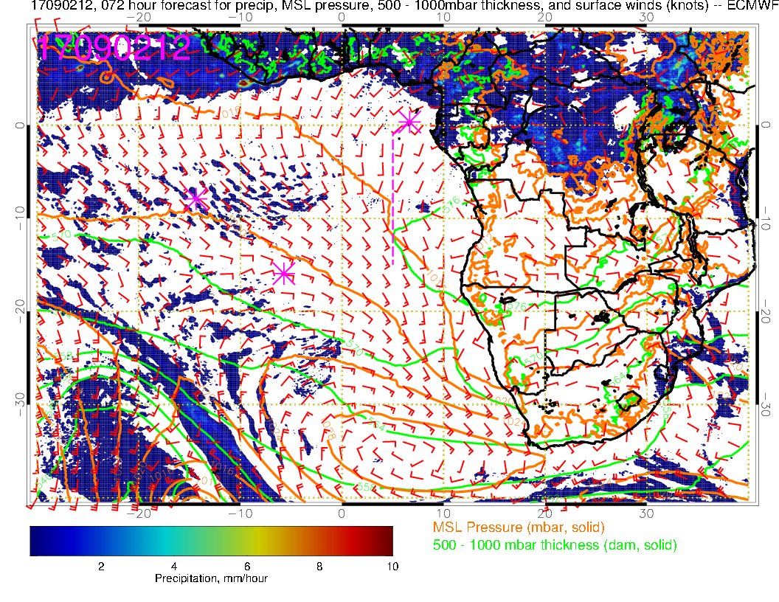
Saturday (Transit science flight): Low level winds have been similar near TMS since 8/31 with westerlies near TMS and an Angola Bay Eddy (which has stronger winds than previous day). Convective patterns similar to previous forecast, with less Congo convection. Winds between TMS and ASI are weaker than they have been as SH high is squeezed to the east by approaching low.

Slide 9
700mb evolution 8/30-9/2

Slide 10
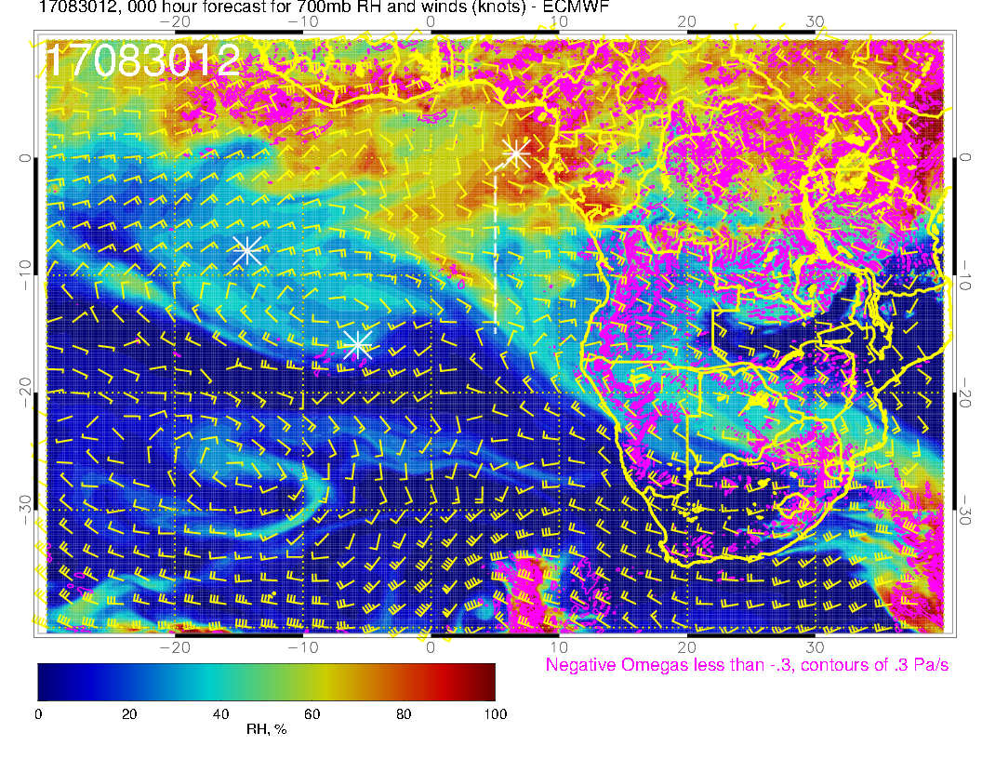
A
A
A
Wednesday (F): Moist air intrusion moving westward developing a V shape with the horizontal shear of the easterlies, which have a strong core of up to 25 knots near the coast. Moisture near TMS more intense than yesterday’s forecast. Note anticyclone near SH that keeps easterlies on track.

Slide 11
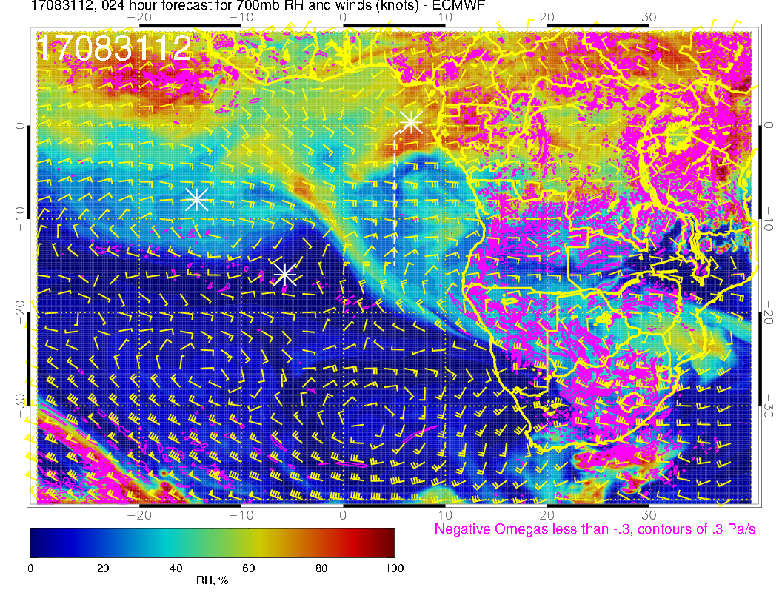
A
A
Thursday (F): Change from previous forecast for today, with sharper, more pronounced northwestward flow west of 0W. Moisture band near 8S, 2W is more intense (probably more vertical velocity). Moisture plume south of TMS is more intense than previous forecast. So, RH pattern overall much less “washed out” than yesterday’s fcst.

Slide 12
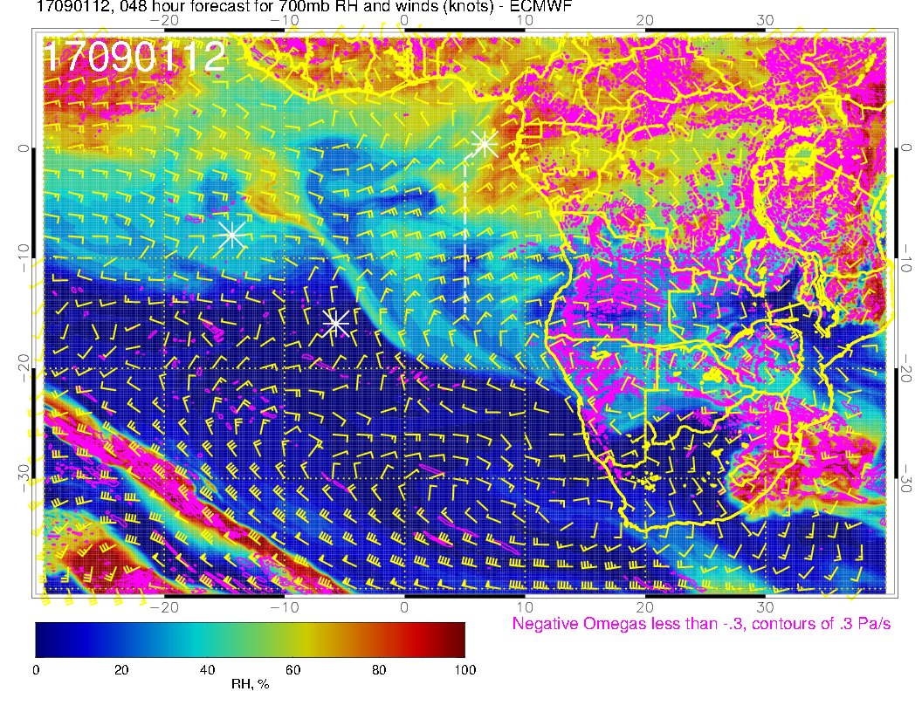
A
A
Friday (NF): Winds less zonal than in previous forecast, with a stronger bowl shape (bottom of bowl near 8W). RH features are thus more intense, both off the Gabon/Cameroon coast, and at 10W (10W feature is same as 4W feature on previous day.

Slide 13
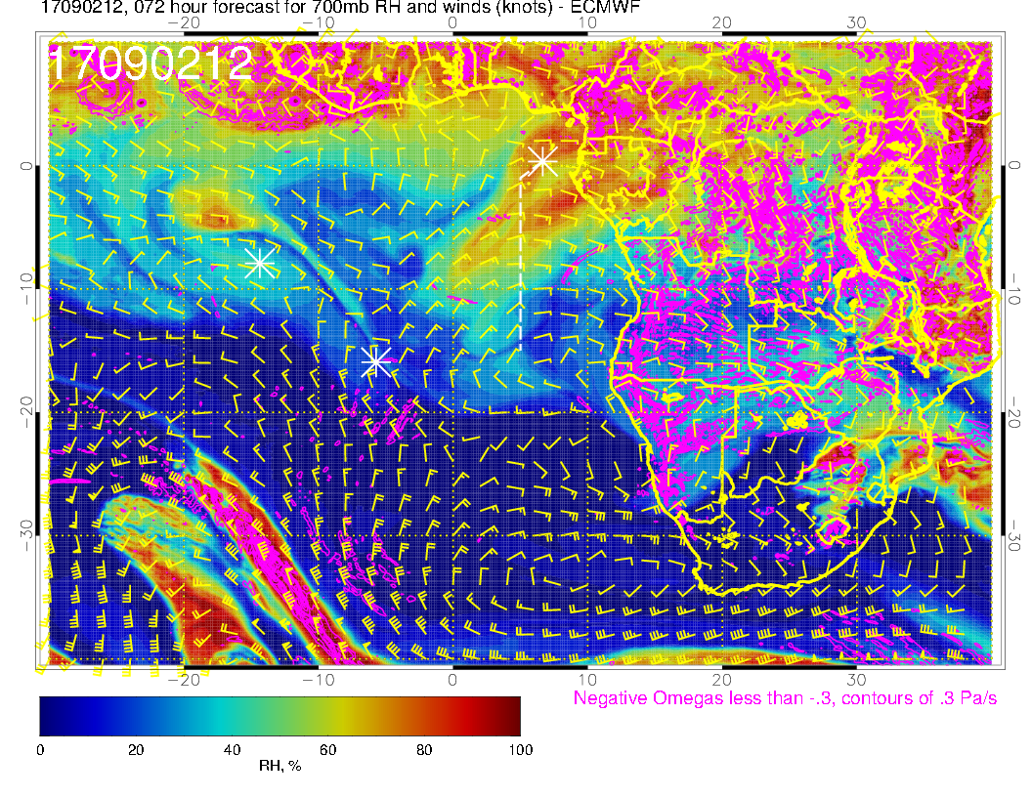
A
A?
A
A
A
Saturday (science transit to ASI): Quite substantial change from previous forecast as a clockwise circulation develops on the equator at 10W. Big thrust of moisture to the southwest from TMS with 15 knot winds. Same moisture blob is now at 5S, 18W and is much more intense than previous forecast. On the continent, flow is more sharply northward (western Congo).

Slide 14
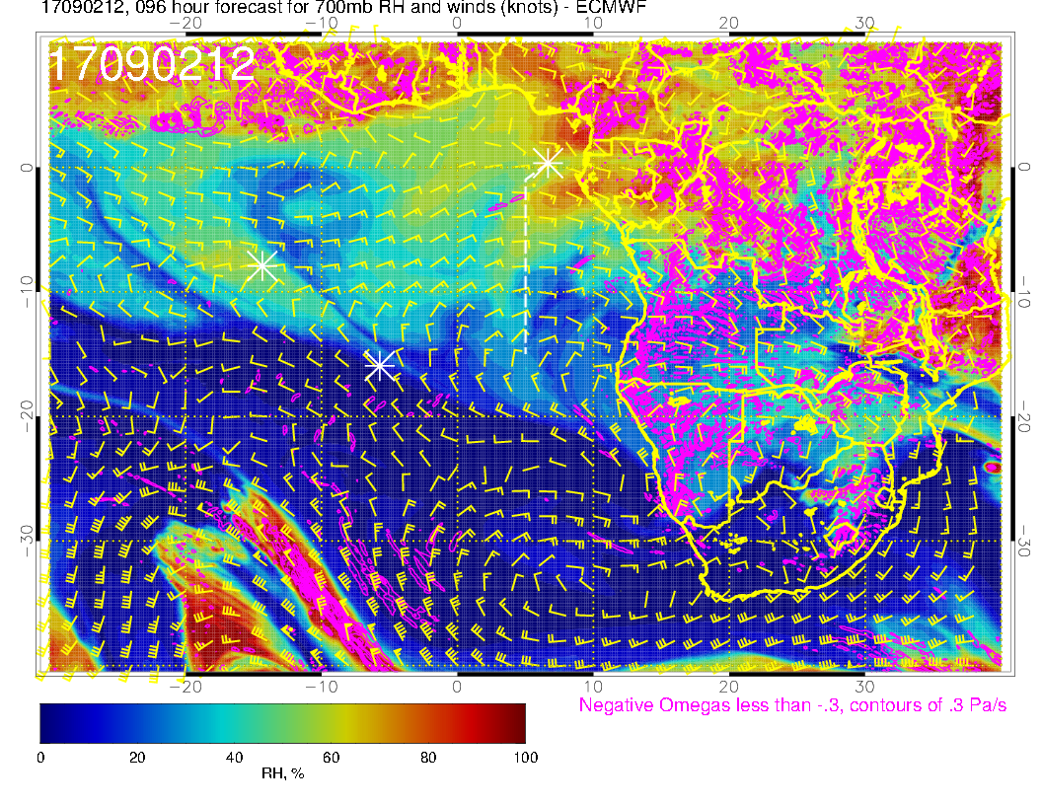
A
A?
A
A
A
OLD FORECAST

Slide 15
Saturday

Slide 16
Saturday (Transit science flight): Winds a little more of a southerly component than in previous forecast at TMS. Angola Bay eddy is less (confined to south of 8S). Between here and Ascension, winds have weakened due to approaching low.

Slide 17
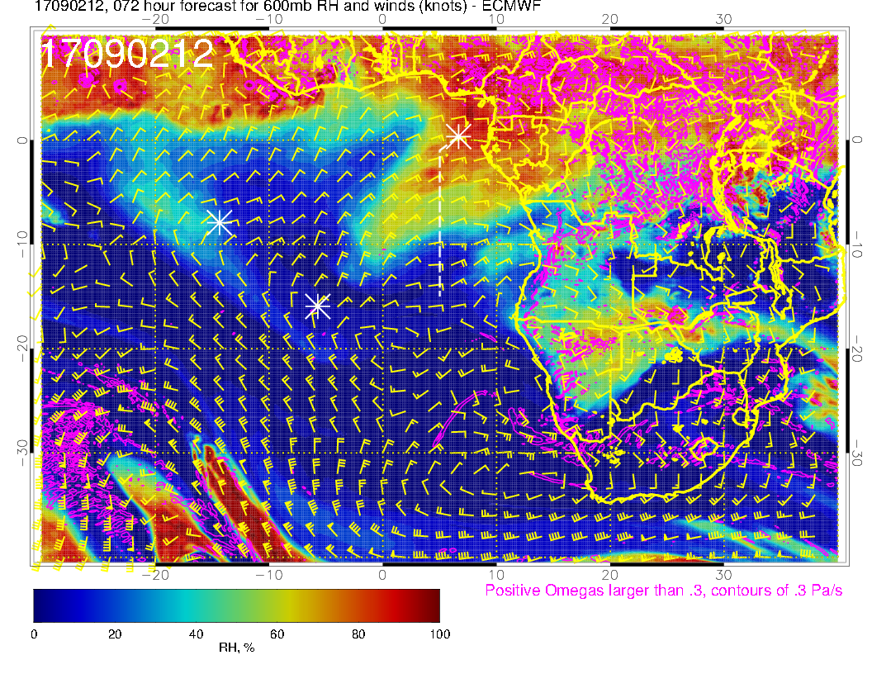
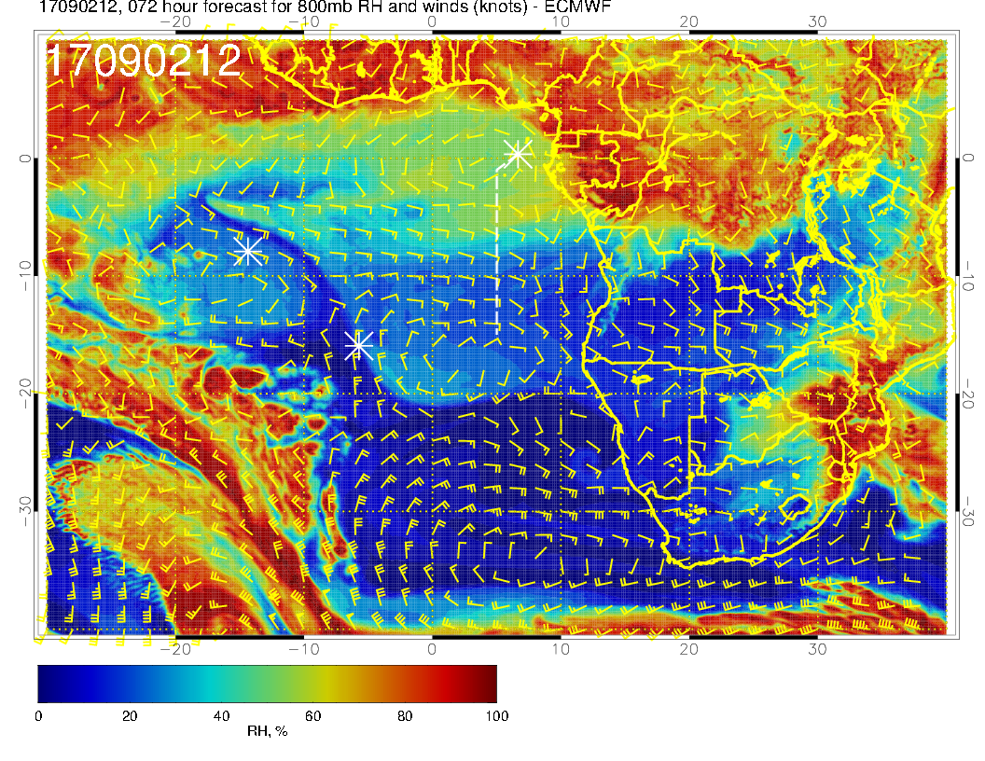
Mid levels for Transit Flight. 600mb AND 700mb patterns BOTH show a southwestward surge west of the routine track (change from previous forecast). Zonal pattern is pretty much gone except at 800mb. RH plume at 800mb similar to previous forecast, but more spread out

Slide 18
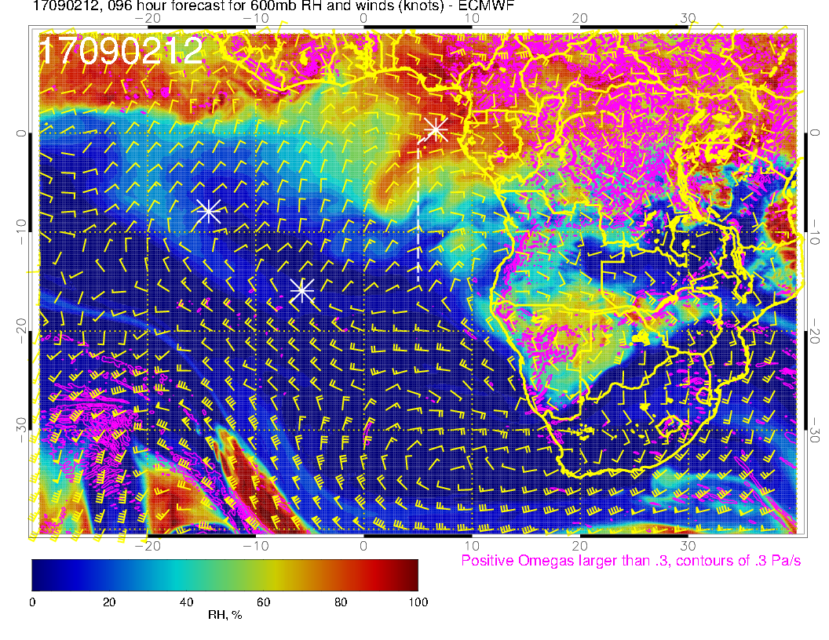
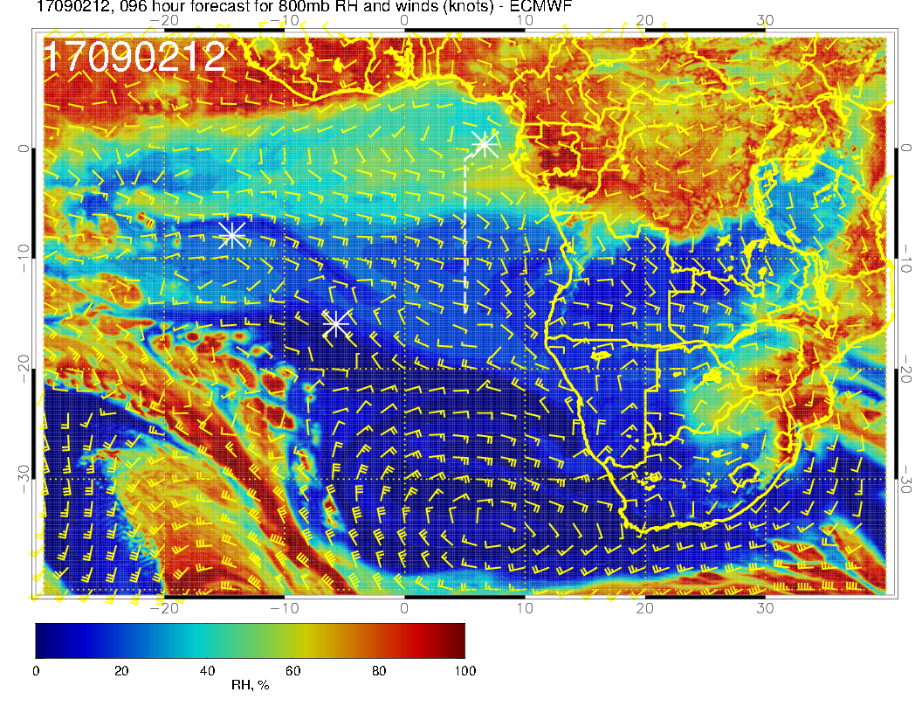
OLD FORECAST

Slide 19
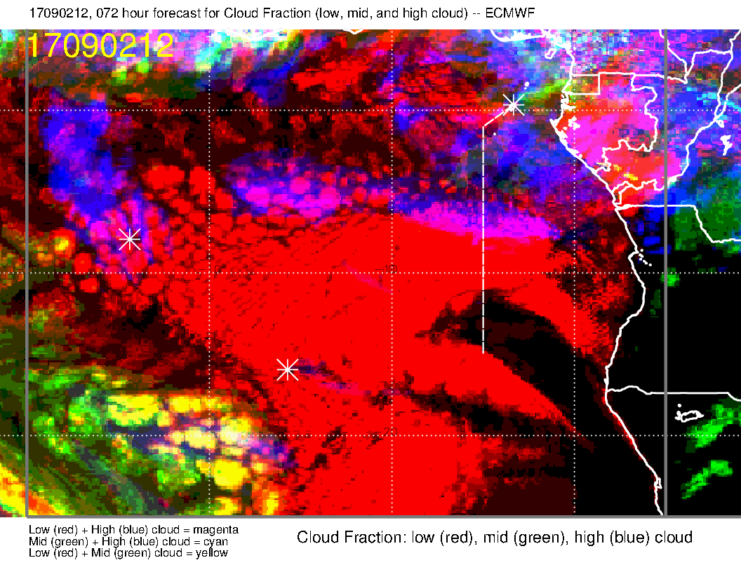
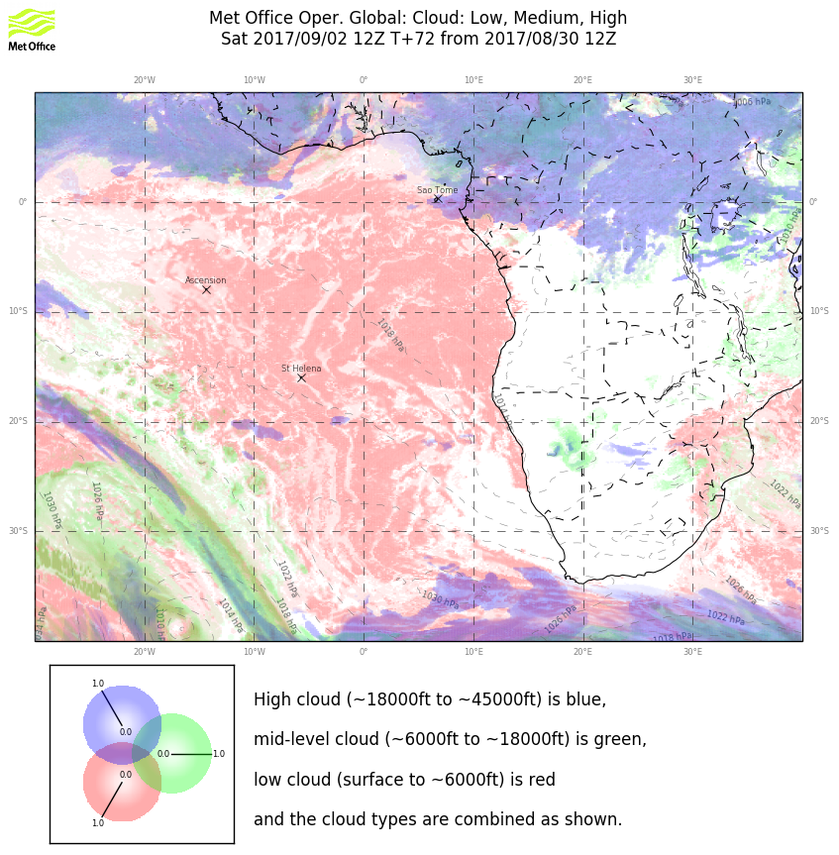
Both cirrus forecasts are reasonably consistent with their previous versions (but they disagree!!). Am inclined to agree with EC. BUT, we are still relying on model generated convection to provide the moisture (next slides).
No middle cloud forecast in spite of mid-level moisture surge (I believe this). Previous forecast had some middle cloud.
Low cloud forecast has changed to a flatter pattern. May be related to the surface wind speed pattern, but really not sure.

Slide 20
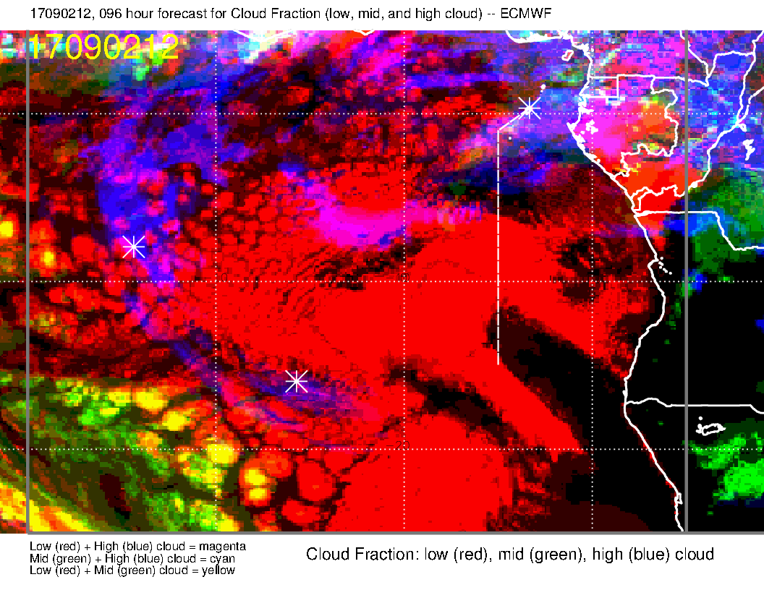
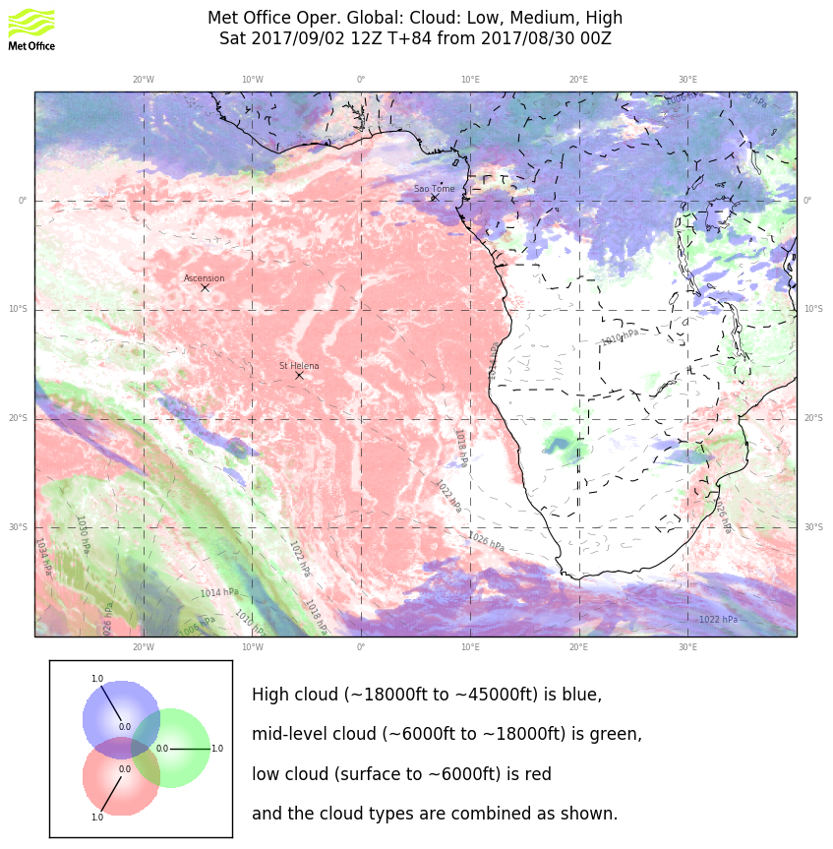
OLD FORECAST

Slide 21
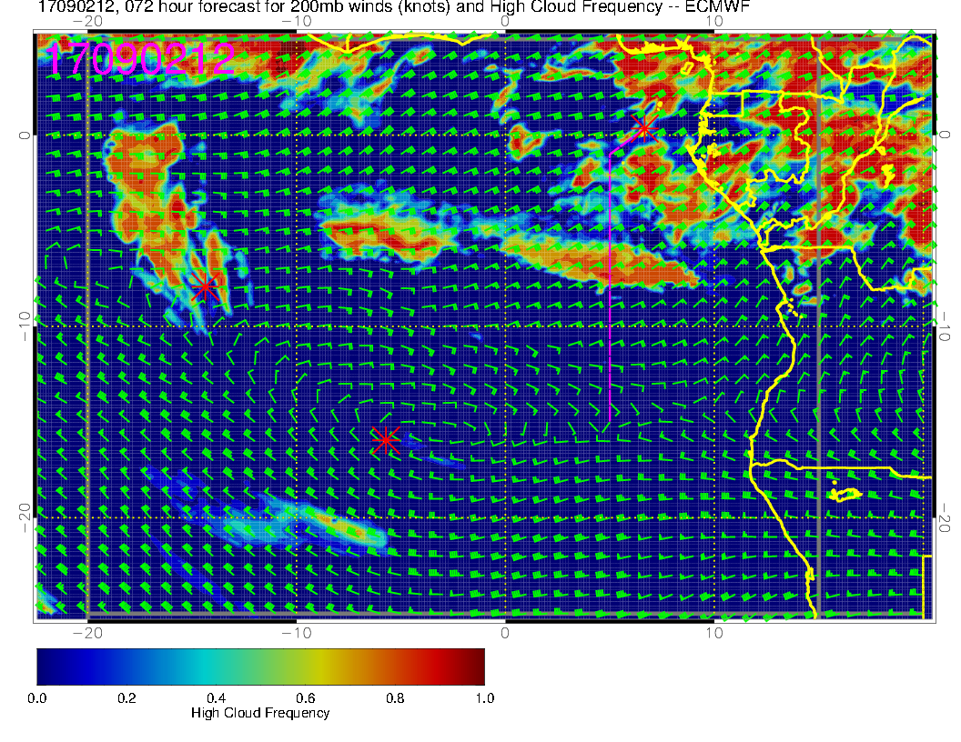
Speed is about 20 meters per second, though lead cloud appears to be moving more slowly (probably with the wave that is generating the cloud from available moisture). In 3 days, parcels move about 45 degrees of longitude, which means that the moisture comes from the continental interior. Thus, we are still relying, at this stage, on model generated convection. Would still consider the 5S flight plan

Slide 22
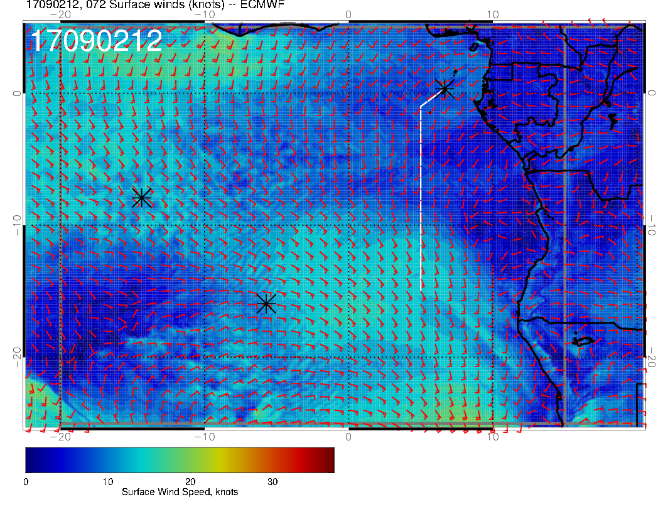
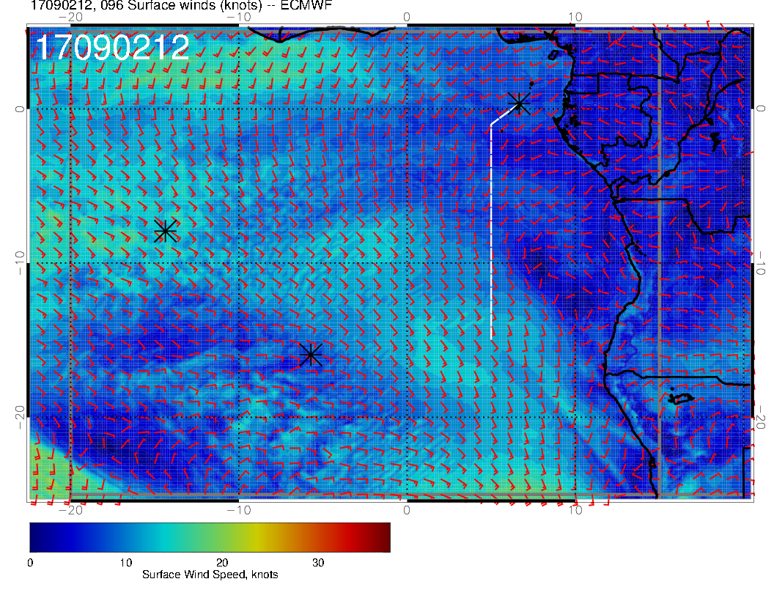
NEW FORECAST
OLD FORECAST

Slide 23
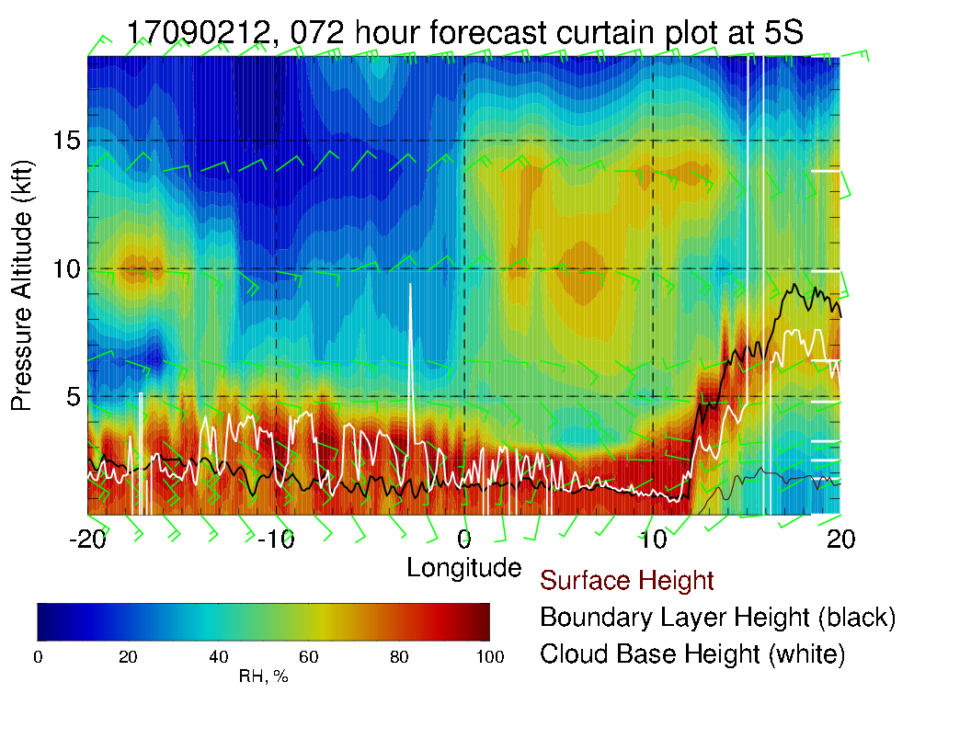
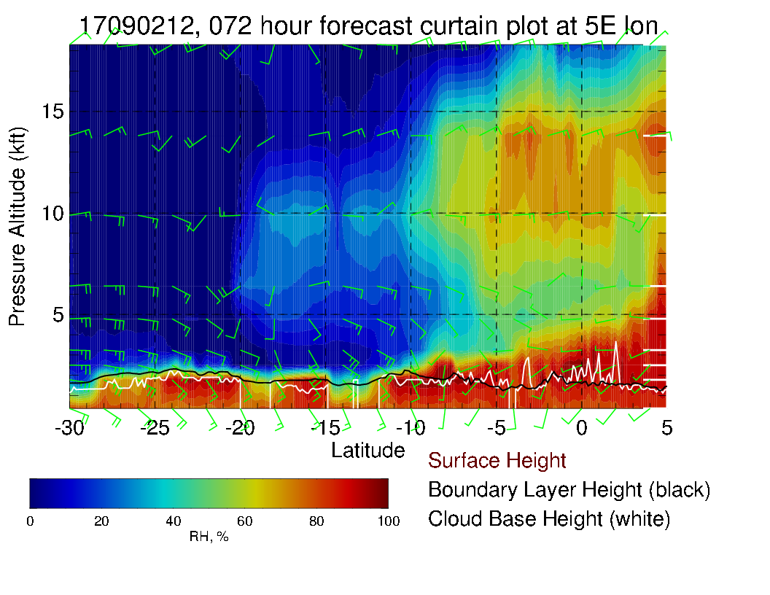
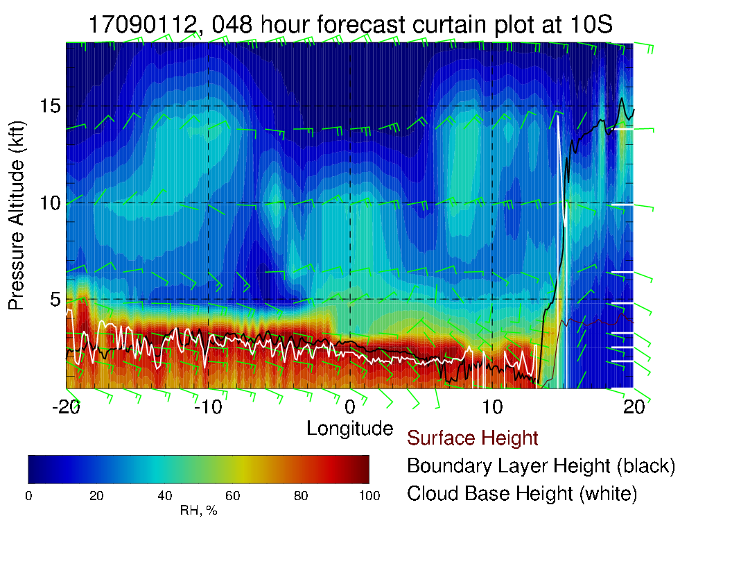
Cross sections on routine track (above) and at 5 and 10S (left). Can see the 600mb moisture surge penetrating to 5S along routine track.
At 5S, have mostly northeasterlies at about 15 knots. At 10S, easterlies at 20-25 knots.
See a lot more moisture along 5S than in previous forecast due to “surge.”

Slide 24
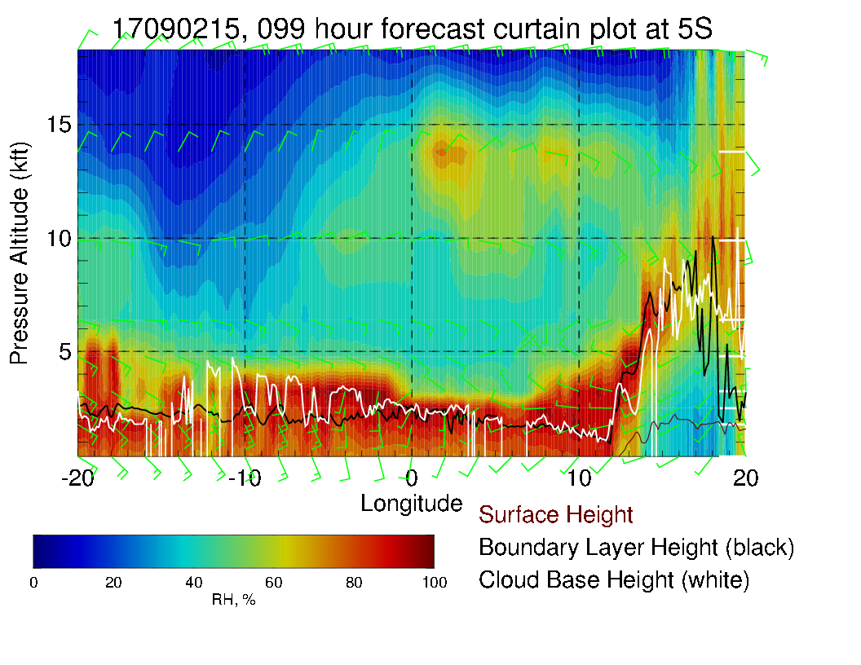
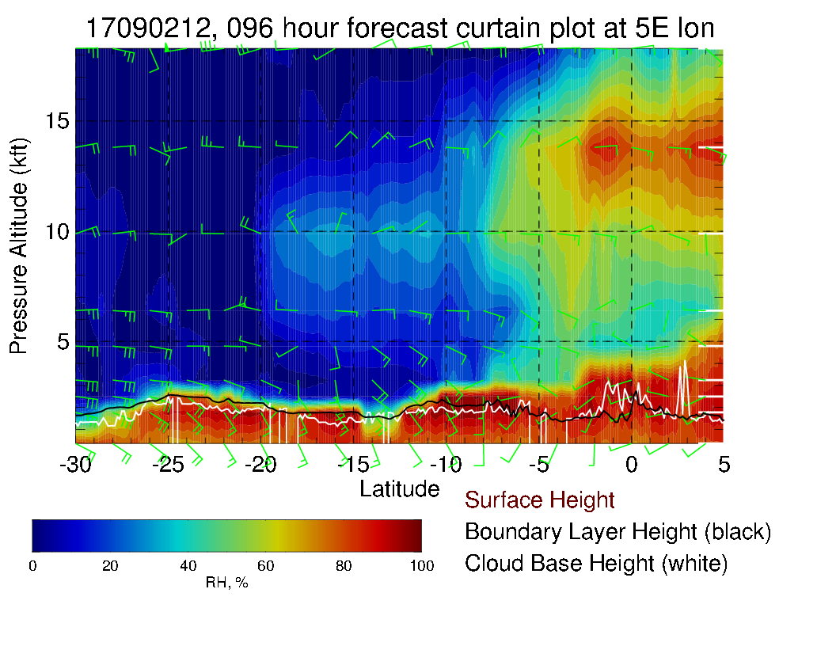
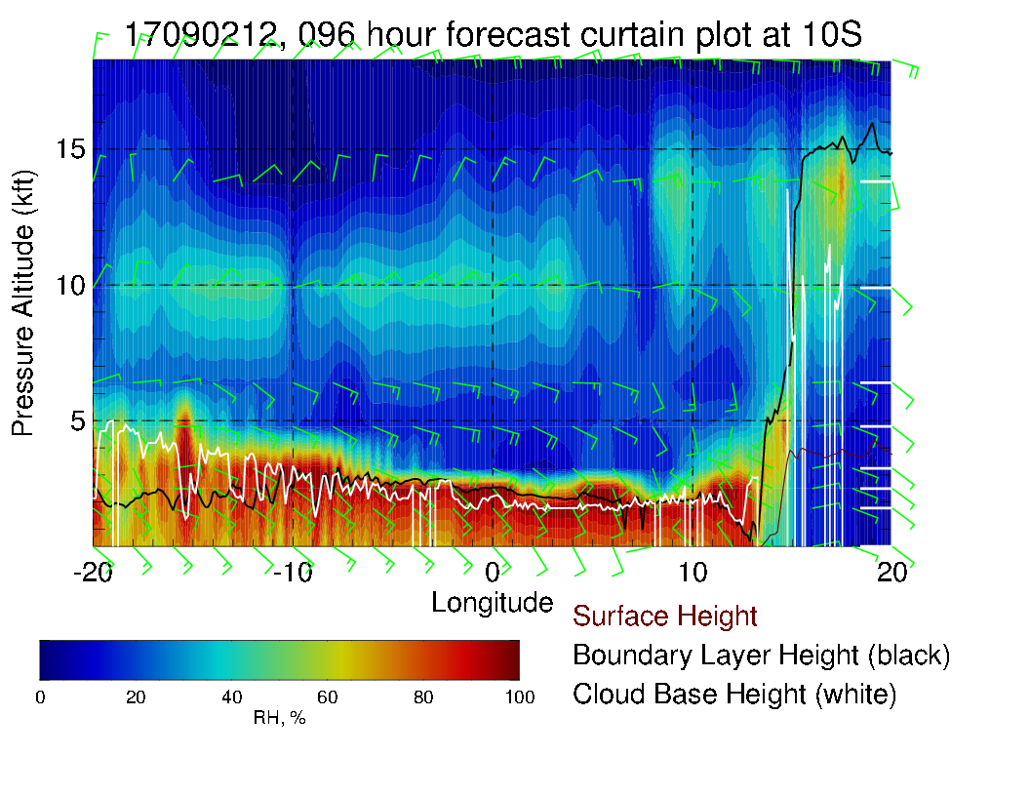
OLD FORECAST

Slide 25
Sunday-Monday Tropical Wx

Slide 26
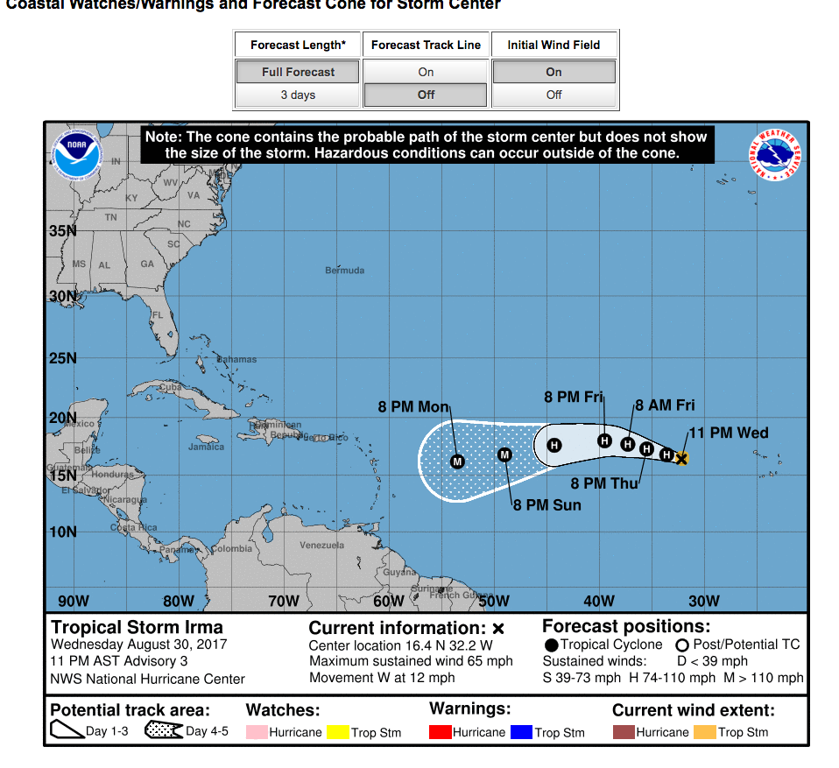
If all goes according to plan, P3 will be long
gone by this time.

Slide 27
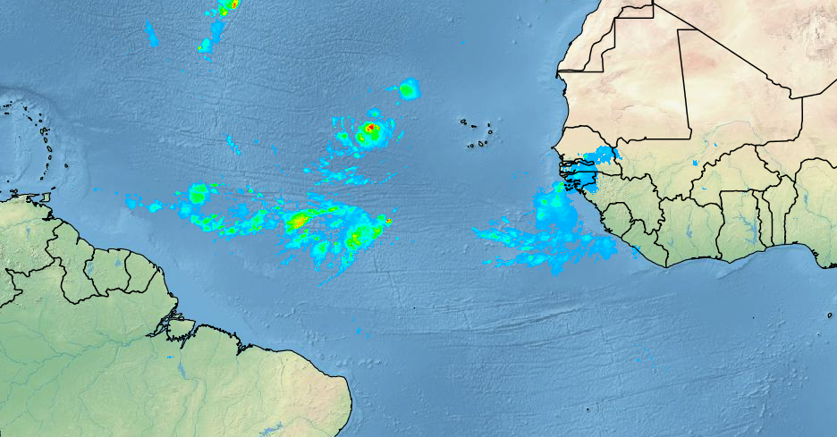
SEVIRI mean precip estimate at 8:15 GMT. TC may suck the air out of all the other
rain bands, but if they hold, they may be more of an issue than the TC itself (IRMA)

