Slide 1
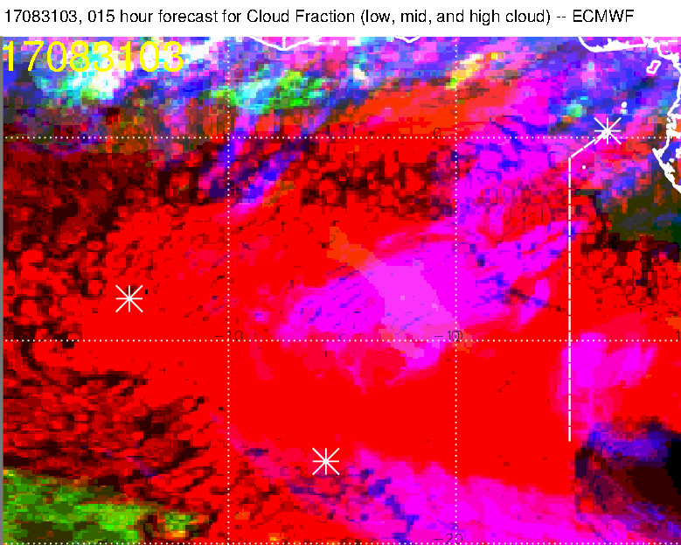
Reasonable forecast for high cloud and
middle cloud at 3 AM. Does get a hint of
the “two sections” of high cloud.
Insufficient clearing of low clouds, but we would get a more solid sampling of usual SC if we head back along south track

Slide 2
Not as good, lumps two sections of high
cloud together, I don’t see the middle cloud

Slide 3
Better (this is 4 km model), but still
no middle cloud

Slide 4
LARC has altitudes of 3-5 km for this
middle cloud feature. Best guess is that it
is something at 600mb – 500mb is dry..

Slide 5
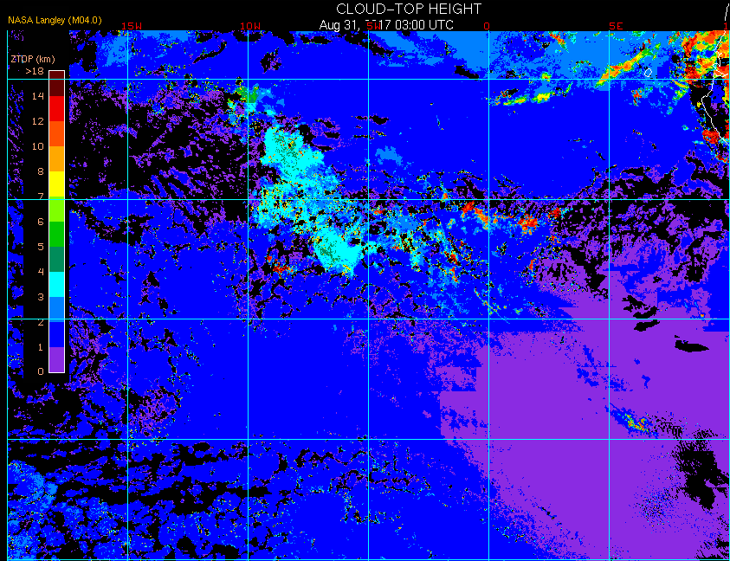
LARC has altitudes of 3-5 km for this
middle cloud feature. Best guess is that it
is something at 600mb – 500mb is dry.

Slide 6
Some forecasts

Slide 7
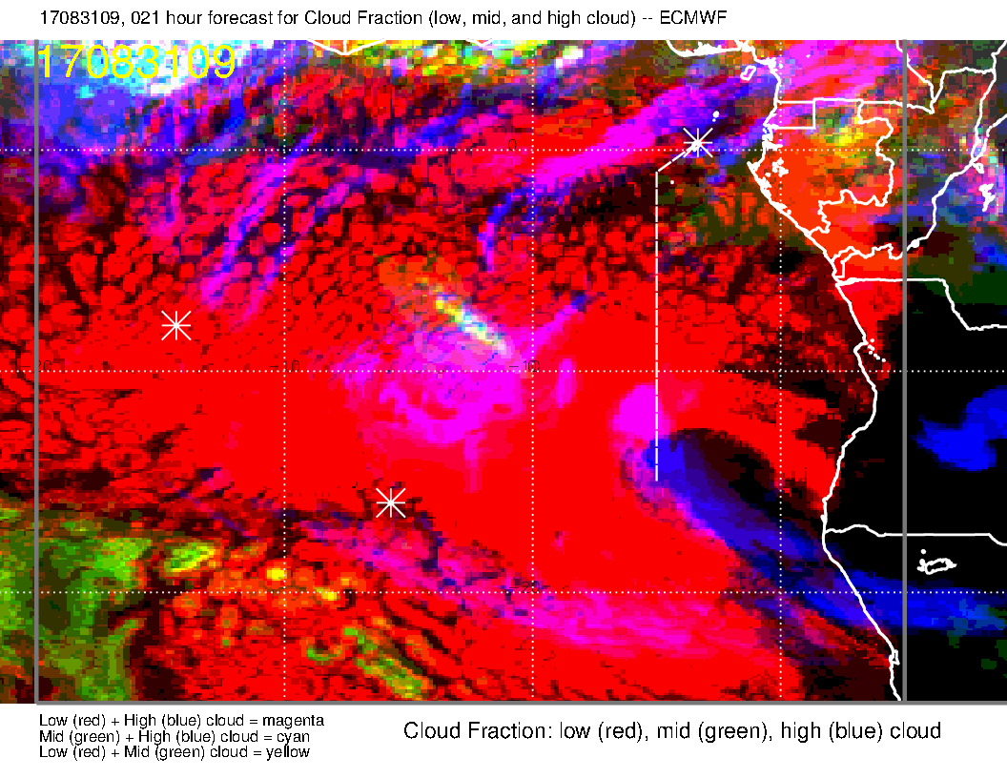
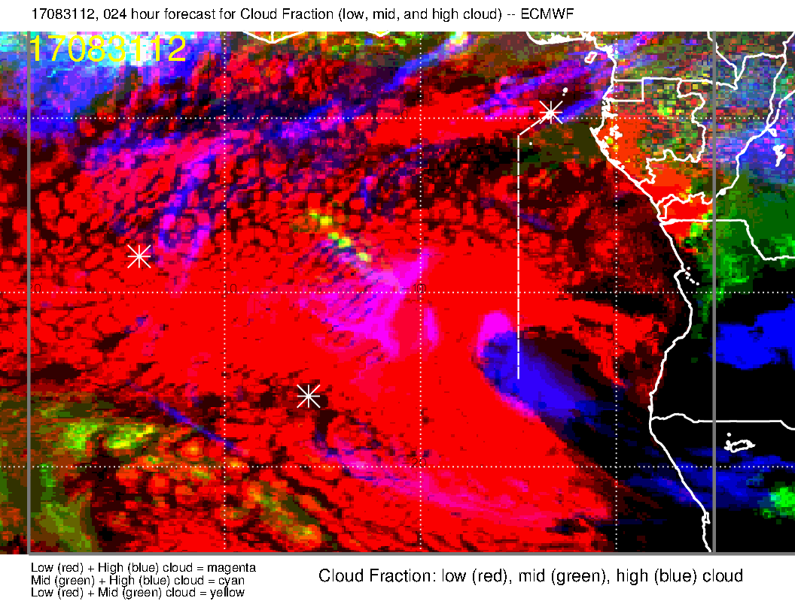
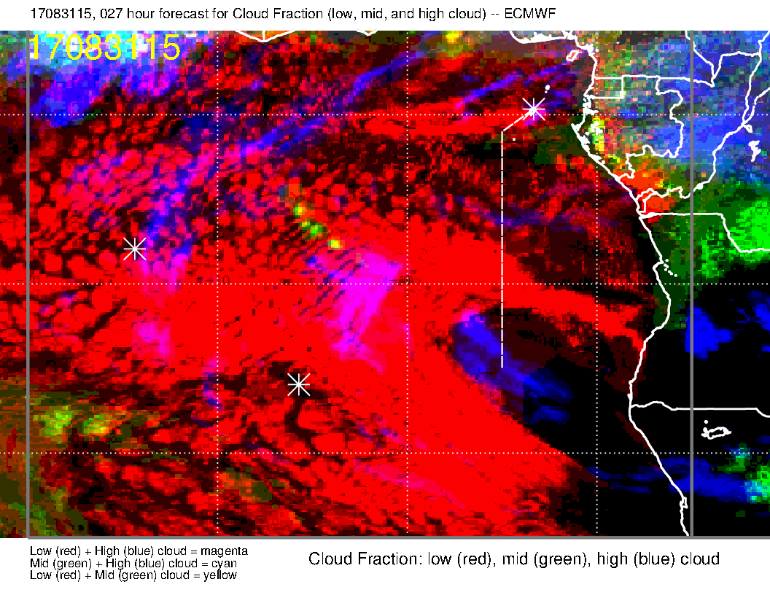
The middle cloud seems to have disappeared by noon. We are left with SC that are high enough to get into middle cloud range (yellow dots).
Forecast is for some cirrus possible on the way there, and strings of cirrus likely near southern point at 0W, 10S.

Slide 8
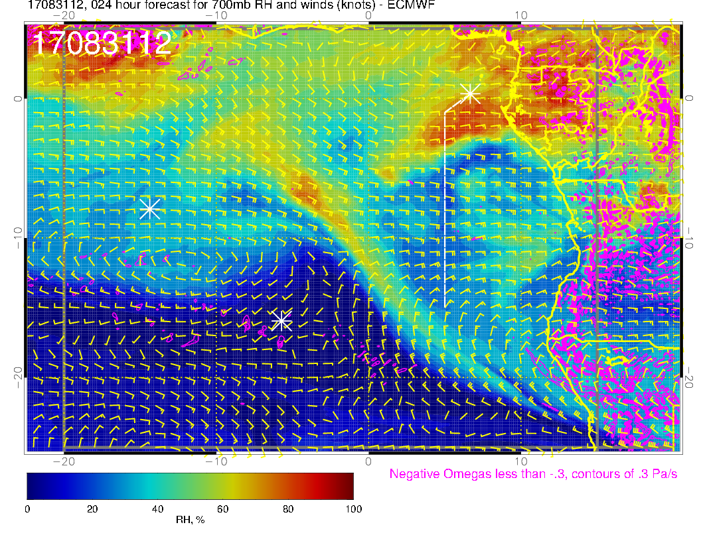
Easterlies to east southeasterlies around 20 knots (3 km)

Slide 9
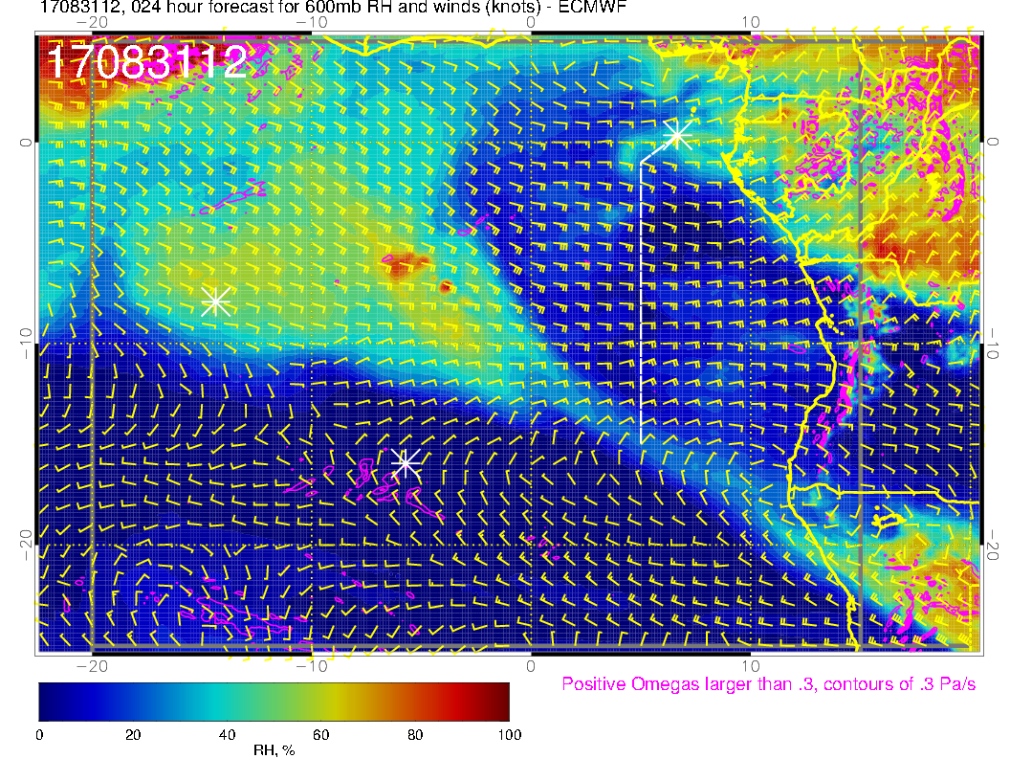
Easterlies to east southeasterlies around 20 to 25 knots (4 km) at noon.

Slide 10
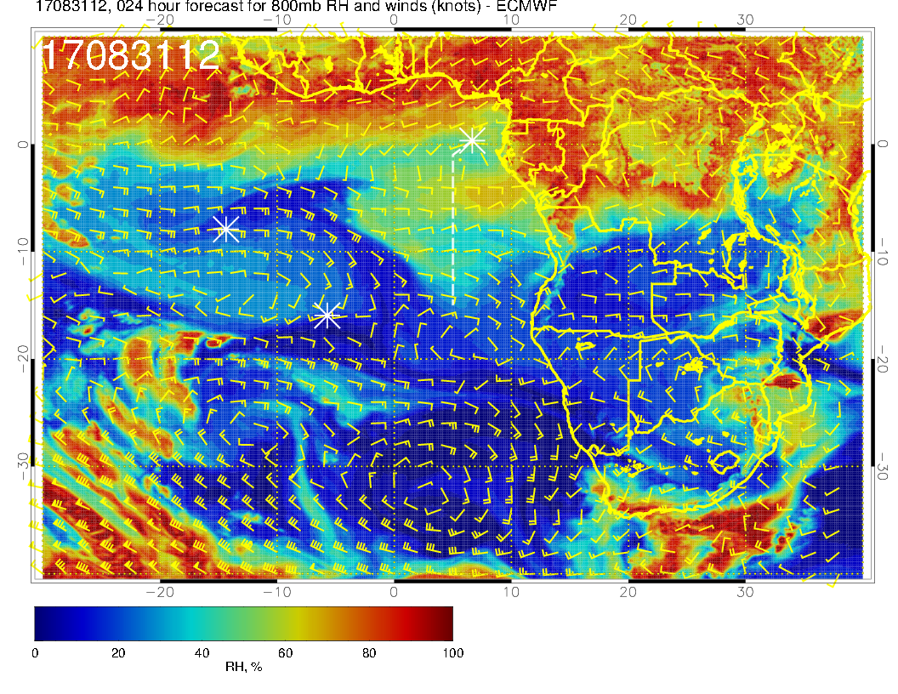
Easterlies to east southeasterlies around 10-15 knots (2 km) at noon.

Slide 11
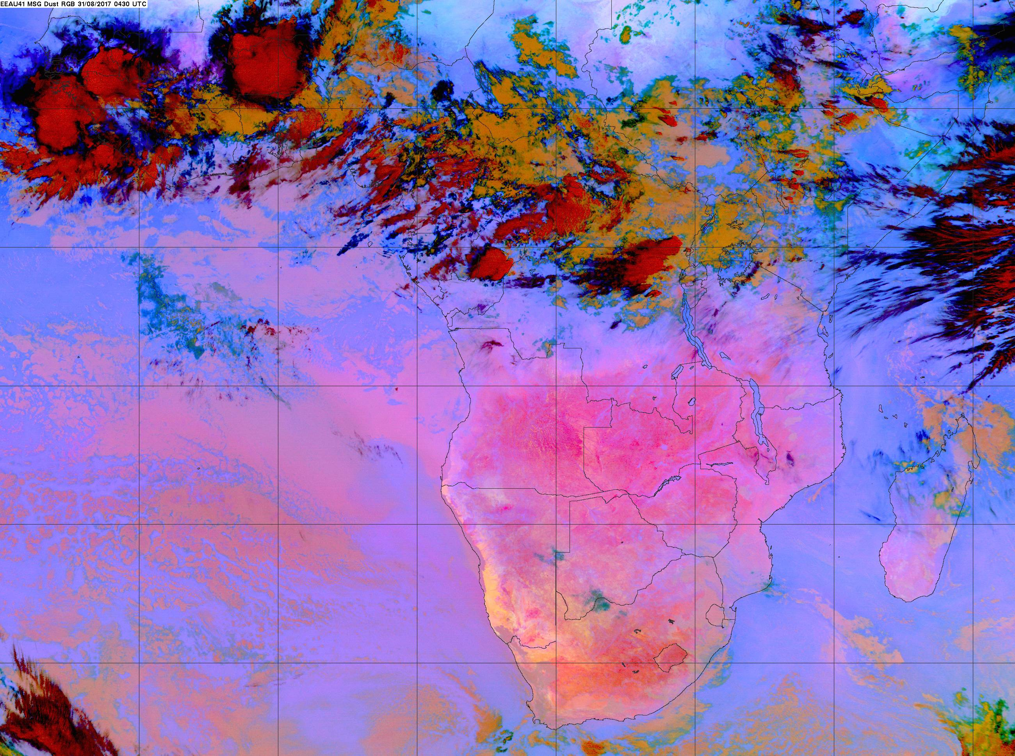

Slide 12
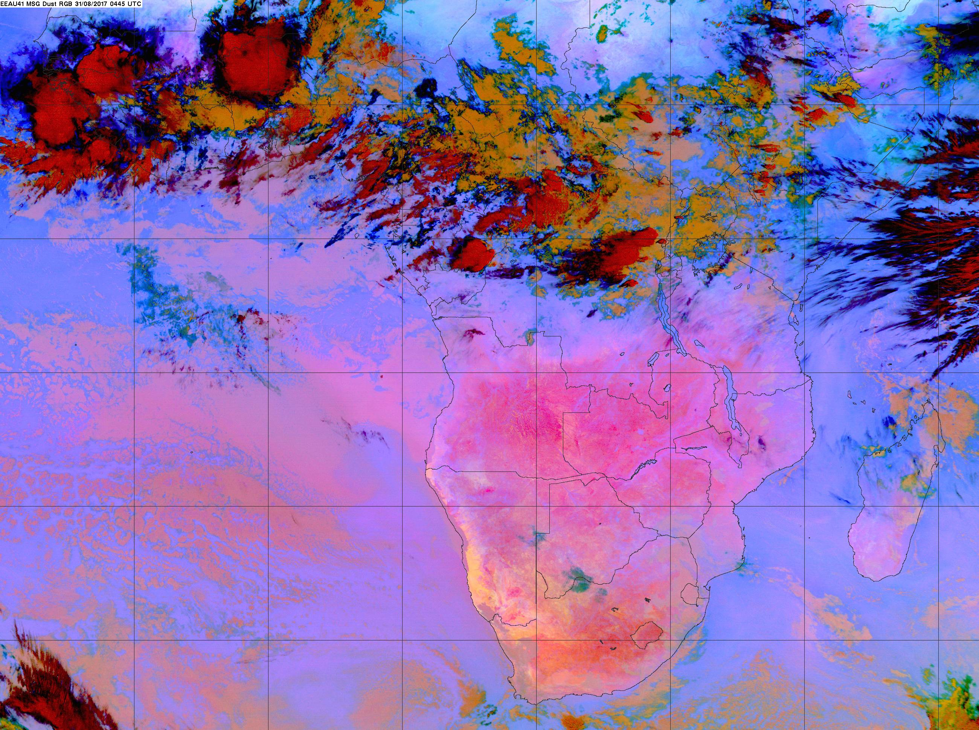

Slide 14
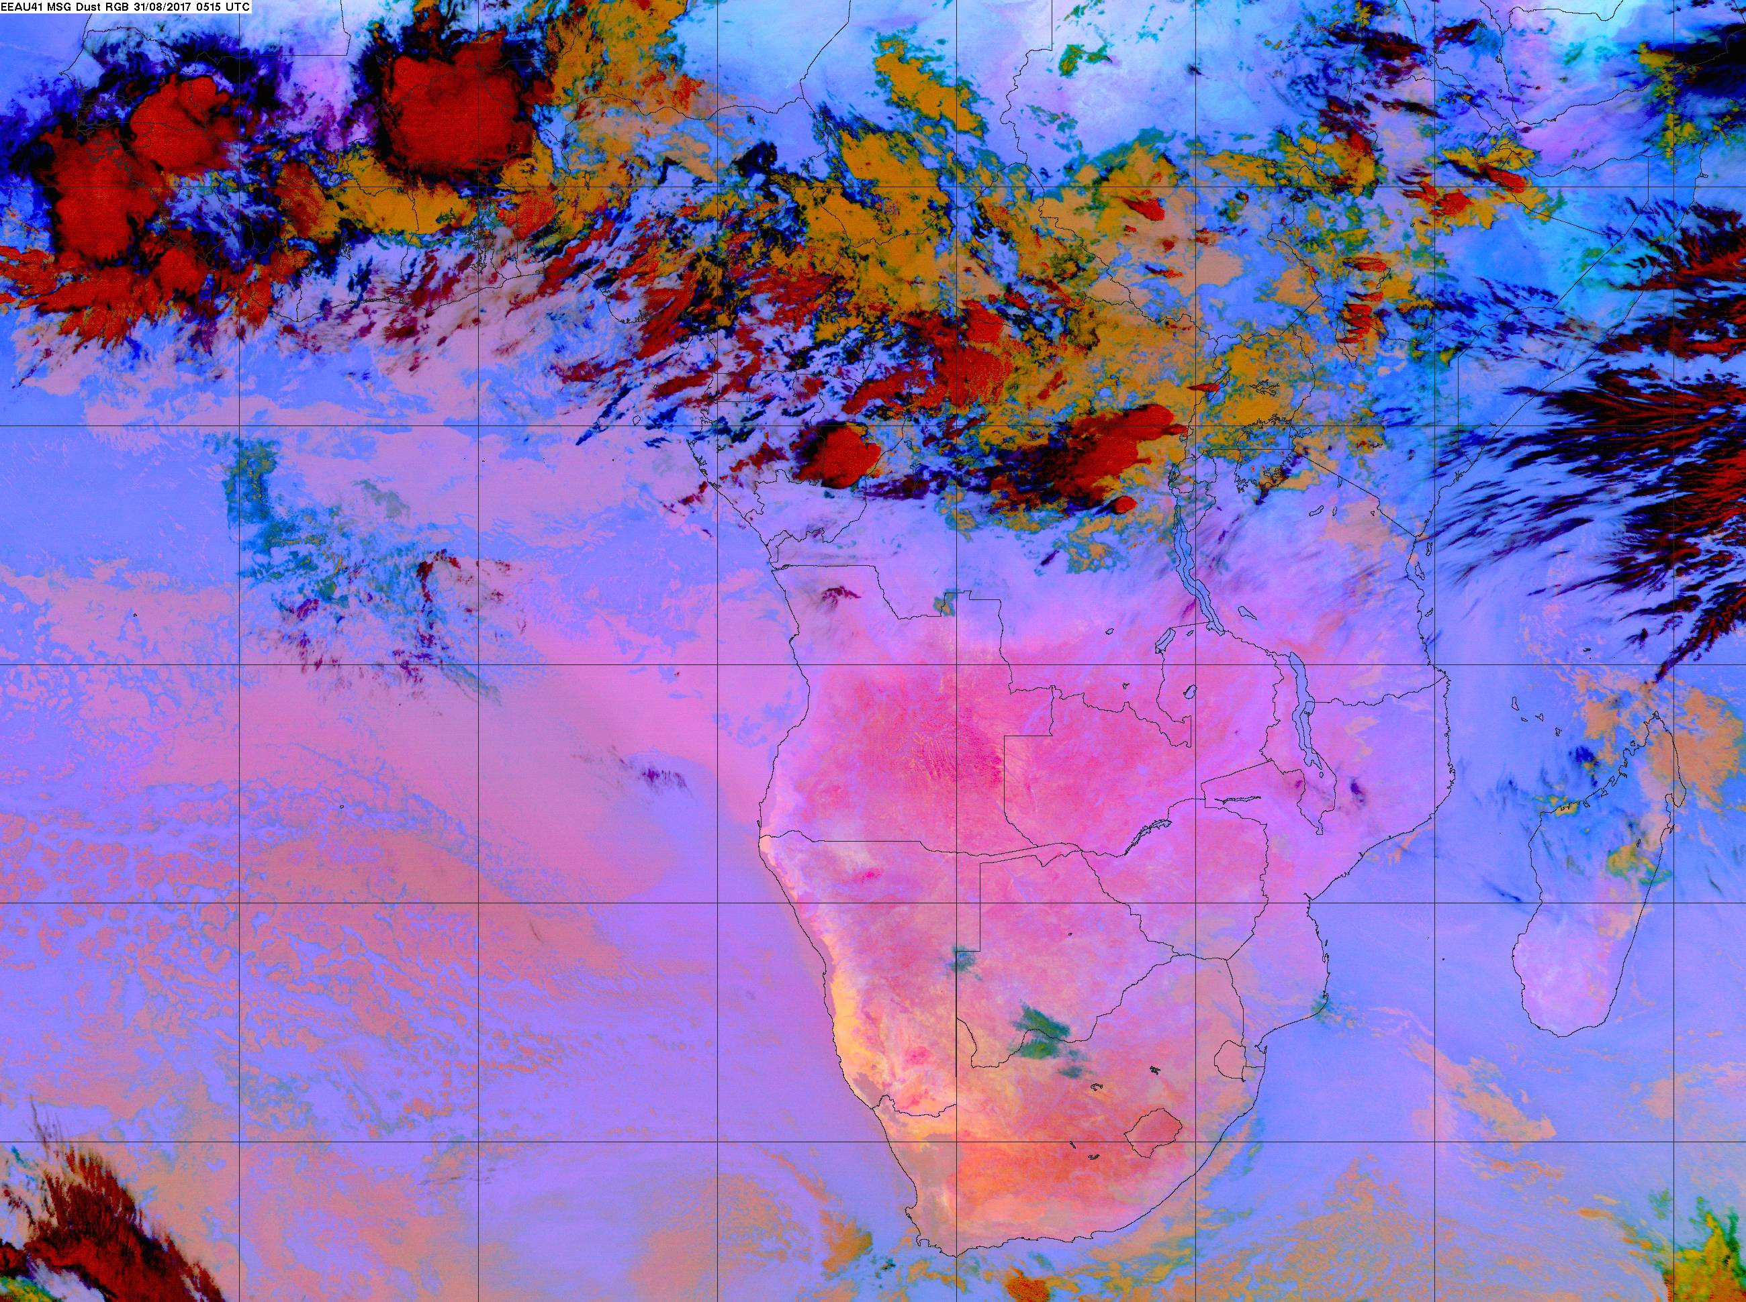

Slide 15
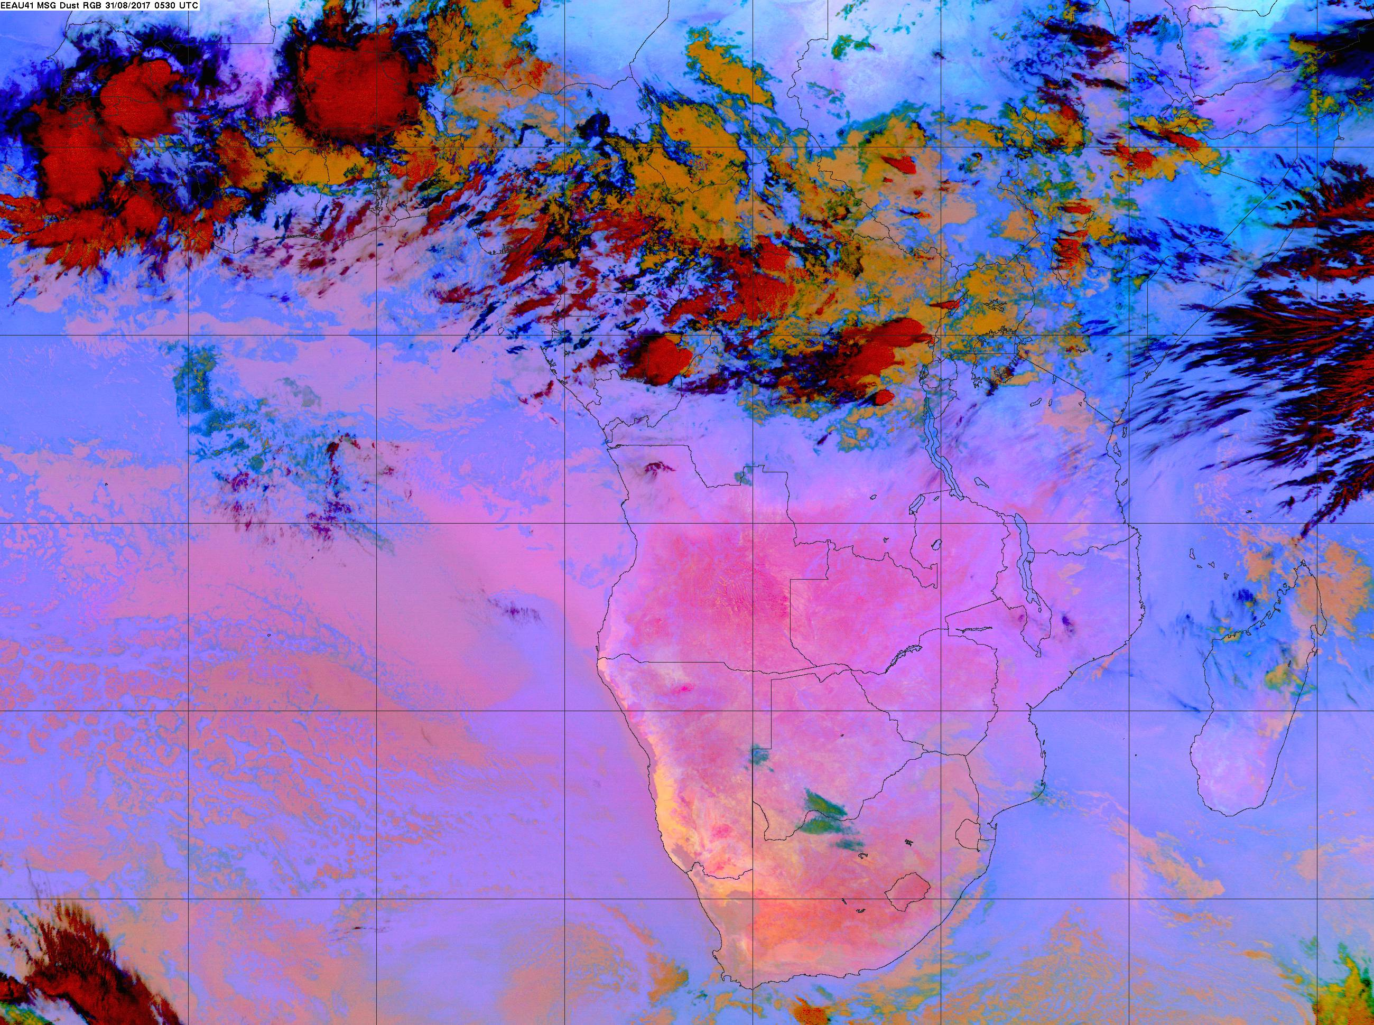

Slide 16
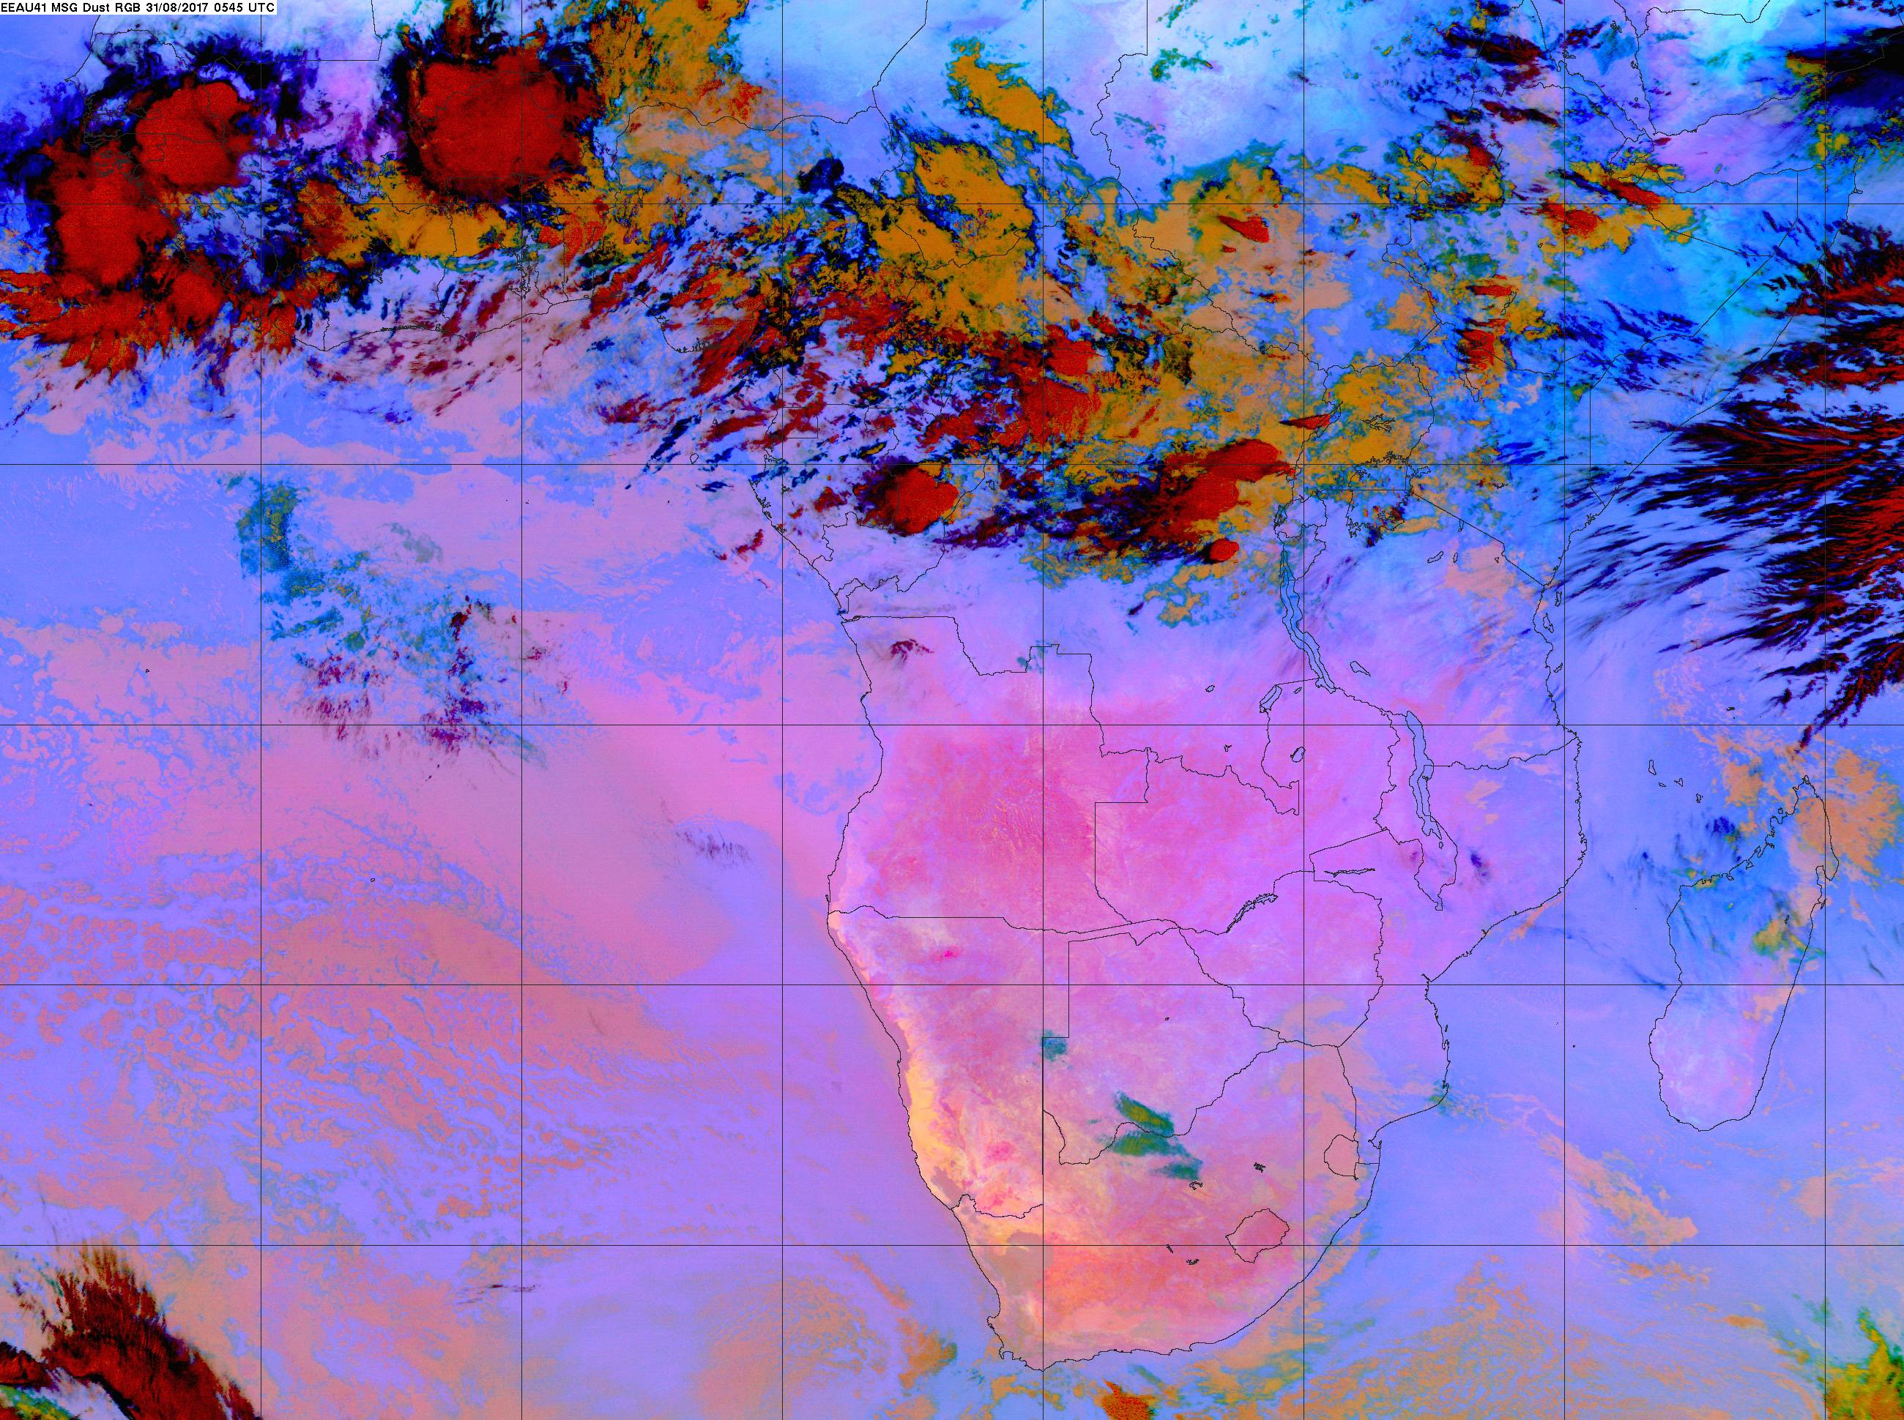

Slide 18
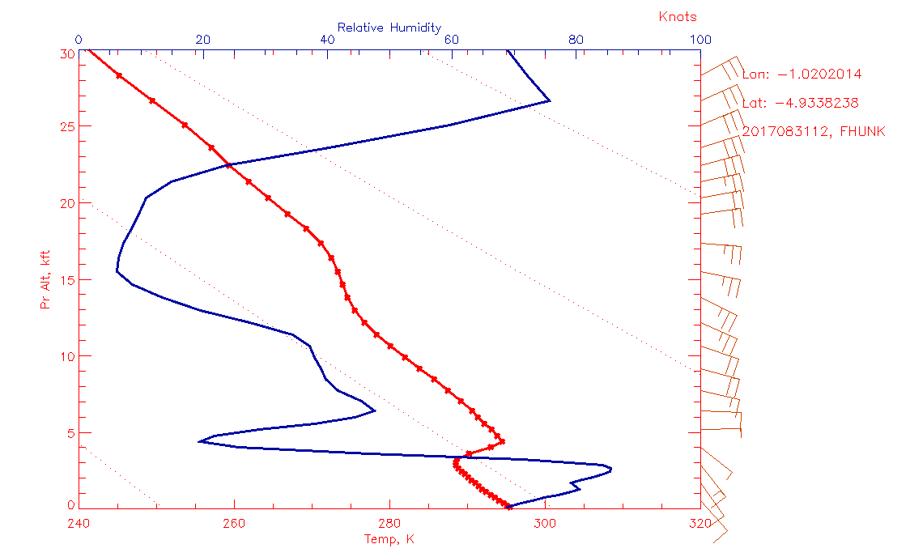

Slide 19
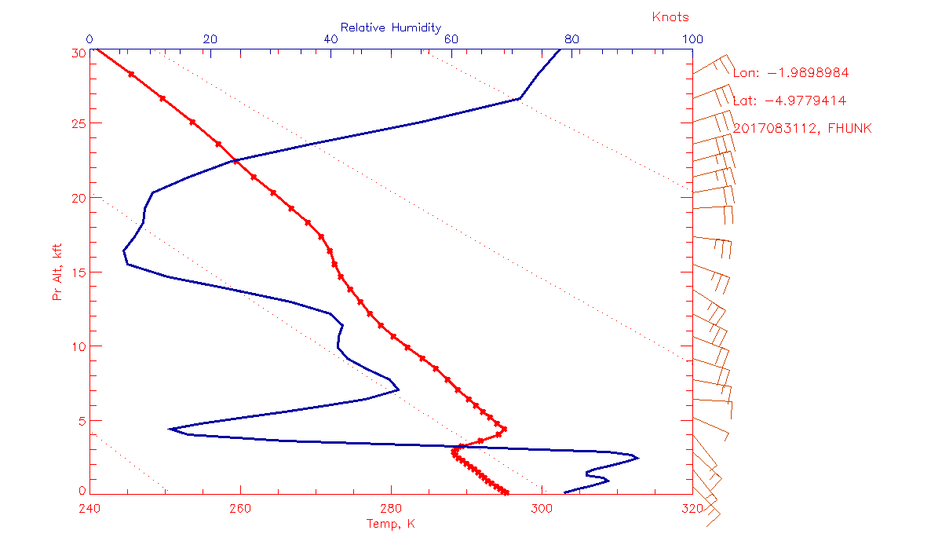

Slide 20
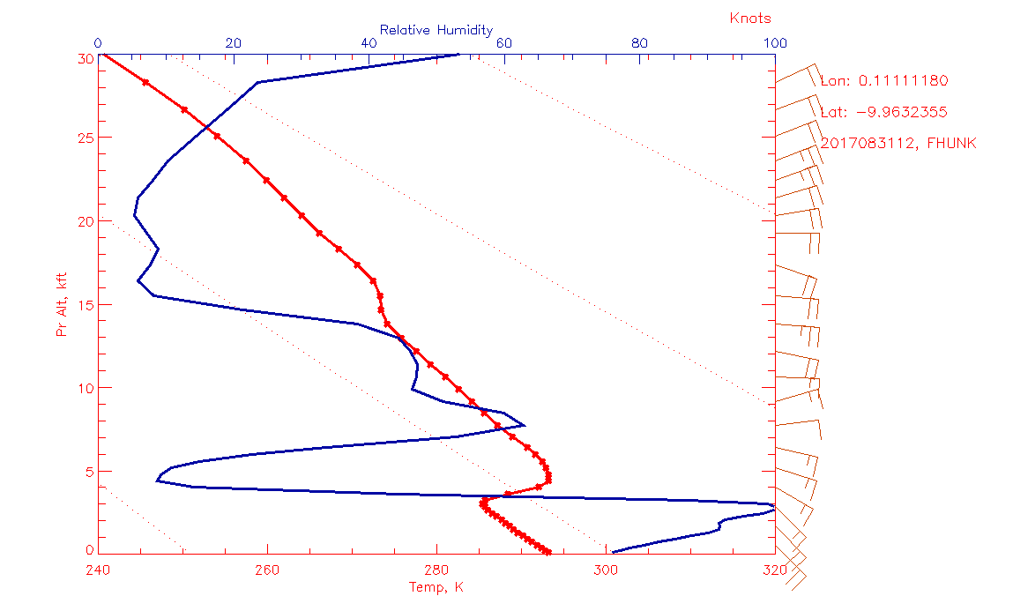

Slide 21
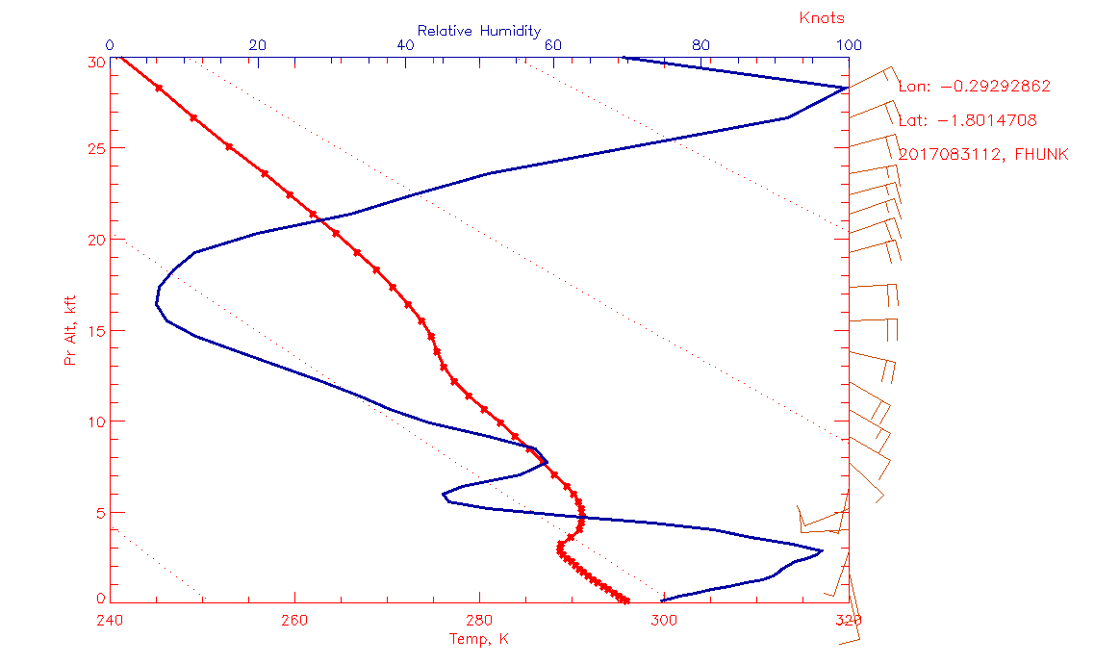

Slide 22
Note, yesterday temperature was 28C at 8 AM, 29 by 10 AM.
Due to scattered and few clouds, winds seemed OK.
Current 4 AM temperature is 25. Have broken clouds

