Slide 1
ORACLES weather briefing
30-Aug-2017
Lenny Pfister and Rei Ueyama

Slide 2
Surface evolution 8/29-9/2

Slide 3
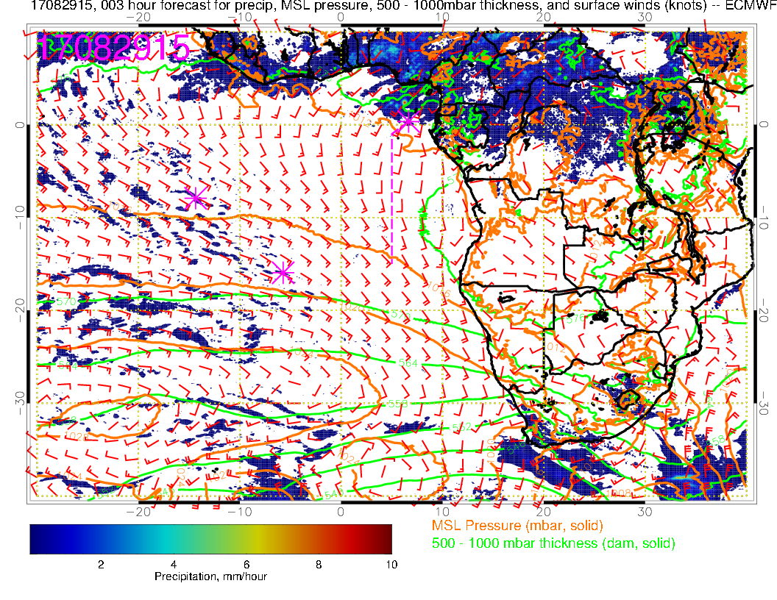
Tuesday (NF): SH high slowly moving eastward. Winds freshen in SE Atlantic overall, SSW over TMS (westerlies pushed to north of TMS). No Angola Bay eddy. Convective focus is Nigeria, CAR, and Chad (and just north of TMS).

Slide 4
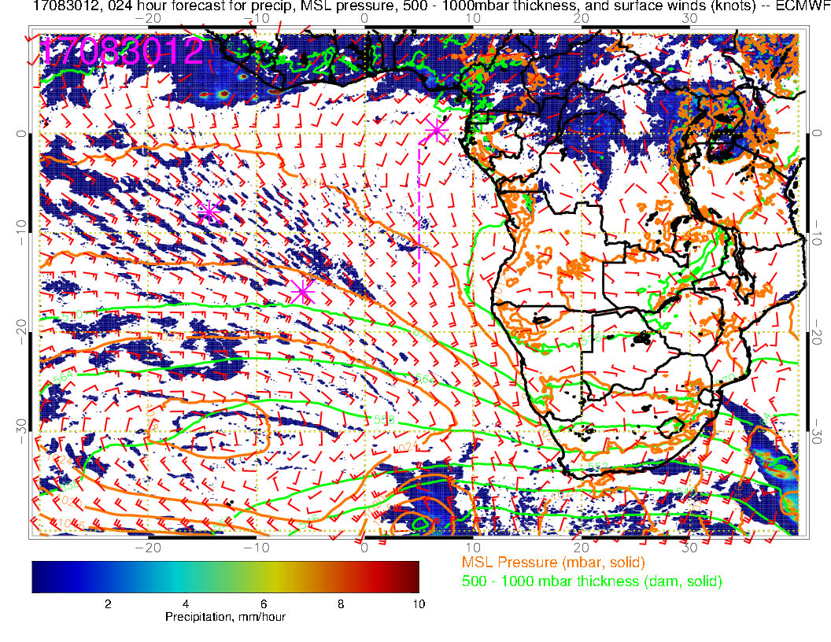
Today (F): Convection developing over Nigeria, off of west African coast (~10W), northwestern Congo, and northeastern Congo. Local winds weaken, Angola Bay eddy starts to redevelop (but not prominent). SH high moves east and winds off of Namibia increase.

Slide 5
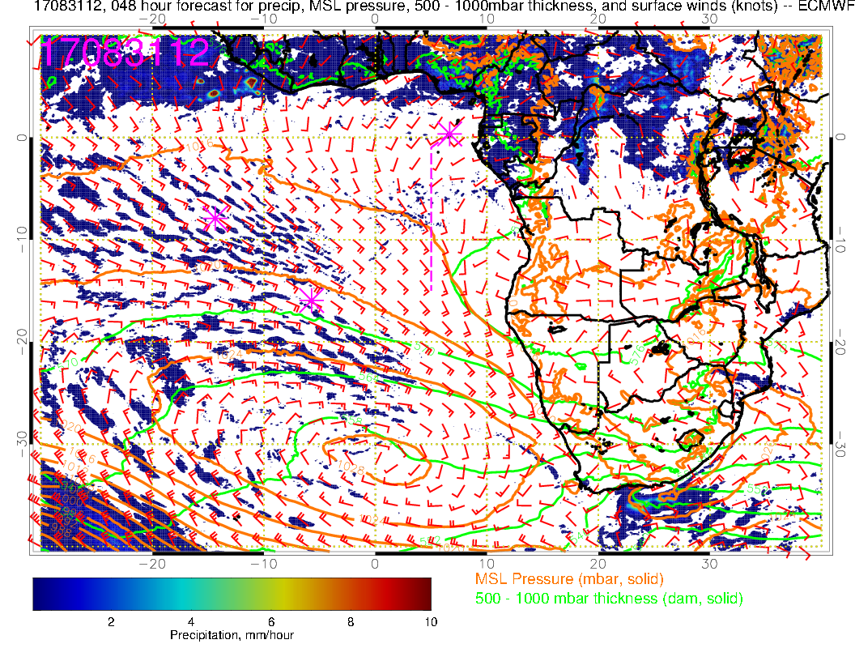
Thursday (F): Have the two foci of convection again (off of West African Coast, and interior Africa. Weak winds extending northwestward from Angola Bay, with near westerlies (not weak, 10 knots) over TMS. SH high is in climo position – 25 knots off Namibia.

Slide 6
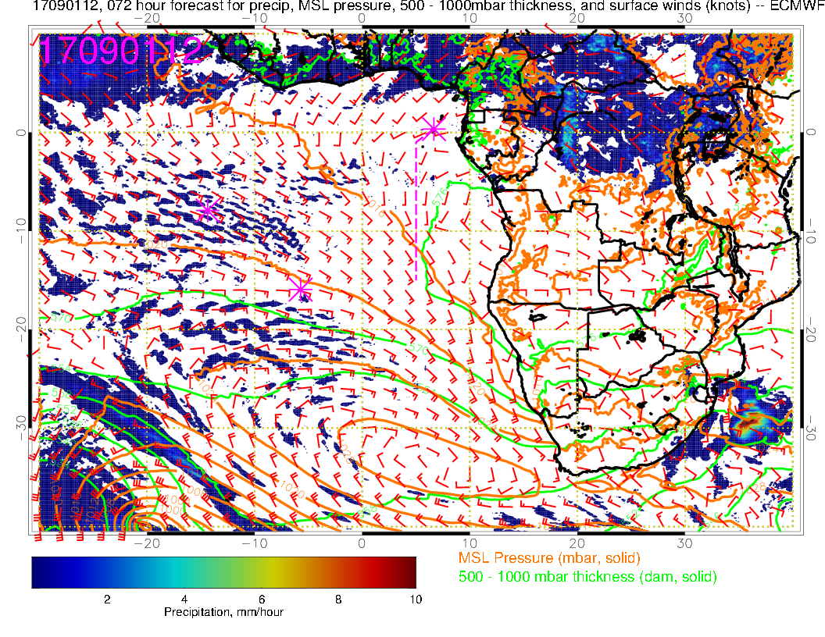
Friday (NF):A new low pressure system moves in, pushing SH high eastward. Winds now really weak in Angola Bay/TMS region, and westerly. Strong convection forecast in interior of Africa (Congo/CAR)

Slide 7
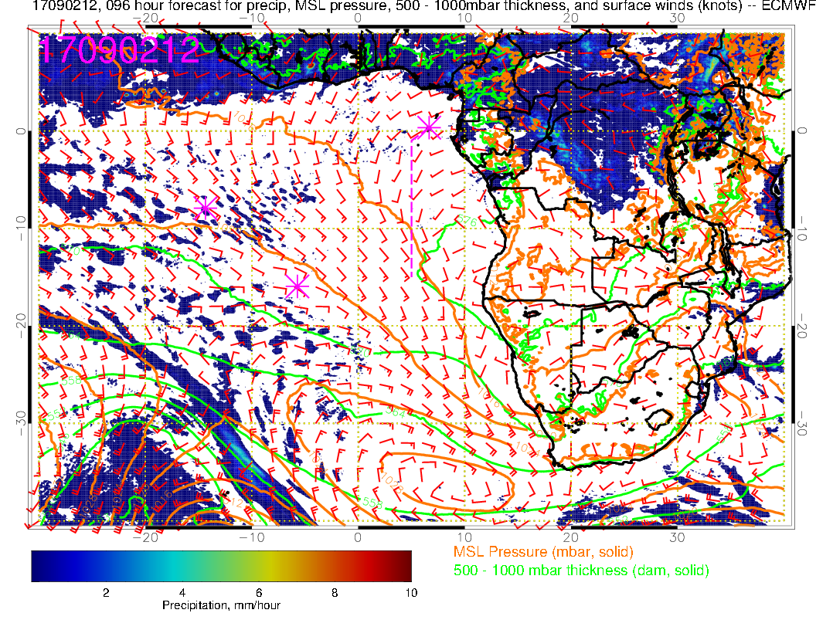
Saturday (Transit science flight): Low level winds have been similar since 8/31 with westerlies near TMS and now a really pronounced Angola Bay Eddy. New forecast has backed off on the Congo convection from previous forecast.

Slide 8
700mb evolution 8/29-9/2

Slide 9
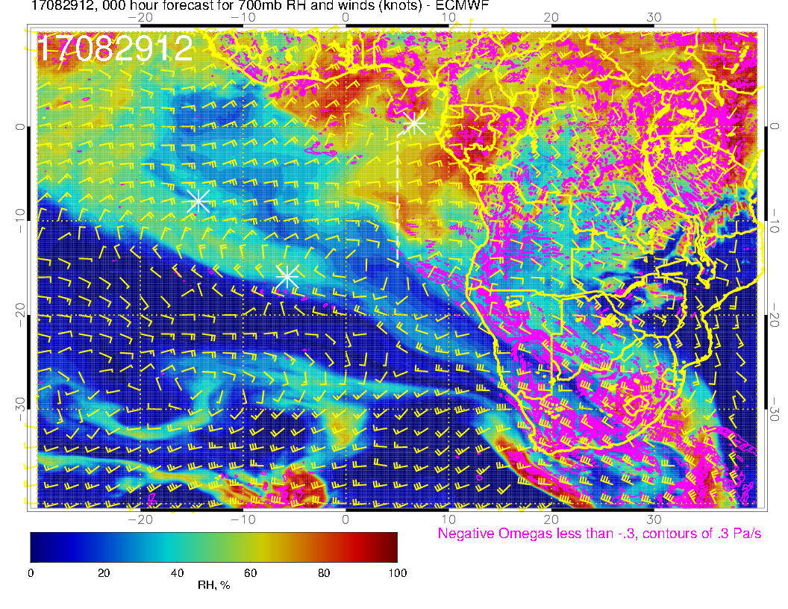
A
A?
A?
A
Today (NF): Continued zonal pattern, 15-25 knots. Confluence from north now at prime meridian as African wave anticyclone pushes westward. Moisture intrusion now fully along routine track. Diffluence toward the south starts near St Helena.

Slide 10
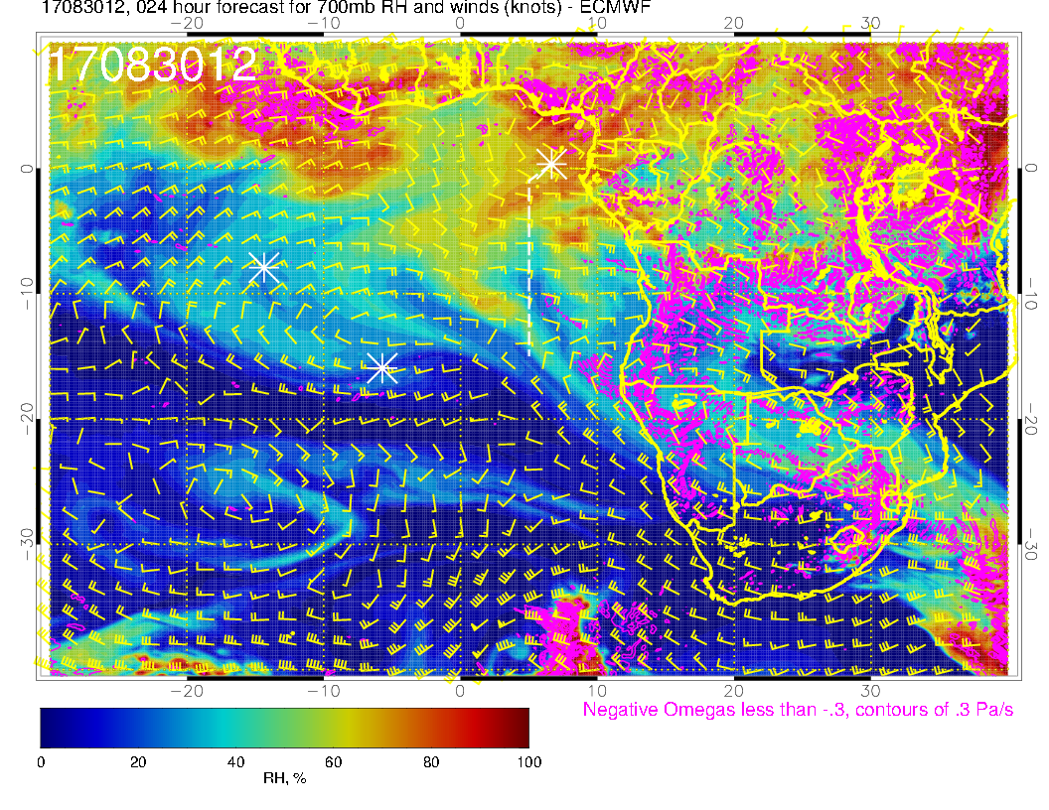
A
A
A
Wednesday (F): Moist air intrusion moves northwestward with the winds (turned southeasterly from easterly north of ~5S. Still a strong core of 20 knot easterlies from 5S to 12S. Drier air moves in behind the moving moist air. Anticyclone near Saint Helena becomes distinct and moves westward. Flow north of elongated continental anticyclone is west northwestward.

Slide 11
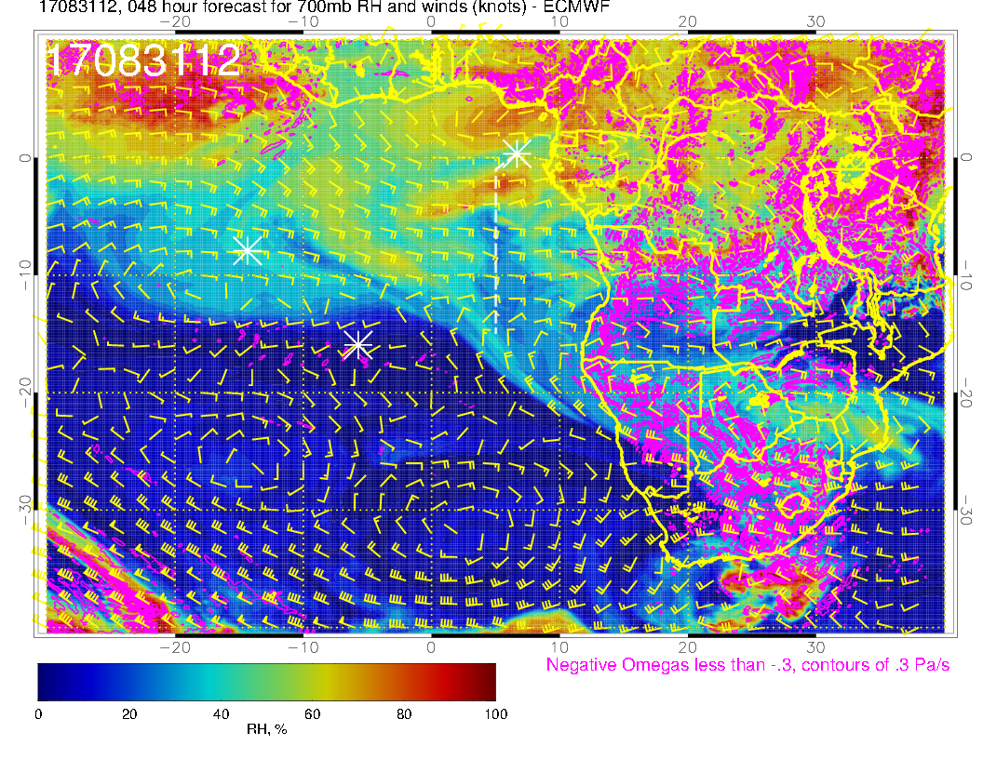
A
A?
A
Thursday (F): Zonal pattern continues with 20-25 knot easterlies. Anticyclone to the north moves west, reducing the northwestward flow, and pushing it westward. RH pattern is washed out. Saint Helena anticyclone is dying; continental flow is more westward.

Slide 12
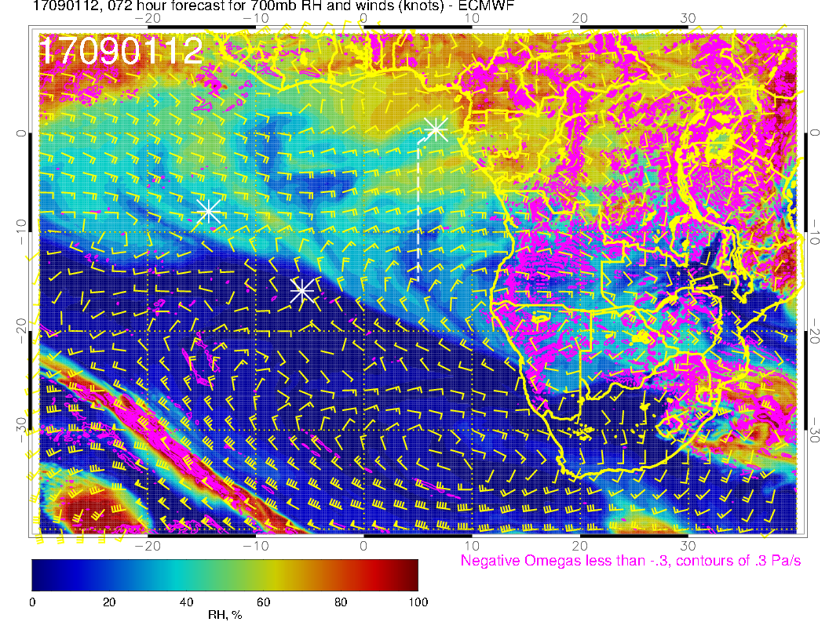
A
A
Friday (NF): Wind speeds similar, but subtle change in direction, with a stronger southward component than in previous forecast (and compared to previous day). Basically, the two southern anticyclones have “combined” to produce this southward component. Anticyclone to the north has moved west pushing northwestward flow further westward. New moist intrusion north of 4S from continent.

Slide 13
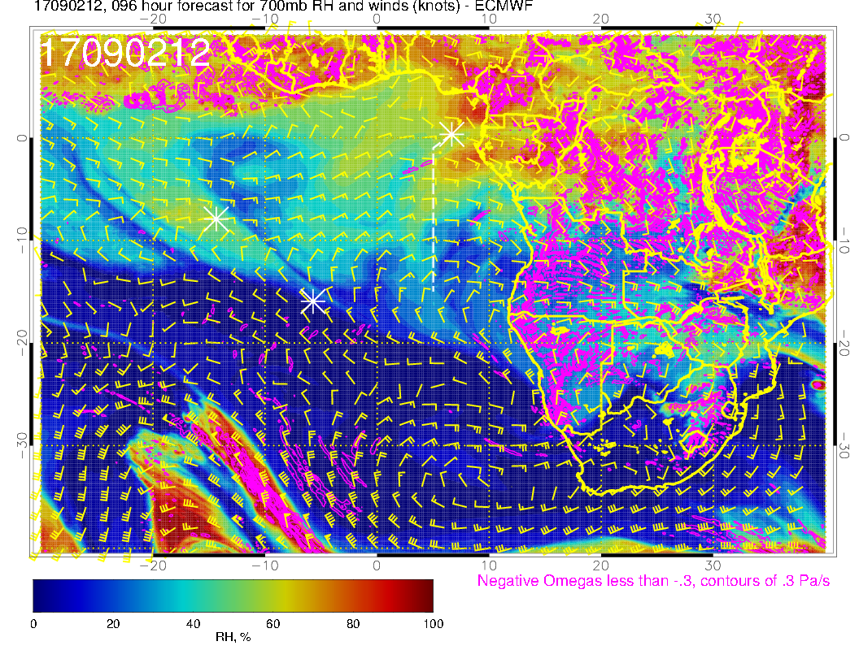
A
A?
A
A
A
Saturday (science transit to ASI): Easterlies start to weaken to 10-15 knots east of the prime meridian. Moisture intrusion north of about 5S continues westward, but dry air at this level further south off the continent. Southward flow component west of the prime meridian becomes stronger. On the continent, flow is more sharply northward (western Congo).

Slide 14
Tomorrow (Thursday)

Slide 15
Thursday (F): Have the two foci of convection again (off of West African Coast, and interior Africa. Weak winds extending northwestward from Angola Bay, with near westerlies (not weak, 10 knots) over TMS. SH high is in climo position – 25 knots off Namibia.

Slide 16
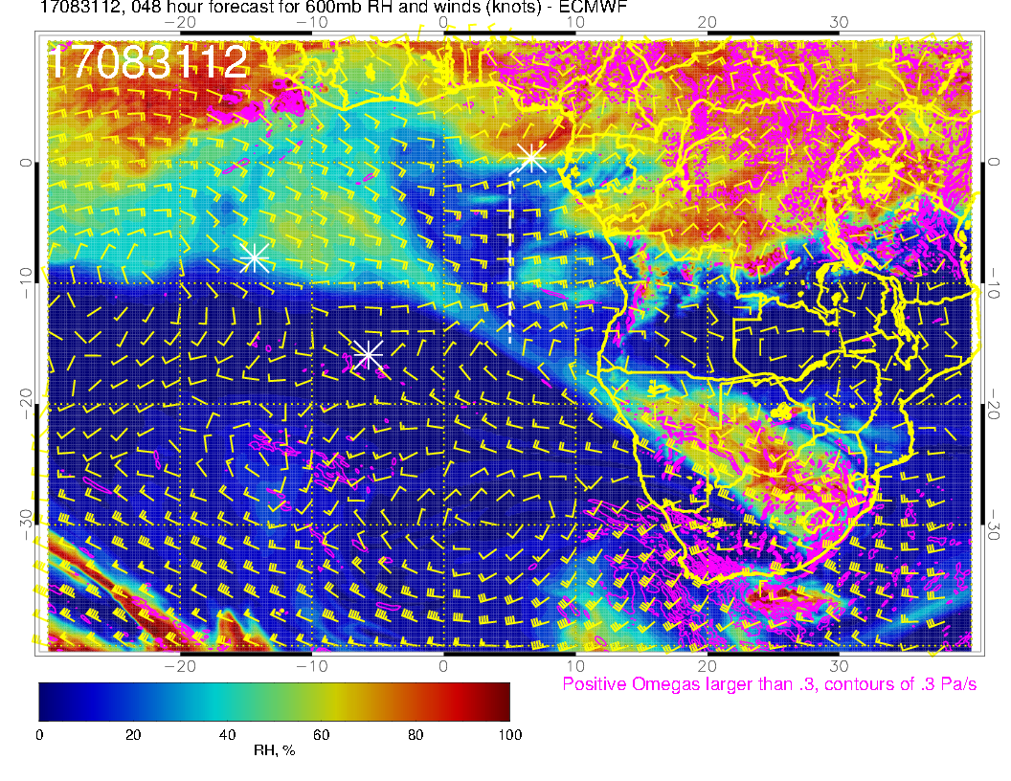
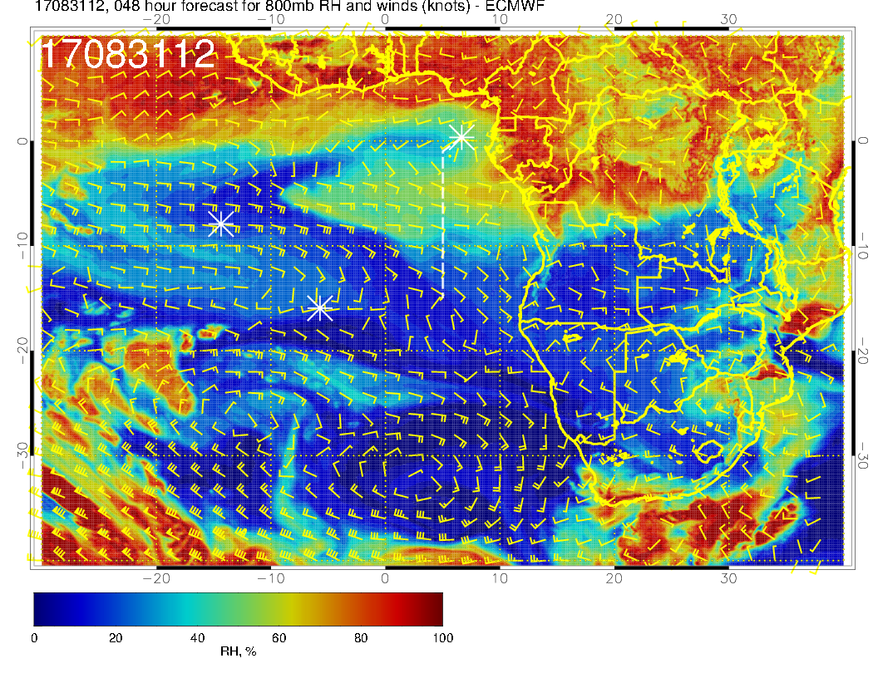
Zonal flow (westward) at upper two levels in our region, with no turn to southeasterlies until 5W (at 600mb, above). Winds are strong, up to 30 knots at 600mb. RH pattern is fairly “washed out” at upper two levels. A traveling surge of RH associated with significant zonal winds at 800mb (right) near 0-5W and 5S. Perhaps the most important feature is the consistent easterlies at all levels along the routine track.

Slide 17
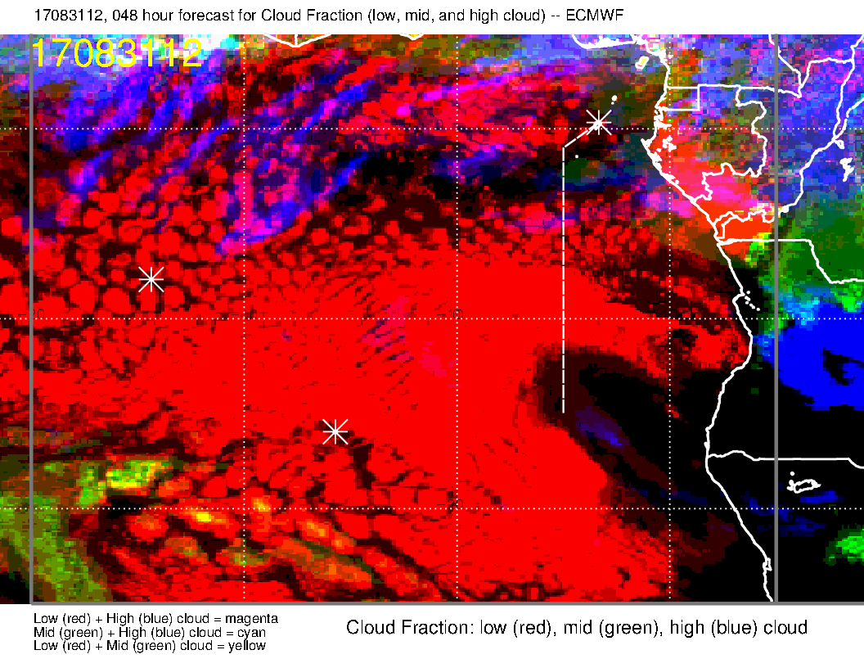
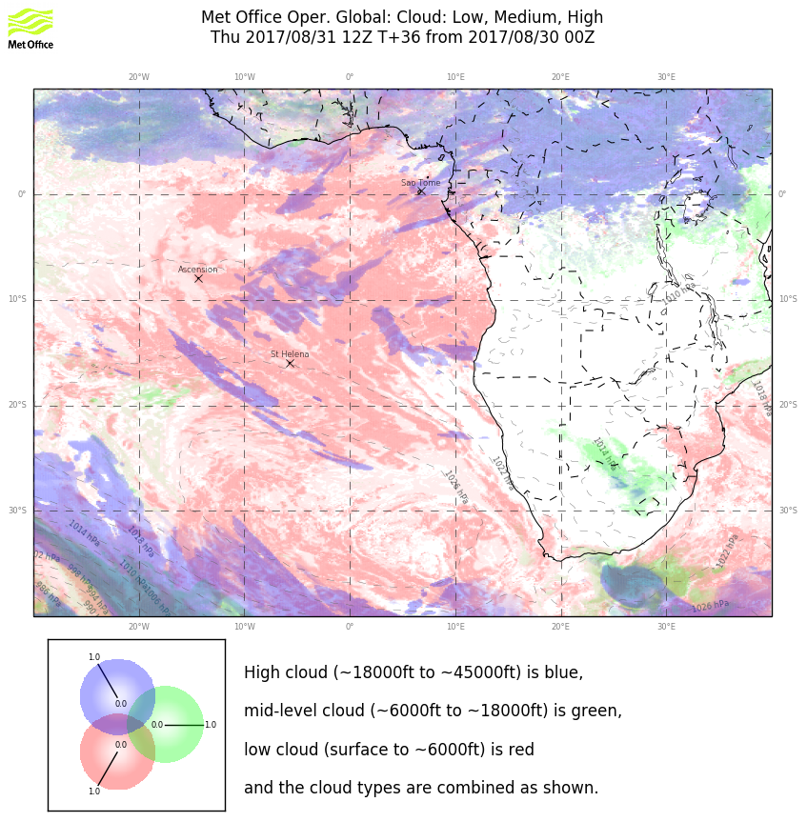
Models have come into rough agreement on the cirrus.
Low clouds: Far western point appears within main SC “shield” based on forecast and on August 30 visible imagery (next slide).

Slide 18
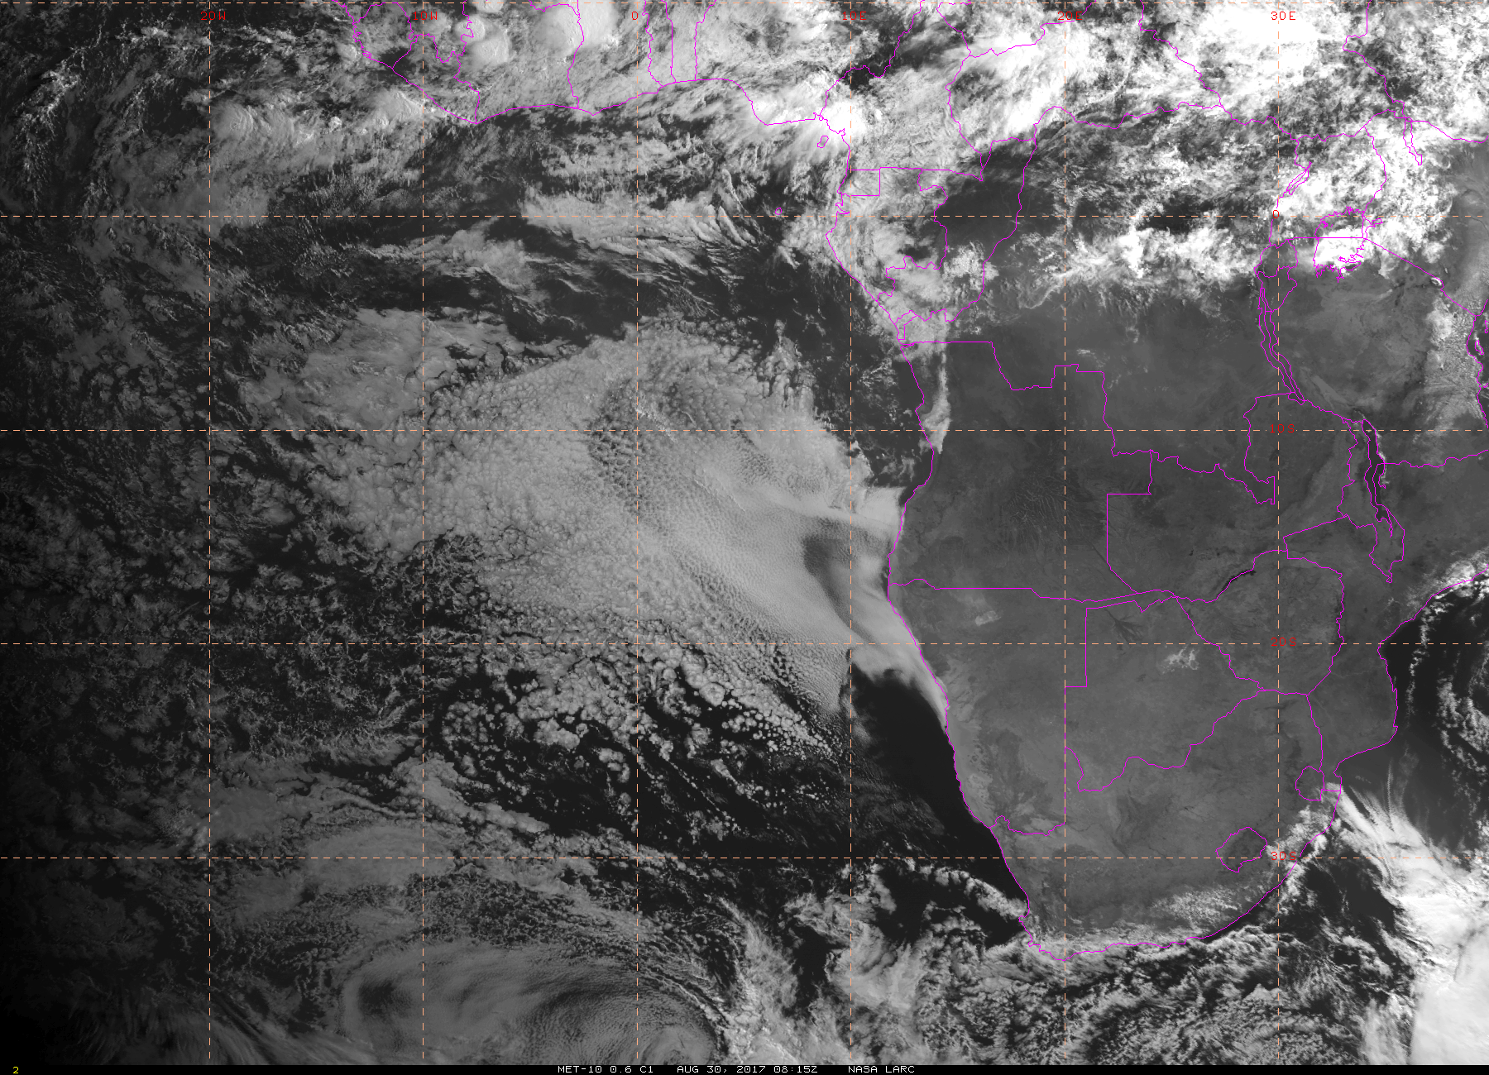

Slide 19
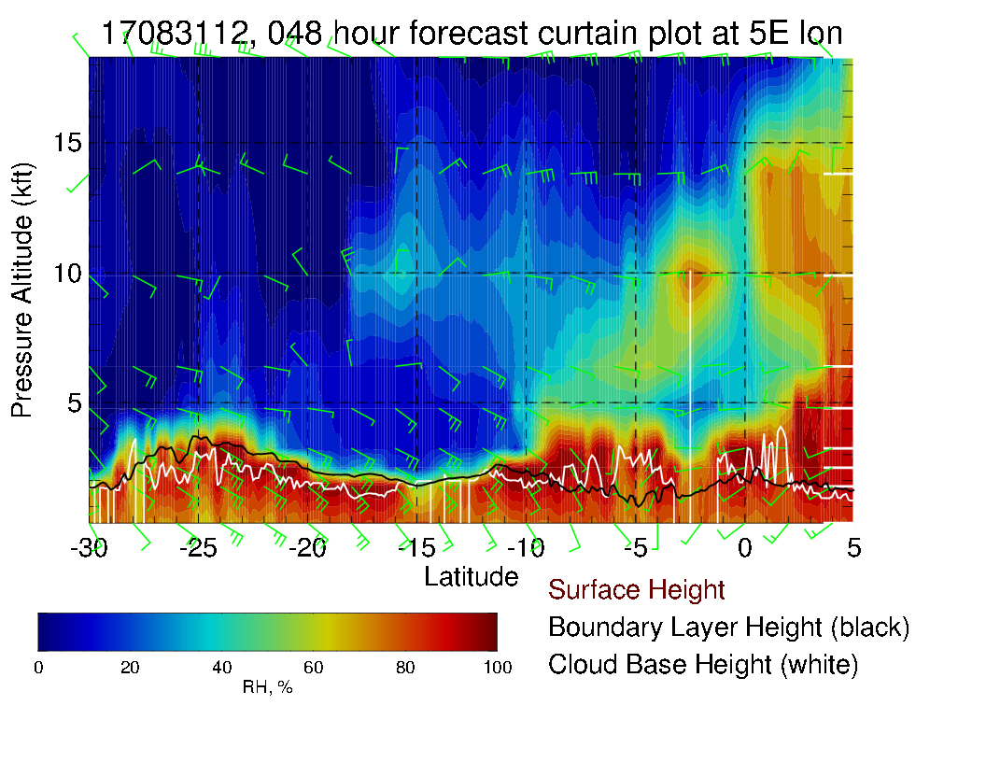
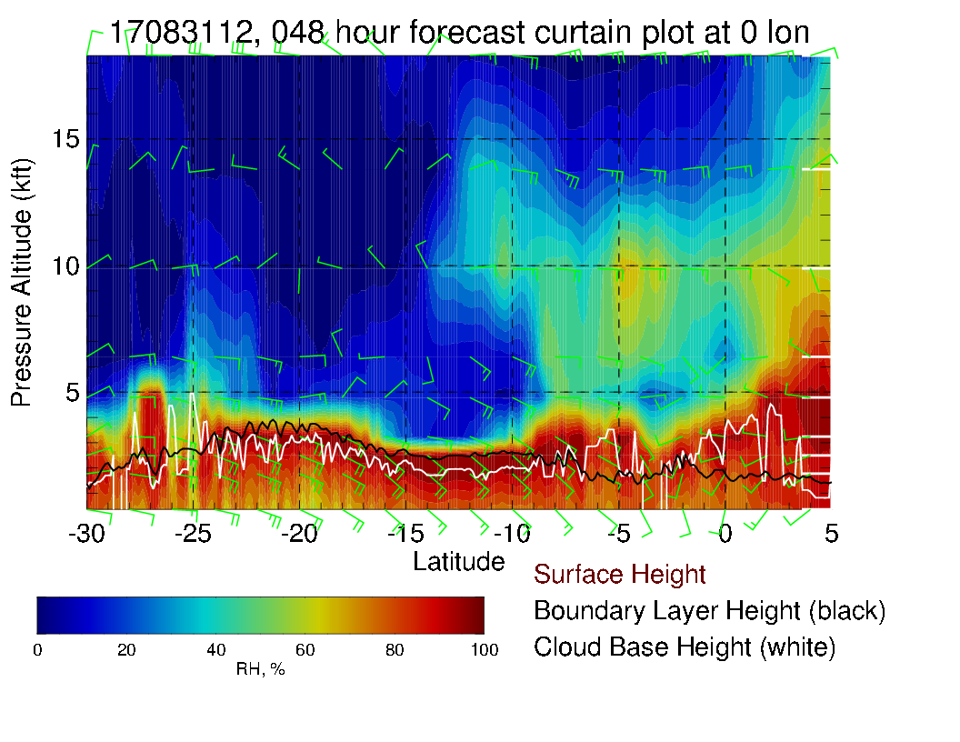
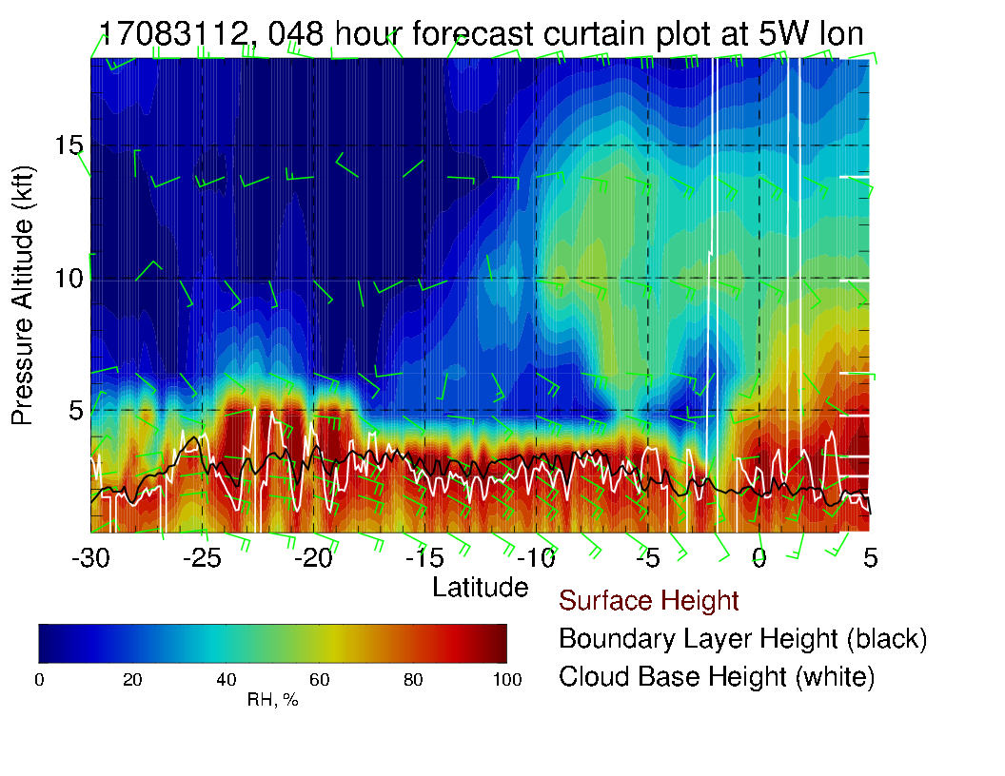
Along routine track, 0 , and 5W (north-south Xsect). Easterly winds are strong, up to 30 knots at 600mb near 10S (we get to 9S).

Slide 20
Curtain plot of RH to about 8 km

Slide 21
Saturday

Slide 22
Saturday (Transit science flight): Low level winds have been similar since 8/31 with westerlies near TMS and now a really pronounced Angola Bay Eddy. New forecast has backed off on the Congo convection from previous forecast.

Slide 23
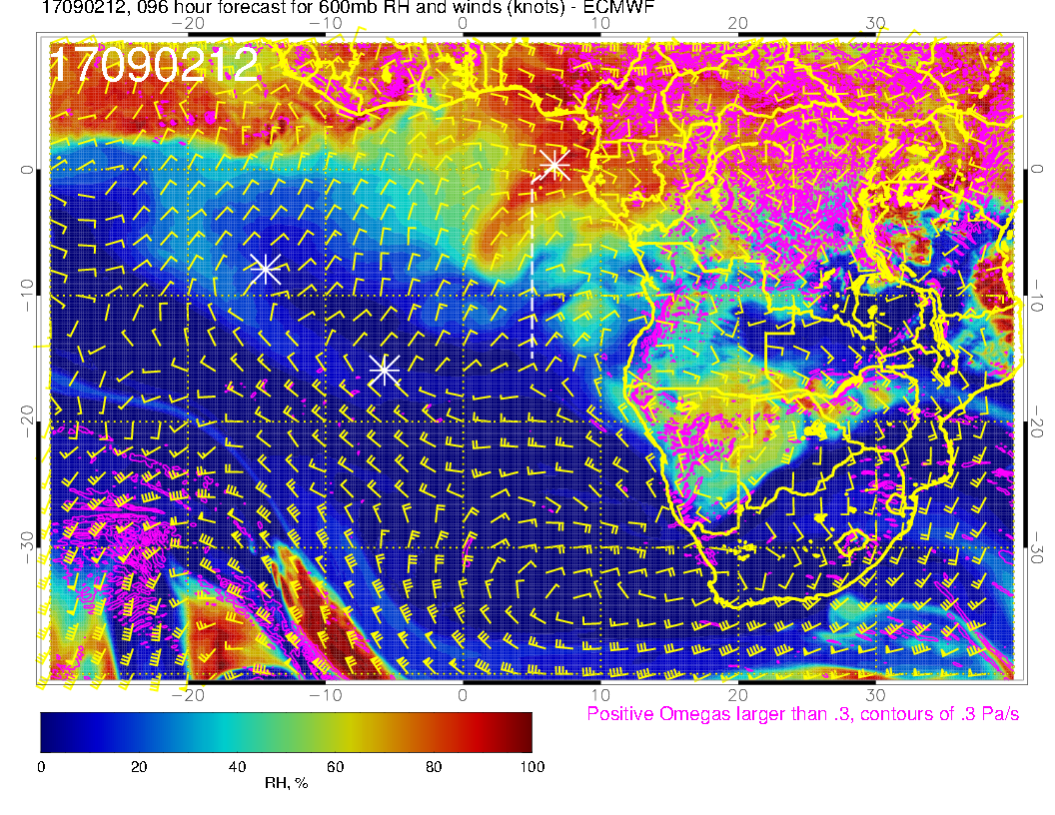
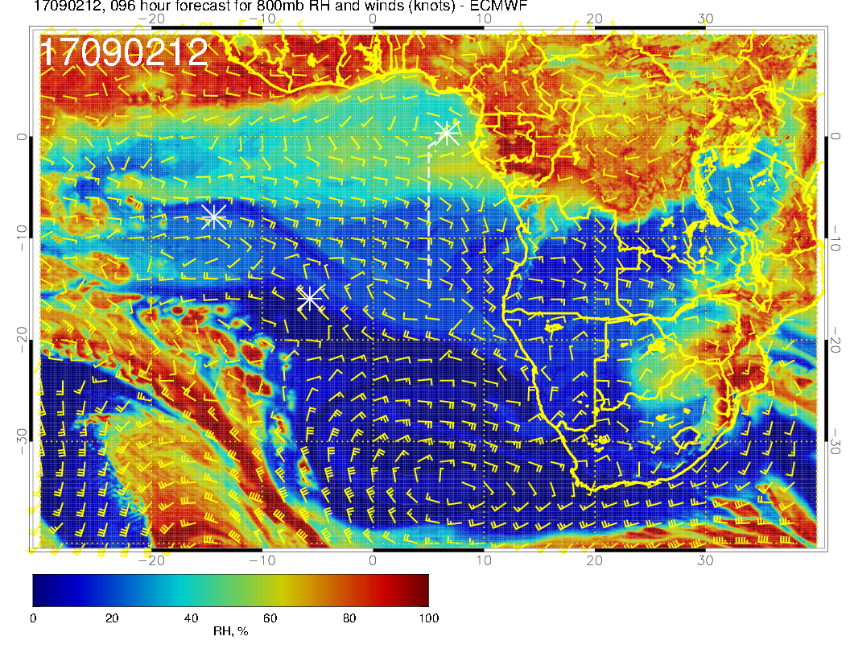
Mid levels for Transit Flight. 600mb pattern shows a southwestward surge everywhere west of the routine track; 700mb also shows a [milder] southwestward flow (change from previous forecast, apparent on new Sep 1 forecast as well). The 600mb pattern change ought to have an impact on any trajectories. At 800mb, the moisture stream we noted on 8/31 has distended westward and moved a bit north, to be replaced by dry air descending from the south.

Slide 24
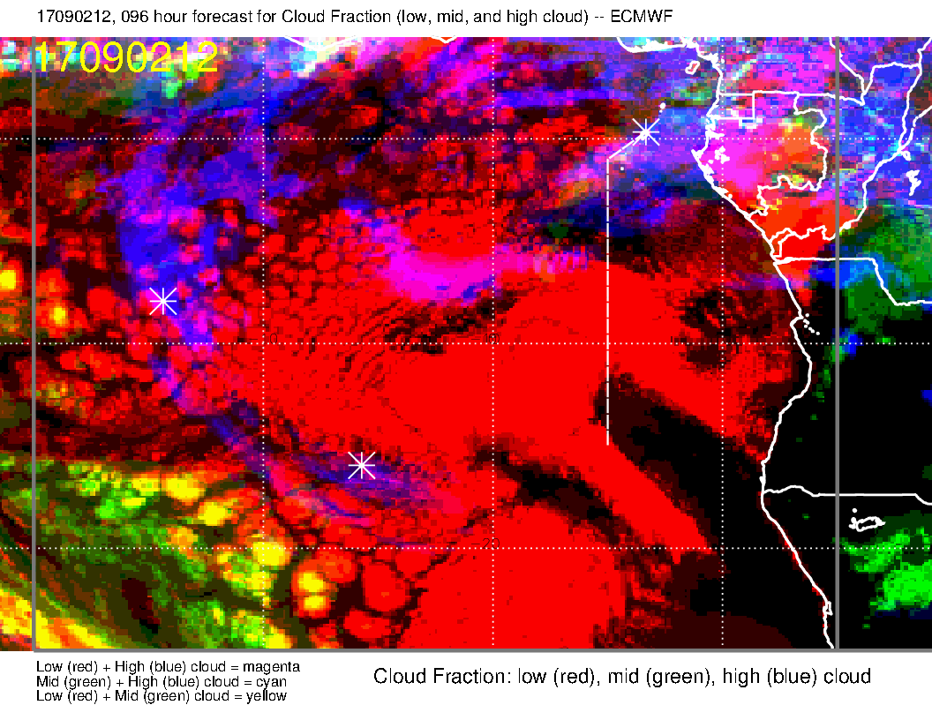
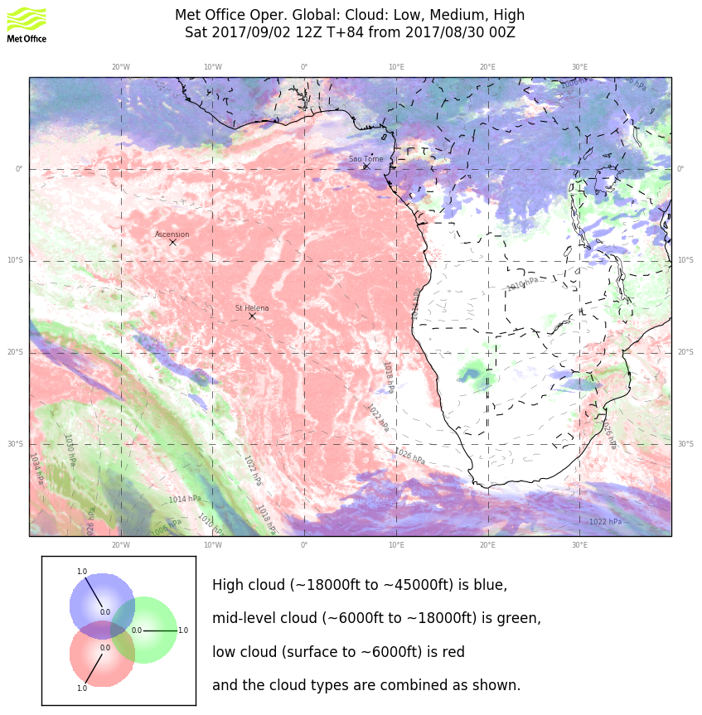
Moisture surge at 600mb yields some middle cloud near TMS and southwestward. Expect that most of this will have dissipated by the time we take off (but bears watching). A bit early for cirrus evaluation, but expect that longer over water (and no convection) trajectory should help us on the forecast.

Slide 25
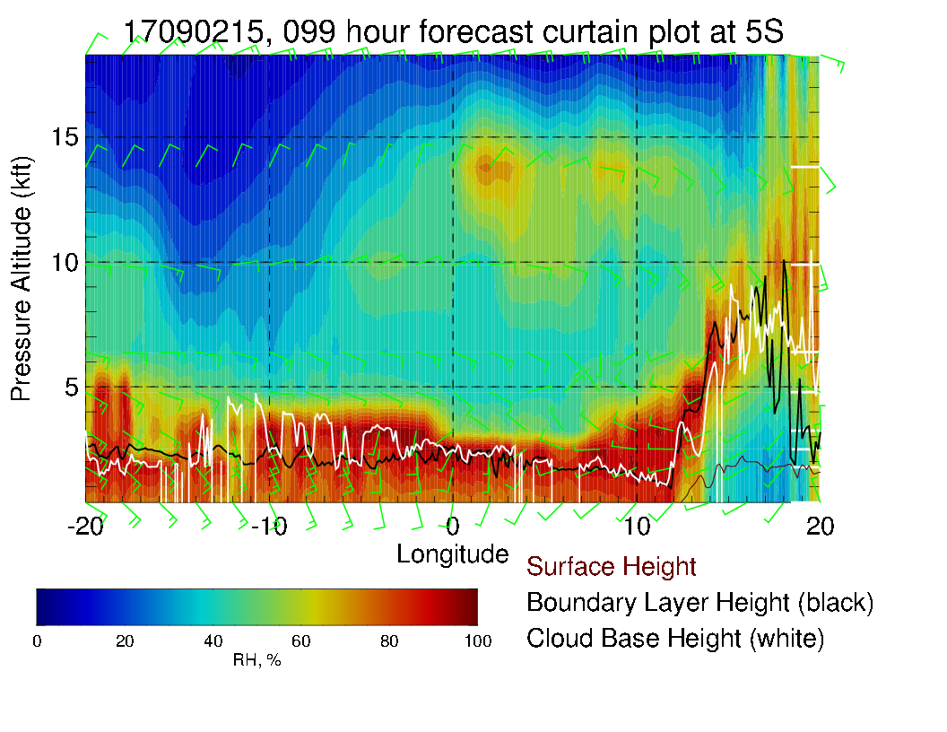
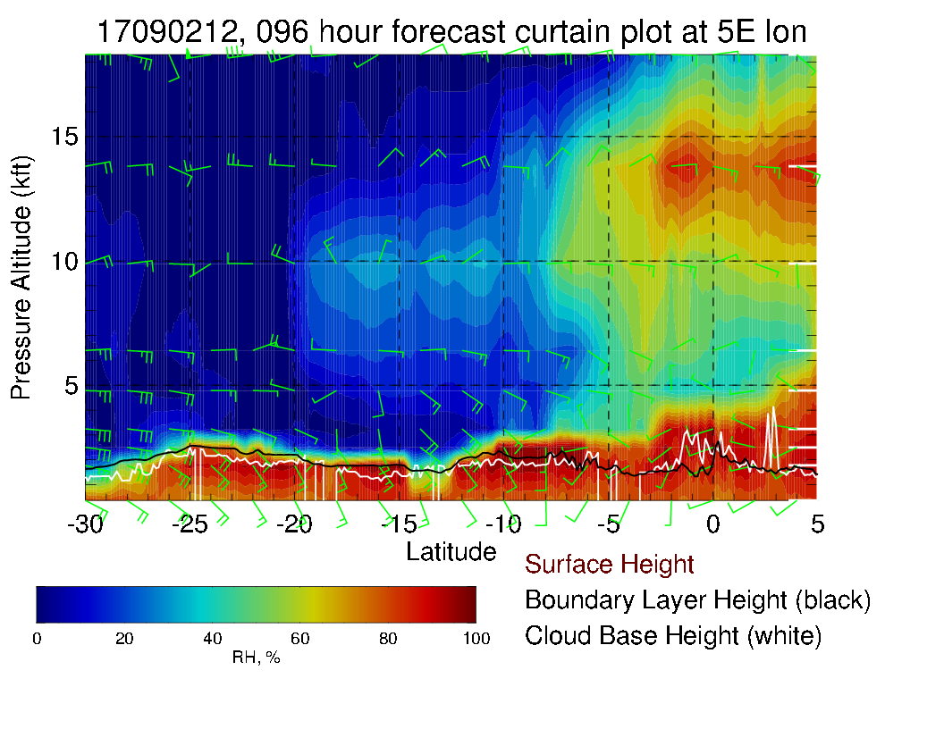
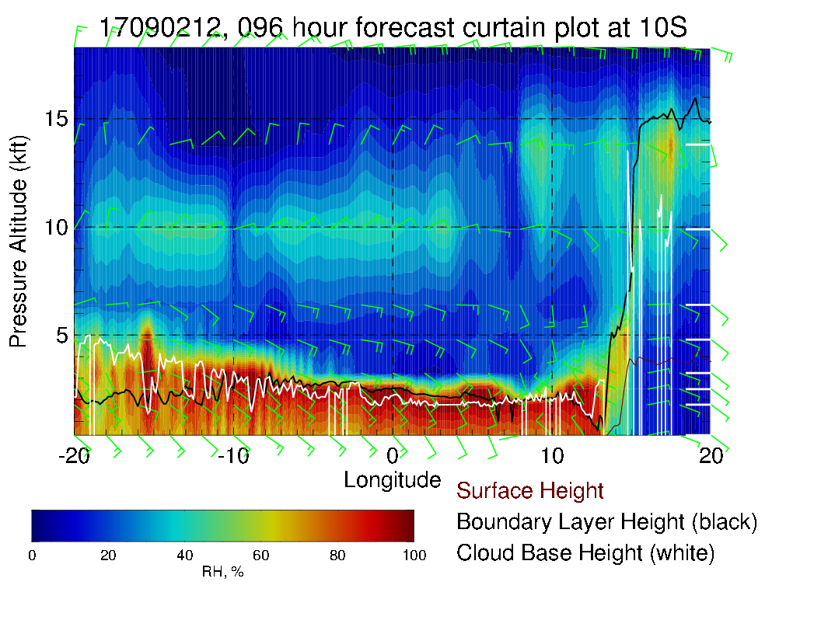
Cross sections on routine track (above) and at 5 and 10S (left). Can see the 600mb moisture surge penetrating to 2S along routine track.
Note tailwinds at upper two levels, 10-15 knots.

