Slide 2
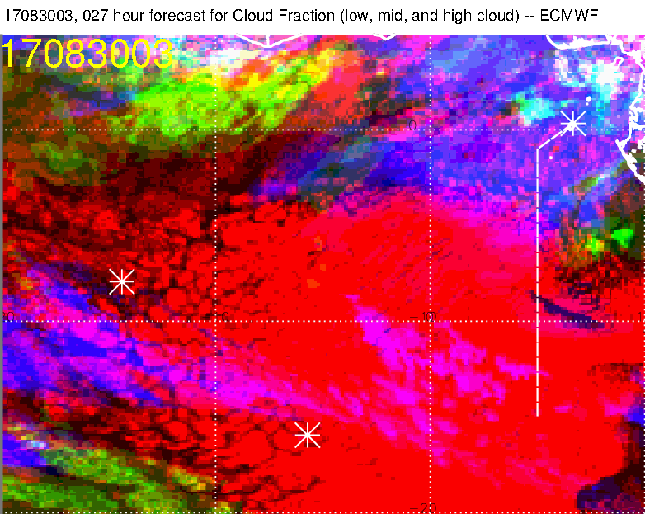

Slide 4
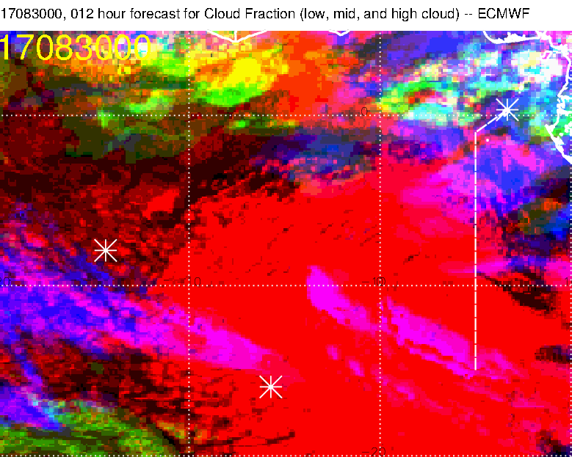

Slide 5
Huh??

Slide 6
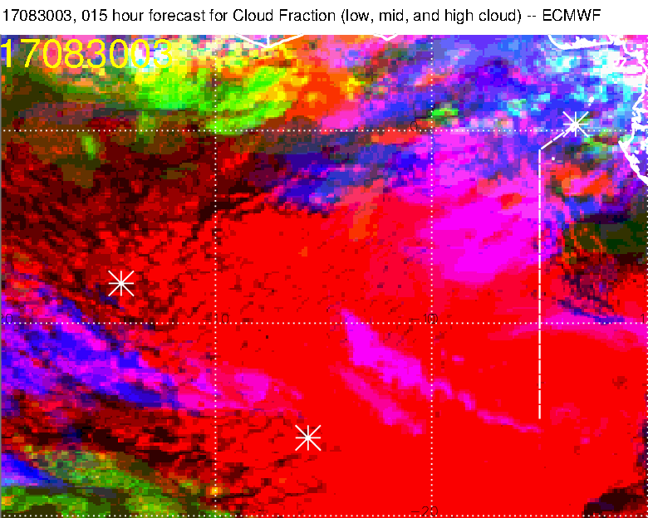
Neither forecast is particularly good

Slide 7
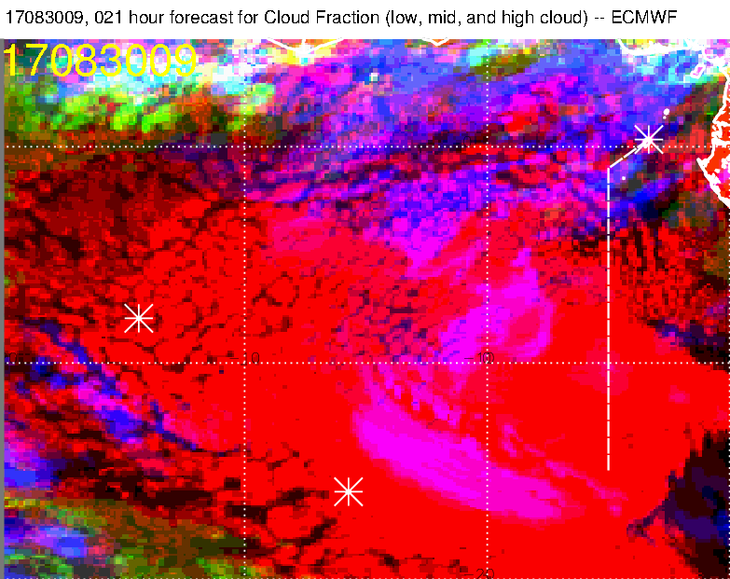
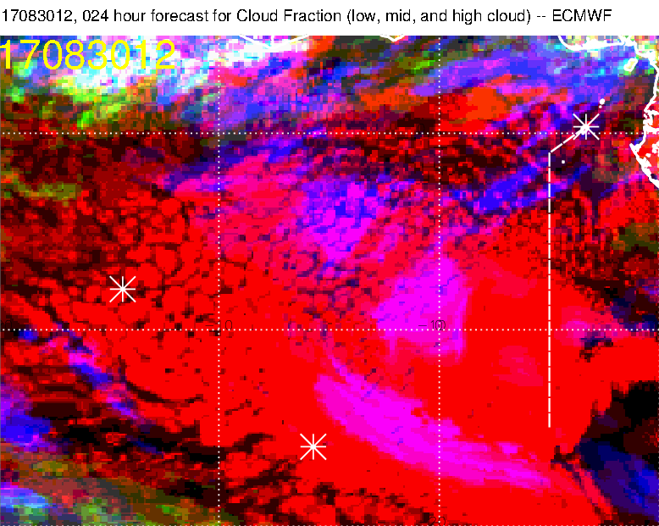
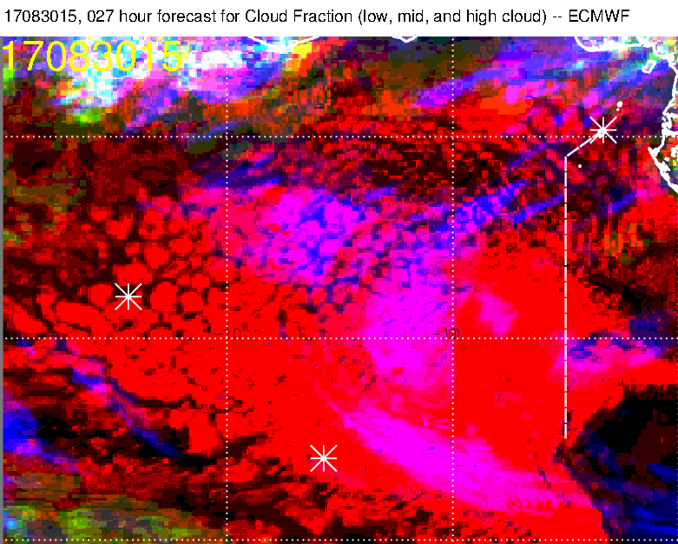
In any case, we see stuff in the
target area in the forecast

Slide 8
EC high cloud only. Can see wisps more easily

Slide 9
Sequence every half hour

Slide 10
In 7 hours, the two blobs will
be in our target area
7*3600.*20./111000. = 4.5 degrees

Slide 11
Maybe the southern blob is
dissipating a little.
Note that low cloud is still
filling in in target area

Slide 12
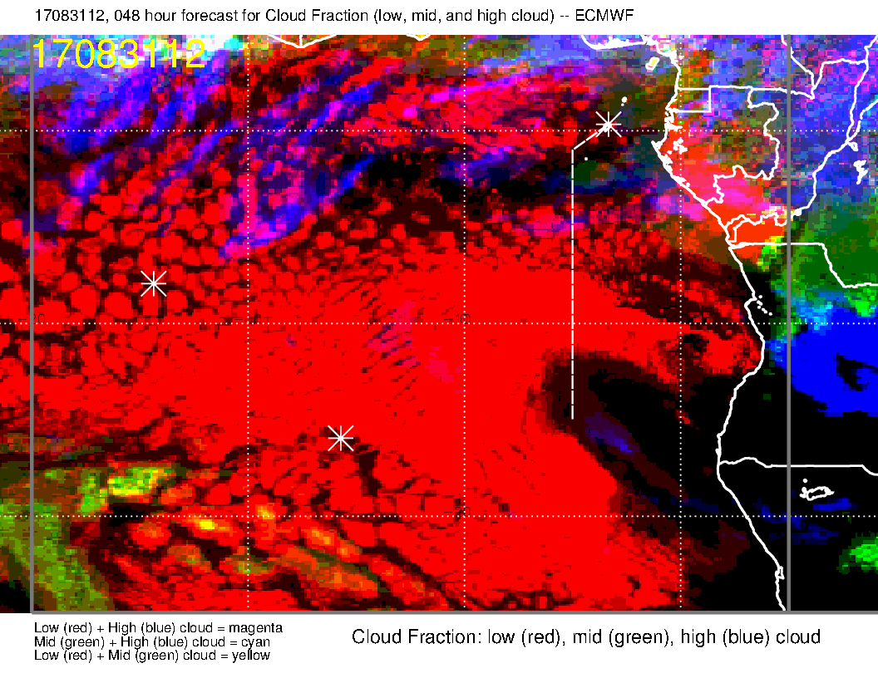
For what it’s worth tomorrow does look better.

