Slide 1
ORACLES weather briefing
29-Aug-2017
Lenny Pfister and Rei Ueyama

Slide 2
Low cloud and convection verification

Slide 3
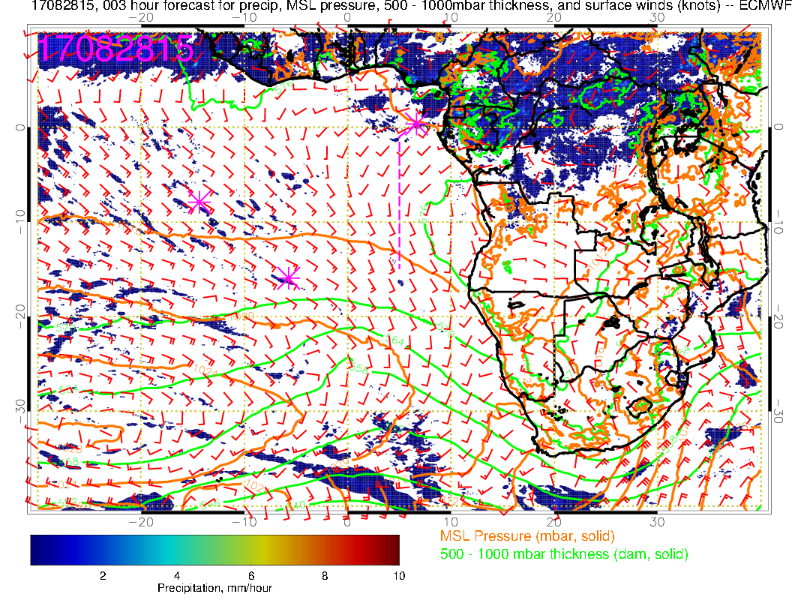
Yesterday(F): Weaker than normal winds across much of SE Atlantic as SH high is west of its climo position. Westerlies in northern Gulf of Guinea.

Slide 4
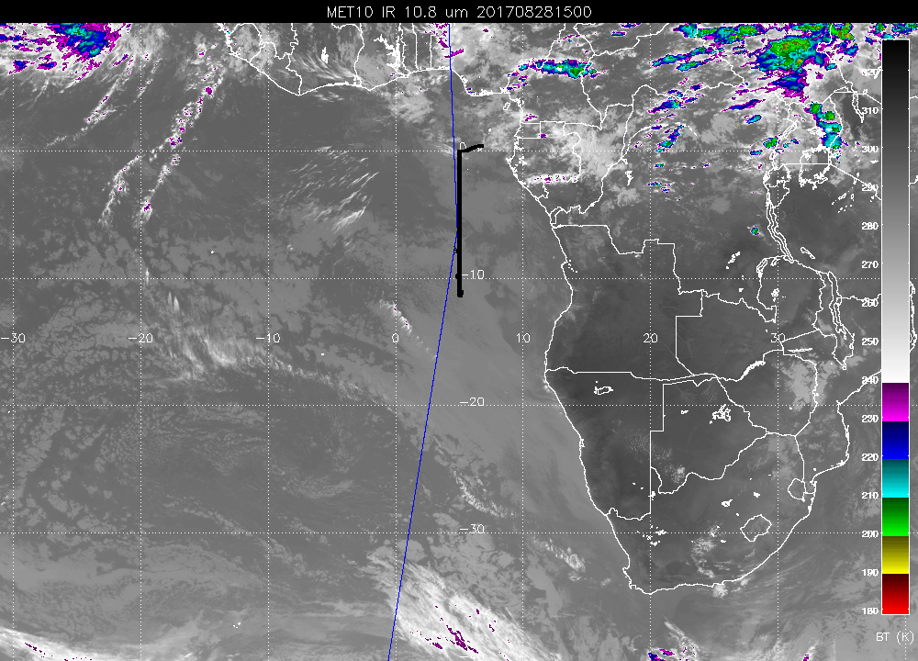
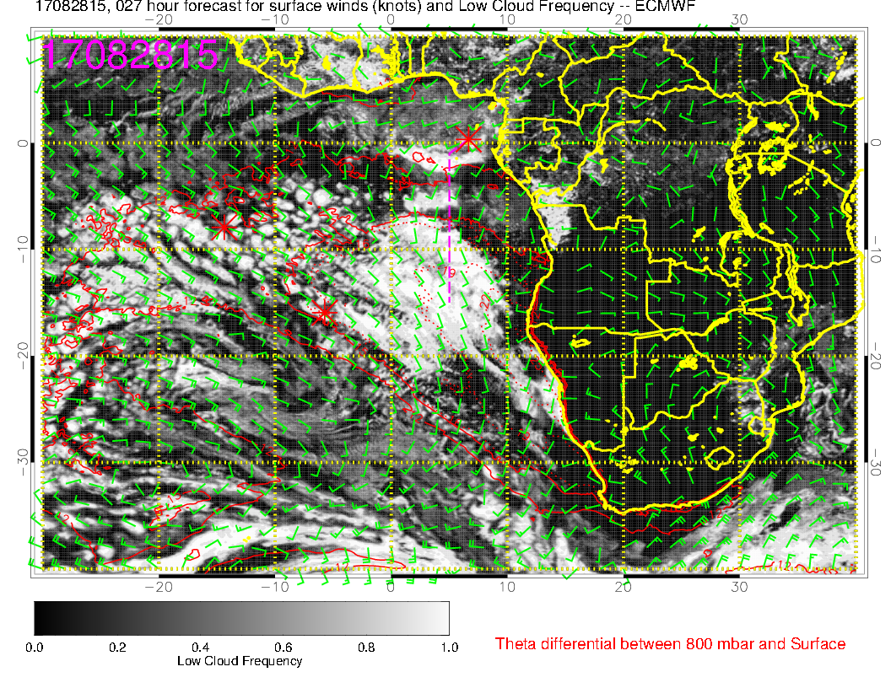
Convection in roughly a line from Cameroon to southern Sudan, which model is sort of getting (previous slide). Convection in northern Congo seems subnormal. Low clouds “stop” in usual place between 5-10S, but are then found north of 5S again.
Forecast used yesterday (right) is getting most of the structure along our track.

Slide 5
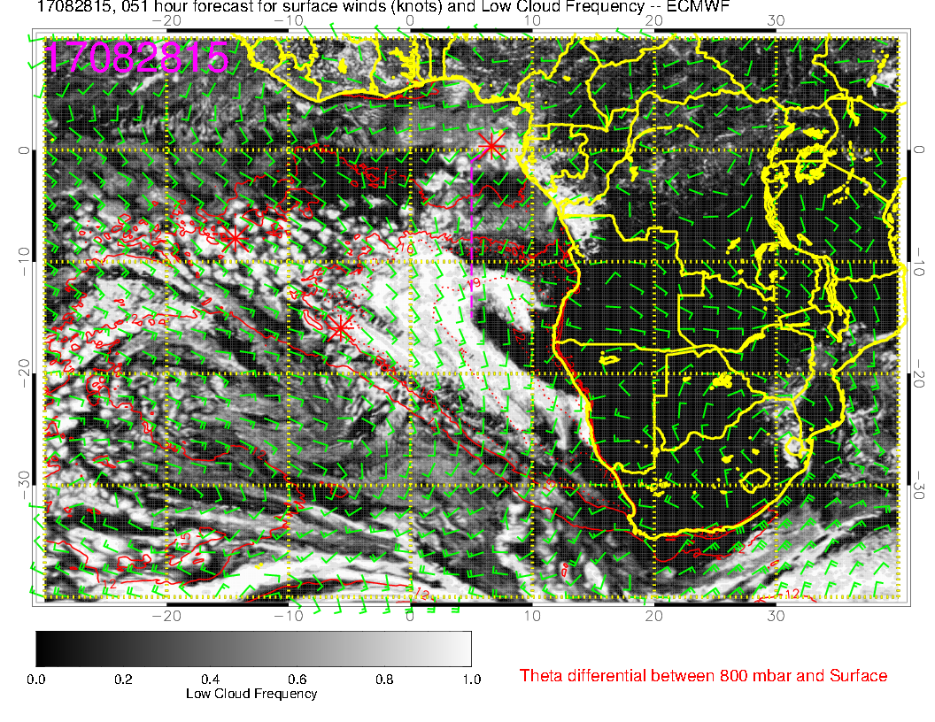
OLD
NEW
Comparison between new (right) and old (above) forecast. Gross features (e.g. change in character west of 5W and south of 20S) are similar, but for our purposes (details near 5-10S) the old forecast would not have been useful.

Slide 6
Surface evolution 8/28-9/2

Slide 7
Yesterday(F): Weaker than normal winds across much of SE Atlantic as SH high is west of its climo position. Westerlies in northern Gulf of Guinea.

Slide 8
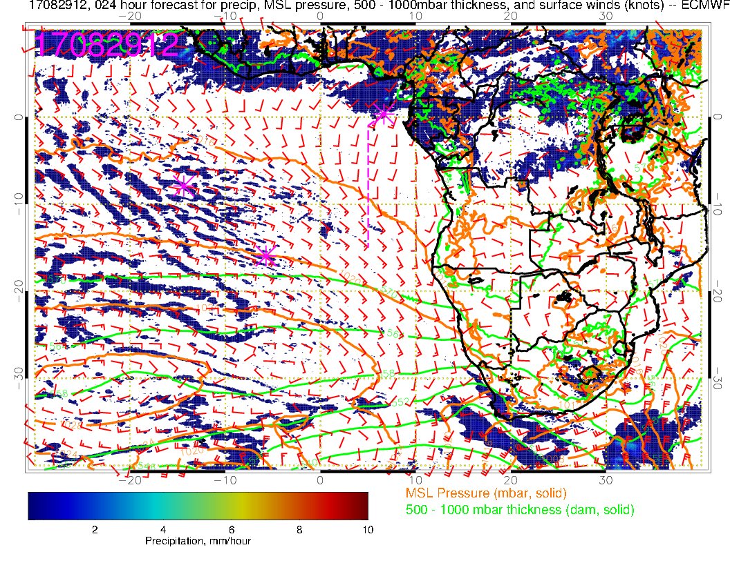
Tuesday (NF): Some convection developing near TMS and Gabon. Also southern Congo. SH high slowly moving eastward. Winds freshen in SE Atlantic overall, SSW over TMS (westerlies pushed to north of TMS), stronger winds south of us (10 knots instead of 5). No Angola Bay eddy.

Slide 9
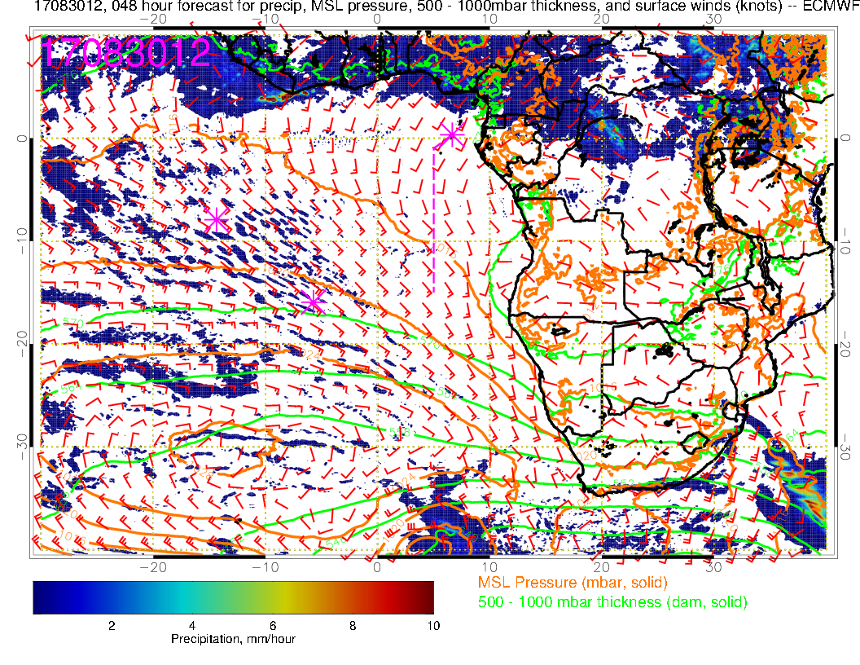
Wednesday (F): Convection developing over Nigeria, off of west African coast (~10W) and northwestern Congo. Congo system is traveling eastward in the model – VERY uncharacteristic – remind me to verify this. Local winds are more southwesterly than the southerlies on the 29th. Angola Bay eddy starts to redevelop. SH high moves east and winds off of Namibia increase.

Slide 10
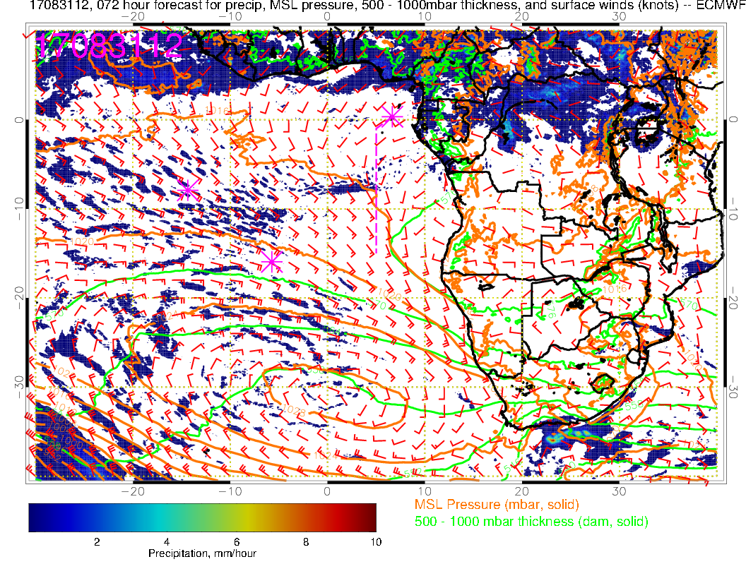
Thursday (F): Have the two foci of convection again (off of West African Coast, and interior Africa. Weak winds extending northwestward from Angola Bay, with near westerlies (not weak, 10 knots) over TMS. SH high is in climo position – 25 knots off Namibia.

Slide 11
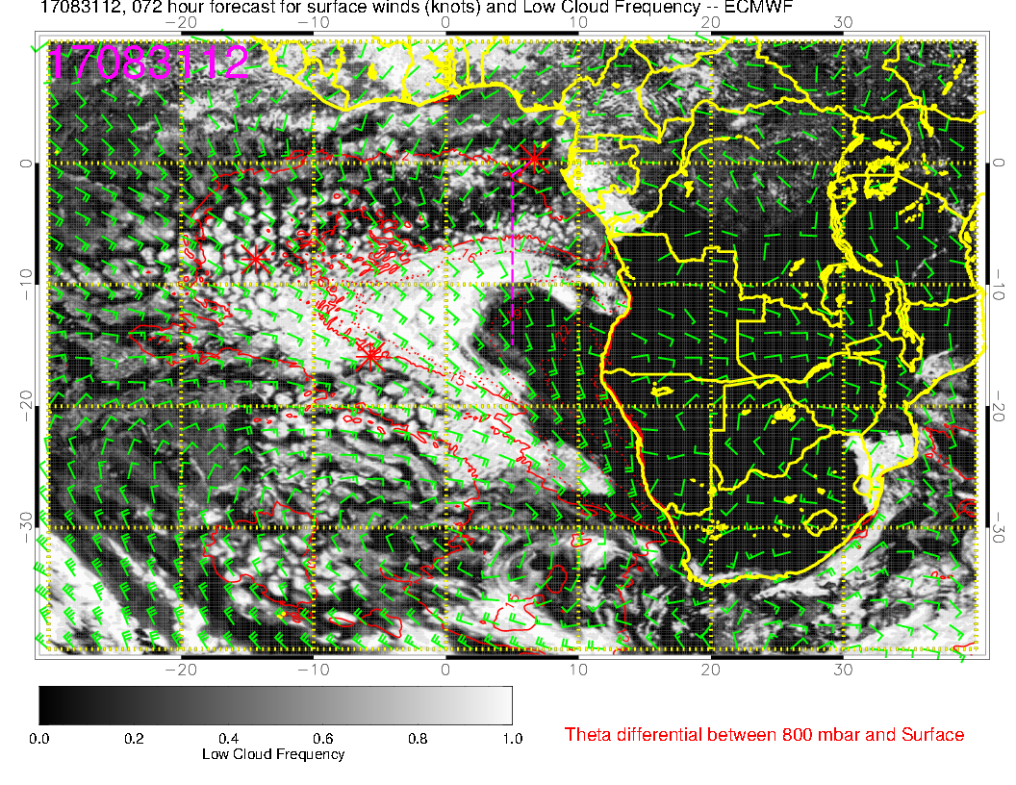
Model forecasts northern edge (along routine track) of low clouds to be associated with the diffluence and weaker winds (5-7 S). Excessive clearing south of 10S, but we all know that.

Slide 12
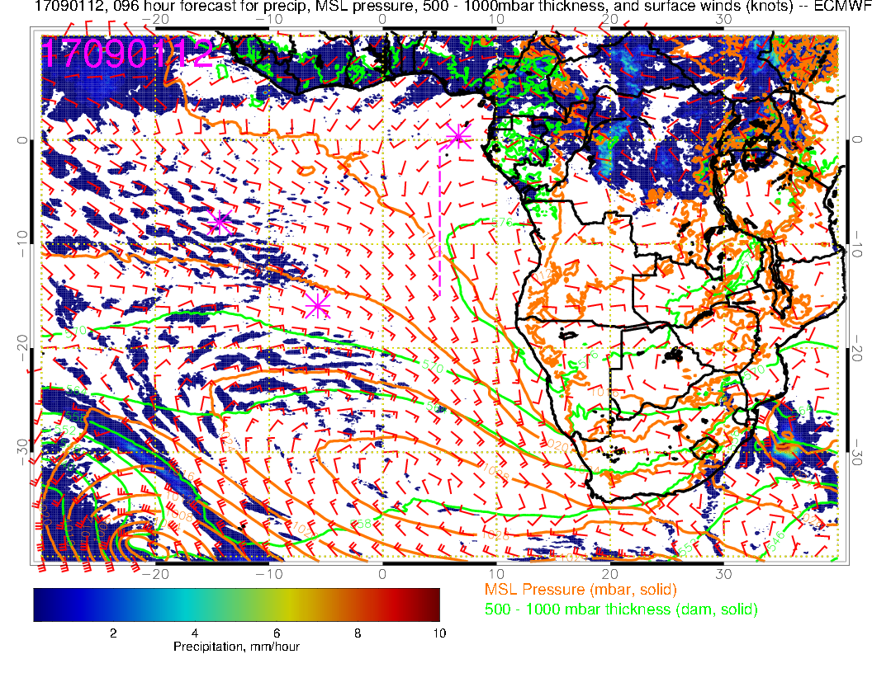
Friday (NF):A new low pressure system moves in, pushing SH high eastward. Winds now really weak in Angola Bay/TMS region, and westerly. Strong convection forecast in interior of Africa (Congo/CAR)

Slide 13
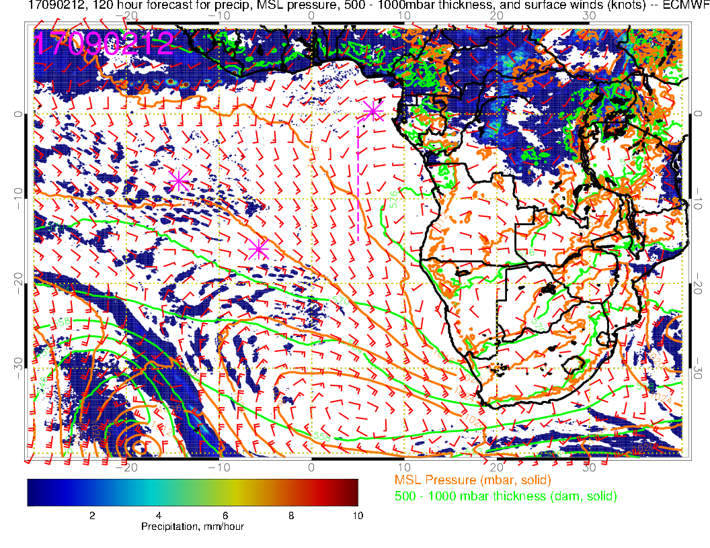
Saturday (Transit science flight): Low level winds have been similar since 8/31 with westerlies near TMS and now a really pronounced Angola Bay Eddy. Strong convection forecast over NW Congo. Most recent verifiable 120 hour forecast also produced strong convection there, which did not verify yesterday.

Slide 14
700mb evolution 8/28-9/2

Slide 15
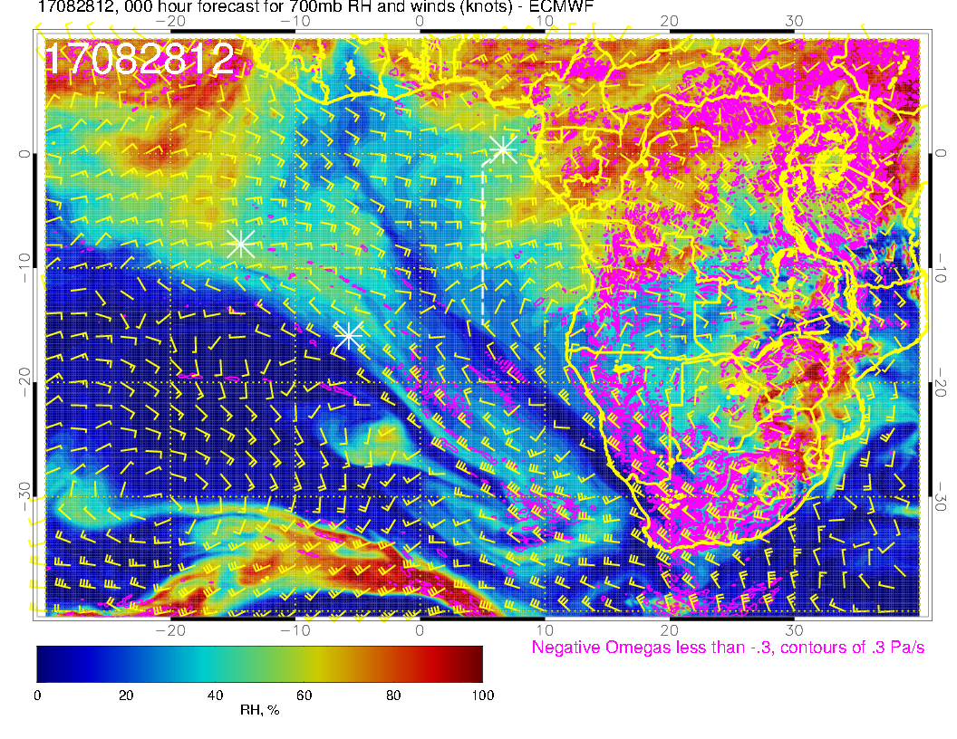
A
A?
A
Yesterday (F): Zonal pattern, 15-20 knots. See moisture intrusion off of Angola and Gabon/Congo Brazzaville. Diffluence northward near 5W associated with African wave anticyclone to north. Diffluence along the southern edge due to midlatitude troughs.

Slide 16
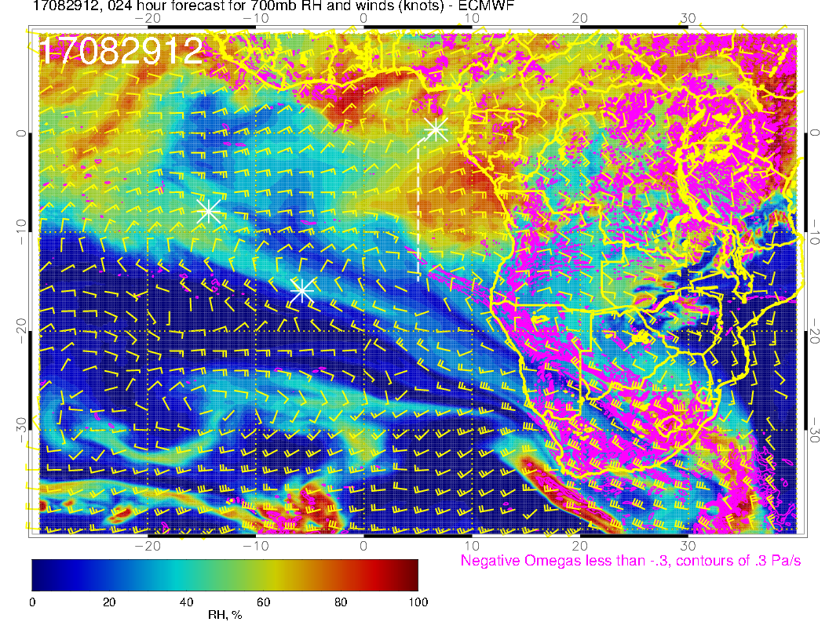
A
A?
A
Today (NF): Continued zonal pattern, 15-20 knots. Confluence from north now at prime meridian as African wave anticyclone pushes westward. Moisture intrusion now fully along routine track. Diffluence toward the south starts around Ascension.

Slide 17
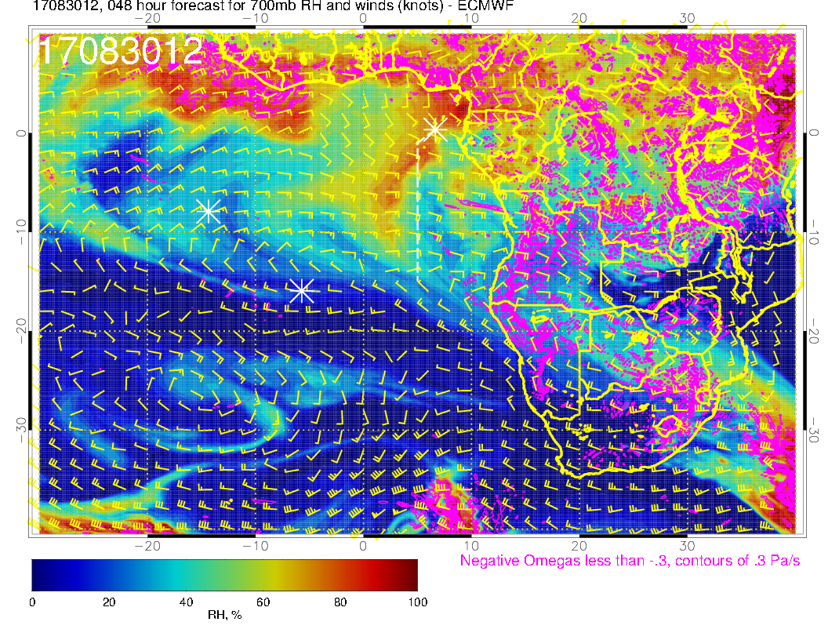
A
A
A
Wednesday (F): Moist air intrusion moves northwestward with the winds (turned southeasterly from easterly north of ~5S. Still a strong core of 20 knot easterlies from 5S to 12S. Drier air moves in behind the moving moist air.

Slide 18
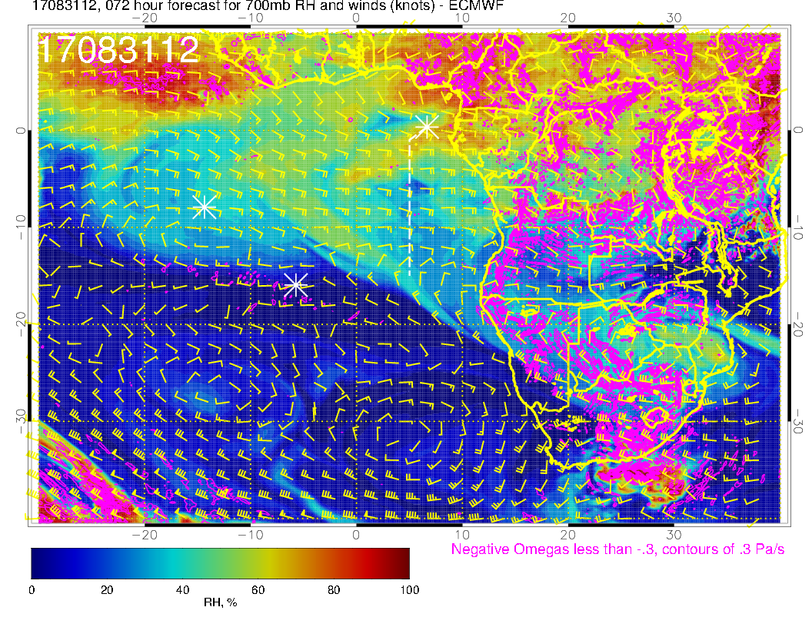
A
A
A
Thursday (F): Zonal pattern continues with 20 knot easterlies. Anticyclone to the north becomes elongated, reducing the northwestward flow, and pushing it westward. RH pattern is washed out. Over continent, the offshore anticyclone near southern Angola has given the flow a northward component the last few days.

Slide 19
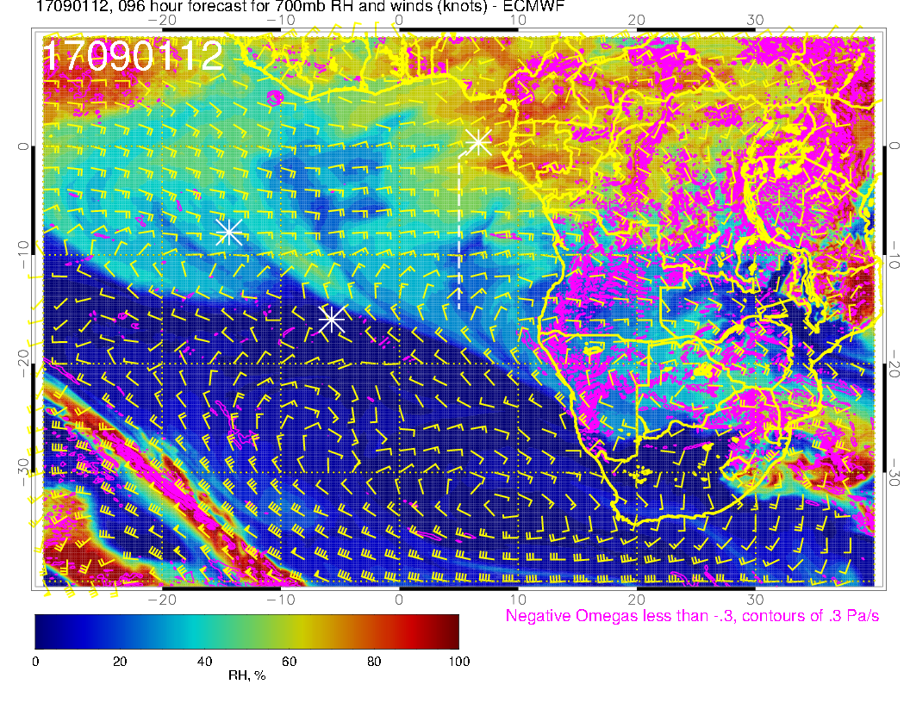
A
A
A
Friday (NF): Zonal pattern continues with 15-20 knot easterlies. Anticyclone to the north has moved west pushing northwestward flow further westward. New moist intrusion north of 4S from continent. Same elongated anticyclone from Botswana to off of Angolan coast is related to a fairly steady flow pattern over the past few days.

Slide 20
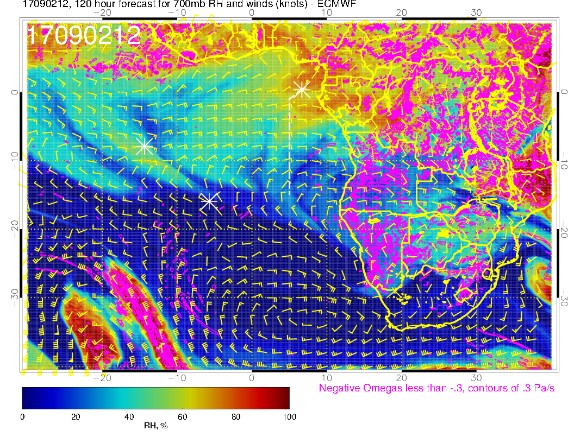
A
A?
A
A
Saturday (science transit to ASI): Zonal pattern continues, but easterlies start to weaken to 10-15 knots east of the prime meridian. Moisture intrusion north of about 5S continues westward, but dry air at this level further south off the continent. On the continent, flow is more sharply northward (western Congo). I think a perturbation wave is developing, probably responsible for weakening easterlies over us (??)

Slide 21
Tomorrow (Wednesday)

Slide 22
Wednesday (F): Surface flow. This is close to a “typical” climo flow pattern in the tropical SE Atlantic.

Slide 23
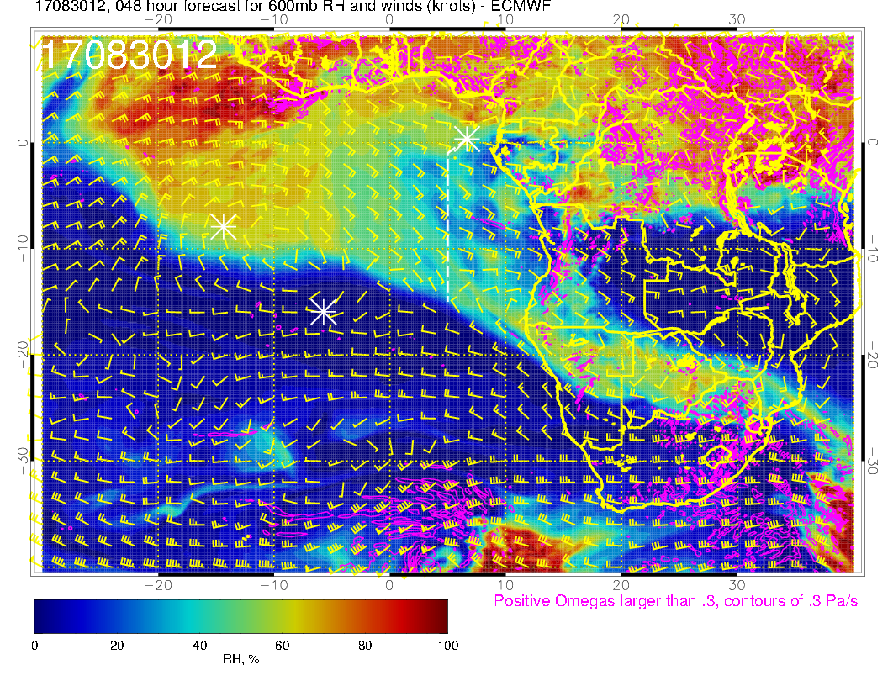
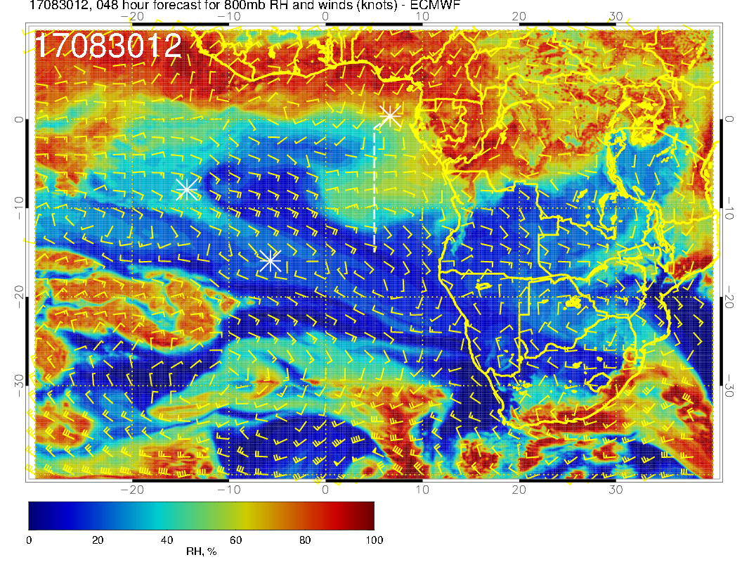
Mid level flow for Wednesday. Northwestward flow is much more pronounced at 4 km (600mb, above) than at 3 km (700mb, above right). Flow over us at 4 km is from the southeast, and is thus, dry. 2 km flow (right) is much more zonal. Appears to come from the south.

Slide 24
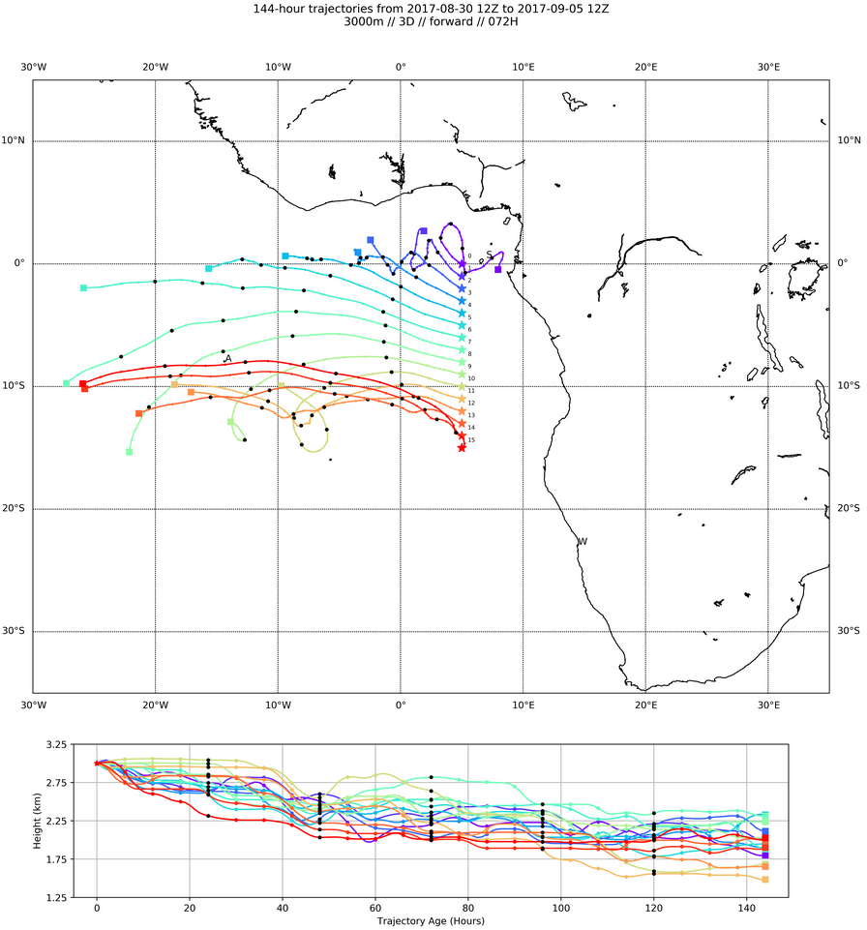
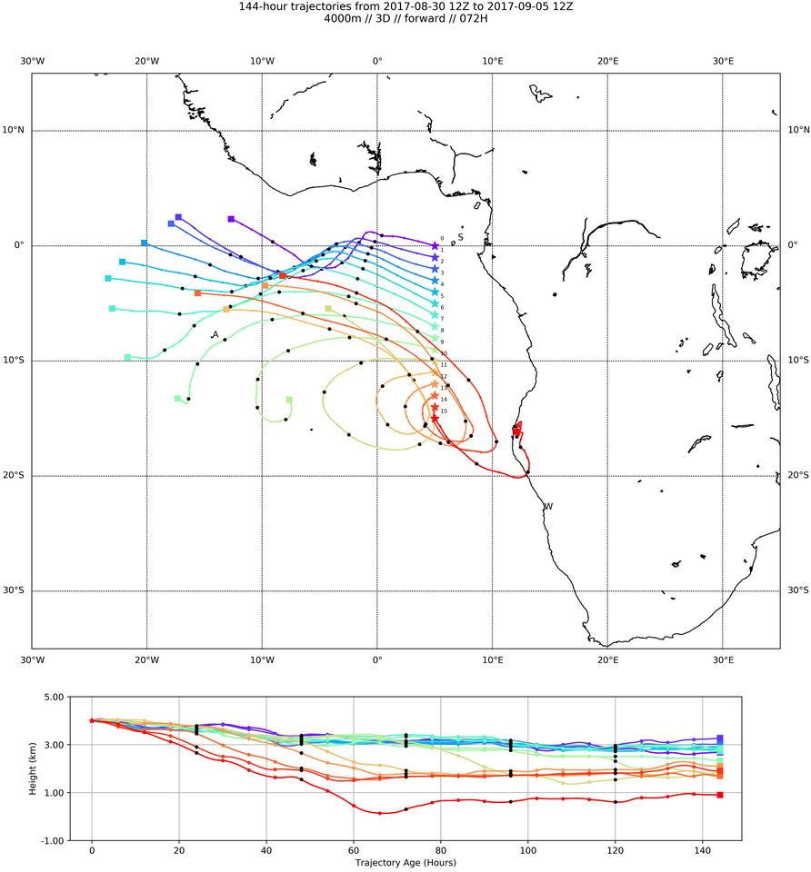
Forward trajectories at 700mb (left) and 600mb (right). Good zonal pattern
at both levels to about 10S.
NOTE: TRAJECORY RUNS ARE ON THE OLD SIDE.

Slide 25
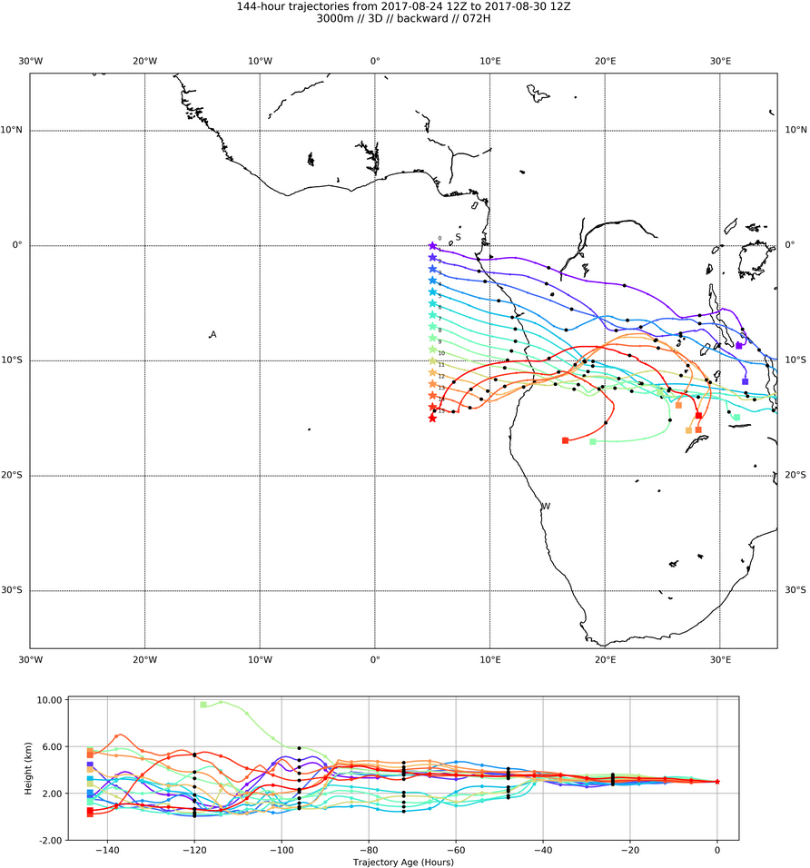
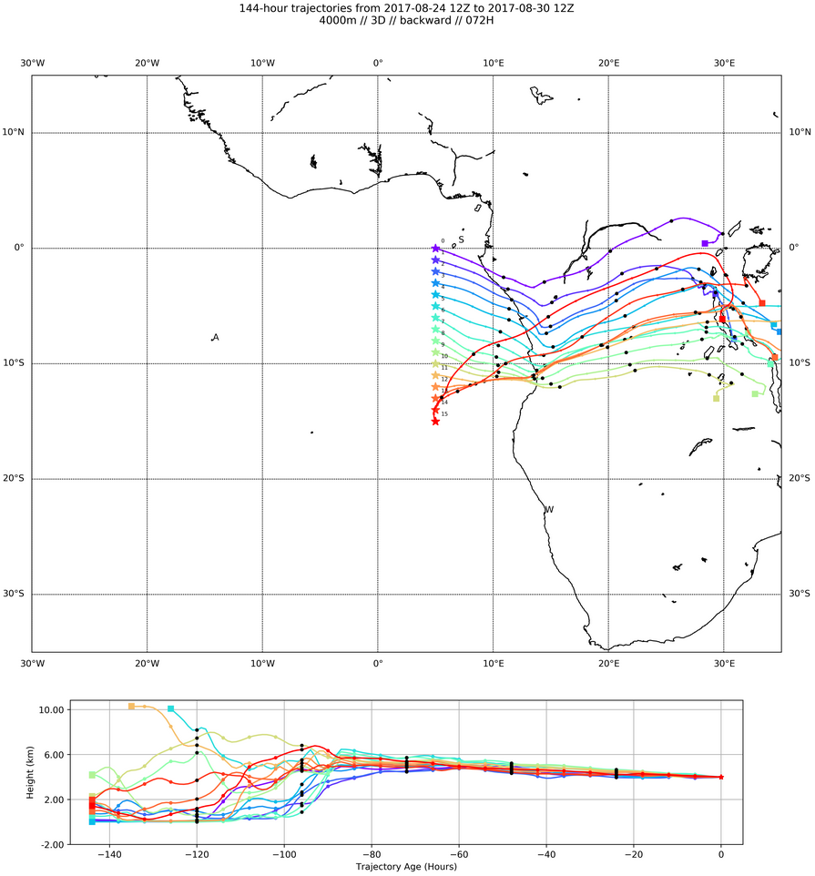
4 km
3 km
A
BTs at 700mb (3km, left) and 600mb (4 km, right). Expect some moist
processing in northern part. Though recent 4 km direction is toward the
northwest, parcel trajectory history shows a northern Congo origin for
air on the northern routine track.

Slide 26
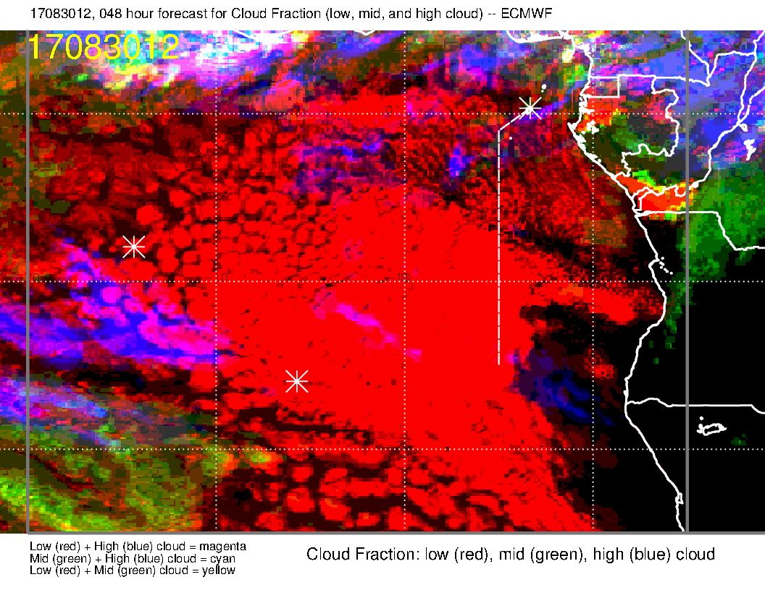
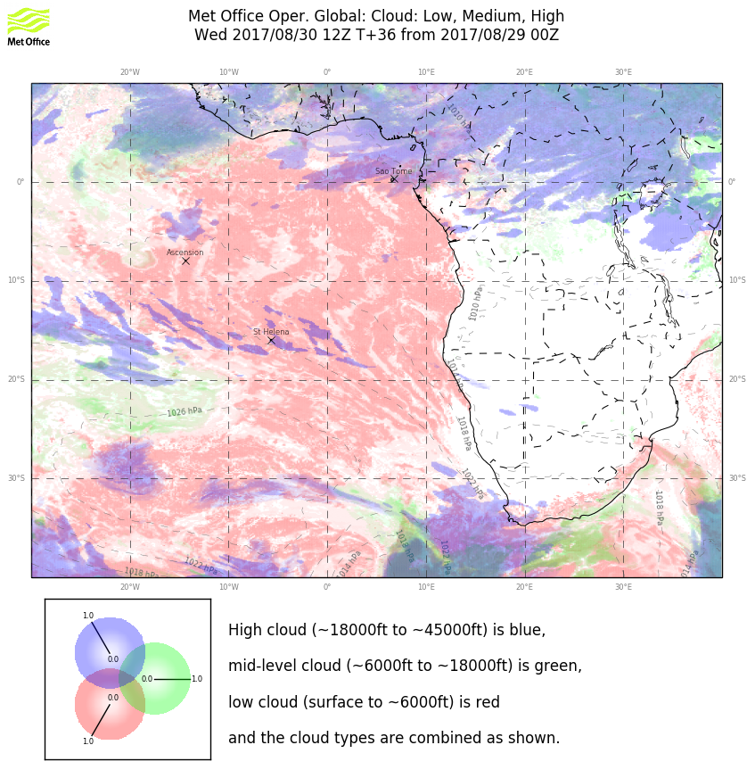
New forecast cycle indicates generally favorable cirrus conditions south of about 5S. Subnormal convection upstream since August 28 (based on satellite imagery), though daily cycle at Gabon today could have an impact. Need to watch this because of little bits in different spots in the two models.
Low cloud forecast is “stable” for tomorrow. Note that winds south of us are near climo. No thorough study by any means, but we had these kinds of “climo” winds on August 25. And there were assorted low clouds (not very solid) between 10S and TMS.

Slide 27
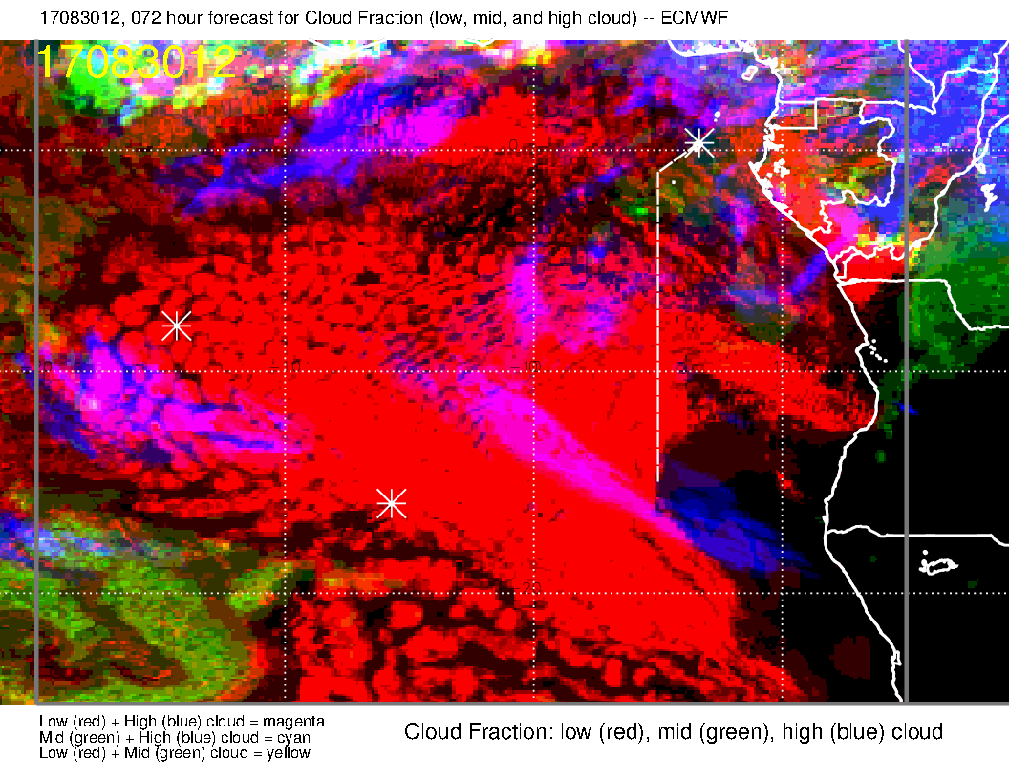
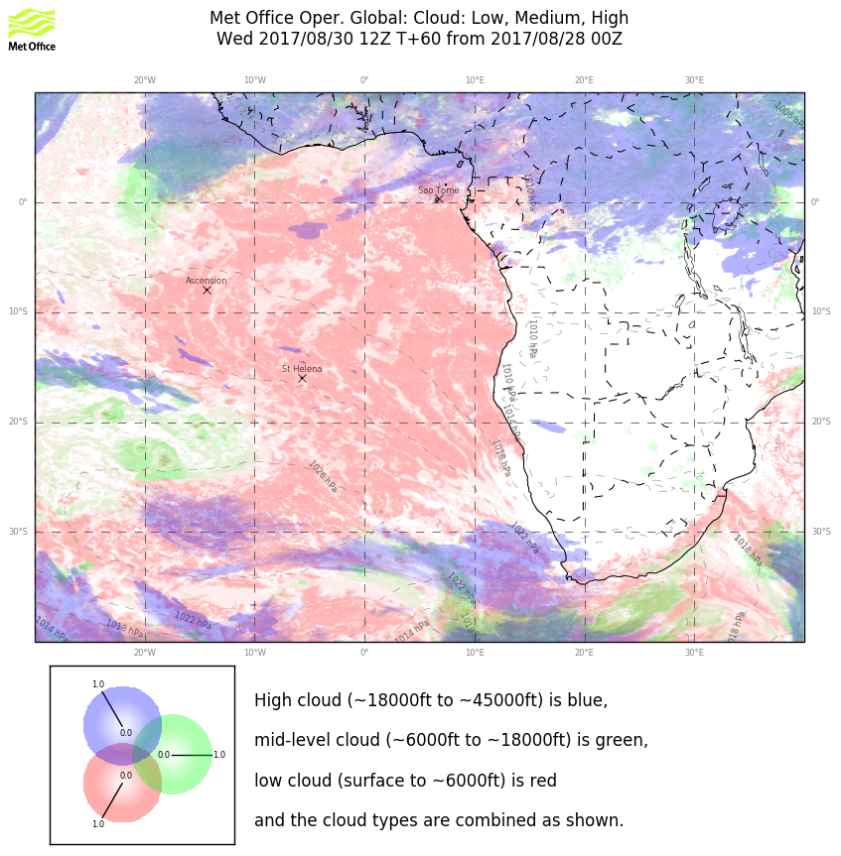
Previous forecast cycle. UKMO consistently clear, EC not stabilized yet. Based on the
subnormal convection upstream observed, am inclined to go with the current EC
forecast (not this one).

Slide 28
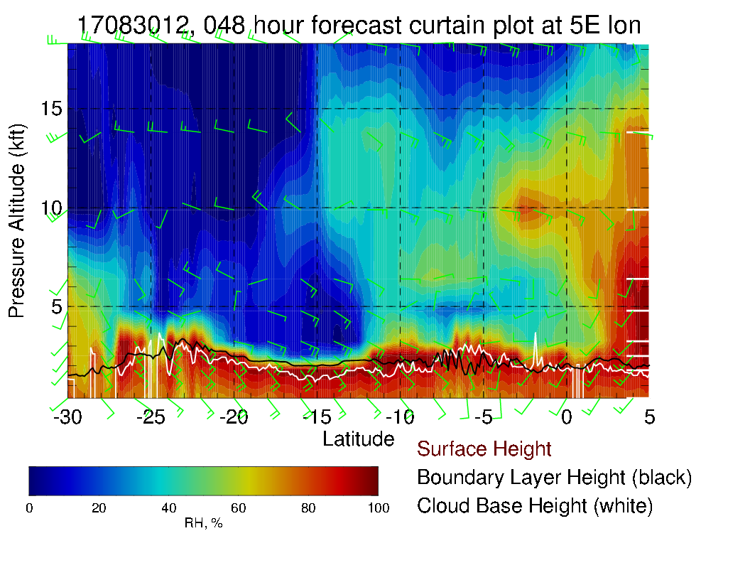
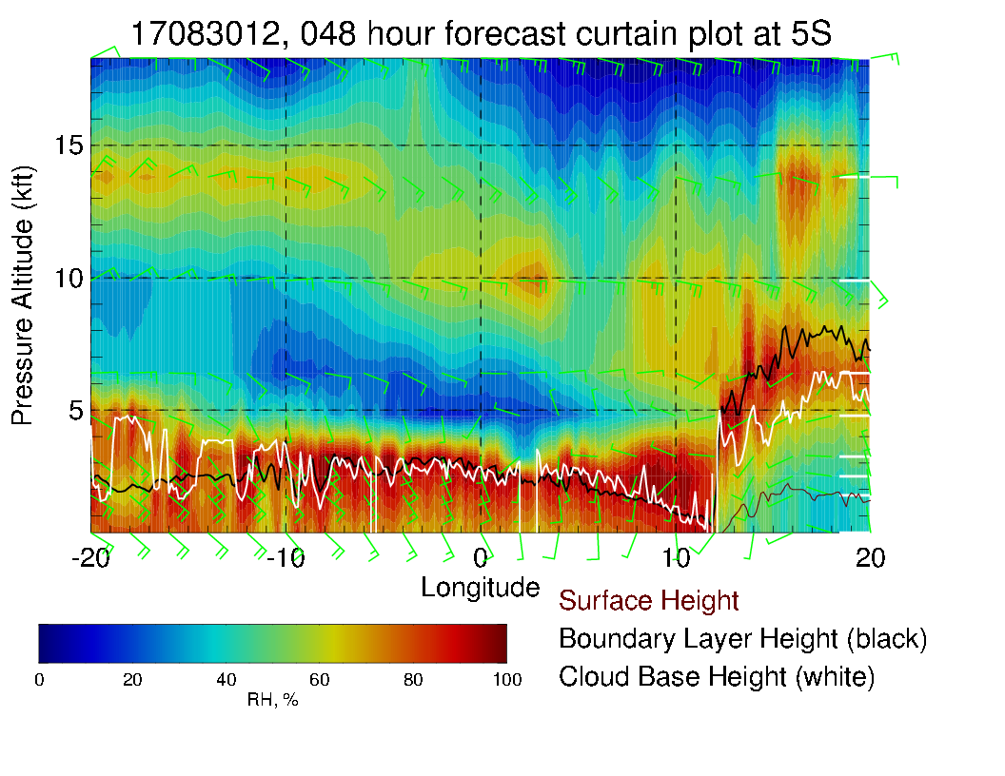
Routine track (above), shows the flow off the continent (and moister air) going to 15S at 700mb and 600mb (10 and 14kft). Mostly easterlies at 700mb, 15-20 knots, as noted more southeasterly at 600mb and stronger (15-25 knots). Easterlies at 800mb as well (but weak). Near typical surface winds (10 knots, except 15 knots near end of routine track).
Along 5S (left) can see the difference in direction between 10kft and 14kft winds.

Slide 29
Routine flight plan time height RH contour plot to 8 km. Some enhanced RH near the
south end of the flight track.

Slide 30
Thursday

Slide 31
Thursday (F): Angola Bay eddy develops, near westerlies over TMS, climo position for SH high, strong winds over SE Atlantic south of ~15S. The two foci of convection again.

Slide 32
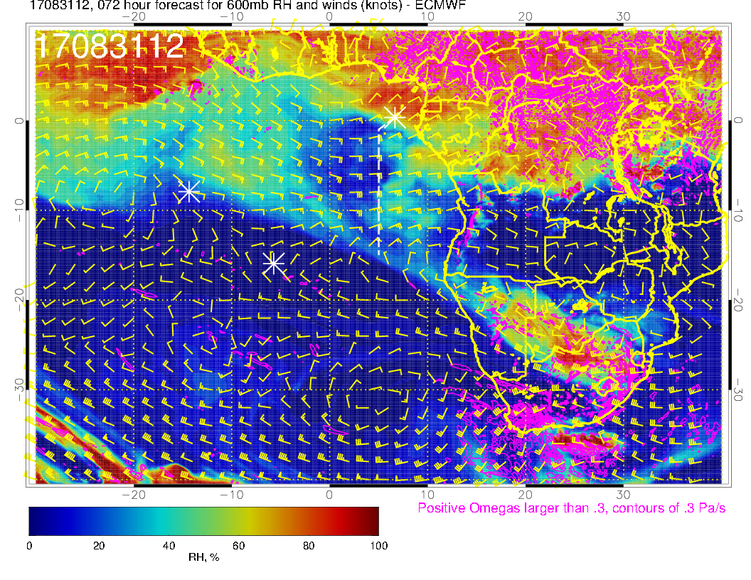
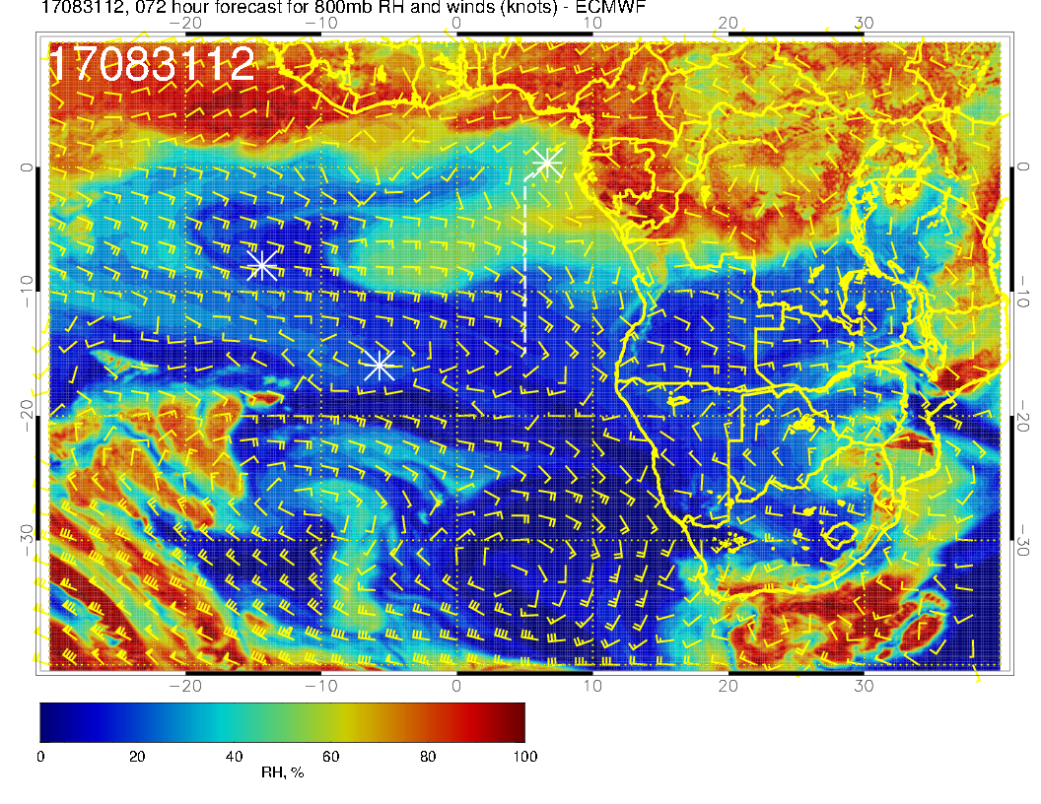
Zonal flow (westward) at upper two levels in our region, with no turn to southeasterlies until 5W (at 600mb, above). Winds are strong, up to 30 knots at 600mb. RH pattern is fairly “washed out” compared to previous day at upper two levels. A traveling surge of RH associated with significant zonal winds at 800mb (right) near 0-5W and 5S. Perhaps the most important feature is the consistent easterlies at all levels along the routine track.

Slide 33
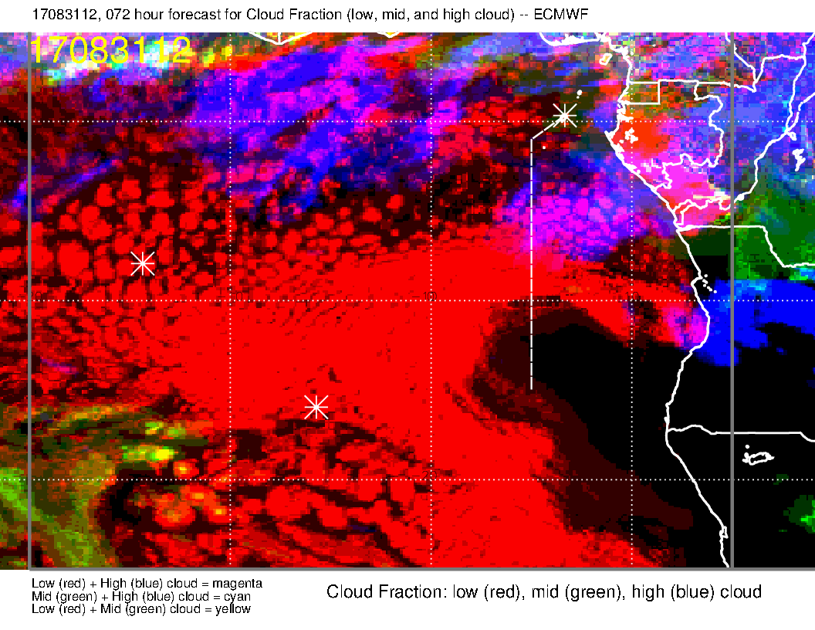
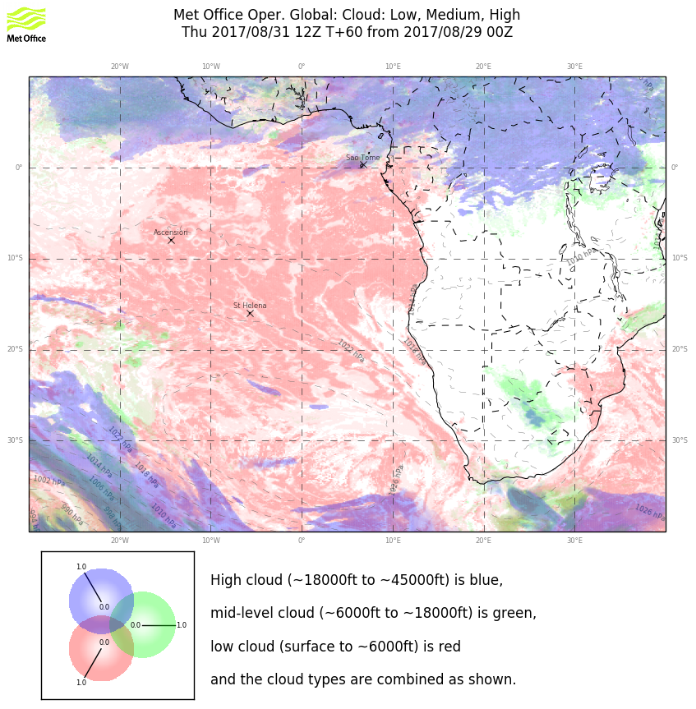
Models disagree on cirrus, clearly due to moisture source. We should be cirrus free south of 10S, but that’s not much of a help here since we need cirrus-free close by for radiation walls.
Low clouds: Strong winds lead to pushing the higher BLs and deeper SC further north (“front” is near 7S), but have usual excessive cloud clearing off of NAM/South Ang coast in EC model. On the 27th of August, had a quasi-similar pattern of low level winds, and things were pretty clear on the routine track north of the “front” at about 7-8 S. So, am inclined to think we will have limited, irregular cloud north of the front as model suggests (EC).

Slide 34
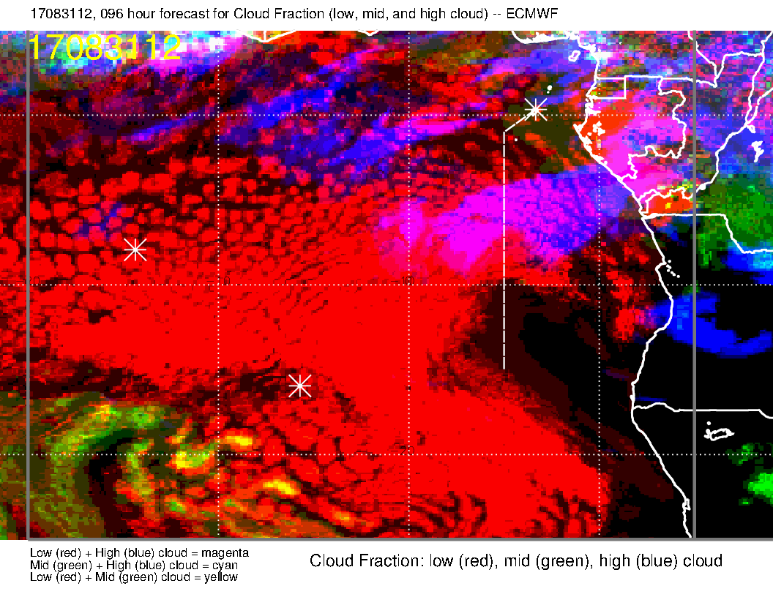
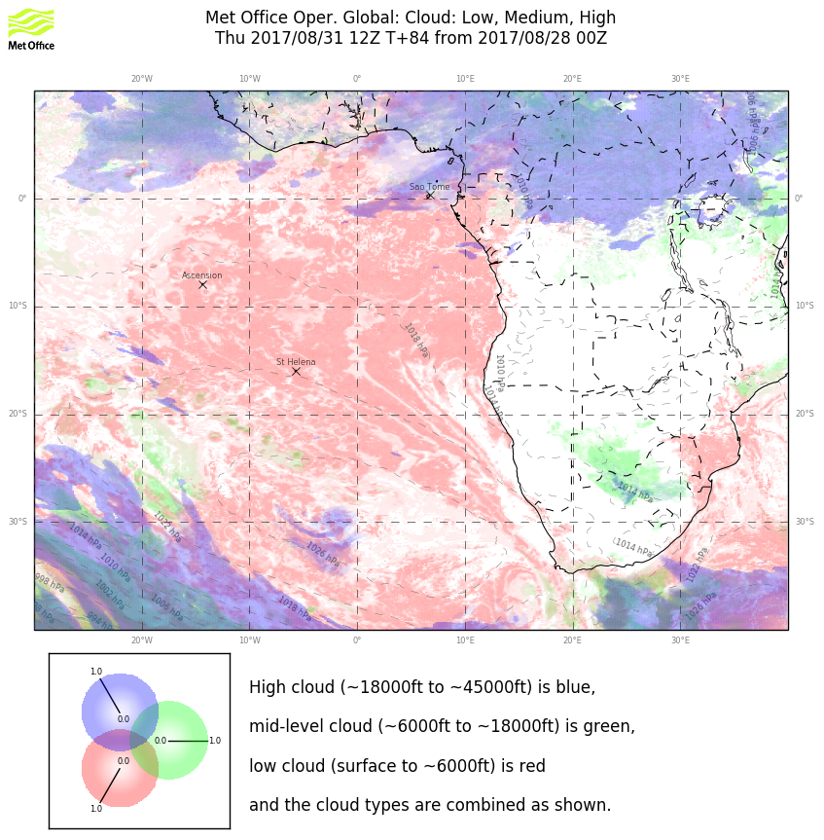
Old forecast: Both forecasts are stable with respect to their own old forecasts, but
disagree. Obvious problem is treatment of upstream convection (forecasting). Rei
has noted problem with the EC in the northwestern Congo a few times.

Slide 35
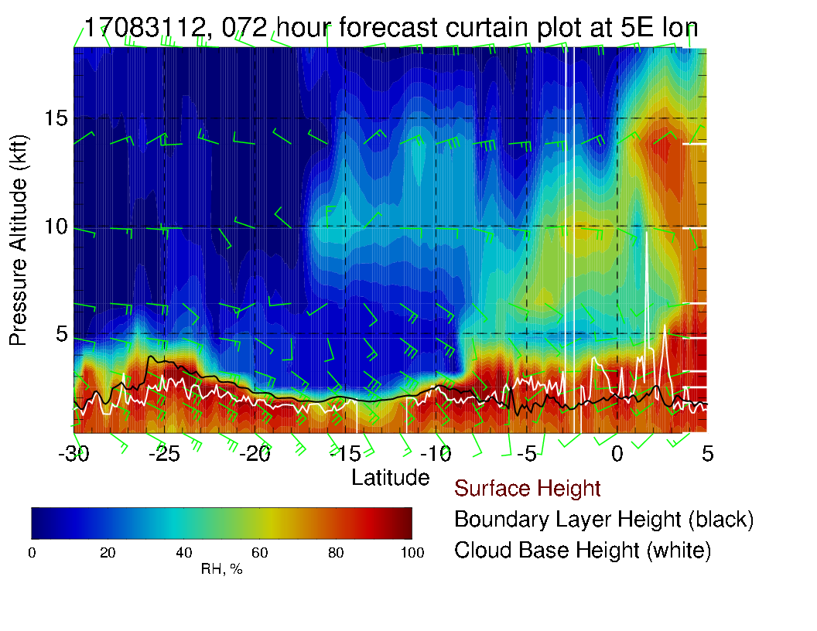
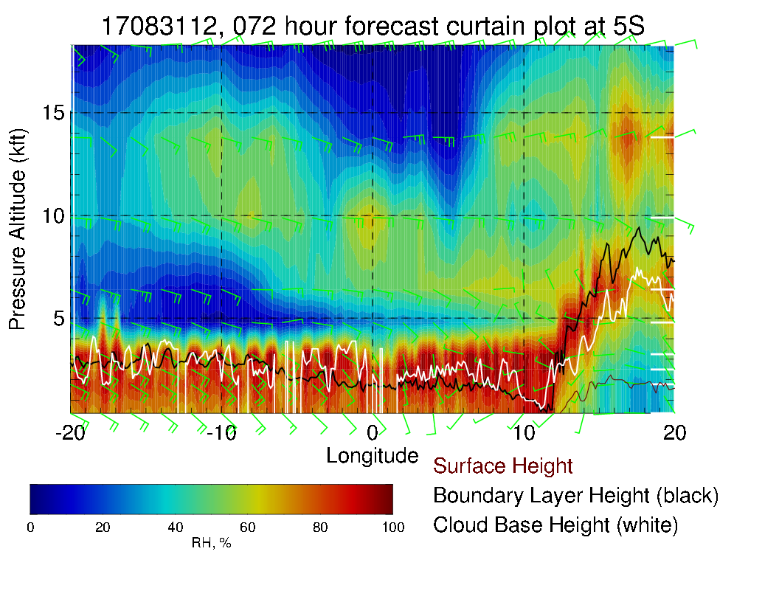
Along routine track, note strong easterlies, especially at 14kft (600mb, 4 km). Generally drier than previous day. Along 5S, note the easterlies (or southeasterlies at 800mb) pushing steadily all along this latitude circle. Moisture pattern fairly washed out – again westward and upward tilt.

Slide 36
Saturday

Slide 37
Saturday (Transit science flight): Low level winds have been similar since 8/31 with westerlies near TMS and now a really pronounced Angola Bay Eddy. Strong convection forecast over NW Congo. Most of SE Atlantic toward Ascension Island has fairly typical wind directions, perhaps not quite as strong as climo.

Slide 38
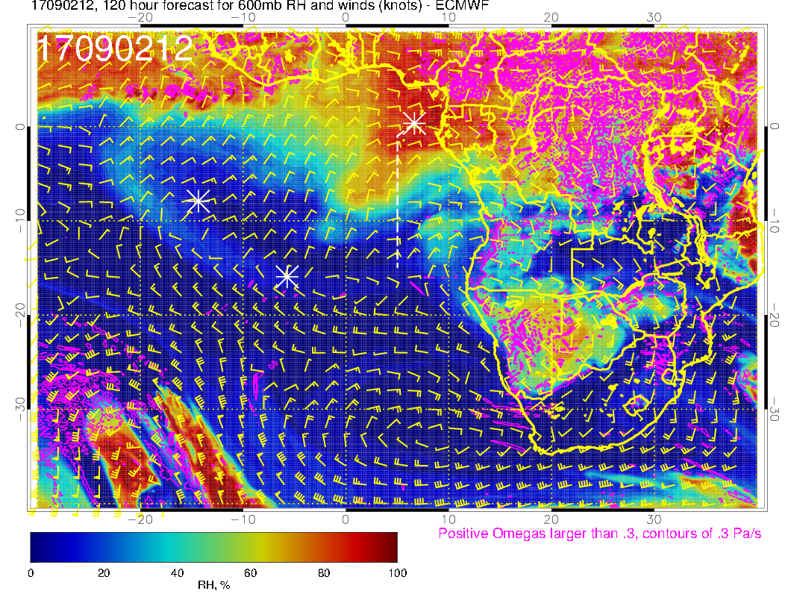
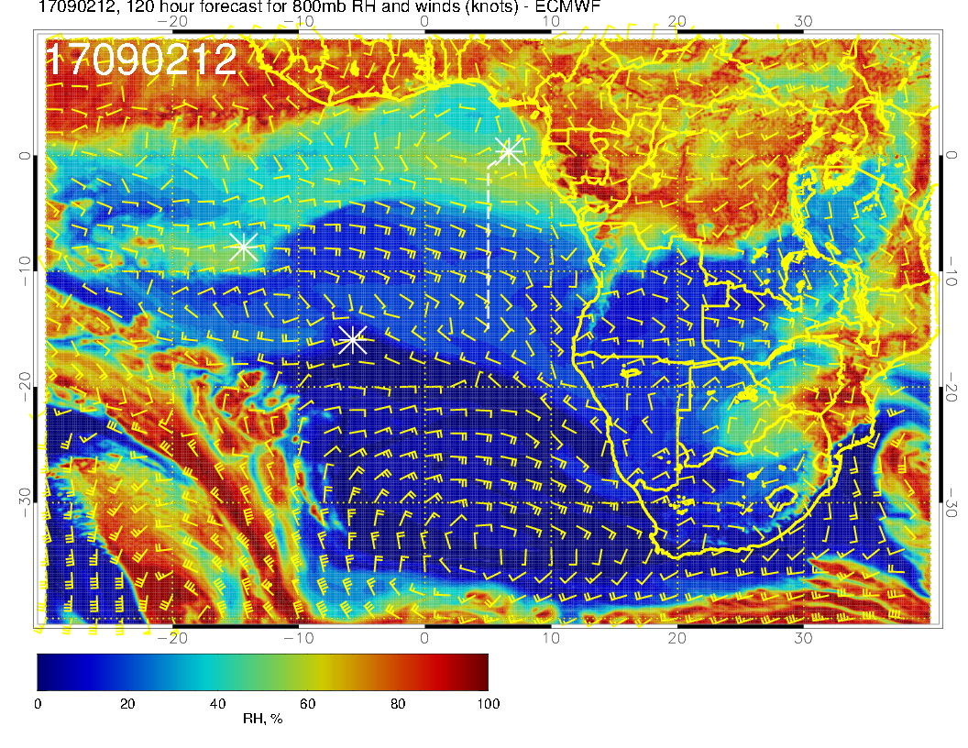
Mid levels for Transit Flight. 600mb pattern shows a southwestward surge everywhere west of the routine track, while 700mb continues zonal. (This 600mb surge arguably is visible on 8/31 with a moisture corner starting to intrude near Cameroon). The 600mb pattern change ought to have an impact on trajectories. At 800mb, the moisture stream we noted on 8/31 has distended westward and moved north, to be replaced by dry air descending from the south.

Slide 39
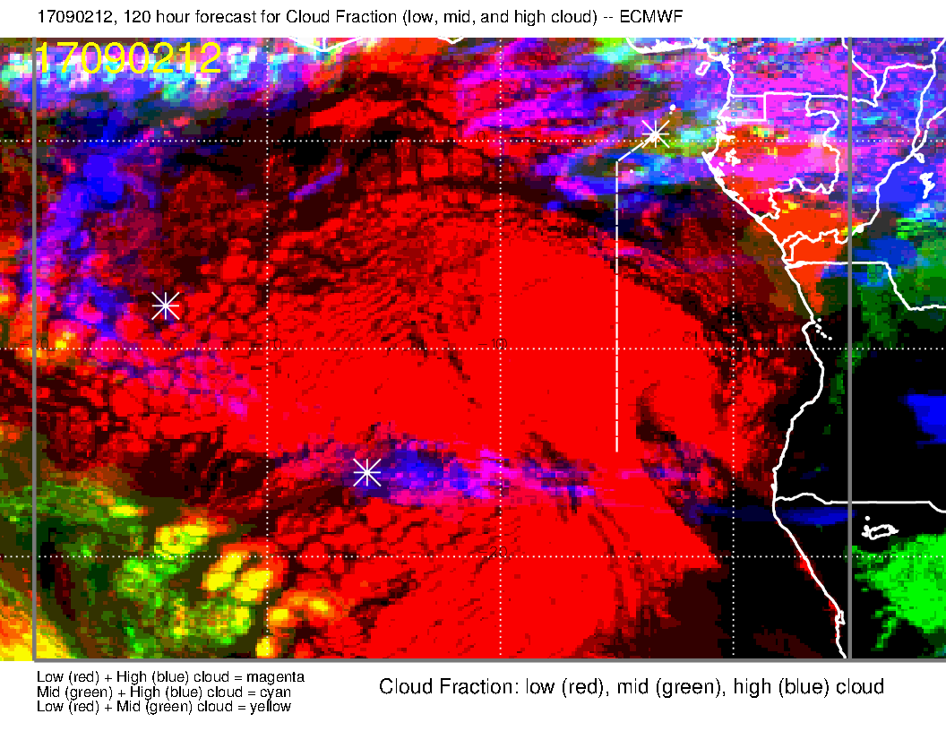
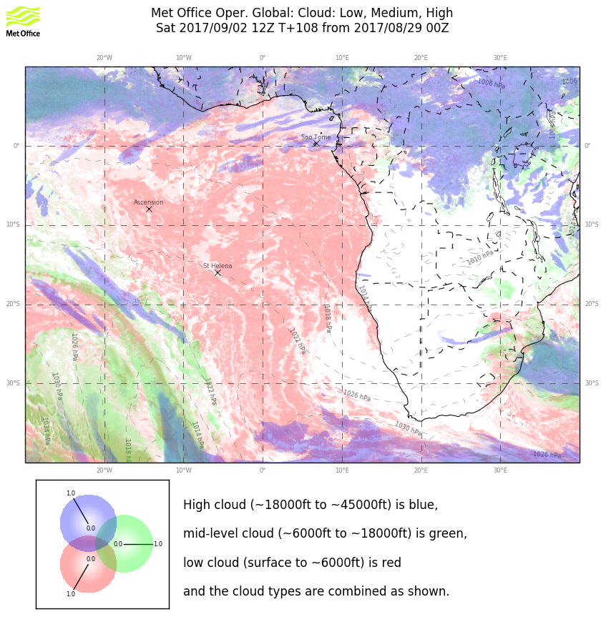
I really think a lot of this is in the realm of imagination, especially the high level cirrus (or lack thereof). Northern position of “front” is consistent with where the surface winds weaken and bend, and may actually hold. Cloud clearing near Namibian latitudes is likely. Anything north of the “front” is imagination. Some midlevel cloud is forecast near TMS by EC. This is quite possible with the moisture surge at 600mb, so should not be discounted.

Slide 40
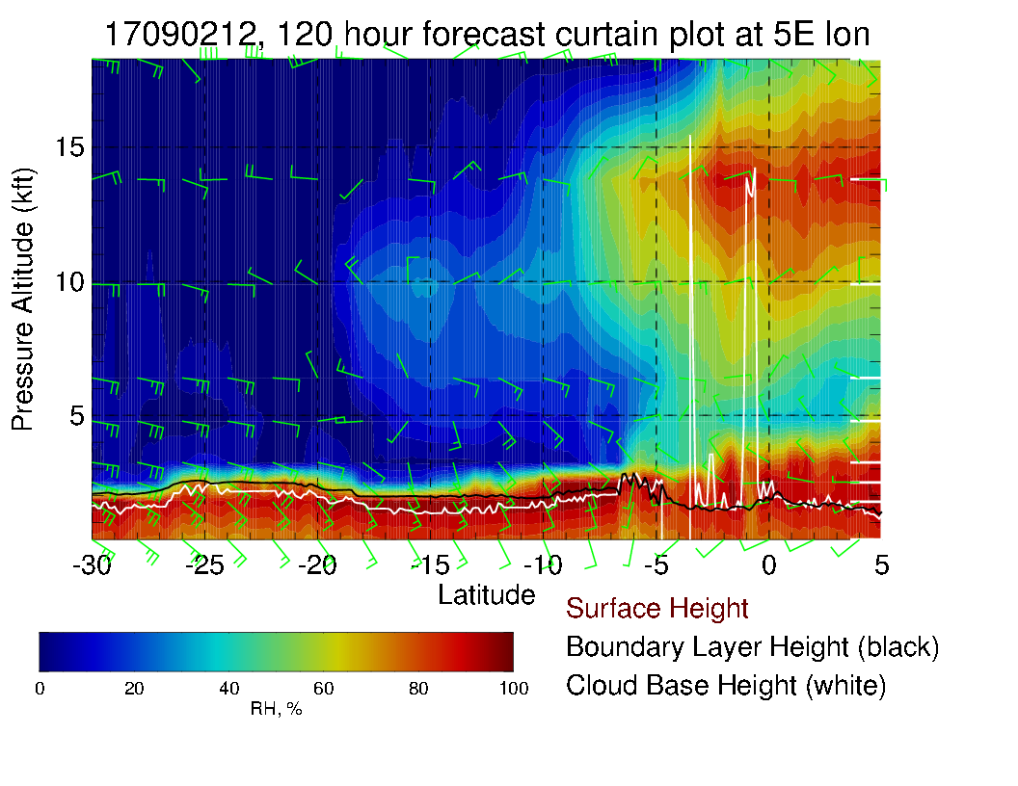
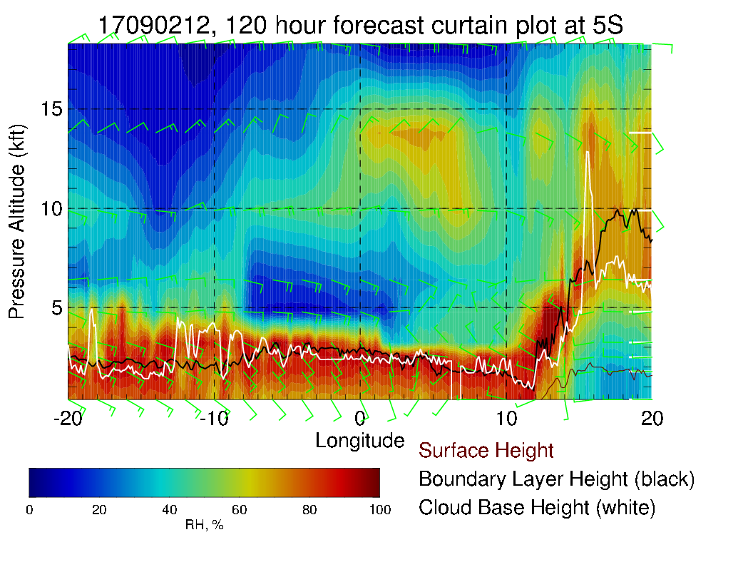
600mb moisture surge from is apparent in routine track (above). Winds much weaker than on 8/31, especially at 600mb. Only 700mb shows the persistent zonal pattern extending along the 5S latitude circle (left). The upward and westward tilt in the moisture pattern at 5S is gone with the new development at 600mb.

