Slide 1
ORACLES weather briefing
28-Aug-2017
Lenny Pfister and Rei Ueyama

Slide 2
Monday

Slide 3
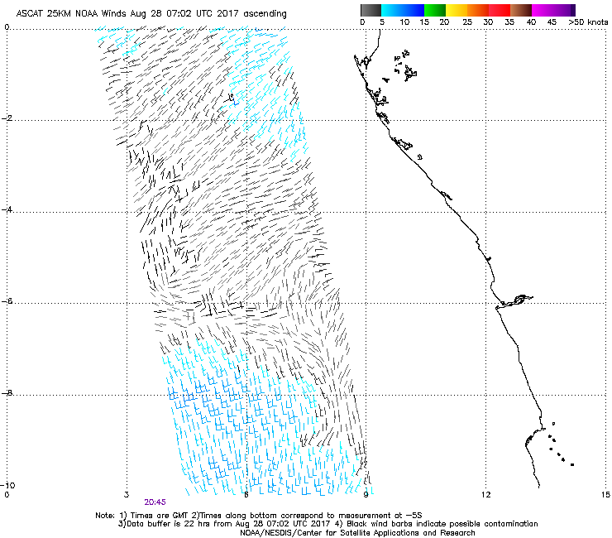
Yesterday, 9 PM
Short term forecast (12Z Sunday init) does not get full
westward penetration of the Angolan Eddy last night
Forecast “initialization” exercise

Slide 4
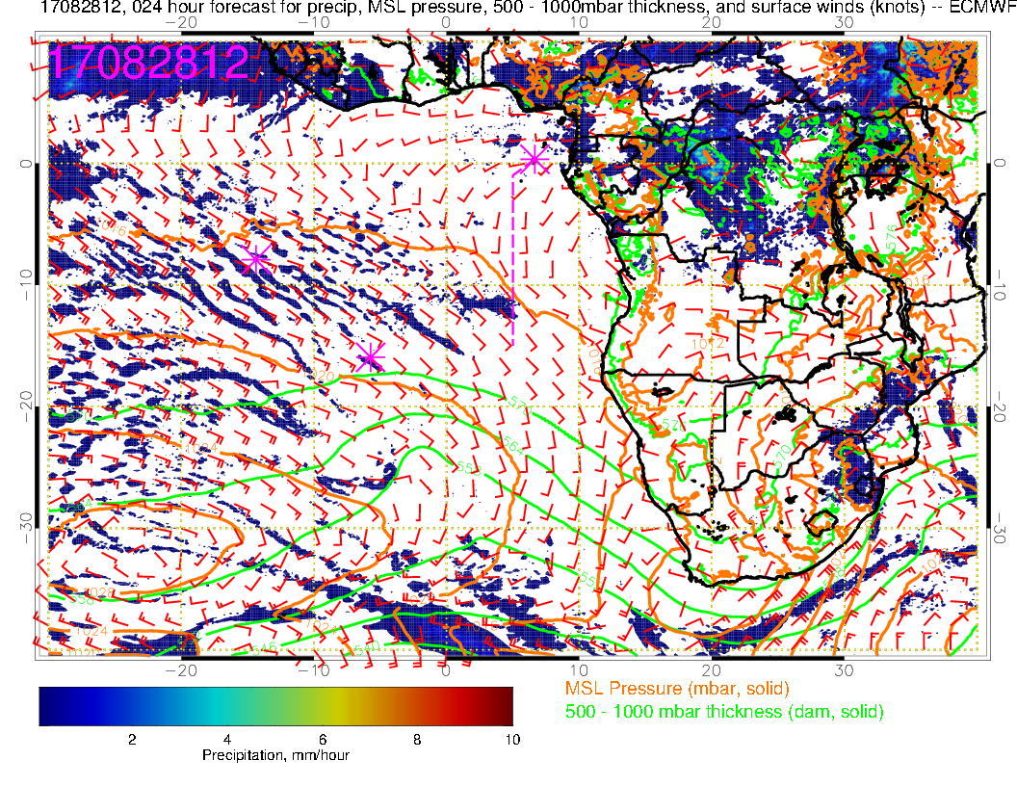
Weaker than typical surface winds along track, westerlies at TMS.

Slide 5
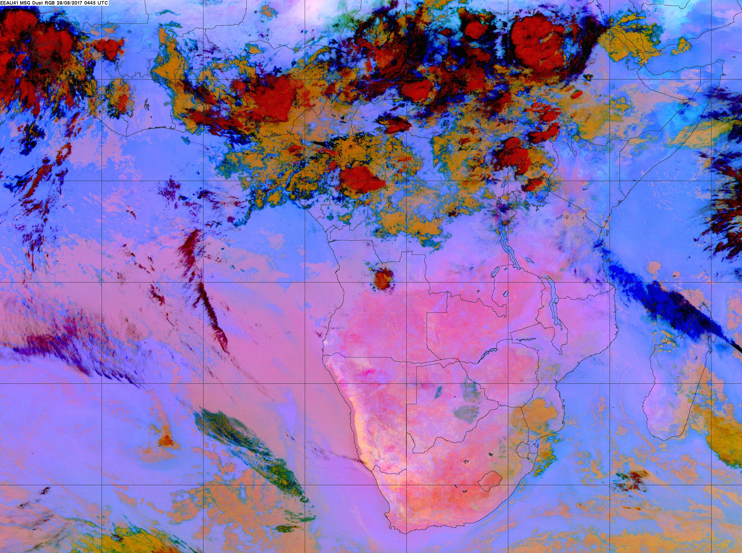
0445

Slide 6
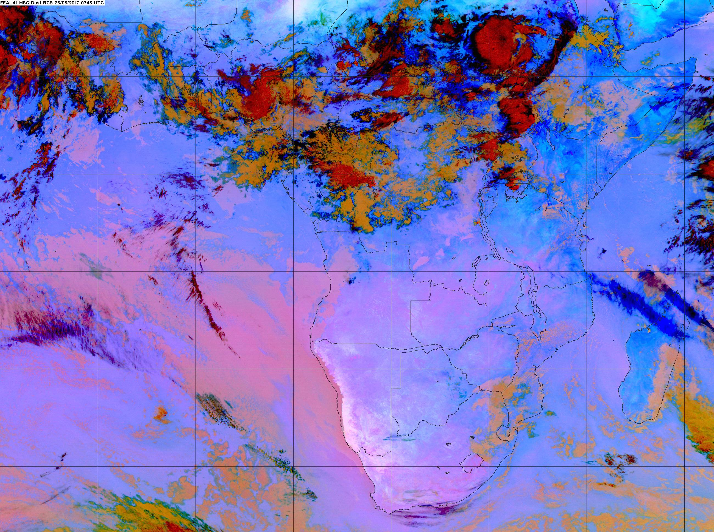
Low cloud clearing advancing from the north maybe a degree every 3 hours, guess it might be near 10S by 11 AM.
0745

Slide 7
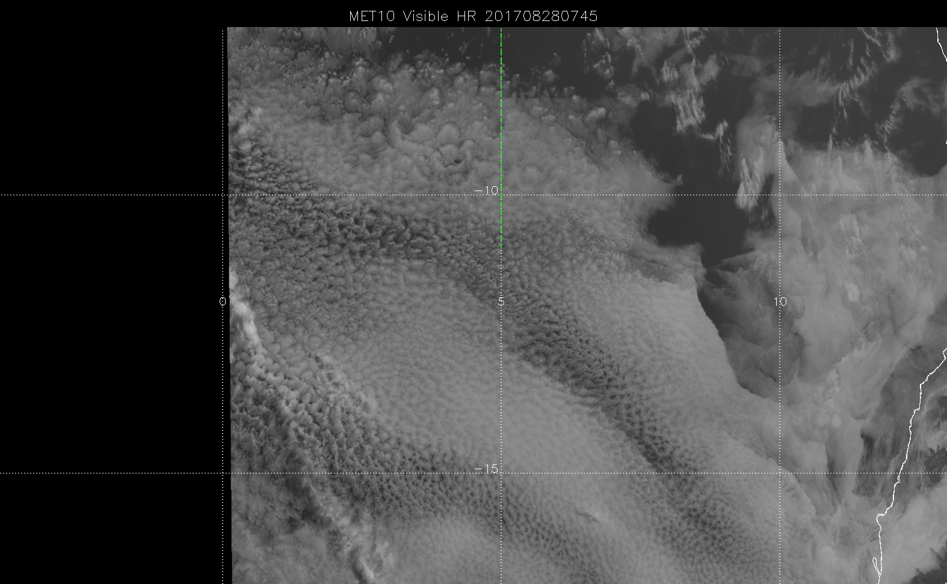
0745 high res. Not sure how “broken” this looks. Boundary is on the sharp side.

Slide 8
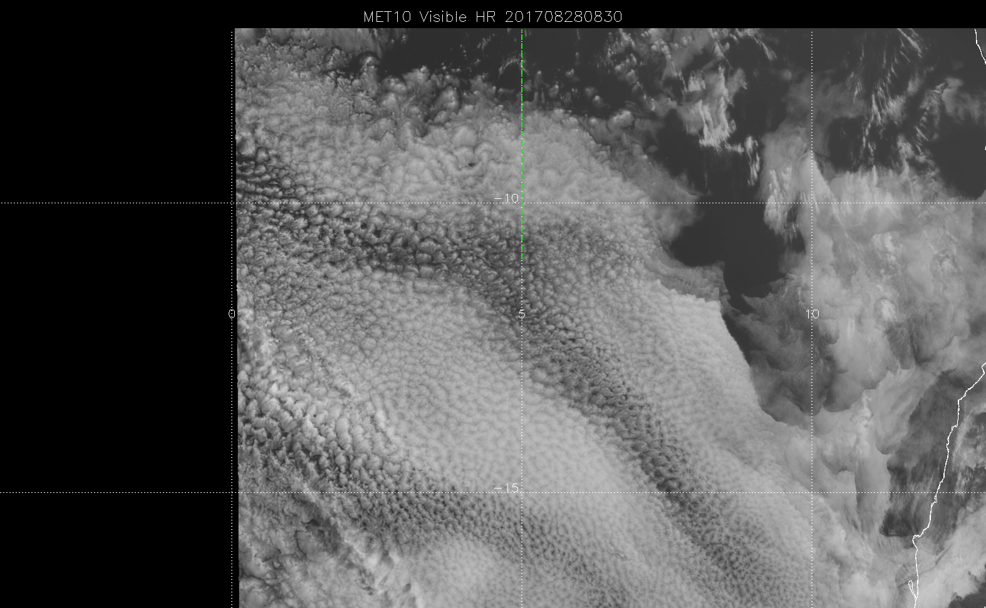
Latest high res. Not sure how “broken” this looks. Boundary is on the sharp side. Advanced south by about half a degree in 45 minutes.

Slide 9
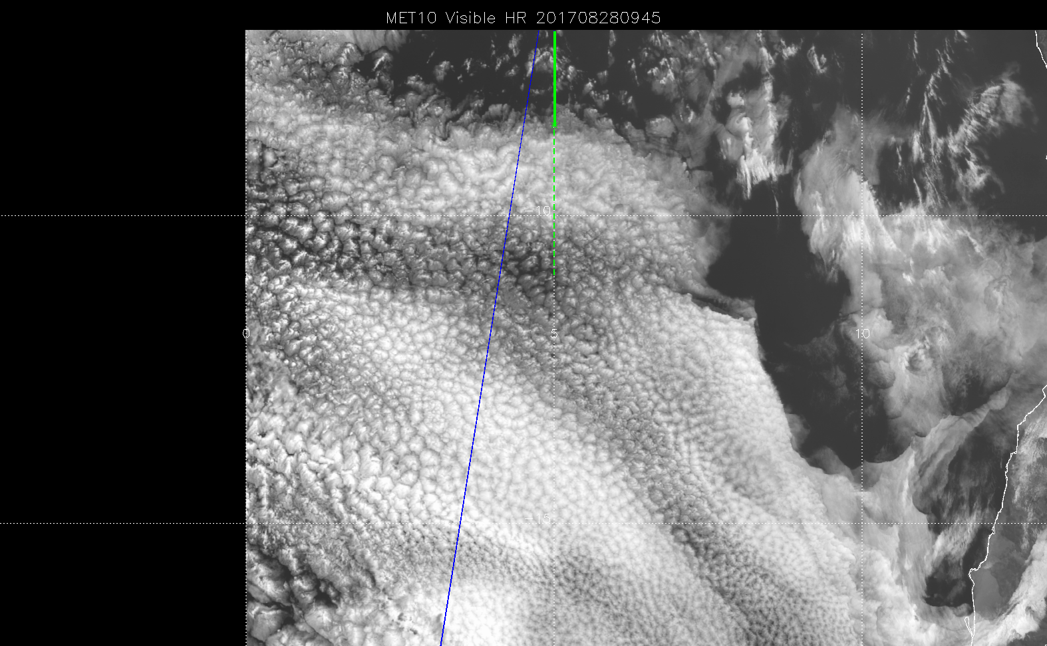

Slide 10
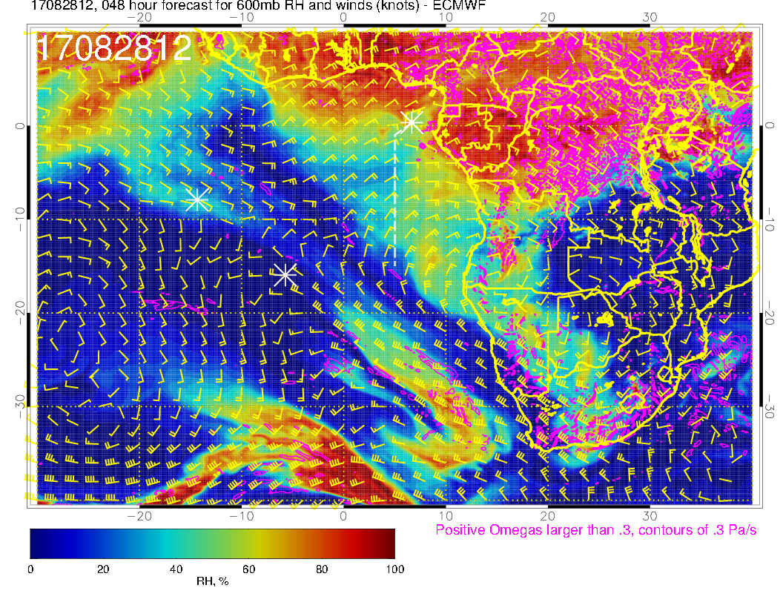
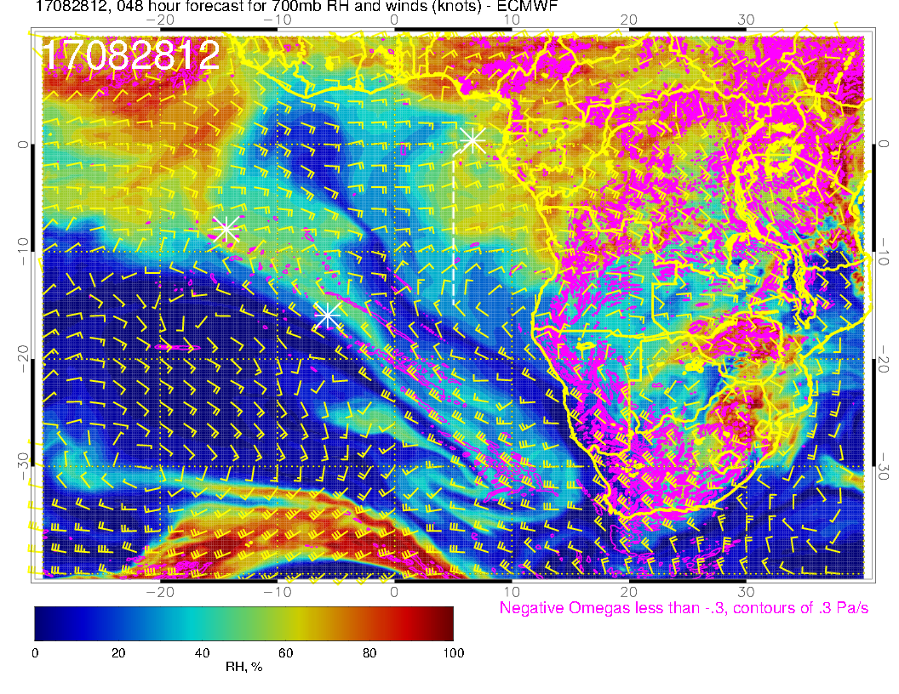
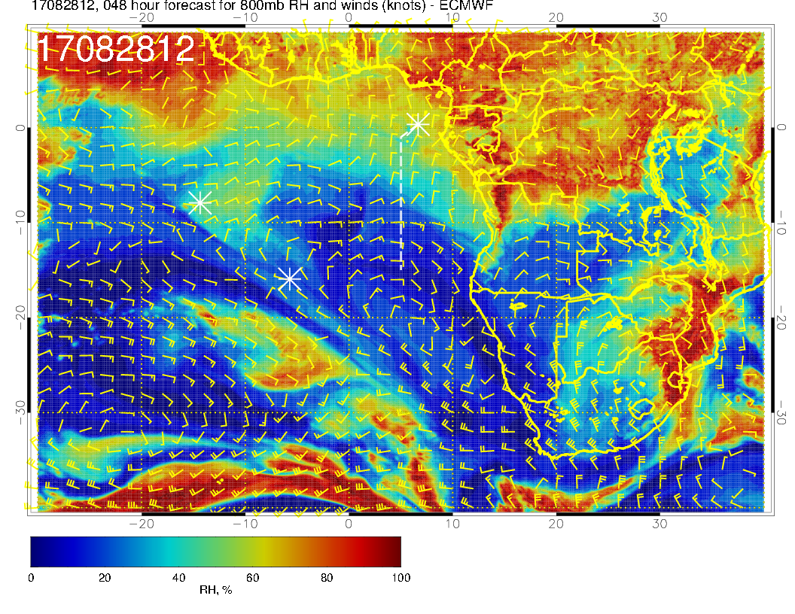
OLD FORECAST

Slide 11
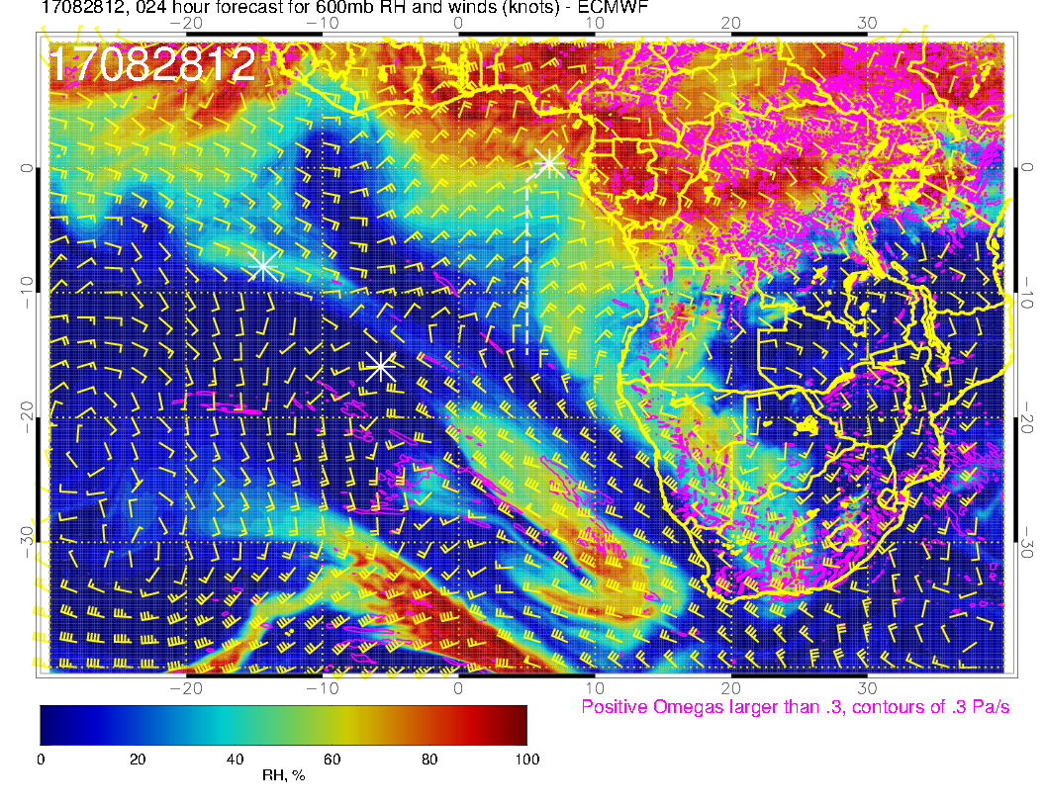
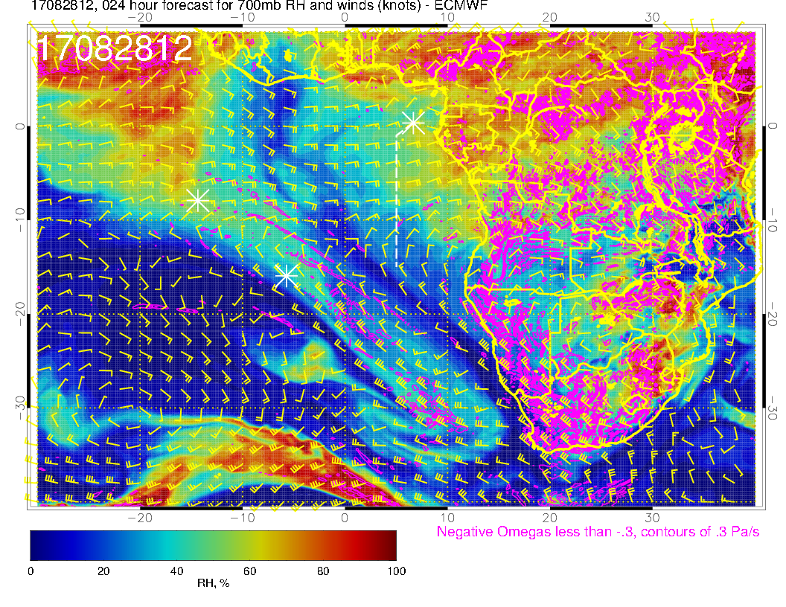
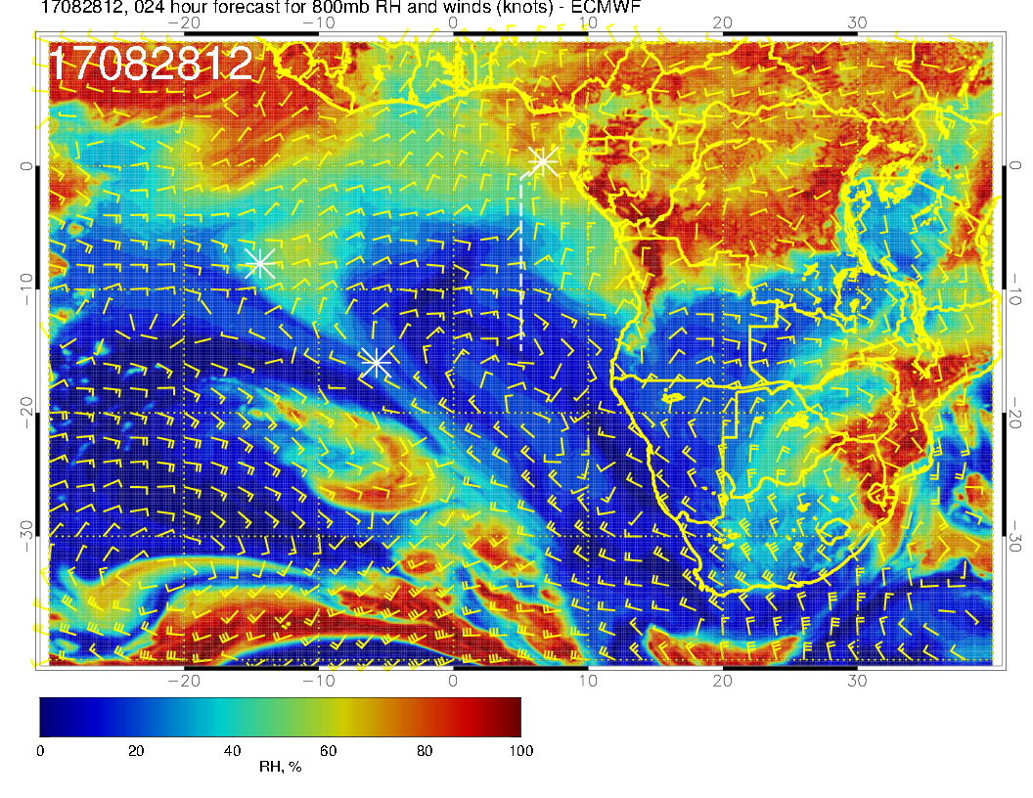
Mid level flow for Monday. At eastern edge of a dry region. All patterns are noticeably less advanced to the west than yesterday’s forecast. This includes both the RH patterns in the two upper levels, and the curves in the wind patterns.
Seems like we definitely want to update our trajectories.

Slide 12
Tuesday

Slide 13
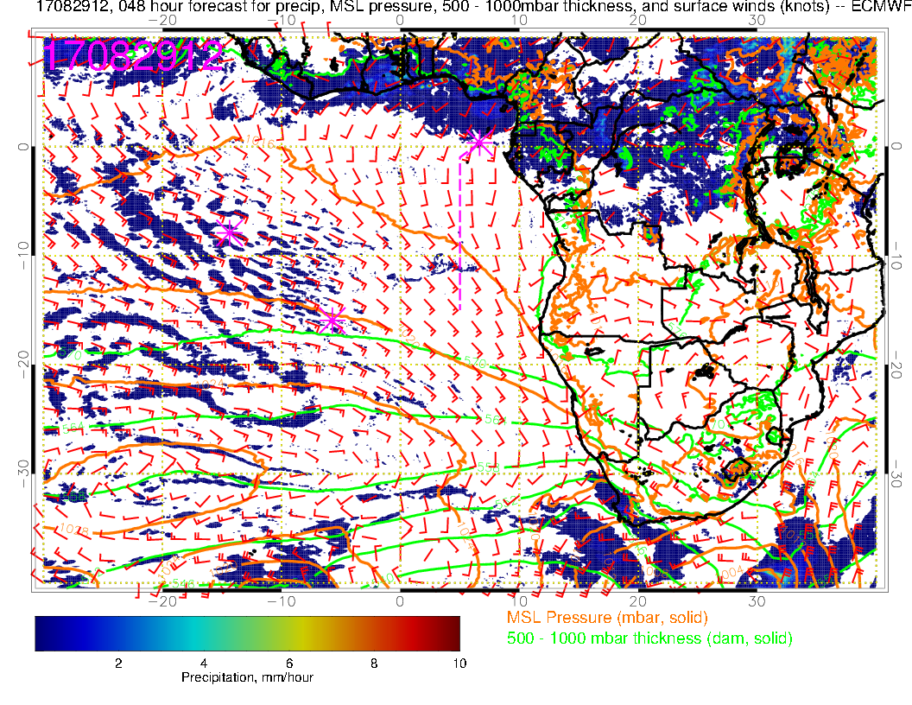
Tuesday (Lagrangian sampling flight): Saint Helena high moving eastward toward climo position. Winds in SE Atlantic fairly typical. Some convection near TMS (more than yesterday’s fcst, also more Ghana convection than previous fcst, northwestern Congo convection is less than yesterday’s fcst

Slide 14
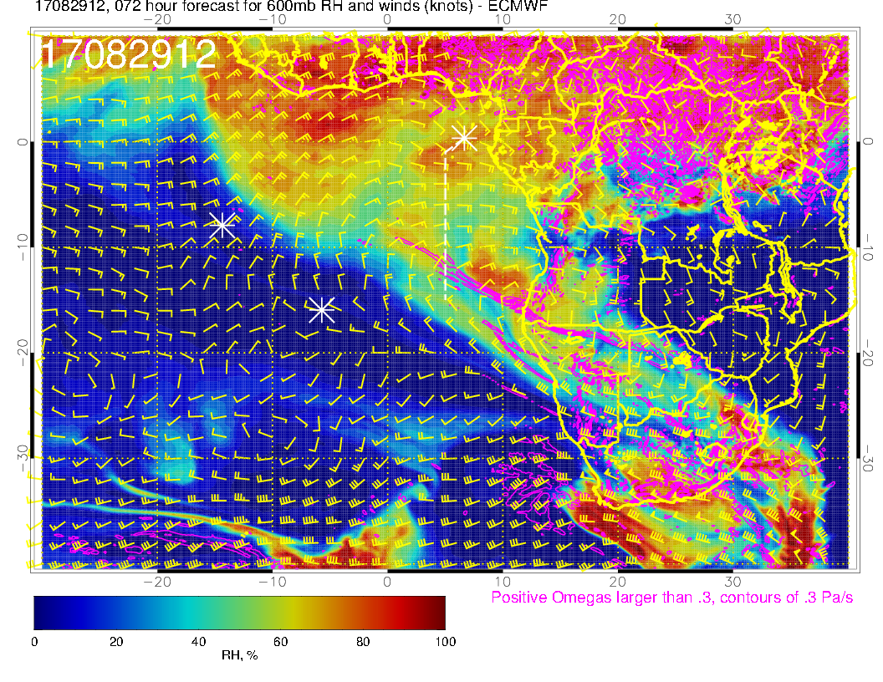
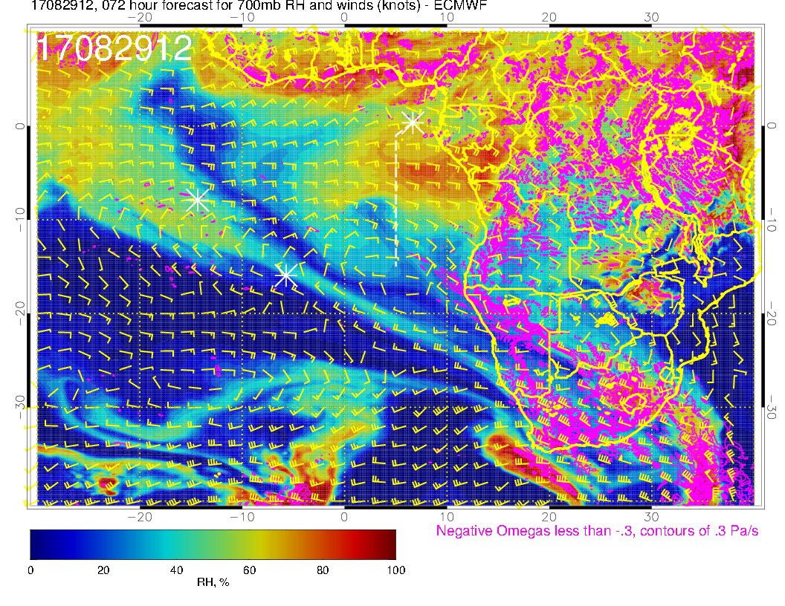
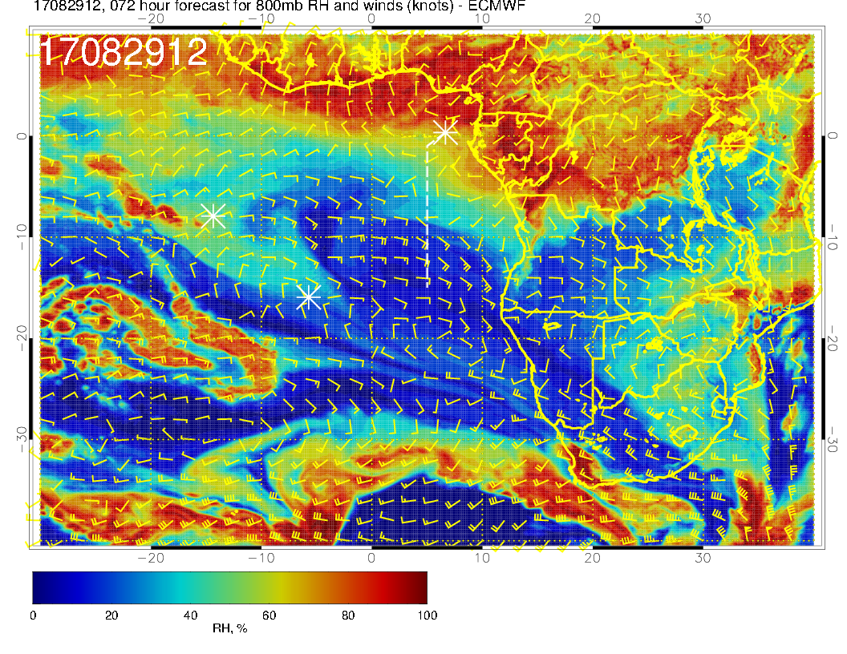
Yesterday’s fcst

Slide 15
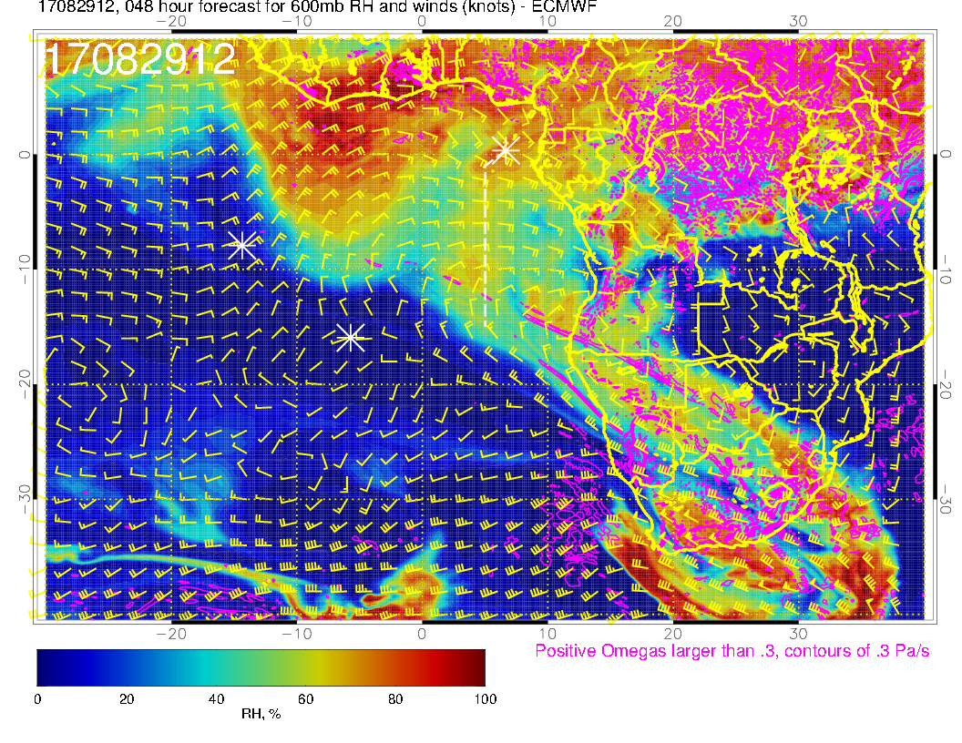
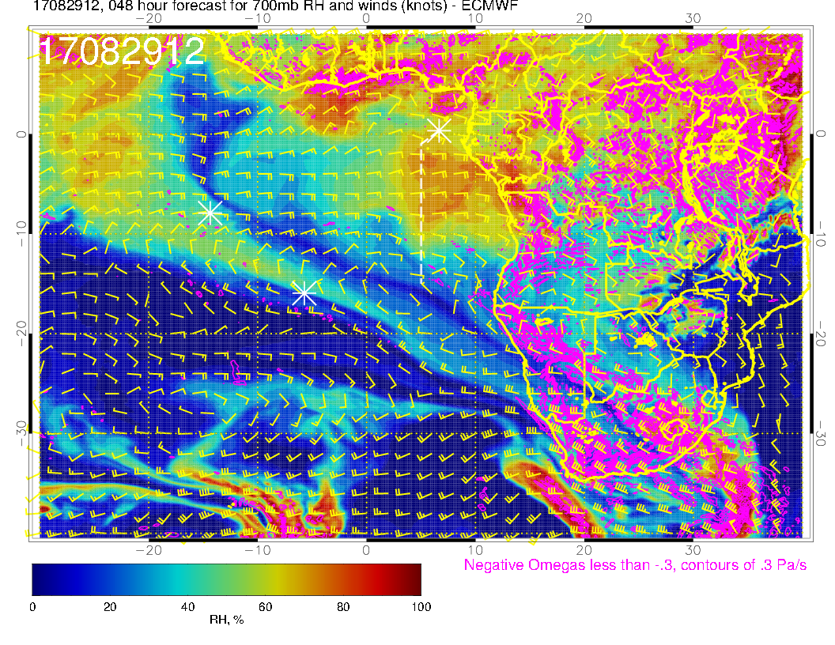
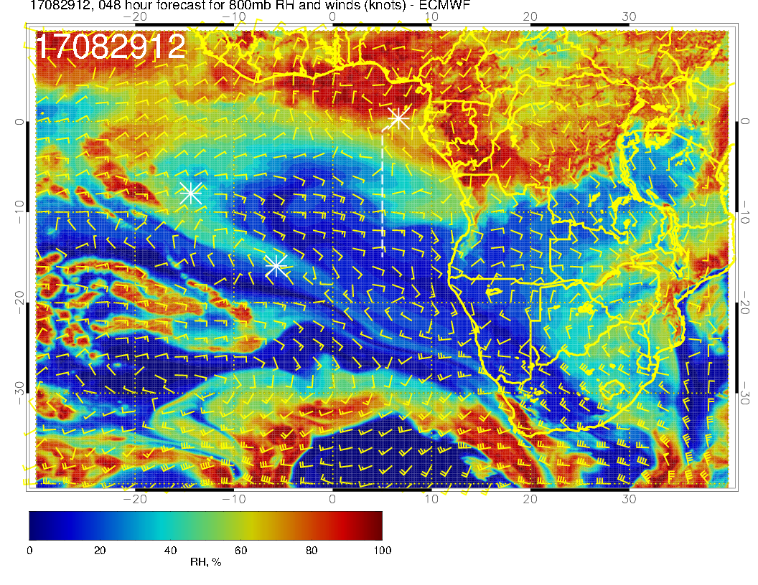
Winds weaker than yesterday’s fcst by about 5 knots, and patterns (RH) are less advanced by a few degrees. Wind at 800mb is more zonal than in yesterday’s fcst. 700mb RH feature is broader in latitude than yesterday’s fcst

Slide 16
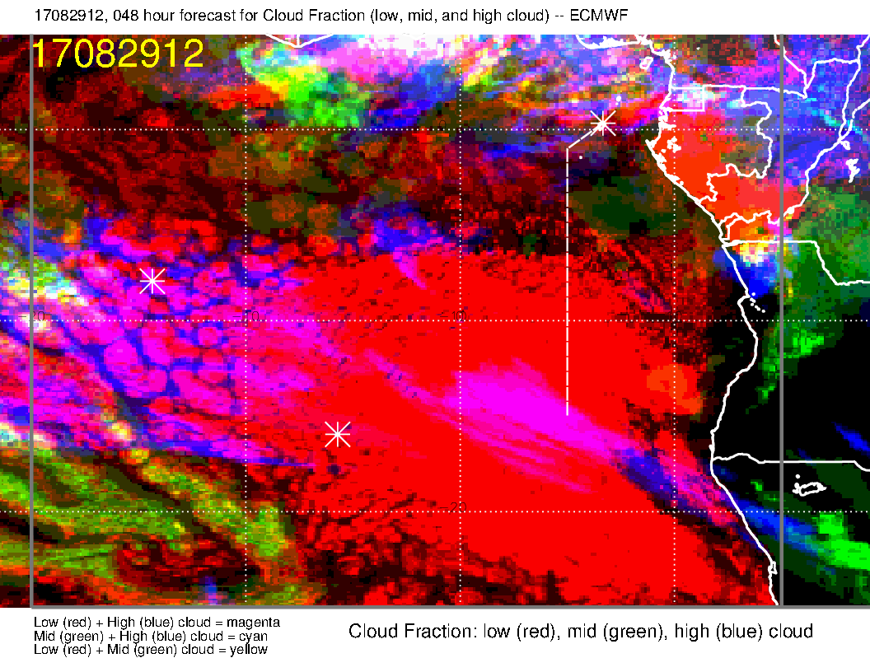
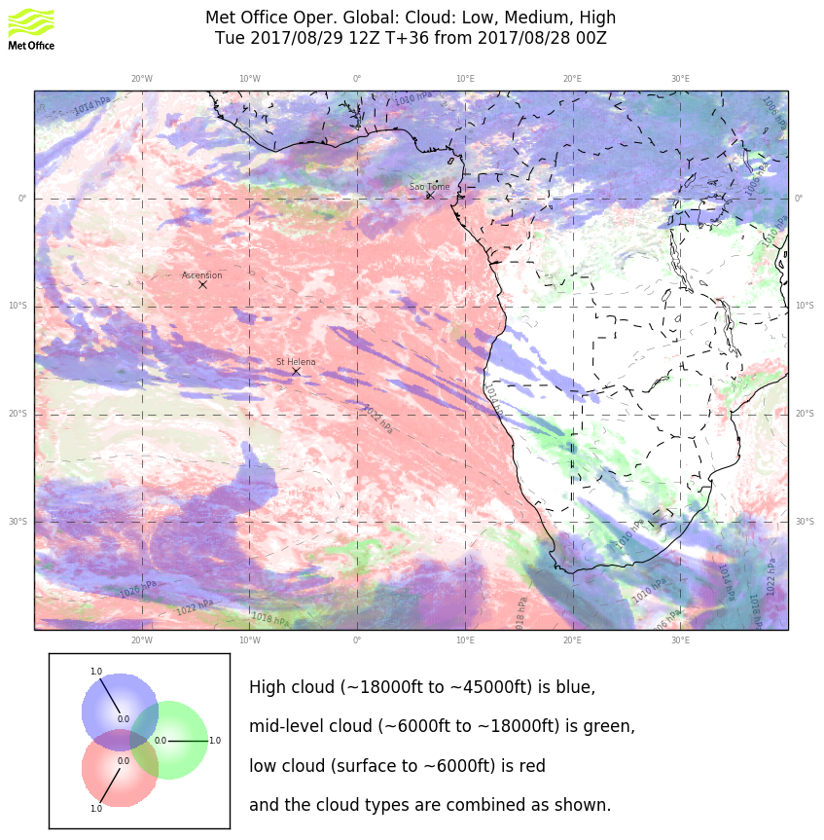
A decided change in the forecast. Two models roughly agree in region of interest.

Slide 17
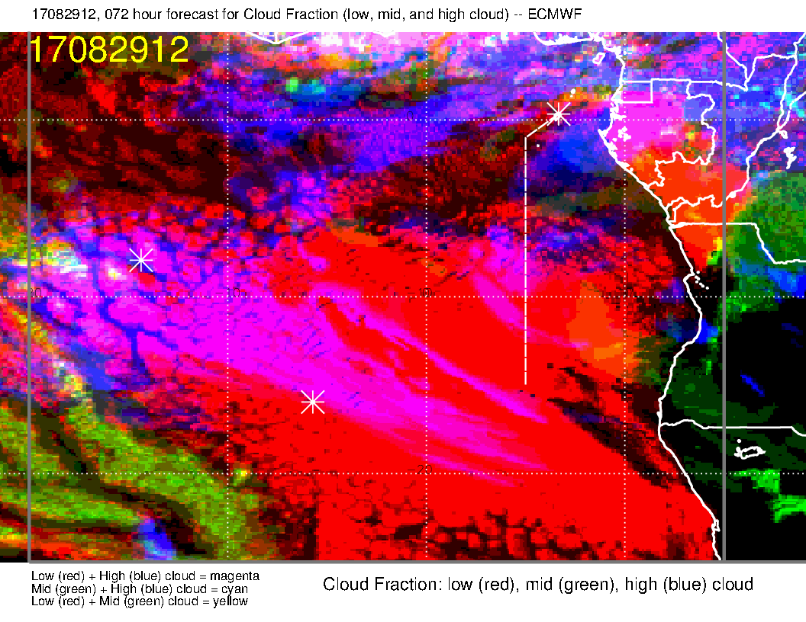
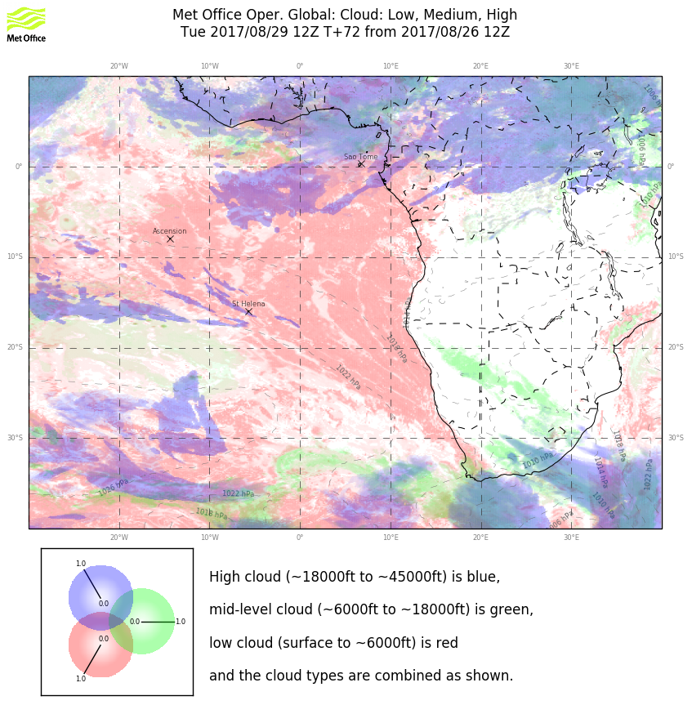
Old forecast. Different in both models, and they don’t agree. UKMO exhibits
less change, I would say.

Slide 18
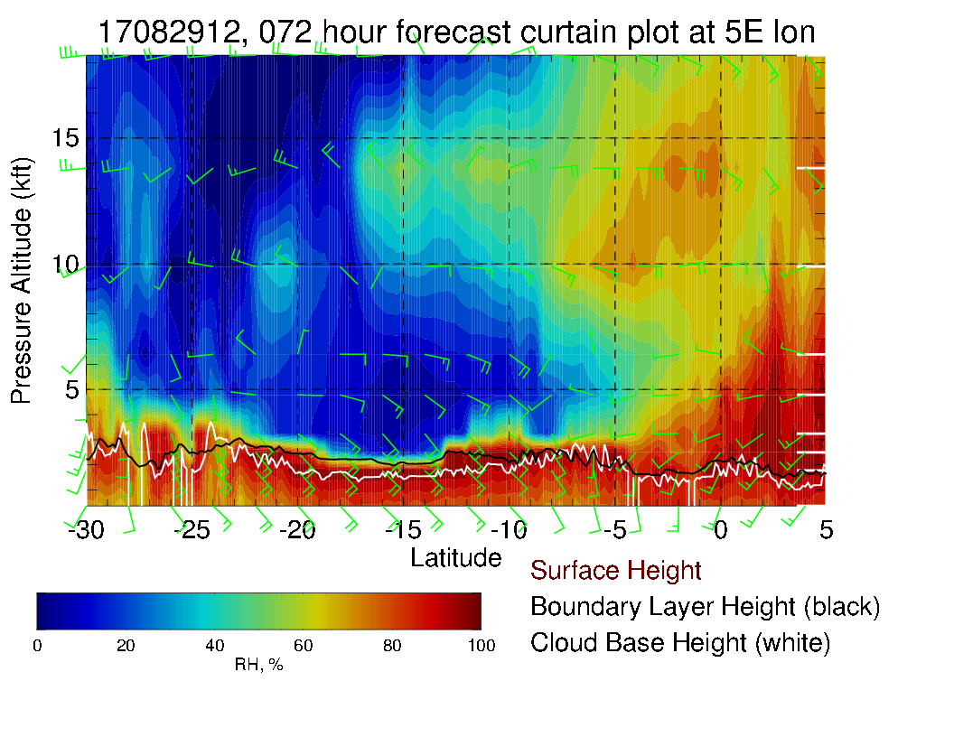
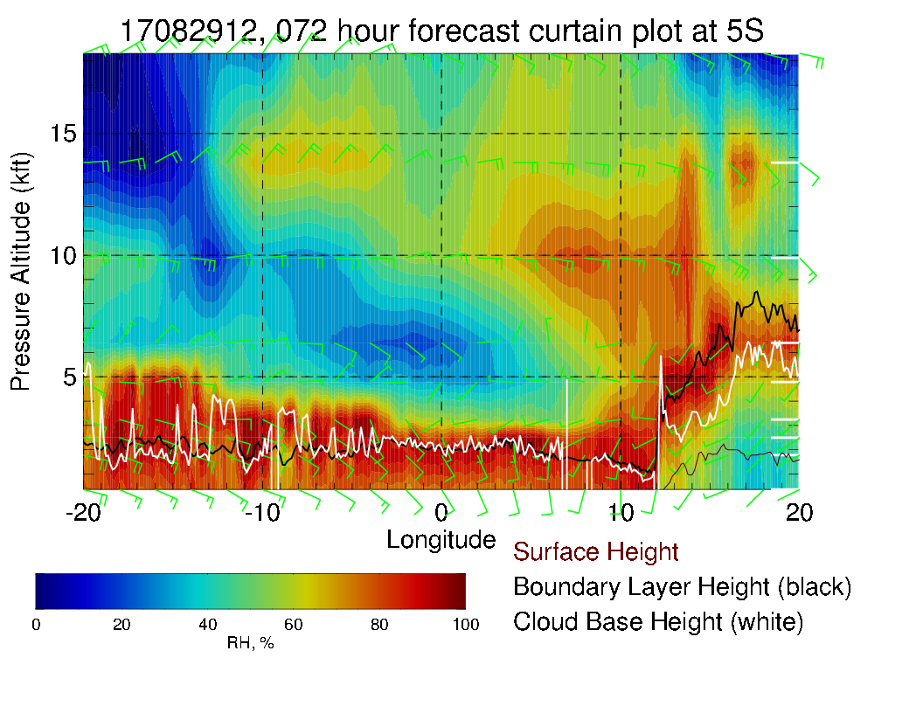
Yesterday’s fcst

Slide 19
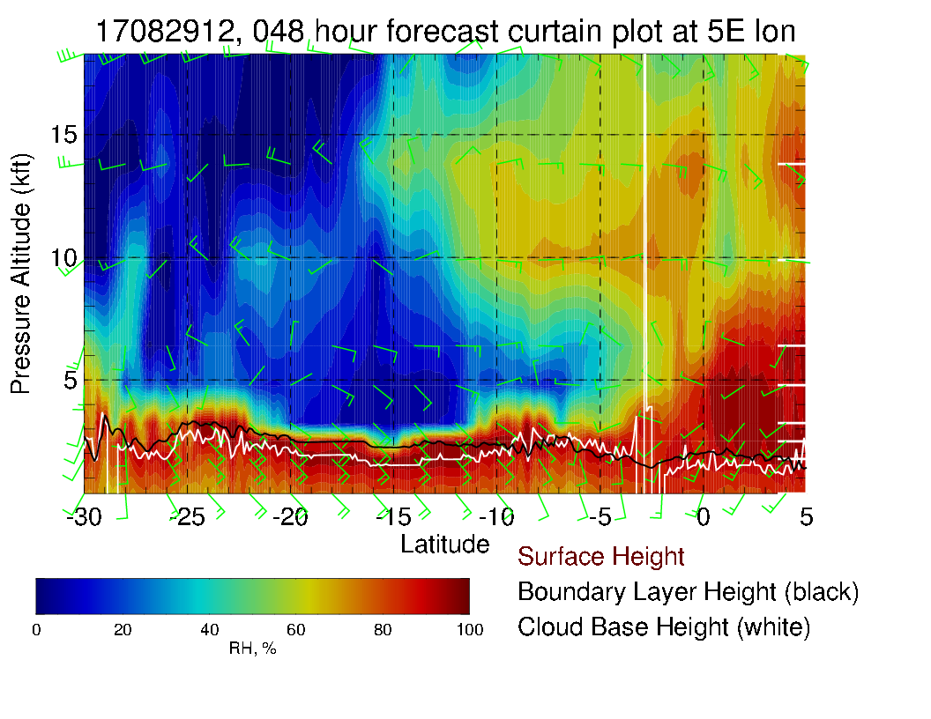
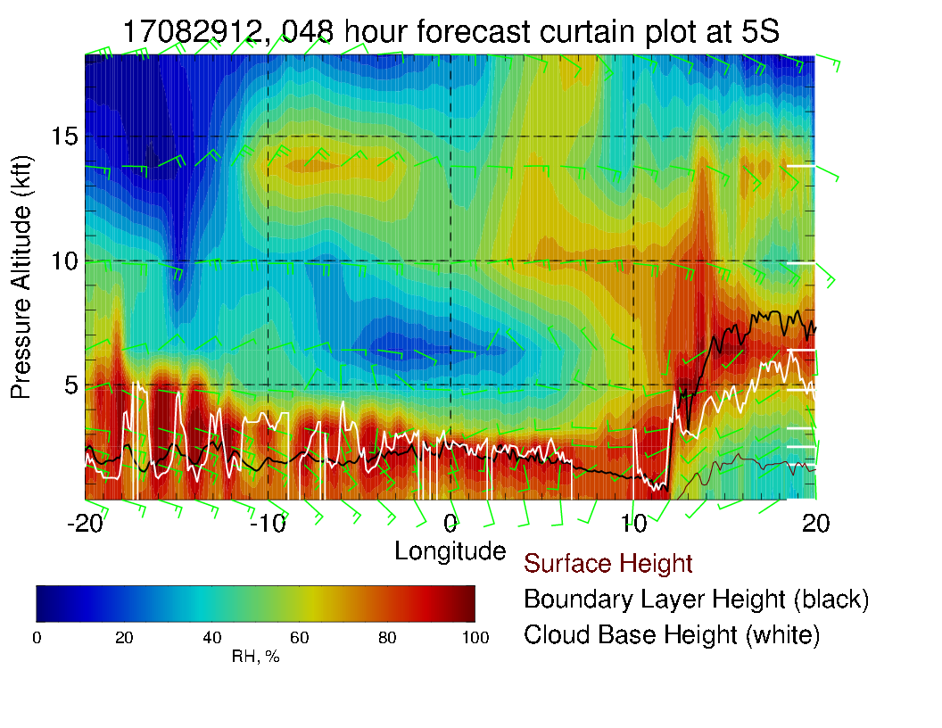
Mid level moisture starting to enter routine track (above) at 600mb especially, and can see how it is moving westward (left), tilting westward with altitude. Winds pretty much easterly, 15-20 knots at midlevels. Note westerlies at 800/850 mb north of 5S, shifting to southeasterlies south of that. Surface winds southerly, typical strength.

Slide 20
RH along planned track for Tuesday’s flight.

Slide 21
Thursday

Slide 22
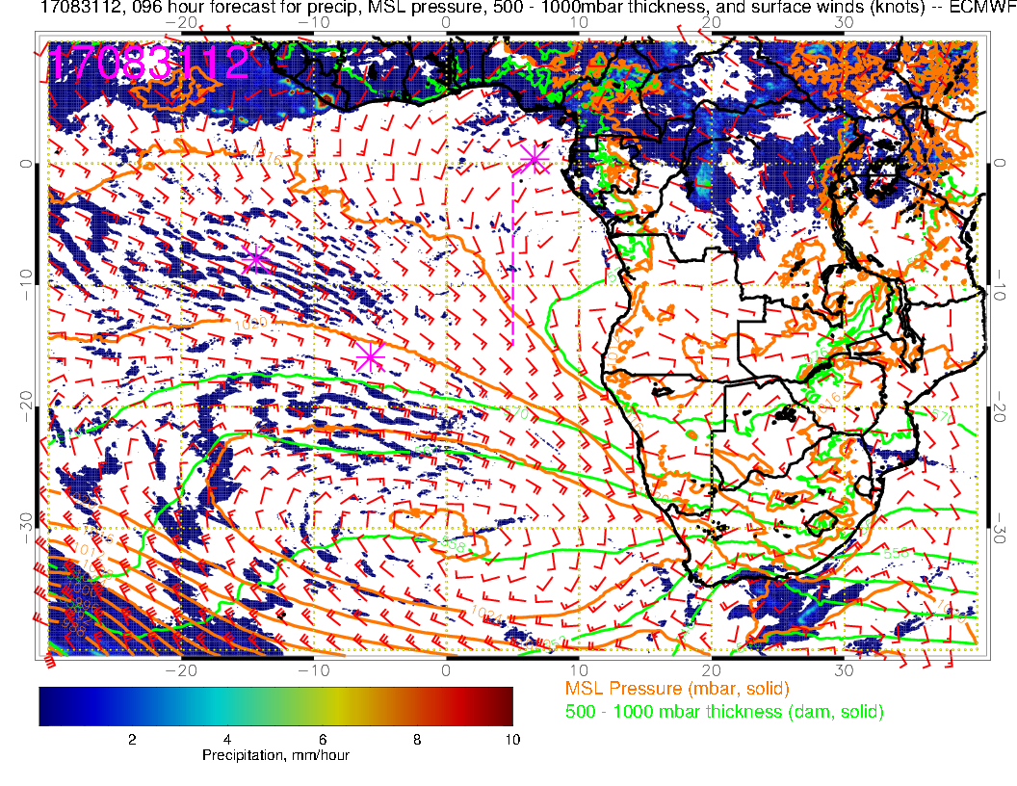
Thursday (F): Winds anomalously westerly near TMS. Getting the two foci of convection again (central Africa and West Africa). Southern Atlantic winds are slightly stronger than typical.

Slide 23
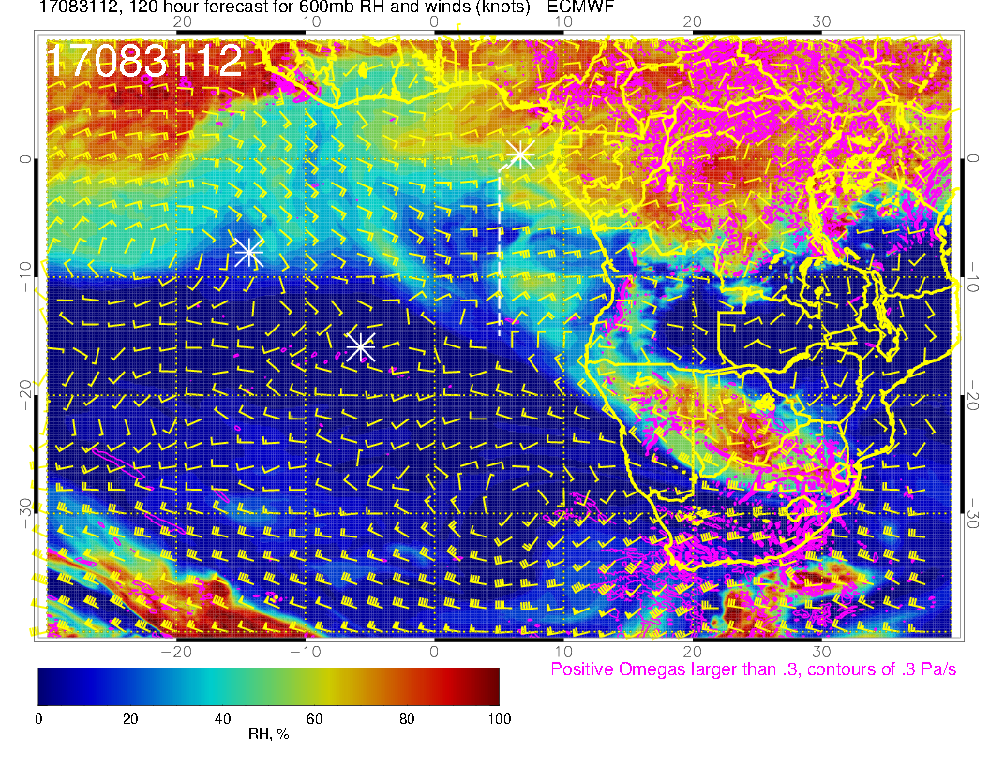
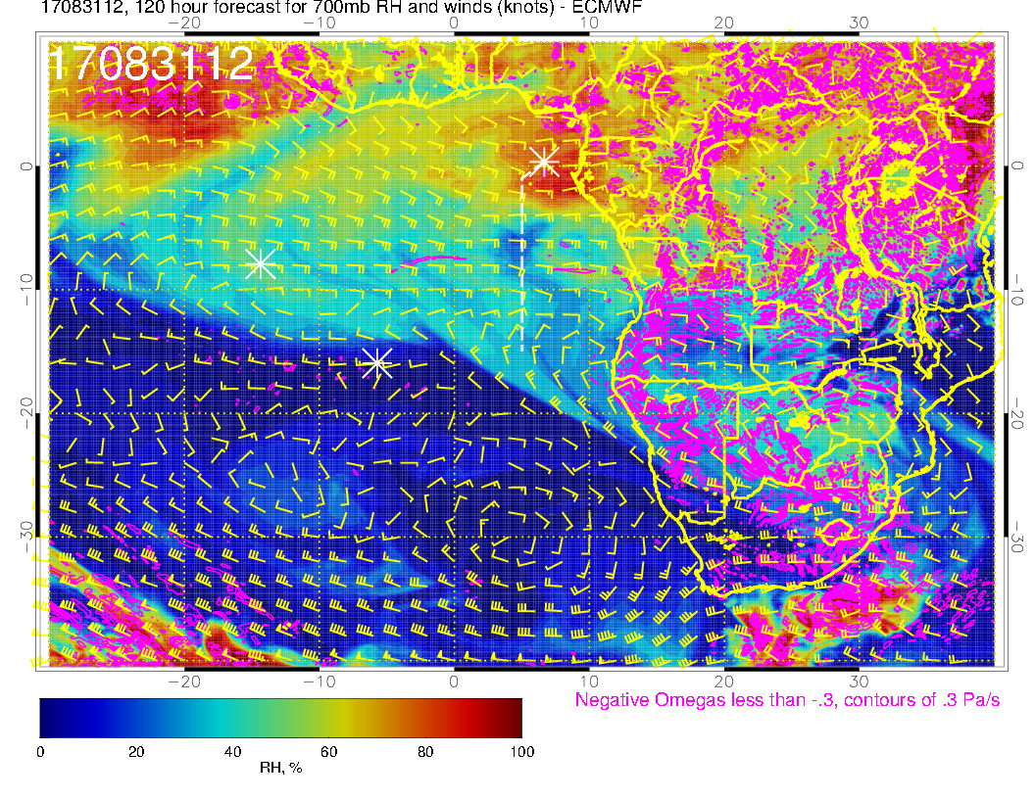
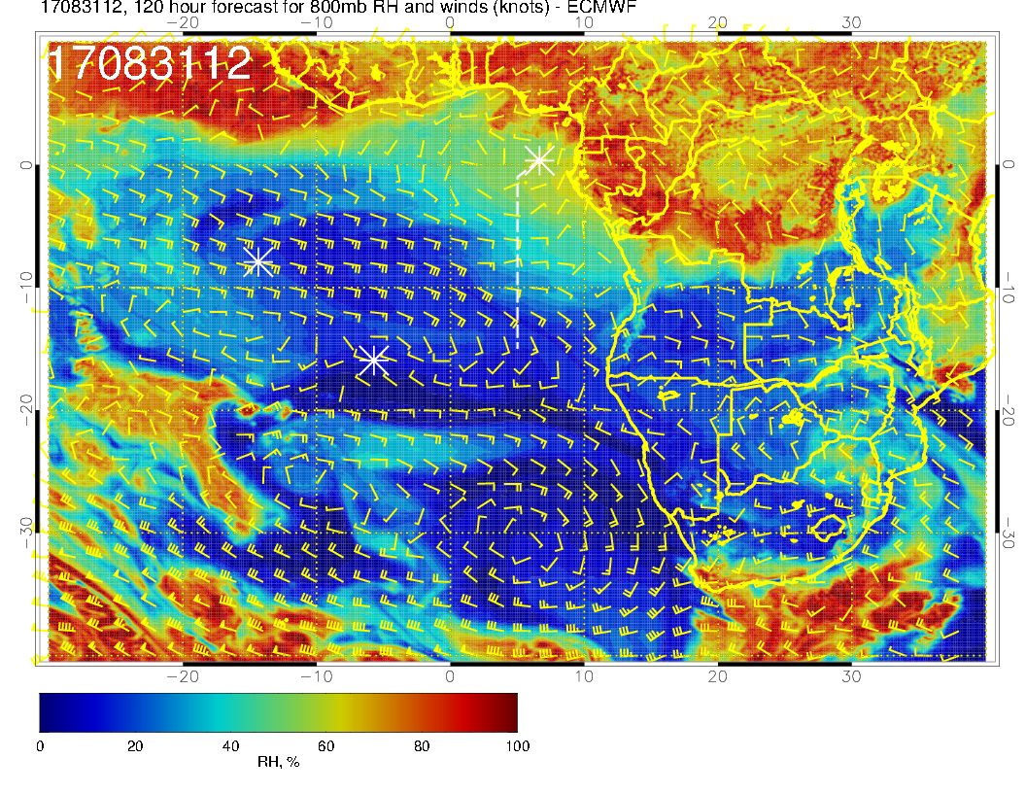
Old forecast

Slide 24
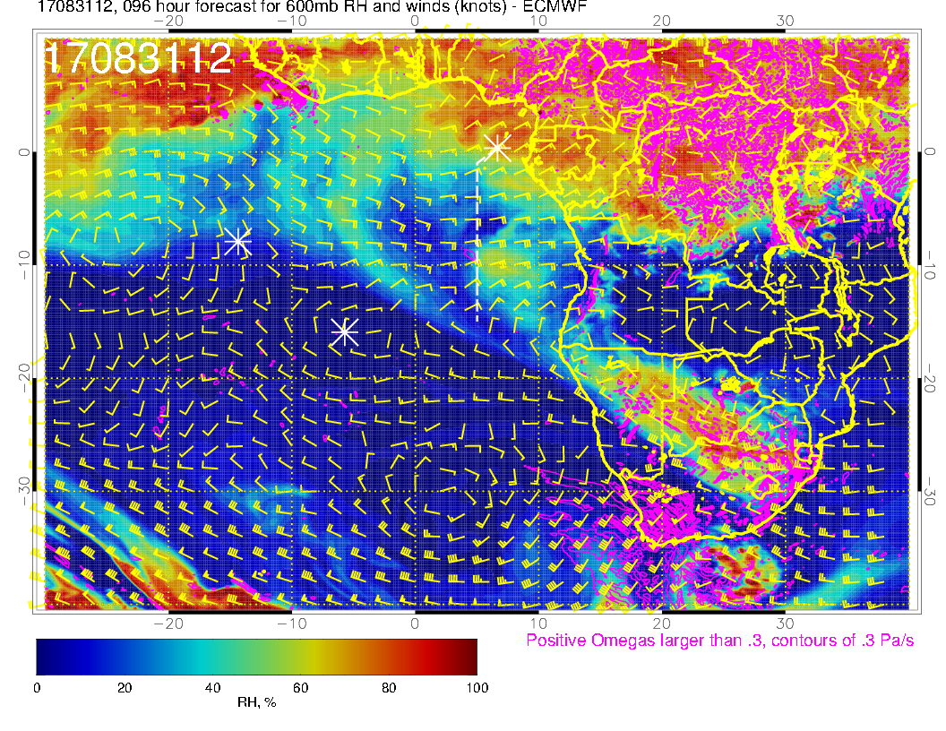
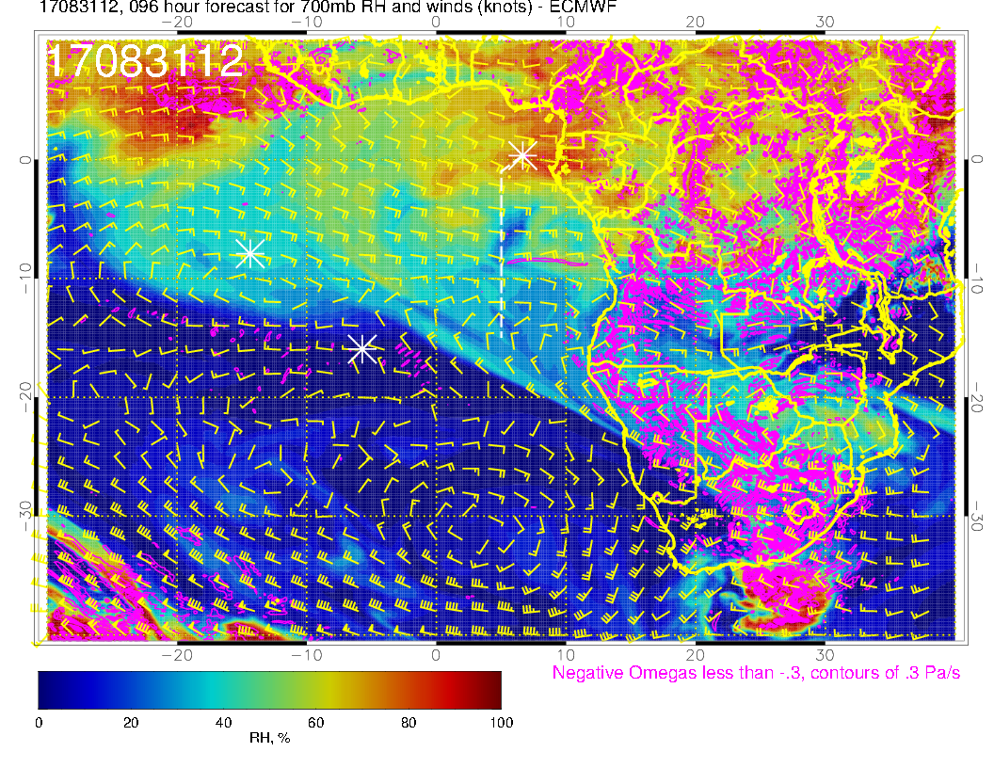
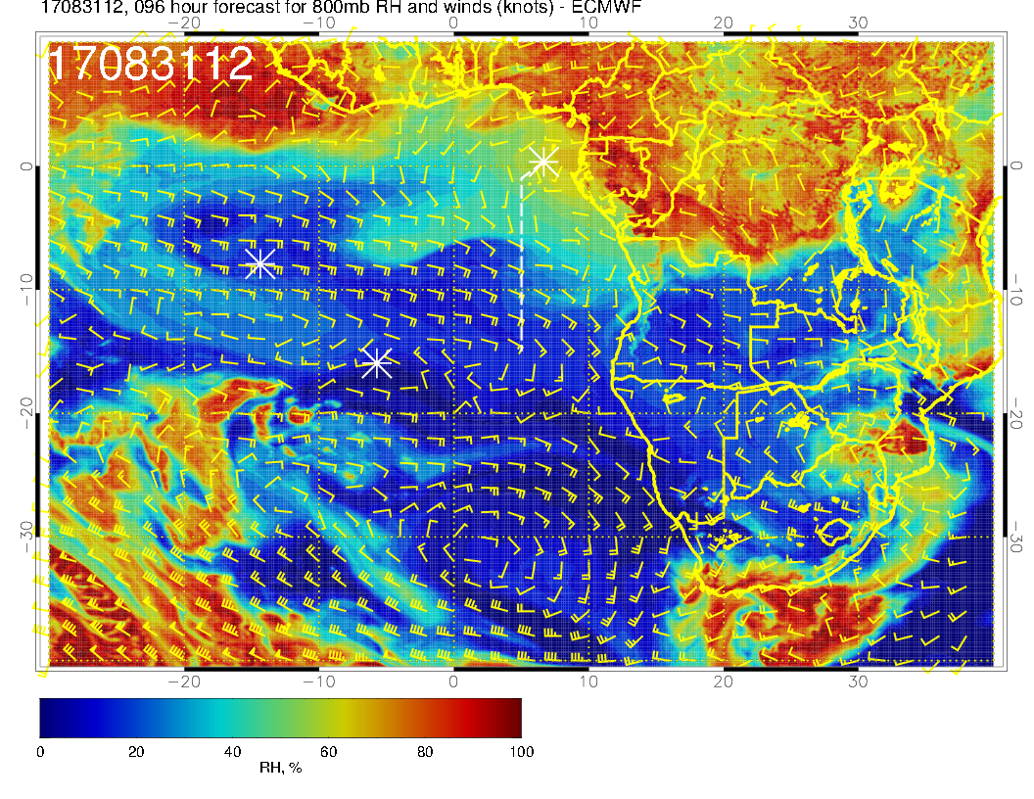
Mid levels for Thursday. Zonal pattern, with most of the RH features fairly washed out. Perhaps the biggest change from the old forecast is the better developed clockwise circulation near TMS at 800mb, and the overall more zonal pattern at 800mb. The dry convection blob of moisture at 600mb is pretty much in the same position.

Slide 25
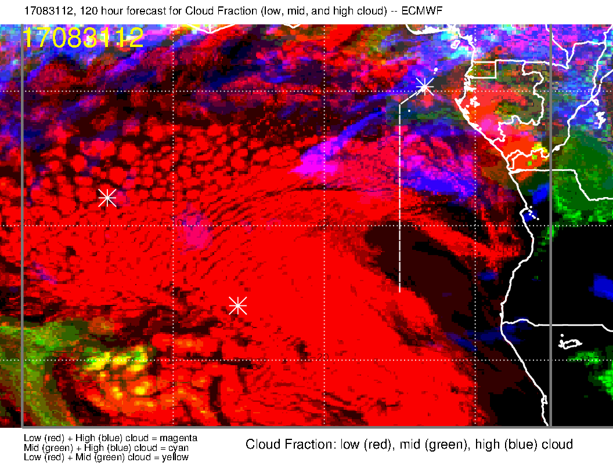
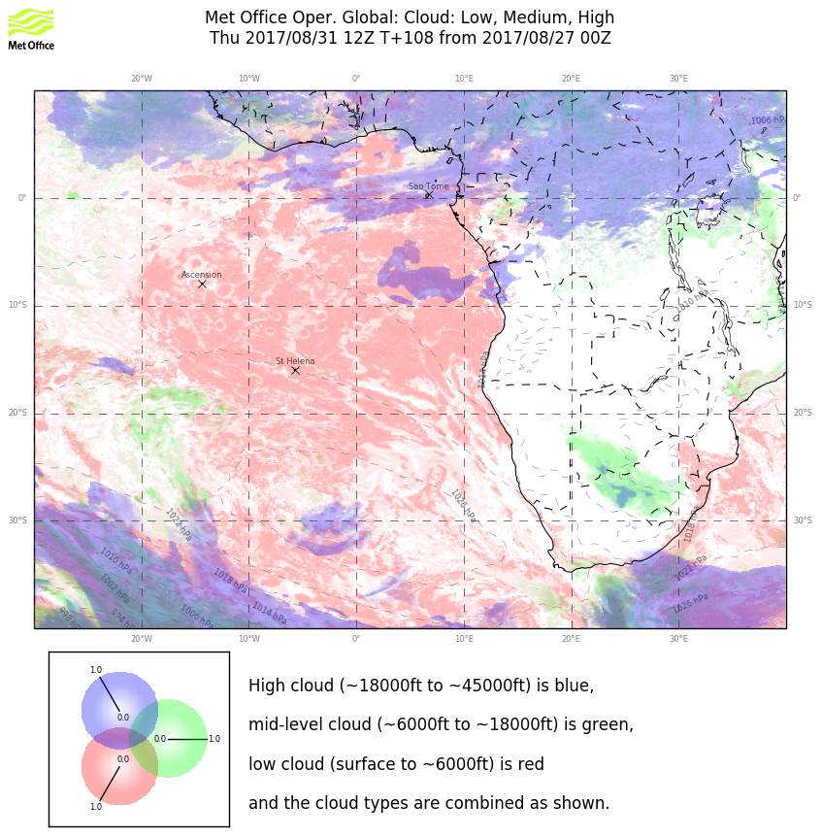
Old forecast

Slide 26
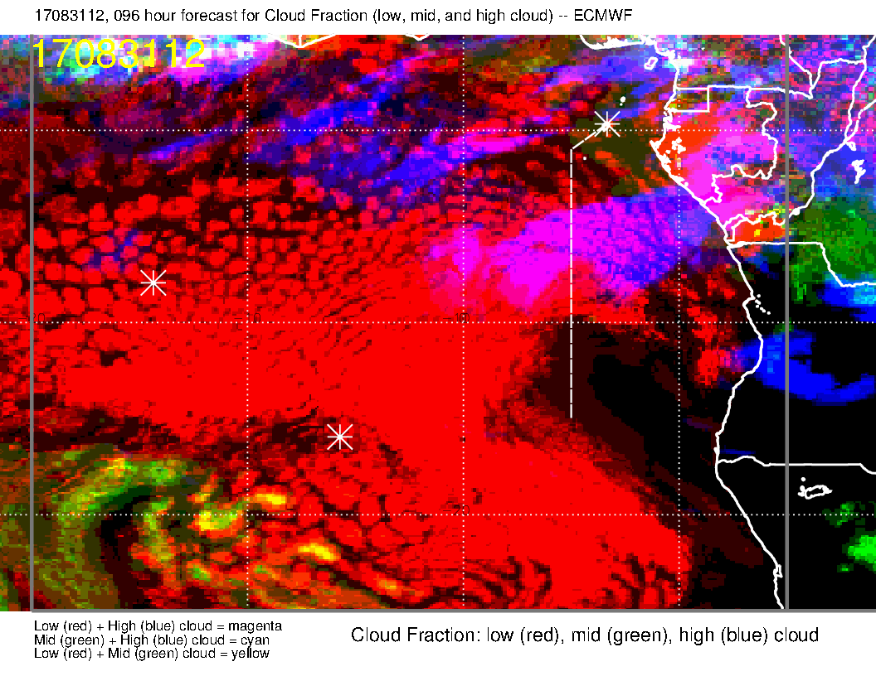
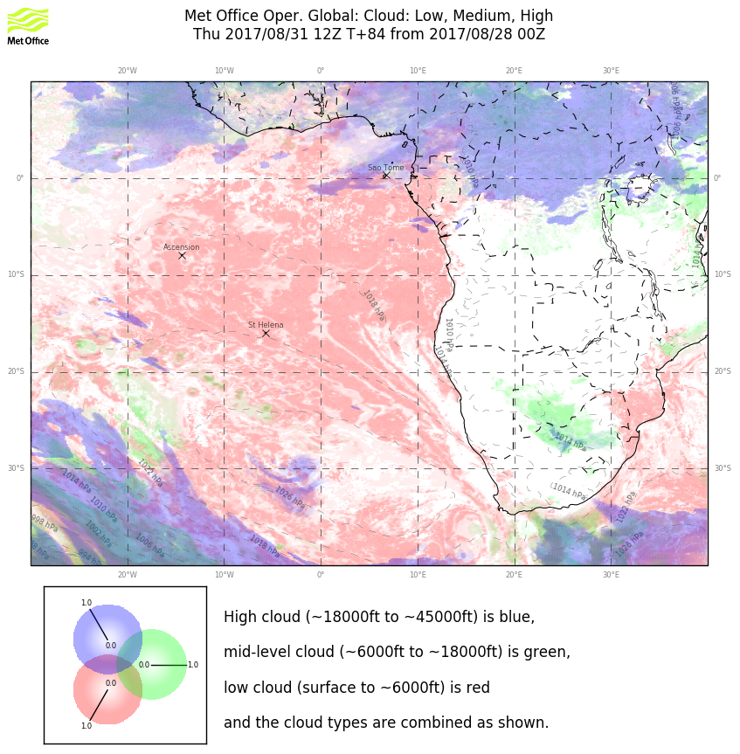
Models do not agree, and neither model has forecast consistency in the high clouds with
Yesterday’s forecast.

Slide 27
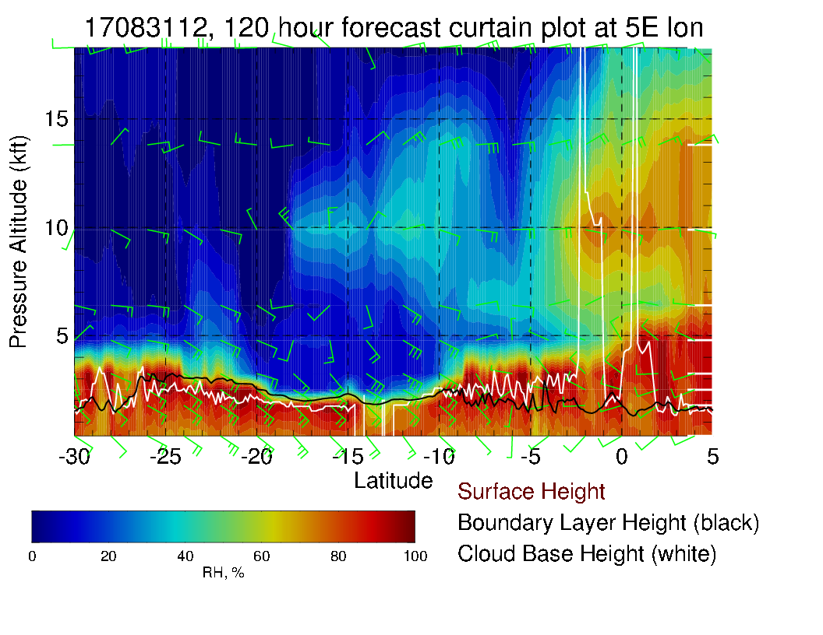
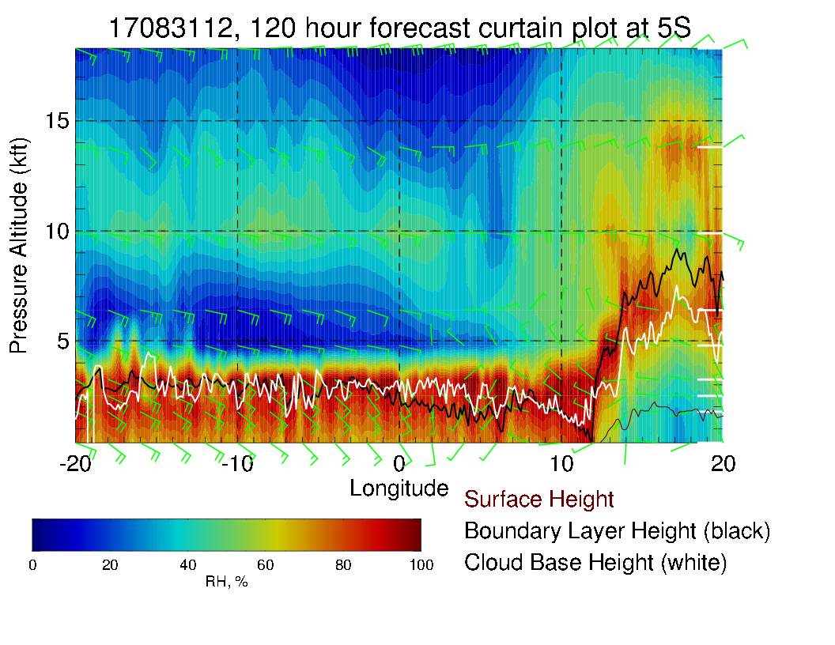
Old forecast

Slide 28
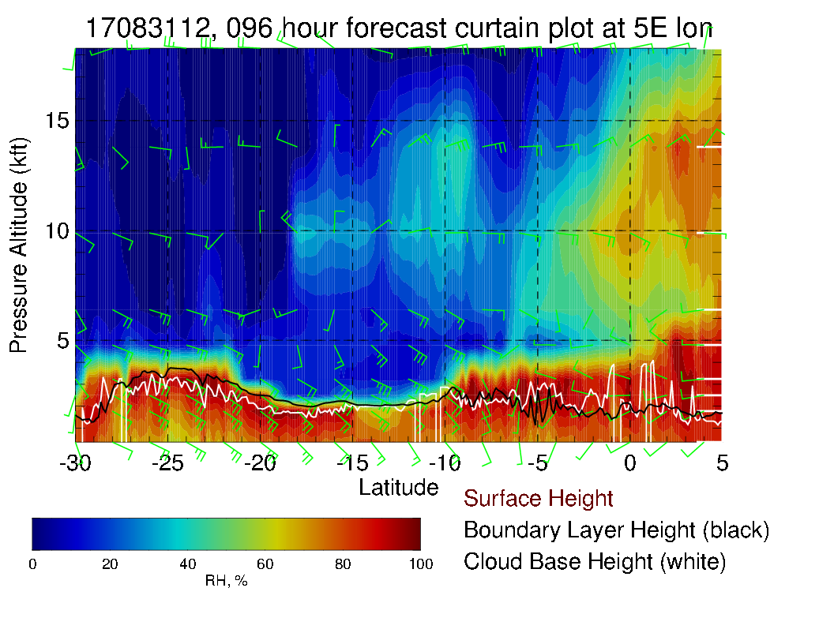
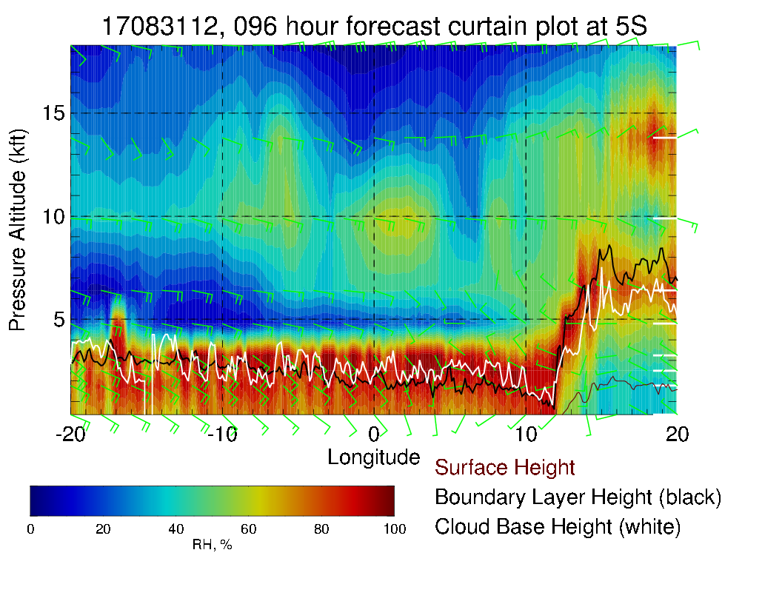
Since RH pattern is not particularly strong, changes are not particularly notable. Surface winds are weak until you get to 10S. Still a notable zonal pattern in the 600 and 700mb winds, which are easterly up to 25 knots. Weak winds at 800mb along the routine track.

