Slide 1
Early Briefing, 20170828

Slide 2
Cirrus for today, 8/28

Slide 3
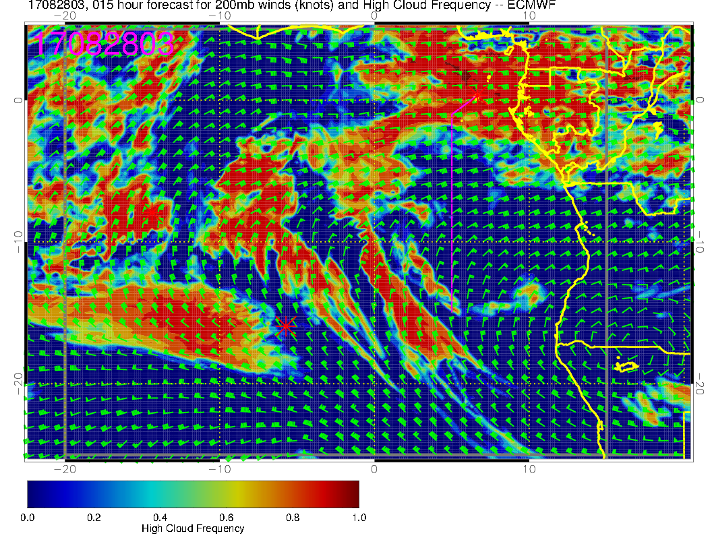
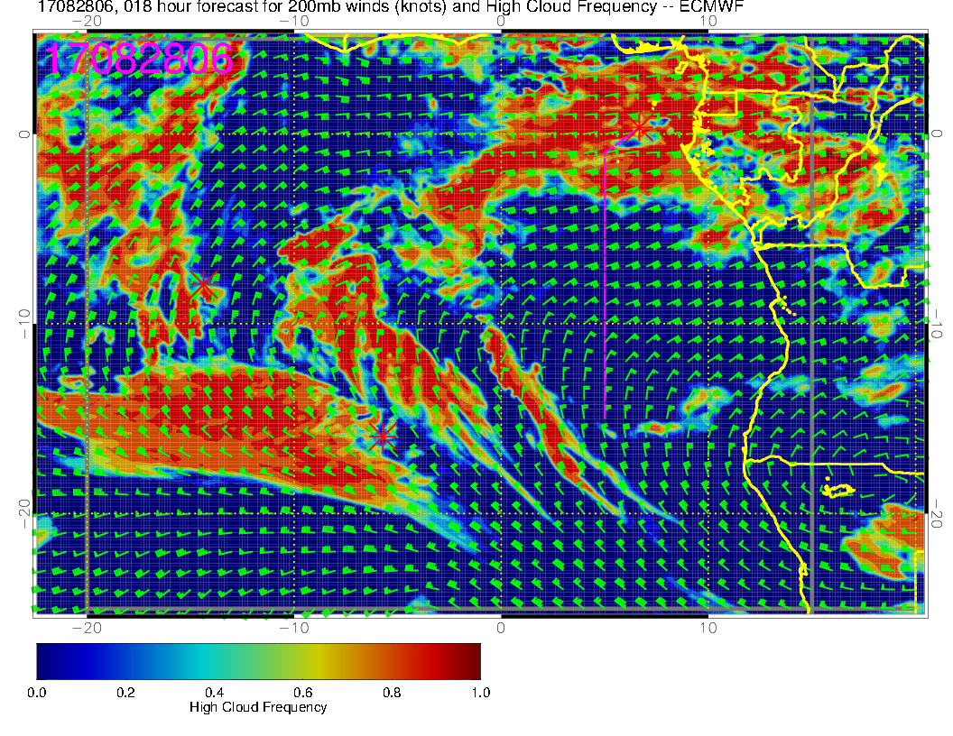
Evolution of forecast from 3 AM to 3 PM today for high clouds, ec

Slide 4
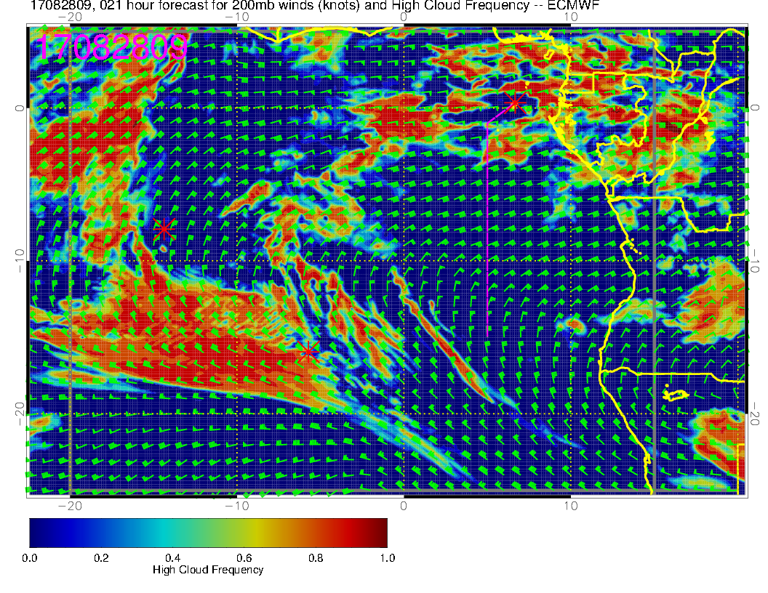
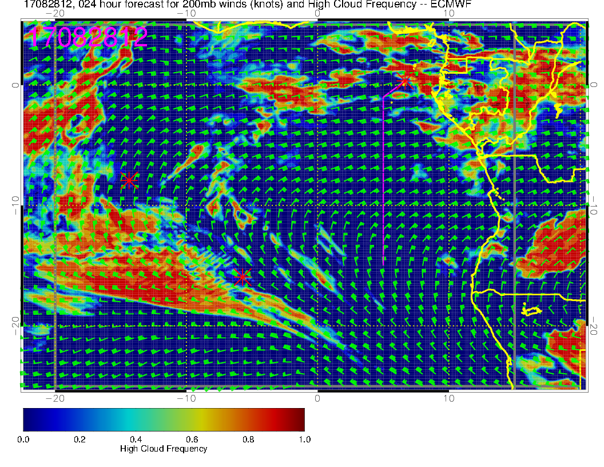
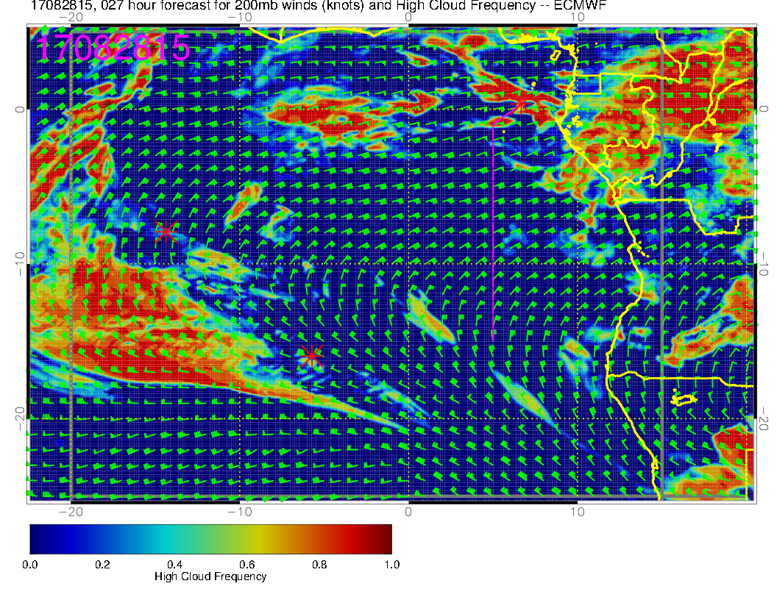
Forecast indicates that a gap is opening up and then will close late in the flight. Note that sun reaches its lowest zenith angle at about 1130 GMT at these longitudes.

Slide 5
High cloud Forecast reliable at this stage Not getting all the fibers

Slide 6
UKMO; is more generous with the cloud. Covering all the fibers and then some

Slide 7
Forecast from UKMO quite consistent with EC in cirrus intrusion approaching around
3 PM.

Slide 8
Low cloud

Slide 9
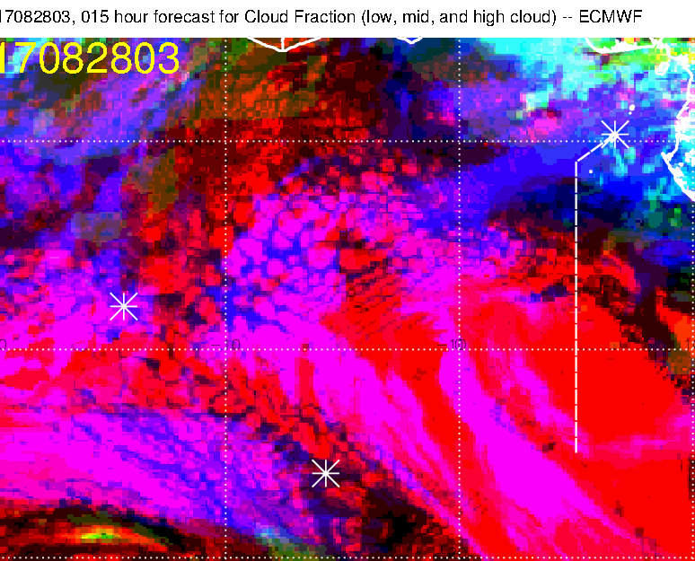
Forecast reliable at this stage. Low cloud front in sort of about the right spot.

Slide 10
Cloud front retreating at about a degree in 4 hours at this time. (later picture
on left).

Slide 11
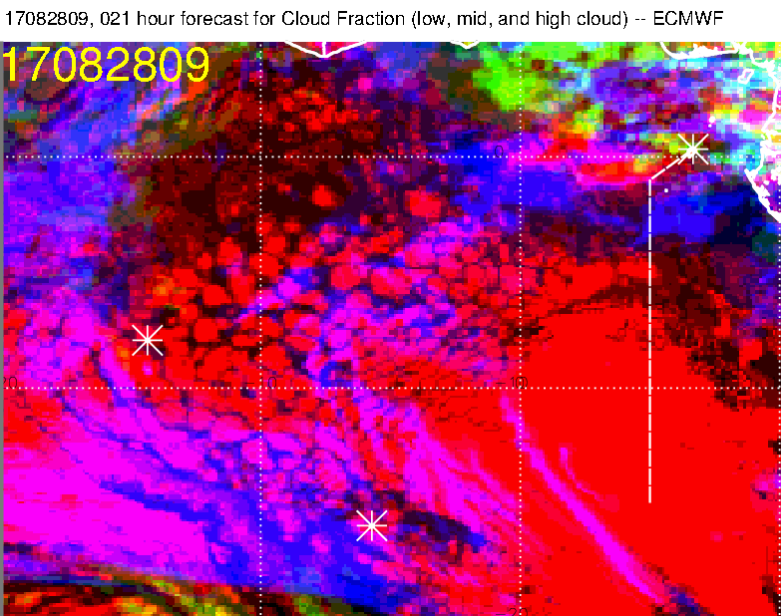
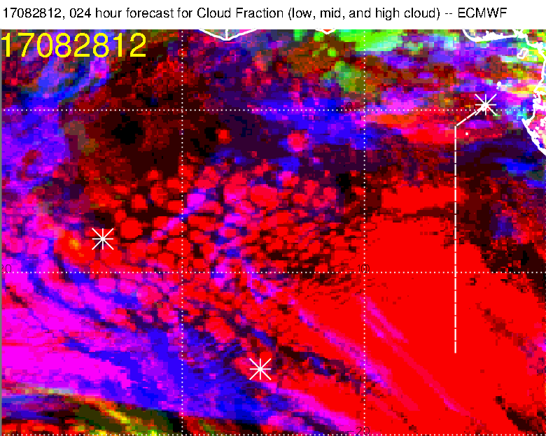
Model does not forecast a lot of
cloud clearing, though. There is
some, mostly from the east.

Slide 12
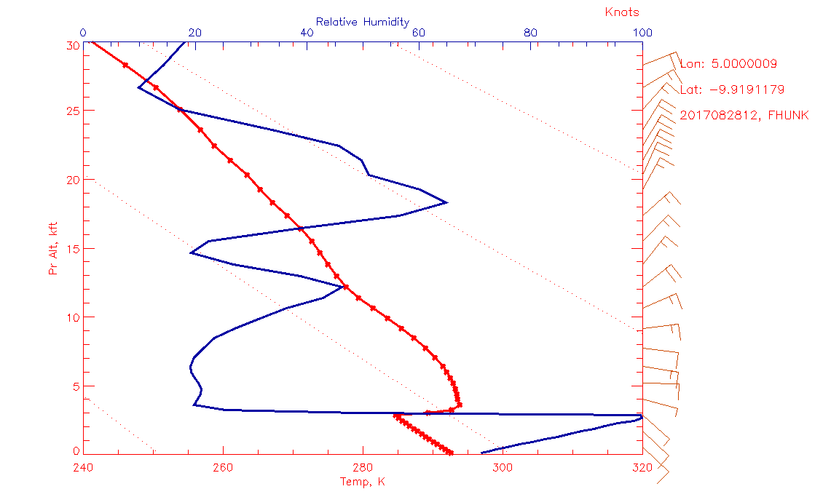
How’s about that? Dry convection “element” at 10S?

Slide 13
Other days for rad run?

Slide 14
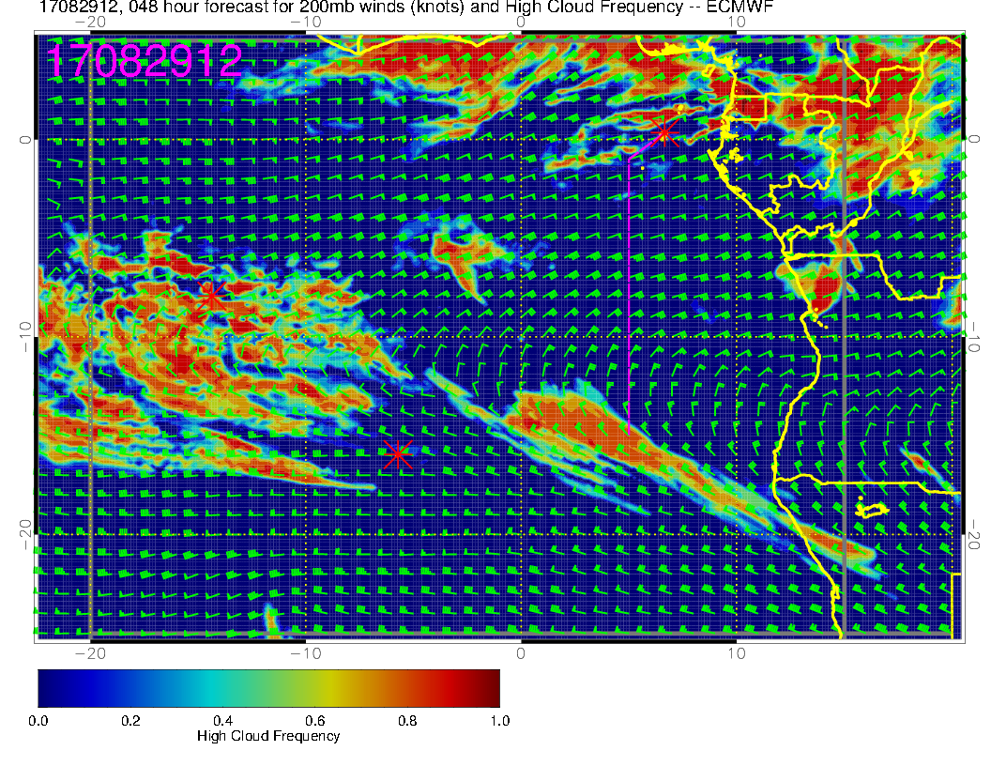
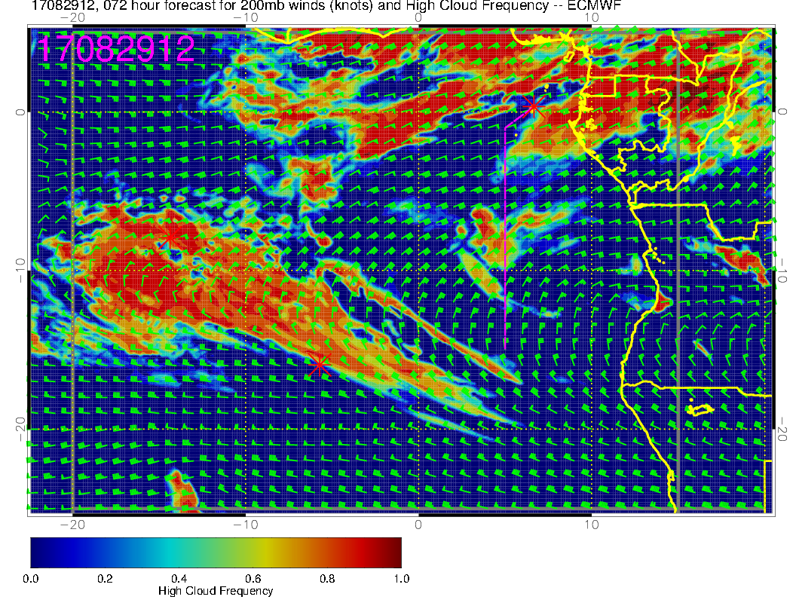
TOMORROW’s cirrus forecast.
NEW
Note quite a change from 48 to 72 hour forecast for tomorrow. No shift recommended (it’s about as good as today). Plume lifetime opportunity is really much too good to make a change.
OLD

Slide 15
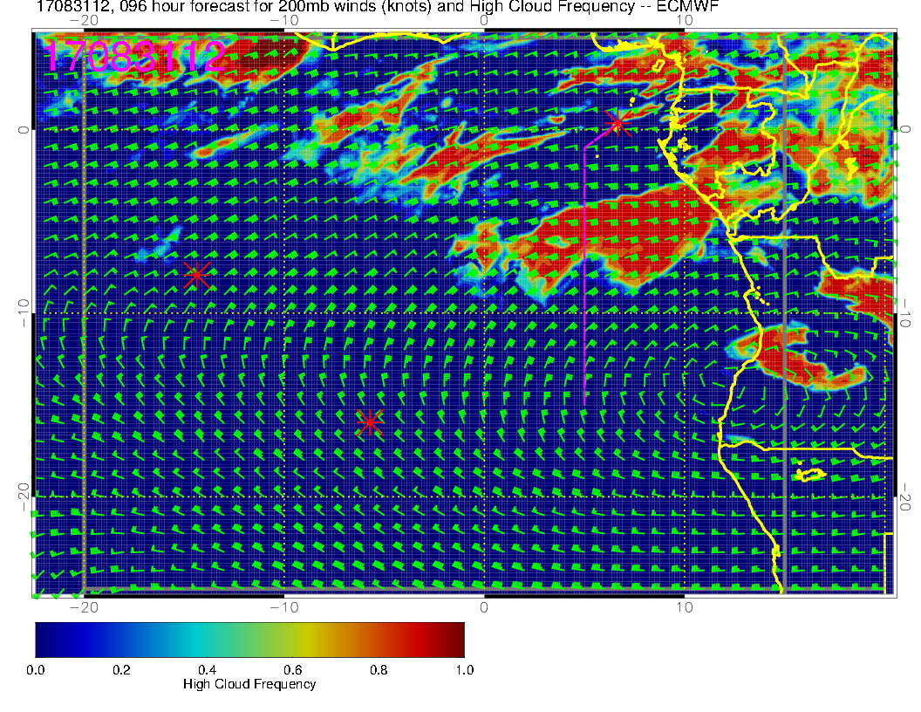
Forecast for Thursday. Not good, but could change. 48 hour fcsts were stable (that is, they did not change a huge amount as forecast times got shorter than 48 hours). At this point, however, Thursday is not good for radiation flight.

Slide 16
Latest satellite imagery

Slide 22
