Slide 1
ORACLES weather briefing
27-Aug-2017
Lenny Pfister and Rei Ueyama

Slide 2
Surface evolution 8/26-8/31

Slide 3
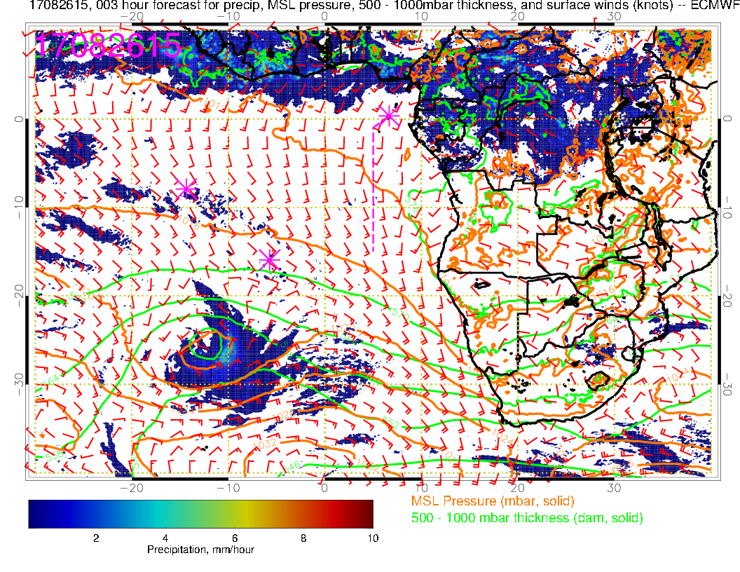
Yesterday (F): Surface winds similar to yesterday’s run, less convection in the African interior, but some further south in the Congo.

Slide 4
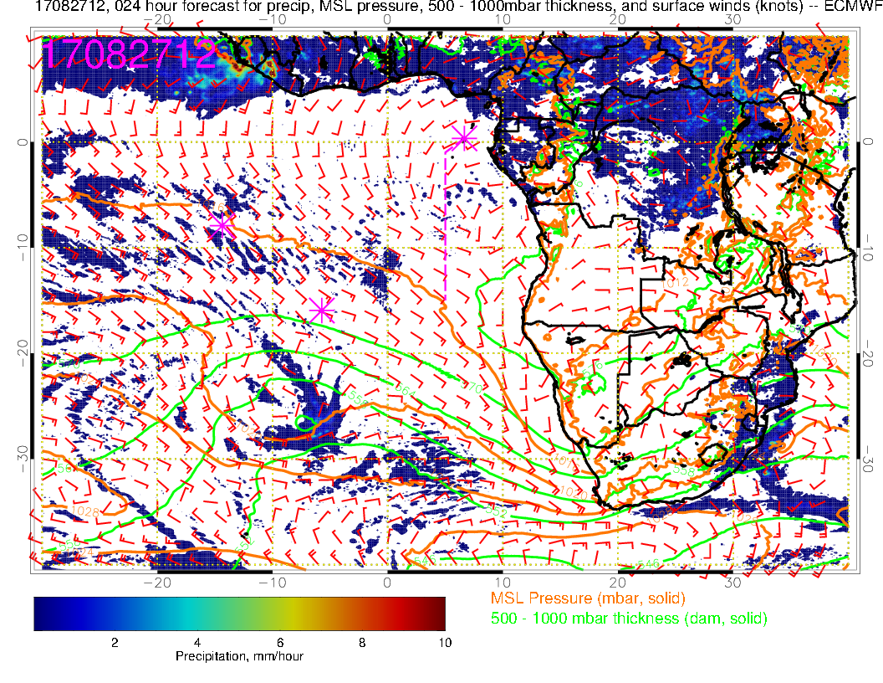
Today (NF): Some change from yesterday’s run. Weak winds over much of SE Atlantic the same. Congo convection is much less than yesterday, instead shifted further east. Surface winds in tropics are aiming at two loci of convection – Congo/east central Africa and off of west Africa. SH high displaced far south.

Slide 5
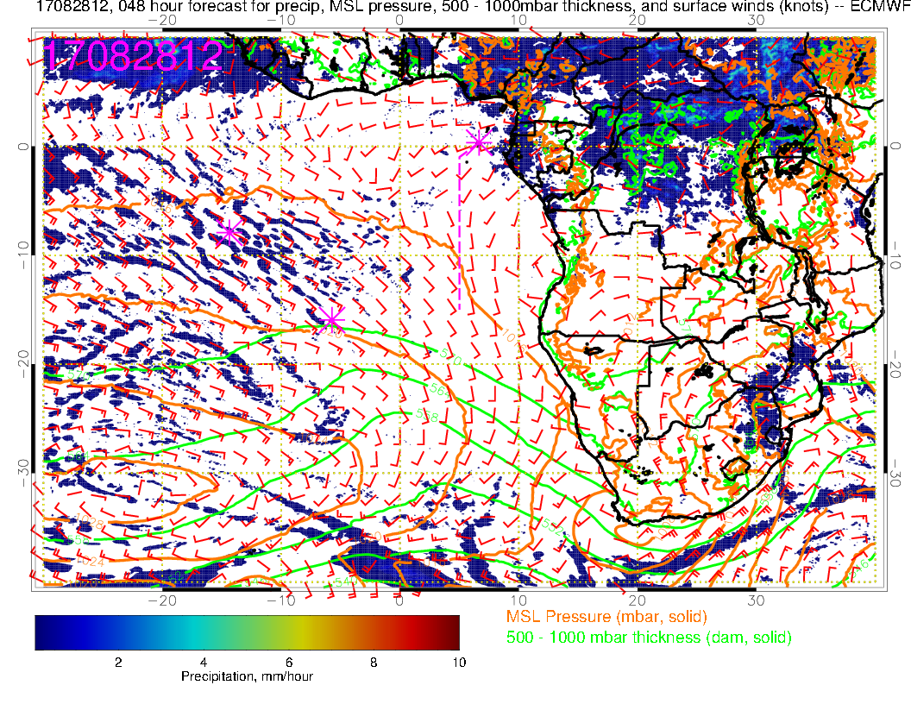
Tomorrow(F): Still weak winds as SH high reforms to the west. Again, tropical surface winds aim to Congo/east central Africa and off of West Africa. Near westerlies (weak) again at TMS. FCST consistent

Slide 6
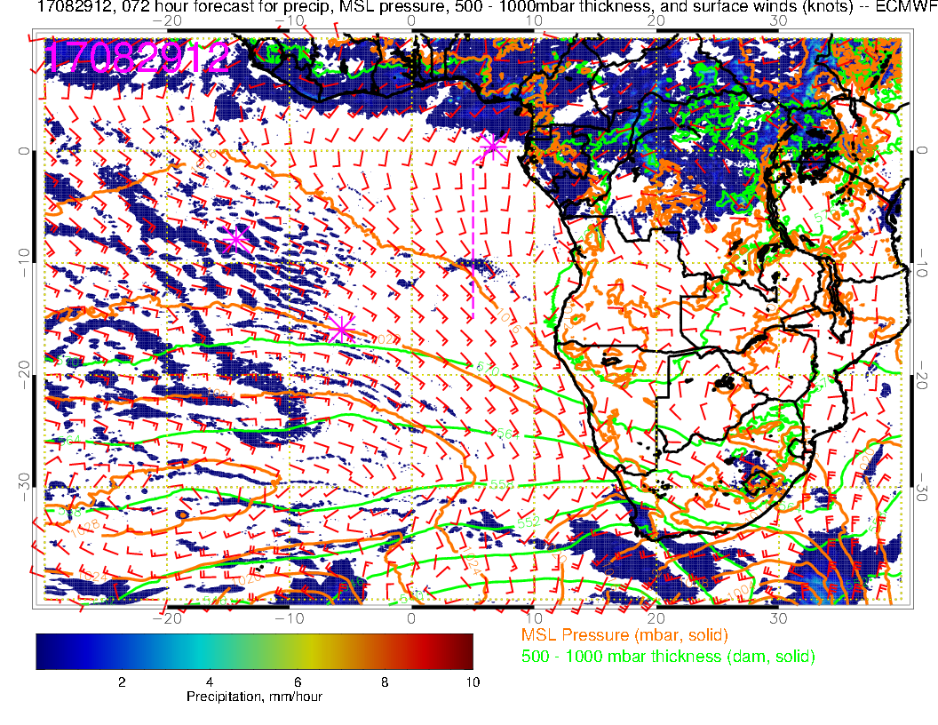
Tuesday (F): Some deviations from previous fcst start to appear. SH high moving more rapidly eastward in new forecast. Curve westward in winds north of TMS is not as strong. More convection in Congo region again, less in Nigeria and southern Sudan.

Slide 7
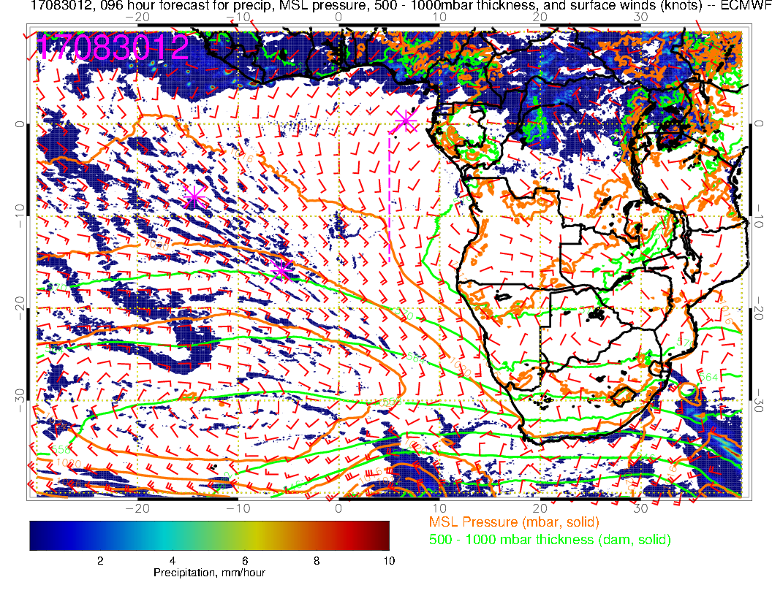
Wednesday (NF): Hardly any change in the winds or the convection from previous forecast. A little less off the African coast just north of us and some minor shifts in central Africa. Start to see some definition in the convection. Winds weaken in our region and start to turn more westerly from prvs day

Slide 8
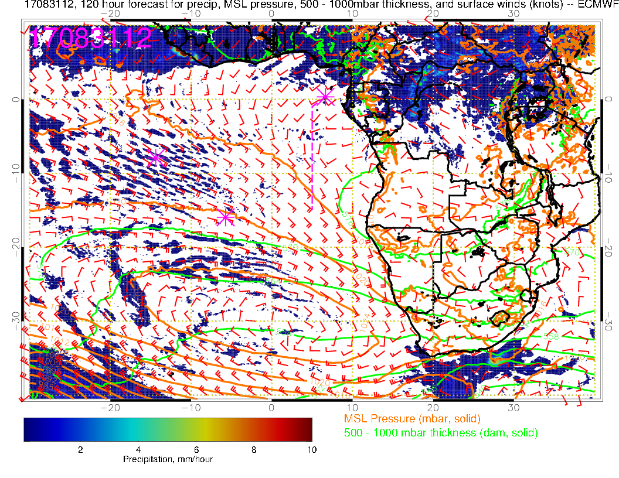
Thursday (F): Winds turn even more westerly. I don’t think Central African convection is getting stronger, rather convection north of us (Nigeria) is getting weaker. Getting the two foci again (central Africa and West Africa)

Slide 9
700mb evolution 8/26-8/31

Slide 10
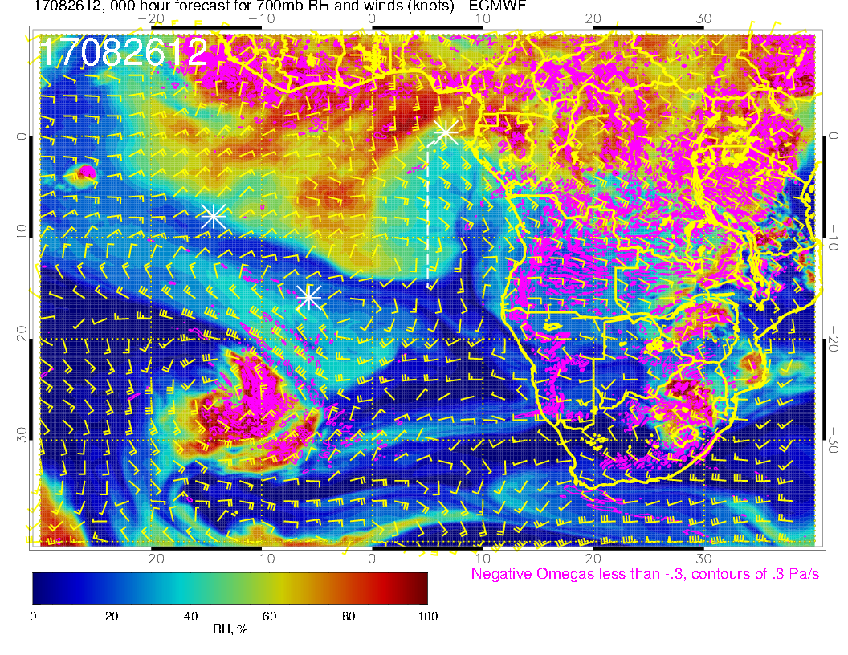
A
A
A
Yesterday (F): Forecast consistent with yesterday’s in drying out our region at midlevels. Anticyclone advances westward, bringing southeasterlies (and drier air, some descent).

Slide 11
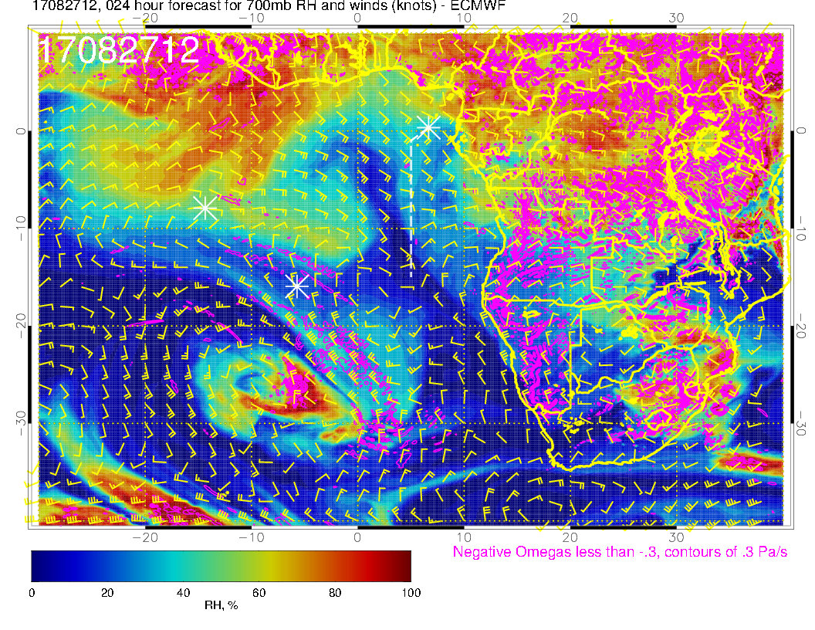
A
A
Today(NF): Flow becomes more zonal at the shore as anticyclone moves westward. Progression of dry air north of anticyclone is more rapid than yesterday’s forecast, environment east of routine track is also drier than yesterdays fcst.

Slide 12
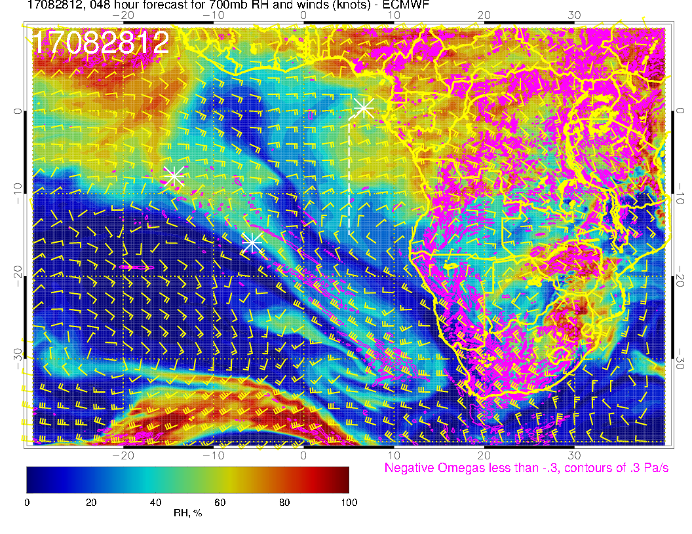
A?
A
Tomorrow (F): Flow becomes zonal over our region, continued dry (but note beginnings of moisture coming from the east, which is more advanced than yesterday’s forecast.

Slide 13
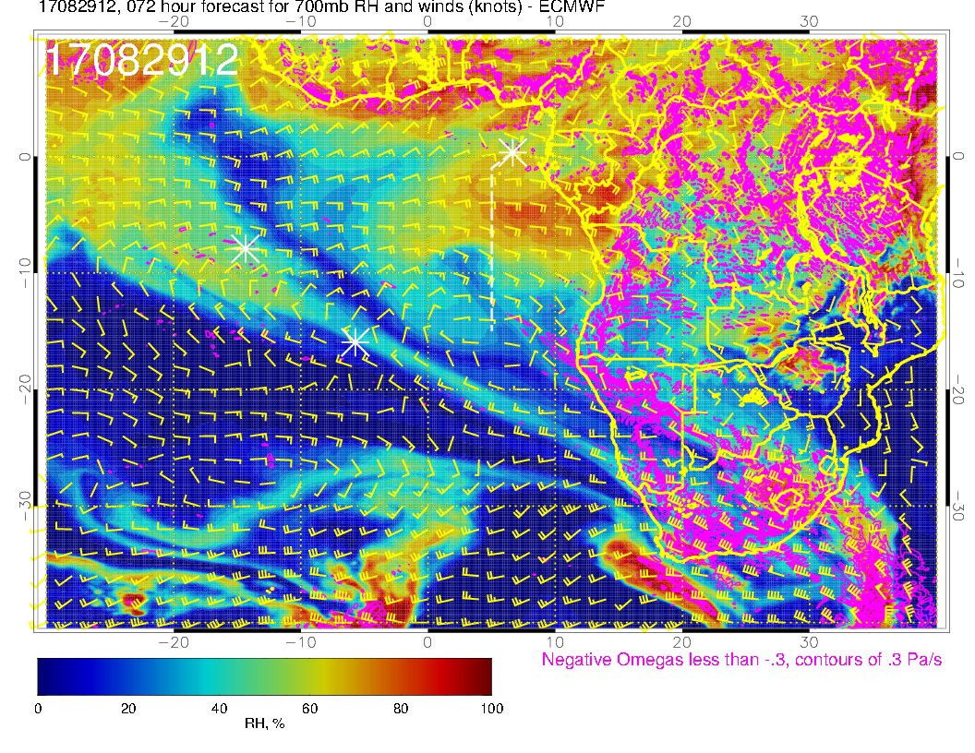
A
A
A
Tuesday(F-BB): Flow zonal over our region, moisture intrusion from the east over us, more intense than yesterday’s fcst (fcsts are progressively increasing this).

Slide 14
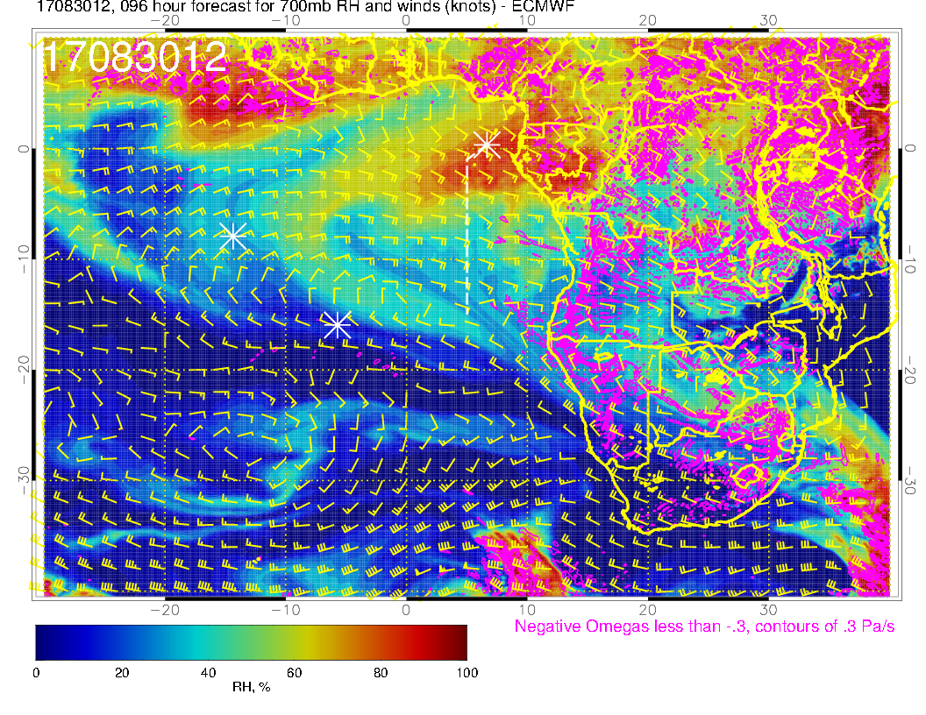
A
A
A
Wednesday (NF): Moist air intrusion moves northwestward with the winds (turned southeasterly from easterly north of 5S.

Slide 15
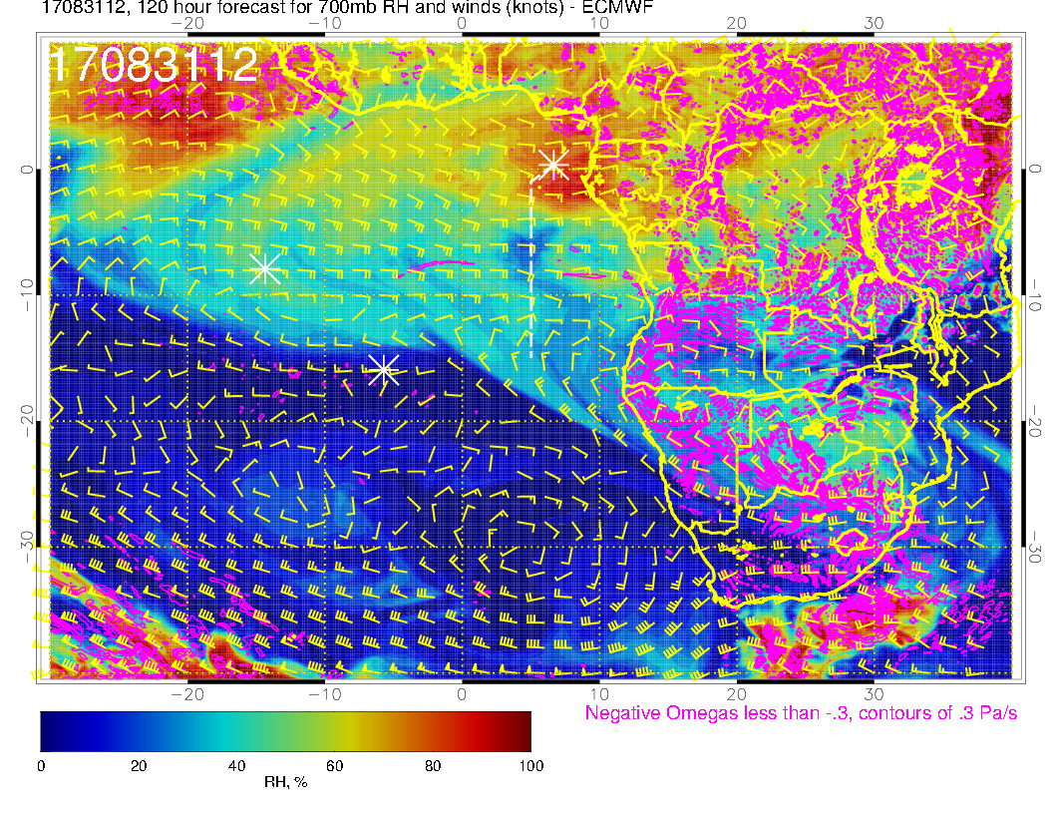
A
A
A
Thursday (F): Moist air intrusion is quasi stationary over us, flow is mostly zonal, but moisture streamer west of us rotates clockwise. No obvious movement of the anticyclones to the south. Disturbance north of us causing southeasterlies to progress to west

Slide 16
Monday

Slide 17
Tomorrow(F): Still weak winds as SH high reforms to the west. Again, tropical surface winds aim to Congo/east central Africa and off of West Africa. Near westerlies (weak) again at TMS. FCST consistent

Slide 18
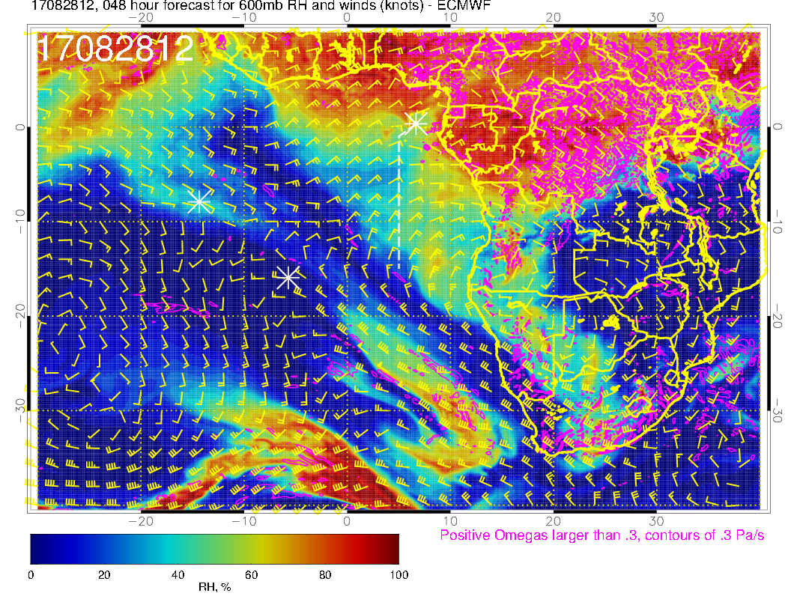
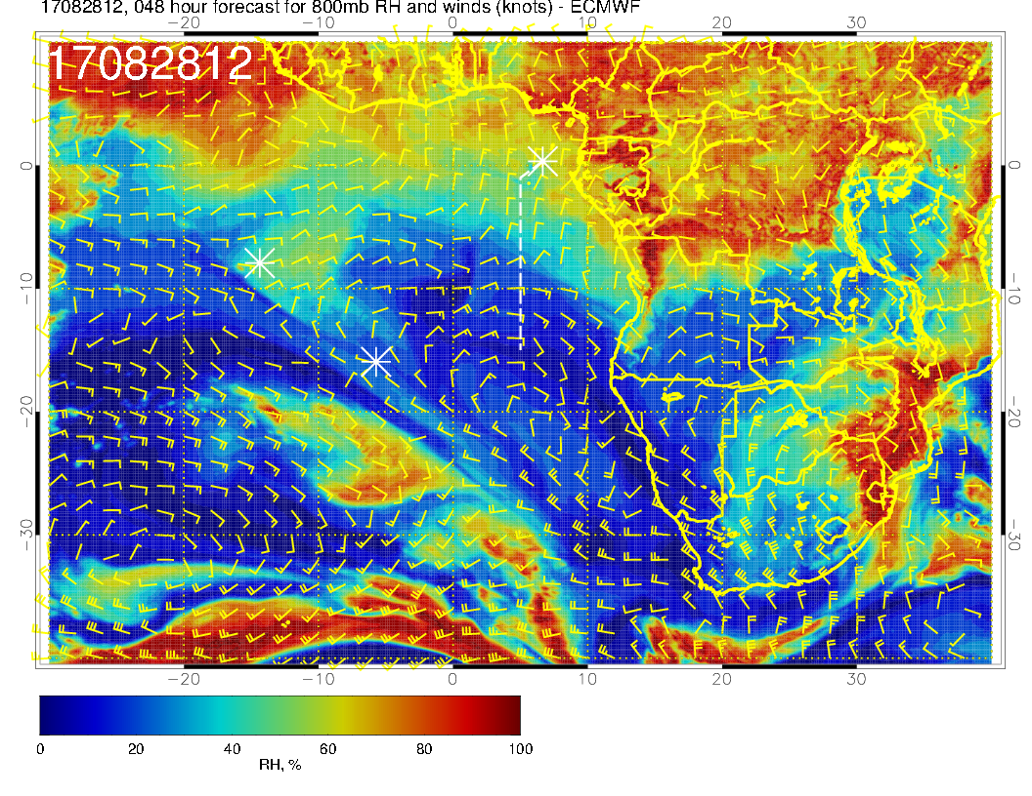
Mid level flow for Monday. We are on the east edge of a dry region. Flow quite zonal at 700mb. Moisture intrusion from north at 600mb. Also at 600mb, the moist air from 18S to 10S east of the routine track is probably from dry convection. 800mb (2 km) circulation has northerlies to 8S, bringing moderately moist air southward (as yesterday, too recent to affect BTs).

Slide 19
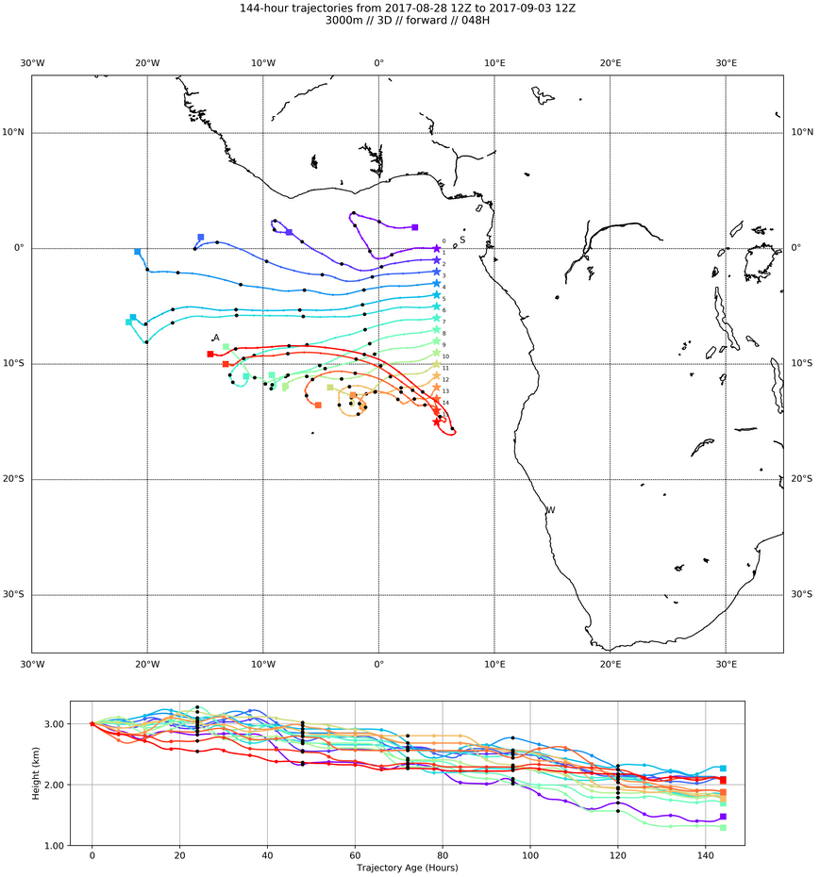
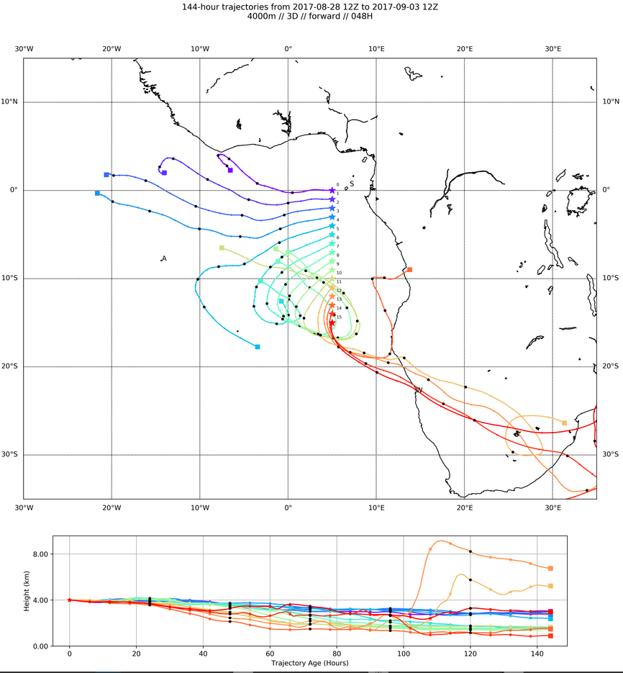
Forward trajectories at 700mb (left) and 600mb (right). Good zonal pattern
at both levels to about 7S (further at lower level)

Slide 20
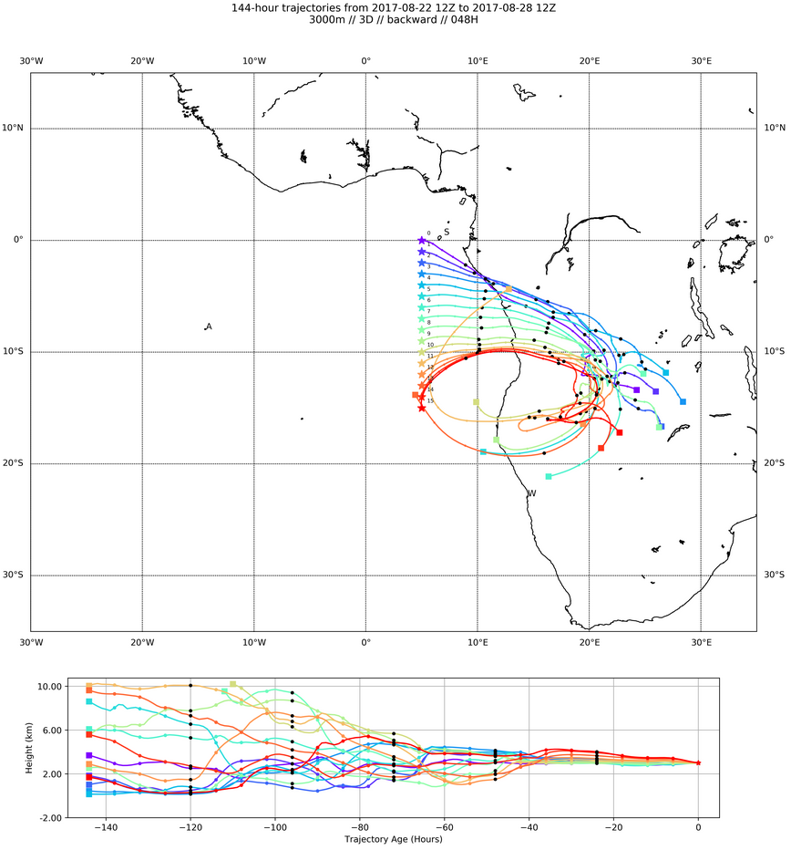
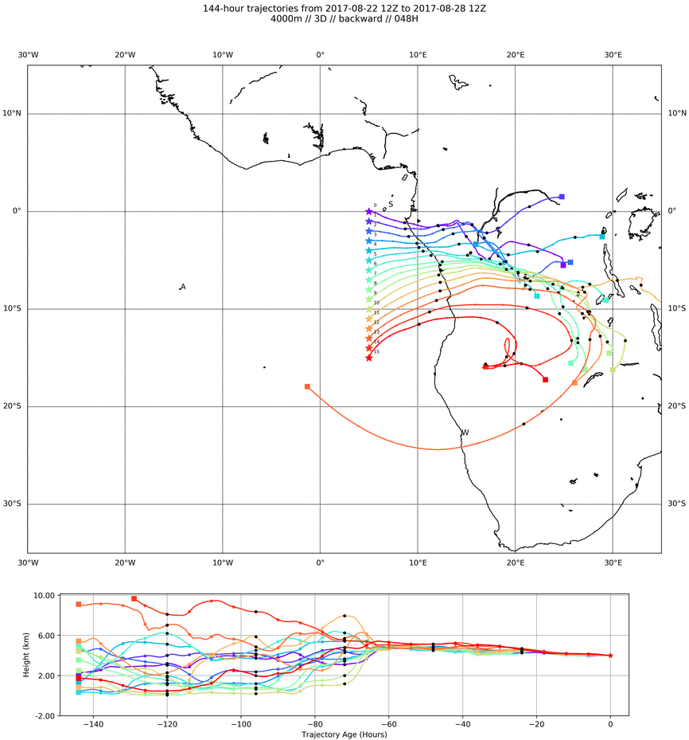
4 km
3 km
A
BTs at 700mb (3km, left) and 600mb (4 km, right). Expect some moist
processing in northern part, especially for 600mb parcels.

Slide 21
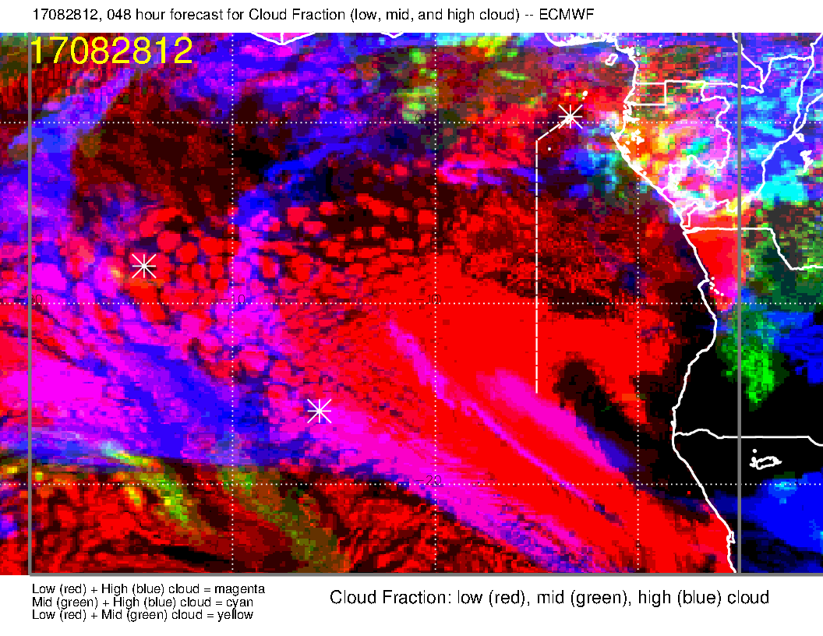
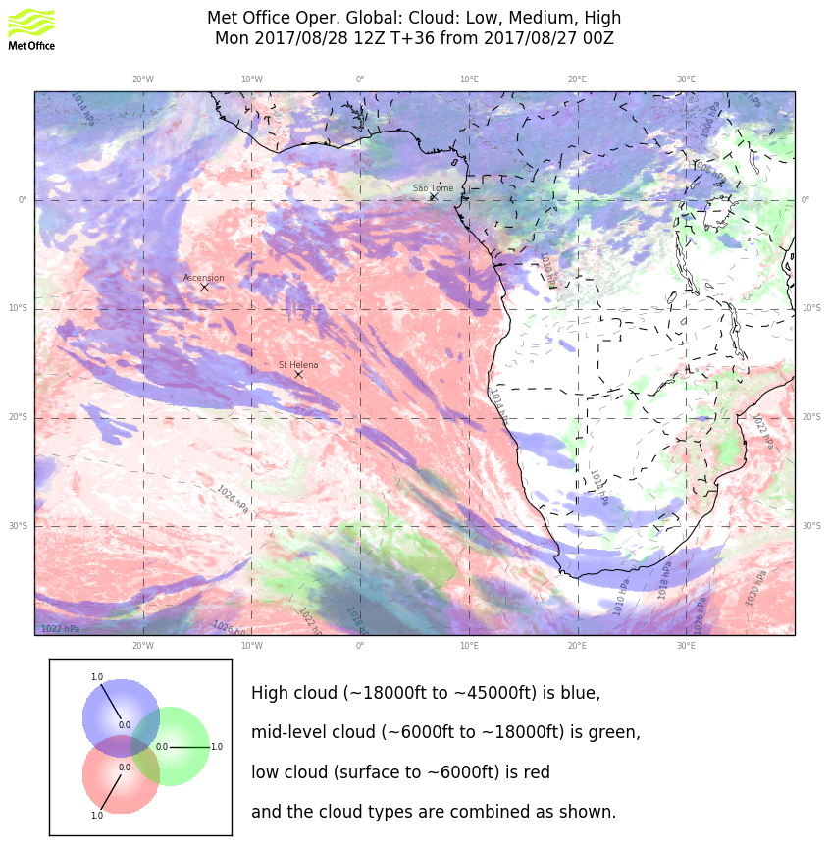
Some forecast consistency in the EC low cloud, with a shaft of enhanced low cloud extending northward as in previous fcst. Basically more cloud clearing than previous fcst
Model comparison for high clouds shows both models with the overall reverse comma shape. Quantity and coverage is very different. Both are clear south of 5S along routine track.
Mid levels are dry, and both models show no mid-level cloud except very near the coasts (north and east of our region)

Slide 22
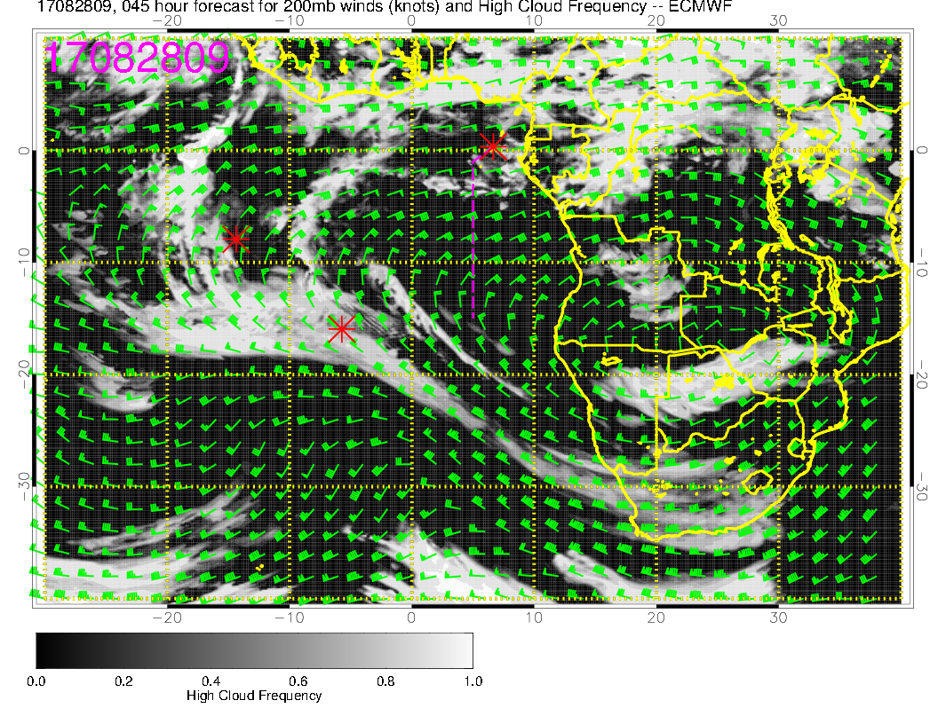
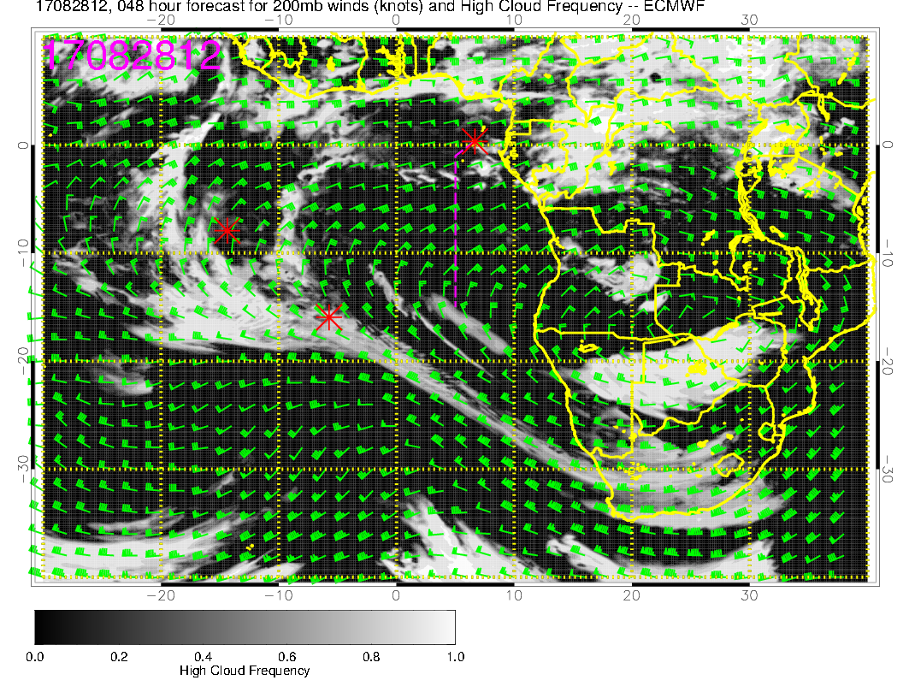
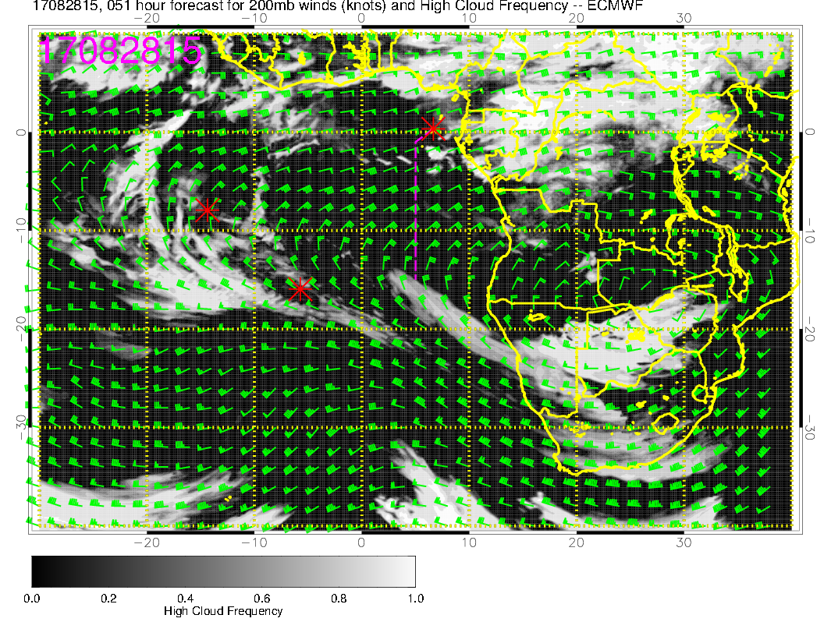
This could be one of the more favorable cirrus days, especially further south near 10S. Flow is more easterly than northeasterly, which is a bit better (less convection upstream. 200mb anticyclone is well-established, which was not the case earlier in the month when 200mb flow was often not directly off the continent (or had a southeasterly component).

Slide 23
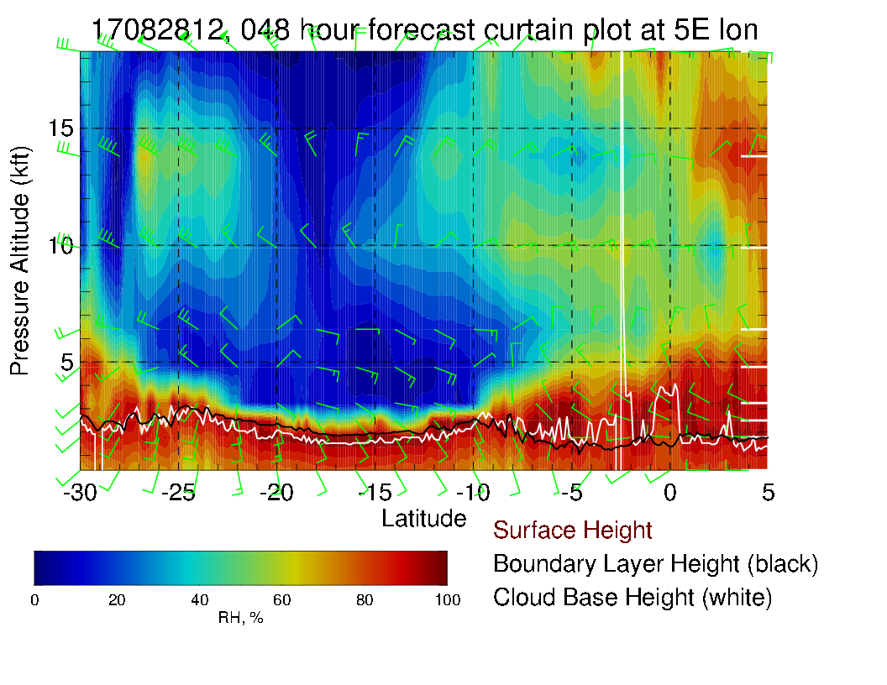
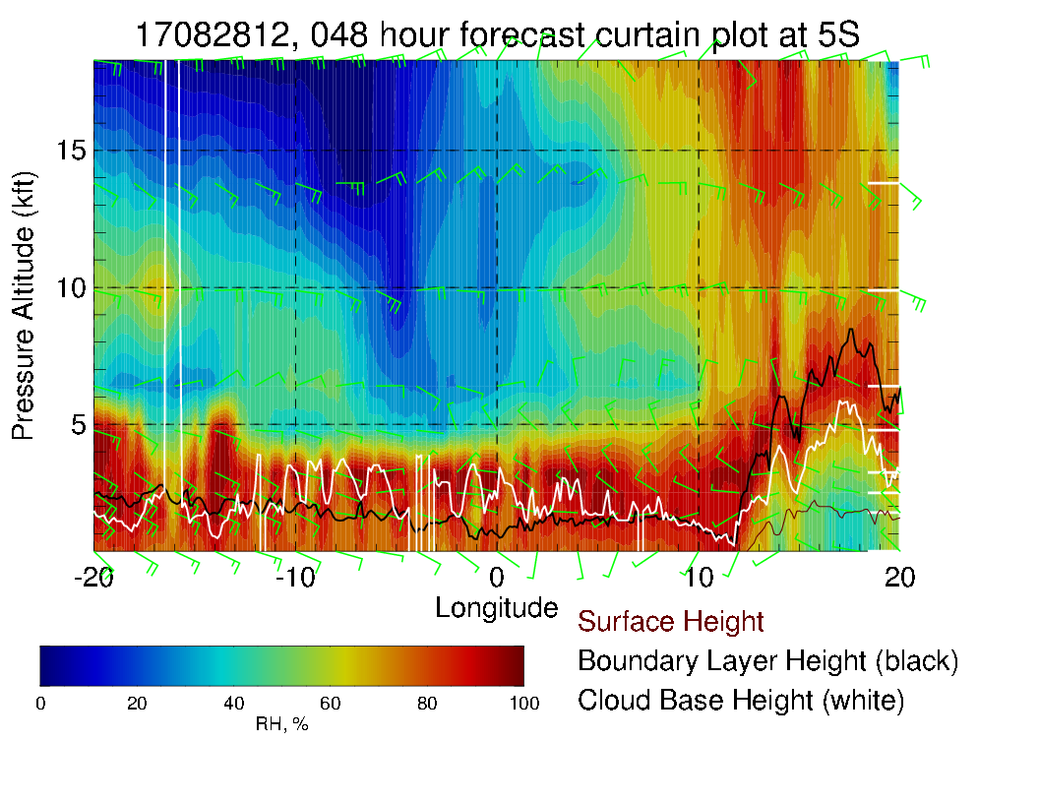
Routine track (above), shows mostly dry conditions. Easterlies at 25 knots at 3 km. Near south end, getting northeasterlies near 20 knots at 4 km, weaker northeasterlies at 5 km. Northerlies at 2 km to 7S. Weak surface winds. At 5S (left) can see dry air to west of routine track, some moisture intrusion from the east.

Slide 24
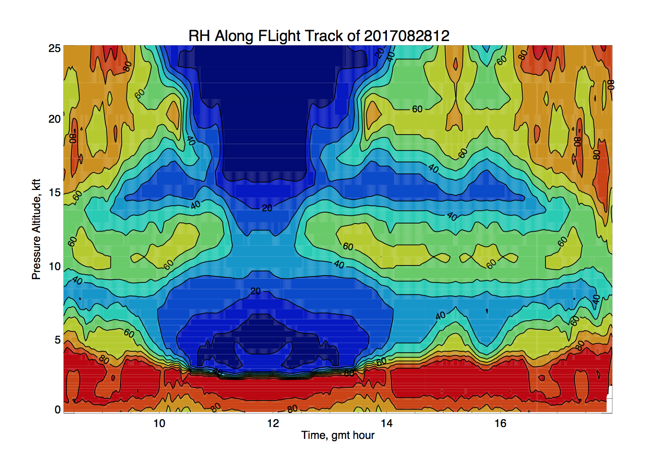
Routine flight plan time height RH contour plot to 8 km. Double RH structure with
max at about 600mb

Slide 25
Tuesday

Slide 26
Tuesday (F): Saint Helena high moving eastward toward climo position. Winds in SE Atlantic fairly typical (“average”). Some convection near TMS – focus appears to be southern Sudan and Congo

Slide 27
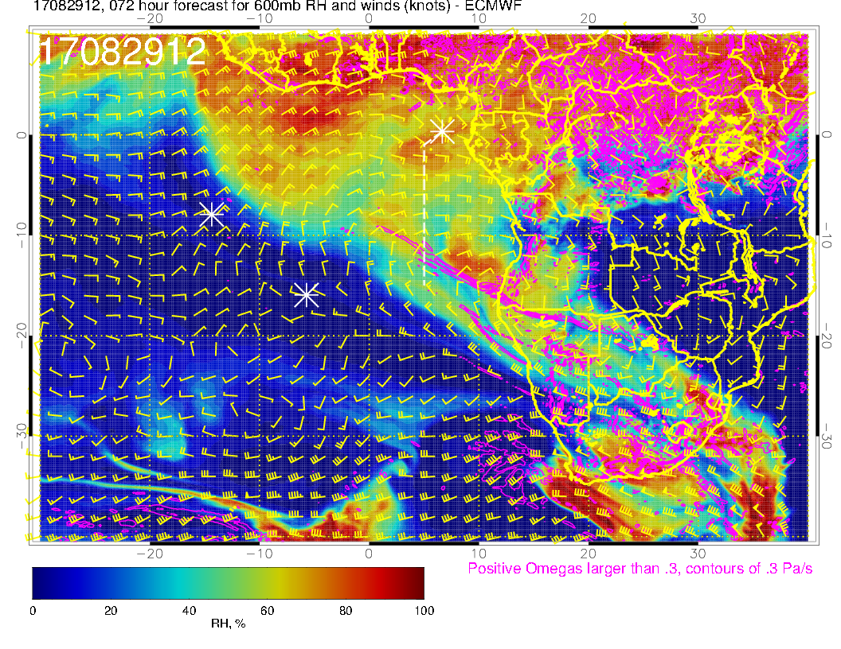
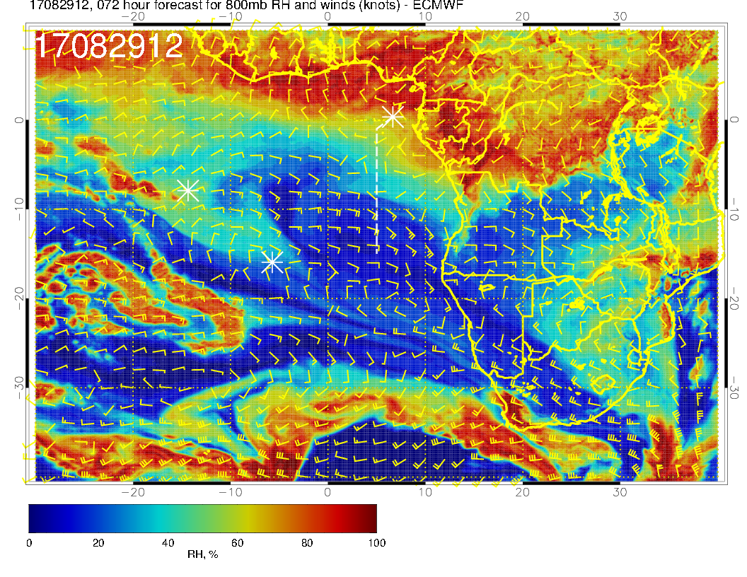
Zonal flow (westward) at upper two levels. Note the dry convective moisture off the Angolan coast at 600mb, a bit out of our reach. Also note the southward “curl” of the 600mb flow along the diagonal from Walvis Bay to Ascension.800mb flow is far less well-organized than in the previous forecast near the Gabon coast.

Slide 28
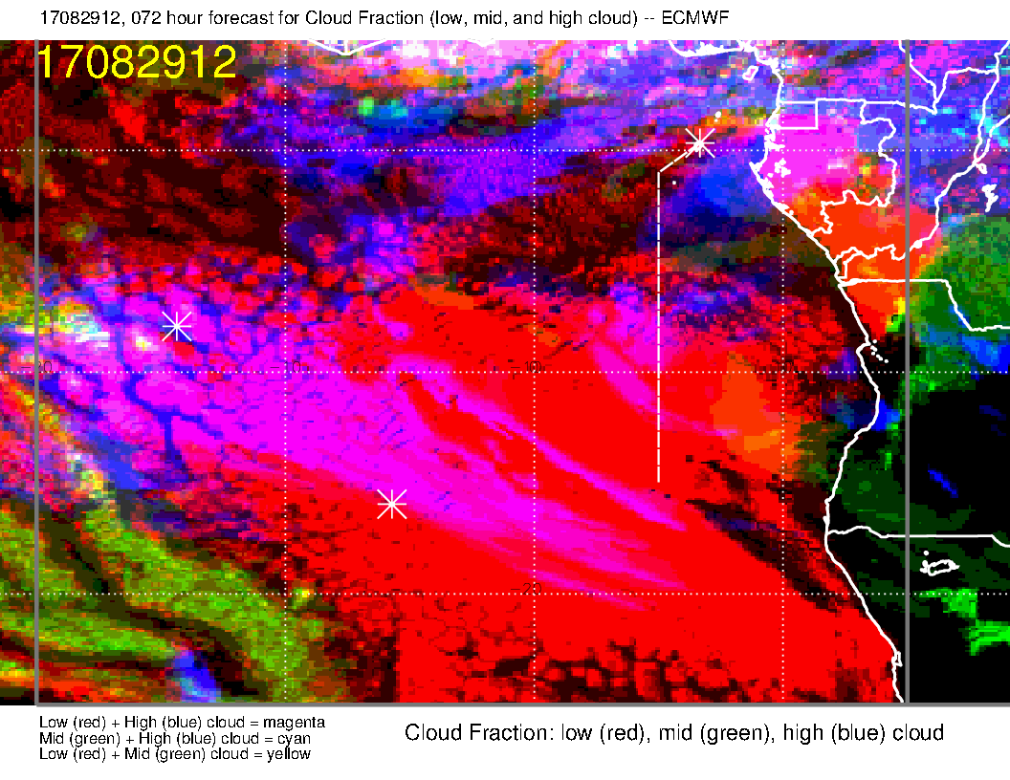
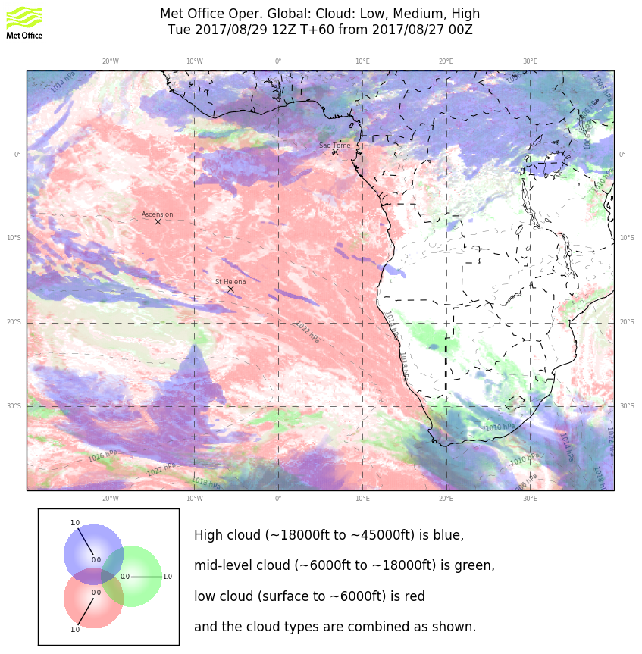
EC again has some middle cloud in operating region, which I would discount. I think this is a less favorable cirrus day than Monday, based on the EC forecast.

Slide 29
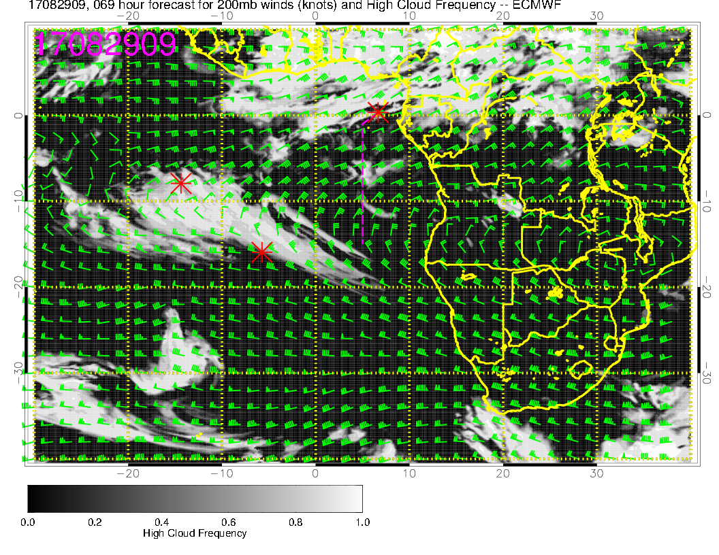
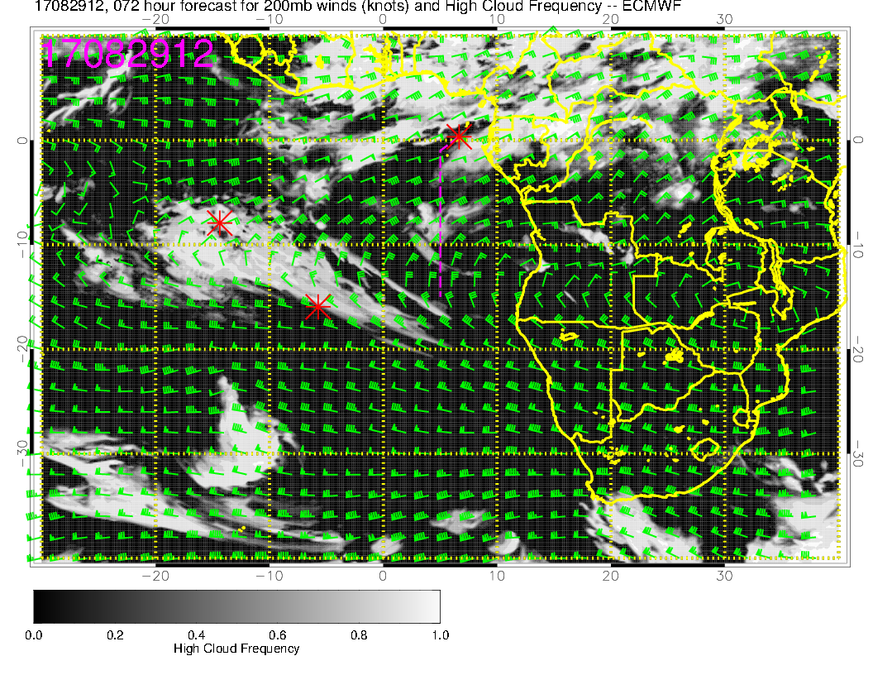
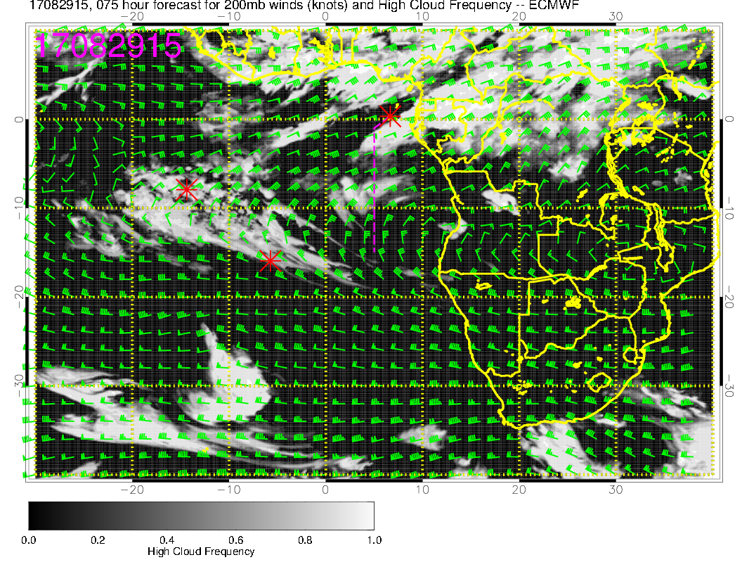
Overall, a less favorable day for cirrus
than Monday. Flow is angled more
from the northeast than on Monday,
and the cloud incidence shows it. I
don’t see any obvious regions that
could be cirrus free close by.

Slide 30
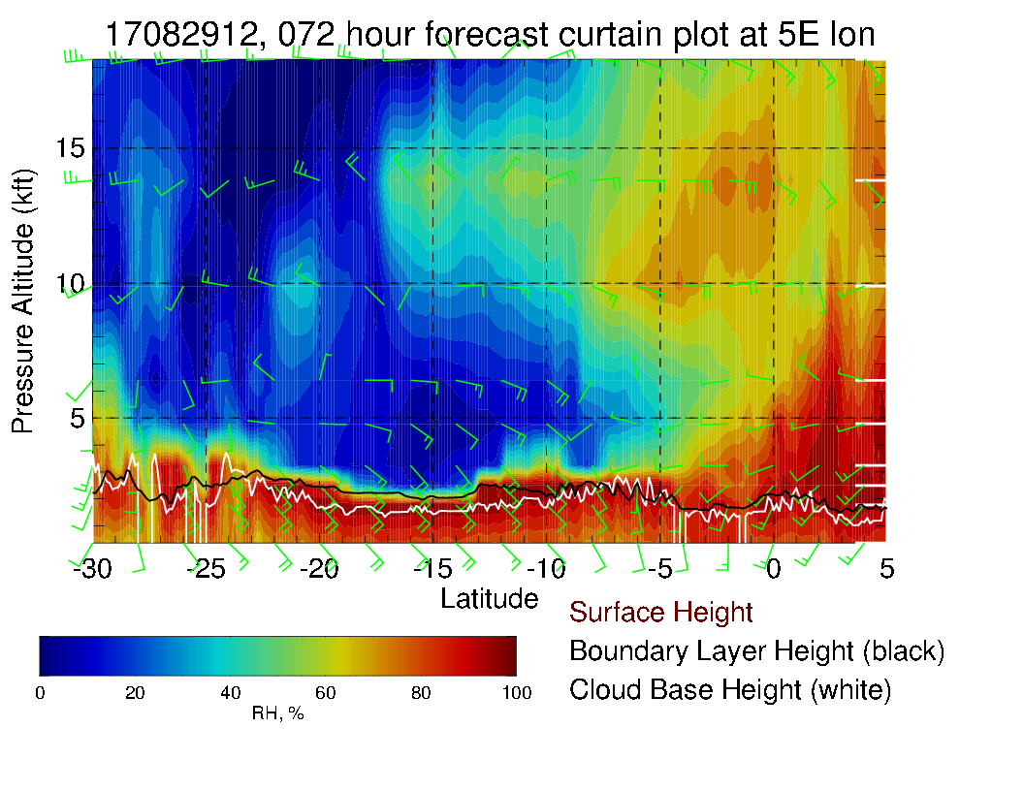
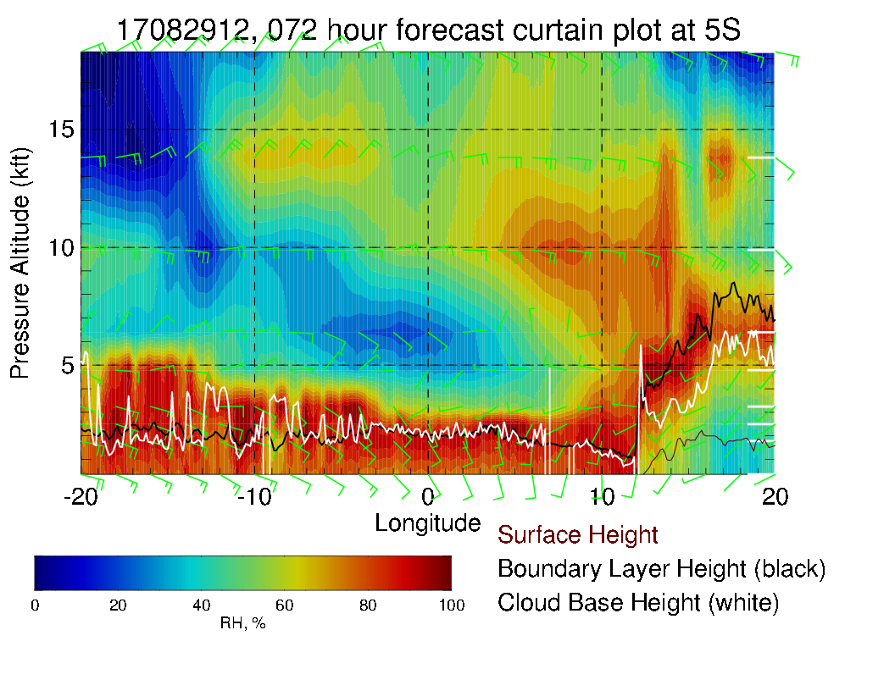
Mid level moisture starting to enter routine track (above) at 600mb especially, and can see how it is moving westward (left), tilting westward with altitude. Winds pretty much easterly, 15-20 knots at midlevels. Note westerlies at 800/850 mb north of 5S, shifting to southeasterlies south of that. Surface winds southerly, typical strength.

Slide 31
Wednesday

Slide 32
SH High moving eastward near climo, winds have an “average” strength and direction. Convection in Nigeria, west Africa, and CAR/Congo.

Slide 33
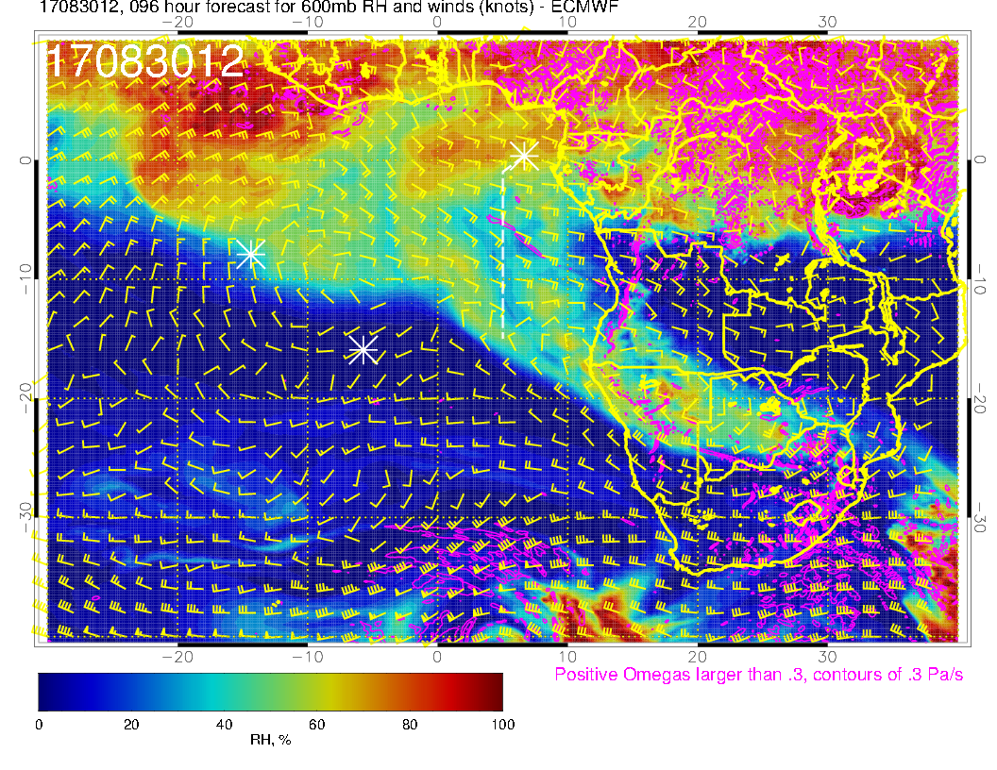
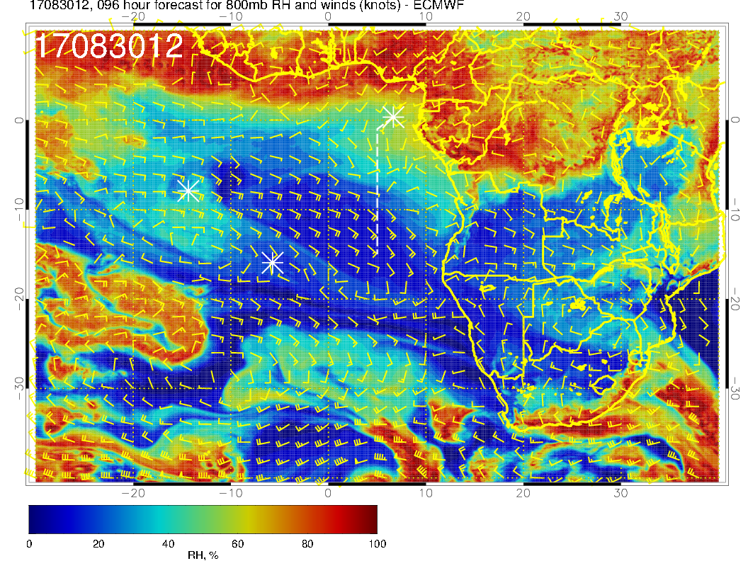
Pattern advances to the west. In general, a more southeasterly component to the wind compared to previous days at upper two levels. Can see the individual surges of moisture along the latitude circle (say 10S). Continued mid level moisture enhancement around TMS. Turning into westerlies gives the stretching feature from Namibia to Ascension. Southeasterlies produce drying at the lowest level.

Slide 34
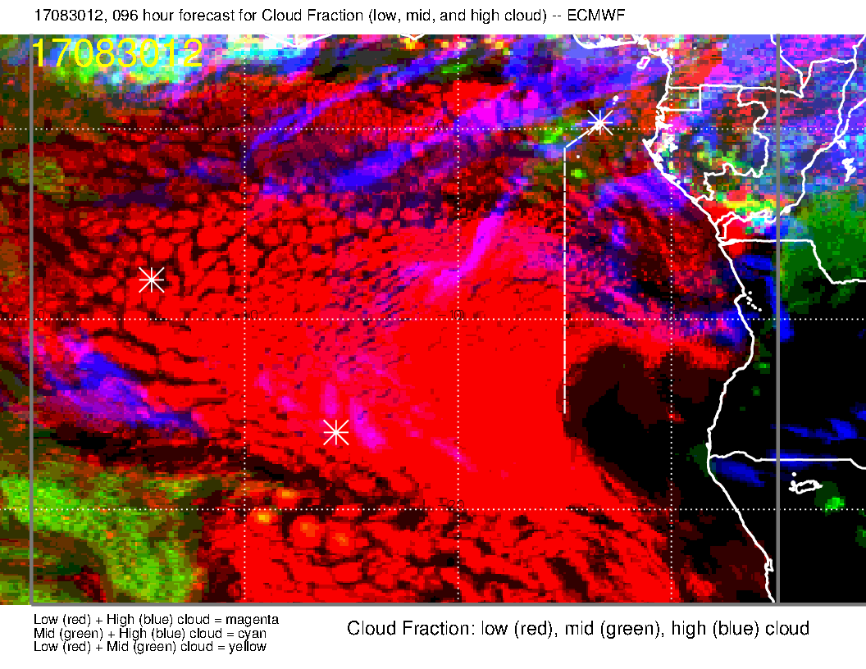
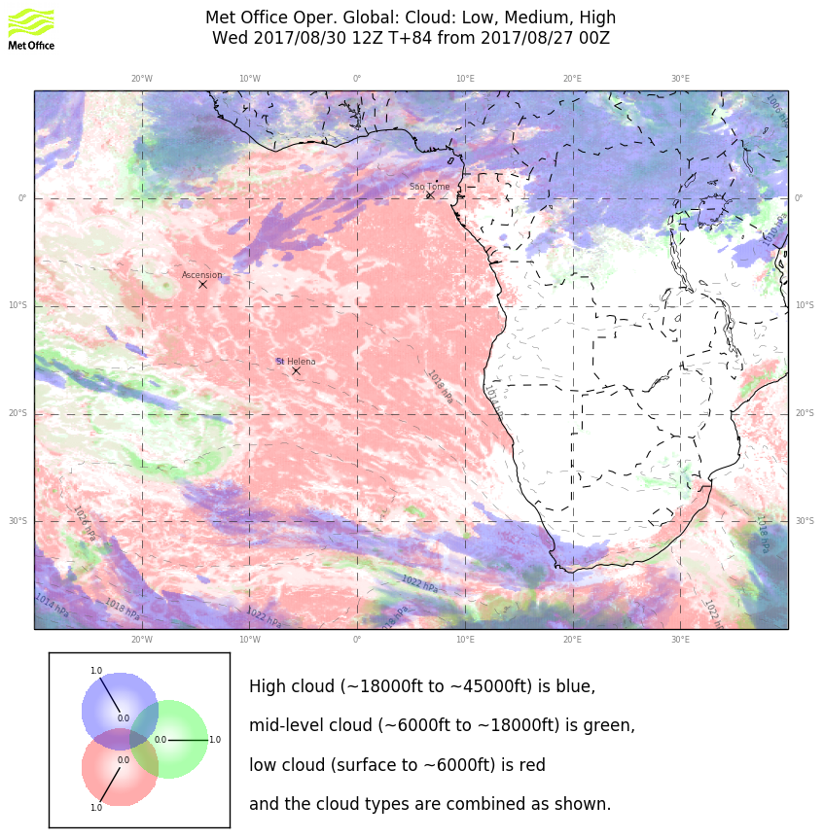
Both models have backed off on the cirrus from previous forecast, but EC psychedelic plot is deceptive in this case.. I would discount the middle cloud forecast by the EC model for reasons given previously.

Slide 35
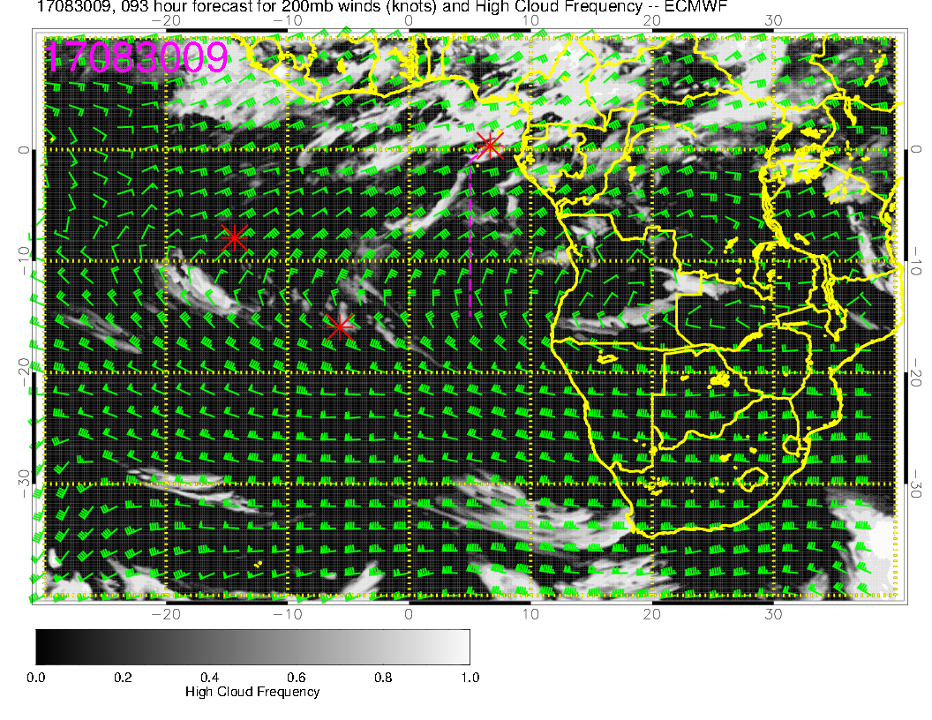
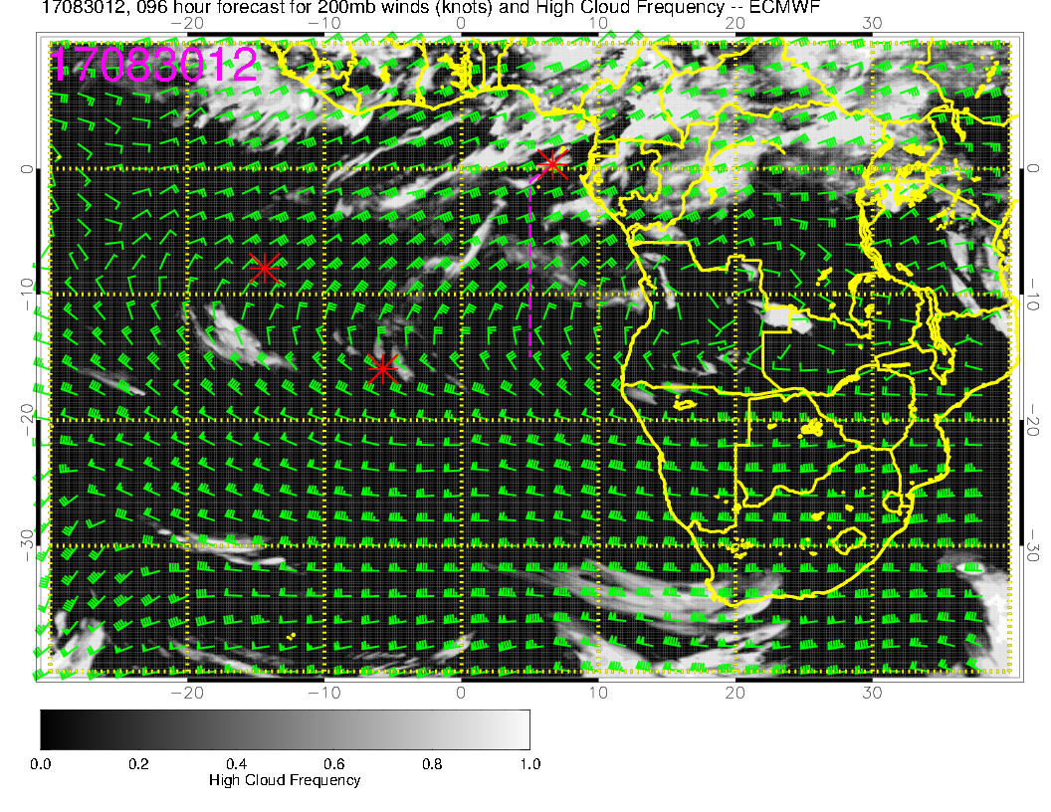
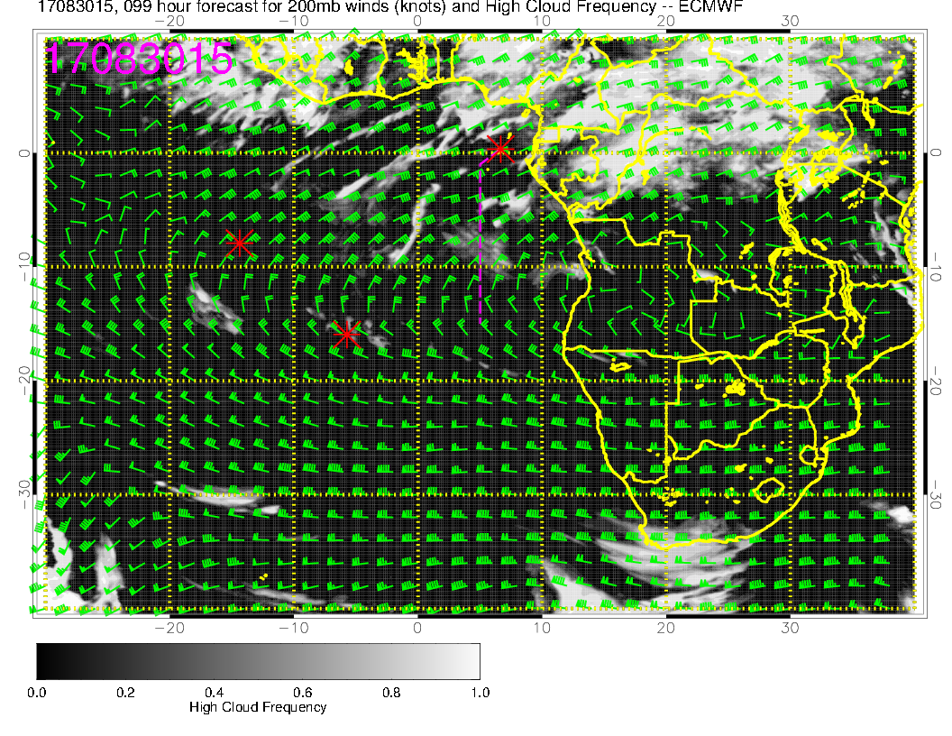
Strong northeasterly component indicates that cirrus will be a problem on this day, though it will be fairly thin. Would want to go south of 10S to escape it.

Slide 36
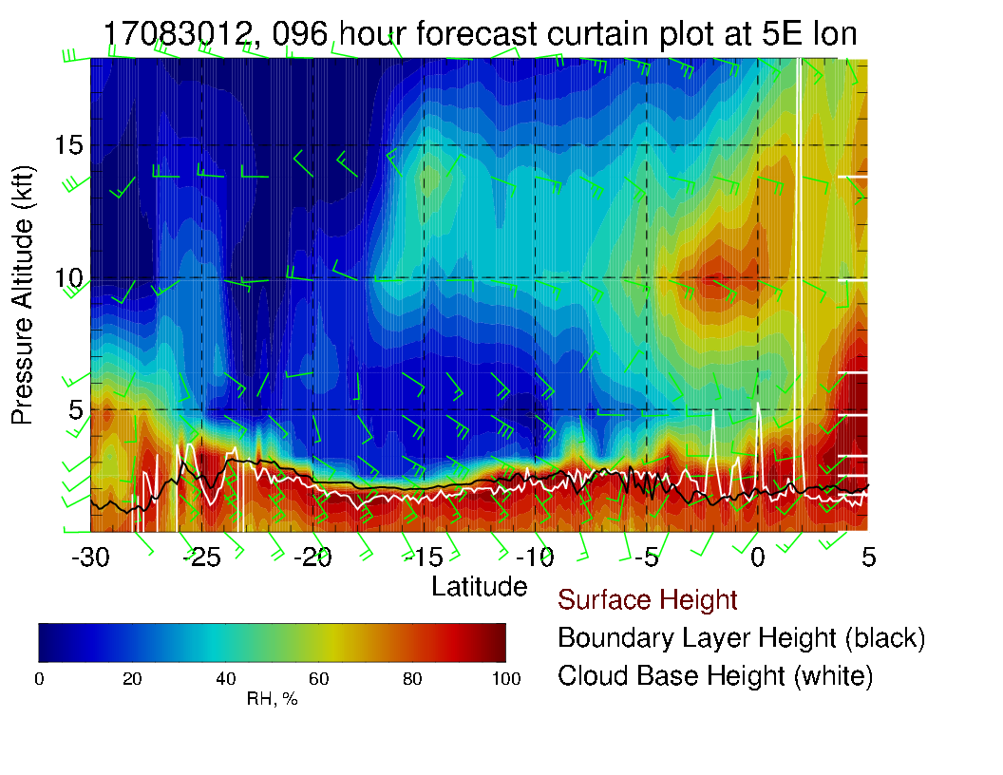
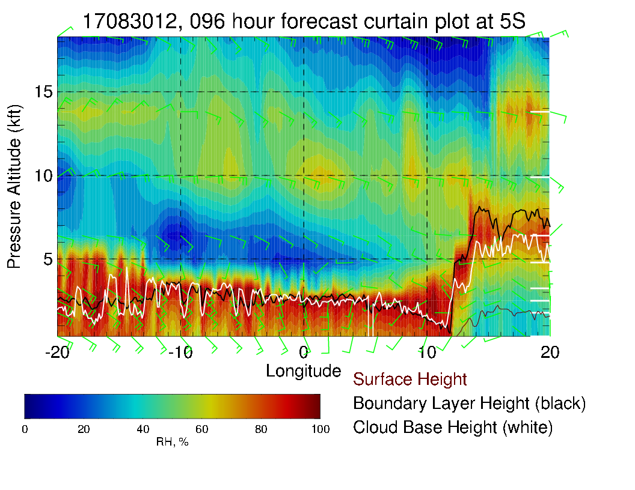
Mid level moisture in routine track (above), and moving westward (left). Winds pretty much southeasterly, 15-20 knots at midlevels. Note westerlies at 800/850 mb. Surface winds southerly, typical strength.

Slide 37
Thursday

Slide 38
Thursday (F): Winds anomalously westerly near TMS. Central African convection is not getting stronger, rather convection north of us (Nigeria) is getting weaker. Getting the two foci again (central Africa and West Africa)

Slide 39
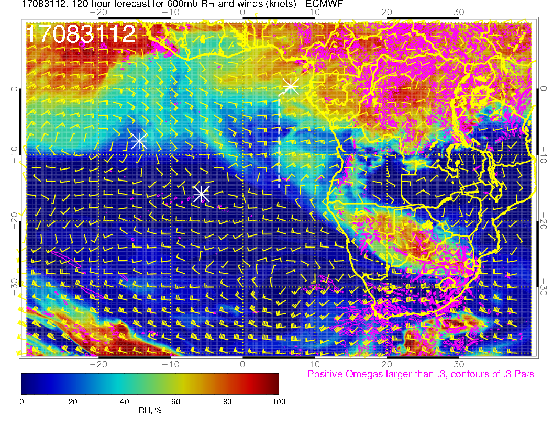
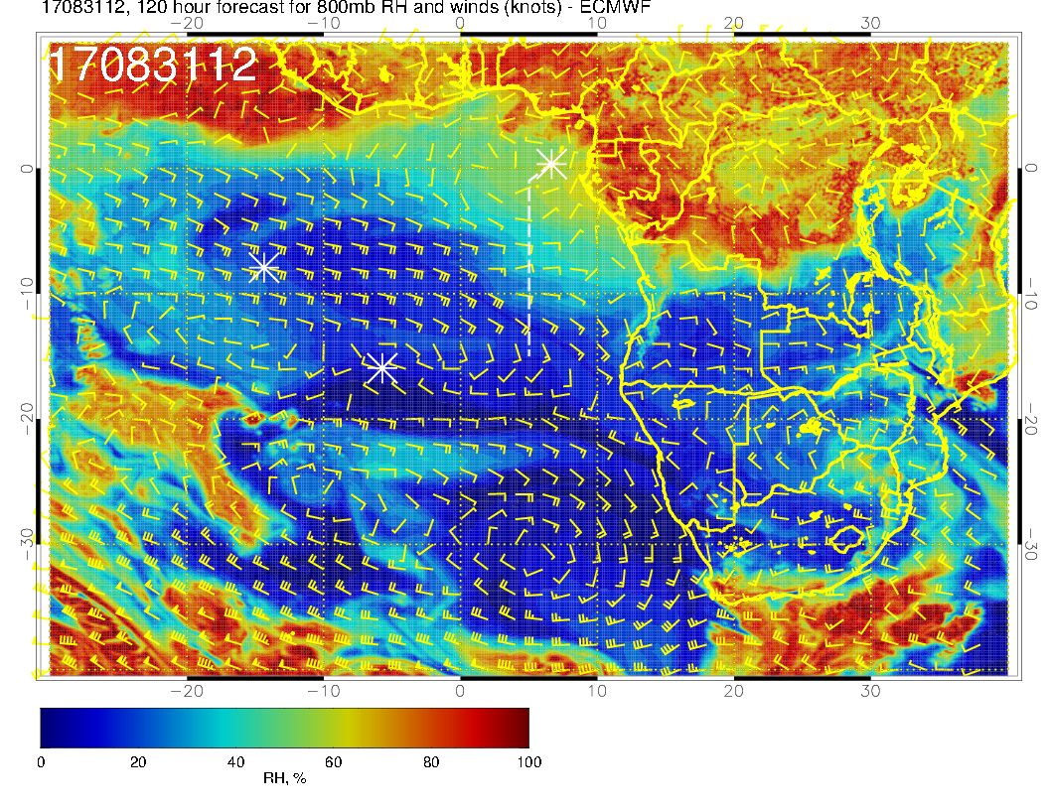
Mid levels for Thursday. Continued moisture in region near TMS, now at all levels. Zonal to southeasterly flow. This has now reached to 800mb. Can see the dry convective moisture approaching the routine track near 10-15S at 600mb.

Slide 40
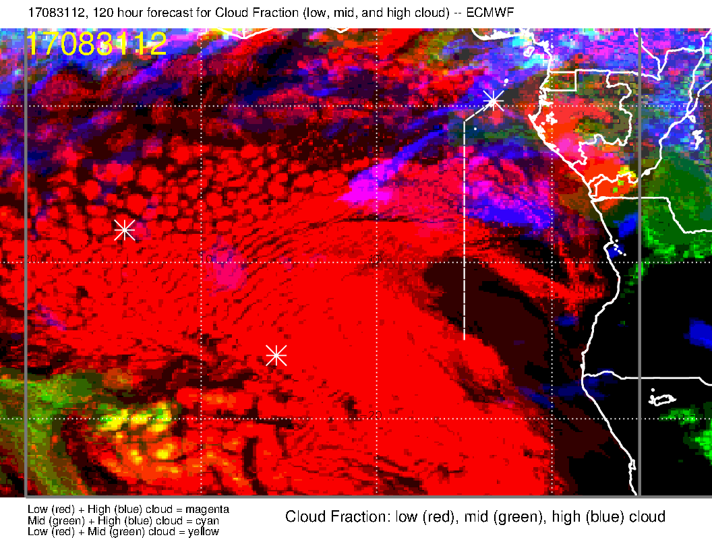
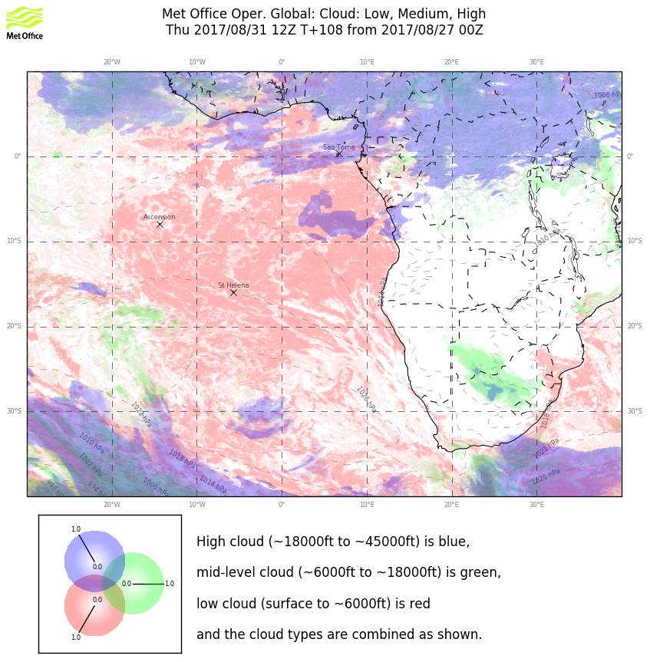
Not a lot of model agreement on the details of the clouds at 5 day forecast.
Don’t expect much middle cloud (despite EC forecast south of TMS).

Slide 41
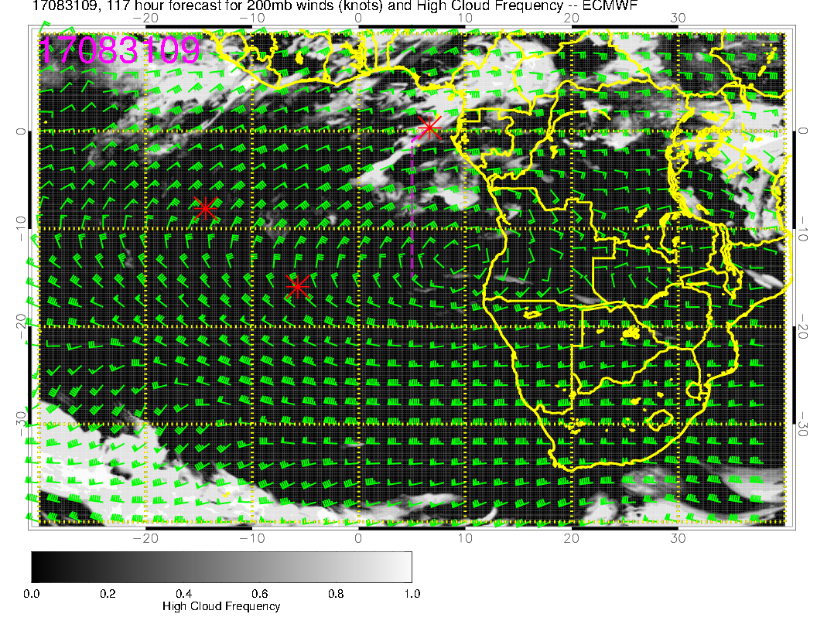
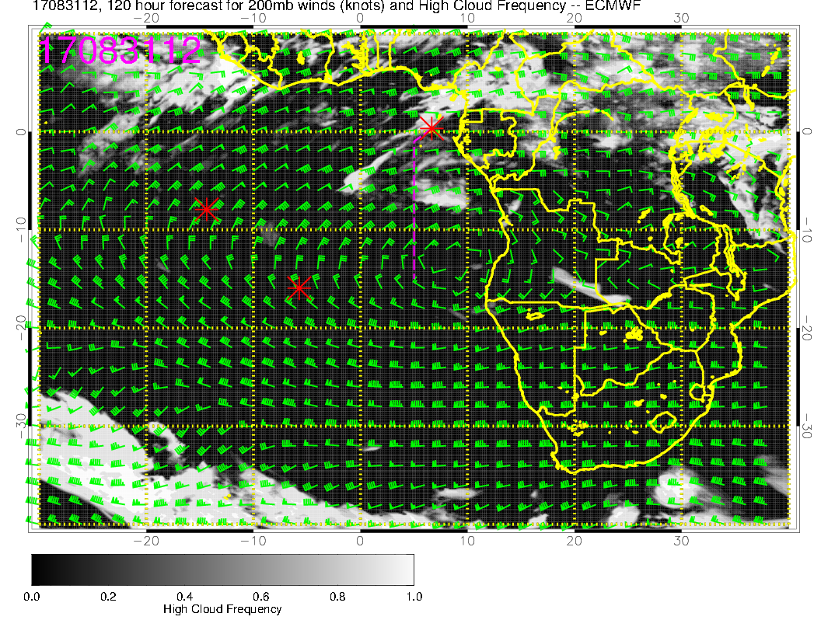
Individual high cloud only pictures suggest a bleak picture for high clouds
on Thursday. Anticyclone’s position is probably responsible for some upward
motion in the model. Actual clouds depend on moisture source, which is very
uncertain, but should not count on good cloud conditions.

Slide 42
X-sections show drying at mid levels.
Strong easterlies along routine track
at 600mb (30knots), weak easterlies at
800mb north of 5S. Weak surface
winds until you get to 10S. Very zonal
wind pattern

