Slide 1
ORACLES weather briefing
26-Aug-2017
Lenny Pfister and Rei Ueyama

Slide 2
Surface evolution 8/25-8/30

Slide 3
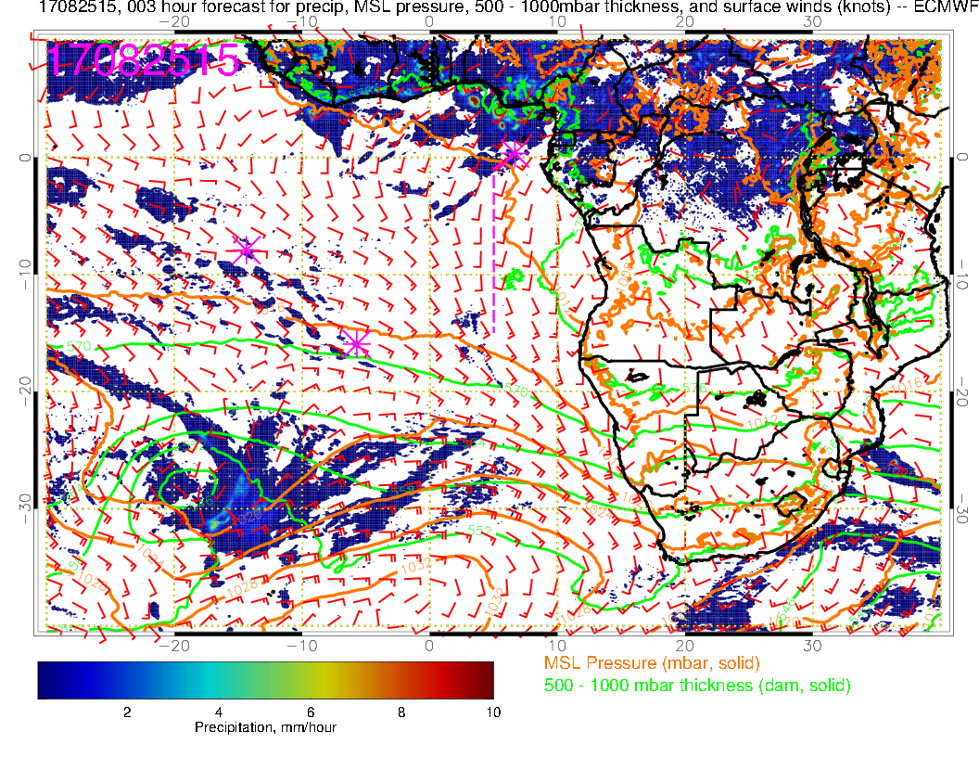
Yesterday. Surface winds strengthen wrt 24th, and the rain retreats. Convection focussed on Nigeria region

Slide 4
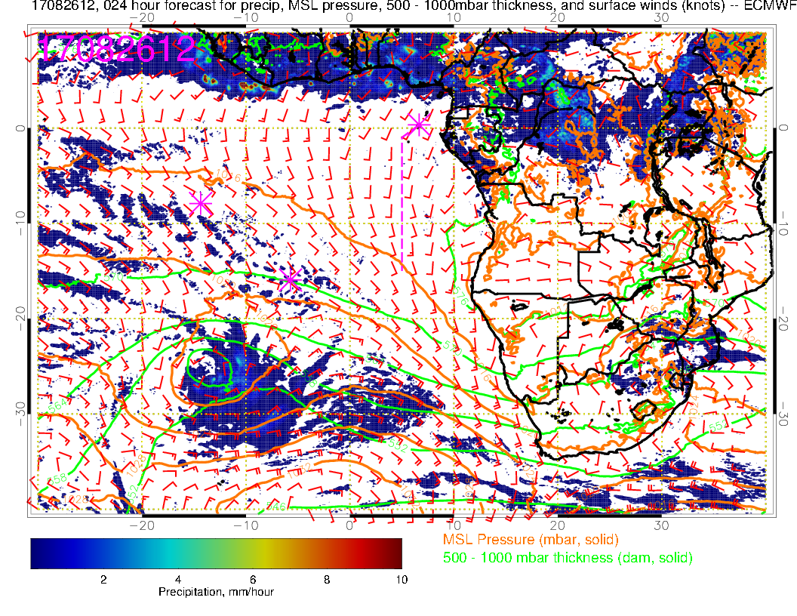
Today: Winds southerly, a bit weaker than yesterday’s fcst, Congo convection gets started.

Slide 5
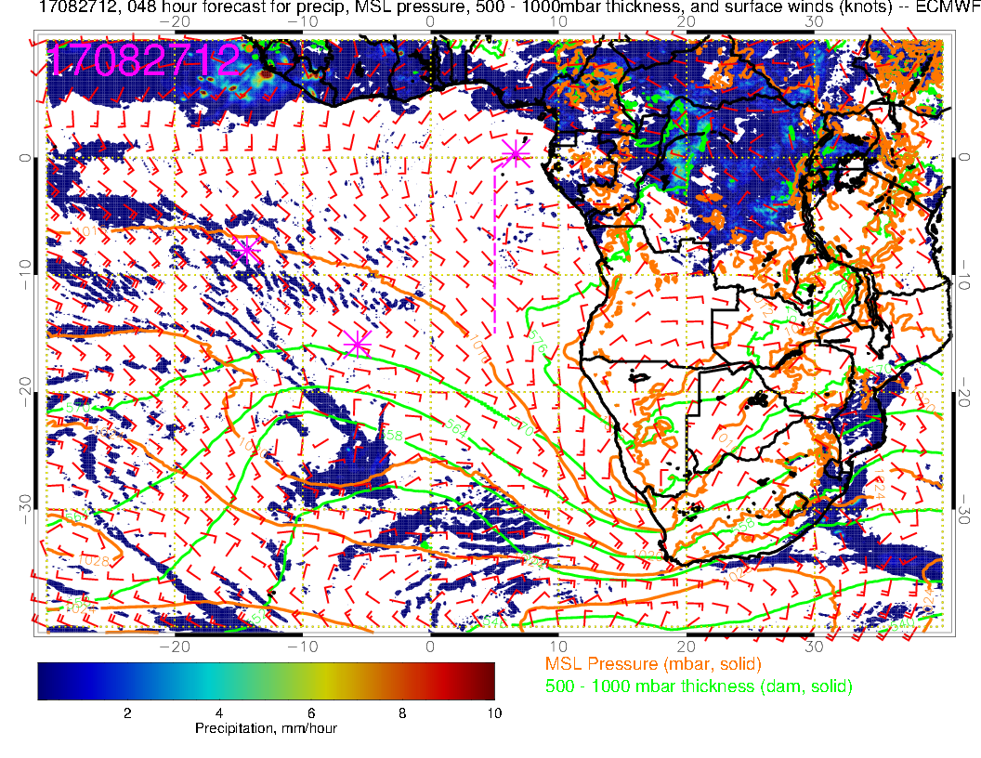
Tomorrow: Good consistency with yesterday’s fcst. Weak winds over much of SE Atlantic. Surface winds in tropics are aiming at two loci of convection – Congo and off the coast of western Africa. SH high displaced far south.

Slide 6
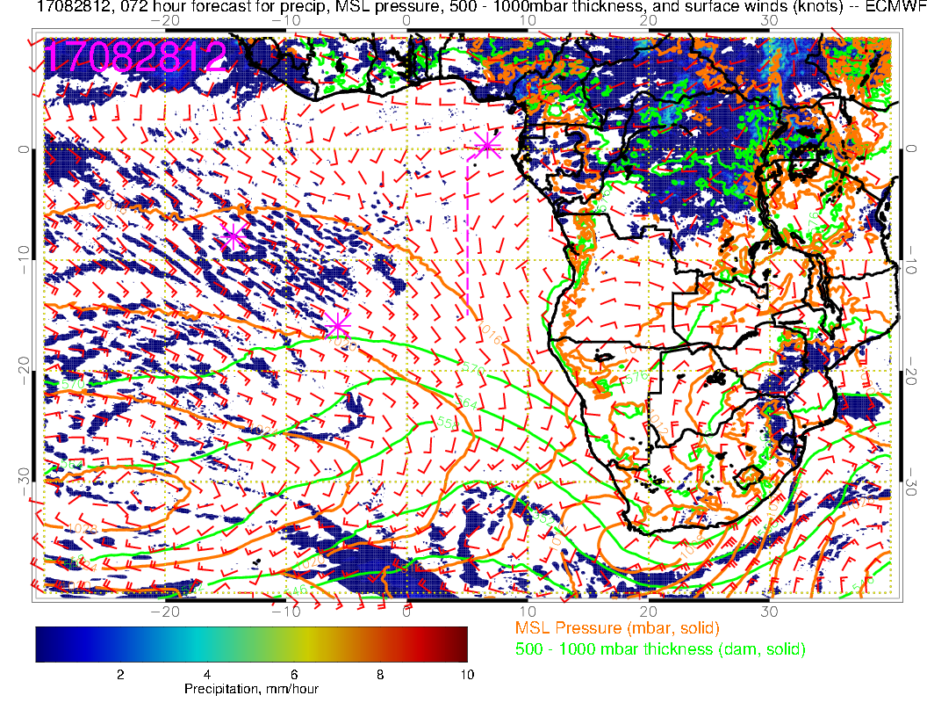
Monday: Still weak winds as SH high reforms to the west. Again, tropical surface winds aim to Congo and off of African coast. Near westerlies (weak) again at TMS. FCST consistent

Slide 7
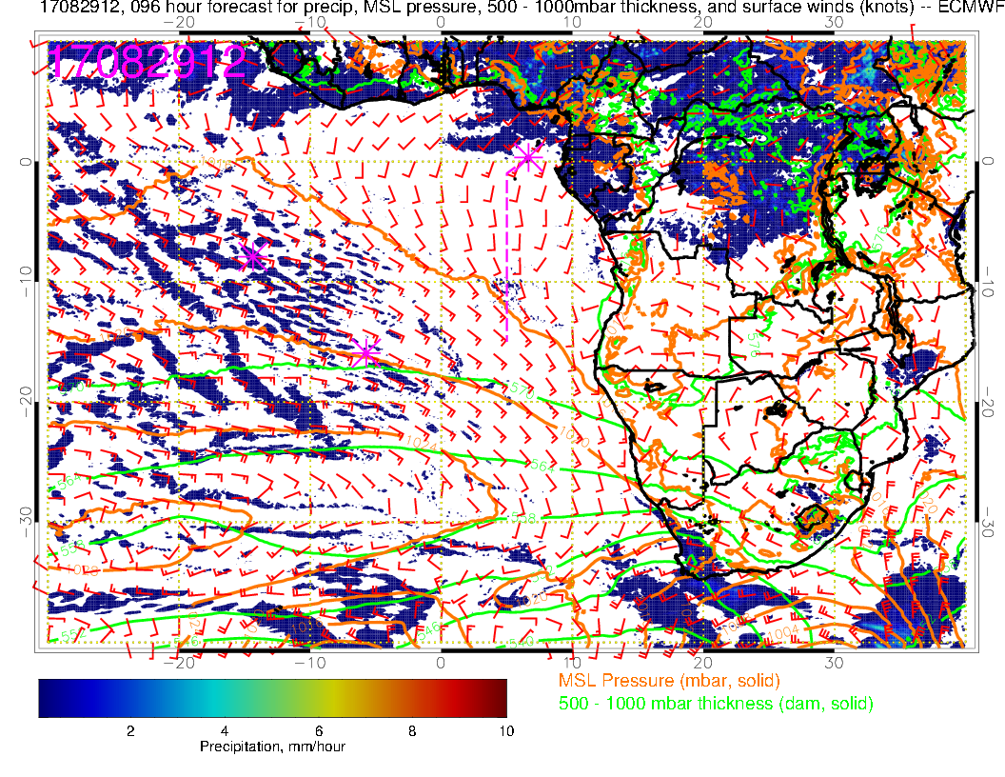
SH High moving into more typical place, winds strengthen, more typically southerly at TMS. African convection moving north. Note more development in Gabon and in the vicinity of TMS (again). Stronger convection in Nigeria wrt CAR than previous fcst

Slide 8
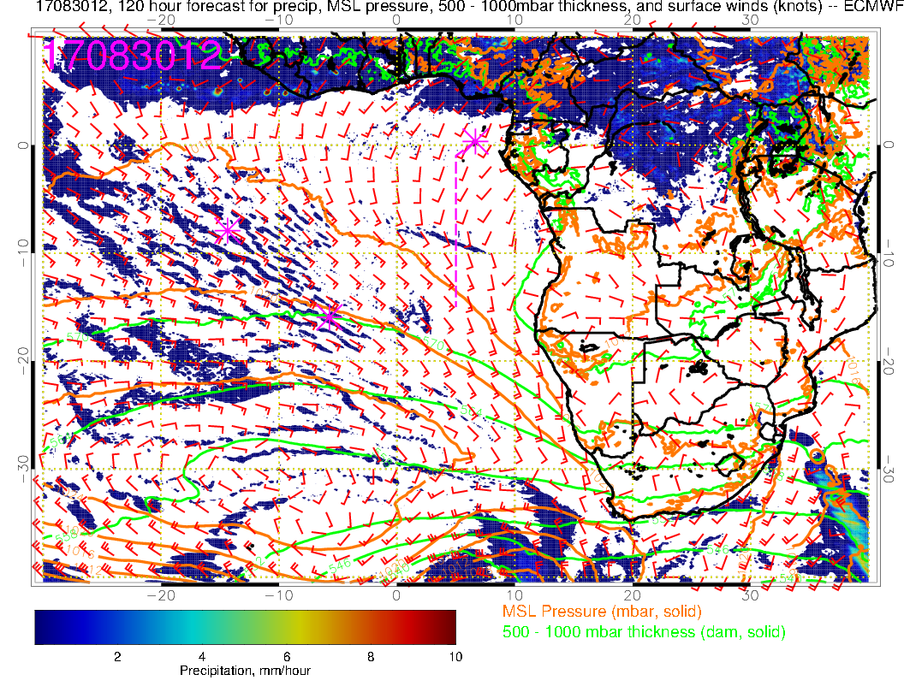
SH High moving eastward near climo, winds show typical directions in tropical Atlantic (though a little weaker than average). Convection looks kind of washed out (same everywhere on the continent), which is probably not right.

Slide 9
700mb evolution 8/25-8/30

Slide 10
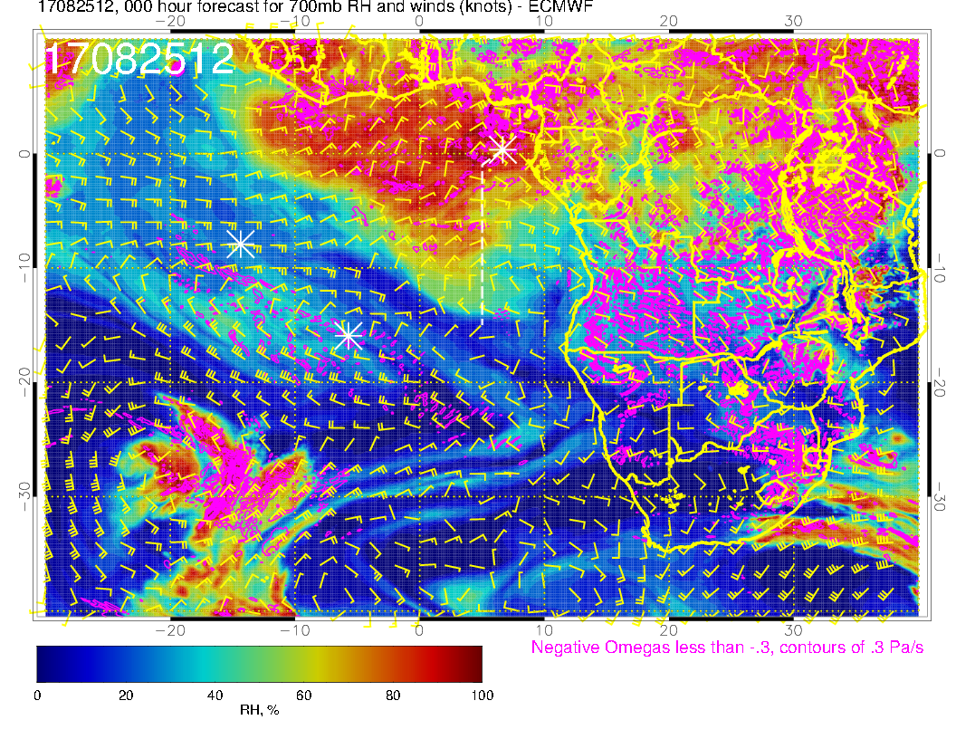
A
A
Yesterday: Forecast consistency. Dry air moving in, ESE flow over operating region.

Slide 11
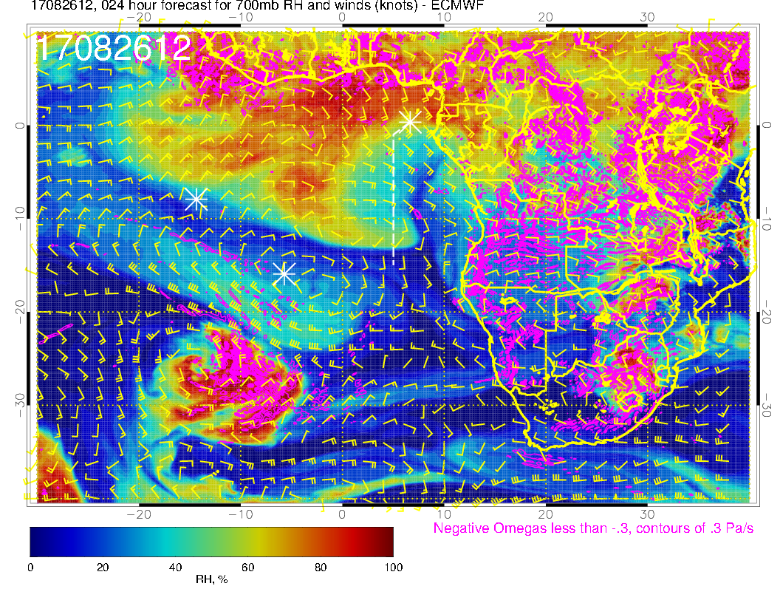
A
A
A
Today(F): Forecast consistent with yesterday’s in drying out our region at midlevels. Anticyclone advances westward, bringing southeasterlies (and drier air, some descent).

Slide 12
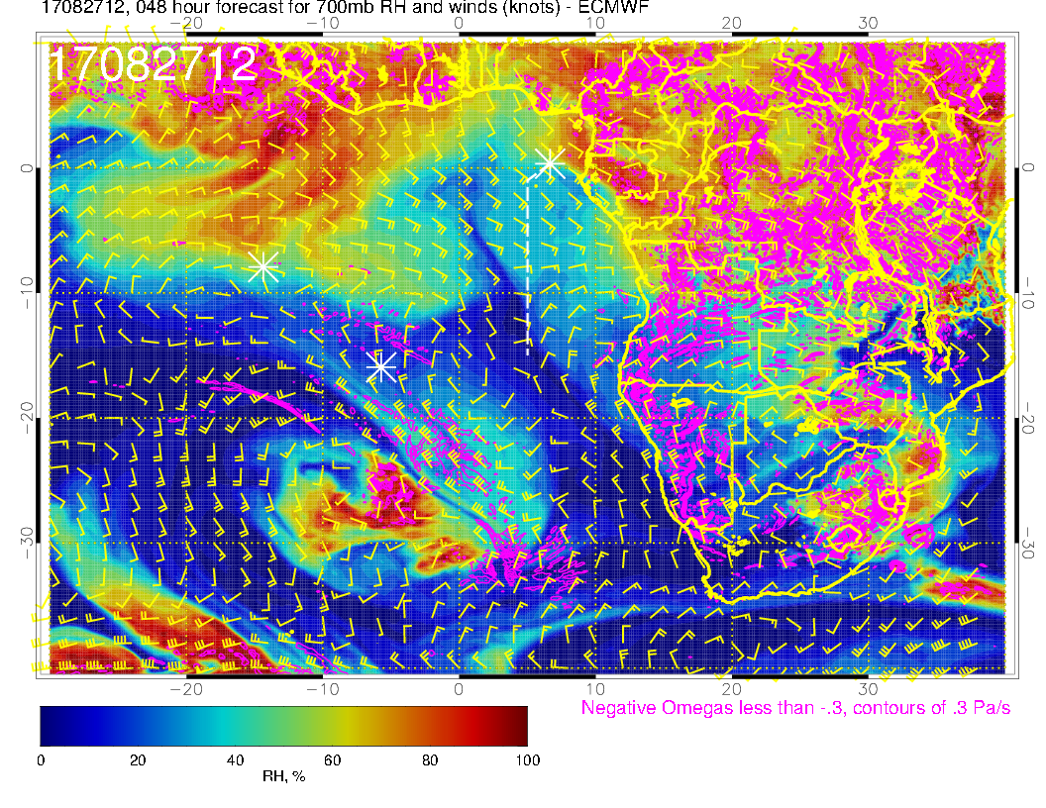
A
A
Tomorrow(NF): Flow becomes more zonal at the shore as anticyclone moves westward. Consistent with previous forecast, continued dry in our region, southeasterlies (which have weakened slightly from previous fcst (25 knots to 20).

Slide 13
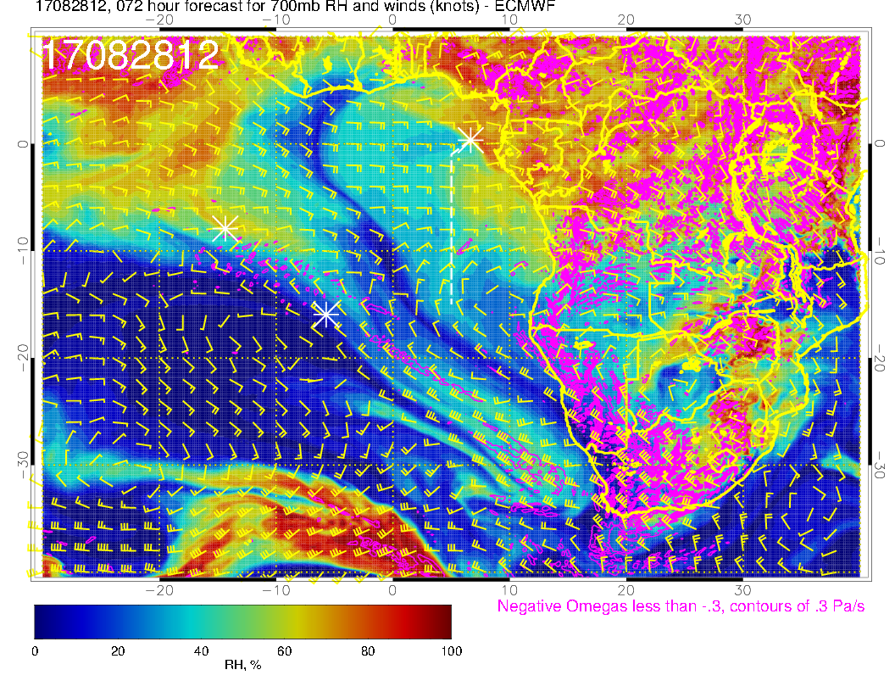
A?
A
Monday(F): Flow becomes zonal over our region, continued dry (but note beginnings of moisture coming from the east. Little change from previous fcst, but moisture a little less intense.

Slide 14
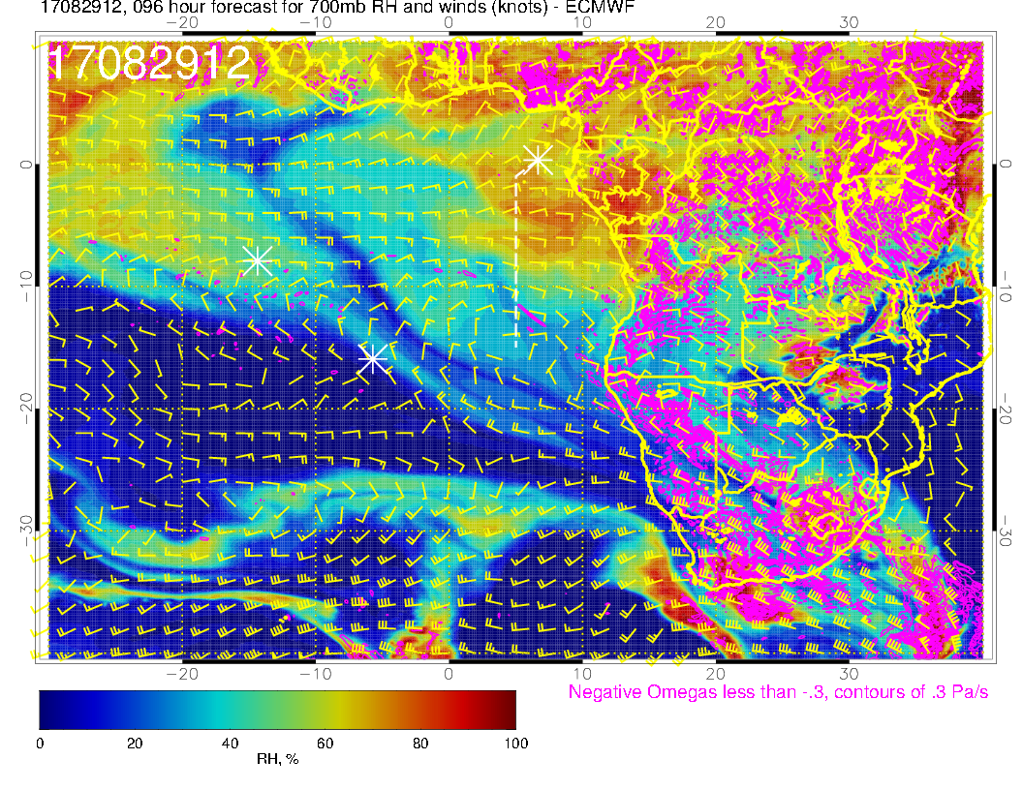
A
A
A
Tuesday(F-BB): Flow zonal over our region, moisture intrusion from the east over us, a little more intense than yesterday’s fcst.

Slide 15
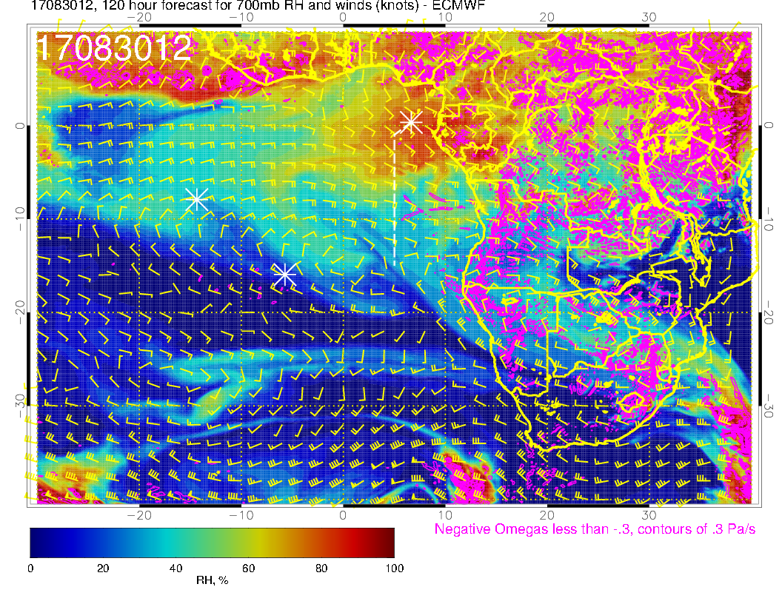
A
A
A
Wednesday (F): Moister air moves in as we get southeasterlies north of 5S

Slide 16
Sunday

Slide 17
Tomorrow: Good consistency with yesterday’s fcst. Weak winds over much of SE Atlantic. Surface winds in tropics are aiming at two loci of convection – Congo and off the coast of western Africa. SH high displaced far south.

Slide 18
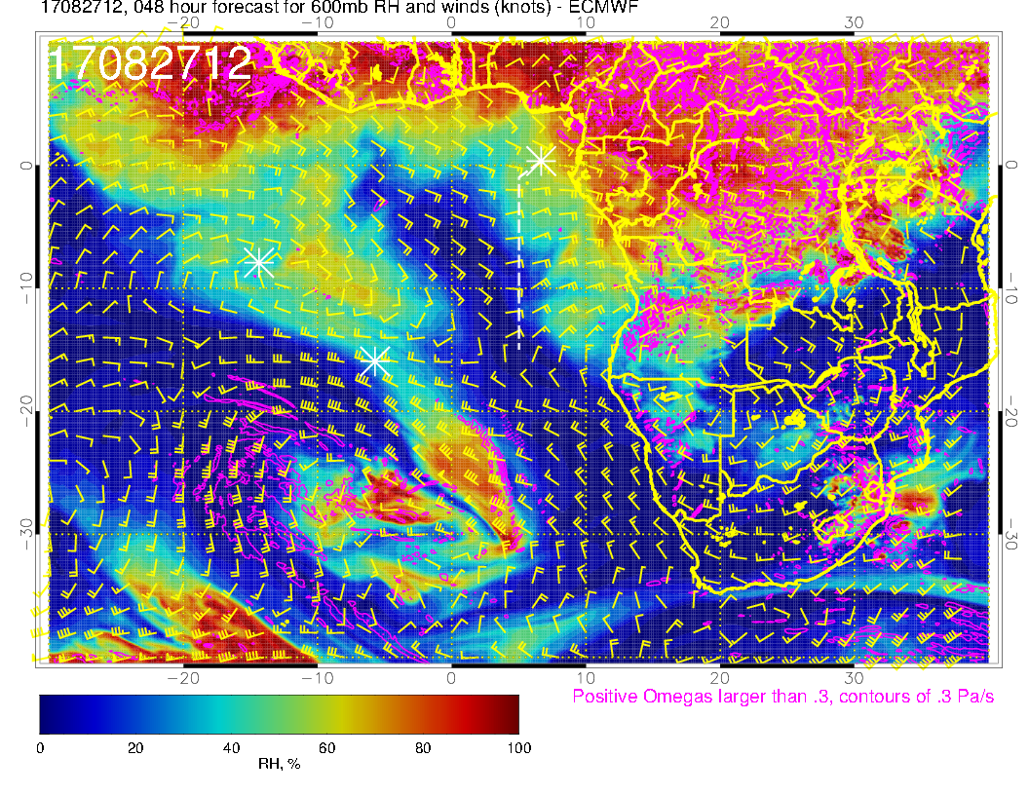
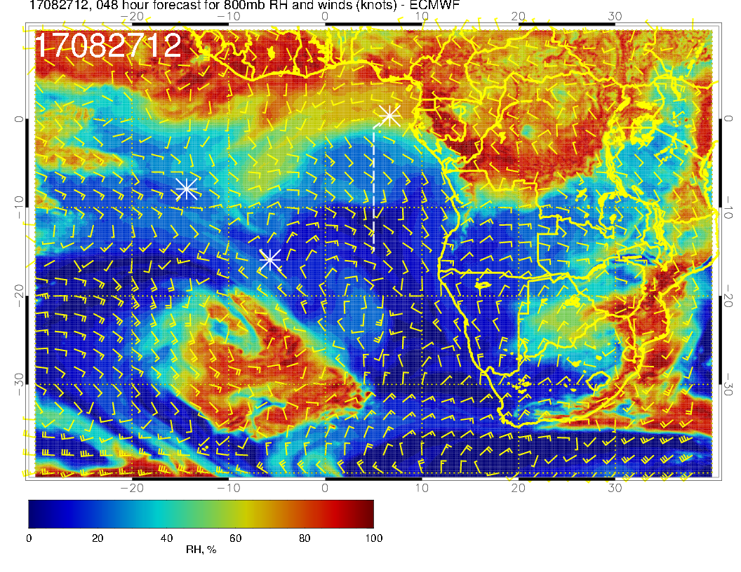
Mid level flow for Sunday. Pronounced southeasterlies from Angola into our region. Blob of dry convective moisture at 600mb has moved off of Angola. Pronounced drying at 800mb.

Slide 19
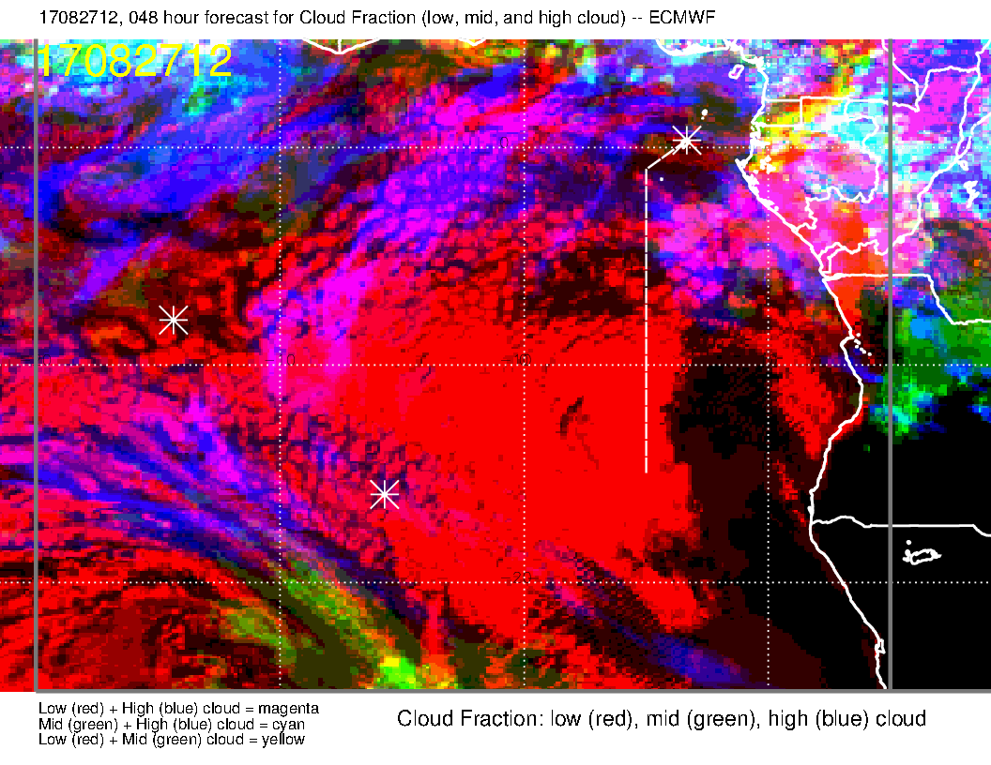
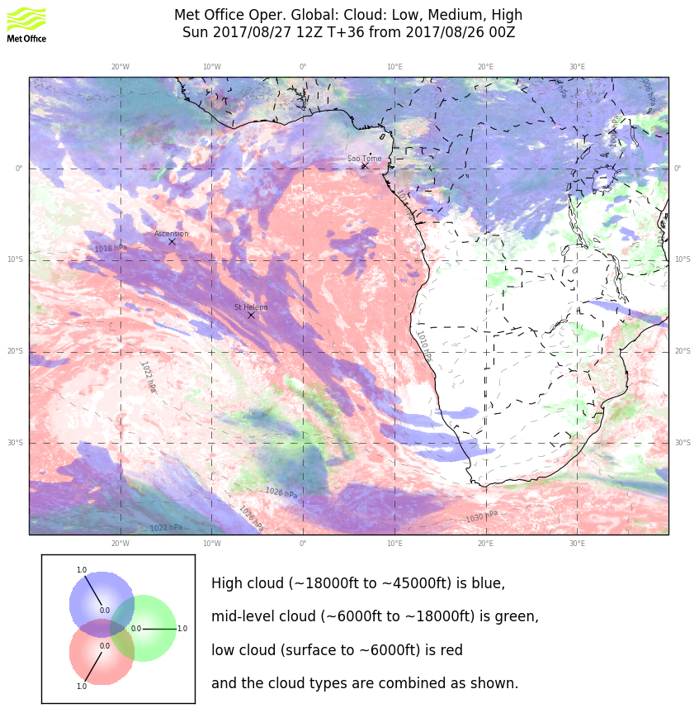
Clouds for Sunday. Middle clouds have gone away with the moisture. High clouds are not in agreement (which is typical – EC has more high clouds). Upward bowed structure in the high cloud pattern is similar at least. Low cloud clearing has increased wrt previous forecast in the EC. Note the weak winds and anomalous direction at the surface (previous slide)

Slide 20
Monday

Slide 21
Monday: Still weak winds as SH high reforms to the west. Again, tropical surface winds aim to Congo and off of African coast. Near westerlies (weak) again at TMS. FCST consistent

Slide 22
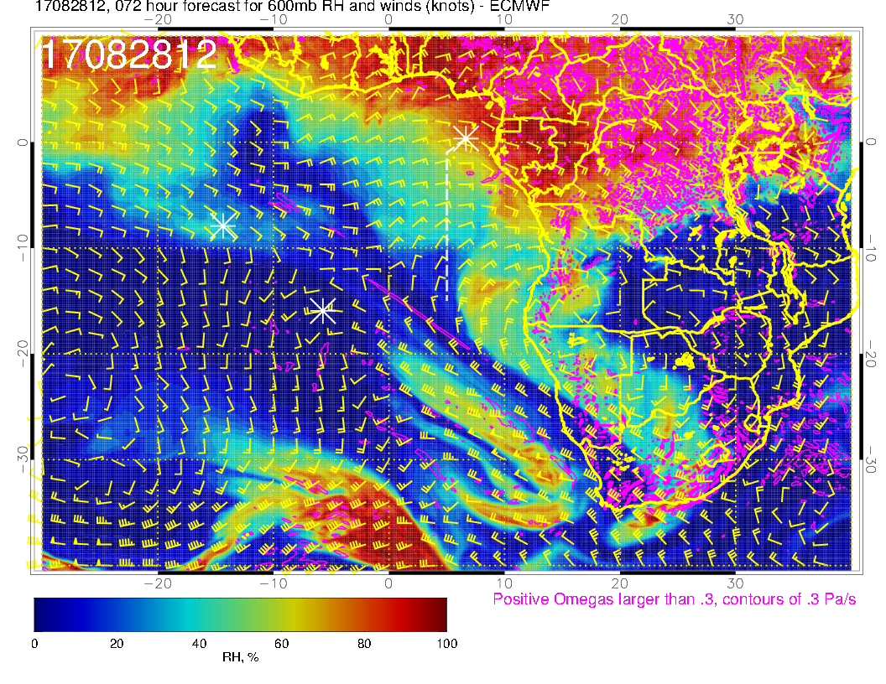
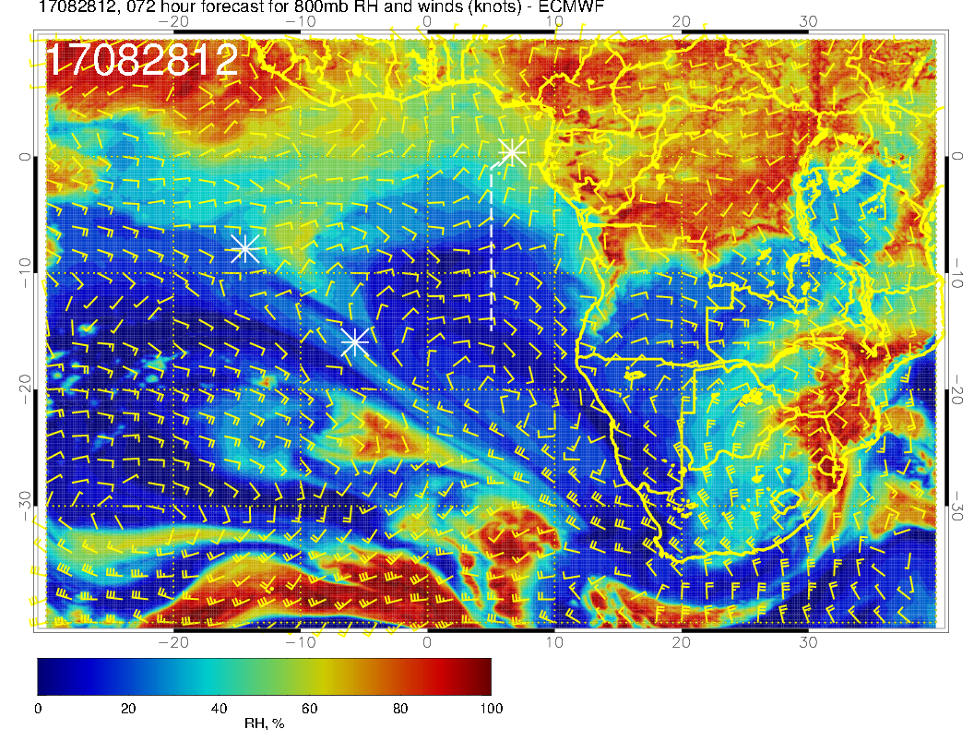
Mid level flow for Monday. Flow quite zonal at 600 and 700mb. Moist air near the coasts at these levels. At 600mb see dry convection blob of moisture coming off the coast, consistent with previous fcst. Circulation different at 2 km (right), with flow off the West African continent. (Effect of this flow not yet apparent in back trajectories – not shown).

Slide 23
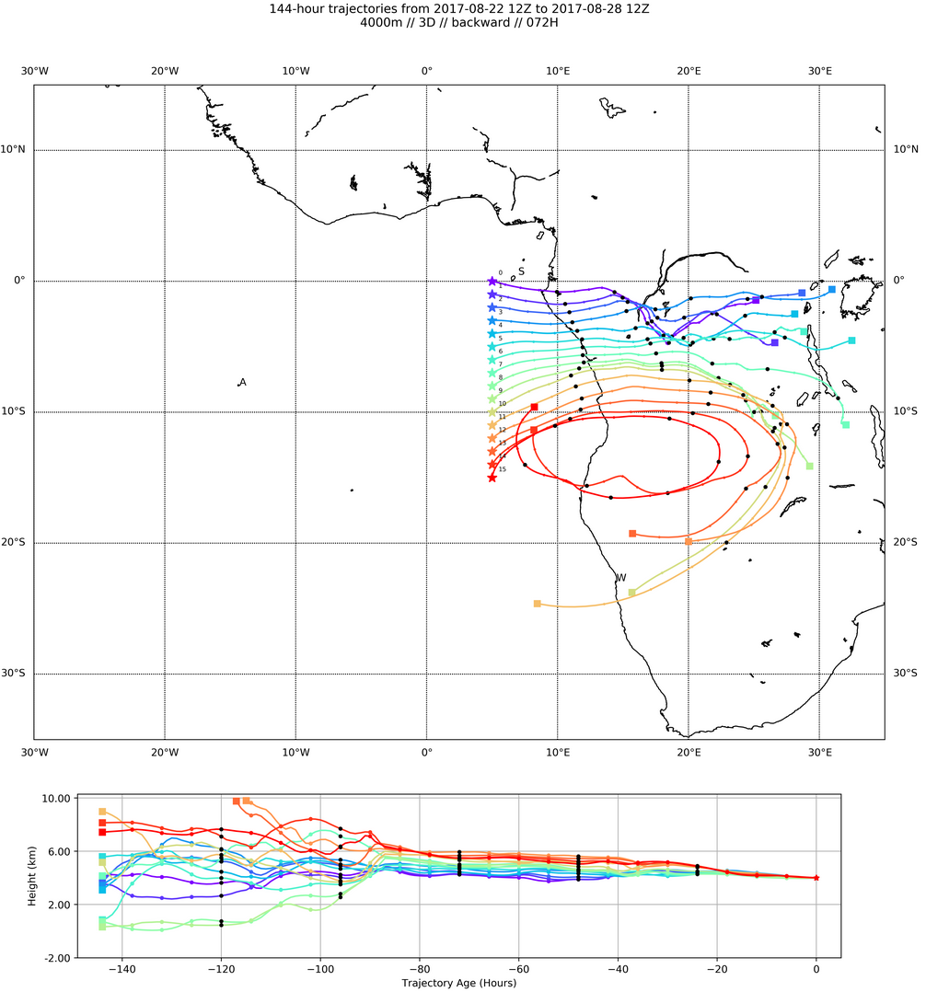
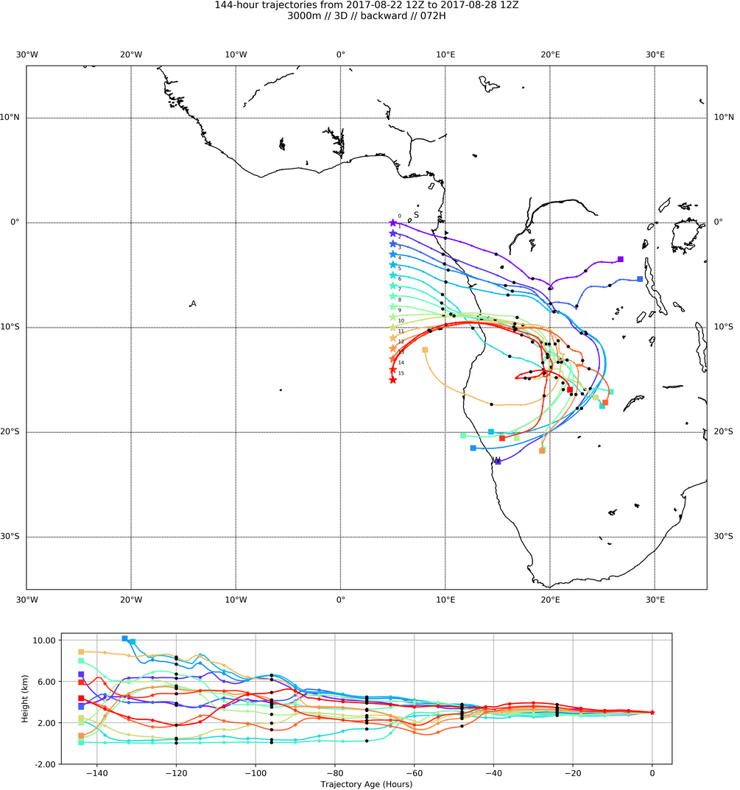
4 km
3 km
A
BTs at 600mb (4km, left) and 700mb (3 km, right). Expect some moist
processing in northern part, especially for 600mb parcels.

Slide 24
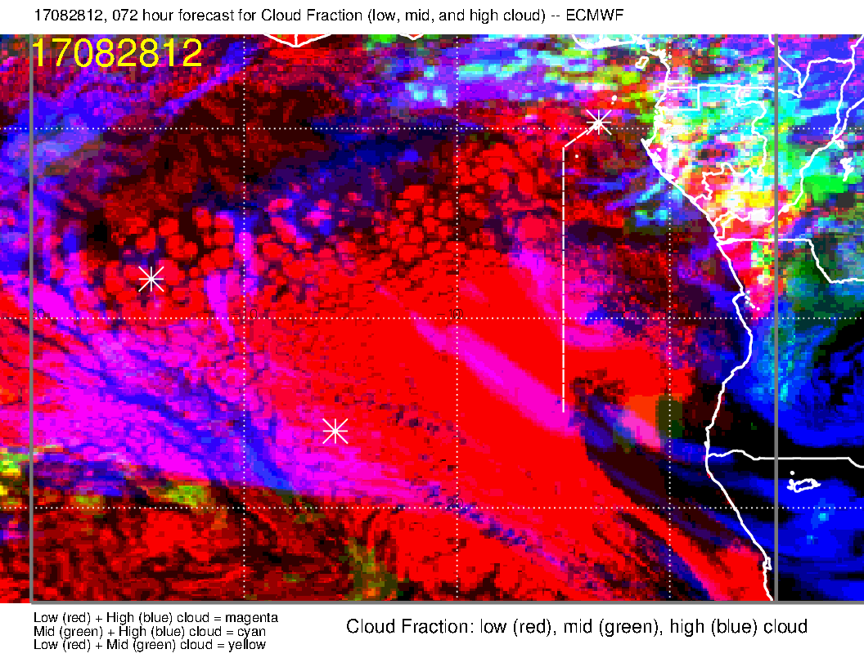
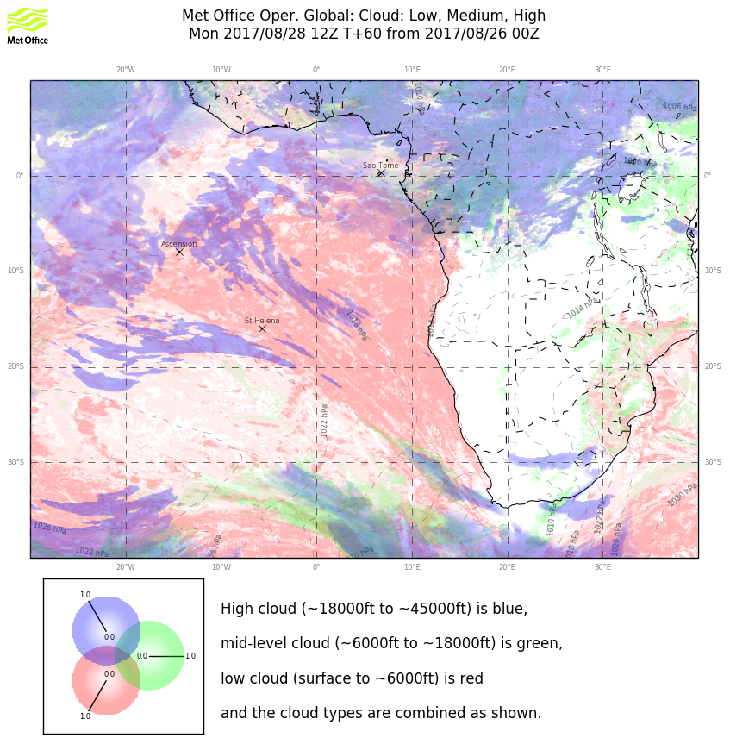
Some forecast consistency in the EC low cloud, with a shaft of enhanced low cloud extending northward as in previous fcst.
Model comparison poor on the high clouds in our operating region. UK is a shorter forecast, and is more consistent with its previous forecast. My judgment is that it is early to forecast the high cloud reliably.
Mid levels are dry, and both models show no mid-level cloud except very near the coasts (north and east of our region)

Slide 25
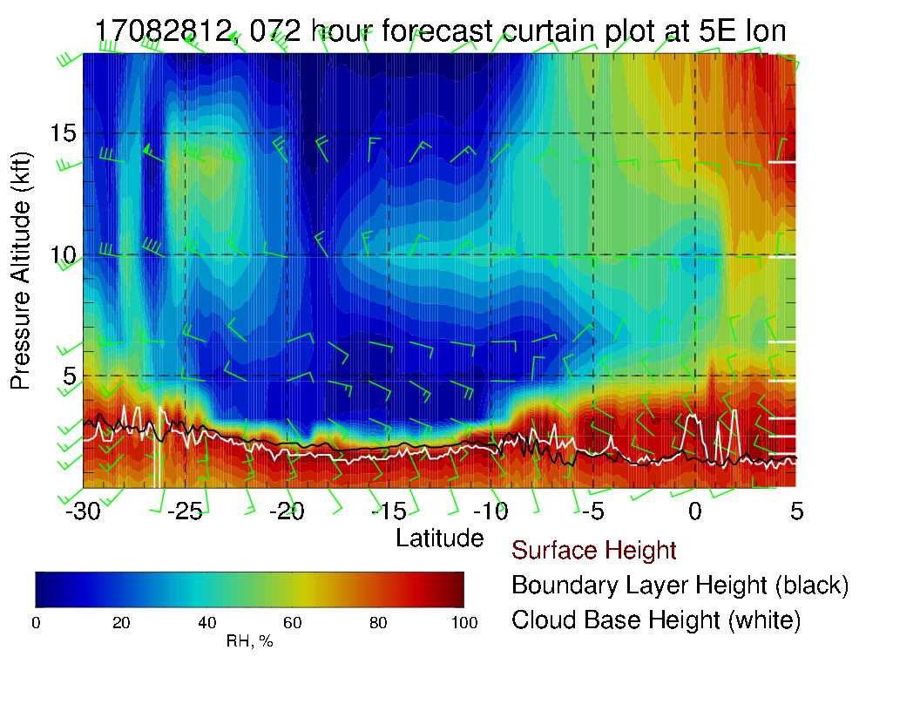
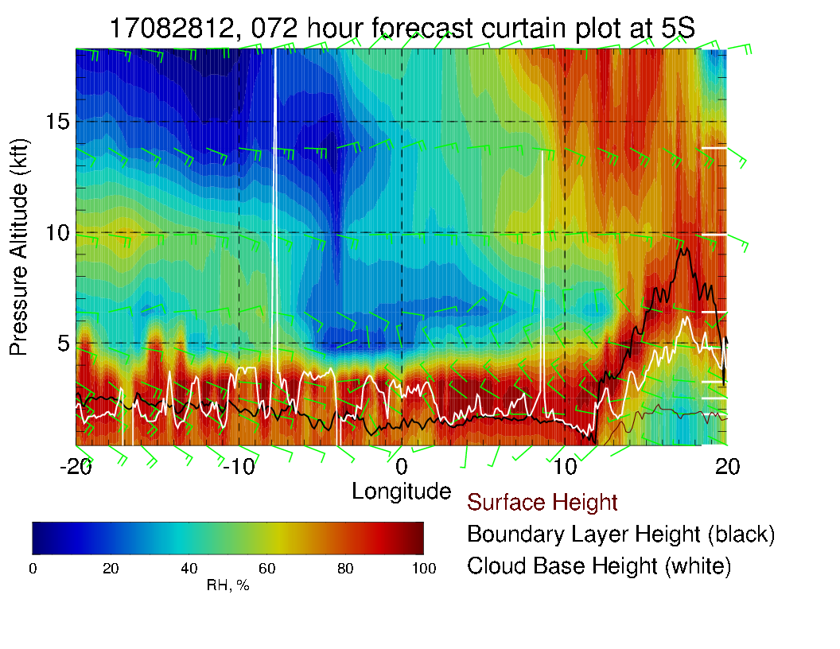
More moisture along routine track (above) than Sunday, consistent with westward propagation of dry and moist regions. Above, along 5S, can see mid level moisture start to penetrate into the region from the top. Winds are weak at the surface with varying direction. Easterlies and northeasterlies 15-20 knots at midlevels. Note the northwesterlies at 800/850mb.

Slide 26
Tuesday

Slide 27
SH High moving into more typical place, winds strengthen, more typically southerly at TMS. African convection moving north. Note more development in Gabon and in the vicinity of TMS (again). Stronger convection in Nigeria wrt CAR than previous fcst

Slide 28
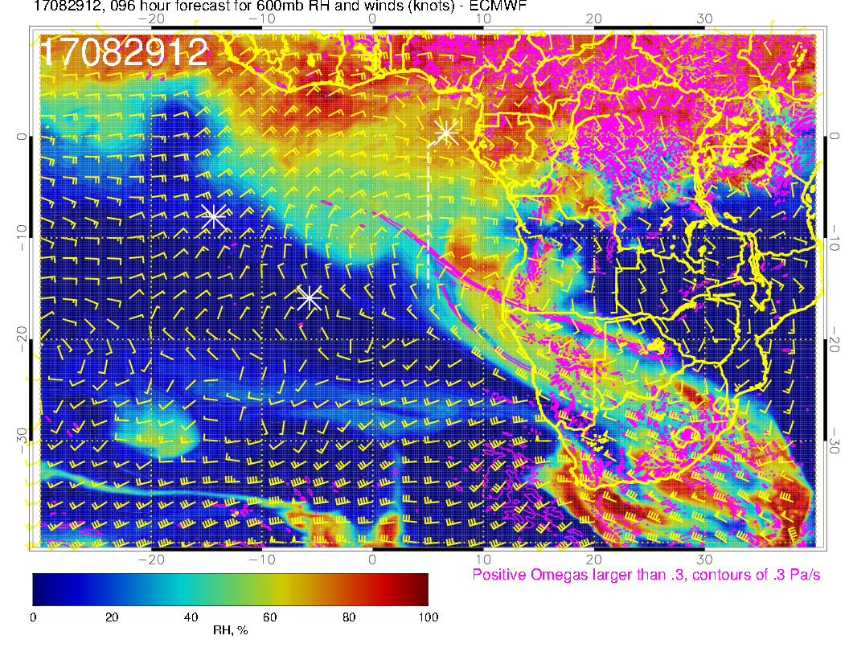
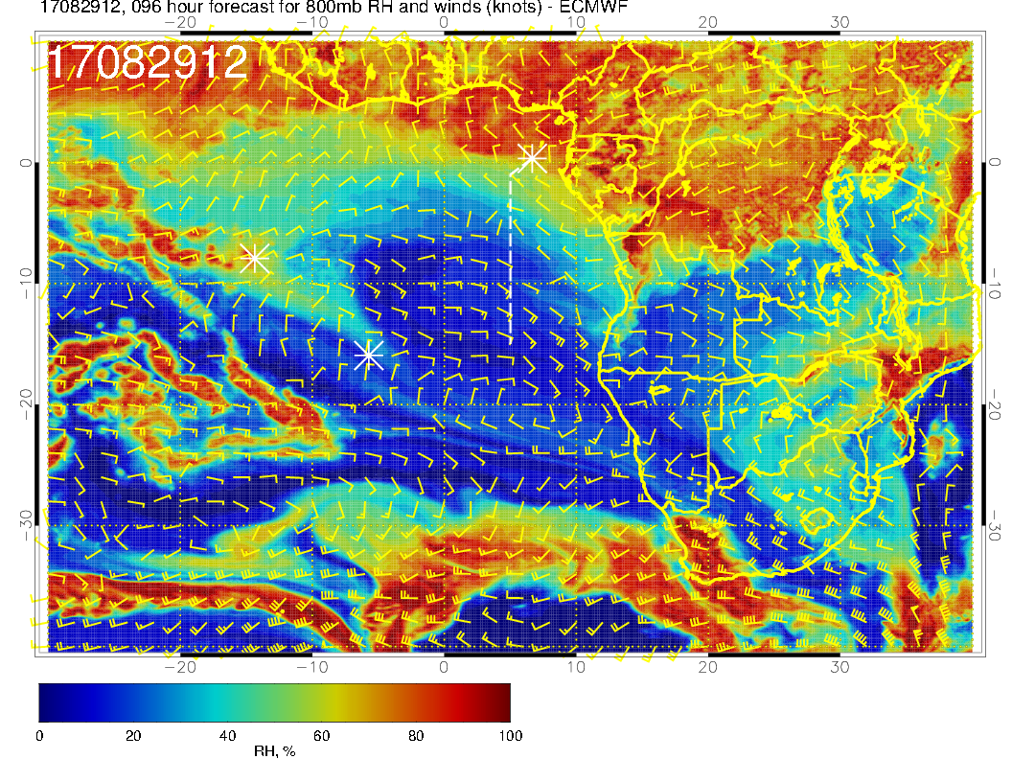
Zonal flow (westward) at upper two levels. Note northward flow is penetrating further south at 2 km near the shore. At 700mb, there is a bit more moisture further south than previous fcst. Note the dry convective moisture off the Angolan coast, a bit out of our reach.

Slide 29
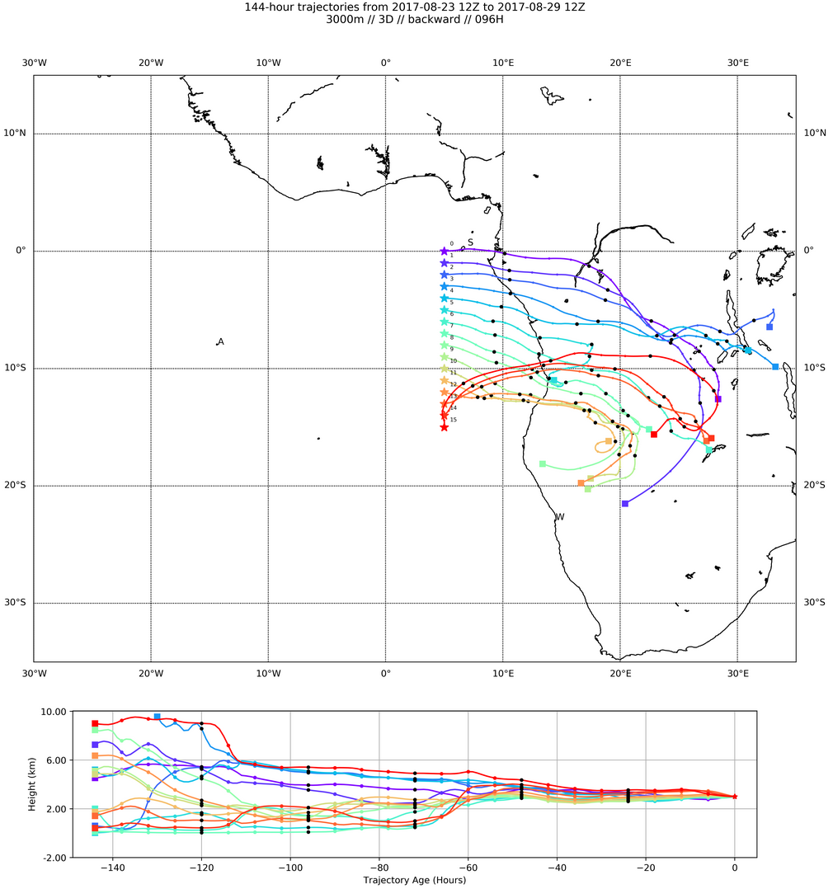
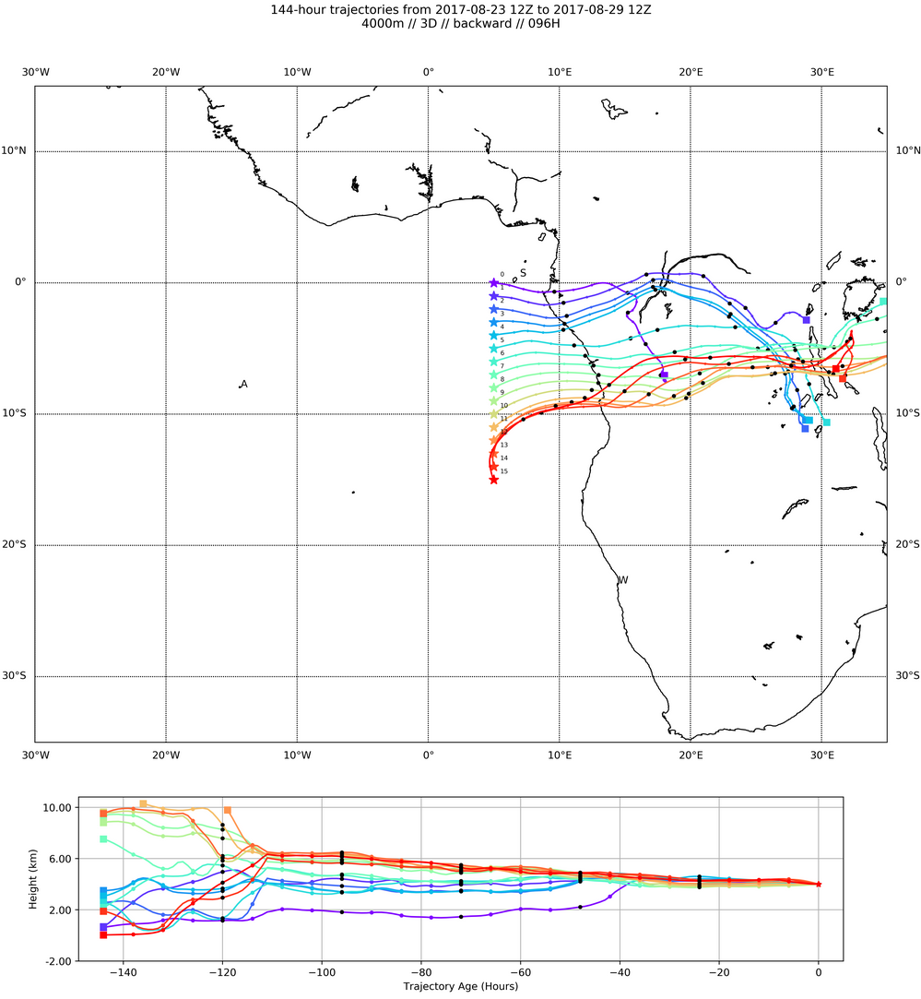
3 km BT
4 km BT
BTs for 700 and 600mb. As on Monday, BTs are more zonal at the higher level

Slide 30
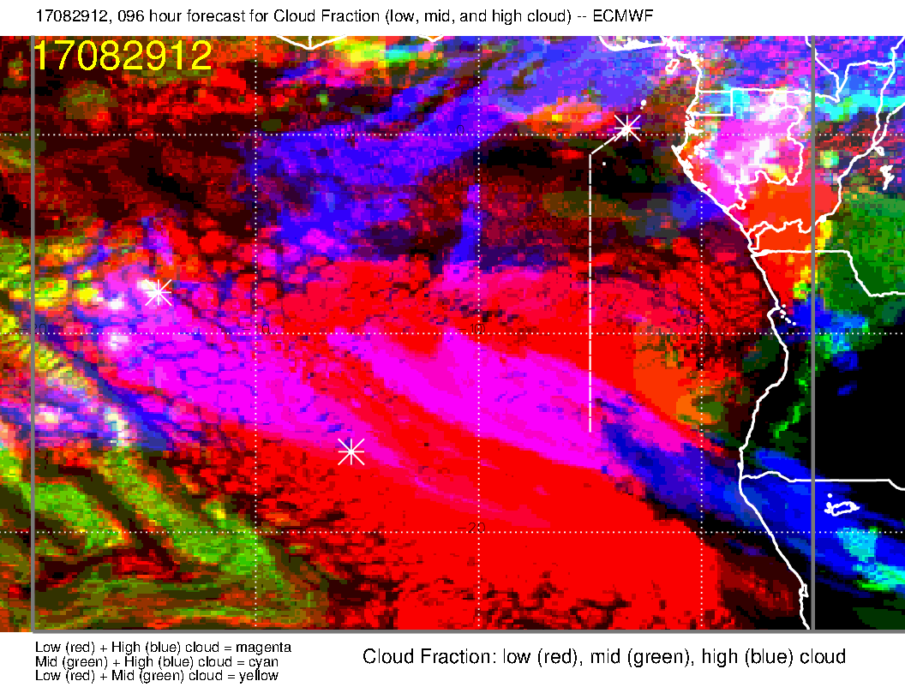
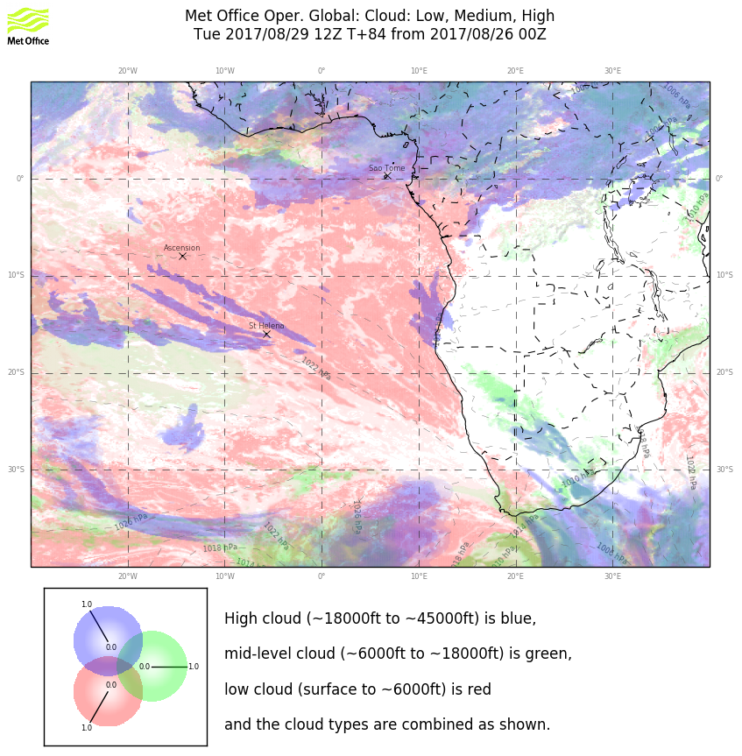
A long way out. EC has some middle cloud in operating region. I would discount this as the EC overpredicts mid-level cloud in long term forecasts (and does not capture the full diurnal clearing at mid-day). All I can tell on the high clouds for sure is the presence of jet stream cirrus and the fact that we expect outflow cirrus north of the equator.

Slide 31
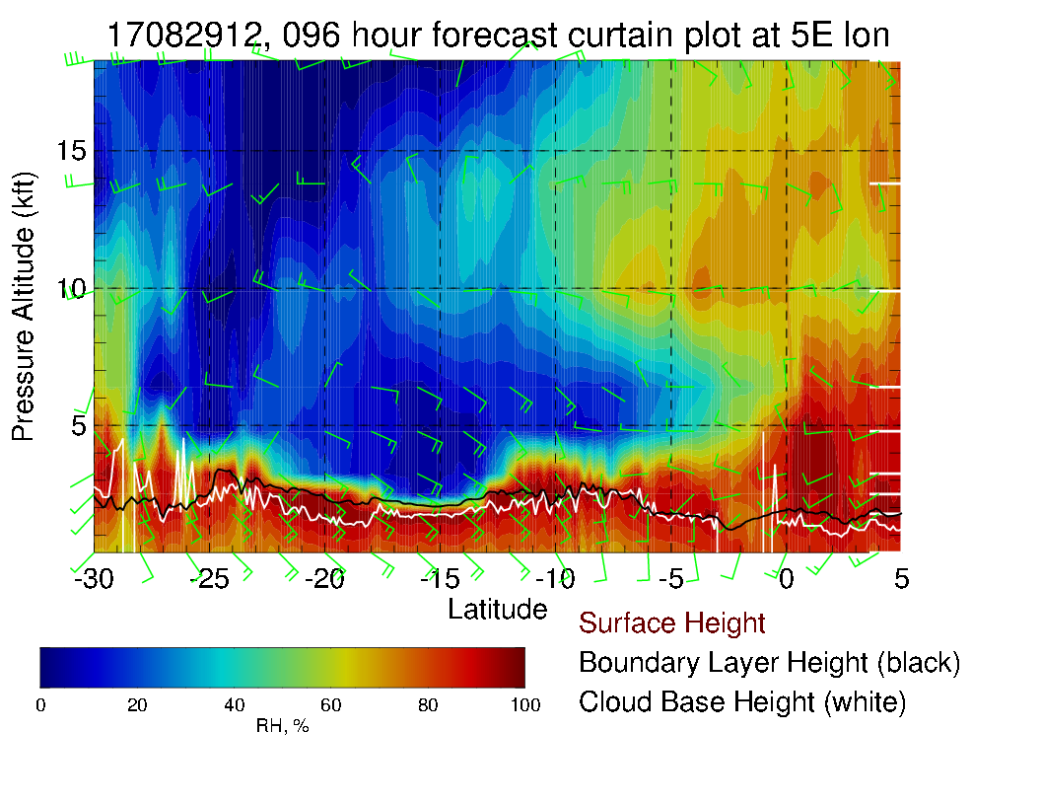
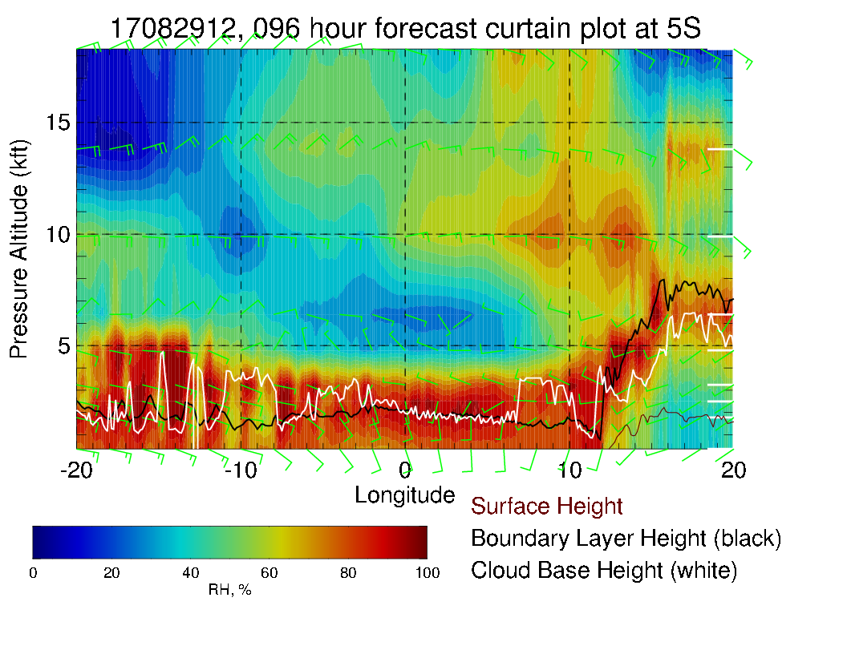
Mid level moisture starting to enter routine track (above), and can see how it is moving westward (left). More moisture further south on routine track than previous fcst. Winds pretty much easterly, 15-20 knots at midlevels. Note westerlies at 800/850 mb. Surface winds southerly, typical strength.

Slide 32
Wednesday

Slide 33
SH High moving eastward near climo, winds show typical directions in tropical Atlantic (though a little weaker than average). Convection looks kind of washed out (same everywhere on the continent), which is probably not right.

Slide 34
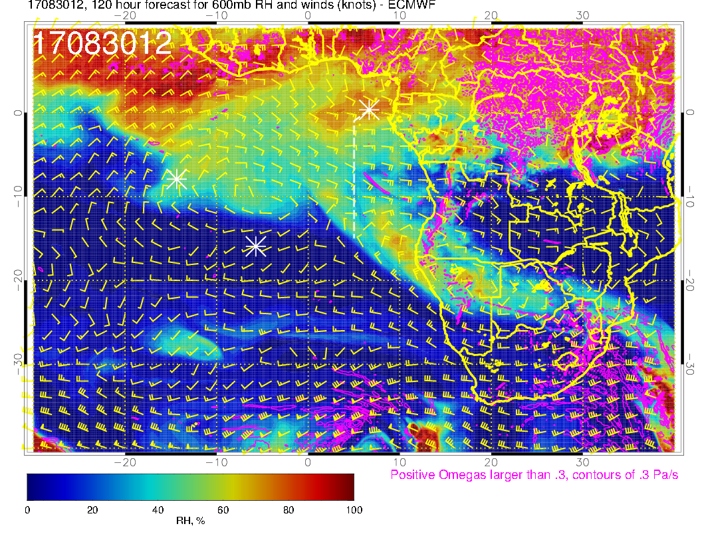
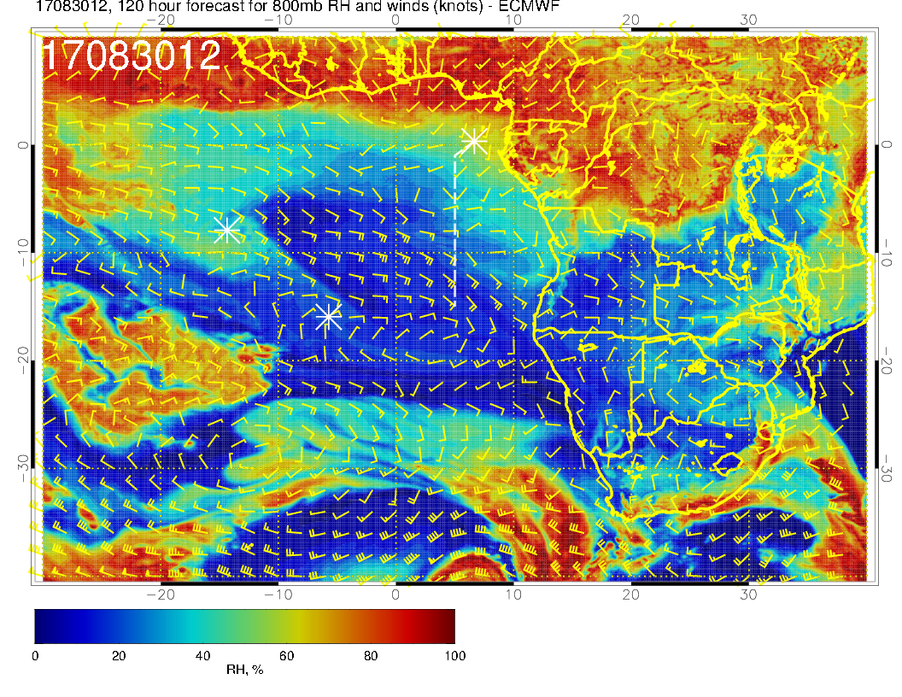
Not the previous vertical coherence between the levels as on previous days. See zonal motion south of about 5S at the upper two levels, with approaching southeasterlies at 700mb (a bit ahead at 600mb). Looks like the dry convective moisture is trying to approach the routine flight track at 600mb. 800mb flow is weak east of 5E. Significant mid level moisture limited to 700mb.

Slide 35
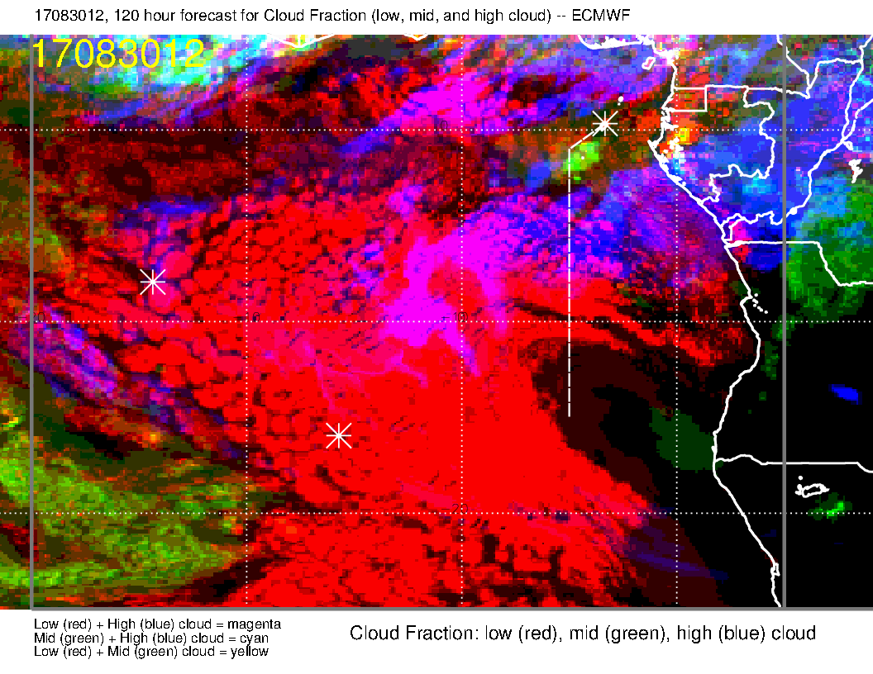
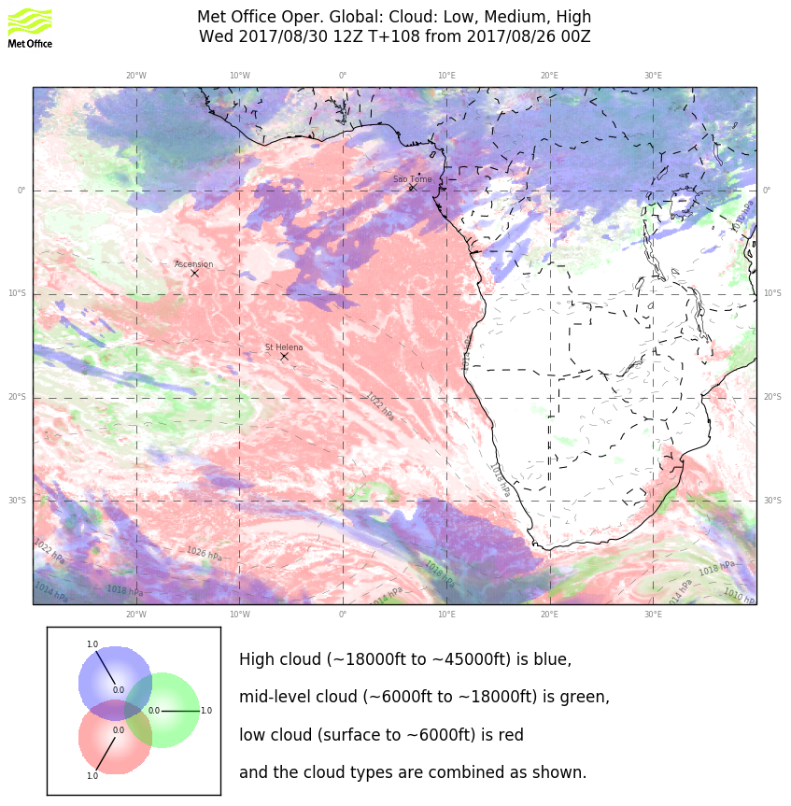
So, at the end of the forecast cycle, the models agree on the high clouds.
Go figure.
“Somewhere in the darkness, the gambler he broke even??”
(Middle cloud bullseye is the 700mb moisture. Not buying it.)

Slide 36
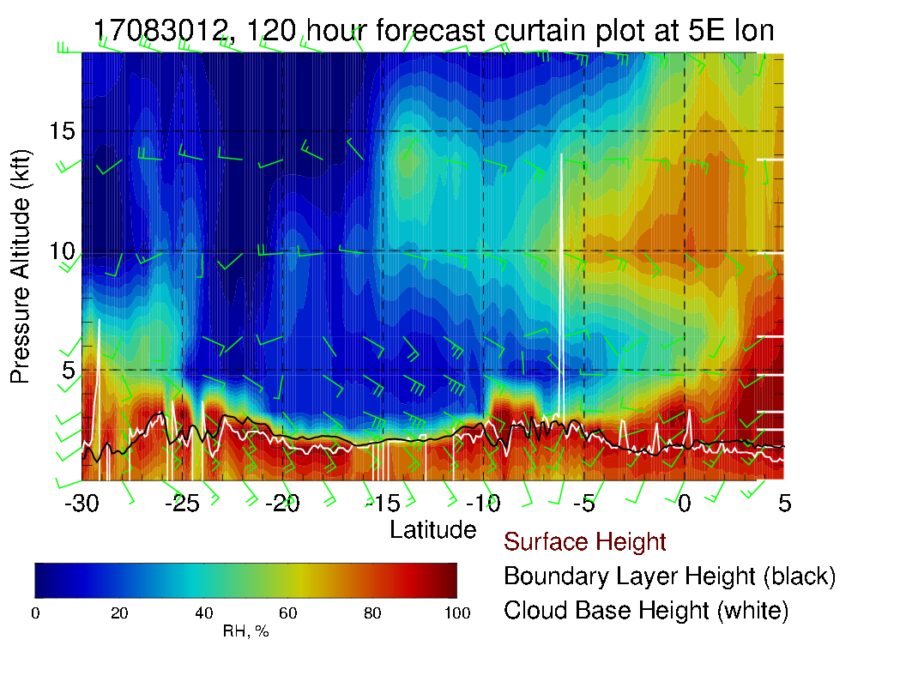
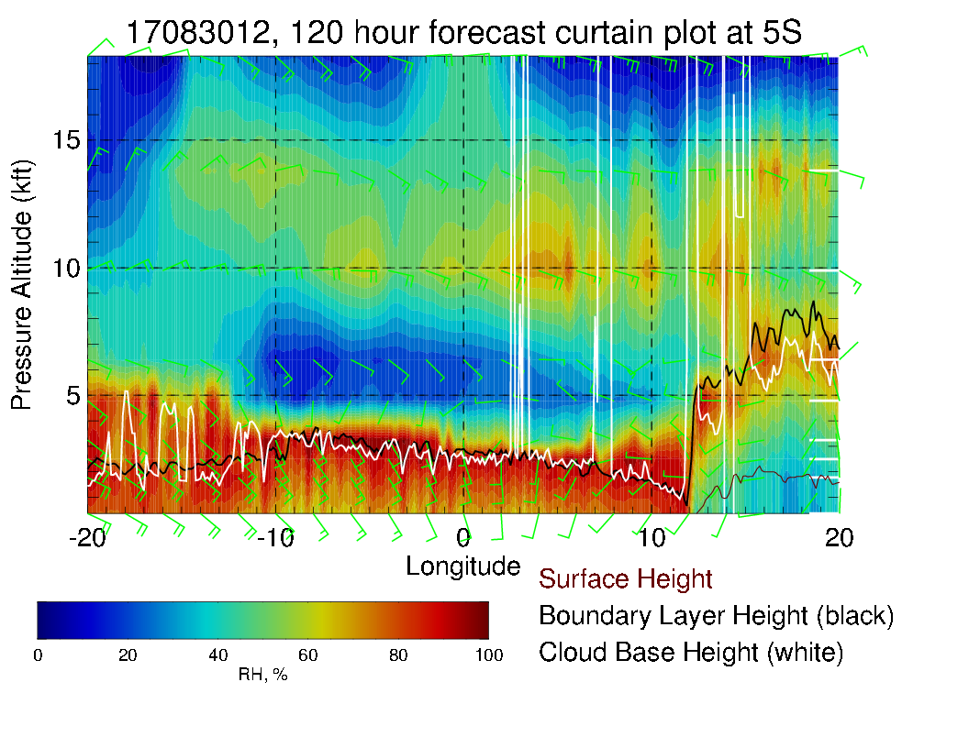
Mid level moisture inroutine track (above), and moving westward (left).. Winds pretty much easterly, 15-20 knots at midlevels. Note westerlies at 800/850 mb. Surface winds southerly, typical strength.

