Slide 1
Points
Southern part of square looks OK right now.
EC forecasts cirrus at 12Z in most of square
UKMO is clear in most of square
Probably want to be on the south side of the square anyway because low cloud boundary is progged to be further south than yesterday
I think a good assumption is to assume that there will be some cirrus northwest of the current boundary, which is a “compromise” between the EC and the UKMO for midday cirrus.
I would be nervous about the radiation flight.
Middle cloud will clear.

Slide 2
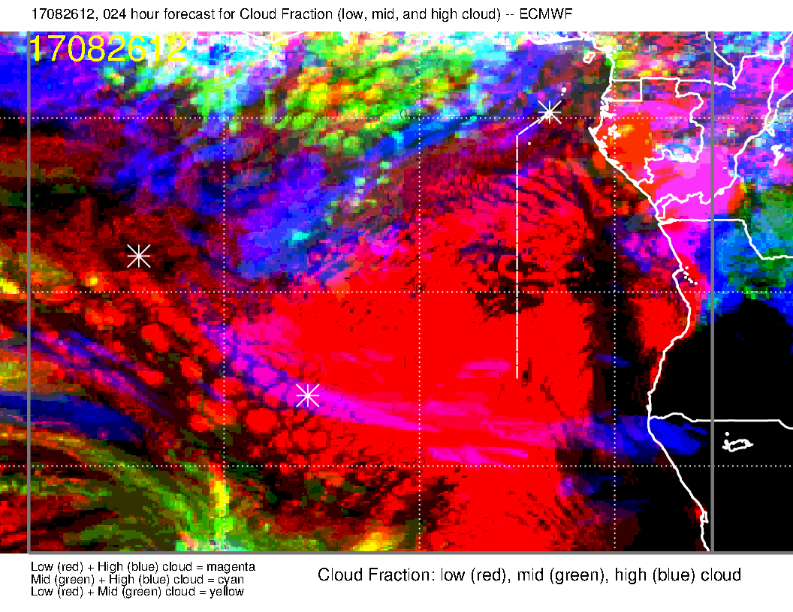
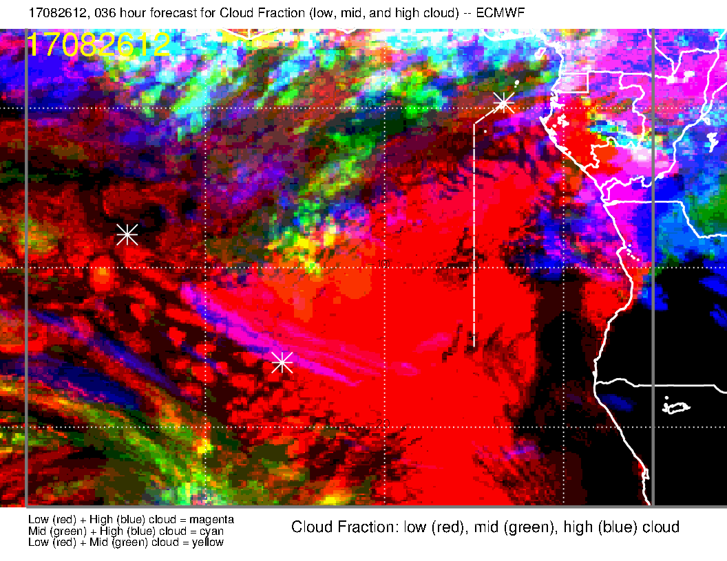
More cirrus in new forecast
Model tends to underestimate middle cloud clearing from 6 to 9, but gets cirrus clearing (diurnal) OK (based on last few days).
OLD

Slide 3
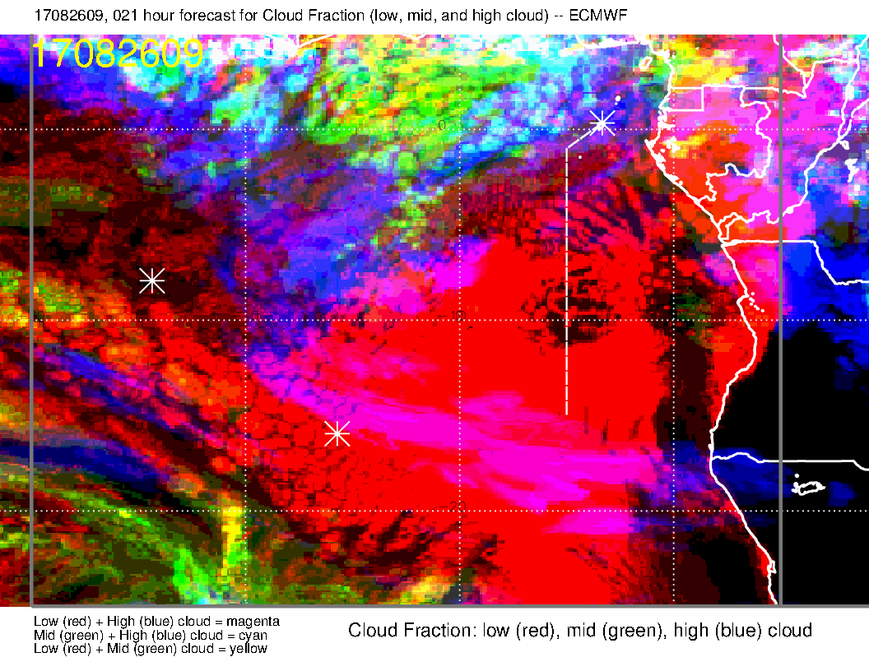
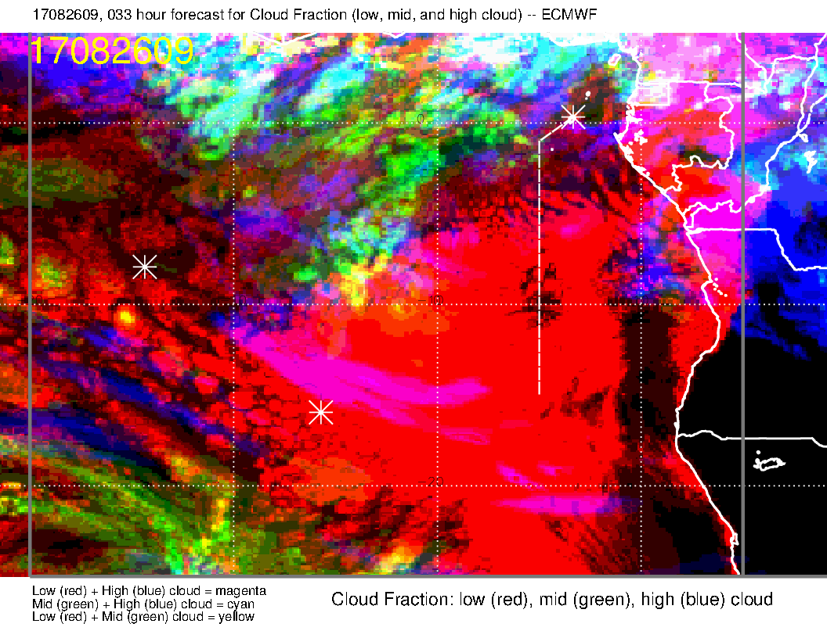
More cirrus in new forecast
Slightly less middle cloud clearing
In new forecast.
OLD

Slide 4
Midday model comparison
More cirrus in EC forecast than UK
Model tends to underestimate middle cloud clearing from 6 to 9, but gets cirrus clearing (diurnal) OK (based on last few days).
OLD

Slide 5
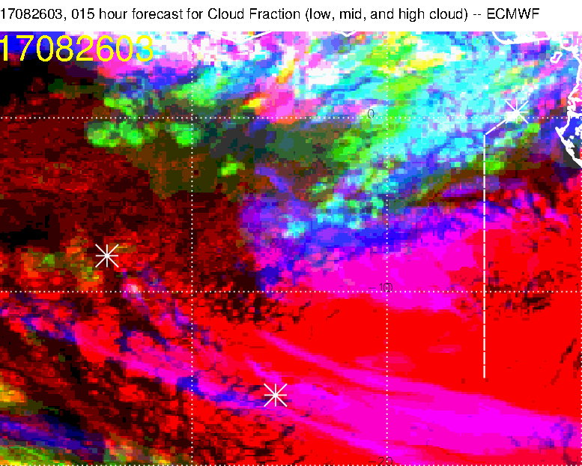
3Z comparison
The southern section is clearing
away, the northern section is progged to
persist

Slide 6
3Z comparison – UKMO is better on extent southern cirrus, but we don’t
care about that anyway. Rest of forecast is comparable to EC

Slide 7
High cloud only for 3Z

Slide 8
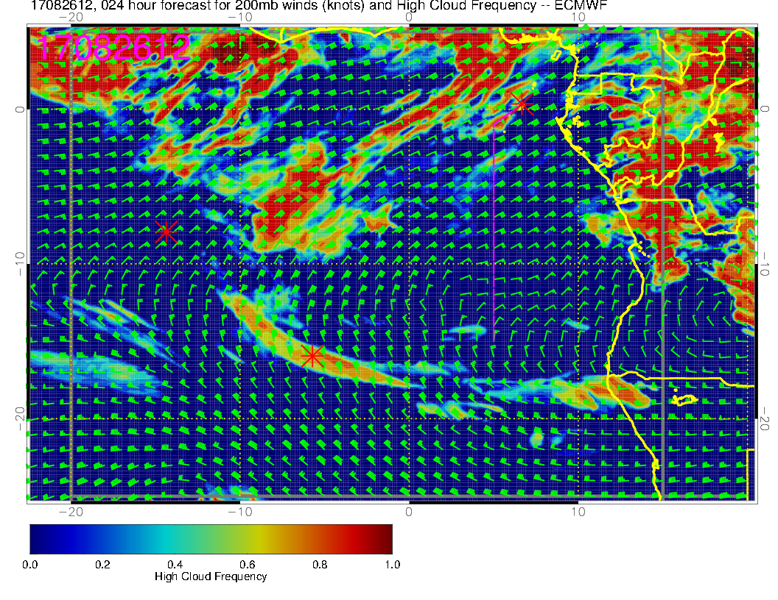
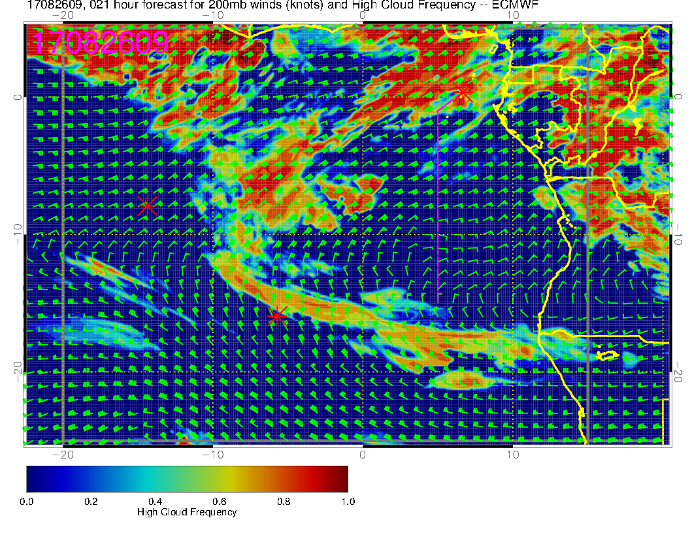

Slide 9
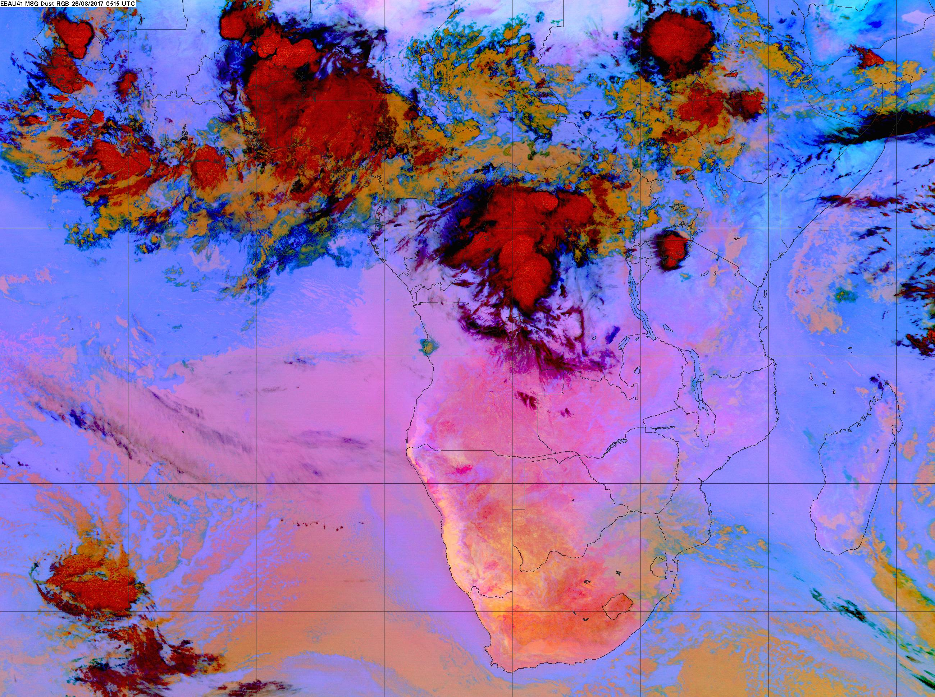

Slide 11
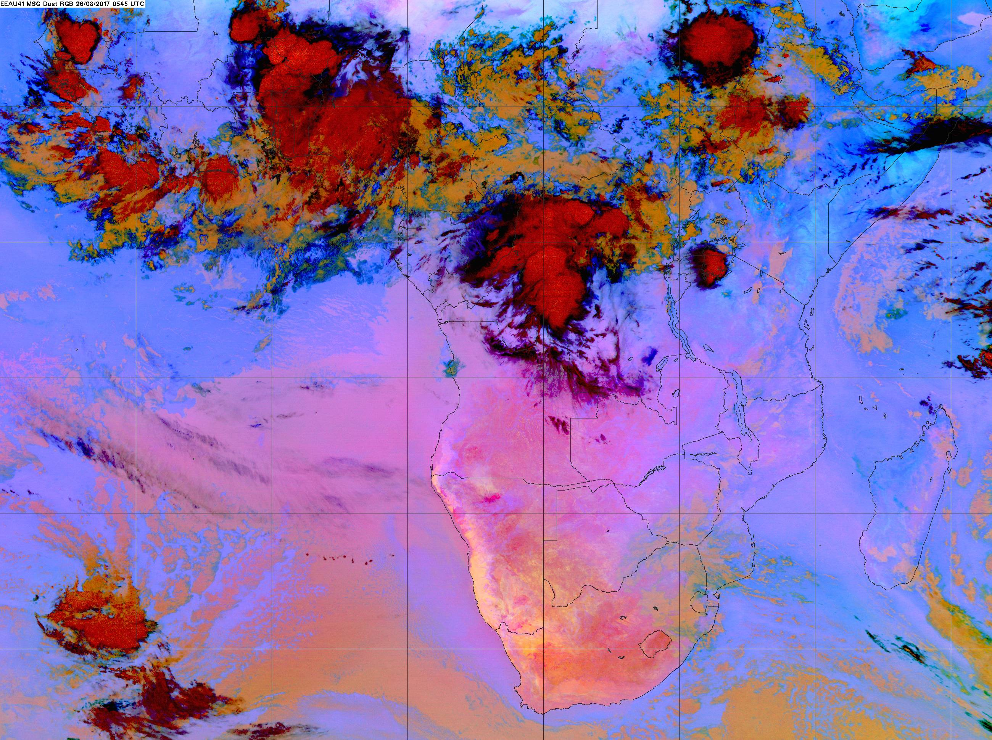

Slide 12
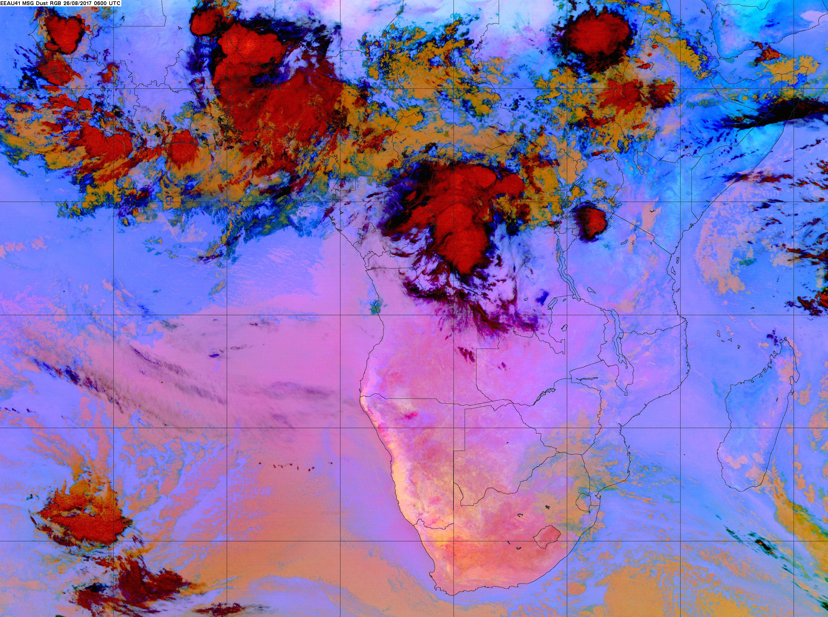

Slide 13
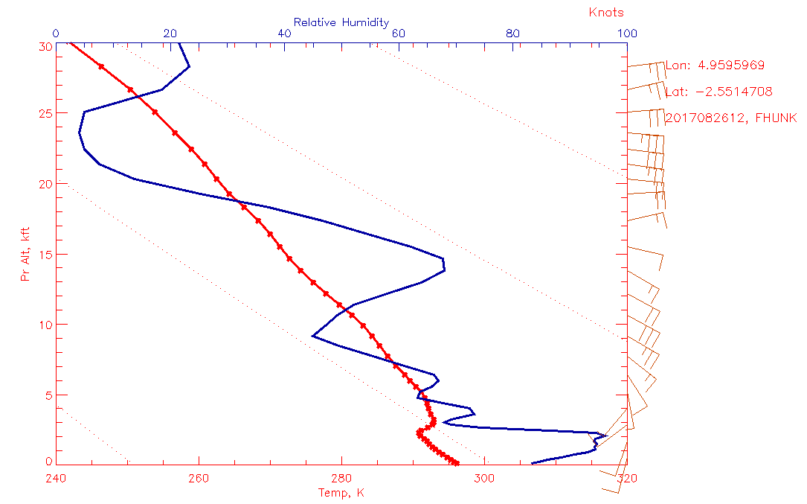

Slide 14
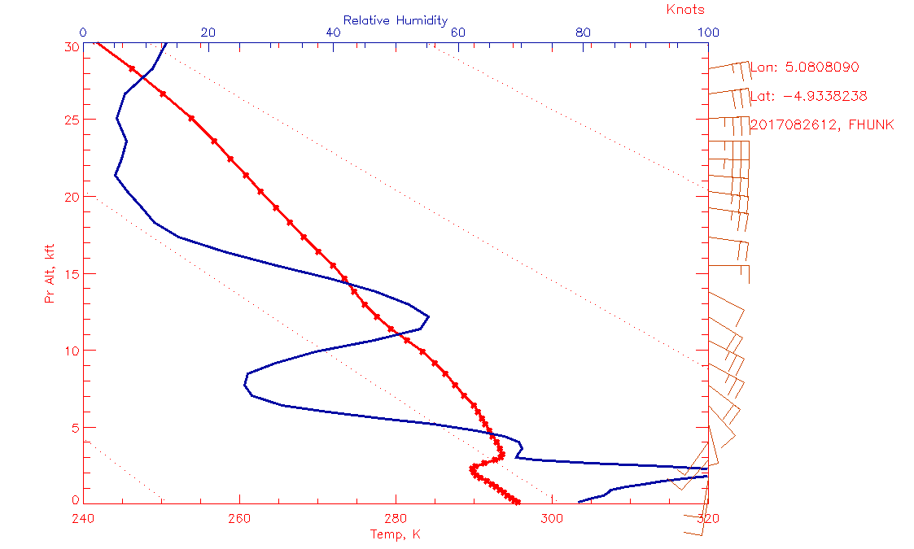

Slide 15
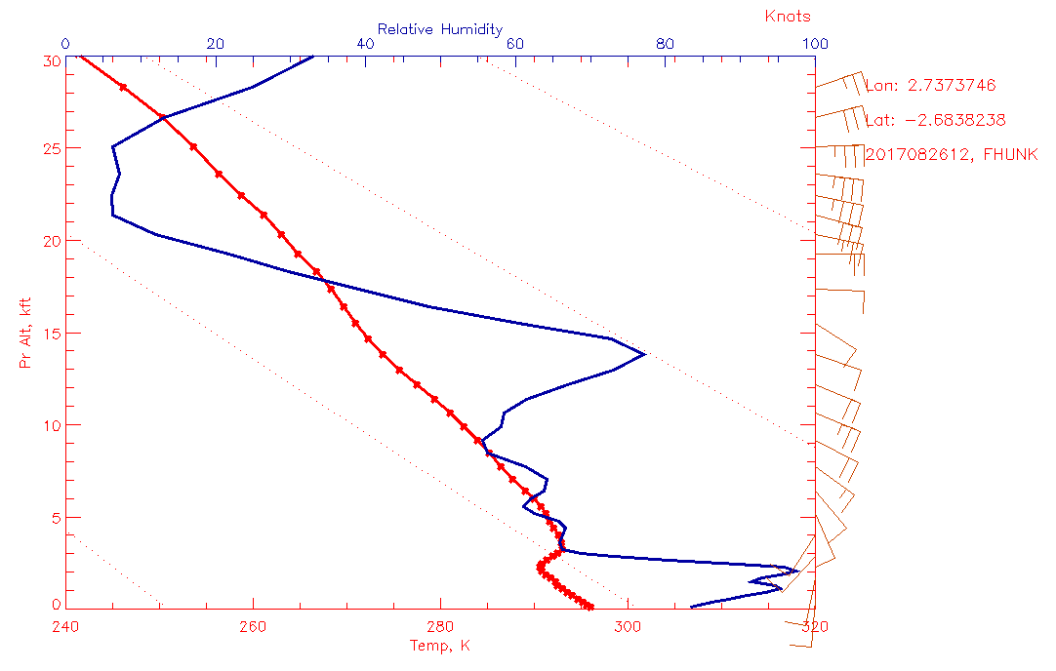

Slide 16
