Slide 1
ORACLES weather briefing
25-Aug-2017
Lenny Pfister and Rei Ueyama

Slide 2
Rain!

Slide 3
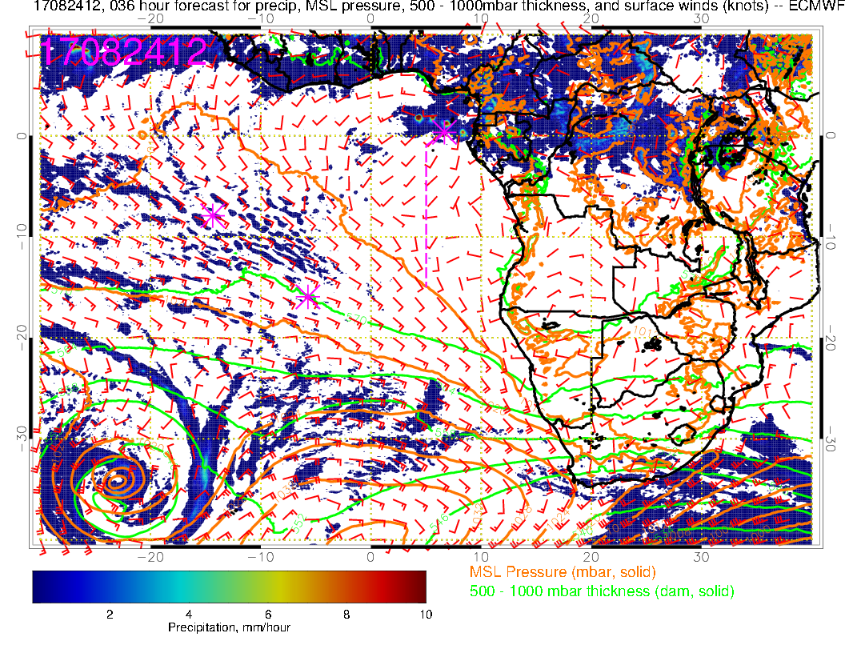
36 hour forecast trying to put rain near TMS.

Slide 4
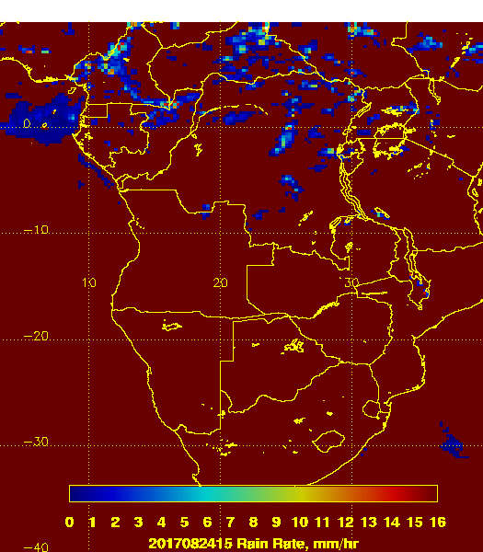
Satellite rain product indicates rain over the island at 3 PM (north end).

Slide 5
1330 IR image:
Precip came from band of cloud
with a mid-level top moving ssw behind
the main body of middle cloud. It lasted quite a while (hours, though RA for less than an hour) due to orientation of band.

Slide 6
Yesterday’s clouds

Slide 7
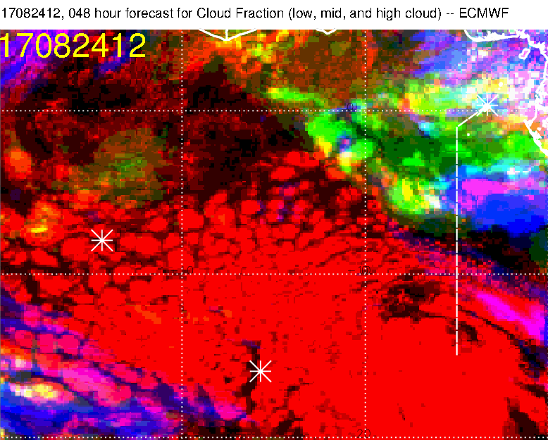
FCST verification at 48 hours for yesterday
Yesterday: EC overforecasted middle cloud (diurnal variation not fully captured). Though by 3 PM, middle cloud was filling in to 8S. High cloud is marginal, though it gets a few streamers. High cloud north of TMS is pretty good.

Slide 8
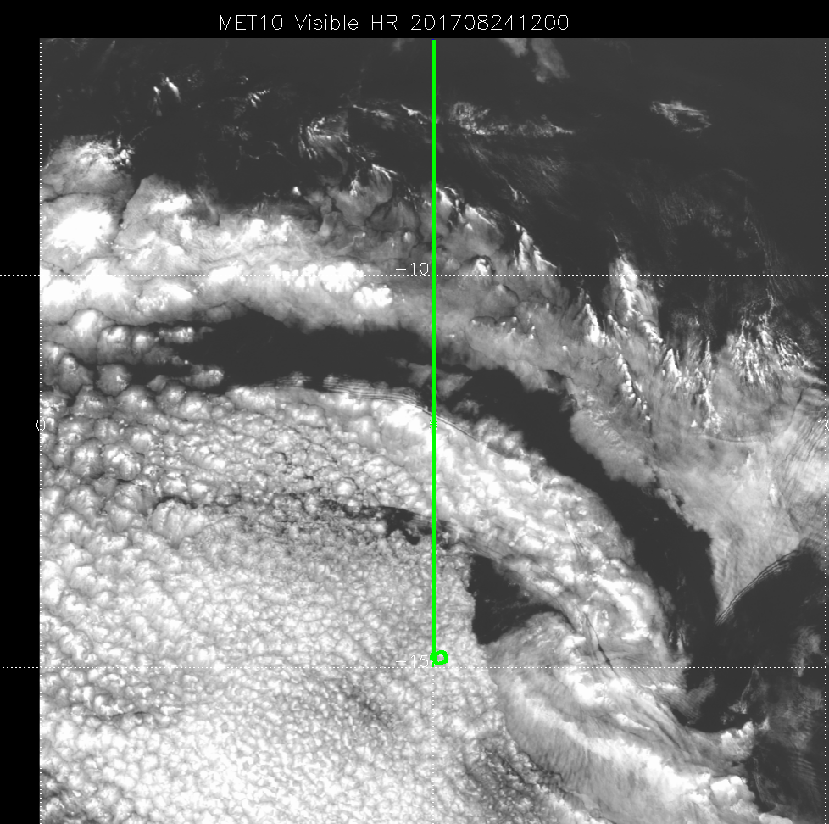
Yesterday: Low cloud boundary near 10S is pretty good. Spooky.
FCST verification at 48 hours for yesterday

Slide 9
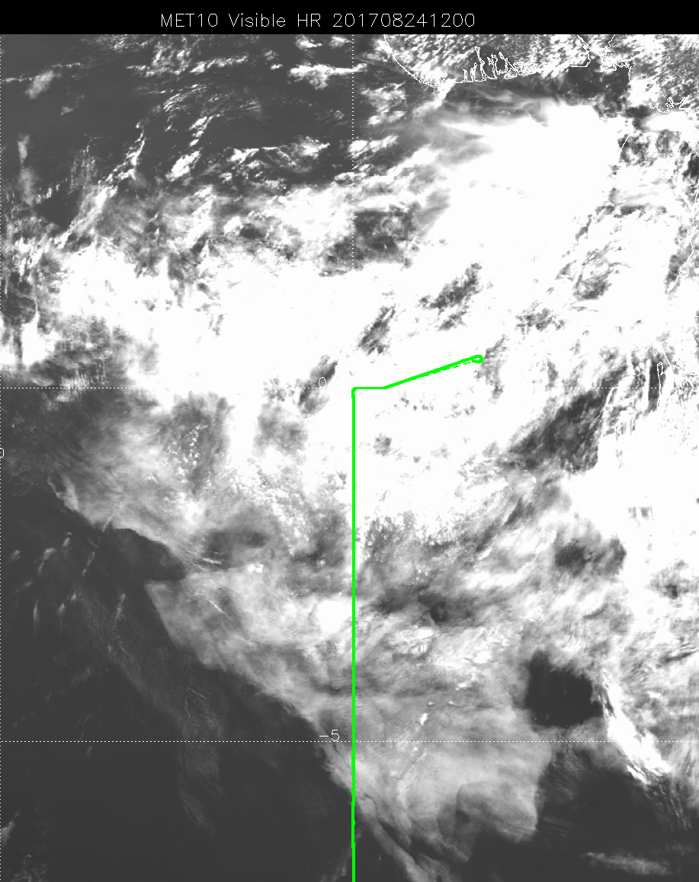
FCST verification at 48 hours for yesterday
Yesterday: Really not getting, at 48 hours, the situation at 12Z in northern part of routine track. Top part in visible image is middle cloud, but bottom part is low cloud. Clearing is overestimated by EC.

Slide 10
UKMO not getting the solidity of the middle cloud. High cloud maybe a little better than EC (but not north of TMS). Bottom line is that even at 48 hours, this is problematic. UKMO low cloud forecast is not good.

Slide 11
Surface evolution 8/24-8/29

Slide 12
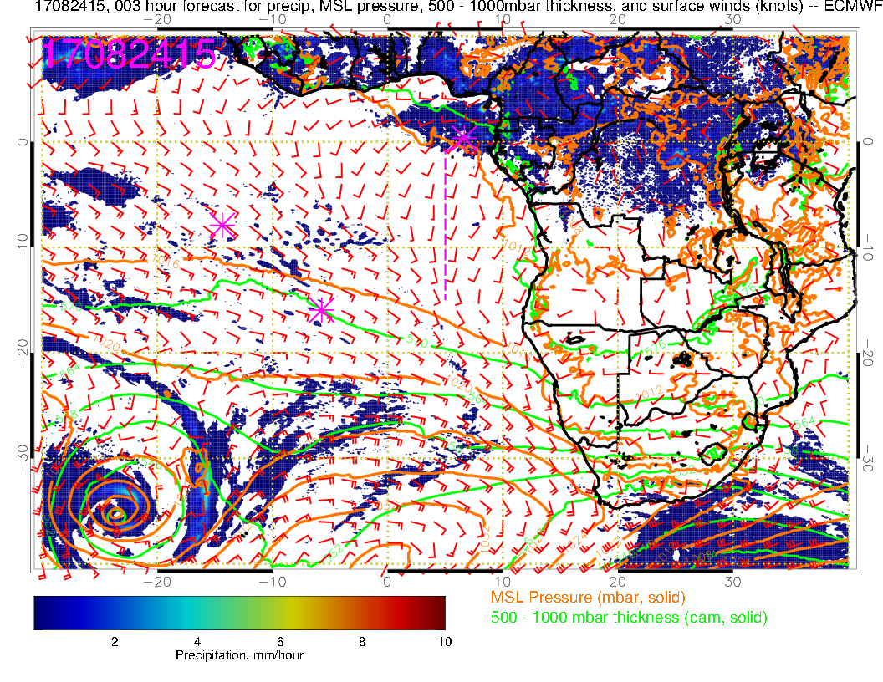
Yesterday, weak surface winds, convection over Cameroon, so winds aiming there. Precip locally. SH high is disturbed, so winds in Atlantic generally weak north of 15S.

Slide 13
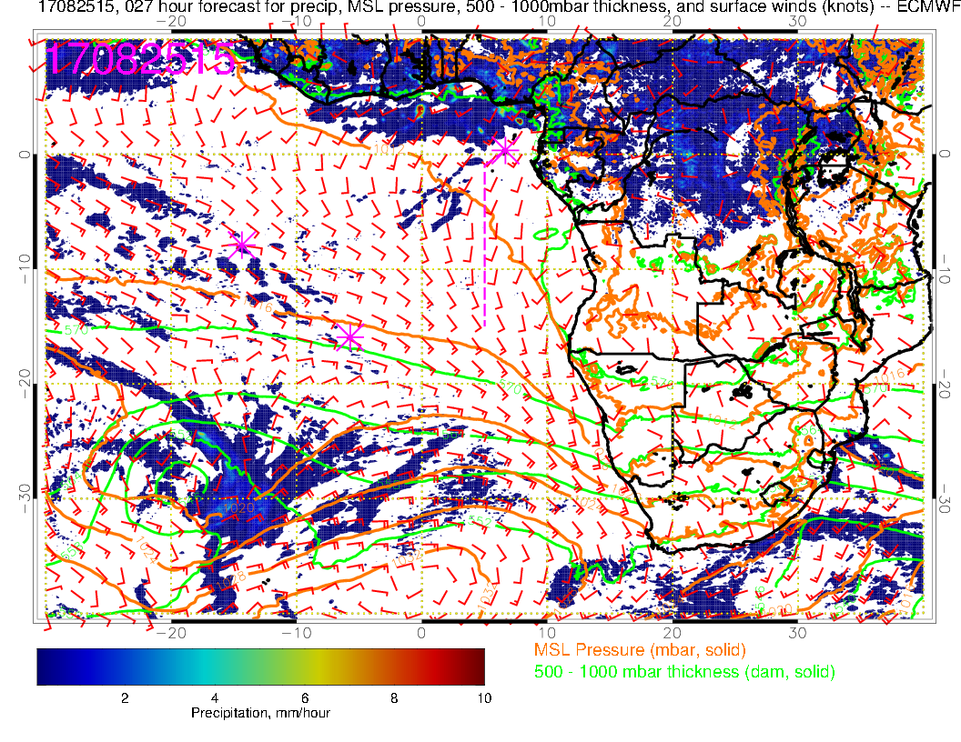
Today: Precip clears up, winds strengthen near TMS, convection over West Africa moves west, Congo convection developing.

Slide 14
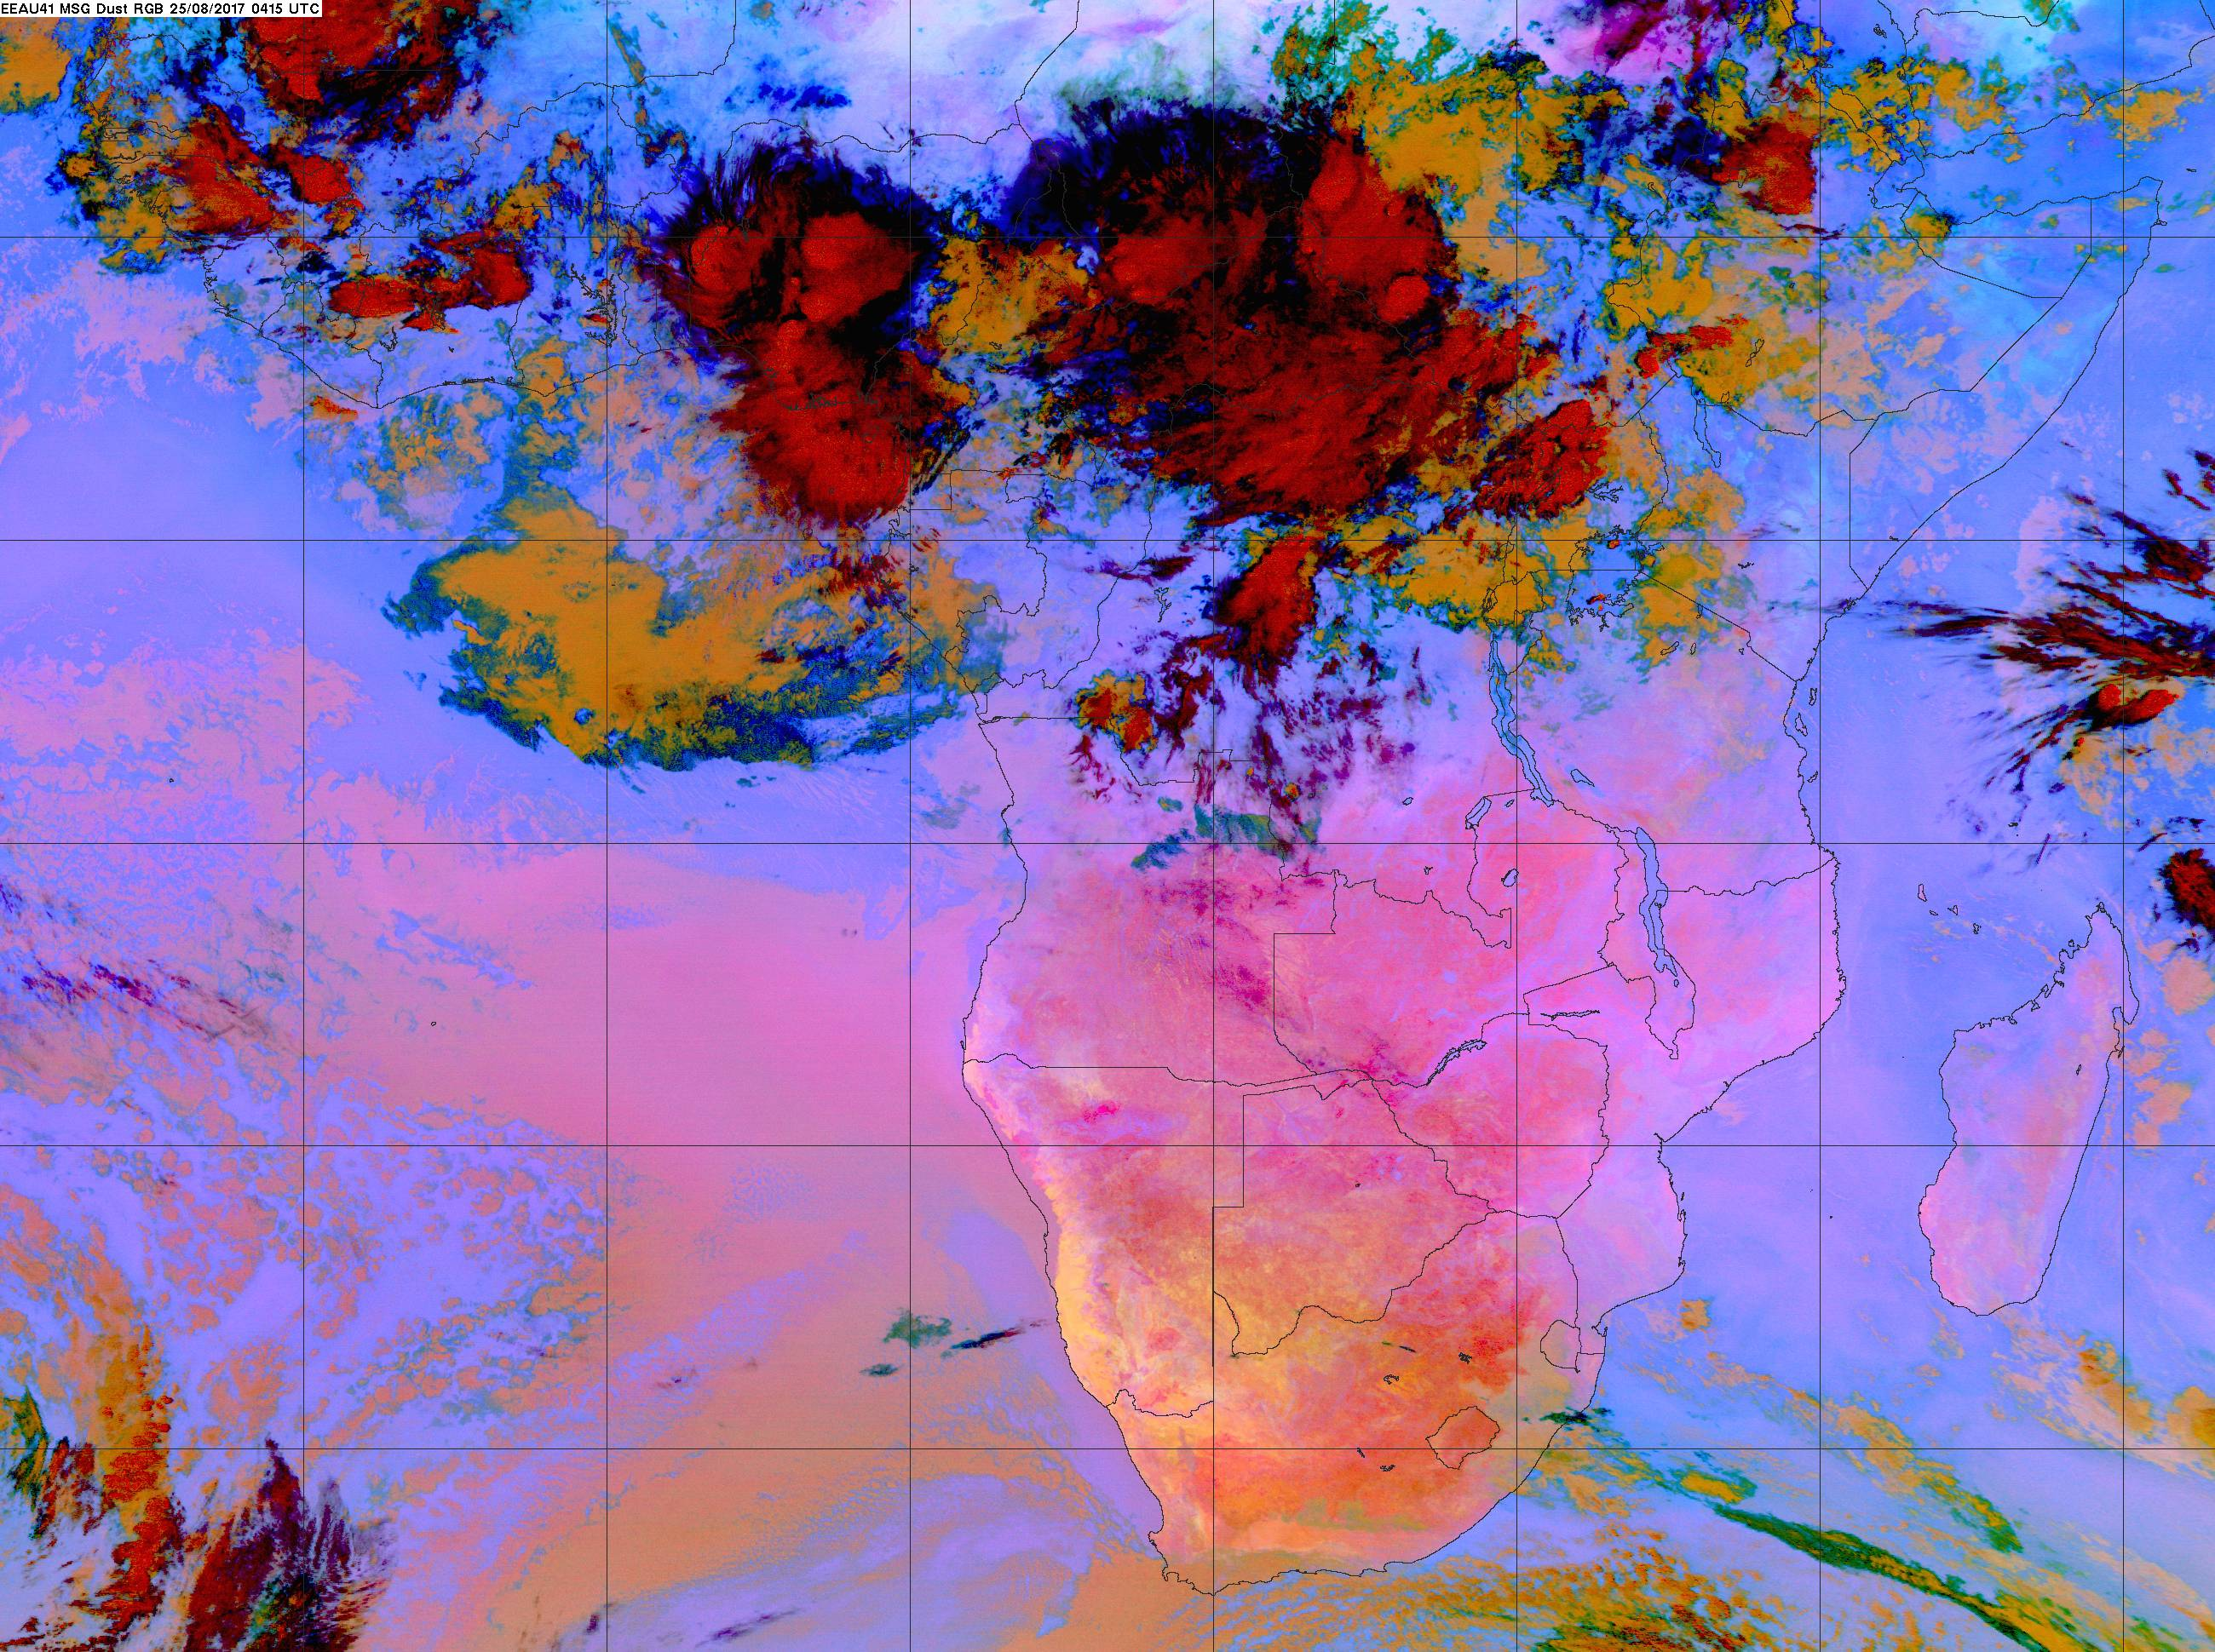
Ugly Angry middle cloud deck is still south of us, moved west. Next slide
shows movement, no diurnal dissipation yet apparent.

Slide 15
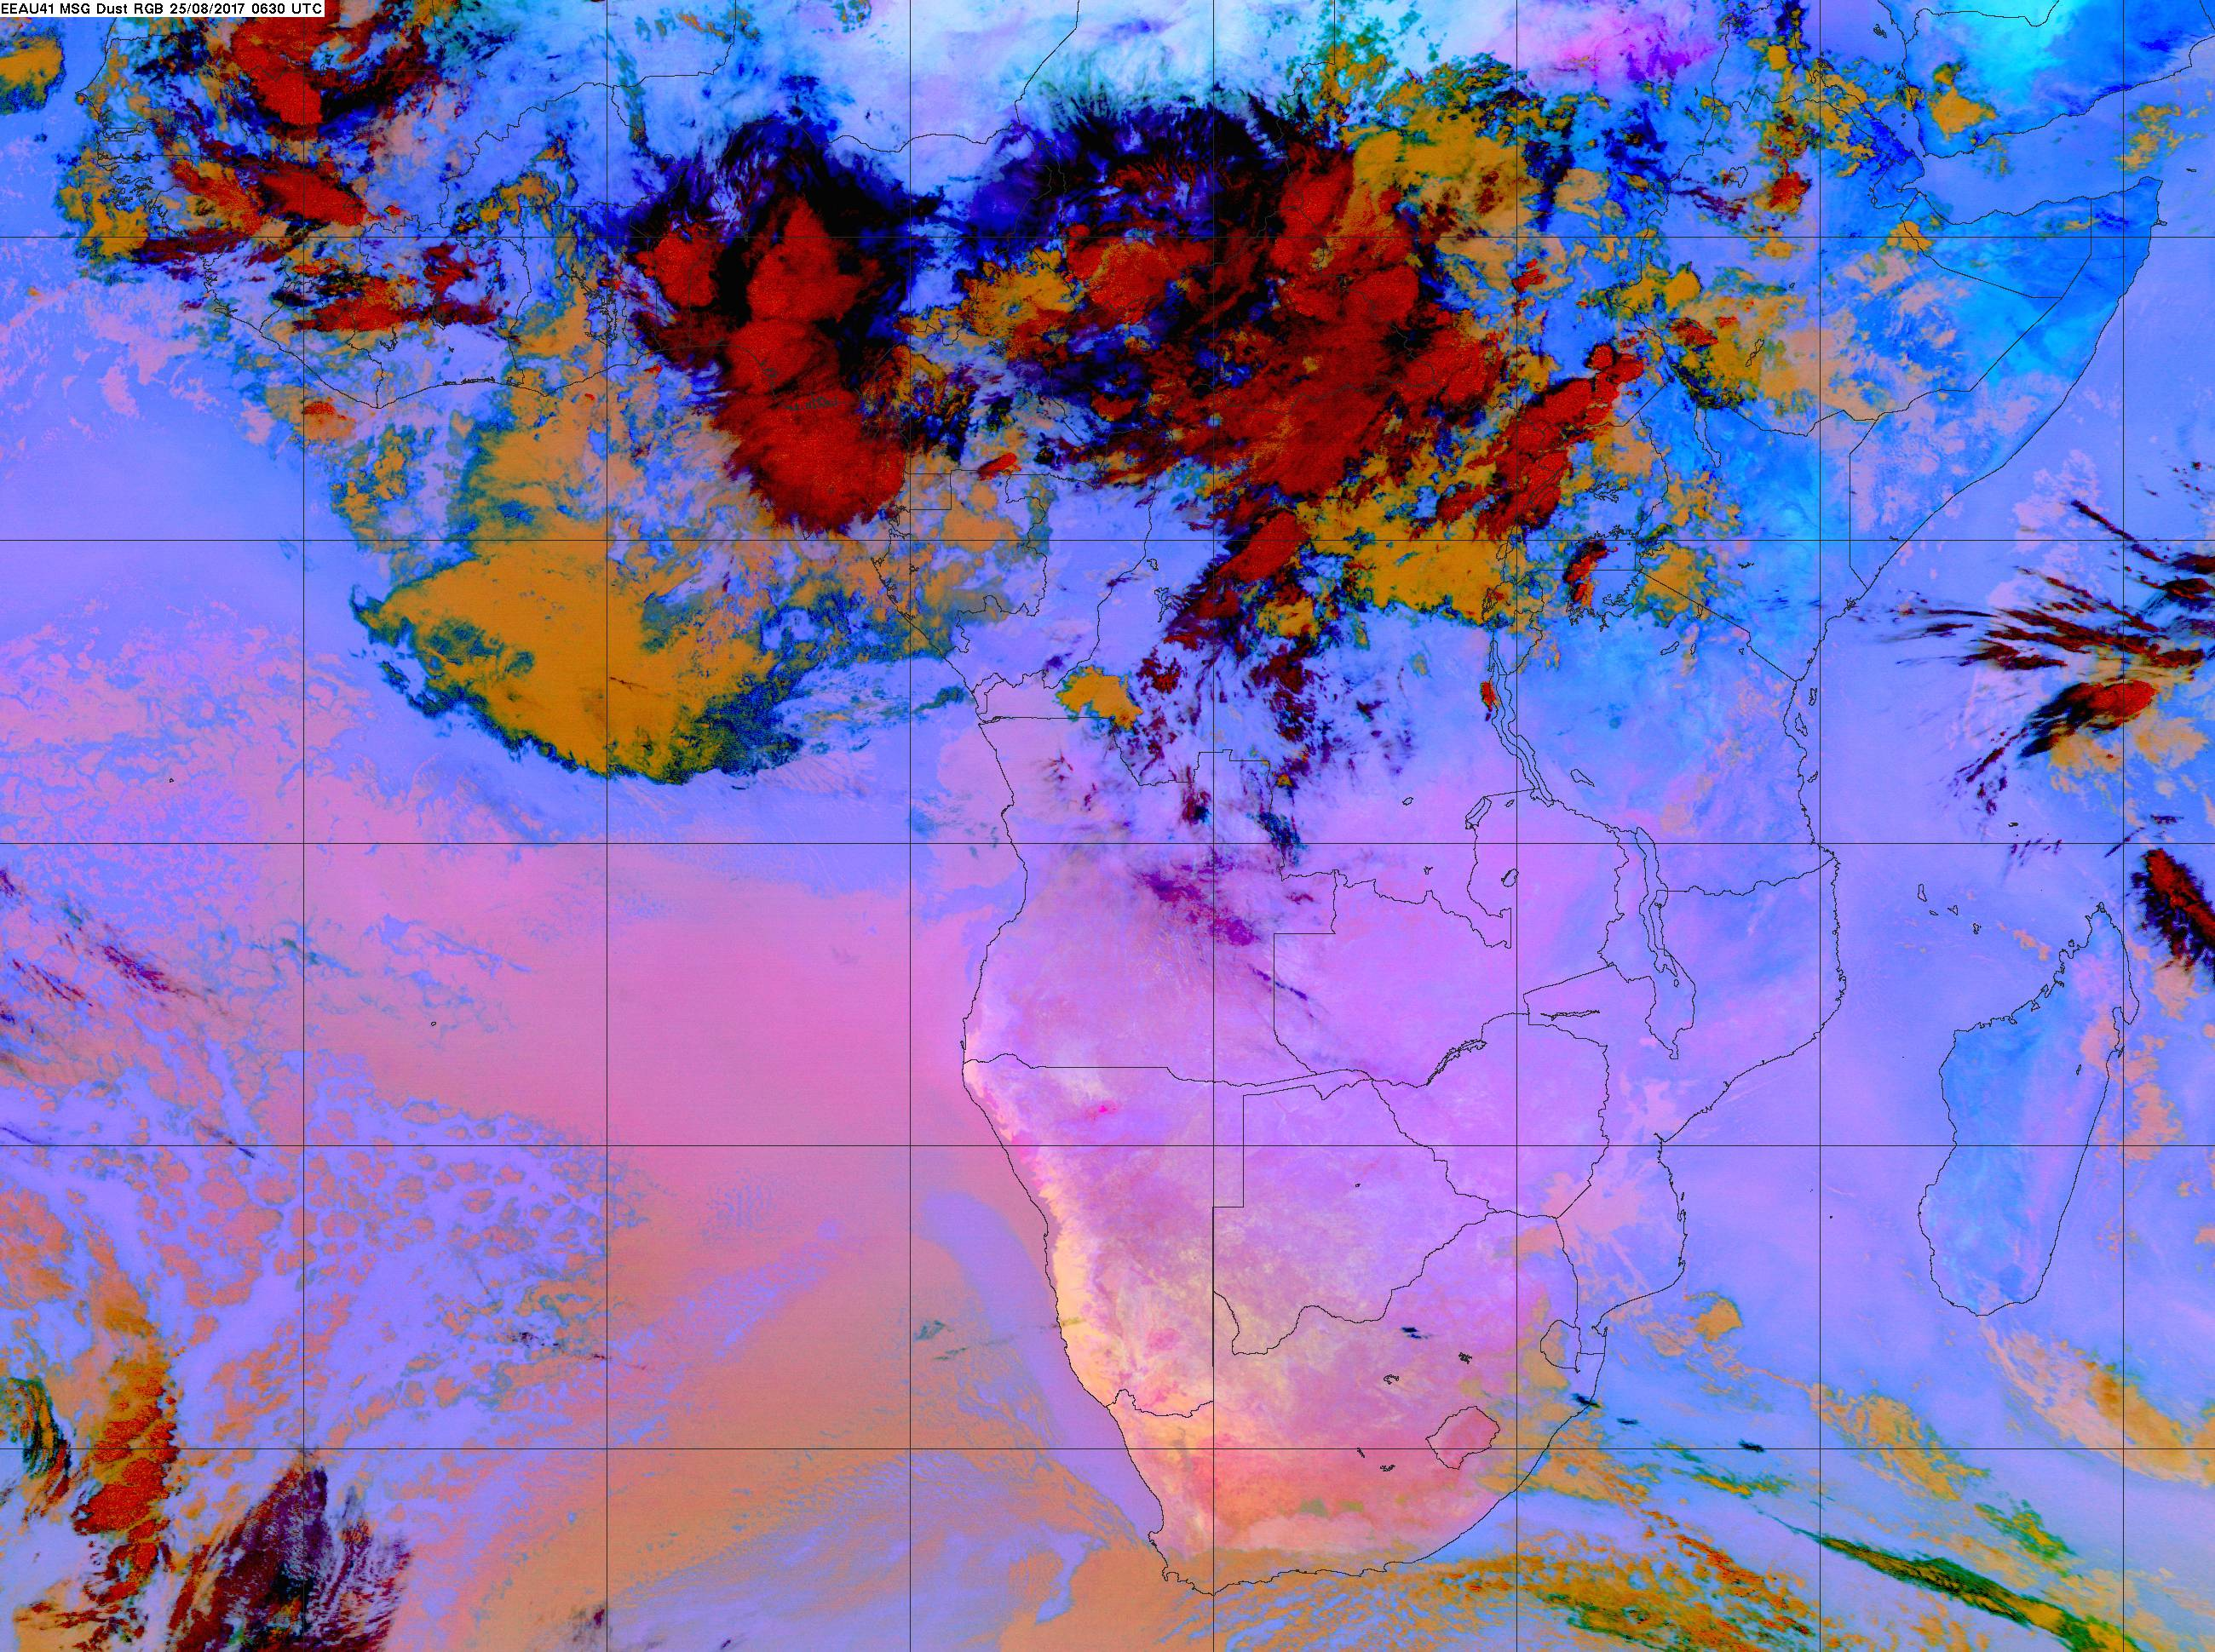

Slide 16
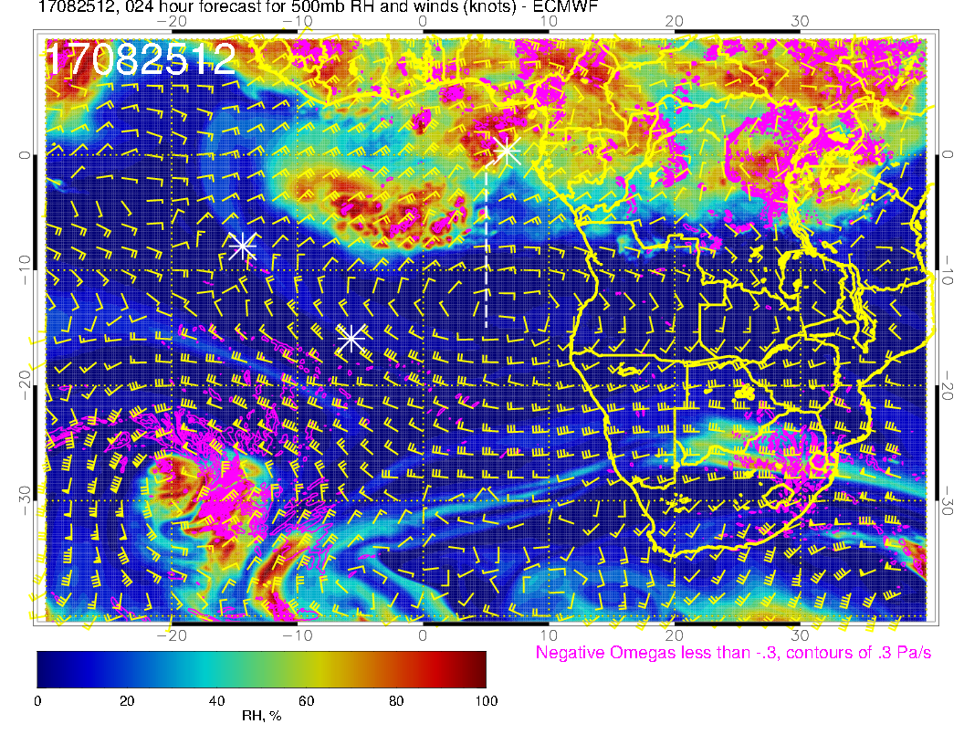
500mb today. Don’t usually see so much angry moisture this far south in 500mb charts.

Slide 17
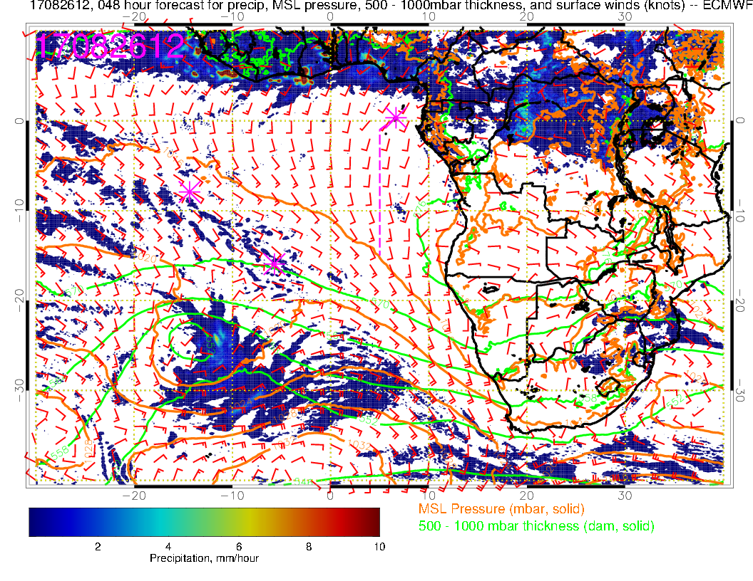
Saturday: Winds a bit more typical, Congo convection continues.

Slide 18
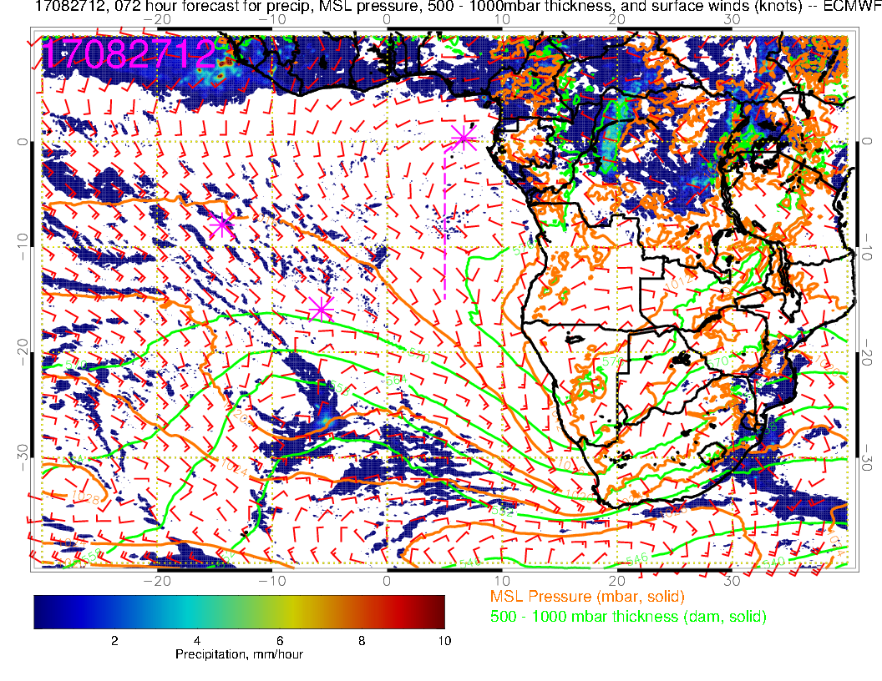
Sunday: Weak winds over much of SE Atlantic. Surface winds in tropics are aiming at two loci of convection – Congo and off the coast of western Africa. SH high displaced far south.

Slide 19
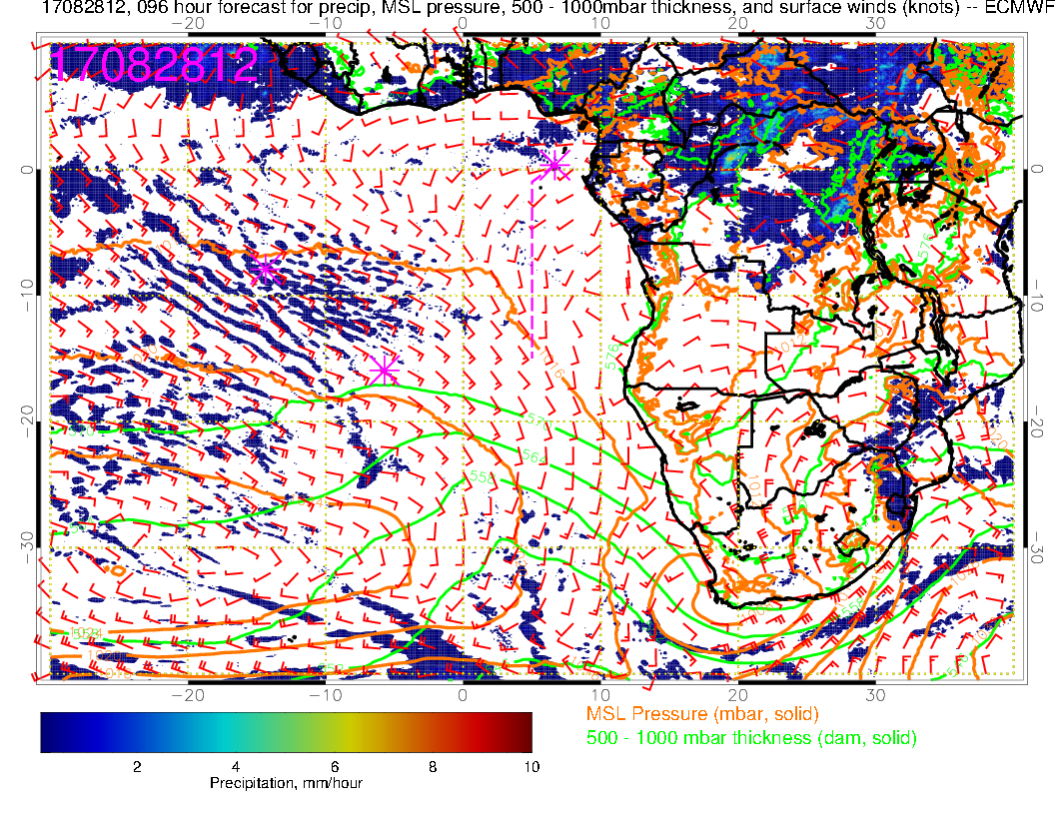
Monday: Still weak winds as SH high reforms to the west. Again, tropical surface winds aim to Congo and off of African coast. Near westerlies (weak) again at TMS.

Slide 20
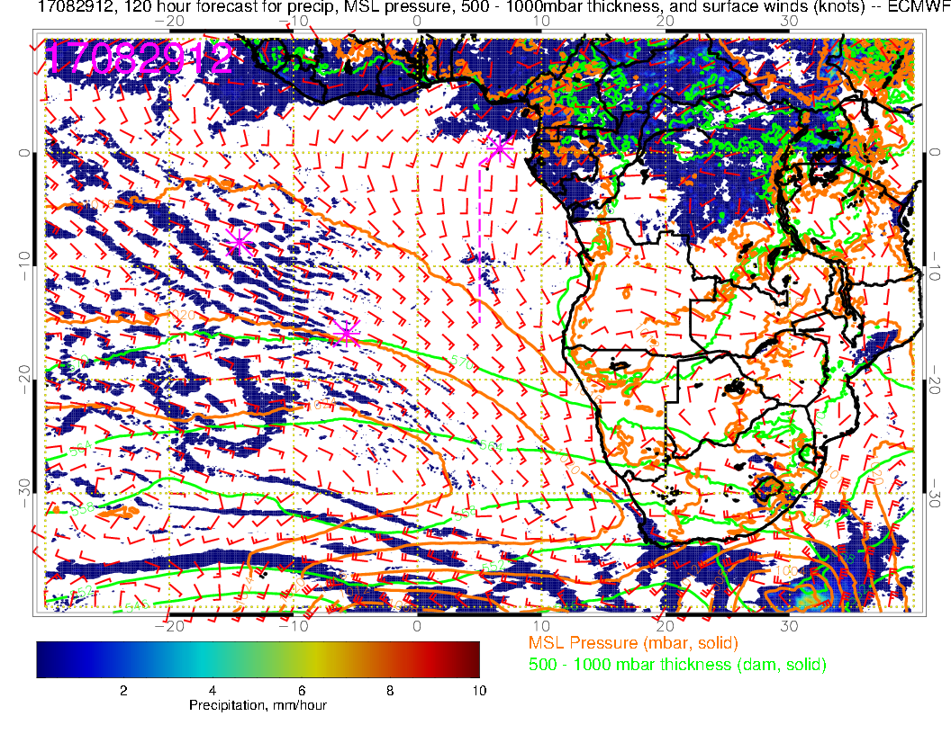
SH High moving into more typical place, winds strengthen, more typically southerly at TMS. African convection moved north into CAR.

Slide 21
700mb evolution 8/24-8/29

Slide 22
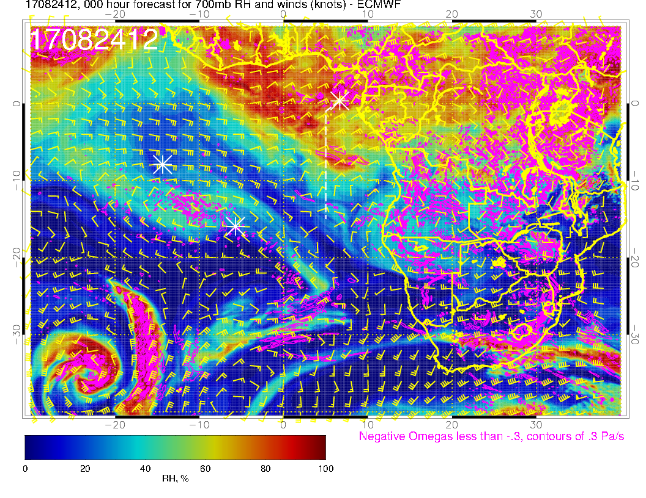
A
A?
A
New anticyclone over southern Angola. Get another northerly push of moist air
tomorrow.

Slide 23
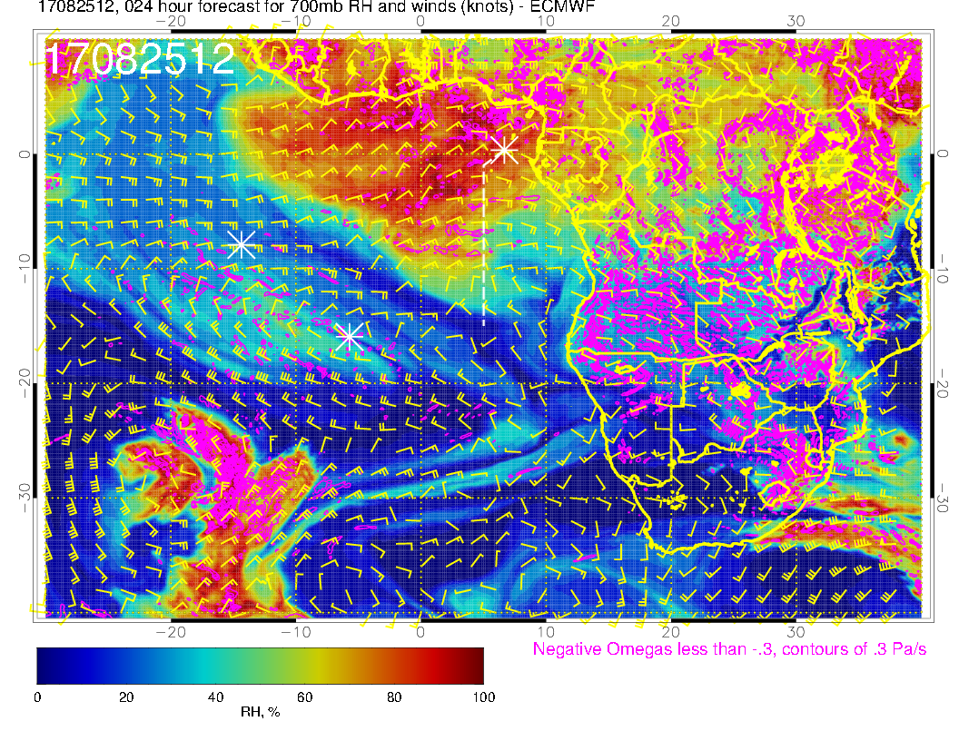
A
A
Slightly moister over our region than yesterday’s fcst. Still, dry air moving onto RT
as new anticyclone advances westward.

Slide 24
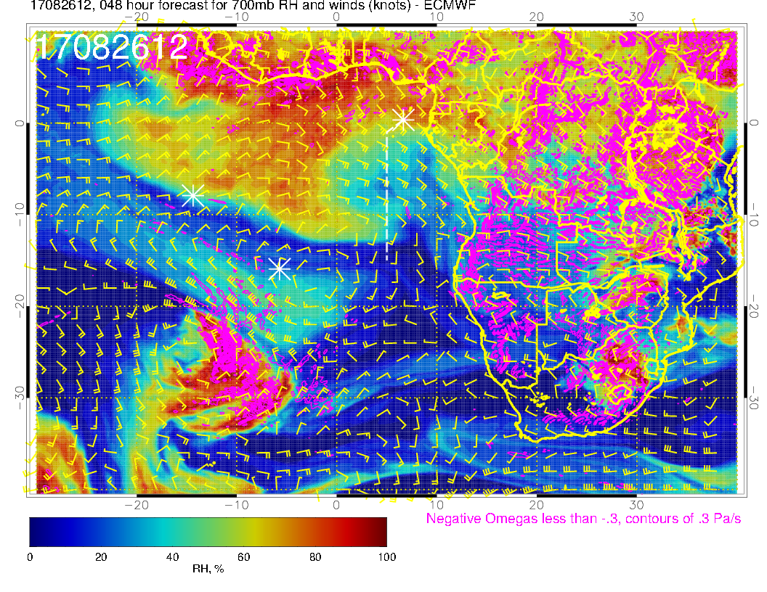
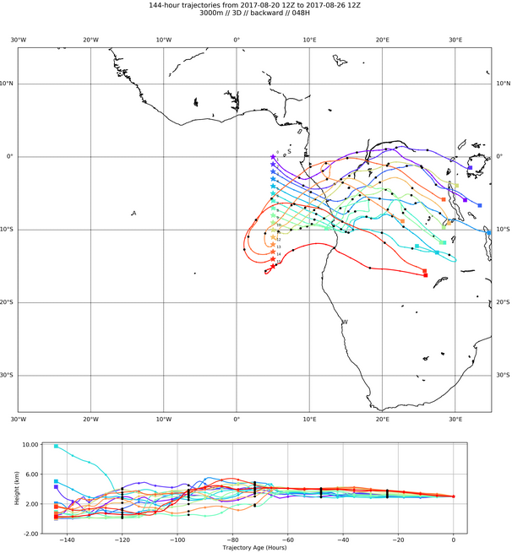
A
A
Forecast consistent with yesterday in drying out our region (just slightly drier). Anticyclone advances westward, bringing southeasterlies (and drier air, some descent). BT shows air from northern Angola/southern Congo

Slide 25
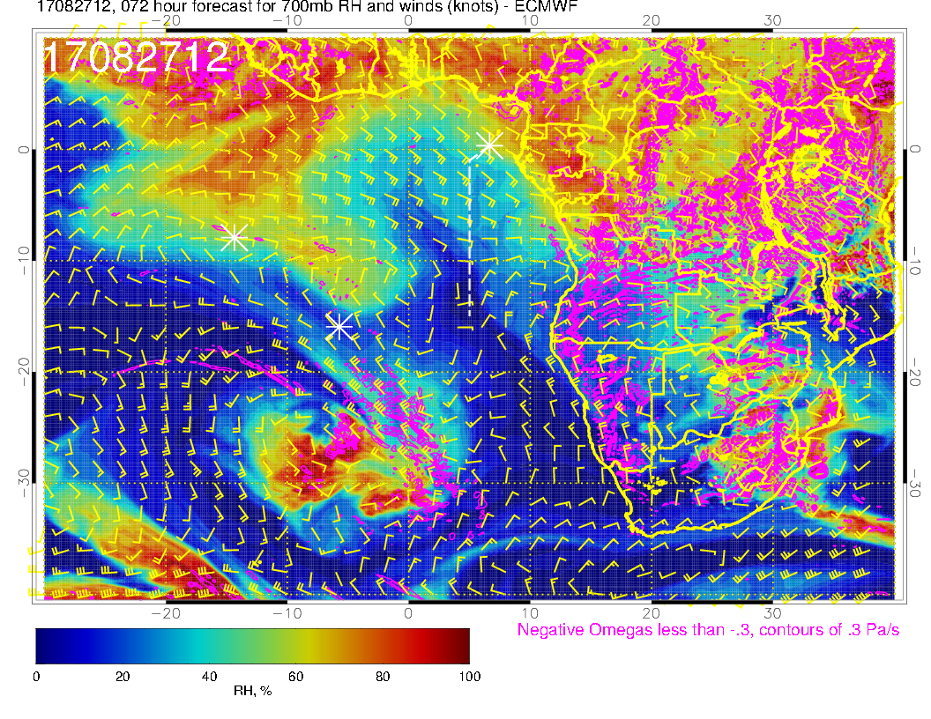
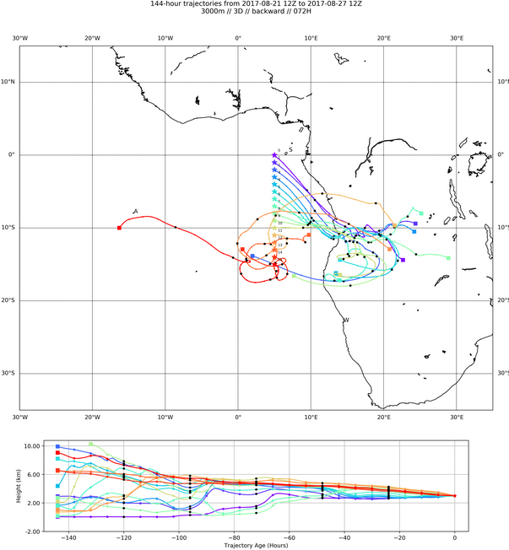
A
Flow becomes more zonal at the shore as anticyclone moves westward. Consistent with previous forecast, continued dry in our region, southeasterlies. BT shows air coming from Angola.

Slide 26
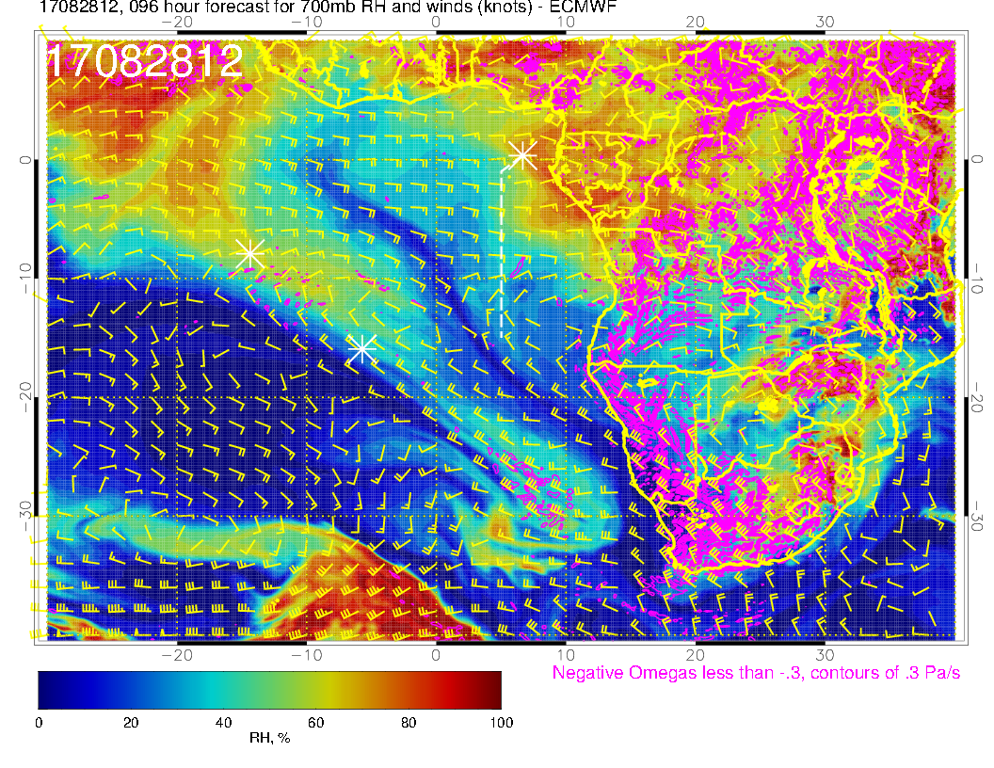
A?
A
Flow becomes more zonal over our region, continued dry (but note beginnings of moisture coming from the east.

Slide 27
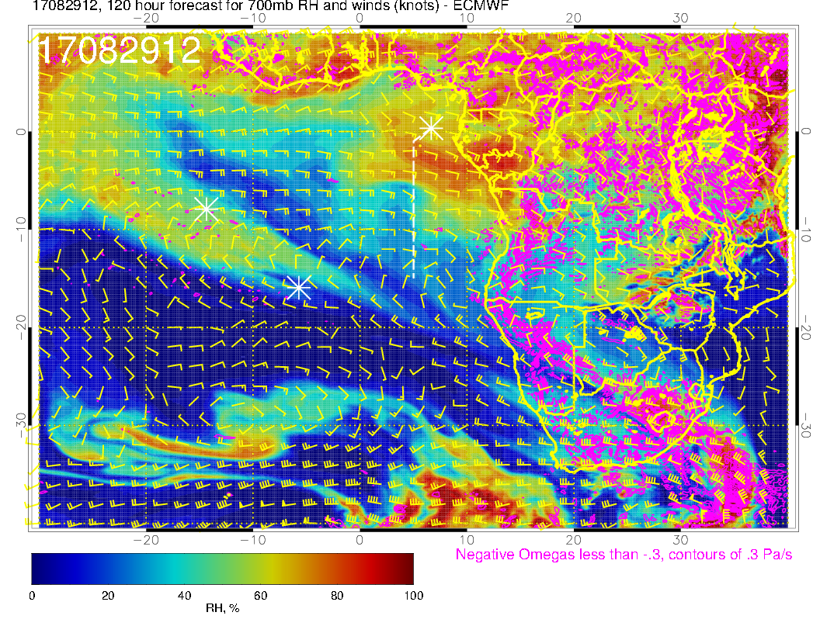
A?
A
Flow zonal over our region, moisture intrusion from the east over us, but noticeably less intense than yesterday/today.

Slide 28
Saturday

Slide 29
Roughly consistent with yesterday’s fcst, except West African convection is a little further west, so westerly component over us is less. Congo convection consistent. Angola Bay Eddy is typical. Note convergence on Angolan coast (diurnal)

Slide 30
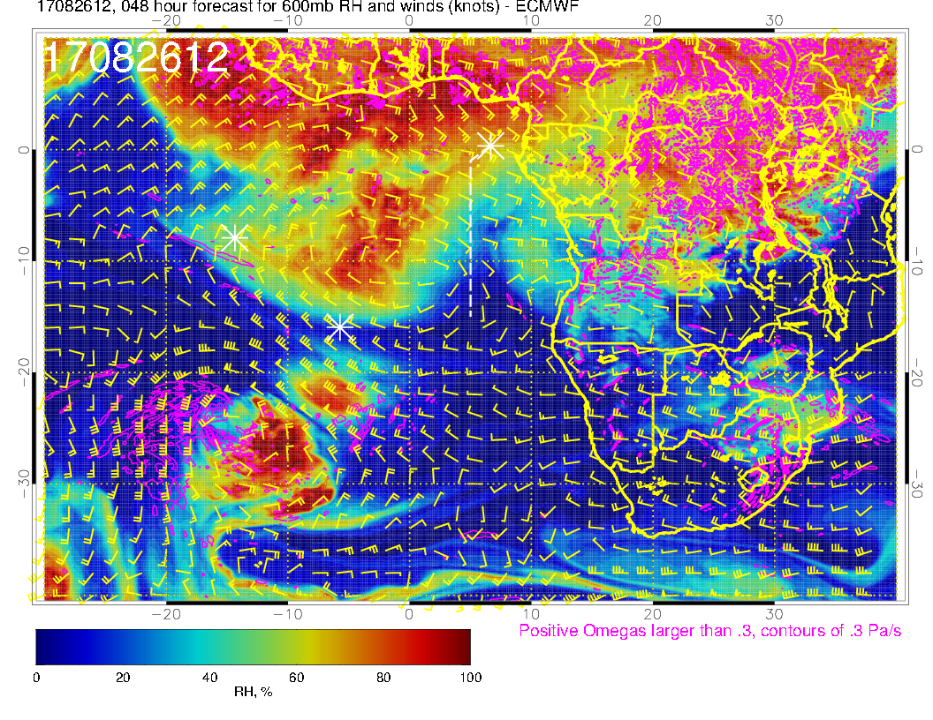
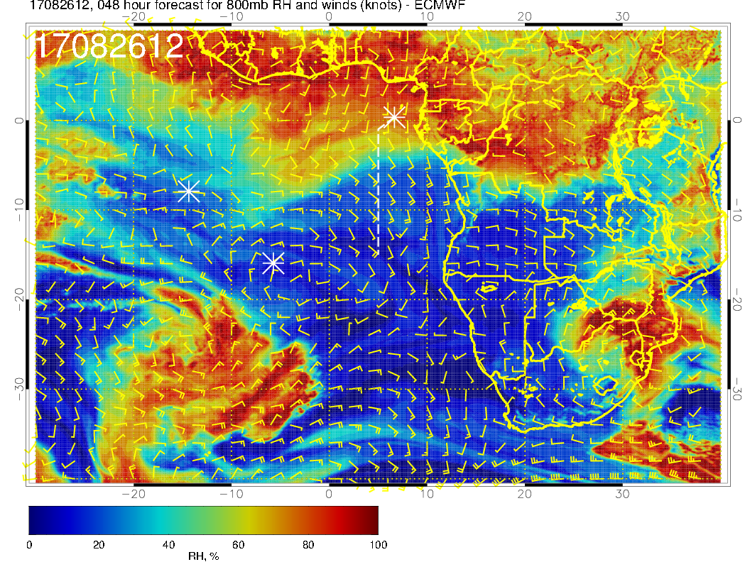
A
Mid level flow for Saturday. Dry air in operating region (even more so than yesterday’s fcst).

Slide 31
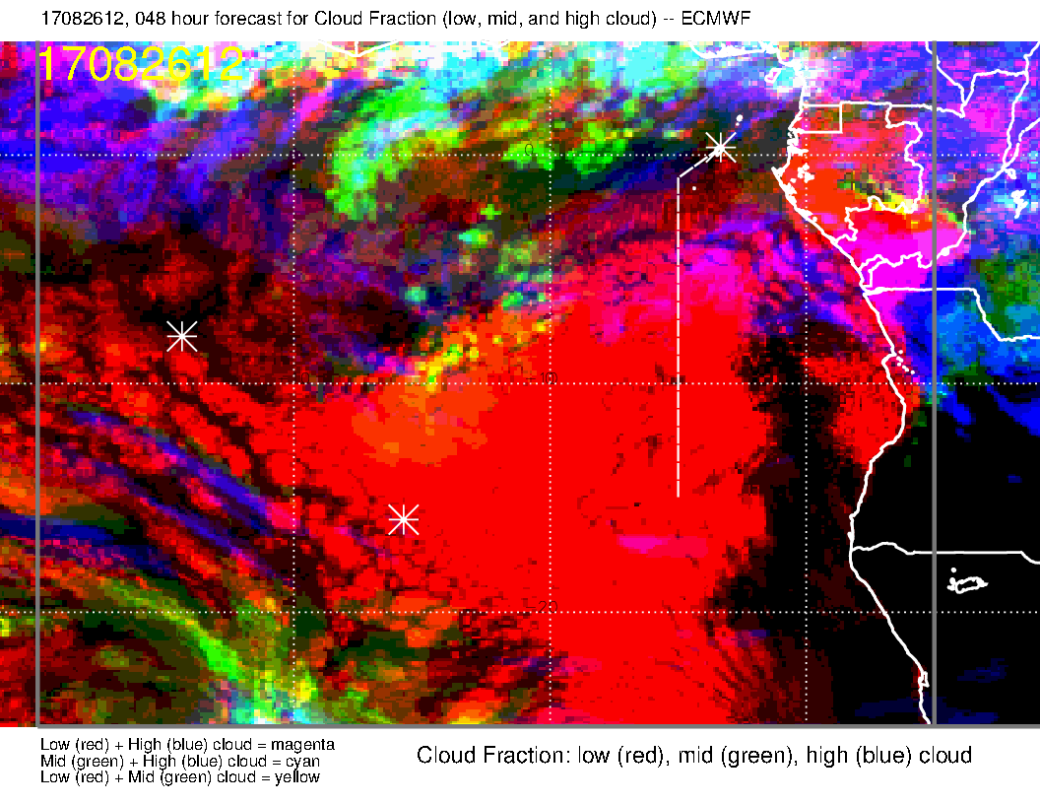
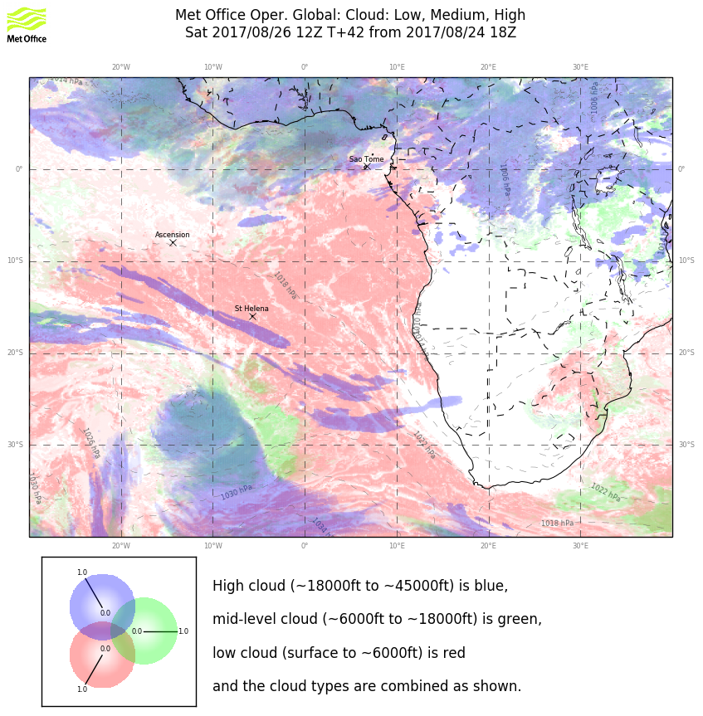
Clouds for Saturday. Similar to yesterday’s fcst for the mid level clouds: (1) unlike yesterday, there is nothing east of the prime meridian; (2) higher cloud fractions than yesterday just west of the prime meridian. Models disagree on high cloud east of prime meridian. EC has more cloud. Neither model is truly reliable for high level cloud at 48 hours based on experience.
Rei points out that the EC model does not fully capture the diurnal clearing of mid-level cloud (which played a role in yesterday’s overestimate of mid-level cloud). Based on this, we discount the importance of the mid-level cloud to our operations. High level cloud is likely to be occasional streamers, much like yesterday.

Slide 32
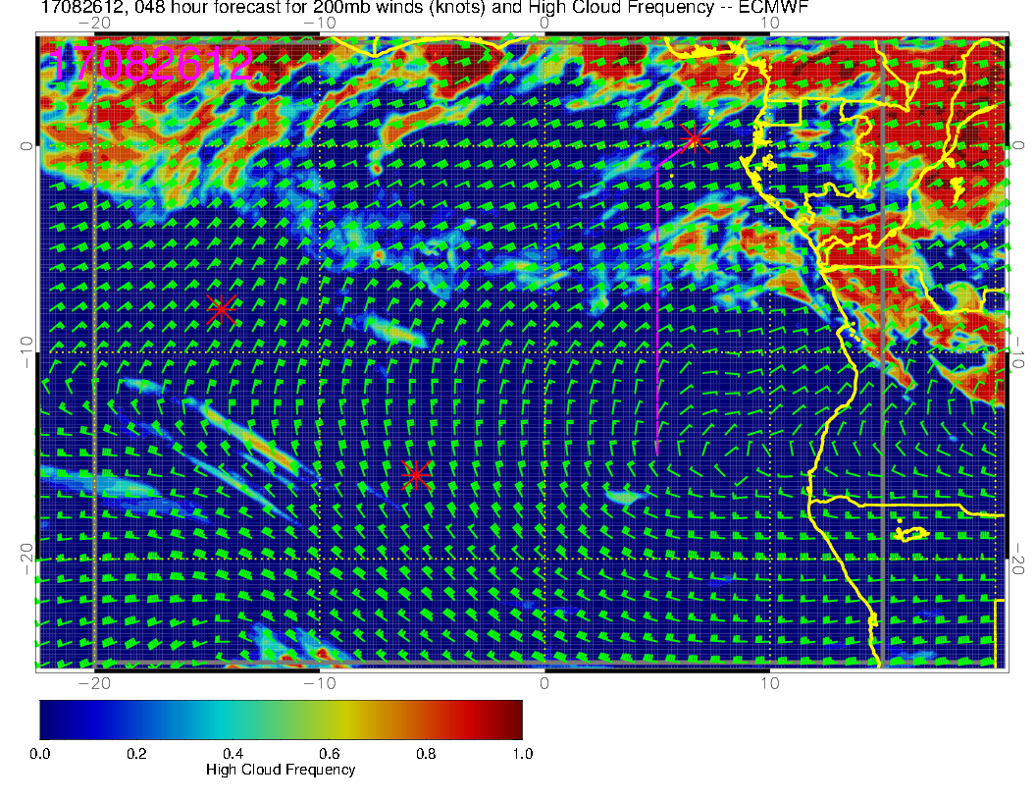
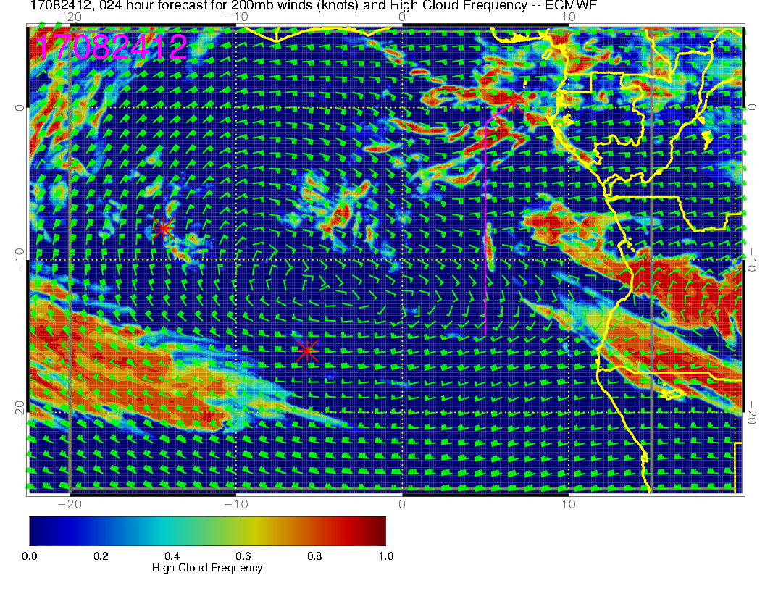
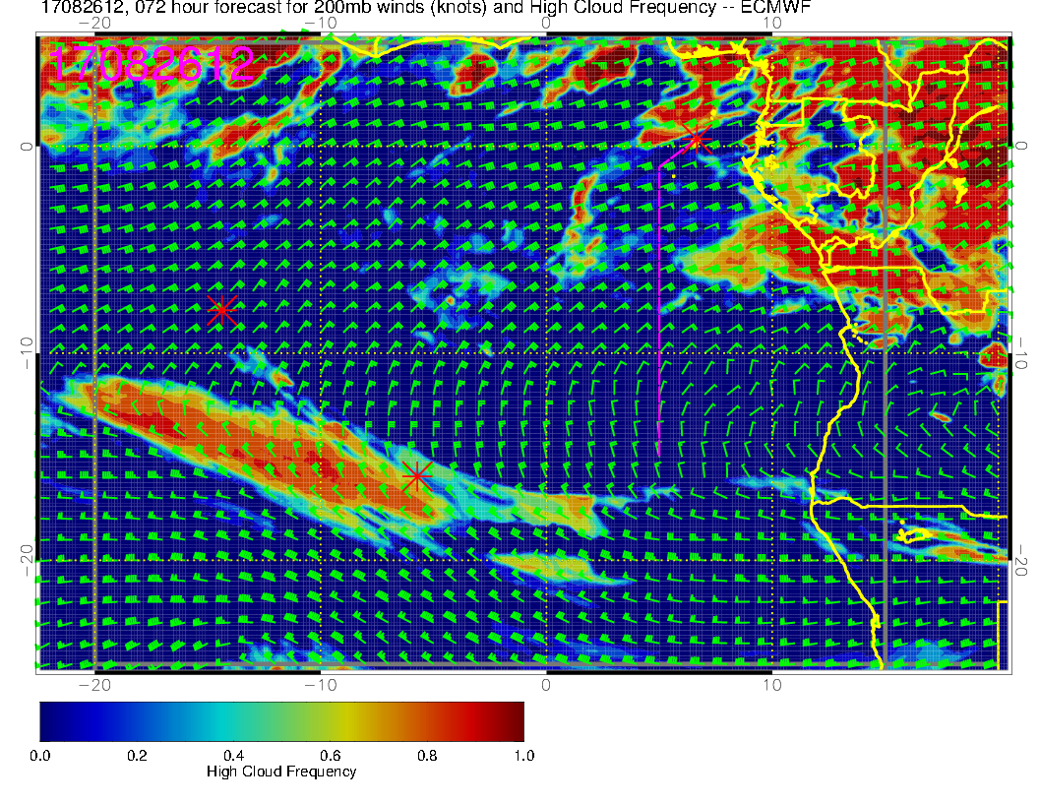
EC high clouds for Saturday (above).
Old forecast is at right. Some consistency. Judgment is that the situation will be comparable to yesterday, with occasional streamers. Doesn’t look like a lot of streamers unless you are east of the routine track.

Slide 33
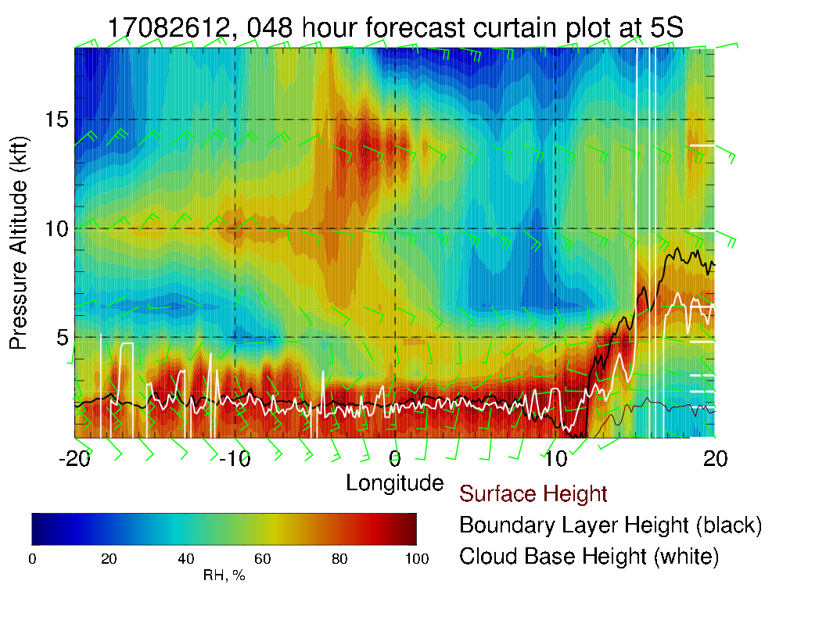
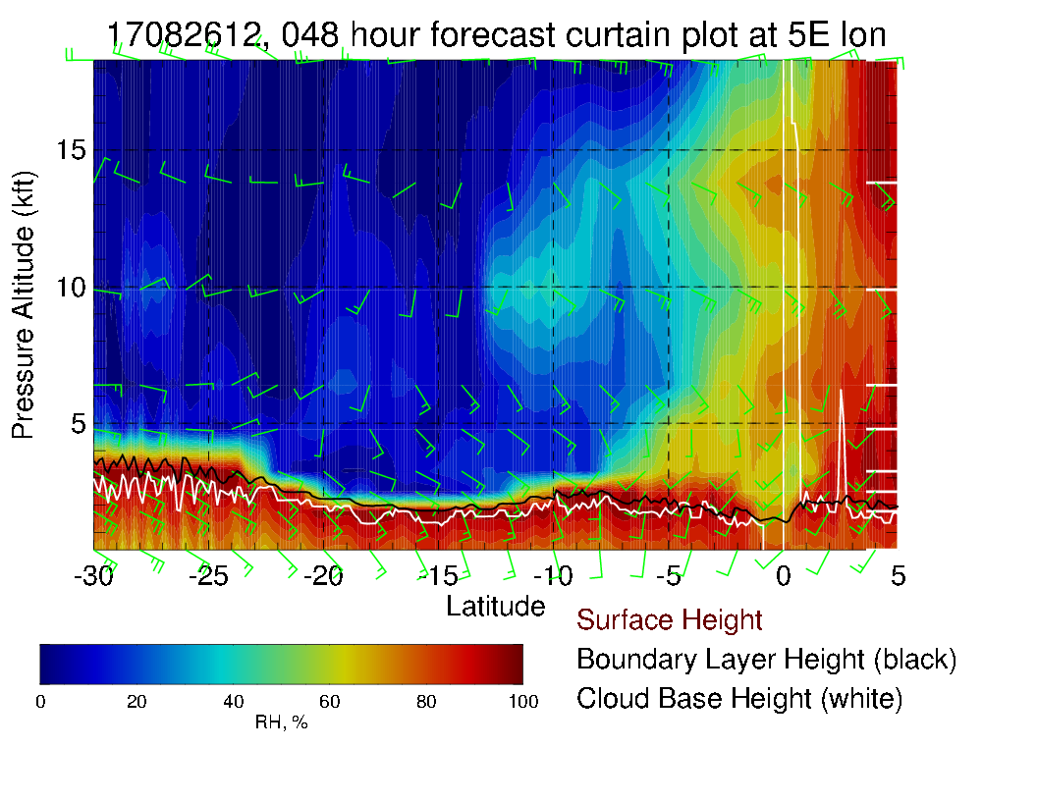
Routine track X-sect (left), Xsect along 5S above. Mid level moisture west of prime meridian (a bit more intense than yesterday’s fcst). Routine track (left) is dry to 2S (drier than yesterday). Surface winds nominal southerlies 10 knots. Mid level winds ESE at 15-20.

Slide 34
Latest EC cloud forecasts

Slide 35
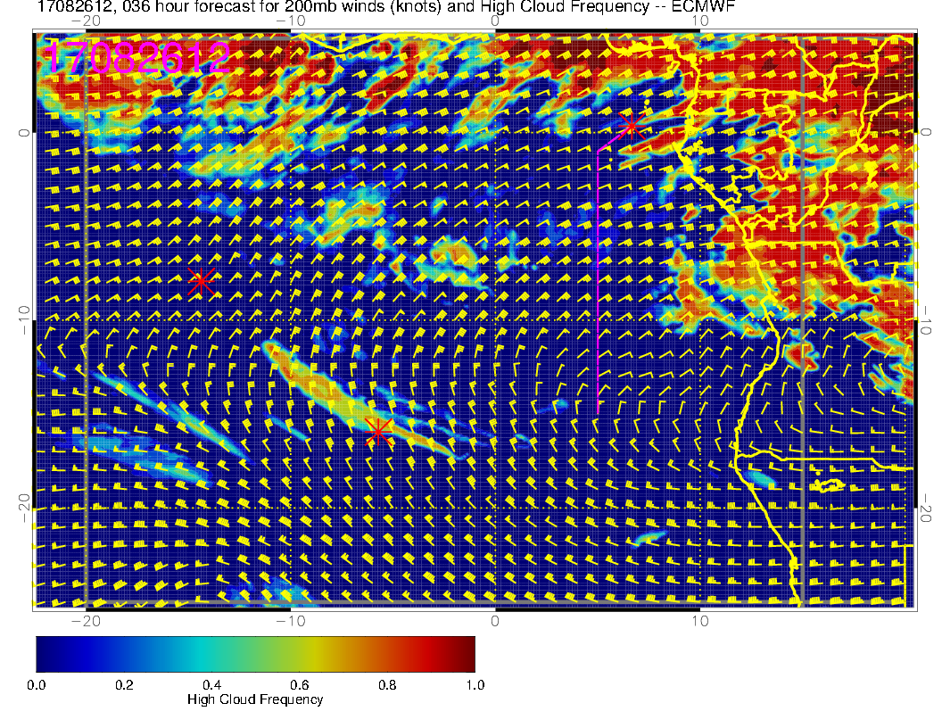

Slide 36
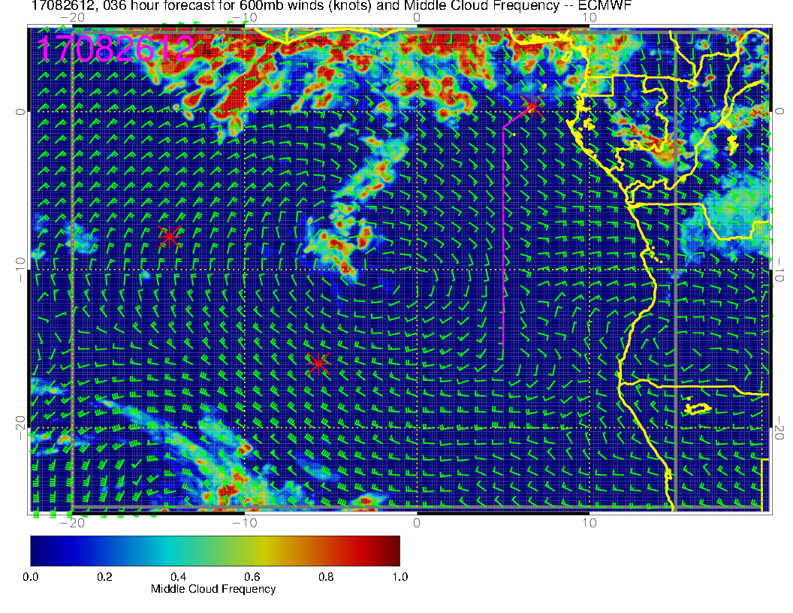

Slide 38
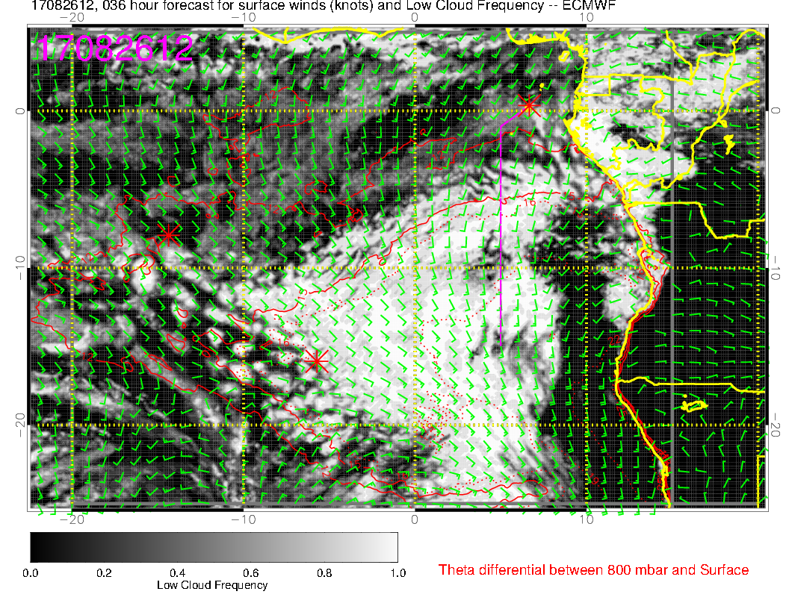

Slide 39
Sunday

Slide 40
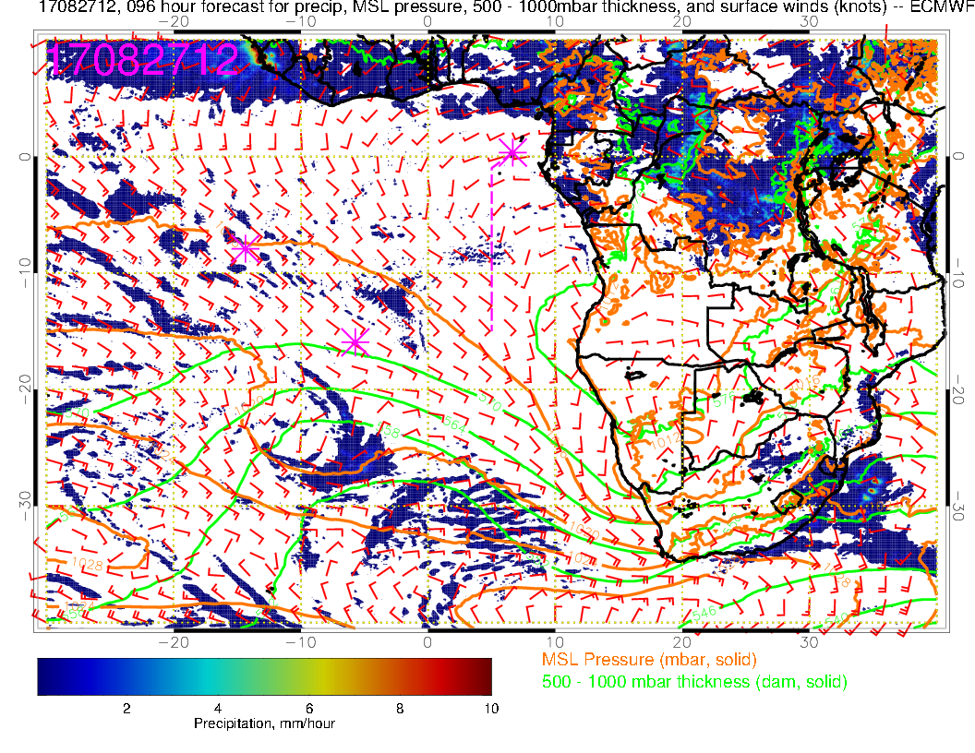
Surface chart for Sunday. Convection now focused in northern Congo, and surface winds have changed direction accordingly. With SH high well to the south, overall SE Atlantic winds are weak.

Slide 41
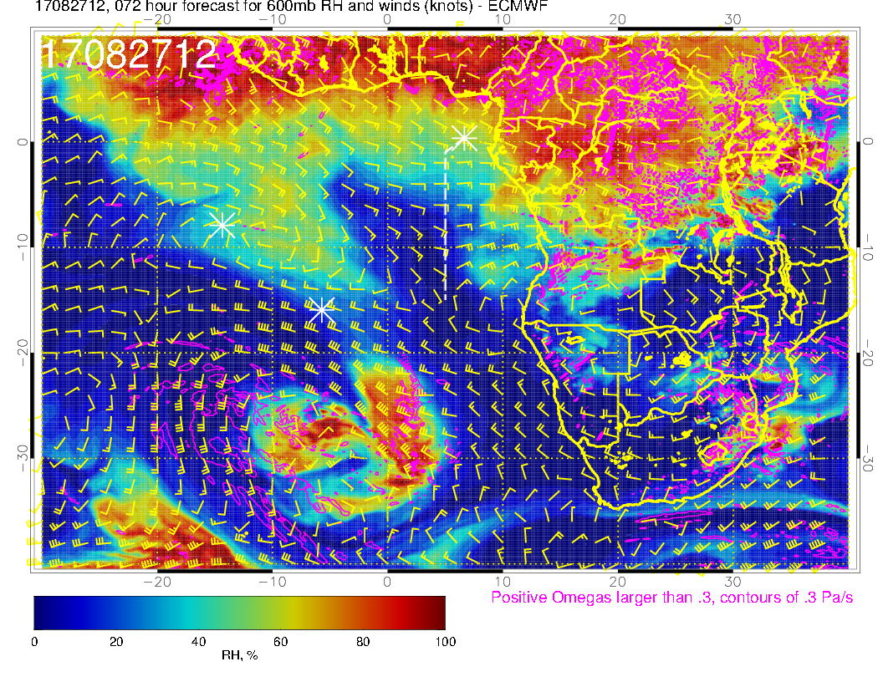
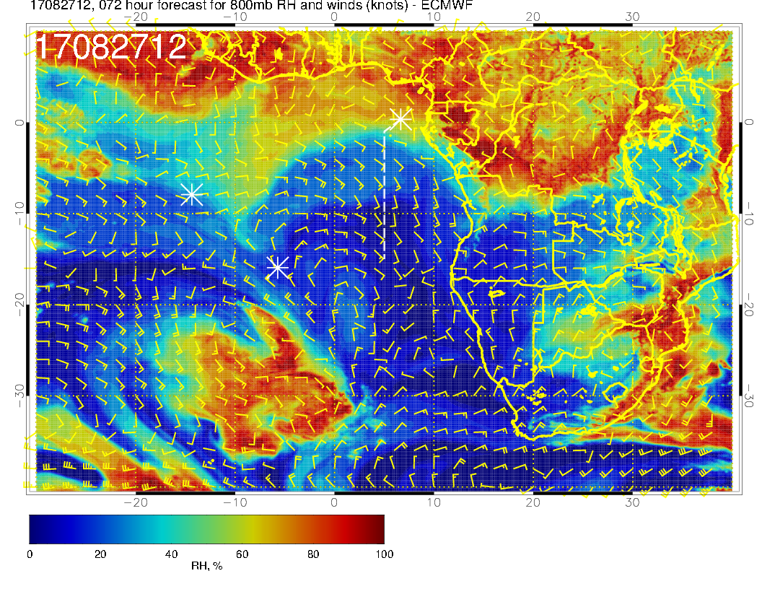
A
Mid level flow for Sunday. Pronounced southerly component of flow at 700mb from Angola into our region. Blob of dry convective moisture at 600mb has moved off of Angola. Pronounced drying at 800mb. Consistent with yesterday’s forecast, except slightly drier

Slide 42
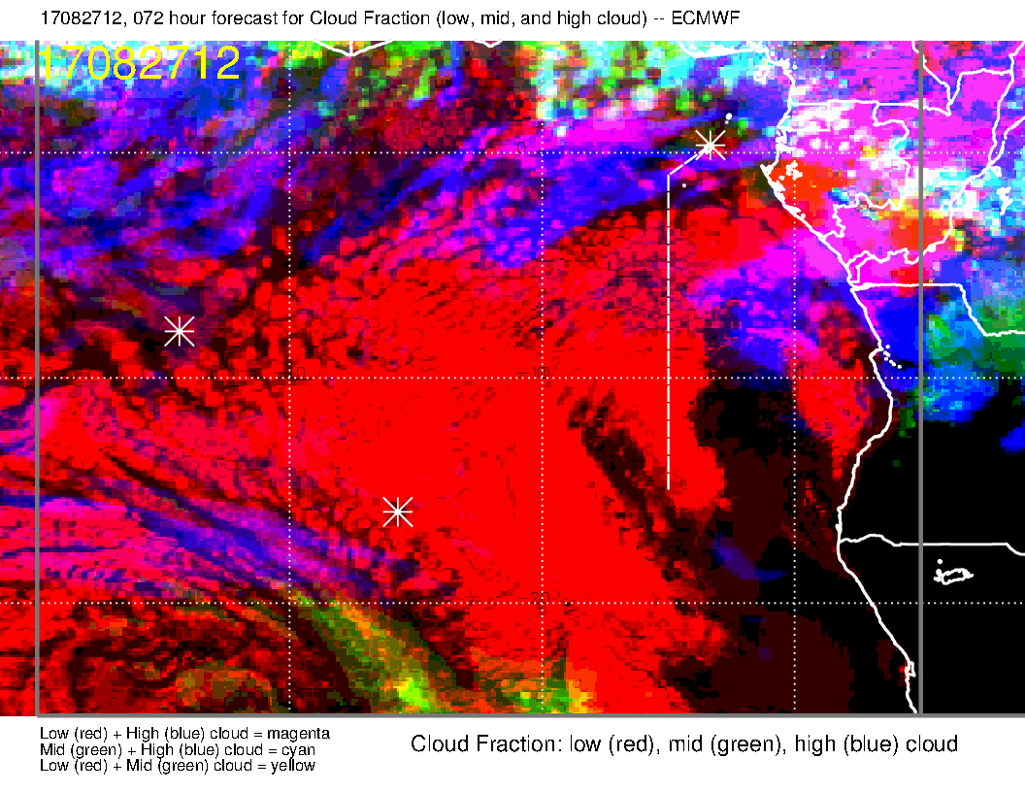
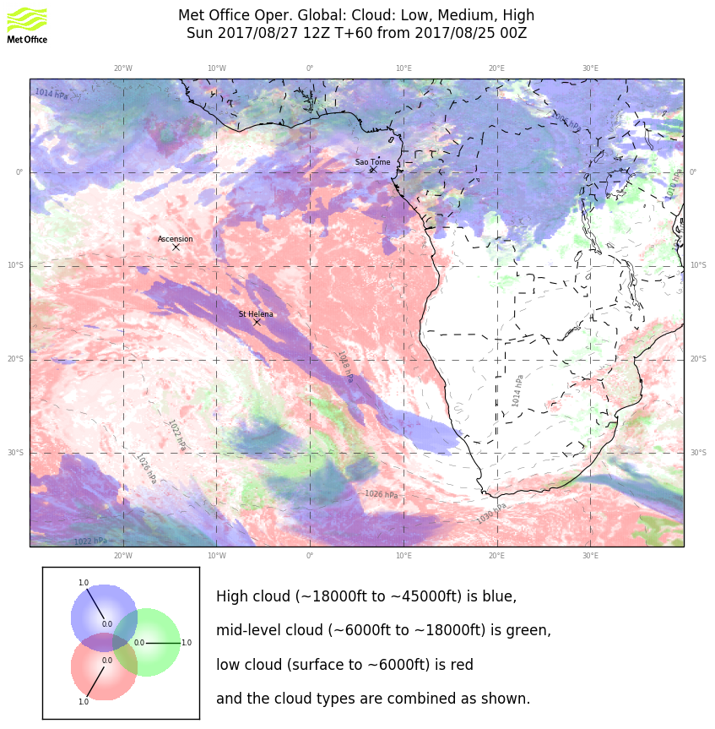
Clouds for Sunday. Broad agreement on high and middle clouds. EC forecast has backed off quite a bit from previous, and is now the less “pessimistic” of the two models in our operation. Neither forecast is clear to the north.

Slide 43
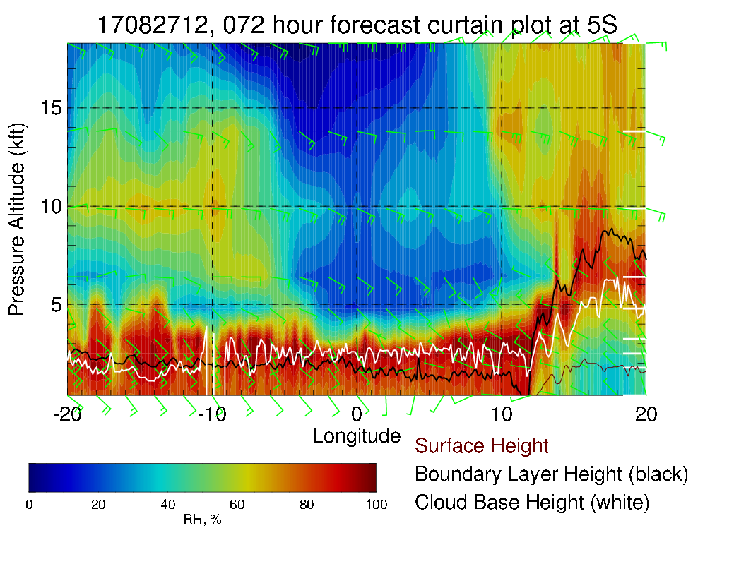
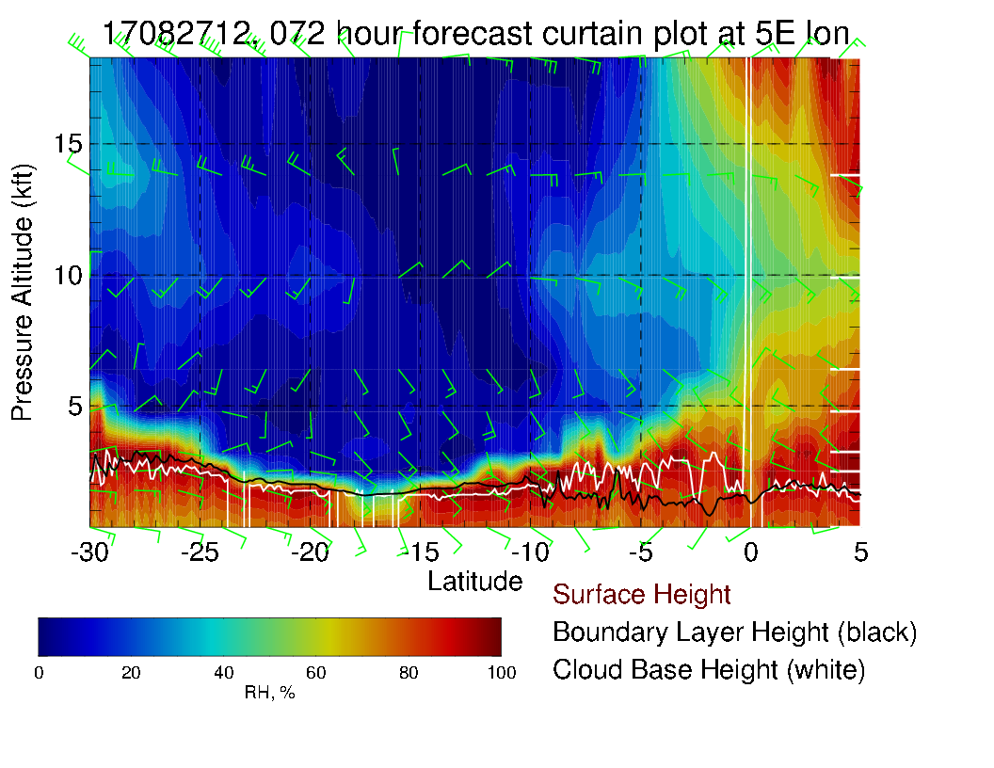
Nice retreat of mid-level moisture in
Dry mid-level environment except to the north of the equator and west of 10W.

Slide 44
Monday

Slide 45
Continued strong convection over the Congo on Monday, and can see surface winds heading for the two convective regions, same as Sunday. Westerly component at TMS stronger than previous forecast. Generally weak surface winds in the region. SH high is reforming to west

Slide 46
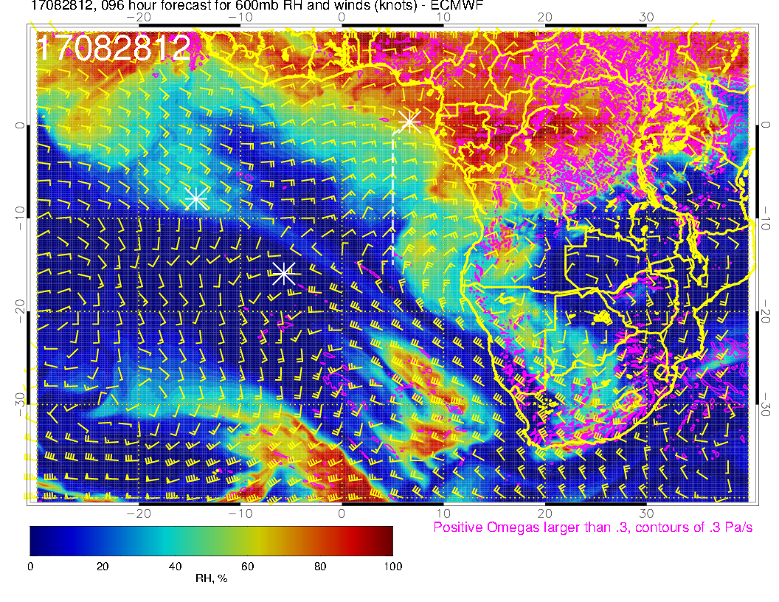
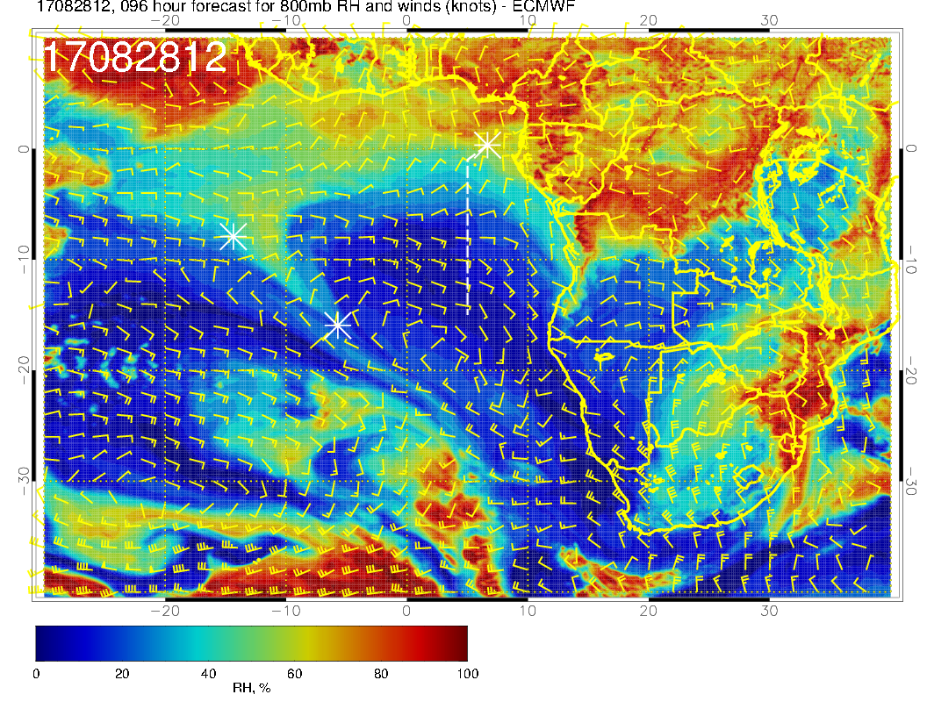
Mid level flow for Monday. Flow quite zonal. Moisture at 600mb and 700mb is coming off the coast of Gabon a bit faster than previous forecast. At 600mb see dry convection blob of moisture coming off the coast.

Slide 47
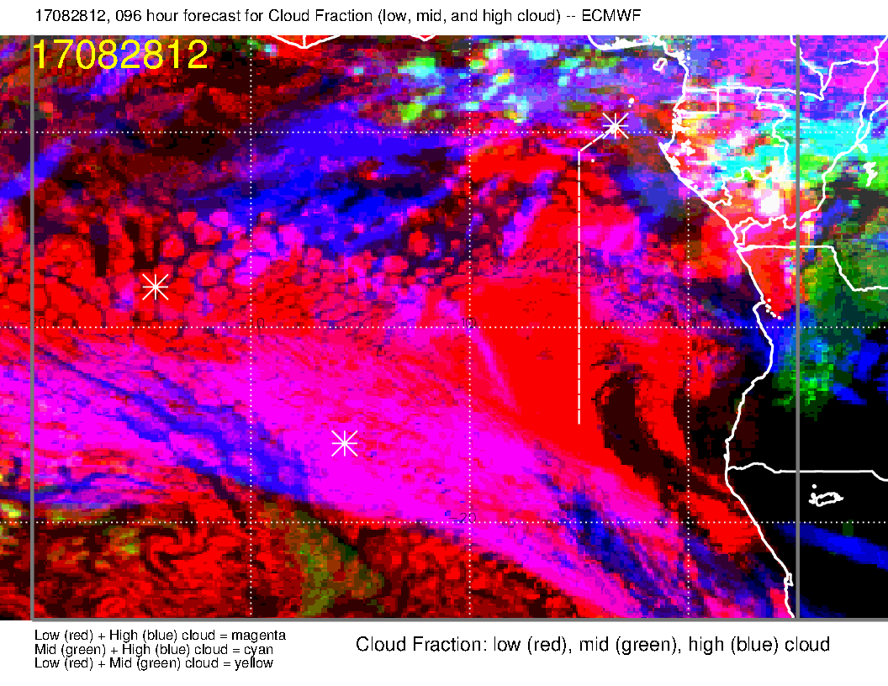
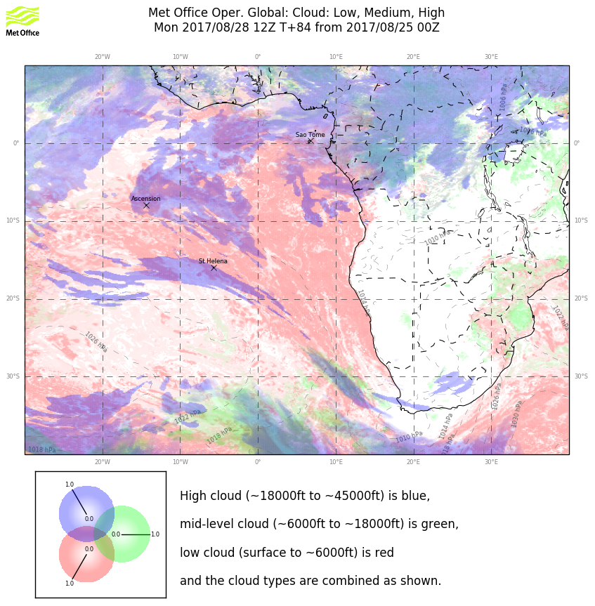
Clouds for Monday. Dry mid-levels are consistent with no mid-level cloud. Model agreement on the high cloud distribution. Neither model too consistent on this with previous forecast. Except for the jet stream cirrus, would be wary.

Slide 48
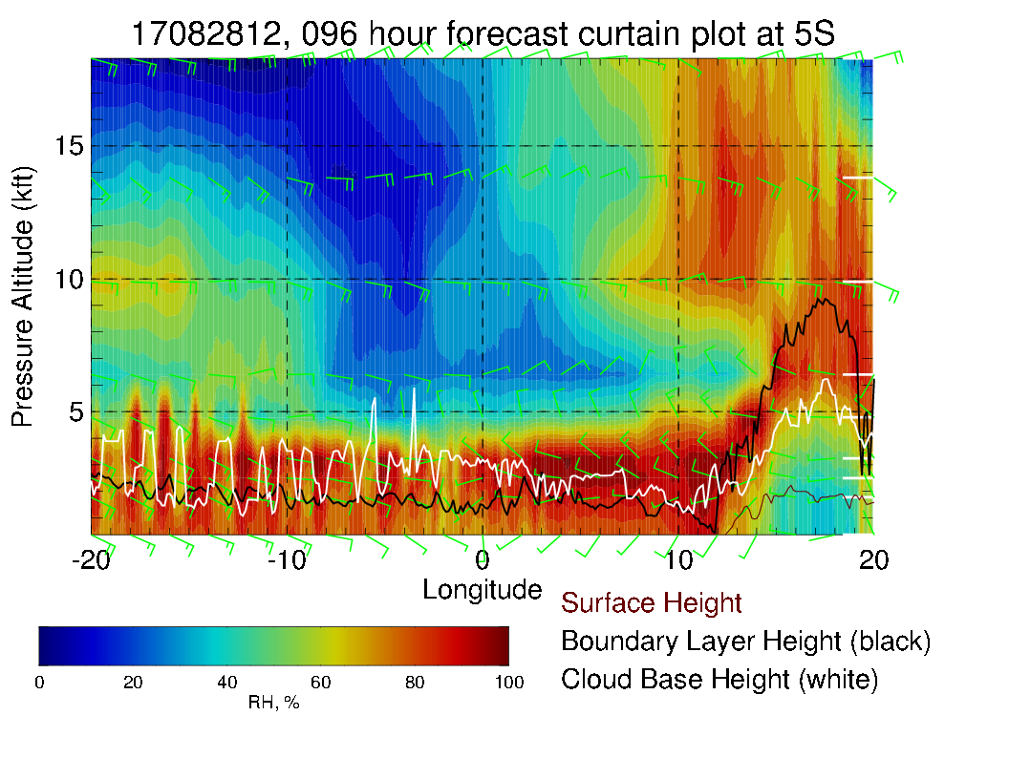
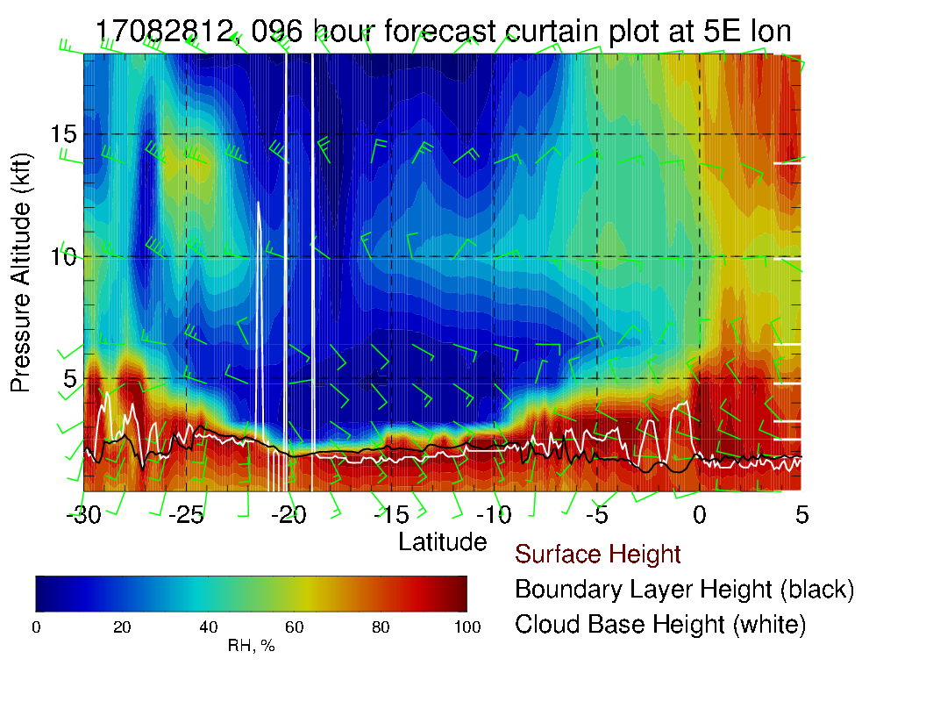
More moisture along routine track (left) than yesterday’s forecast, consistent with mid-level charts. Above, along 5S, can see mid level moisture start to penetrate into the region. Winds are weak at the surface. Easterlies and northeasterlies 15-20 knots at midlevels

Slide 49
Tuesday

Slide 50
SH high moving eastward, winds in SE Atlantic are picking up, stronger winds at TMS and much more southerly. Maybe a more rapid resupply of clean air from the south. Convection is now over CAR (moved north, if you believe it)

Slide 51
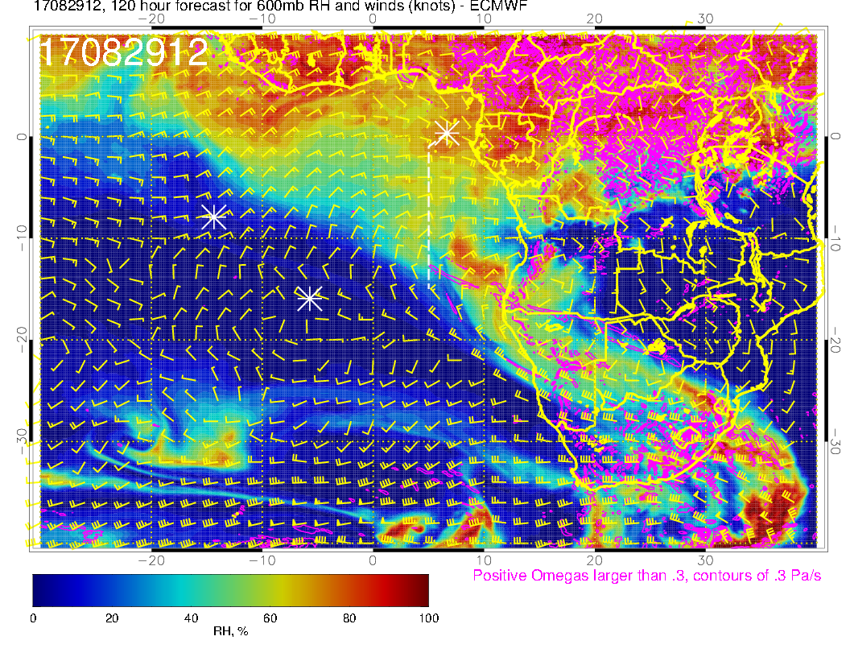
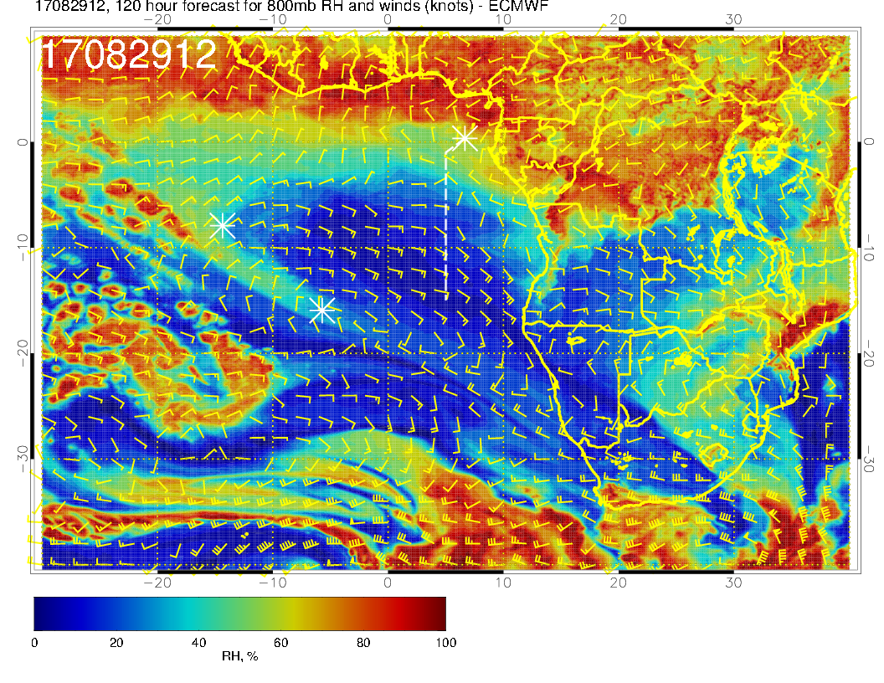

Slide 52
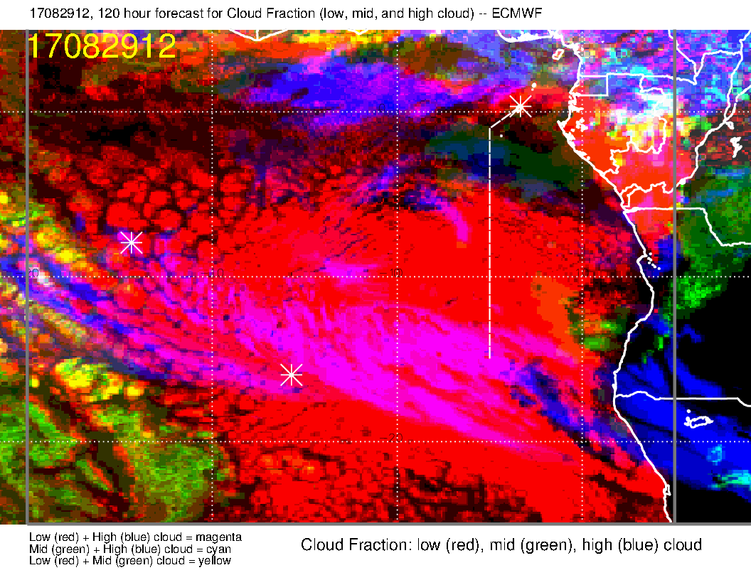
A long way out. EC has some middle cloud in operating region. I would discount this as the EC overpredicts mid-level cloud in long term forecasts (and does not capture the full diurnal clearing at mid-day). High clouds hard to tell five days out given the dependence on convection.

Slide 53
Mid level moisture starting to enter routine track (above), and can see how it is moving westward (left). Winds pretty much easterly, 15-20 knots at midlevels. Surface winds southerly, typical strength.

