Slide 1
ORACLES weather briefing
24-Aug-2017
Lenny Pfister and Rei Ueyama

Slide 2
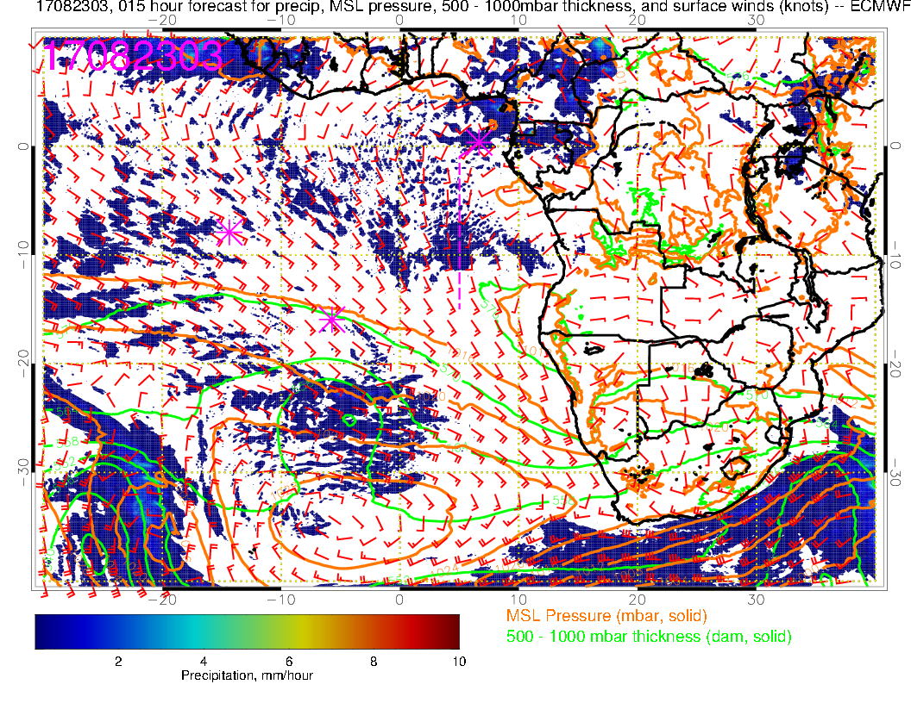
EC model precip forecast, 15 hours, valid 8/23 3Z (left). 8/23 3Z rain rate from combined
3B42RT rain rate product (combined satellites – right). Even at 15 hour forecast, model is not able to capture a major system on the border between the Congos.

Slide 3
700mb evolution 8/21-8/28

Slide 4
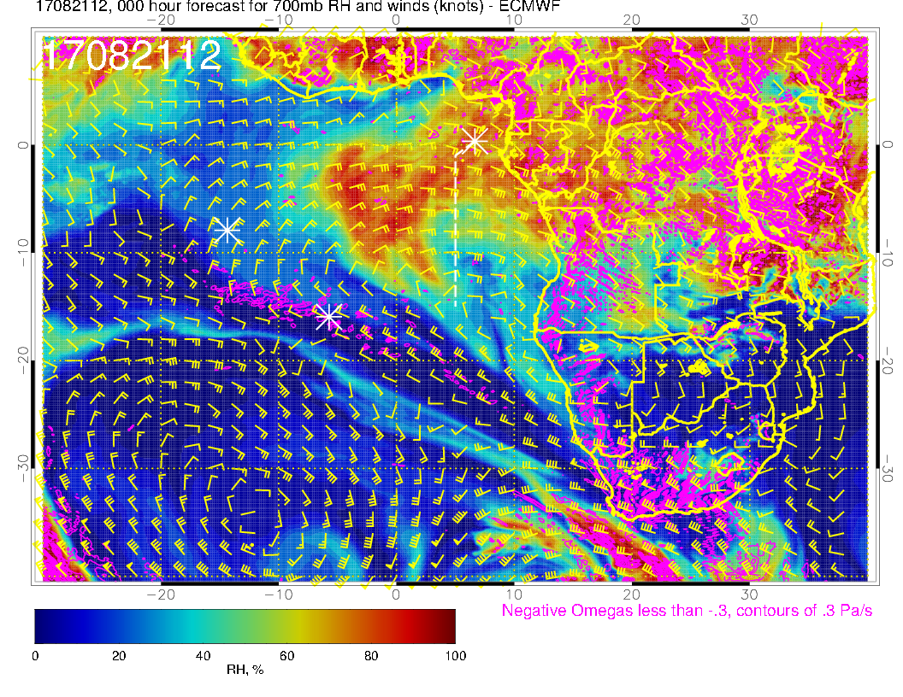
A
Monday’s flight: Offshore push of moist (north) and drier (south) air – strong plume

Slide 5
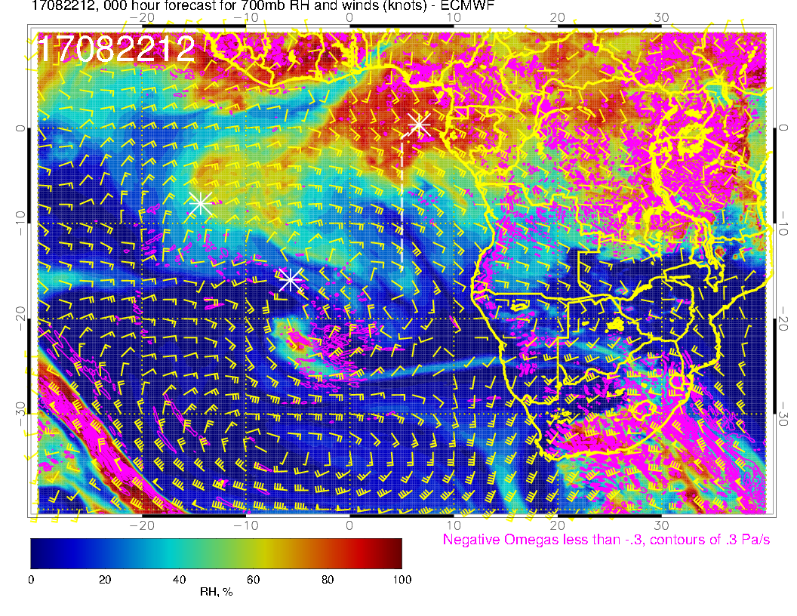
A
Anticyclone moves westward. Northward component of offshore flow increases.
Moisture plume over TMS can be seen in motion of middle cloud in satpic yesterday

Slide 6
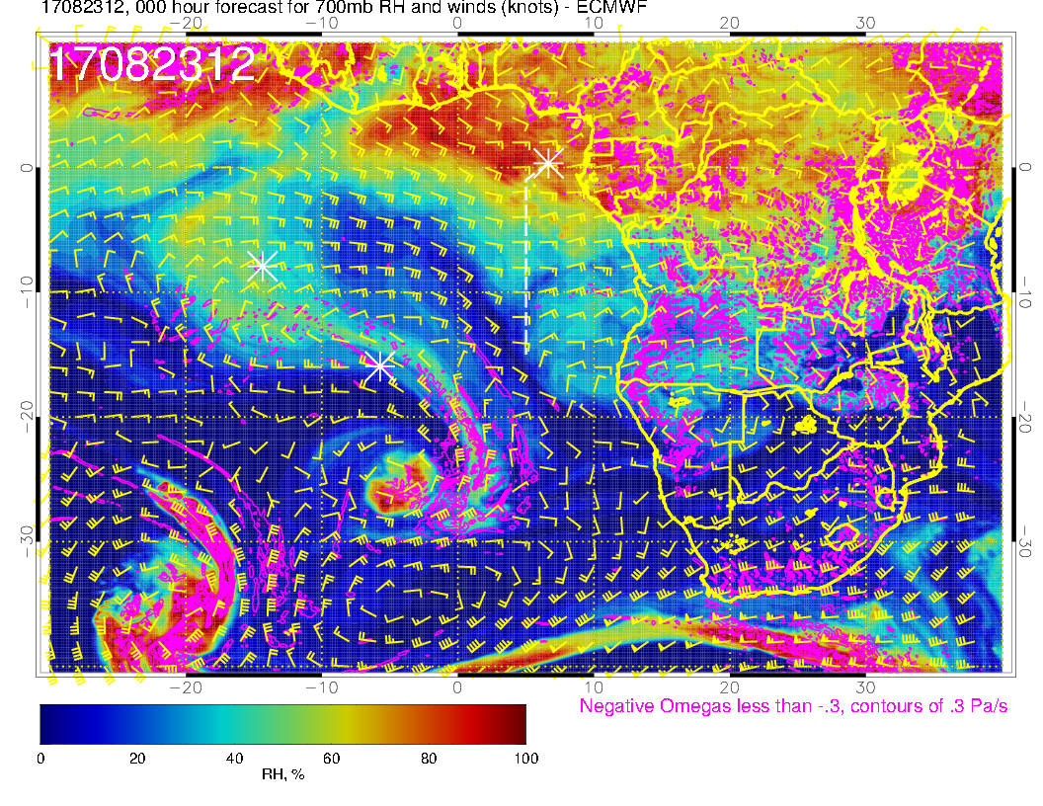
A
A
Anticyclone weakens (interaction with midlatitude low). Flow more westward. African wave anticyclone becomes apparent

Slide 7
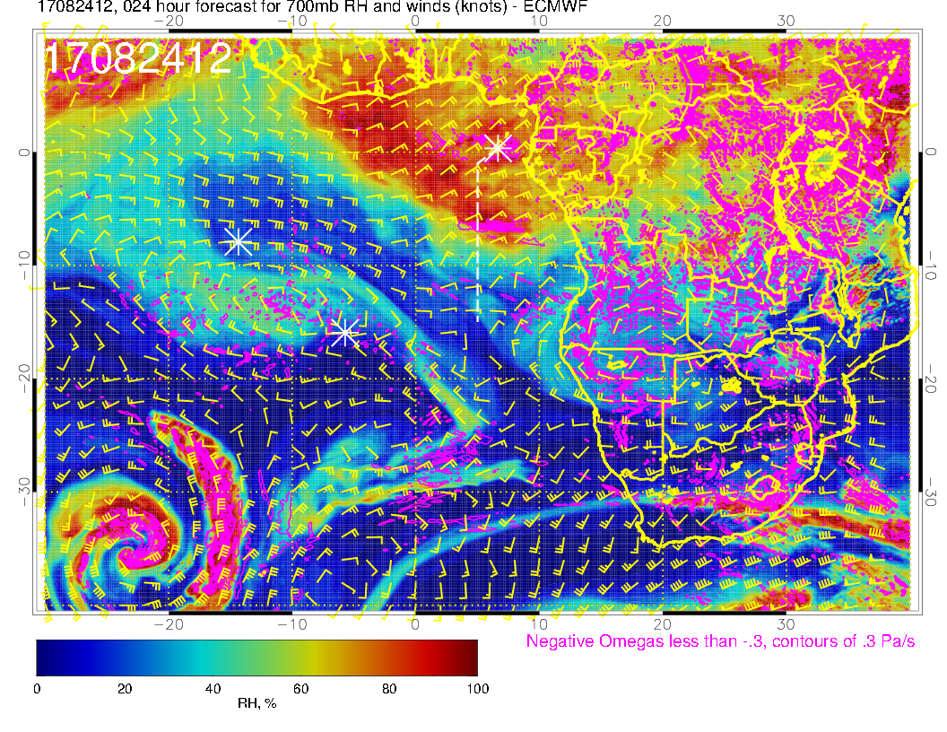
A
A?
A
New anticyclone over southern Angola. Get another northerly push of moist air
tomorrow.

Slide 8
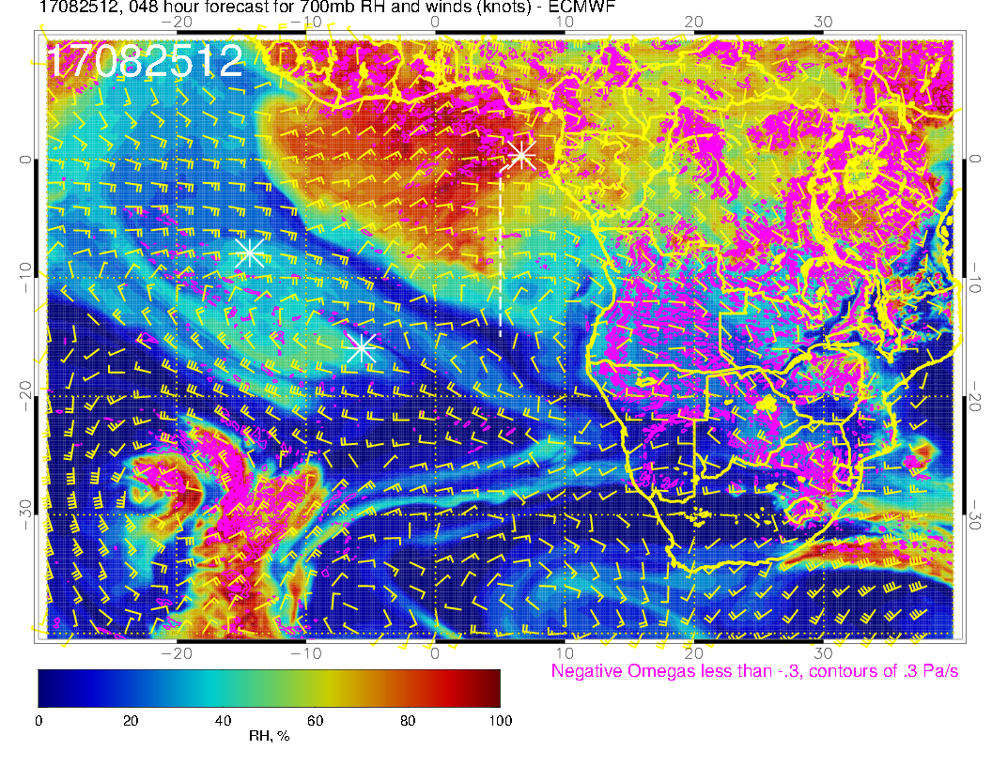
A
A
Anticyclone moves over, as does the moist pattern. Anticyclone initiates (?) southerly
component offshore

Slide 9
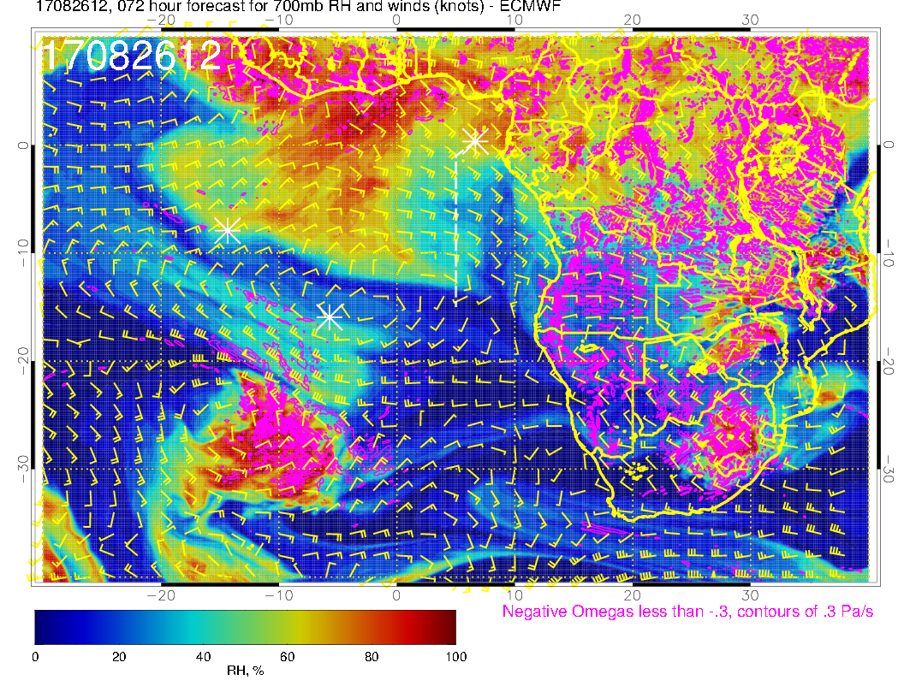
A
A
Southern anticyclone moves westward, enhancing southerly flow component offshore.

Slide 10
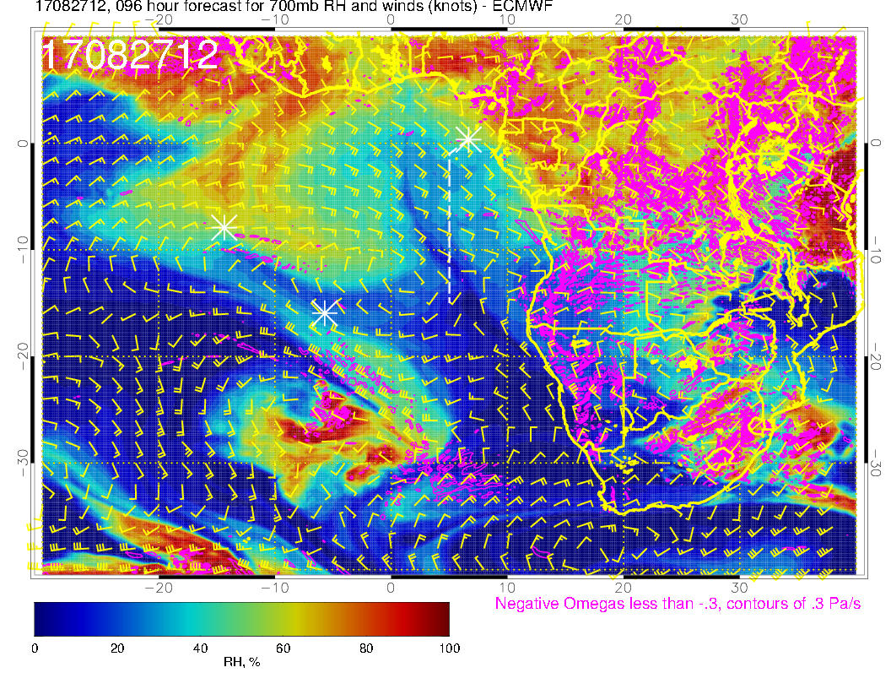
A
Flow becomes more zonal at the shore as anticyclone moves westward

Slide 11
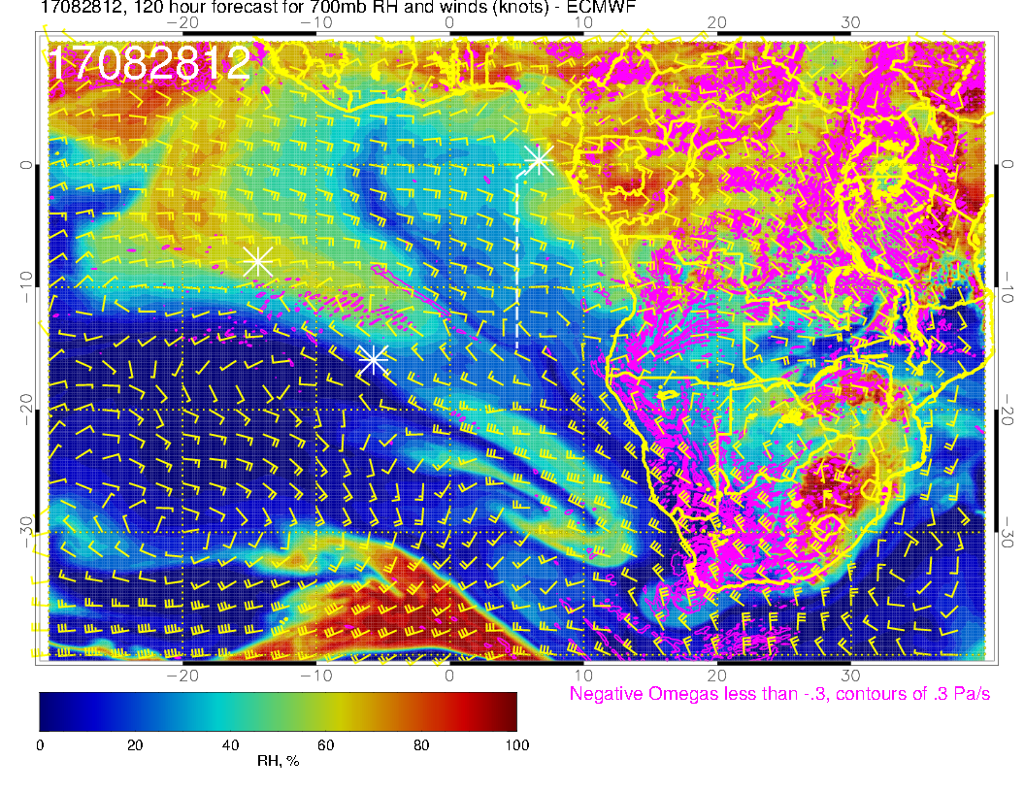
A?
Flow “flattens” as anticyclone moves offshore, still dry

Slide 12
Friday

Slide 13
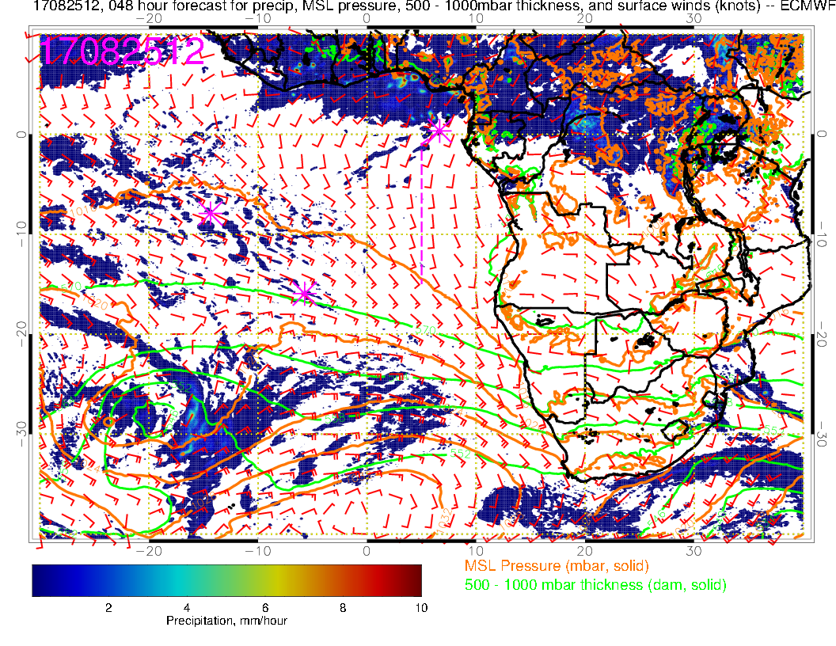
Surface chart for noon tomorrow. Precip near TMS has backed off from yesterday’s fcst. Angola bay eddy is weaker than Thursday. A more “typical” surface wind pattern. Convection mostly north, even northwest of TMS, so stronger southerly component.

Slide 14
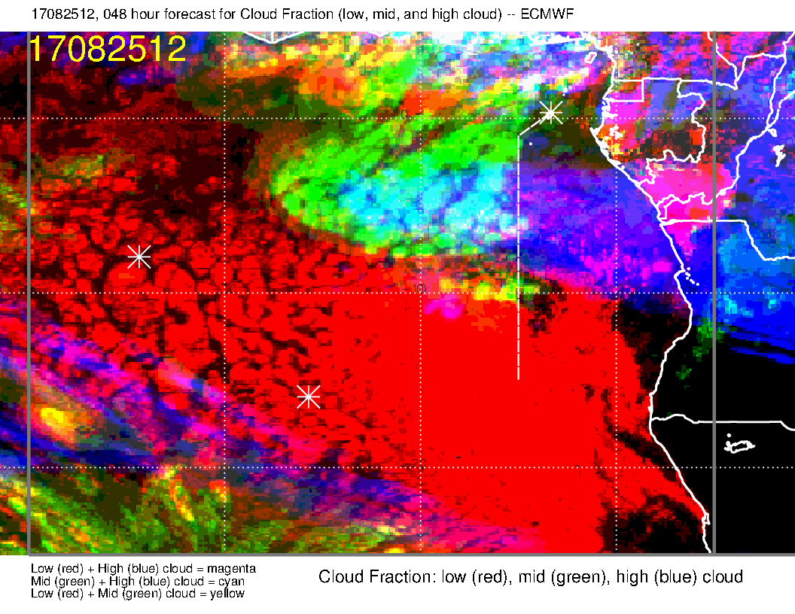
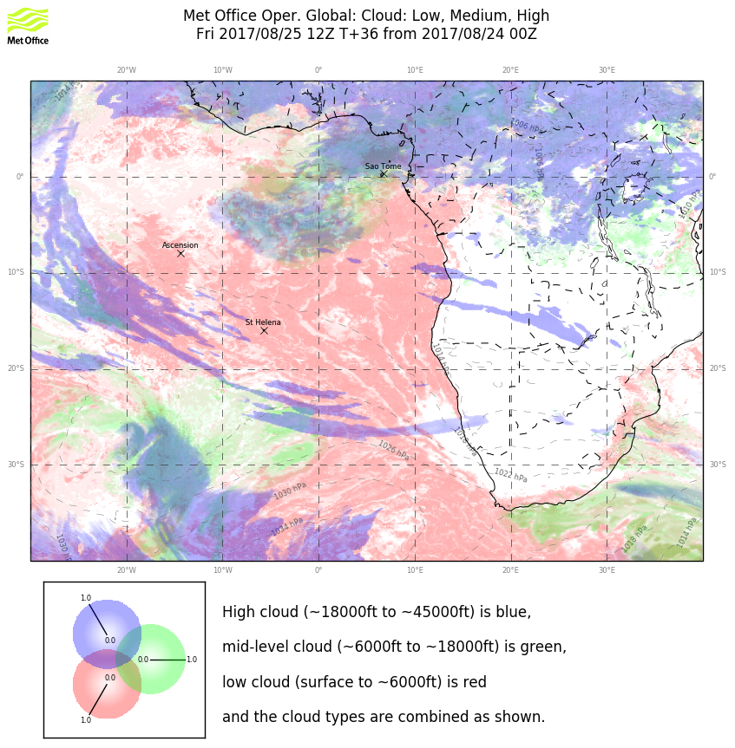
Cloud forecast for Friday. Little change from yesterday’s forecast except placement of mid cloud region is further east by 1-2 degrees in EC. Models agree on large middle cloud mass though UK has leading edge to west about 3 degrees further west.
Substantial difference on high clouds on and east of the routine track (UKMO does not have any). GMAO (not shown) does not agree with either.
Consensus is that there will be high cloud west of the routine track.

Slide 15
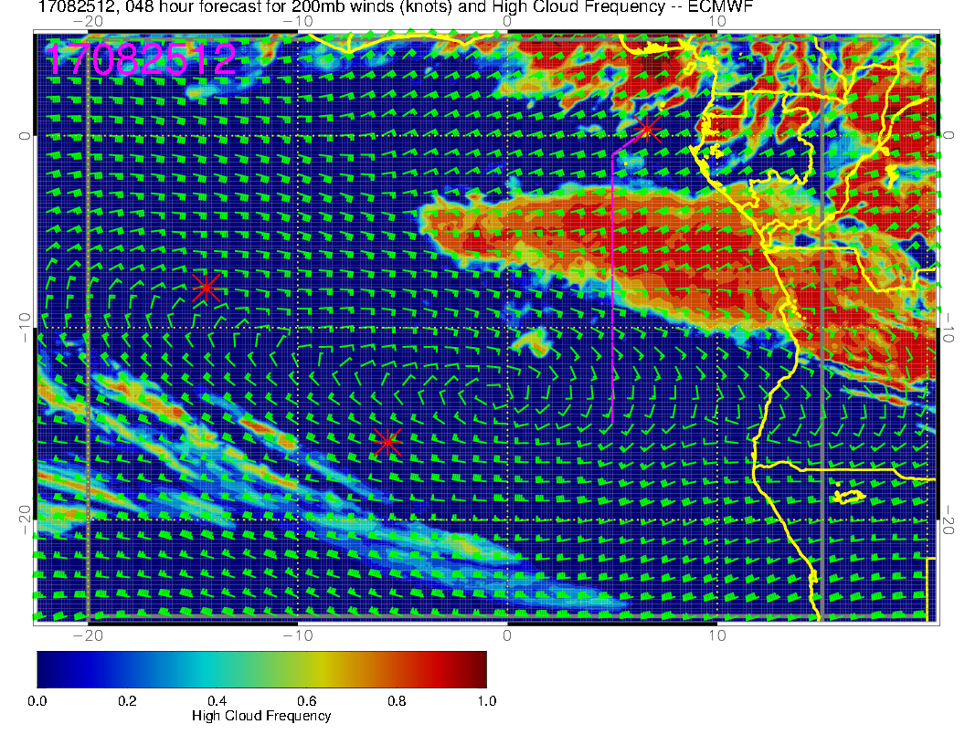
High Cloud forecast for Friday. Comment here is that the moisture source is not the “usual” region northeast of our operating area. However, there is convection in the EESE direction, and this is fairly directly downstream, so would not discount this.

Slide 16
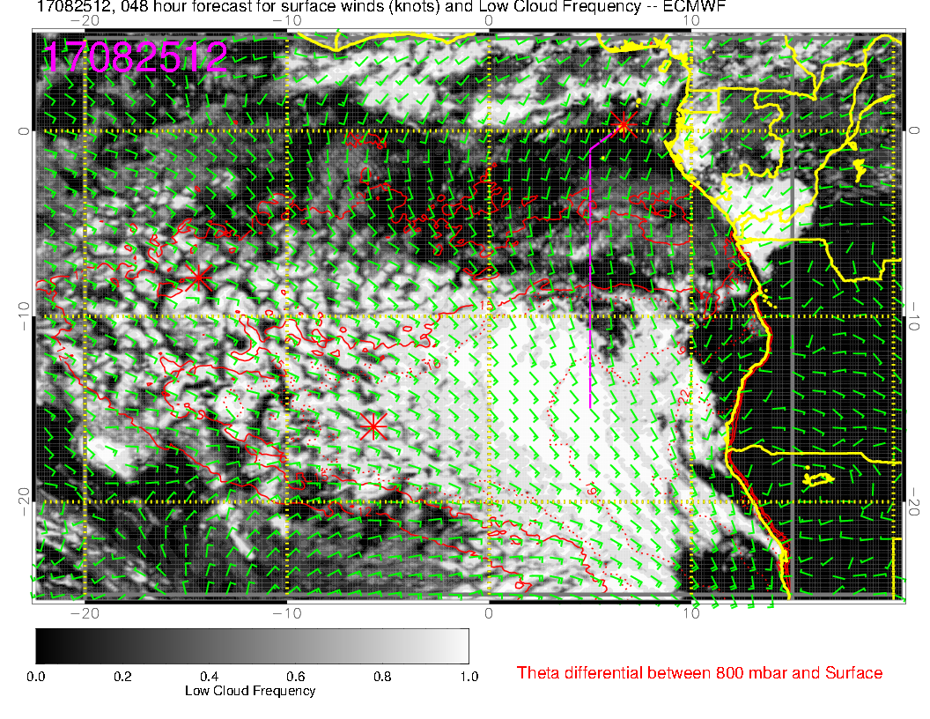
Cloud forecast (low level) for Friday. Consistent in forecasting more low cloud than for Thursday.

Slide 17
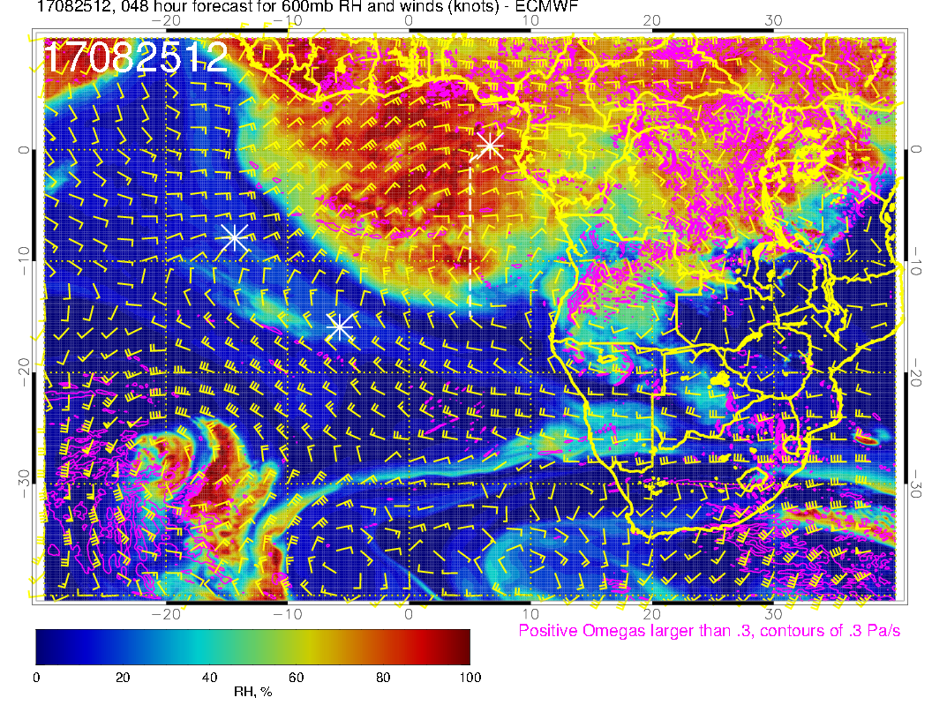
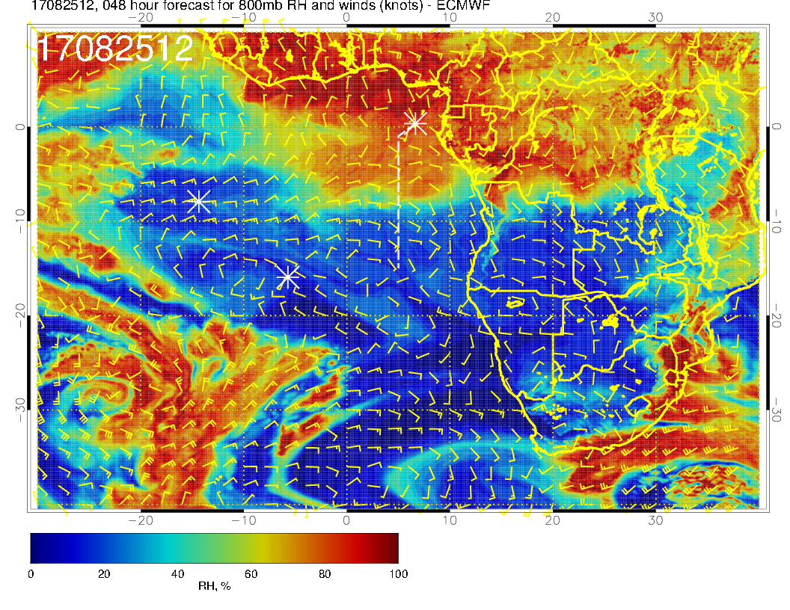
A
Mid level flow for Friday. Basic message is that moist air prevails over the operating region at all the mid levels.

Slide 18
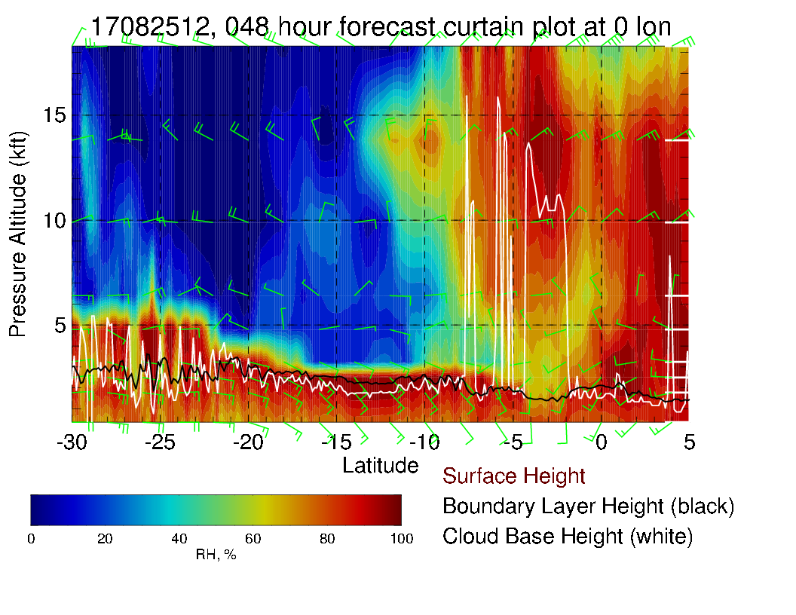
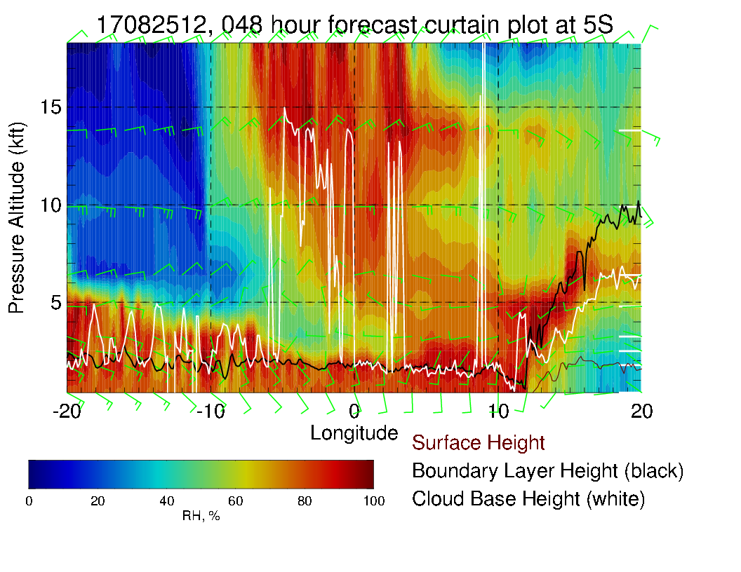
Cross section along prim meridian indicating mid-level cloud (above). Tail wind at high levels (for southwestward leg).
X-sect at 5S to right.

Slide 19
Saturday

Slide 20
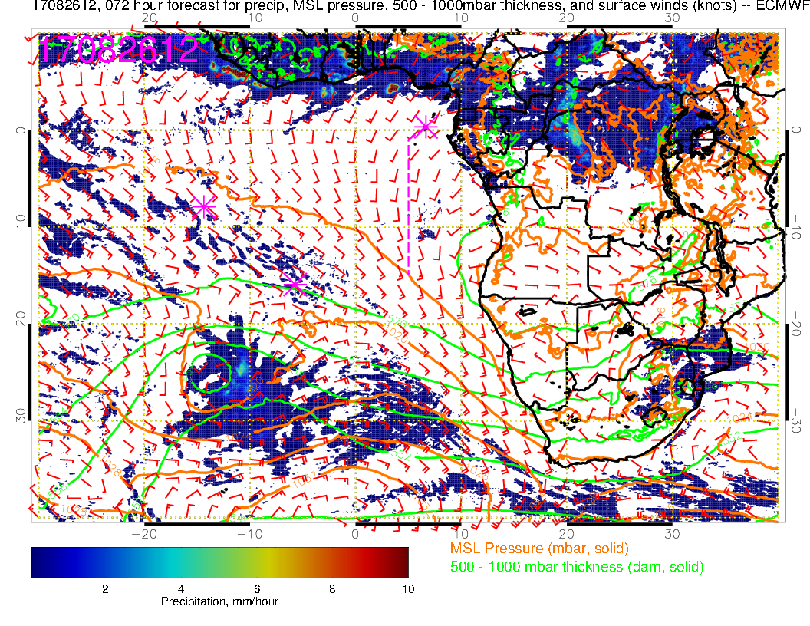
Surface winds near TMS on Saturday weaker than Friday, more pronounced Angola Bay eddy, shift to a more westerly component near TMS.

Slide 21
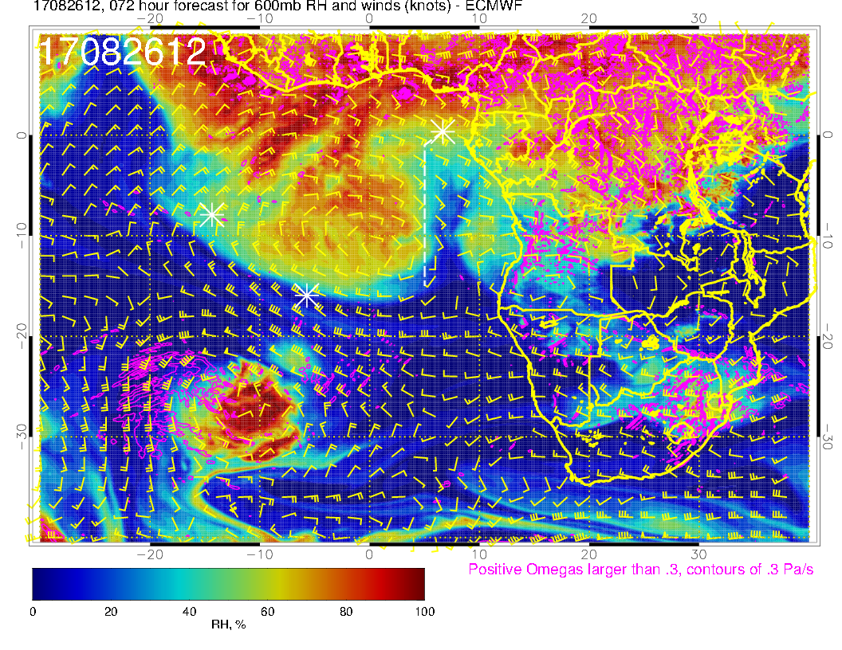
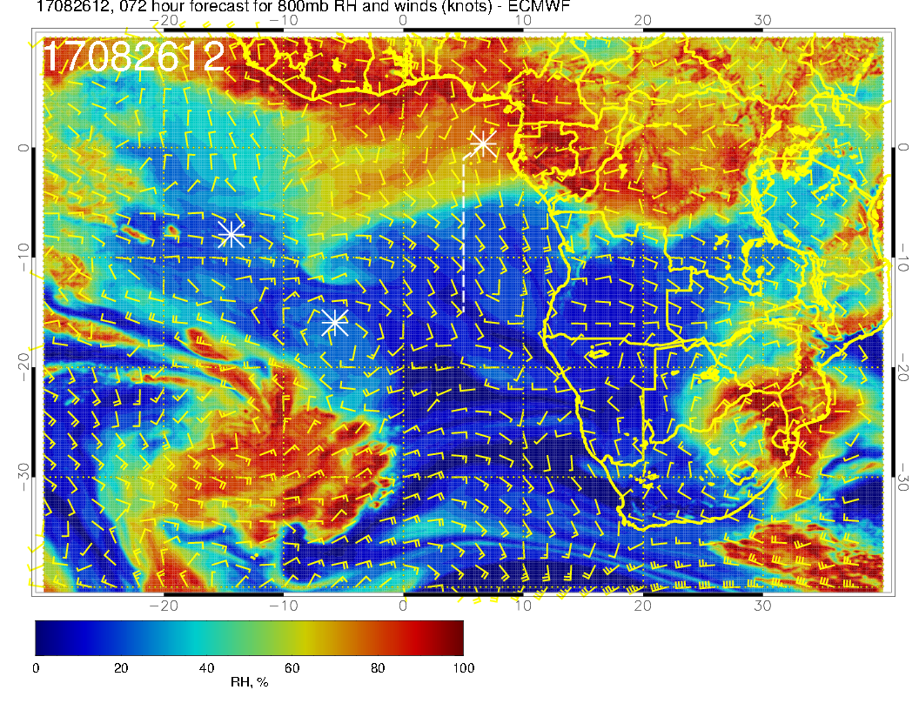
A
Mid level flow for Saturday. Movement of anticyclone leads to drying in operating region. At 600mb, movement of moist air westward is slightly slower than previous forecast.

Slide 22
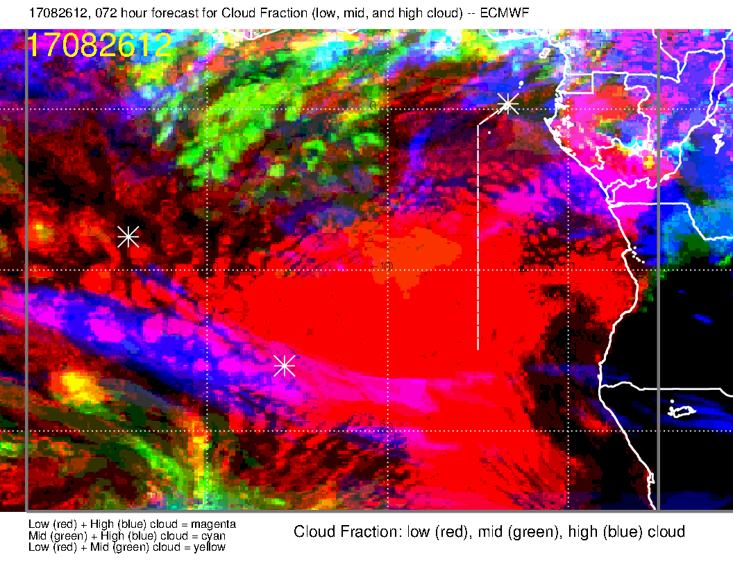
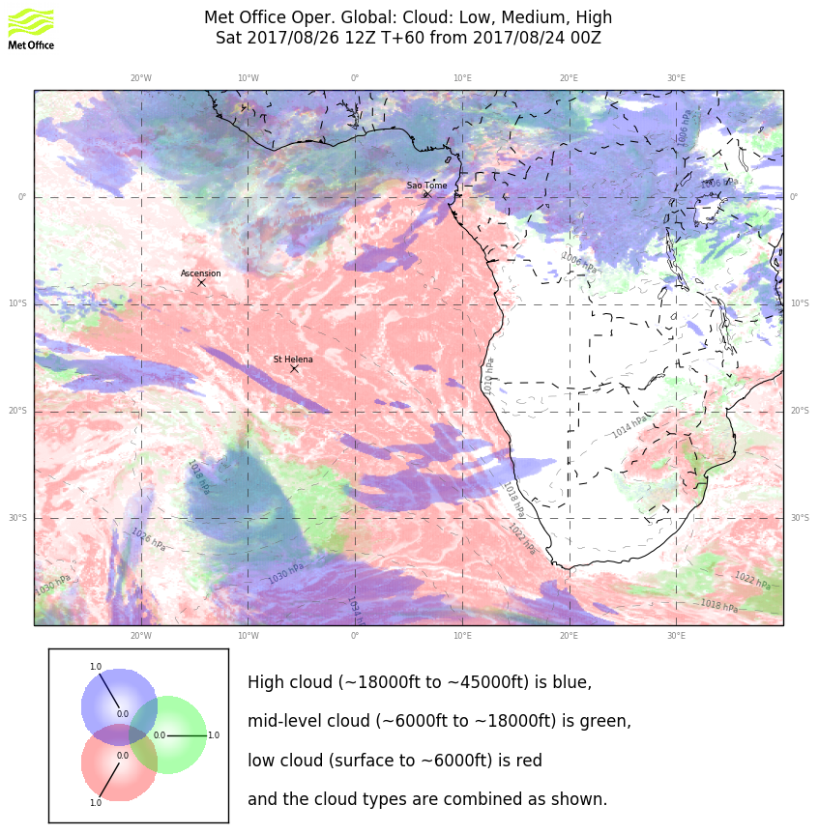
Clouds for Saturday. Similar to yesterday’s fcst for the mid level clouds, except that motion westward is a little less near the equator. Also have a splotch (not in UKMO) near 10S and the prime meridian. High clouds marginally more favorable, with a possible cloud free region near TMS with a low cloud “boundary”. Models disagree on extent of high clouds, though. EC has a small clear region north of the equator, UKMO does not.

Slide 23
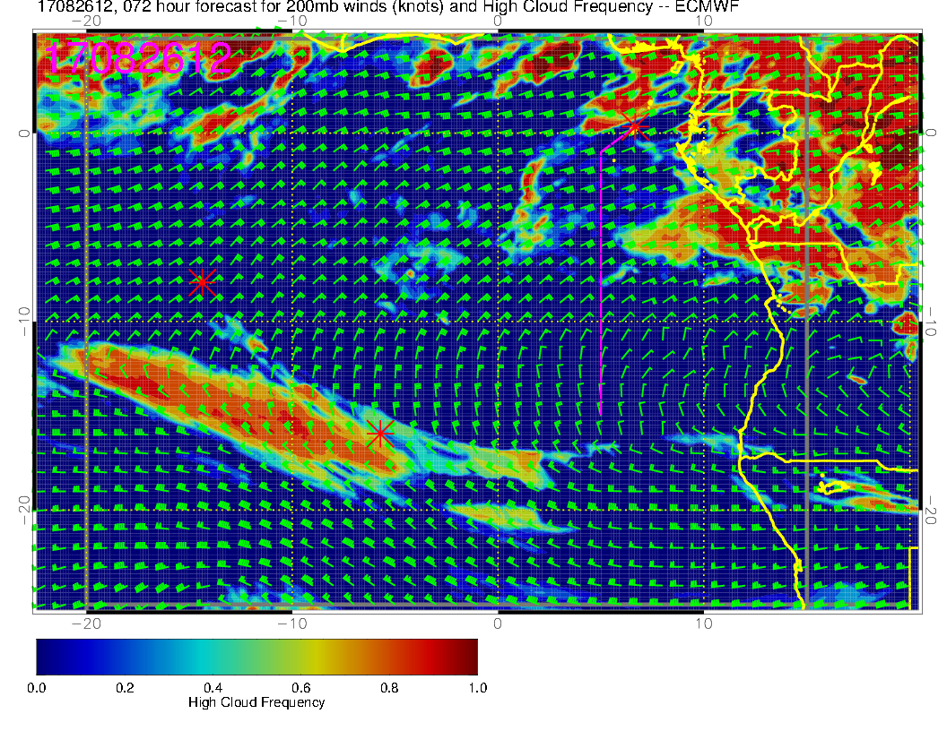
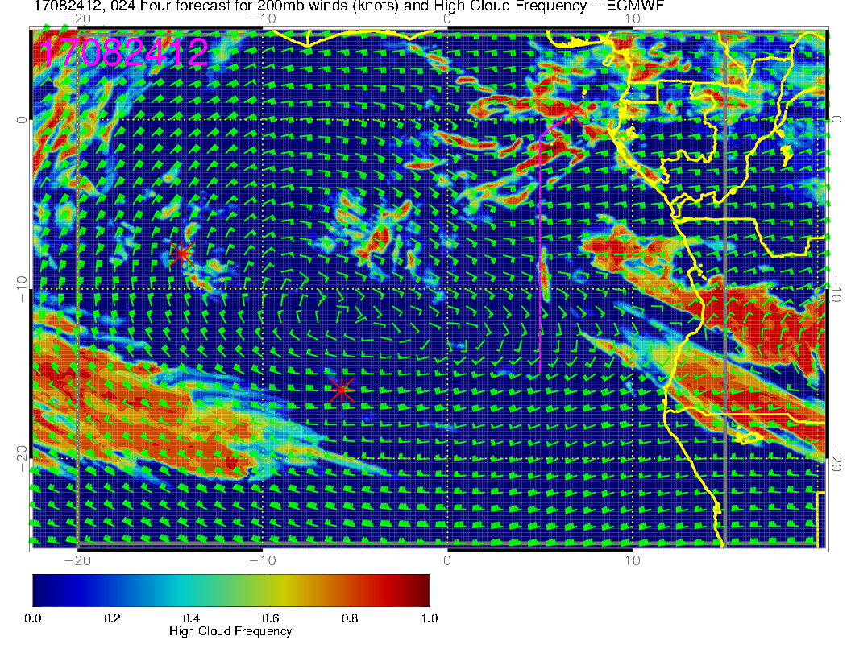
EC high clouds for Saturday (above). Forecast less activity than today (right) in our operating region.

Slide 24
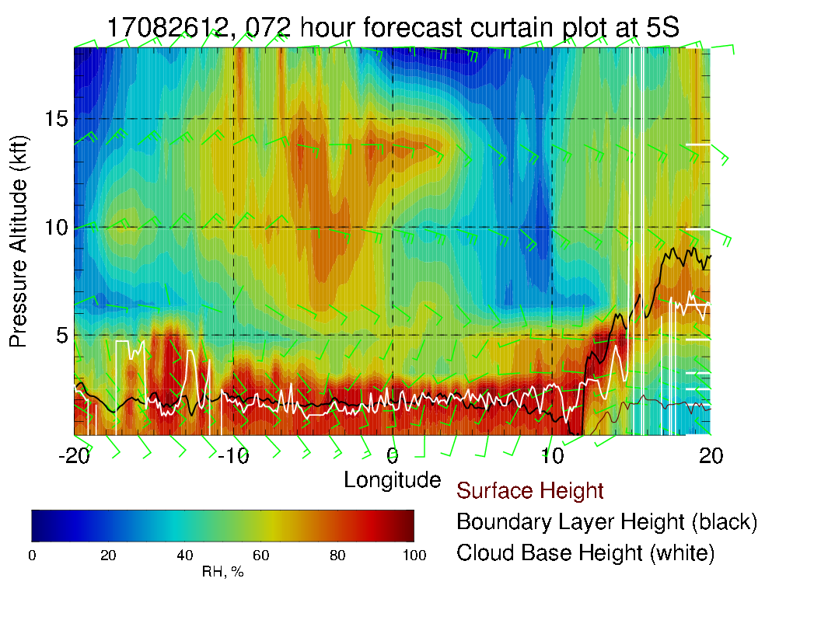
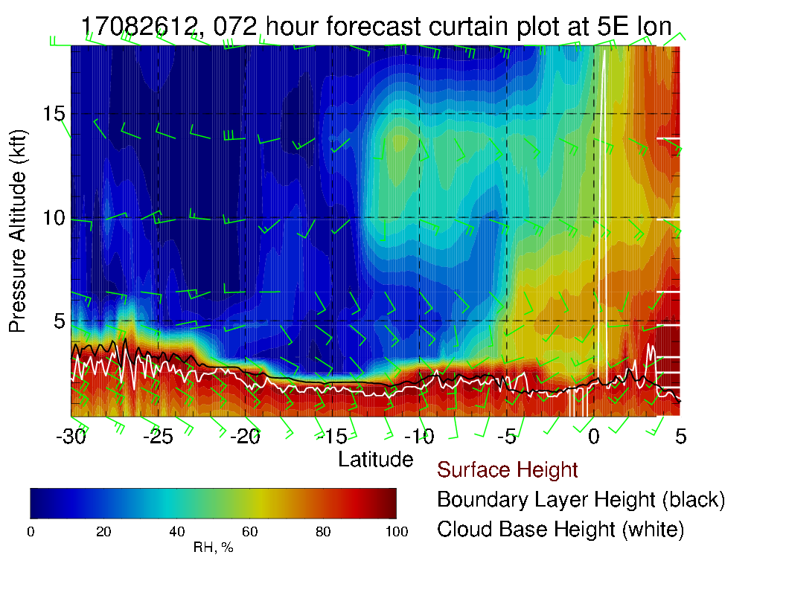
Routine track X-sect (left), Xsect along 5S above. Mid level moisture west of prime meridian, max winds (easterlies) at 700mb .

Slide 25
Sunday

Slide 26
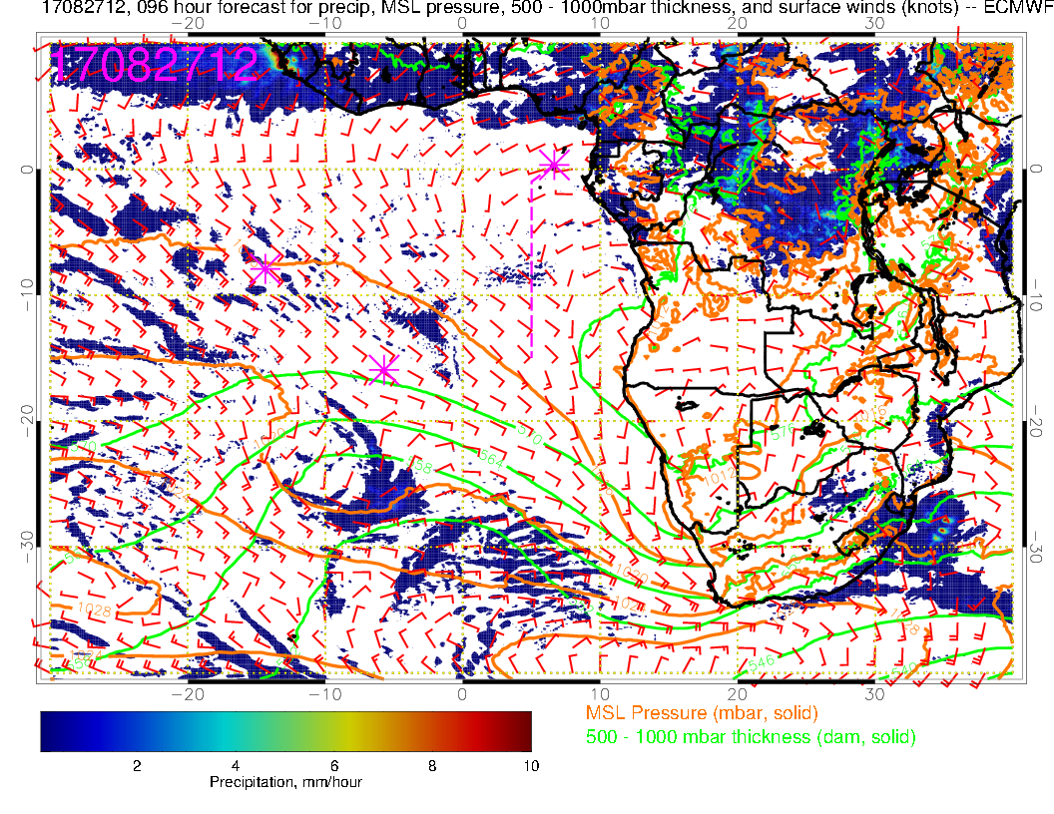
Surface chart for Sunday. Convection now focused in northern Congo, and surface winds have changed direction accordingly. With SH high well to the south, overall SE Atlantic winds are weak.

Slide 27
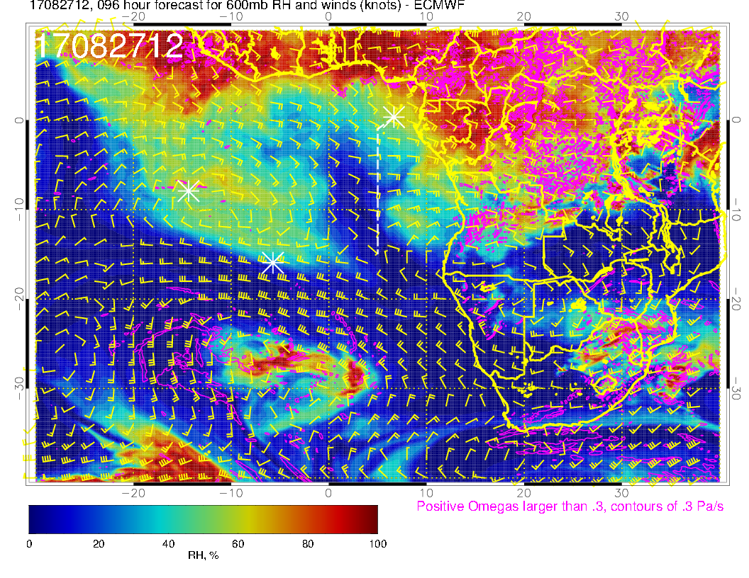
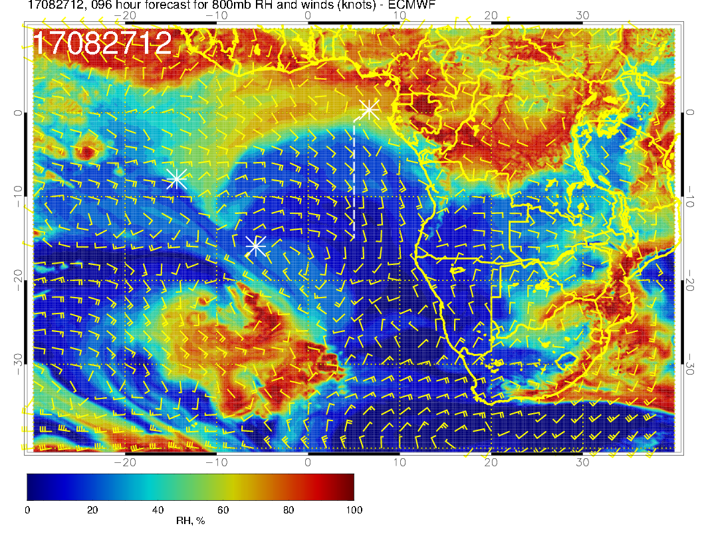
A
Mid level flow for Sunday. Pronounced southerly component of flow at 700mb from Angola into our region. Blob of dry convective moisture at 600mb has moved off of Angola. Pronounced drying at 800mb.

Slide 28
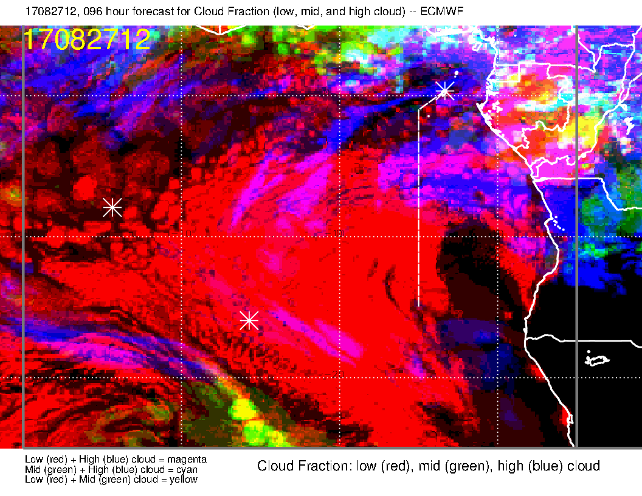
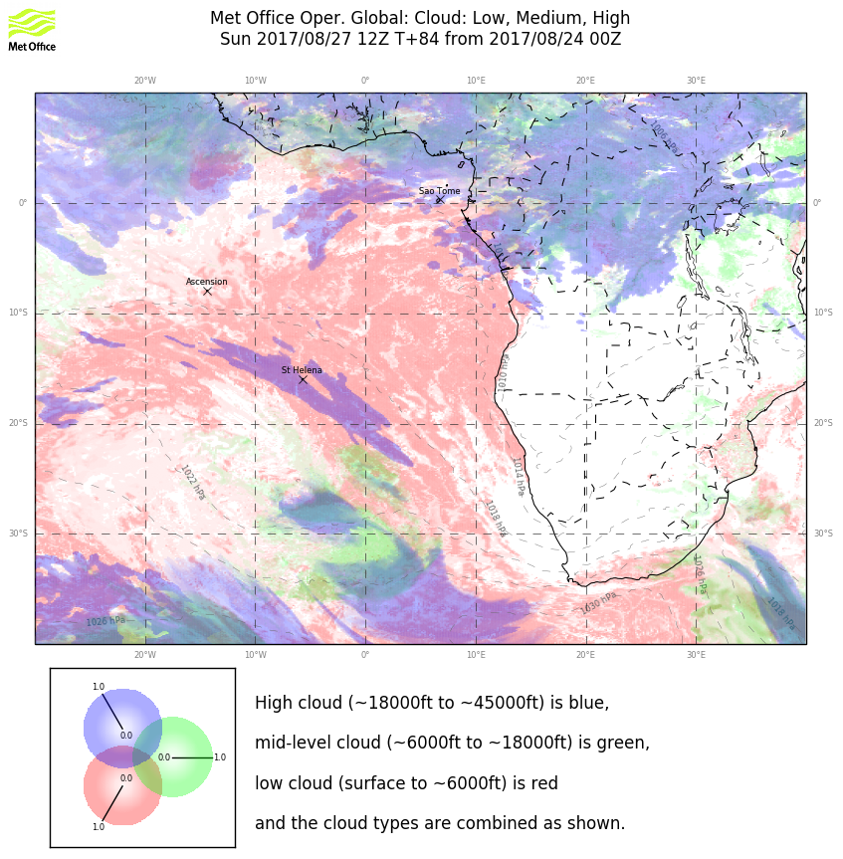
Clouds for Sunday. Broad agreement on high and middle clouds. EC forecast more “pessimistic” (and consistent with previous forecast). Neither forecast is clear to the north.

Slide 29
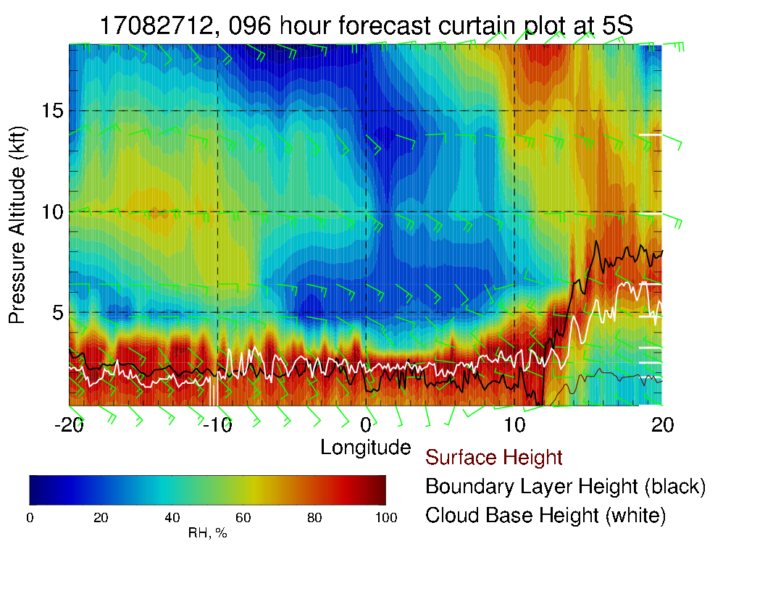
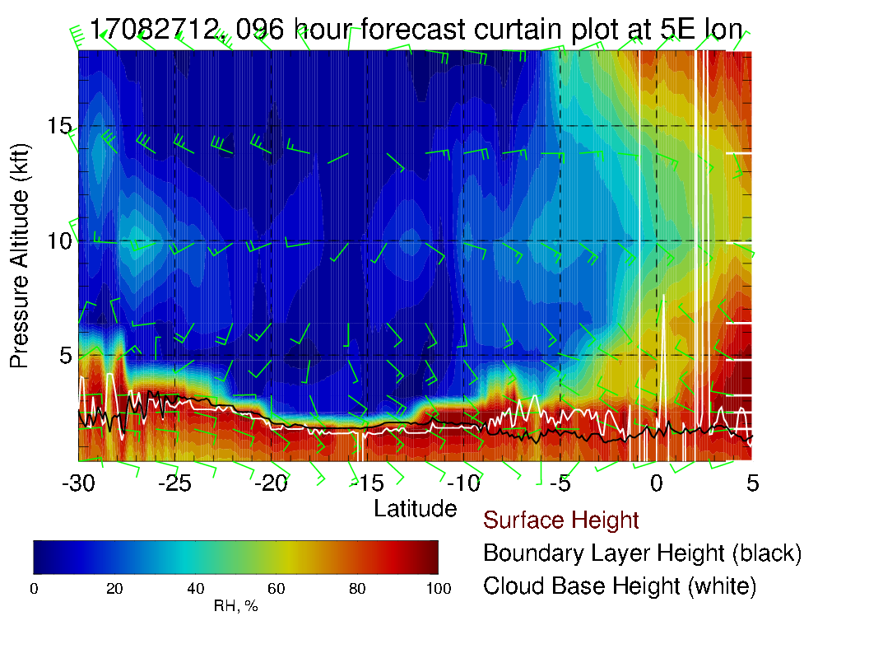
Nice retreat of mid-level moisture in
Dry mid-level environment except to the north of the equator and west of 10W.

Slide 30
Monday

Slide 31
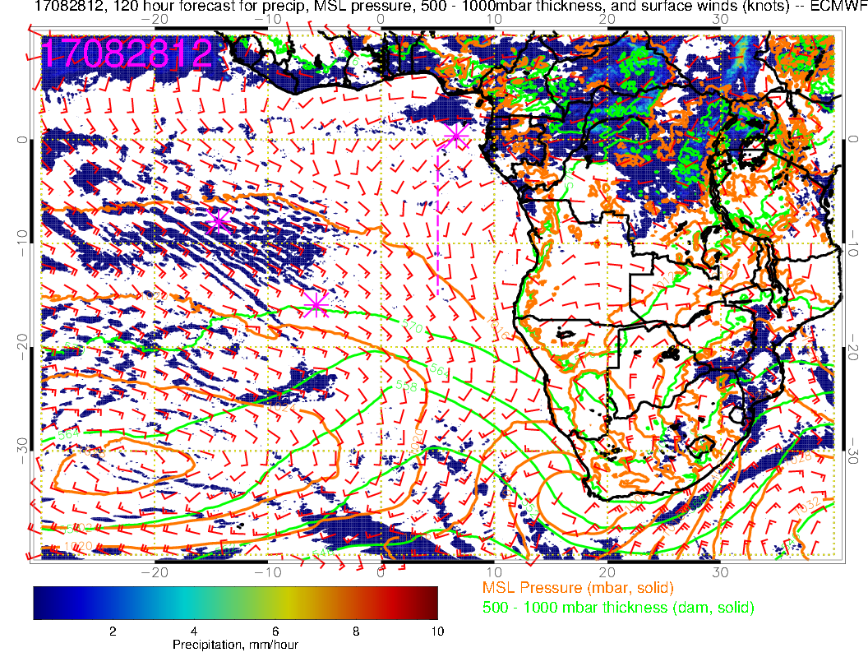
Continued strong convection over the Congo on Monday. Westerly component again near TMS. SH high reforms near 30S, 20W and overall SE Atlantic winds start to increase.

Slide 32
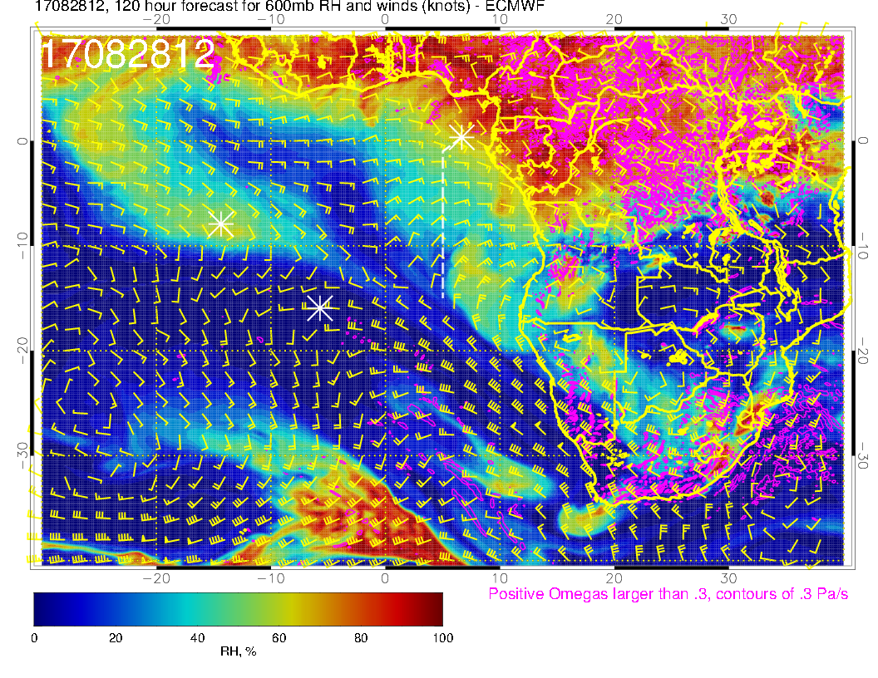
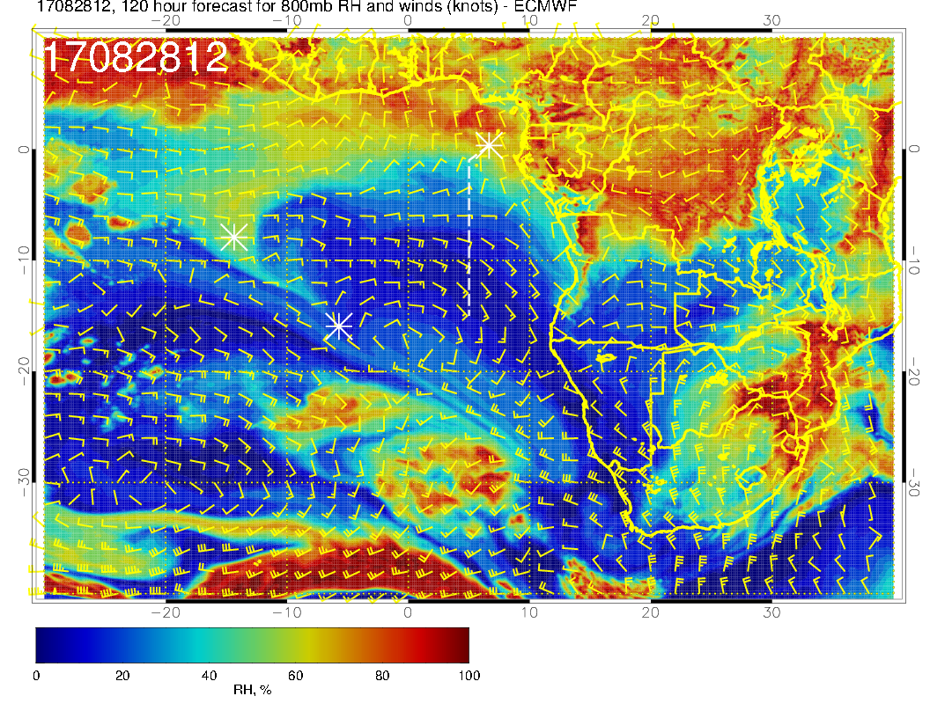
Mid level flow for Monday. At 600mb see dry convection blob of moisture coming off the coast. 700mb flow continues southerly component, so dry. In fact, southerly component extends to all levels, so mid-level operating region is dry.

Slide 33
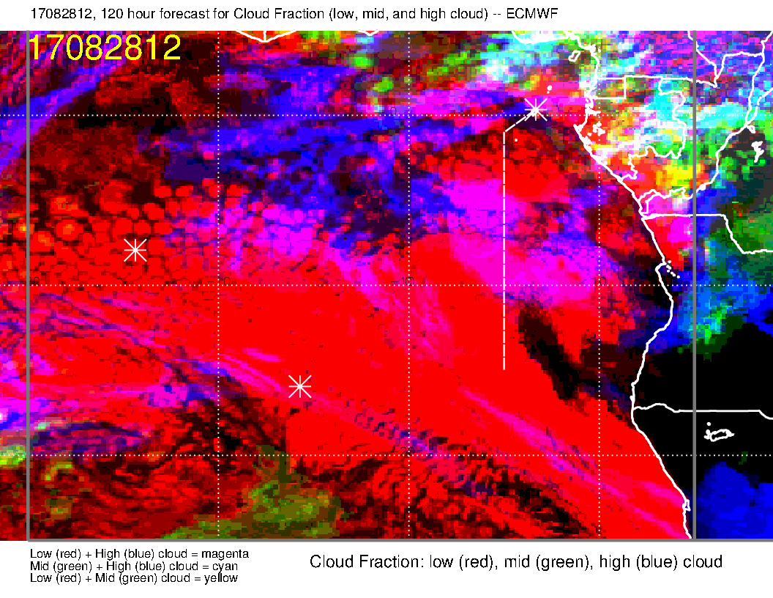
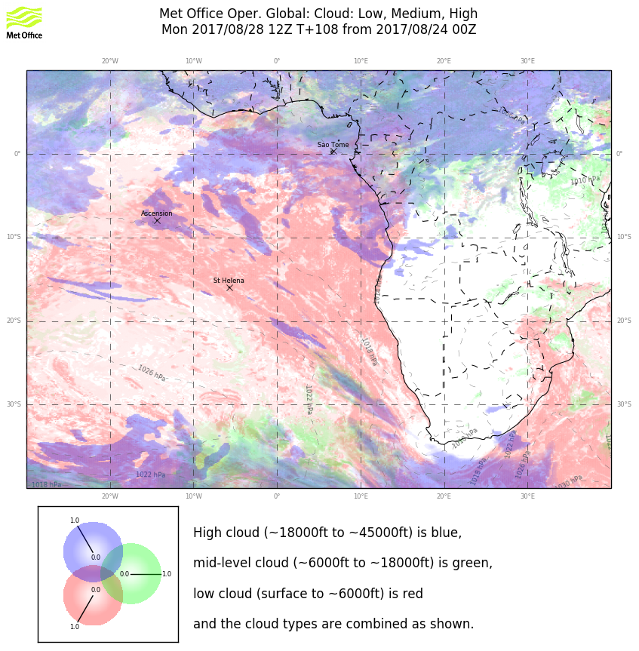
Clouds for Monday. Dry mid-levels are consistent with no mid-level cloud. High cloud forecast is problematic in the details.

Slide 34
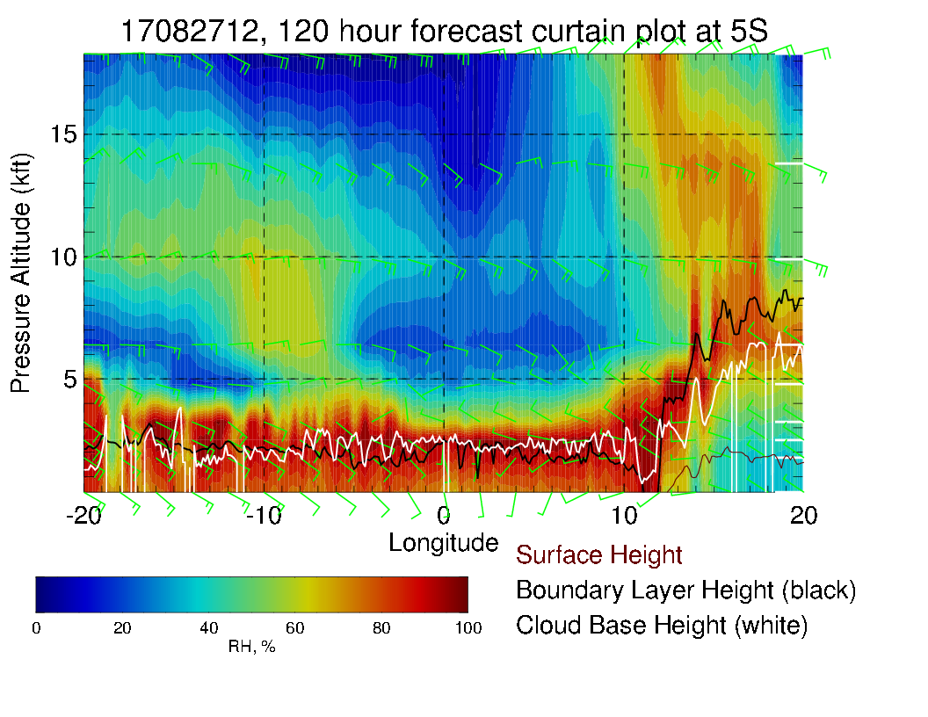
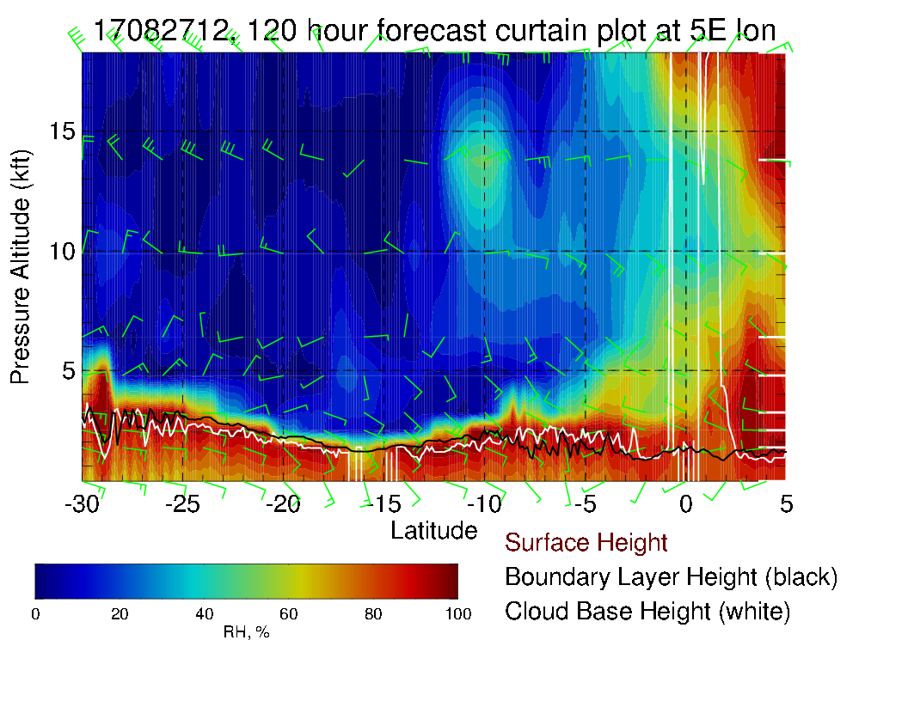
Dry routine flight track at mid levels. 5S east west X-sect also dry.

