Slide 1
Points
Middle cloud deck expected to move onto flight track by early afternoon (12Z).
3Z forecast and satellite imagery agree well on high and mid cloud (15 hour fcst)
Arrival of middle cloud is delayed by about 3 hours relative to yesterday’s fcst.
Low cloud boundary at 10S is well represented
Extensive clearing between 0 and 5S should have happened already based on fcst, and is not happening now. Would forecast that this clearing will not occur, and clear region north of 10S will be smaller than anticipated yesterday.

Slide 2
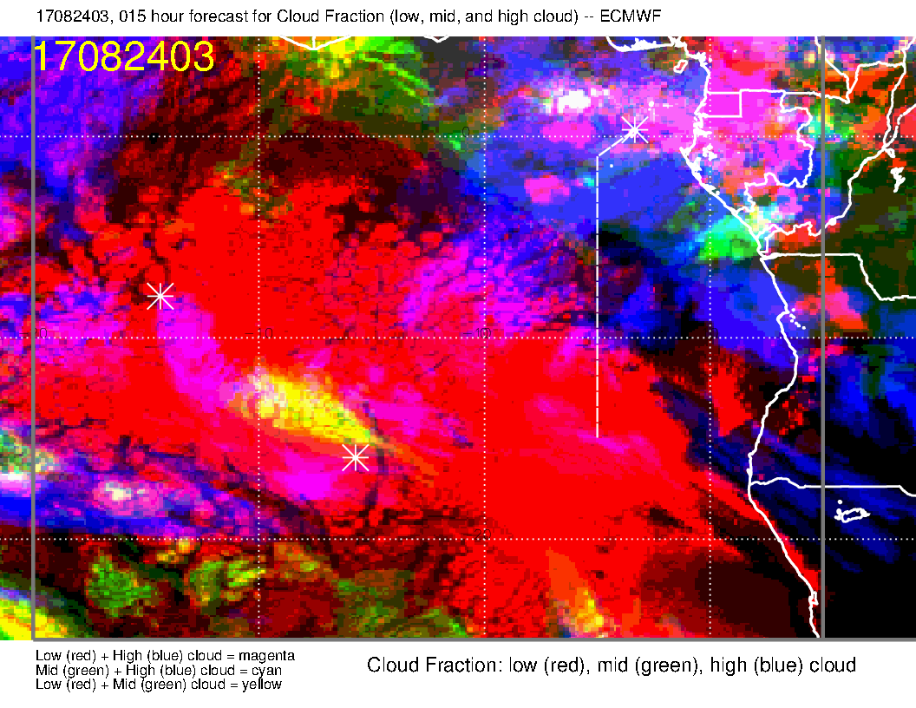
High and mid cloud forecast is surprisingly good, even in the details at 3 AM (15 hour
forecast.
Clouds are still filling in at low levels at this time. Surprisingly good even on some of the details (Angolan coast, cloud boundary at 10S, light stuff just west of track at 8S etc)
Model still projects a lot of clearing from 0 to 10S. Right now, that is filling in.

Slide 3
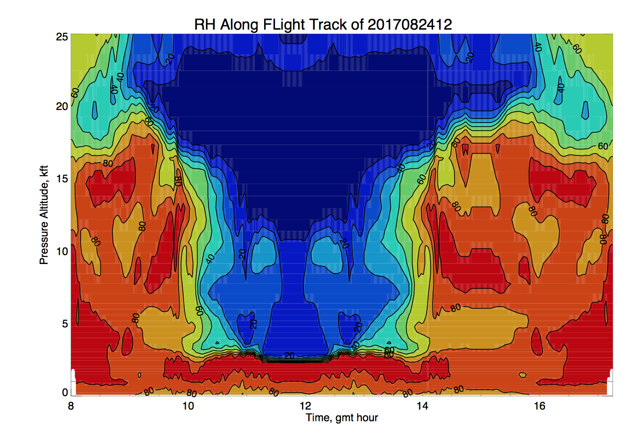
-10
-15
-10

Slide 4
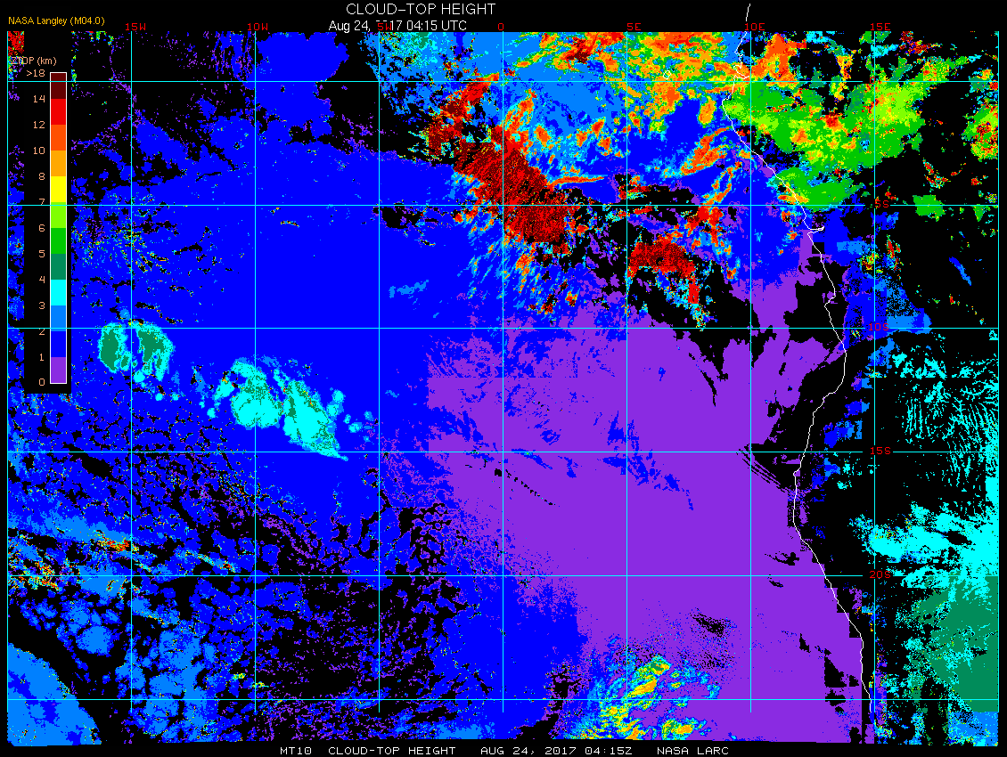
415 cloud top altitudes. Low clouds at <1 to 1-2 km cloud top. High clouds are above
14 km (though I doubt it, based on circulation, probably about 40kft tops.

Slide 6
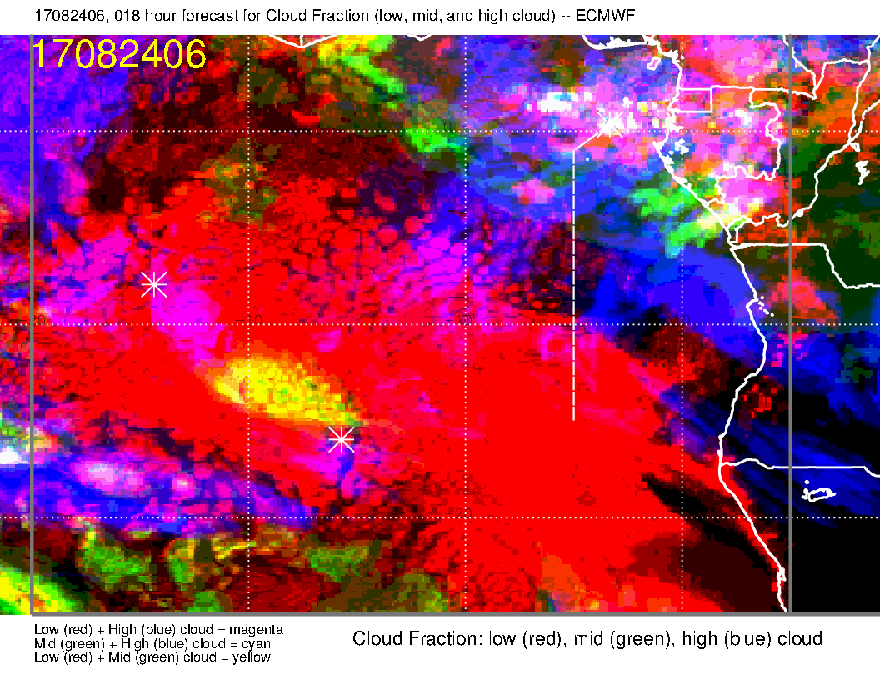

Slide 7
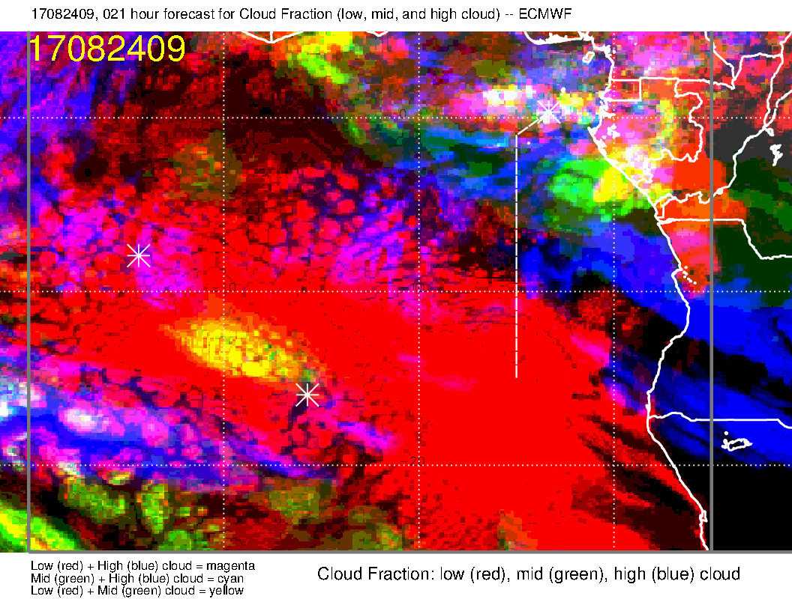

Slide 8
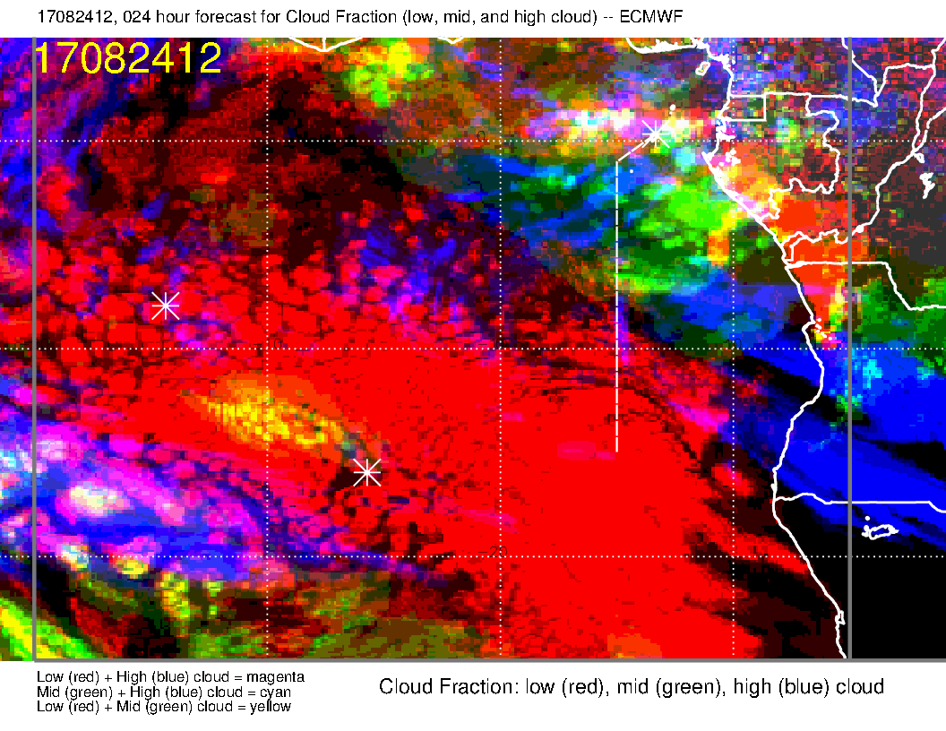

Slide 9
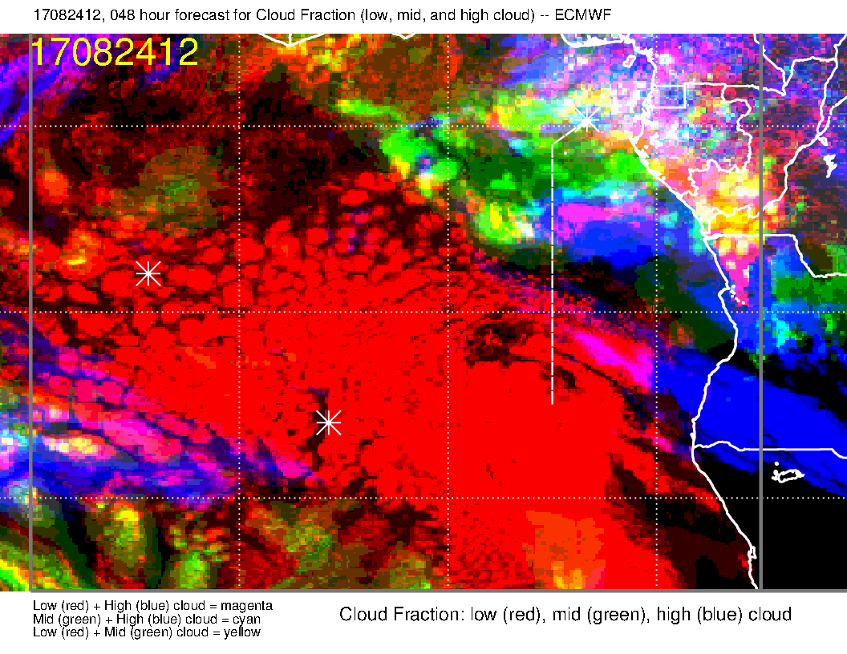
OLD FORECAST
Arrival of middle cloud is definitely delayed compared to old forecast by about 3 hours.

Slide 10
Most recent forecasts are in agreement on the positioning of high and
middle cloud at 12Z. UKMO is a little behind – is a slightly shorter term
forecast.

Slide 11
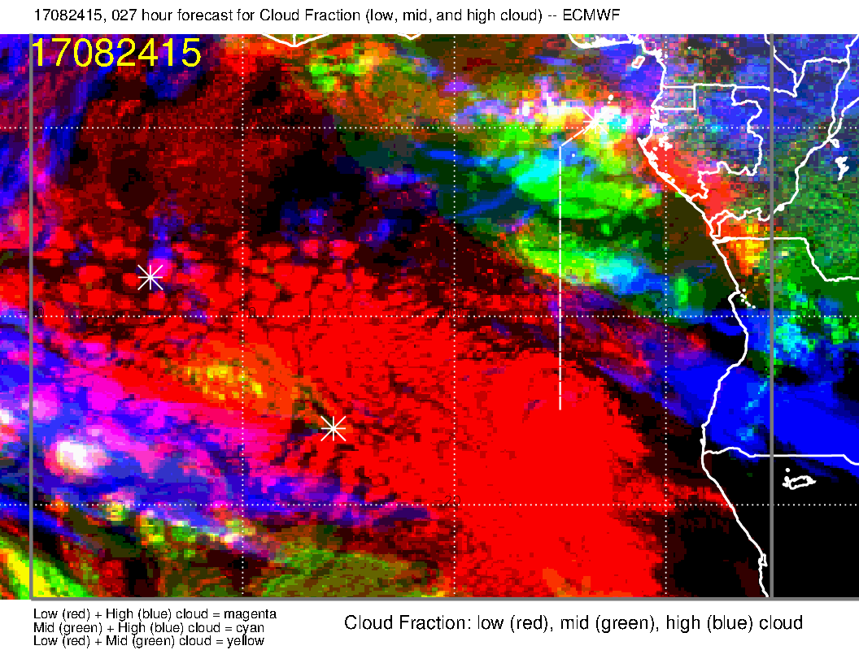

Slide 12
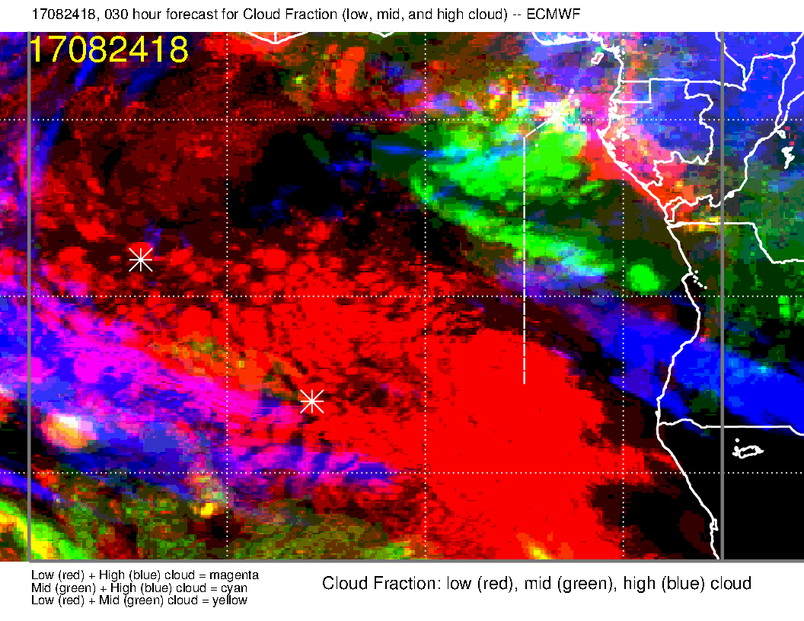

Slide 13
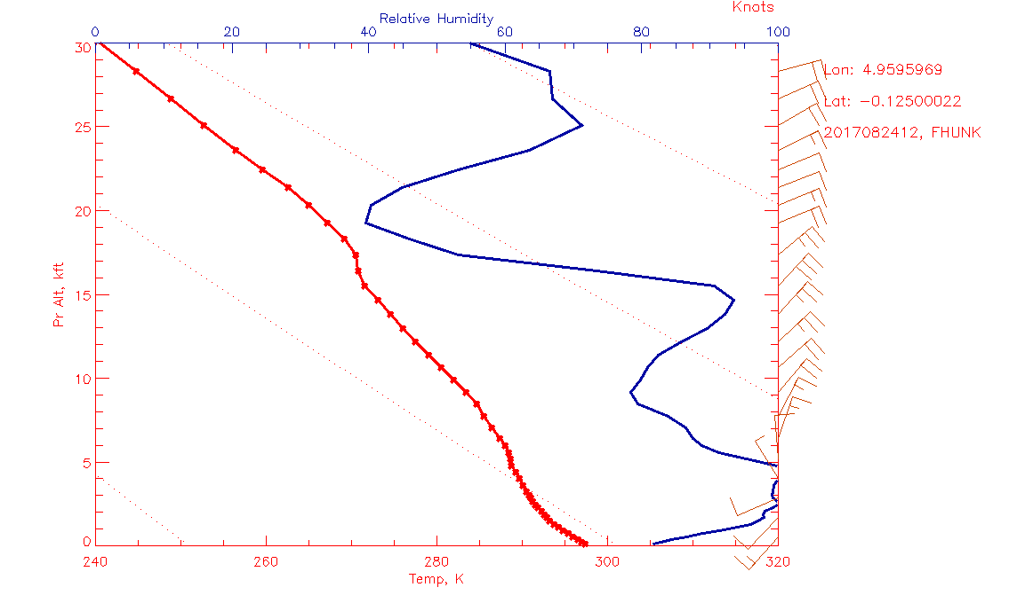

Slide 14
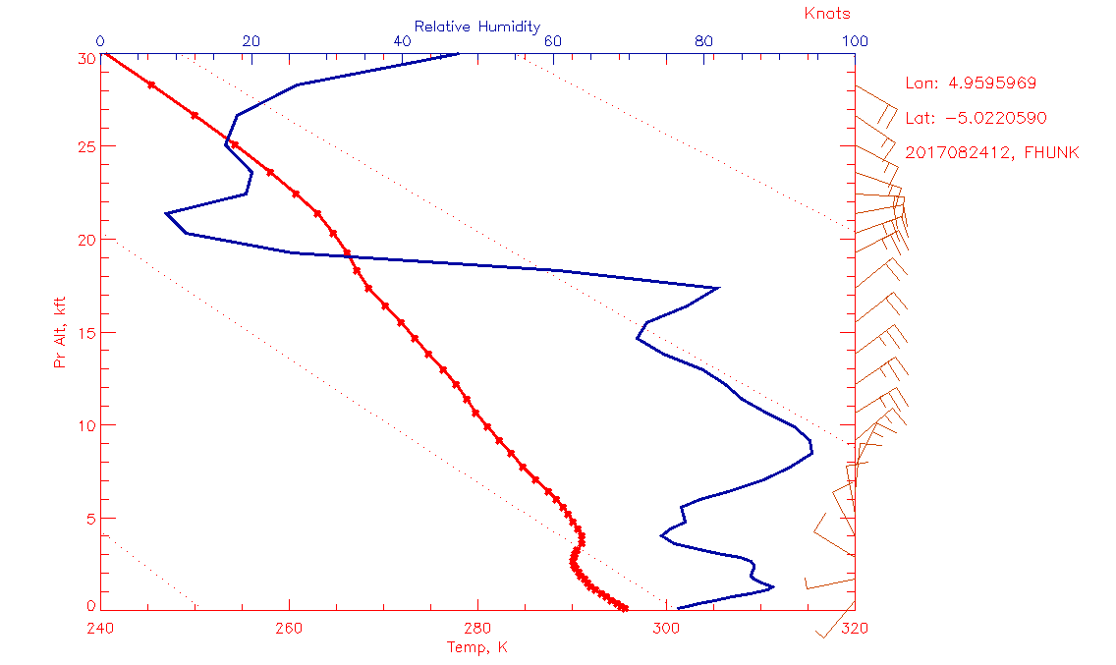

Slide 15
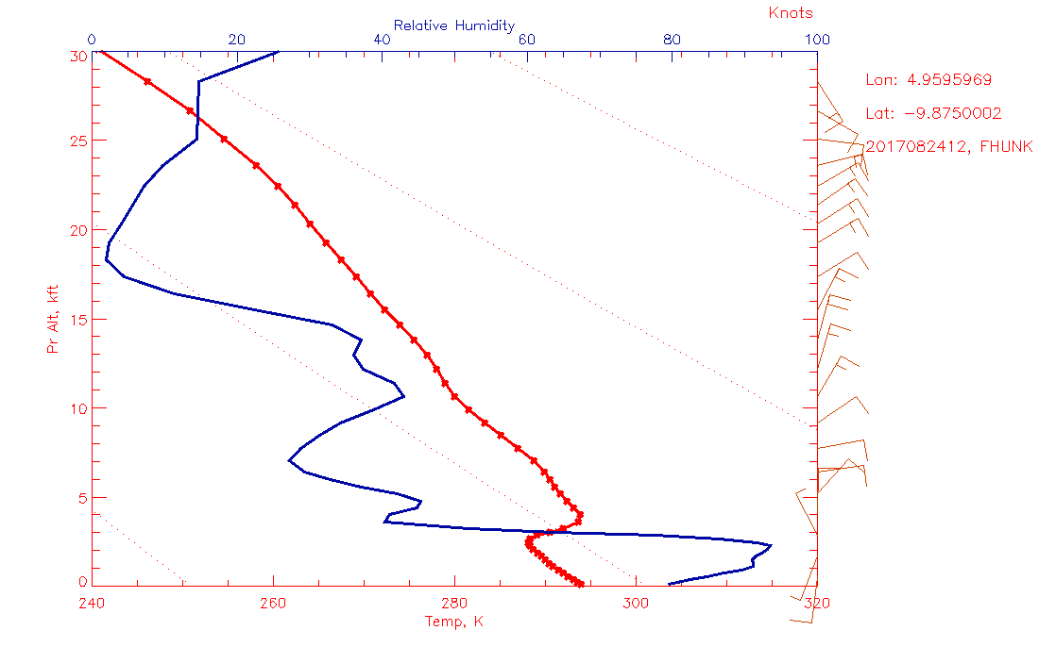

Slide 16
