Slide 1
ORACLES weather briefing
23-Aug-2017
Lenny Pfister and Rei Ueyama

Slide 2
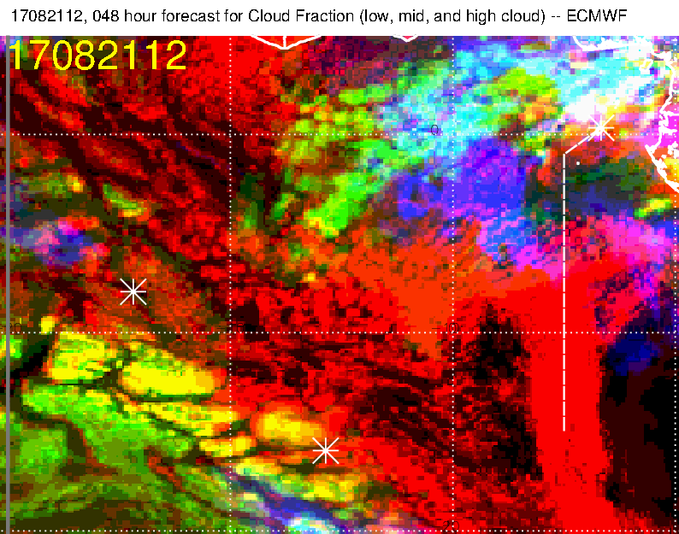
Forecast verification exercise. 12Z mid (brown) and high (red/blue) level clouds in
sat pic on left, as compared with 48 hour forecast (right). Basic shape is reasonable,
but fcst gives impression of “solid” cloud, where really scattered to isolated streamers
are the reality

Slide 3
48 hour fcst (below) vs observations.
Midlevel cloud encountered here and here. Forecast actually gets this fairly well, though main body is a bit too far west in fcst. If we had entertained going the direct route, fcst would have been useful in deterring us.

Slide 4
48 hour fcst (below) vs observations.
High cloud forecast gets structure right, but it’s not solid like the fcst

Slide 5
48 hour forecast for low cloud (below) vs
observations.
If we had expected something “solid” east of 5W, we would have been
misled. Clear area on routine section is captured

Slide 6
700mb evolution Monday-Sunday

Slide 7
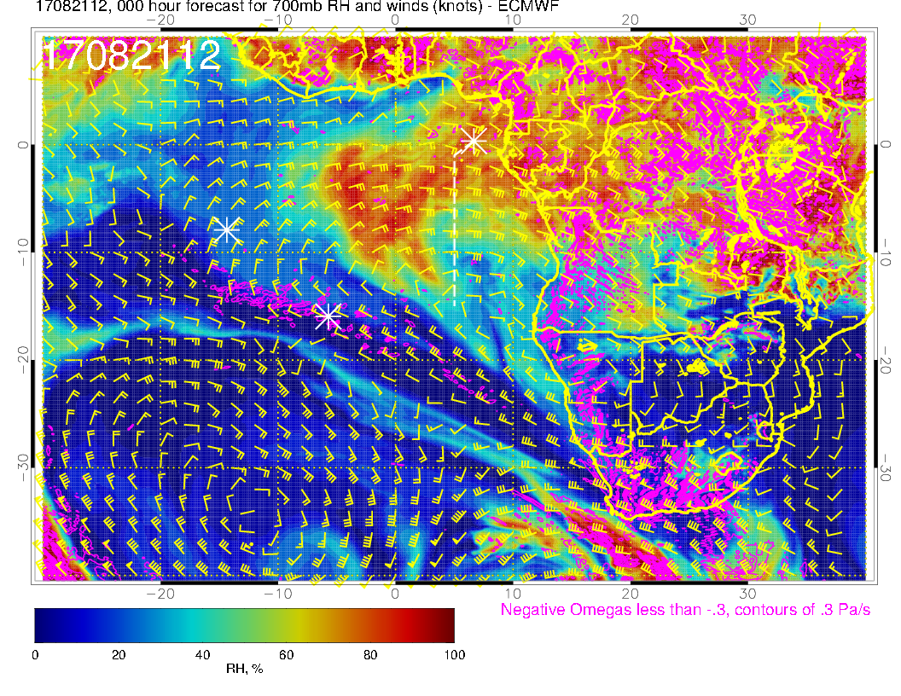
A
Monday’s flight: Offshore push of moist (north) and drier (south) air – strong plume

Slide 8
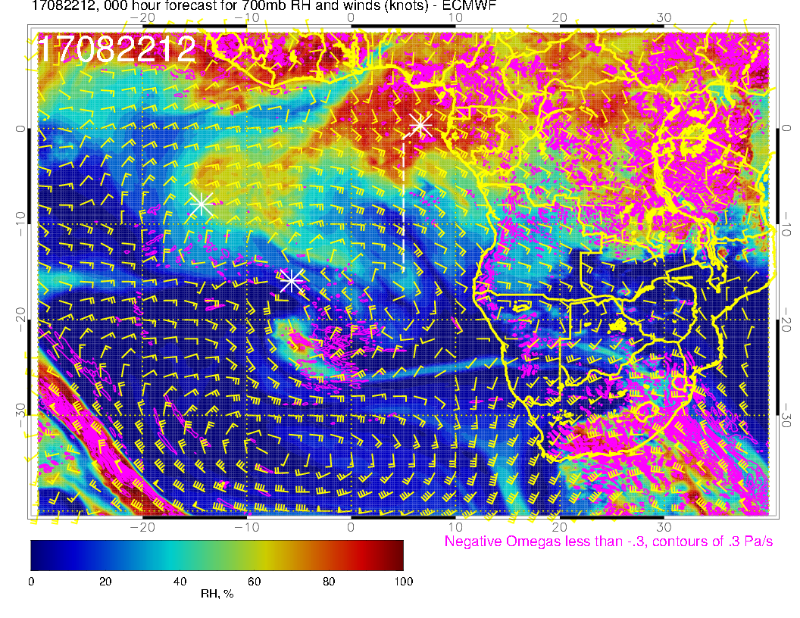
A
Anticyclone moves westward. Northward component of offshore flow increases.
Moisture plume over TMS can be seen in motion of middle cloud in satpic yesterday

Slide 9
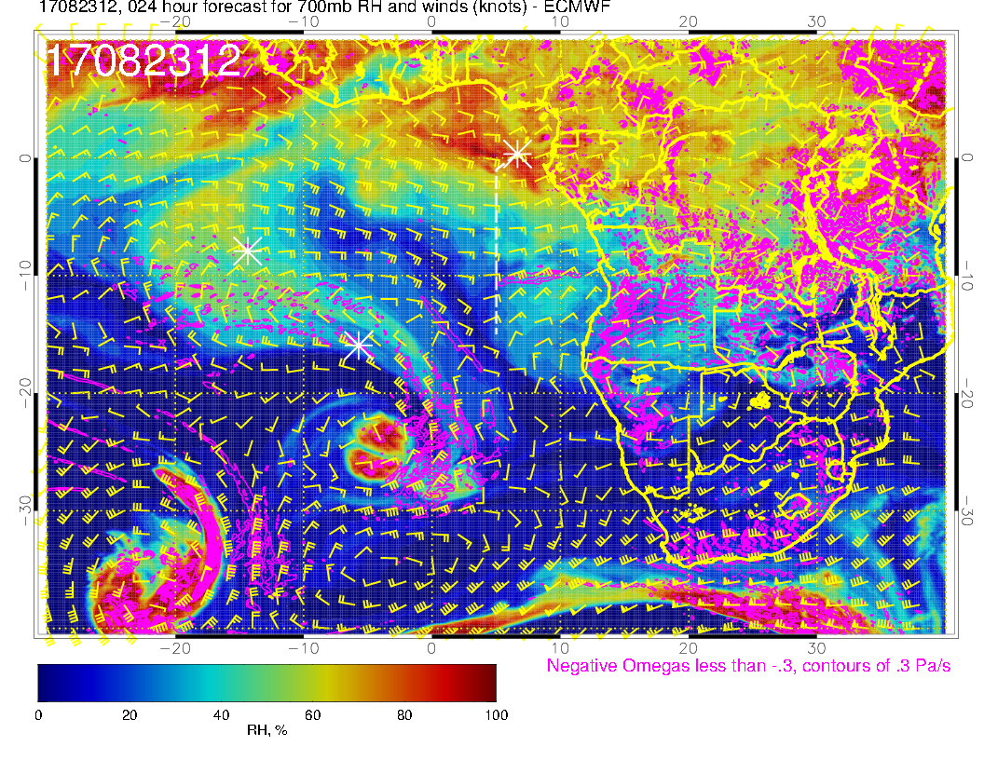
A
A
Anticyclone weakens (interaction with midlatitude low). Flow more westward. African wave anticyclone becomes apparent

Slide 10
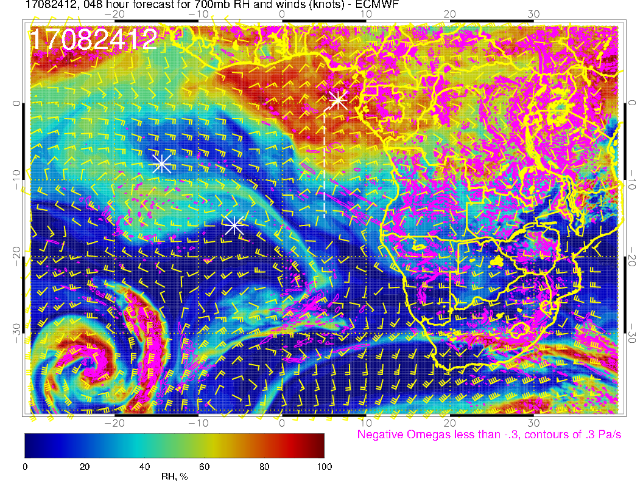
A
A?
A
New anticyclone over southern Angola. Get another northerly push of moist air
tomorrow.

Slide 11
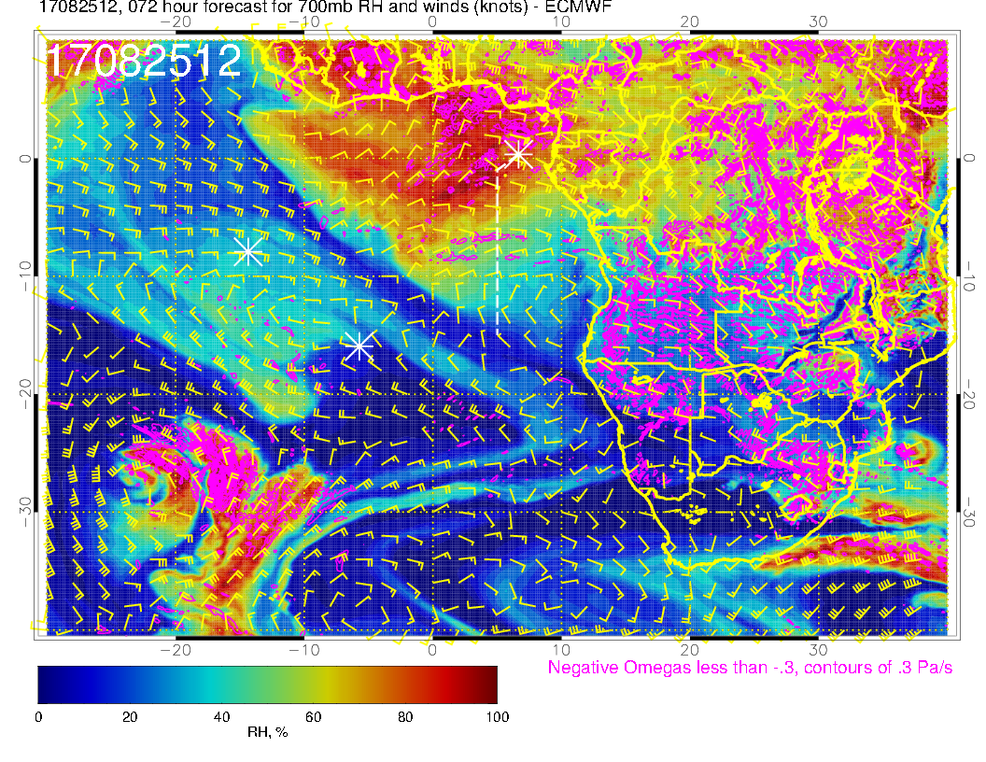
A
A
Anticyclone moves over, as does the moist pattern. Anticyclone initiates (?) southerly
component offshore

Slide 12
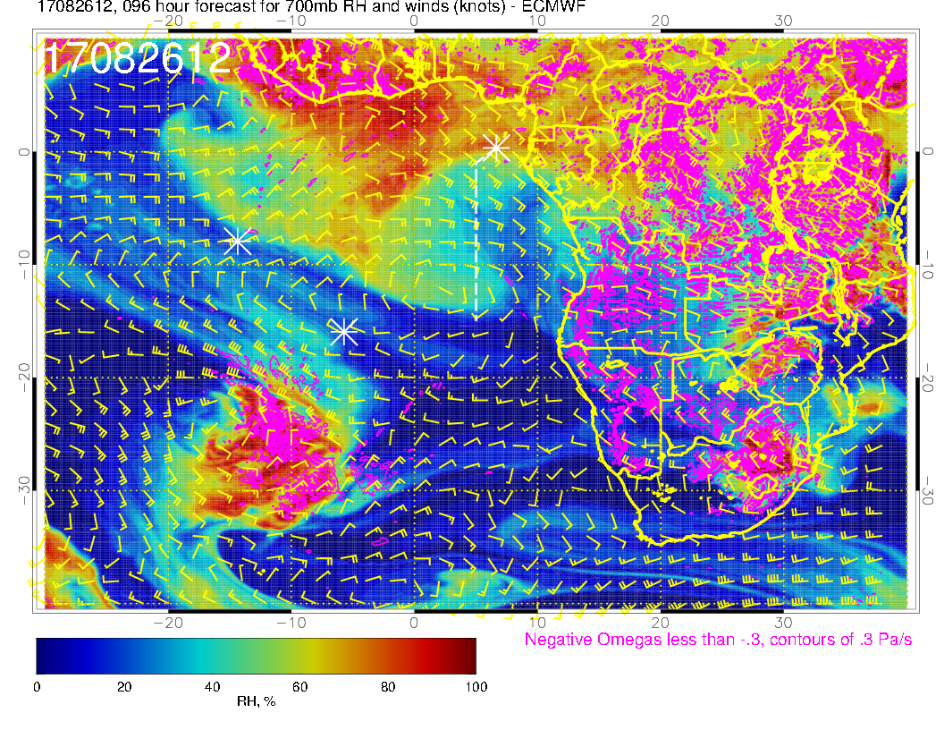
A
A
Southern anticyclone continues to enhance a southerly flow

Slide 13
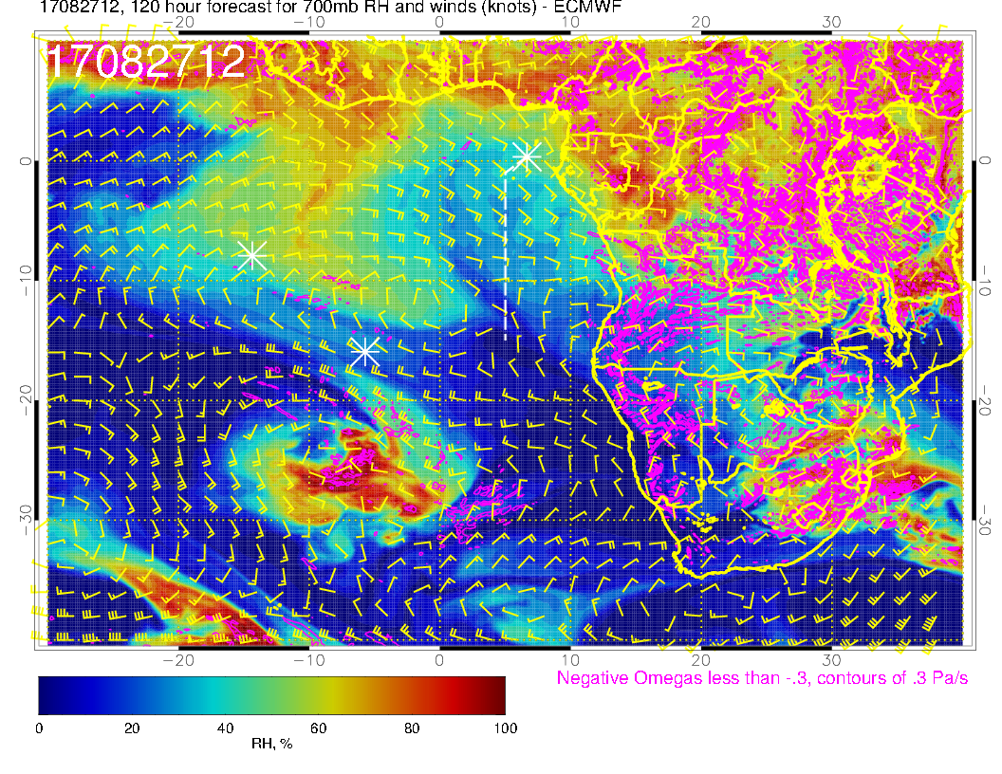
A
Flow “flattens” as anticyclone moves offshore, still dry

Slide 14
Thursday

Slide 15
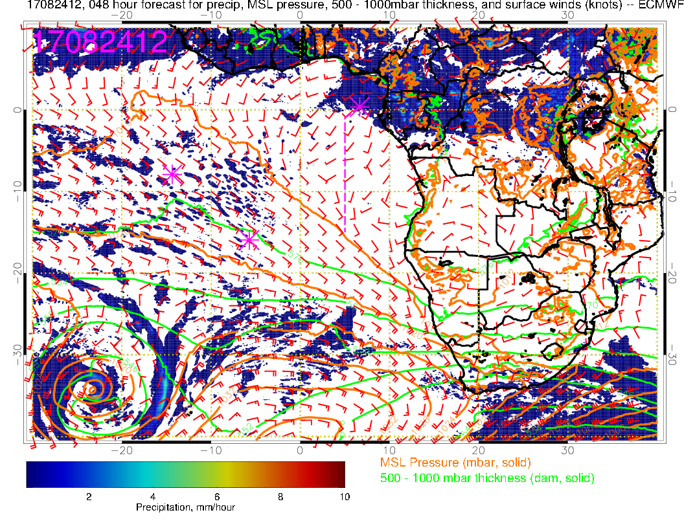
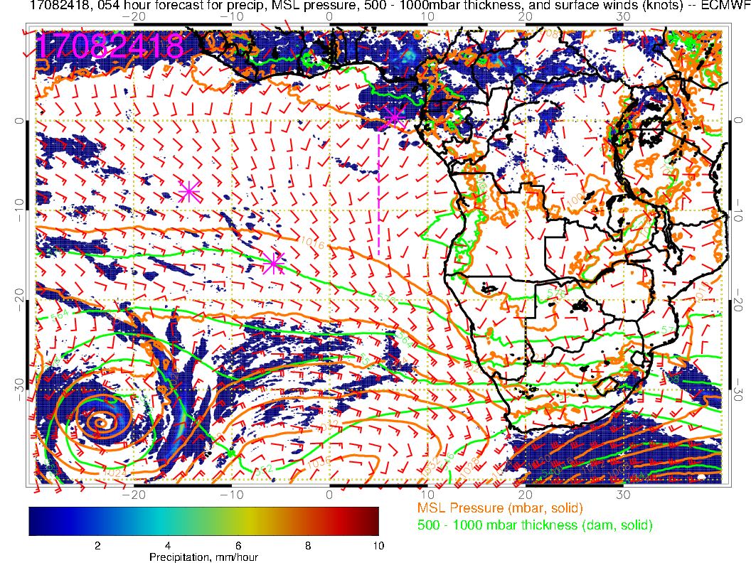
Surface chart for noon tomorrow (left) and 6 PM tomorrow. Convective precip is getting close to TMS, WSW winds are strengthening to 15 knots during the day.

Slide 16
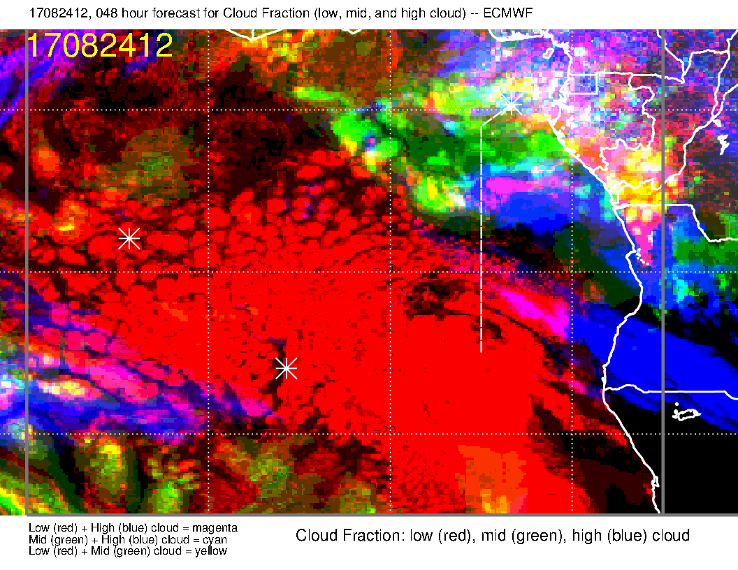
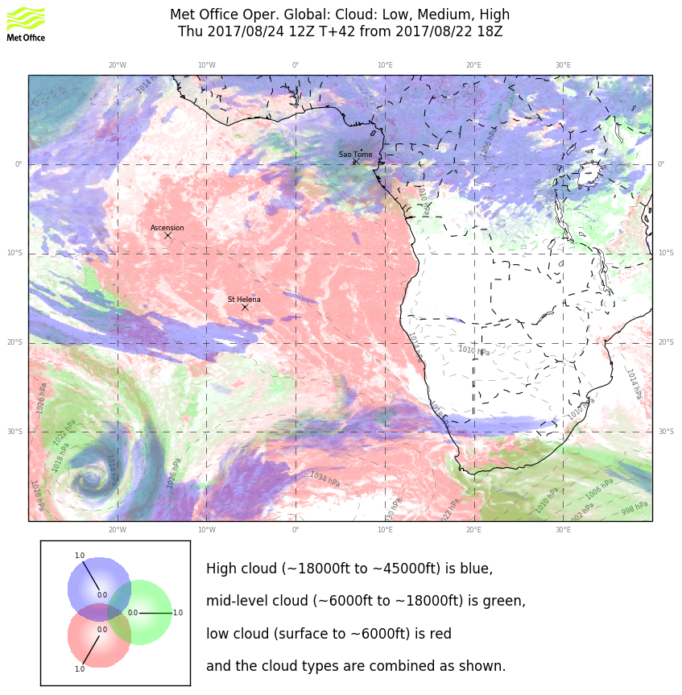
Cloud forecast for tomorrow. High clouds forecast off of Angola unlikely (recirculation), mid-level clouds to 3-4 S on routine track (perhaps further), high clouds to 5-6S.

Slide 17
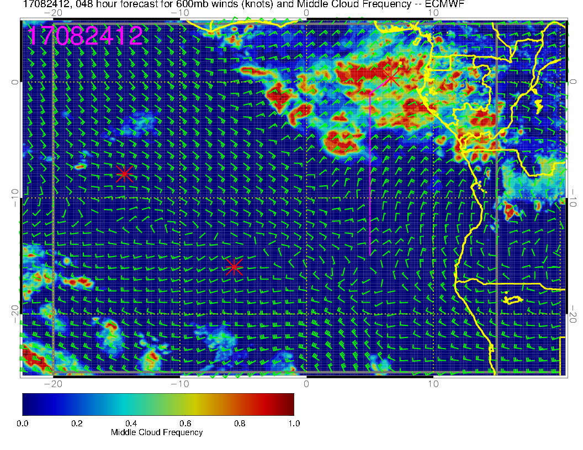
Cloud forecast (mid-level) for tomorrow. Never as solid as these forecasts indicate, but models agree on basic structure. Could have issues to 6S.

Slide 18
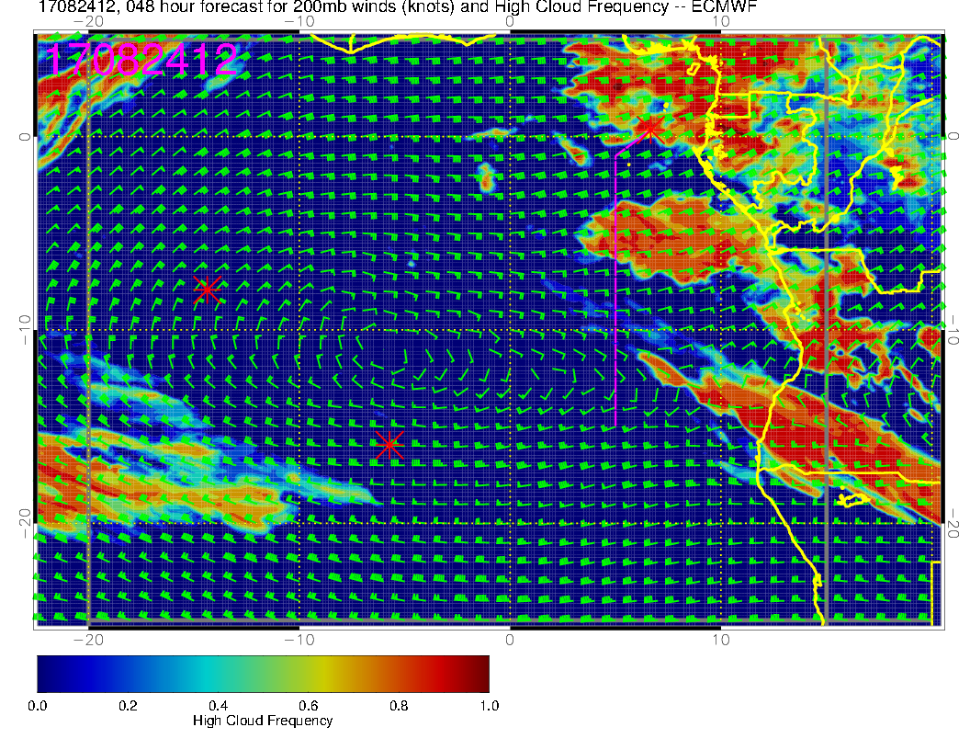
Cloud forecast (high level) for tomorrow. Go with UKMO model on not trusting the high level cloud south of about 7S.

Slide 19
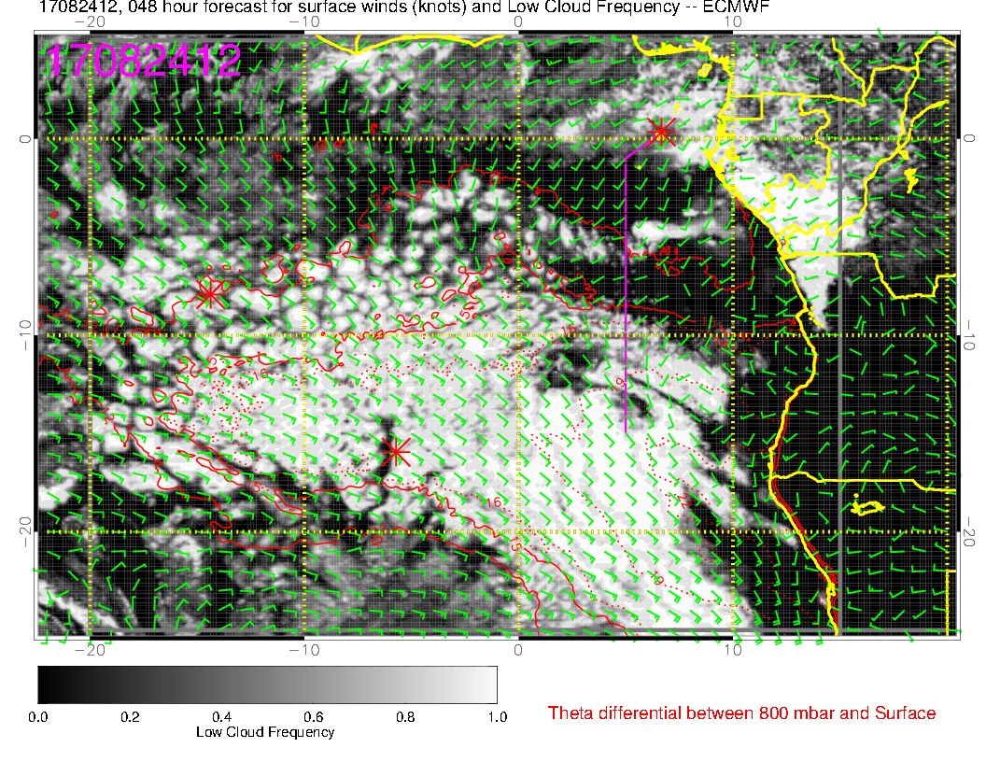
Cloud forecast (low level) for tomorrow. Substantial low level cloud clearing forecast (associated with very weak low level flow??? Even UKMO has some clearing. Sounding shows weak inversion north of 5S or so

Slide 20
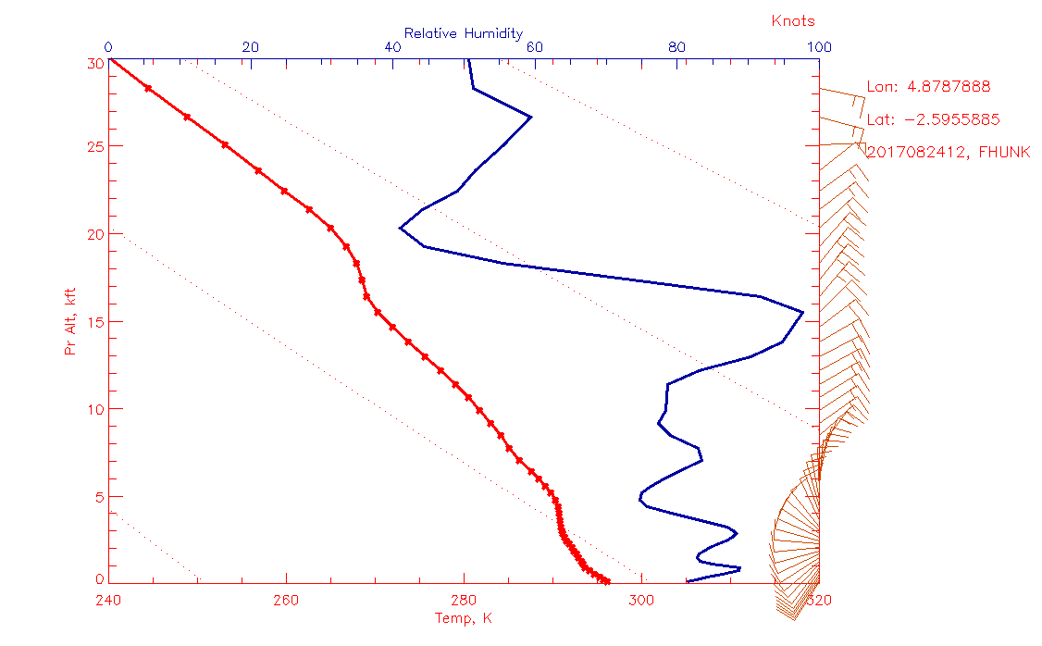
Cloud forecast (low level) for tomorrow. Substantial low level cloud clearing forecast (associated with very weak low level flow??? Even UKMO has some clearing. Sounding shows weak inversion north of 5S or so – can’t keep the moist layer moist?

Slide 21
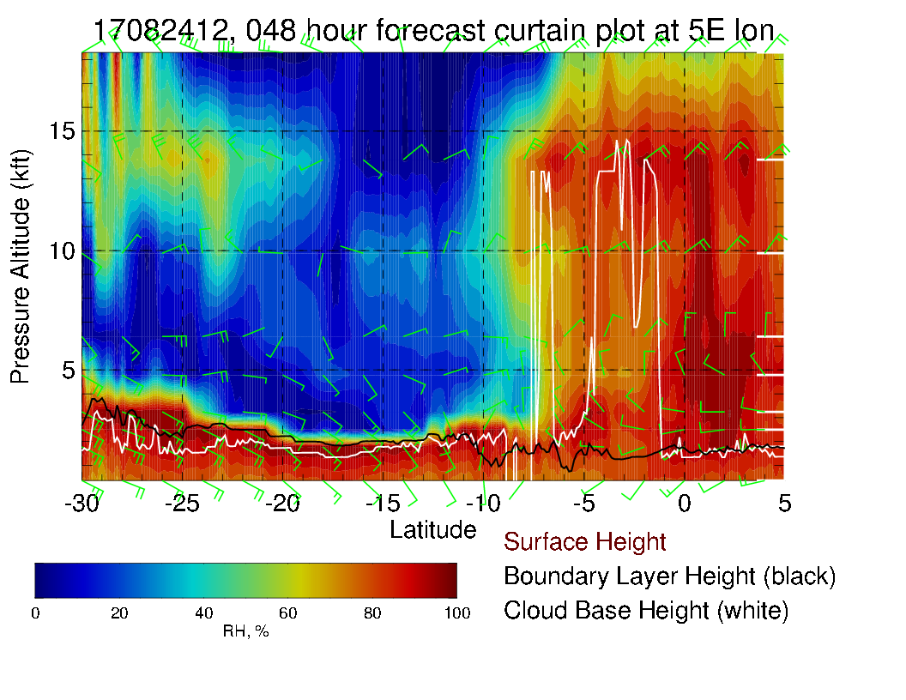
Cross section along routine track indicating possible mid-level cloud. Low level winds are weak. More northerly component than typical at high levels, good tailwind component on HSRL leg south (!).

Slide 22
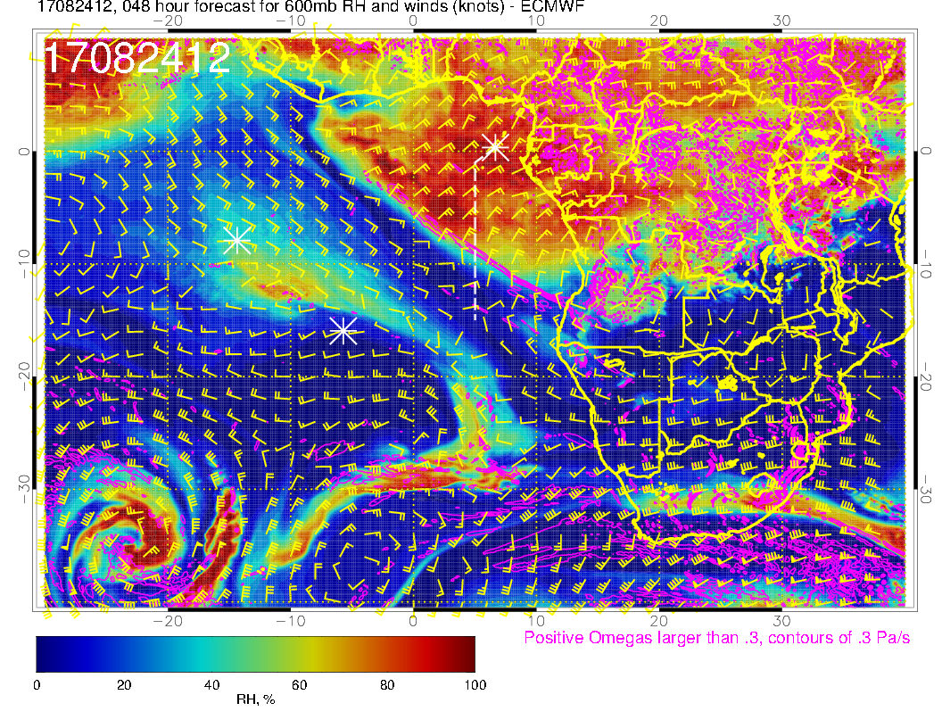
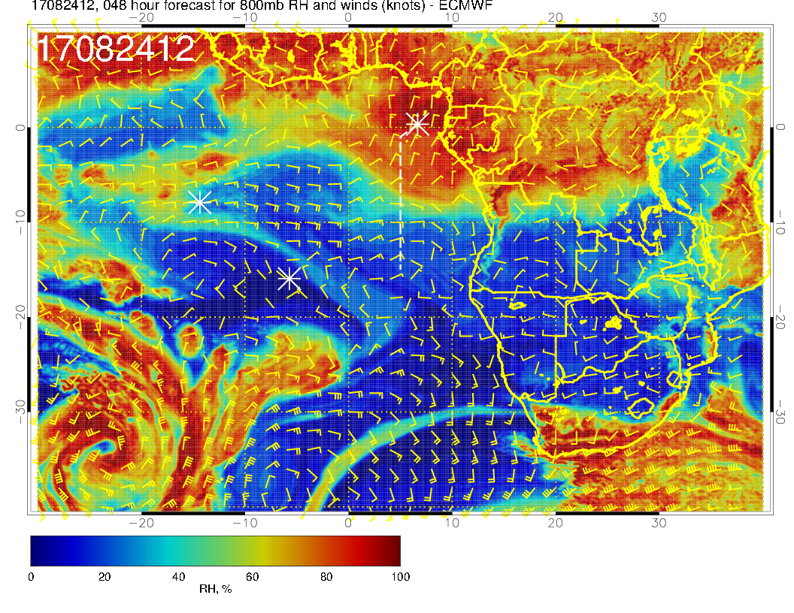
A
Mid level flow for tomorrow. Northerly component at all the midlevels.

Slide 23
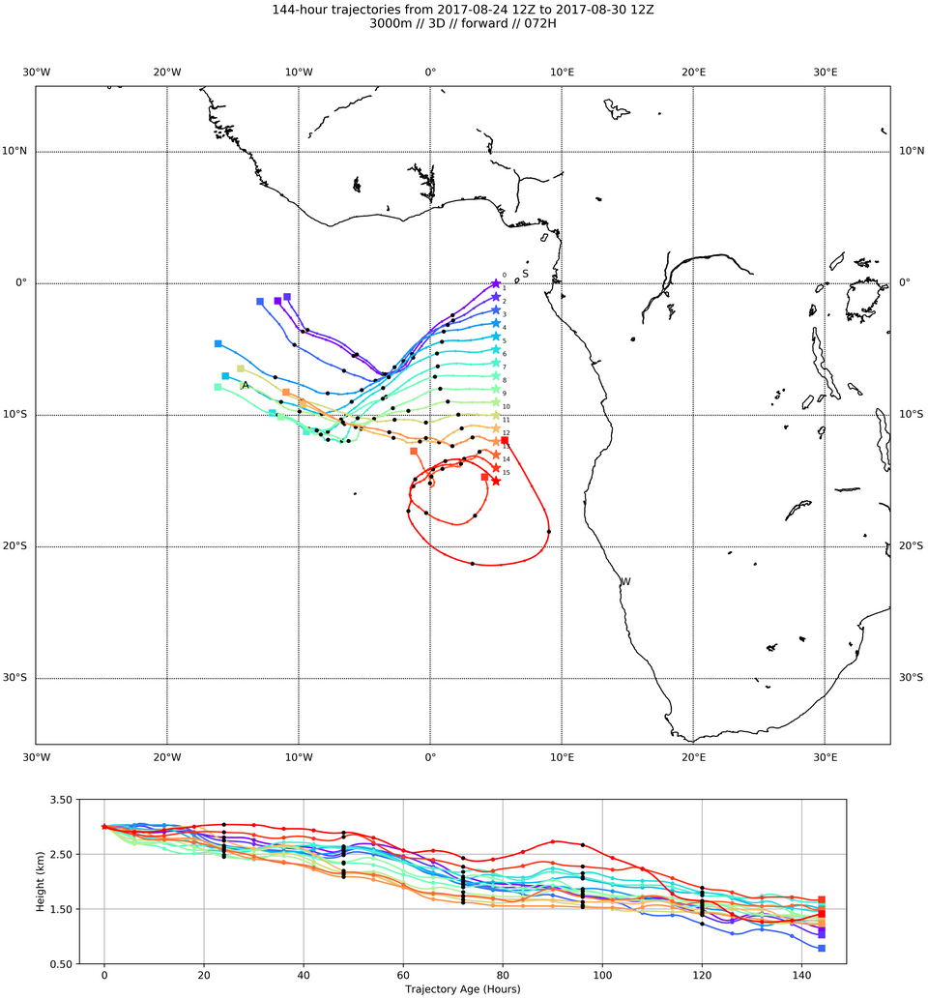
3 km trajectories show straightforward westward parcel motion over two days north of about 10S

Slide 24
Friday

Slide 25
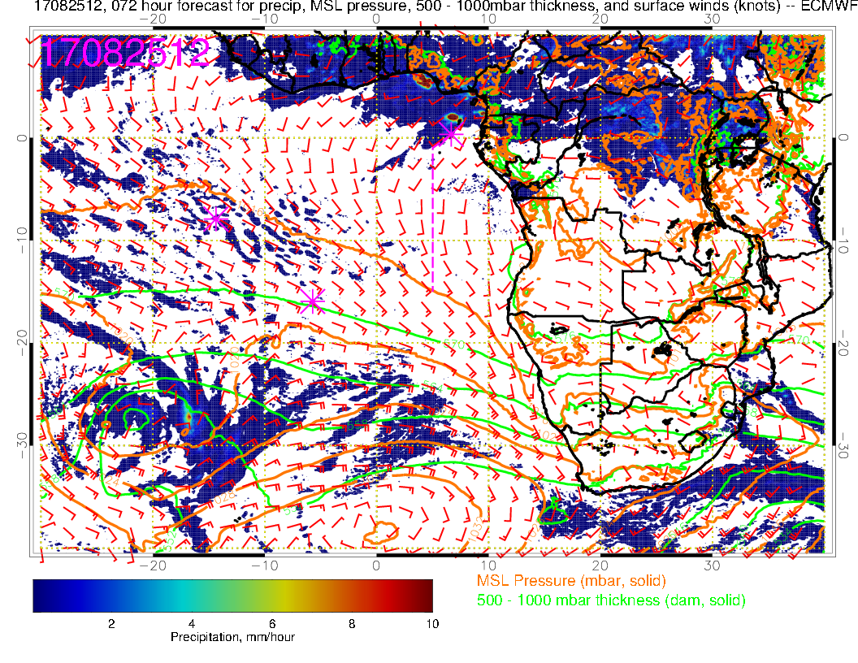
Convection developing very close to TMS, surface circulation to south of TMS becoming reorganized.

Slide 26
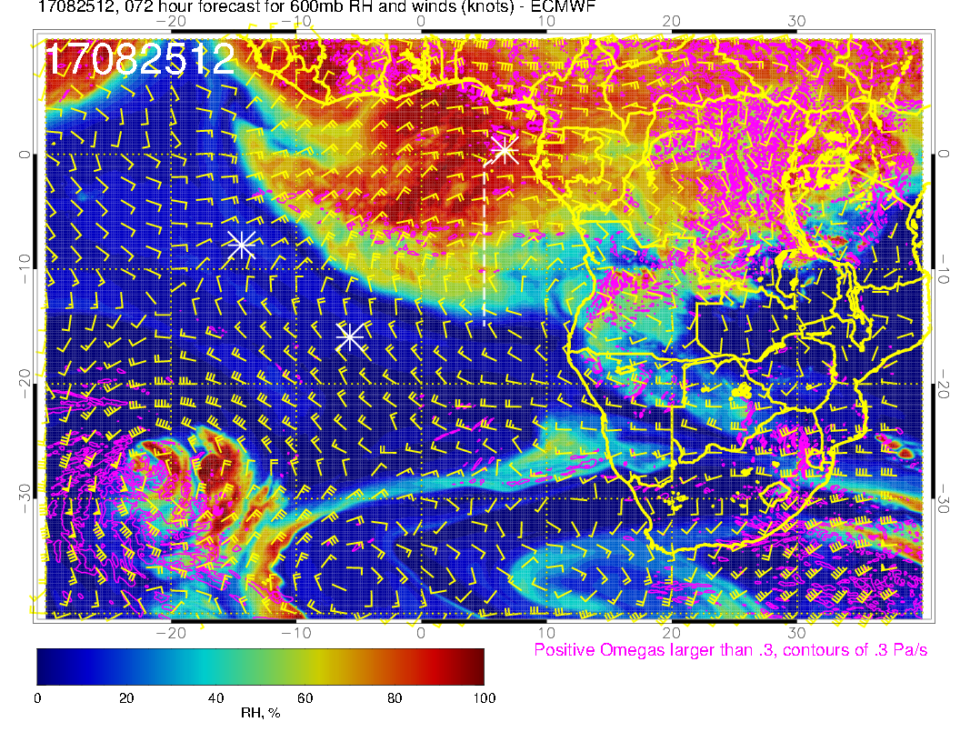
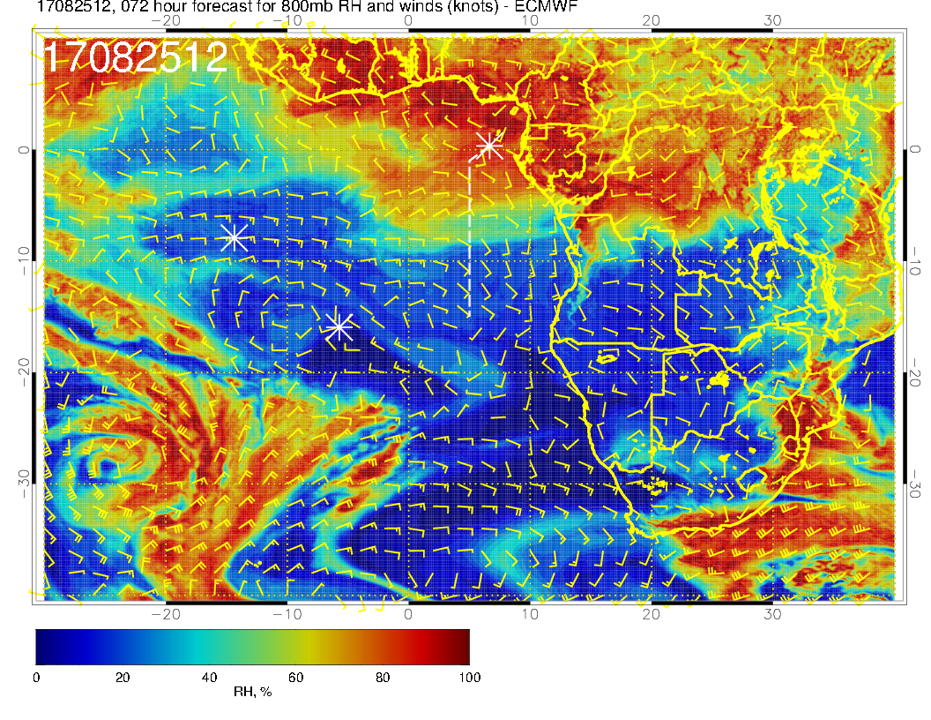
A
A
Mid level flow for Friday. Starting to see a southerly component of flow at 700mb from Angola into our region. Dry convection over Angola is moistening the 600mb level

Slide 27
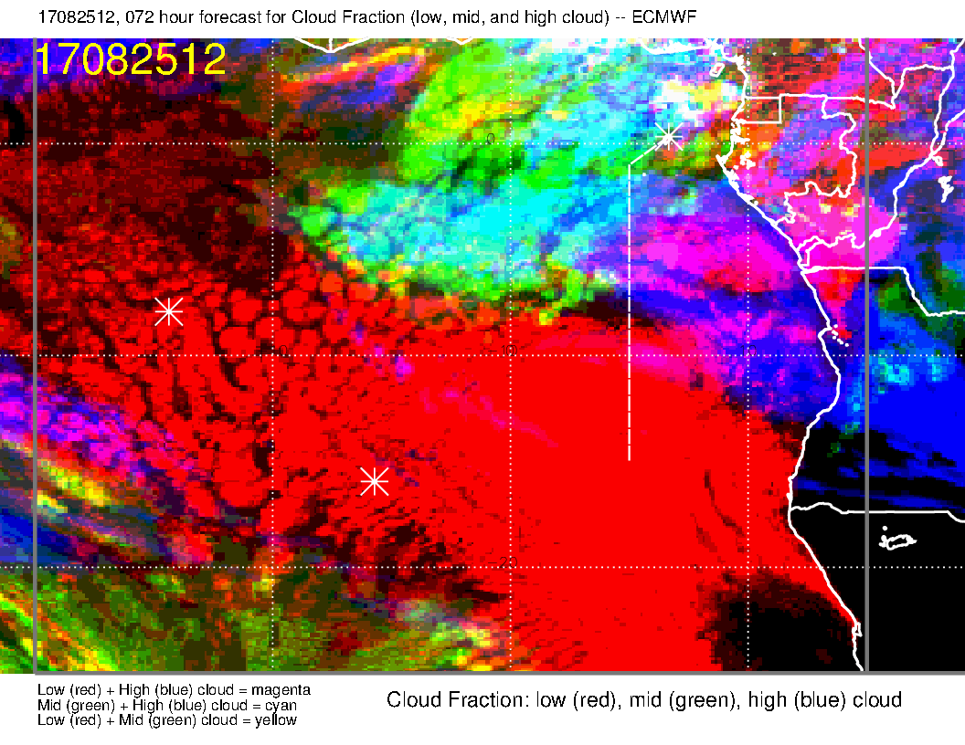
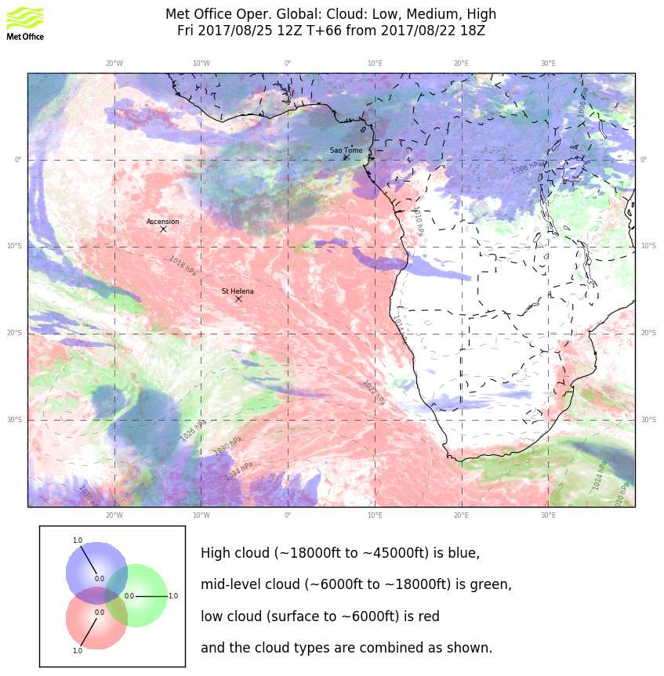
Clouds for Friday. Models disagree on extent of high clouds. Expect significant (though hardly solid) middle cloud west of routine track. Some high cloud streamers (200mb) are likely (go with EC on the high cloud, but no solid deck. There is likely to be more low cloud than on Thursday.

Slide 28
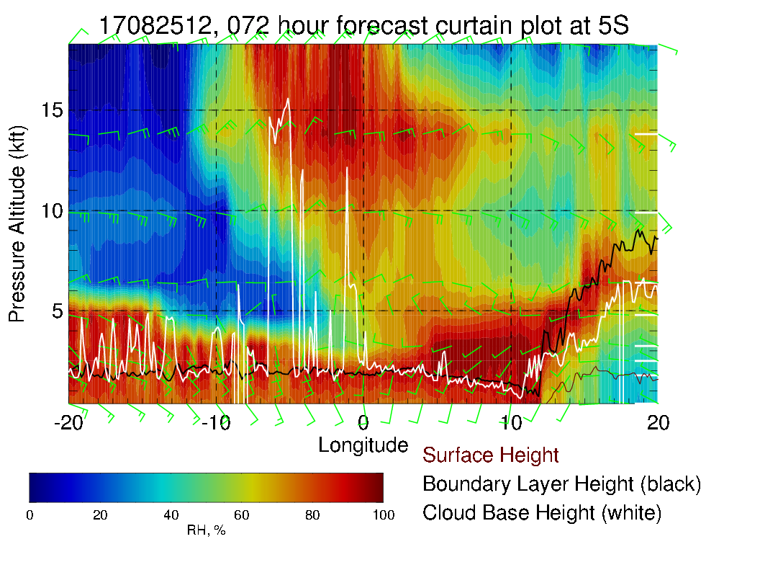
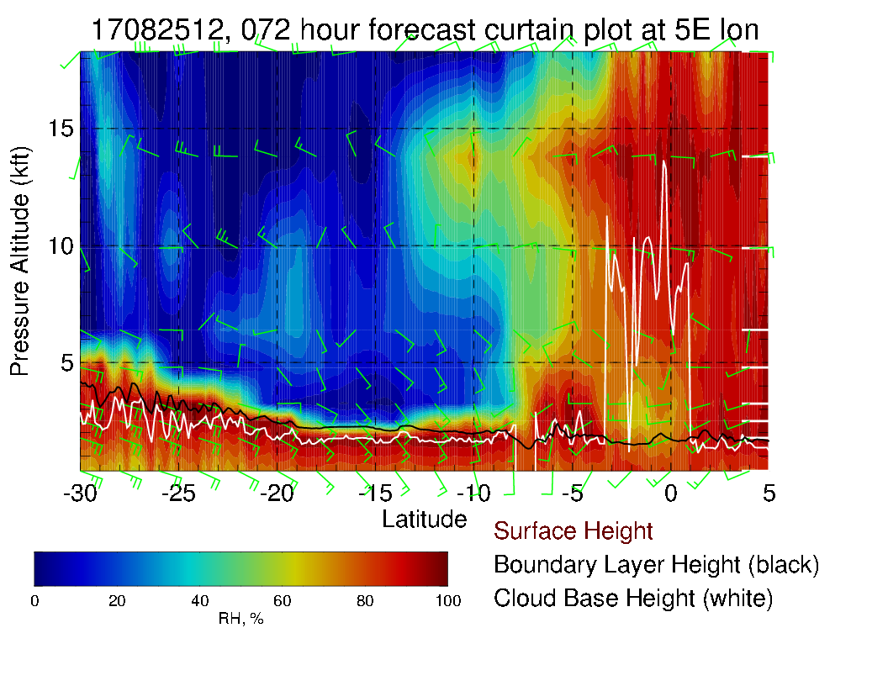
More typical surface and low level winds along routine track (left). Can see extensive moisture west of routine track in EW cross section above. More low level moisture consistent with more low cloud.

Slide 29
Saturday

Slide 30
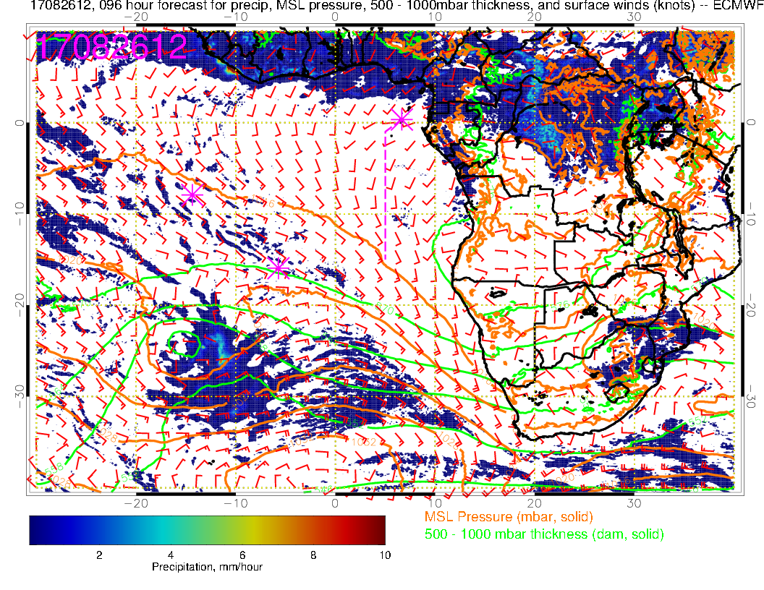
Surface chart for Sunday. Convection has retreated from TMS, weak local winds. Northern Congo has substantial convection today

Slide 31
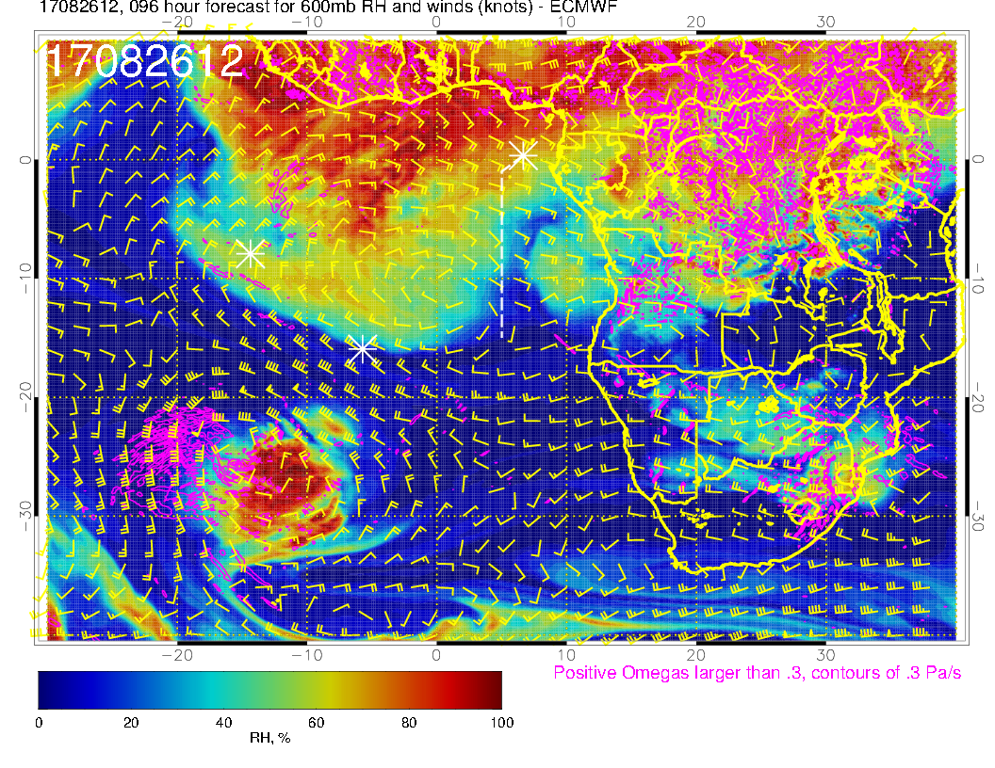
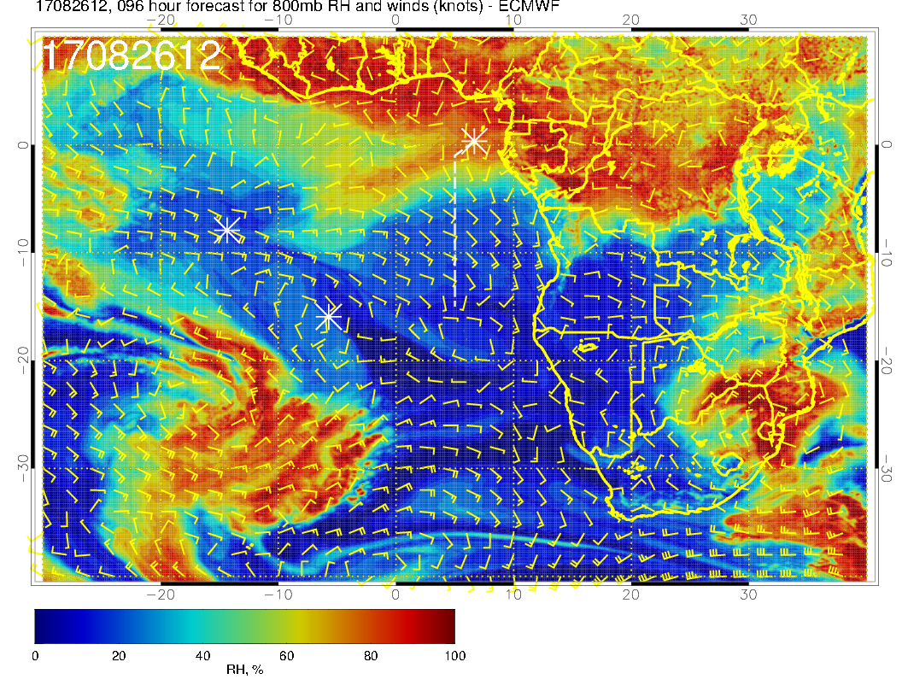
A
A
Mid level flow for Saturday. Pronounced southerly component of flow at 700mb from Angola into our region. Blob of dry convective moisture at 600mb has moved off of Angola.

Slide 32
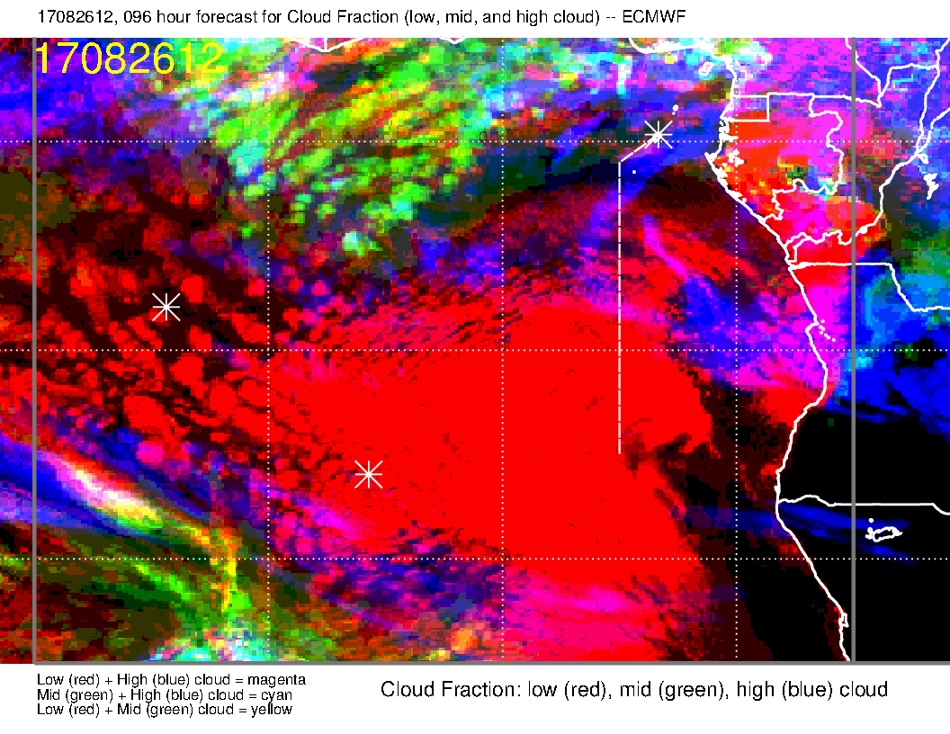
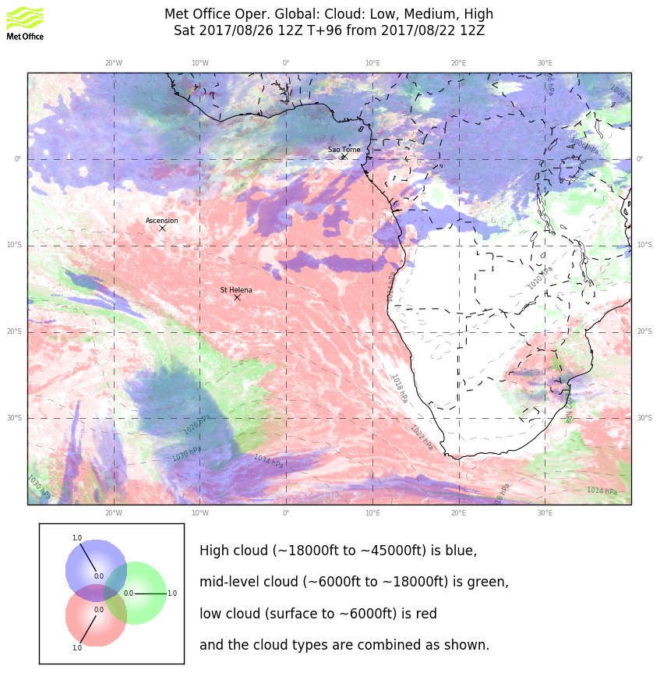
Clouds for Saturday. Broad agreement on high and middle clouds. High cloud streamers will be present, but likely no more “hazardous” than on Monday’s flight. Too early to say much about the low clouds.

Slide 33
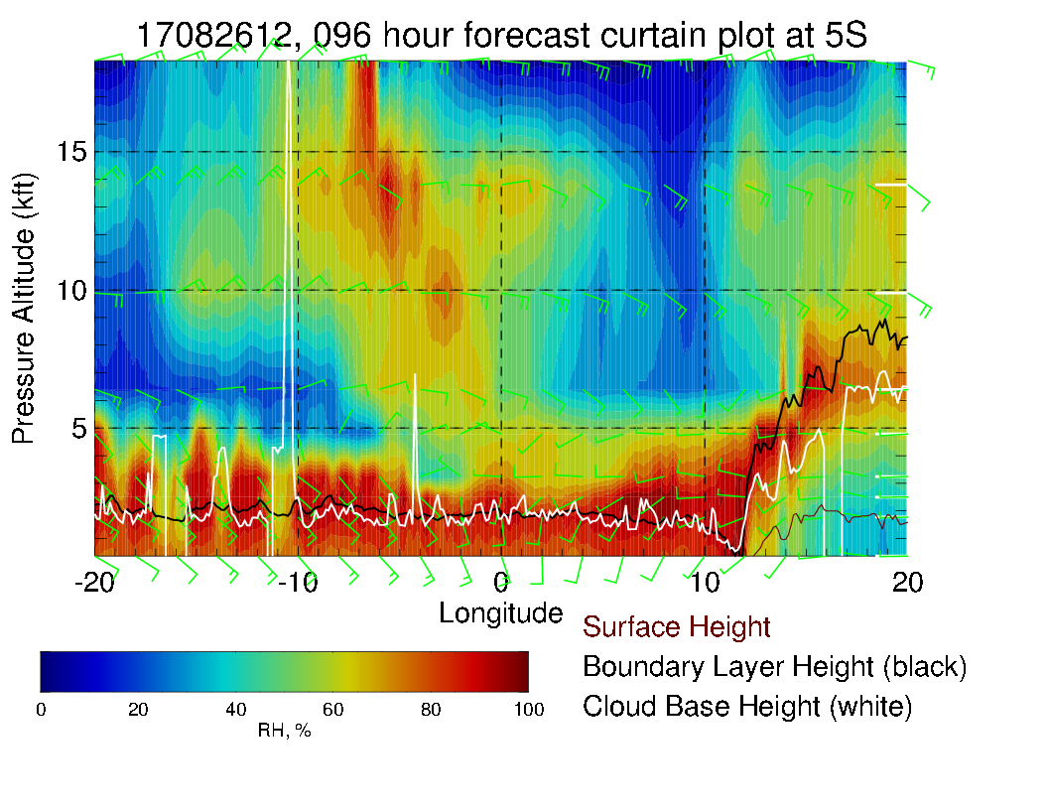
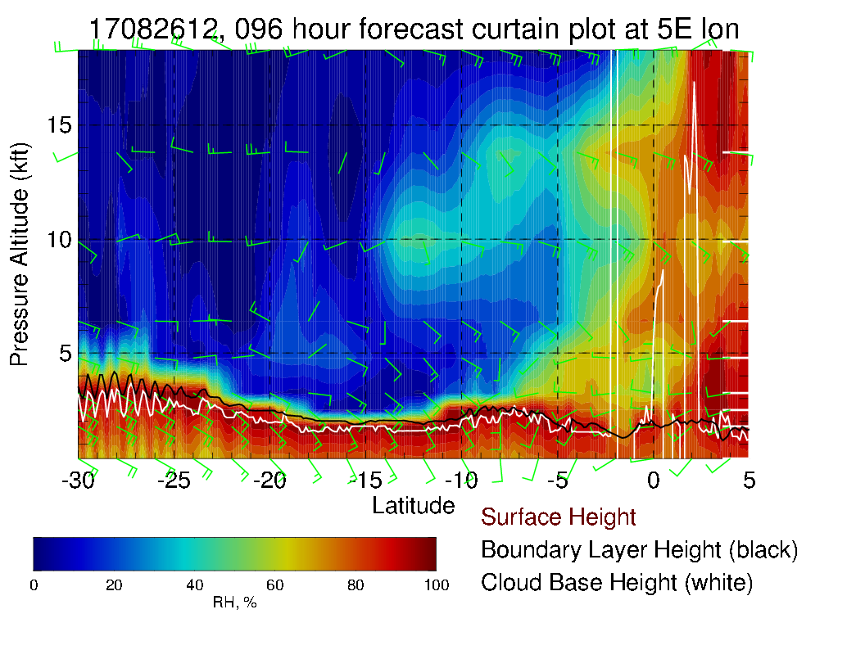
Nice retreat of mid-level moisture in routine track Xsect (left).

Slide 34
Sunday

Slide 35
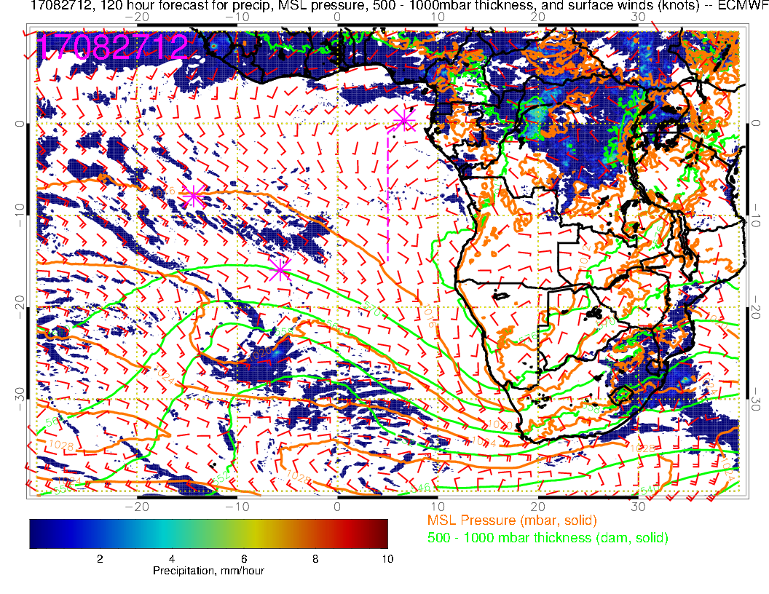
Continued strong convection over the Congo. Surface winds more “disorganized” and weaker south of TMS – weak winds locally with a strong westerly component.

Slide 36
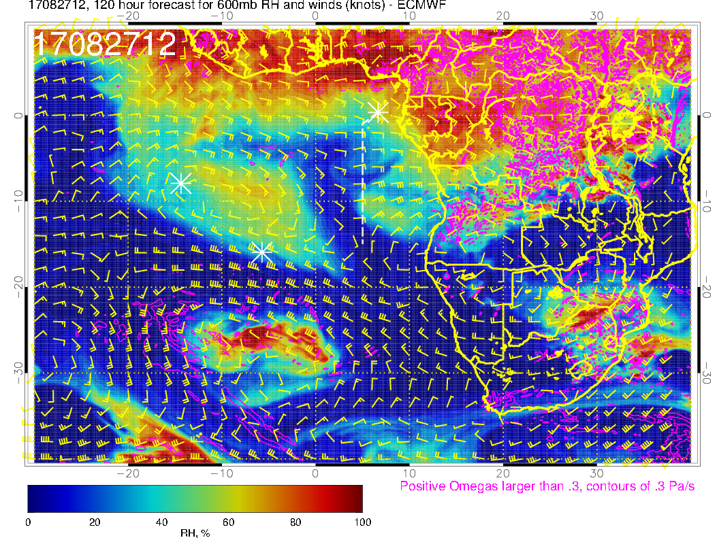
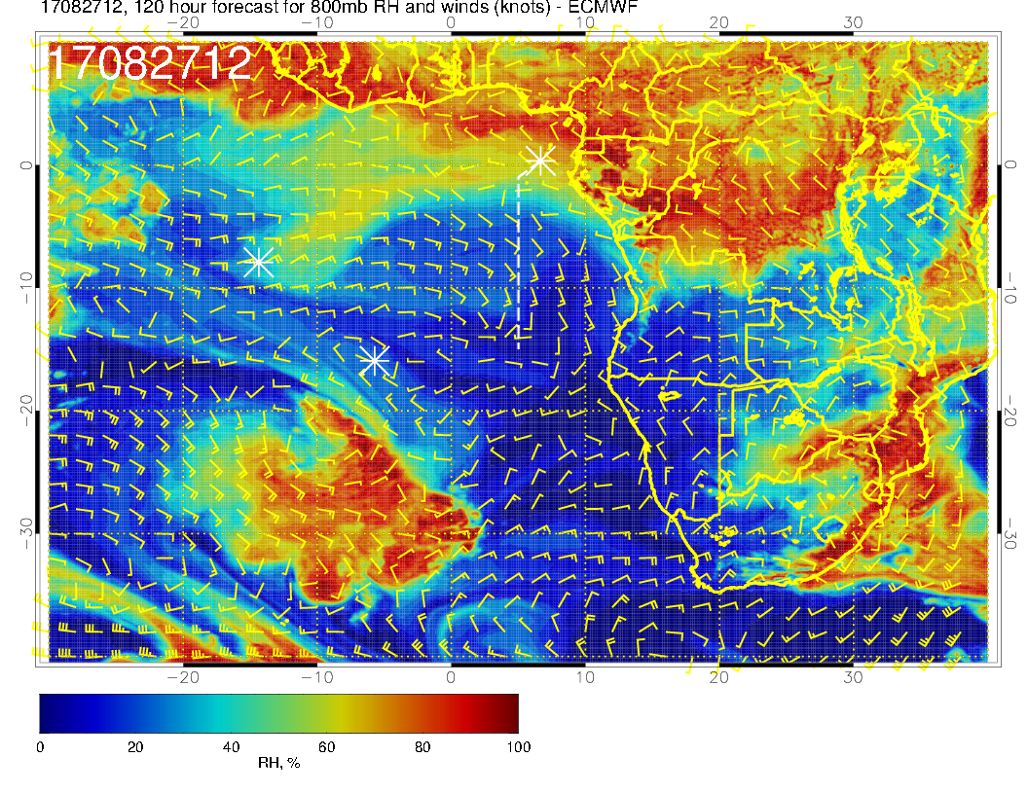
A
A
A
Mid level flow for Sunday. At 600mb see dry convection blob of moisture coming off the coast. 700mb flow continues southerly component, so dry. I wonder if the 800mb flow has some influence from midlatitudes (going down the theta surfaces and dry).

Slide 37
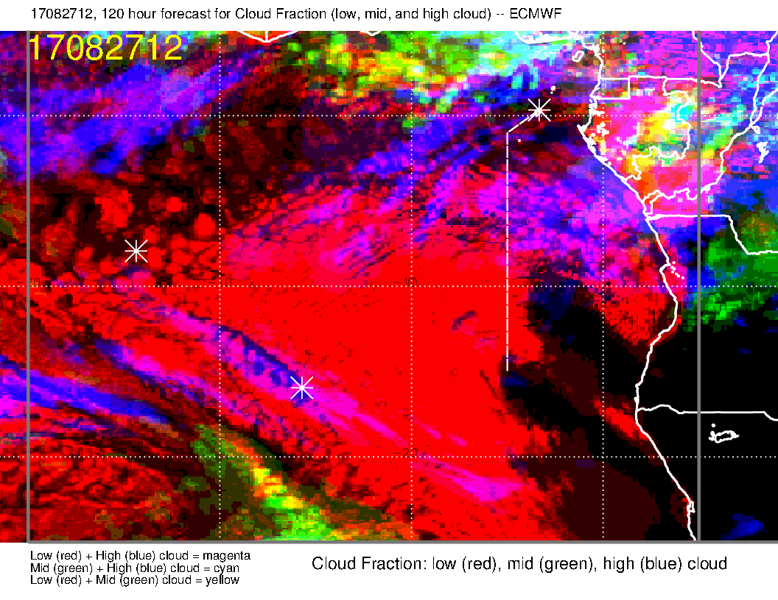
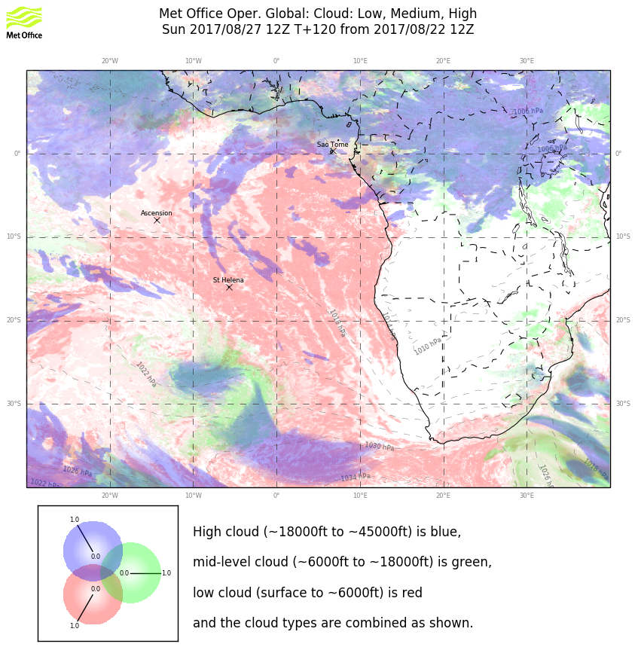
Clouds for Sunday. Dry mid-levels are consistent with limited mid-level cloud. We have flow from the east at high levels and ample convection. Have to consider that streamers will occur in flight region

Slide 38
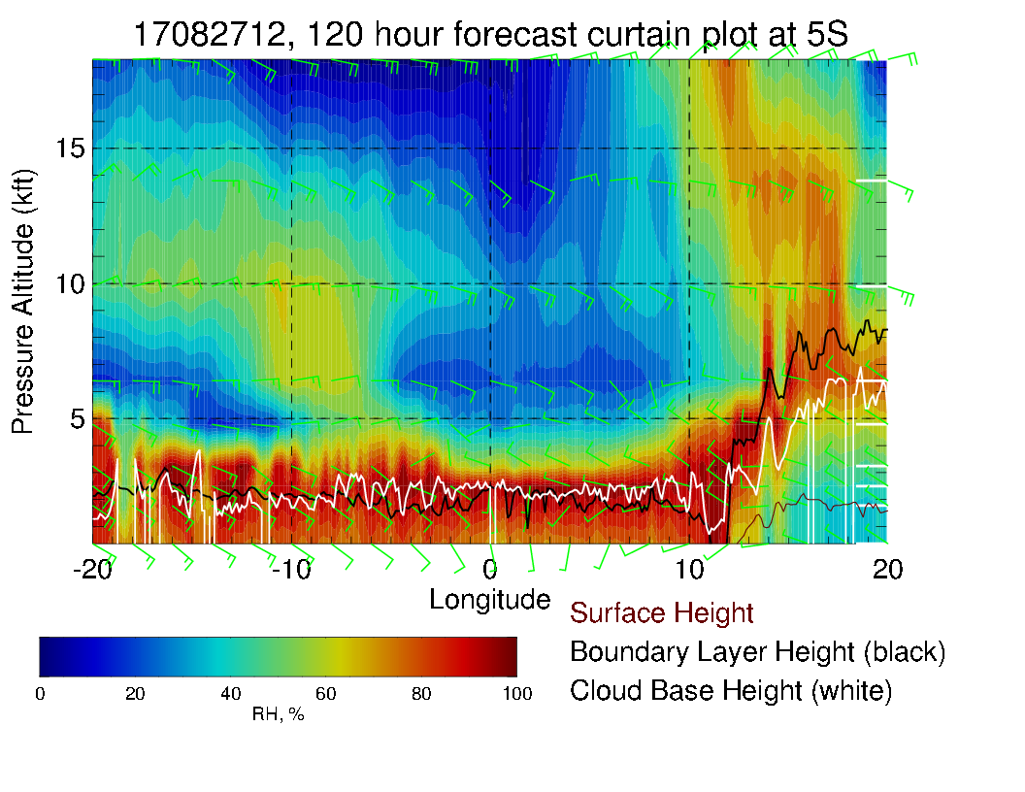
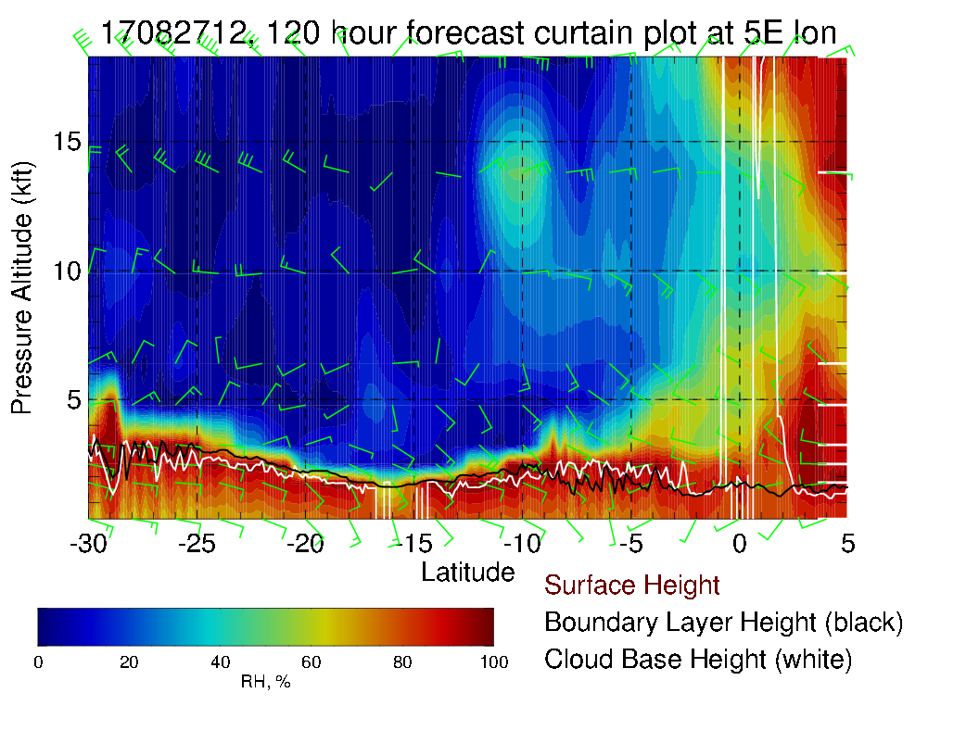
Dry routine flight track at mid levels. 5S east west X-sect also dry.

