Slide 1
ORACLES weather briefing
21-Aug-2017
Lenny Pfister and Rei Ueyama

Slide 2
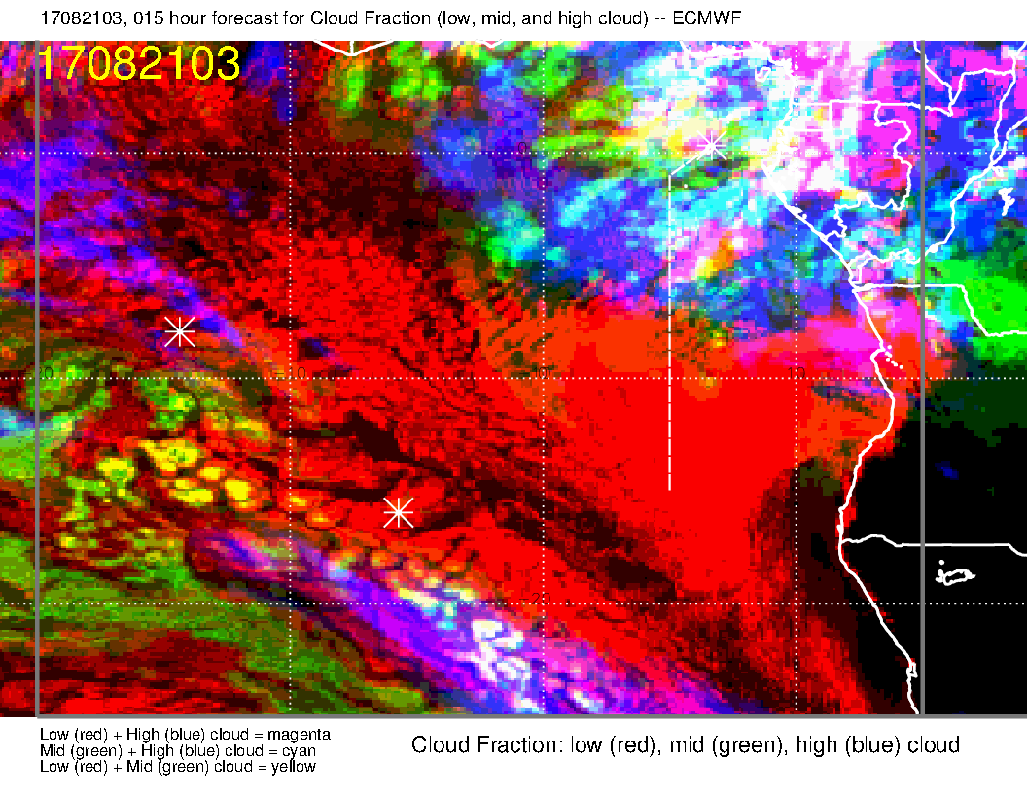
Cloud forecast/obs comparison
Mid cloud is verifying well, including along the flight track (orange in forecast diagram)
High cloud near routine track (magenta) is also present in forecast
3 AM
3 AM

Slide 3
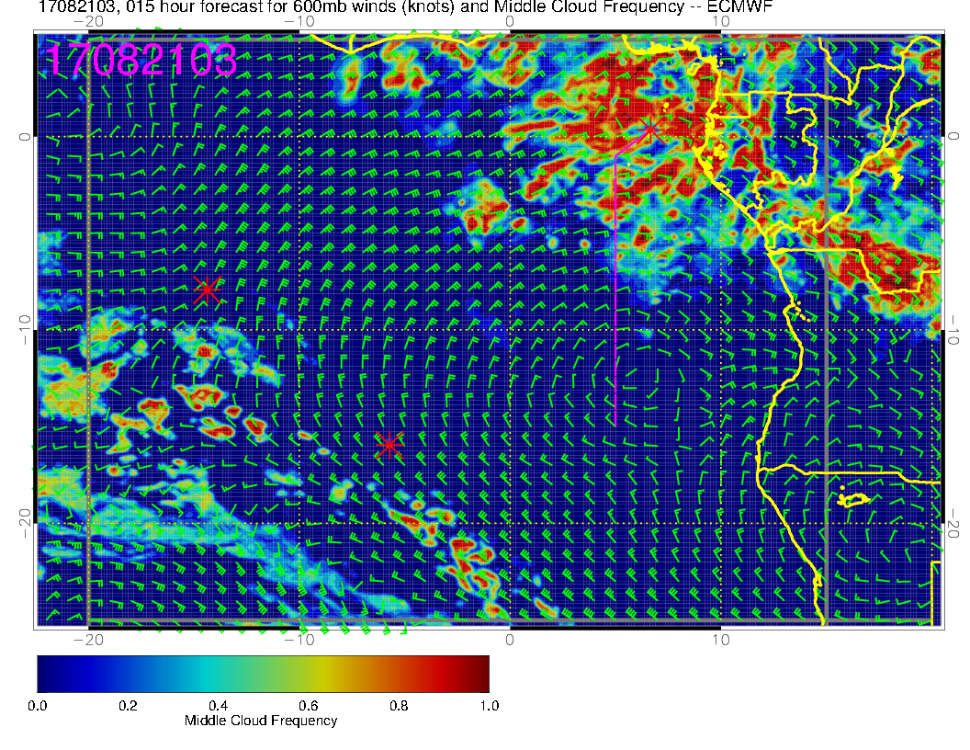
Cloud forecast/obs
Mid cloud is verifying well, including along the flight track (white in diagram)
3 AM
3 AM

Slide 4
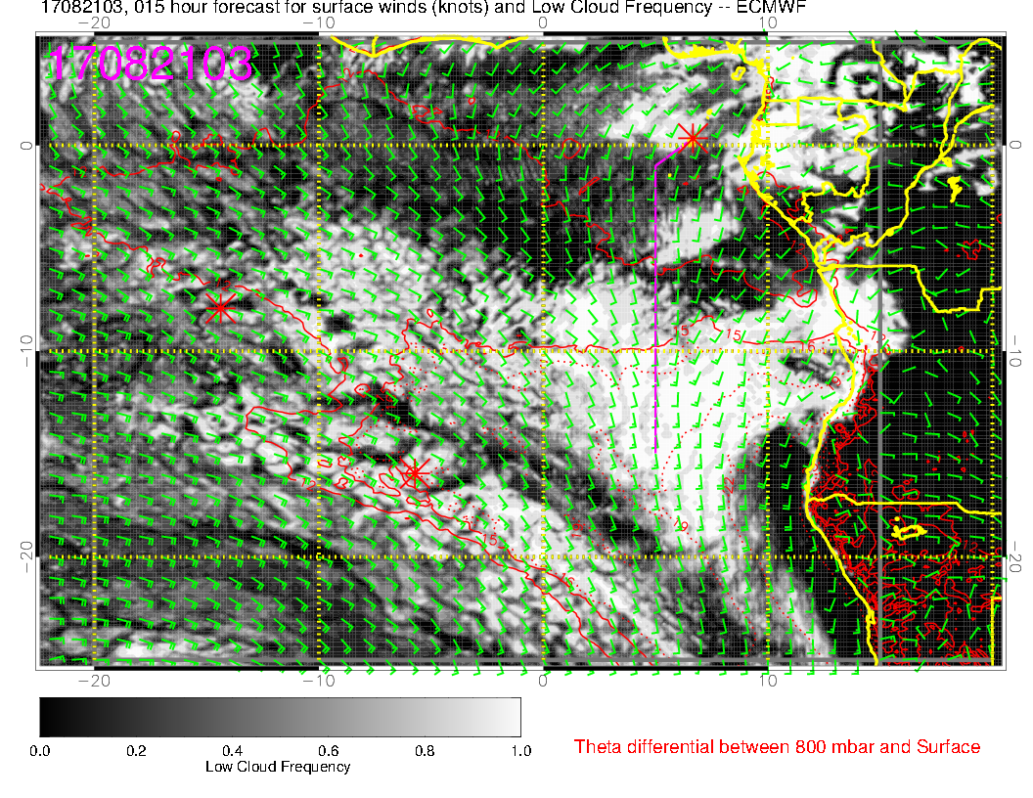
Cloud forecast/obs
Low cloud forecast is really not very good at all. Fcst splits a low cloud region where there is not a split (orange).
“Corner” area is not bad.
UKMO is worse.
3 AM
3 AM

Slide 5
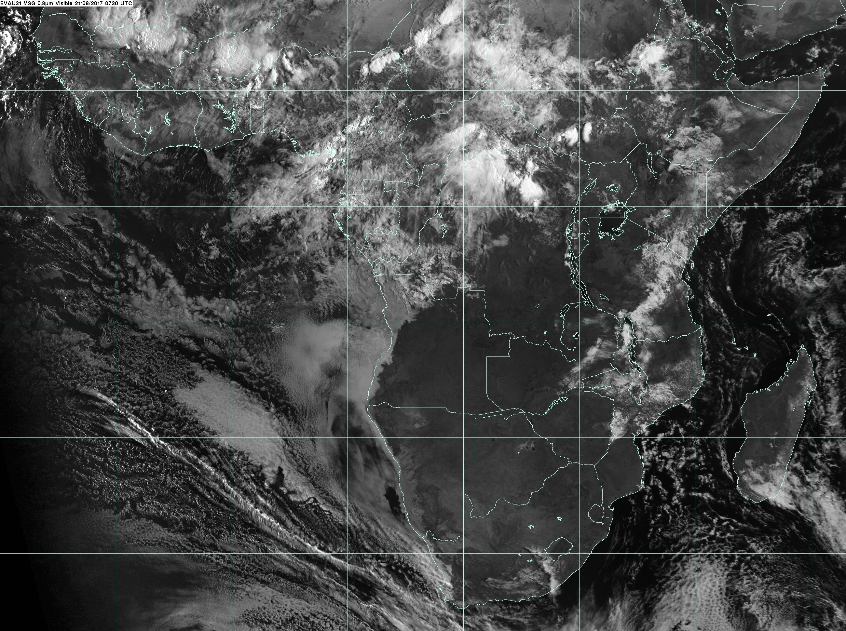
Latest Vis image, 0730
700 AM image (vis)

Slide 6
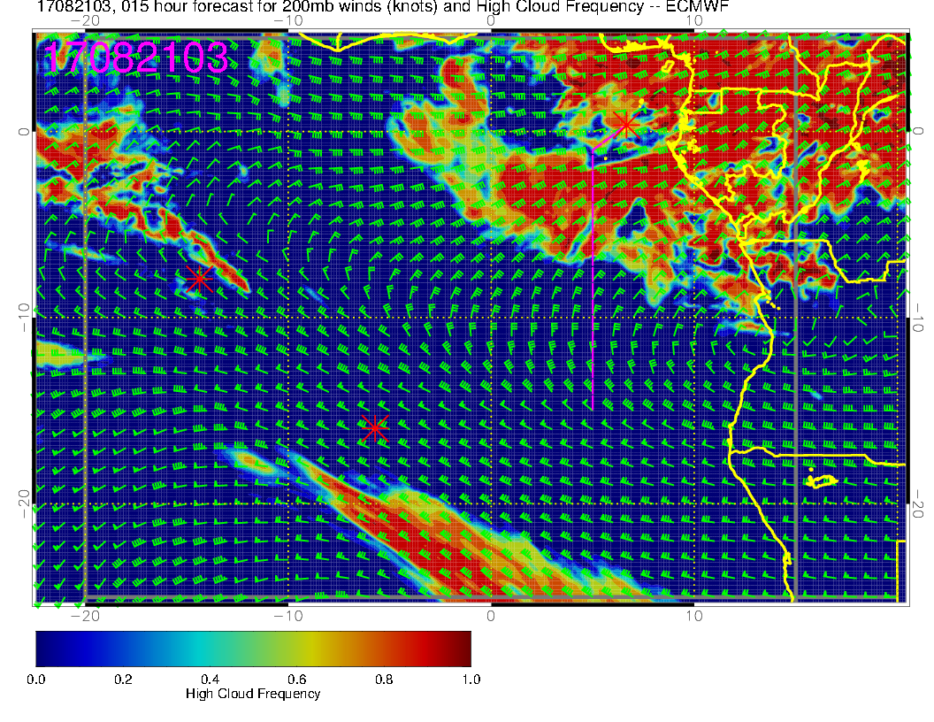
High cloud forecast/obs
Hard to distinguish from mid levels when it is faint, but there is reasonable correspondence.
3 AM
3 AM

Slide 7
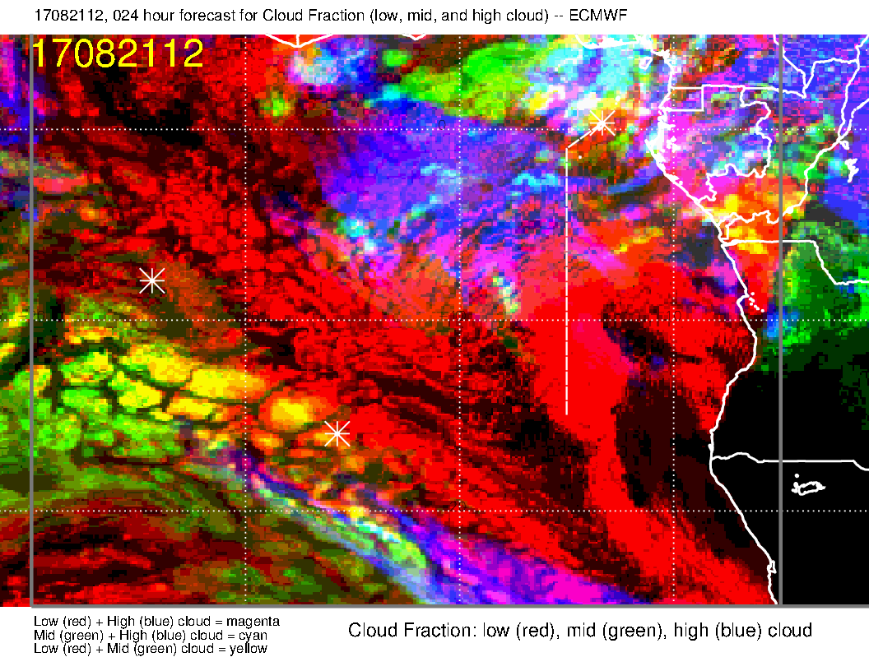
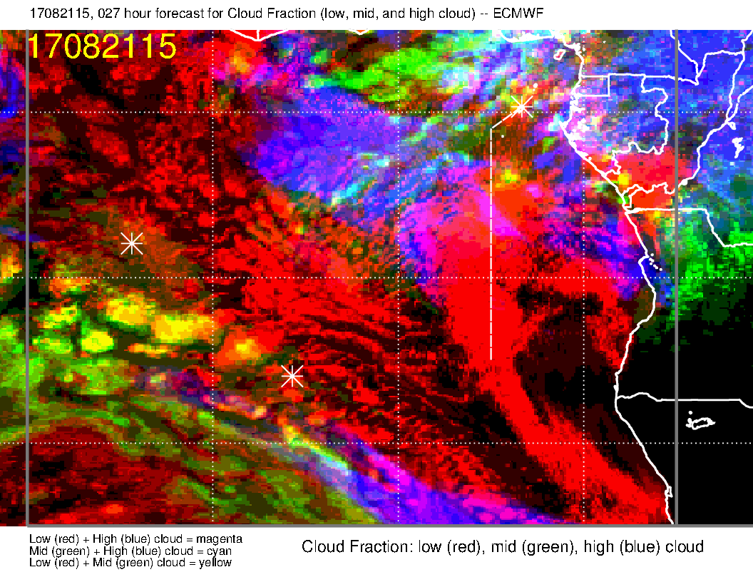
Cloud forecast for today.
EC middle cloud fcst is verifying for current time, so is believable. High cloud may be overdone.
Middle cloud (white circle, yellow/green) near track is possible with all the moisture coming off the continent
High cloud (orange, circle, magenta/blue) along routine track possible
Noon
3 PM

Slide 8
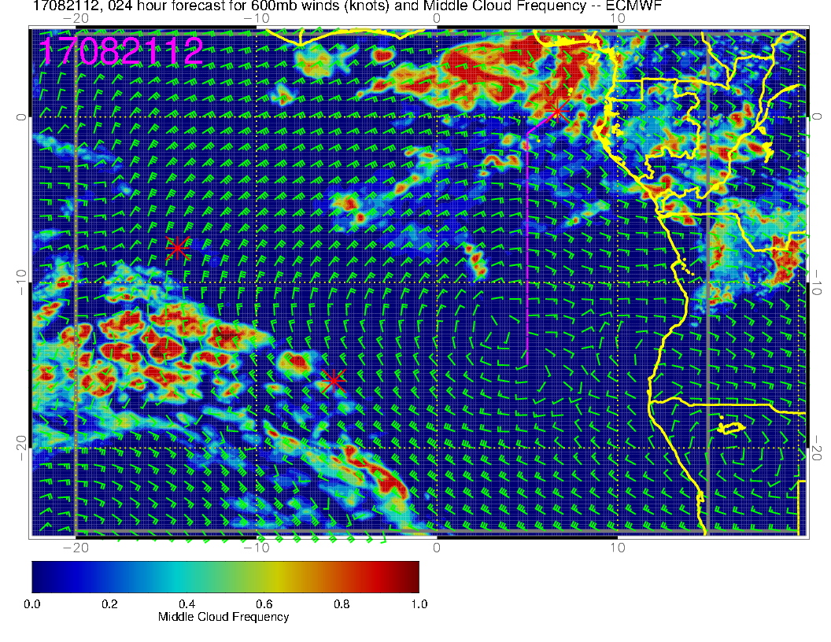
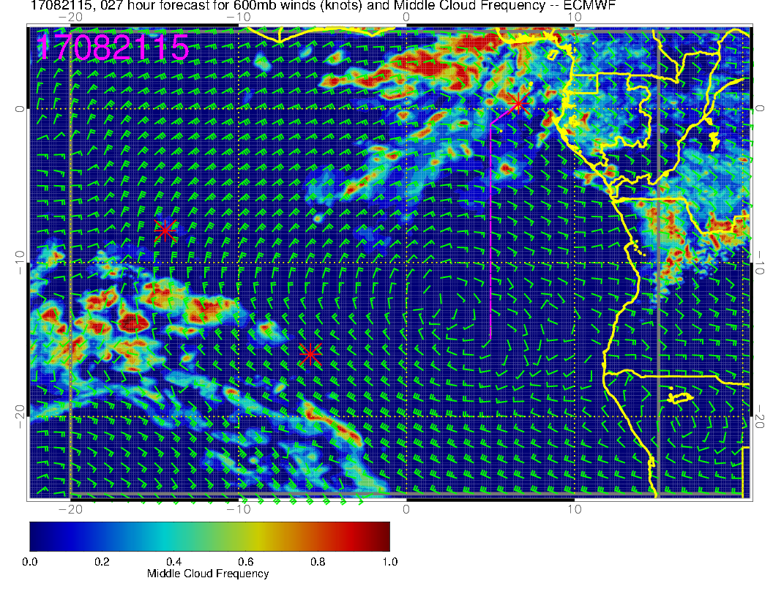
Middle Cloud forecast for today.
Note mid-cloud along track
Middle cloud (white circle and orange circle) near track is possible with all the moisture coming off the continent
Noon
3 PM

Slide 9
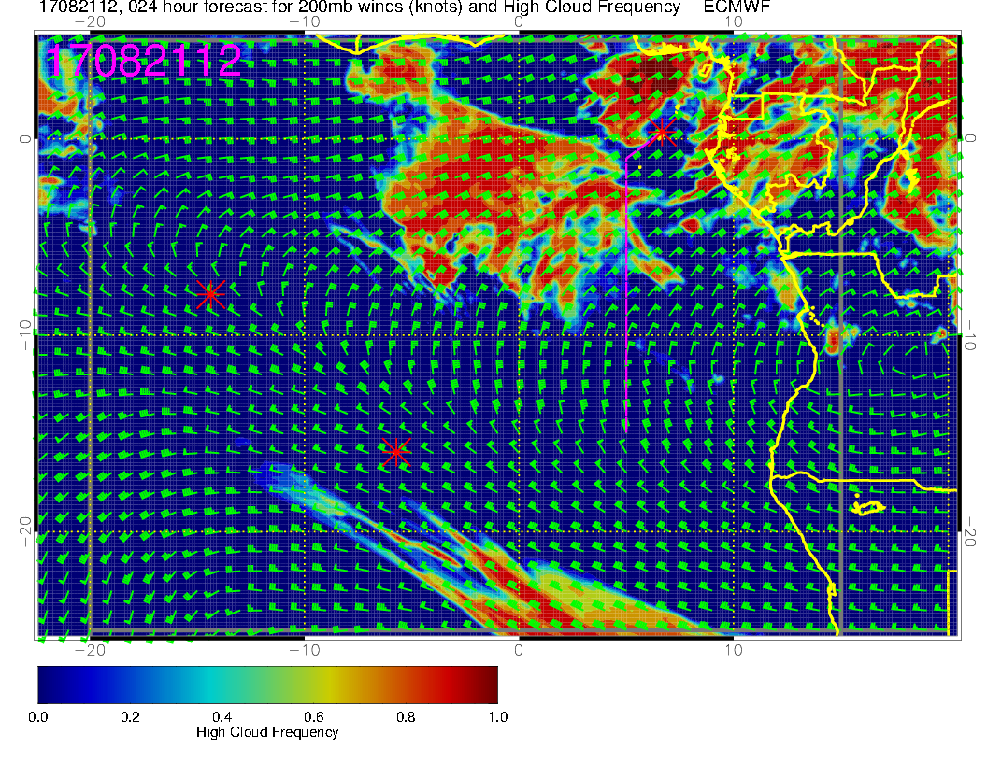
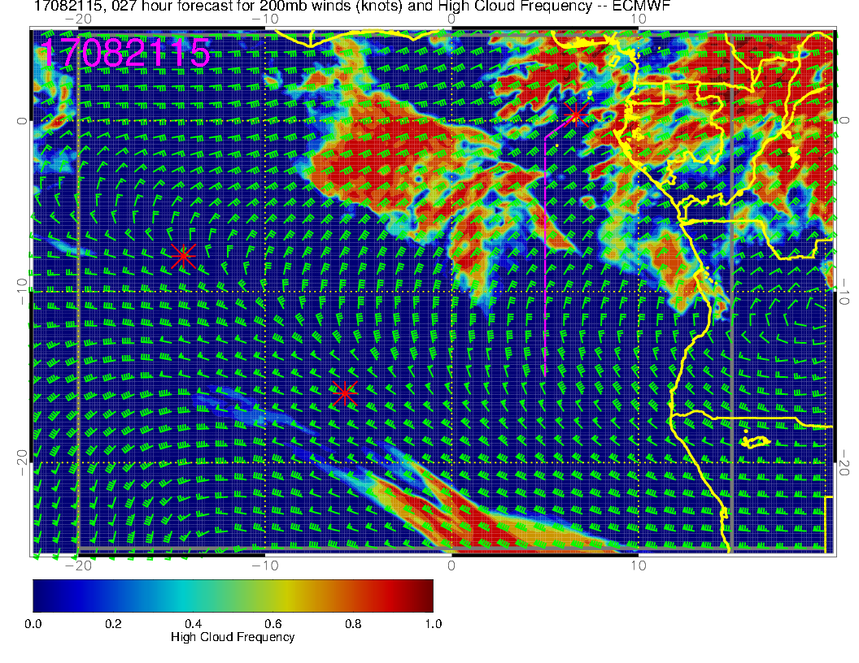
High Cloud forecast for today.
Based on comparison with this morning, this may be overdone.
But, have high cloud at about the same spots as with middle cloud.
Noon
3 PM

Slide 10
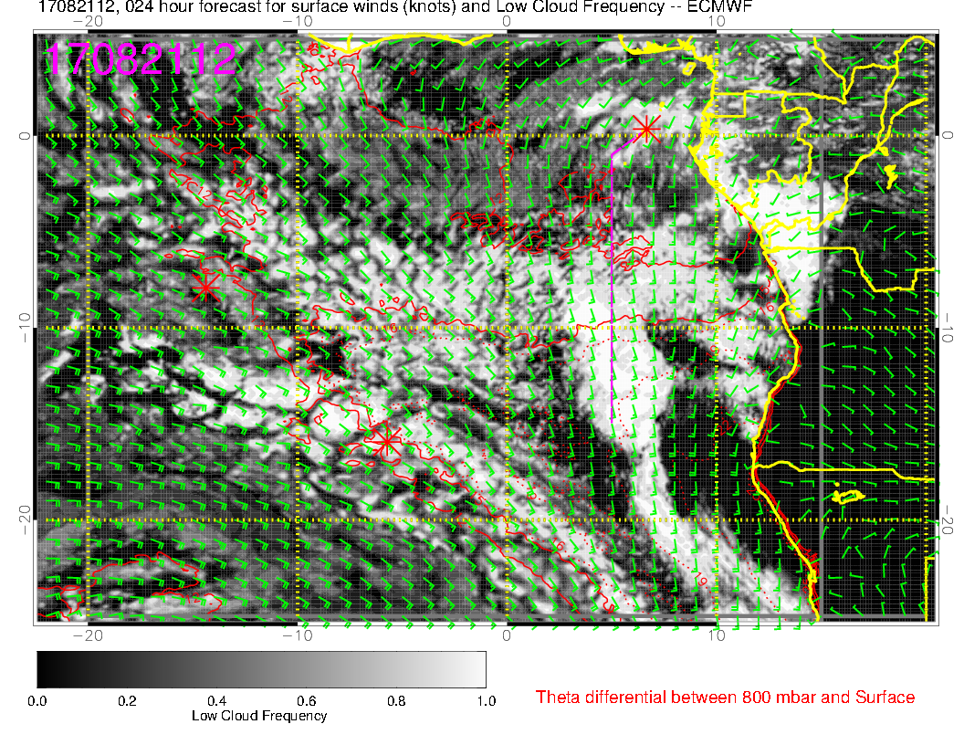
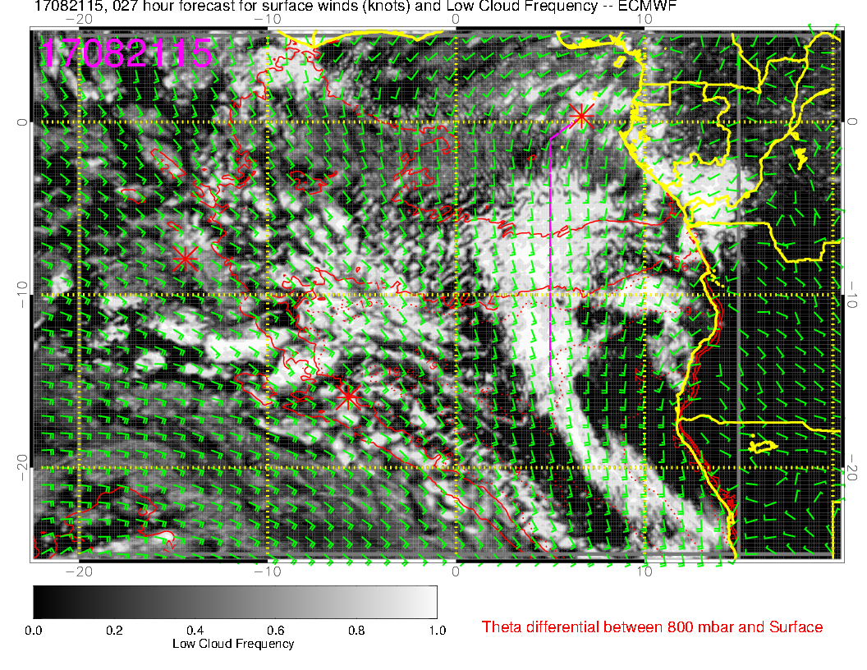
Low Cloud forecast for today.
Probably scattered along all except the last part of the 8S track.
Diurnal clearing in most areas.
Model forecasts an increase from noon to 3 PM in circled region
Surface wind speeds are increasing during the day, so this might materialize.
Noon
3 PM

Slide 11
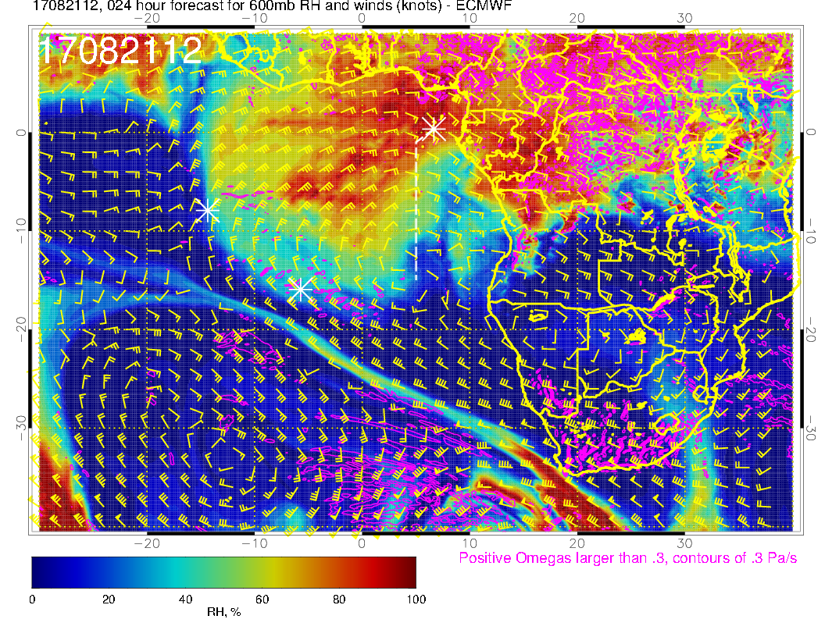
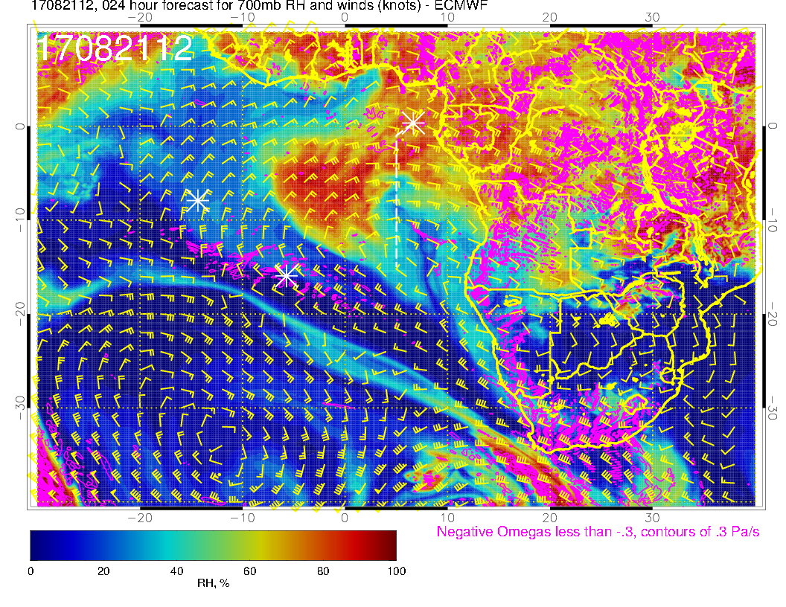
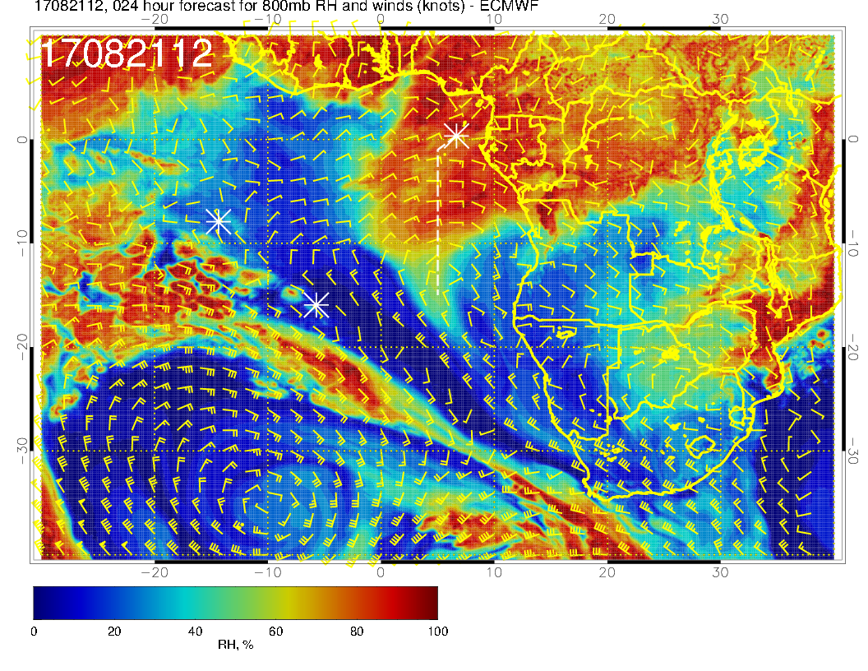
A
600mb
700mb
Noon mid level flow
Flow strongest at 600mb.
RH max (obviously) responsible for middle cloud issues.
In forecast sequences (not shown), can see the 600mb anticyclone “rolling” westward, carrying the RH blob with it.
800mb

Slide 12
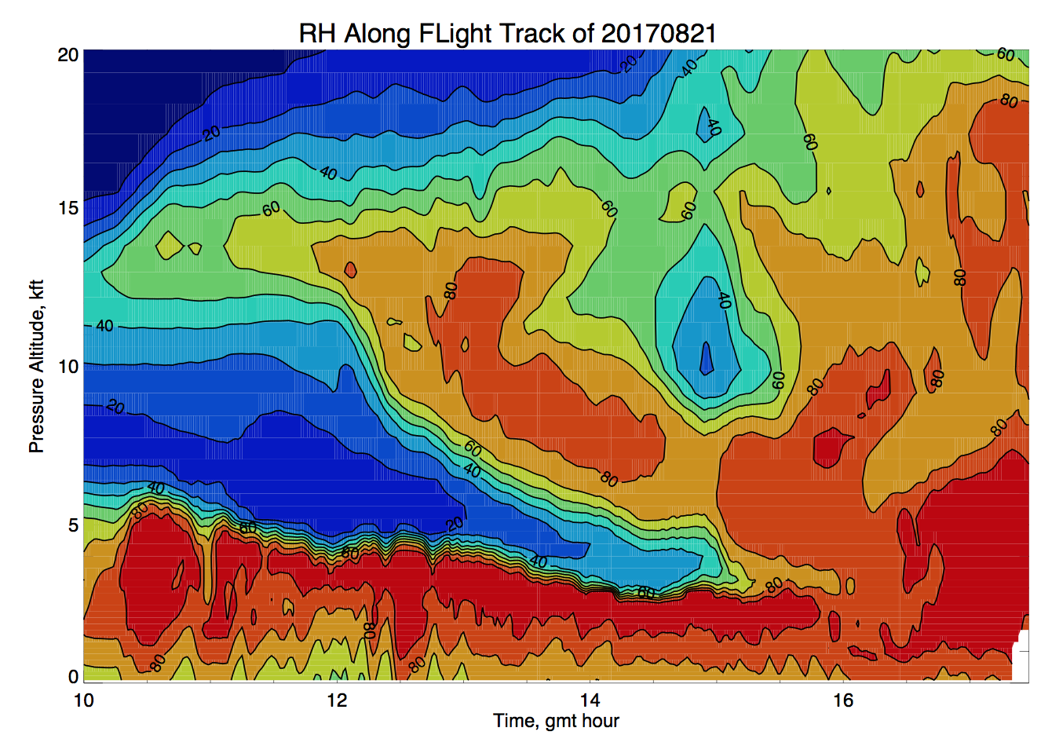
Curtain using forecast valid 2017082112
Corner turn on track

Slide 13
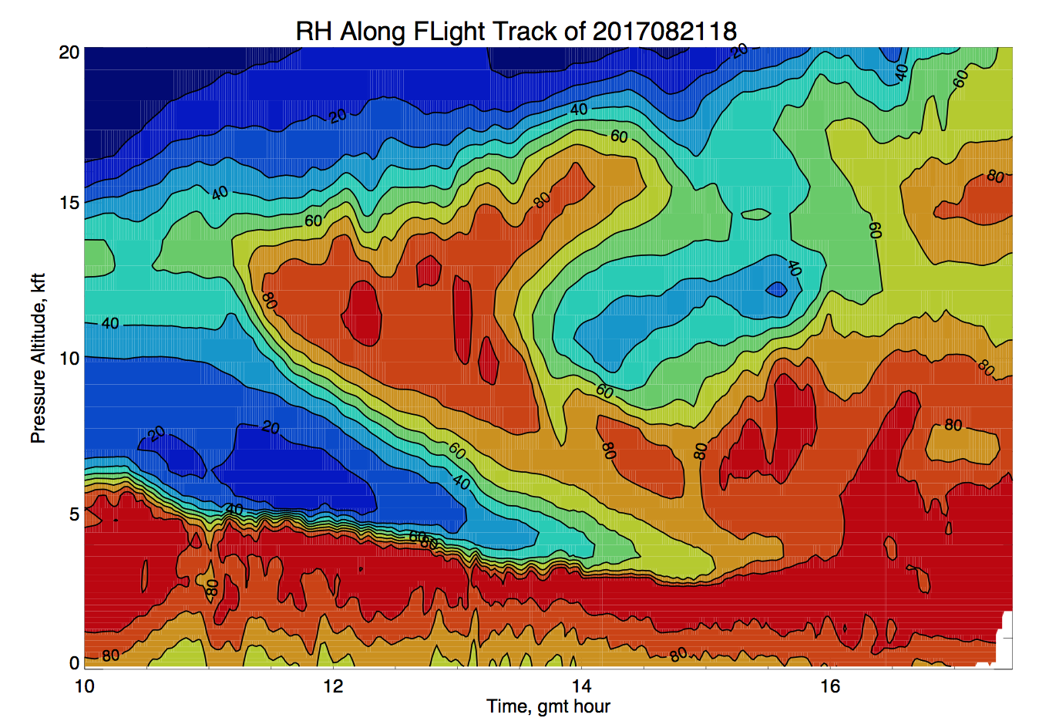
Curtain using forecast valid 2017082118
Corner turn on track

Slide 14
Thursday
A new moisture surge, this time from the northeast, enters the surveyed region.
Expect middle and/or high cloud down to 5S (scattered).

Slide 15
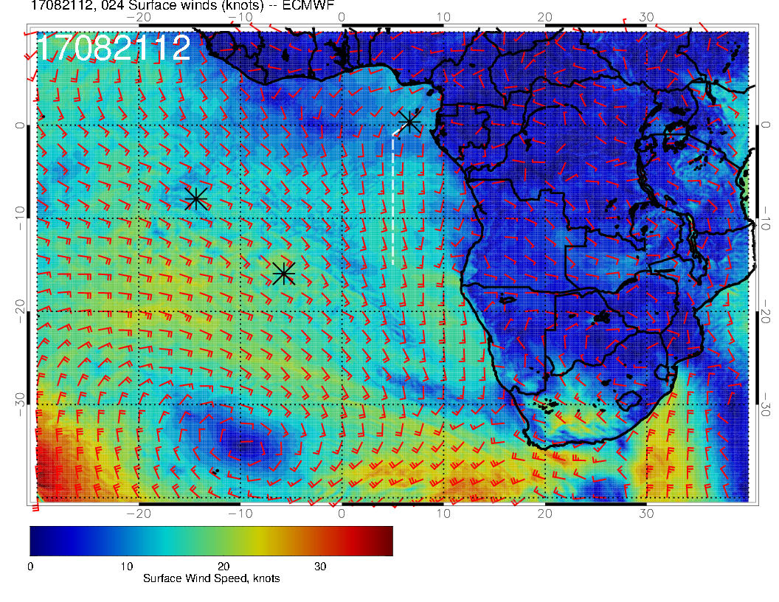
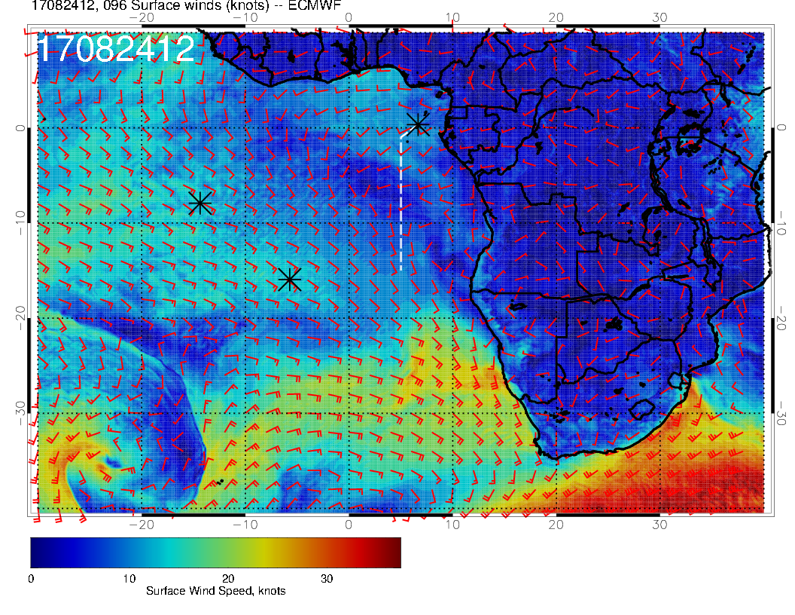
TODAY
Thursday
VERY anomalous surface wind pattern on Thursday. SH high “separated” from basic northwestward flow toward ASI and STH by a wind minimum. Near westerlies at STP with Angola Bay eddy extending far off the African coast.

Slide 16
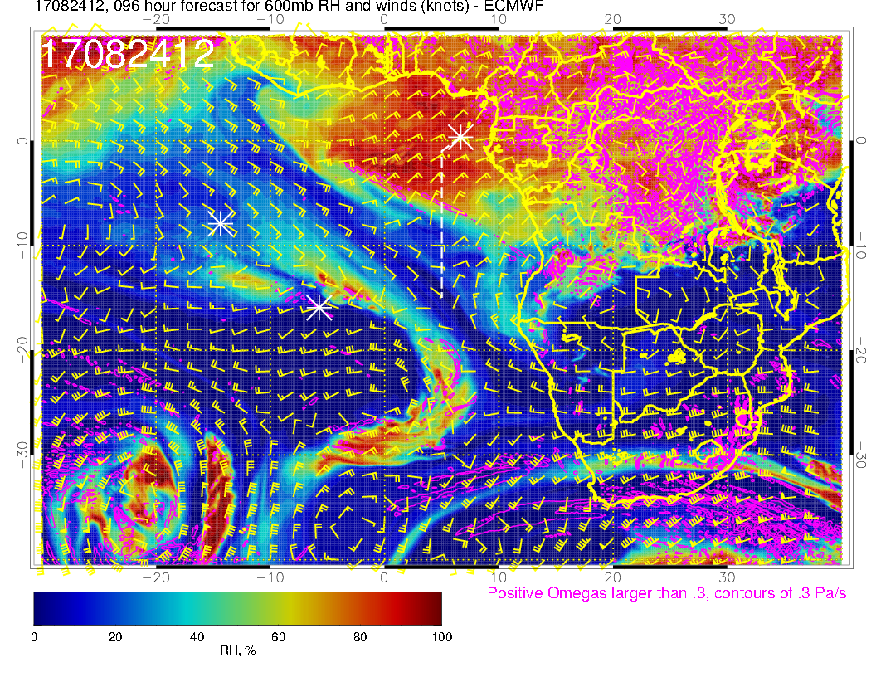
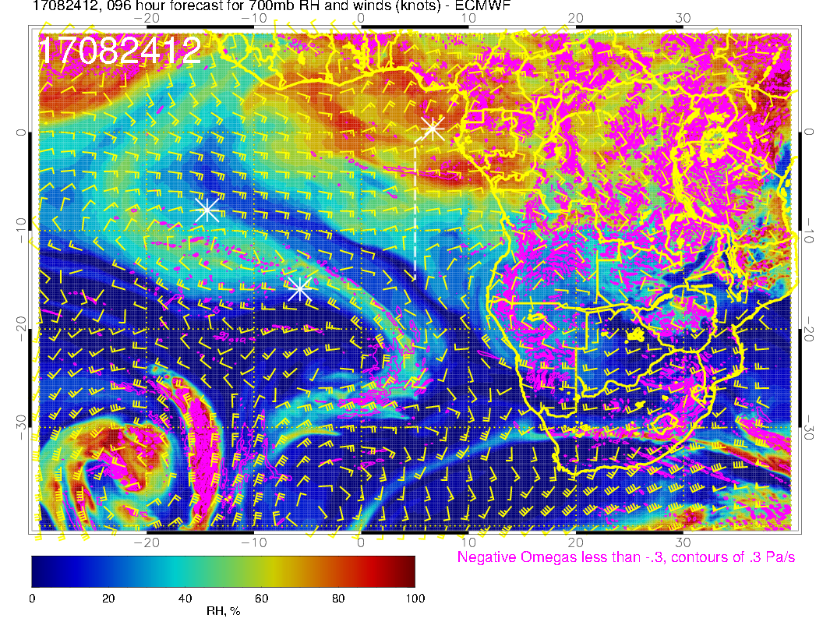
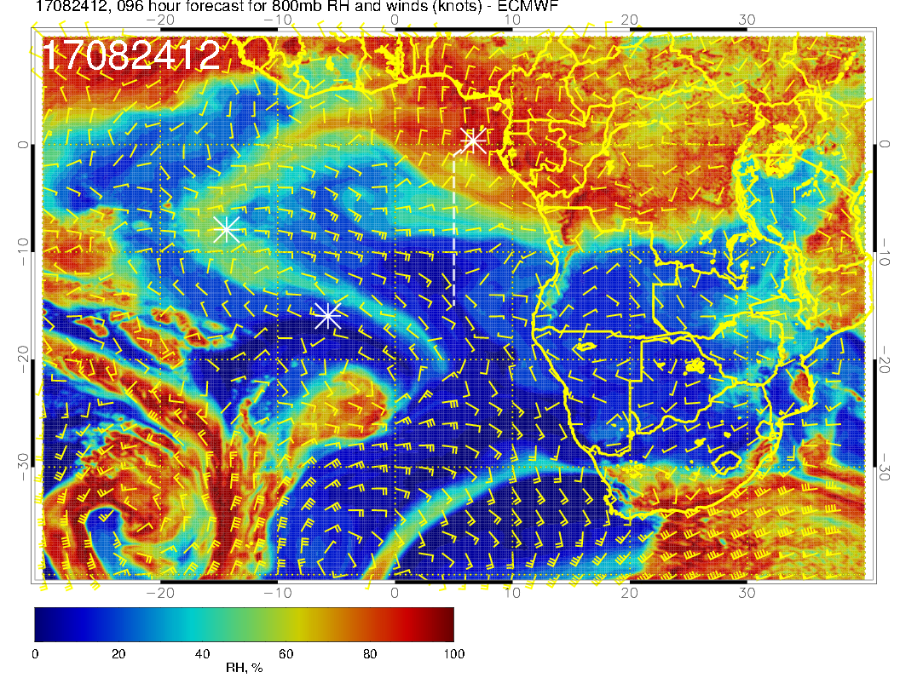
600mb
700mb
Noon Thursday mid level flow
Surge of moist air coming from the north at 800mb
Surge apparent at other mid levels (more from the northeast.
Dry air ahead (600mb in particular) is due to descent.
800mb

Slide 17
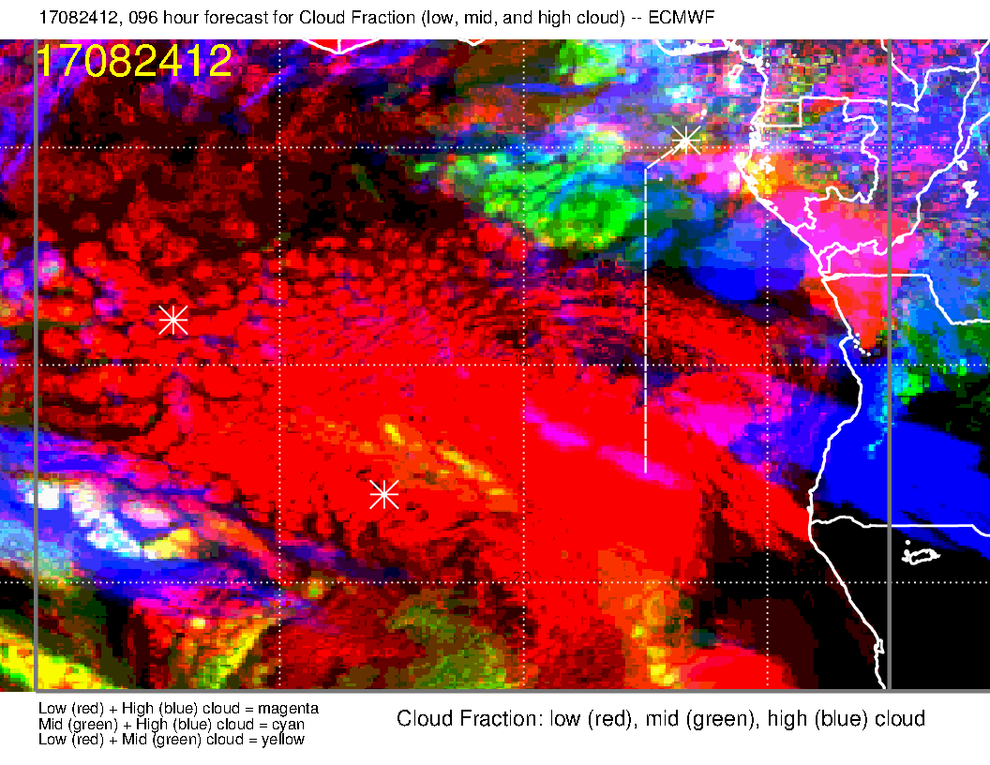
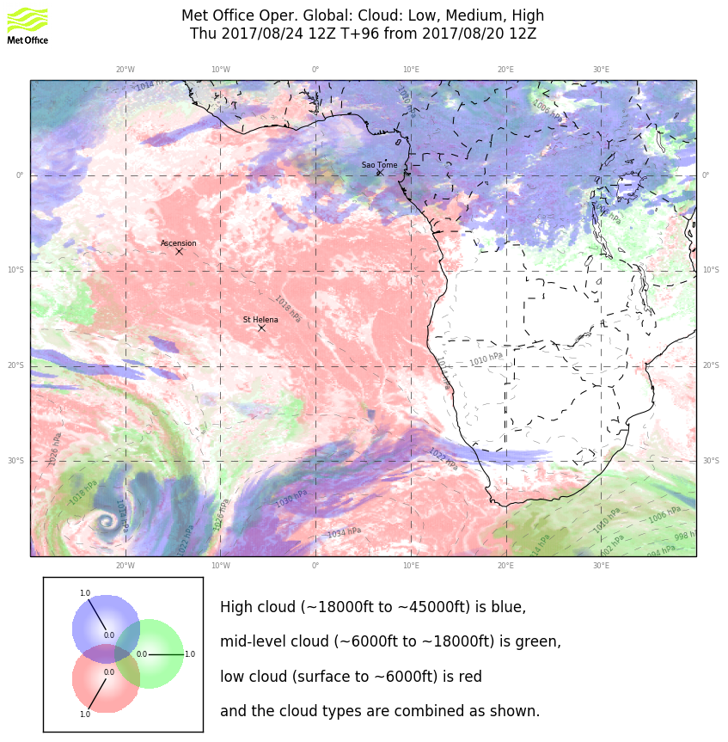
Northeasterlies at 200mb (not shown) lead to high clouds north of 5S. High clouds forecast at south end are at 150mb, doubtful because of long moisture trajectory. May see some high clouds near tropopause as there is a pronounced southward flow from the convective region (and high forecast RH). These might go to 10S.
Middle clouds are expected (though they tend to decrease with forecast hour) due to moisture surge.
Too early to forecast low clouds reliably, but anomalous wind speeds have not had an obviously substantial effect on the forecast distribution.

Slide 18
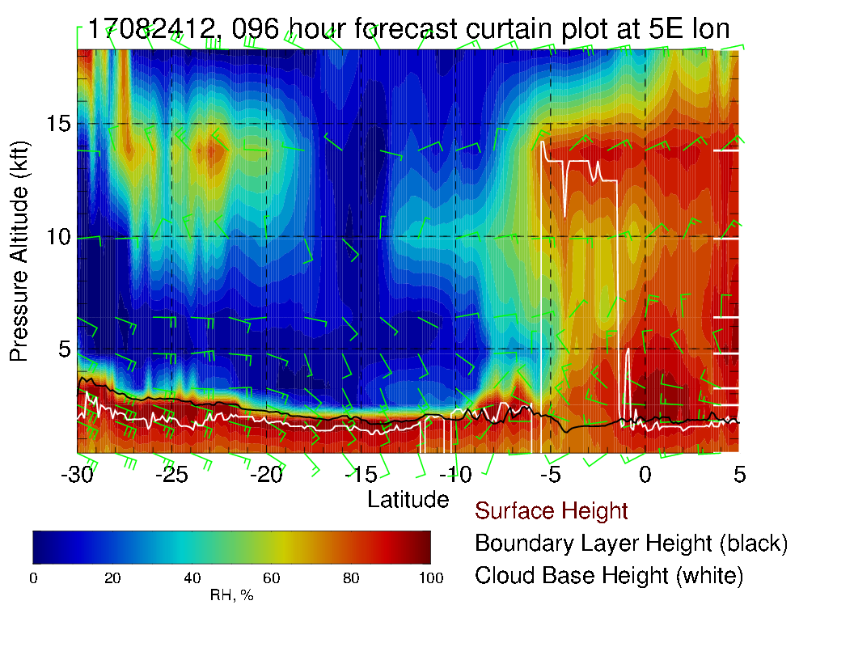
Can see the RH plume at 600mb from the northeast impacting the cloud base to 5S along the routine track. Generally light winds except those associated with the RH plume.

Slide 19
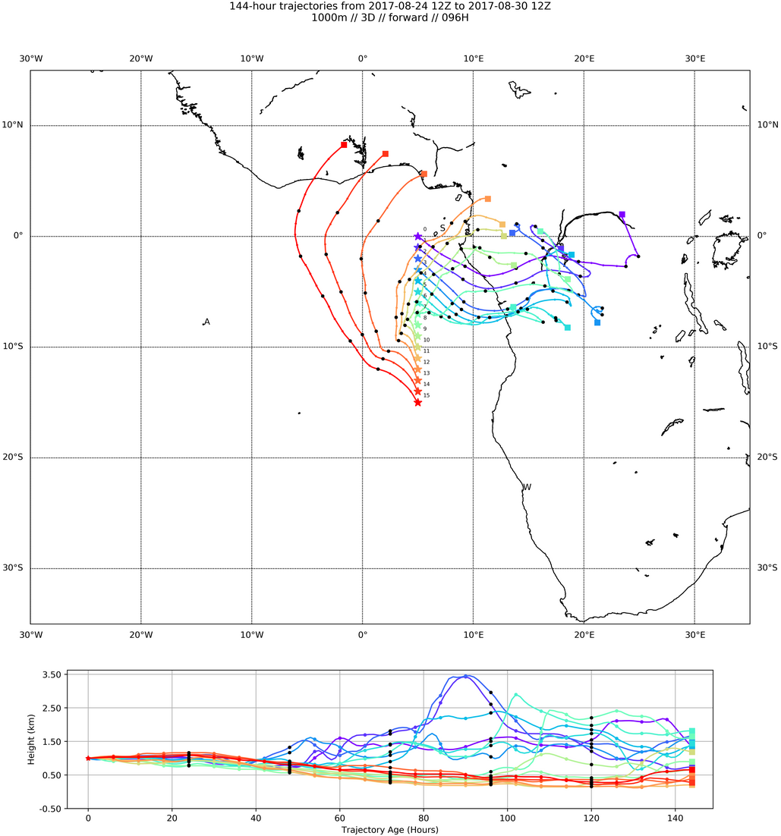
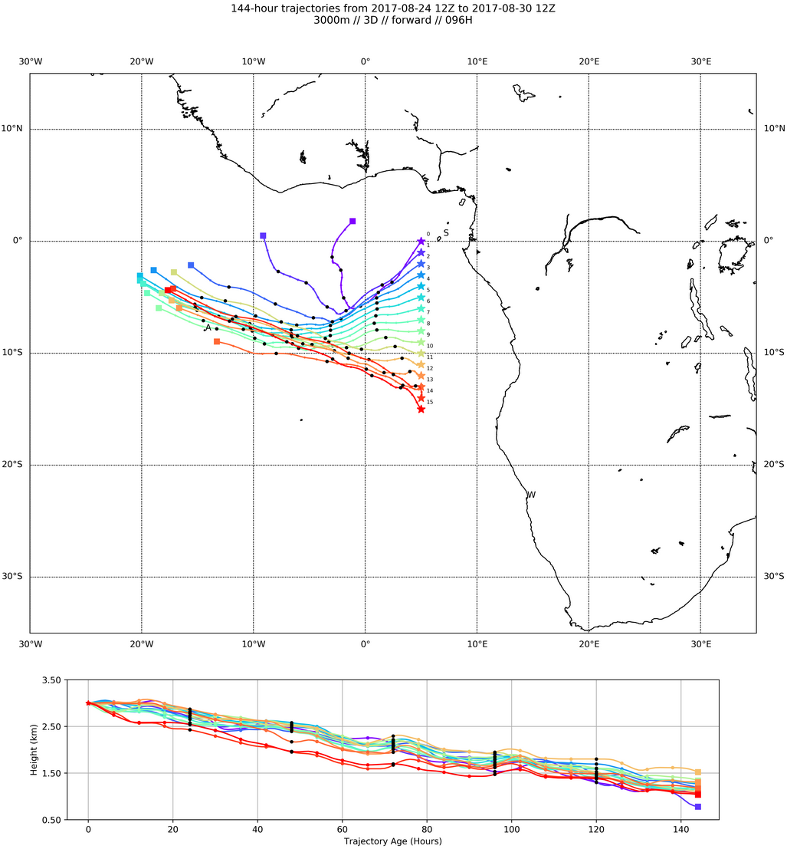
At 1 km, 2 day trajectories are reachable and coherent from south end.
At 3 km (right), trajectories from ~5S head west coherently. “Convergence”

Slide 20
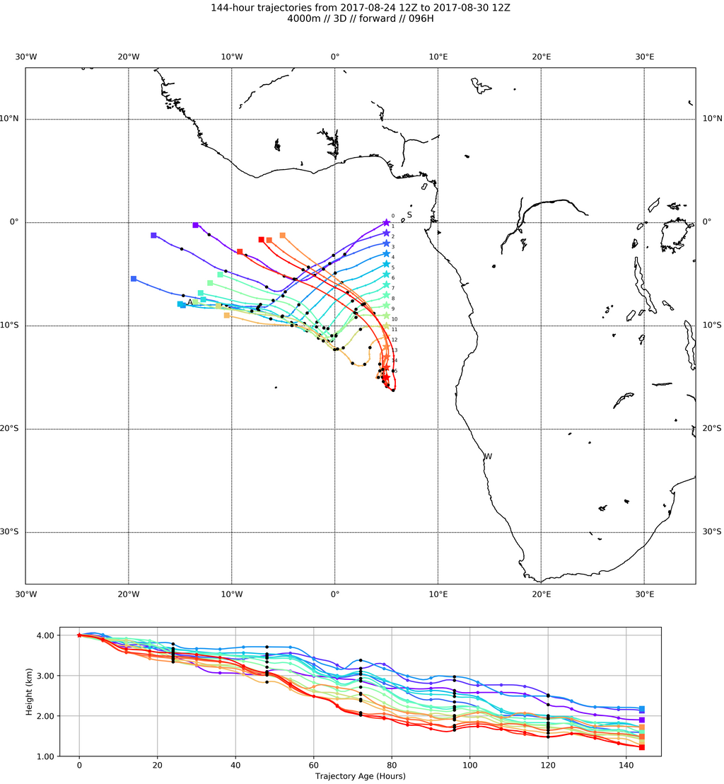
600mb (4km). Again, see possibilities of reaching coherently moving air masses west of routine flight track in two days. Direction similar to 3 km.

Slide 21
Friday
Midlevel flow shows moisture surge progressing westward, strongly led by 600mb level (faster flow).
High and middle cloud similar to Thursday, except that mid level cloud has advanced to the west

Slide 22
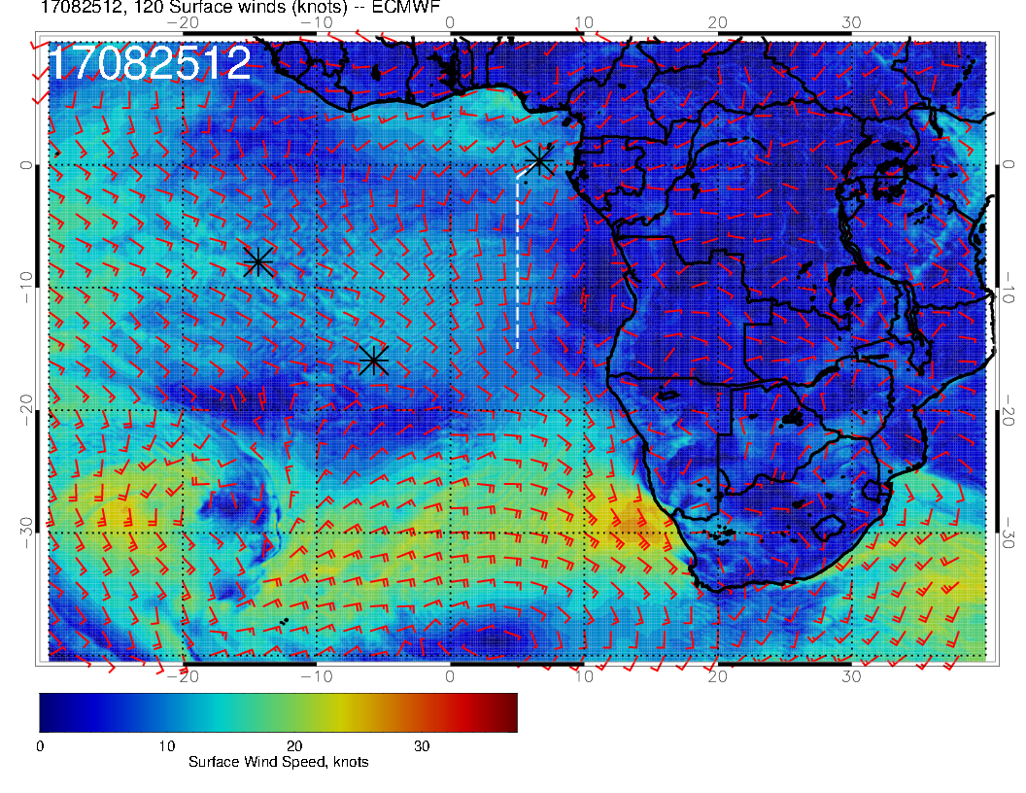
Thursday
Friday
Thursday
Still weak surface winds, but Angola bay eddy is back to “normal” size.

Slide 23
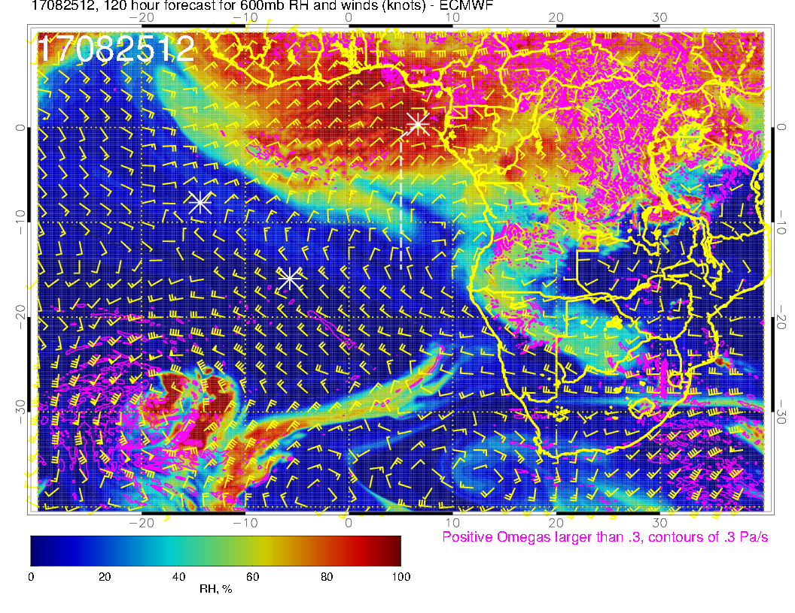
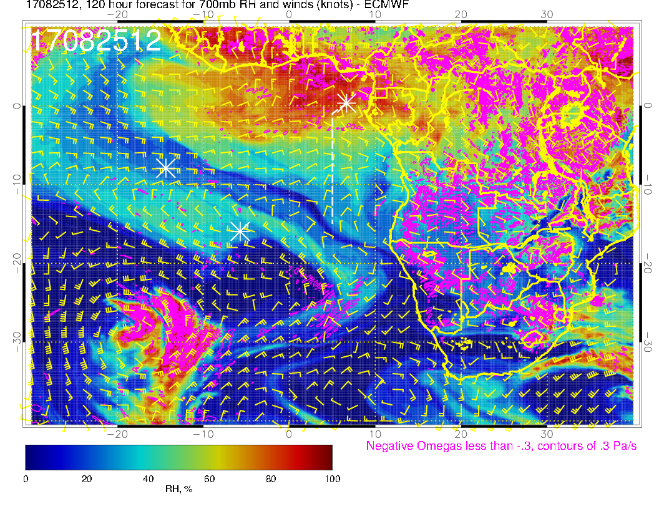
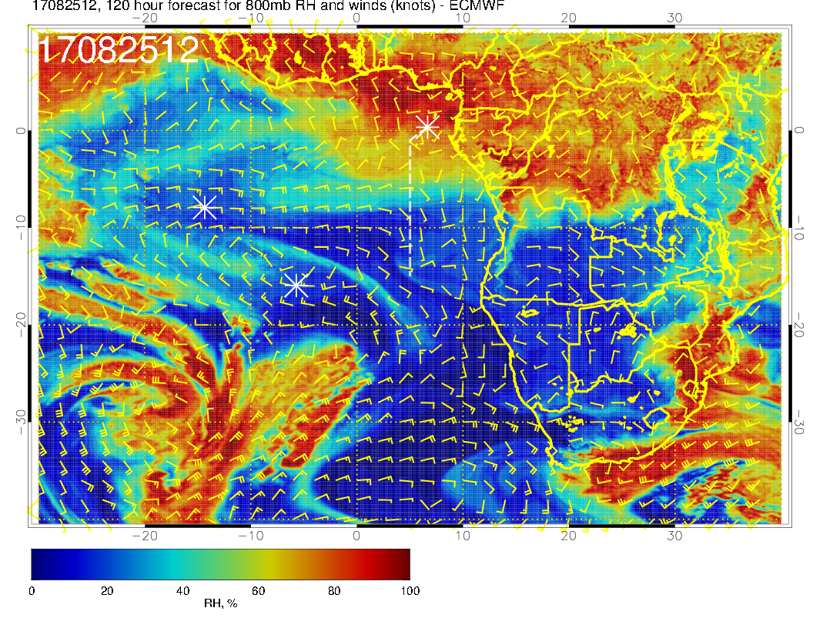
600mb
700mb
Noon Friday mid level flow shows the
westward motion of RH surge most apparent at 600mb.
800mb

Slide 24
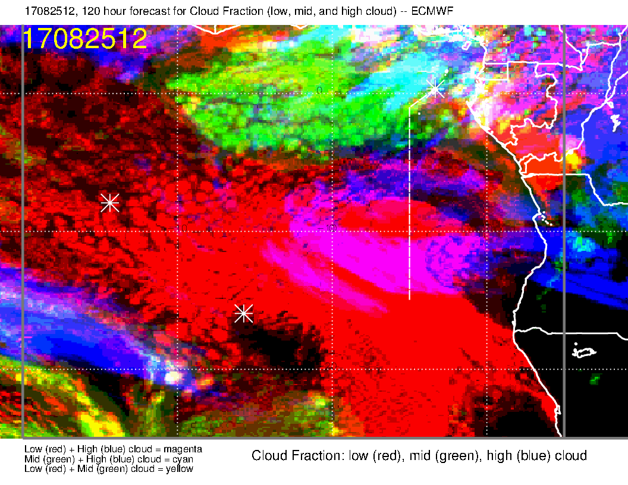
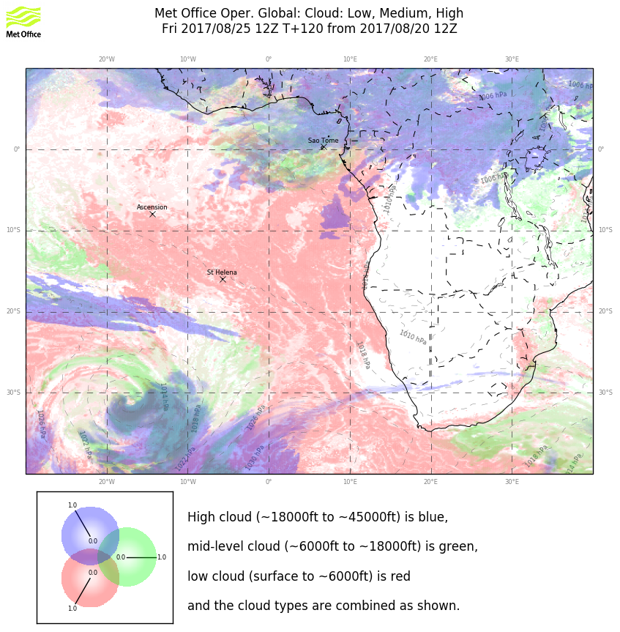
Similar pattern for midlevel clouds for both models (though EC goes further west). Obviously related to moisture surge in previous slides.
Broad agreement in high level clouds as well north of 5S. Northeasterlies indicate that some high level clouds are to be expected.
Extensive high clouds in EC south of 5S uncertain.

Slide 25
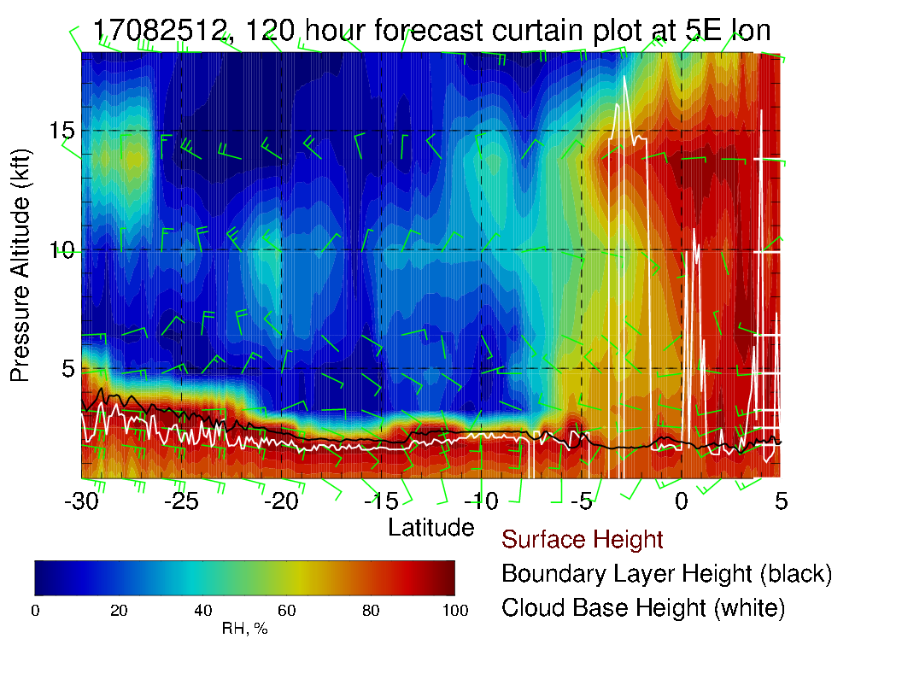
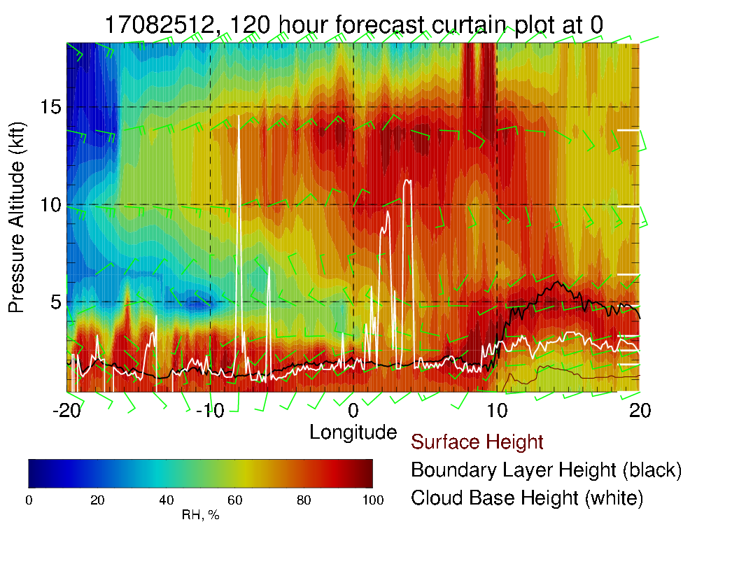
Saturday cross sections along routine track longitude (left), and along equator (below). Prominence of 600mb RH is apparent. Consistent with flow speed, 600mb leads the lower levels.

