Slide 1
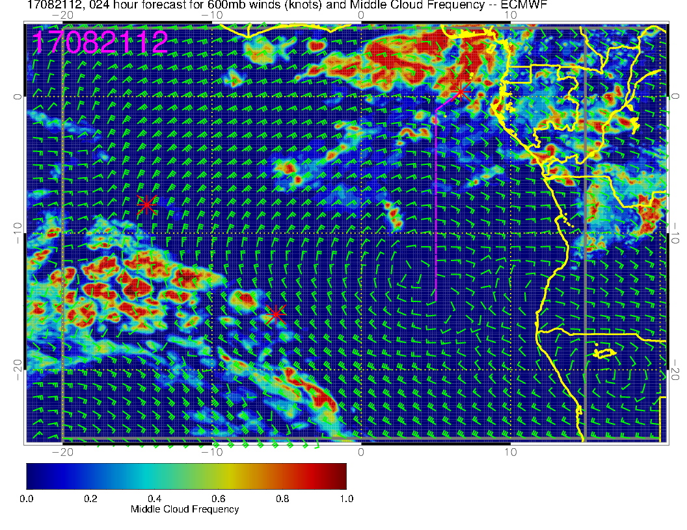
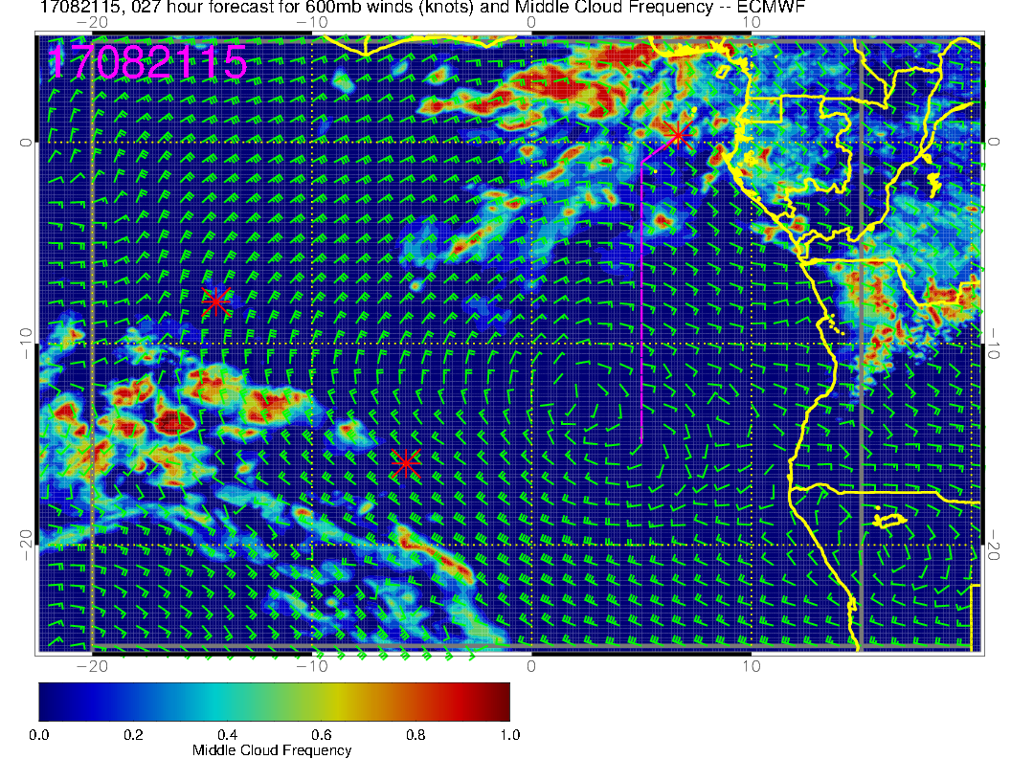
Middle Cloud forecast for today.
Note mid-cloud along track
Middle cloud (white circle, yellow/green) near track is possible with all the moisture coming off the continent
Noon
3 PM

Slide 2
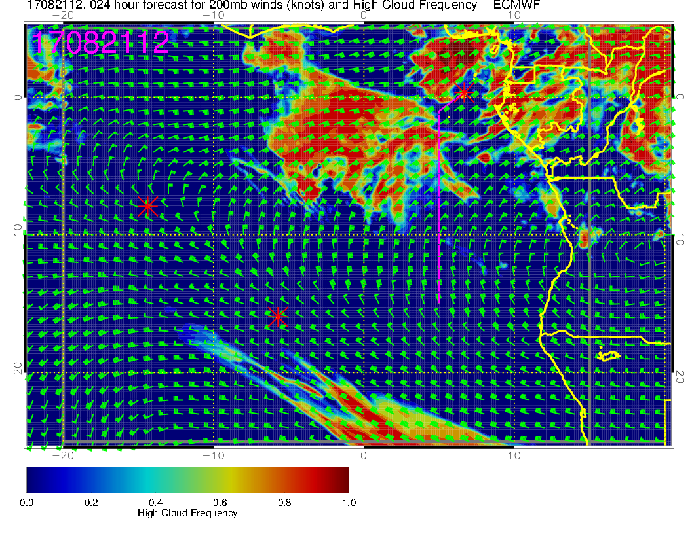
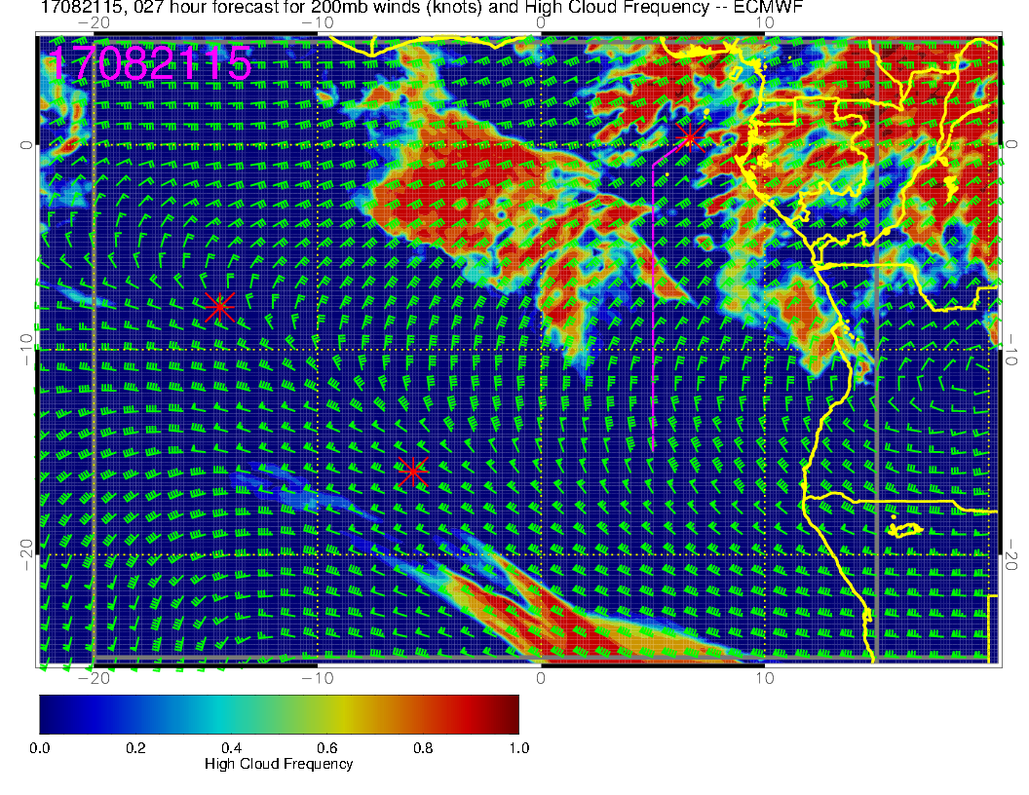
High Cloud forecast for today.
Based on comparison with this morning, this may be overdone.
But, have “problems” about the same spots as with middle cloud.
Noon
3 PM

Slide 3
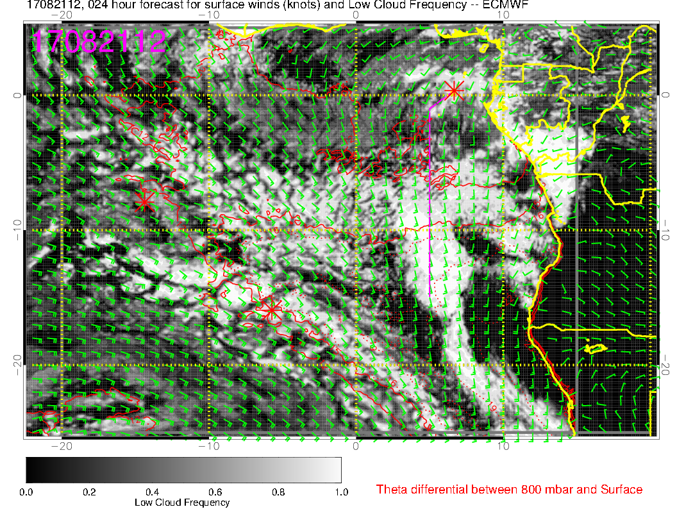
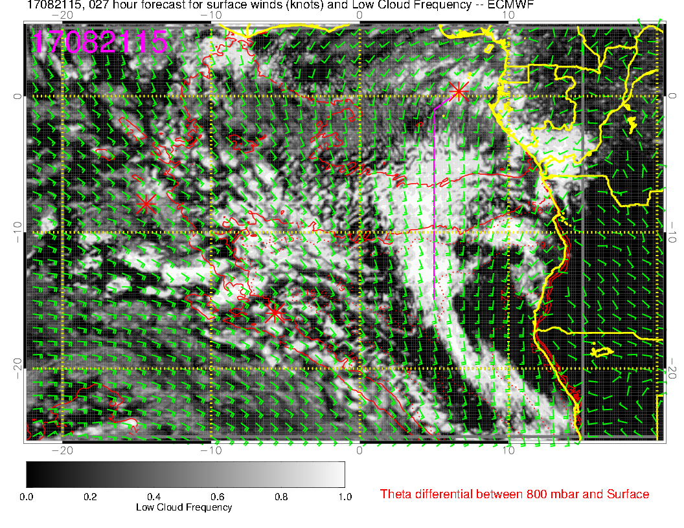
Low Cloud forecast for today.
Probably scattered along all except the last part of the 8S track.
Model forecasts increase from noon to 3 PM
Surface wind speeds are increasing during the day, so this might materialize.
Noon
3 PM

Slide 4
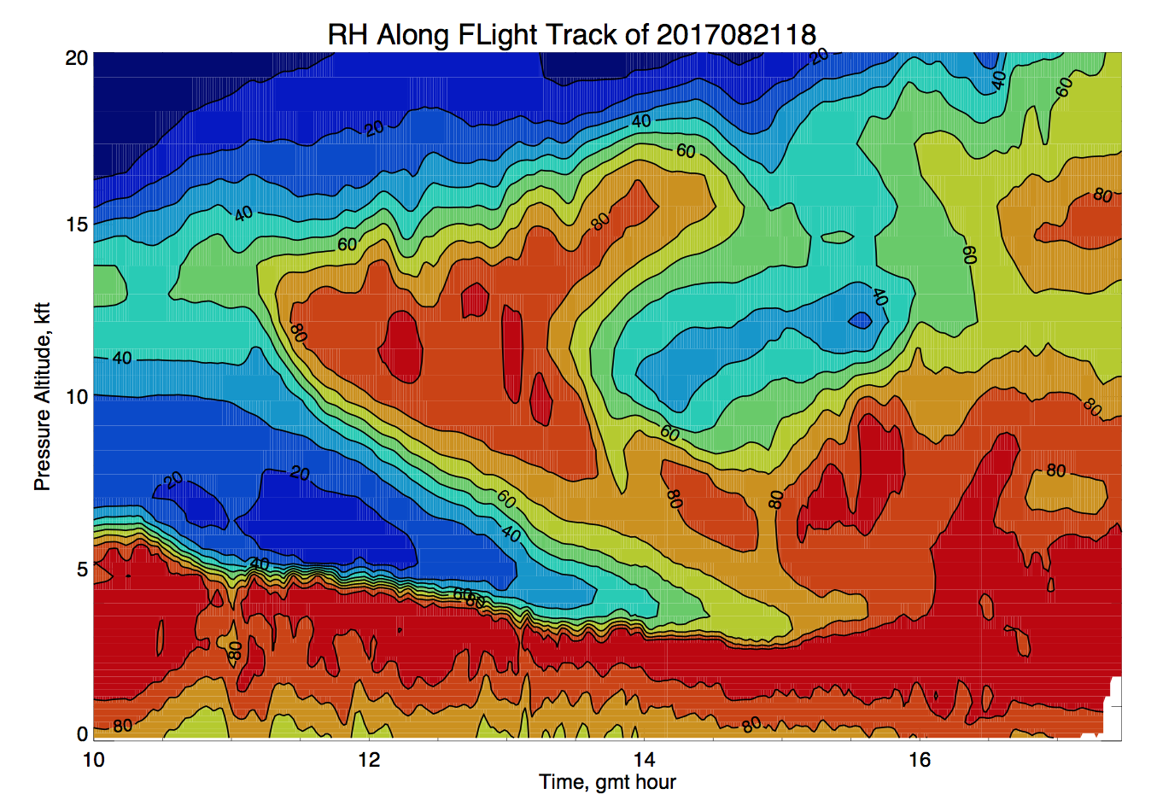
Corner turn on track

Slide 5
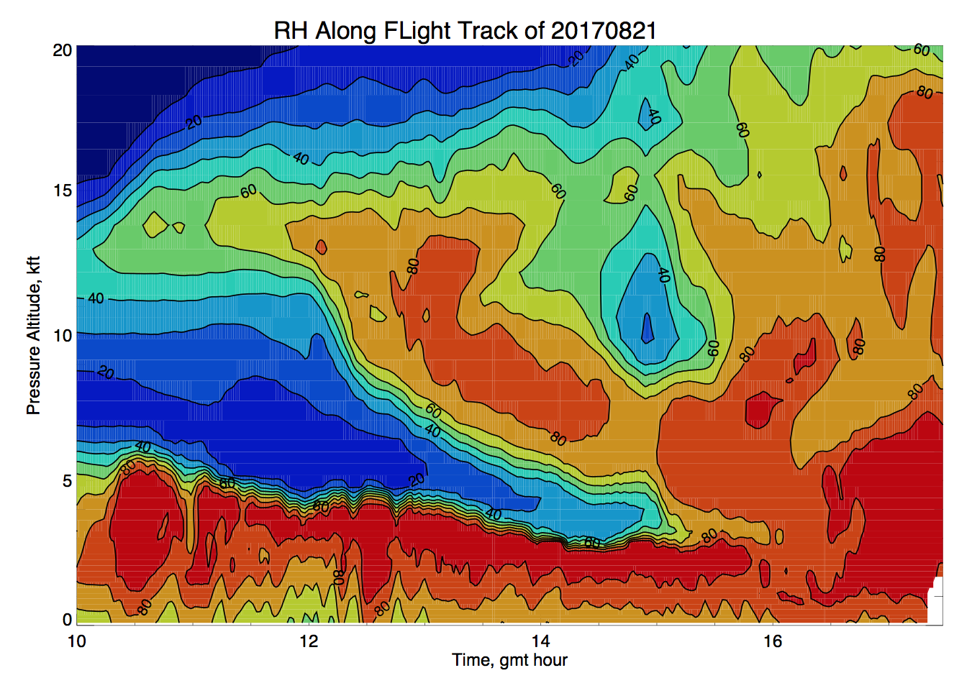
Corner turn on track

