Slide 1
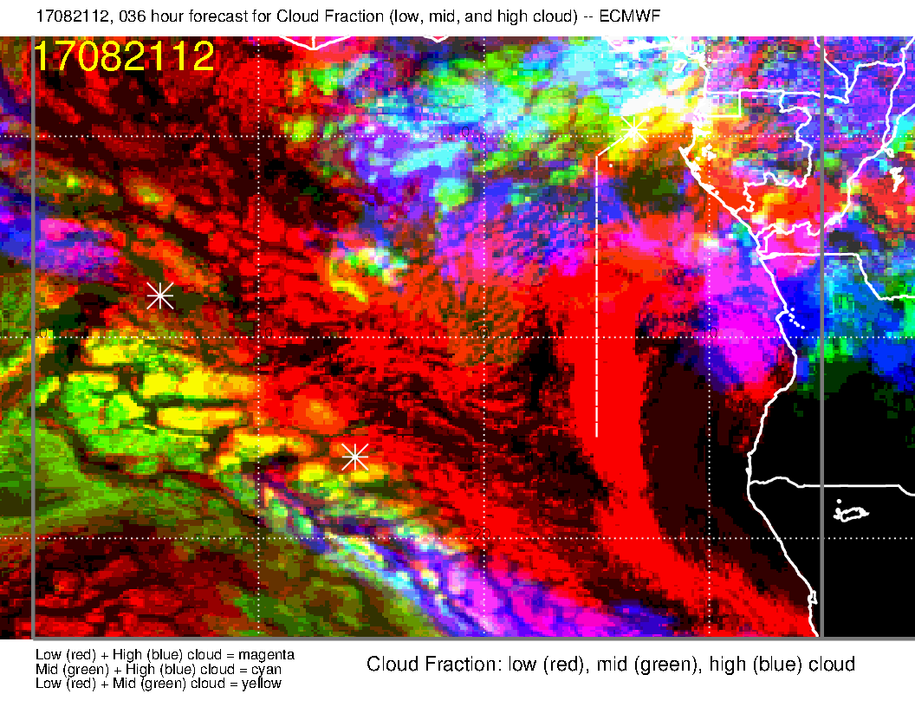
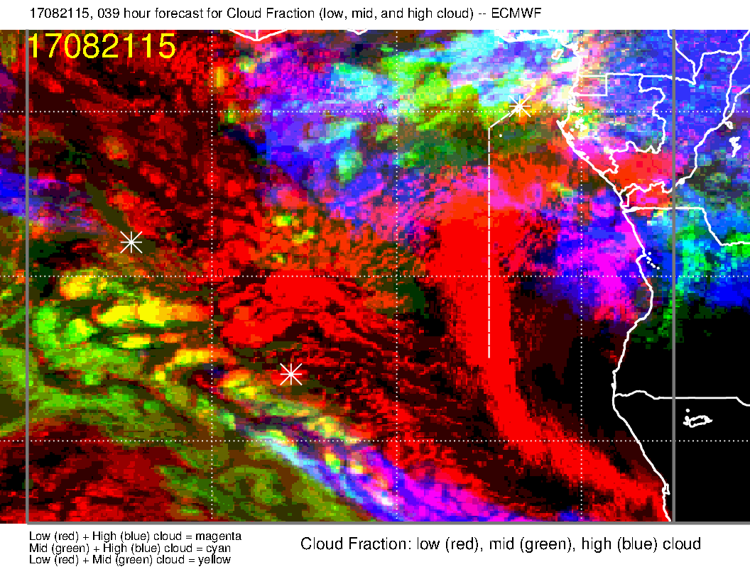
Cloud forecast for tomorrow.
EC high and middle cloud fcst is verifying for current time, so is believable.
Middle cloud (white circle, yellow/green) near track is possible with all the moisture coming off the continent
High cloud (orange, circle, magenta/blue) along routine track also believable.
Noon
3 PM

Slide 2
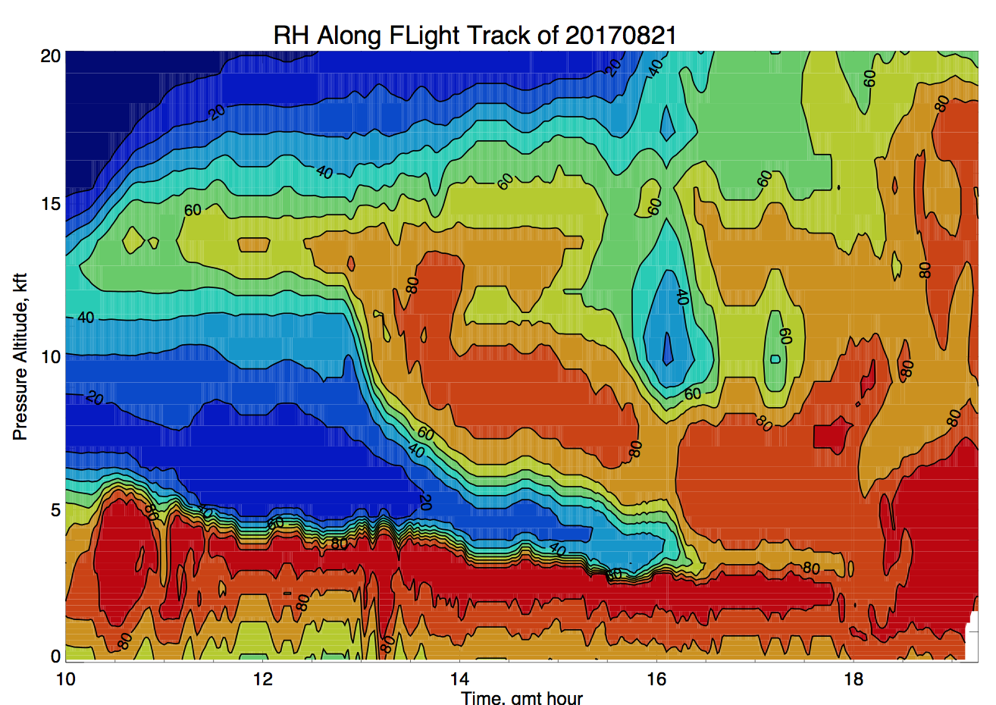
Turn onto routine track

