Slide 1
ORACLES weather briefing
19-Aug-2017
Lenny Pfister and Rei Ueyama

Slide 2
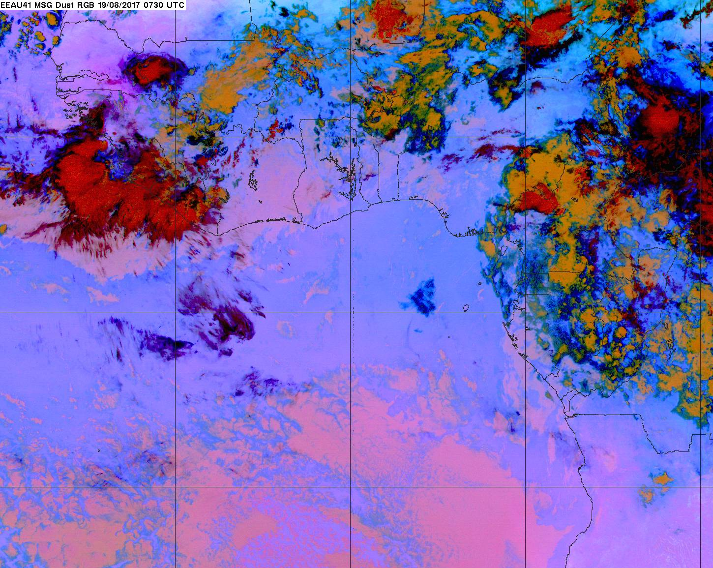
Enhanced IR satellite imagery at 8/19 Sat @ 7:30AM
Band of high clouds >18 km moving SW (dissipating at the SW edge, reforming at NE edge) – main band likely will not intersect track, but generates thin streamers that propagate southward across 8S track (mostly west of 0)
Models miss these mid clouds (7-8 km), but have dissipated
These high clouds will likely dissipate
Upper-level winds recirculate these high clouds towards the SE (reforming at the N edge) – could still be present along 8S track west of ~12W at 10AM takeoff

Slide 3
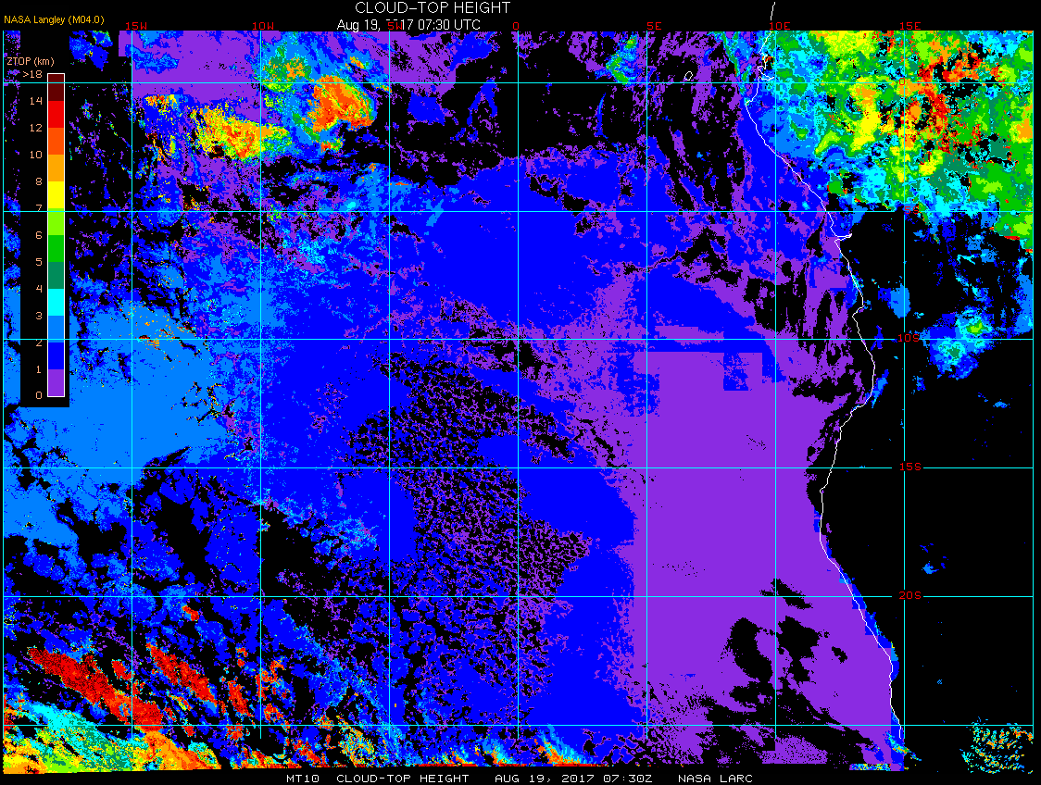
Cloud-top height (estimated from satellite) at 8/19 Sat @ 7:30AM

Slide 4
Enhanced IR satellite imagery at 8/19 Sat @ 7:30AM
Low cloud clearing has started
Low clouds filling in

Slide 5
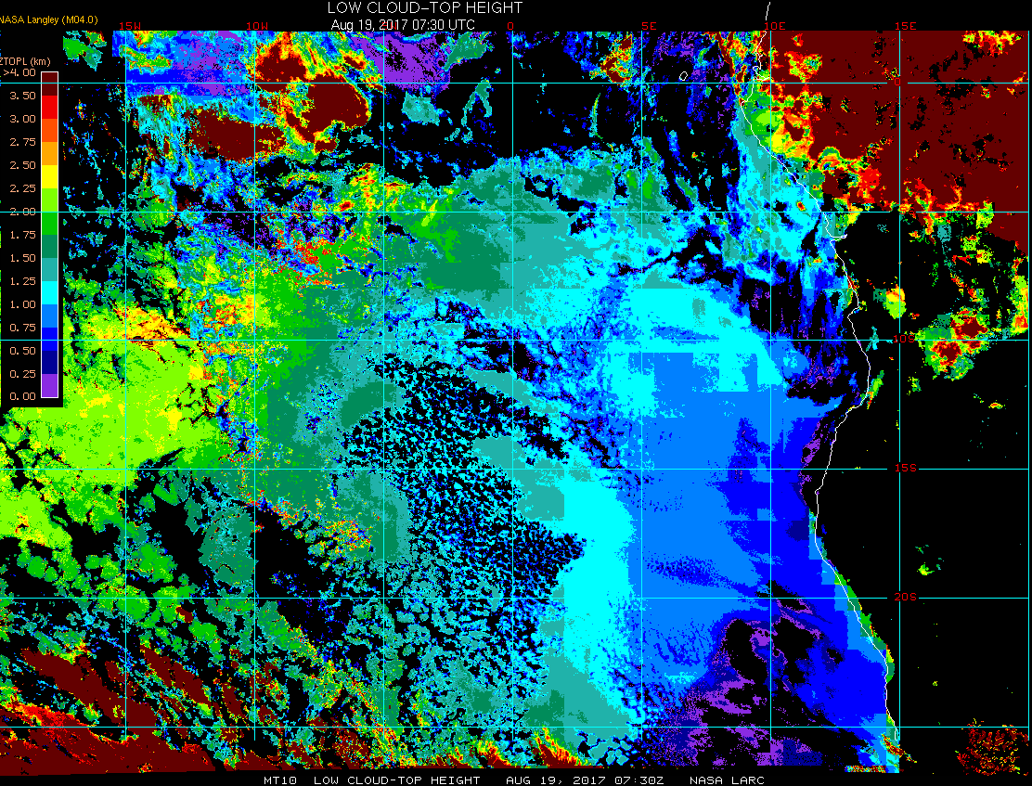
Low cloud-top height (estimated from satellite) at 8/19 Sat @ 7:30AM

Slide 6
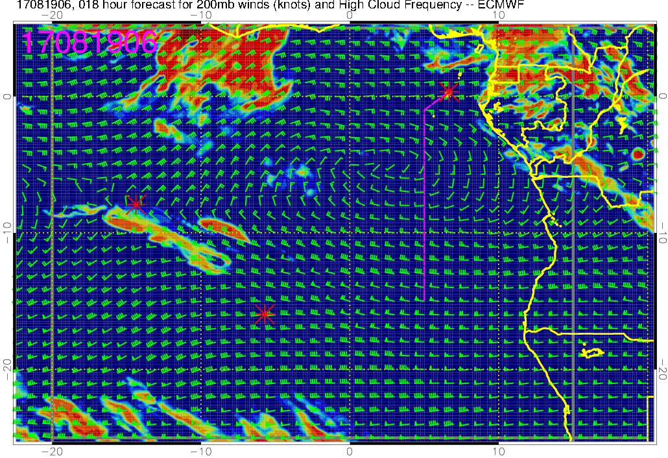
High cloud (18-hr) forecast for 8/19 Sat @ 6AM
General location of this high cloud band is well simulated, but not as expansive as observed
Winds shift from NE to NW across the 8S track
These high clouds are more expansive and displaced southward compared to satellite images

Slide 7
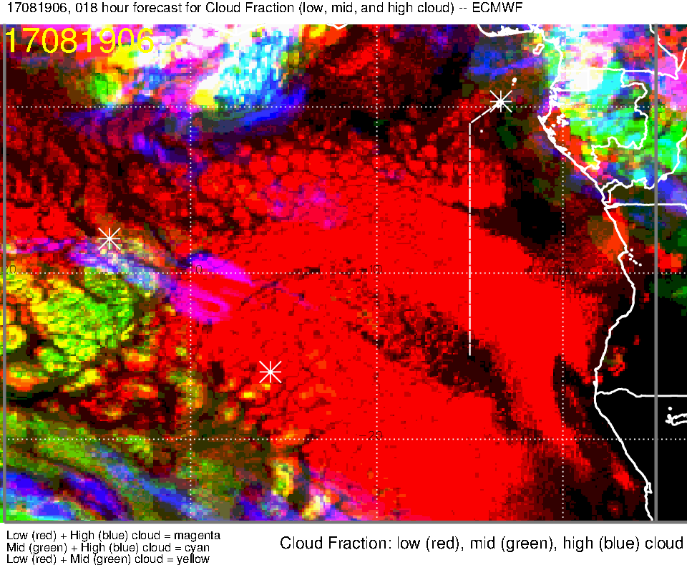
Low, middle, high cloud (18-hr) forecast for 8/19 Sat @ 6AM
Band of high clouds displaced southward in the forecast

Slide 8
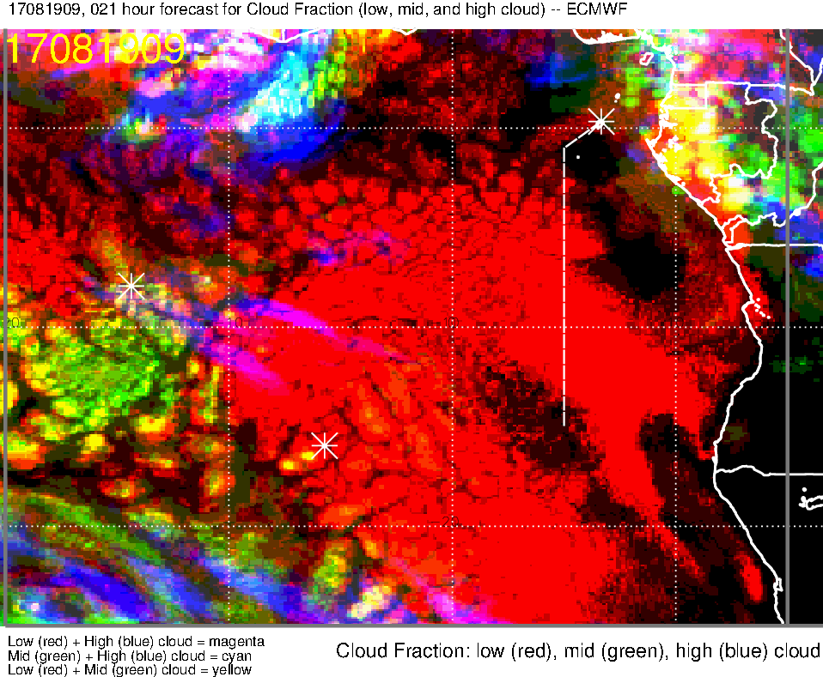
Low, middle, high cloud (21-hr) forecast for 8/19 Sat @ 9AM

Slide 9
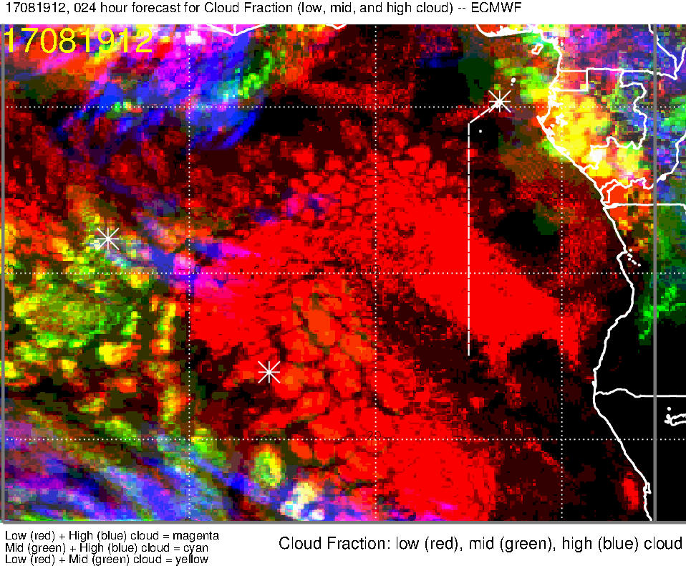
Low, middle, high cloud (24-hr) forecast for 8/19 Sat @ 12PM

Slide 10
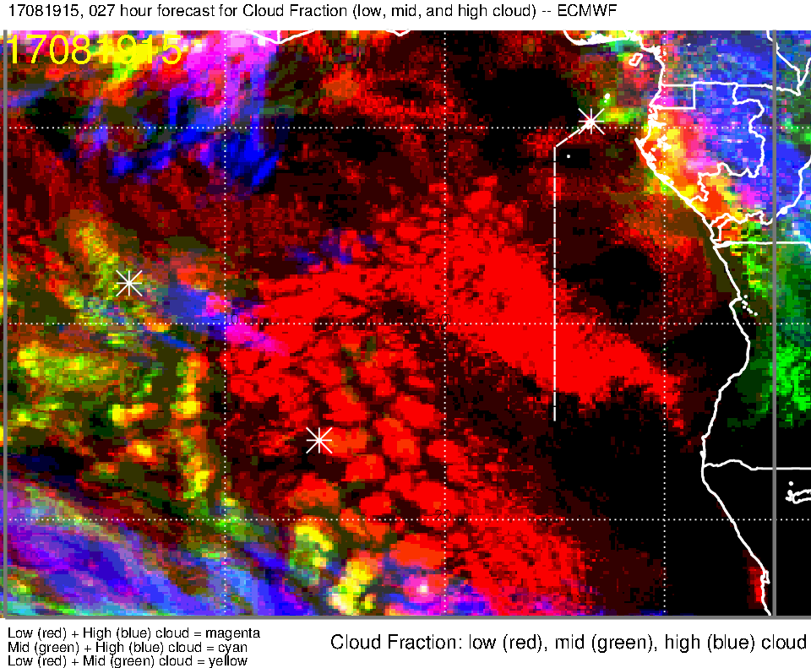
Low, middle, high cloud (27-hr) forecast for 8/19 Sat @ 3PM

Slide 11
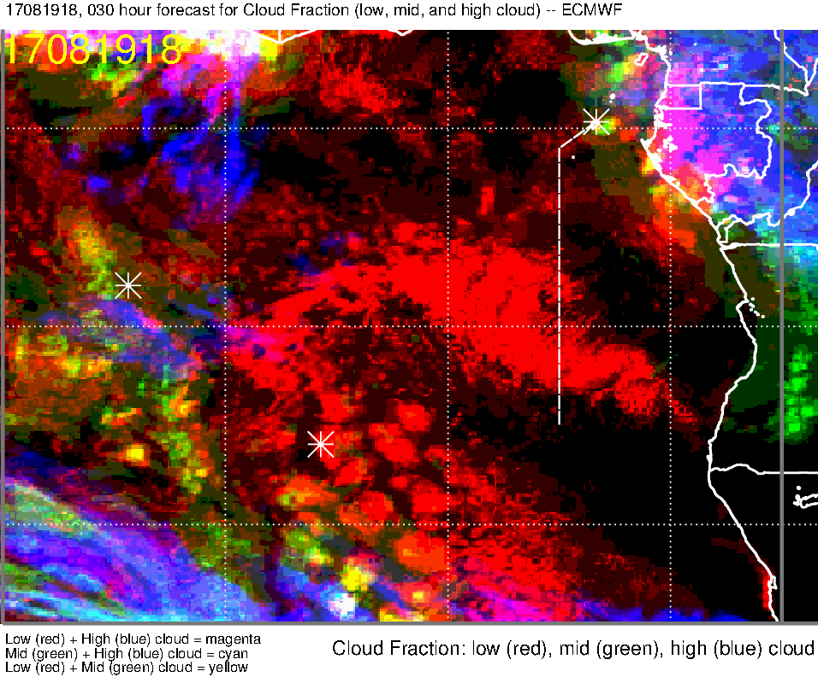
Low, middle, high cloud (30-hr) forecast for 8/19 Sat @ 6PM

Slide 12
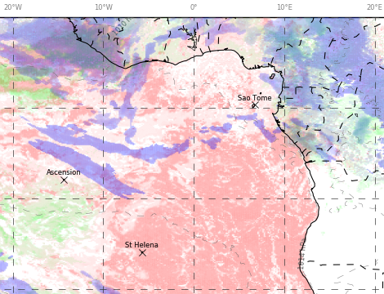
Low, middle, high cloud forecast for 8/19 Sat @ 12PM
UKMO (12-hr)
ECMWF (24-hr)
High clouds
High clouds
High clouds possible west of ~8W along 8S
Low cloud cover is overestimated in both models
Scattered to broken low clouds along 8S; most dense low clouds 0-5E along 8S
Low cloud clearing south of TMS to ~7S

Slide 13
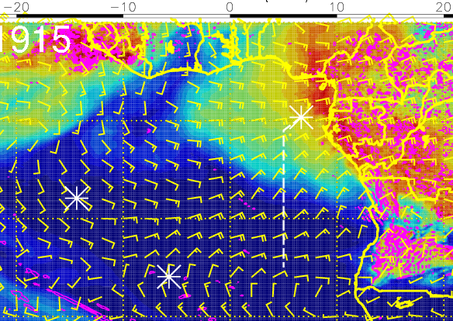
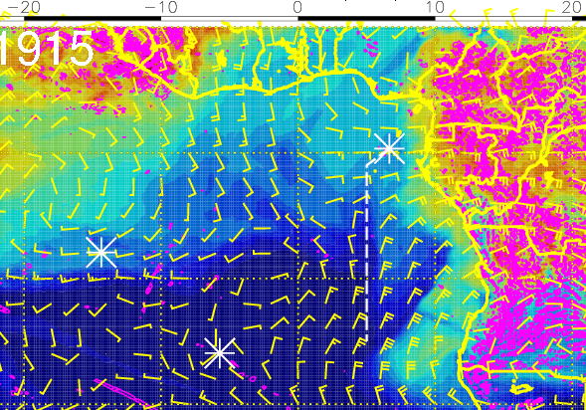
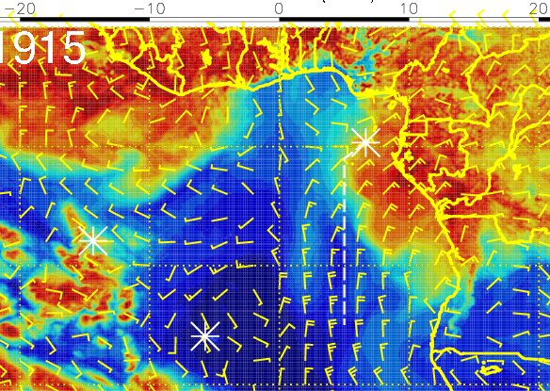
RH (color), winds, vert. velocity (pink) at 8/19 Sat @ 3PM
600 mb
700 mb
High RH at 600 and 800mb near TMS
Winds transport moisture towards the routine flight track
800 mb

Slide 14
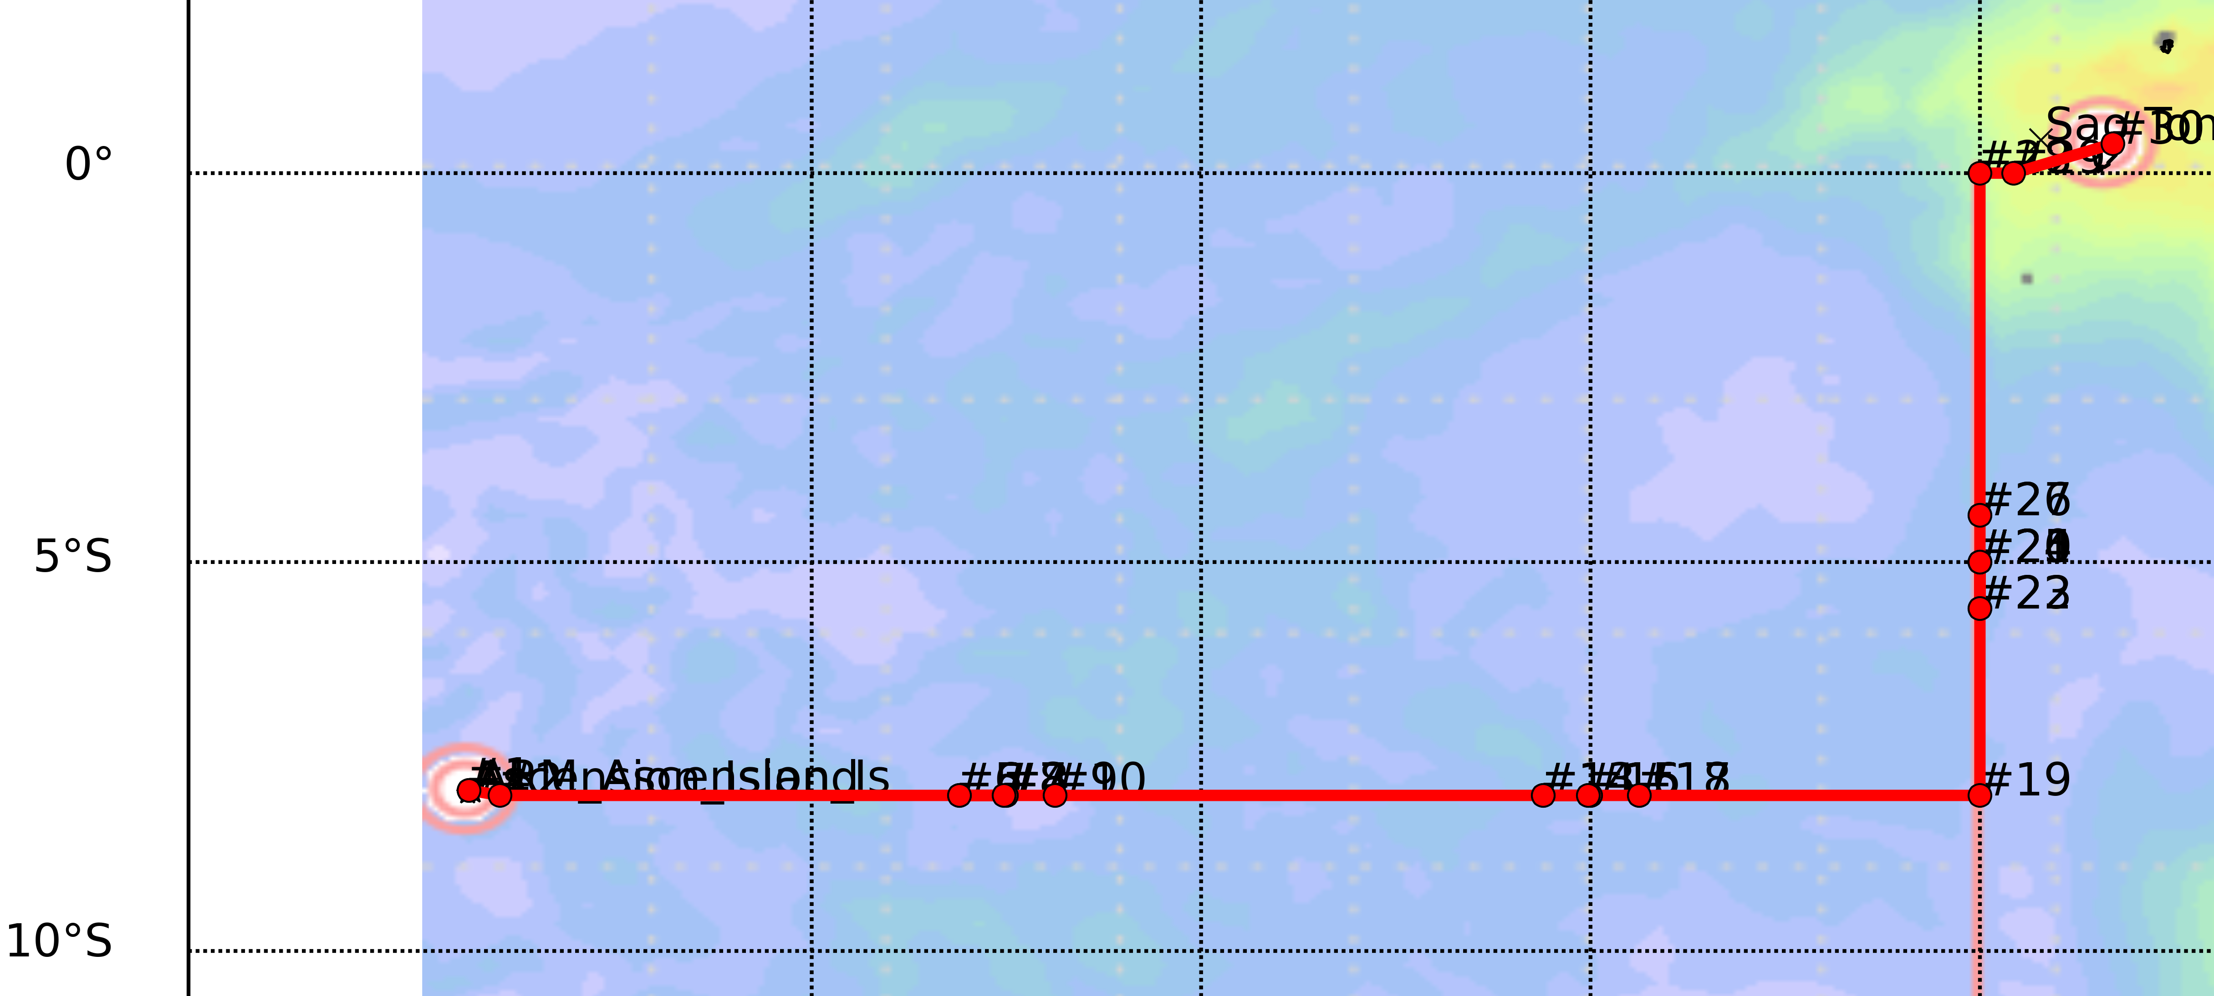
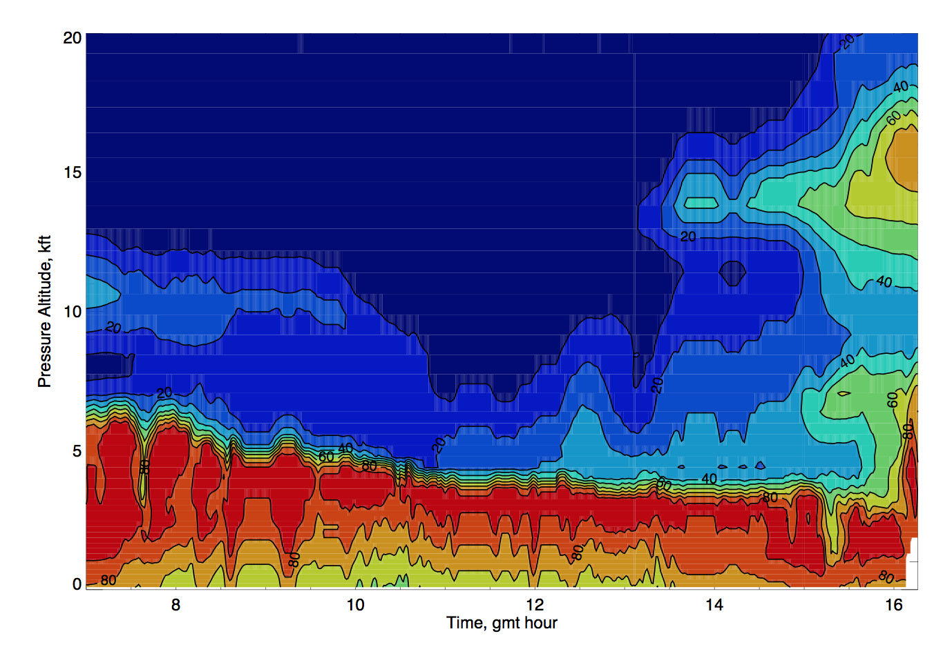
RH curtain along the flight track
(using 8/18 12Z forecast)
A
8S, 7.5W
B
8S, 0
C
5S, 5E
~6kft
~4kft

Slide 15
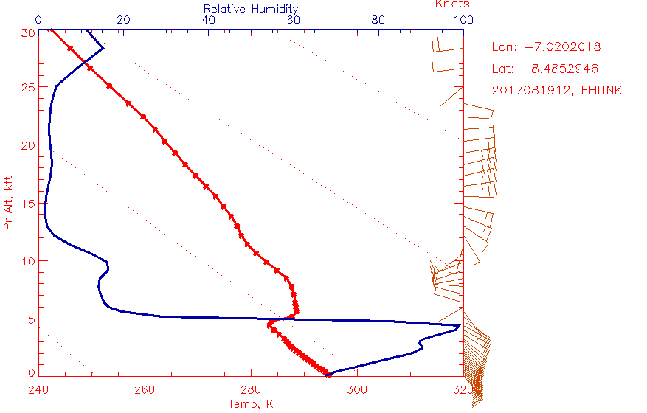
Forecast sounding at A (~8S, ~7E)

Slide 16
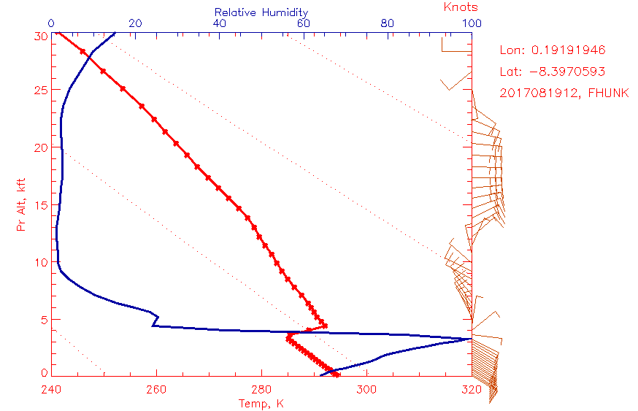
Forecast sounding at B (~8S, ~0)

Slide 17
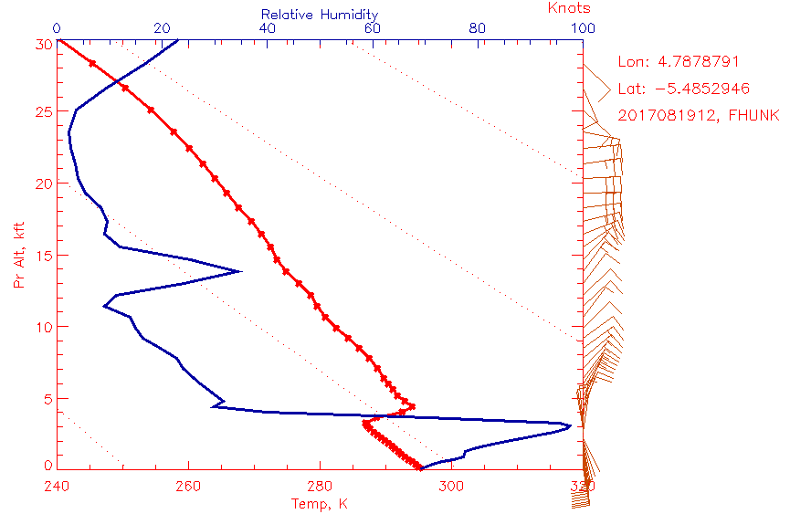
Forecast sounding at C (~5S, ~5E)

Slide 18
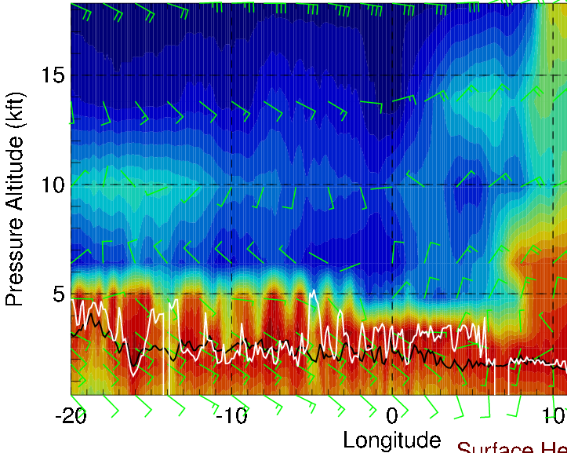
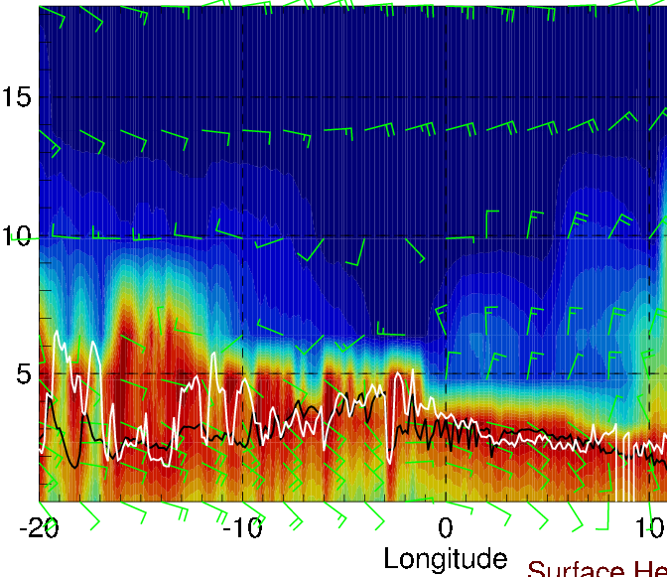
Longitudinal cross-sections of RH (color), wind, BL and cloud base heights
on 8/19 Sat @ 12 PM
along 5S
Along ~8S
Cloud tops decrease from ~6 kft to ~4 kft
Headwinds of 10-15 knots at 15 kft (increasing to the east)
Tailwinds of 5-15 knots at 7-10 kft 14W-0 (northerly crosswinds 0-5E)
along 10S

Slide 19
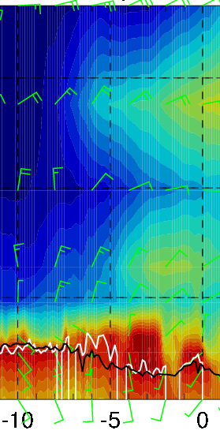
RH (color), wind, BL and cloud base heights along 5E, 8/19 Sat @ 3PM
15-25 knts
15-20 knts
10 knts
Moist air from the east at 15 kft: north of ~6S along the routine flight track
crosswinds 10-20 knots above 10 kft; headwinds ~10 knots at 5-7 kft

