Slide 1
ORACLES weather briefing for Monday and Wednesday
19-Aug-2017
Lenny Pfister and Rei Ueyama

Slide 2
Monday
Expect a good chance of extensive high cloud cover over at least northern part routine track – tops around 40kft
This is due to enhanced convection forecast near the shore – this is in both UKMO and EC models.
Mid levels show continued decisive offshore quasi zonal flow with high RH north of 7S. Can see it even at 300mb (north of equator.
Mid level RH plume implies a good chance of significant mid-level cloud north of 7S.

Slide 3
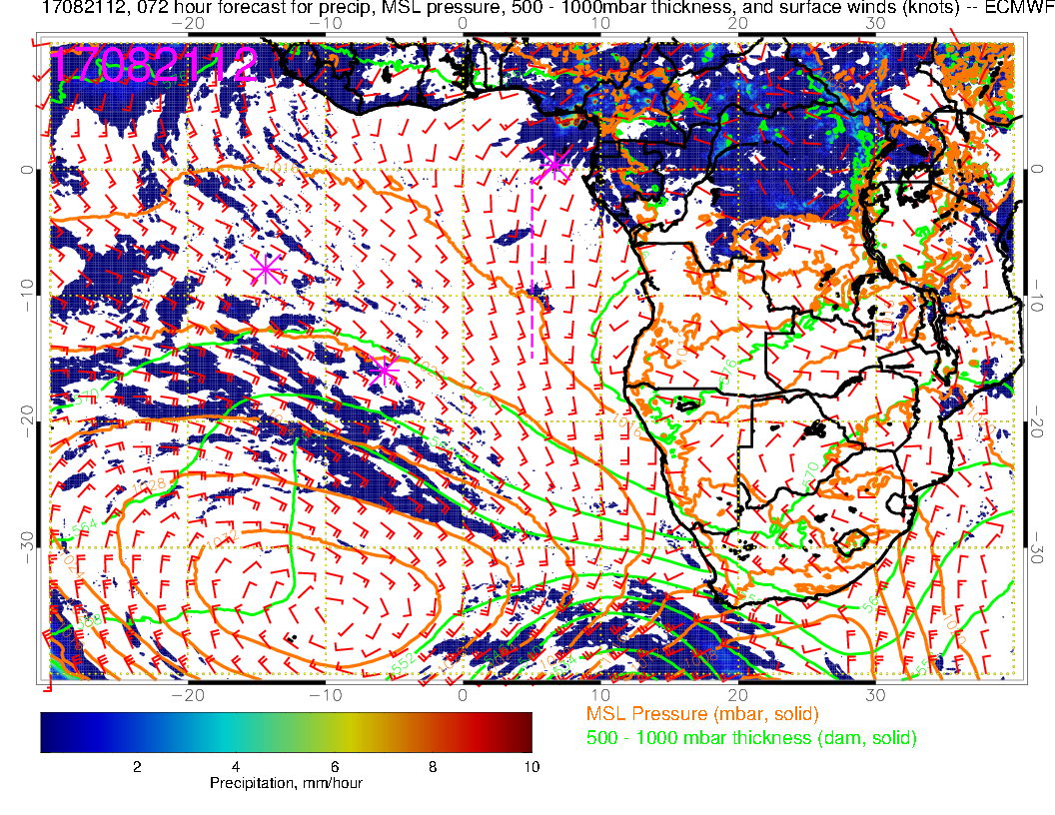
H
Saint Helena High reestablishing itself, is still west of climo position. Note anomalous eastward “bending” of flow north of Sao Tome, probably into modeled convection. UKMO has similar wind pattern and precip off the Cameroon/Gabon coast.

Slide 4
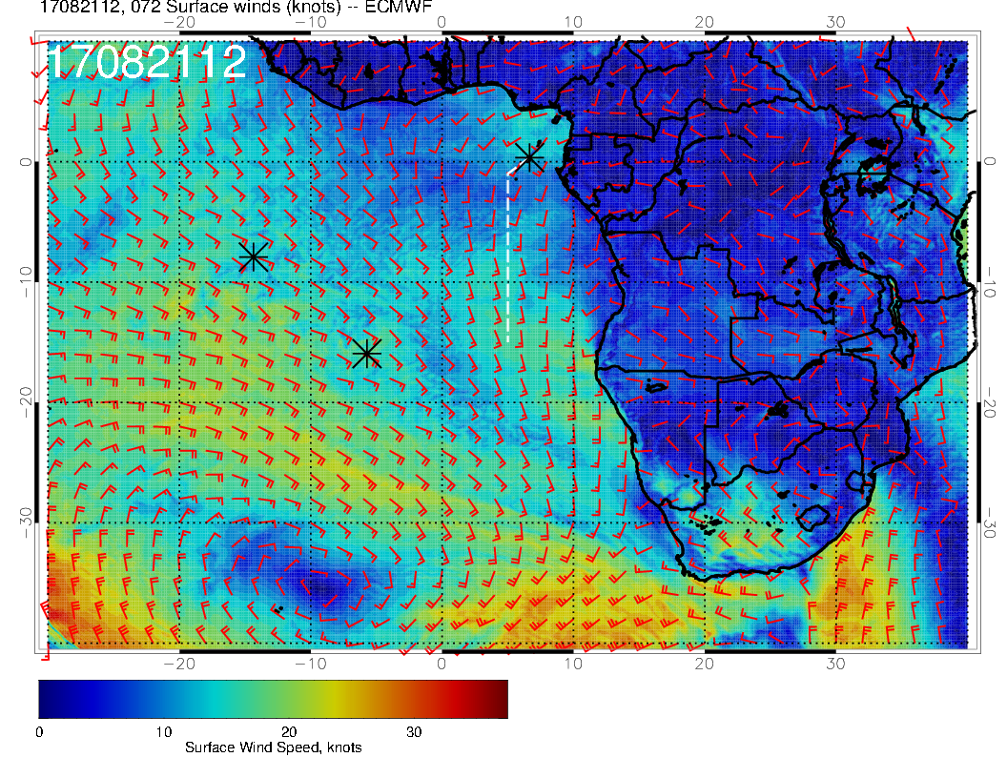
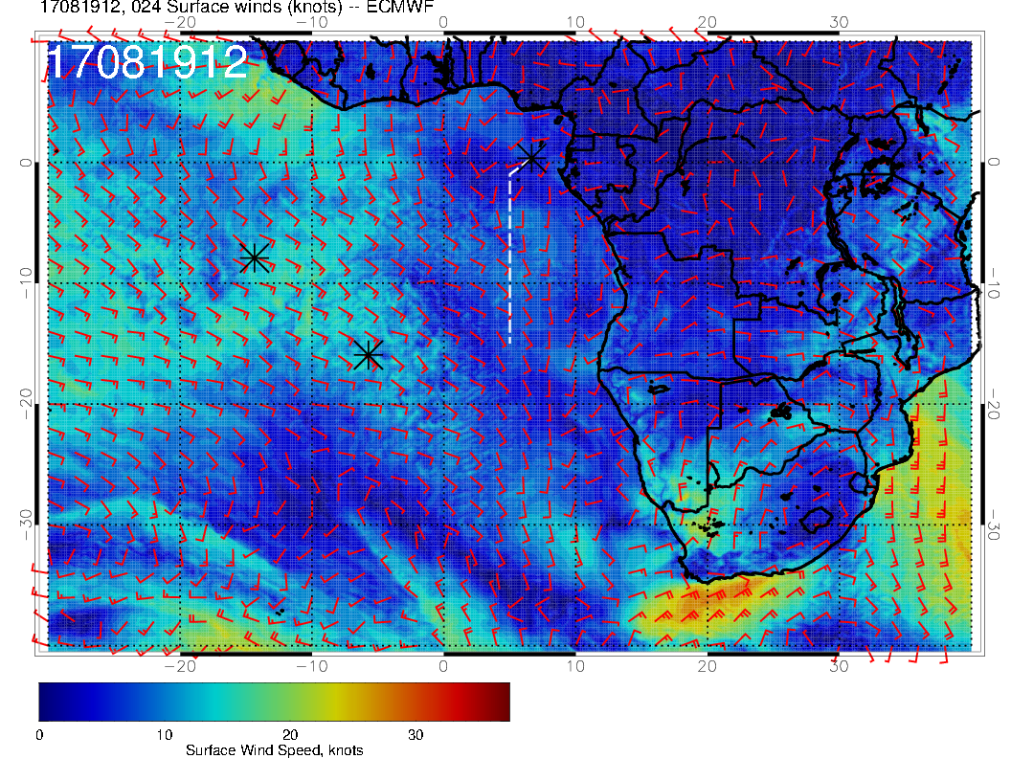
Separate southerly wind maximum near the coast. There is often a wind max off the Nam/Ang border, but usually not separate in the east-west direction. Note also how much stronger surface winds are than today.

Slide 5
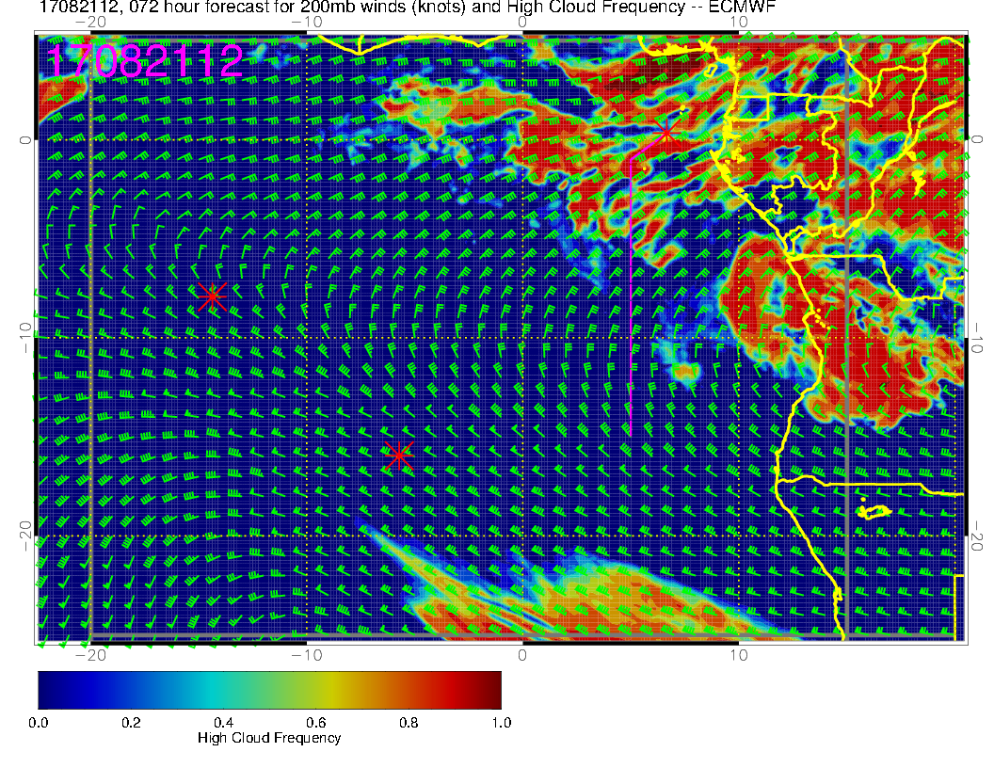
Northeasterly flow at 200mb (outflow level or slightly below). Lots of high cloud in northern part of track.

Slide 6
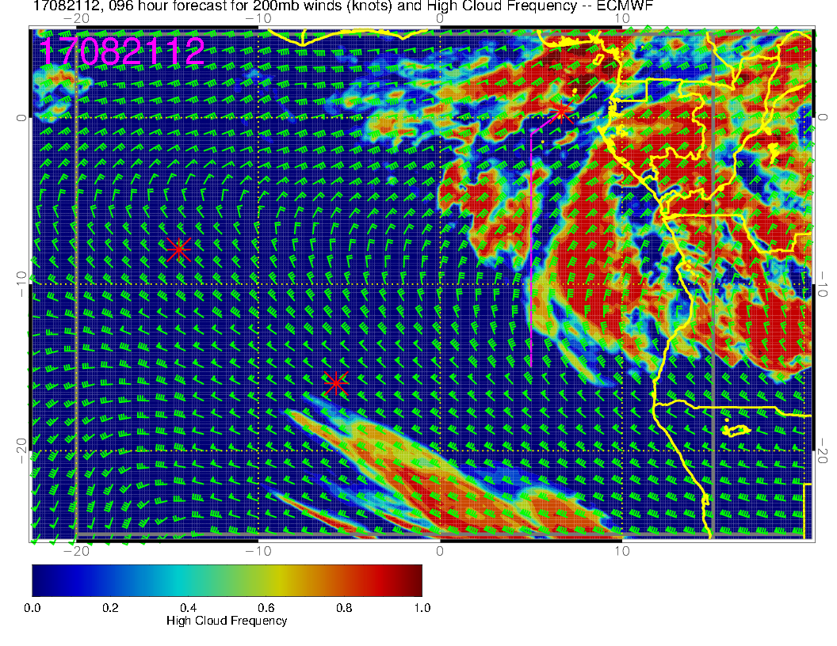
Older forecast, so “forecast stability” has not yet been reached.

Slide 7
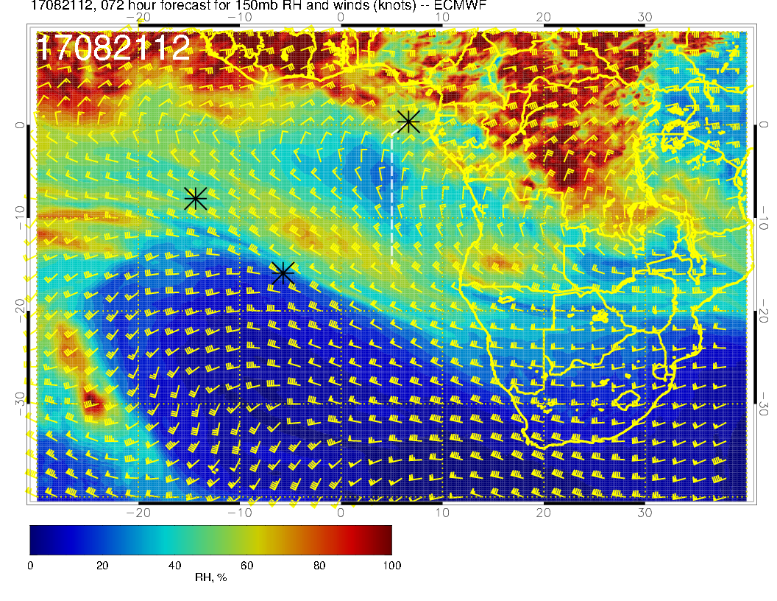
RH’s not real high at this level – model tops of high clouds are probably 40kft.

Slide 8
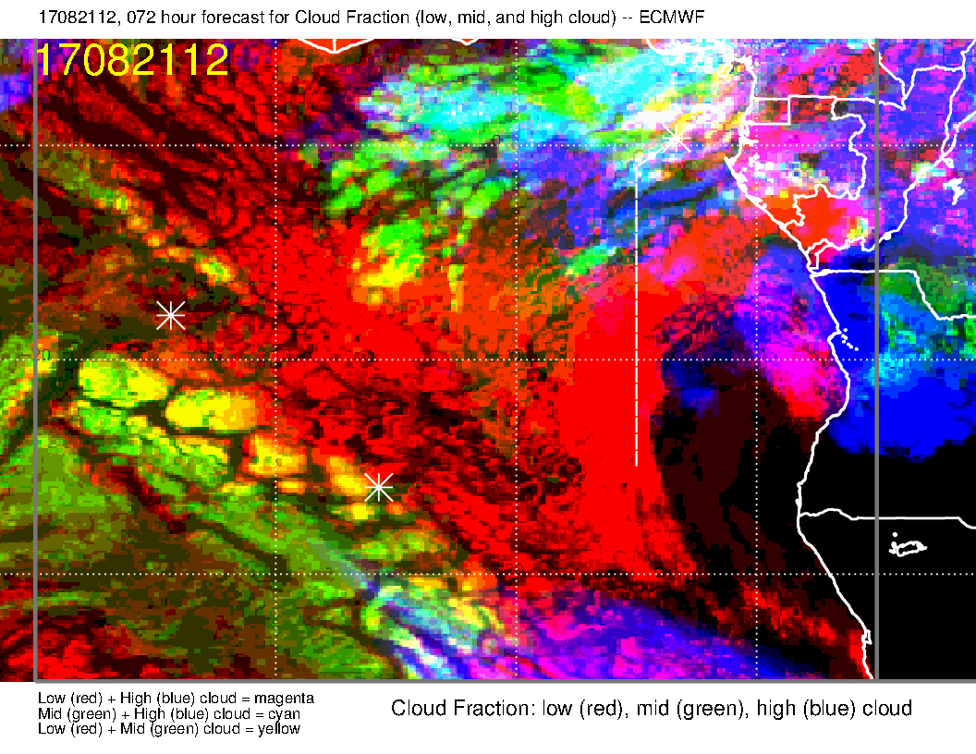
Overall cloud pattern on Monday – model comparison. Basic pattern is similar for both high and middle clouds. Note extensive mid-level cloud in both forecasts. Not unusual, though diurnal variation often reduces this substantially by 12Z.
Note added after brief: In general, later forecasts often reduce the middle cloud incidence in STP region. We have not seen much middle cloud south of the equator this deployment

Slide 9
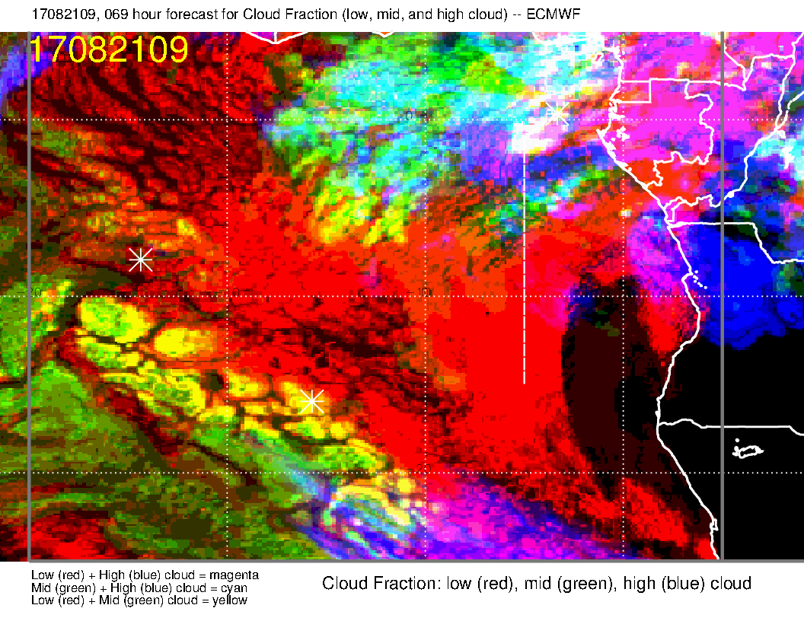
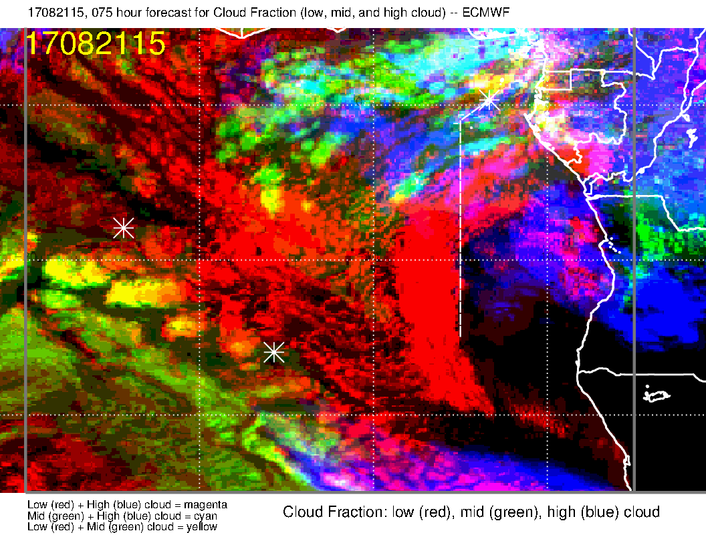
Monday diurnal cycle. Middle cloud is less in the afternoon, but this is too fundamental to go away

Slide 10
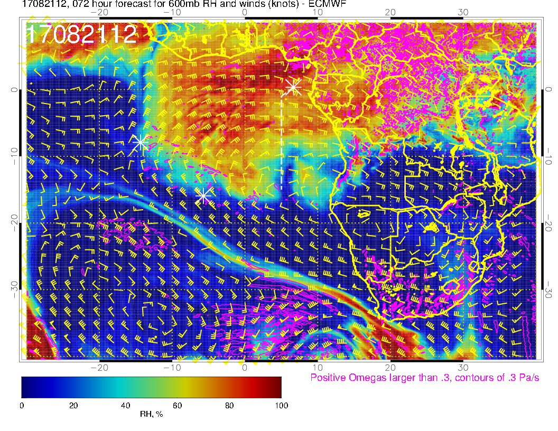
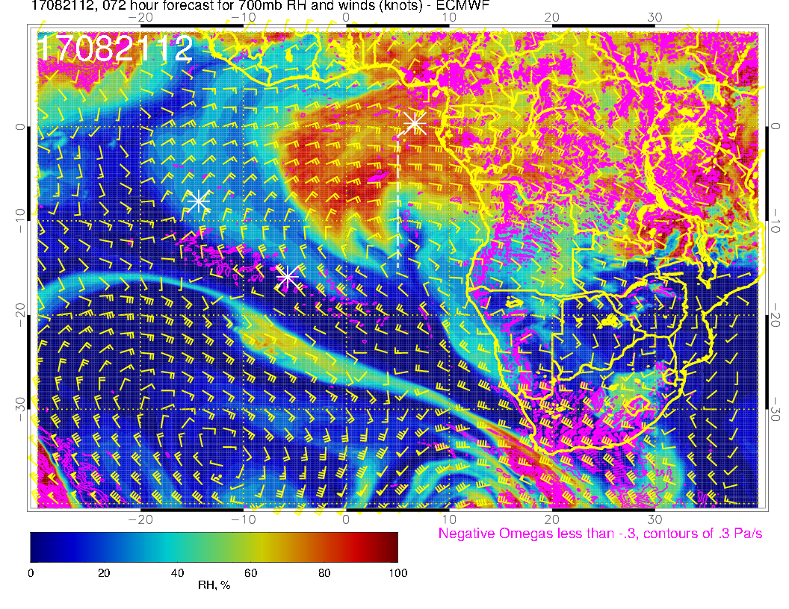
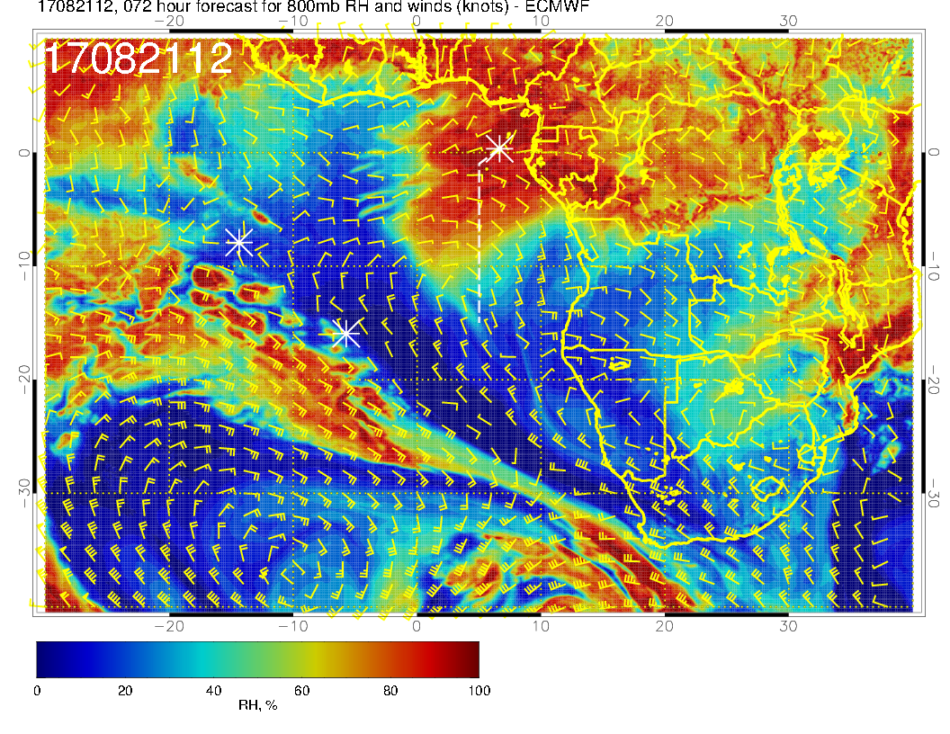
600mb
700mb
A decisive surge of moisture is coming off the coast. Will capture this in the northern part of our routine track.
Emerges from coast on the 19th (3Z at 800mb, 18Z at 700mb, 12Z at 600mb).
Horizontal extent differences due to wind shear.
Forward front is more advanced than older forecast.
Deep penetration of westerly jet (STJ, strong shear and winds, near 50knots)
800mb

Slide 11
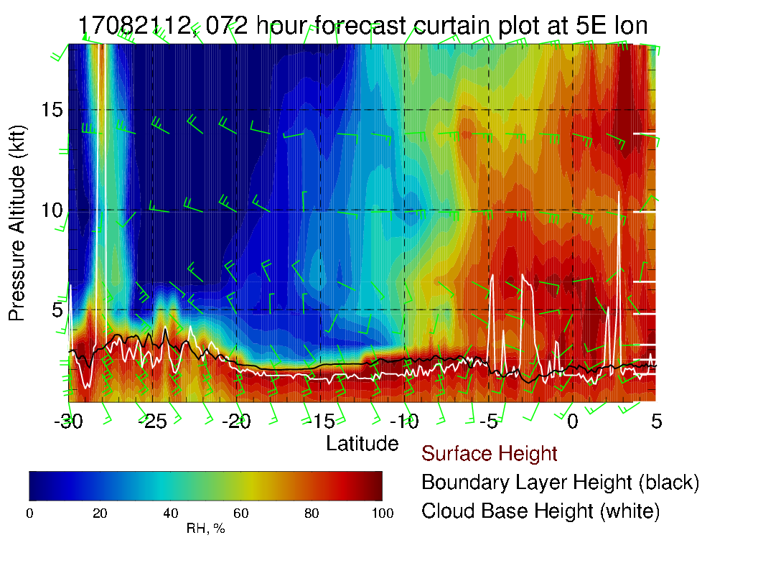
This is not a typical situation. Moisture surge leads to the high incidence of middle cloud in the forecast, and it is not going away diurnally. Note stronger than typical cross winds (25 knots) at 600 and 700mb.

Slide 12
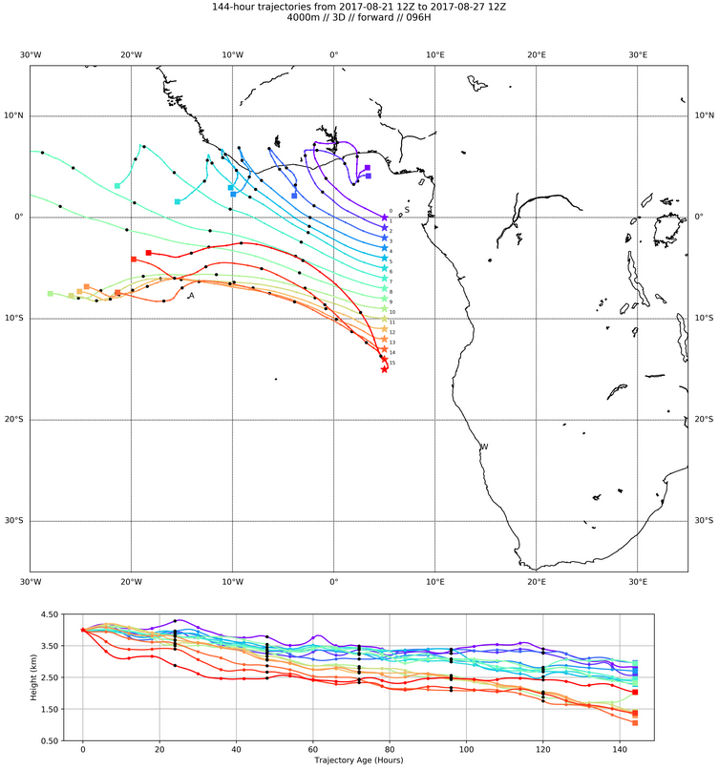
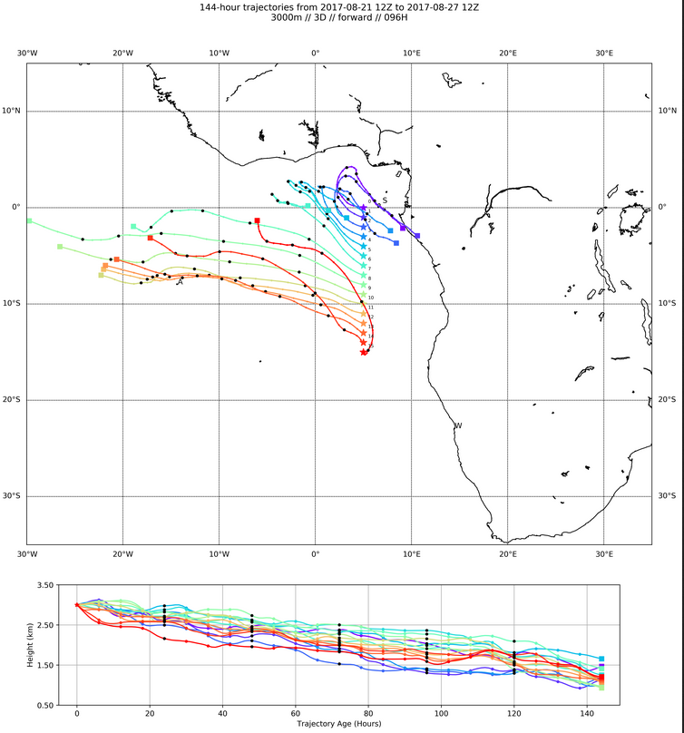
600mb
700mb
Hans’ Forward Trajectories from Monday. At 600mb, trajectories almost travel too far to be easily sampled.
700mb trajectories are slower (as expected).
I think these are the preferred levels to look at

Slide 13
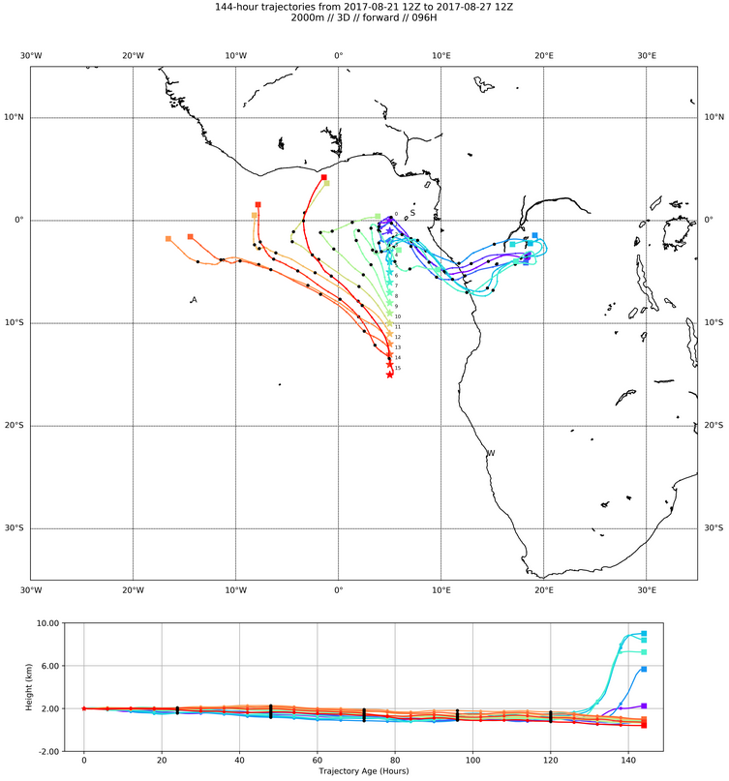
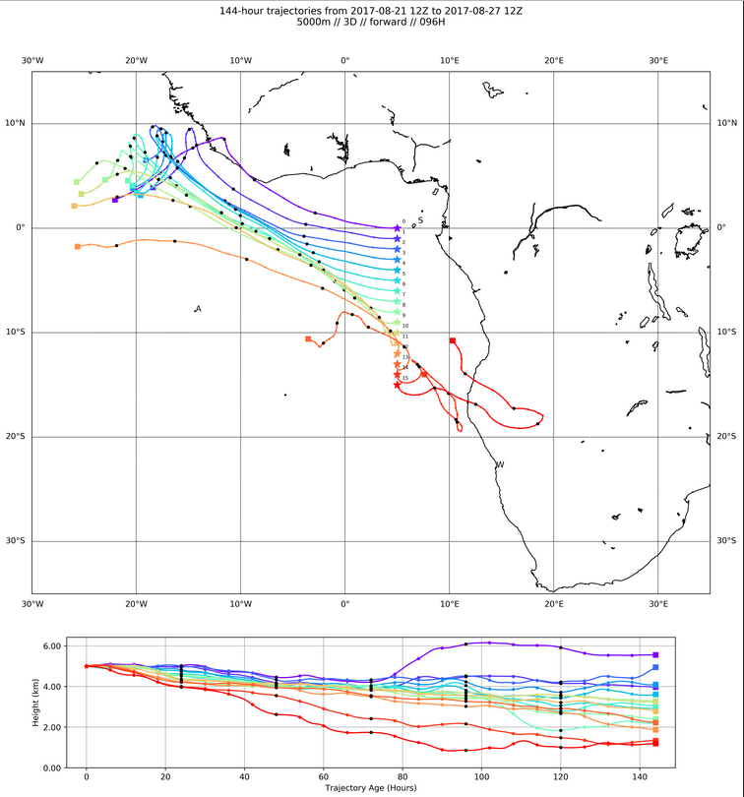
800mb
500mb
800mb (2 km) trajectories. Tend to head north, but are reasonably on the STP-ASI track.
This is the level we picked the last time.
If we want to start in the “high RH” region described previously (which is north of 7S), would want to pick more northern points, whose trajectories appear squirrelly (and some go back to Africa)
500mb trajectories that originate north of 7S move rapidly. Only those closest to 7S stay arguably within range. Probably above aerosol layer anyway.

Slide 14
Wednesday flight (to ASI)
Overall met – surface winds not as strong in our region – Angola eddy returns after temporary absence on Monday
RH moisture surge continues westward, and is horizontally distorted (winds moving faster in the southern part than the northern part.
At 600mb and 700mb, RH “plume” is caught up in a narrow deep trough and travels southeastward into midlatitudes
No midlevel clouds in the forecast.
High level clouds streaming southwestward from African convection, may reach to 5S.

Slide 15
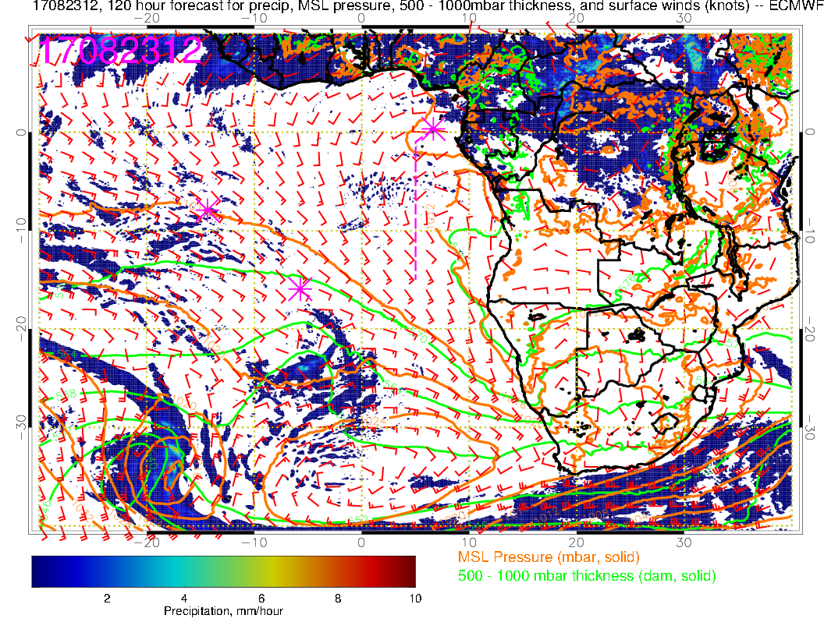
L
H
SH high has moved eastward, low forming behind it. Still have strongly angled flow near Sao Tome (westerly component).

Slide 16
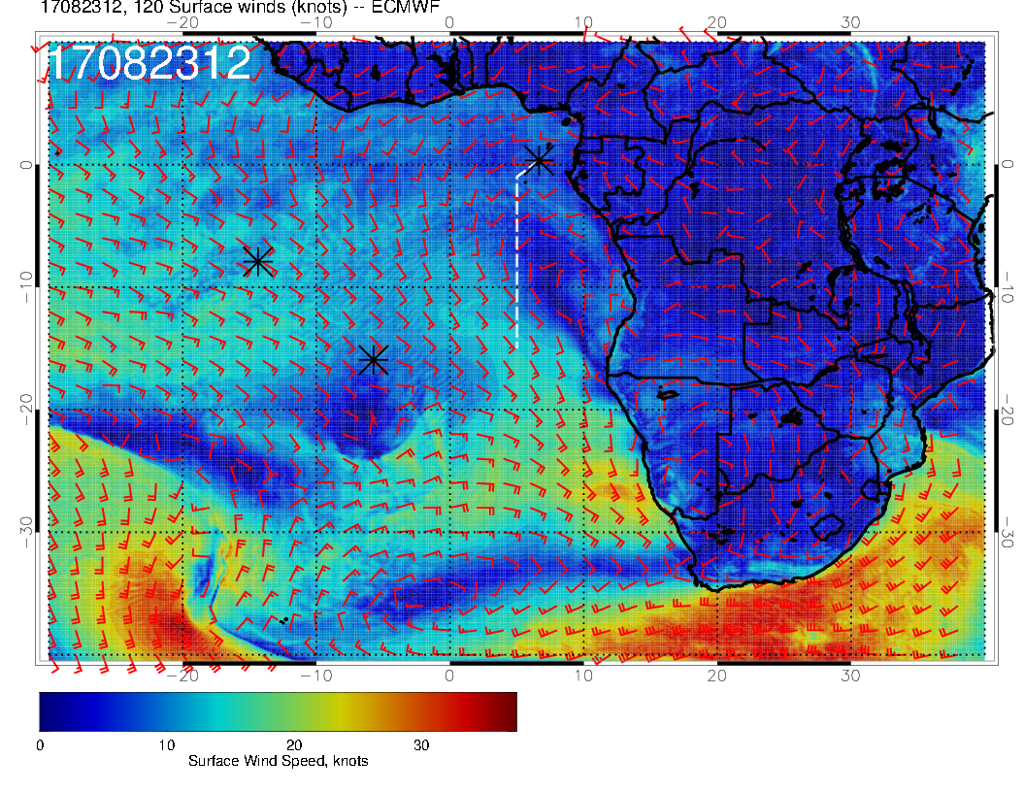
Surface winds substantially weaker north of 20S than on Monday. Strong Angola Bay eddy returns

Slide 17
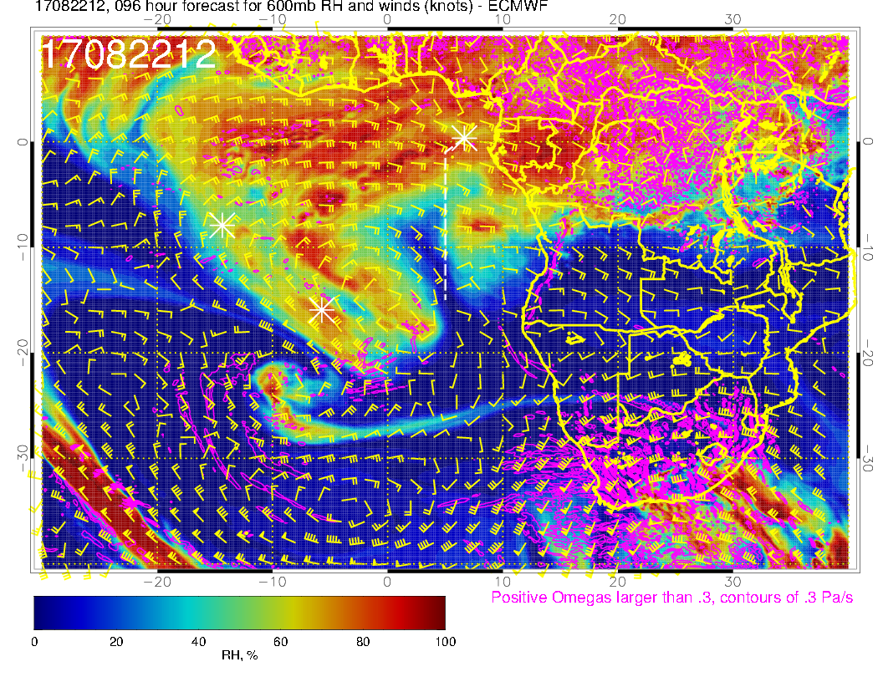
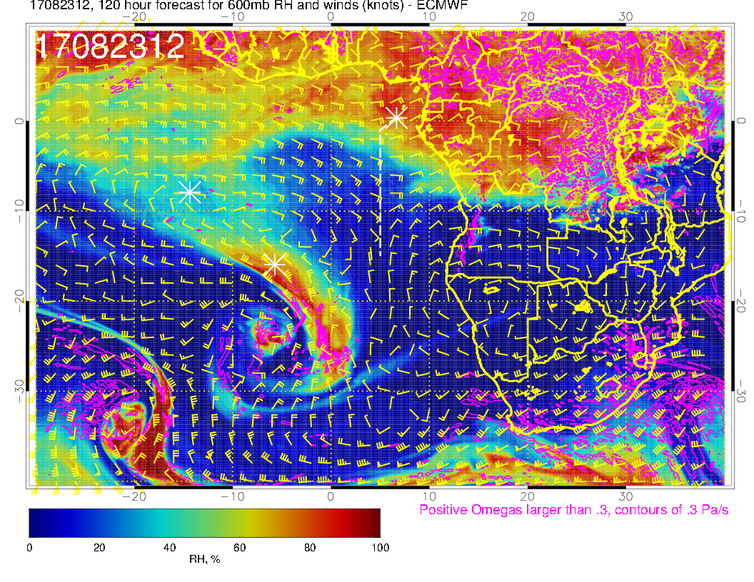
600mb Monday
600mb Tuesday
600mb
Sequence of events (daily) from Monday to Wednesday at 600mb
Moisture starts getting wrapped around into jet
Low forms along jet (good model agreement).
600mb Wednesday

Slide 18
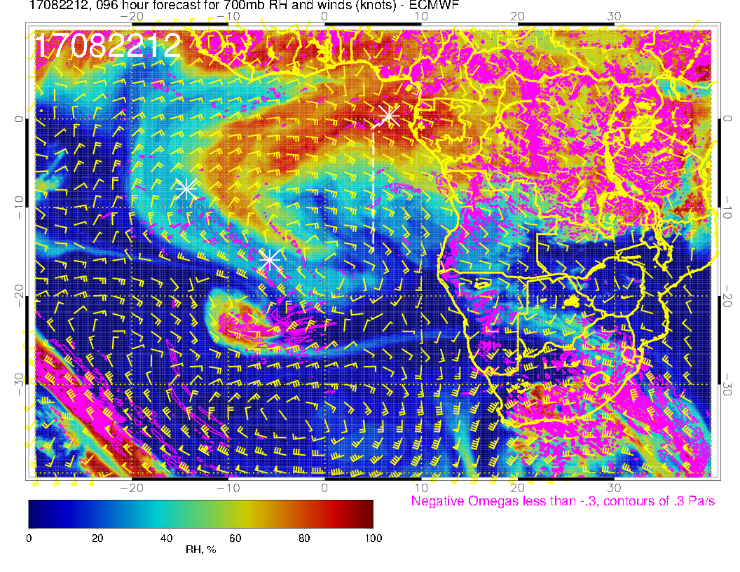
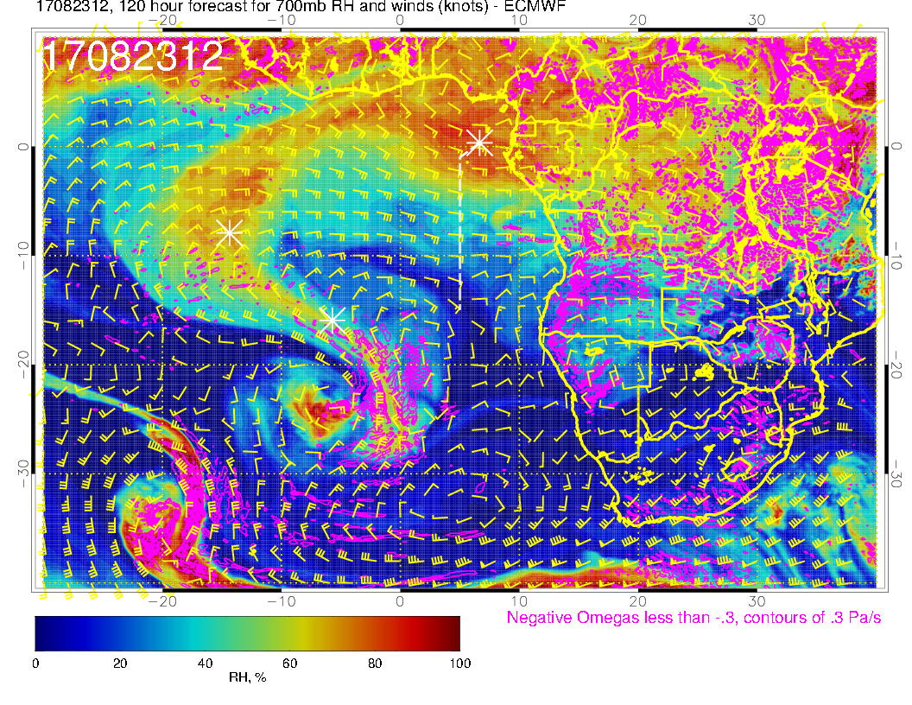
700mb Monday
700mb Tuesday
Sequence of events (daily) from Monday to Wednesday at 700mb
Much the same basic pattern as at 600mb.
Moisture plume over Ascension at 12Z on Wednesday
700mb Wednesday

Slide 19
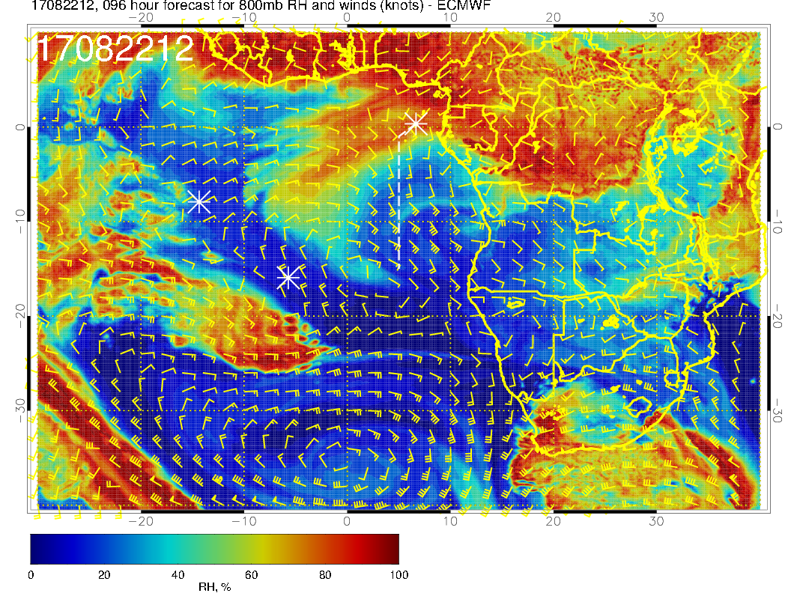
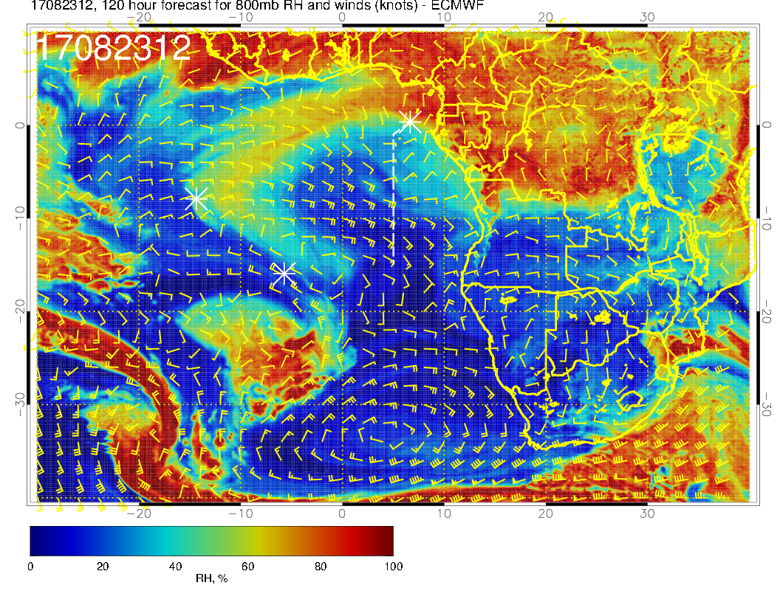
800mb Monday
800mb Tuesday
Sequence of events (daily) from Monday to Wednesday at 800mb
Advance is not as rapid.
800mb Wednesday

Slide 20
600mb
700mb
Mid levels for Wednesday. All show horizontal shearing (Stronger flow in the southern part of the moisture plume. Upper levels start getting wrapped around the lower parts of the STJ. 600mb plume has largely dissipated at ASI.
800mb

Slide 21
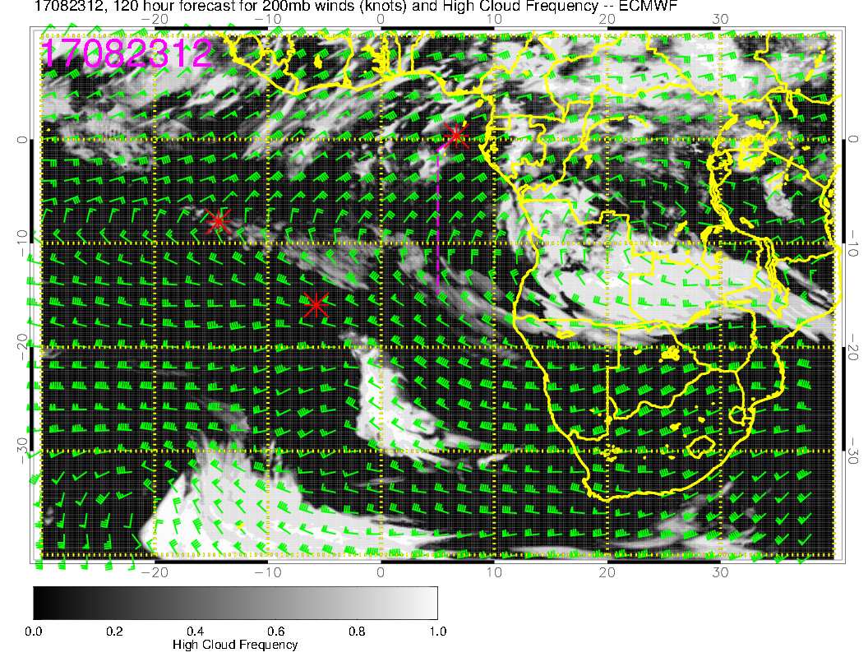
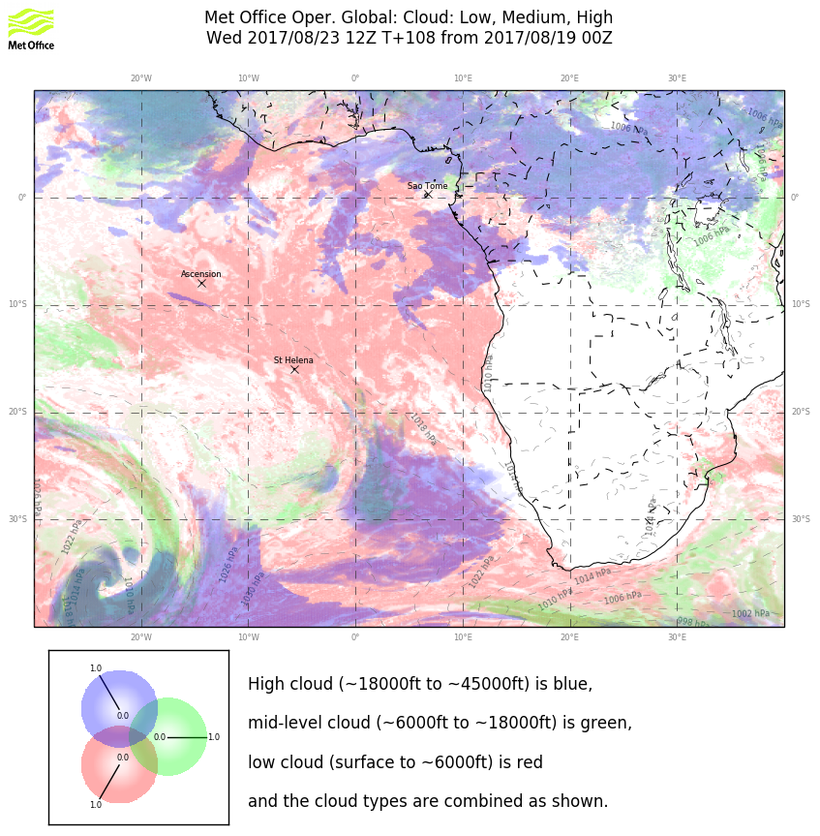
I trust the cloud north of about 3S, associated with convective outflow moisture
I don’t trust the stuff SE of Ascension, seems like it is from wraparound tropical moisture, plus a really long term forecast.
Don’t trust much except maybe the high cloud this far out, but UKMO shows very little except near Sao Tome.

Slide 22
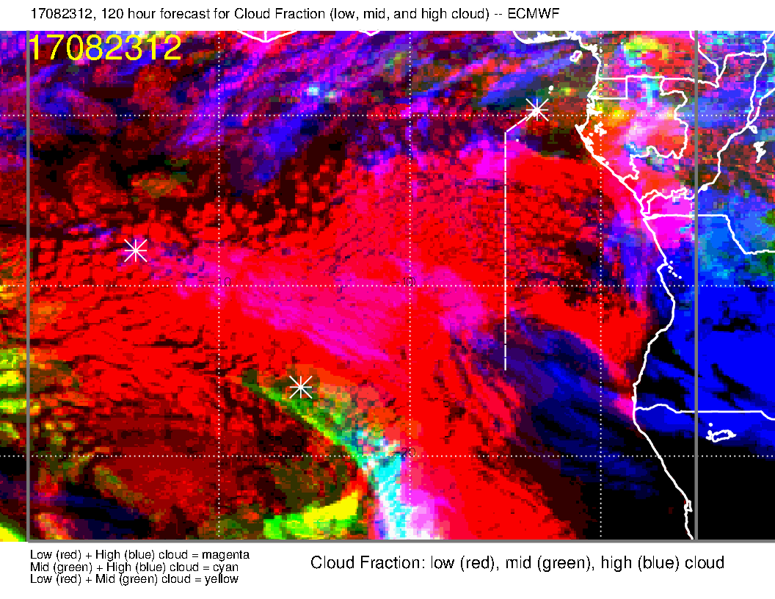
EC complete cloud forecast. No comment on low clouds, but agrees with UKMO on middle clouds

Slide 23
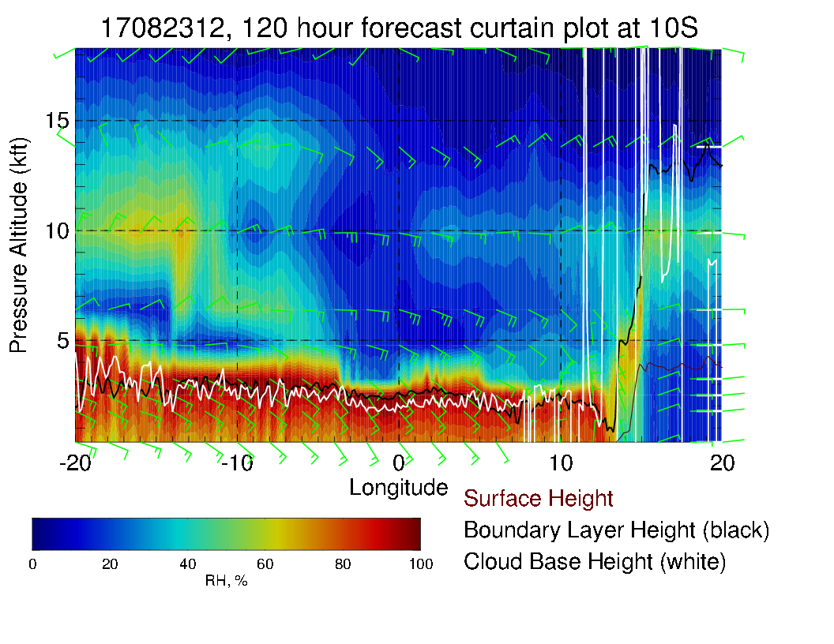
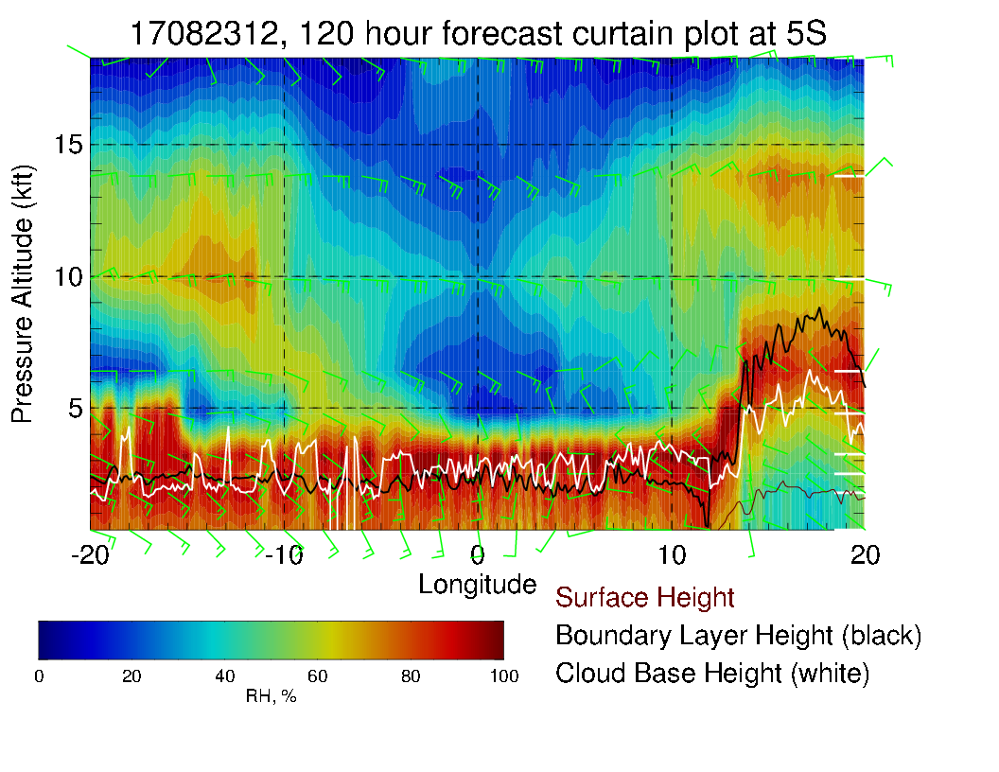
Cross sections. Can see moisture plume centered at 700mb near ASI. Slope with altitude (5S curtain) is apparent. Plume more advanced at 10S (as in previous slides).

