Slide 1
Cloud Forecast for today
Satellite image shows some “healthy” low cloud cover.
This will dissipate some during the day, as is typical
Forecasts show some thin cirrus (high cloud) south of the island in the afternoon. This is found in several forecasts.
There is no sign of this high cloud at this time.
Some of the low clouds may poke up well above 5kft.

Slide 2
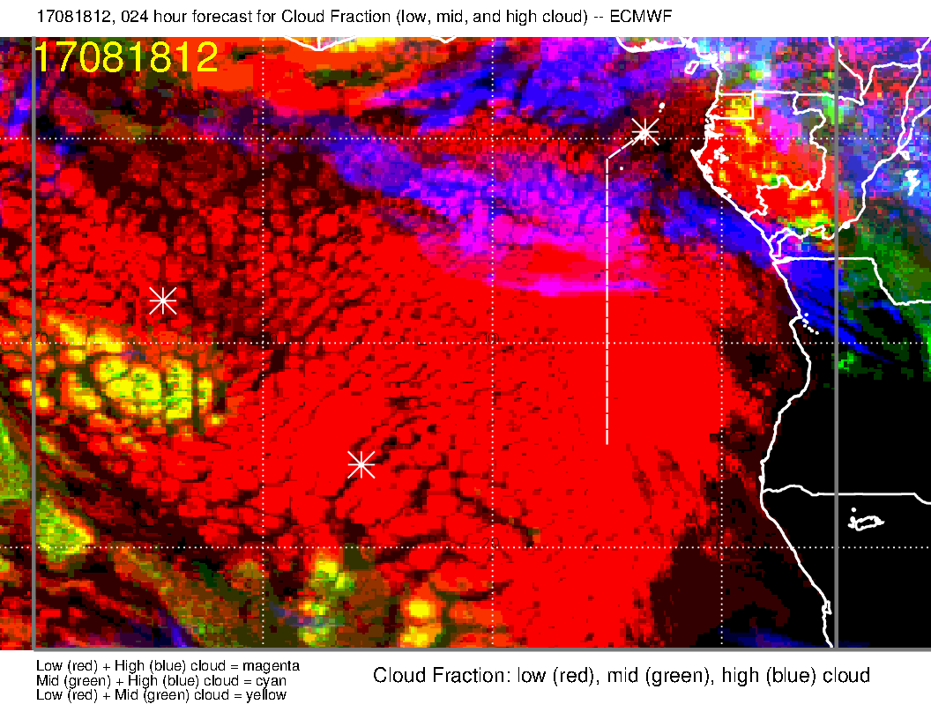
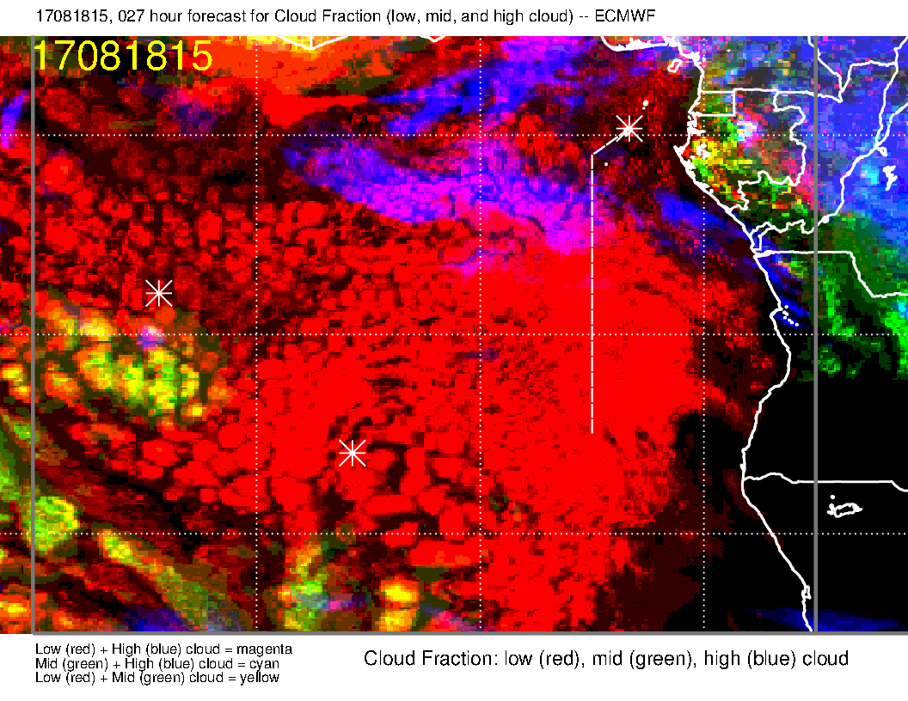
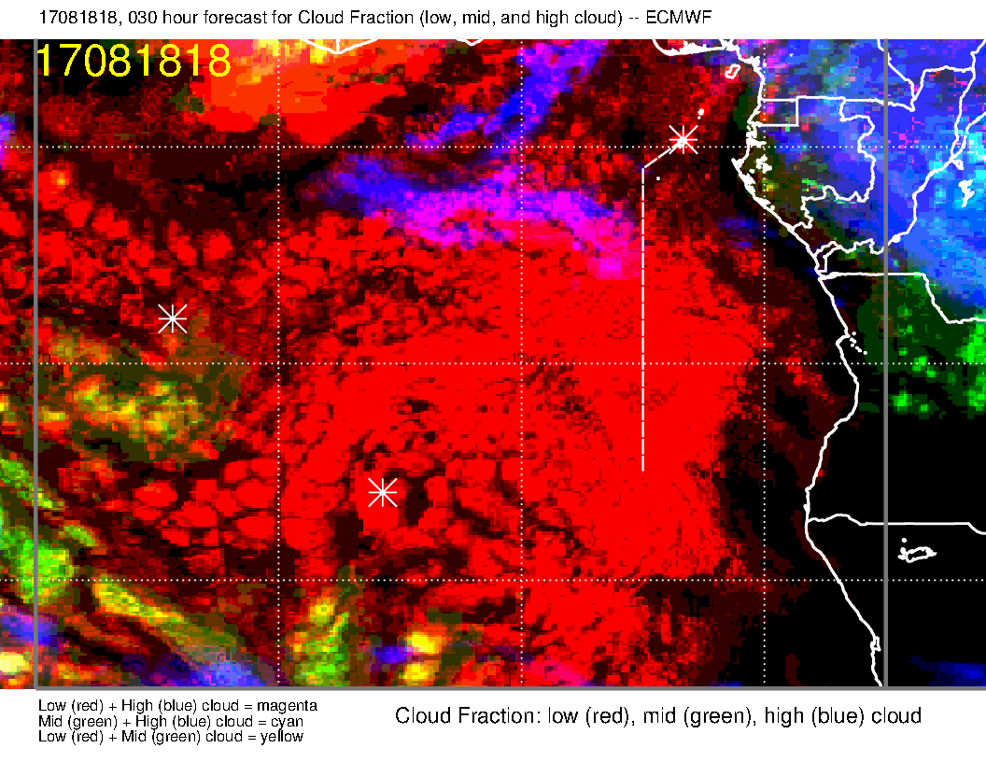
EC cloud forecast for noon, 3 PM, and 6 PM today. A blob of high cloud shows up at 3 PM. (white spot at 10S south of the island). The middle cloud are pop up cumulus penetrating into the middle cloud range (as I have discussed before).
Low cloud reducing during the day

Slide 3
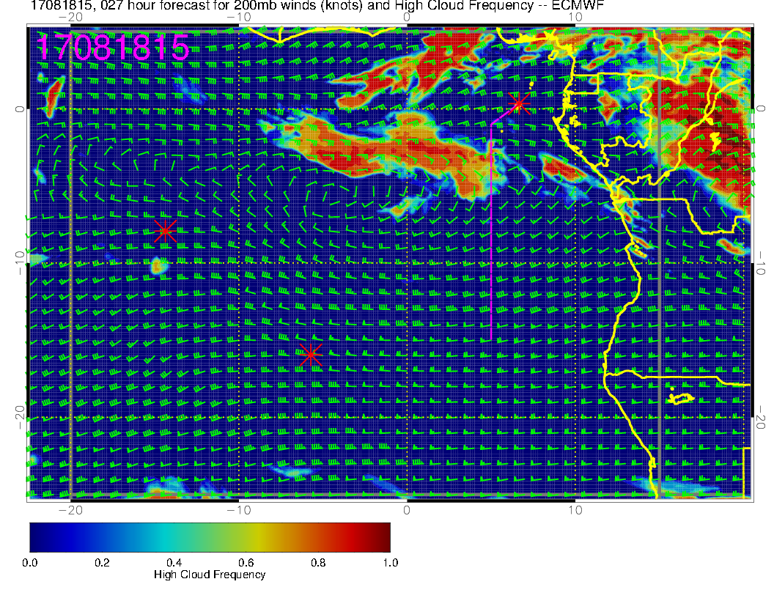
Just the high cloud, so you can clearly see what I am talking about.

Slide 4
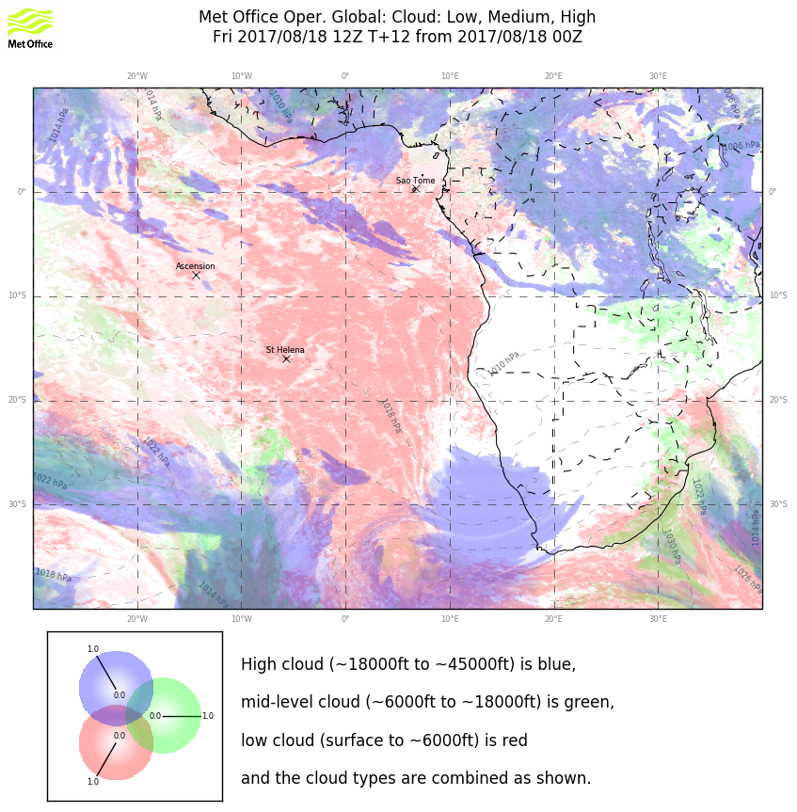
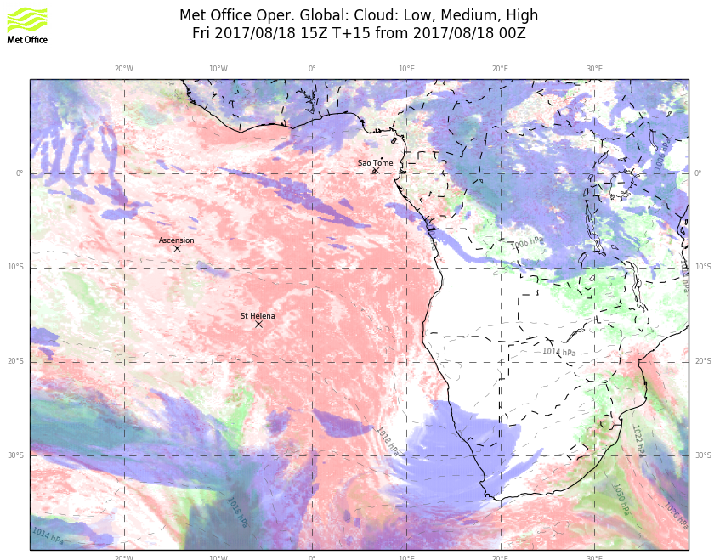
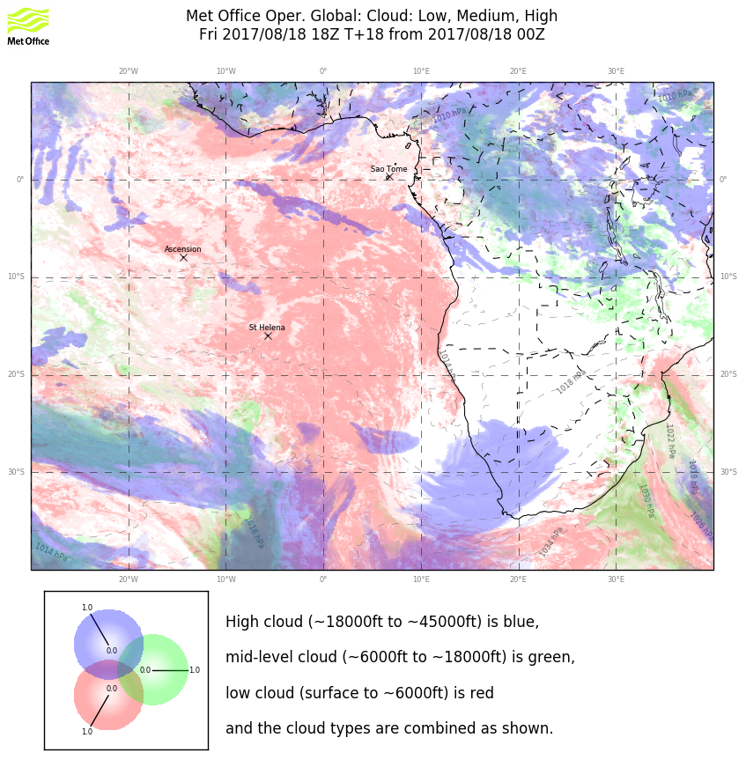
noon
3 PM
UKMO global model shows the same thing. This is associated with a midlatitude trough coupled with a tropical moisture source. Given that it is in both models, and it is a short term forecast, I believe that there will be something south of the island in the way of very thin high clouds. It won’t be widespread. The 4 km UKMO does NOT show this high cloud feature, nor does the GFS. The GMAO (a habitual overpredictor) has a large mass starting just southeast of the island, and extending southeastward starting at 3 PM.
6 PM

Slide 5
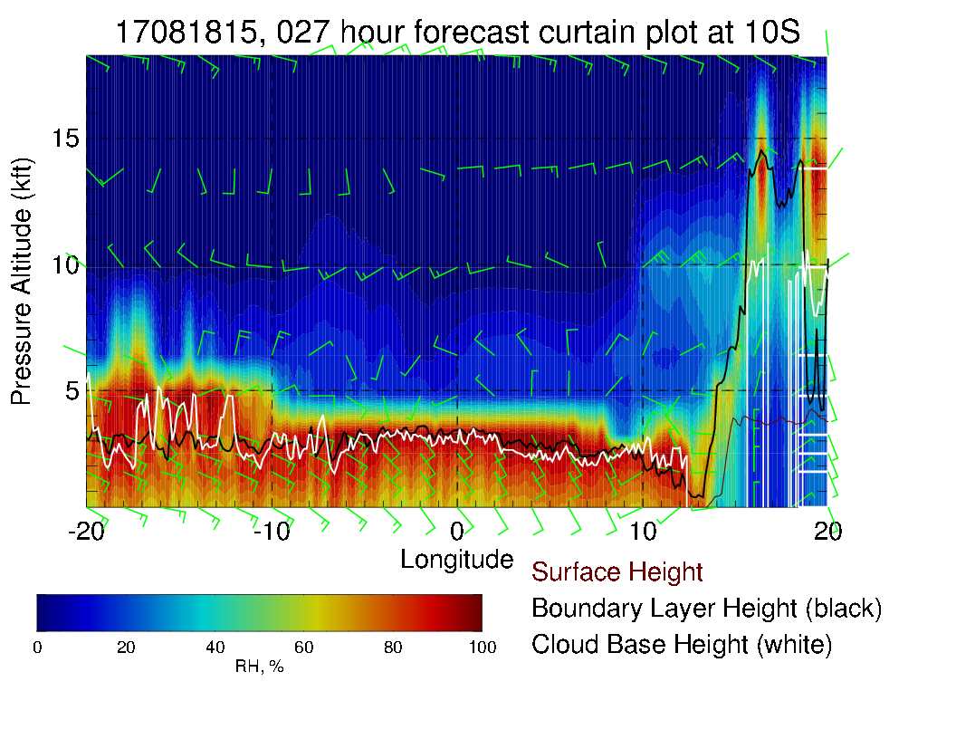
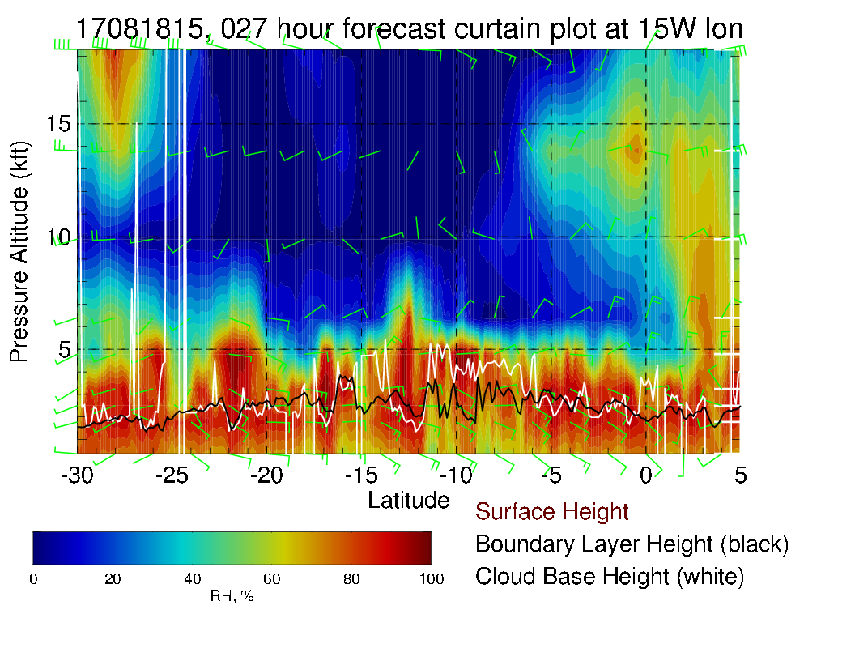
Cross sections at 10S (above) and 15W (right). Local flight so concentrate on near ASI (red line).

Slide 6
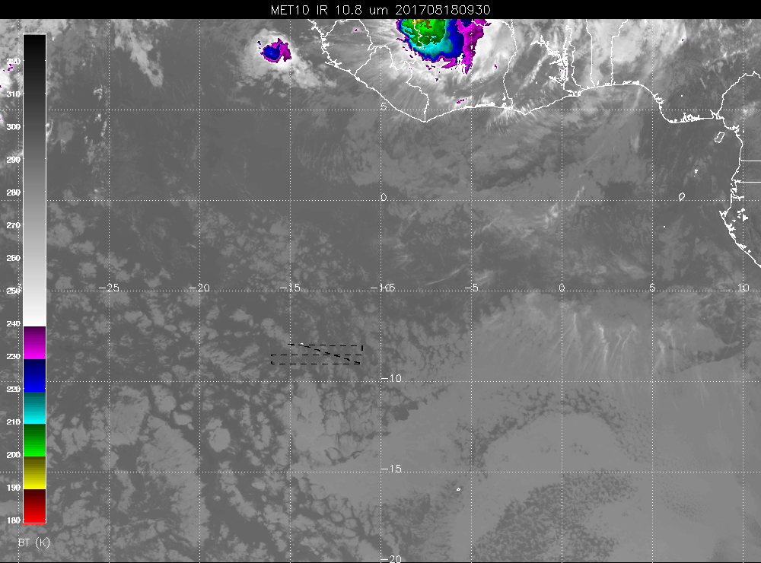

Slide 7
