Slide 1
ORACLES weather briefing for Friday and Monday
18-Aug-2017
Lenny Pfister and Rei Ueyama

Slide 2
How did the forecasts do on 8/17?
Cloud distribution
Low cloud altitudes

Slide 3
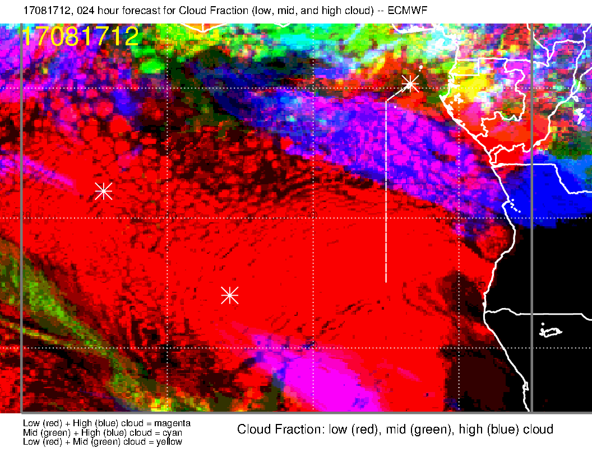
Noon GMT, 8/17
24 hour forecast compared to enhanced satellite image. Remarkably good, indicates that these forecasts can be a really good guide on the morning of the flight for high clouds, especially if we are dealing with direct transport of moisture from the convective region. Note that fcst does not capture it all.

Slide 4
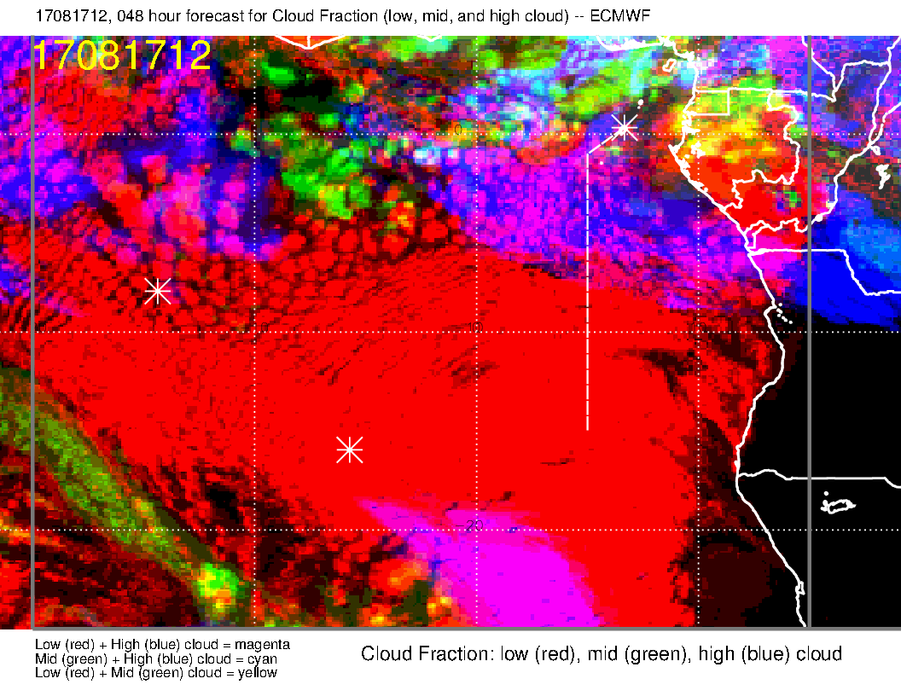
Noon GMT, 8/17
48 hour high cloud in this situation is very consistent pretty much everywhere. Middle cloud is exaggerated in the tropics.

Slide 5
Noon GMT, 8/17
Comparison with UKMO 24 hour forecast. Captures more of the thin cloud west of the prime meridian. UKMO separates what is probably one cloud into two

Slide 6
Noon GMT, 8/17
Comparison with UKMO 48 hour forecast. Does not capture the basic shape of the high cloud pattern as well as EC 48 hour. Captures more of the thin cloud west of the prime meridian. UKMO separates what is probably one cloud into two

Slide 7
Noon GMT, 8/17
Comparison with UKMO 24 hour forecast, 4 km UKMO model. In this case, the least capable of the models.

Slide 8
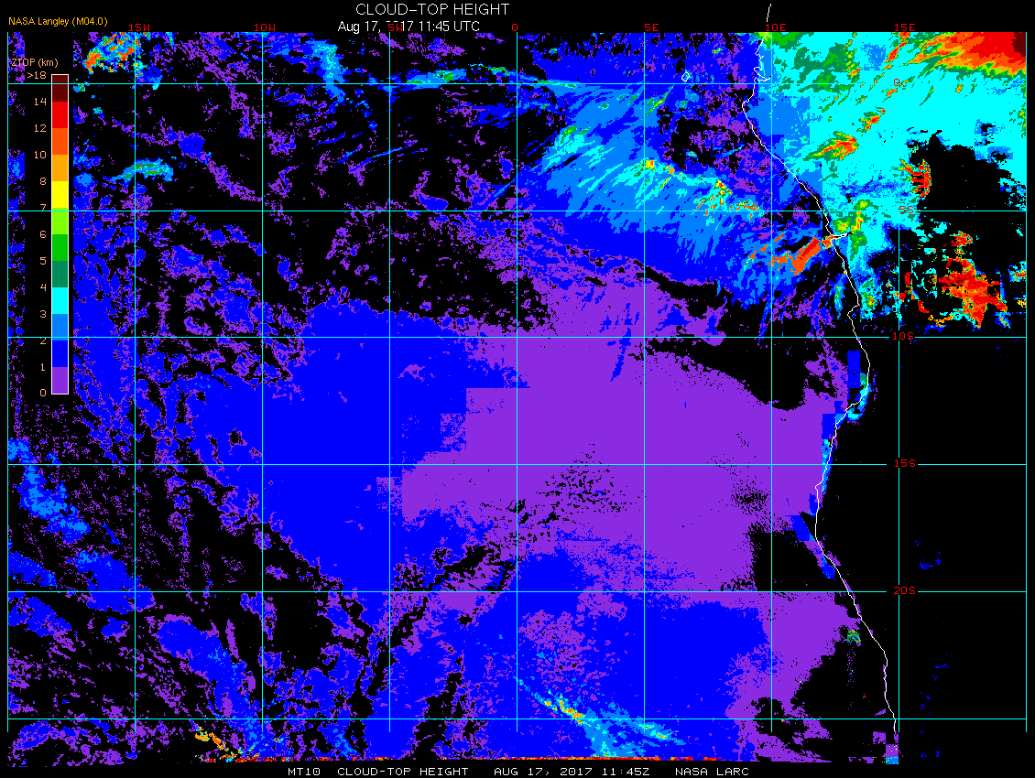
Noon GMT, 8/17
Cloud top altitudes are probably at least 14 km. Based on the upstream convection, likely to be higher. I think it is hard for IR methods to capture altitudes of these thin clouds.

Slide 9
Noon GMT, 8/17
Looking at the low clouds at noon. With some imagination, there is some agreement. Disagreement is more than just an underestimate of the cloud clearing.

Slide 10
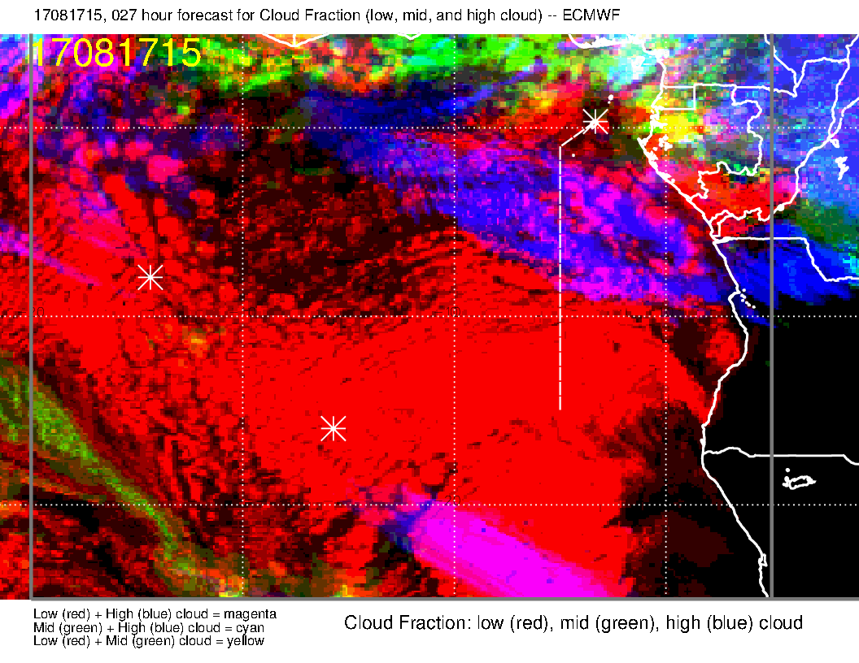
3 PM GMT, 8/17
Looking at the low clouds at 3 PM. Perhaps this basic structure is captured, but low cloud near ASI is substantially overestmated.

Slide 11
A brief look at low cloud altitude

Slide 12
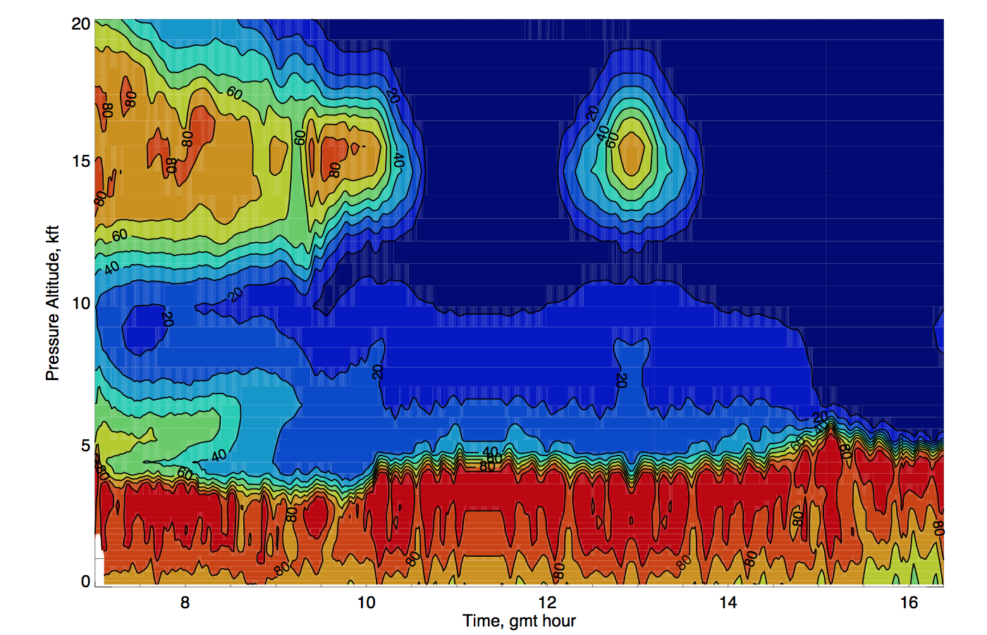
HSRL (left) and model level forecast (24 hour, below) for cloud top. HSRL shows 6-7 kft, model is less than 5 kft for cloud tops (RH gradient).

Slide 13
Cloud Forecast for today
Satellite image shows some “healthy” low cloud cover.
This will dissipate some during the day, as is typical
Forecasts show some thin cirrus (high cloud) south of the island in the afternoon. This is found in several forecasts.
There is no sign of this high cloud at this time.
Some of the low clouds may poke up well above 5kft.

Slide 14
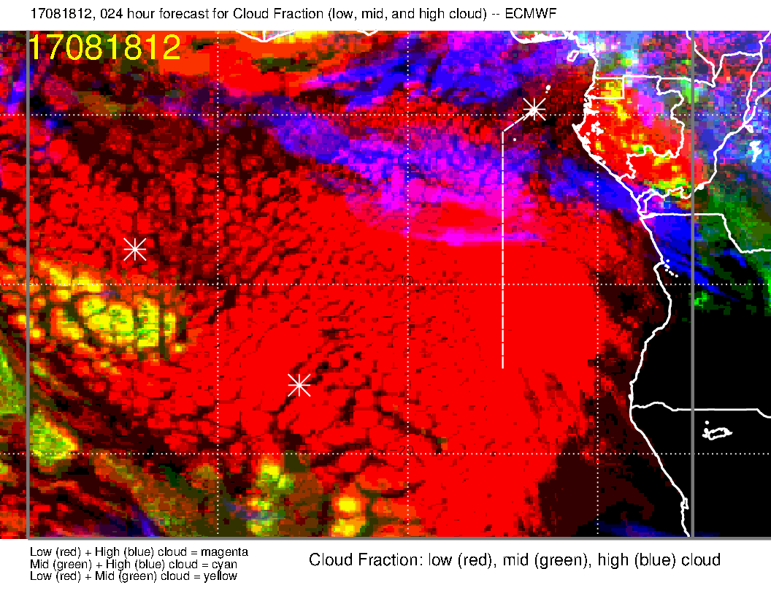
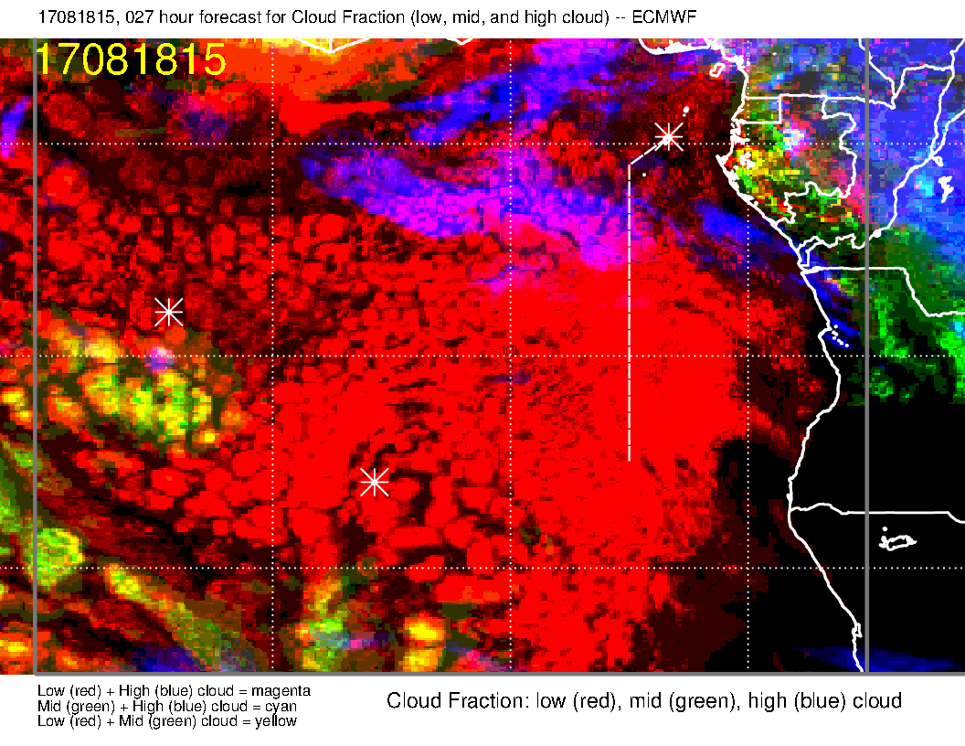
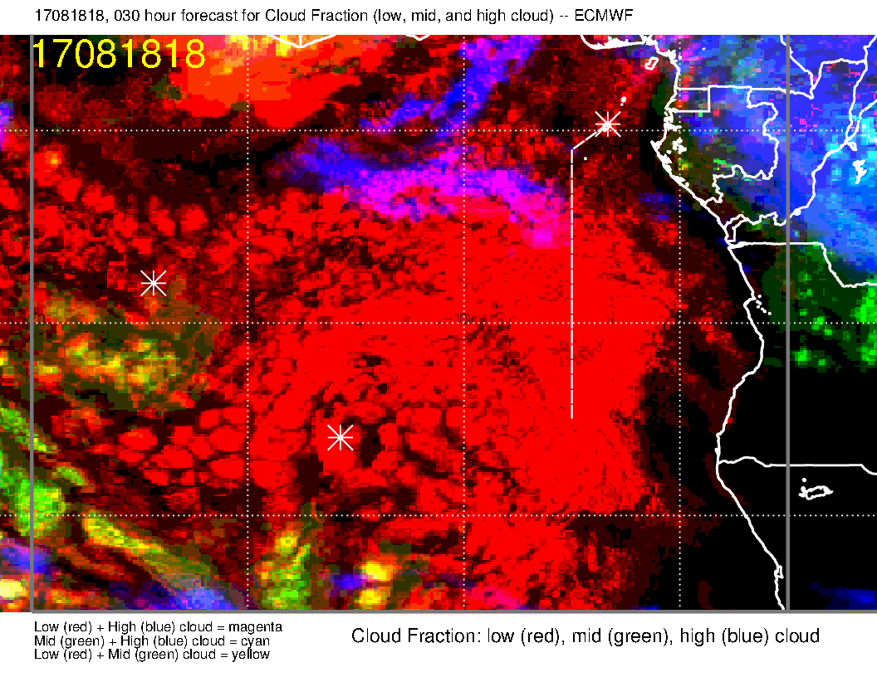
EC cloud forecast for noon, 3 PM, and 6 PM today. A blob of high cloud shows up at 3 PM. (white spot at 10S south of the island). The middle cloud are pop up cumulus penetrating into the middle cloud range (as I have discussed before).
Low cloud reducing during the day

Slide 15
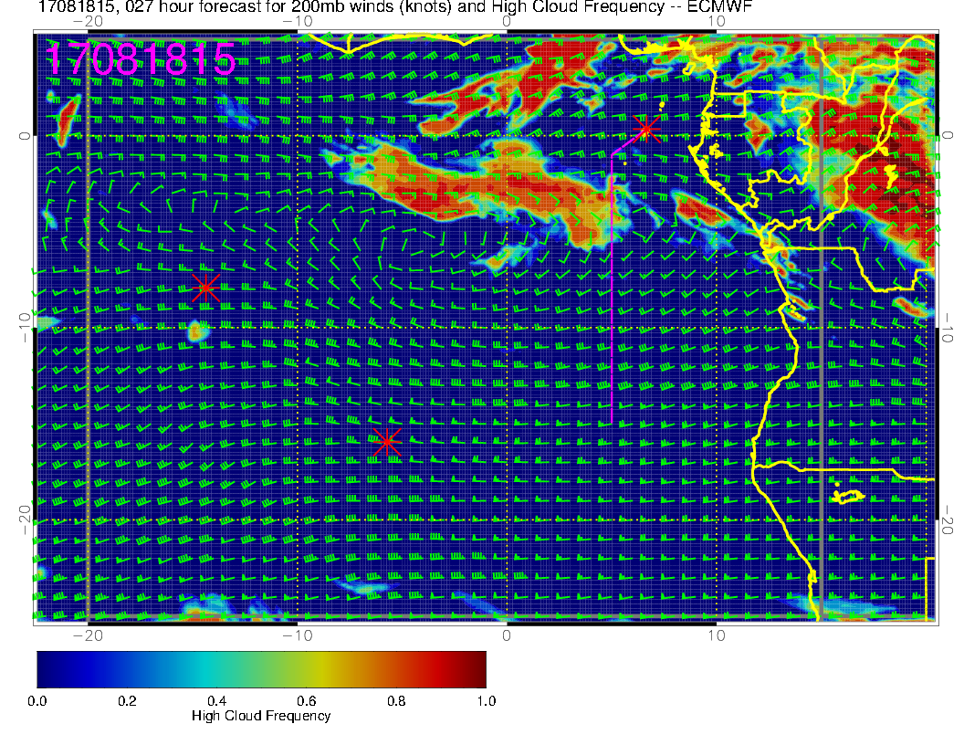
Just the high cloud, so you can clearly see what I am talking about.

Slide 16
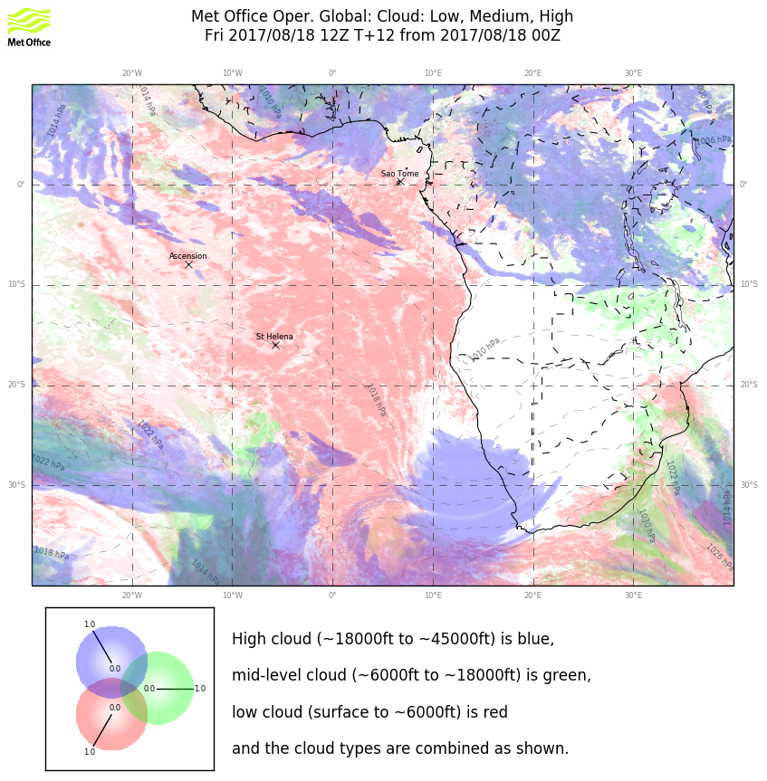
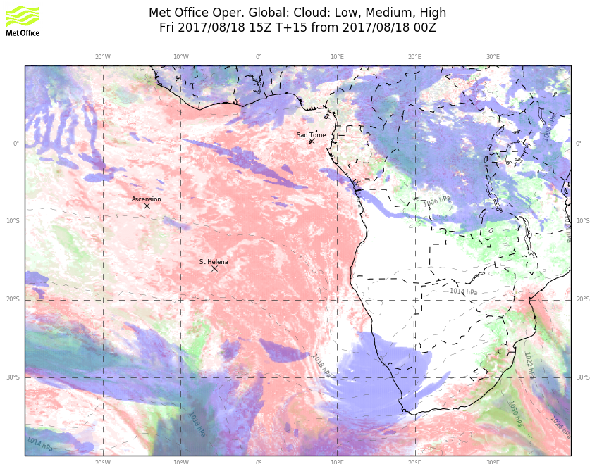
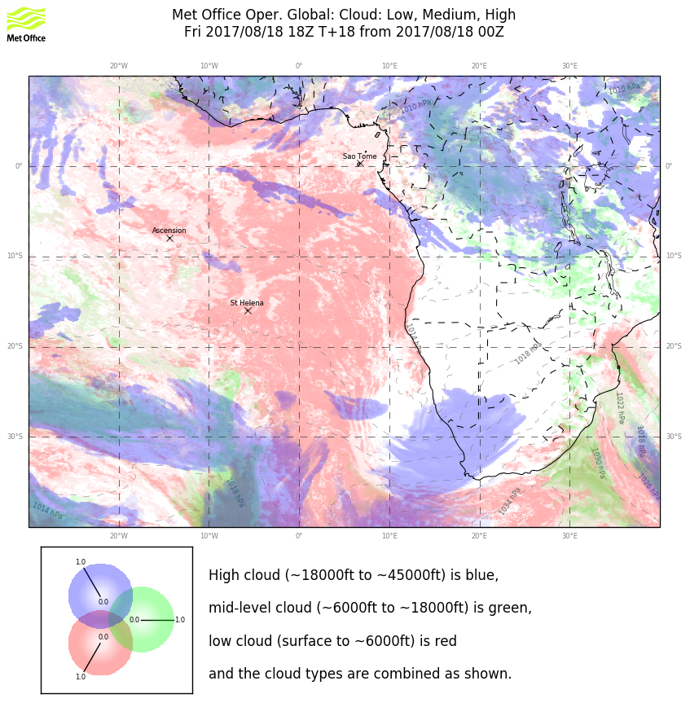
noon
3 PM
UKMO global model shows the same thing. This is associated with a midlatitude trough coupled with a tropical moisture source. Given that it is in both models, and it is a short term forecast, I believe that there will be something south of the island in the way of very thin high clouds. It won’t be everywhere. The 4 km UKMO does NOT show this high cloud feature, nor does the GFS. The GMAO (a habitual overpredictor) has a large mass starting just southeast of the island, and extending southeastward starting at 3 PM.
6 PM

Slide 17
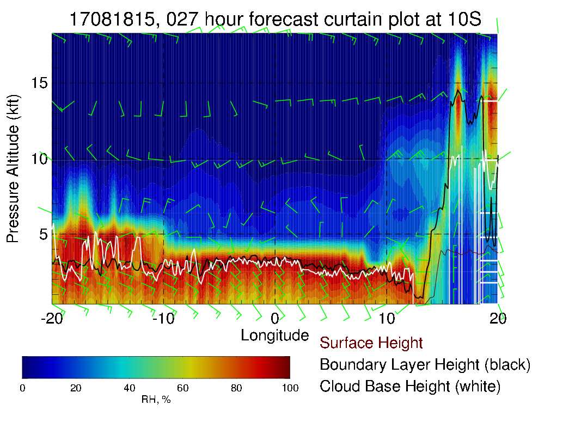
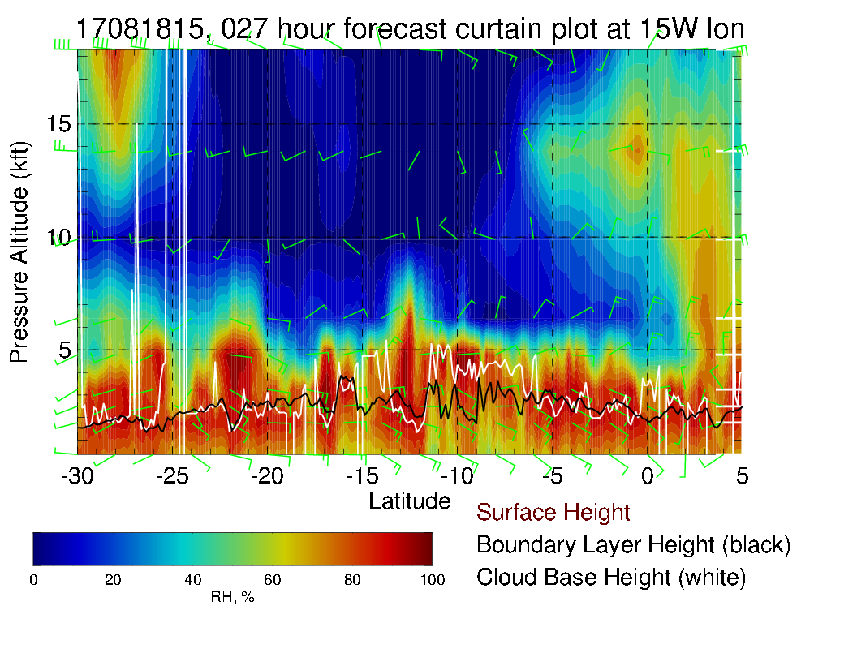
Cross sections at 10S (above) and 15W (right). Local flight so concentrate on near ASI (red line).

Slide 18
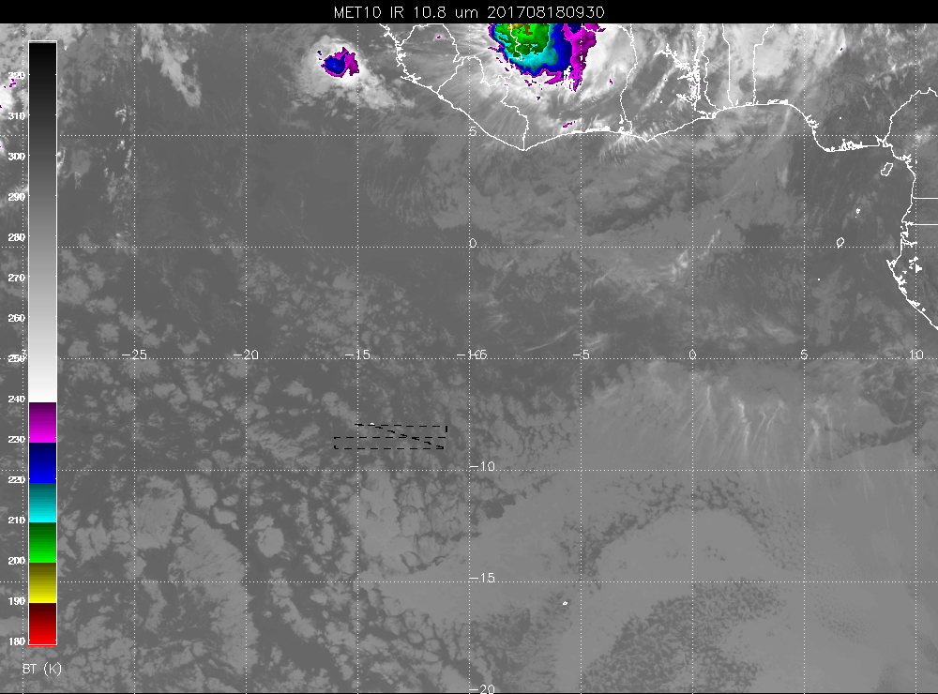

Slide 19
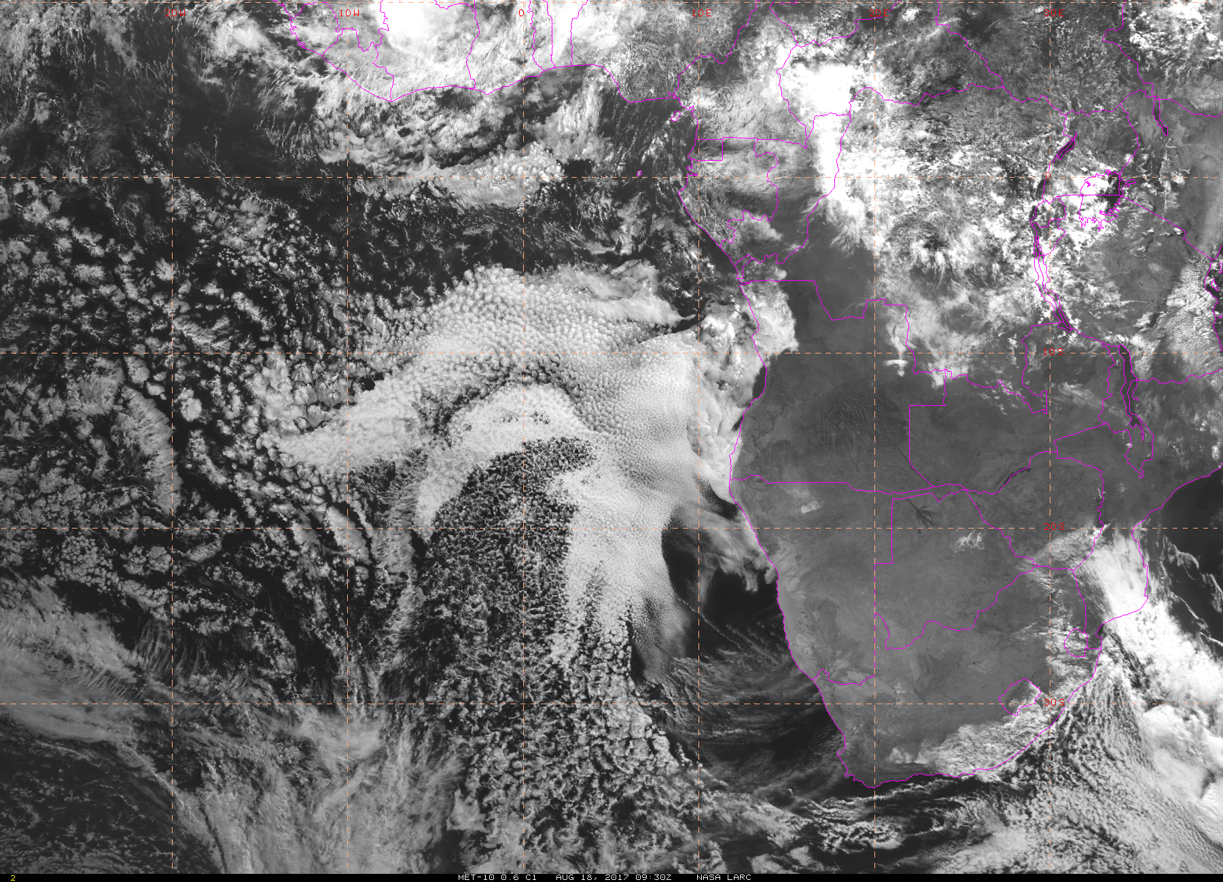

Slide 20
Monday
Expect a good chance of extensive high cloud cover over routine track
This is due to enhanced convection forecast near the shore – this is in both UKMO and EC models.
200mb flow brings moisture from convective output over routine track.
Mid levels show continued decisive offshore quasi zonal flow with high RH north of 7S

Slide 21
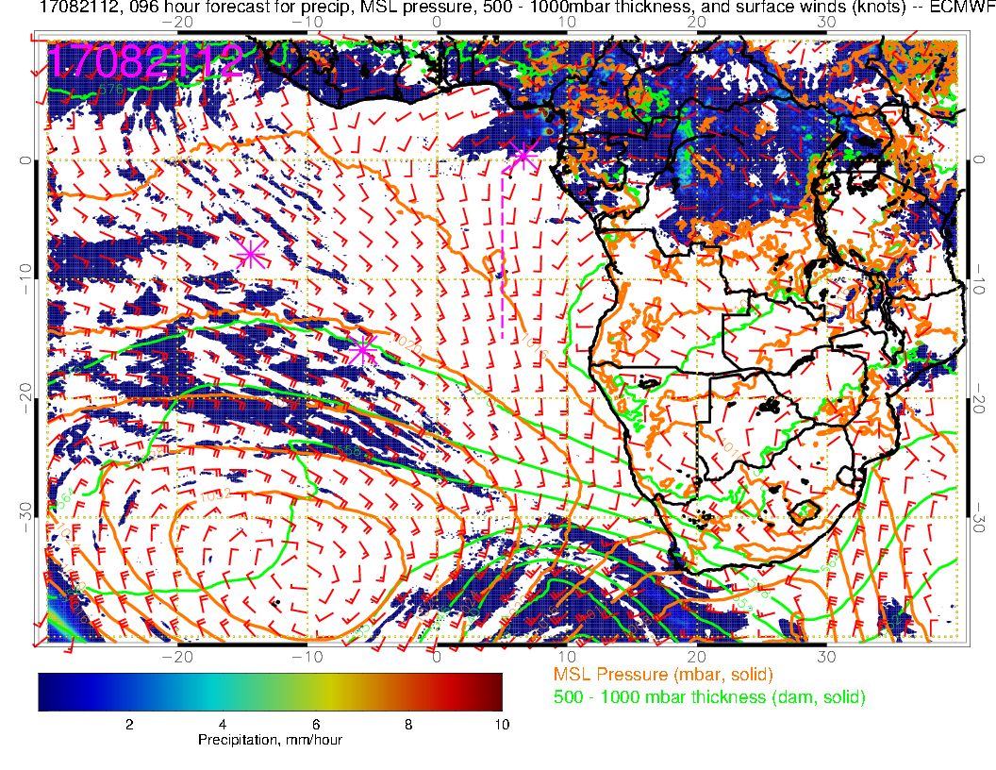
H
Saint Helena High reestablishing itself, is west of climo position. Note anomalous eastward “bending” of flow north of Sao Tome, probably into modeled convection. UKMO has similar wind pattern and precip off the Cameroon/Gabon coast.

Slide 22
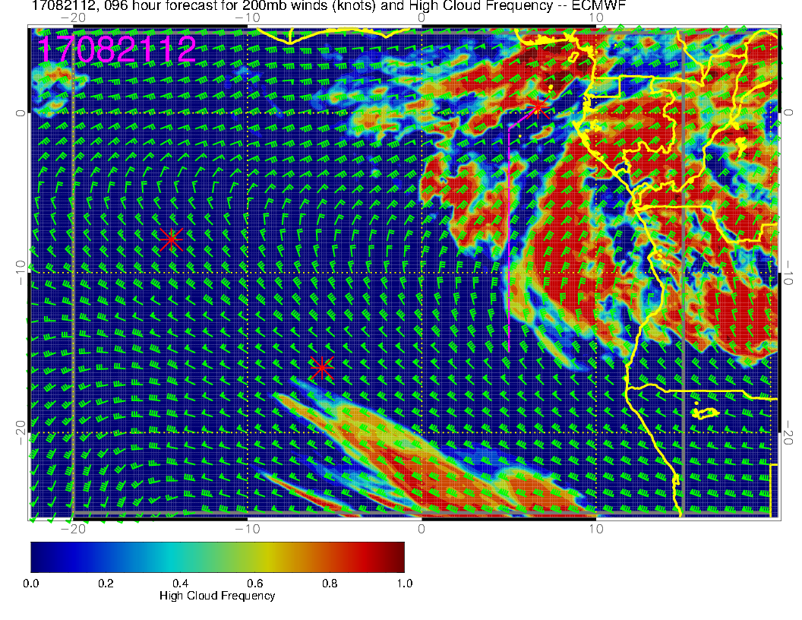
Northeasterly flow at 200mb (outflow level or slightly below). Lots of high cloud. A bit far out and depends on forecast precip, but expect enhanced high cloud on this date.

Slide 23
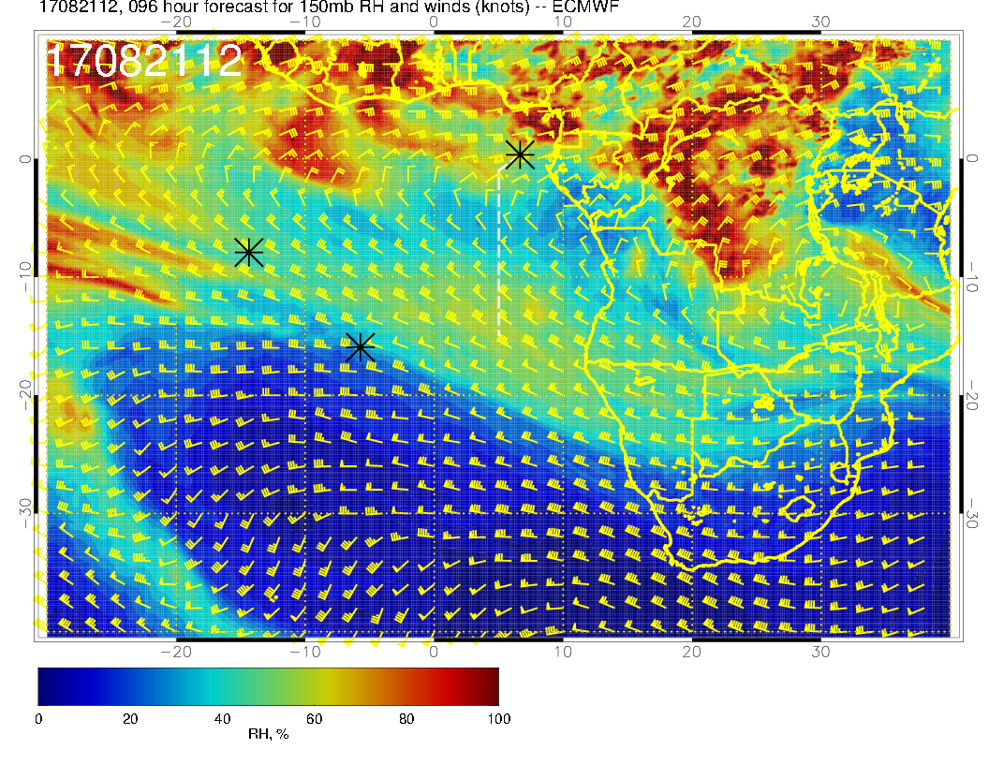
Note that the flow at 150mb (near top of main outflow layer) is more easterly, so drier at that level. Expect the high clouds at about 40kft or so based

Slide 24
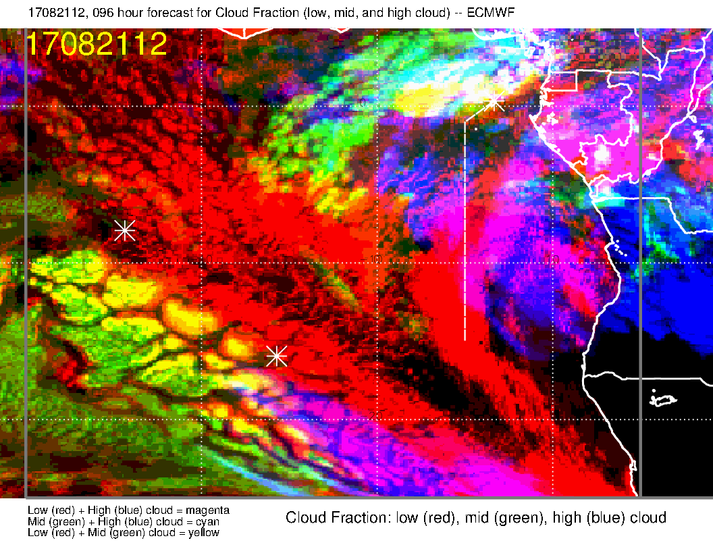
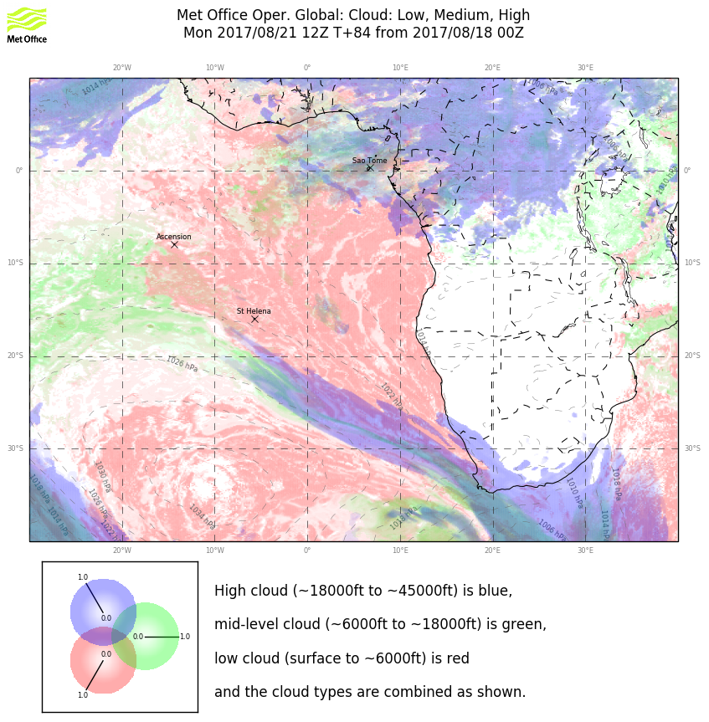
Overall cloud pattern on Monday – model comparison. Agreement on middle cloud. My judgment is that the UKMO is underpredicting the high cloud. Not sure why – flow patterns are similar. GMAO (an overpredictor) has even more high clouds than EC.

Slide 25
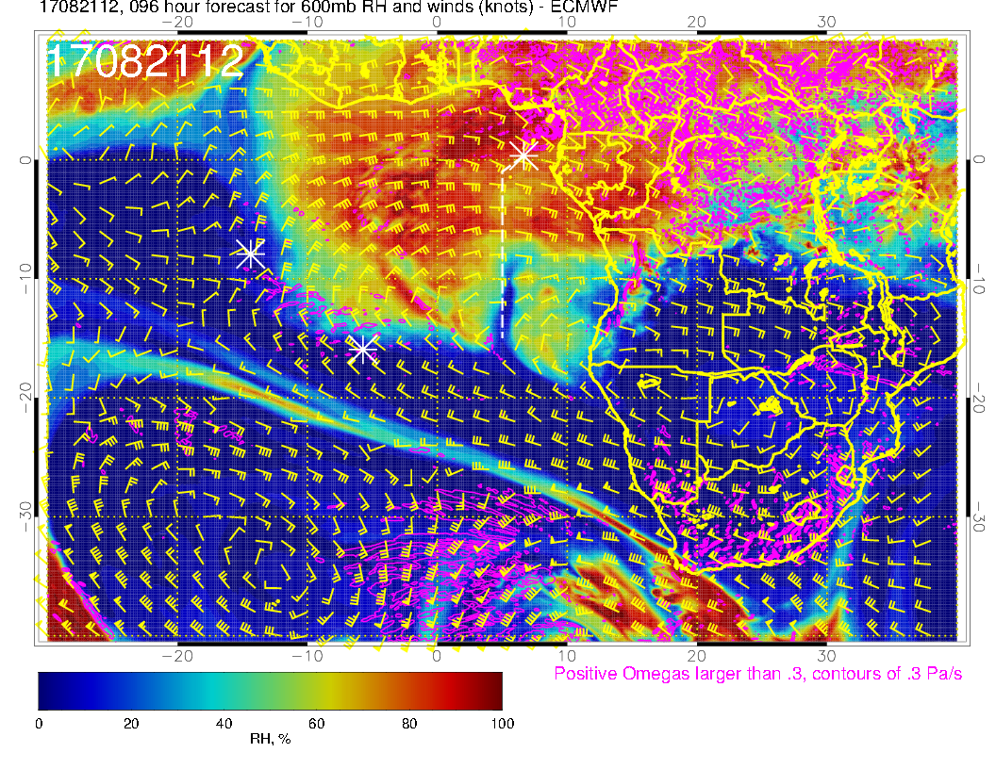
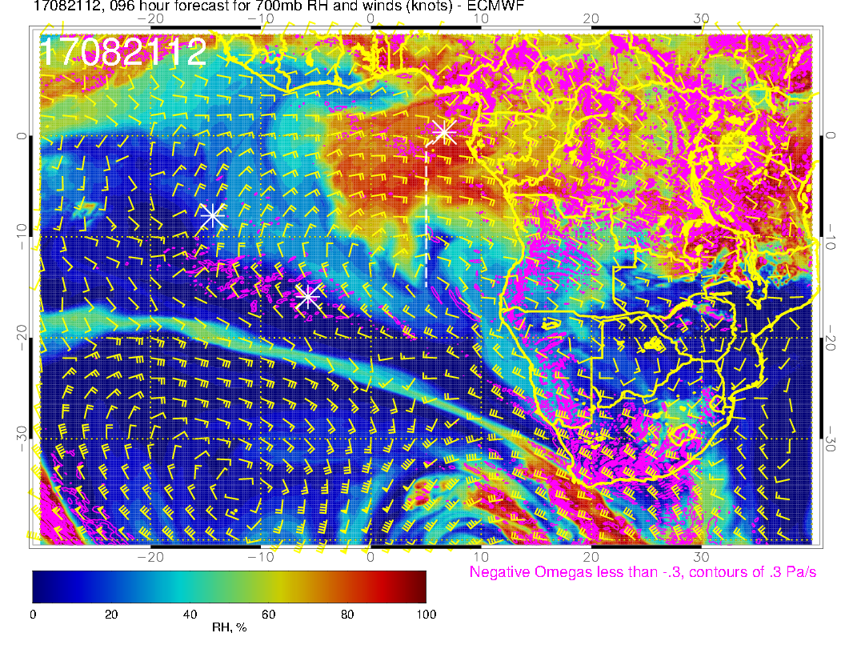
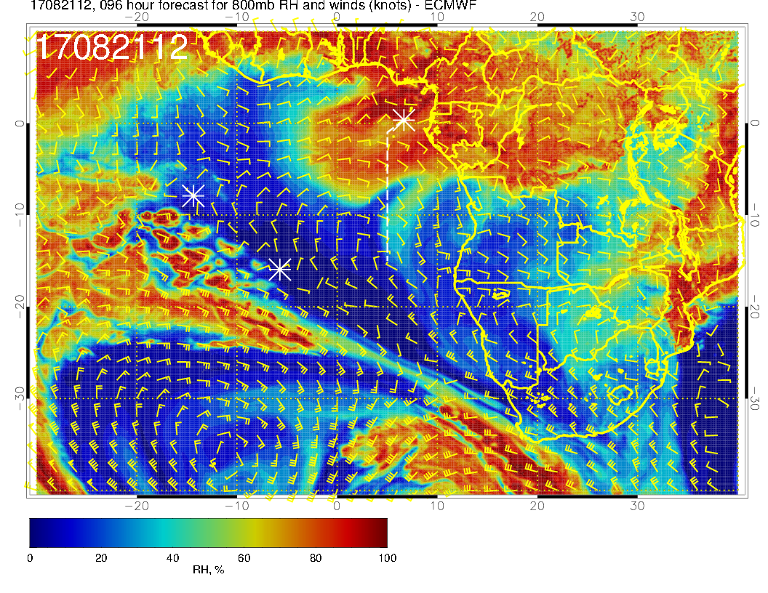
600mb
700mb
A decisive surge of moisture is coming off the coast. Will capture this in the northern part of our routine track.
800mb

