Slide 1
ORACLES weather briefing (cloud forecast on Sat 8/19)
18-Aug-2017
Lenny Pfister and Rei Ueyama

Slide 2
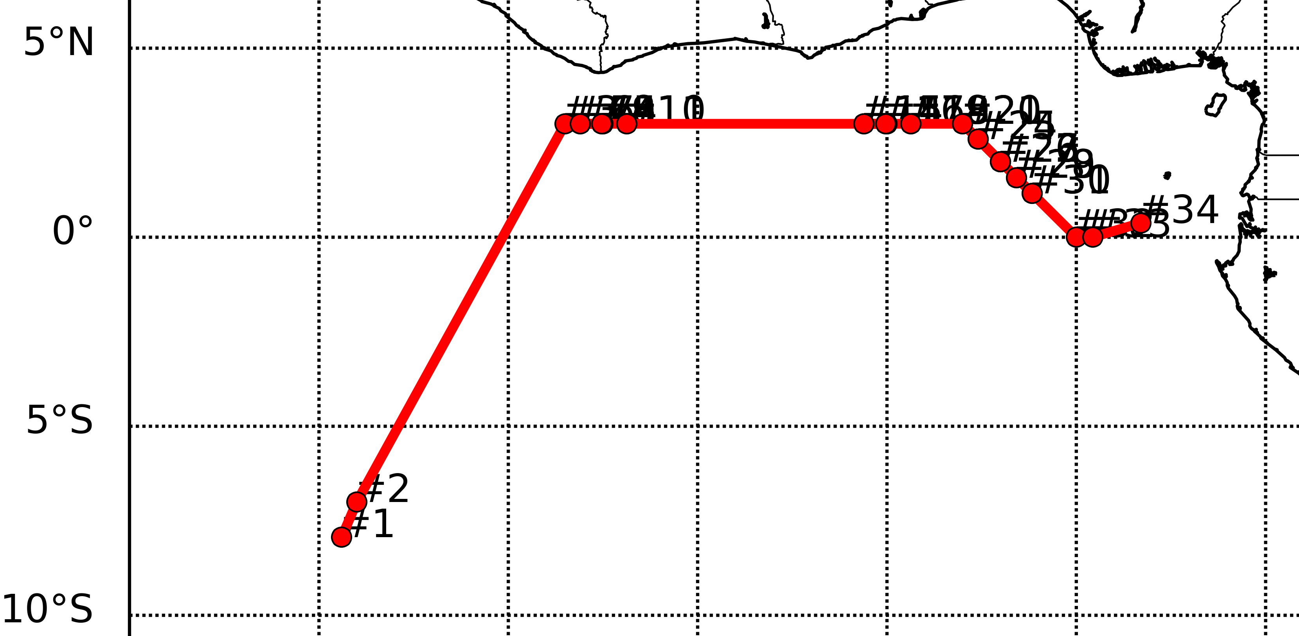
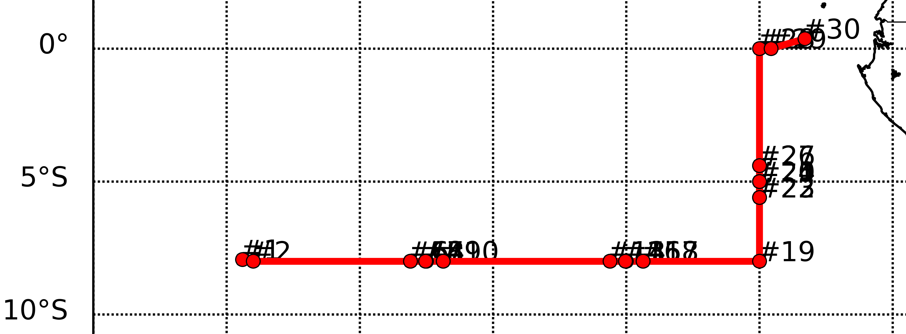
Saturday 8/19
North track
West end of 3N flight leg: Mid clouds mostly west of 10W and north of 3N, but there may be a few occurrences around the equator on our track
East end of 3N flight leg: High clouds east of prime meridian between 2N-1S [but there is model disagreement and forecast-to-forecast variability]
Scattered to broken low clouds along 3N; least amount of clouds along the 0-1S latitudinal band
Cloud top heights decrease along 3N
~8W: 5-8000 ft
~3W: 3-5000 ft
~2E: 2-4000 ft and some high clouds
South track
Scattered to broken clouds along 8S with tops decreasing from 14W (~4000 ft) to 5E (to ~3000 ft)
Tailwinds of 5-15 knots at 10 kft from ASI to prime meridian; headwinds of 5-15 knots at 15 kft east of 8W
Moist air at 600mb (~15 kft) over TMS extending south to about 5S – expect high clouds along the track north of~1-2S
Low cloud clearing south of TMS to ~6-7S; most dense low clouds south of ~7-8S

Slide 3
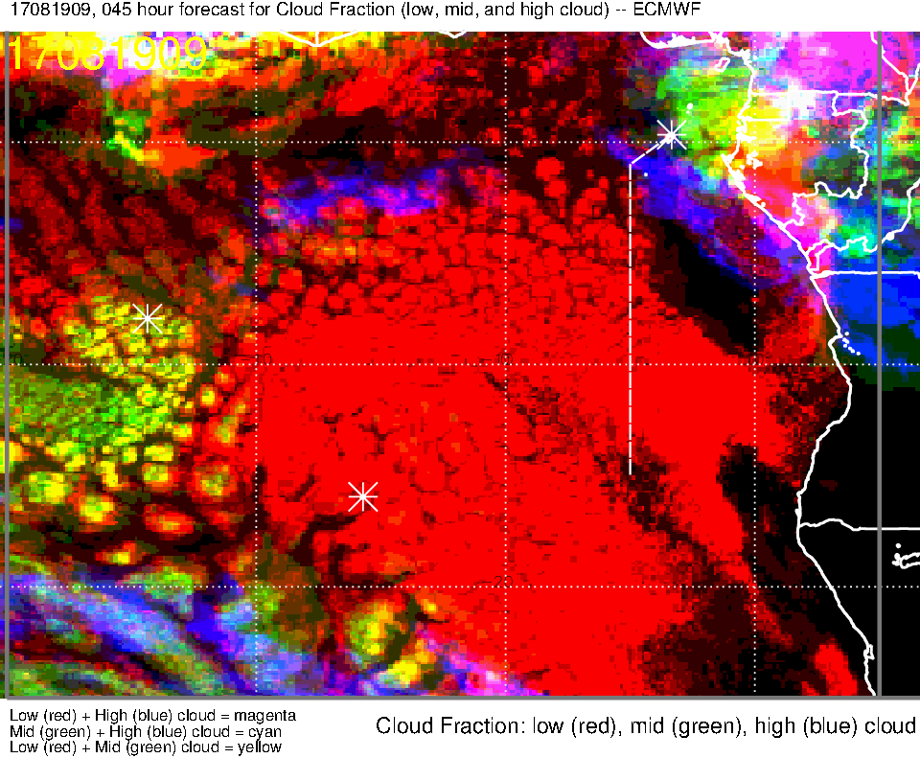
Low, middle, high cloud (45-hr) forecast for 8/19 Sat @ 9AM
thin high cloud streamer at 3N, 4W in UKMO
High clouds (blue, magenta):
10W-2W, 1S-4S
[UKMO also shows these streamers but places them further east, 5W-0]
Near TMS
Mid clouds (green, yellow):
Mostly to the east and north of our flight track [also in UKMO], but some seen along our track from the equator to 3N [NOT in UKMO]

Slide 4
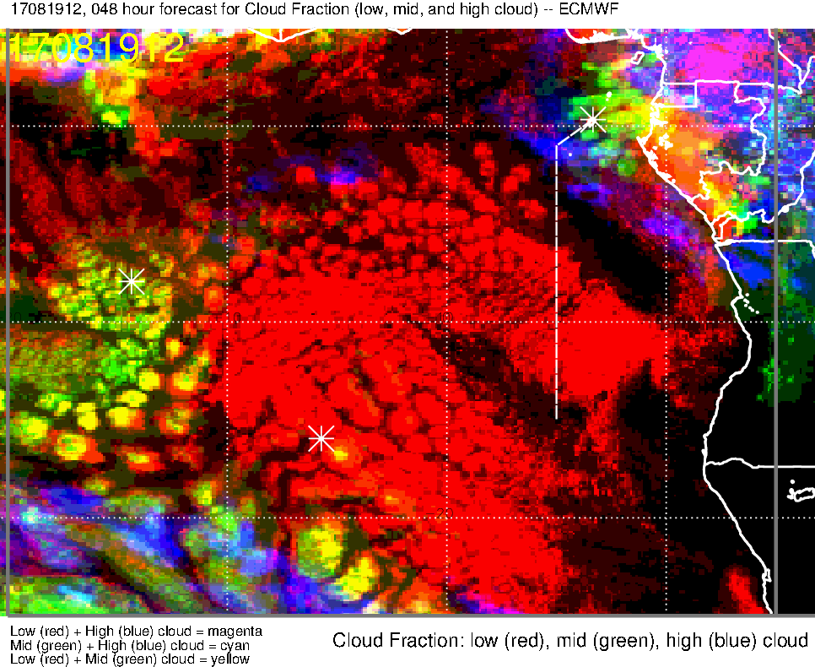
Low, middle, high cloud (48-hr) forecast for 8/19 Sat @ 12PM
Very thin high cloud streamer at 3N, 4W in UKMO
High clouds move NW to ~2E [~4E in UKMO]
Mid clouds have moved NW and mostly dissipated over our track (north of our track)
[also in UKMO]
High cloud streamers are stationary and dissipate – should not be a problem north of 1S

Slide 5
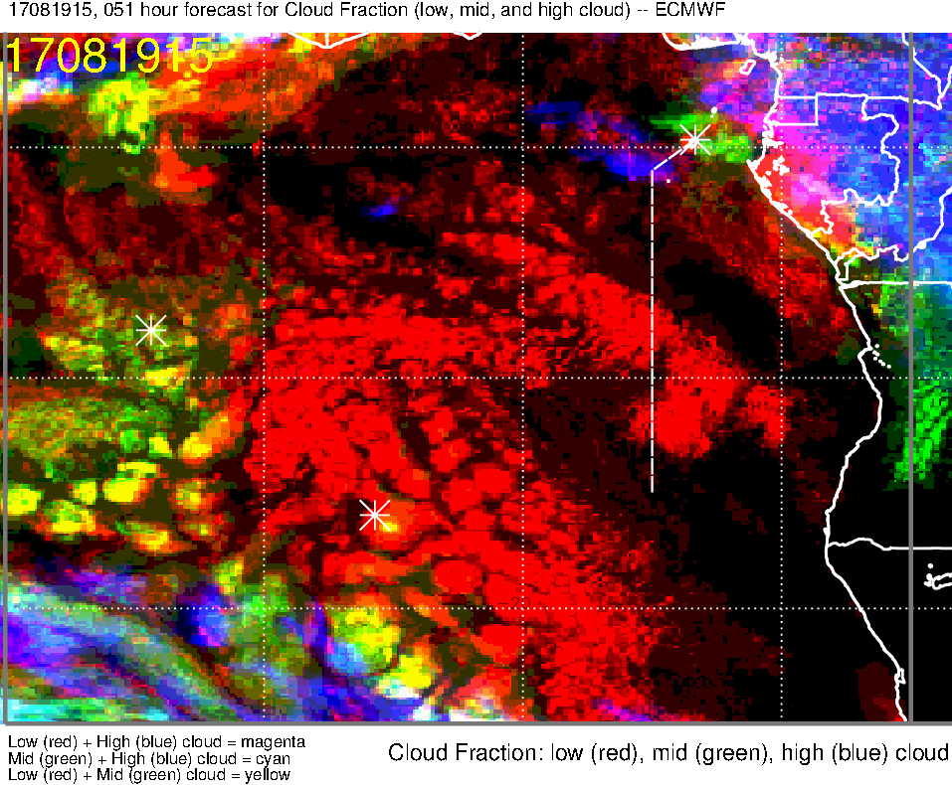
Low, middle, high cloud (51-hr) forecast for 8/19 Sat @ 3PM
High clouds move NW to prime meridian [still at ~4E in UKMO]
Mid clouds (green, yellow) mainly over TMS

Slide 6
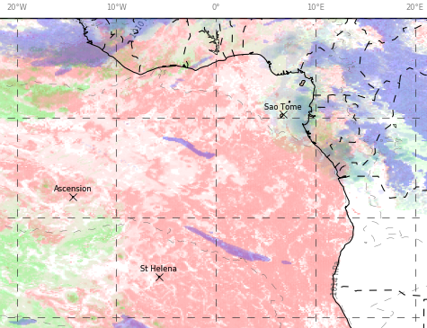
Low, middle, high cloud forecast for 8/19 Sat @ 12PM
UKMO (42-hr)
ECMWF (48-hr)
High clouds
High clouds
N track
Scattered low clouds throughout track (less dense along 0-1S band)
mid clouds may be an issue on our track around the equator (but mainly to the west and north of track)
High cloud streamers absent 3N-1S
High clouds possible east of ~0-2E towards TMS
S track
Scattered to broken low clouds along 8S and southern portion (7-8S) of 5E leg
Low cloud clearing south of TMS (to ~6-7S)
mid to high clouds north of ~1-2S

Slide 7
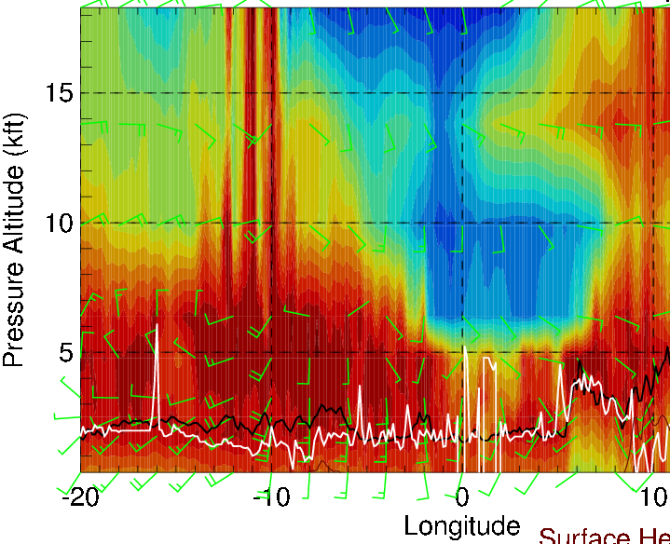
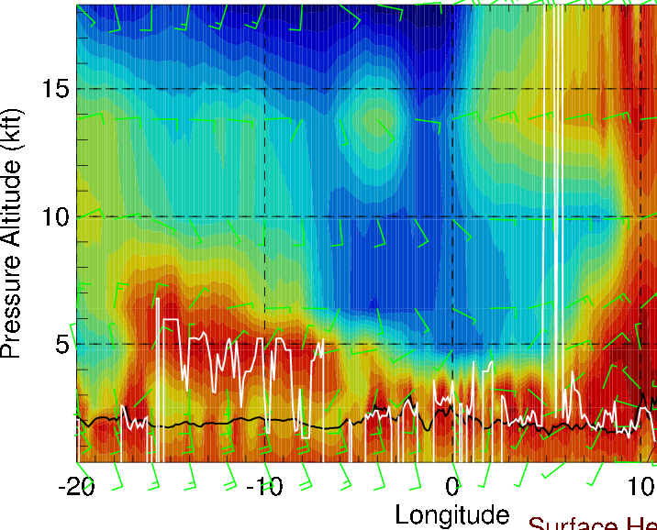
Longitudinal cross-sections of RH (color), wind, BL and cloud base heights
on 8/19 Sat @ 12 PM
along 5N
Cloud heights at ~3N:
8W (start of leg): 5-8000 ft
3W: 3-5000 ft
2E (end of leg): 2-4000 ft
along equator

Slide 8
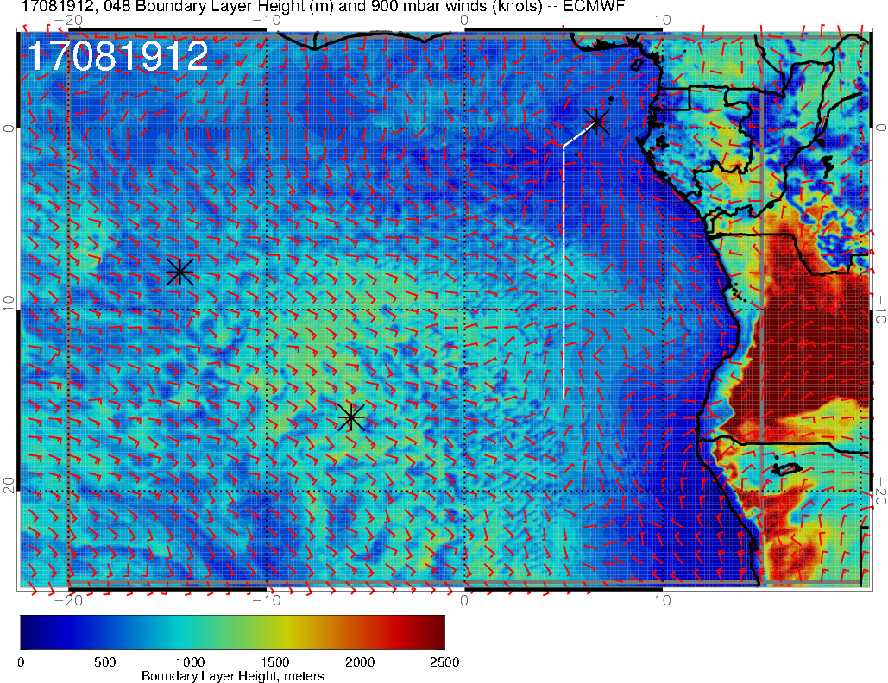
BL height forecast for 8/19 Sat @ 12PM

Slide 9
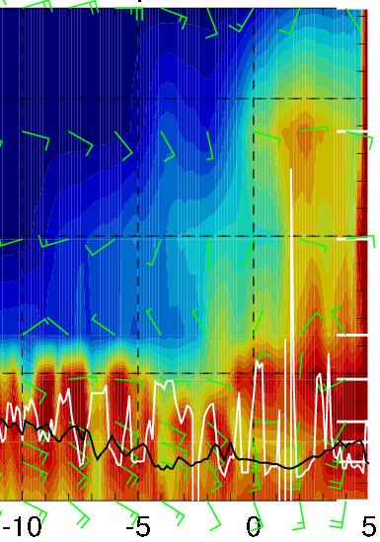
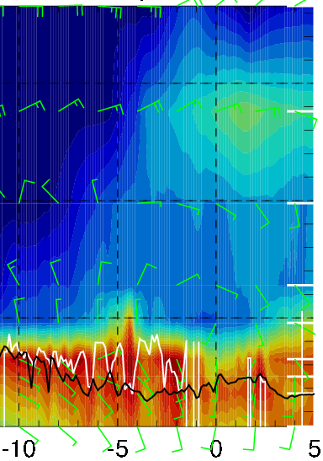
Latitudinal cross-sections of RH (color), wind, BL and cloud base heights
on 8/19 Sat @ 9AM - 3 PM
mid clouds (5000ft) 1-2N
Latitude along 10W (9AM)
Low cloud heights from 10W to 0:
3N (N track): mid clouds (~5000 ft) to 2-4000 ft
8S (S track): 4-5000 ft to 3-4000 ft
Latitude along 0 (3PM)

Slide 10
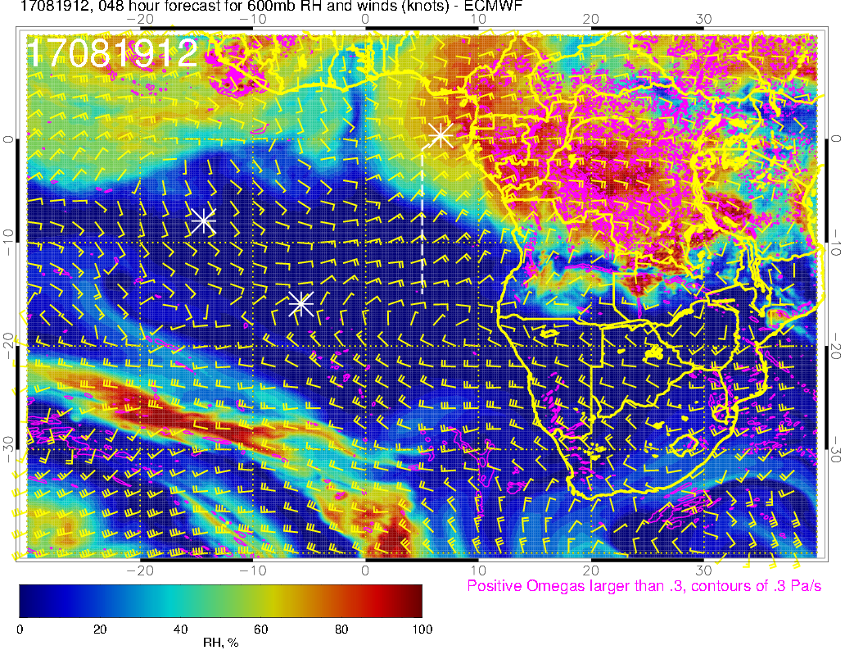
Relatively dry 1W-0 due to southerly flow
RH not as high as in yesterday’s forecast
Moist air confined to the east compared to yesterday’s forecast (high clouds retreat a little)
600 mb (8/19 @ 12PM)

Slide 11
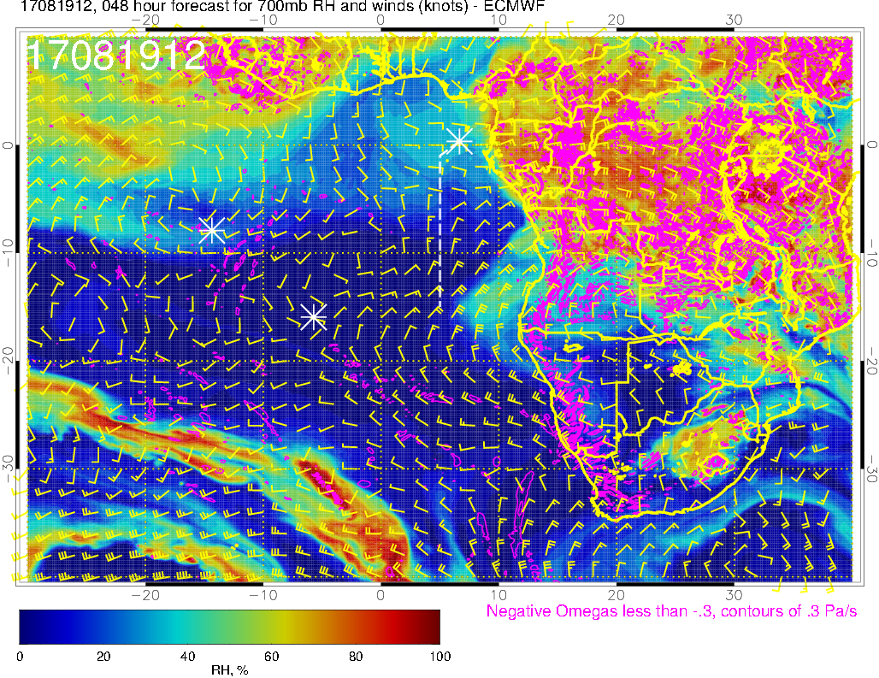
Relatively dry 4W-0 along 3N due to southerly flow
700 mb (8/19 @ 12PM)

Slide 12
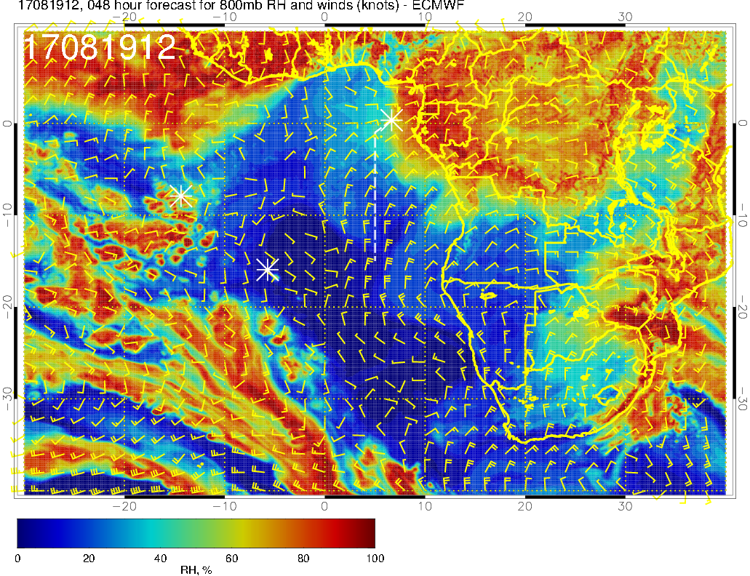
Stronger NEly winds from land compared to yesterday’s forecast
800 mb (8/19 @ 12PM)

Slide 13
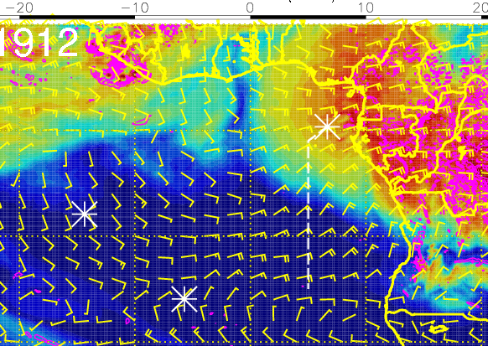
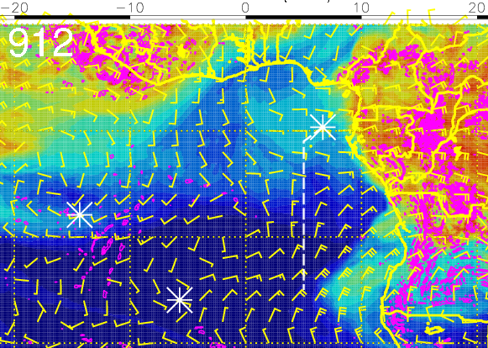
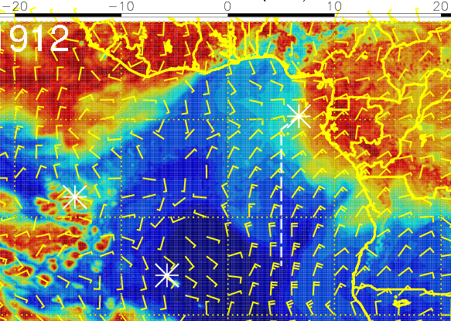
RH (color), winds, vert. velocity (pink) at 8/19 Sat @ 12PM
600 mb
700 mb
N track
Driest mid-level air between 4W-0 along 3N leg
Mostly S crosswinds along the track, but headwinds of up to 15 knots at 600mb (15 kft) 0-2E along the track
S track
Headwinds of 5-15 knots at 600mb (15 kft) east of ~8W
Moist air from the NE along 5E leg
800 mb

Slide 14
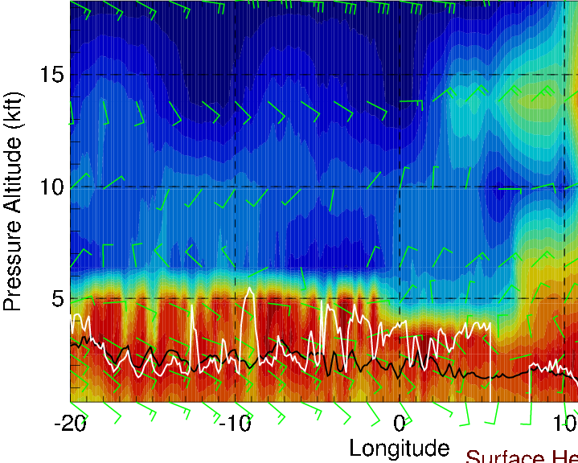
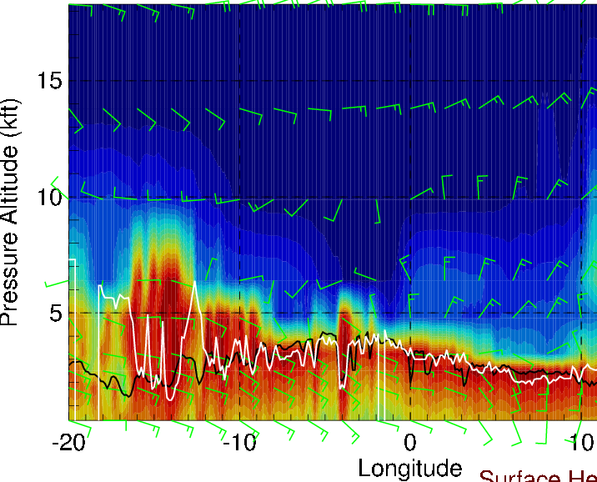
Longitudinal cross-sections of RH (color), wind, BL and cloud base heights
on 8/19 Sat @ 12 PM
along 5S
Along ~8S
Headwinds of 5-15 knots at 15 kft east of ~8W (increasing to the east)
Tailwinds of 5-15 knots at 10 kft from ASI to prime meridian (northerly crosswinds thereafter)
Cloud tops decrease slightly from ~4000 ft to ~3000 ft
along 10S

Slide 15
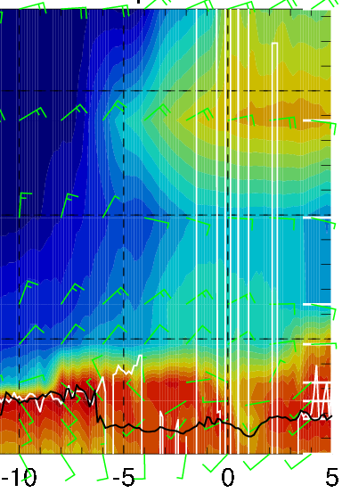
RH (color), wind, BL and cloud base heights along 5E, 8/19 Sat @ 3PM
15-20 knts
15-20 knts
5-15 knts
Big surge of moisture from the east at 15 kft: north of ~5S along the routine flight track
E and NE crosswinds of up to 20 knots above 5 kft
Mid to high clouds north of ~1-2S

