Slide 1
ORACLES weather briefing (cloud forecast on Sat 8/19 – update)
18-Aug-2017
Lenny Pfister and Rei Ueyama

Slide 2
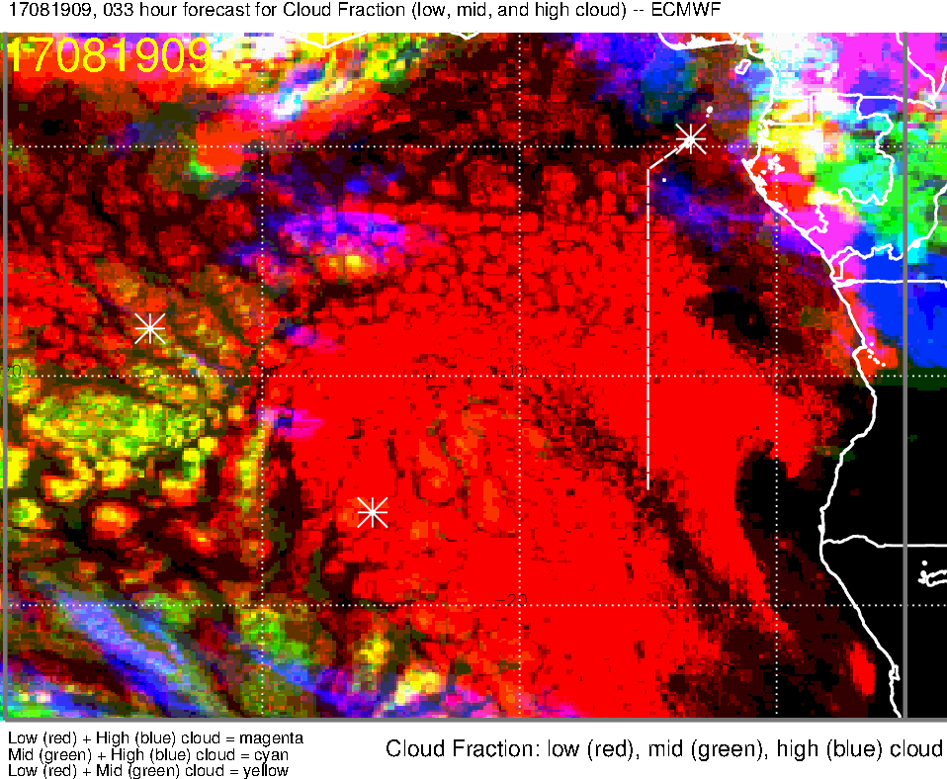
Low, middle, high cloud (33-hr) forecast for 8/19 Sat @ 9AM
high clouds further west
high clouds have retreated eastward
High clouds ~2-4S are further west in this forecast (moving SW so may intersect track at ~5-1S) [also in UKMO]
Mid and high clouds over our flight track

Slide 3
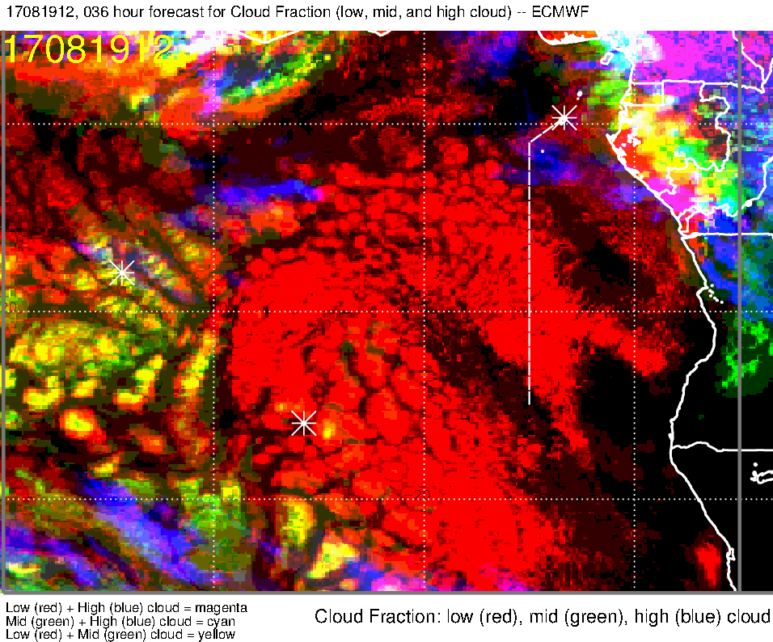
Low, middle, high cloud (36-hr) forecast for 8/19 Sat @ 12PM
High clouds move NW [~4E in UKMO]
Mid clouds on our flight track (north of equator, west of 5W along 3N) – increased RH at 800mb
[UKMO places them east and north of track, not on the track]
High clouds are west of the track
Not a lot of change in low cloud forecast along flight track

Slide 4
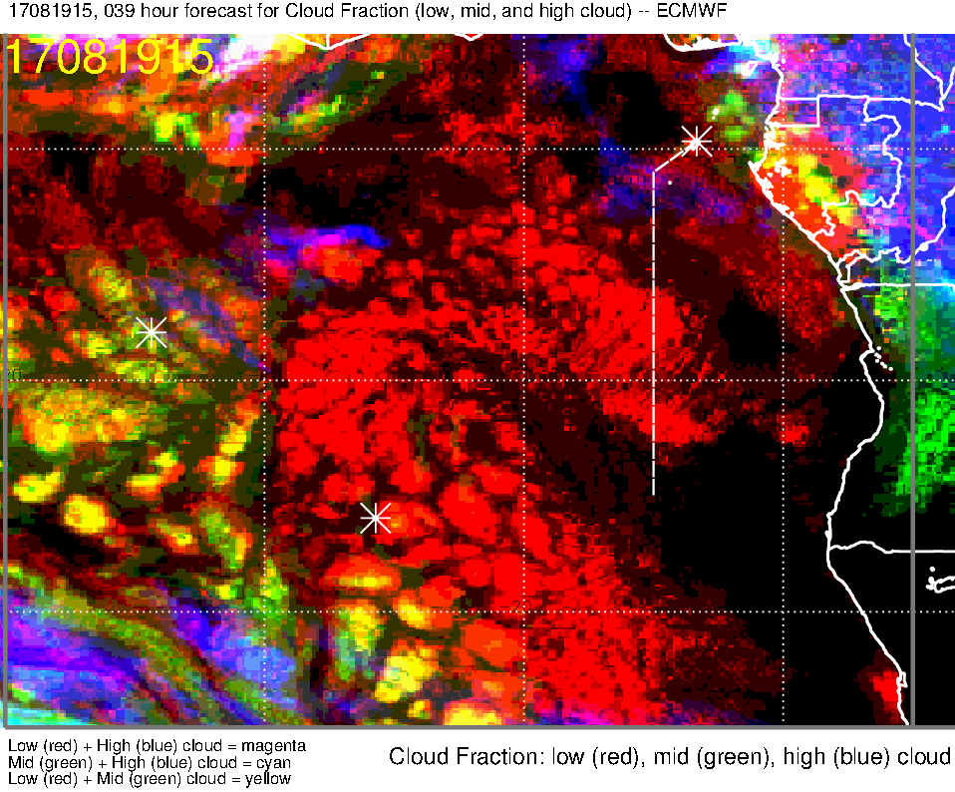
Low, middle, high cloud (39-hr) forecast for 8/19 Sat @ 3PM
Low cloud clearing south of TMS (to ~6S)
- less clearing than 51-hr forecast
High clouds 1-2E, 3-5N [NOT in UKMO]
High clouds east of 4E, 0-3S [also in UKMO]

Slide 5
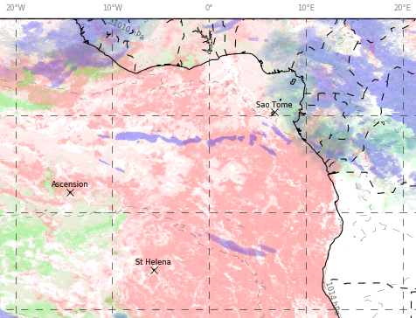
Low, middle, high cloud forecast for 8/19 Sat @ 12PM
UKMO (36-hr)
ECMWF (36-hr)
High clouds
Mid clouds
High clouds
N track
Scattered low clouds throughout track (least dense along the equator)
mid clouds on our track north of the equator and west of 5W [model disagreement]
High cloud streamers along 2-3S
High clouds possible east of ~1-2E towards TMS [model disagreement]
S track
Scattered to broken low clouds along 8S and southern portion (7-8S) of 5E leg
Low cloud clearing south of TMS (to ~5-6S)
High clouds north of ~2-3S

Slide 6
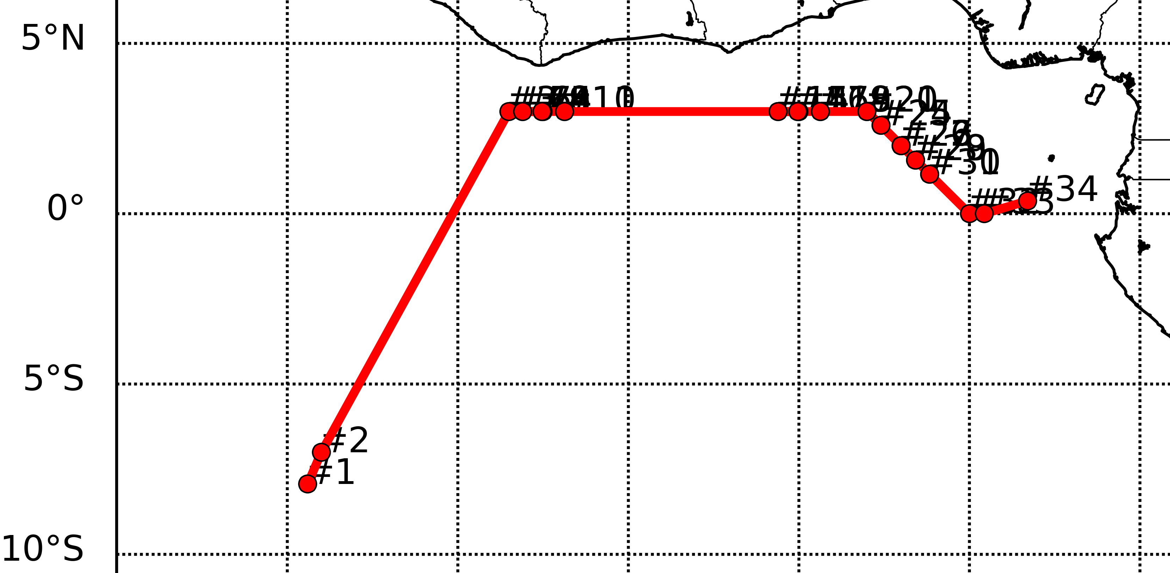
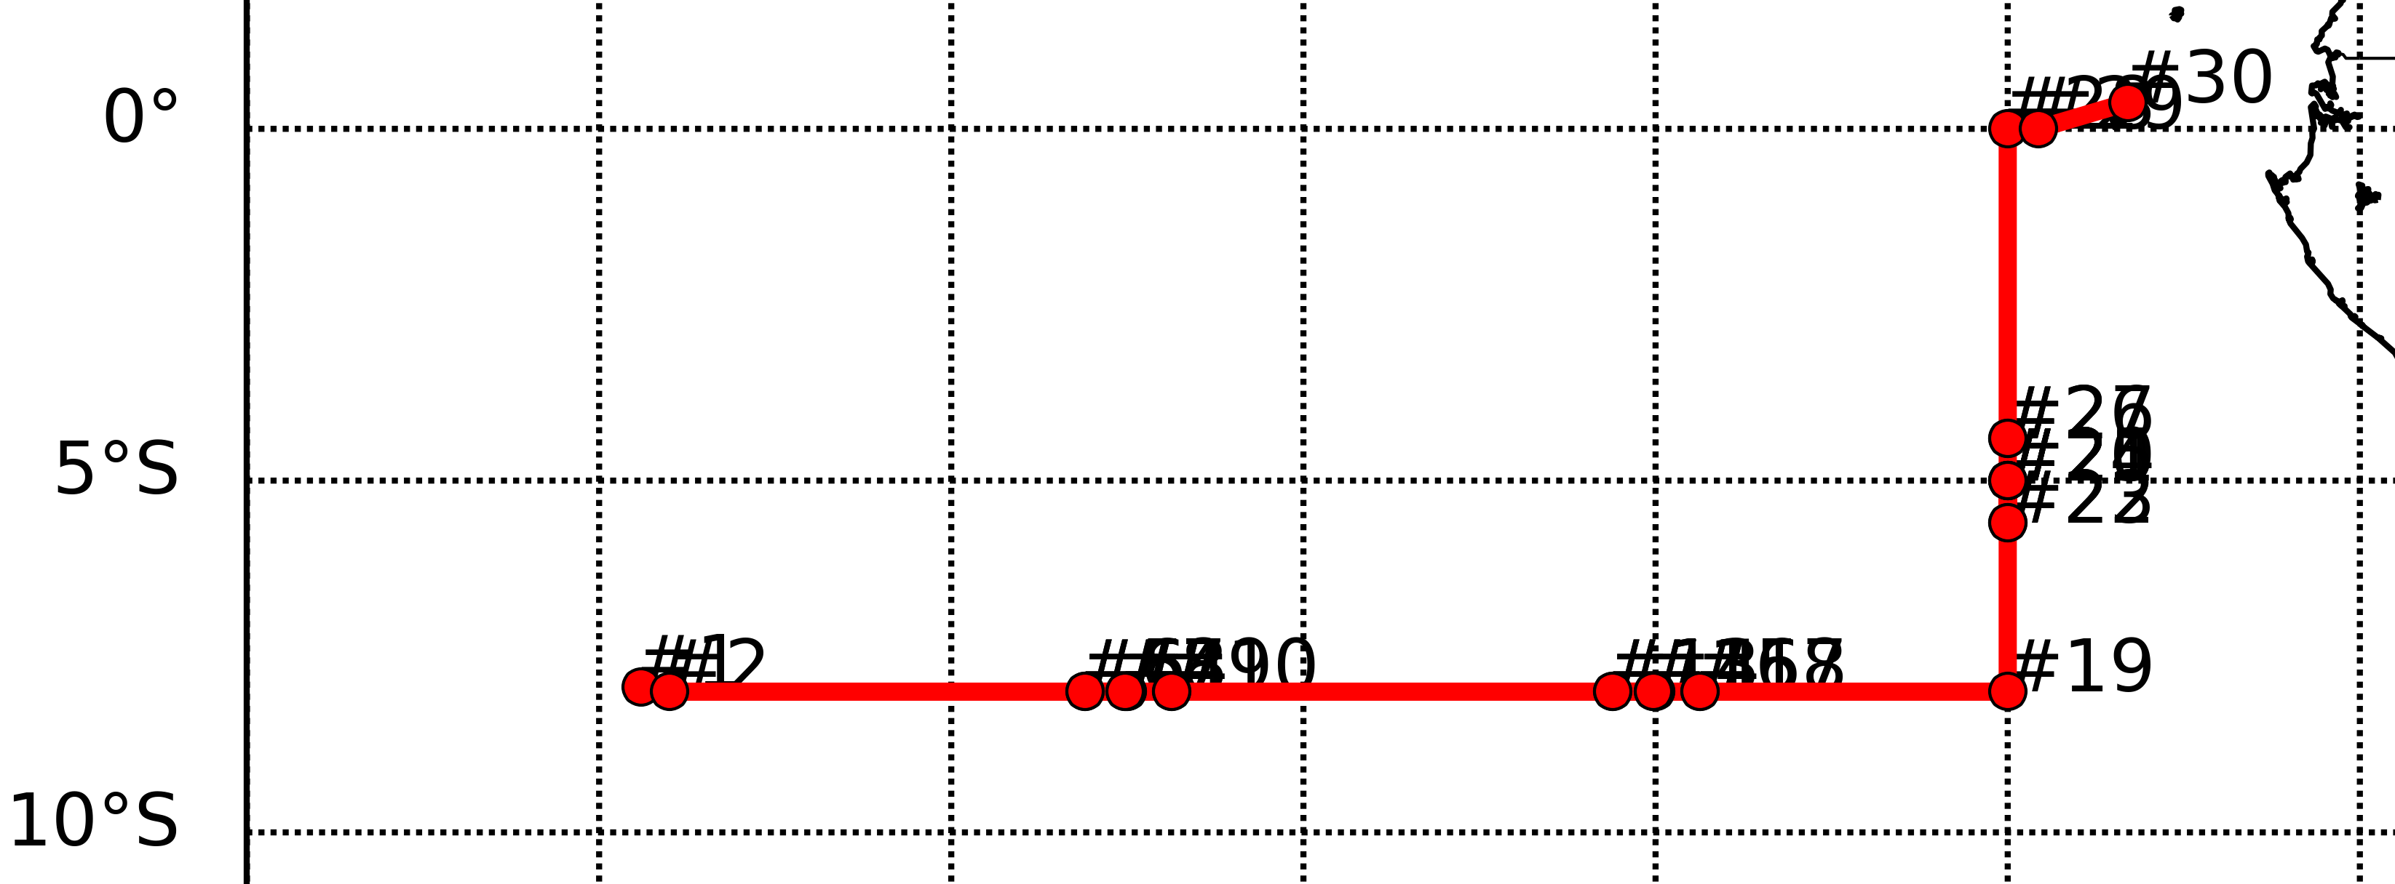
Saturday 8/19
* Forecast changes since 9am briefing are underlined
North track
West end of 3N flight leg: Mid clouds on our flight track (north of equator, west of 5W along 3N) [west and east of the track in UKMO]
East end of 3N flight leg: High clouds east of ~1-2E on our flight track [confined east of 4E in UKMO]
Scattered to broken low clouds along 3N; least amount of clouds along the equator
Cloud top heights decrease along 3N
~8W: 5-8000 ft
~3W: 3-5000 ft
~2E: 2-4000 ft and some high clouds
South track
Scattered to broken clouds along 8S with tops decreasing from 14W (~4000 ft) to 5E (to ~3000 ft)
Low cloud clearing south of TMS to ~5-6S; most dense low clouds 6-8S
High clouds along the track north of ~2-3S [model agreement]
Tailwinds of 5-15 knots at 10 kft from ASI to prime meridian; headwinds of 5-15 knots at 15 kft east of 8W
Moist air at 600mb (~15 kft) over TMS extending south to about 5S

Slide 7
Forecast validation

Slide 8
Situation at 12Z today, fcst vs reality. Model gets the approaching dry slot. Model also gets most of the high clouds. High cloud forecast does not extend as far south as cirrus streamers.
SEVIRI enhanced IR
EC forecast valid 12Z today

Slide 9
HIGH CLOUD FORECAST
Situation at 12Z tomorrow, fcst vs fcst: clearly a much less cloudy situation than today . Dry slot has moved westward.
12 hr fcst valid 2017081812
36 hr fcst valid 2017081912

Slide 10
Situation at 12Z today, fcst vs reality

Slide 11
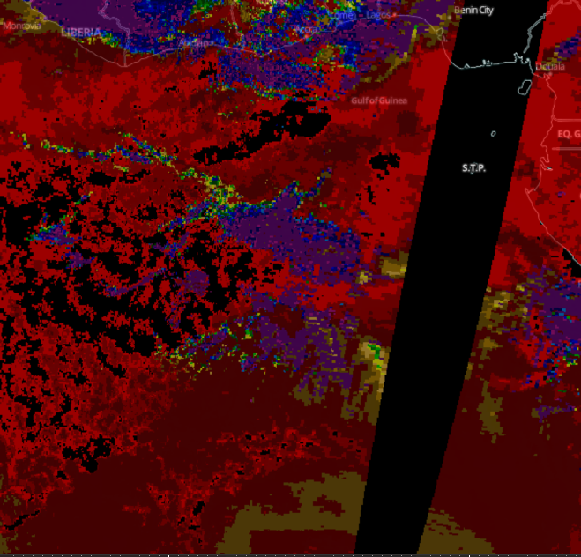
Situation at 12Z today, fcst vs reality
Note dry slot, propagating westward. TERRA Modis also sees no high cloud.

Slide 12
Situation at 12Z today, fcst vs fcst. Clearly much drier than today.

