Slide 1
ORACLES weather briefing (cloud forecast on Sat 8/19)
17-Aug-2017
Lenny Pfister and Rei Ueyama

Slide 2
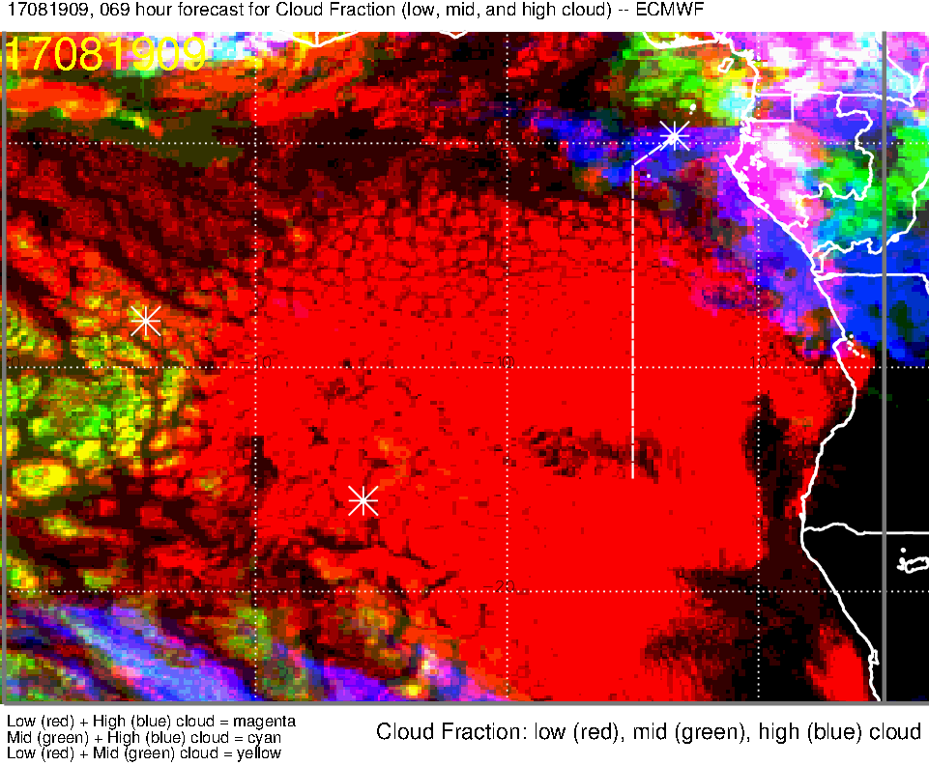
Low, middle, high cloud (69-hr) forecast for 8/19 Sat @ 9AM
High clouds (blue, magenta) east of prime meridian between 2N-1S
Mid clouds (green, yellow) west of 8W and north of 3N

Slide 3
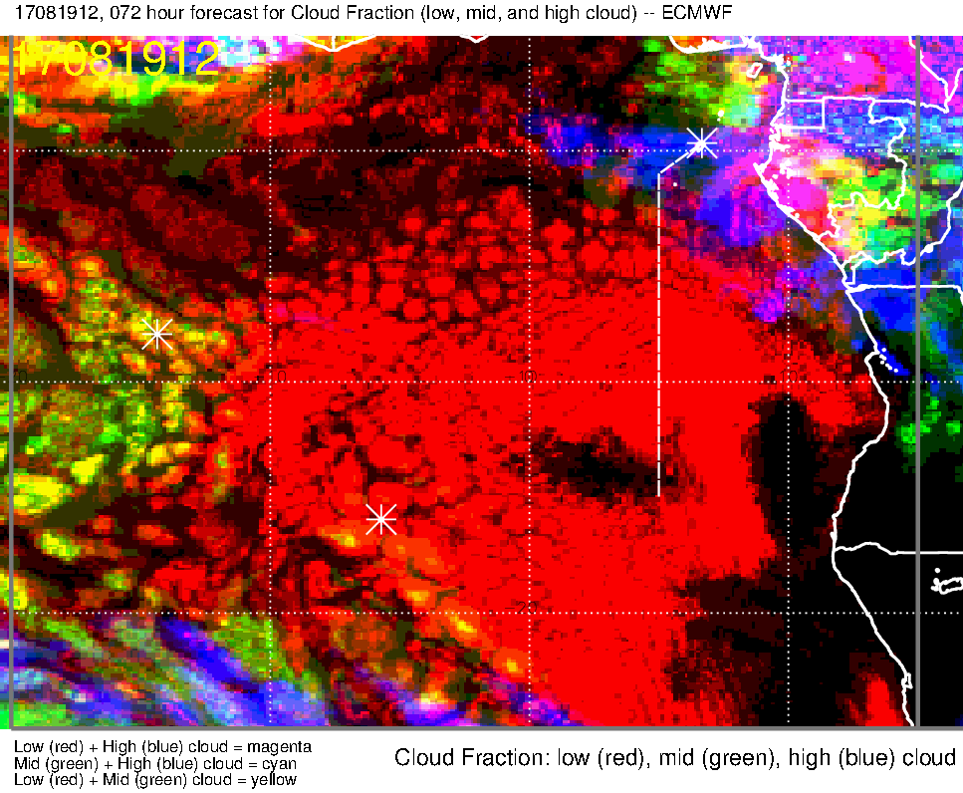
Low, middle, high cloud (72-hr) forecast for 8/19 Sat @ 12PM
Mid clouds (green, yellow) mostly west of 10W, but there are a few occurrences west of 8W and north of 3N
[have moved west]
[stable forecast]
High clouds (blue, magenta) east of prime meridian between 2N-1S
[have moved west]
[unstable forecast]

Slide 4
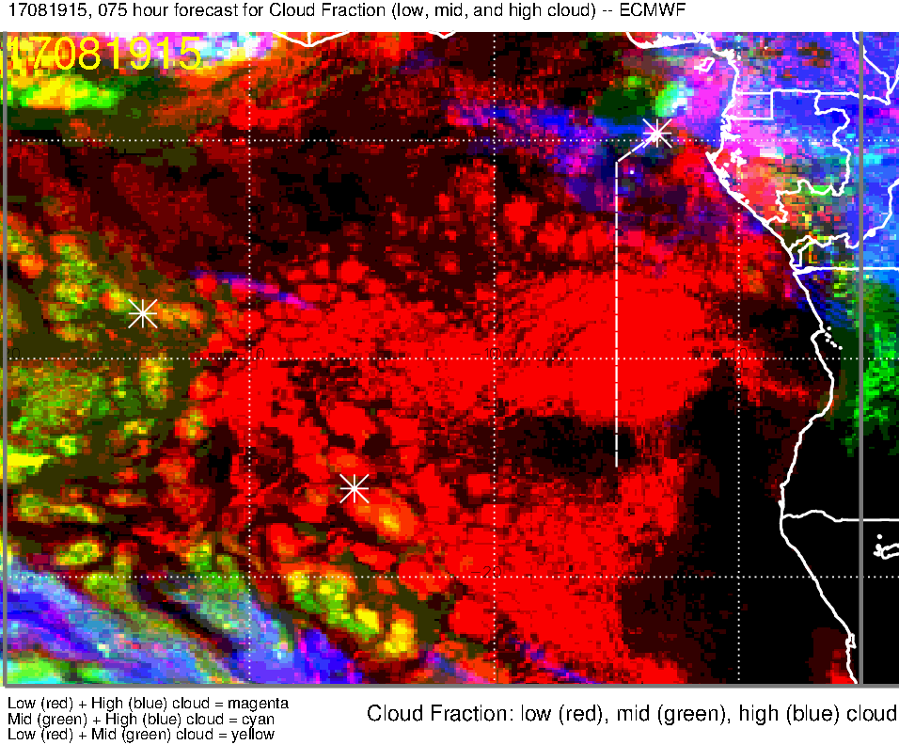
Low, middle, high cloud (75-hr) forecast for 8/19 Sat @ 3PM
High clouds (blue, magenta) east of 2W between 2N-2S
[have moved west]
Mid clouds (green, yellow) mostly west of 10W, but there are a few west of 8W and north of 3N
[have NOT moved much]

Slide 5
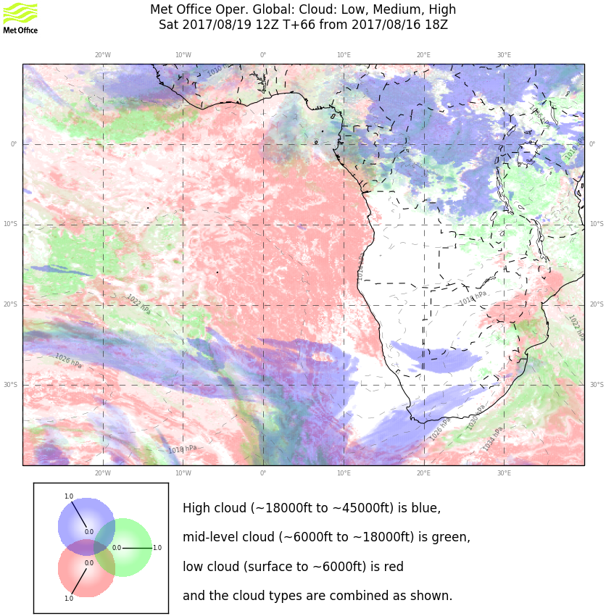
Low, middle, high cloud (66-hr )forecast for 8/19 Sat @ 12PM
Mid clouds (green) west of 8W, but there are a few west of 8W and north of 2N
[compared to 72-hr forecast, higher mid-cloud occurrence in the same general area]
High (blue) and Mid (green) clouds east of prime meridian north of 3S
[compared to 72-hr forecast, high clouds have moved further west, from 1E to 0]

Slide 6
High cloud forecast progression

Slide 7
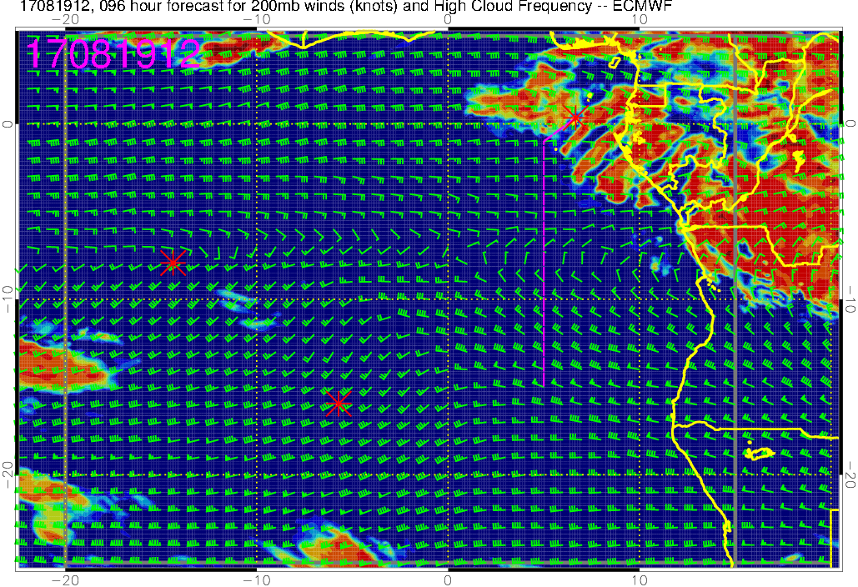
High cloud, 96-hr forecast

Slide 8
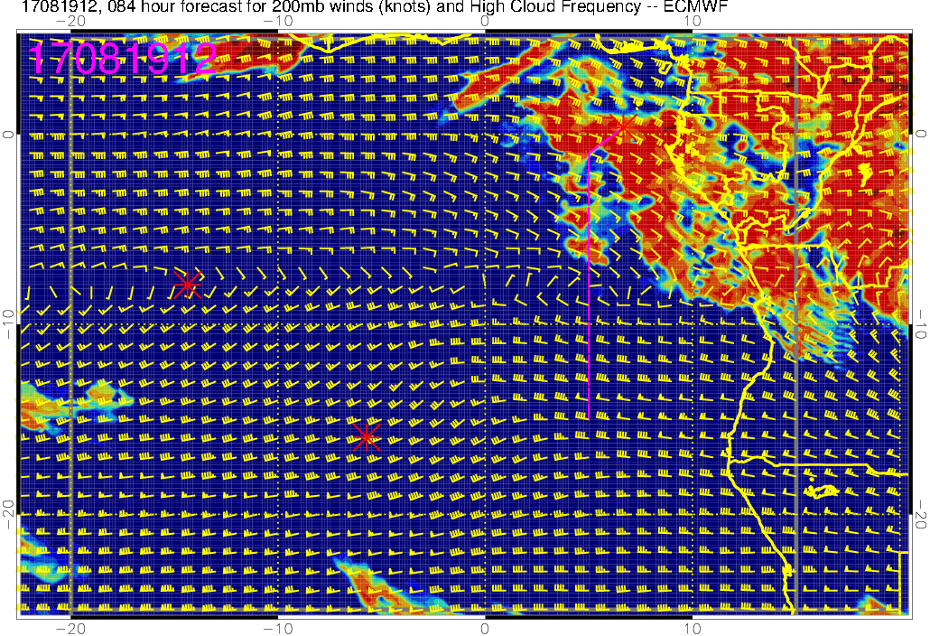
High cloud, 84-hr forecast

Slide 9
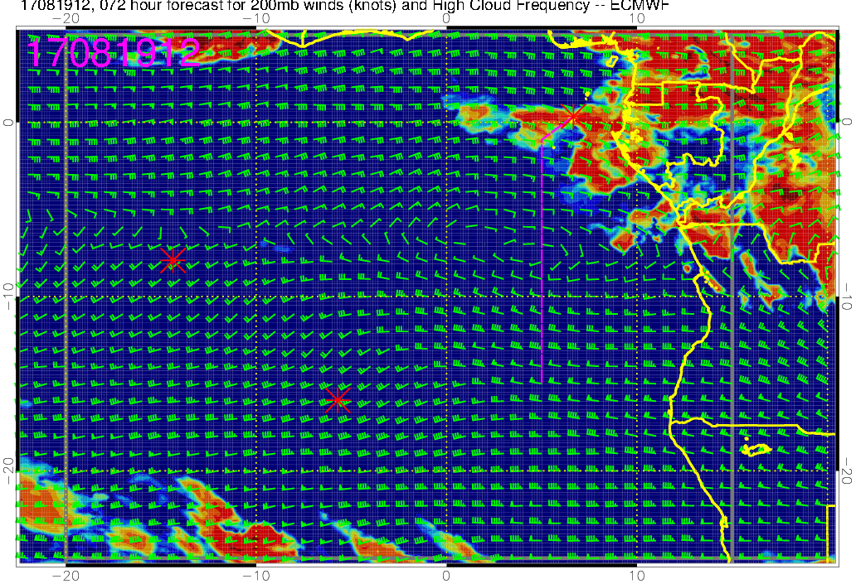
High cloud, 72-hr forecast
These cloud forecasts are relatively stable (i.e., don’t change much from forecast to forecast)
These cloud forecasts are NOT stable (i.e., big changes from forecast to forecast)

Slide 10
Middle cloud forecast progression

Slide 11
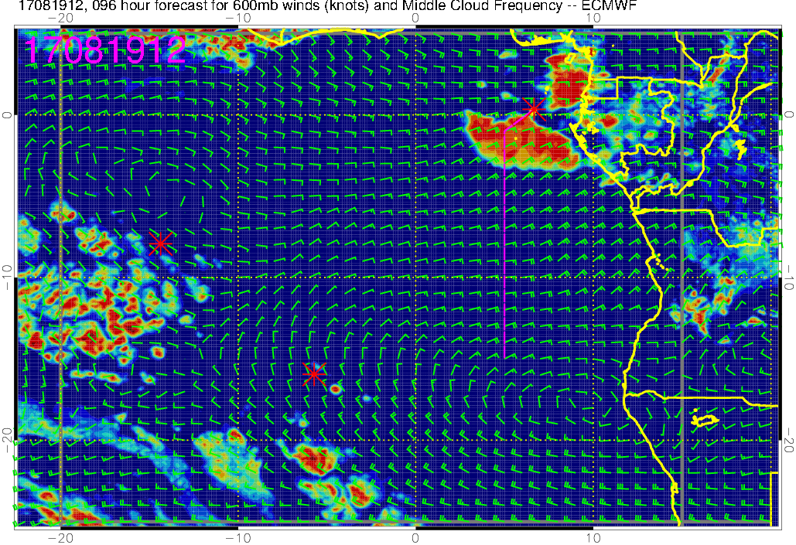
Middle cloud, 96-hr forecast

Slide 12
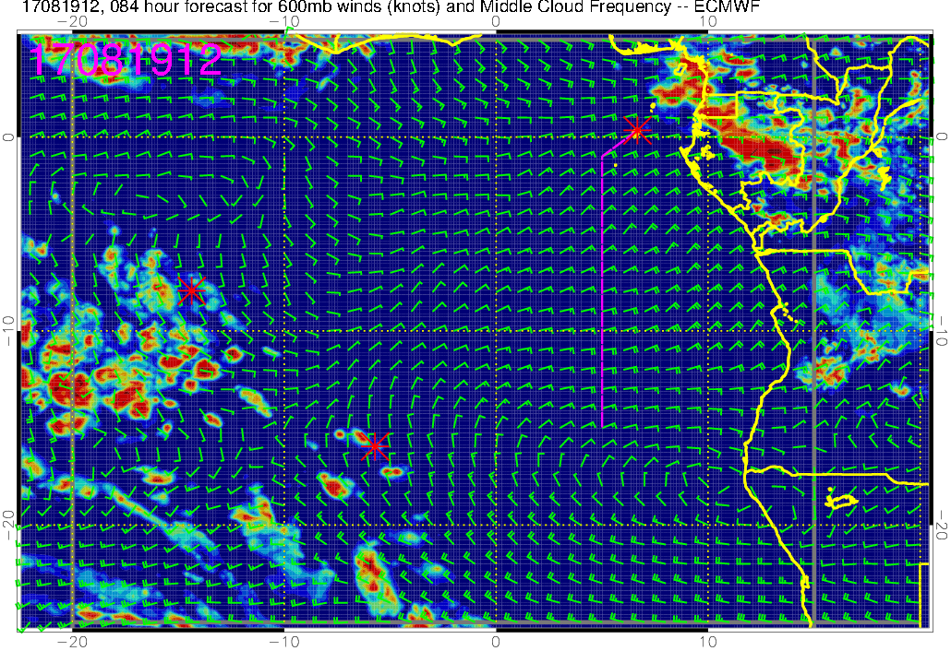
Middle cloud, 84-hr forecast

Slide 13
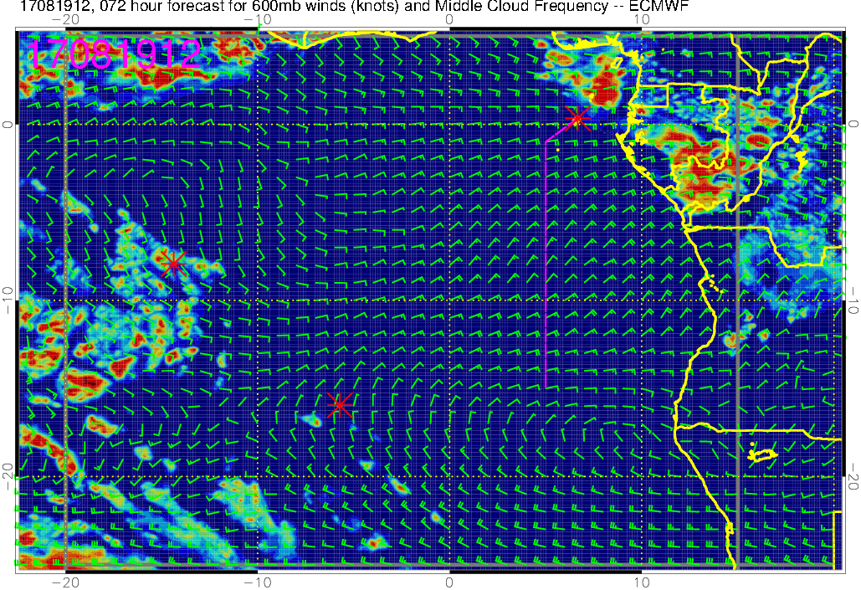
Middle cloud, 72-hr forecast
These cloud forecasts are relatively stable (i.e., don’t change much from forecast to forecast)
More recent forecasts indicate that these clouds won’t be a problem

Slide 14
Low cloud forecast progression

Slide 15
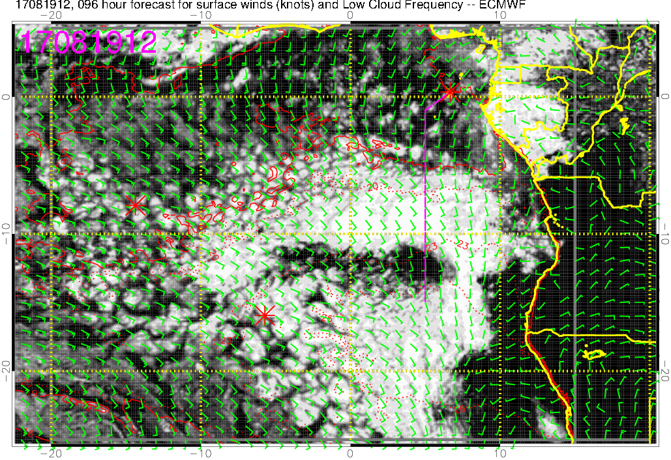
Low cloud, 96-hr forecast

Slide 16
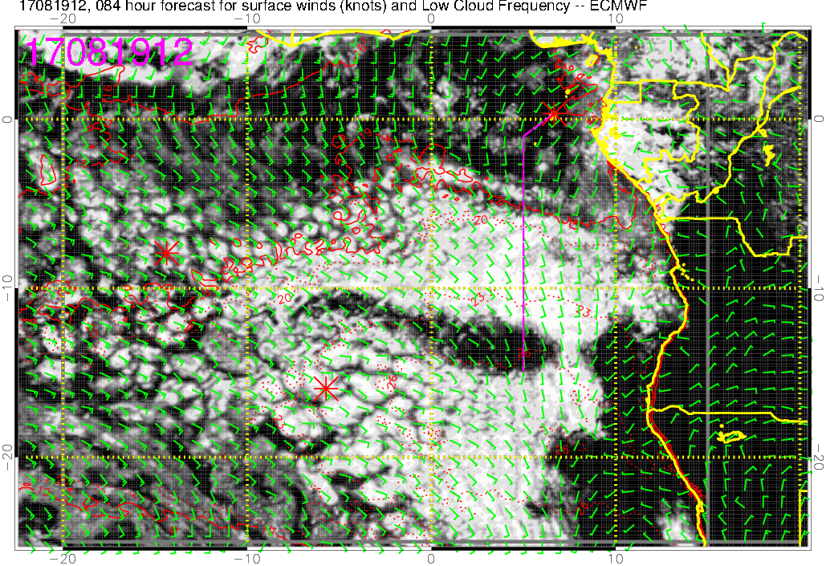
Low cloud, 84-hr forecast

Slide 17
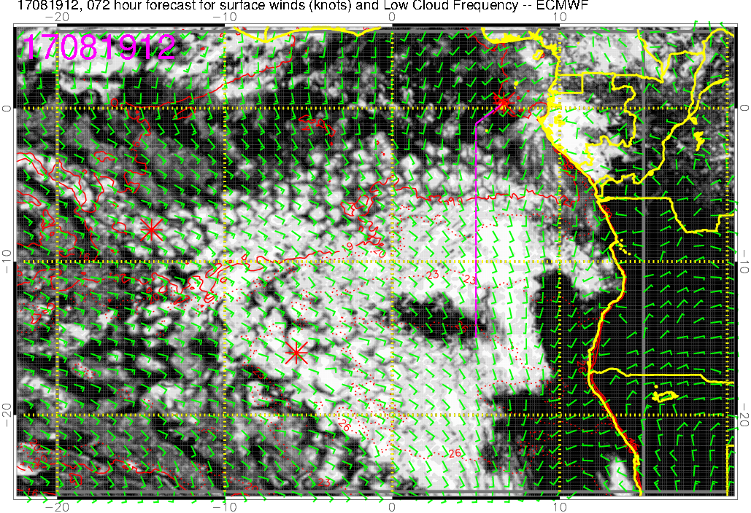
Low cloud, 72-hr forecast
The general pattern (clouds north of the equator, latitudinal band of “clear” region, northern edge of StratCu deck) seems robust, but details change from forecast to forecast

