Slide 1
ORACLES weather briefing for Thursday and Friday
17-Aug-2017
Lenny Pfister and Rei Ueyama

Slide 2
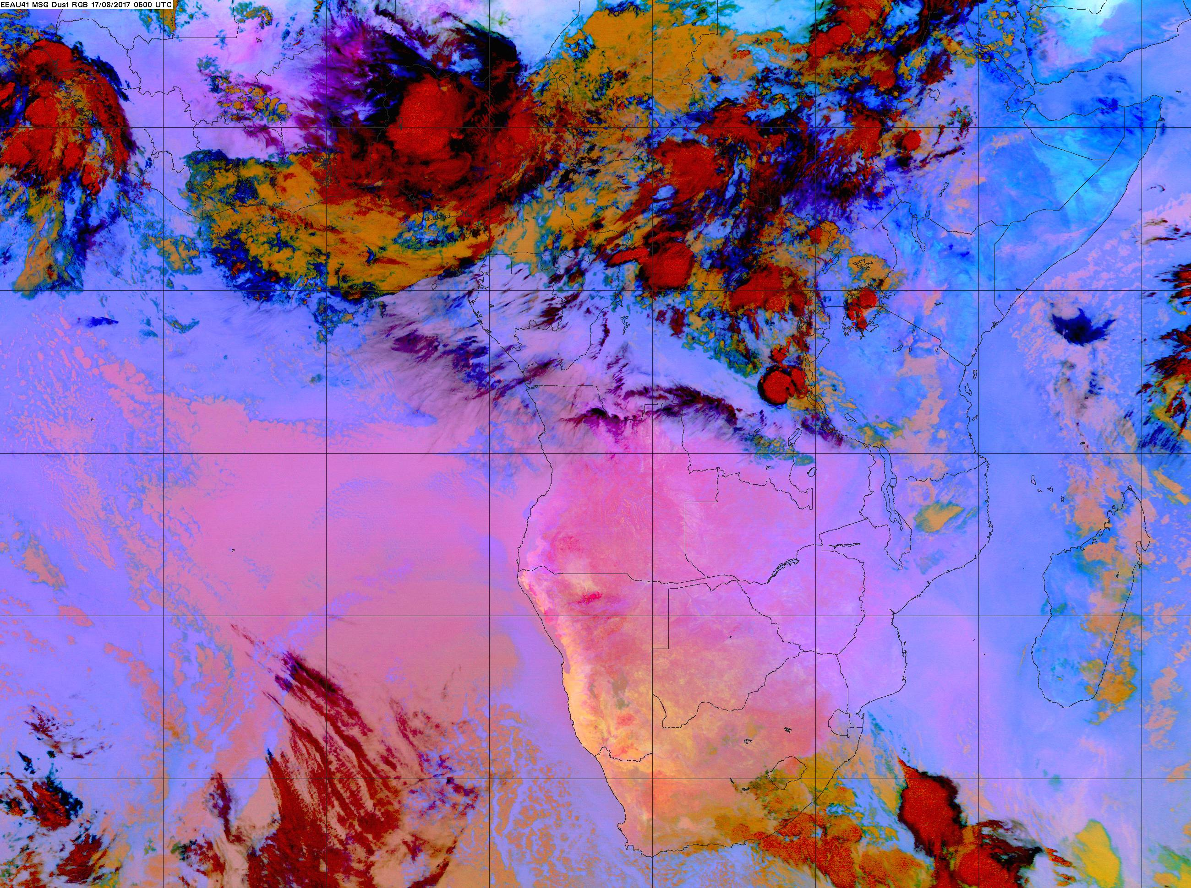
6 AM

Slide 3
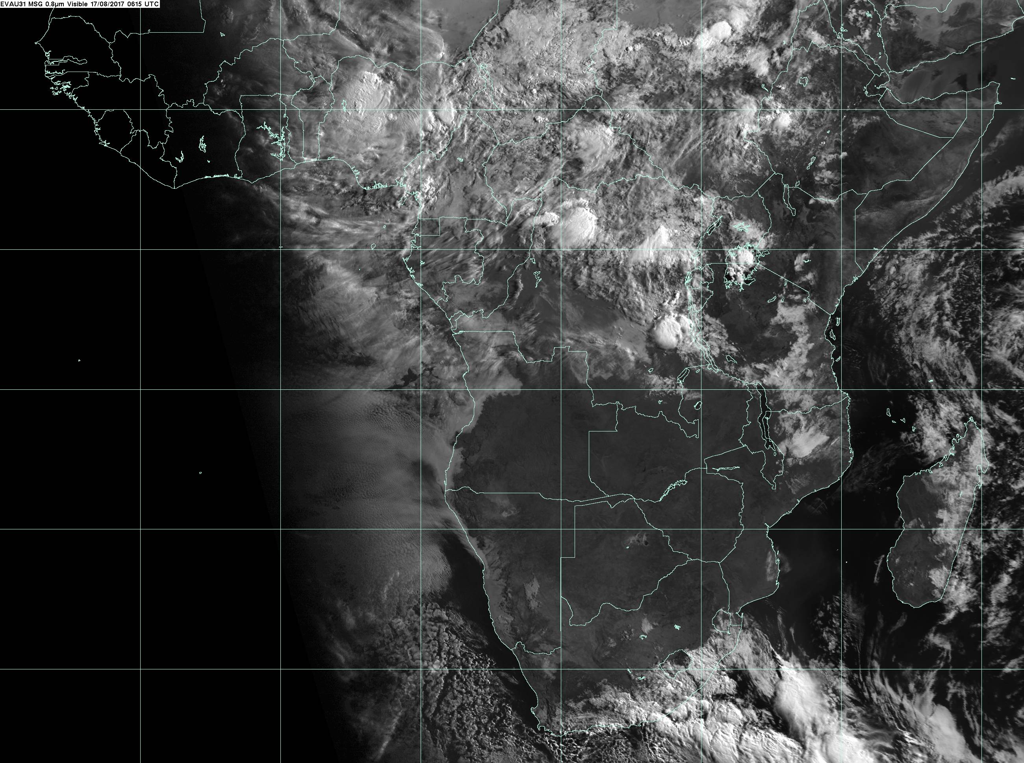
615 AM

Slide 4
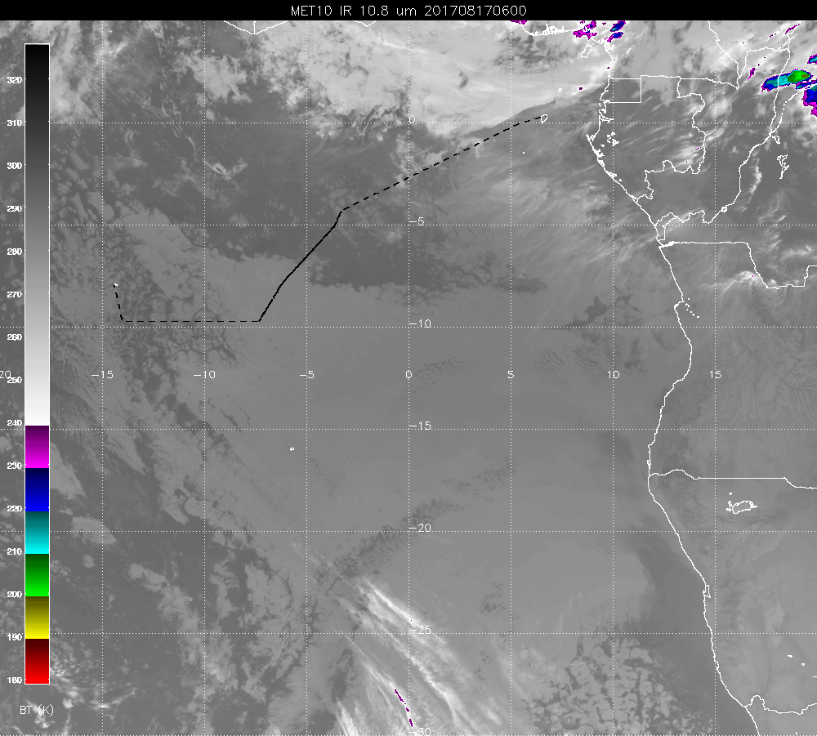

Slide 5
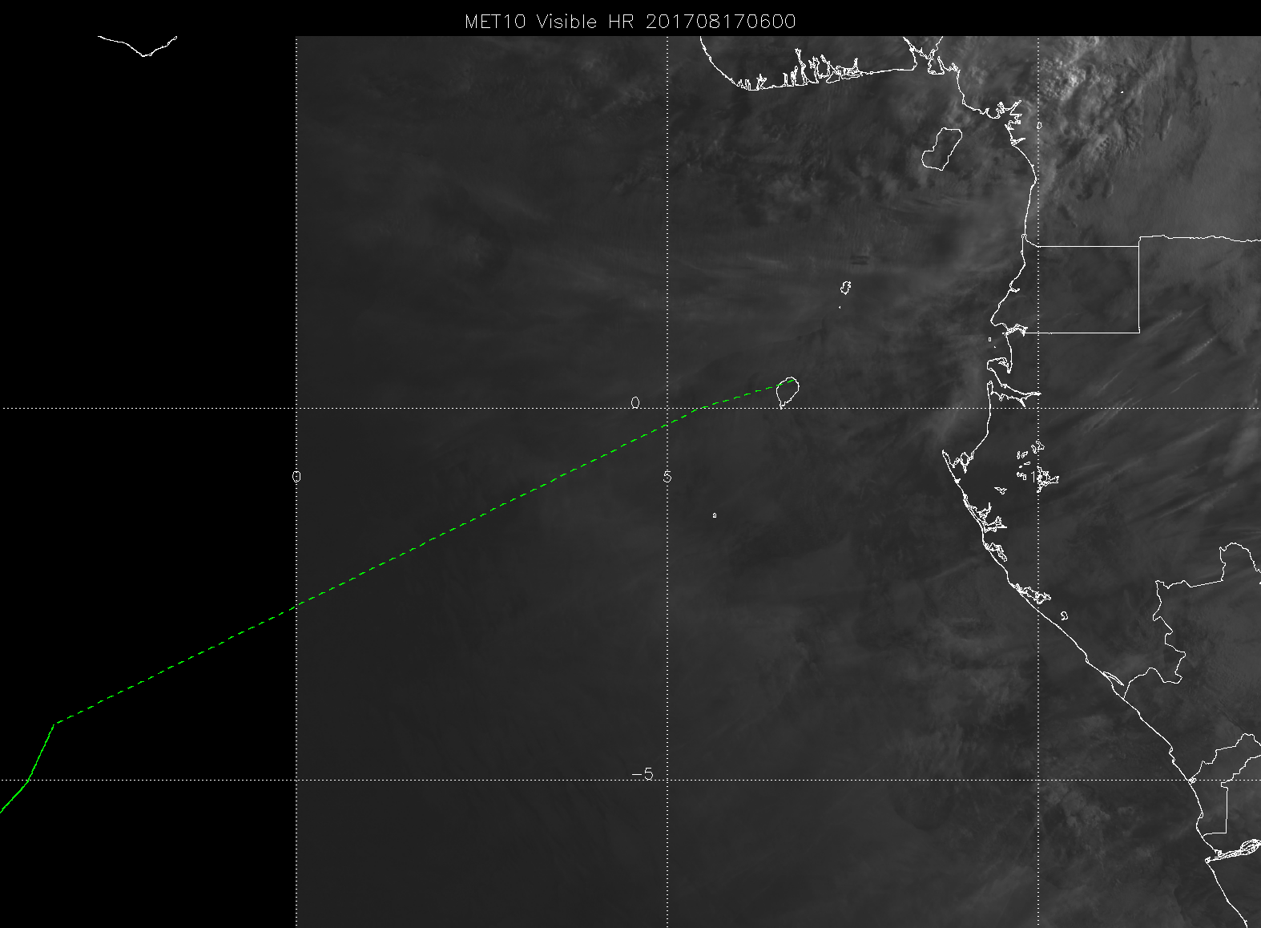

Slide 6
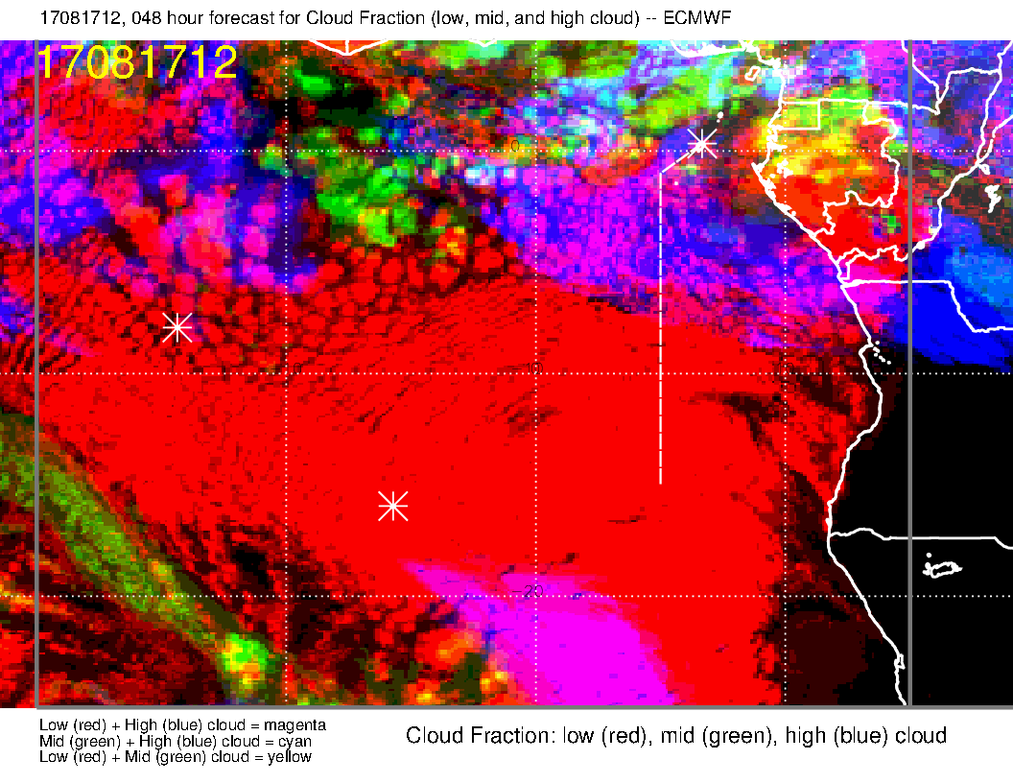
OLD forecast. This indicates high cloud cover on first part of track. We are at the northern edge of the forecast SC deck. Middle clouds are enhanced relative to old fcst.

Slide 7
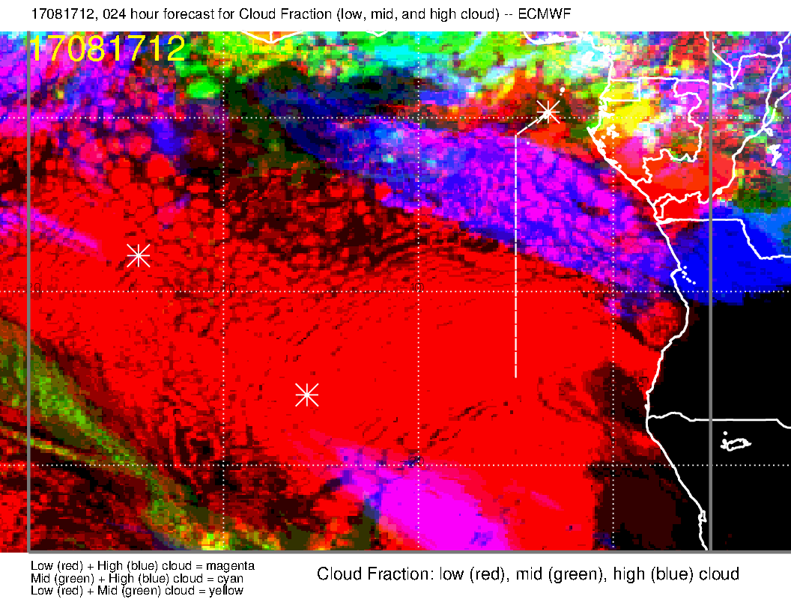
NEW forecast. Less low cloud than the old one, except near last part of track. Less middle cloud. High cloud forecast is consistent, and consistent with satpic

Slide 8
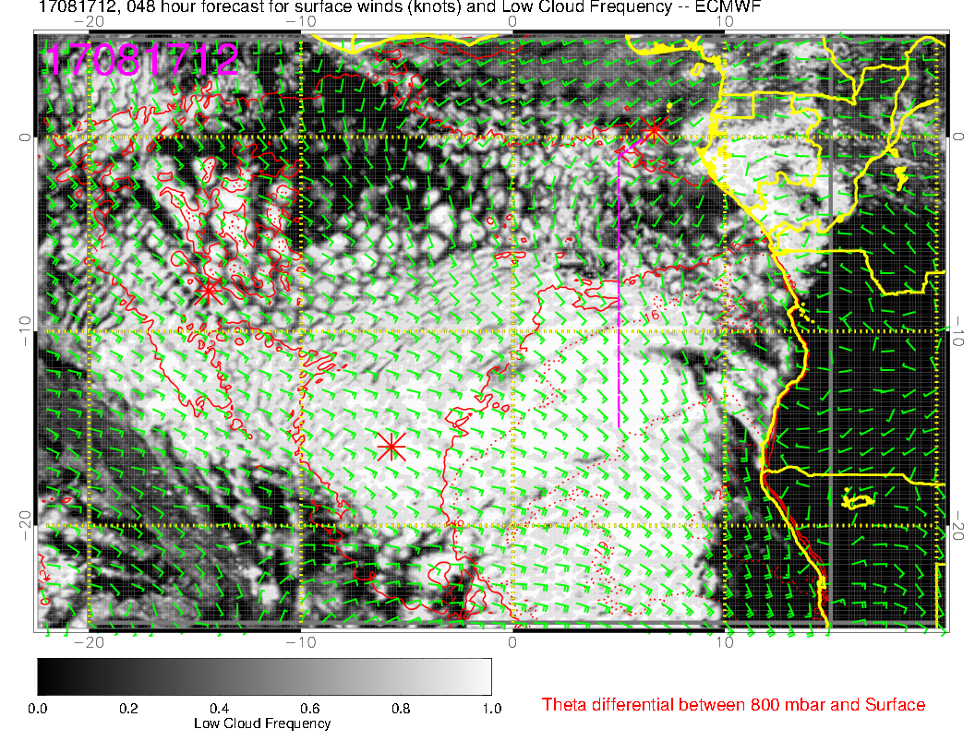
Old forecast for low clouds. We are north of the main deck, and will probably spend a lot of time in scattered and broken clouds in the first half of the flight.

Slide 9
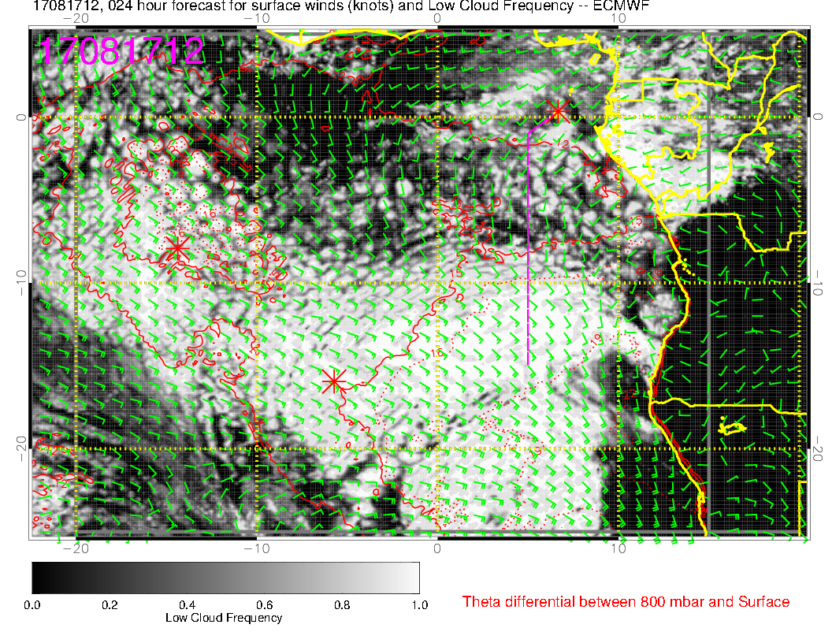
Most recent forecast for low clouds. Looks like most of the first half will have highly broken conditions. More clearing in “clearing region” than previous fcst.

Slide 10
Friday (Lokal Flug)
Surge of 800mb RH is approaching Ascension on this day – retarded compared to old forecast.
High and middle clouds look good (there are none nearby).
New forecast suggests more low cloud than old one.
Region of higher, pop-up broken/scattered large cell startocu is further east than previous forecast.

Slide 11
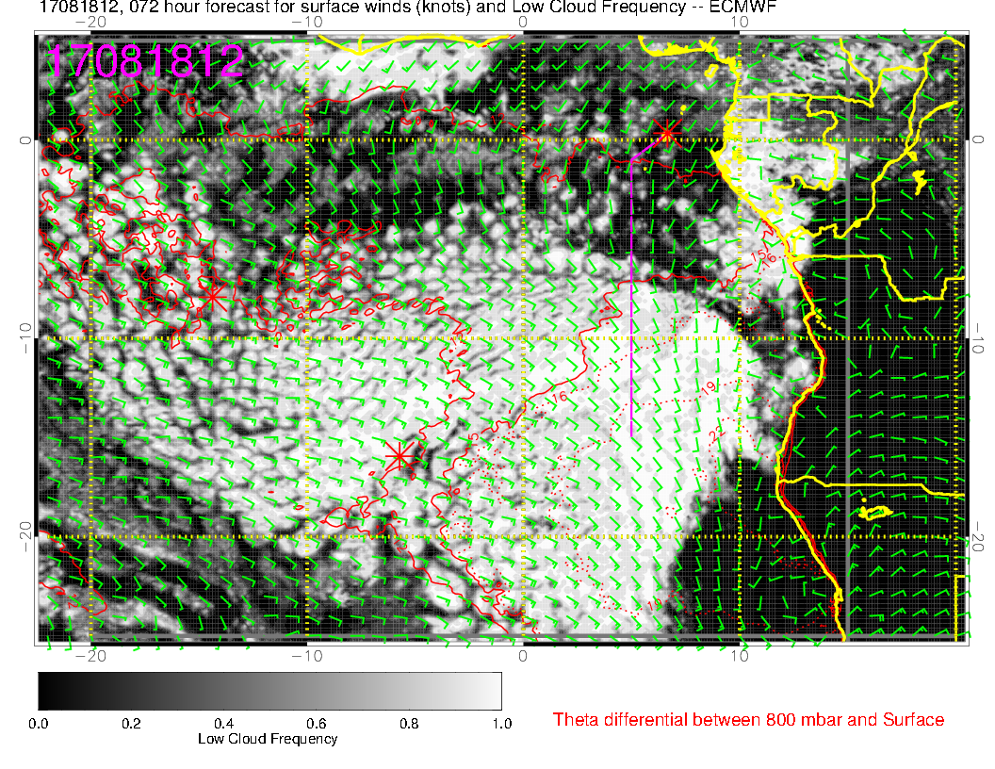
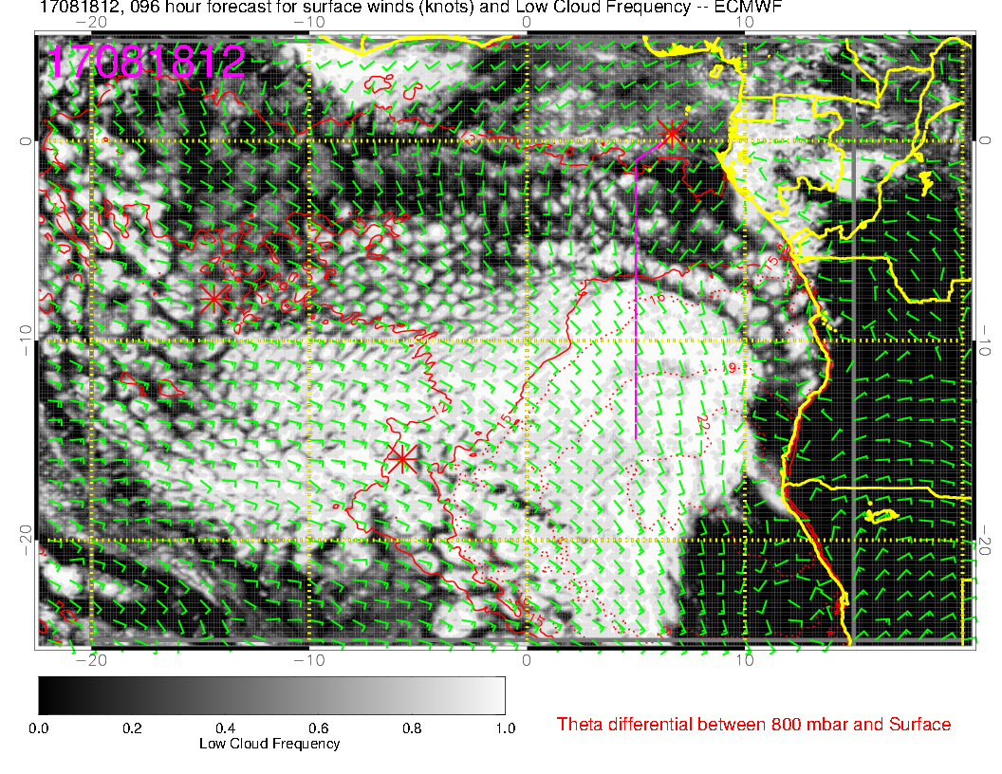
Old (above) and Old-Old (right) forecasts. See next slide for comp with new forecast

Slide 12
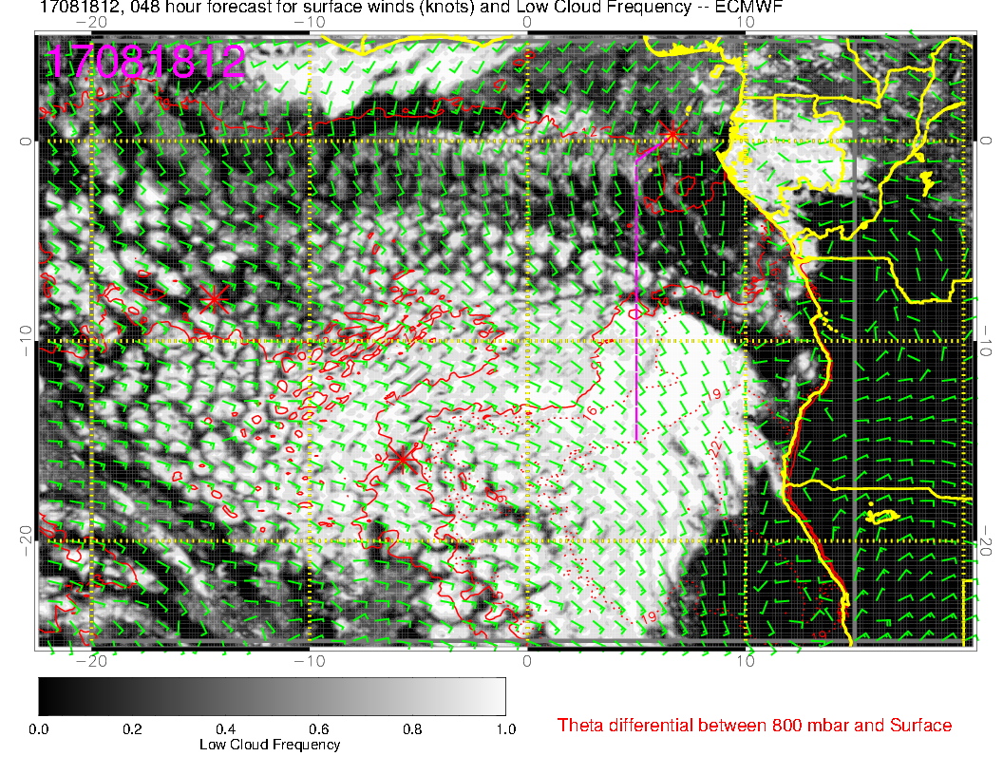
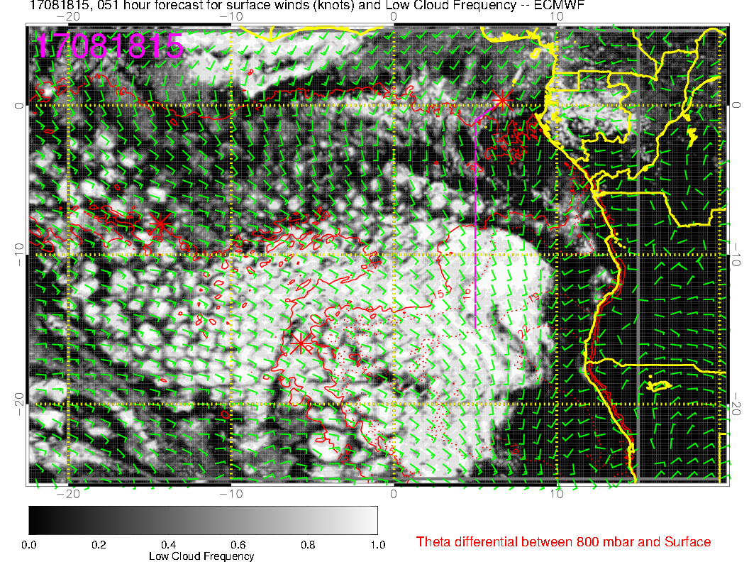
New forecast (above), and new forecast for 3 PM. Can see the cloud clearing, but it does not seem to affect Ascension much. Cloud appears more broken than previous forecast

Slide 13
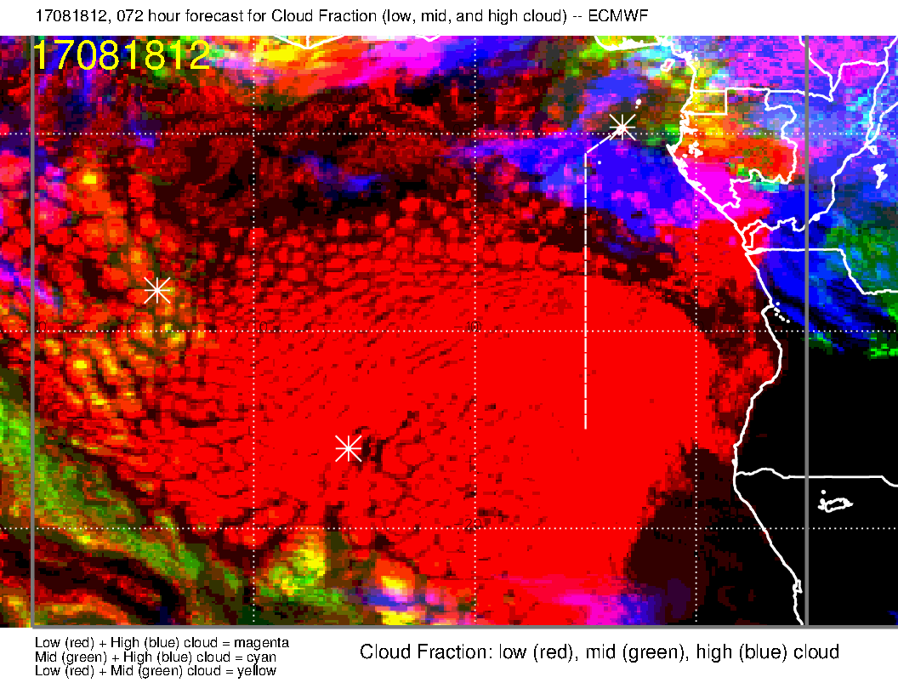
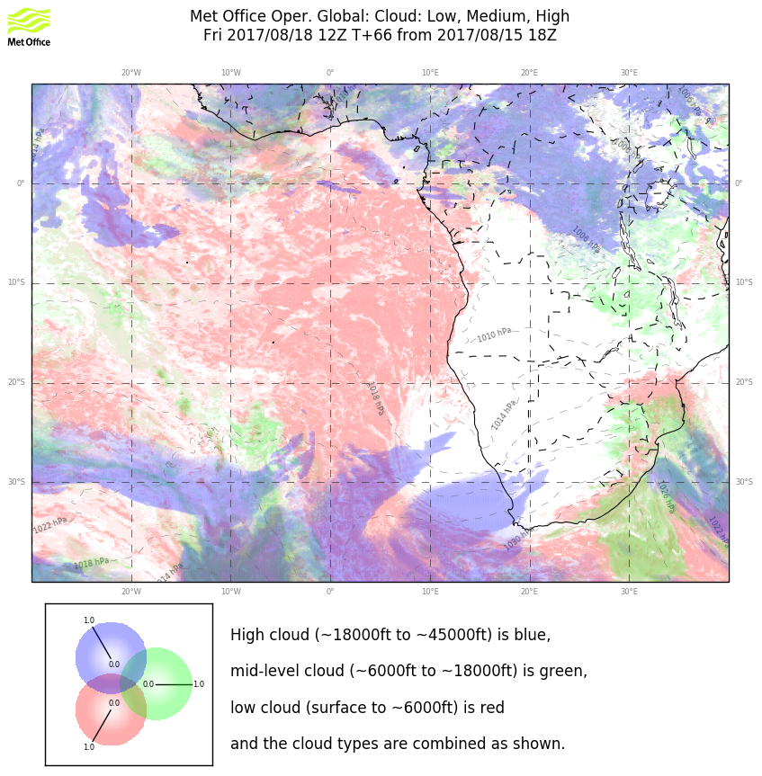
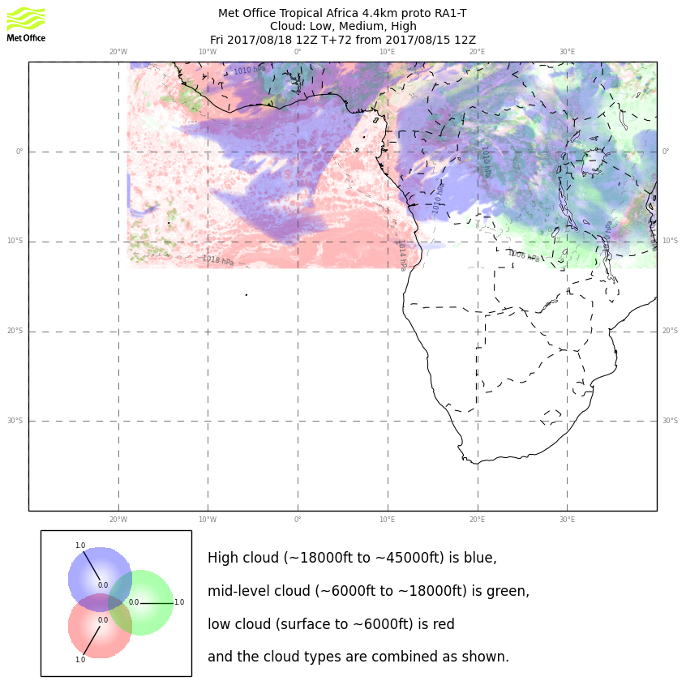
Yahoo! Models agree on the high and middle cloud over Ascension. UKMO 4 km is particularly pessimistic about low cloud. I think we will be in the zone where cells are larger and farther apart, with higher low clouds.

Slide 14
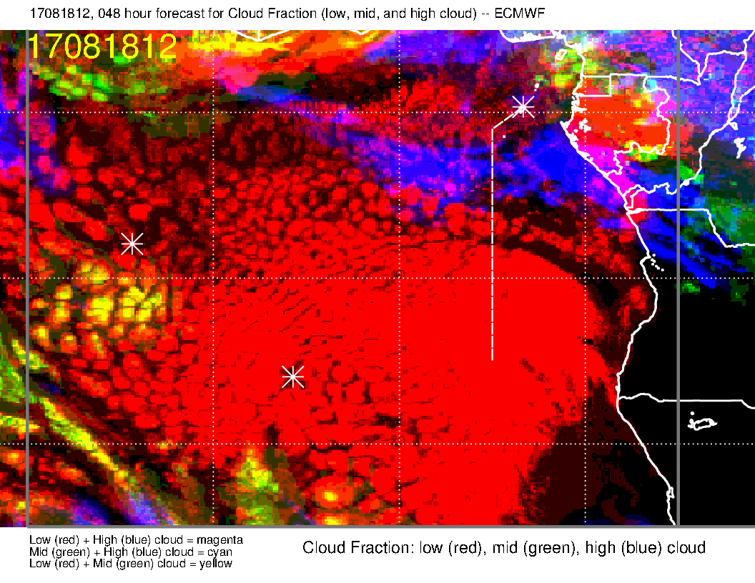
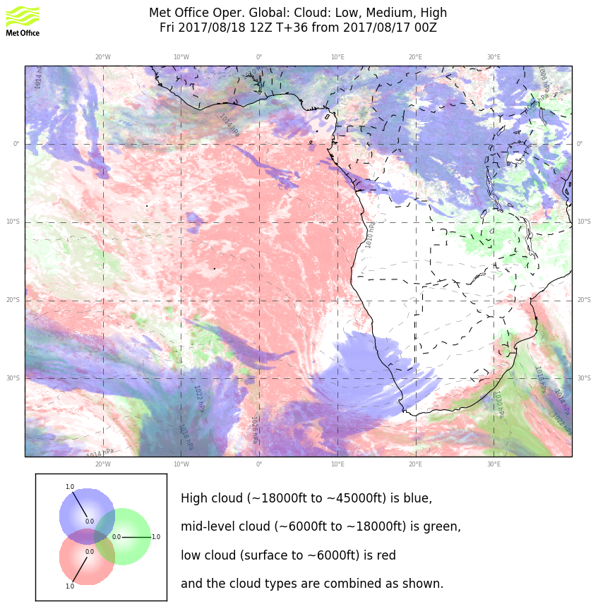
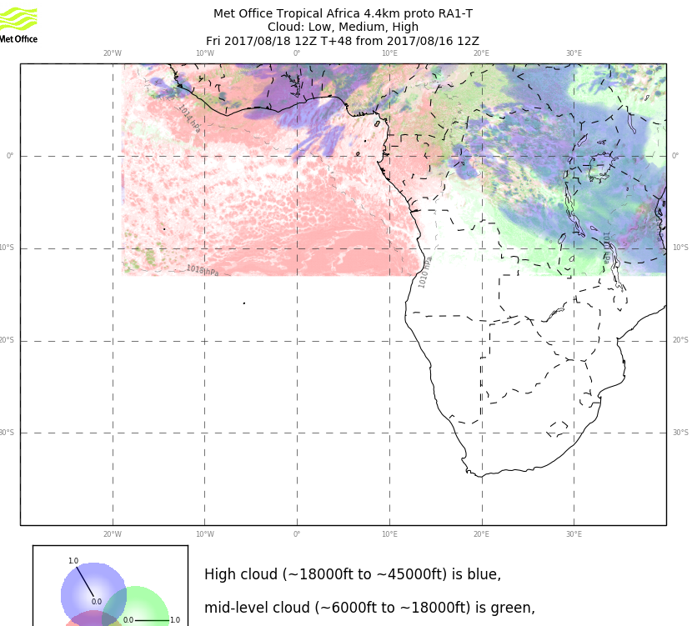
Still no high and middle cloud in the forecast for Ascension region on Friday (tomorrow). I think your best low cloud hunting will be south of the island. Pattern has clearly shifted (for the highest low cloud “pop ups.”

Slide 15
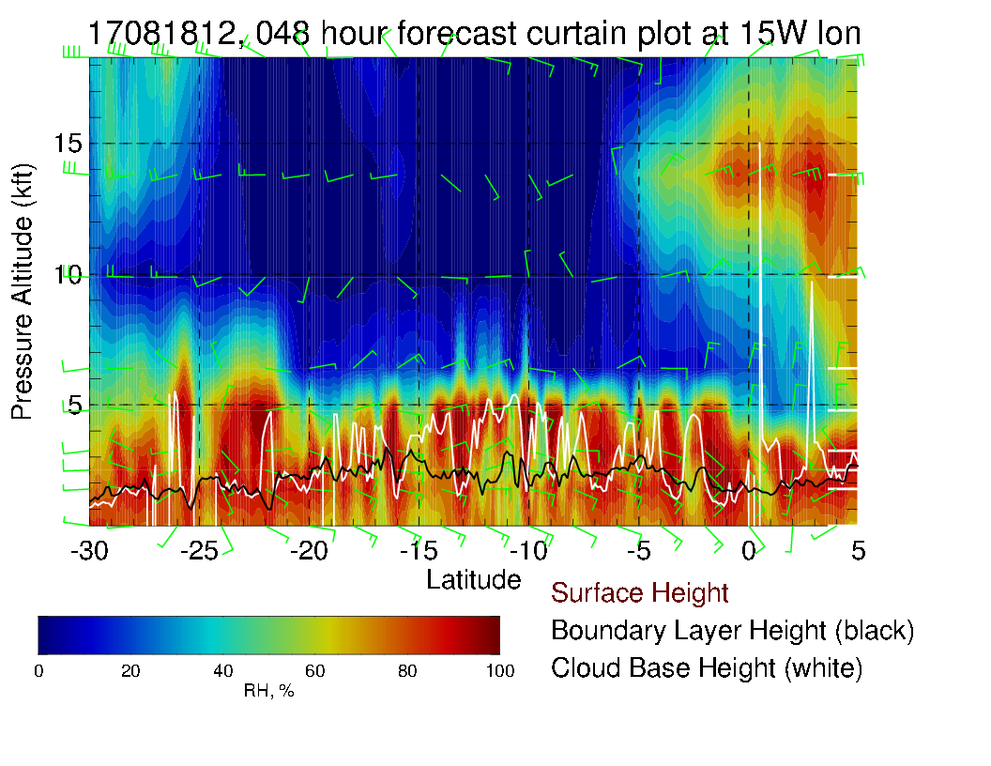
Note region of higher cloud bases south of 10S.

