Slide 1
ORACLES weather briefing
16-Aug-2017
Lenny Pfister and Rei Ueyama

Slide 2
Thursday (der Flug zur Insel des Aufstiegs)
Surge of moisture is being surveyed on this day. 800mb surge is slightly slower (in its westward progression) than previous forecast.
Lagrangian end members (of Aug 15 routine flight) chosen for survey are clearly above the BL on this day.
Based on two cases, UKMO model is underpredicting high clouds in this region. So, expect high clouds (thin) to be on the first third of flight track
600mb (4 km) is also not very organized. Situation dominated by moisture intrusion from the north. This northern 600mb moisture surge appears to be moving faster to the west than previous forecasts.

Slide 3
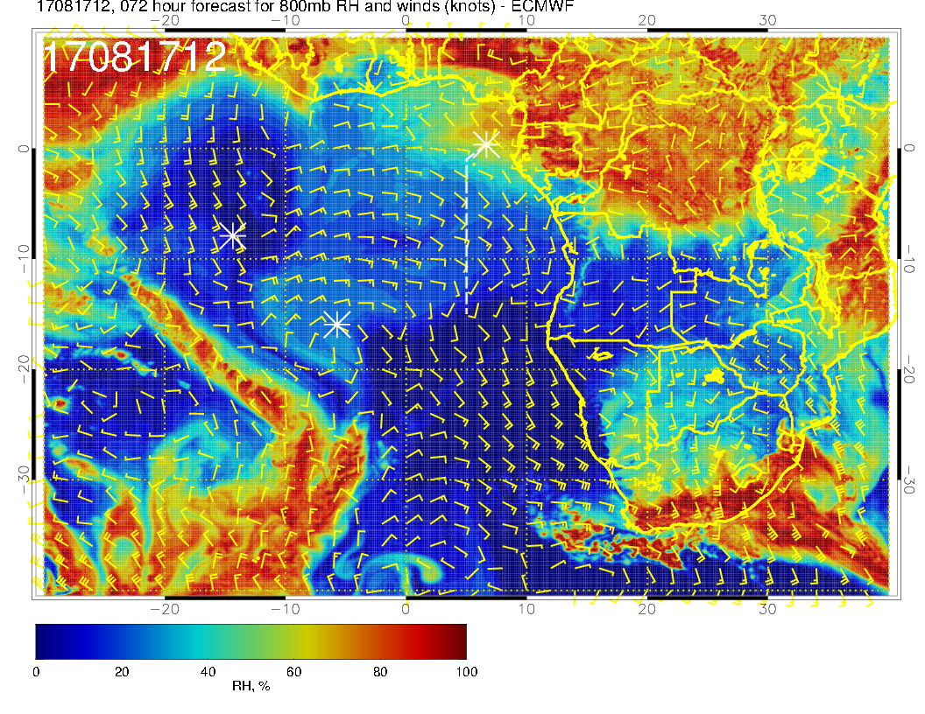
800mb (about 2 km), old forecast
Looking at old (this slide) and new (next slide) forecast for 2 km (level of lagrangian interest), we see little change in the position of the moisture surge. It may have slowed down a bit.

Slide 4
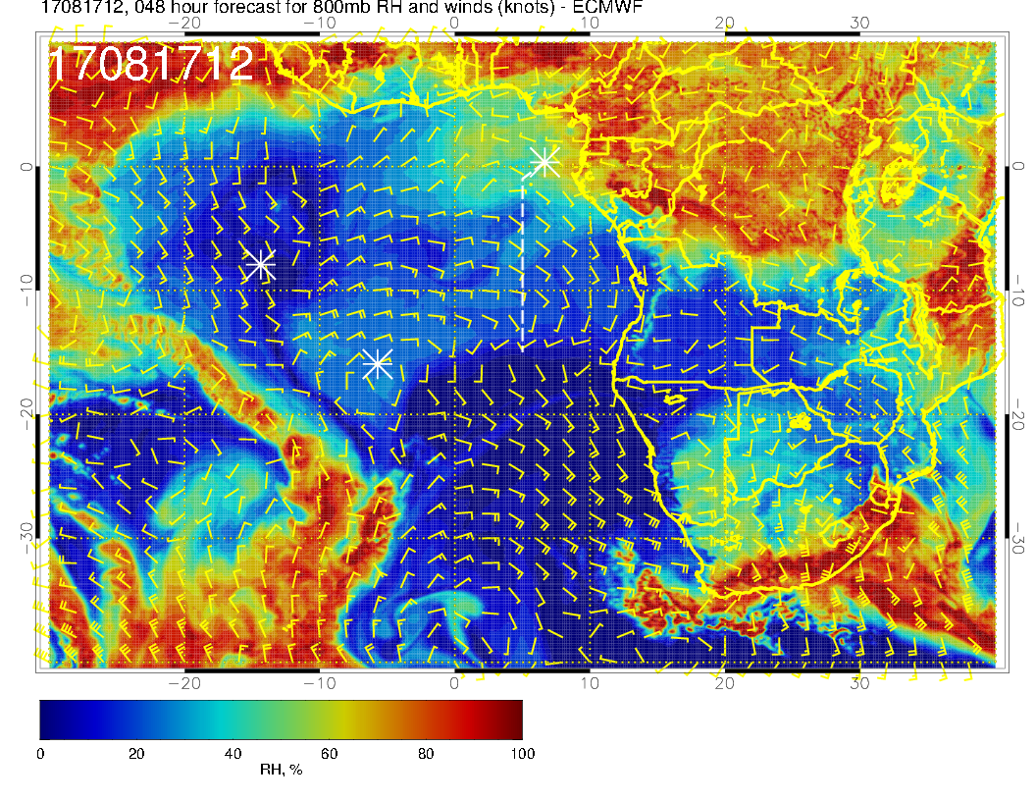
800mb (about 2 km), new forecast
Look at Lagrangian end point that Michael and Hans calculated

Slide 5
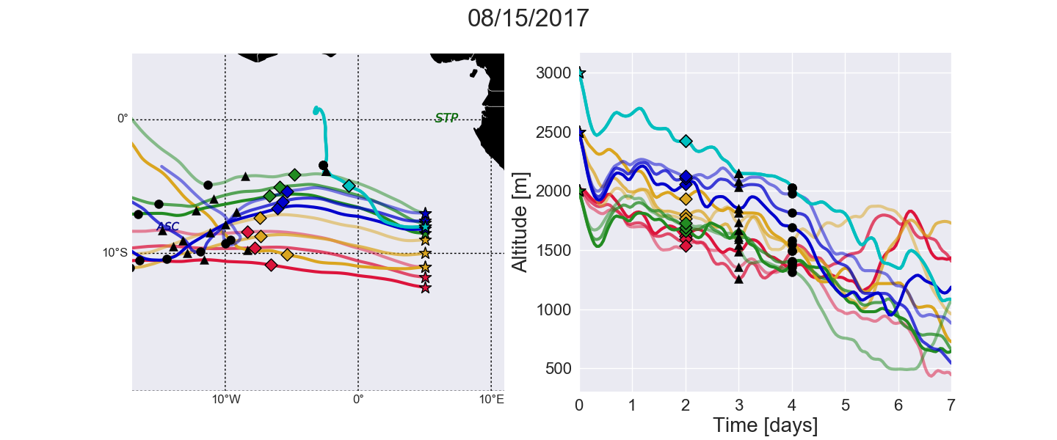
Trajectories are descending to from 1.5 km (4.9kft) to 2.2 km (7.2 kft).

Slide 6
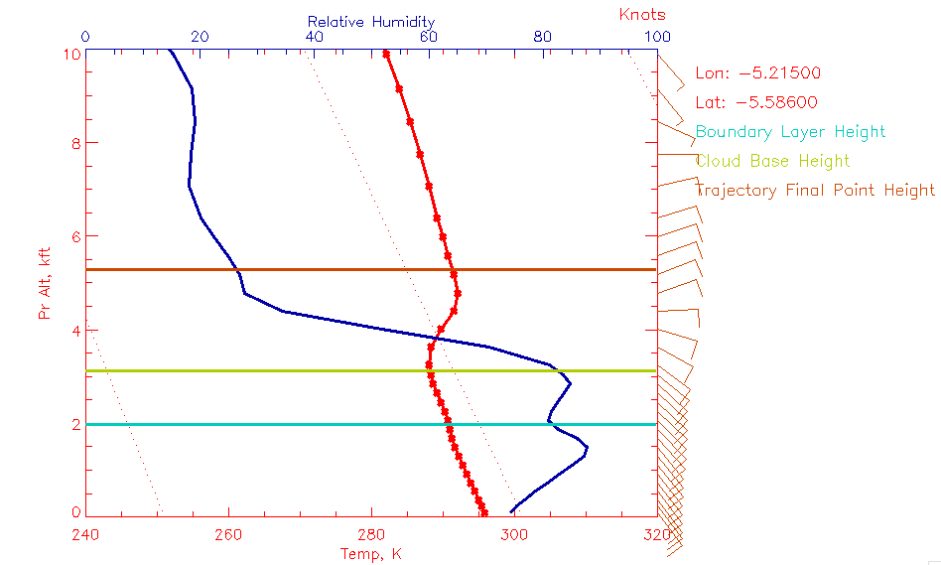
Sounding from model valid at 12Z, Aug 17. Trajectory final point height is above BL and RH gradient. This is the point marked on the map. Other points have the same behavior.

Slide 7
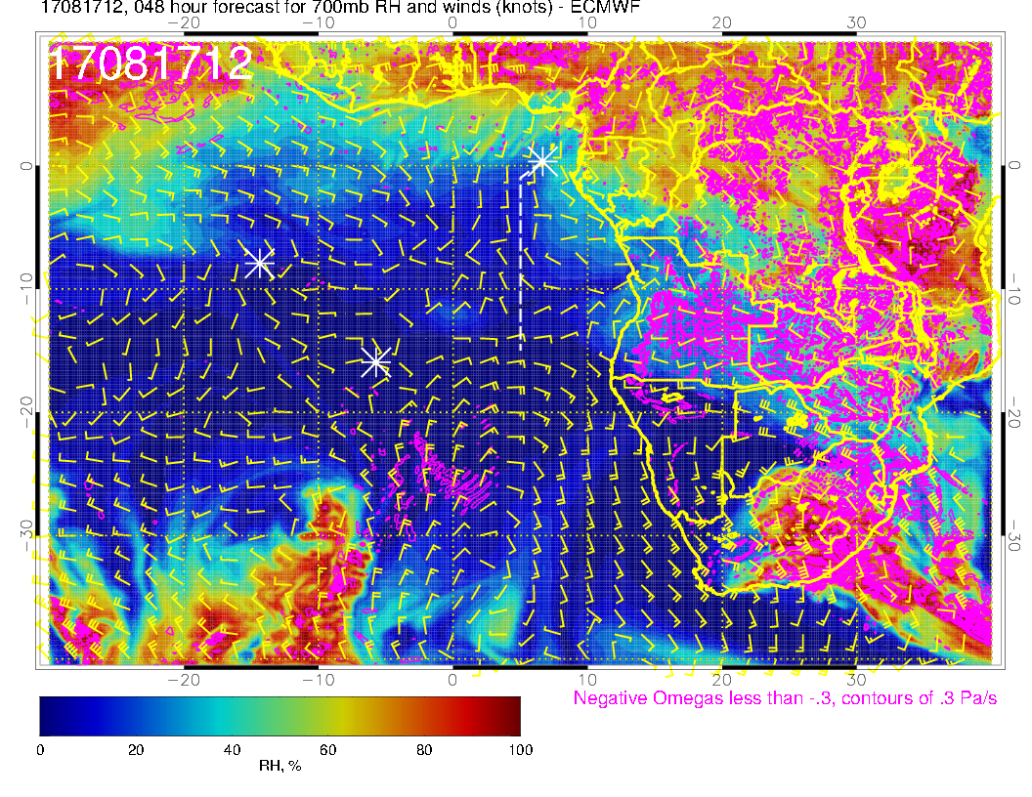
700mb (about 2 km), new forecast
700mb flow, dry as before

Slide 8
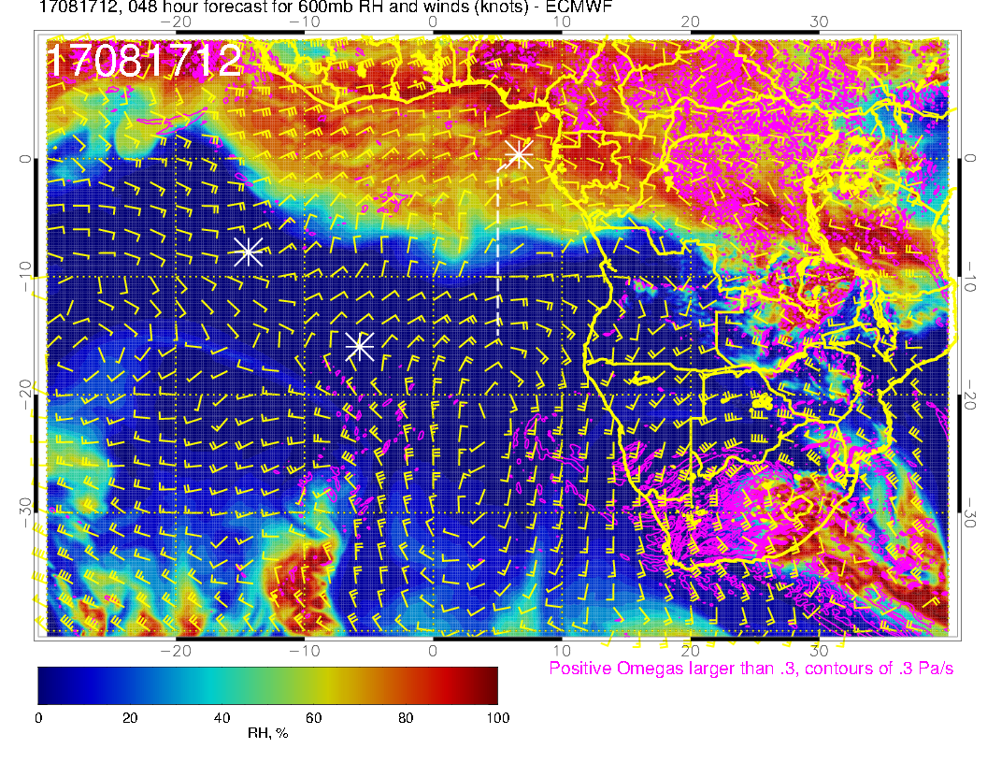
600mb (about 2 km), new forecast
RH is greater in this region than old forecast, so expect more middle cloud there.

Slide 9
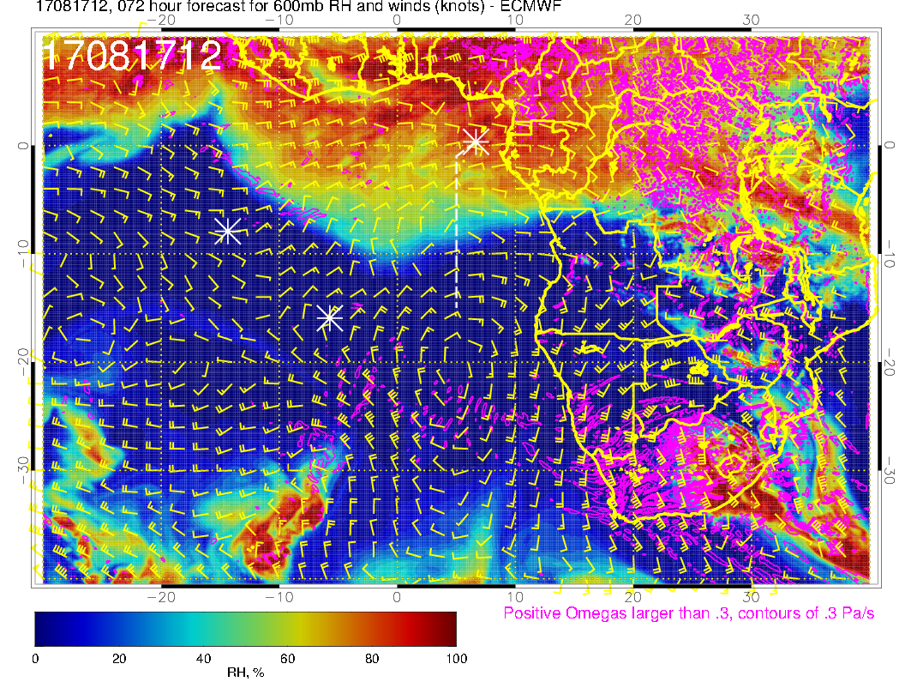
600mb (about 2 km), old forecast
Old forecast; comparison with new forecast shows surge in RH propagating to the west more rapidly

Slide 10
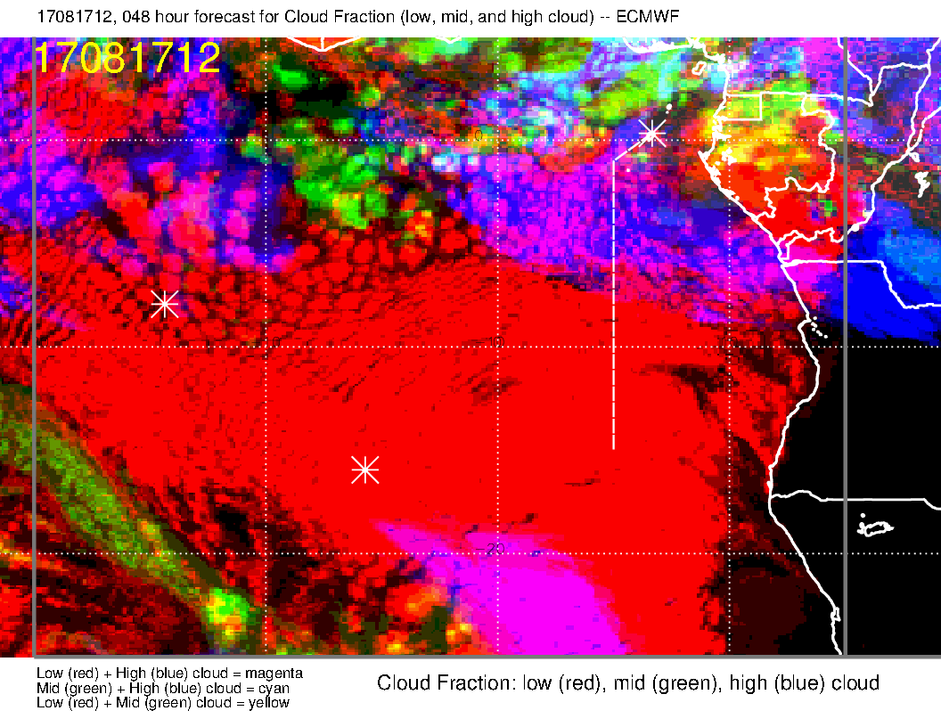
Most recent forecast. This indicates high cloud cover on first part of track. We are at the northern edge of the forecast SC deck. Middle clouds are enhanced relative to old fcst.

Slide 11
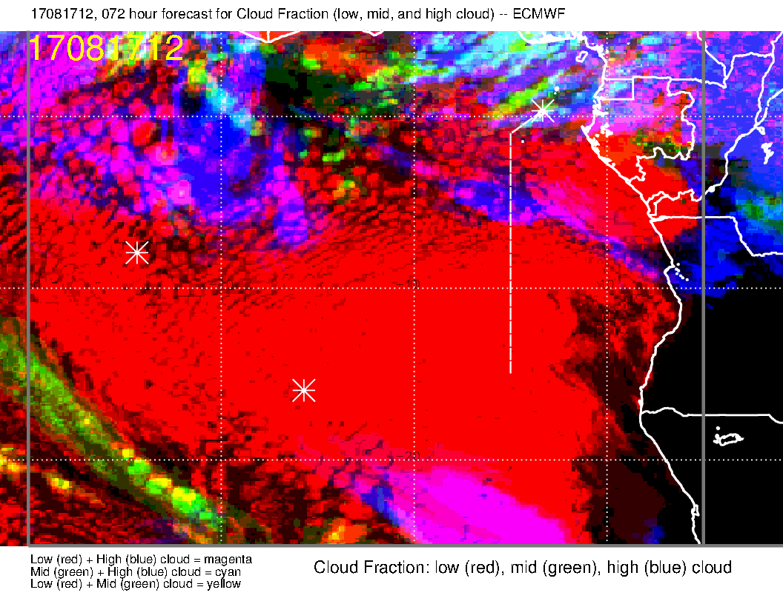
Yesterday’s forecast. No real consistency on the high clouds. Low clouds indicate a rough consistency. Middle clouds are less in old fcst, as we expected based on 600mb RH.

Slide 12
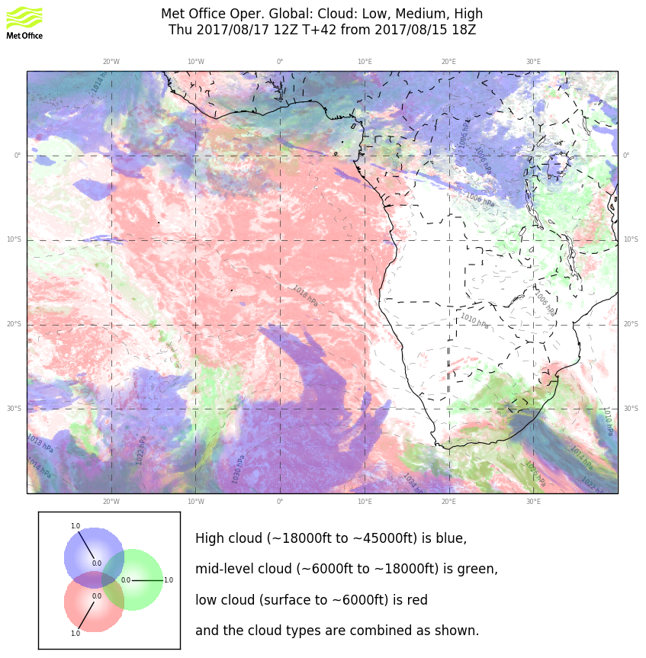
Model comparison. These clearly diverge for high and middle clouds. Based on comparison and experience, I think UKMO is underpredicting. I expect thin high clouds to about the prime meridian.

Slide 13
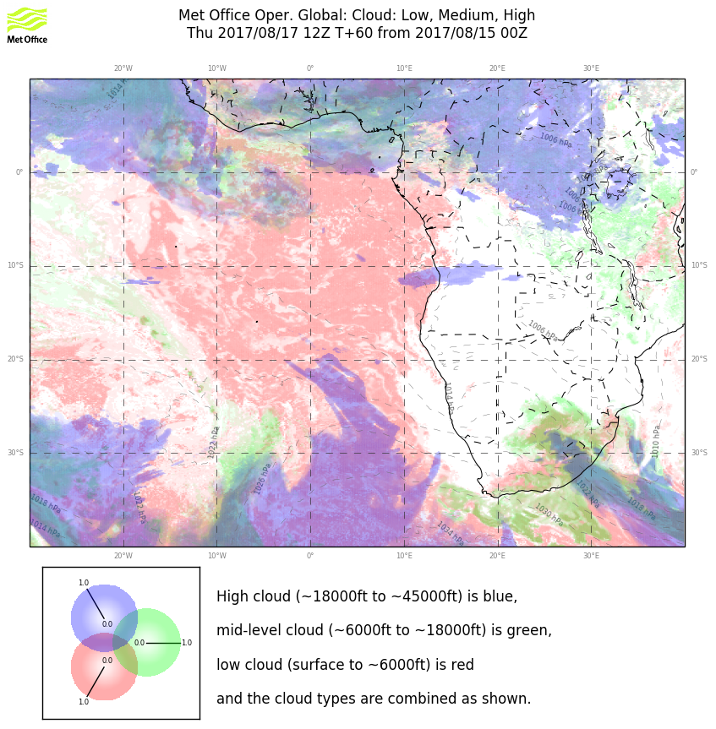
Yesterday’s forecast. UKMO is more consistent between forecasts, but is it right?

Slide 14
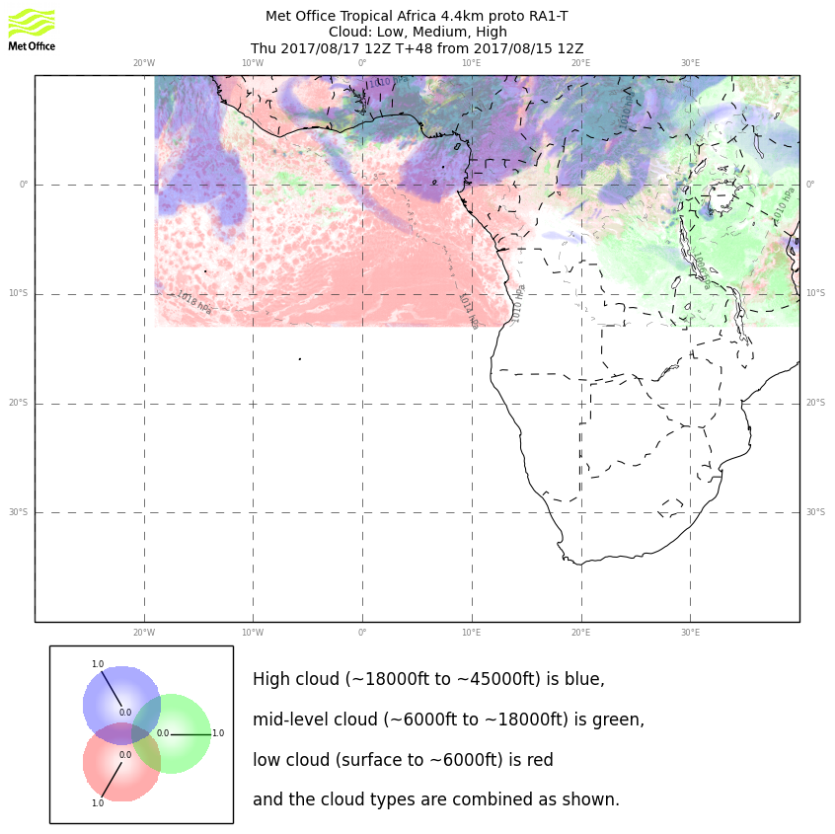
Model comparison with the met office 4 km model. Agreement for high clouds AND low clouds is much better!!. I expect thin high clouds to about the prime meridian. UKMO new model is getting the clear area (formerly known as the gap) much better. [UKMO also has a research global – results much the same as the operational global]

Slide 15
Cloud Model verification

Slide 16
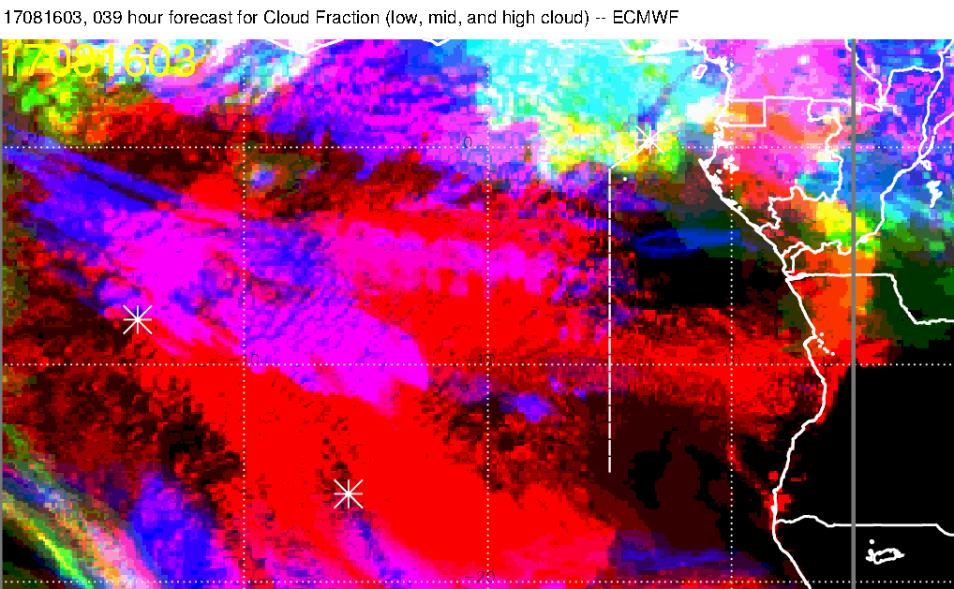
Forecast for this morning (right, 39 hours, 3 AM) and 4:45 image at left. (Note that cropping is consistent EXCEPT for the top). Forecast is actually not bad for high clouds on the really gross features. As usual, low cloud clearing on the Ang/Nam coast is overpredicted, and underpredicted elsewhere

Slide 17
Forecast for this morning (right, 39 hours, 3 AM) and 4:45 image at left, UKMO comparison. UKMO misses the thin clouds in this region.

Slide 18
Another model comparison with forecast (yesterday). At 12Z can see thin high clouds on the routine track to 6S (maybe further in reality)

Slide 19
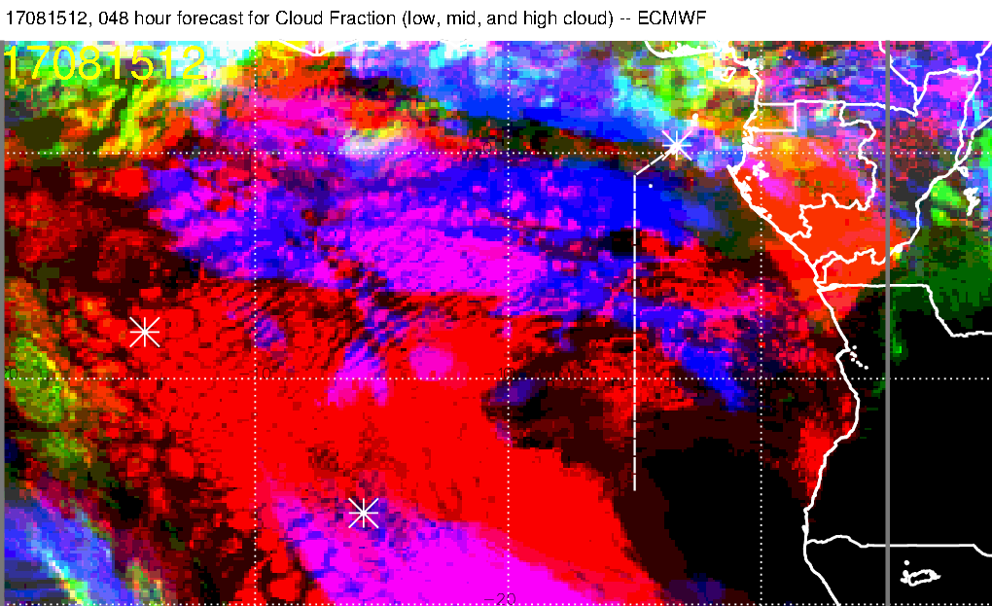
48 hour forecast was pretty good. UKMO underpredicting
Based on: EC agreement with 4 km met office model and better verification with two
recent cases (yesterday and this morning), I will go with the EC forecast for high clouds

Slide 20
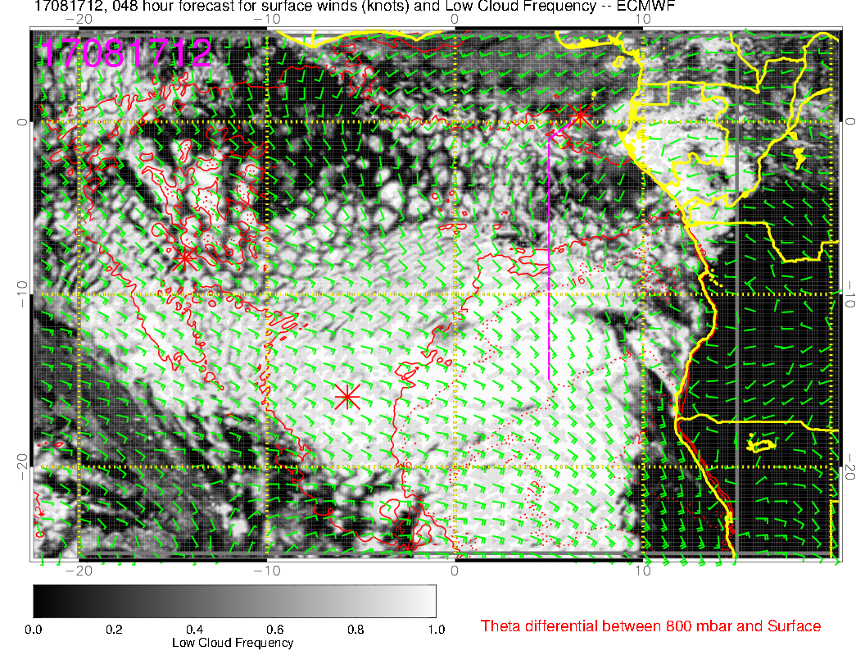
Most recent forecast for low clouds. We are north of the main deck, and will probably spend a lot of time in scattered and broken clouds in the first half of the flight.

Slide 21
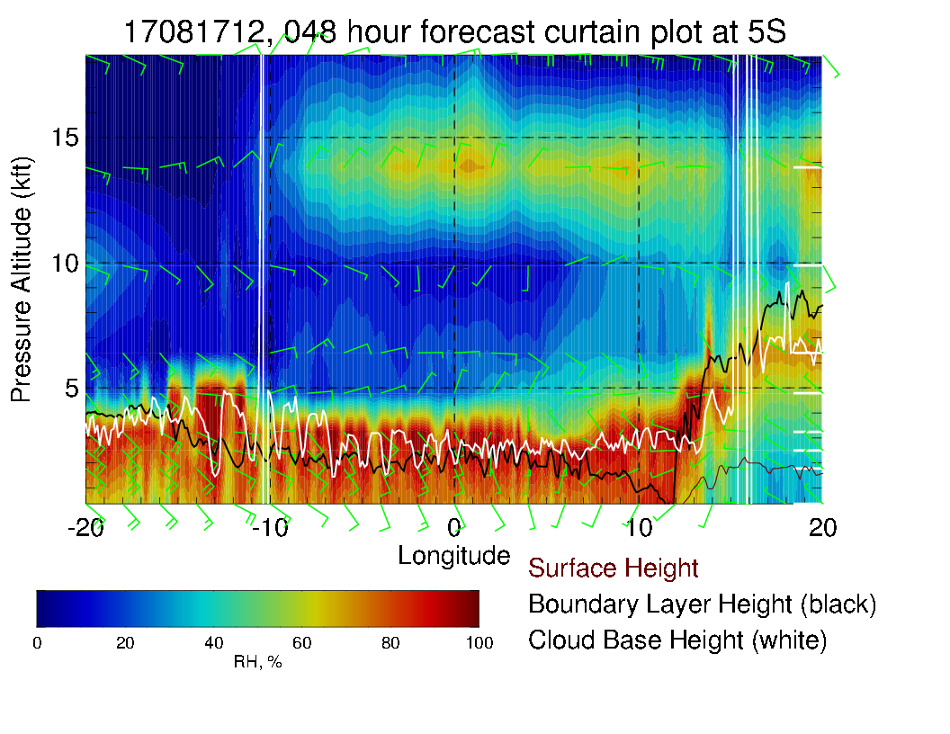
5S Xsect reflects surge of moisture from the north. Enhanced relative to yesterday’s forecast. “On the way” to beginning of Lagrangian points, see enhancement relative to yesterday’s forecast. See deeper low clouds in the model near Ascension’s longitude

Slide 22
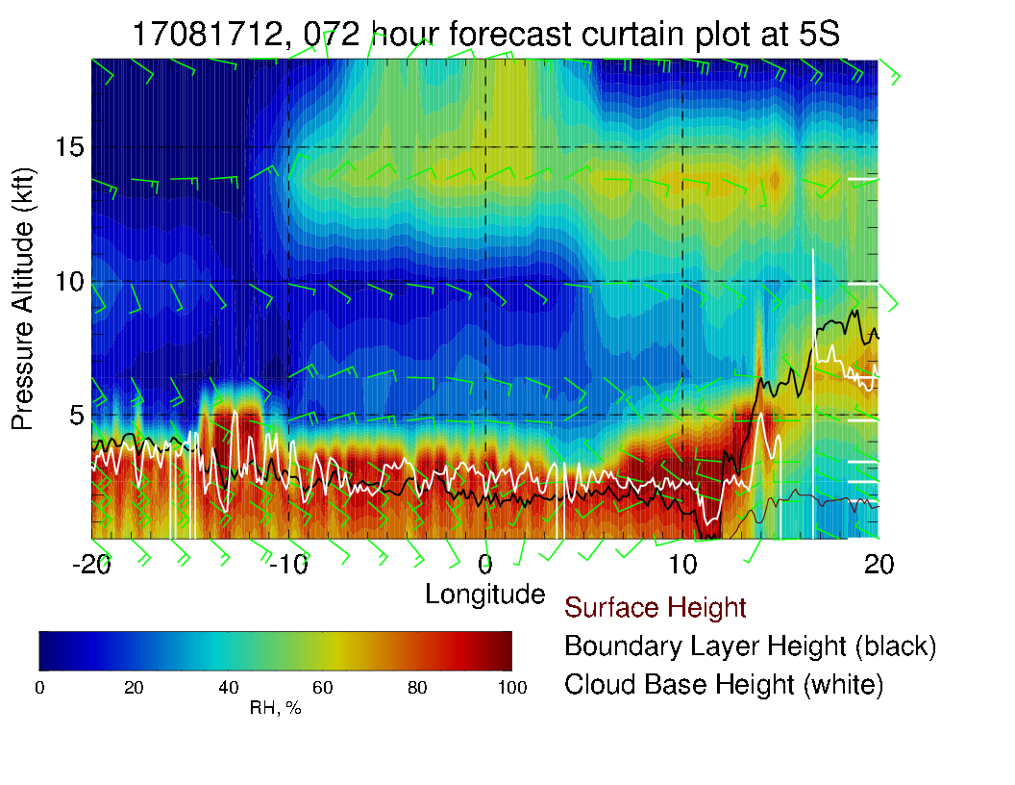
5S Xsect reflects surge of moisture from the north. Similar to yesterday’s fcst

Slide 23
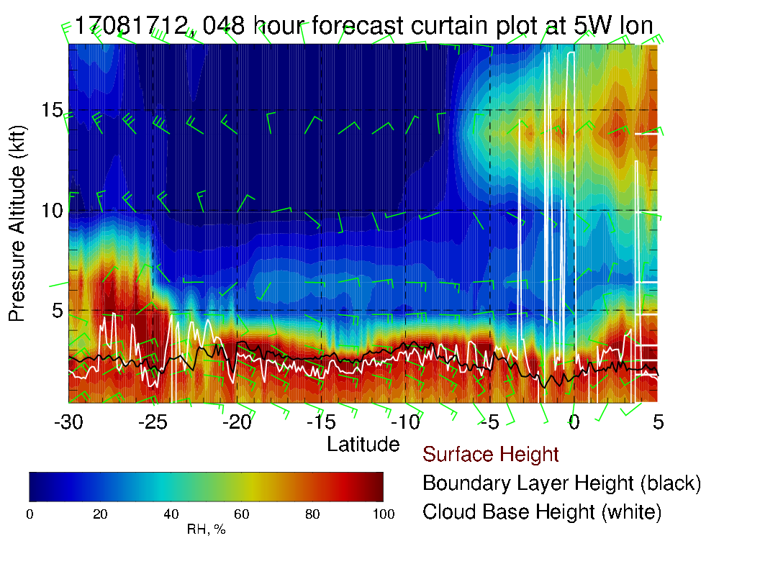
Note region of clearing between 0 and 5S. Surge of moisture seen at 600mb.

Slide 24
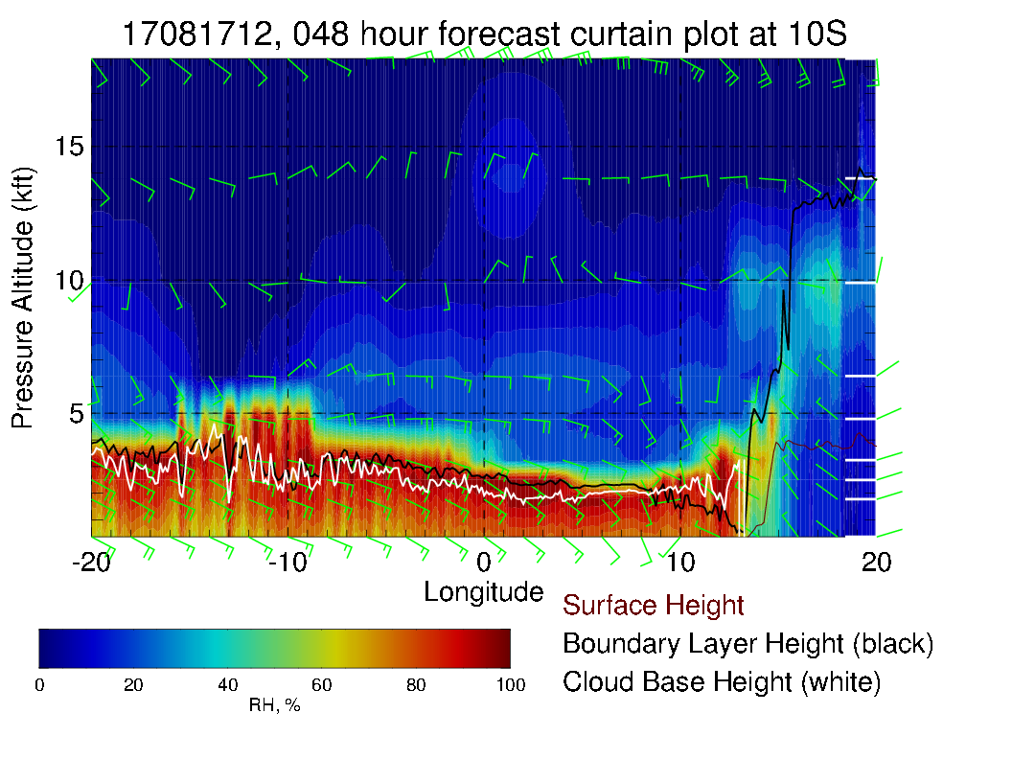
No middle cloud in this region – see the enhanced moisture plume to the east of
Note region of clearing between 0 and 5S. Surge of moisture seen at 800mb, not reaching Ascension.

Slide 25
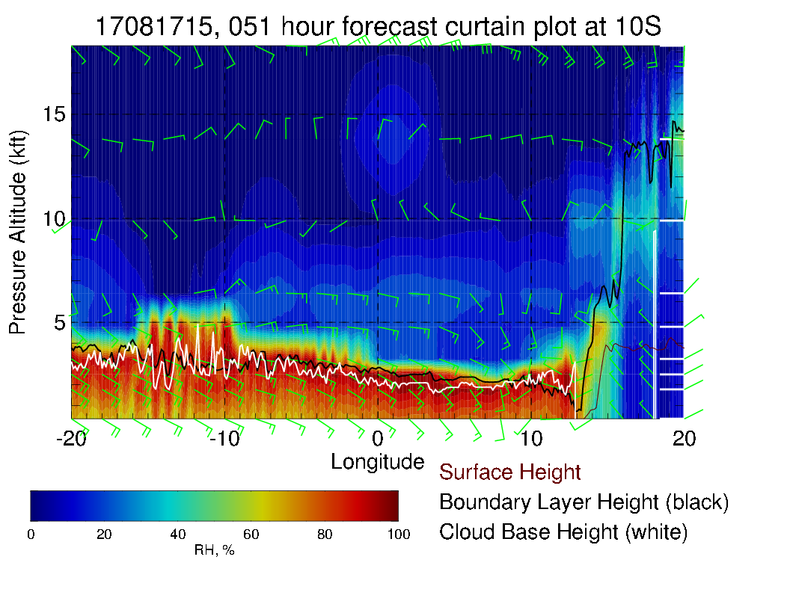
3 hours later (closer to end of flight). Slight westward motion in the moisture plume and in the boundary layer height (elevated low clouds).

Slide 26
Friday (Lokal Flug)
Surge of 800mb RH is approaching Ascension on this day – retarded compared to old forecast.
High and middle clouds look good (there are none nearby).
New forecast suggests more low cloud than old one.
Region of higher, pop-up broken/scattered large cell startocu is further east than previous forecast.

Slide 27
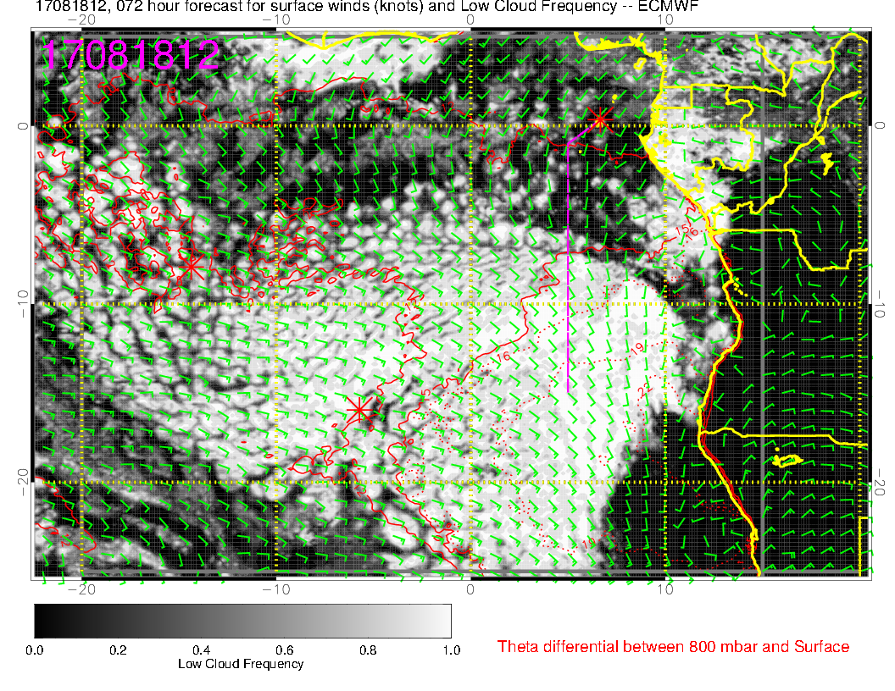
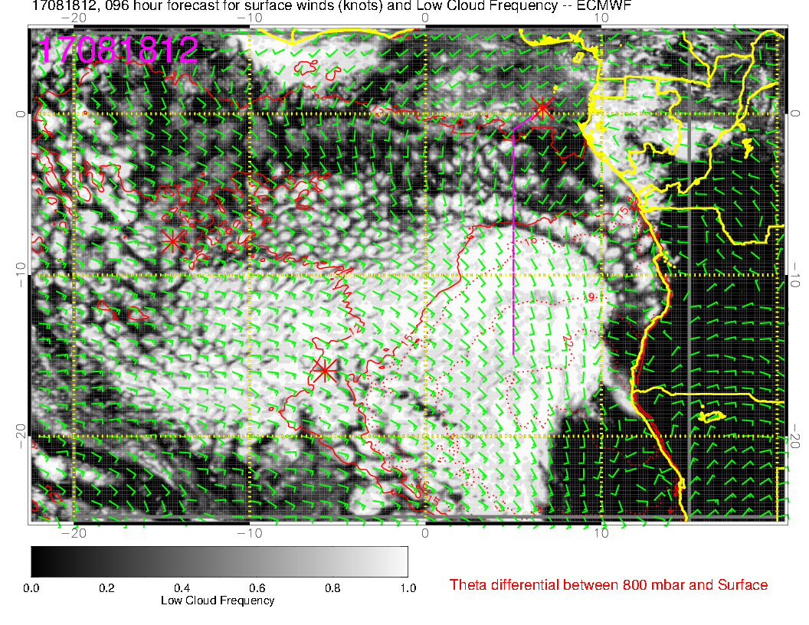
New (above) and Old (right) forecasts. Most patterns are consistent, but Ascension has more clouds than in old forecast.

Slide 28
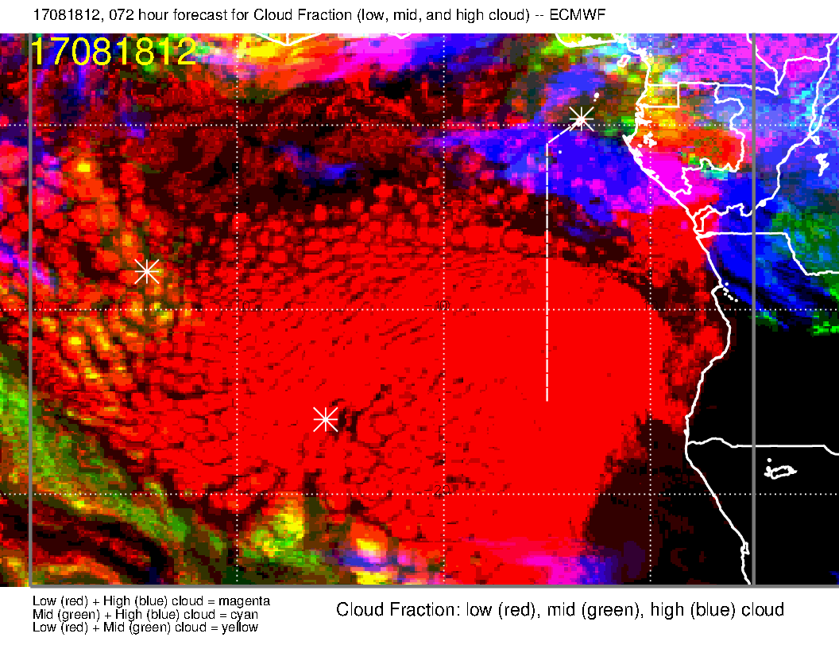
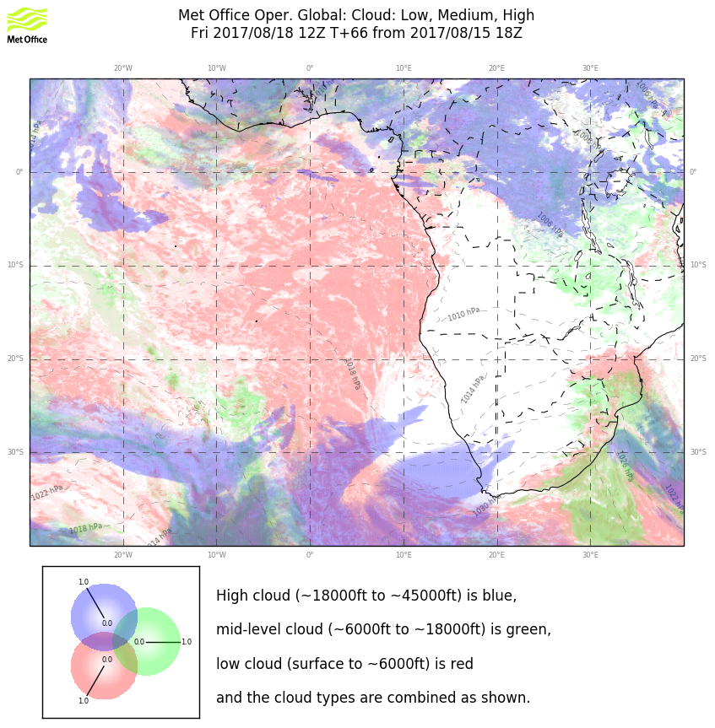
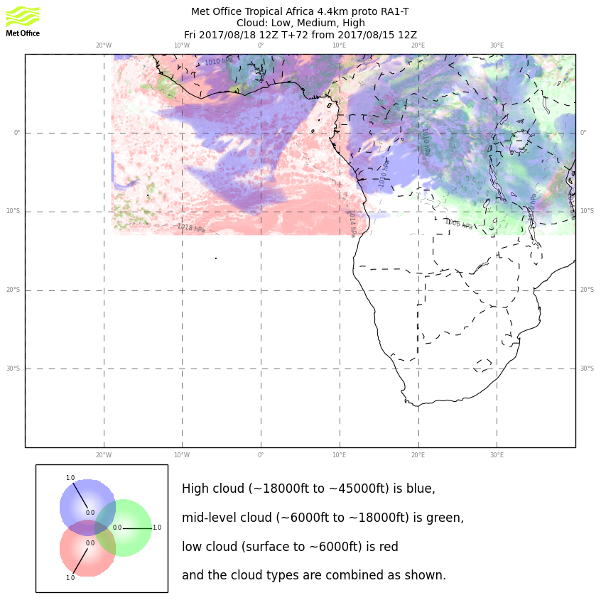
Yahoo! Models agree on the high and middle cloud over Ascension. UKMO 4 km is particularly pessimistic about low cloud. I think we will be in the zone where cells are larger and farther apart, with higher low clouds.

Slide 29
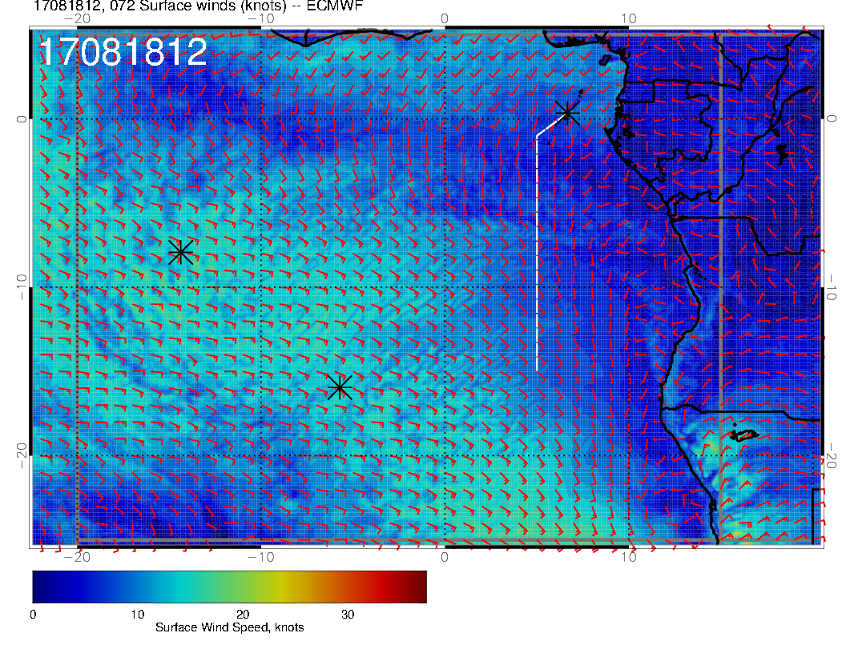
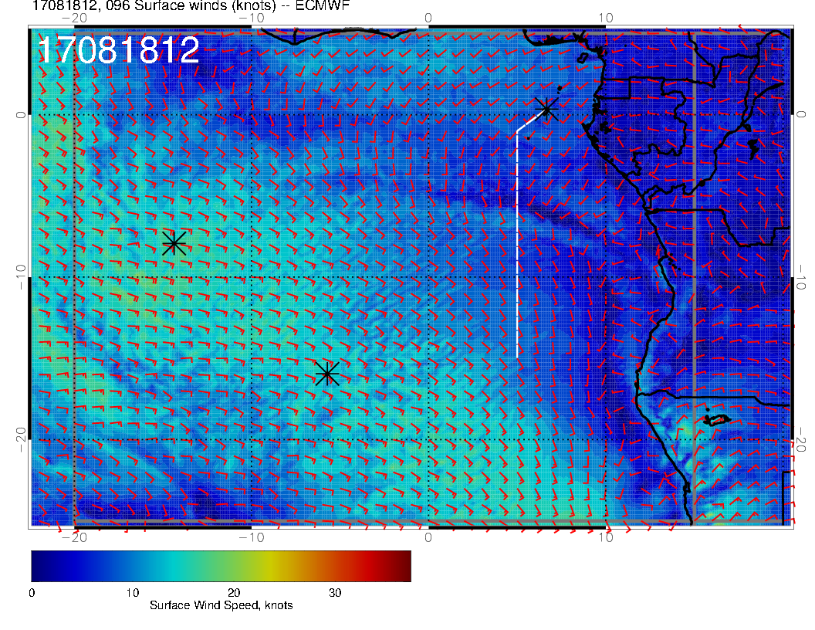
Surface wind speed (new forecast, above) has same direction but is less than in old forecast (right)

Slide 30
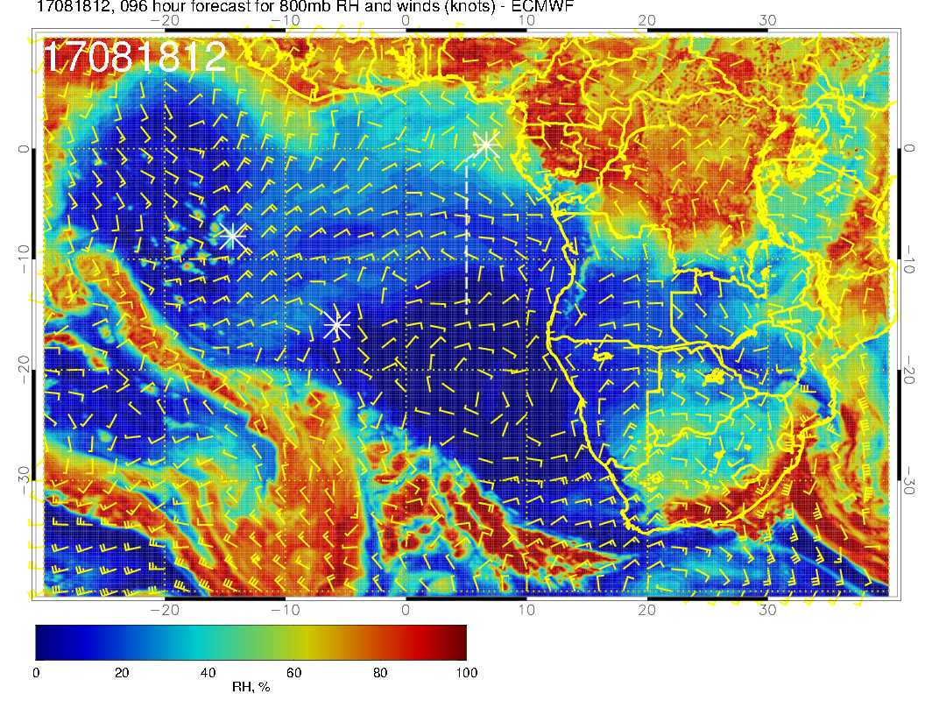
Old forecast
Surge of moisture is more dissipated at Ascension than in previous forecast, and the popups are further east in the new forecast.

Slide 31
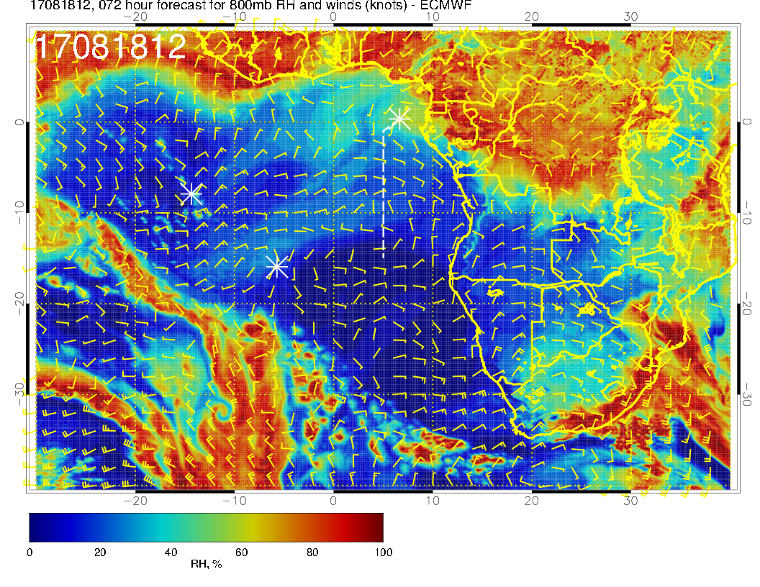
New forecast
SO, for this day, forecasts agree

Slide 32
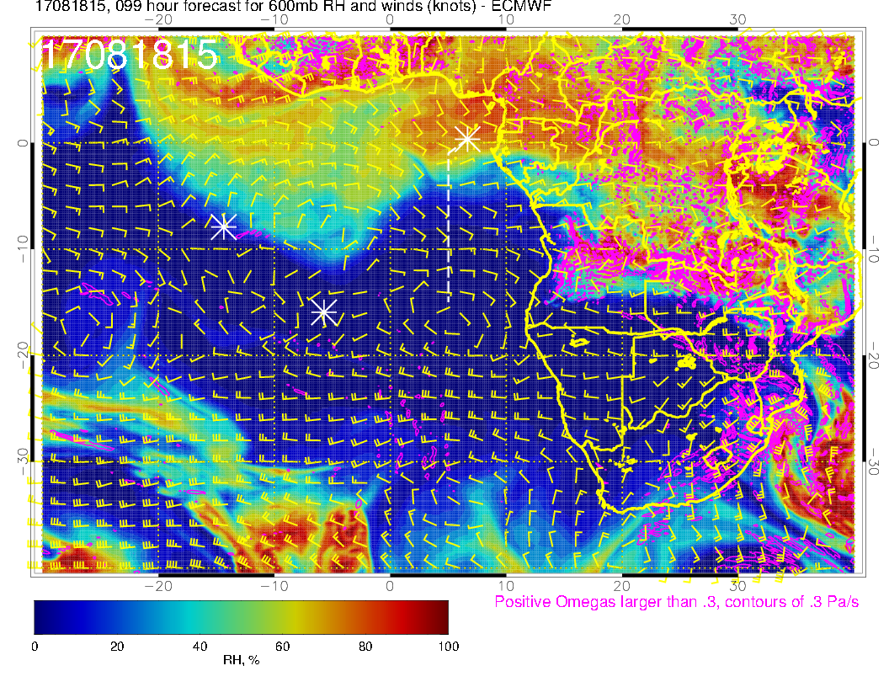

Slide 33
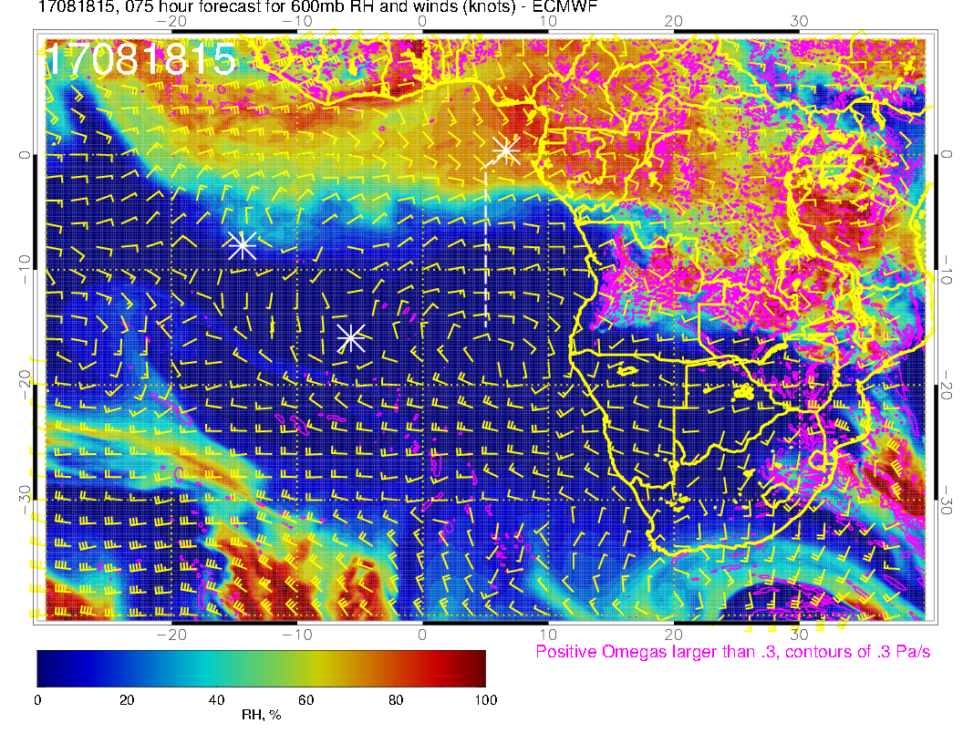
Newer forecast has 600mb northern surge of moisture propagating more rapidly. There actually is more moisture getting to Ascension than in previous forecast

Slide 34
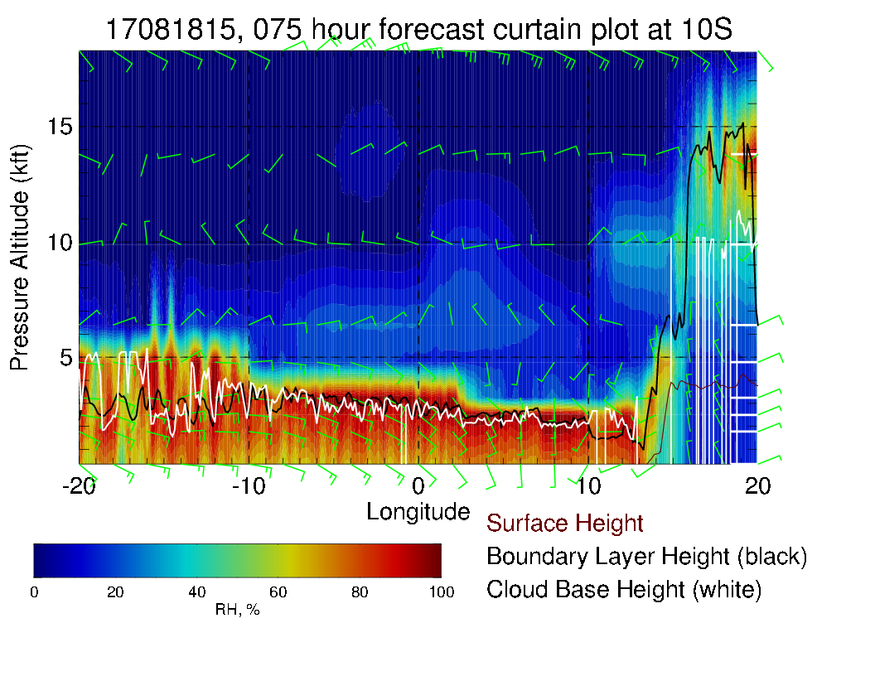
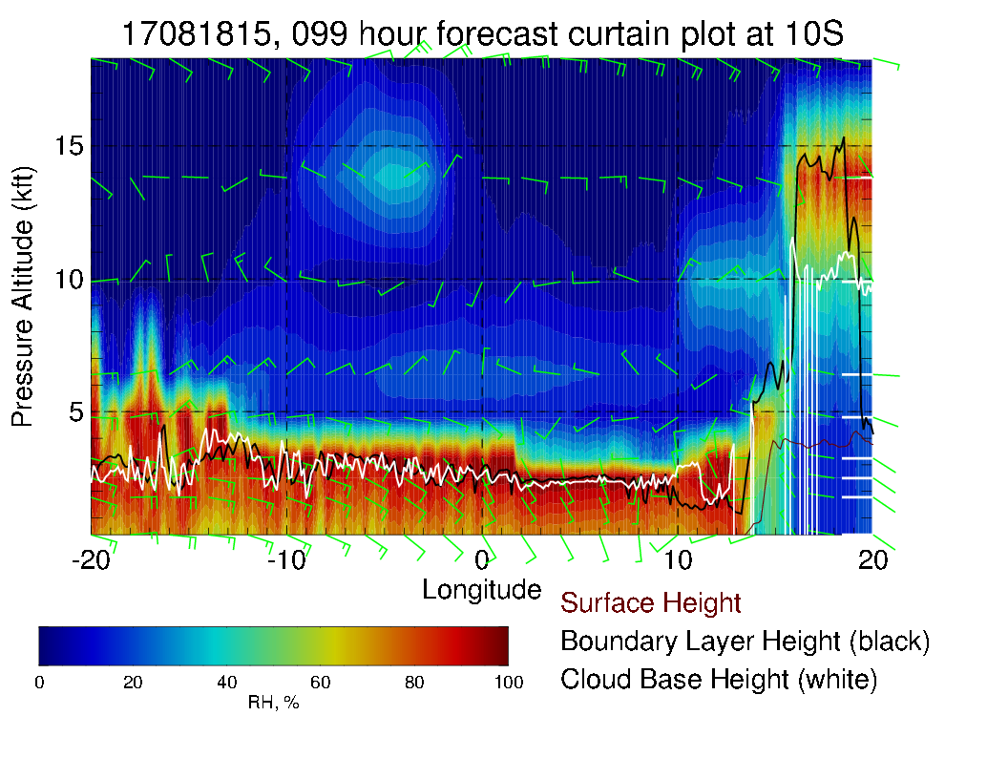

Slide 35
Evolution of flow through Saturday 8/19

Slide 36
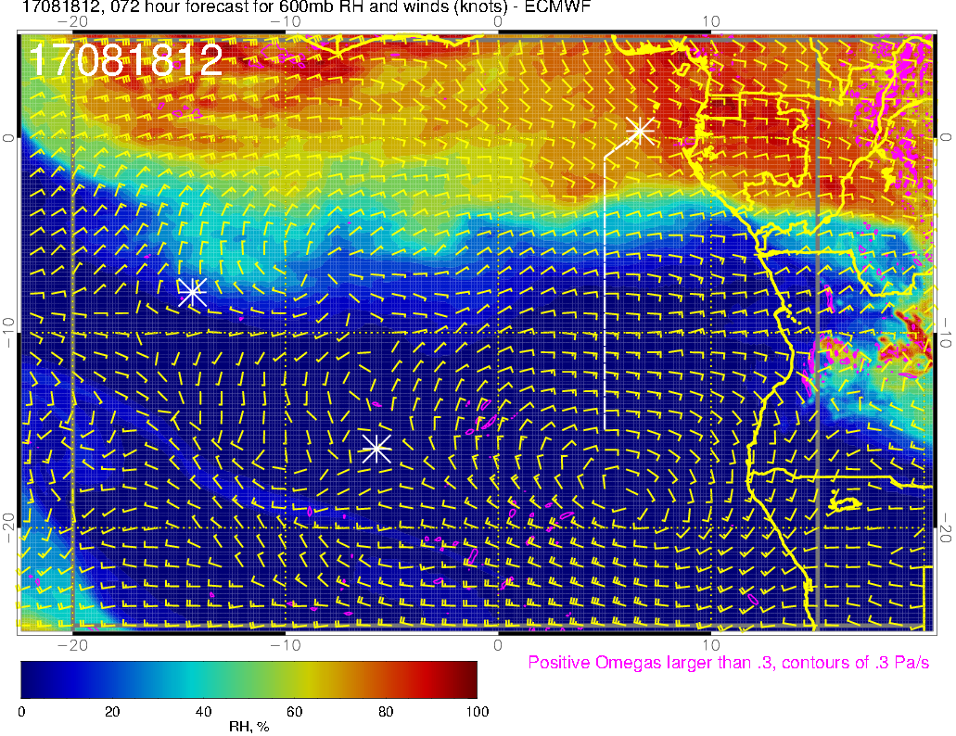
Moist air near Ascension (wrapped around from the N
600 mb (8/18 @ 12PM)

Slide 37
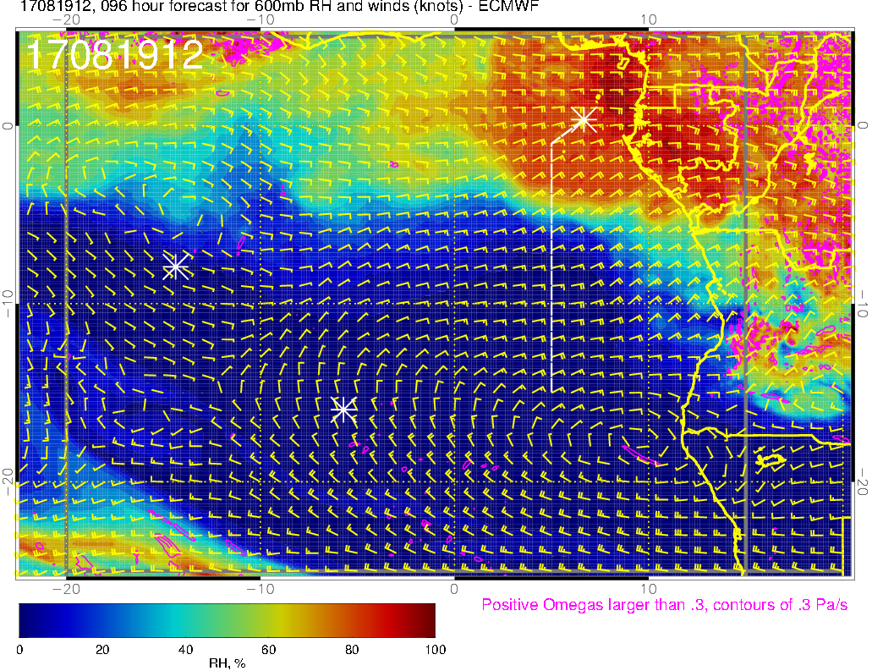
Moist air has moved NW (air surrounding ASI is much drier than yesterday’s forecast)
new plume of moist air is moving westward (faster than yesterday’s forecast)
600 mb (8/19 @ 12PM)

Slide 38
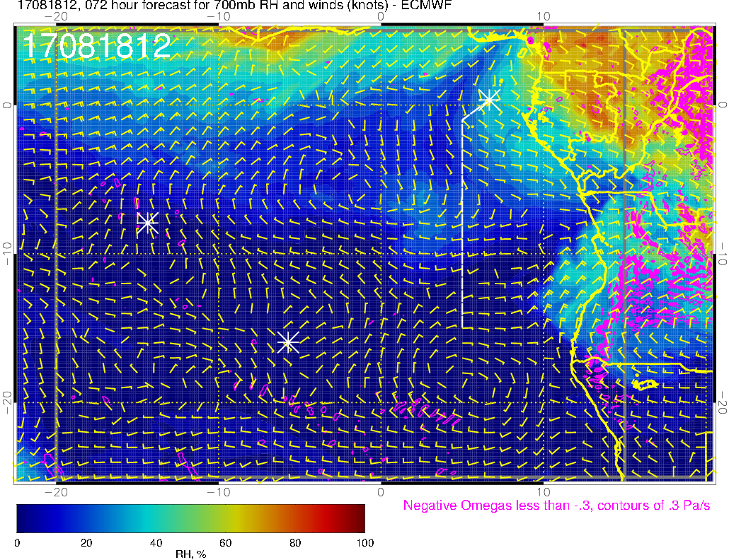
700 mb (8/18 @ 12PM)

Slide 39
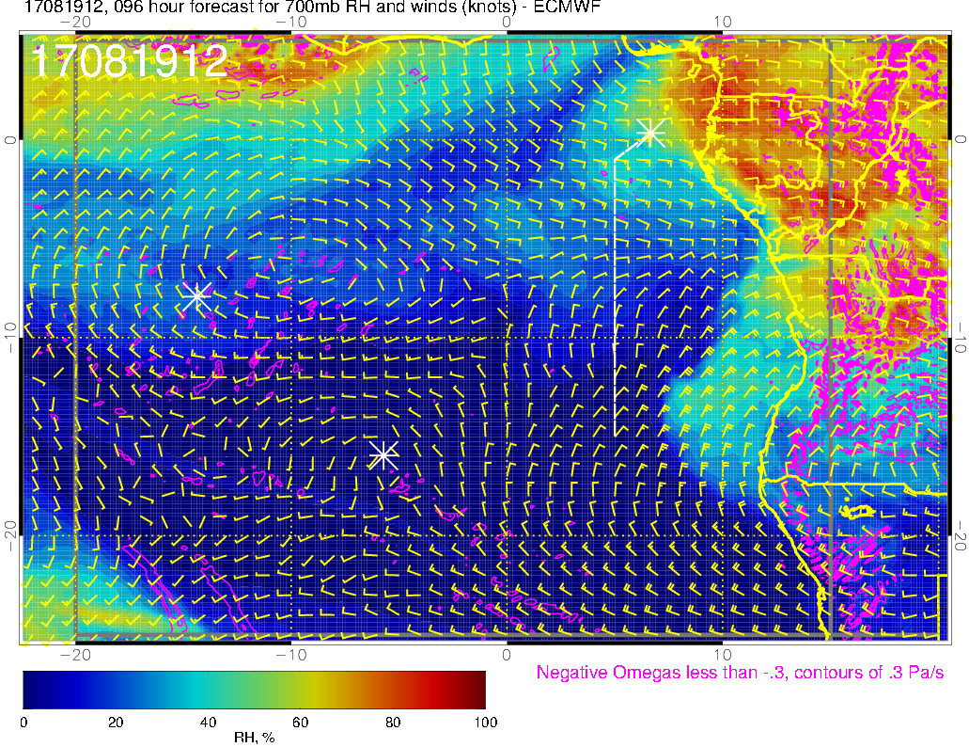
Likely associated with mid clouds, drier air to the east
Moisture wrapped around from the north (more moist than yesterday’s forecast)
700 mb (8/19 @ 12PM)

Slide 40
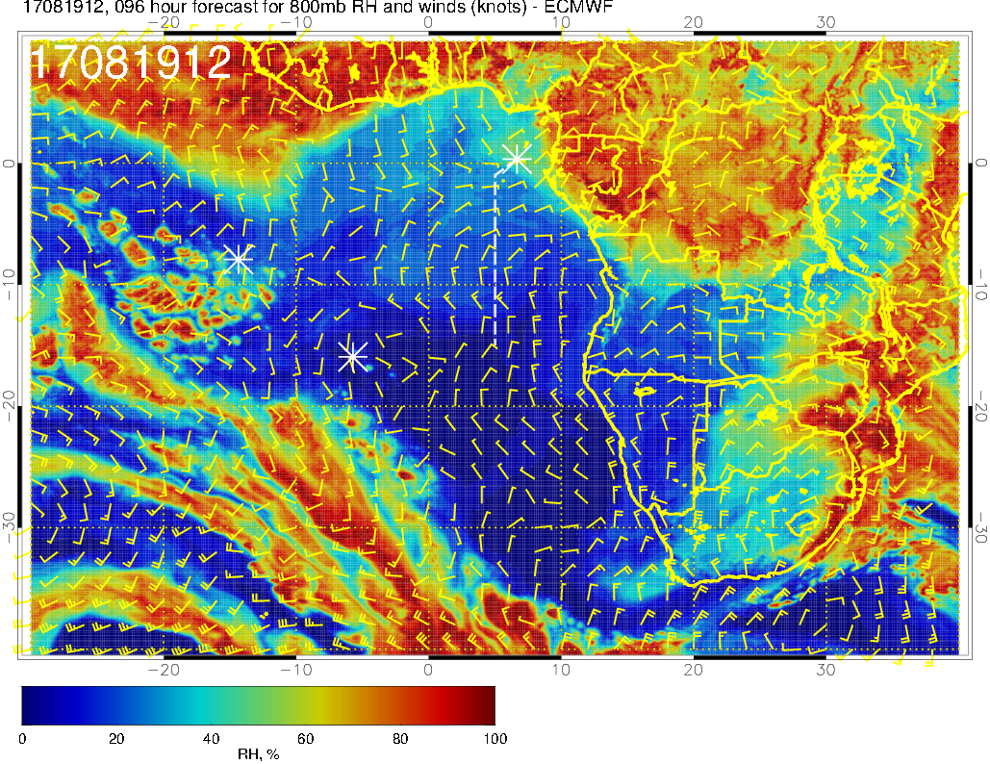
This region is also moist at 800mb
800 mb (8/19 @ 12PM)

Slide 41
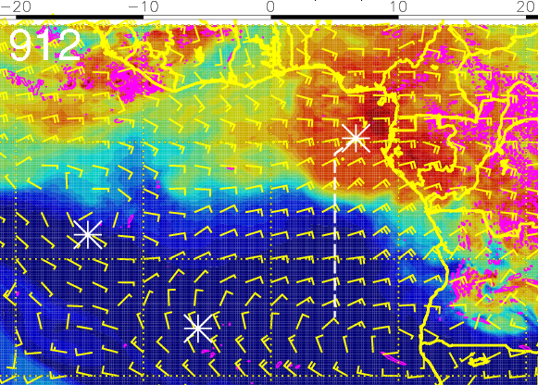
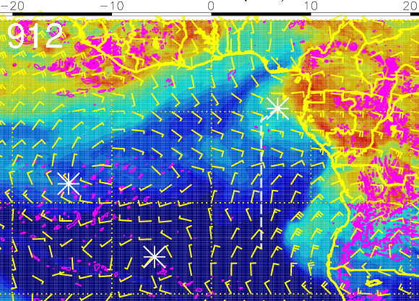
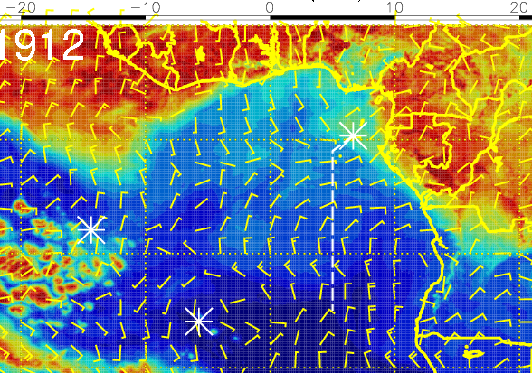
RH (color), winds, vert. velocity (pink) at 8/19 Sat @ 12PM
600 mb
700 mb
600-800mb RH is high off the continent north of ASI and west of 10W – expect some middle and high clouds (drier further east)
Moist air near ASI at 700-800mb is primarily from moist convection to the north
Moist air at 600mb over TMS to~ 5S
800 mb

Slide 42
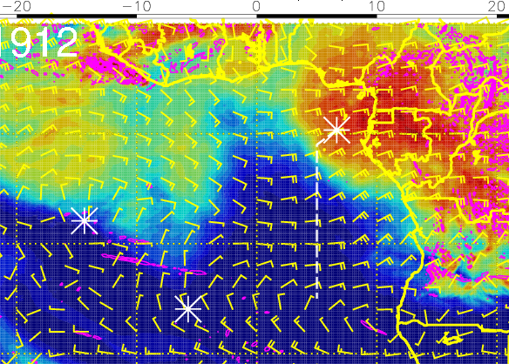
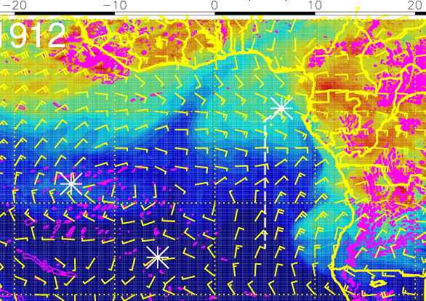
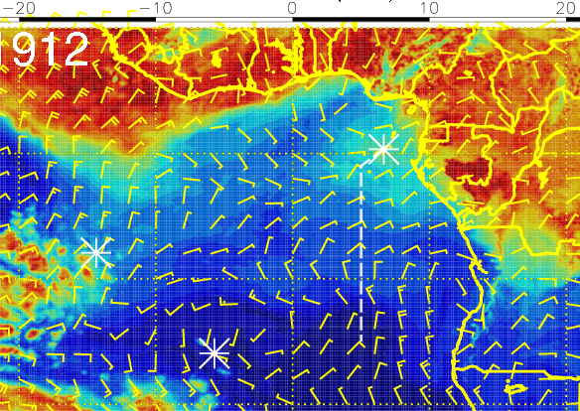
RH (color), winds, vert. velocity (pink) at 8/19 Sat @ 12PM
600 mb
700 mb
Moist air north of ASI at 600mb originated over African coast east of TMS (westward transport)
Moist air north of ASI at 800mb is from moist convection to the north and east
800 mb

Slide 43
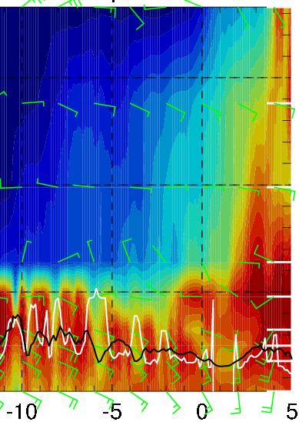
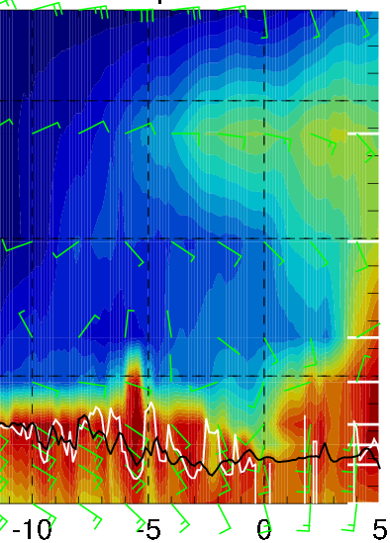
Latitudinal cross-sections of RH (color), wind, BL and cloud base heights
on 8/19 Sat @ 12 PM
Eastern edge of the moist air north of 2N (mid clouds appear west of 10W)
New plume of moist air from the east at 600mb ~15 kft
Latitude along 10W
BL heights (black contours or alternatively, vertical gradient in RH) increase to the south and west
Latitude along 5W

Slide 44
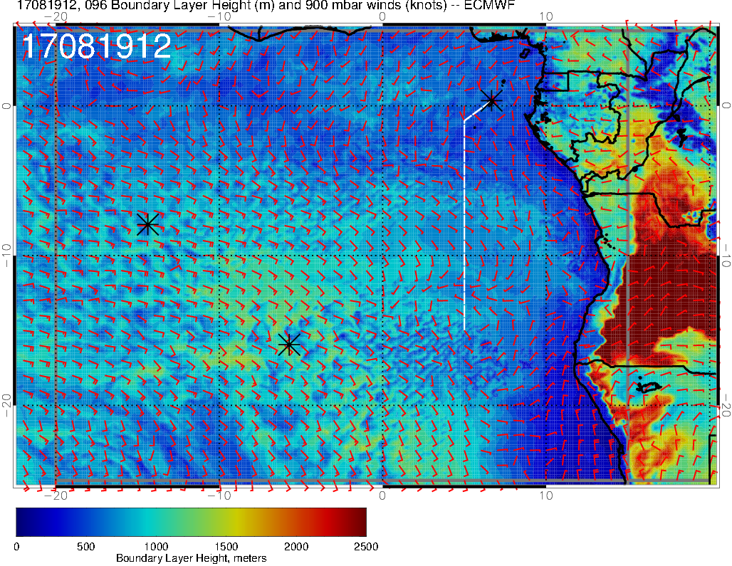
BL height forecast for 8/19 Sat @ 12PM
zonal gradient in BL heights along 8S is relatively small

Slide 45
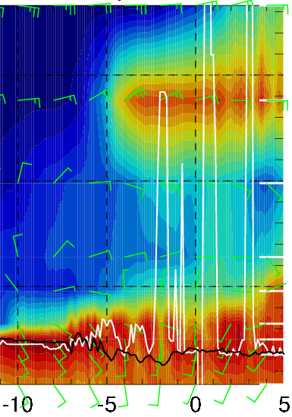
RH (color), wind, BL and cloud base heights along 5E, 8/19 Sat @ 12PM
15-25 knts
15-25 knts
5-15 knts
Big surge of moisture from the east at 15 kft: north of ~5S along the routine flight track
Strong (15-25 knots) easterly crosswinds at 15 kft, weaker winds below
Surface winds are near climatology (~10 knots S)

Slide 46
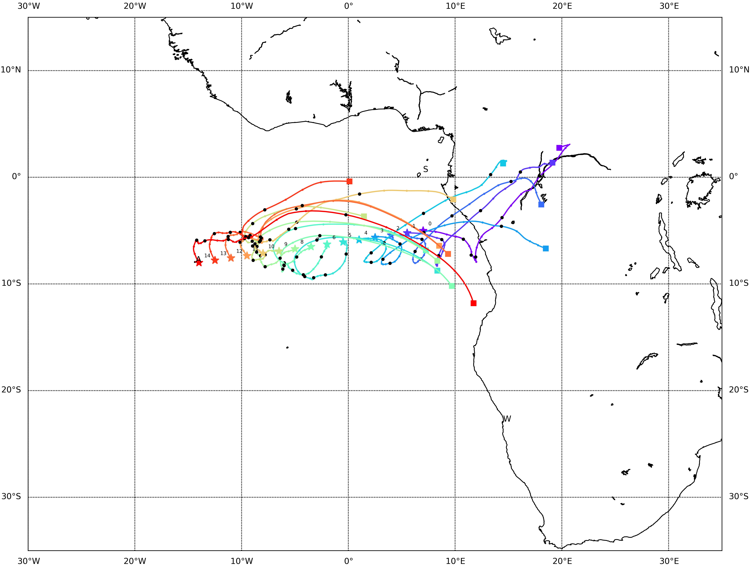
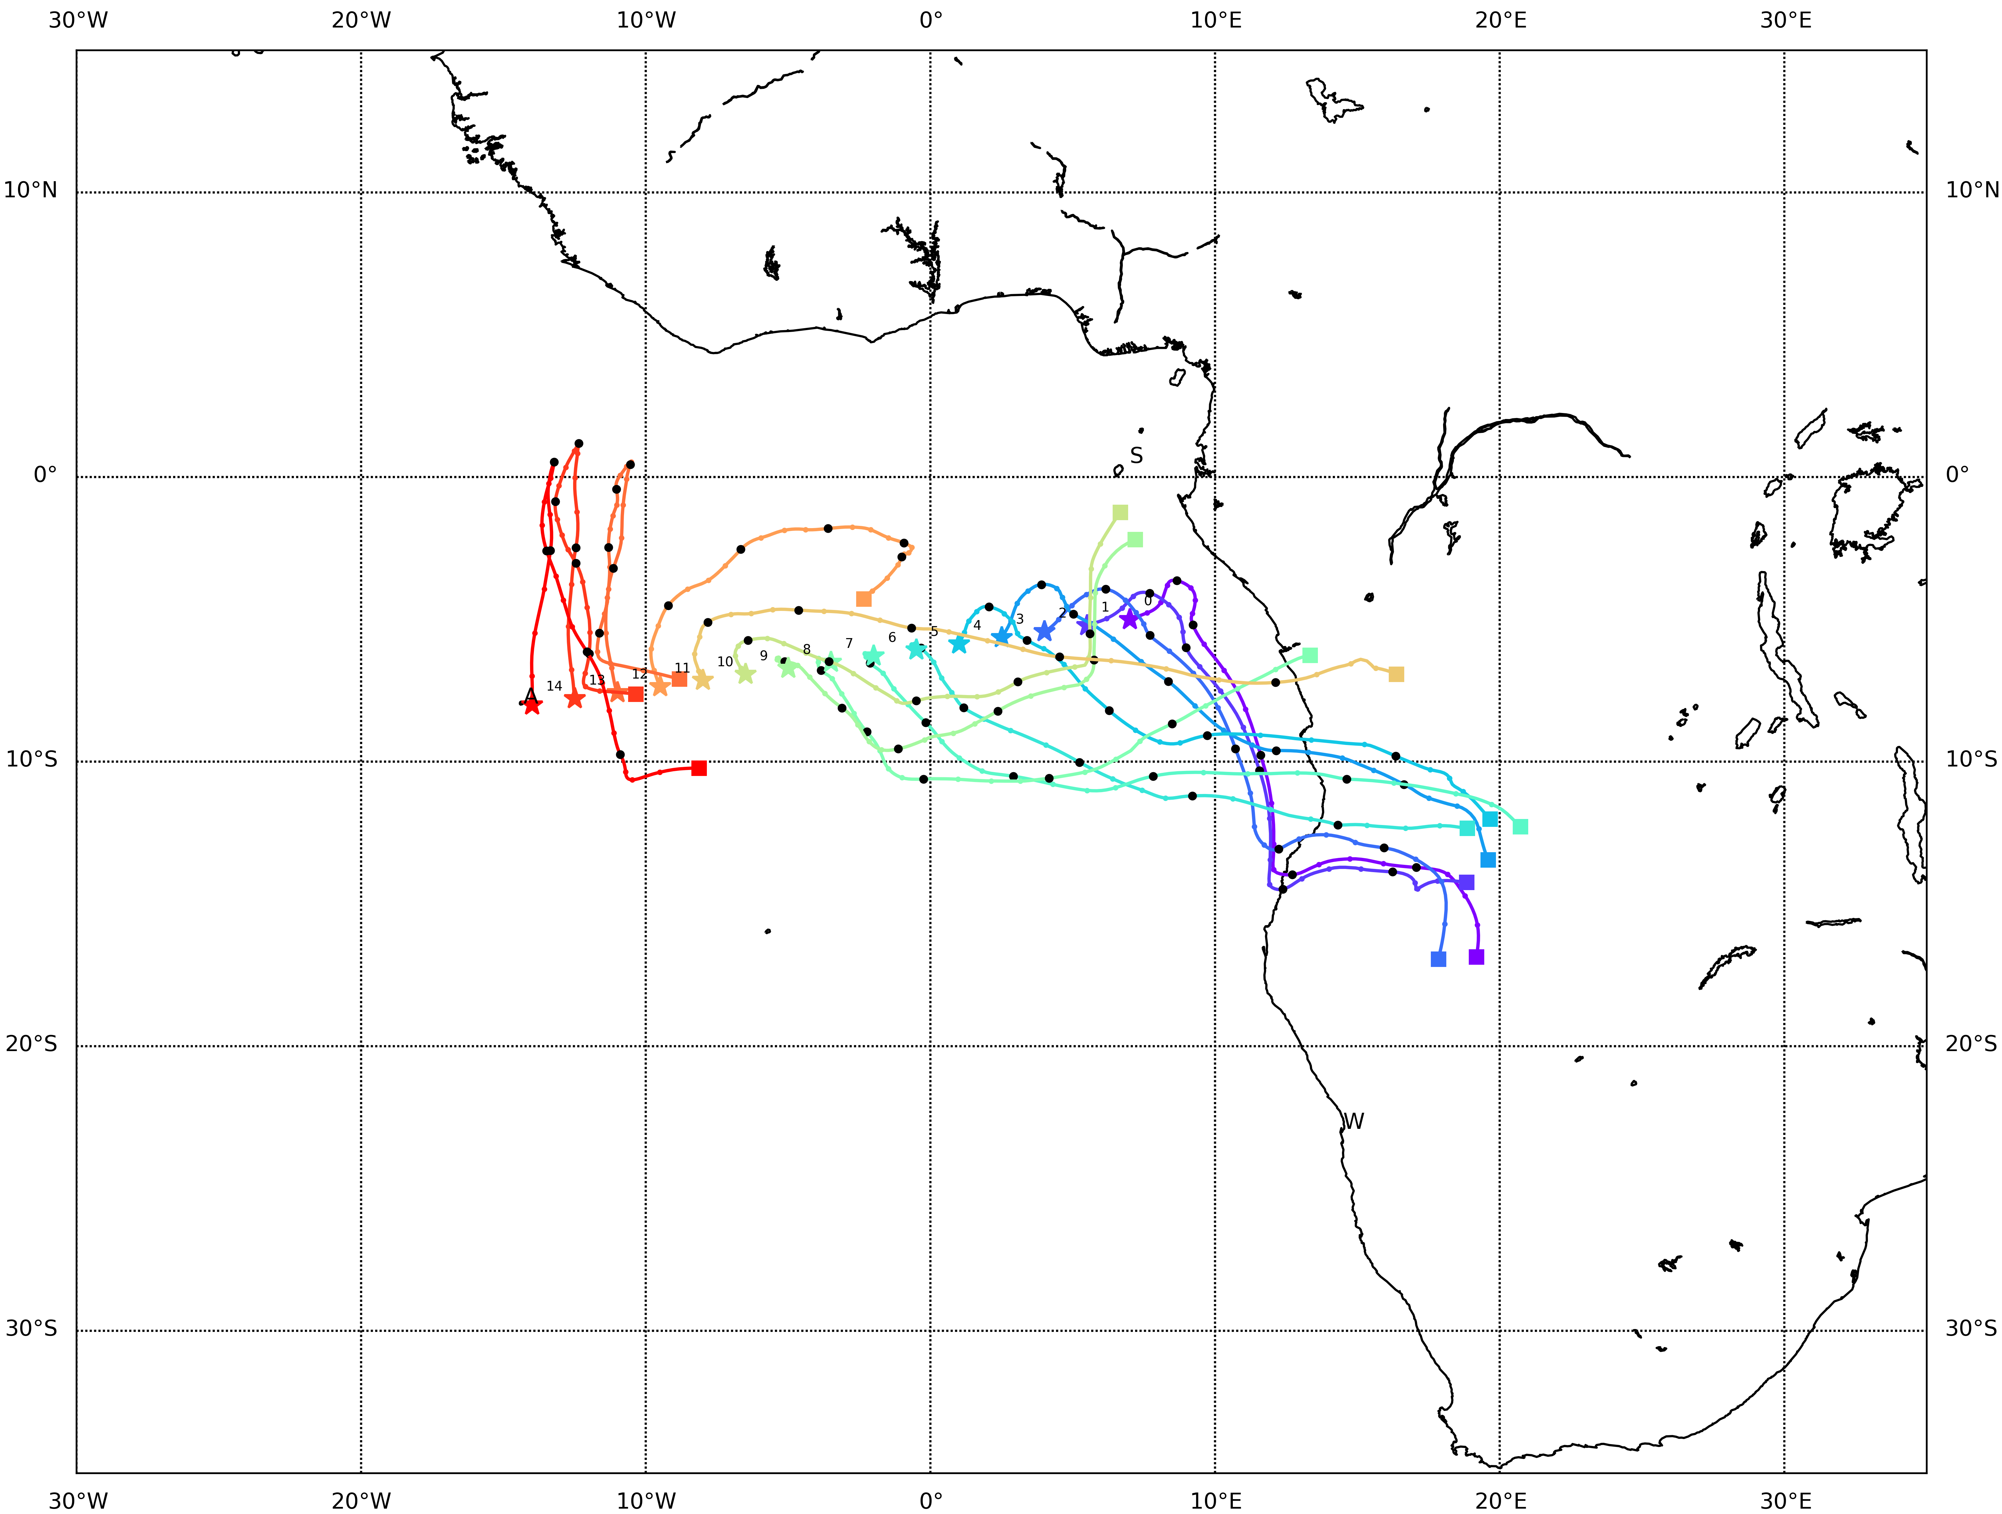
Backward trajectories from suitcase track on
8/19 Fri @ 2 and 3 km
3 km
Along ~11-8W, we may be able to resample the air sampled on the N-S leg of 8/17 flight (parcel altitudes don’t change very much in 2 days)
2 km

Slide 47
Backward trajectories from routine track on
8/19 Fri @ 2 and 3 km
3 km
Parcels at 2km originated from latitudes south of 10S, whereas parcels at 3km (north of 10S) originated from latitudes north of 10S
Flow along N and S branches at 3km
2 km

Slide 48
Low cloud forecast for 8/19 Sat @ 12PM
Northern edge of StratCu deck has retreated SE in today’s forecast (in EC model, but not in UKMO model)

Slide 49
Low, middle, high cloud forecast for 8/19 Sat @ 12PM
mid + high clouds
(west of 9W, north of 2N) – in both EC and UKMO models
mid + high clouds associated with new plume of moist air
High clouds have mostly gone away

Slide 51
Saturday 8/19
Near Ascension
600-800mb RH is high off the continent north of ~2N and west of ~9W – expect some middle and high clouds there, but much drier and less clouds to the east
Some of the parcels at 2km around 11-8W along 8S (suitcase flight track) may be old air sampled earlier (8/17 and 8/15 flights)
Near Sao Tome
Another surge of moisture from the east – moist air at 15 kft from TMS to ~5S along the routine flight track; expect middle and high clouds near TMS
Most dense low clouds south of ~5S
Strong (15-25 knots) easterly crosswinds at 15 kft along the routine flight track (increasing towards TMS)

Slide 52
Cloud Model verification (routine flight on 8/15 Tue, 12PM)

Slide 53
Enhanced IR satellite imagery at 8/15 Tue @ 12PM
10W
0
10E
20E
0S
High clouds
10S
Low cloud clearing towards NW
20S

Slide 54
High cloud, 120-hr forecast

Slide 55
High cloud, 96-hr forecast

Slide 56
High cloud, 72-hr forecast

Slide 57
High cloud, 48-hr forecast

Slide 58
High cloud, 24-hr forecast

Slide 59
Cloud top heights at 8/15 Tue @ 12PM

Slide 60
Low cloud, 120-hr forecast

Slide 61
Low cloud, 96-hr forecast

Slide 62
Low cloud, 72-hr forecast

Slide 63
Low cloud, 48-hr forecast

Slide 64
Low cloud, 24-hr forecast

