Slide 1
ORACLES weather briefing
15-Aug-2017
Lenny Pfister and Rei Ueyama

Slide 2
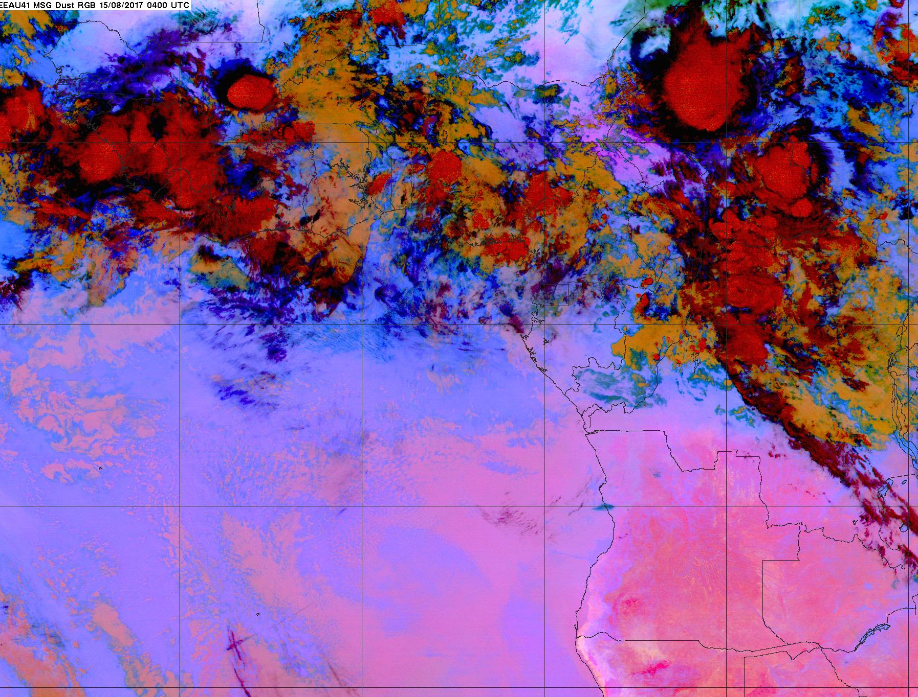
Enhanced IR satellite imagery at 8/15 Tue @ 4AM
10W
0
10E
20E
High clouds (>12 km) moving SSW over TMS
Streamers moving SE (new ones forming on the NW end)
0S
Low cloud clearing
10S
Low cloud clearing towards NW
20S

Slide 3
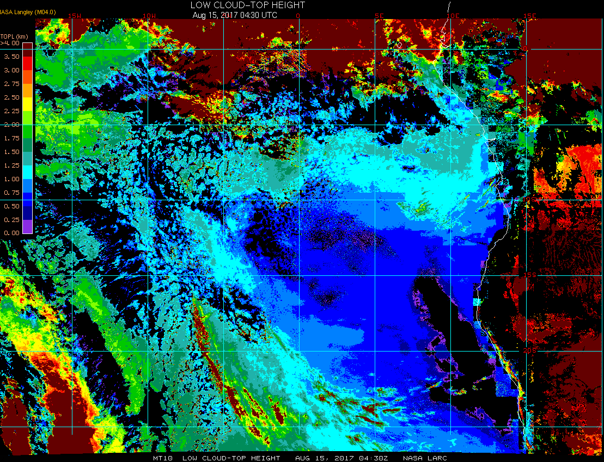
Low cloud top heights at 8/15 Tue @ 4:30AM
10S
15S

Slide 4
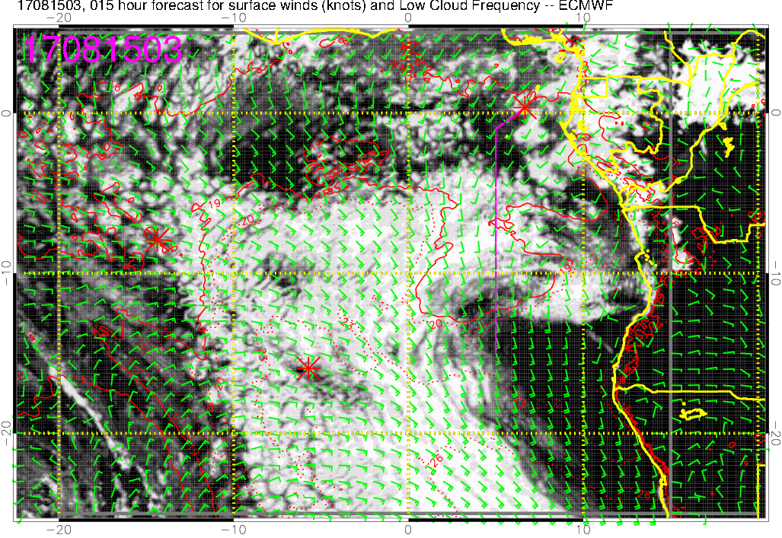
Low cloud forecast on 8/15 Tue @ 3AM

Slide 5
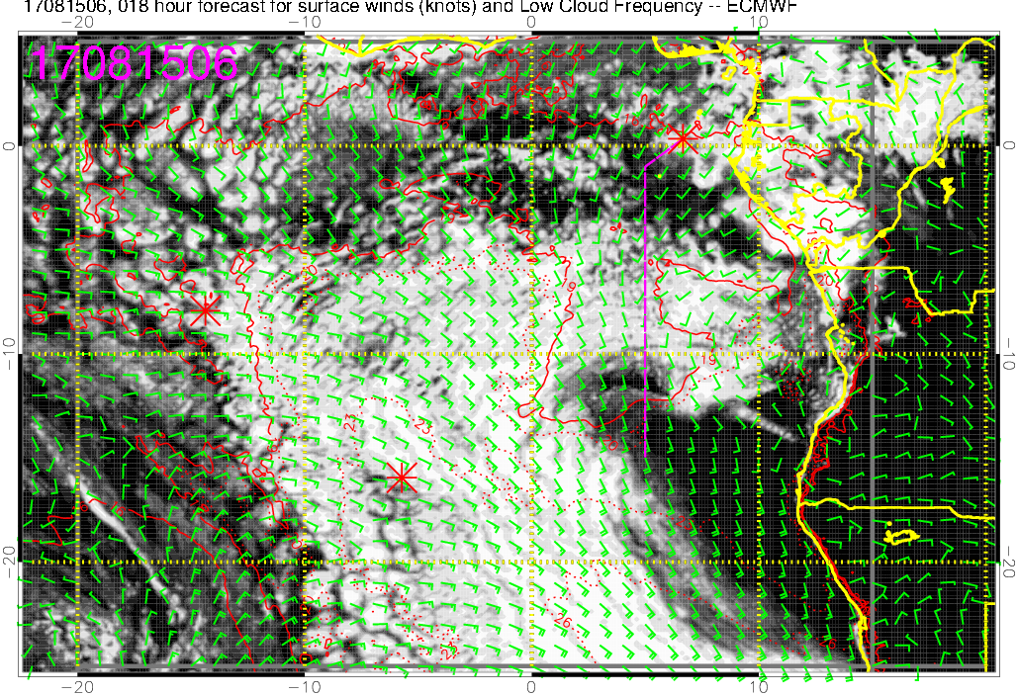
Low cloud forecast on 8/15 Tue @ 6AM

Slide 6
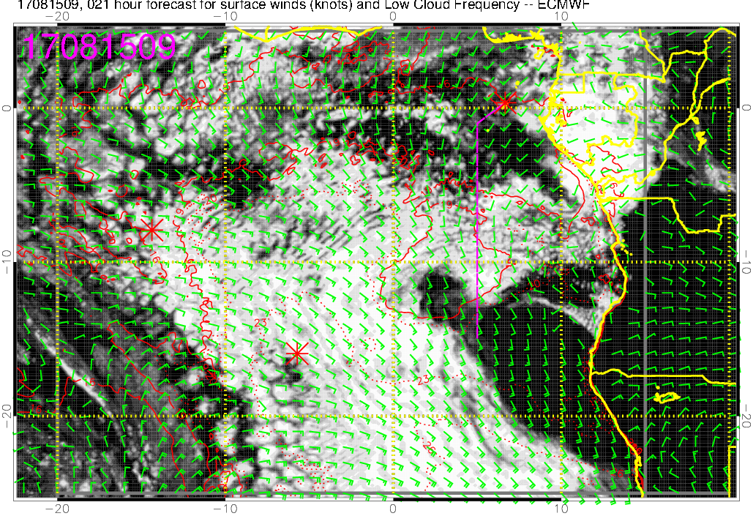
Low cloud forecast on 8/15 Tue @ 9AM

Slide 7
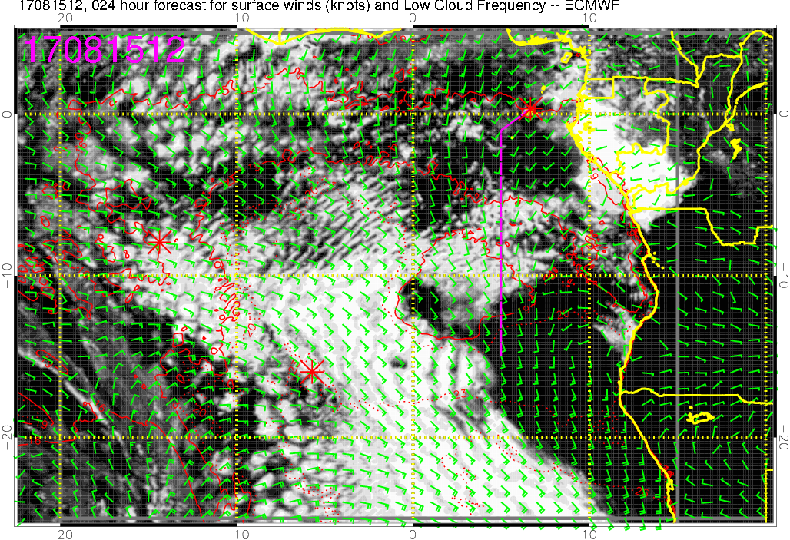
Low cloud forecast on 8/15 Tue @ 12PM
** scattered low clouds TMS to 8S
** dense low clouds ~10S
** thin, small low clouds at 15S at low altitudes

Slide 8
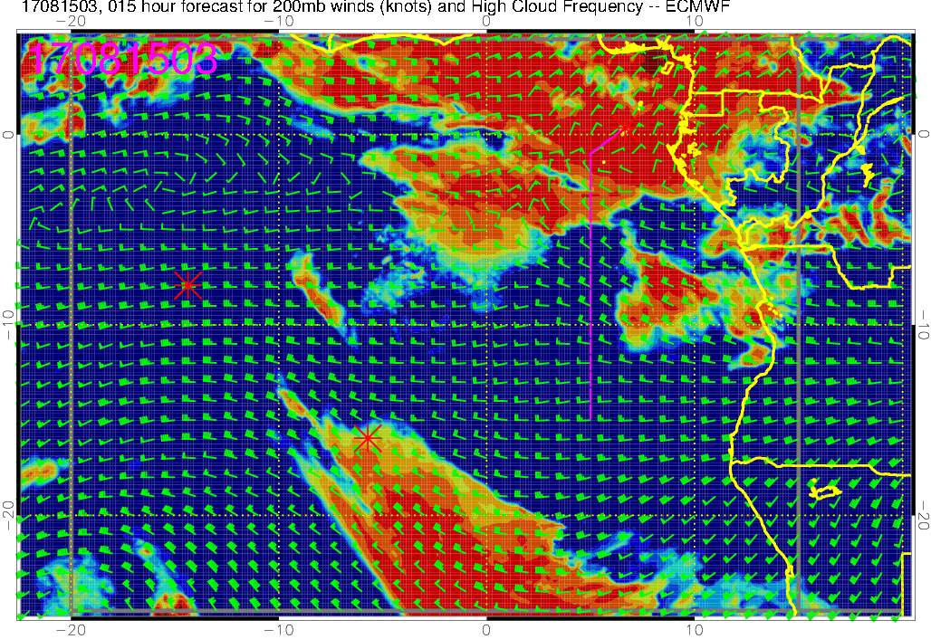
High cloud forecast on 8/15 Tue @ 3AM

Slide 9
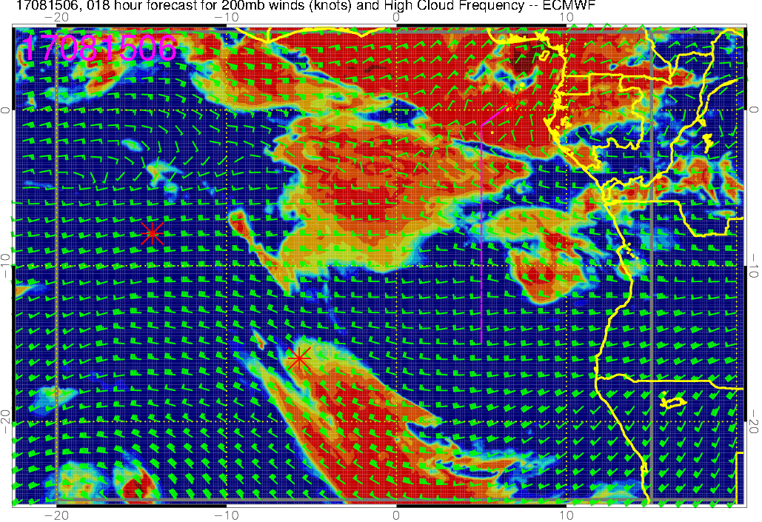
High cloud forecast on 8/15 Tue @ 6AM

Slide 10
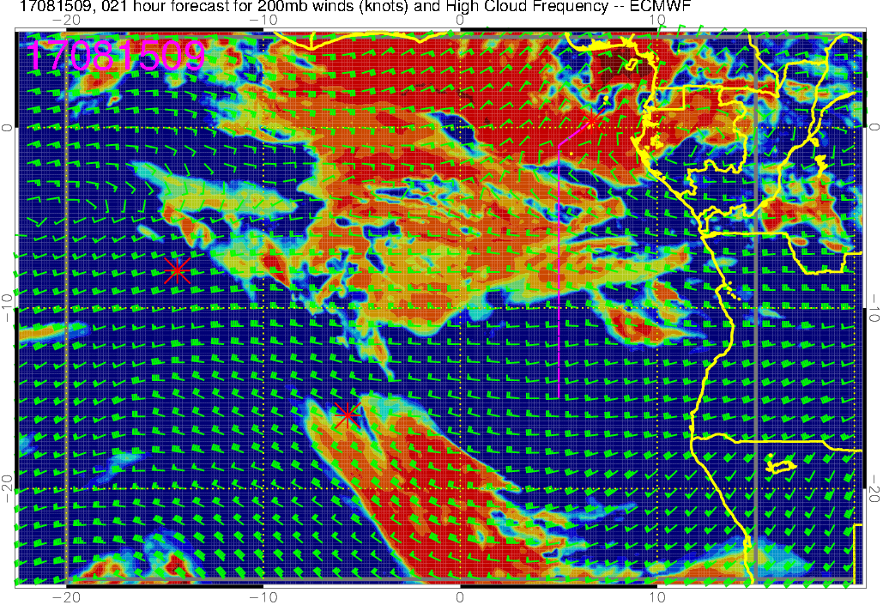
High cloud forecast on 8/15 Tue @ 9AM

Slide 11
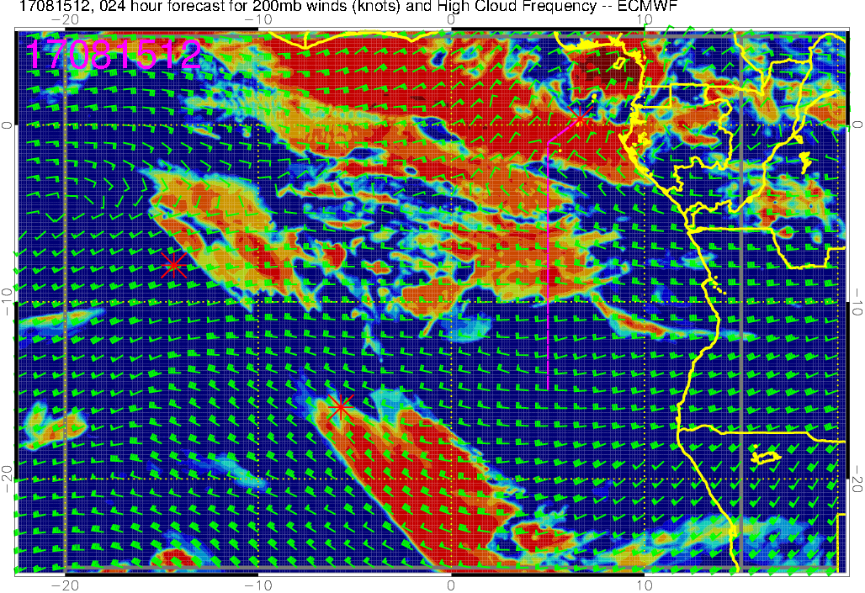
High cloud forecast on 8/15 Tue @ 12PM

