Slide 1
ORACLES weather briefing
15-Aug-2017
Lenny Pfister and Rei Ueyama

Slide 2
Thursday (der Flug zur Insel des Aufstiegs)
Surge of moisture is being surveyed today (back end), trajectories show that these surveyed masses will be at the front end of this moisture surge Thursday.
700mb flow (3 km) is weak and disorganized
600mb (4 km) is also not very organized. Situation dominated by moisture intrusions from the north
Could get some high cloud over the lagrangian survey points.

Slide 3
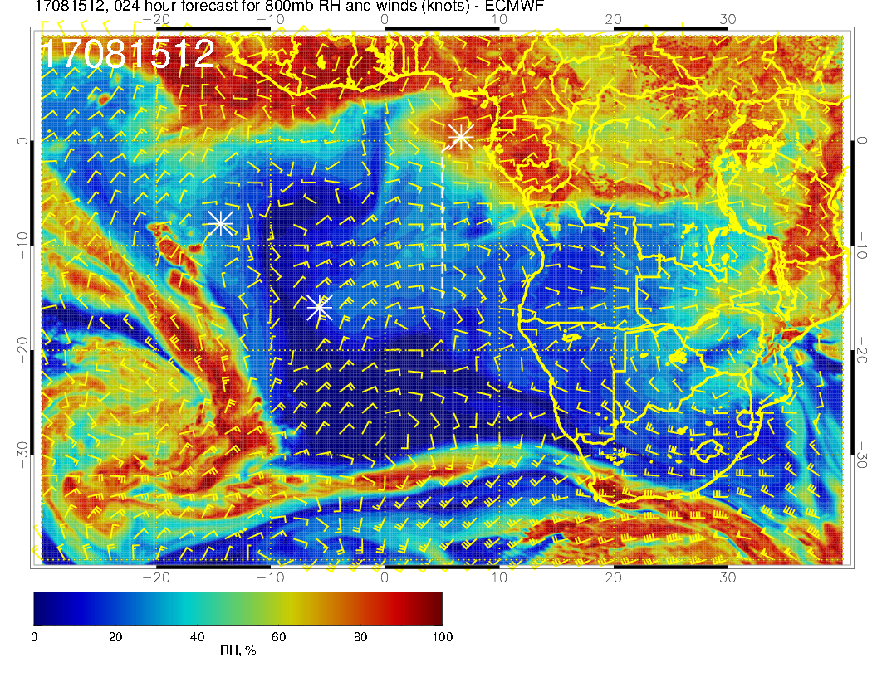
800mb (about 2 km)
Routine flight today at 800mb. See surge of moisture, accompanied by wave of strong zonal wind. Red section of routine track corresponds to points two days later.

Slide 4
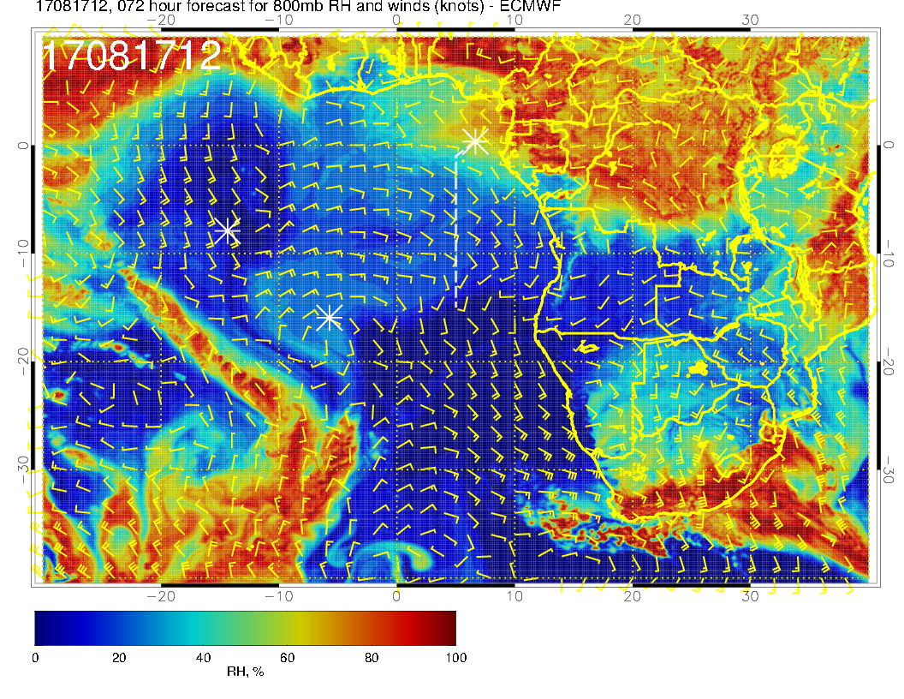
800mb (about 2 km)
Routine track was at the “back” of the surge. See RH surge and zonal wind section propagated westward by Thursday

Slide 5
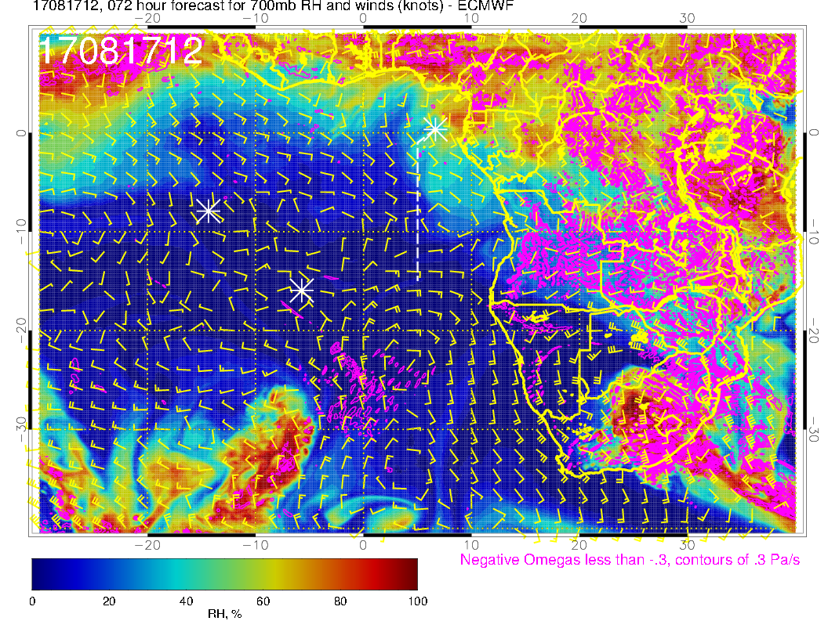
Dry at 700mb. Flow is weaker than below, and tends to head northward. At intermediate times, flow is actually much less organized.

Slide 6
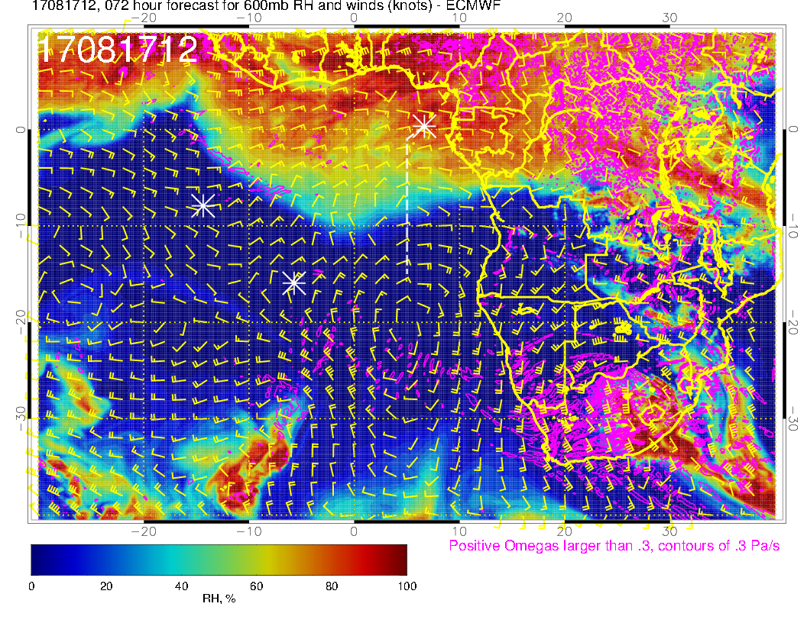
Moisture surge is amplified relative to yesterday’s forecast. Can see that hitting trajectory points may put us under some middle cloud (later)

Slide 7
Flow is weak, except north of 5S at 3 km (700mb). Not the usual easterlies at these latitudes in the climo

Slide 8
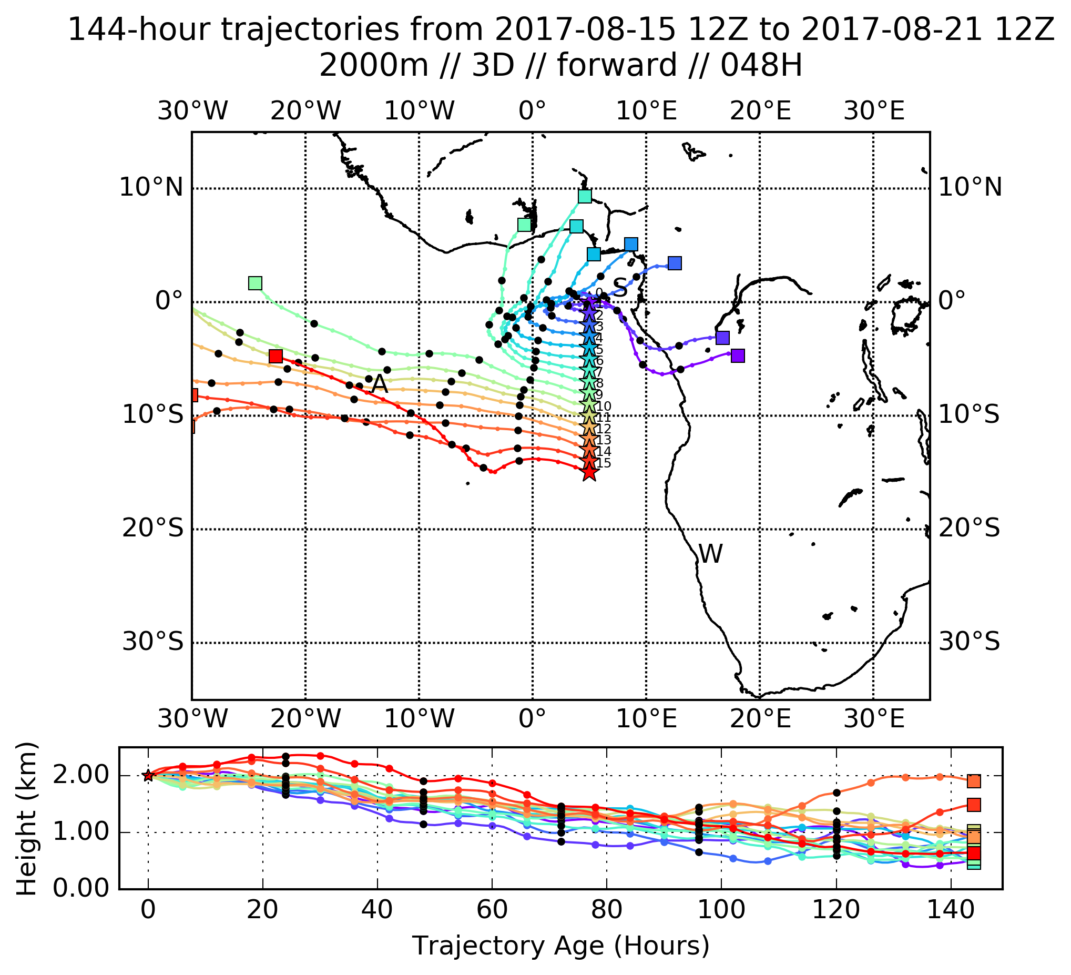
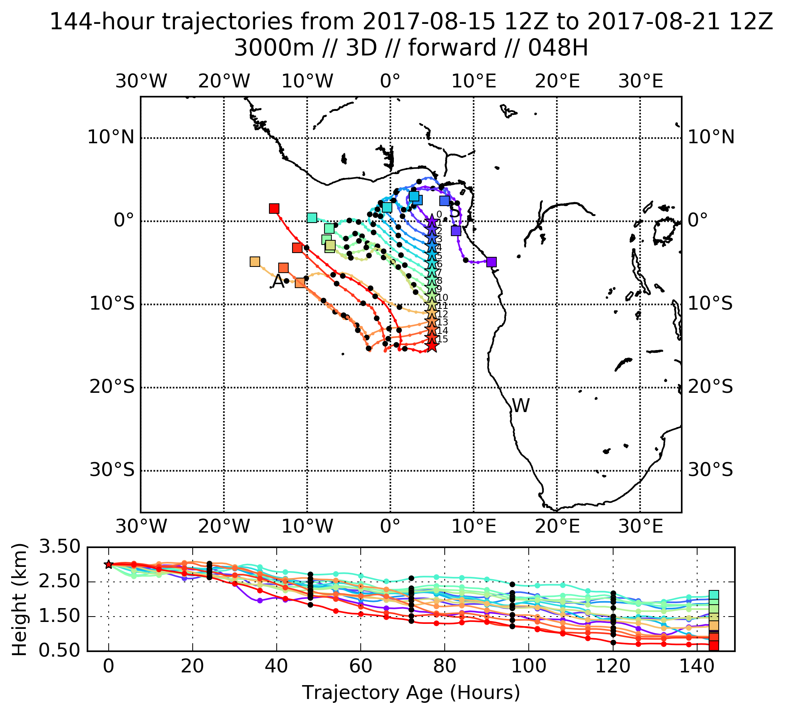
Trajectories (forward from tomorrow’s routine flight) reflect desultory nature of 700mb (3km) and 600mb (4km) flow. Only decisive move to west is at 800mb. 1km flow (and trajectories – not shown) may be deceptive because of too low BL heights in models (???).
YESTERDAY’s trajectories

Slide 9
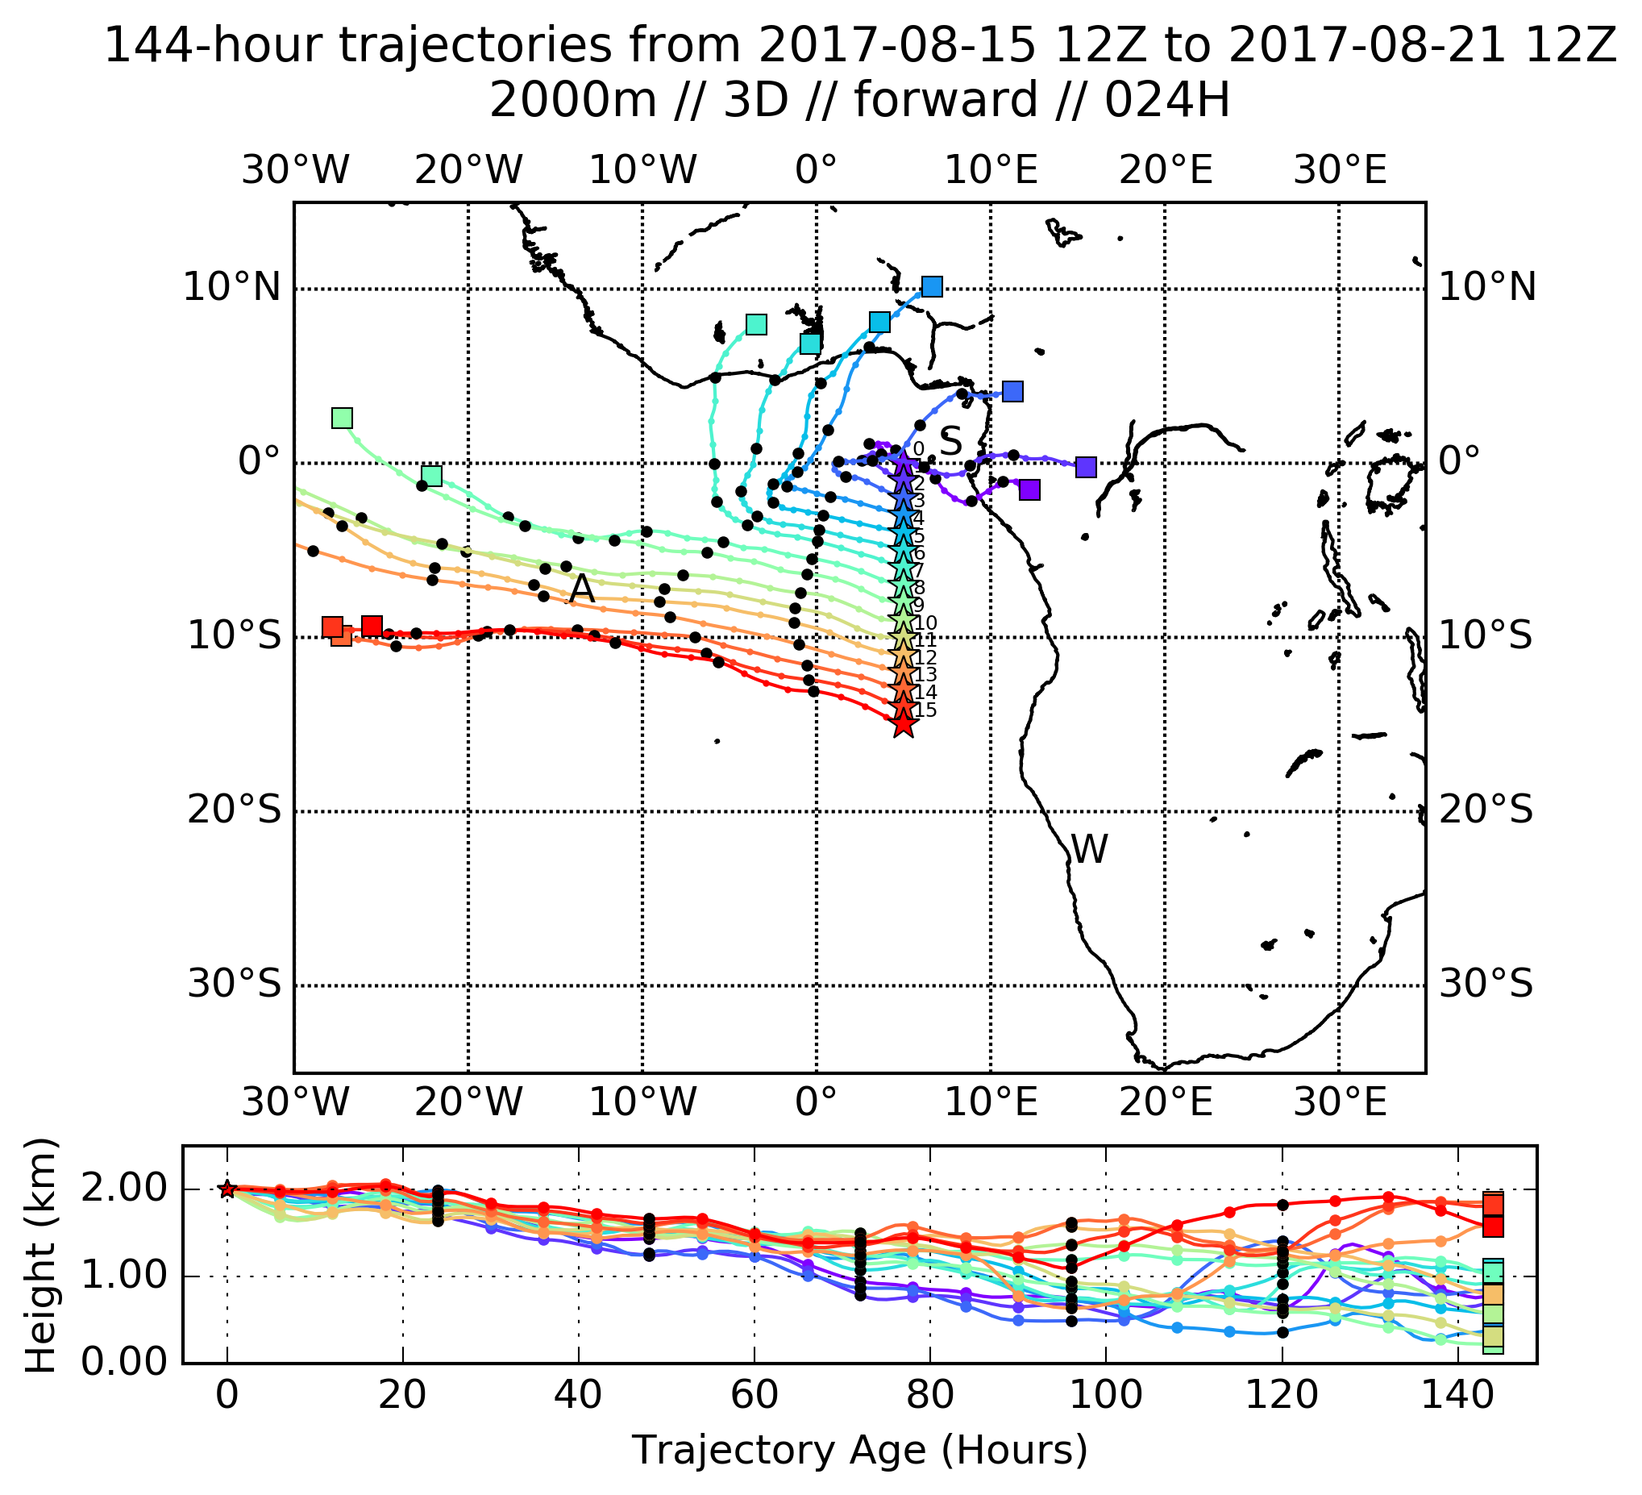
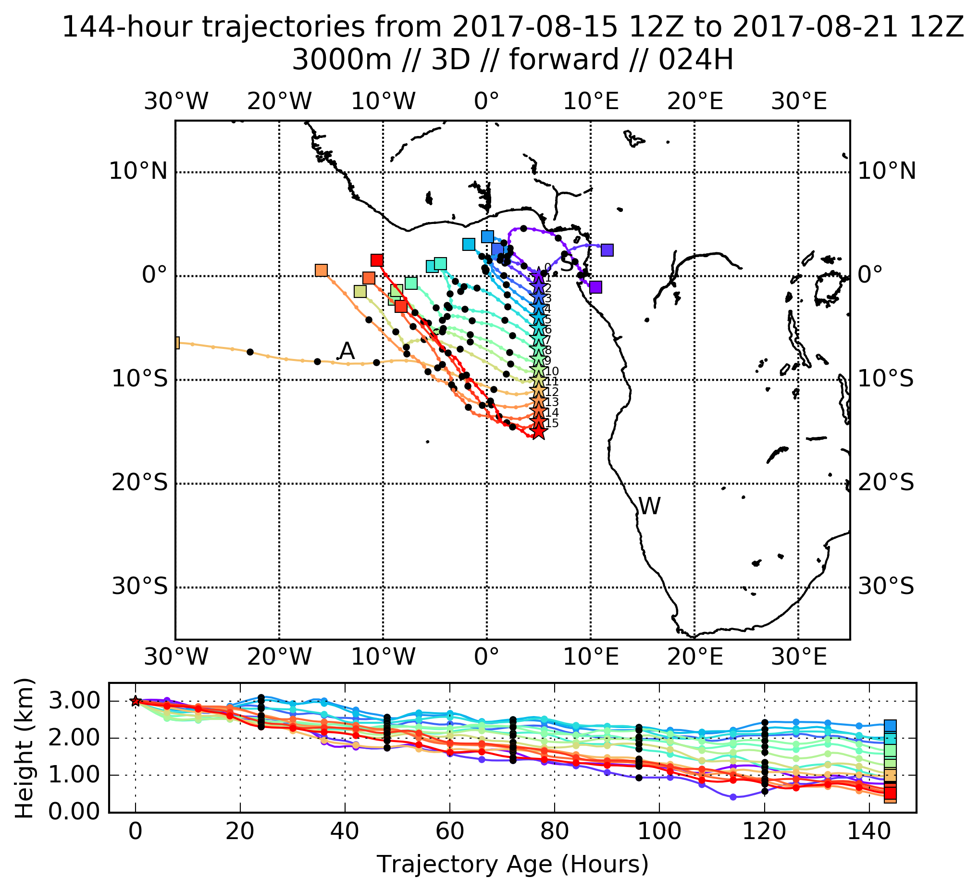
Not much change from yesterday’s trajectories at 2 km (800mb). One lone trajectory at 700mb moves decisively westward at 700mb (3 km), but the basic pattern is stable.

Slide 10
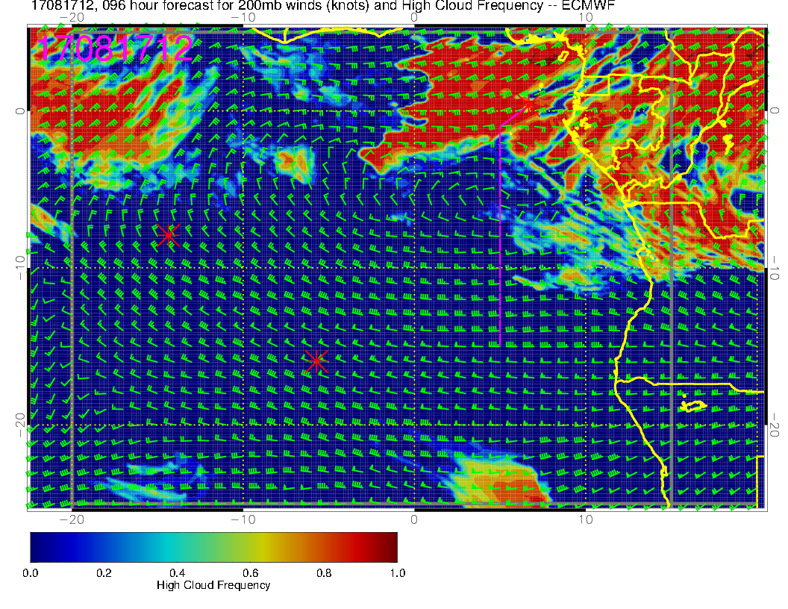
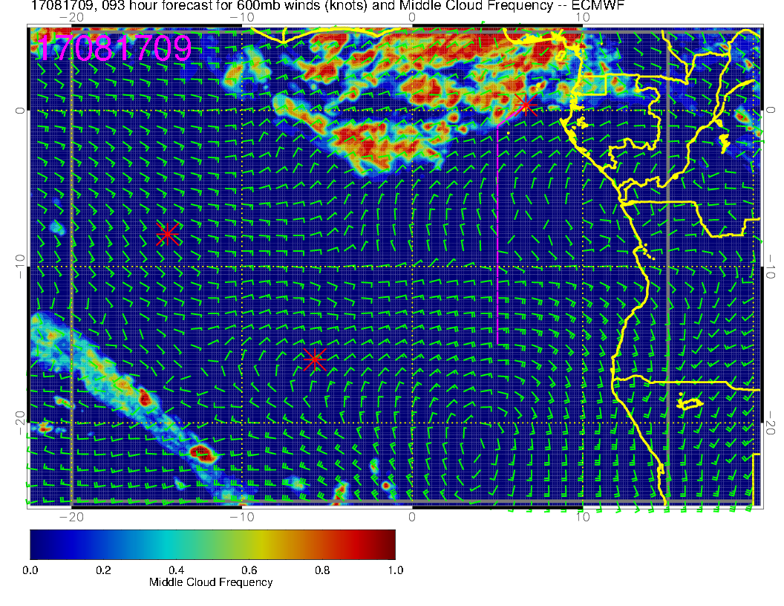
A little far out to be forecasting clouds (though the high and middle clouds depend on large scale flows and moisture fields). At this point, staying south of about 5S will be OK.
HIGH
MIDDLE
I used 9Z, closer to peak in diurnal cycle, which the model does capture

Slide 11
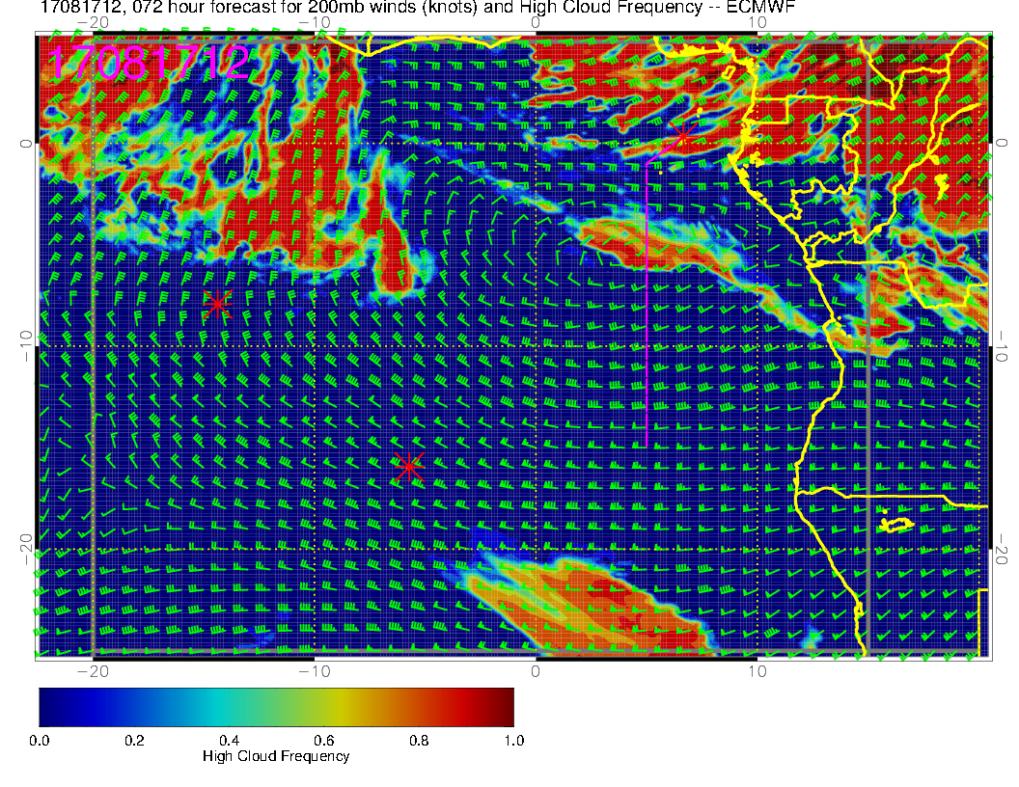
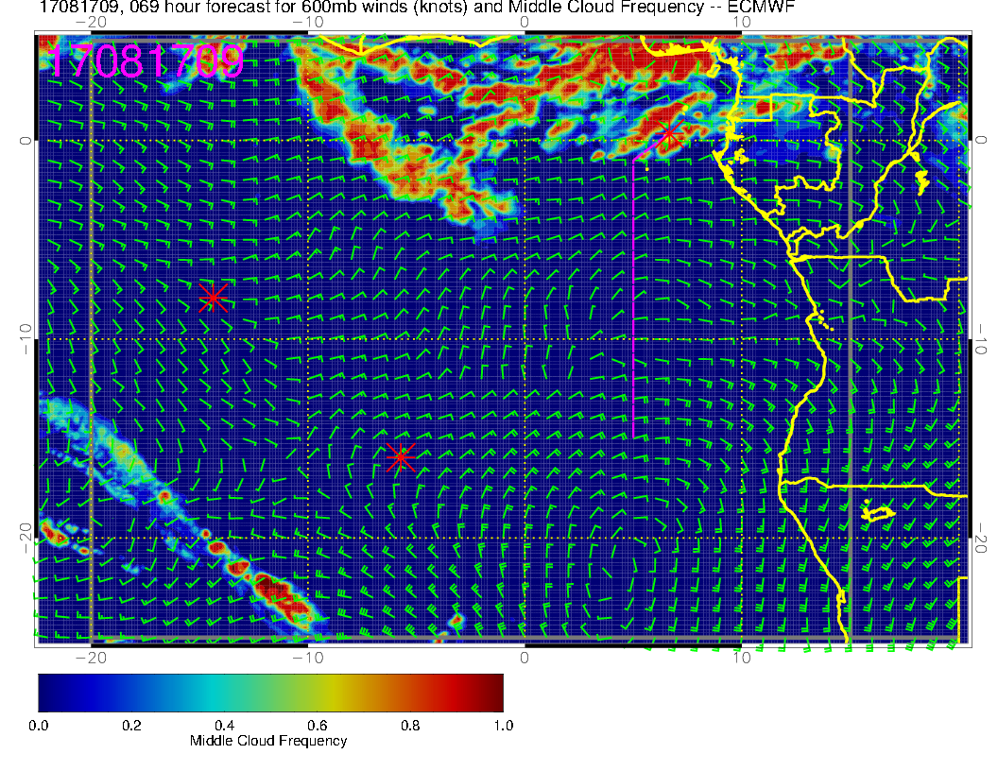
Little change in yesterday’s middle cloud forecast. High cloud forecast is more intrusive into potential flight path.
HIGH
MIDDLE
[I used 9Z, closer to peak in diurnal cycle, which the model does capture]

Slide 12
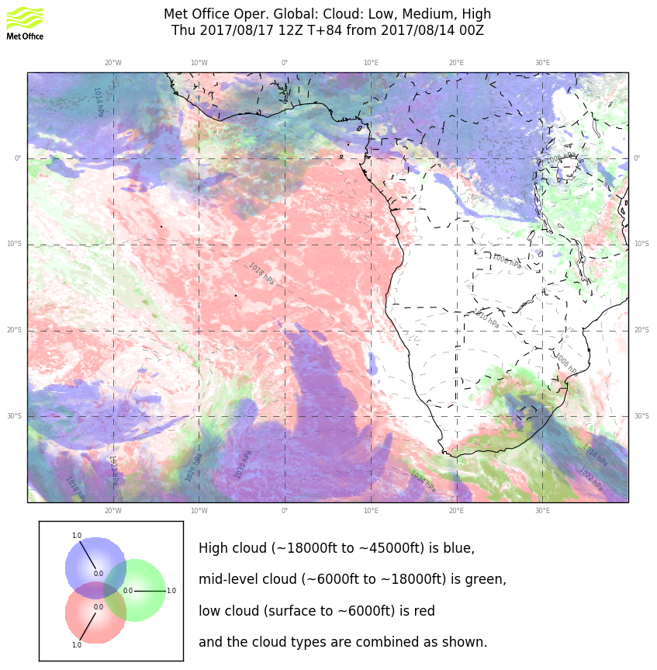
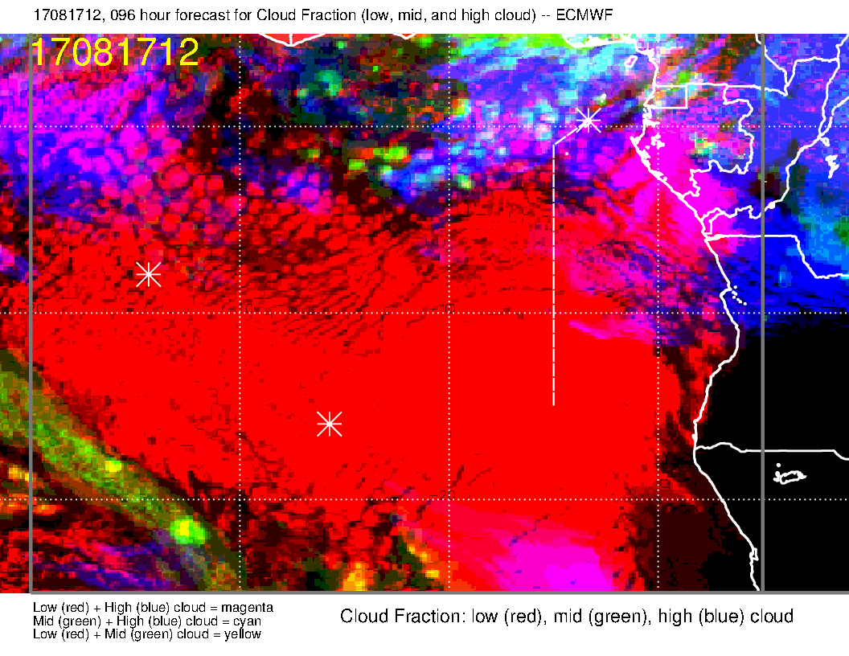
Primarily in situ sampling, but following trajectory end members could lead to flying under some middle cloud.

Slide 13
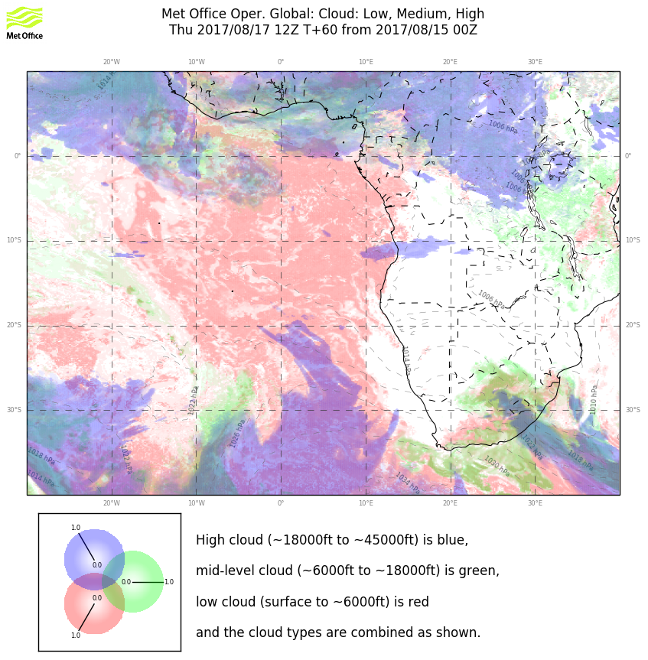
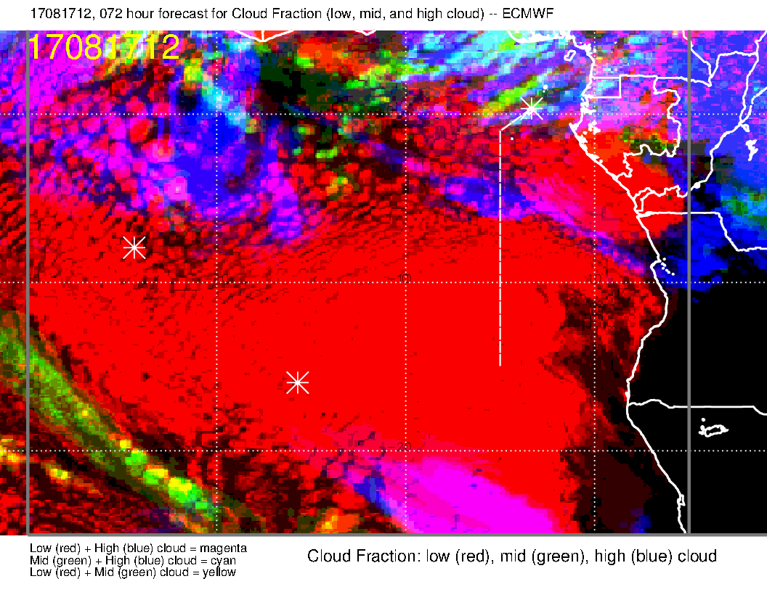
Primarily in situ sampling, but following trajectory end members could lead to flying under some middle cloud (UKMO) or high cloud (ECMWF).

Slide 14
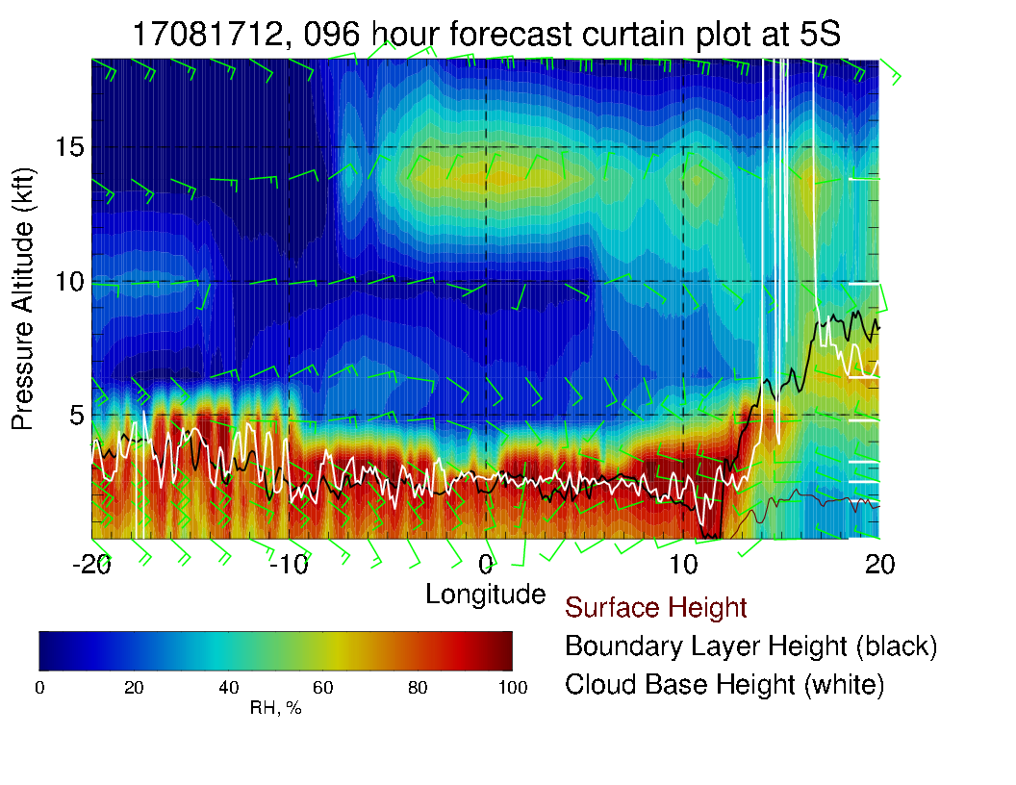
5S Xsect reflects surge of moisture from the north. Enhanced from yester

Slide 15
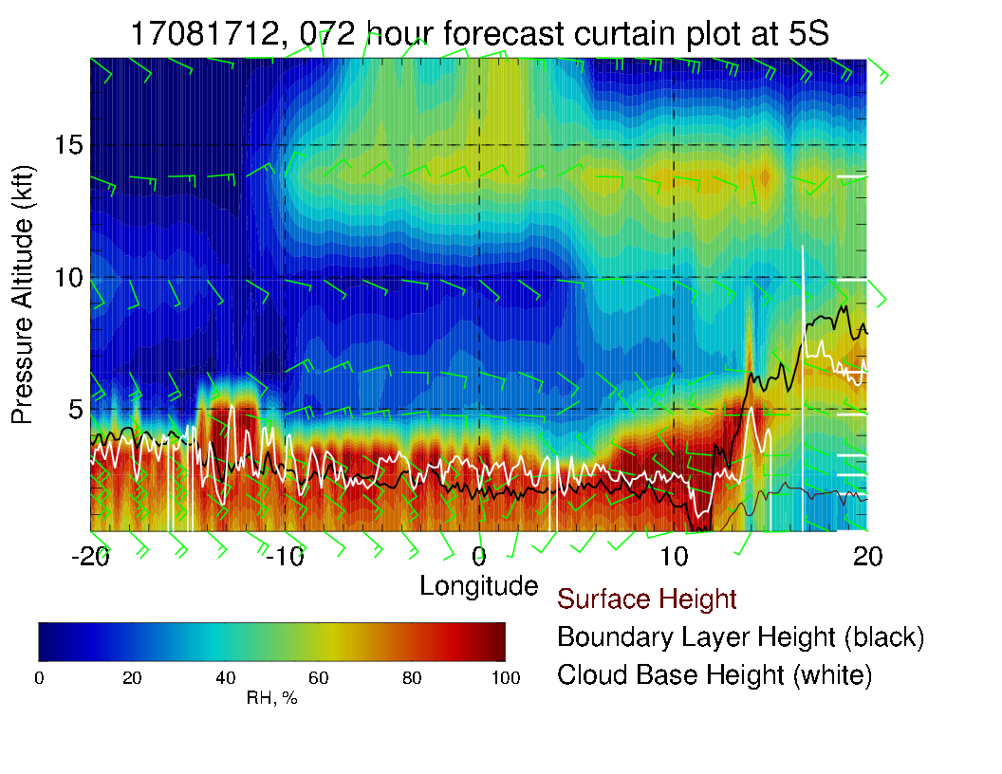
5S Xsect reflects surge of moisture from the north. Enhanced relative to yesterday’s forecast

Slide 16
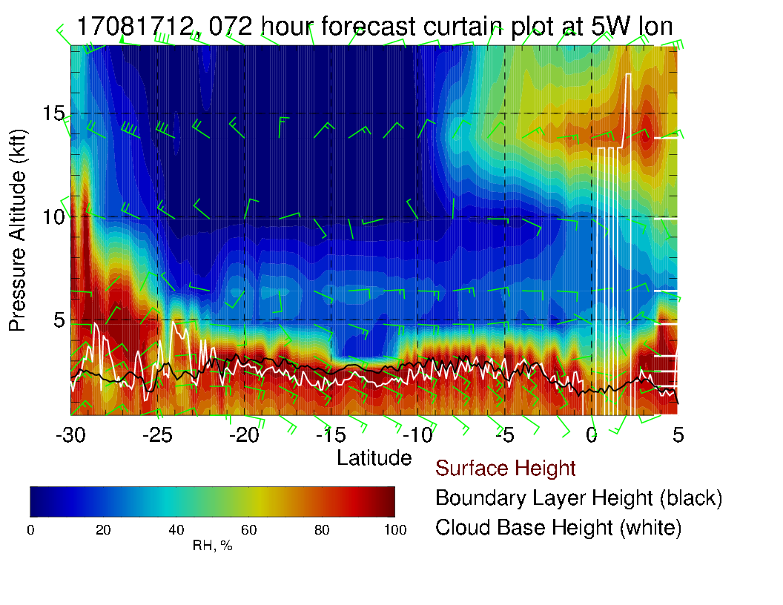

Slide 17
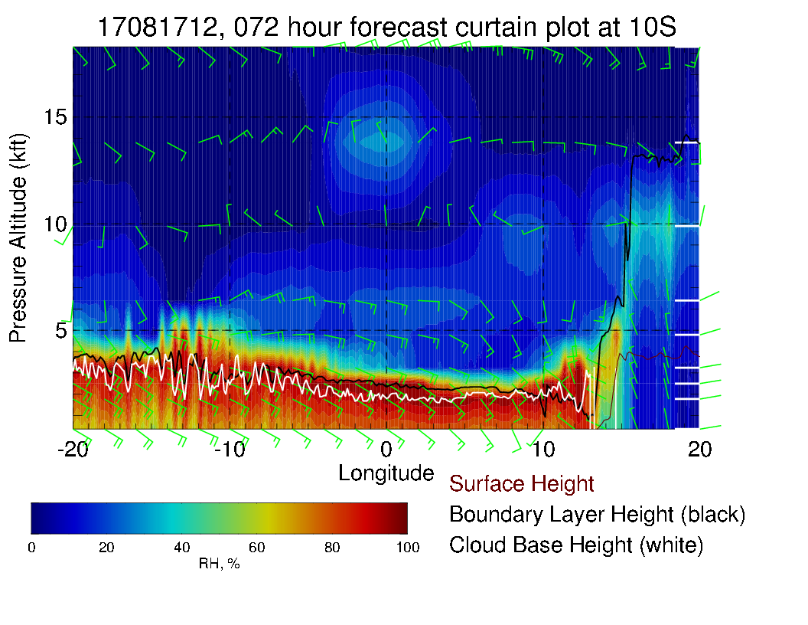
10S Xsect shows a little moisture penetration. None in yesterday’s forecast

Slide 18
Friday (Lokal Flug)
Surge of 800mb RH is at Ascension on this day.
High and middle clouds look good (there are none nearby).
Low clouds expected to be more scattered than on Thursday.

Slide 19
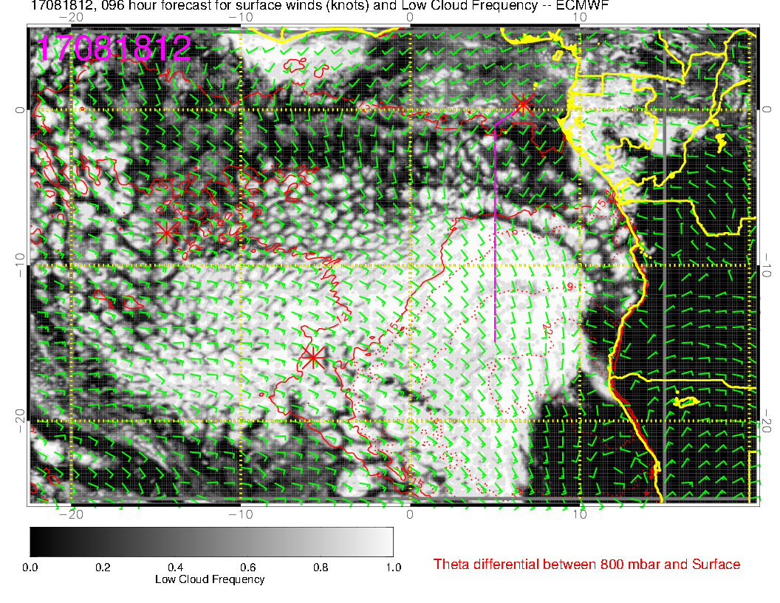
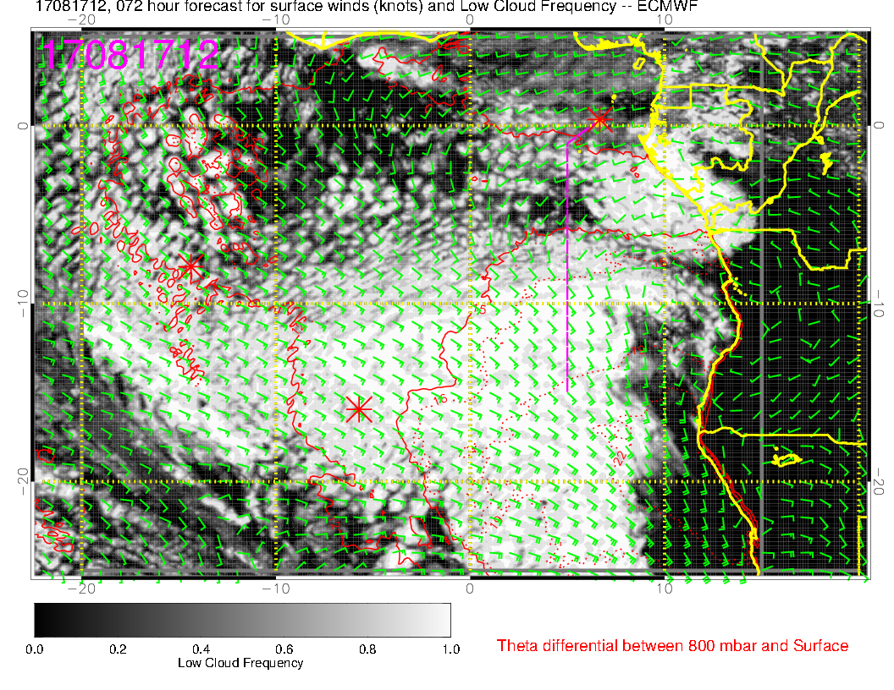
Low clouds Friday (above) and
8/17 (Thursday) at right. Cells appear farther apart on Friday

Slide 20
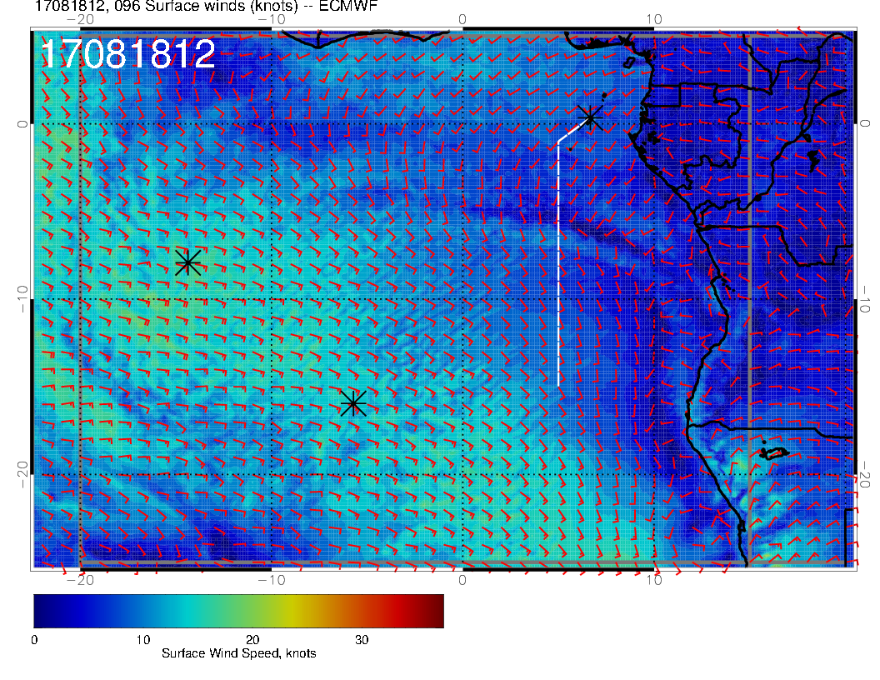
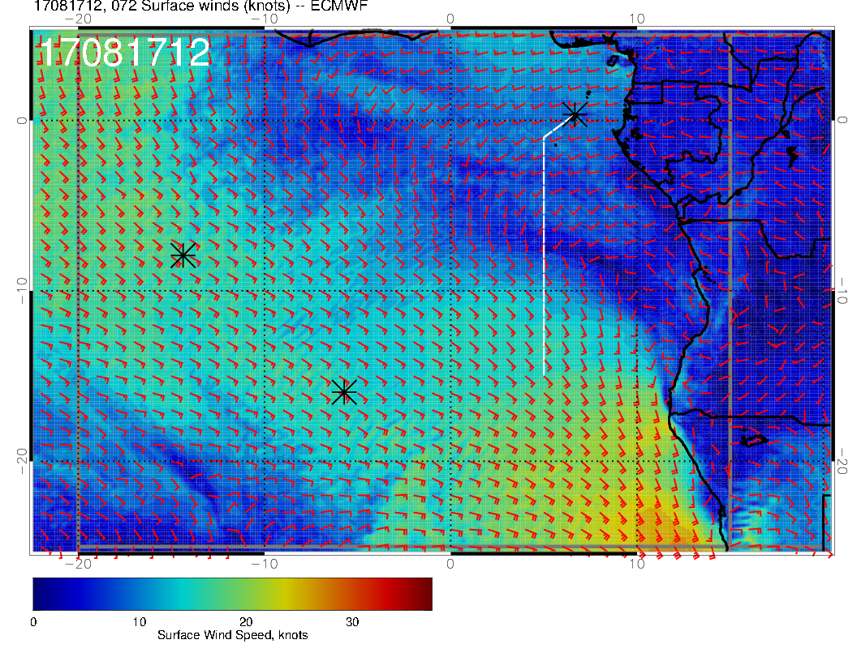
Surface wind speed is a “straight shot” from SE on Thursday (right), but curves around and is weaker on Friday

Slide 21
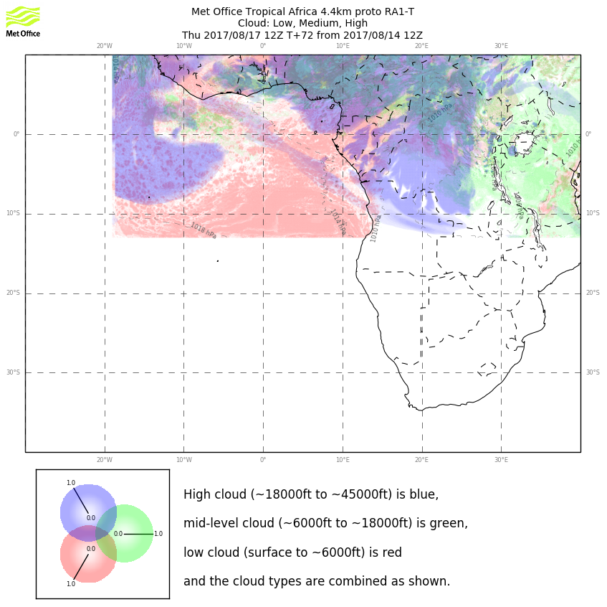

Slide 22
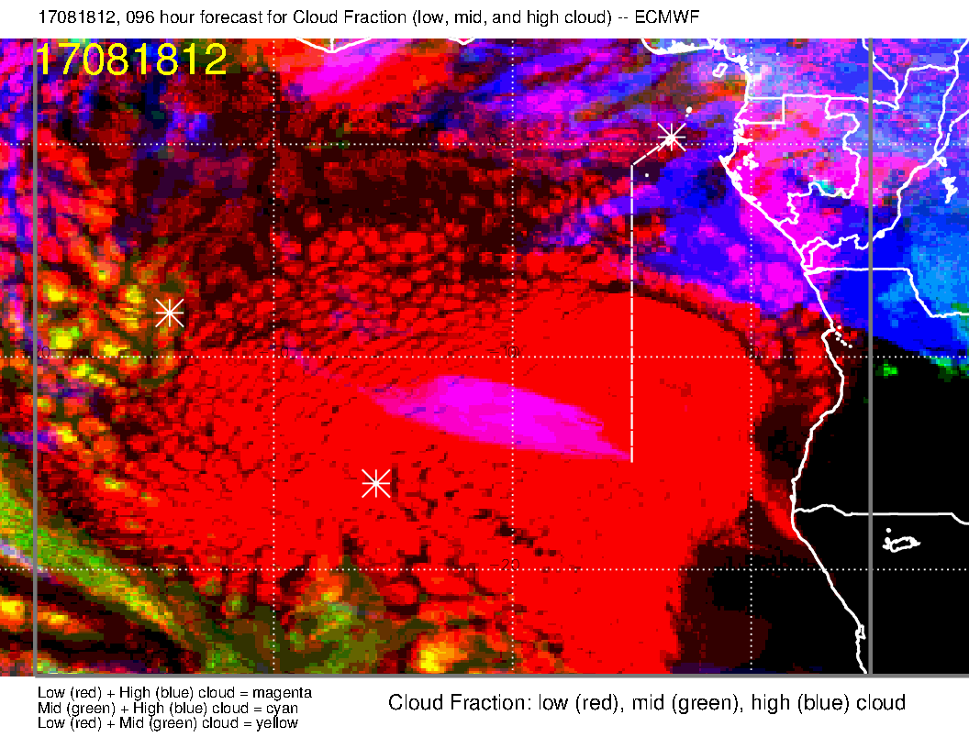
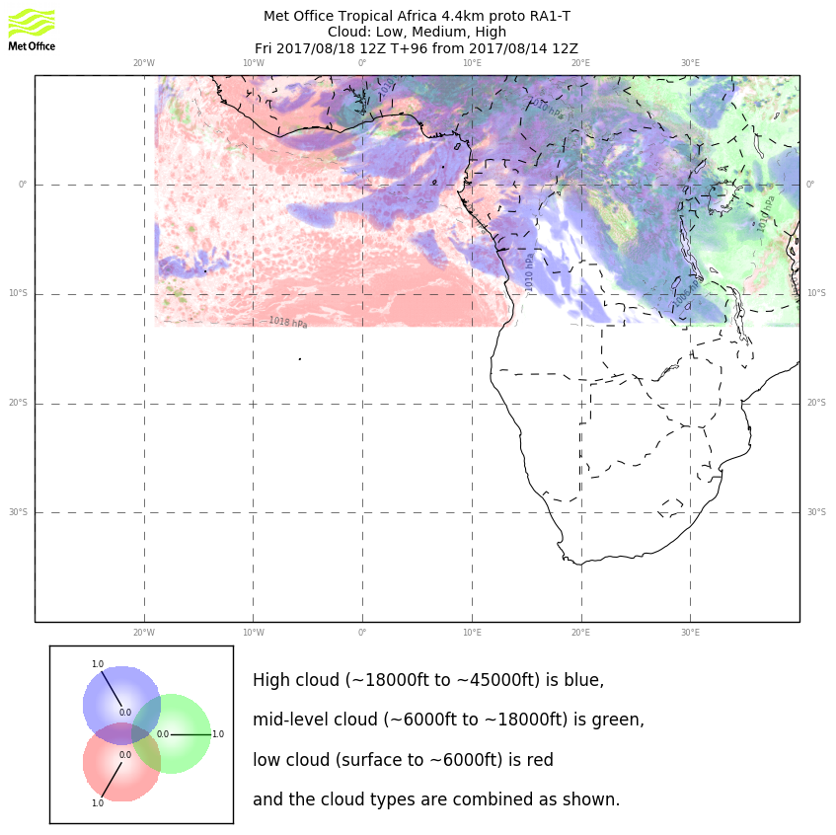
Research global UKMO at right shows
similar low cloud pattern as EC (above). The larger patterns reach upward to the west of Ascension

Slide 23
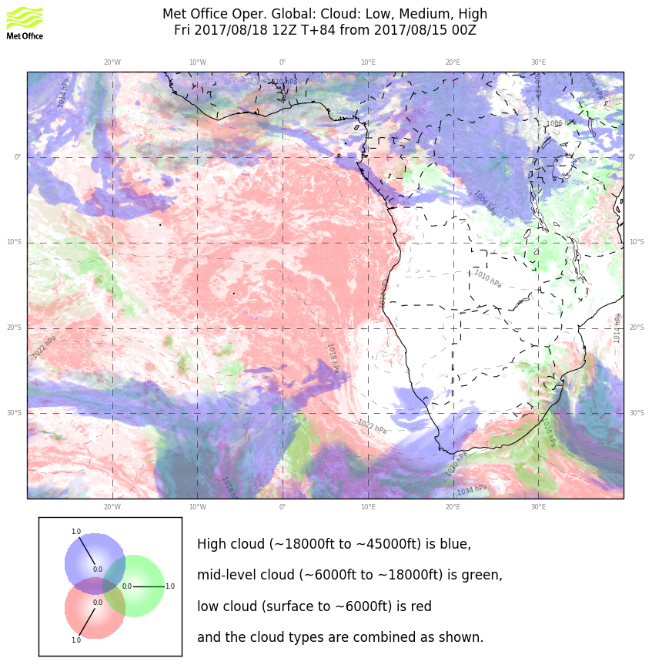
Regular UKMO is in poorer agreement with EC model. We should be OK on high and middle clouds. Only UKMO operational shows issues.

Slide 24
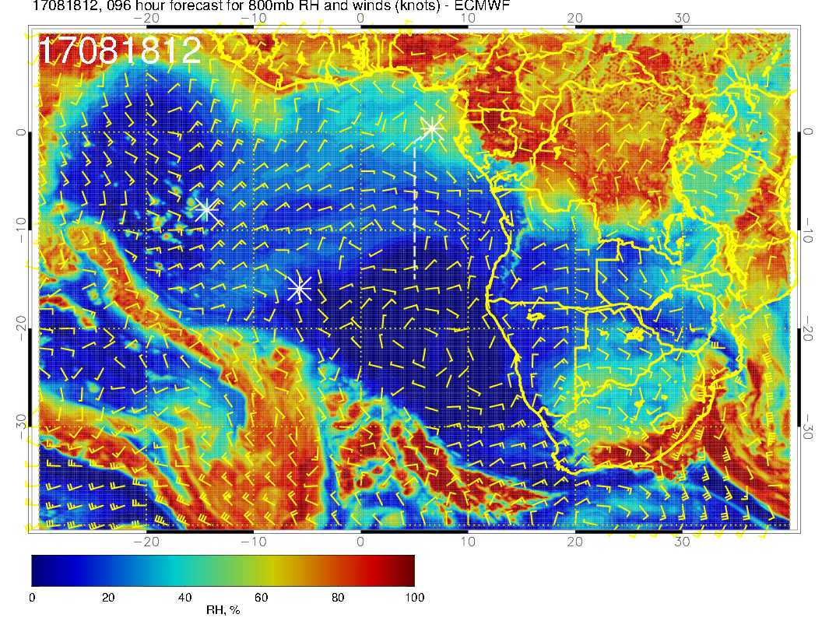
Surge of moisture arrives (distorted) at Ascension at 800mb. If we are flying east of the island, we could catch this. Pop up RH is related to “higher” low clouds discussed previously

Slide 25
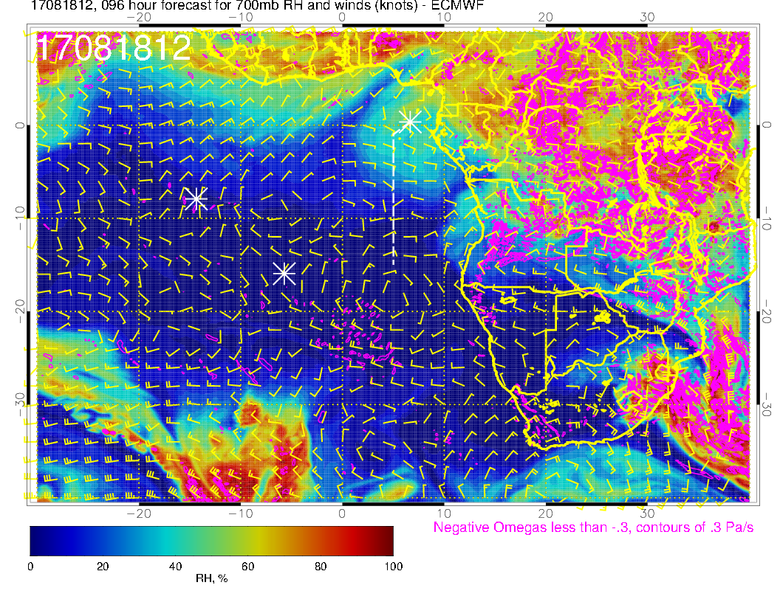
Dry at 700mb, northerly flow.

Slide 26
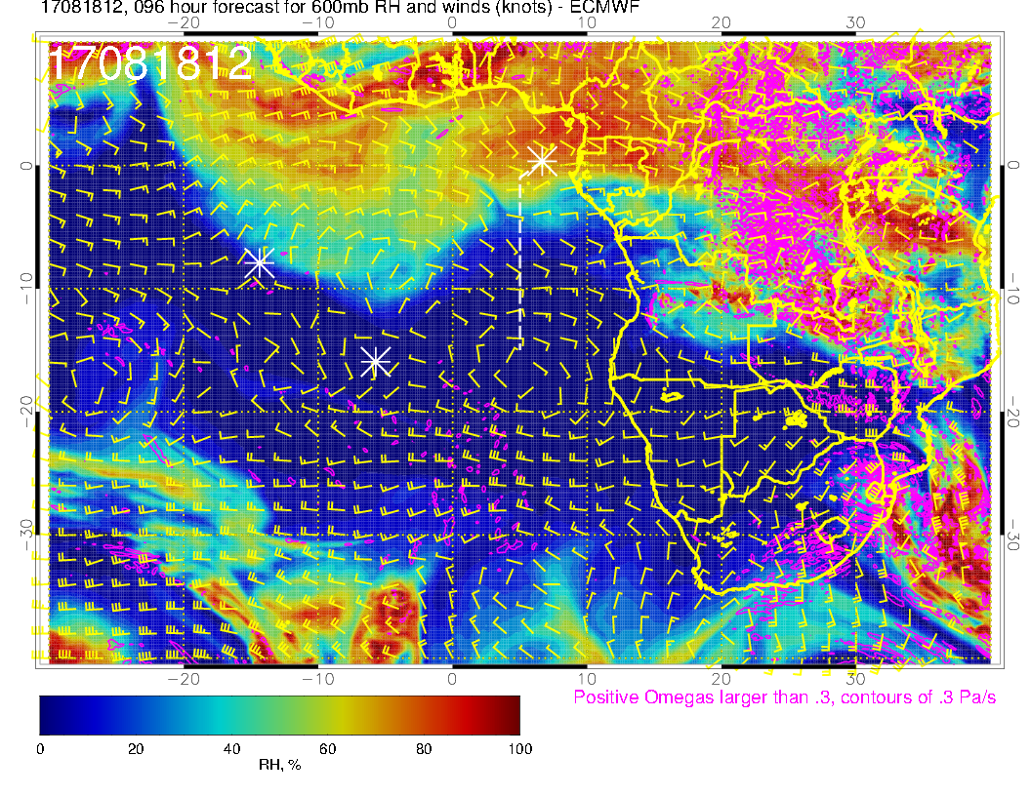
Surge of 600mb moisture propagating westward (along with the 800mb moisture surge – the whole thing looks like an organized wave of some sort).

Slide 27
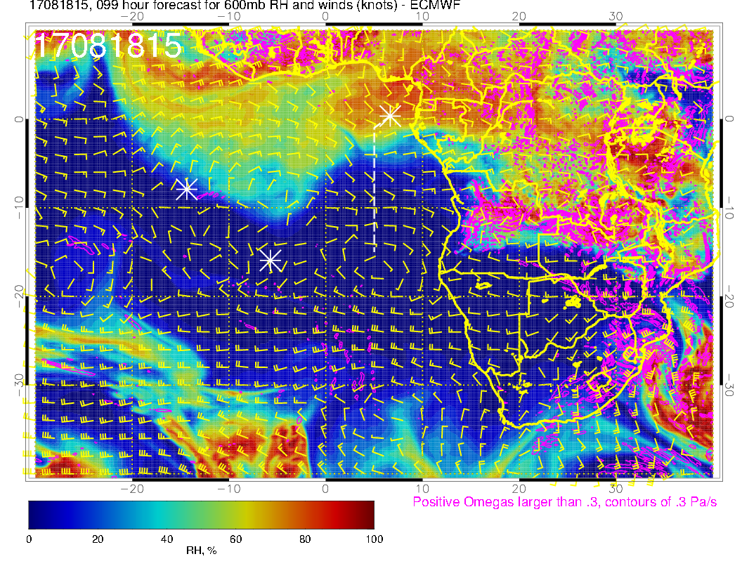

Slide 28
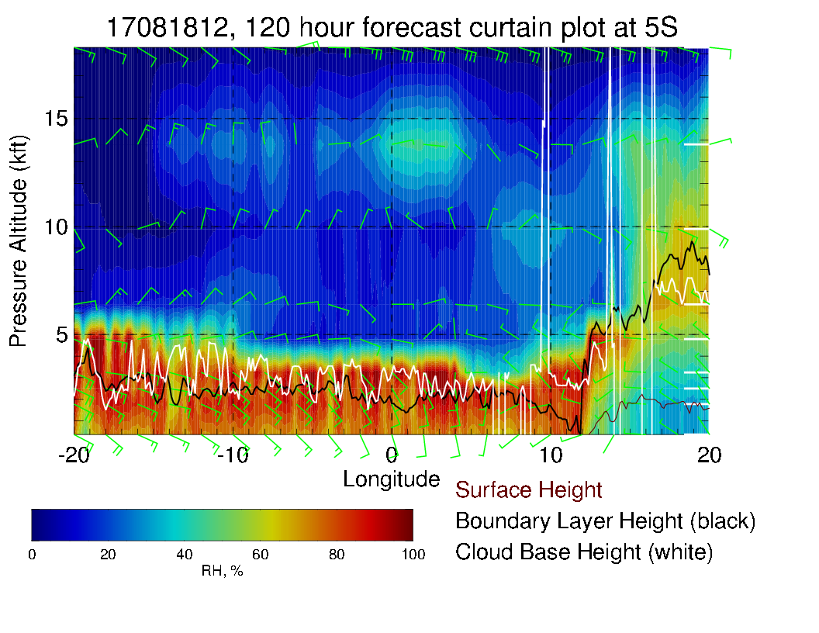
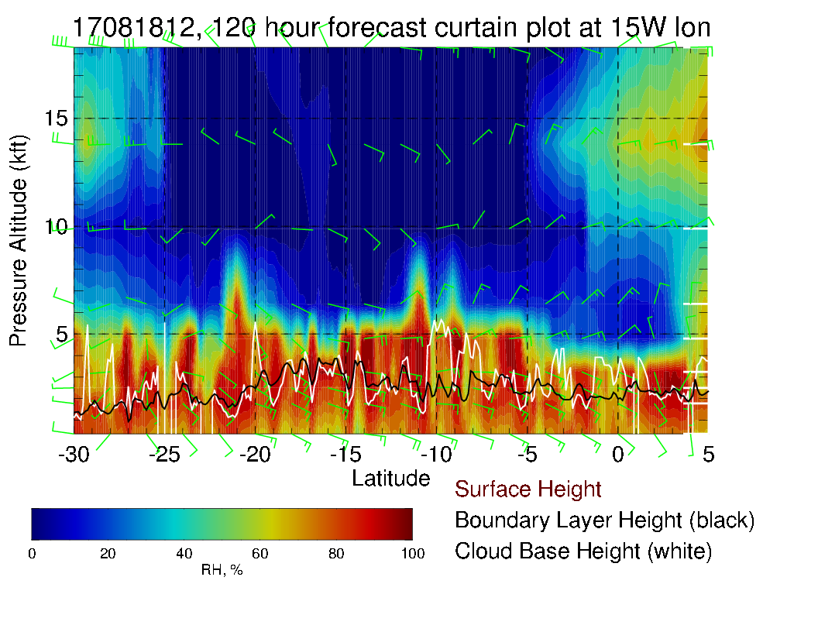
Yesterday’s forecast

Slide 29
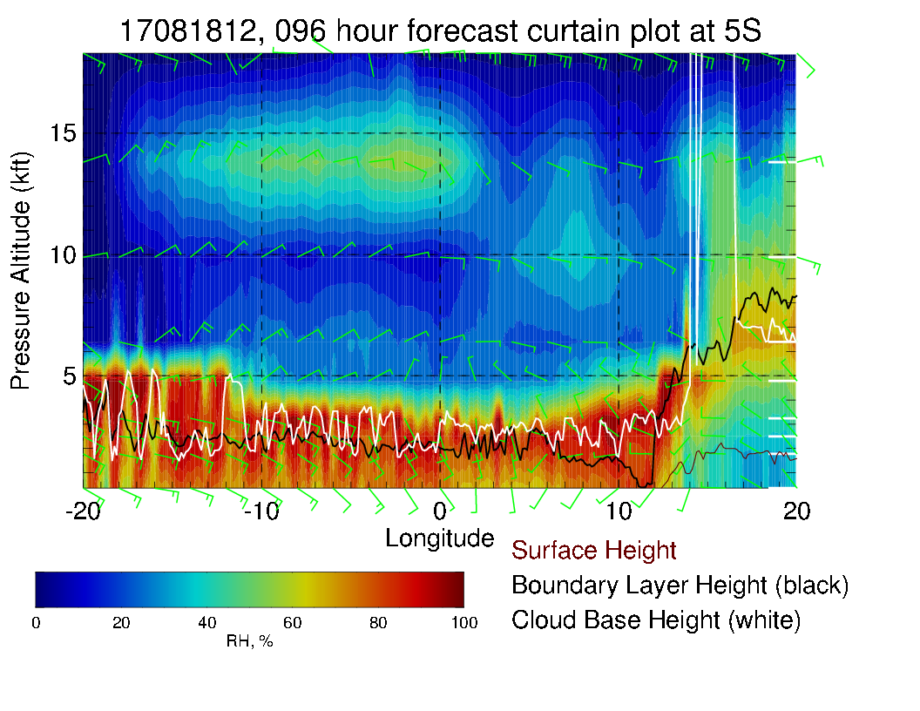
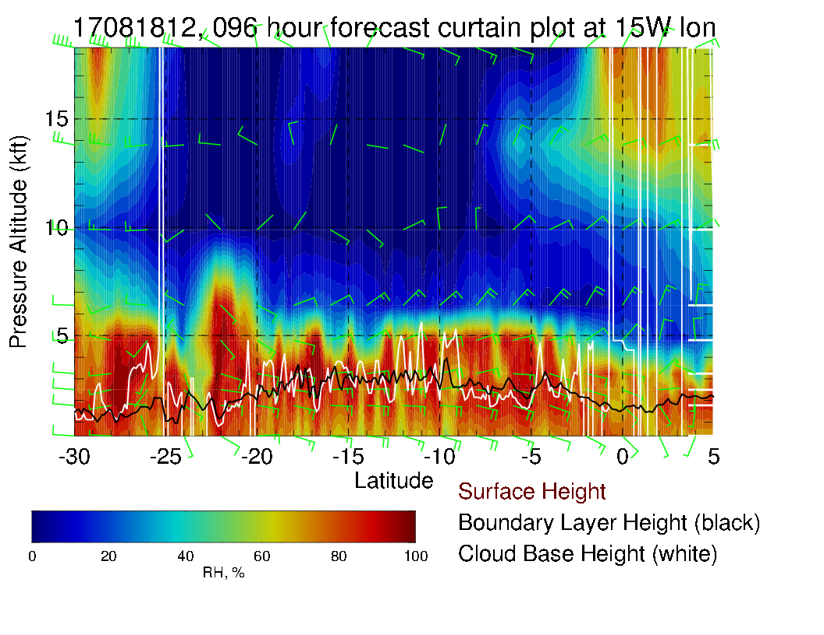
Today’s forecast. More 600mb
moisture. In any case, it does
not penetrate to 8S.

Slide 30
Evolution of flow through Saturday 8/19

Slide 31
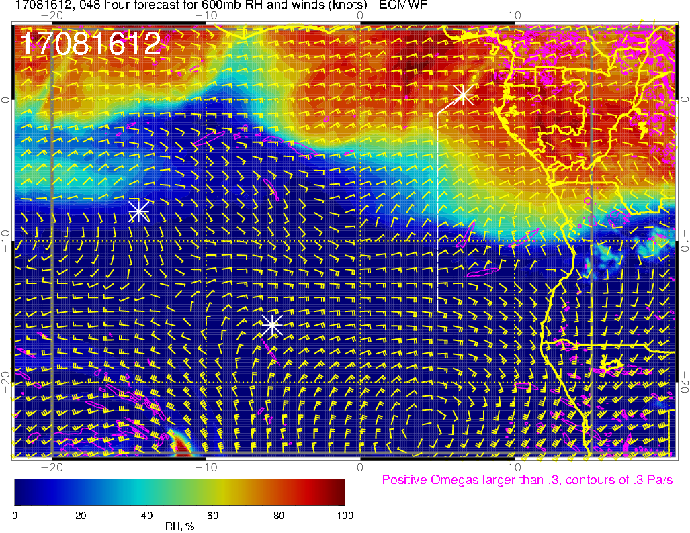
Moisture moving westward
600 mb (8/16 @ 12PM)

Slide 32
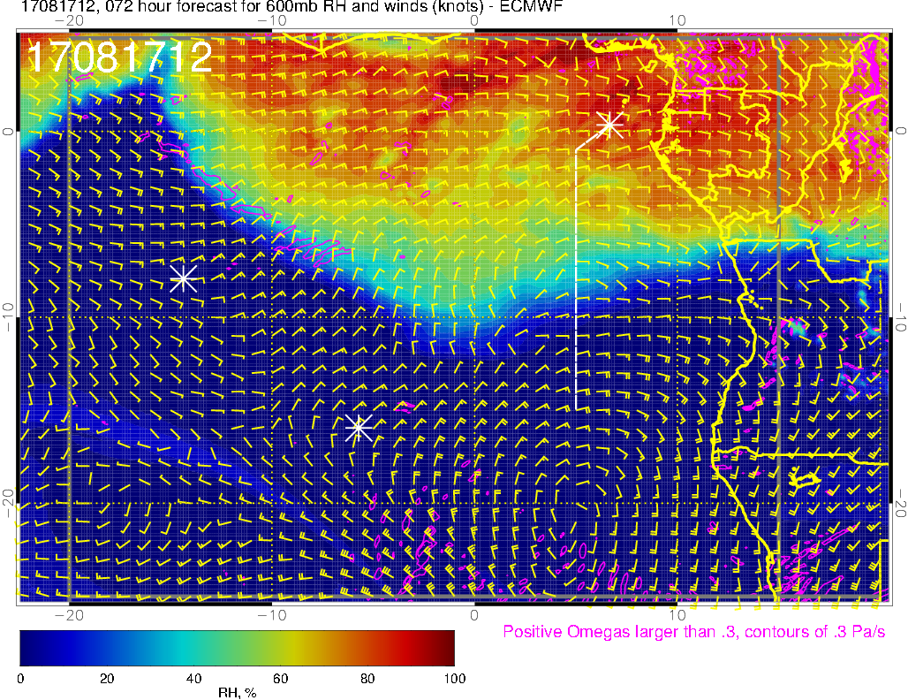
600 mb (8/17 @ 12PM)

Slide 33
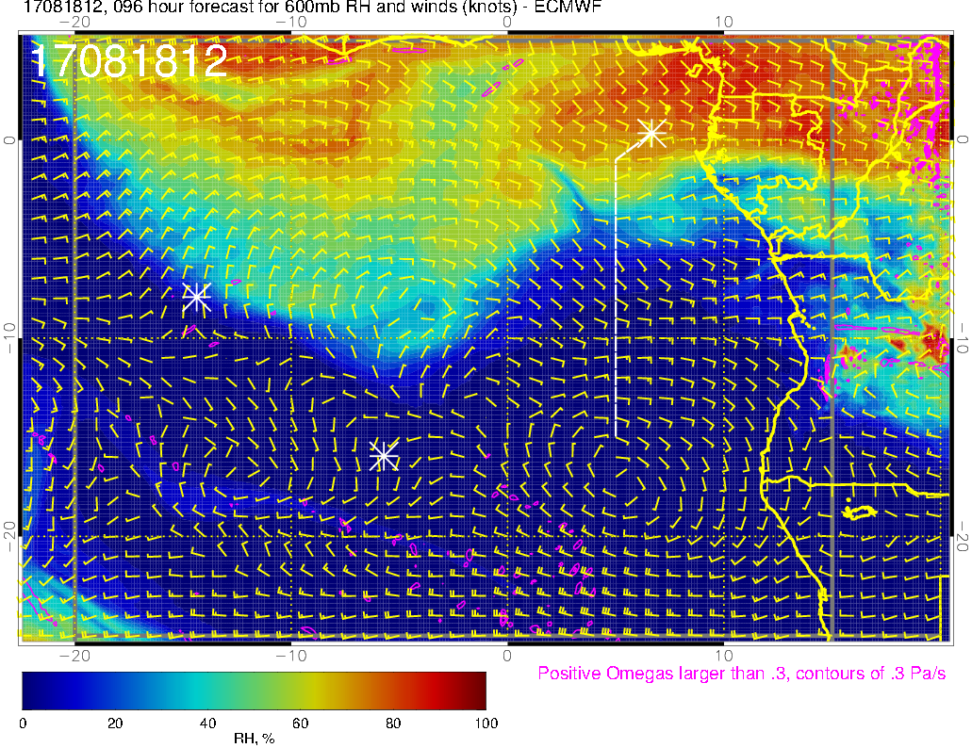
600 mb (8/18 @ 12PM)

Slide 34
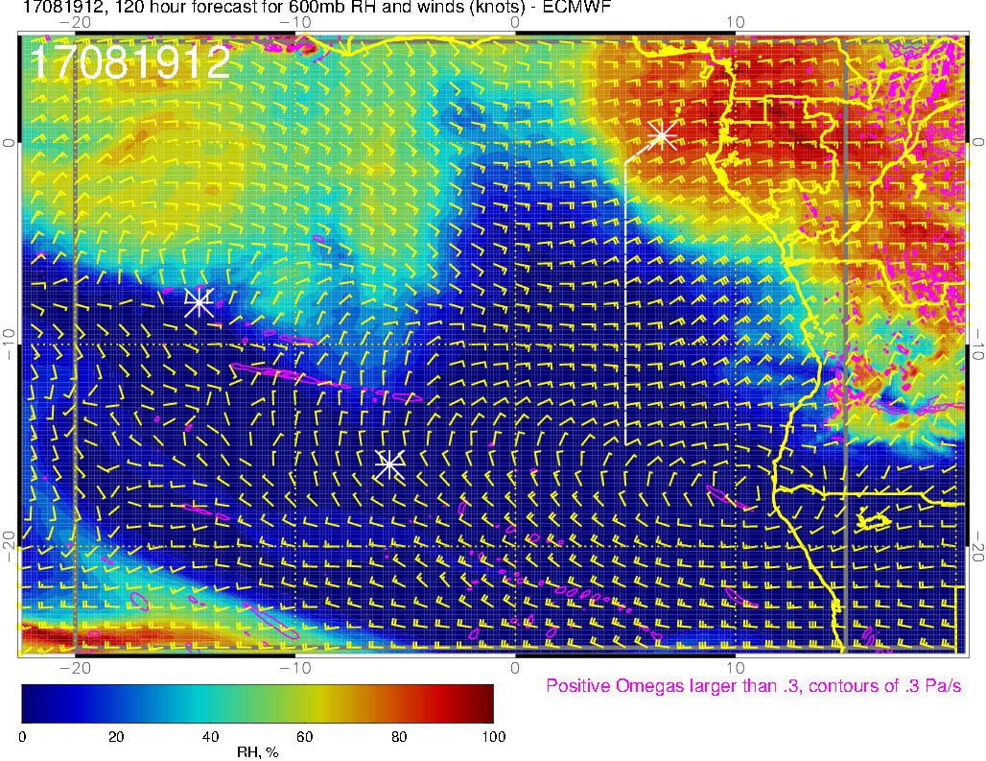
new plume of moist air
600 mb (8/19 @ 12PM)

Slide 35
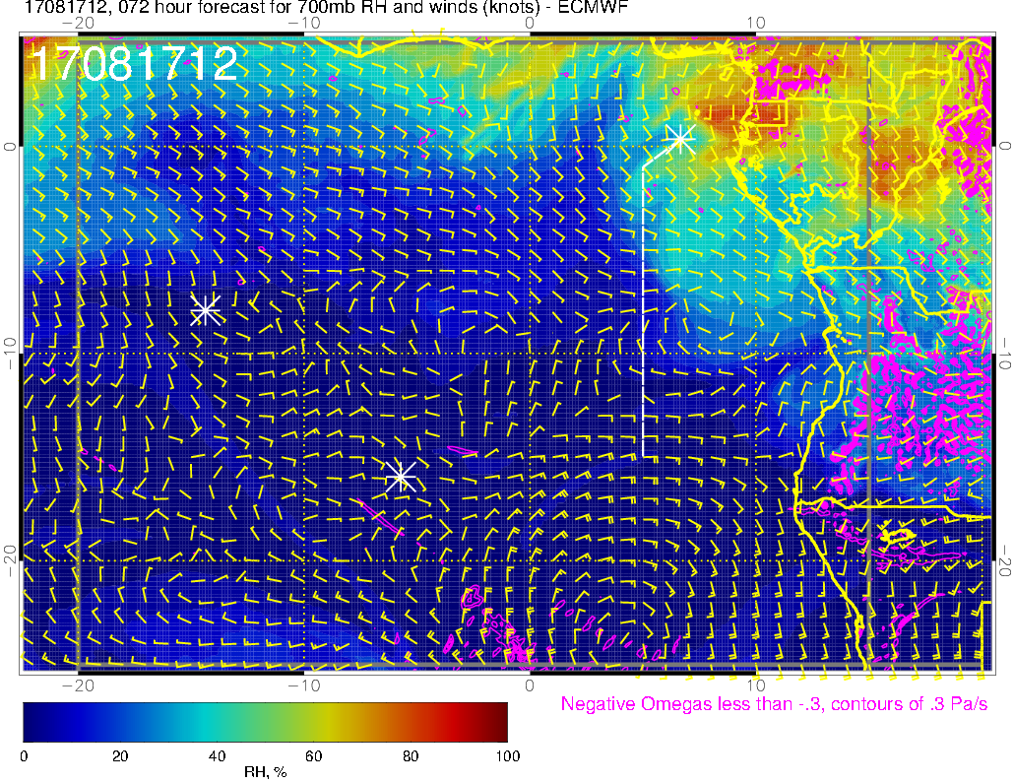
Moisture moving westward
Relatively dry due to anomalous southerly winds transporting dry air northward
700 mb (8/17 @ 12PM)

Slide 36
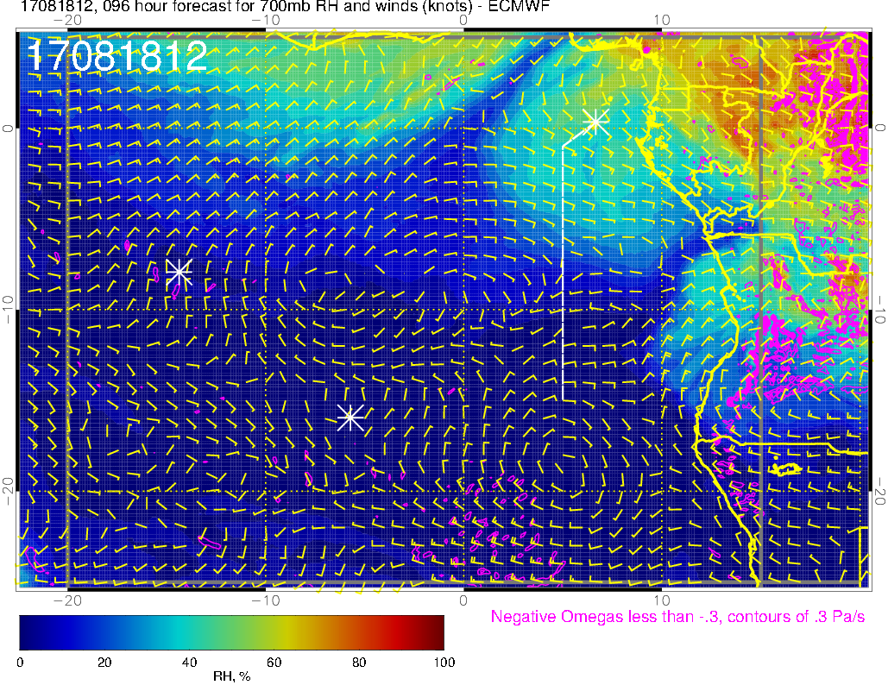
700 mb (8/18 @ 12PM)

Slide 37
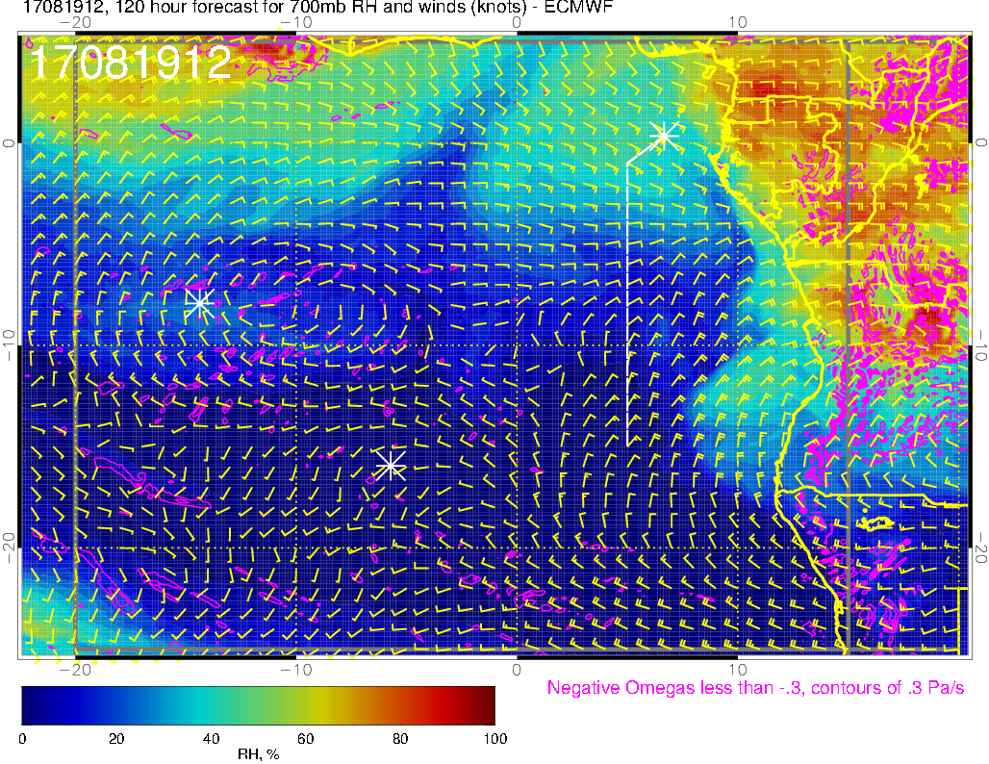
Moisture wrapped around from the north
Winds have become more zonal
700 mb (8/19 @ 12PM)

Slide 38
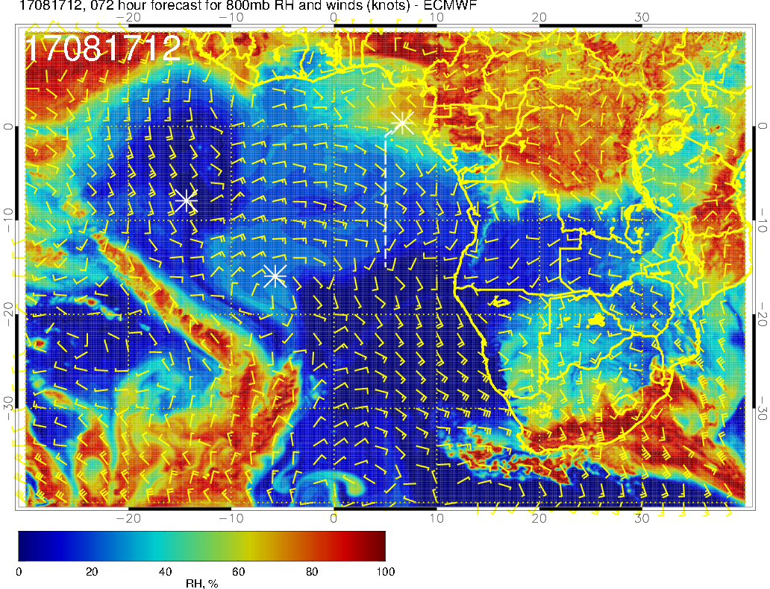
Moisture moving southward
800 mb (8/17 @ 12PM)

Slide 39
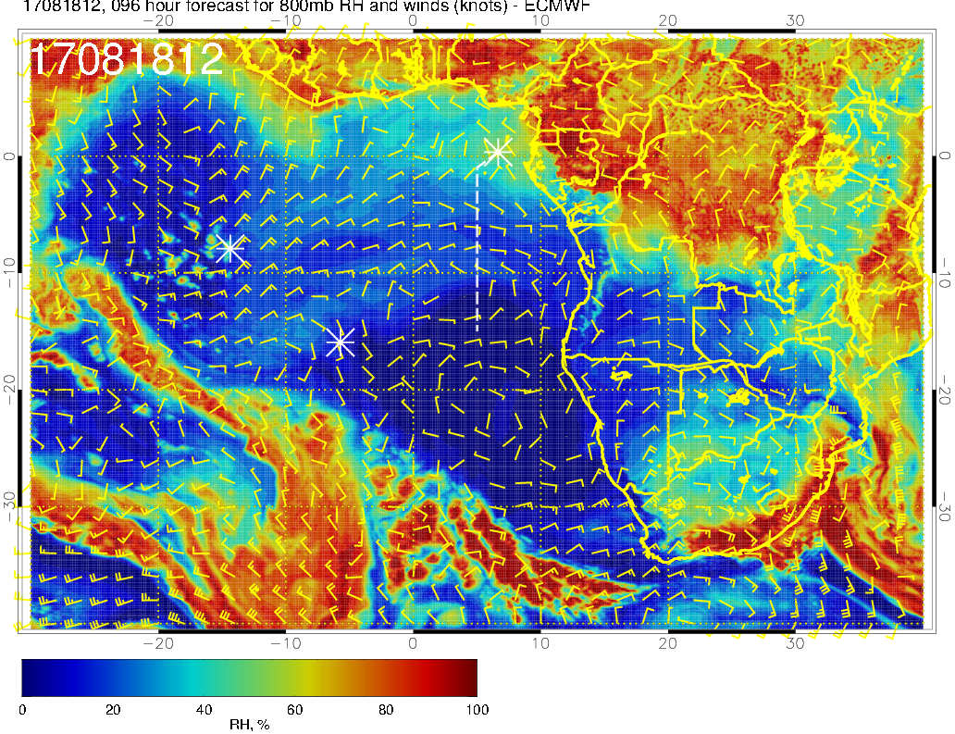
800 mb (8/18 @ 12PM)

Slide 40
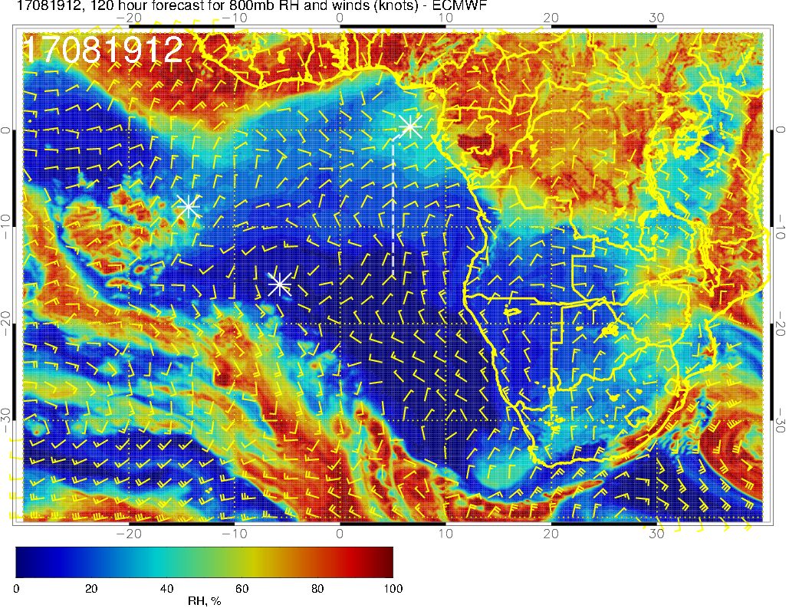
Low clouds over high BL heights
800 mb (8/19 @ 12PM)

Slide 41
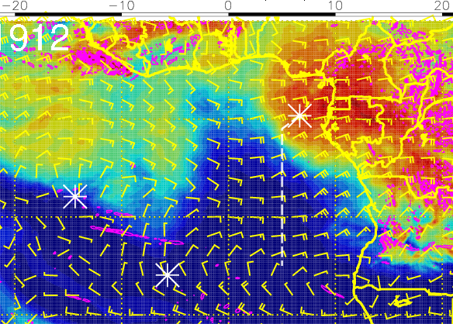
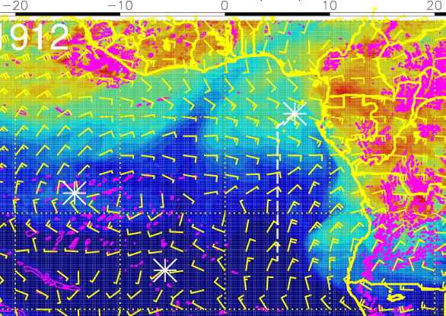
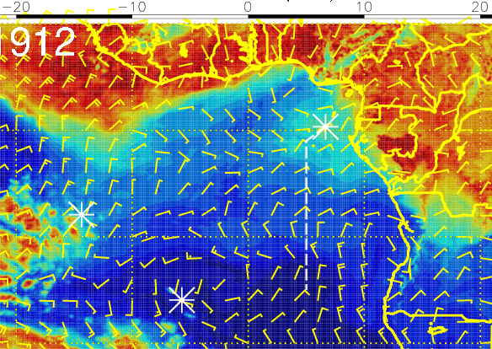
RH (color), winds, vert. velocity (pink) at 8/19 Sat @ 12PM
600 mb
700 mb
Moist air north of ASI at 600mb originated over African coast east of TMS (westward transport)
Moist air north of ASI at 800mb is from moist convection to the north and east
800 mb

Slide 42
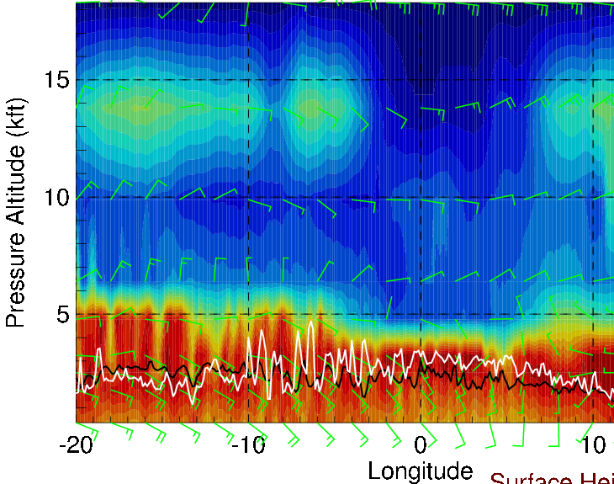
Latitudinal cross-sections of RH (color), wind, BL and cloud base heights
on 8/19 Sat @ 12 PM
Moist air at 600mb transported from the east (combined influence from moist and dry convection?)
along 5S
Deep BL heights to the west near Ascension
Mostly headwinds (5-15 knts) at 15 kft, but crosswinds (5-10 knts) near ASI at 6-10 kft and SE winds (10-20 knts) near surface
along 10S

Slide 43
RH (color), wind, BL and cloud base heights along 5E, 8/19 Sat @ 12PM
20-25 knts
15-25 knts
5-15 knts
Another surge of moisture from east, evident at >5 kft north of ~4-5S along the flight track
Strong (15-25 knots) easterly crosswinds at 15 kft
Surface winds are near climatology (~10 knots S)

Slide 44
Backward trajectories from two flight tracks on
8/18 Fri @ 2 km
(latest forecast available)

Slide 45
Low, middle, high cloud forecast for 8/19 Sat @ 12PM
Expect higher probability of high clouds (blue, magenta) near TMS
High clouds (cirrus) - uncertain
Low clouds (red) between ASI-TMS are close to climatology

Slide 46
Saturday 8/19
Near Ascension
Moist air to the north at 600mb originated over African coast east of Sao Tome (westward transport)
Moist air at 800mb is from moist convection to the north (southward transport) and low clouds over high BL heights
W-E flight leg along 5-10S: mostly headwinds (5-15 knts) at 15 kft, but crosswinds (5-10 knts) near ASI at 6-10 kft
Near Sao Tome
Another surge of moisture from east – moist air above 5 kft from TMS to ~4-5S along the routine flight track
Strong (15-25 knots) easterly crosswinds at 15 kft along the routine flight track
Cloud forecasts
Low cloud cover in our flight region resembles climatology
Higher probability of high clouds closer to TMS

