Slide 1
ORACLES Forecast Briefing (Aerosols)
15 August 2017

Slide 2
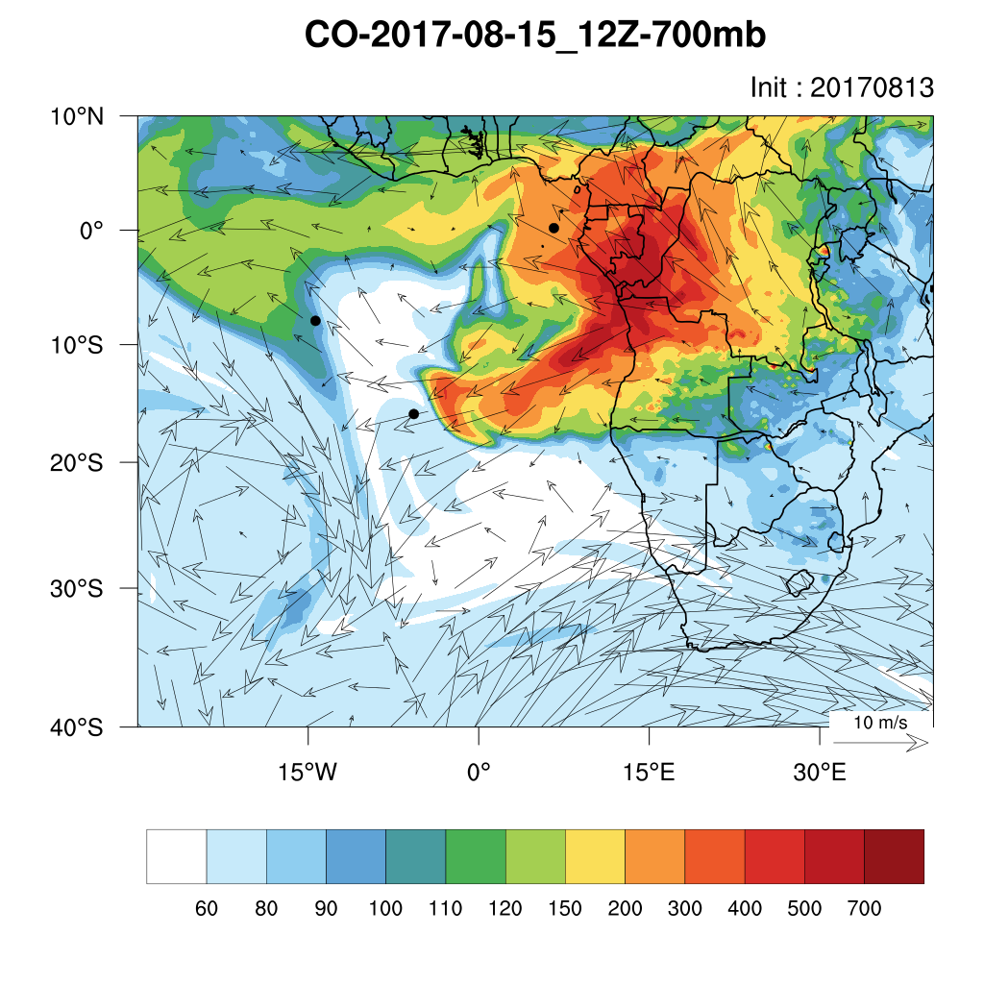
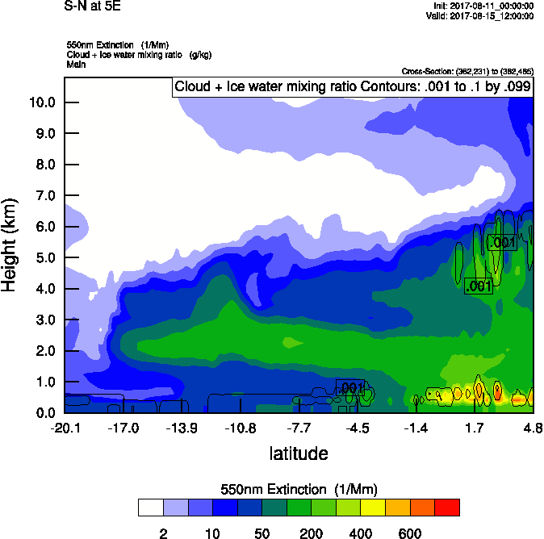
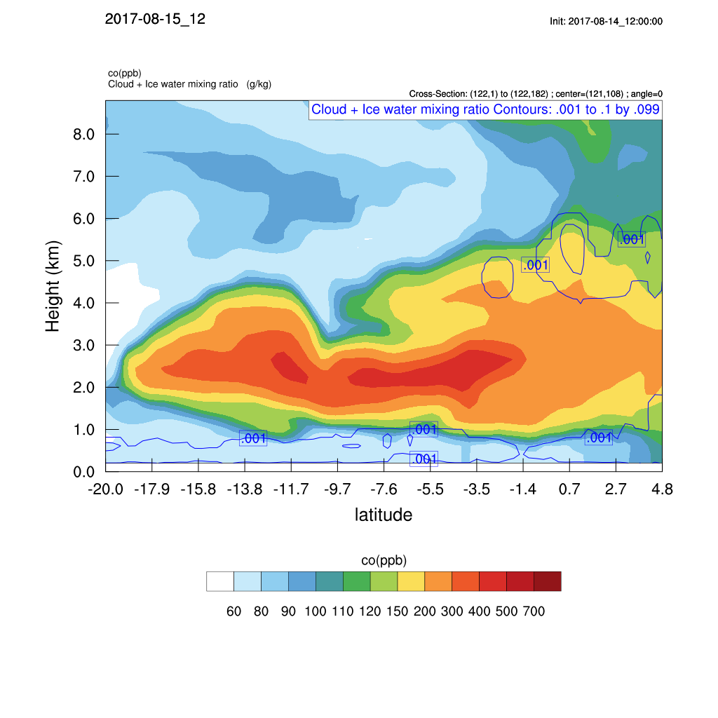
Tuesday August 15 12z

Slide 3
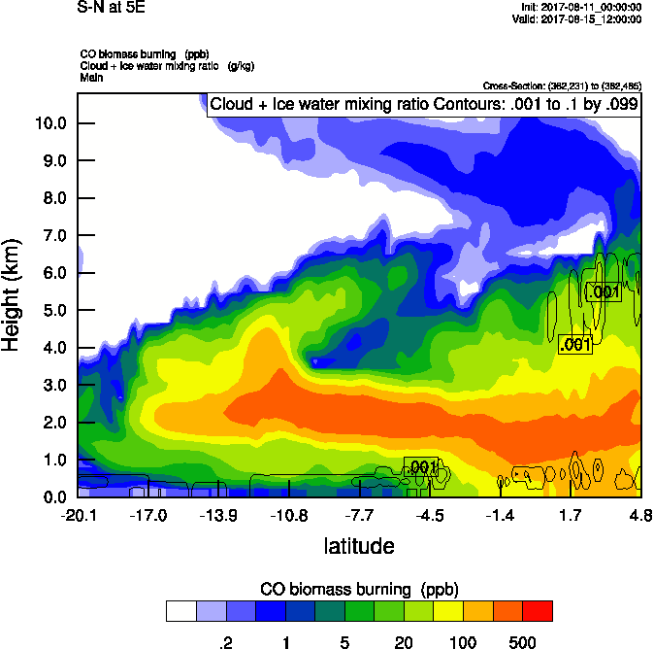
Tuesday August 15 12z

Slide 4
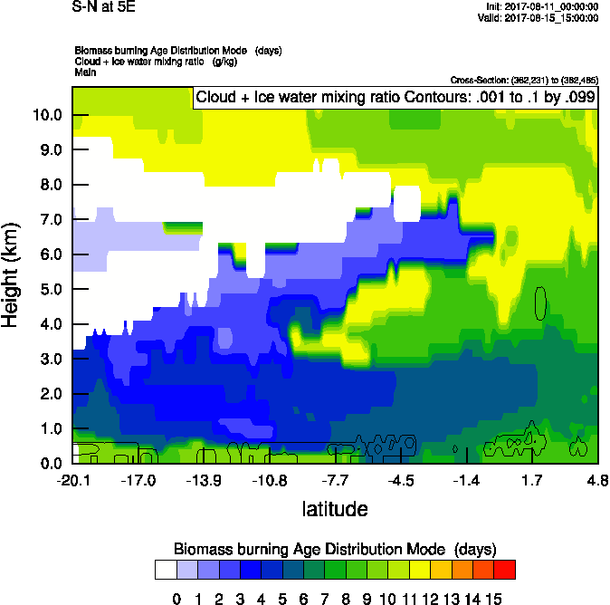
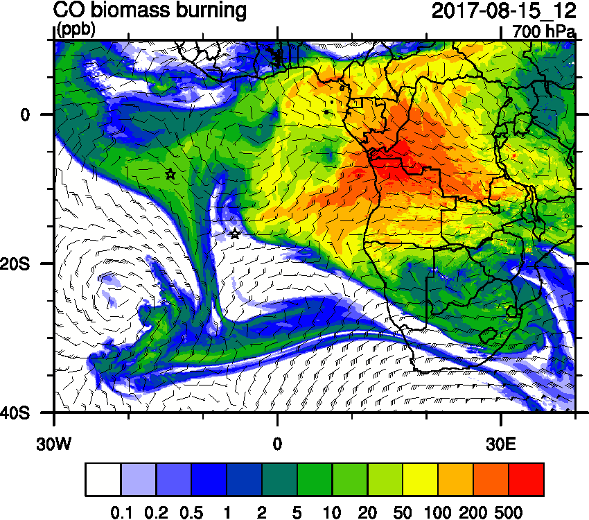
Tuesday August 15 12z

Slide 5
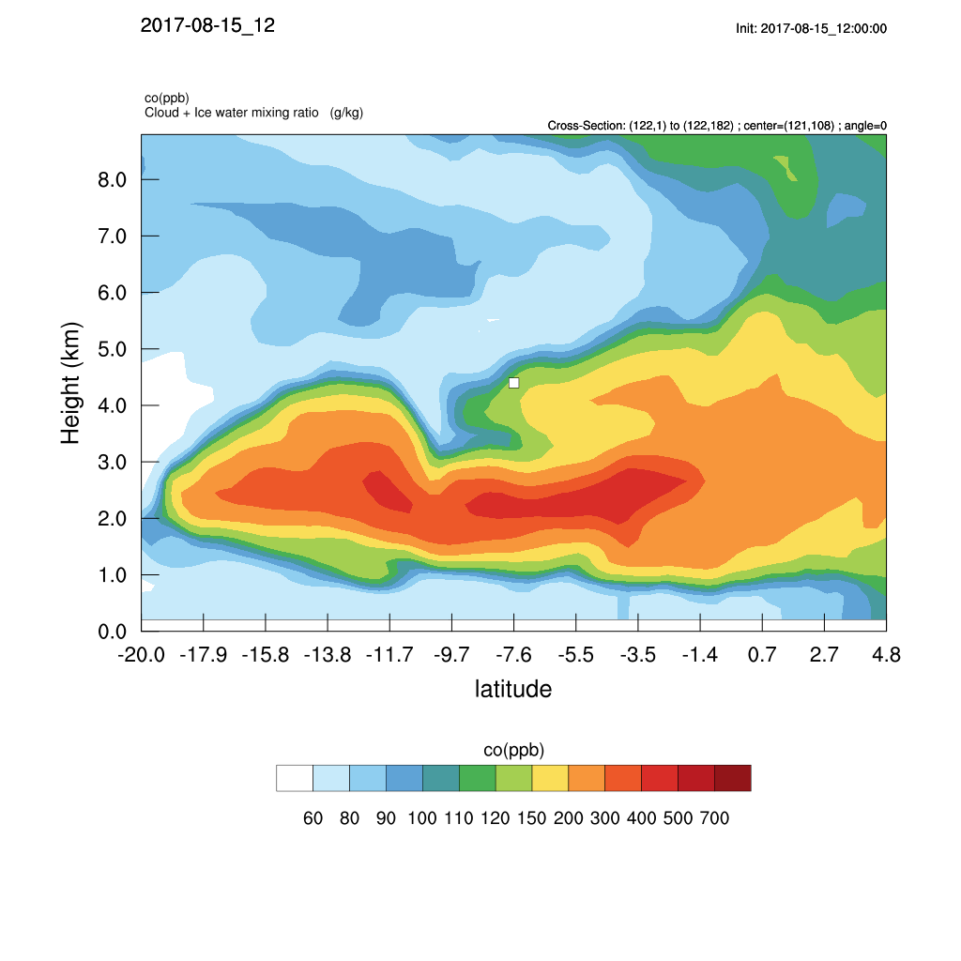
Tuesday August 15 12z (NEW)

Slide 6
Tuesday August 15 12z (OLD)

Slide 7
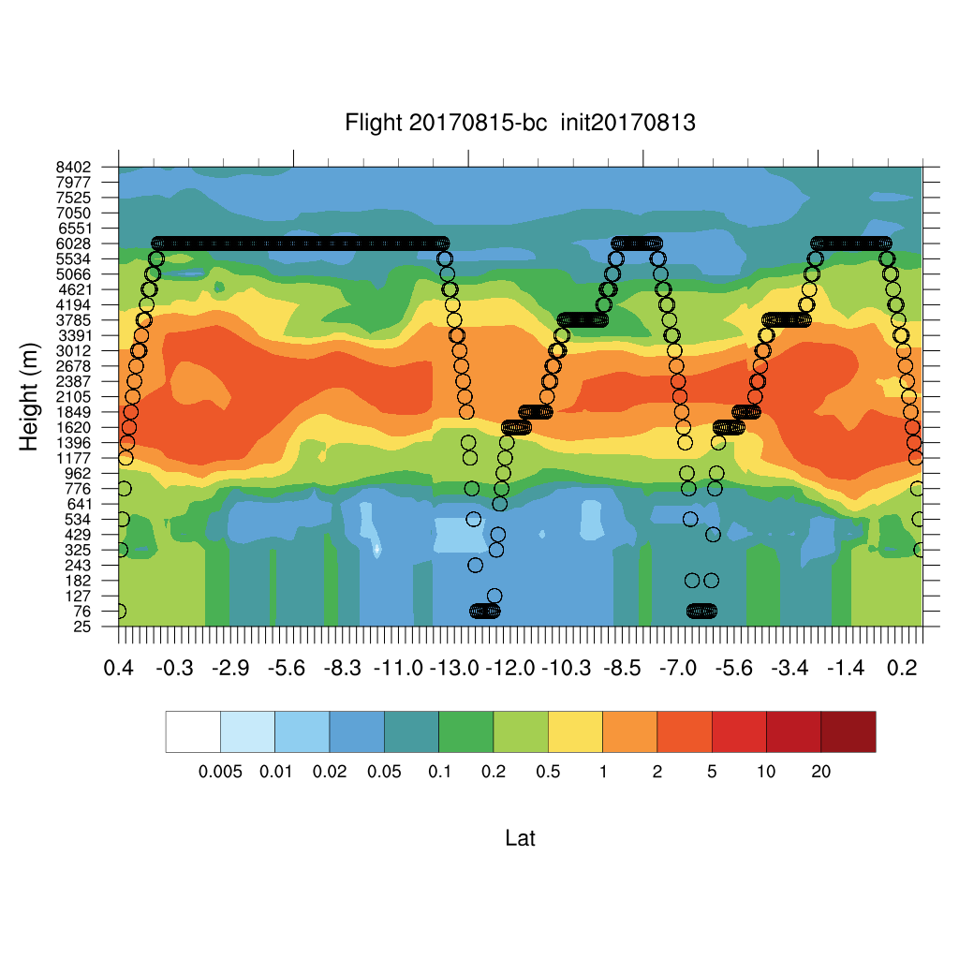
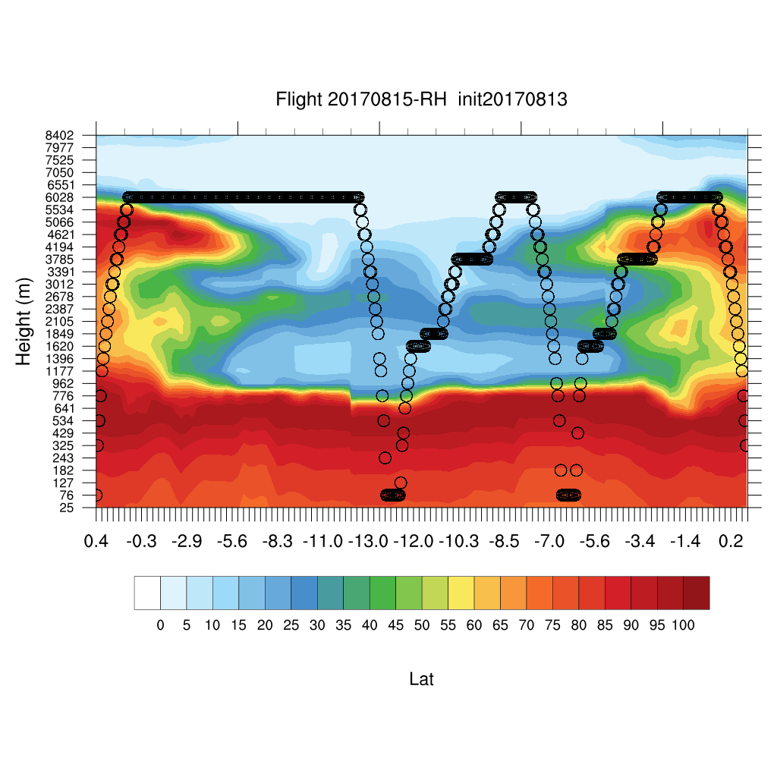
Tuesday August 15 12z (NEW)

Slide 8
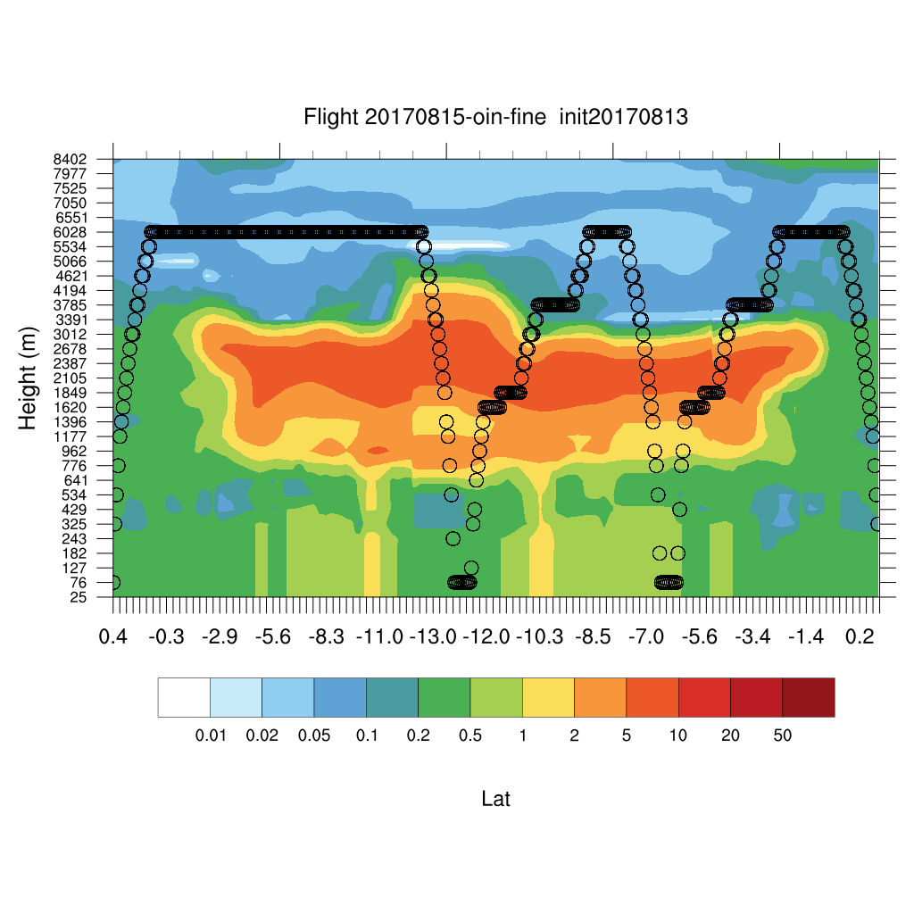
Tuesday August 15 12z (NEW)

Slide 9
BC AOD 08/14-19

Slide 10
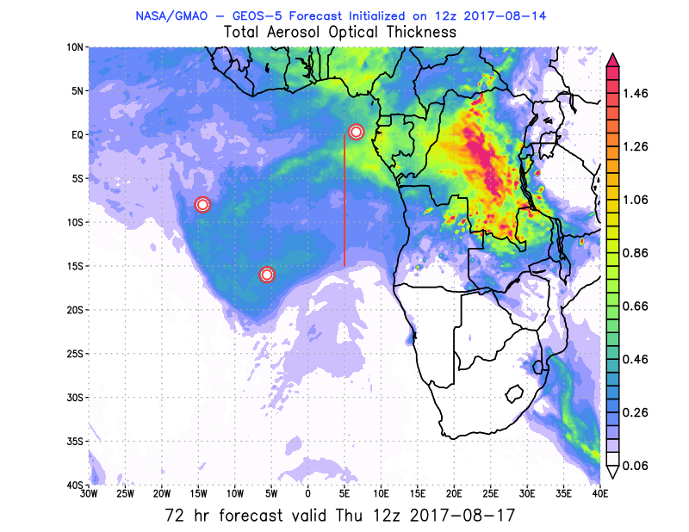
08/15 Tue (48h) 08/16 Wed(72h) 08/17 Thu(96h)
08/13 12Z
08/15 Tue (24h) 08/16 Wed (48h) 08/17 Thu(72h)
08/14 12Z

Slide 11
08/15 Tue (24h) 08/16 Wed(48h) 08/17 Thu(72h)
08/14 12Z
08/15 Tue (36h) 08/16 Wed(60h) 08/17 Thu(84h)
08/14 00Z

Slide 12
08/18 Fri (96h) 08/19 Sat(120h) 08/20 Sun(156h)
08/14 00Z
08/14 12Z
08/18 Fri(108h)
08/14 00Z

Slide 13
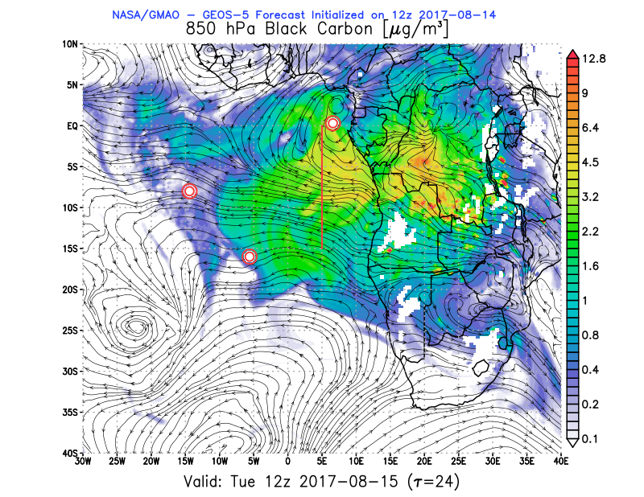
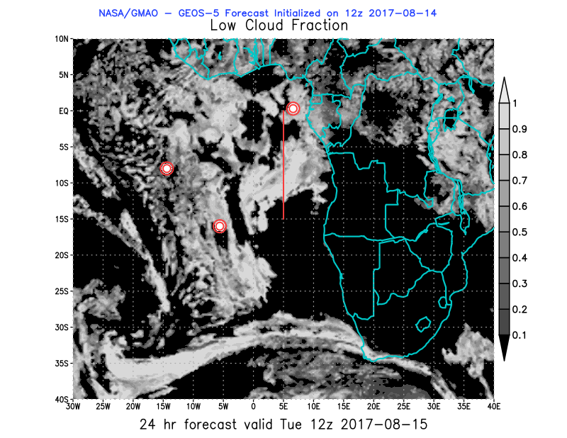
08/15 Tue (24h) 850 hPa 700hPa 600 hPa
08/14 12Z

Slide 14
08/15 Tue (24h) 850 hPa 700hPa 600 hPa
08/14 12Z

Slide 15
Outlook Monday-Friday

Slide 16
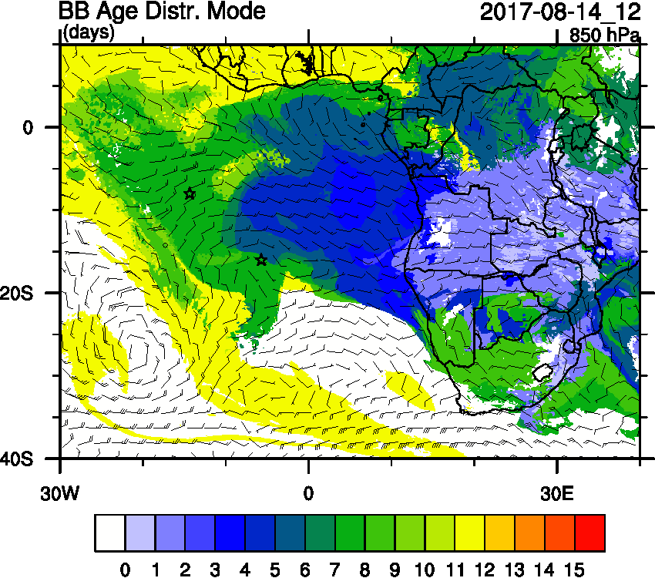
Outlook Monday-Friday

Slide 17
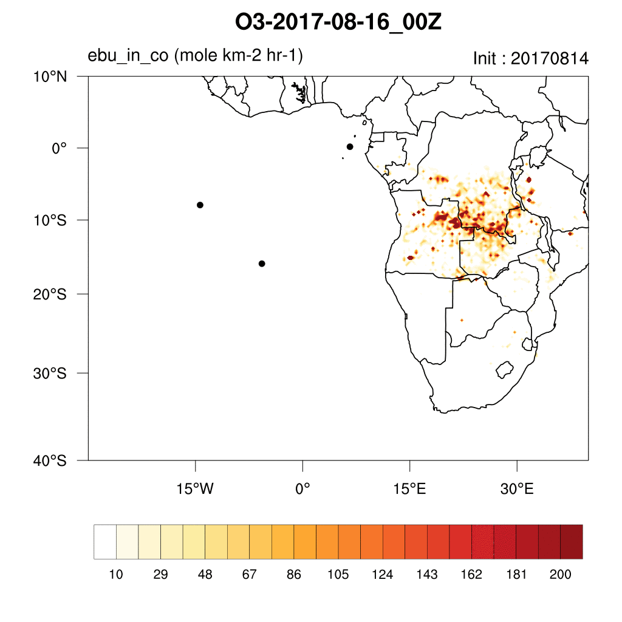
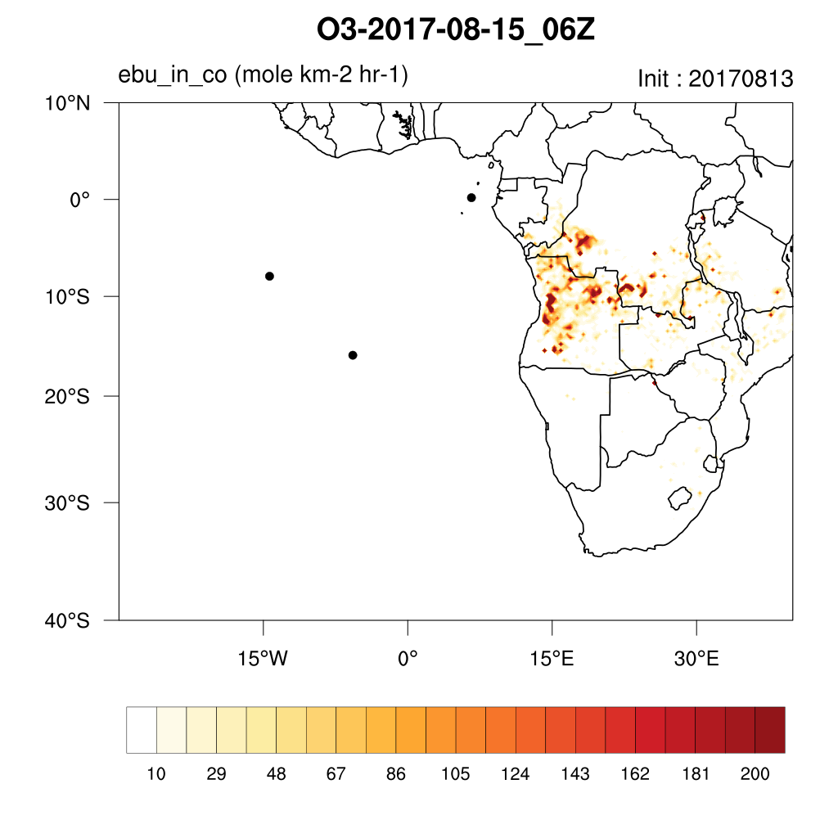
Thursday August 17 12z

Slide 18
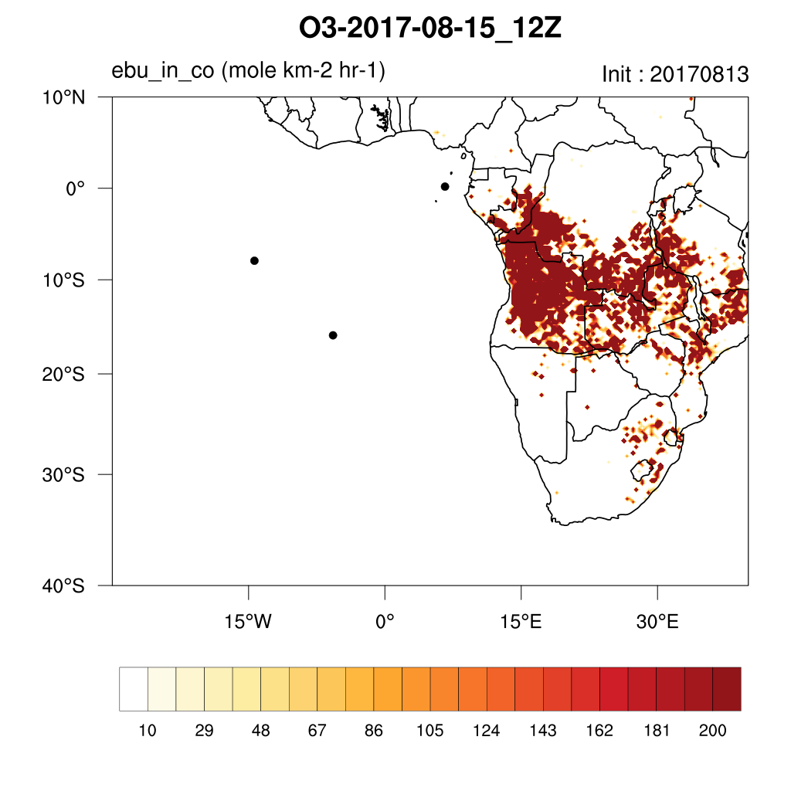
Thursday August 17 12z

Slide 19
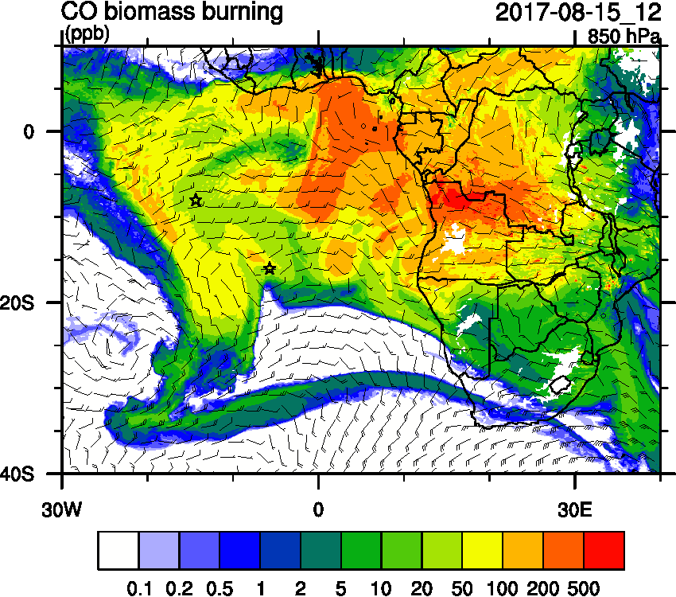
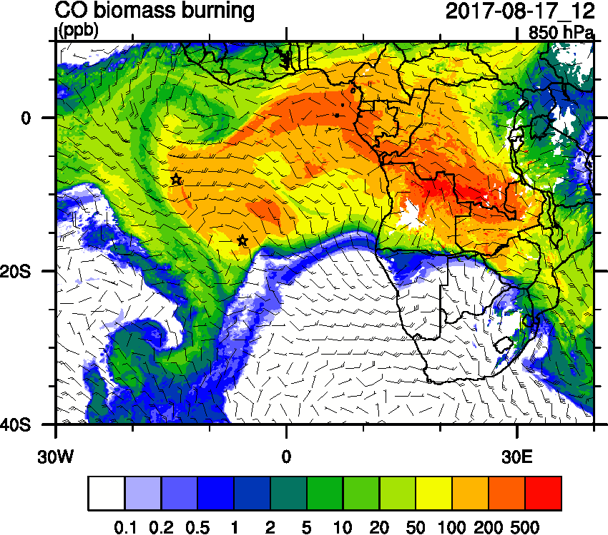
Thursday August 17 12z

Slide 20
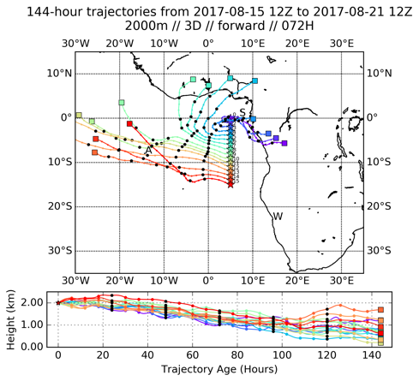
Thursday August 17 12z

Slide 21
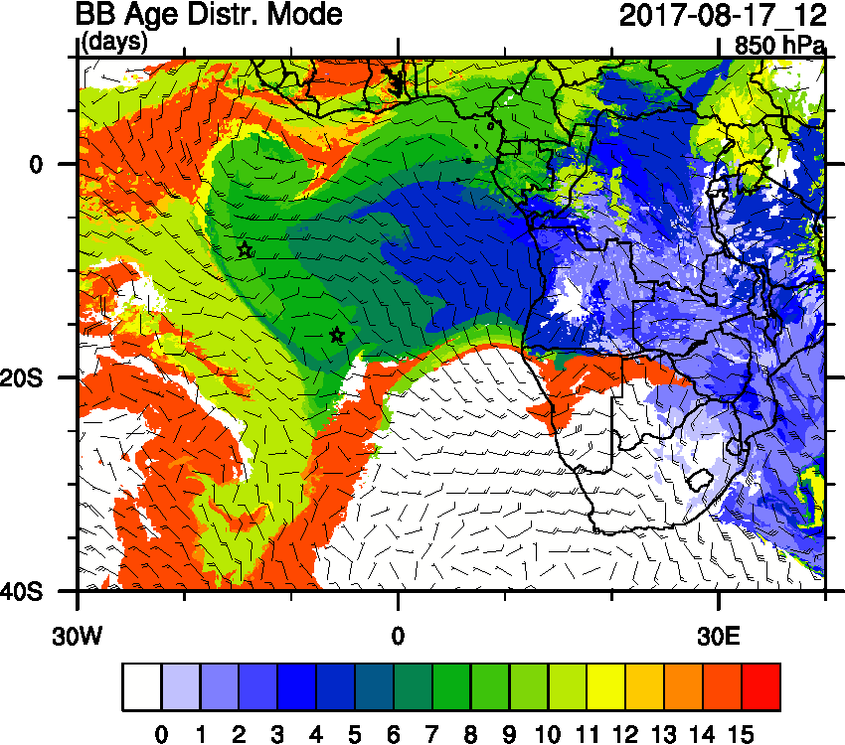
Thursday August 17 12z

Slide 22
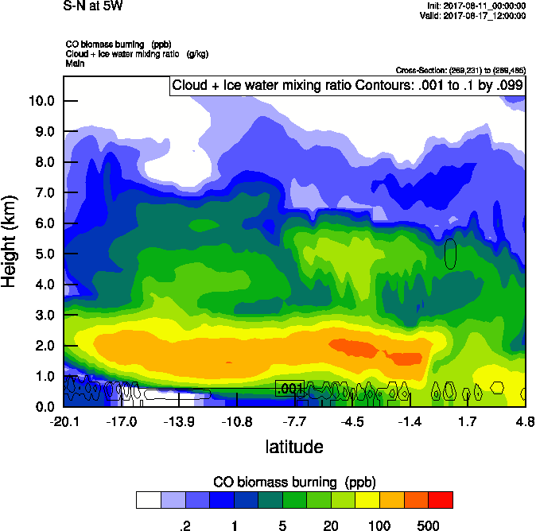
Thursday August 17 12z

Slide 23
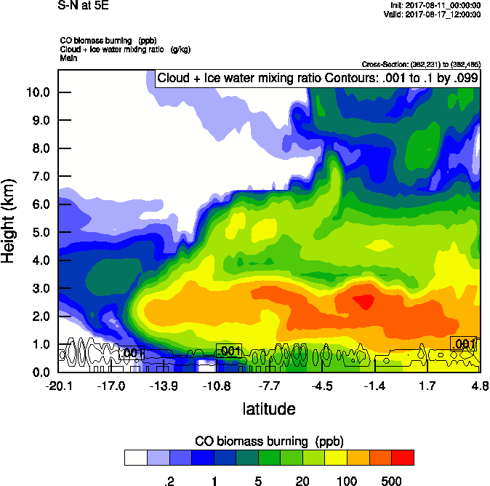
Thursday August 17 12z
5E
5W

Slide 24
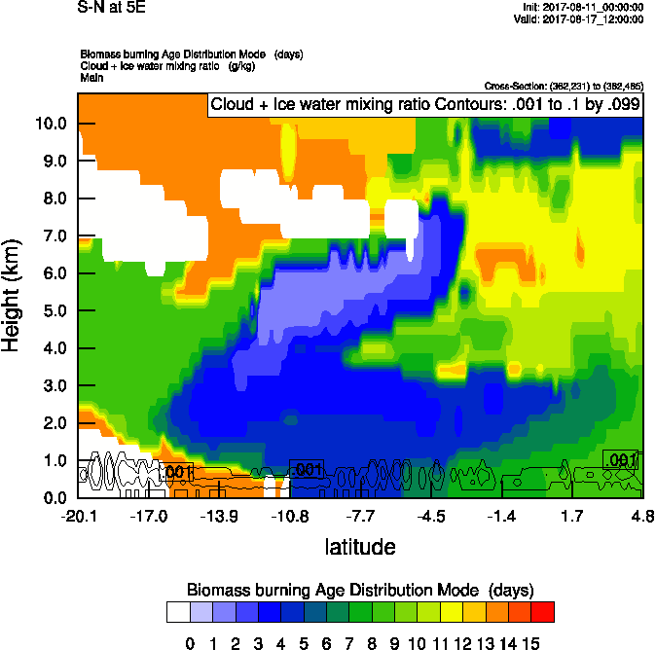
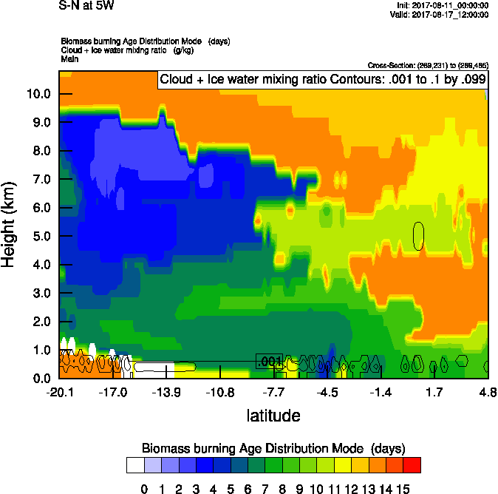
Thursday August 17 12z
5E
5W

Slide 25
Thursday August 17 12z

Slide 26
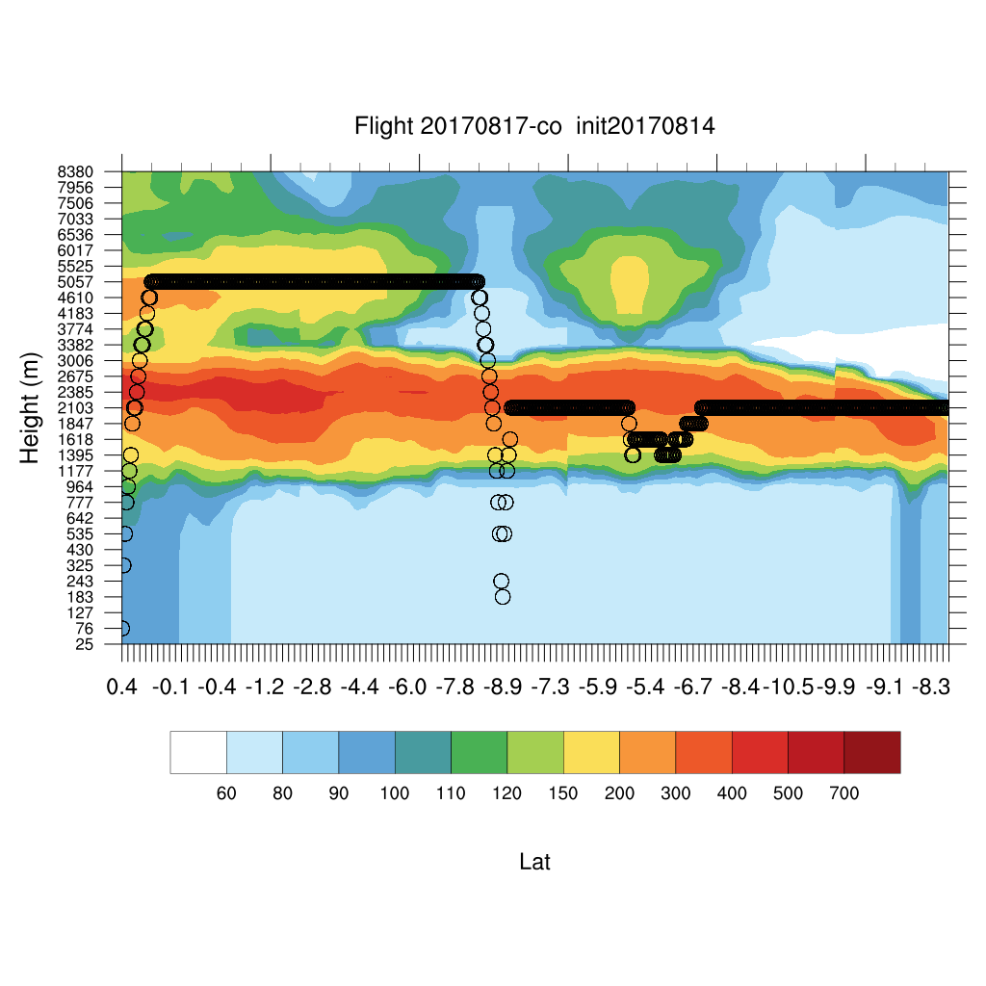
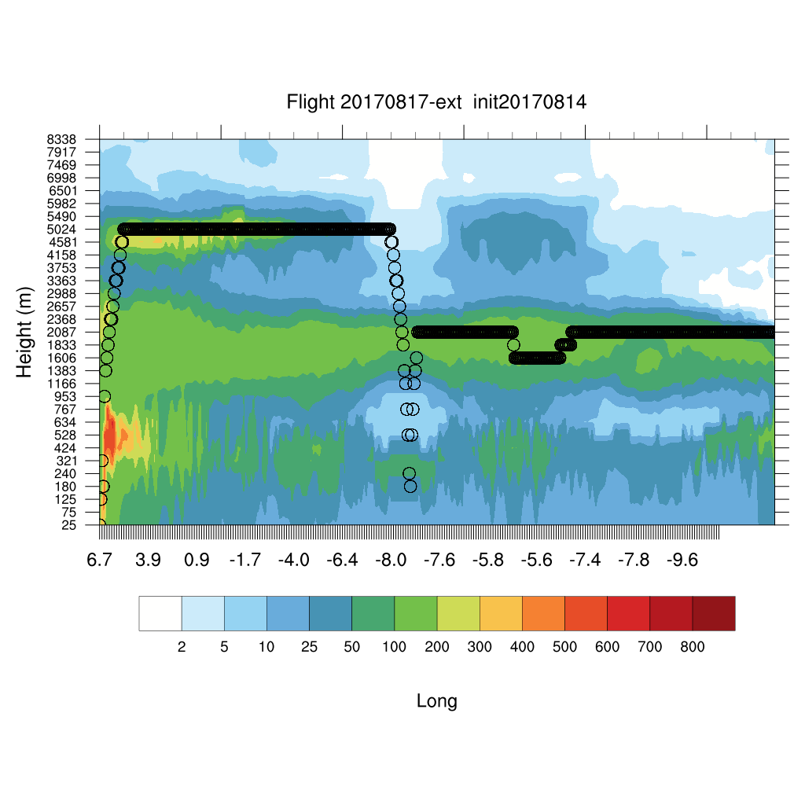
Thursday August 17 12z

Slide 27
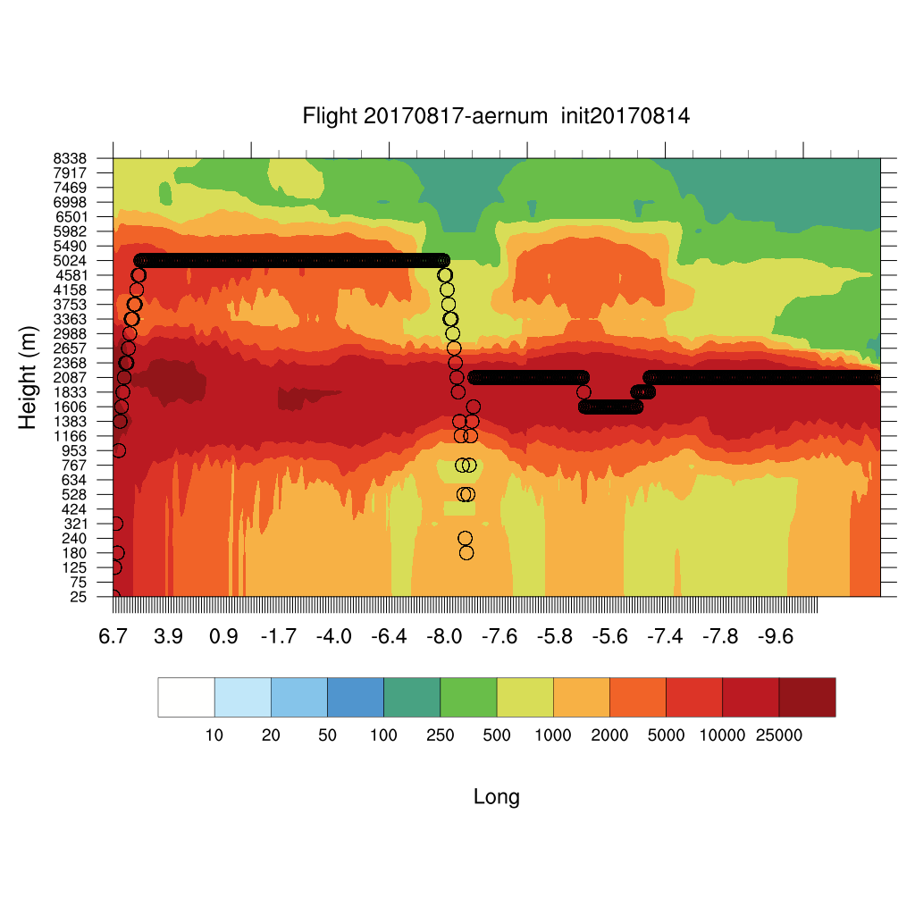
Thursday August 17 12z

Slide 28
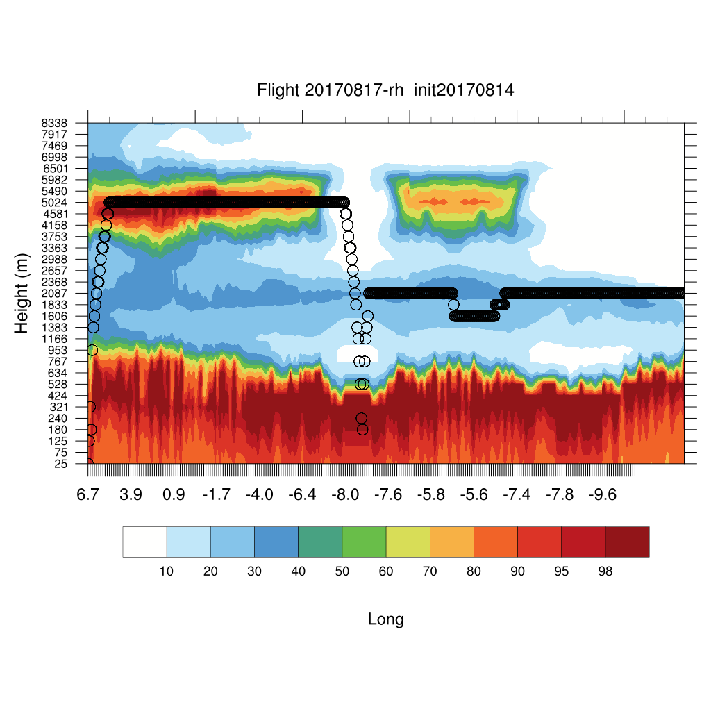
Thursday August 17 12z

Slide 29
Thursday August 17 12z

Slide 30
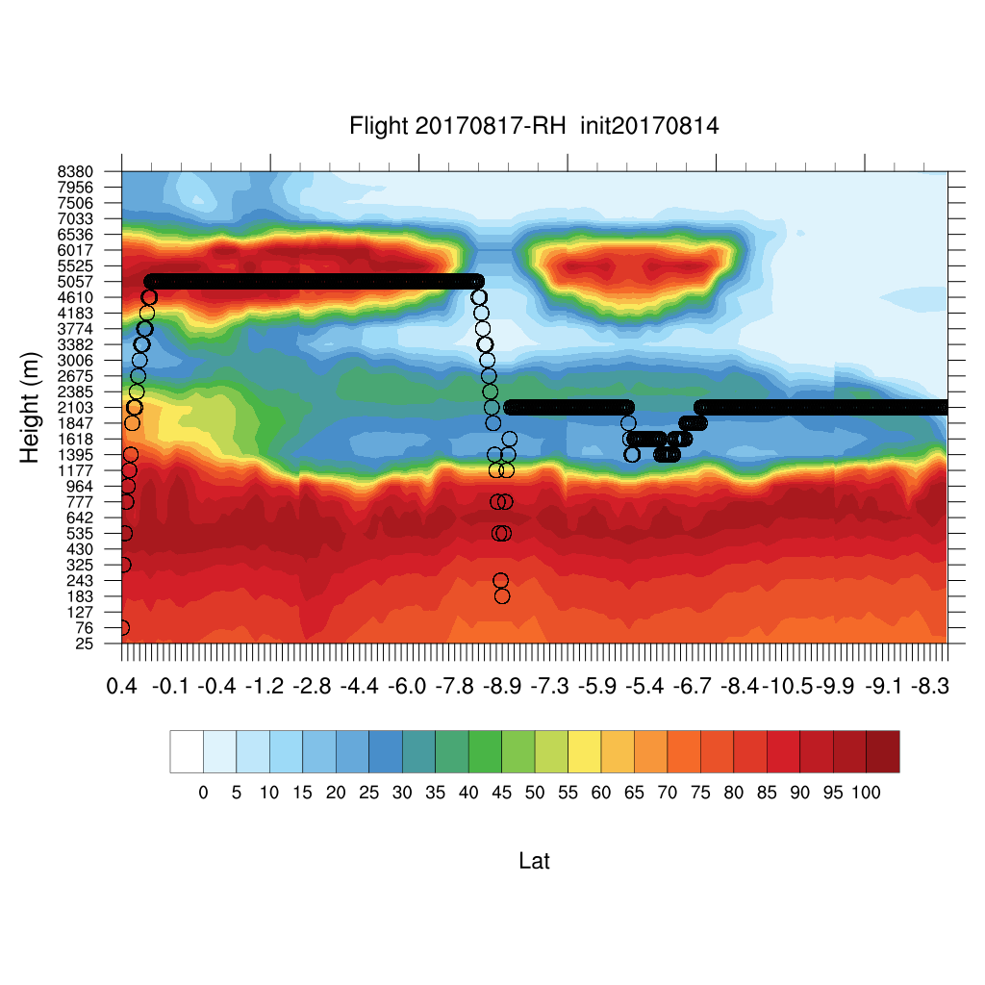
Thursday August 17 12z

Slide 31
08/18 Fri (96h) 850 hPa 700hPa 600 hPa
08/14 12Z

Slide 32
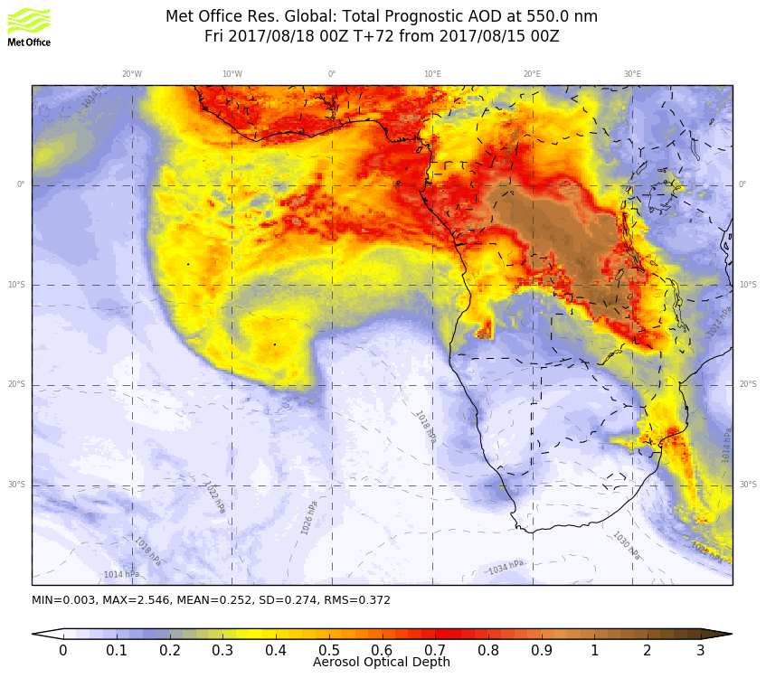
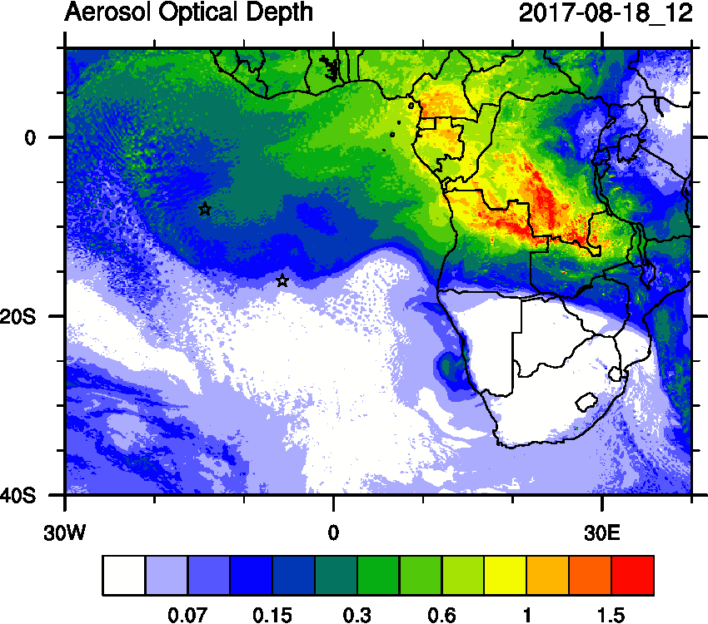
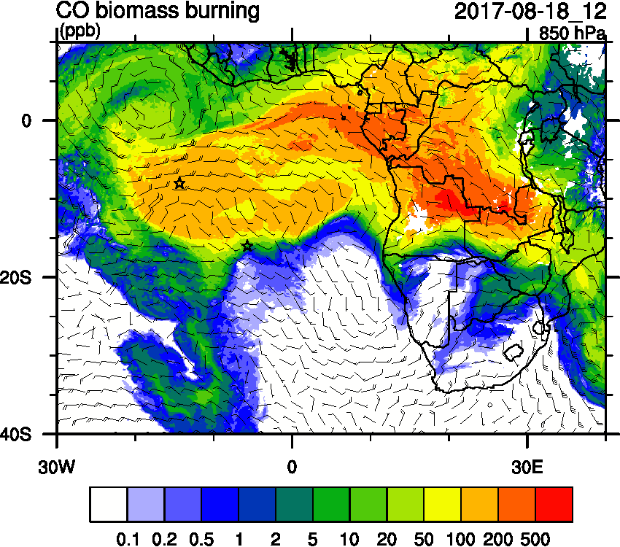
Friday August 18 (12z)

Slide 33
Friday August 18 (12z)

Slide 34
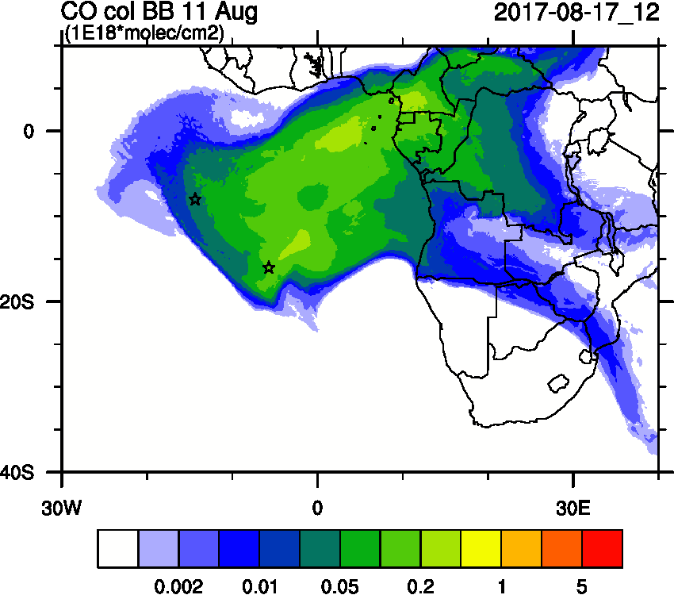
Friday August 18 (12z)

Slide 35
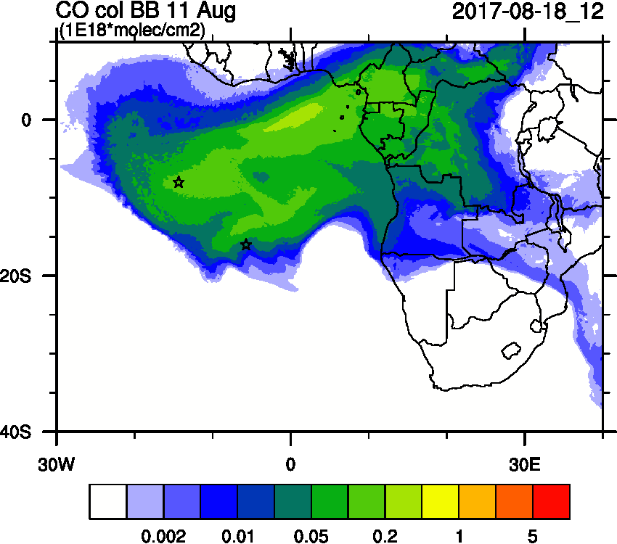
Friday August 18 (12z)

Slide 36
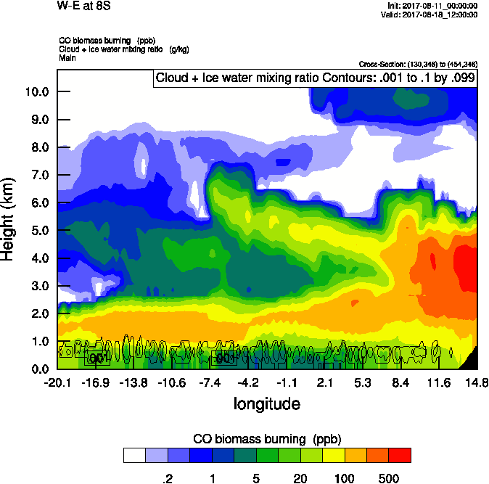
Friday August 18 (12z)

Slide 37
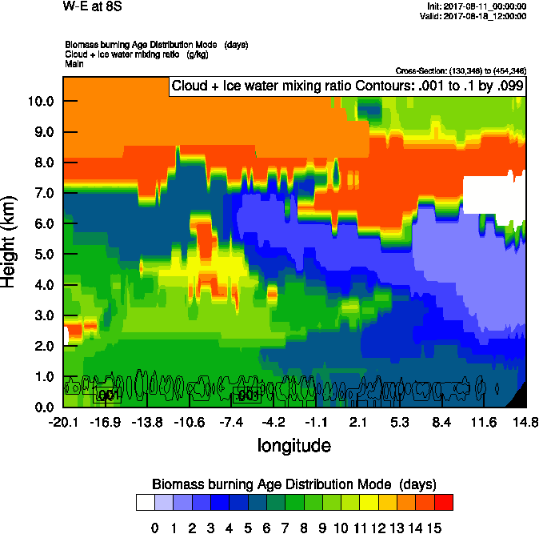
Friday August 18 (12z)

Slide 38
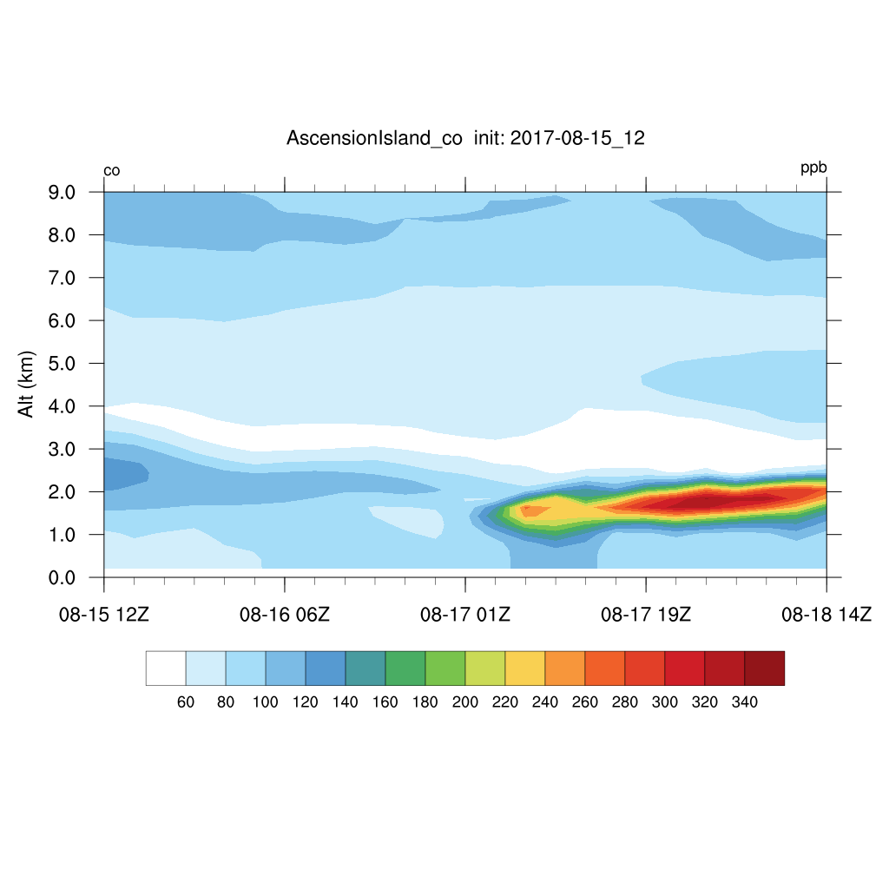
Friday August 18 (12z)

Slide 39
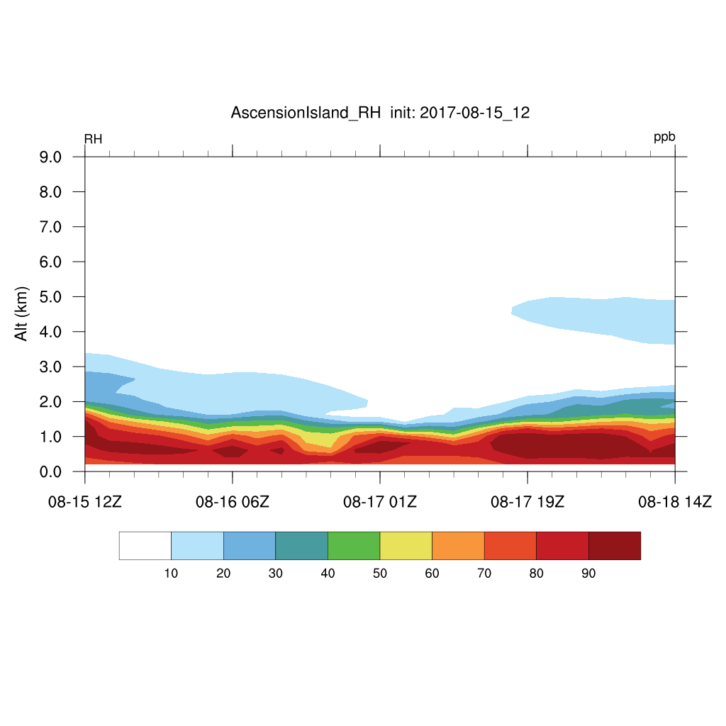
Friday August 18 (12z)

Slide 40
08/19 Sat (120h) 850 hPa 700hPa 600 hPa
08/14 12Z

Slide 41
BC 08/14-24 00Z

Slide 42
Dust 08/14-24 00Z

Slide 43
Ascension São Tomé e Príncipe Sta Helena

Slide 44
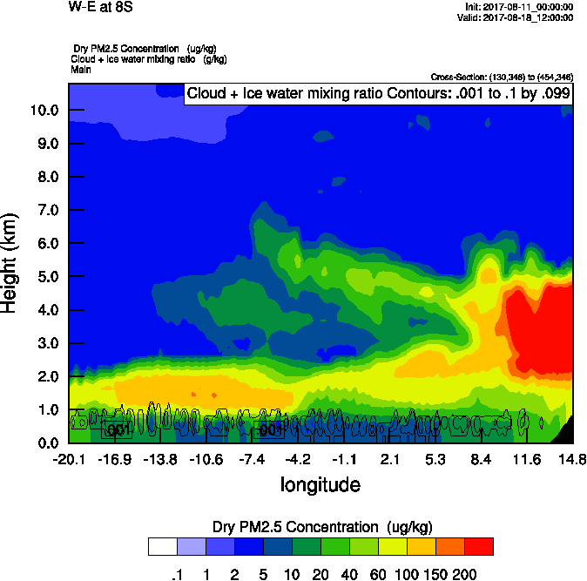
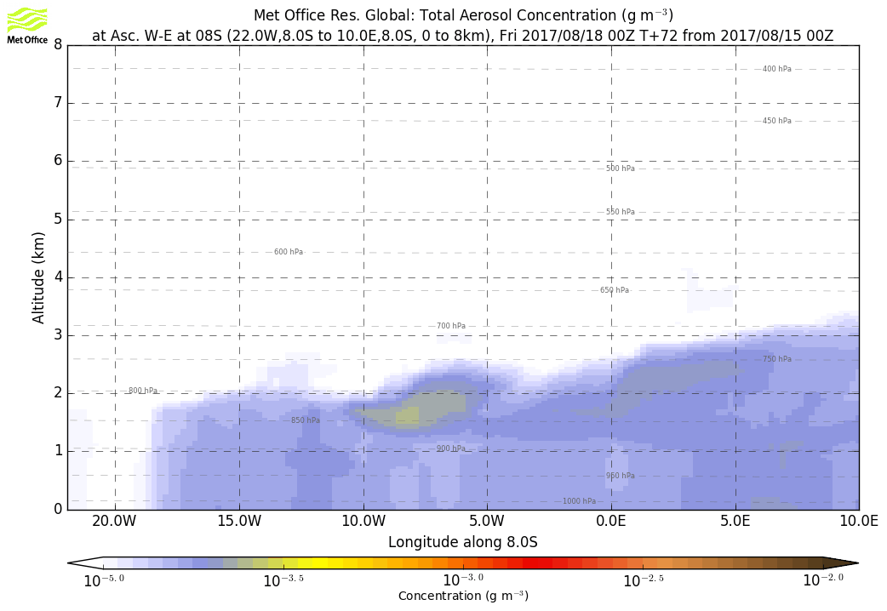
Friday August 18 (12z)

Slide 45
Thursday August 17 12z

Slide 46
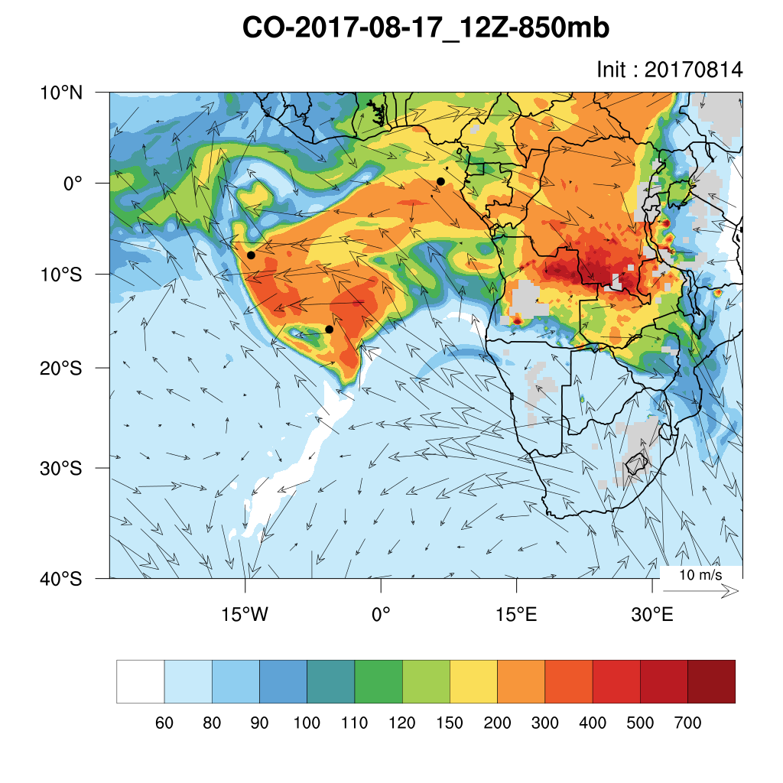
Thursday August 17 12z

Slide 47
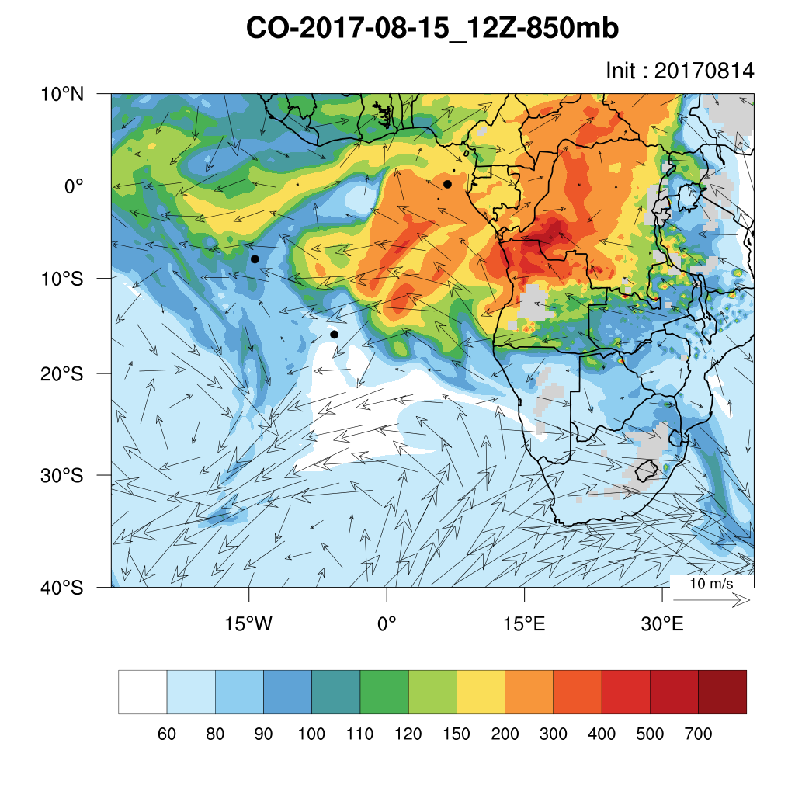
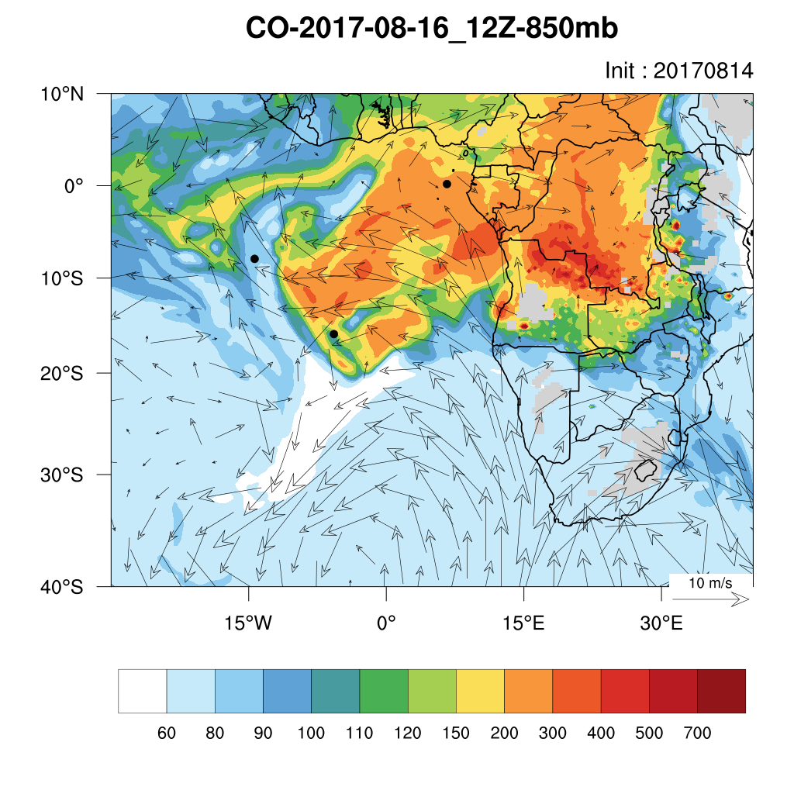
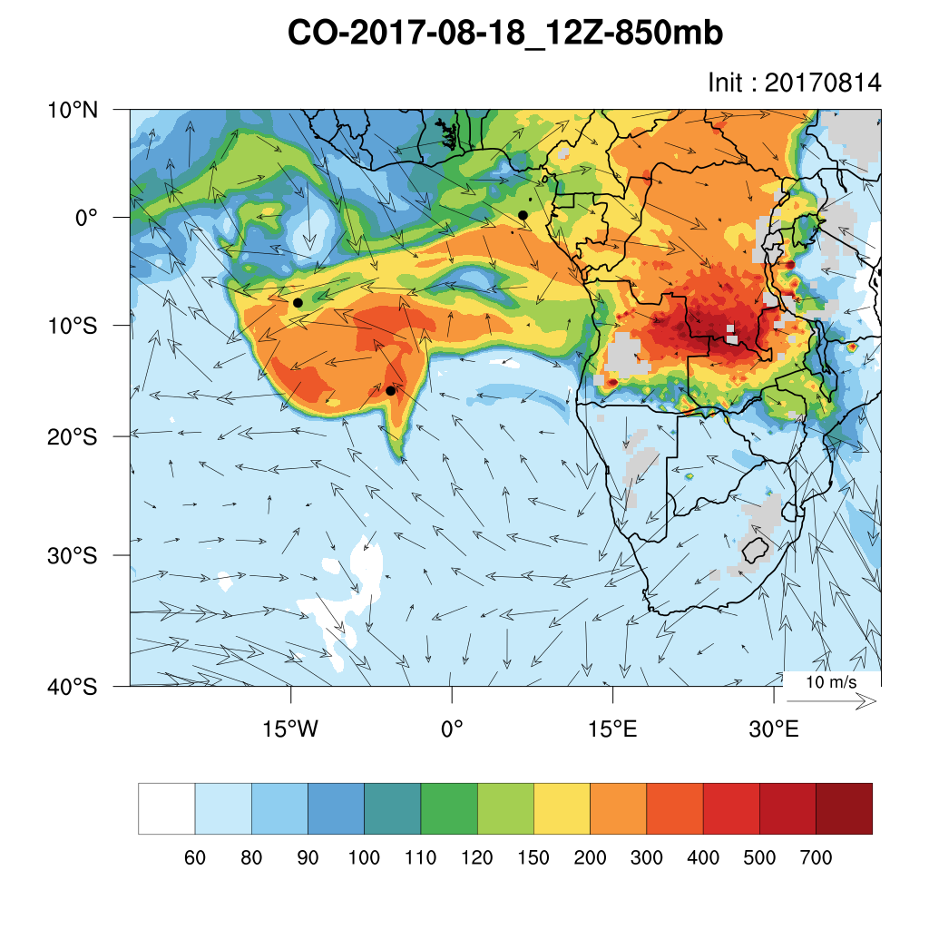
Thursday August 17 12z

