Slide 1
ORACLES weather briefing
14-Aug-2017
Lenny Pfister and Rei Ueyama

Slide 2
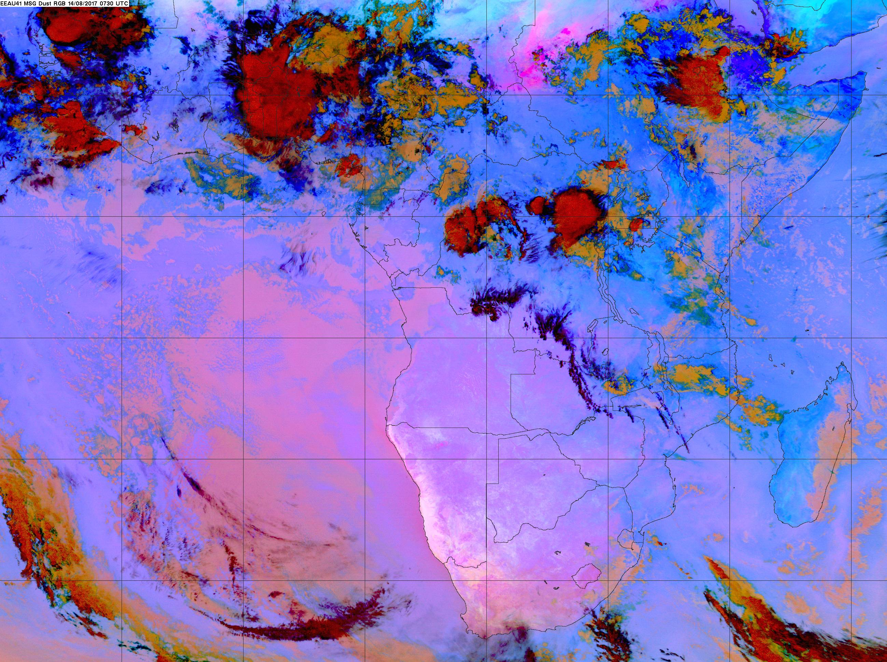
Enhanced IR satellite imagery at 8/14 Mon @ 7:30AM
10W
0
10E
20E
0S
10S
20S
25C at 7am at TMS
Low clouds filling in from the north, cloud deck moving southward
High clouds

Slide 3
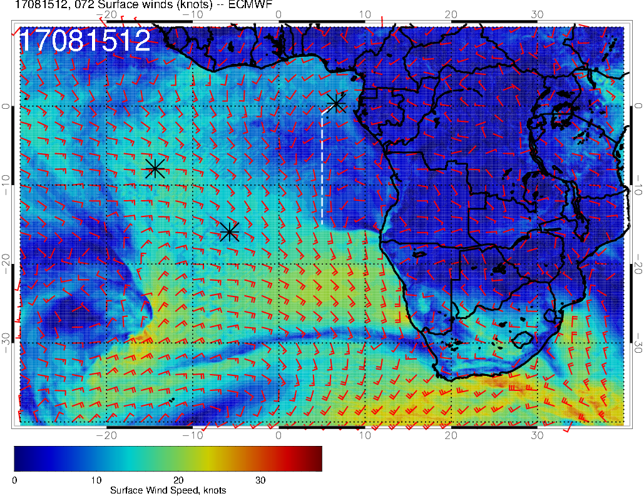
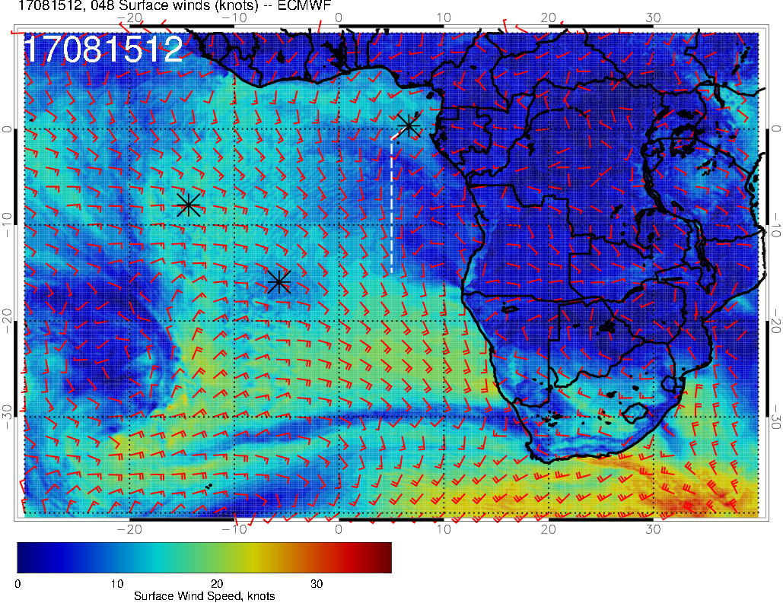
8/15 Tue (72-hr)
Surface winds
Winds over TMS are ~15 knt (stronger) in today’s forecast – not sure why, but there appears to be more precip along the nearby coast
L
8/15 Tue (48-hr)
H
Winds are not as weak and westerly as forecasted yesterday; still 5-10 knots SSW along our flight track
L
H

Slide 4
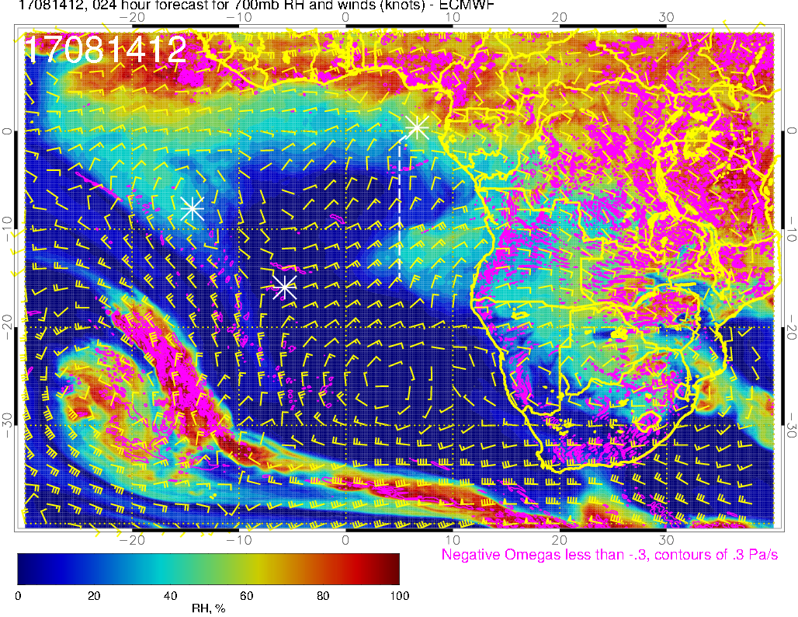
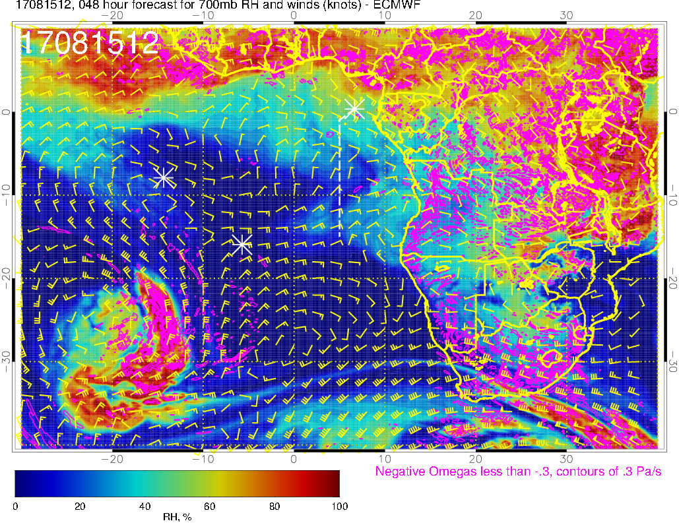
700mb RH, winds
8/14 Mon
8/15 Tue
Moist air influenced by dry convection

Slide 5
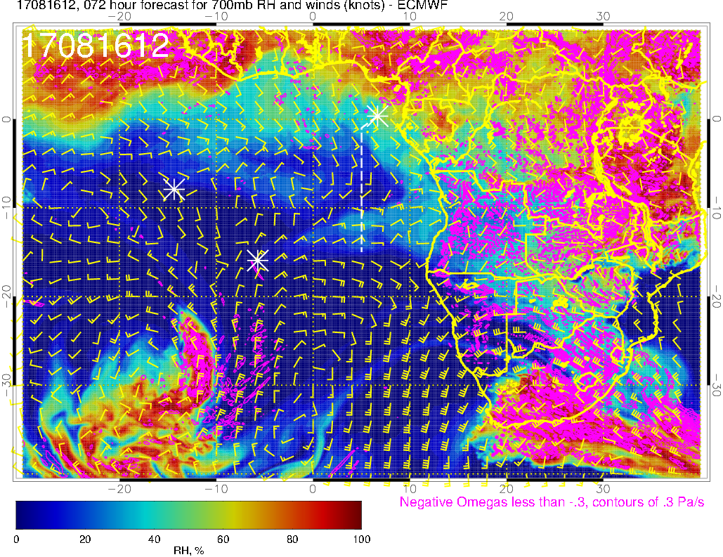
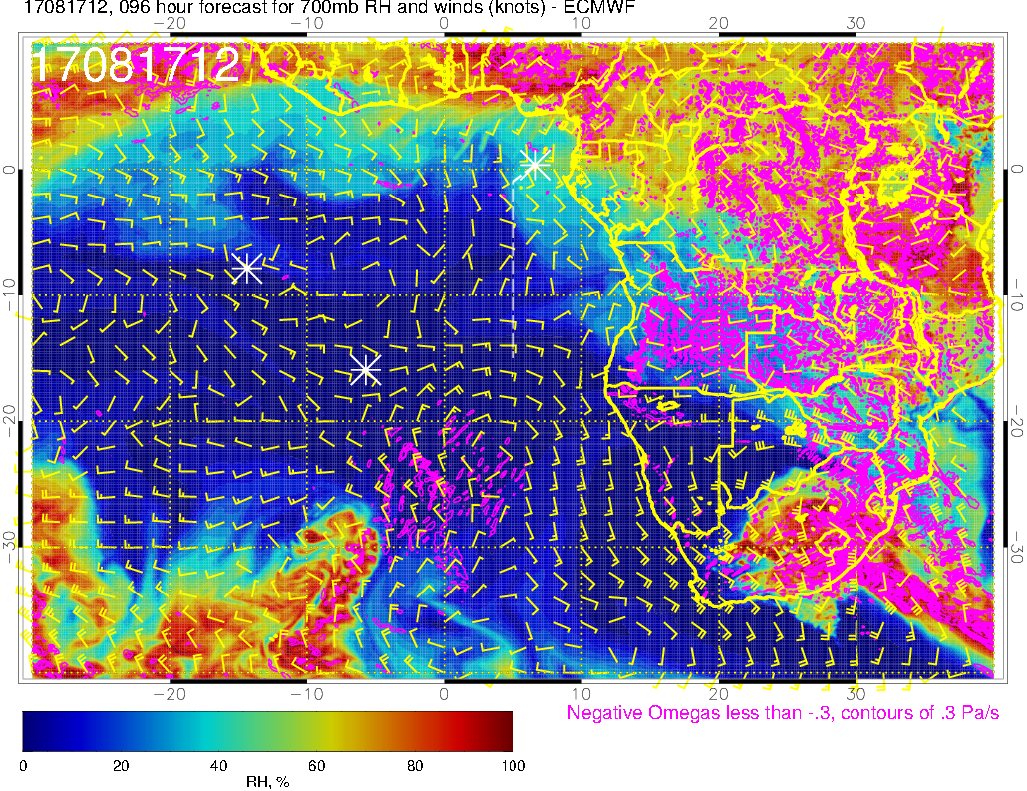
700mb RH, winds
8/16 Wed
8/17 Thu
Flow is less zonal (disorganzied) north of 10S

Slide 6
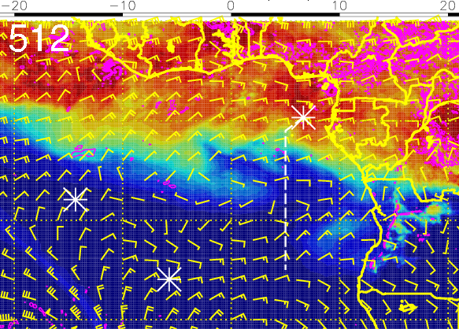
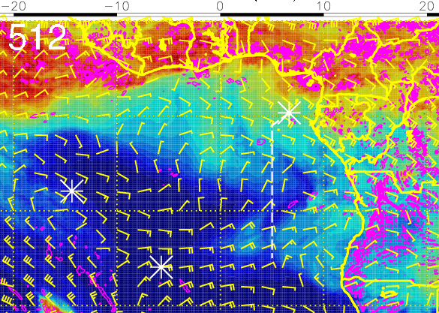
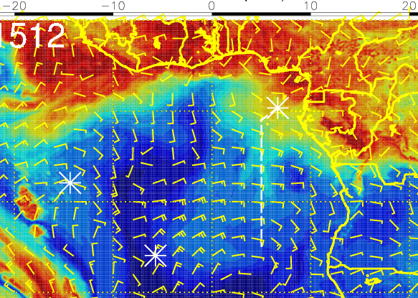
RH (color), winds, vert. velocity (pink) at 8/15 Tue @ 12PM
600 mb
700 mb
Moist air intrusion from the north at 600-700mb not reaching as far south compared to previous forecasts, but 800mb along the flight track is now more moist
Air south of 10S (not as moist) suggests plume transport from dry convection, evident at 700 and 850mb – flow is more zonal than air to the north of 10S
800 mb

Slide 7
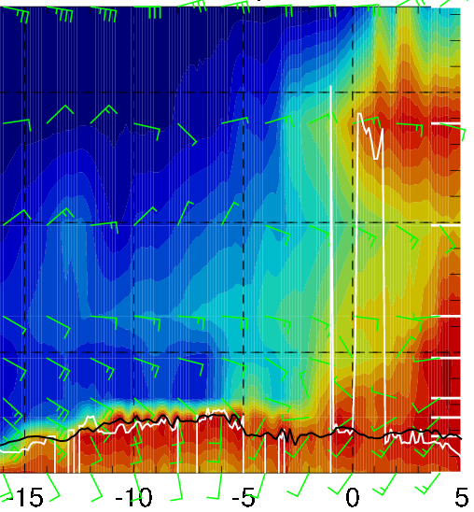
RH (color), wind, BL and cloud base heights along 5E, 8/15 Tue @ 12PM
20-35 knts
Moist air (moist convection) north of ~3S
5-15 knts
5-15 knts
Air influenced by dry convection south of ~10S
Moist air at 600 and 700mb north of 3S is mainly influenced by moist convection, while air to the south of 10S is influenced by dry convection
Easterly crosswinds above 5000ft, but flow is most zonal (from coast to ASI) south of 10S

Slide 8
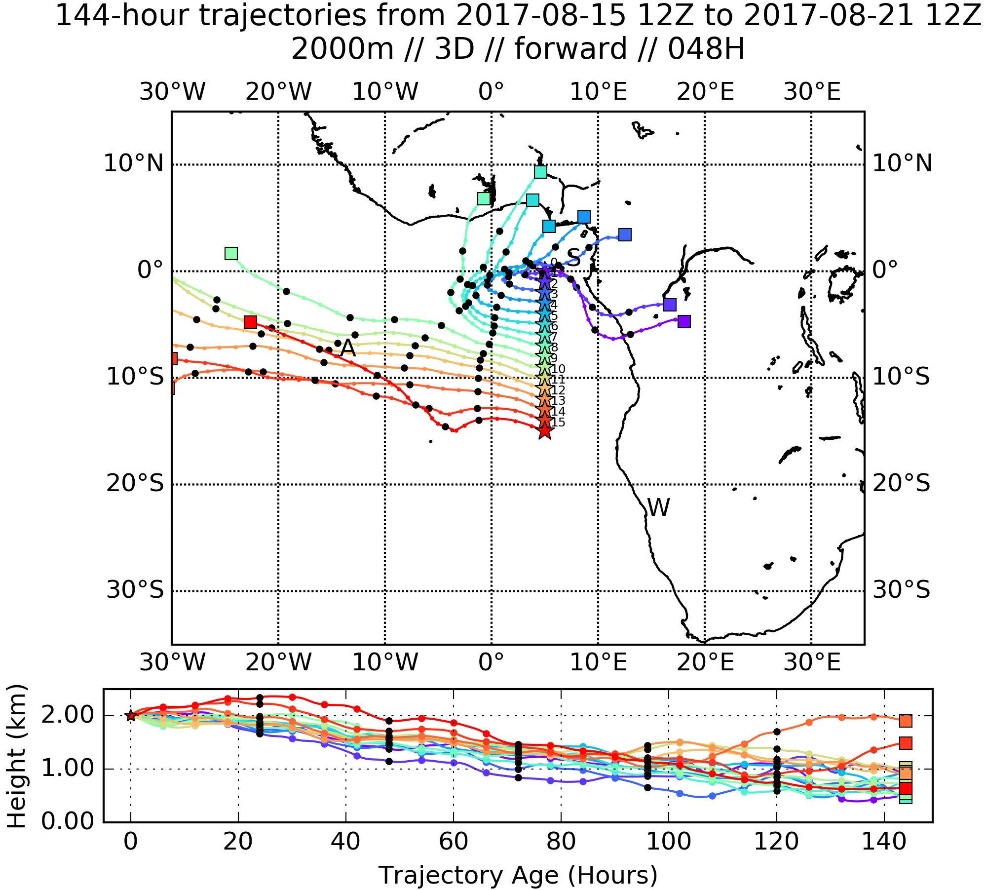
Forward trajectories from routine flight track on 8/16 at
2 km altitude
+2 days (8/17)
Air parcels 9-15S are fairly zonal; parcels 9-12S reach ASI in ~3 days

Slide 9
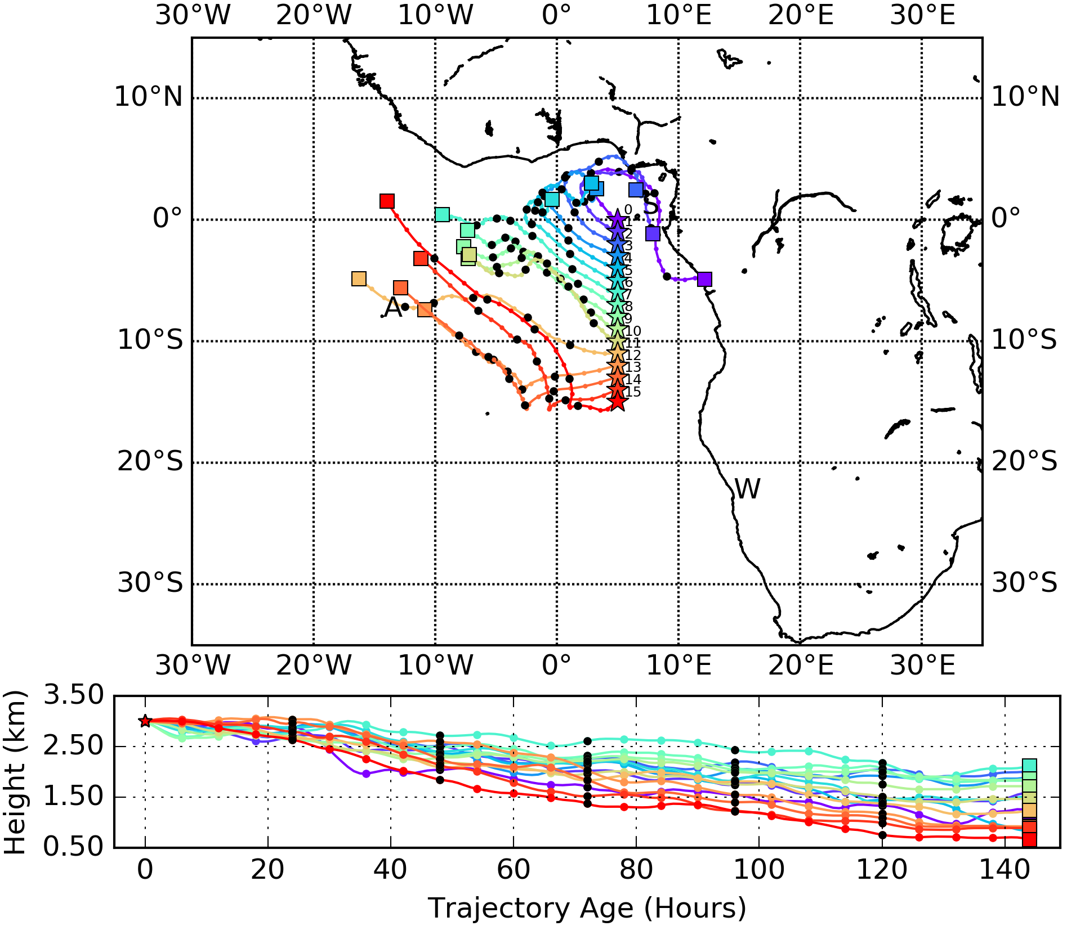
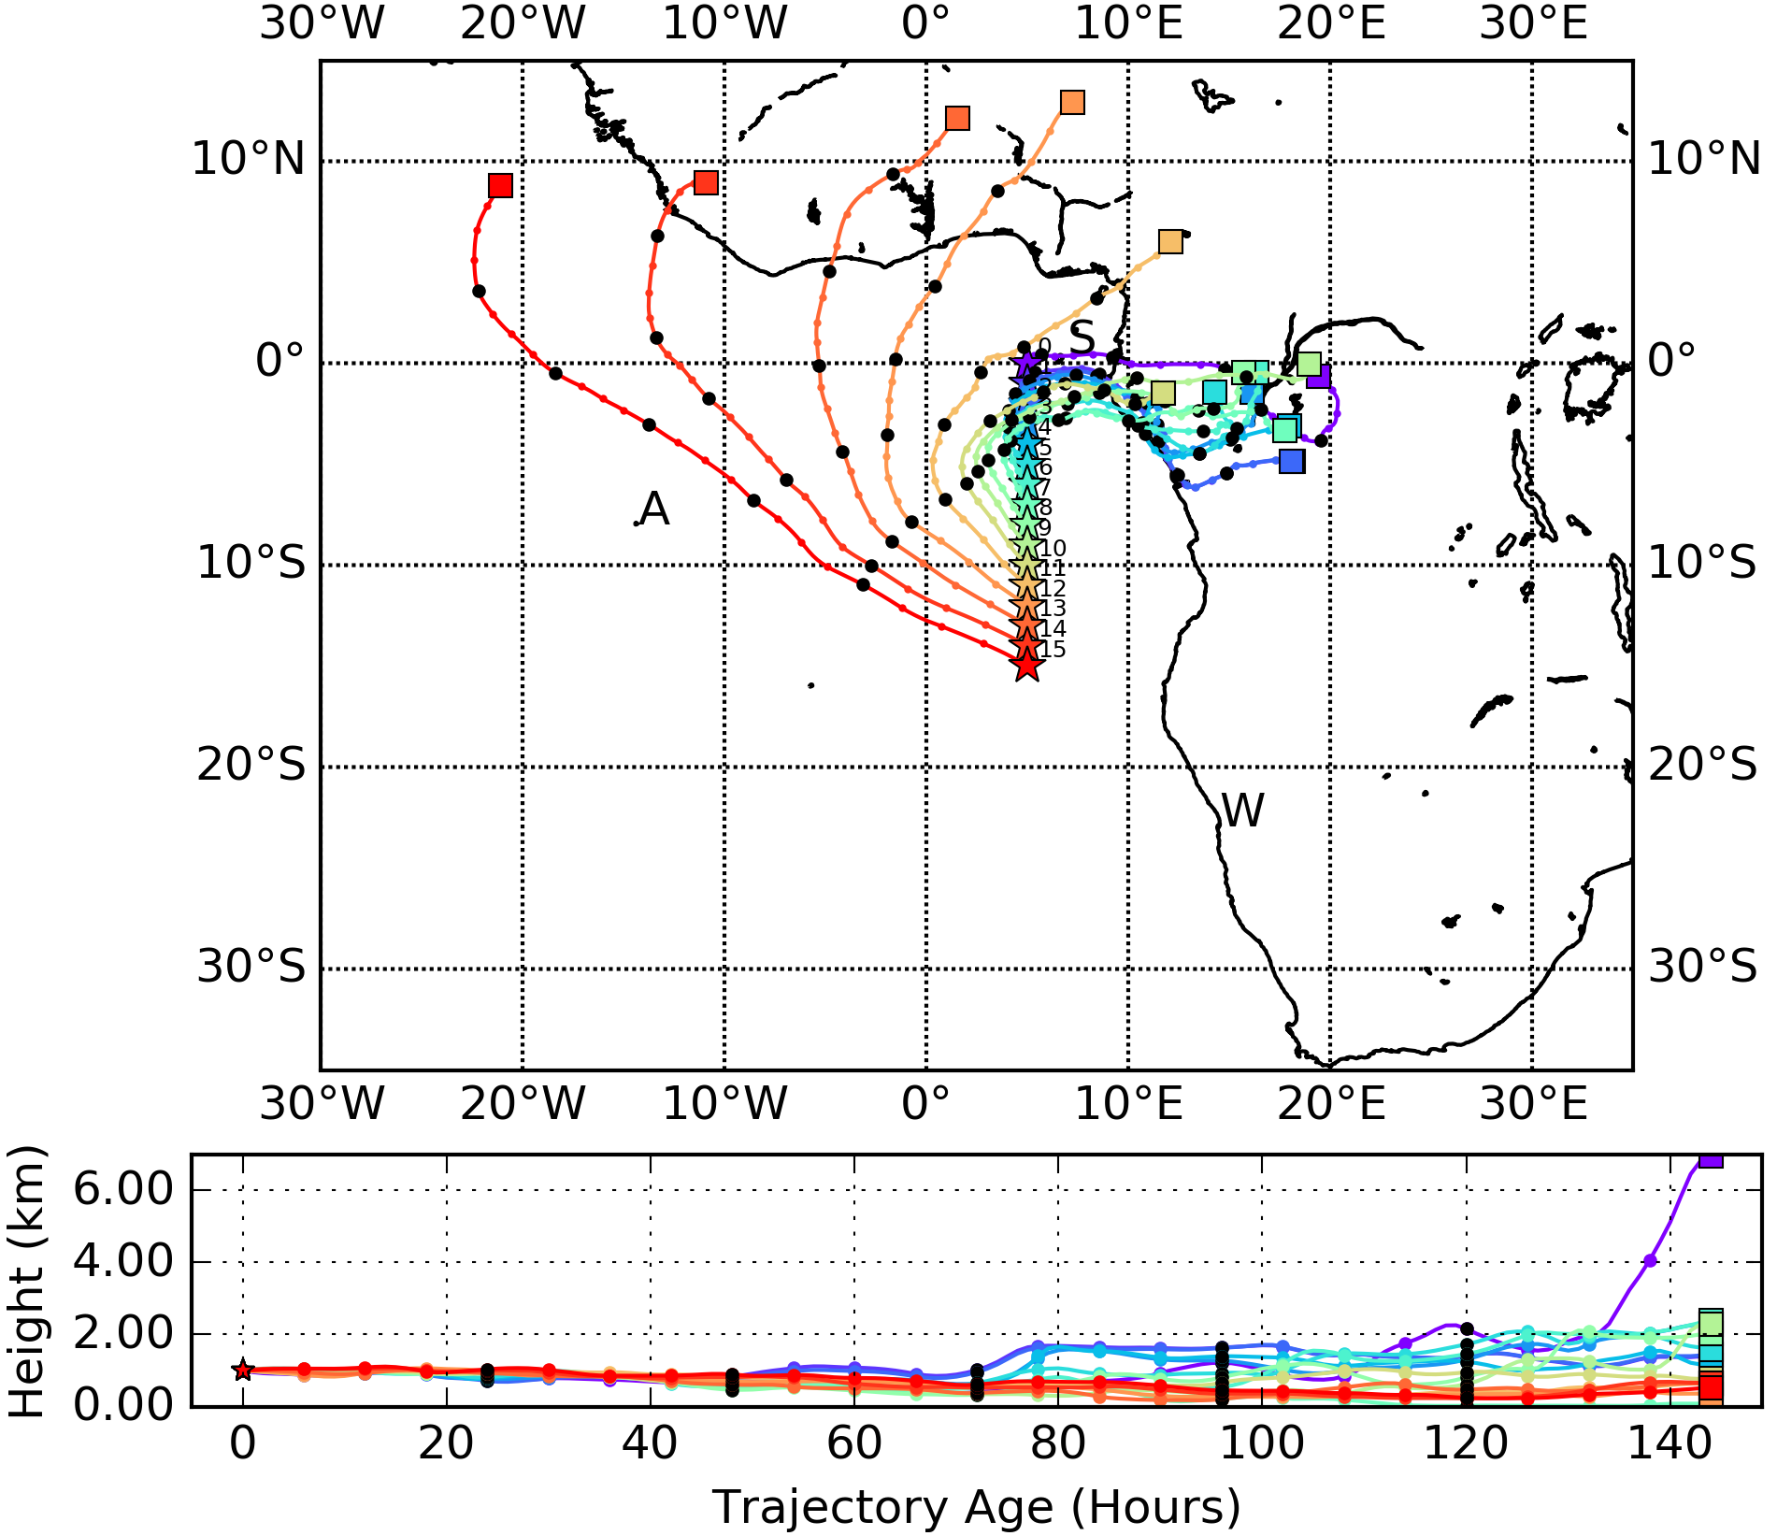
Forward trajectories from routine flight track on 8/15 at 3 and 1 km
3 km
1 km

Slide 10
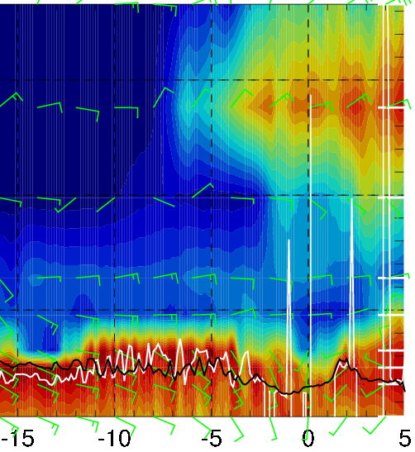
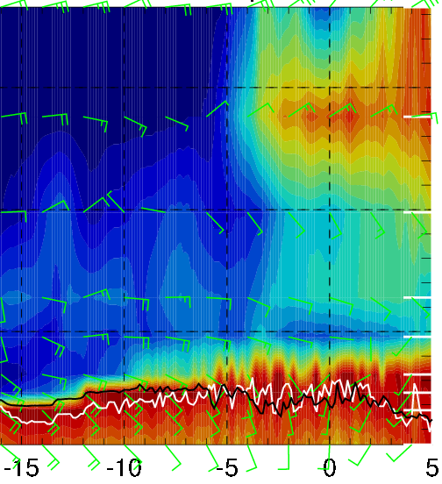
Latitudinal cross-sections of RH (color), wind, BL and cloud base heights
along 5W on 8/17 Thu @ 12PM
along 0° on 8/16 Wed @ 12PM

Slide 11
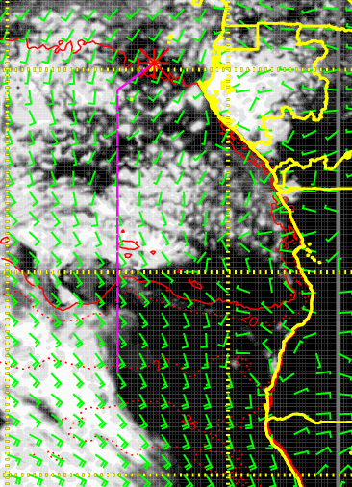
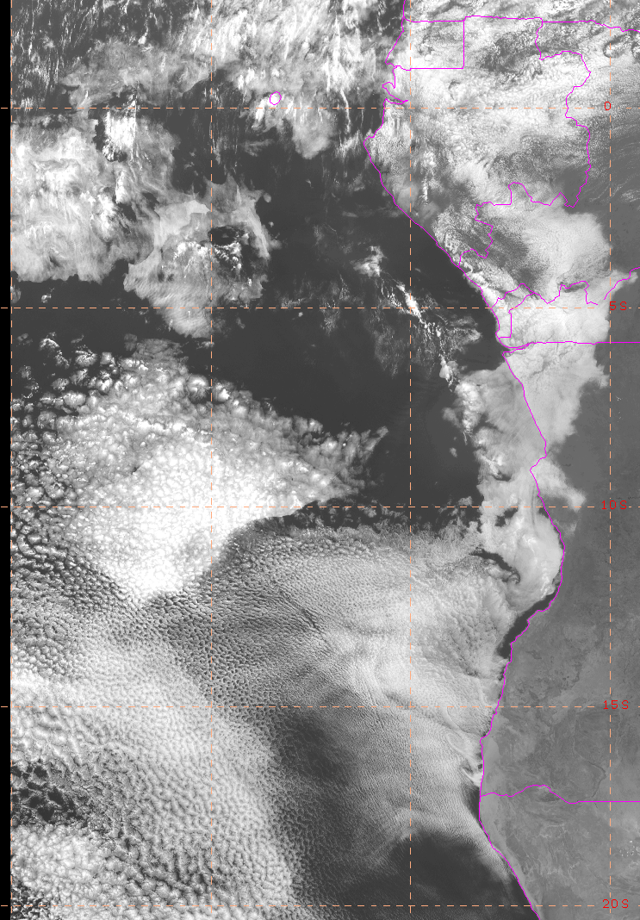
Cloud imagery and 48-hr forecast at 8/13 Sun @ 12PM

Slide 12
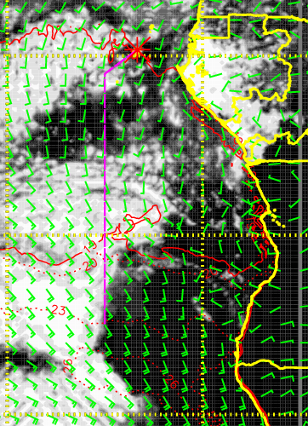
Cloud imagery and 24-hr forecast at 8/13 Sun @ 12PM

Slide 13
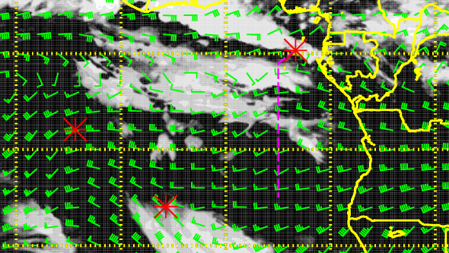
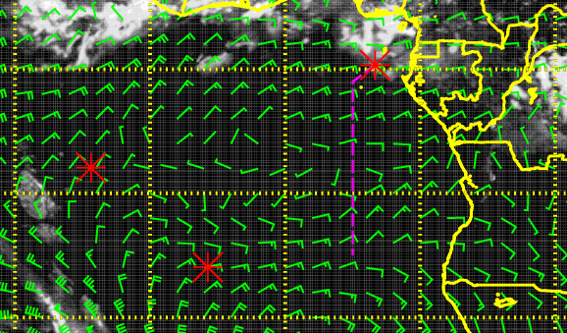
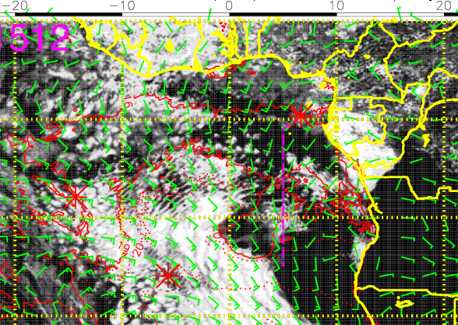
Mid (600mb)
High (200mb)
Cloud forecast (48-hr) for 8/15 Tue @ 12PM
Compared to 72-hr forecasts, (1) high clouds have moved further west and south, (2) less middle clouds over TMS (also in UKMO model)
High clouds north of ~6-7S in our flight region
Expect low cloud clearing south of TMS
Scattered to broken low clouds in the middle of the flight
Low (sfc)

Slide 14
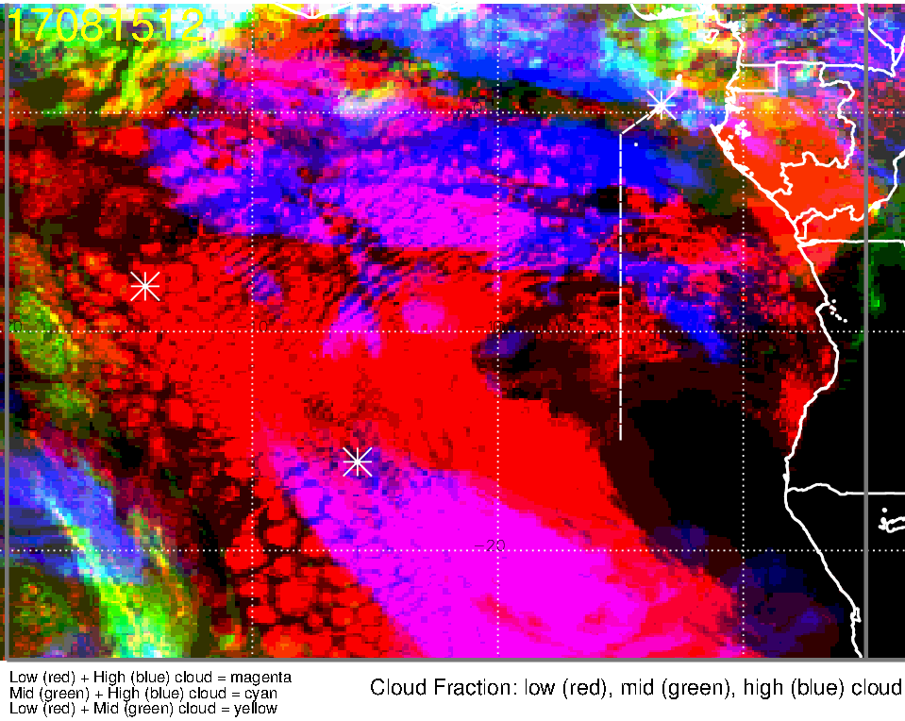
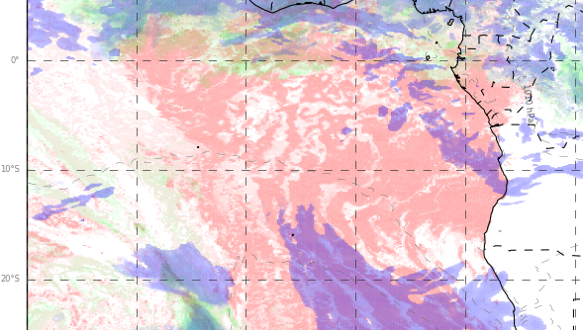
Low, middle, high cloud forecast for 8/15 Tue @ 12PM
ECMWF (72-hr)
UKMO (60-hr)
High clouds only
Low + high clouds
Low clouds only
Low, Mid, High clouds
In both models,
Low cloud clearing south of TMS increases from 8/14 Mon through 8/16 Wed
Middle clouds over TMS increases from 8/14 Mon through 8/16 Wed (mostly to the north of TMS on 8/15)
High clouds on the routine flight track north of ~6-7S

Slide 15
Tuesday 8/15
Given the large amounts of middle and high clouds in the morning (and the dependence of surface temperatures on cloud cover), takeoff temperatures should not be an issue
Low cloud clearing south of TMS and relatively sparse low clouds along the routine flight track (scattered to broken clouds in the middle of the flight)
Expect high cloud “streamers” along the flight track north of ~6-7S
Moist air north of ~3S at 600-700mb influenced by moist convection
Air south of 10S (not as moist) suggests plume transport from dry convection, evident at 700 and 850mb – flow becomes more zonal south of 10S, more disorganized to the north at 700mb
Parcels along the routine flight track between 9 and 12S at 2km reach ASI in ~3 days (8/18)

Slide 16
Thursday (der Flug zur Insel des Aufstiegs)
Step animation shows zonal flow yesterday at 800mb (2km) out to 8W (further west north of 8S).
Surge of moisture coming out today, will catch tail end tomorrow. This surge coincides with a blob of zonal flow propagating out (wave).
By Thursday, this surge of moisture will be around 8W at 8S.
700mb flow (3 km) is weak and disorganized
600mb (4 km) is also not very organized. Situation dominated by moisture intrusions from the north
Early in Thursday’s flight, could get some middle cloud down to 5S
Trajectories consistent with flow discussion – most profitable level is 800mb.

Slide 17
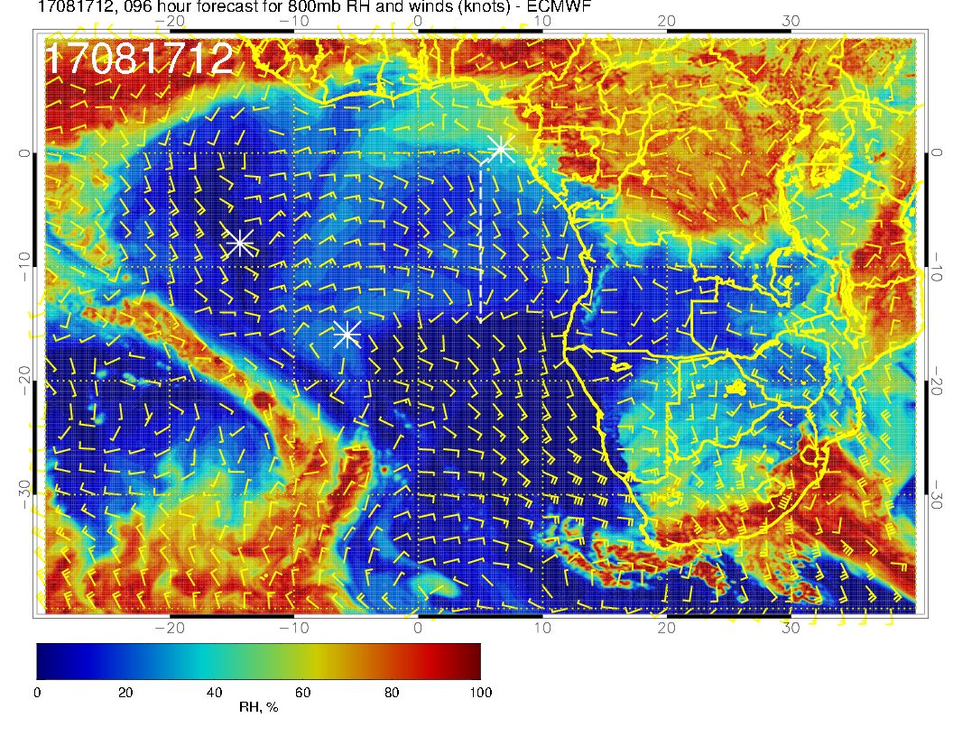
Flying through the RH “surge” at 800mb. Zonal flow roughly coincides with this “surge.”

Slide 18
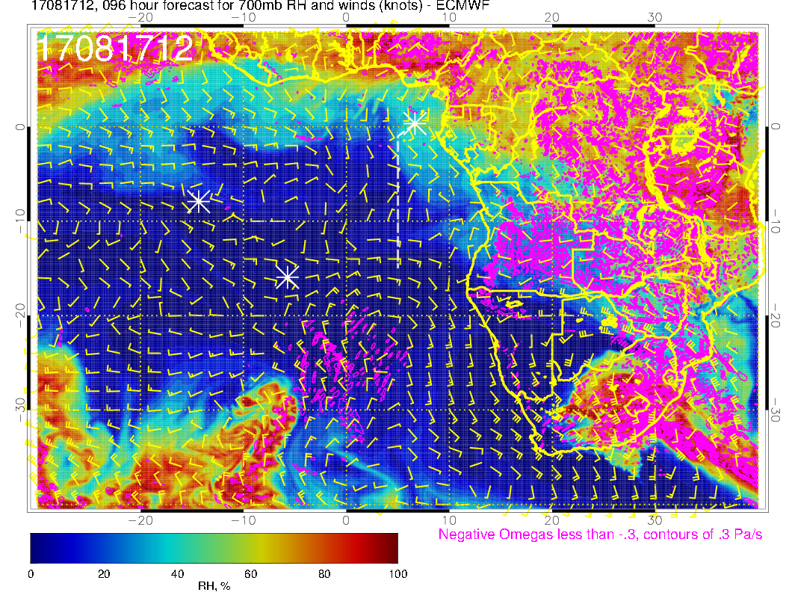
Flow is weak, except north of 5S at 3 km (700mb). Not the usual easterlies at these latitudes in the climo

Slide 19
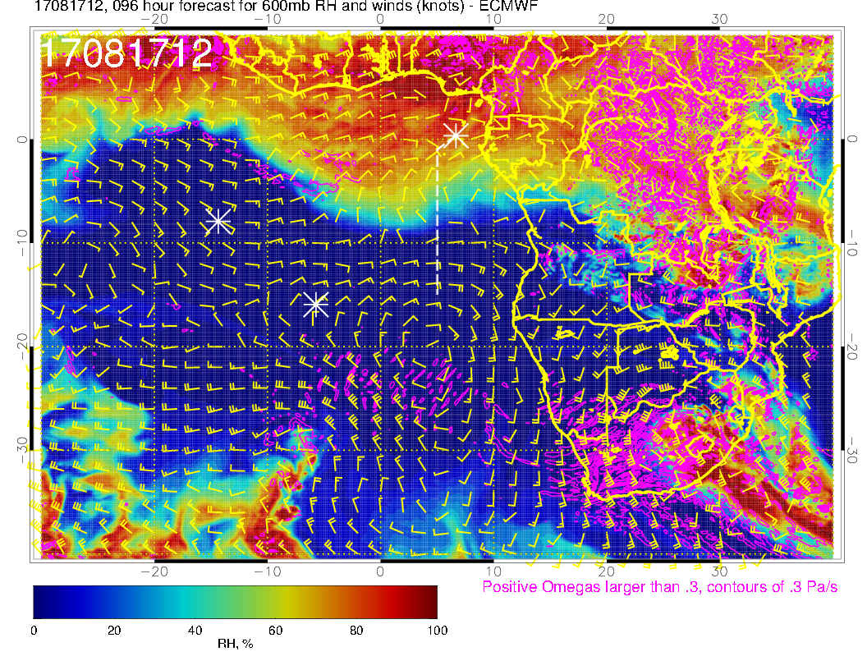
Flow is non-zonal (except to south) at 600mb (4 km). Can see surge of moisture from the north.

Slide 20
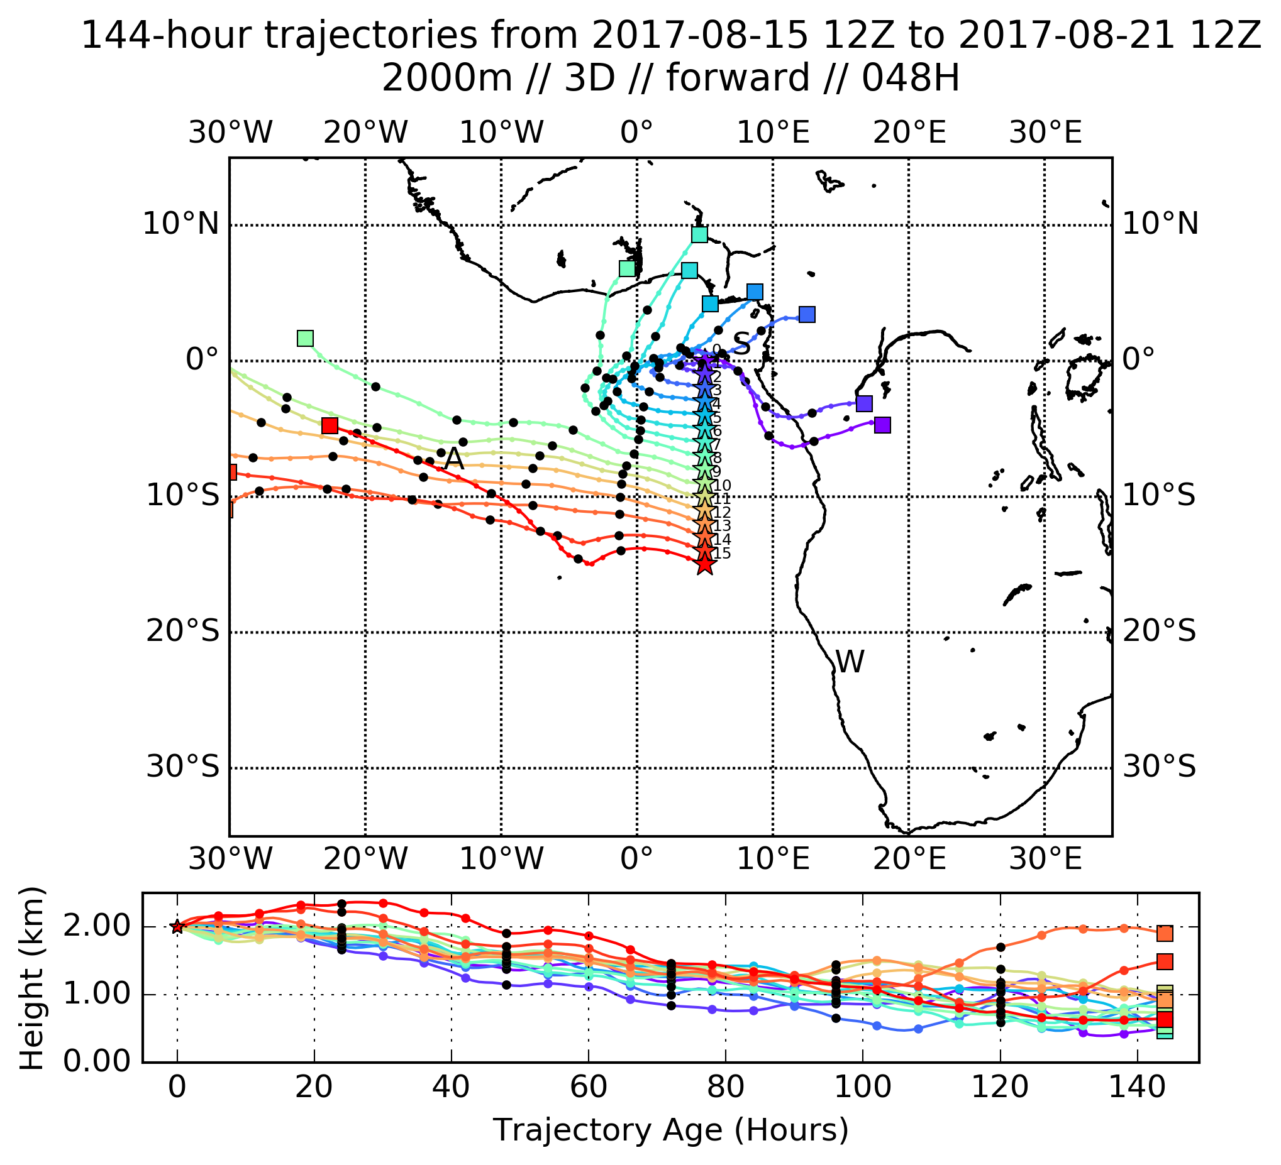
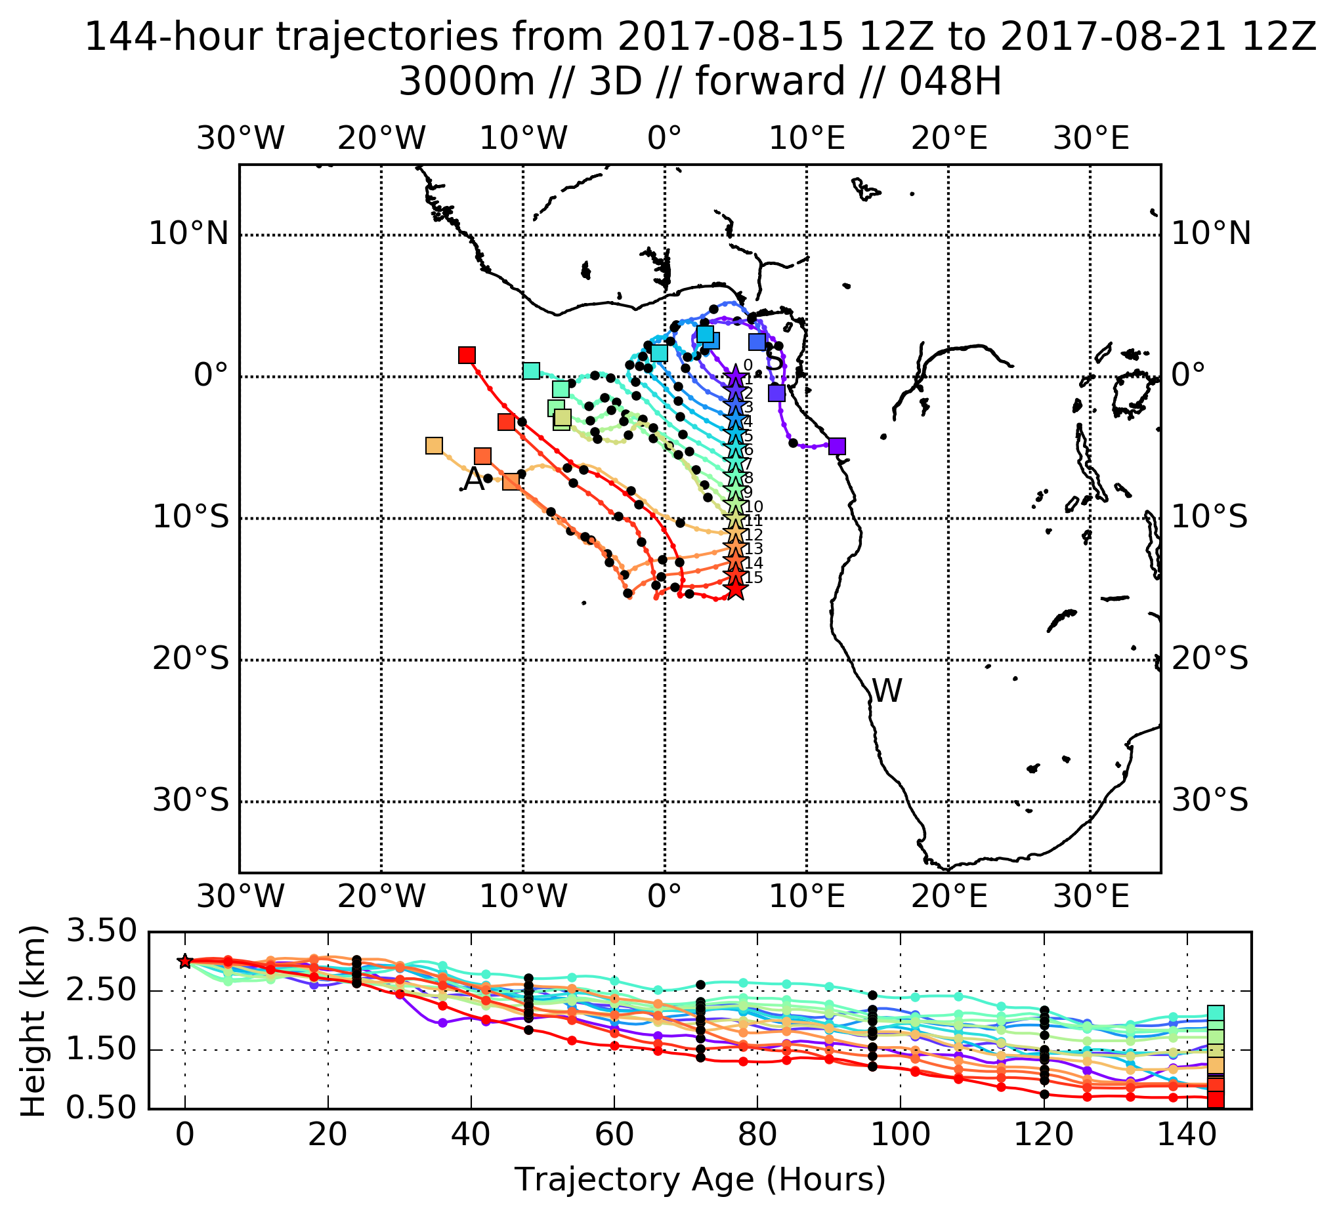
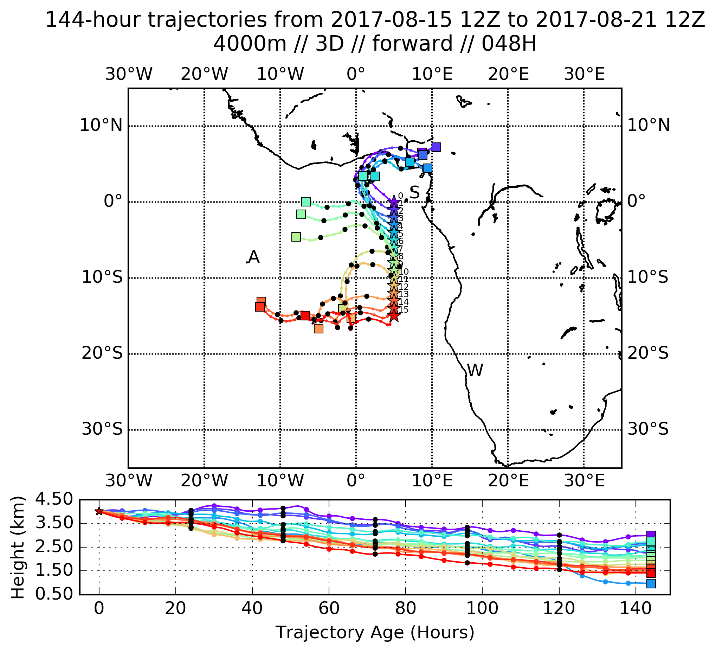
Trajectories (forward from tomorrow’s routine flight) reflect desultory nature of 700mb (3km) and 600mb (4km) flow. Only decisive move to west is at 800mb. 1km flow (and trajectories – not shown) may be deceptive because of too low BL heights in models (???).

Slide 21
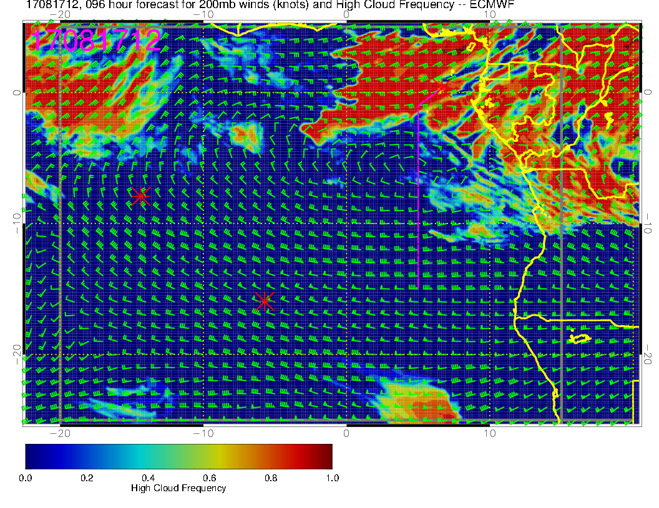
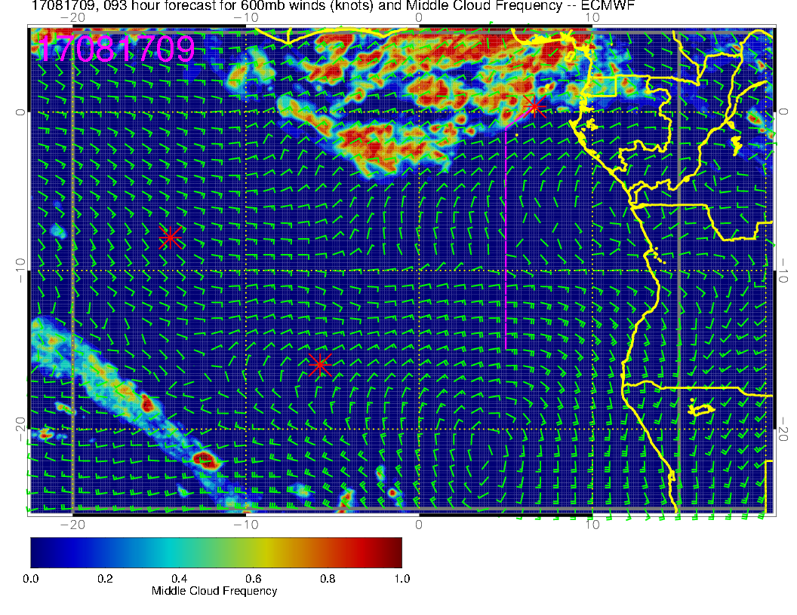
A little far out to be forecasting clouds (though the high and middle clouds depend on large scale flows and moisture fields). At this point, staying south of about 5S will be OK.
HIGH
MIDDLE
I used 9Z, closer to peak in diurnal cycle, which the model does capture

Slide 22
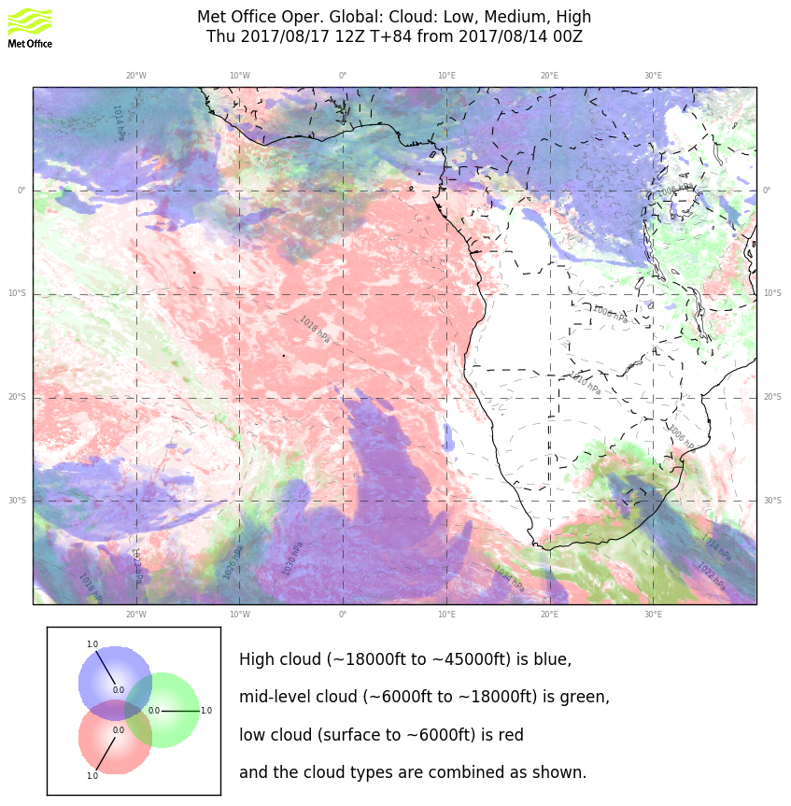
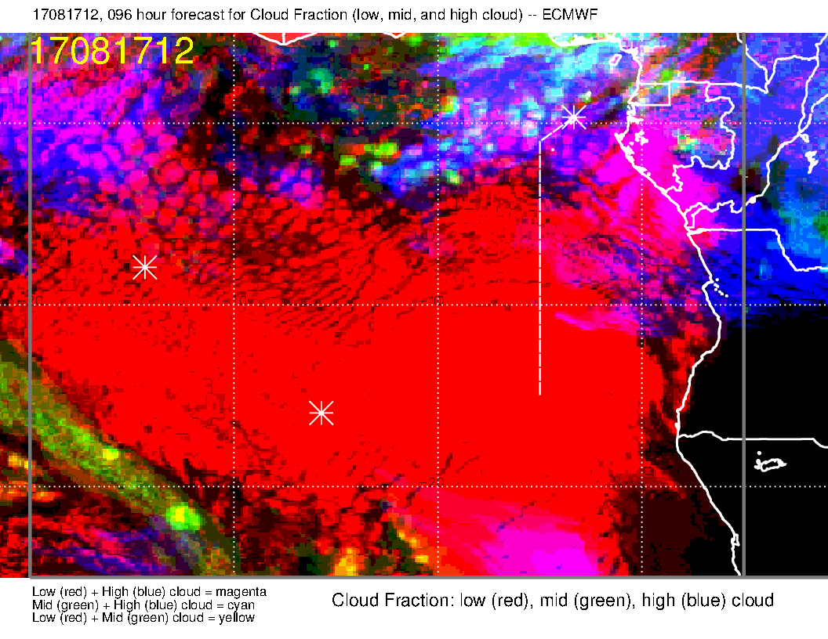
Models actually agree on the gross features of the high and middle cloud. UK model moves HM cloud further south

Slide 23
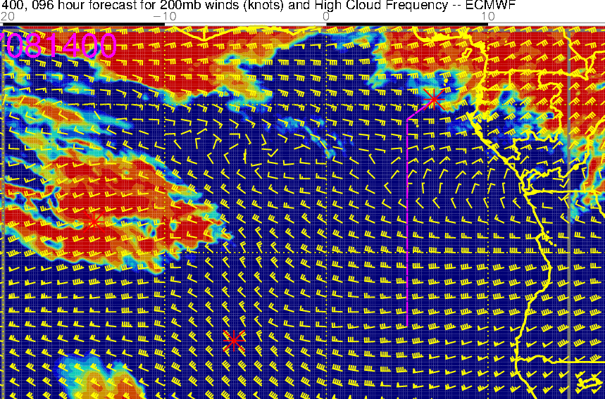
Can we believe 96 hour forecast?
0Z today (below) compared with 96 hour fcst EC (right) and 60 hour fcst UK new 4 km (below, right). Notably, EC gets something right near Ascension, but overdone.
UKMO research model is getting northern
feature better

Slide 24
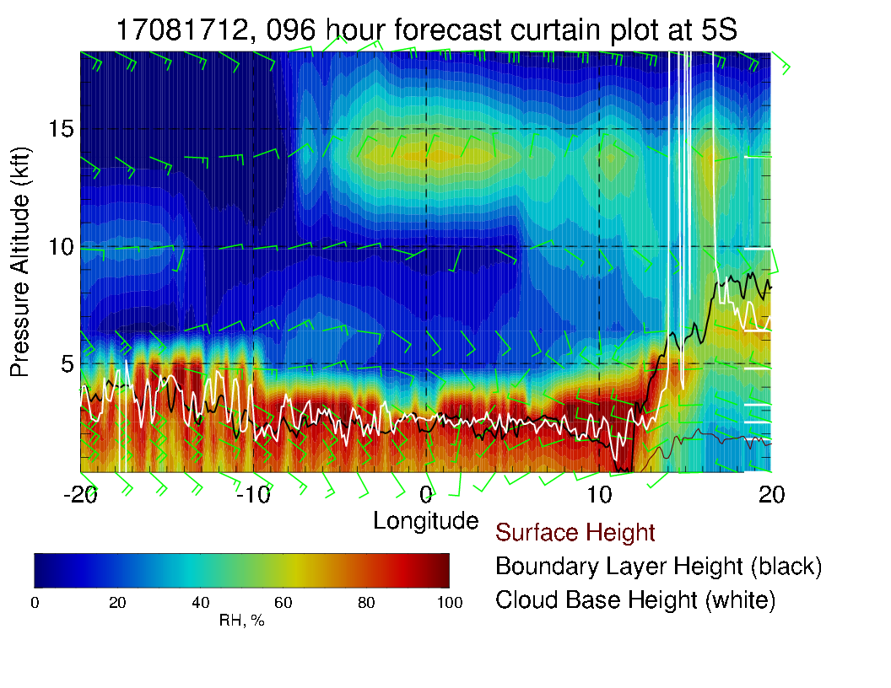
5S Xsect reflects surge of moisture from the north. Note weak winds at 600mb and 700mb

Slide 25
Friday (Lokal Flug)
Surge of 800mb RH is at Ascension on this day.
Forward trajectories suggest that 800mb is the most profitable level for looking at history
High and middle clouds look good (there are none nearby).

Slide 26
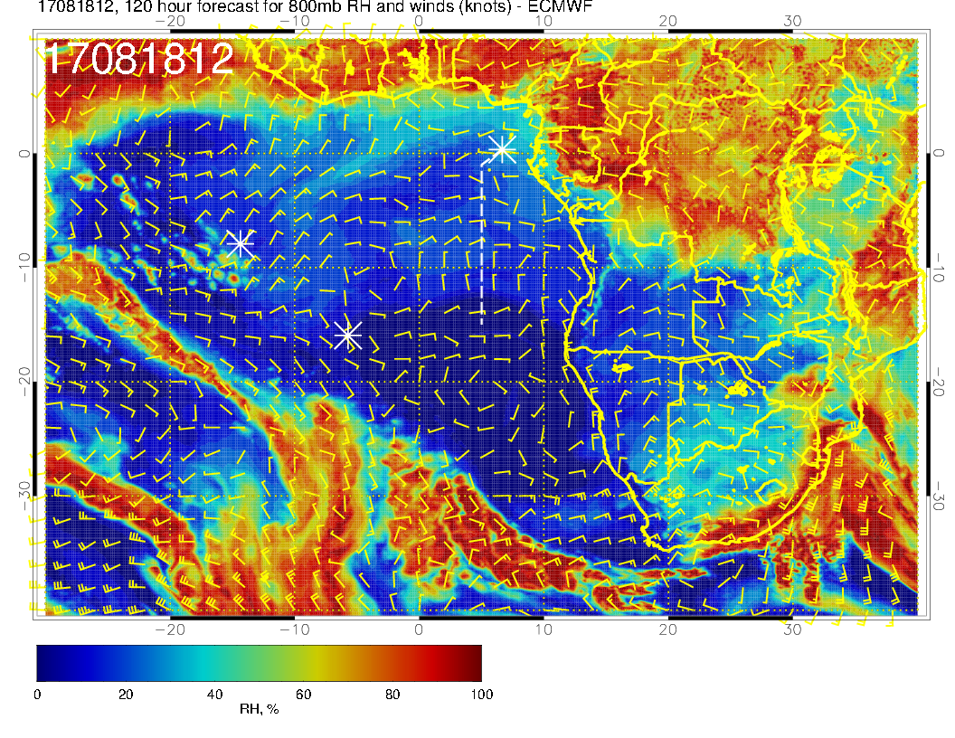
Surge of moisture arrives (sort of, distorted) at Ascension at 800mb. (Pop up RH is related to higher BL in the model

Slide 27
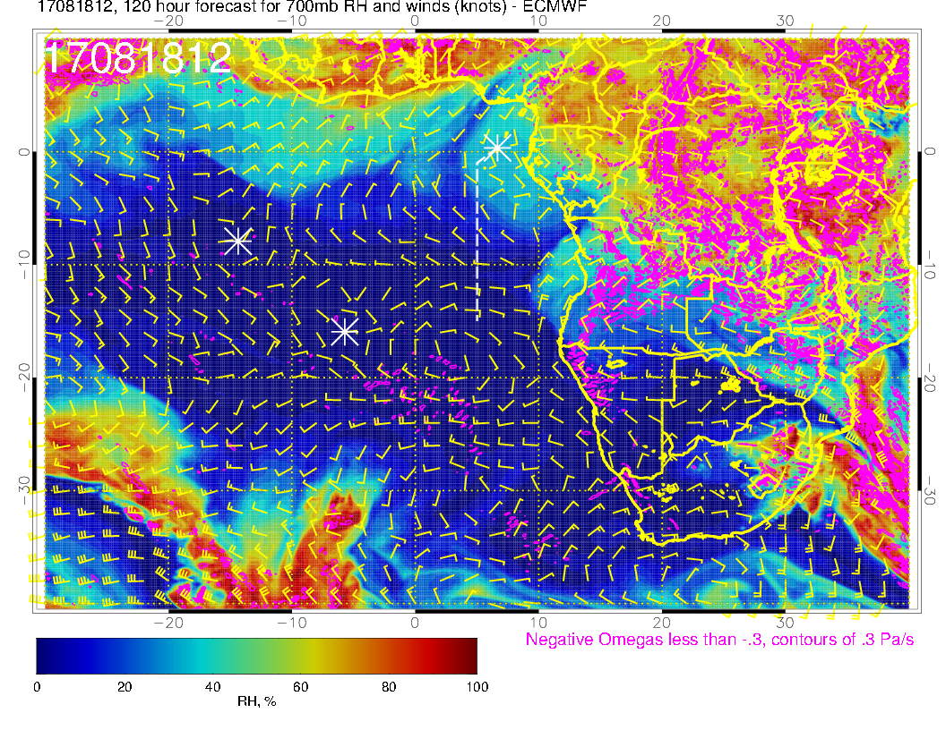
Indifferent flow over Ascension on this day. Nearby, moisture starts moving in from the north

Slide 28
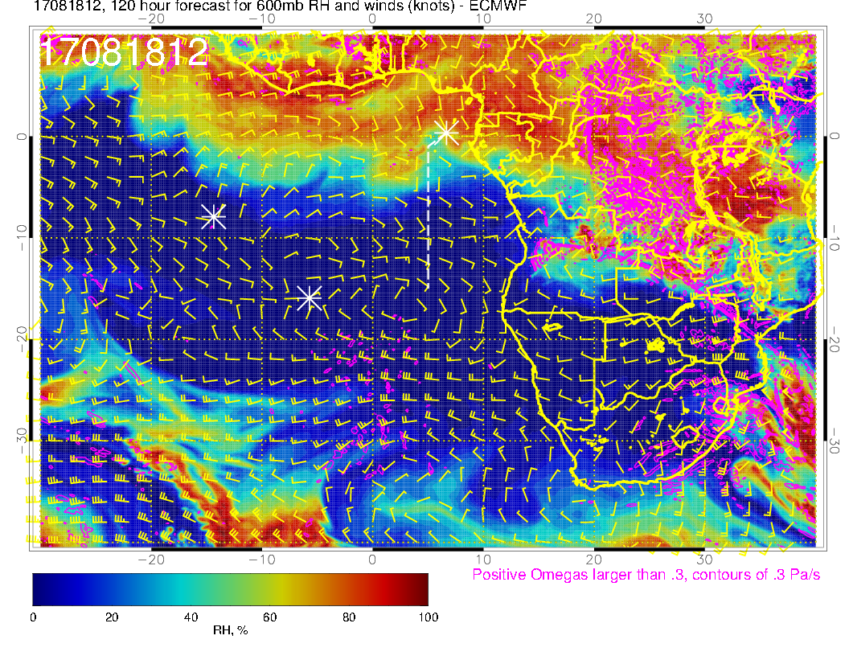
Flow weak at this level also. RH pattern propagates westward to the north (with flow there).

Slide 29
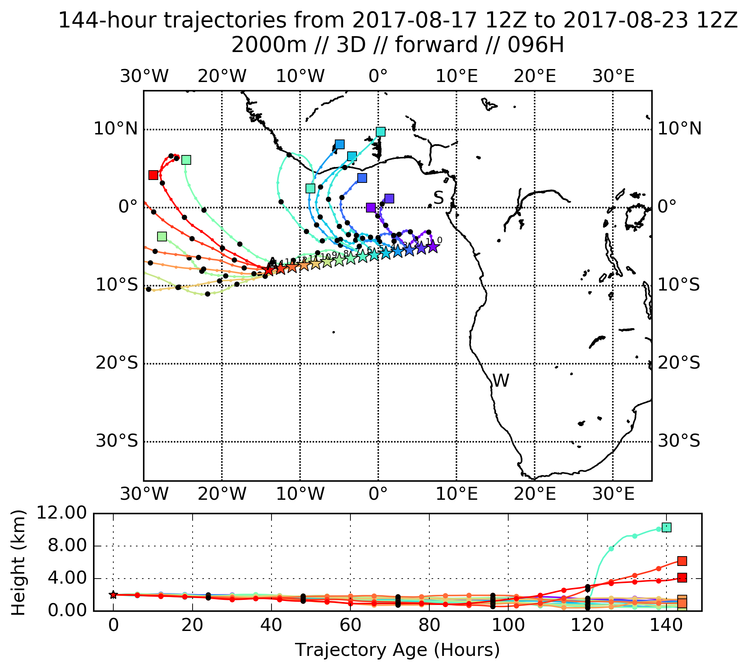
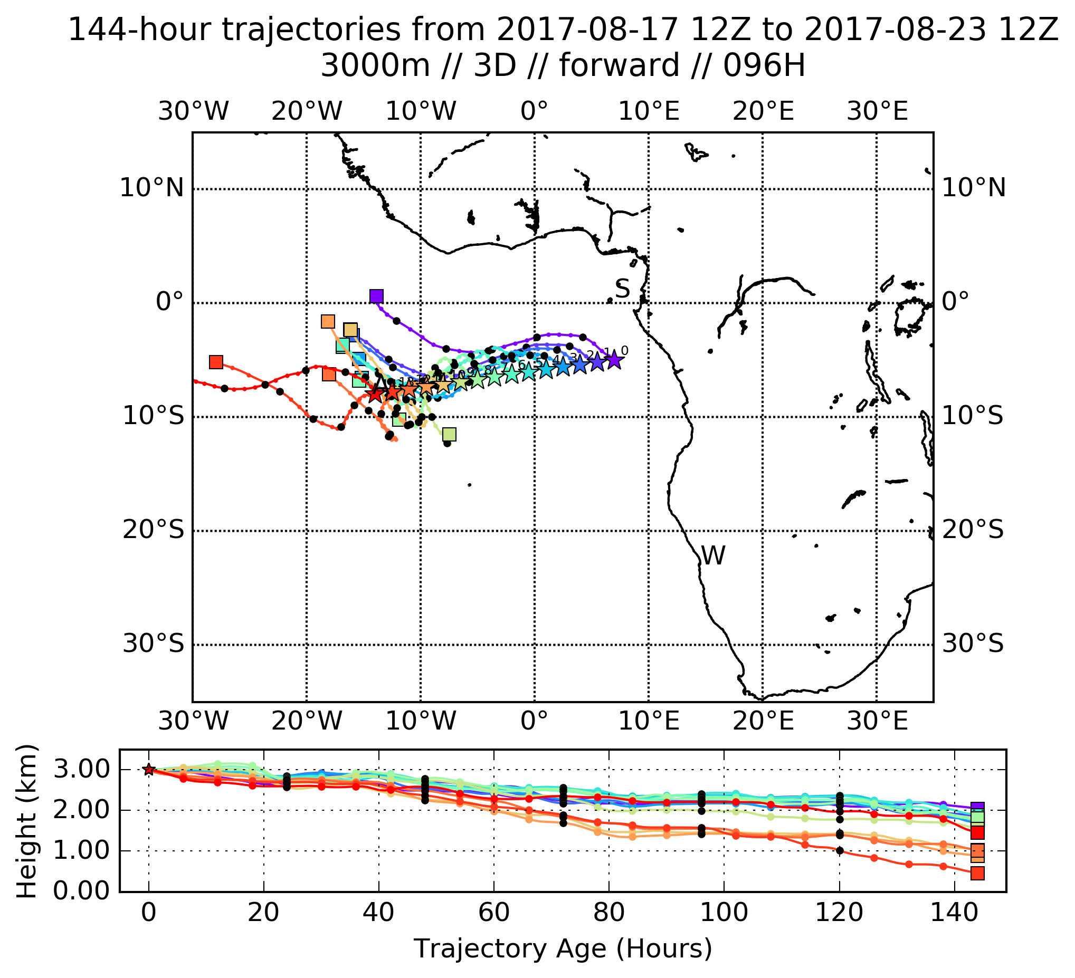
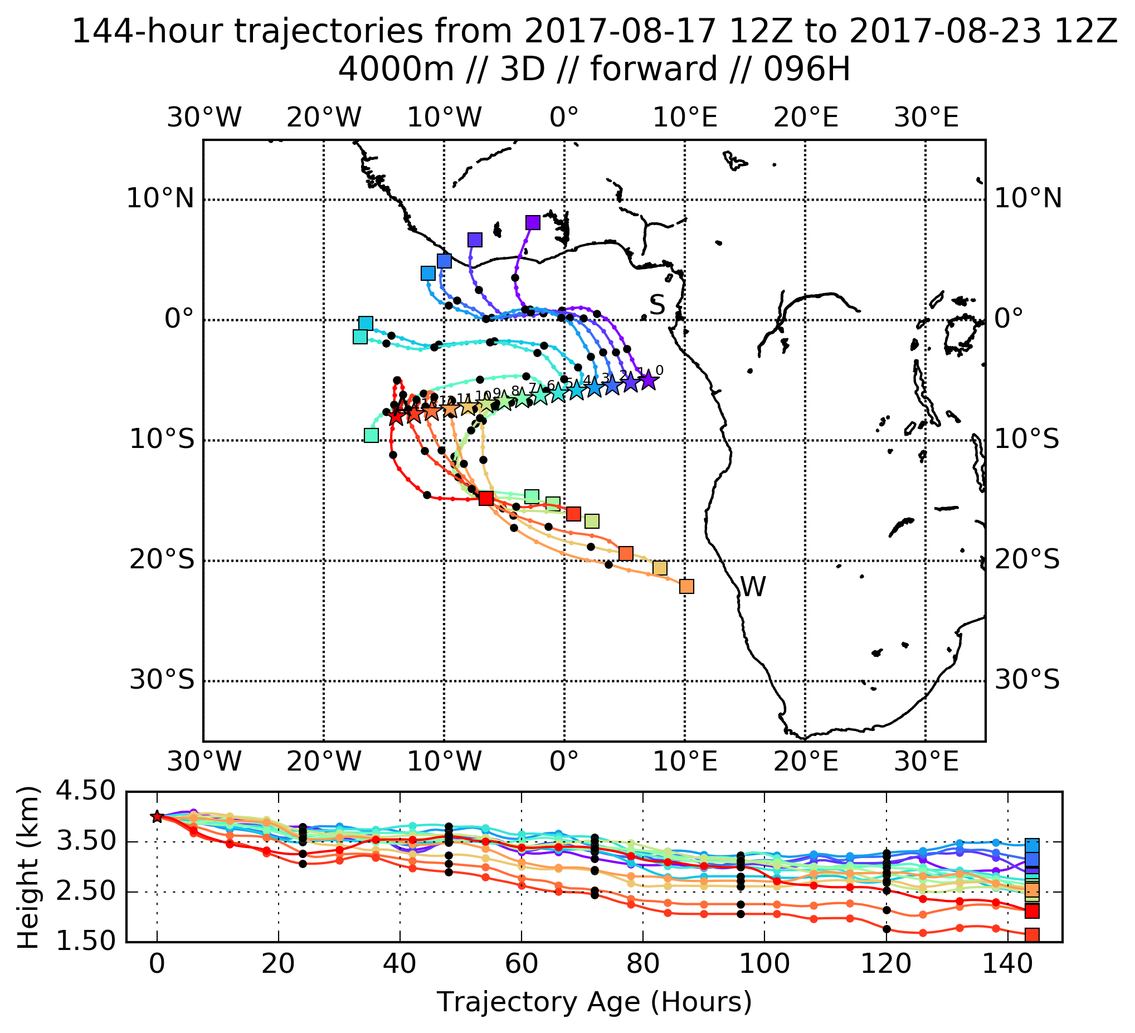
Same story as on Thursday (forward trajectories
from suitcase flight on Thursday). Best prospects for catching air from previous day appear to be at 2 km (800mb).

Slide 30
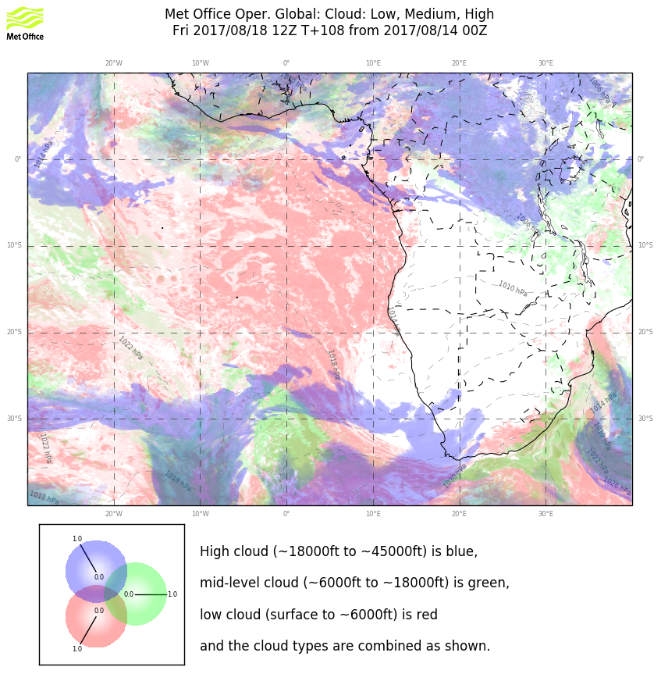
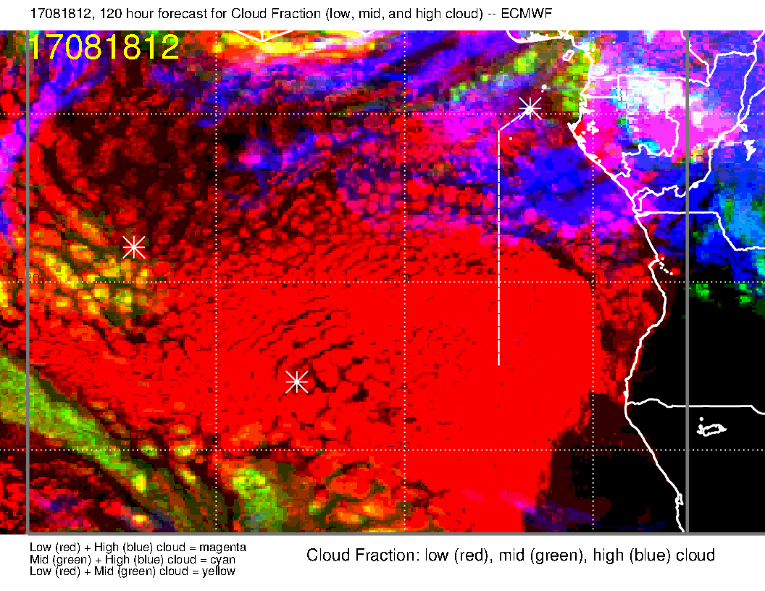
Middle cloud at Ascension in EC model reflects low BL SC penetrating into middle cloud “definition region.” Looks good at this point.
UKMO
ECMWF

Slide 31
