Slide 1
ORACLES Forecast Briefing (Aerosols)
14 August 2017

Slide 2
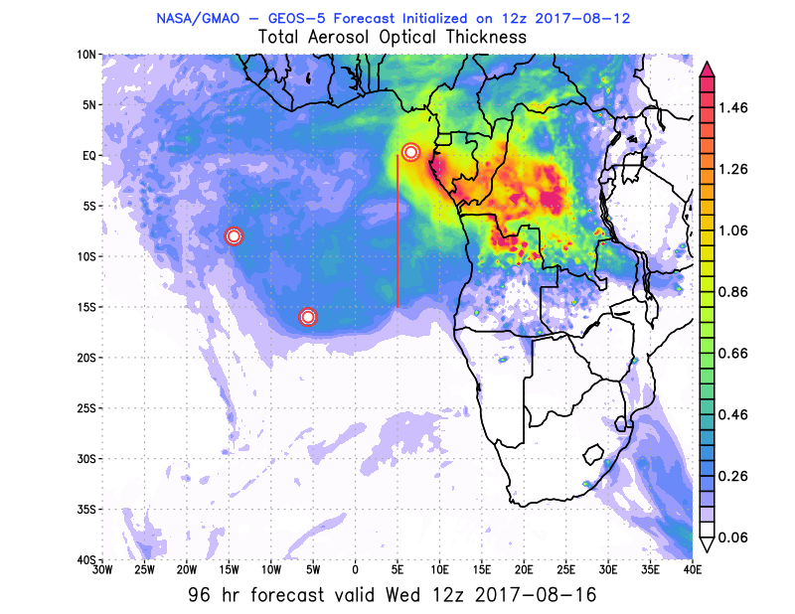
08/14 Mon (48h) 08/15 Tue(72h) 08/16 Wed(96h)
08/12 12Z
08/14 Mon (24h) 08/15 Tues(48h) 08/16 Wed(72h)
08/13 12Z

Slide 3
08/17 Thu (120h)
08/12 12Z
08/17 Thu (96h)
08/13 12Z

Slide 4
08/14 Mon (24h) 08/15 Tue(48h) 08/16 Wed(72h)
08/13 12Z
08/14 Mon (36h) 08/15 Tue(60h) 08/16 Wed(84h)
08/13 00Z

Slide 5
08/17 Thu (96h) 08/18 Fri(120h) 08/19 Sat(156h)
08/13 00Z
08/13 12Z
08/17 Thu(108h)
08/13 00Z

Slide 6
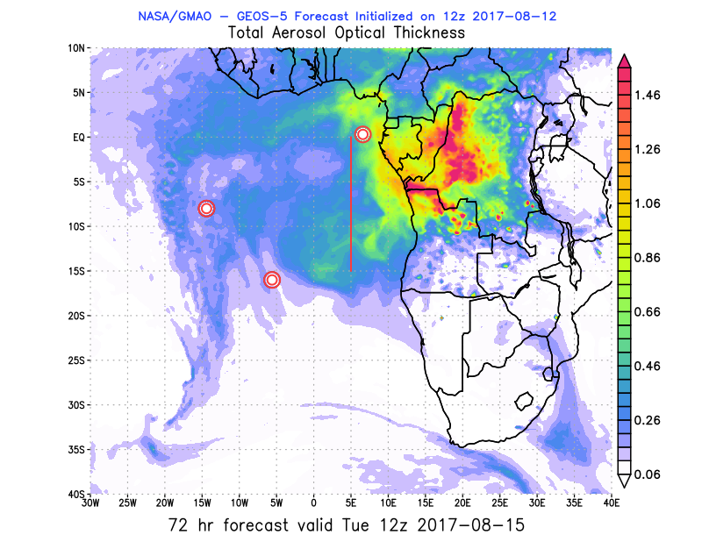
Tuesday August 15 12z

Slide 7
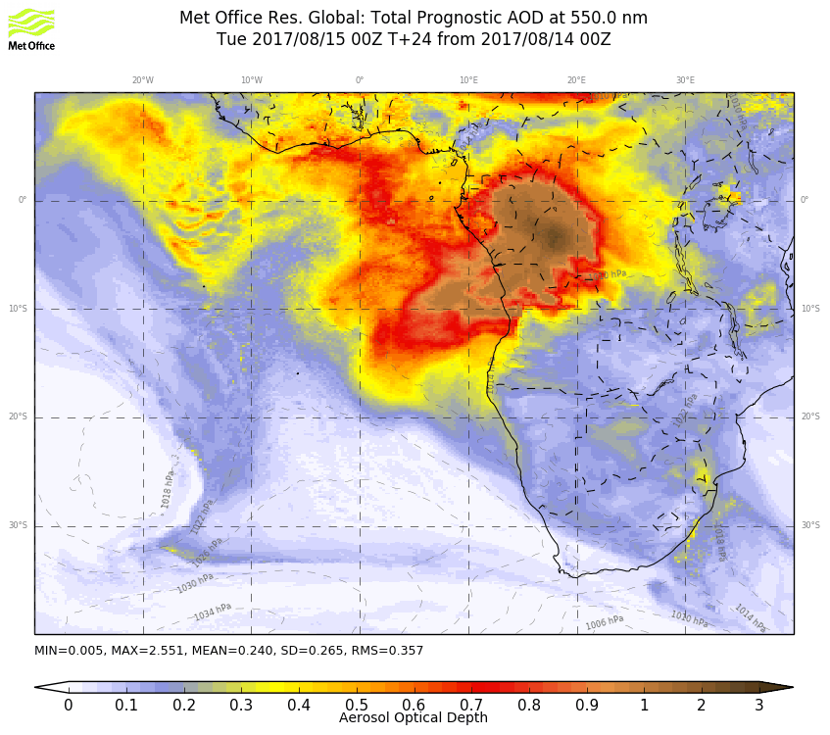
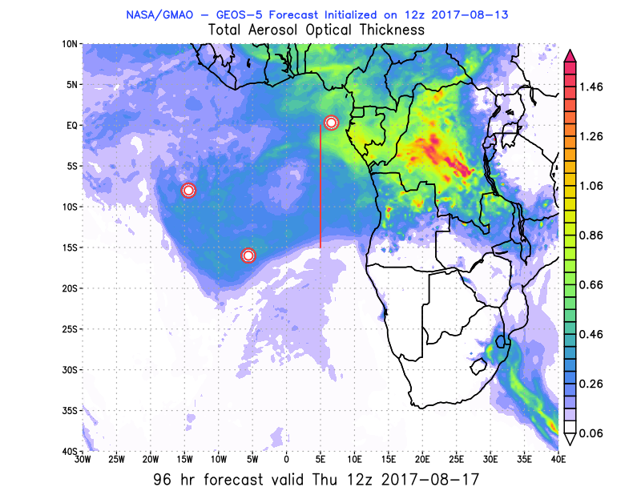
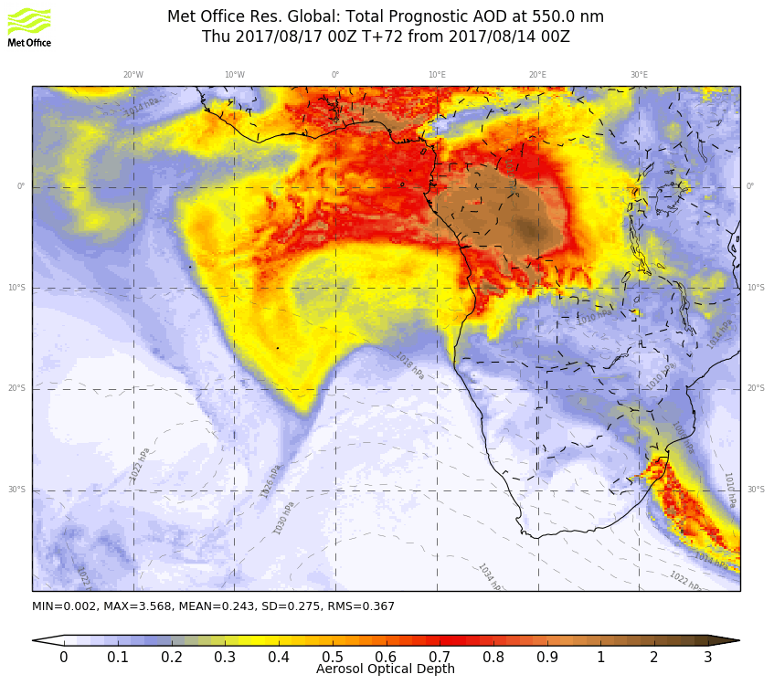
Tuesday August 15 12z

Slide 8
BC AOD 08/13-18

Slide 9
BC 08/13-22 00Z

Slide 10
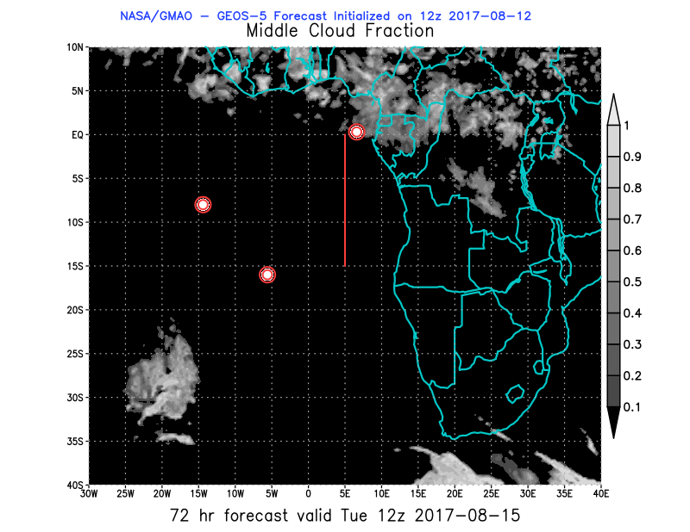
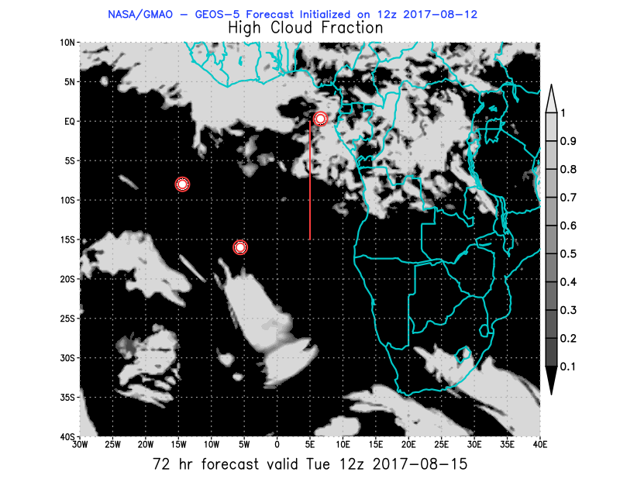
08/15 Tue (72h) 850 hPa 700hPa 600 hPa
08/12 12Z

Slide 11
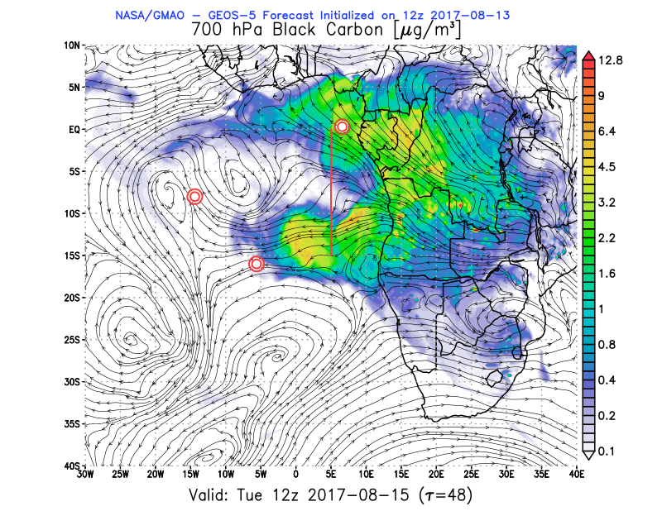
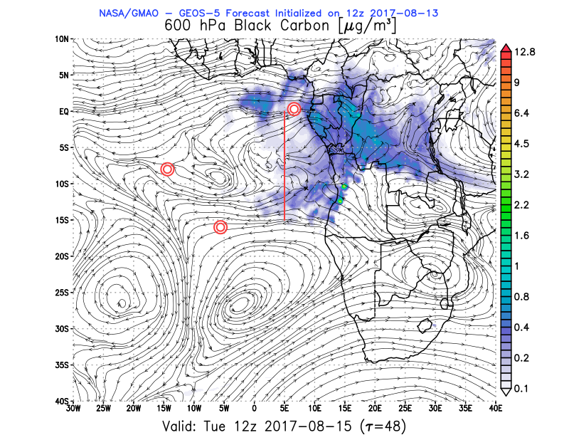
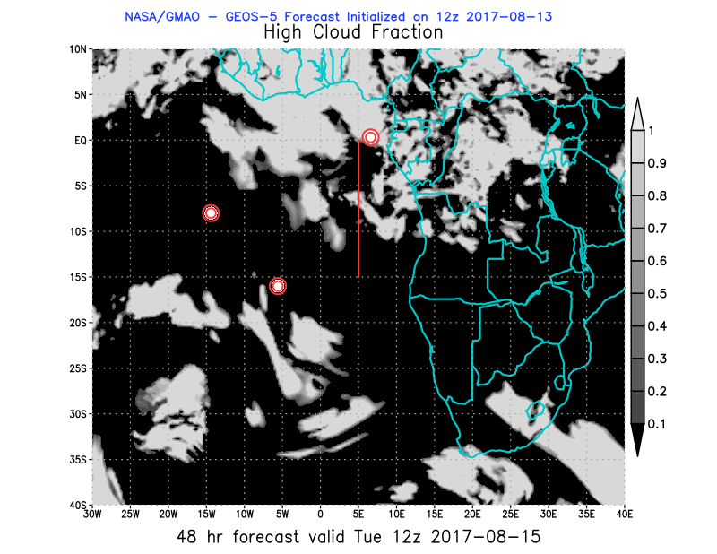
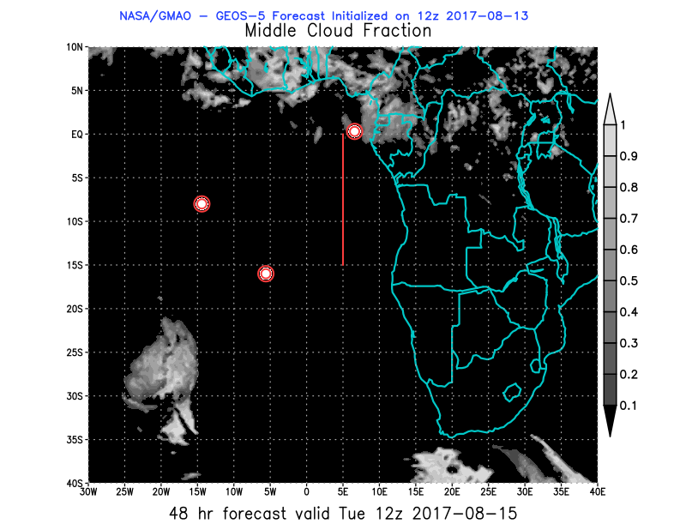
08/15 Tue (48h) 850 hPa 700hPa 600 hPa
08/13 12Z

Slide 12
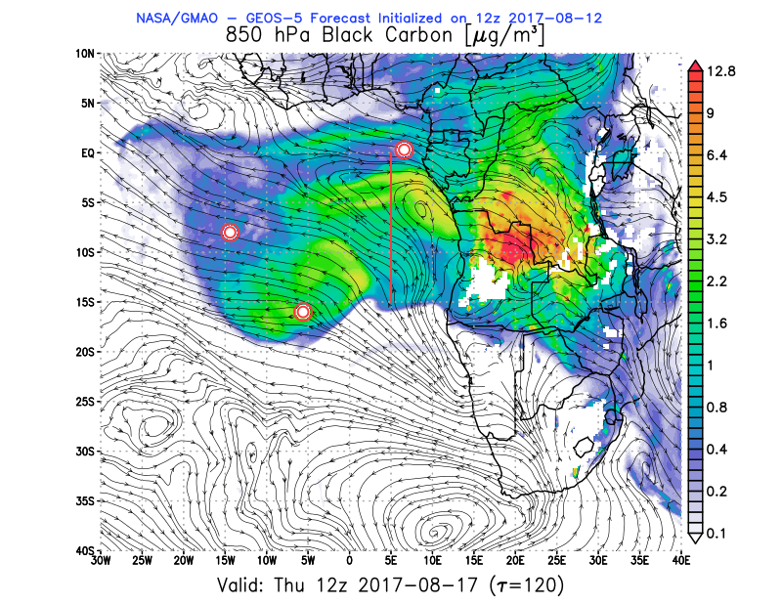
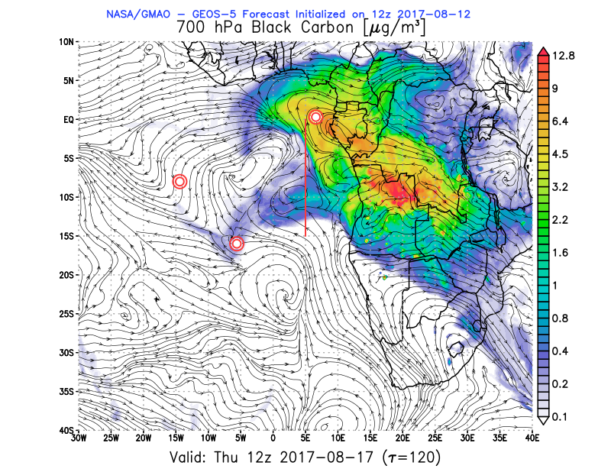
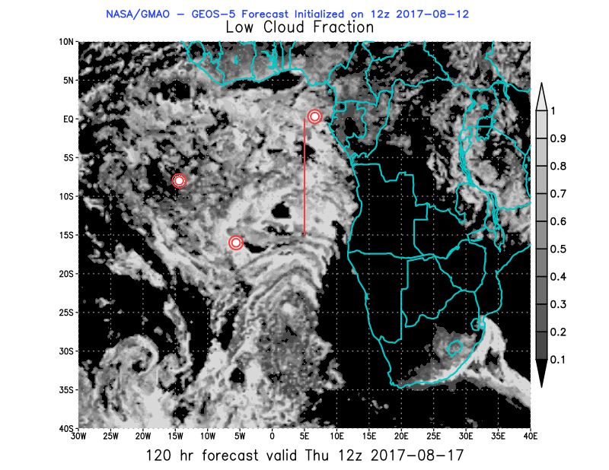
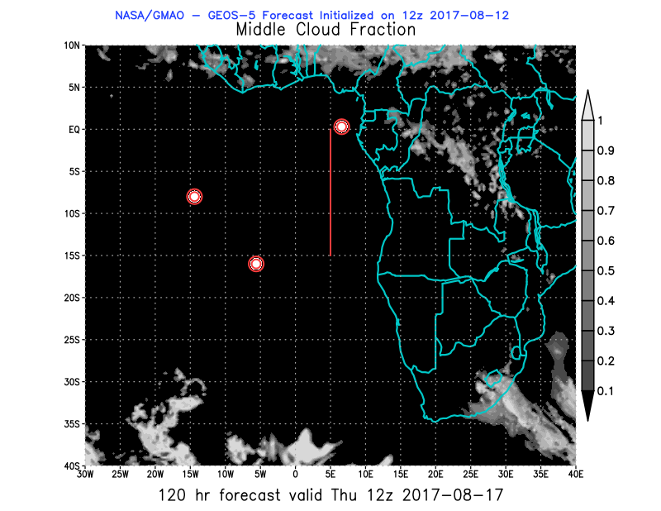
08/17 Thu (120h) 850 hPa 700hPa 600 hPa
08/12 12Z

Slide 13
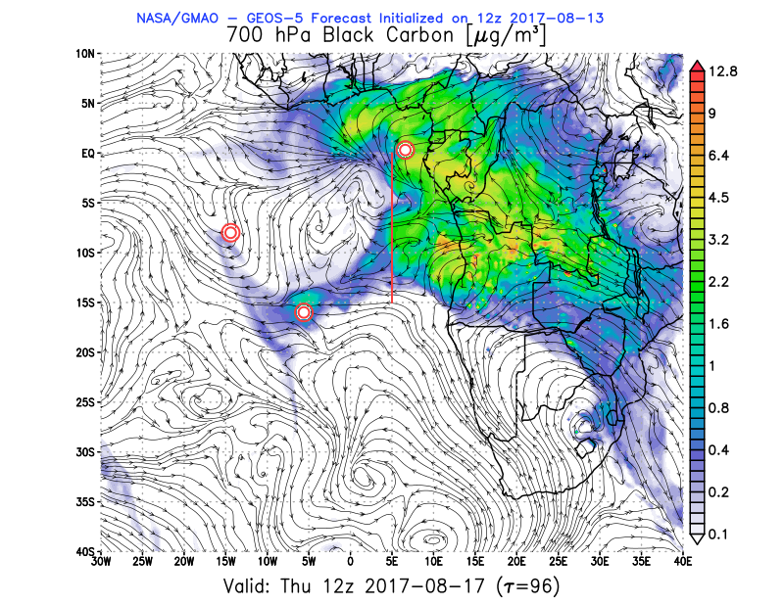
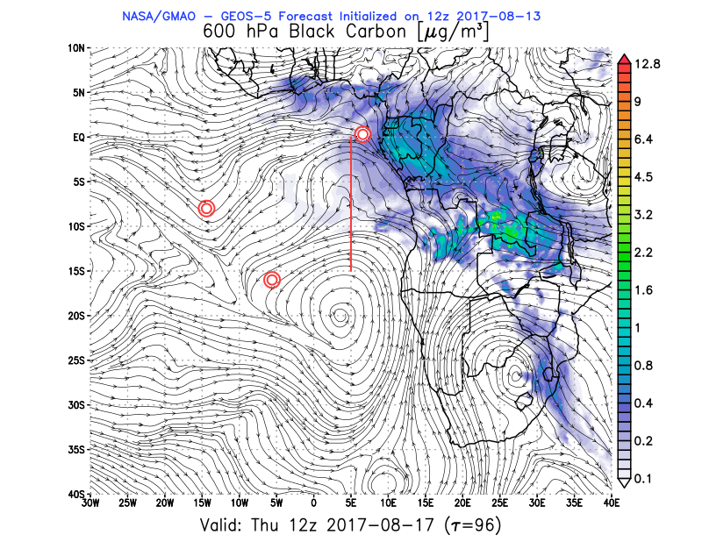
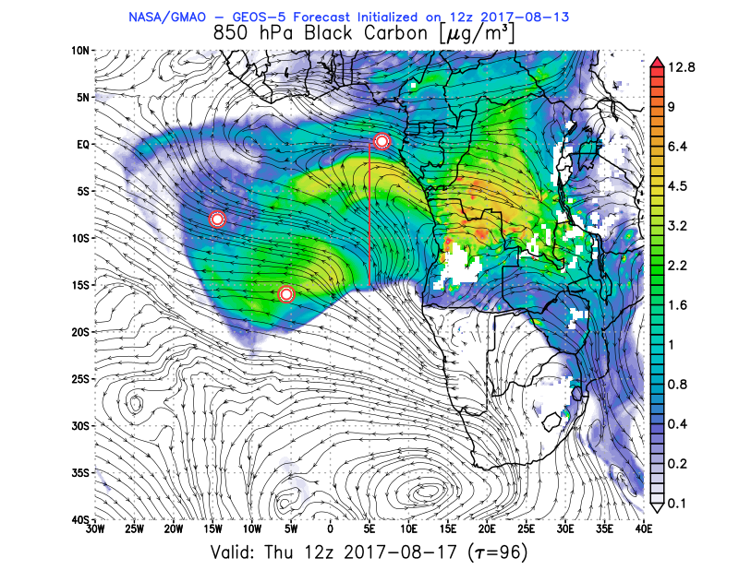
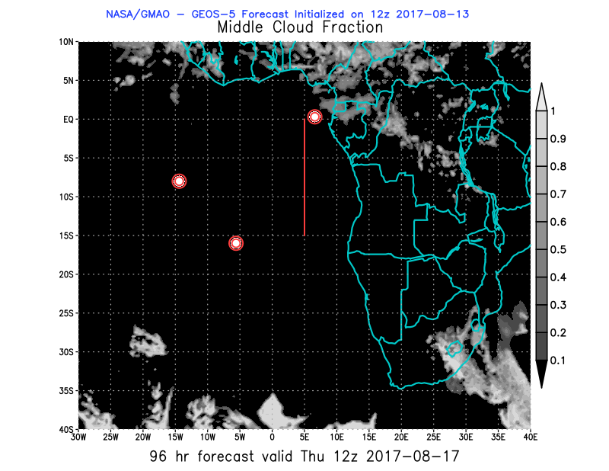
08/17 Thu (96h) 850 hPa 700hPa 600 hPa
08/13 12Z

Slide 14
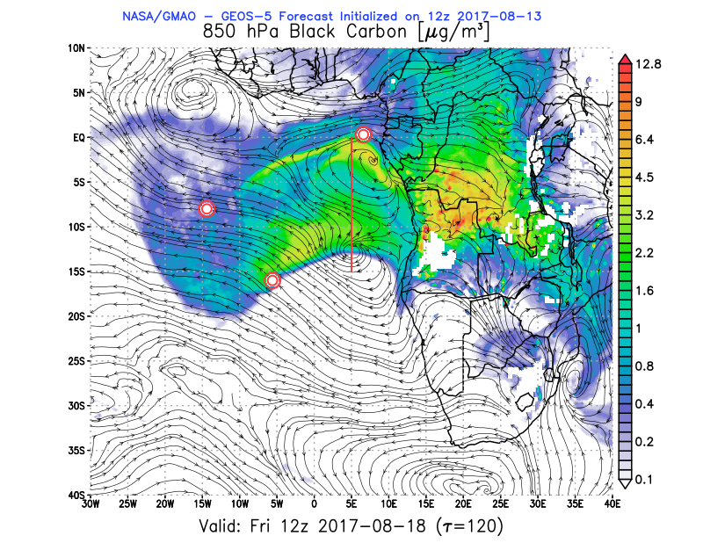
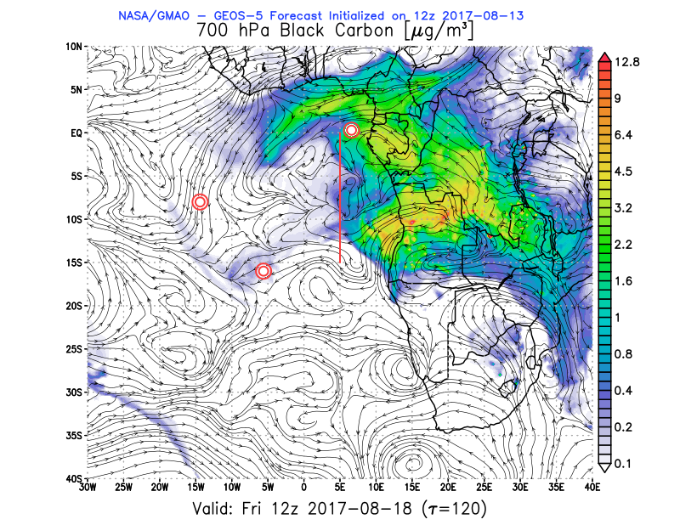
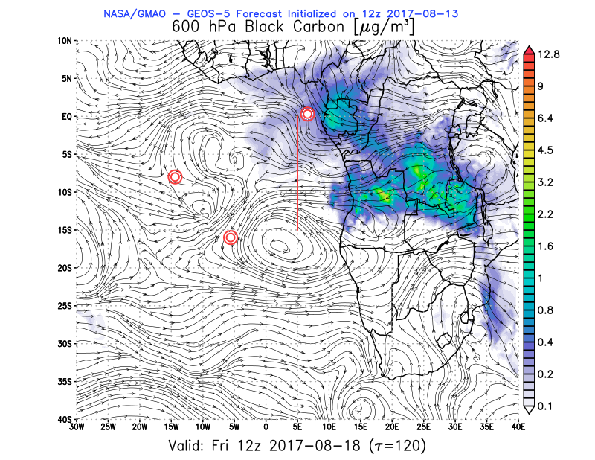
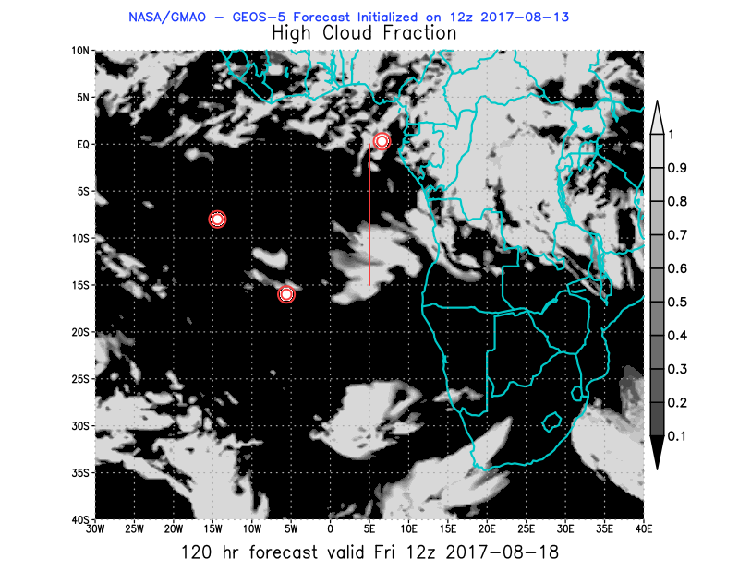
08/18 Fri (120h) 850 hPa 700hPa 600 hPa
08/13 12Z

Slide 15
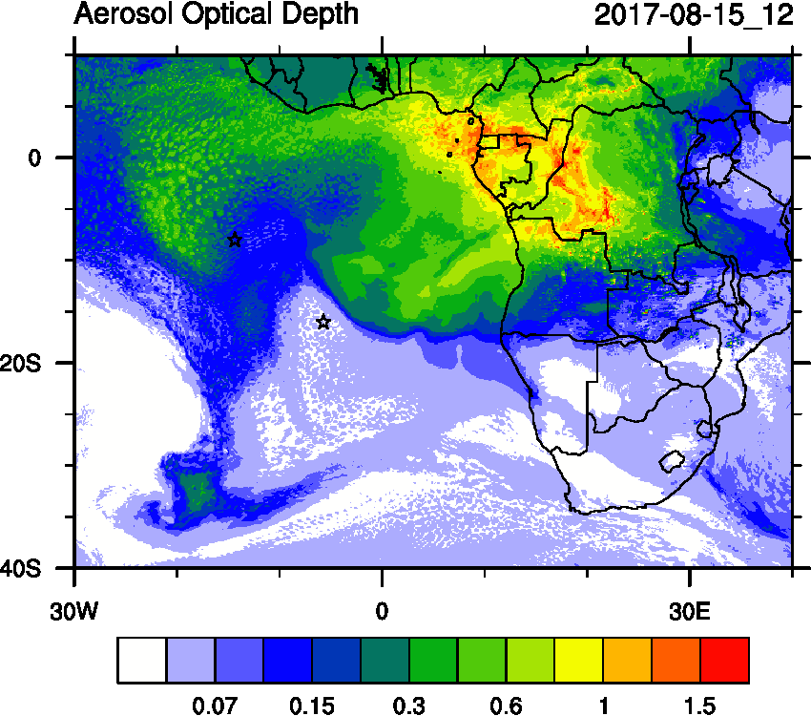
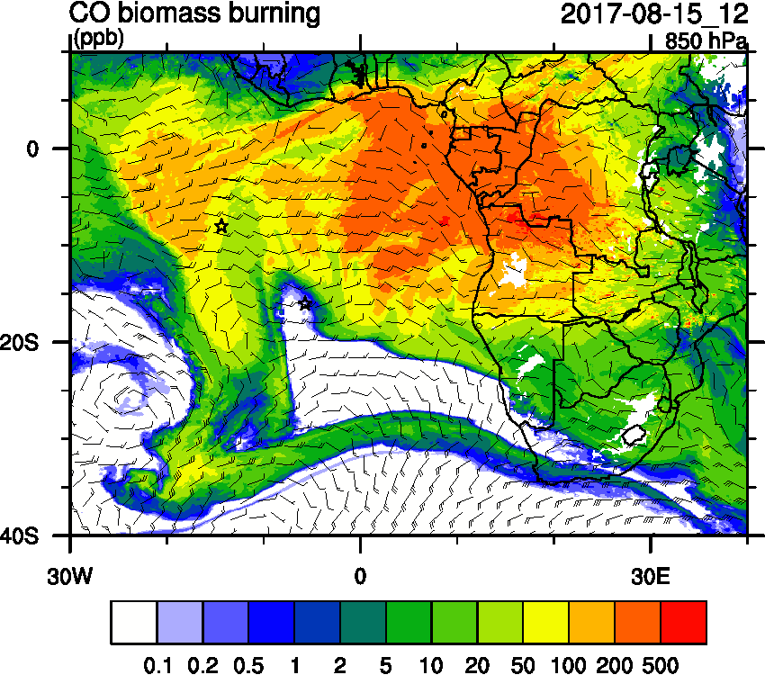
Tuesday August 15 12z WRF-AAM (OLD)

Slide 16
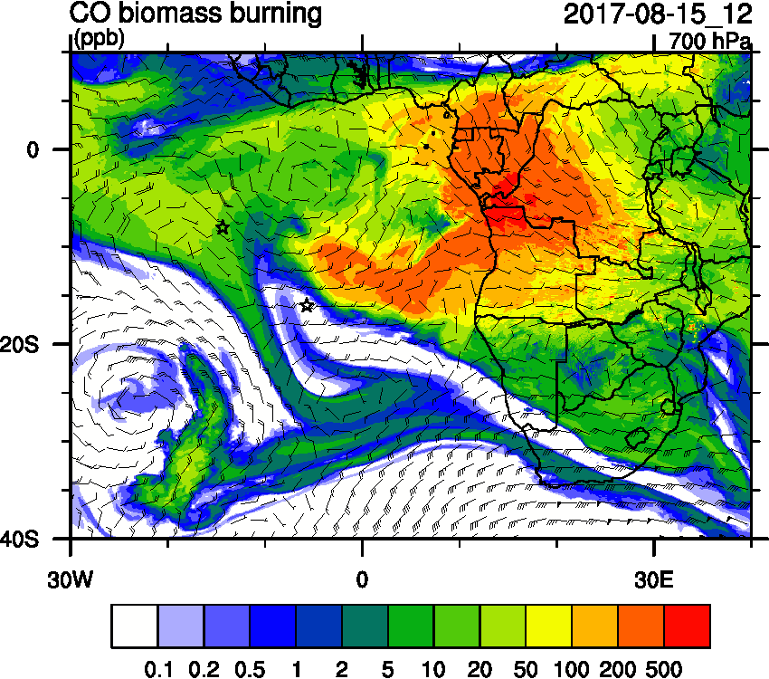
Tuesday August 15 12z WRF-AAM

Slide 17
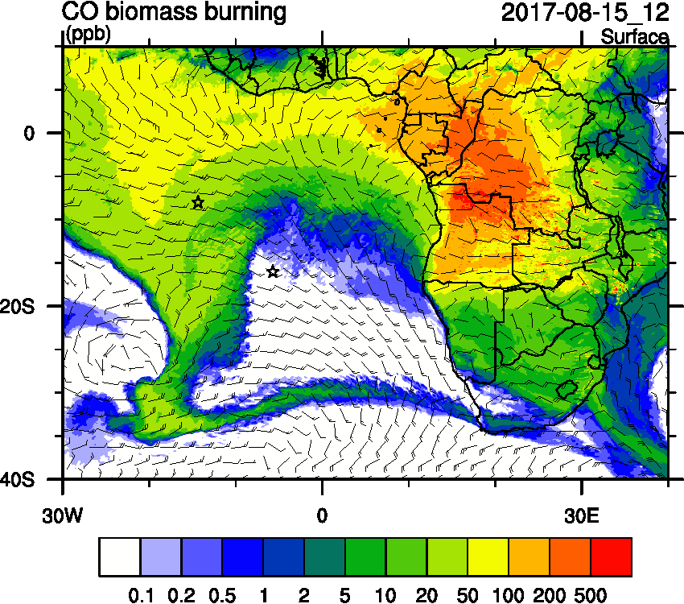
Tuesday August 15 12z WRF-AAM

Slide 18
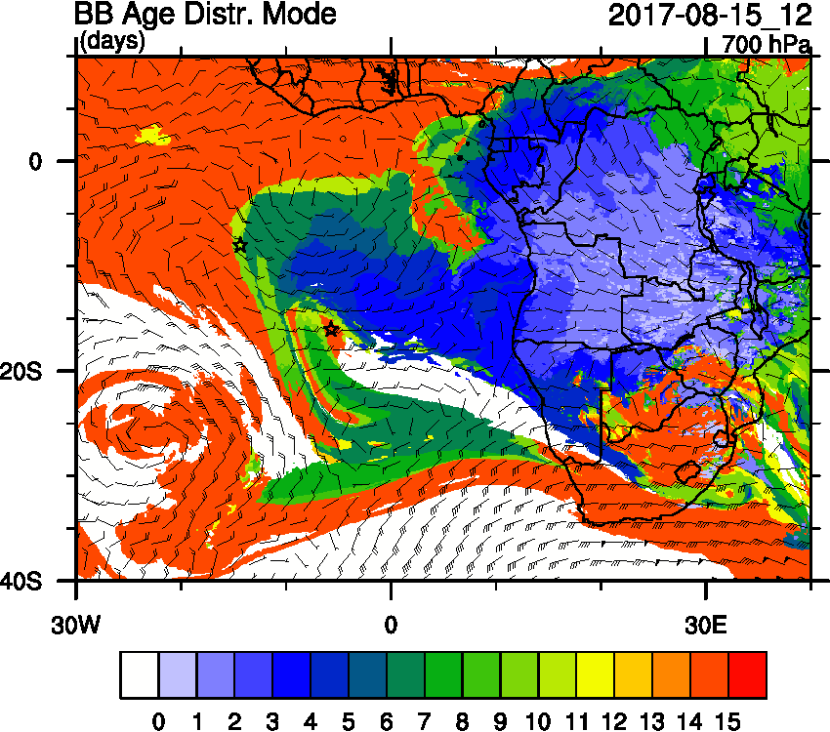
Tuesday August 15 12z WRF-AAM

Slide 19
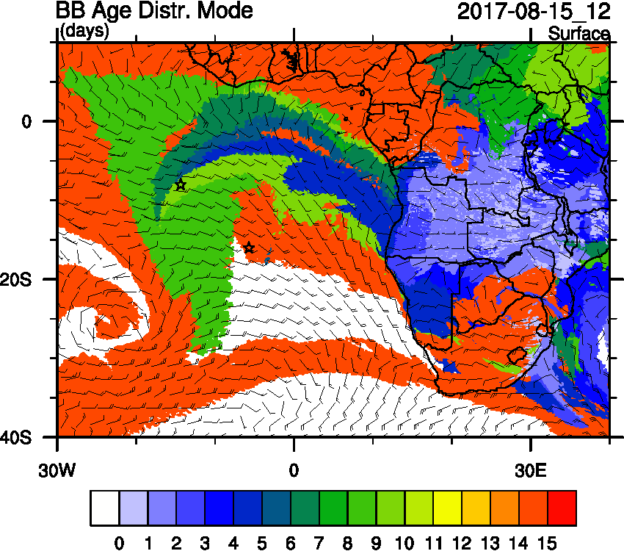
Tuesday August 15 12z WRF-AAM

Slide 20
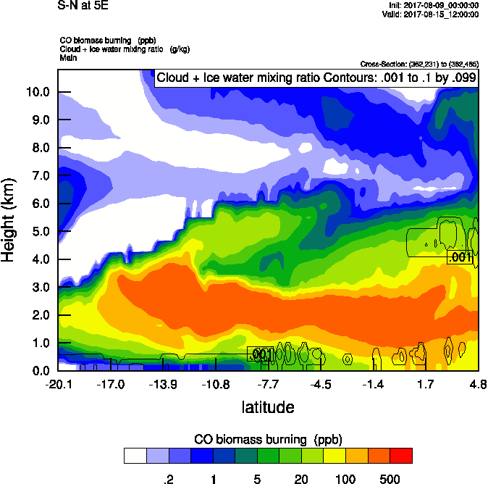
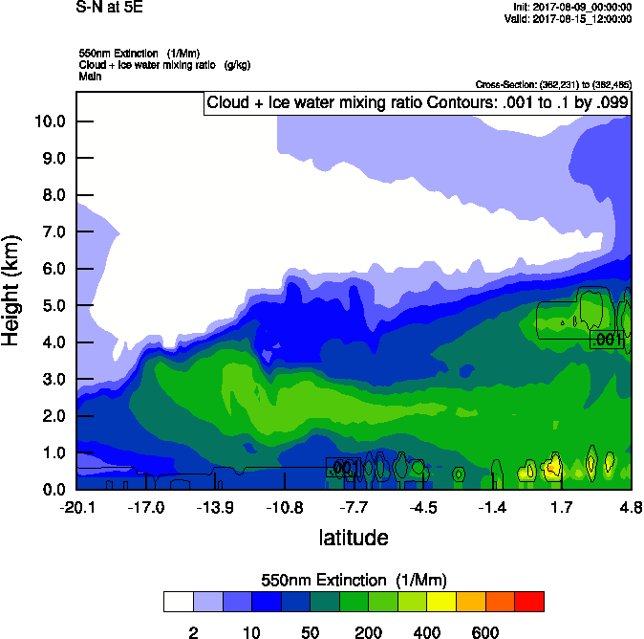
Tuesday August 15 12z WRF-AAM

Slide 21
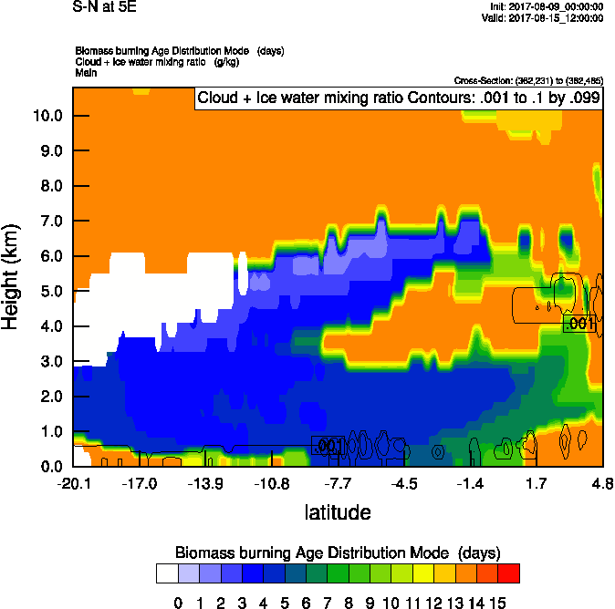
Tuesday August 15 12z WRF-AAM

Slide 22
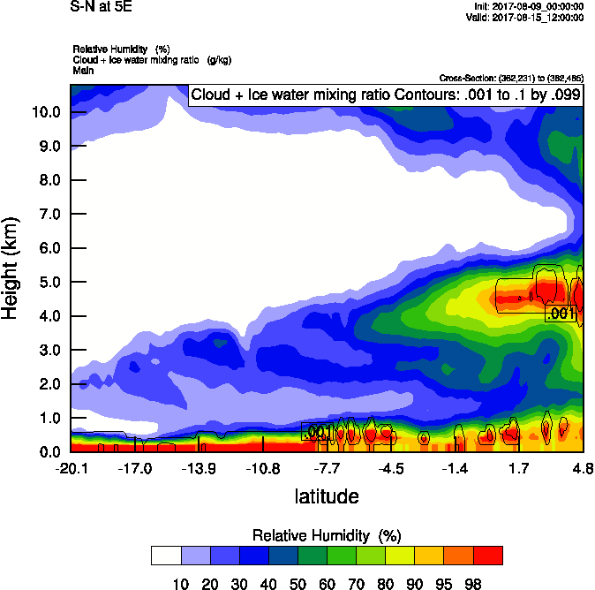
Tuesday August 15 12z WRF-AAM

Slide 23
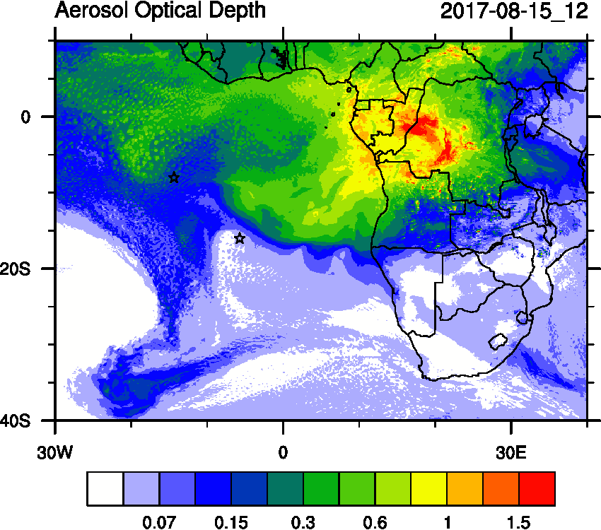
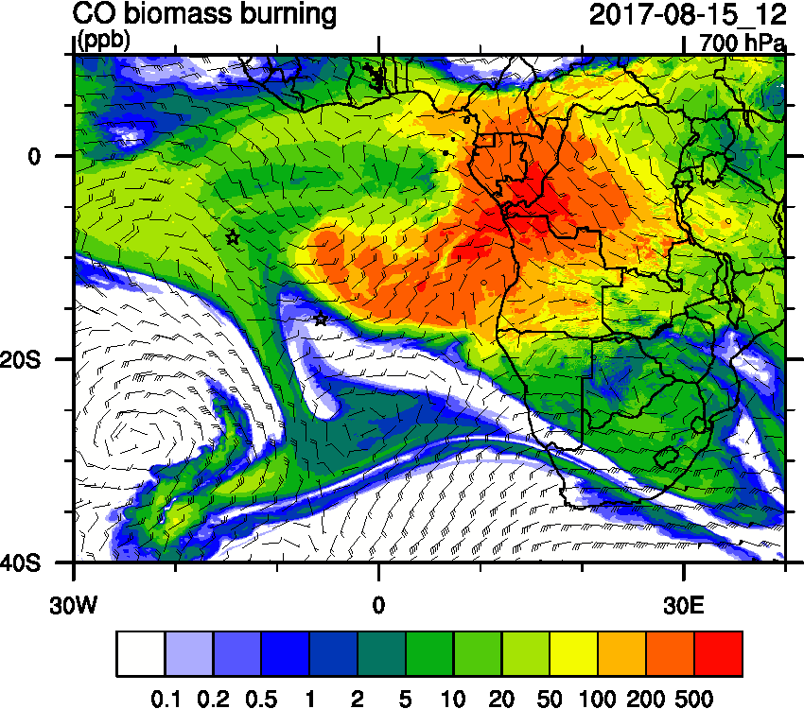
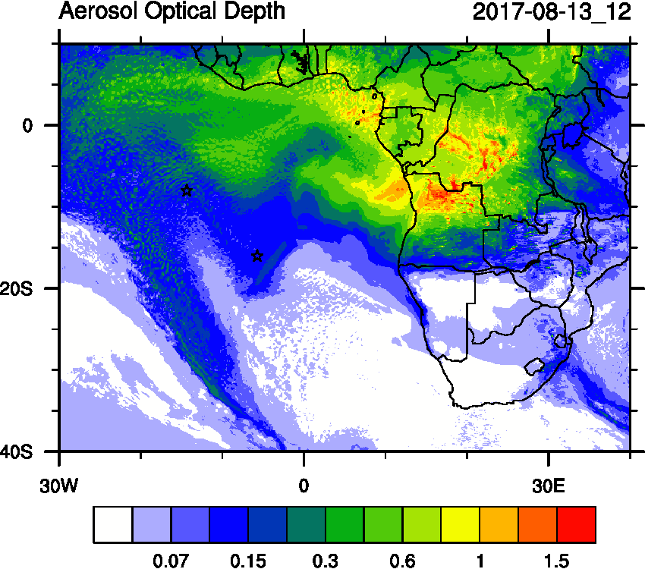
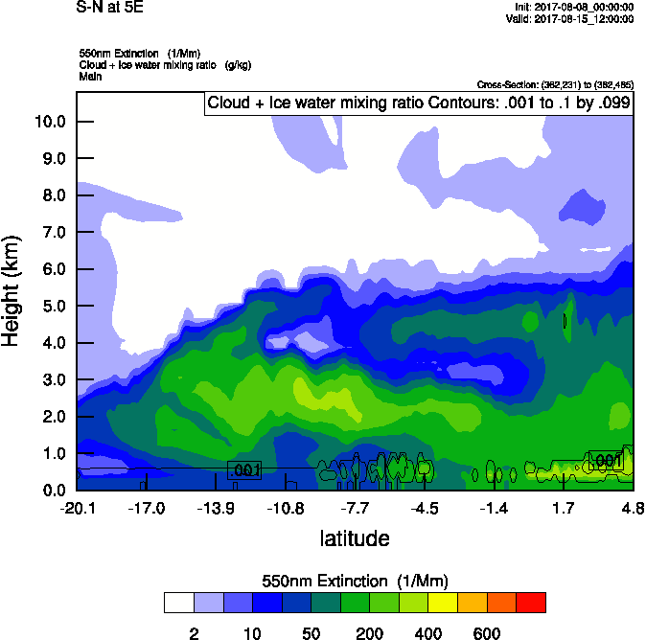
Tuesday August 15 (12z) WRF-AAM (OLD)

Slide 24
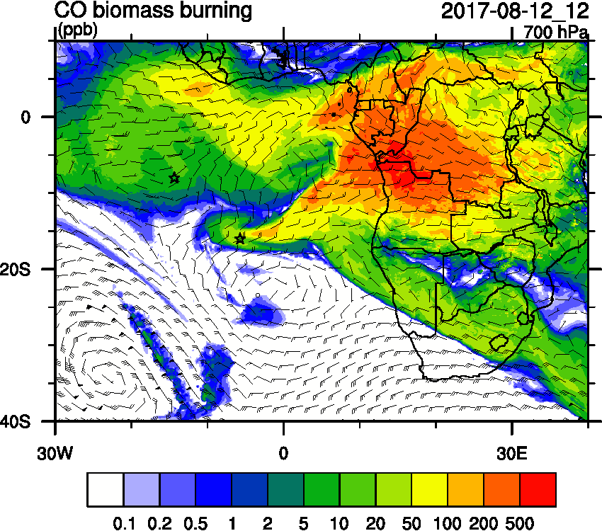
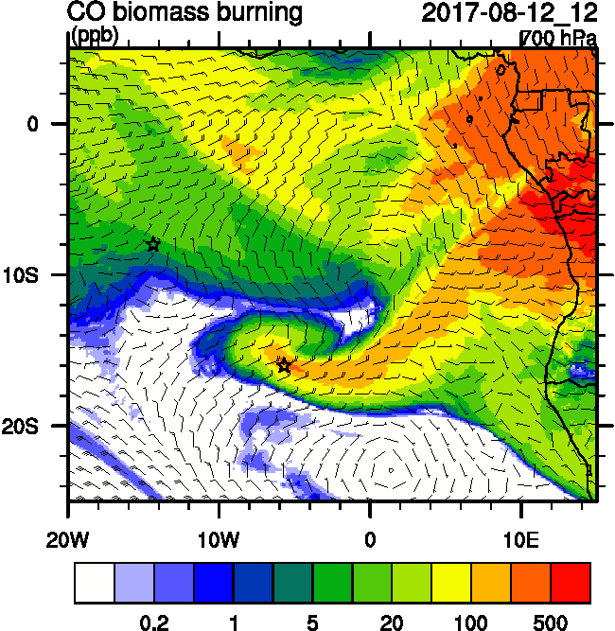
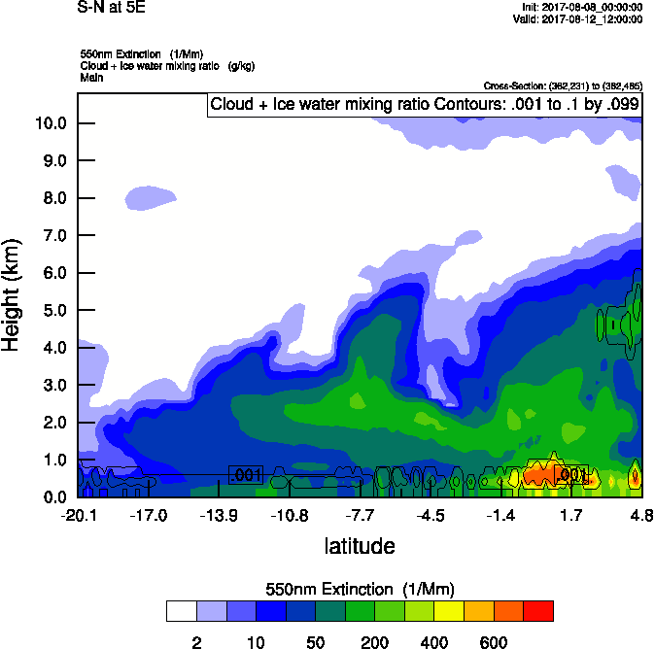
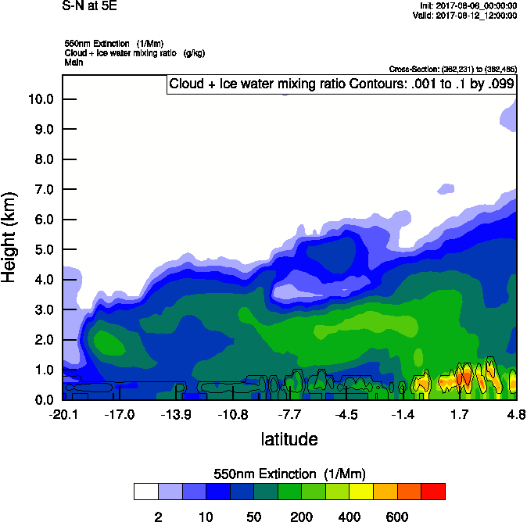
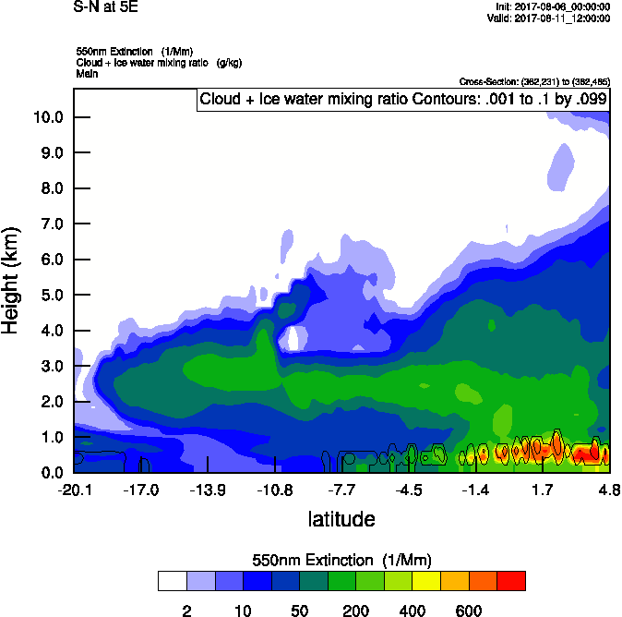
Saturday August 12 (12z) WRF-AAM

Slide 25
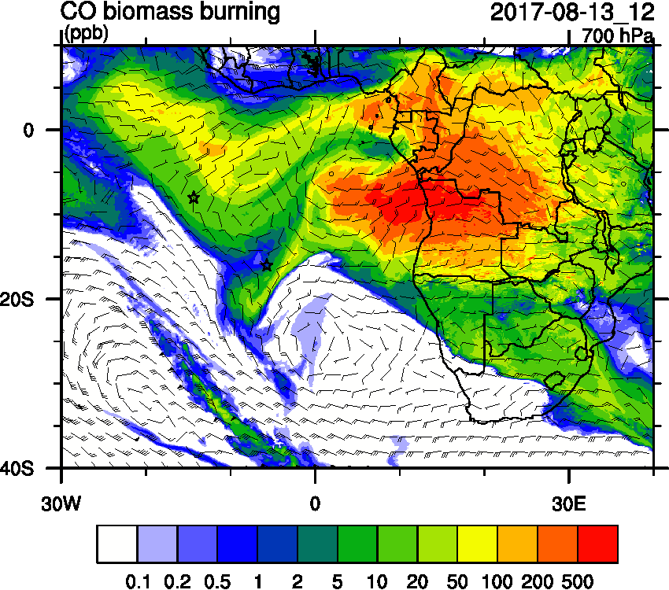
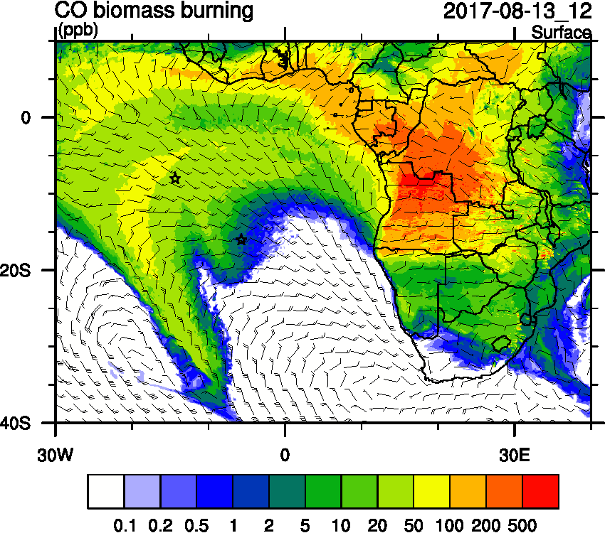
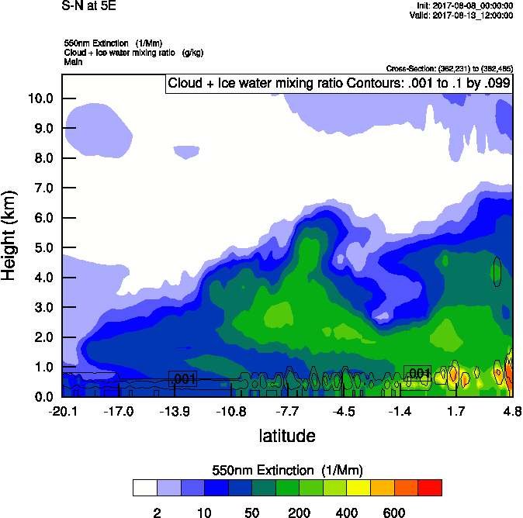
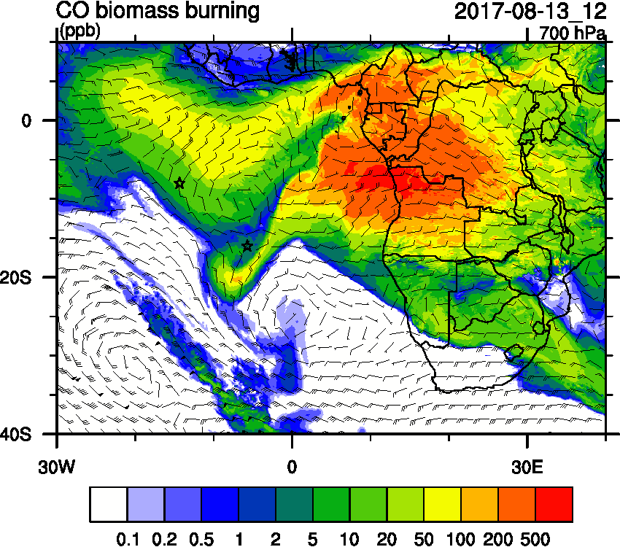
Sunday August 13 (12z) WRF-AAM

Slide 26
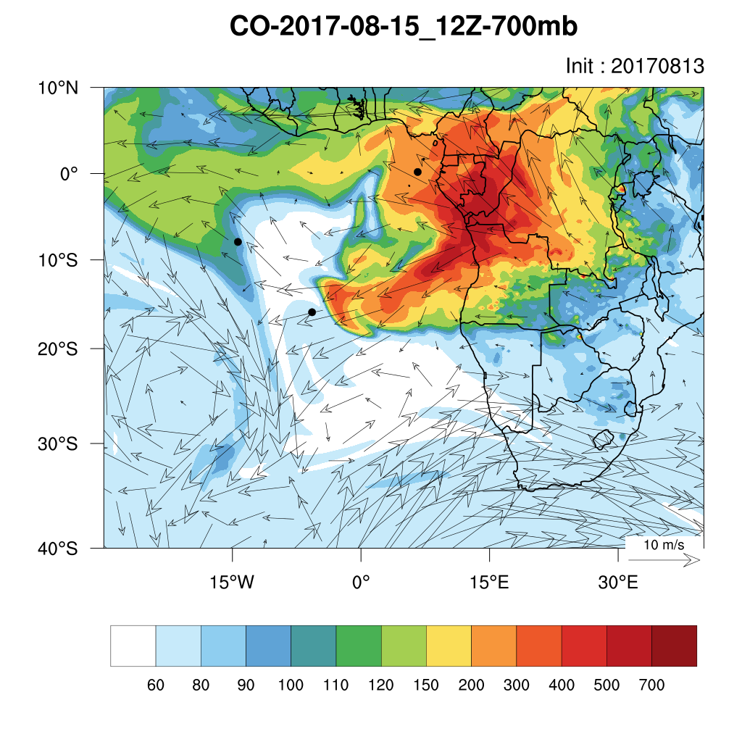
August 15&17 700hPa12z WRF-CAMS

Slide 27
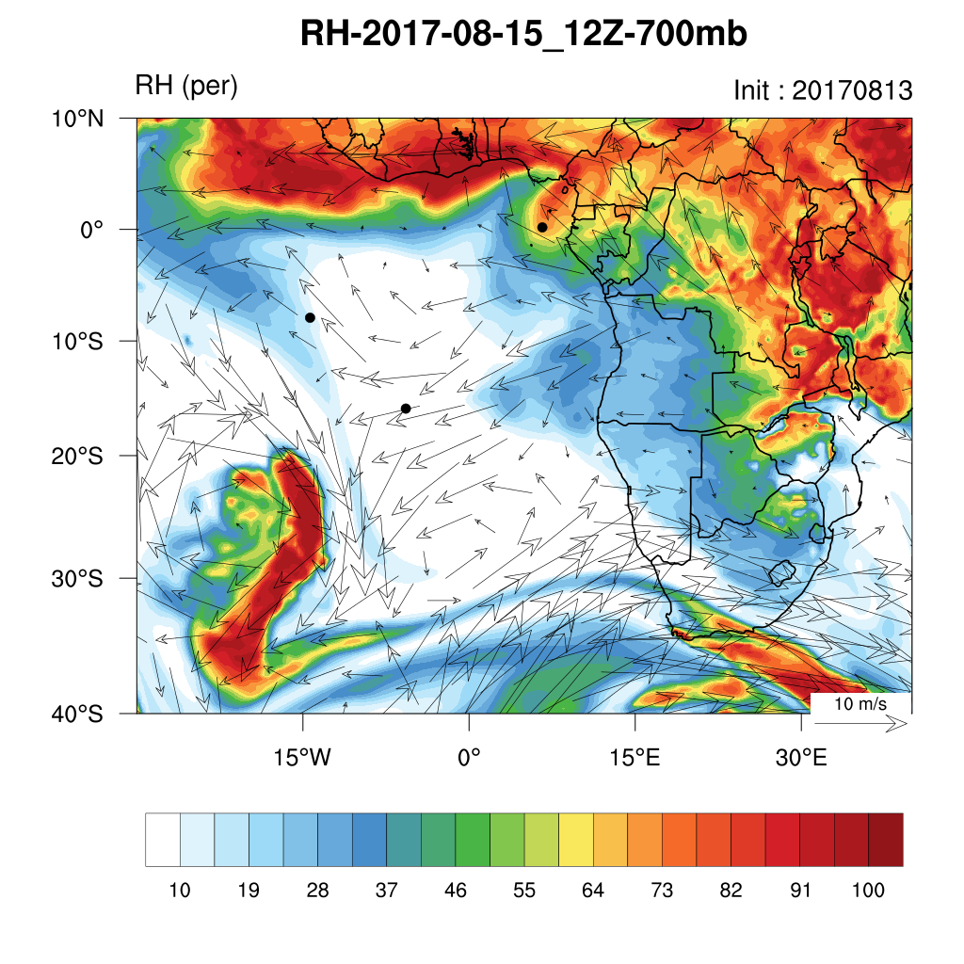
August 15&17 700hPa12z WRF-CAMS

Slide 28
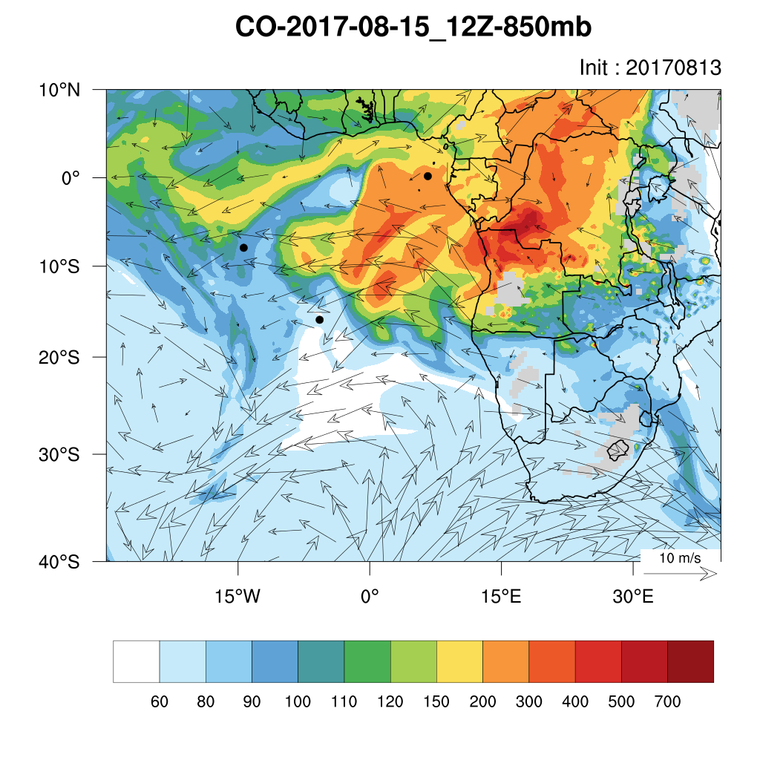
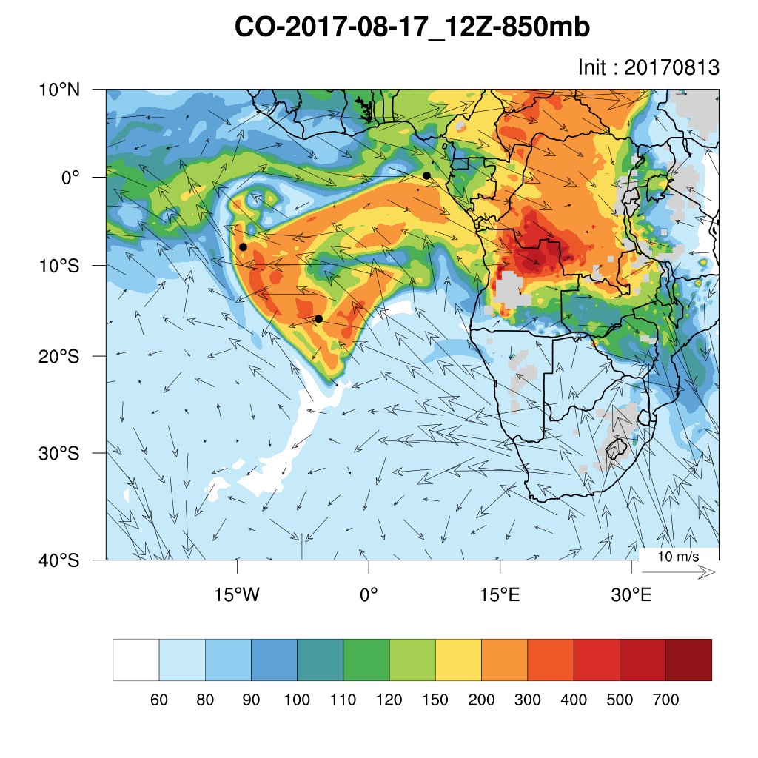
August 15 & 17 850 hPa (12z) WRF-CAMS

Slide 29
15 & 17 Surface (12z)

Slide 30
Tuesday August 15 12z

Slide 31
Tuesday August 15 12z

Slide 32
Tuesday August 15 Flight Path

Slide 33
Tuesday August 15 Flight Path

Slide 34
Tuesday August 15 (12z)

Slide 35
Tuesday August 15 12z WRF-AAM

Slide 36
Tuesday August 17 12z UKMO

Slide 37
Thursday August 17 12z UKMO

Slide 38
Thursday 12 z *s

Slide 39
Thursday 12 z *s

Slide 40
Ascension São Tomé e Príncipe Sta Helena

Slide 41
Thursday August 17 12z

Slide 42
Tuesday August 15 12z WRF-AAM

Slide 43
Tuesday August 15 12z WRF-AAM

Slide 44
Tuesday August 15 12z WRF-AAM

Slide 45
Tuesday August 15 12z WRF-AAM

Slide 46
Tuesday August 15 12z WRF-AAM

Slide 47
Tuesday August 15 12z WRF-AAM

Slide 48
Tuesday August 15 12z WRF-AAM

Slide 49
Tuesday August 15 &16 12z WRF-AAM

Slide 50
August 16 12z WRF-AAM

Slide 51
August 16 12z WRF-AAM

Slide 52
August 16 12z WRF-AAM

