Slide 1
ORACLES weather briefing
13-Aug-2017
Lenny Pfister and Rei Ueyama

Slide 2
IR satellite imagery animation (8/13 00-09Z)

Slide 3
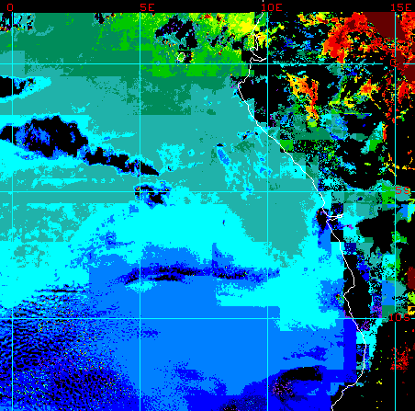
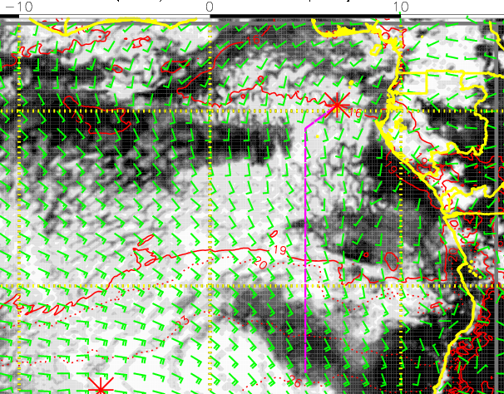
8/13 Sun @ 3AM
(forecast validation)
Low cloud forecast
Low cloud top heights

Slide 4
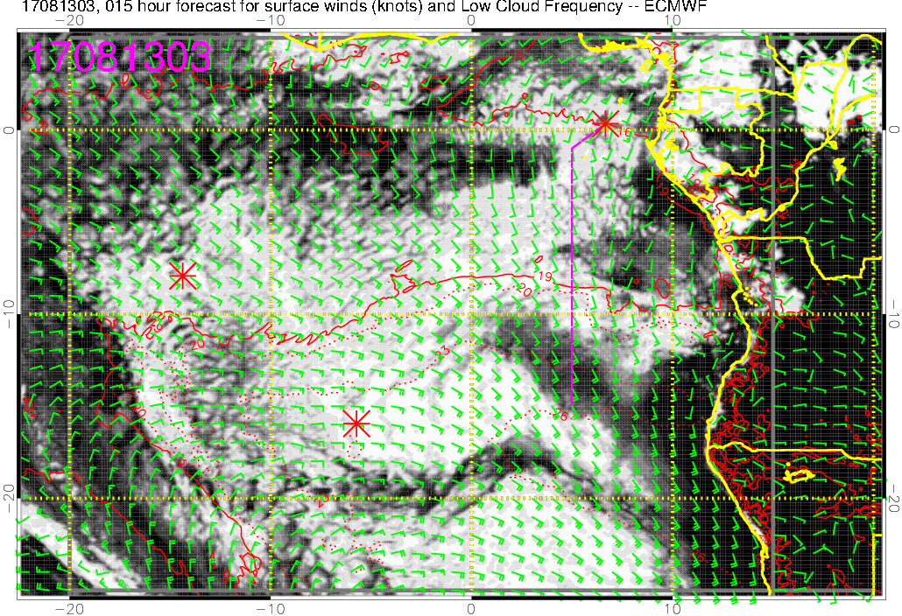
Low cloud forecast on 8/13 Sun @ 3AM

Slide 5
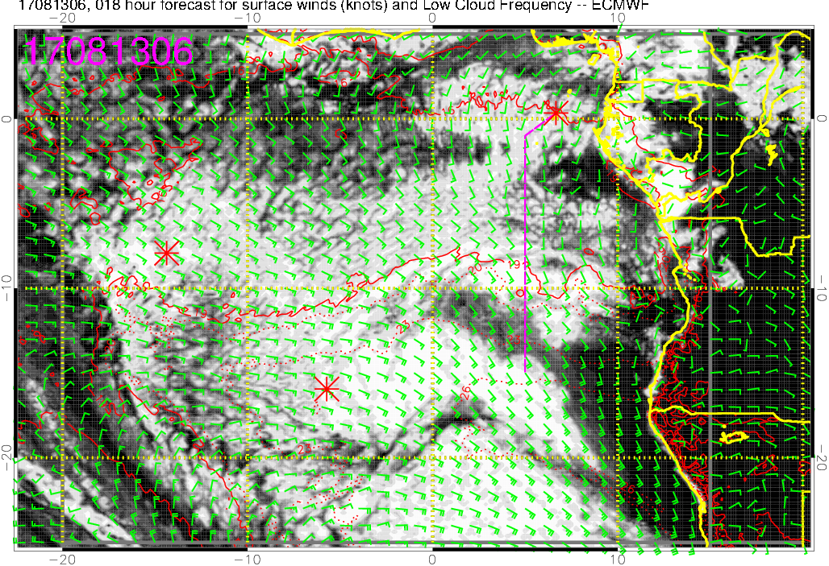
Low cloud forecast on 8/13 Sun @ 6AM
Cloud filling in (but satellite shows clearing have already started)

Slide 6
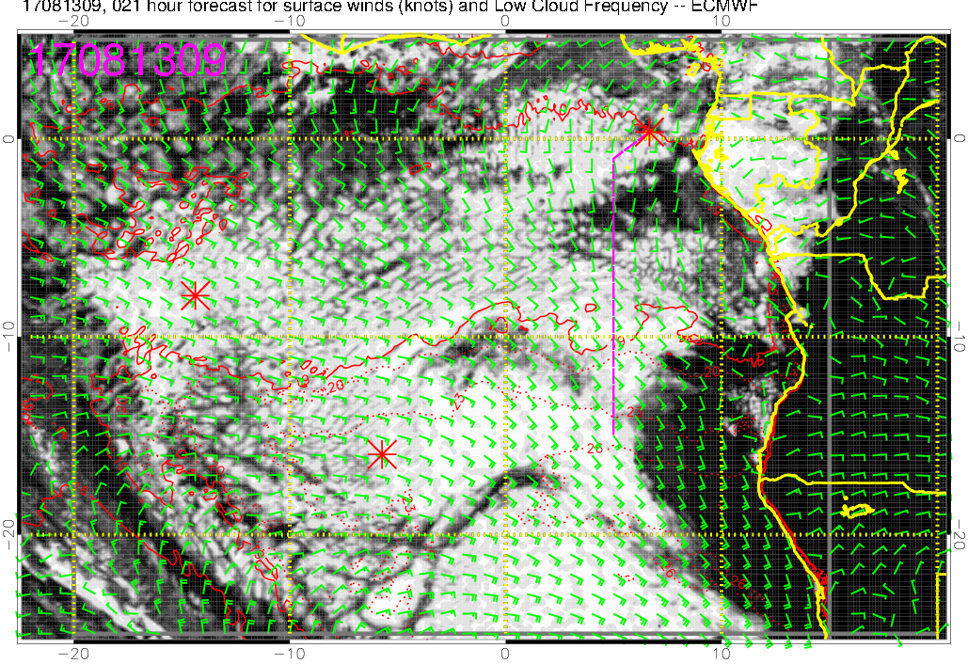
Low cloud forecast on 8/13 Sun @ 9AM
Cloud clearing

Slide 7
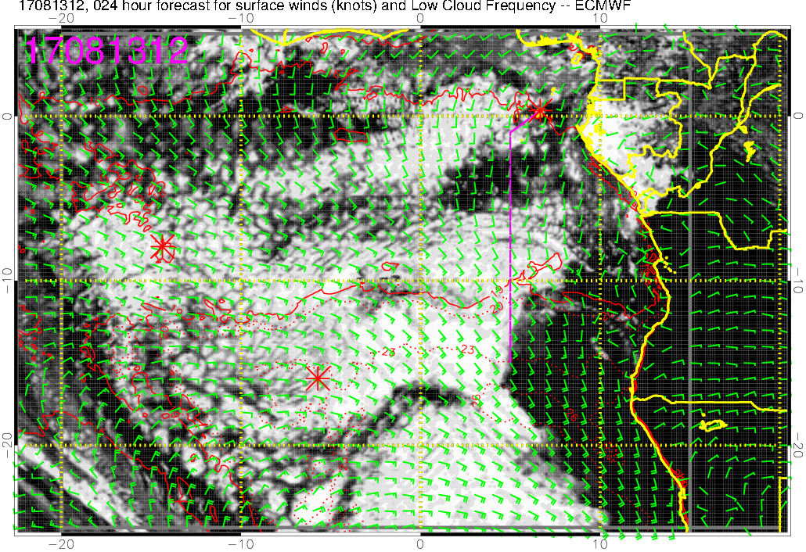
Low cloud forecast on 8/13 Sun @ 12PM
- Scattered clouds 5-8S
- More dense clouds south of 8S (similar to satellite image at 5am)

