Slide 1
ORACLES weather briefing
13-Aug-2017
Lenny Pfister and Rei Ueyama

Slide 2
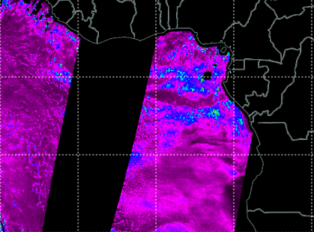
Worldview columnar liquid water at 1:30 AM this morning
Enhanced IR

Slide 3
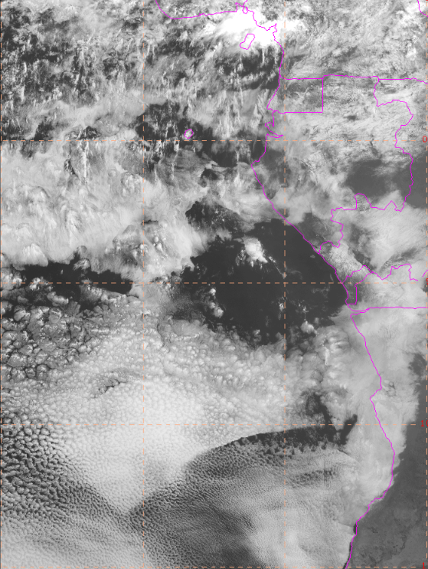
Now (9 AM)
This area appears to be holding
firm
Some dissipation occurring here
This edge is moving, but not
clearing the cells
This edge moving NWwrd, could
threaten cloud edge at 8.5S. It is
NOT clear behind it

Slide 4
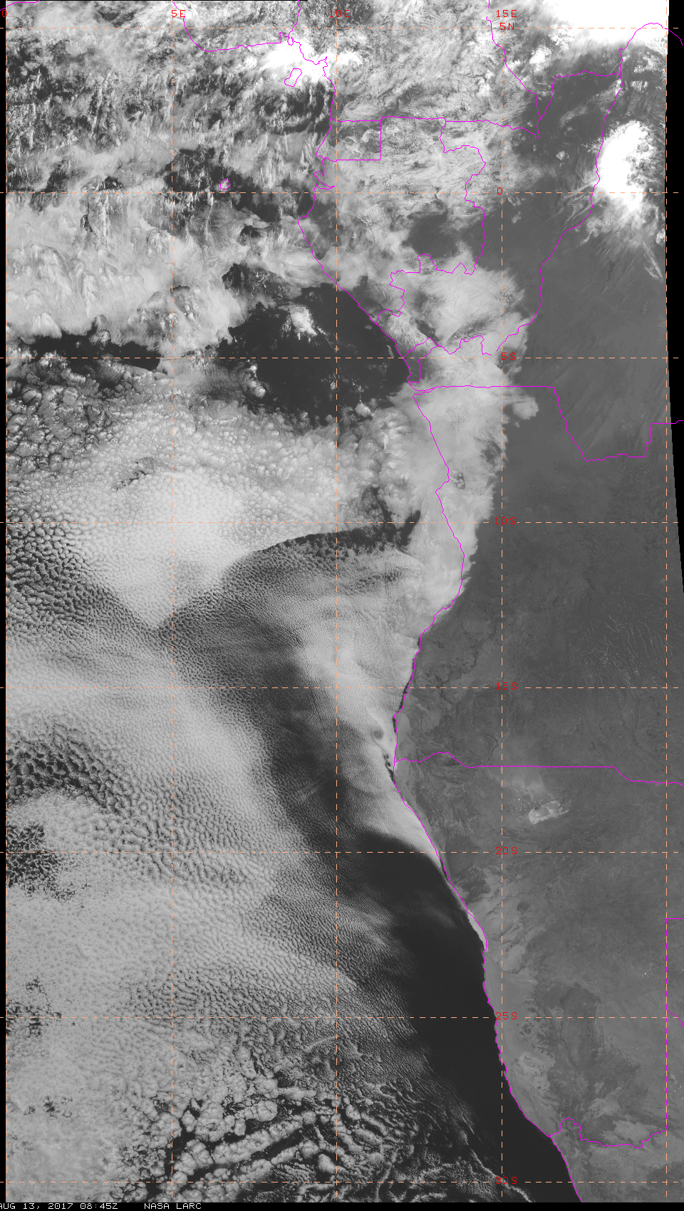
FCST for 9 AM surprisingly good this time. As we found out this morning, cloud clearing north of 10S is inadequate.

Slide 5
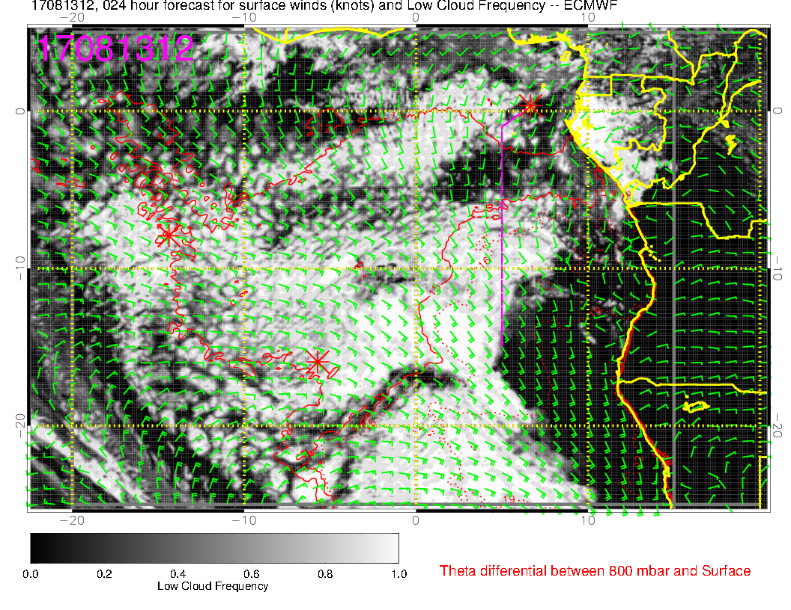
I think we have decided to work this region.

Slide 6
Surface Winds

Slide 7
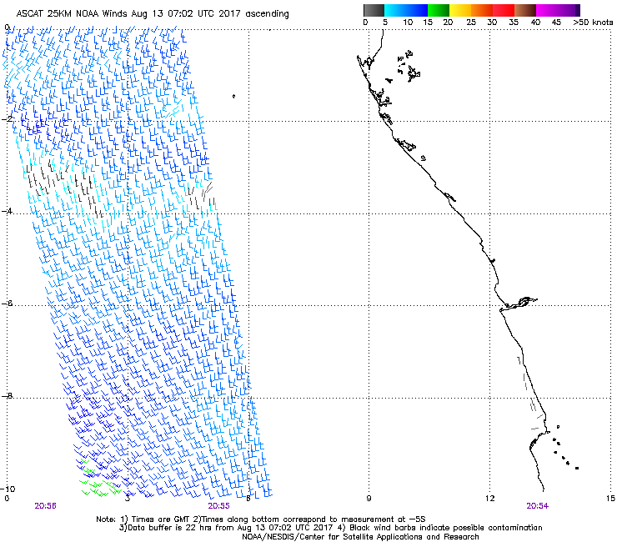
Winds last night, SSE about 10 knots

Slide 8
9 hour fcst – reasonably consistent with ASCAT observations.

Slide 9
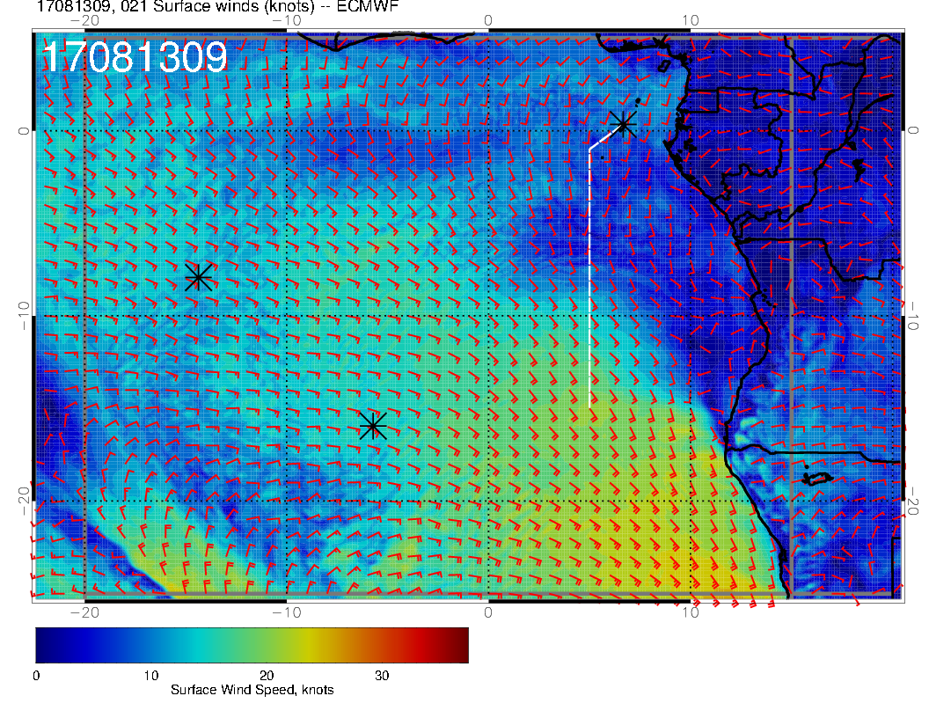
Winds are weakening near 10S. Region of
weak winds moving south. Generally southerly, stronger southwesterly to south

Slide 10
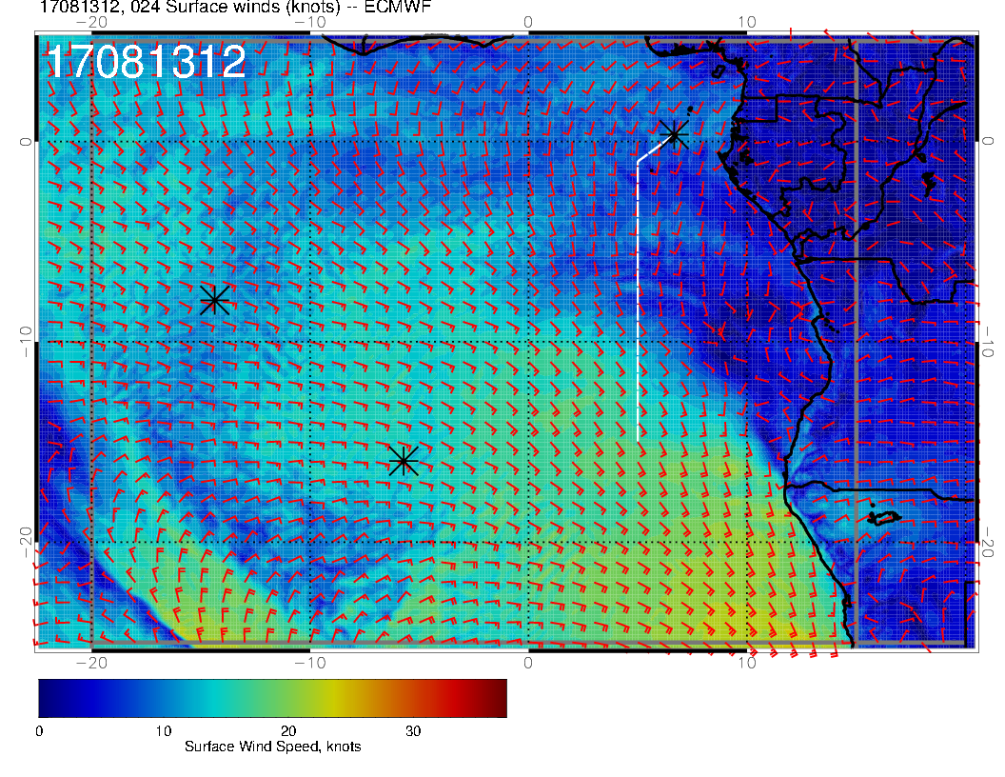

Slide 11
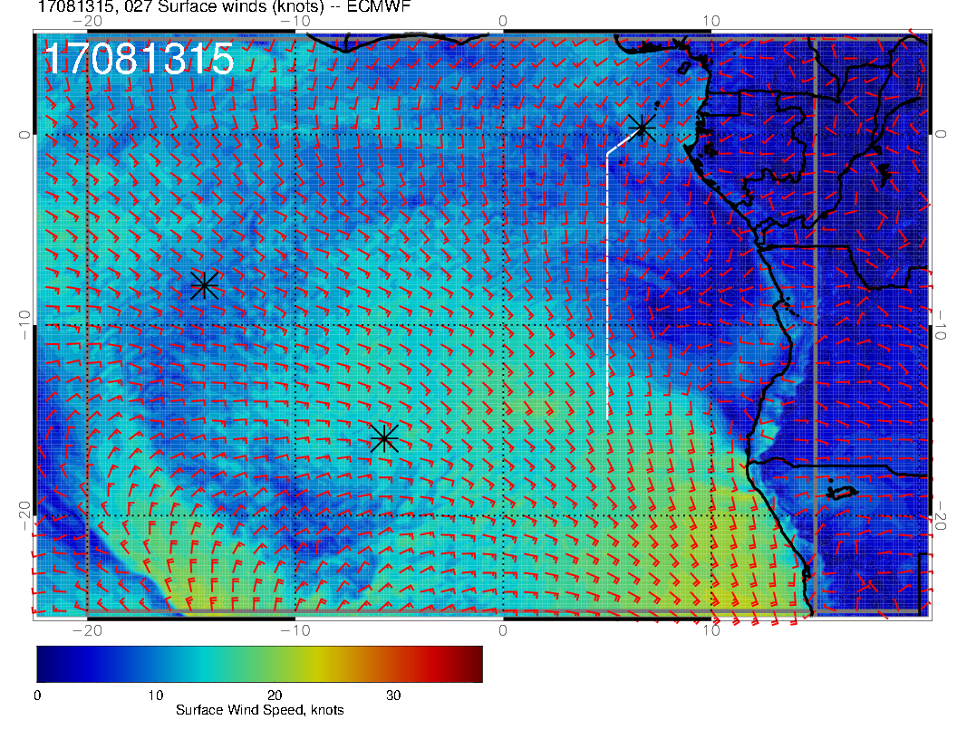

Slide 12
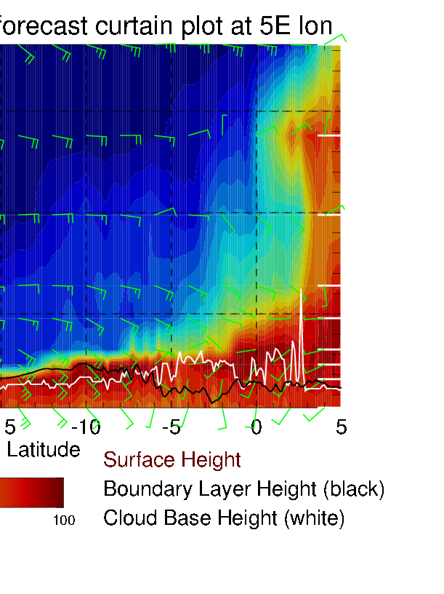
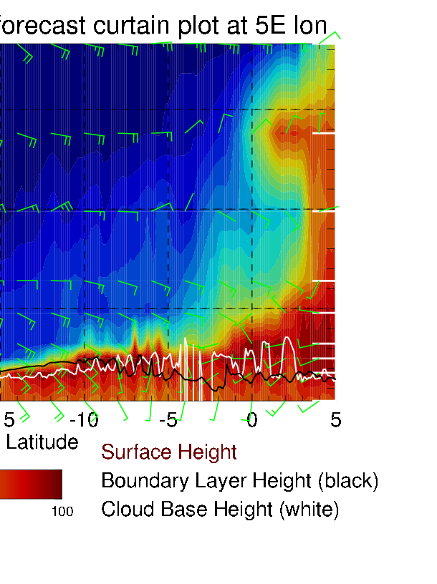
10 kft
5 kft
Surface: 9 AM, southeasterlies about 10-15 knots in operating region
Noon: Weakening – more southerly
3 PM: Shifting to southerly and SSW, strengthening.
900mb (3kft, 1km, top of BL): Same trend except winds are “more easterly by about 30degrees.
850 mb and up. Stable through forecast period, ESE 10-15 nots

Slide 13
12Z
3 kft
Surface
Comparison of top of BL (left) to surface (right). Look at barbs. Top of BL similar
in magnitude, but more easterly.

Slide 14
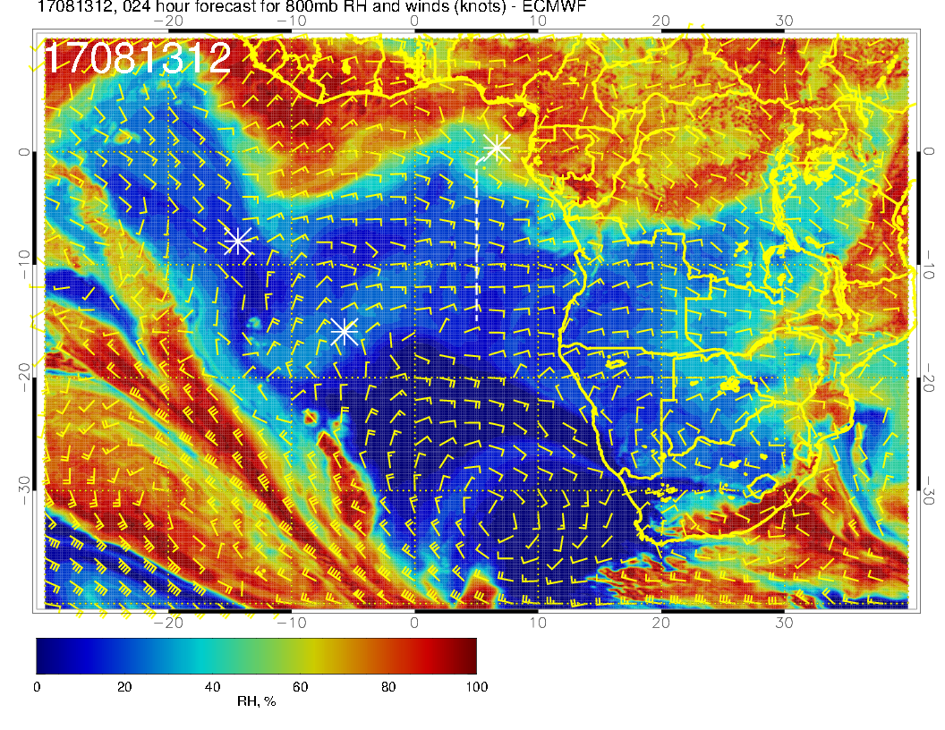
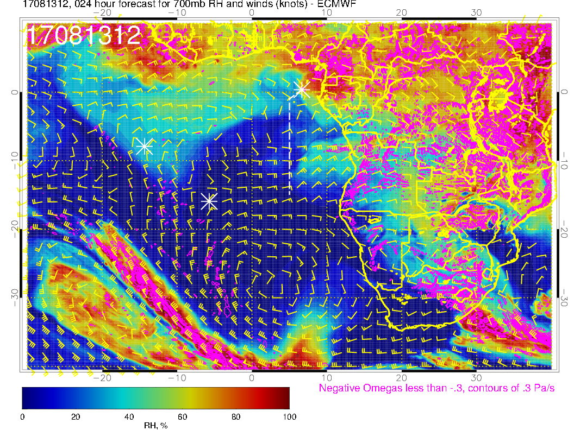
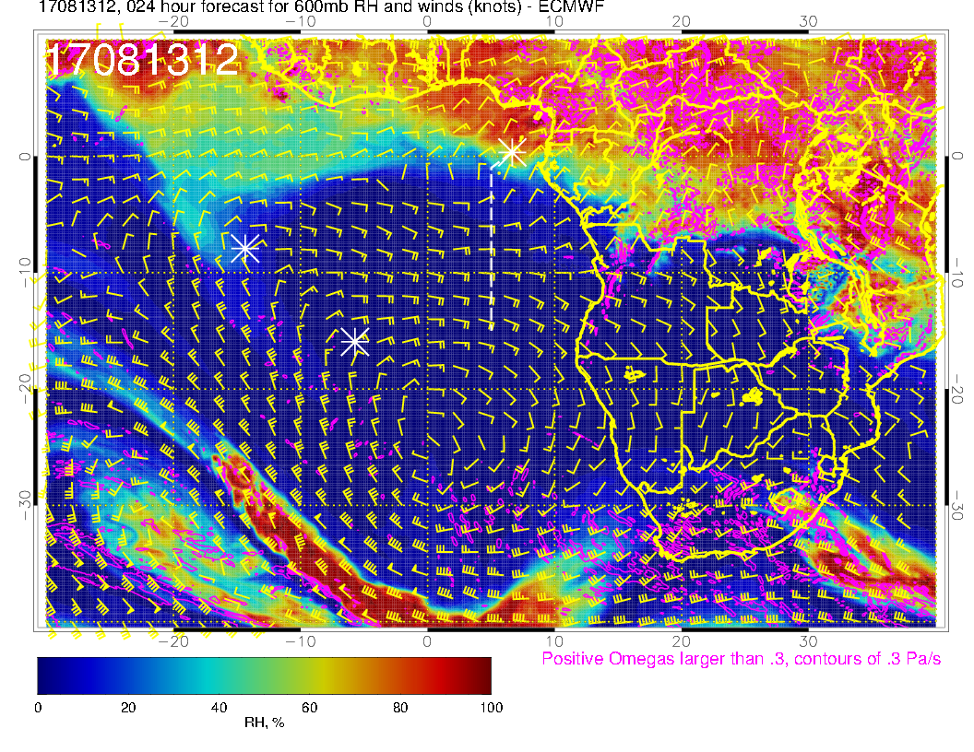
Mid level flows.
Flow is zonal at mid-levels (not what we have had. Conditions are nice and dry over operating region.

Slide 15
Forecast for Tuesday 8/15

Slide 16
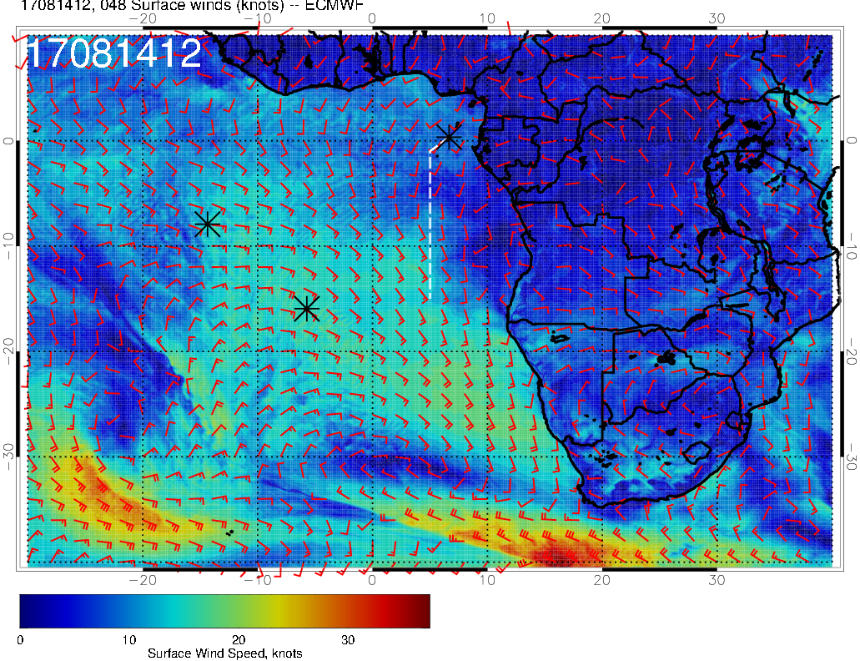
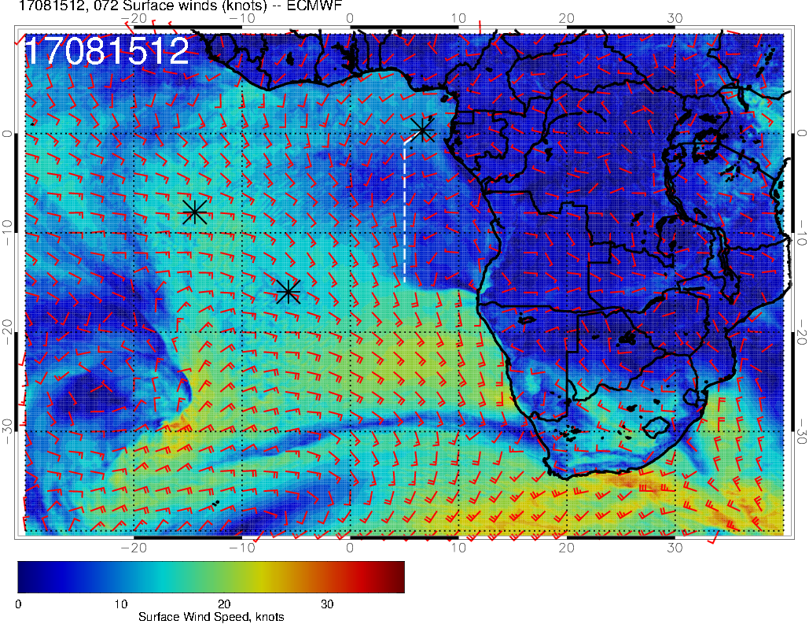
Surface winds
8/14 Mon
L
8/15 Tue (flight day)
H
Winds becoming more westerly and weakening over our flight region
L
H

Slide 17
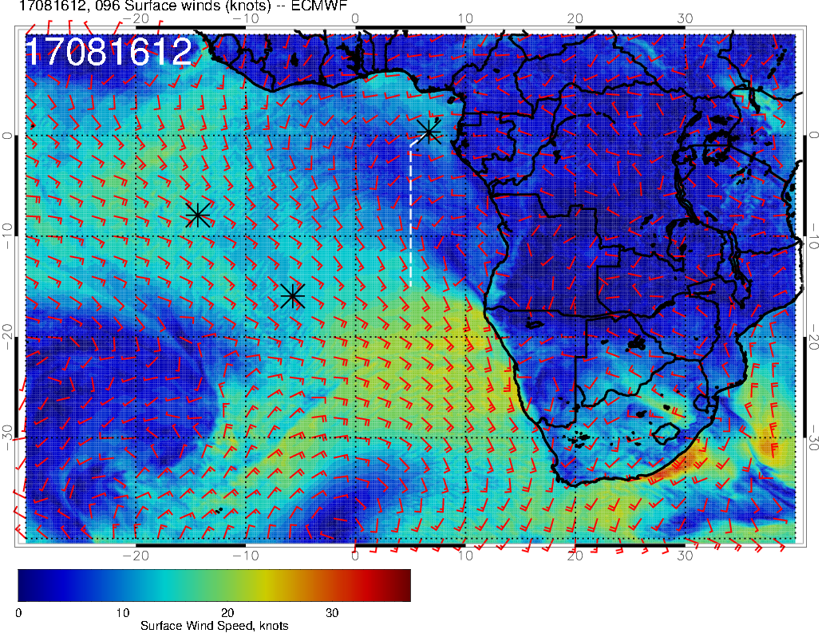
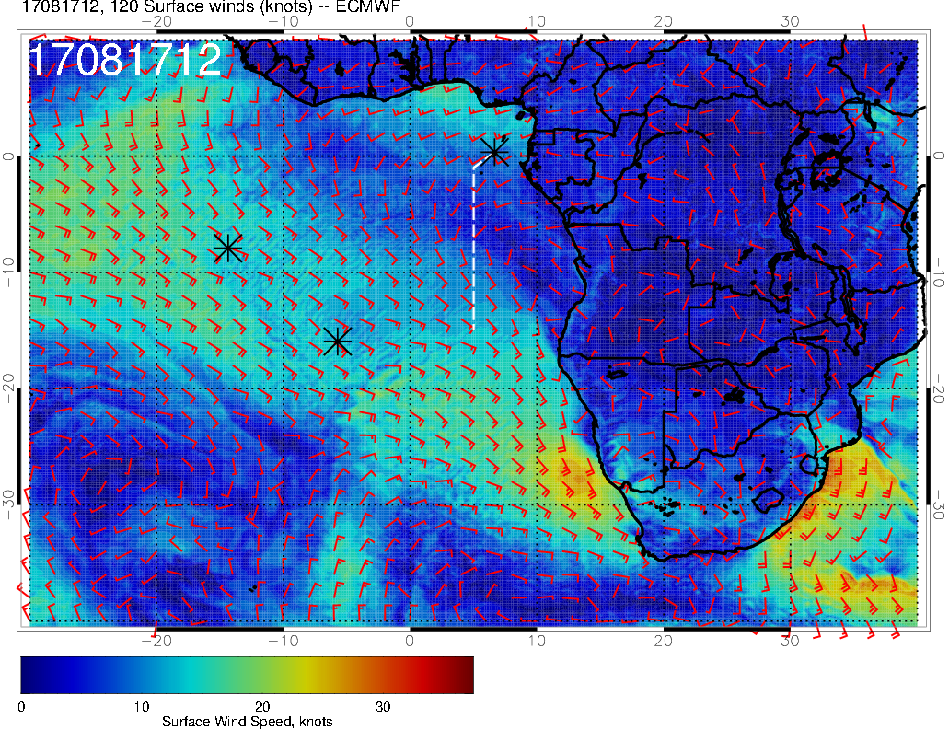
Surface winds
8/16 Wed
8/17 Thu (flight day)
L
H
L
Winds in our flight region continue to weaken
WSW over TMS; SE over ASI
H

Slide 18
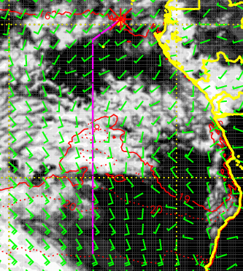
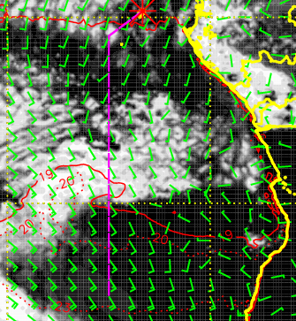
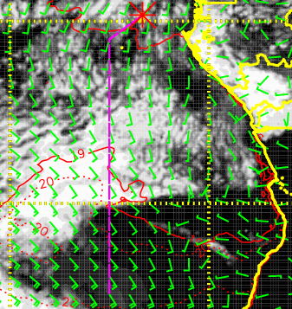
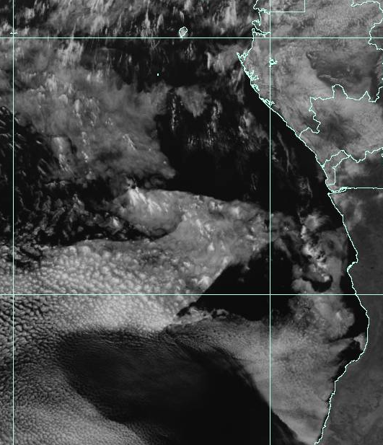
72-hr (very old)
48-hr (old)
24-hr (new)
Cloud forecasts (above) and imagery (right) at 8/12 Sat @ 12PM
Forecasts capture the general picture:
Cloud clearing south of TMS
Low clouds in the middle of the flight track
Larger “cloud-free” region further south
Difficulties:
Exact location of the cloud clearing to the south (related to the speed of the clearing throughout the day)
Low cloud edges (10S model vs. 12S obs)

Slide 19
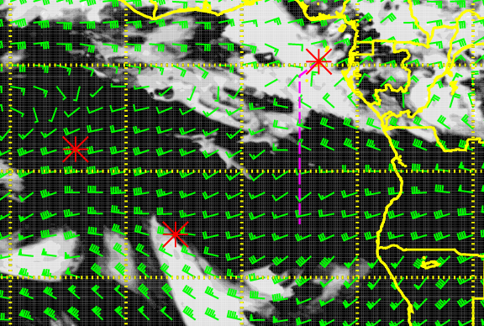
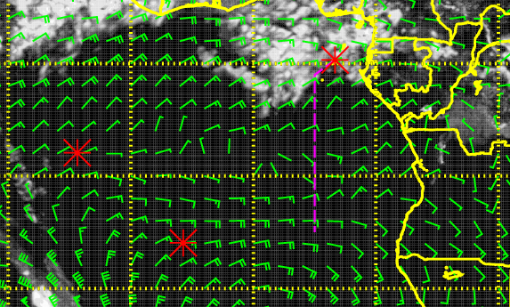
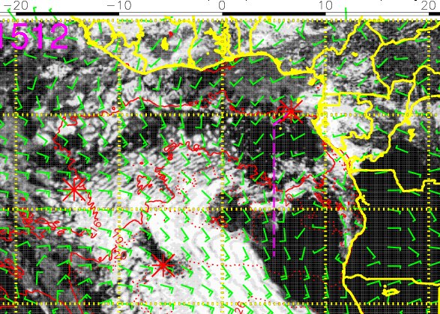
Mid (600mb)
High (200mb)
Cloud forecast (72-hr) for 8/15 Tue @ 12PM
Abundant middle and high clouds north of ~4-5S in our flight region (more than 96-hr forecast)
Low clouds are relatively sparse along the routine flight track with clearing south of TMS
most dense low clouds in the middle of the flight track (exact latitudes uncertain at this time)
Low (sfc)

Slide 20
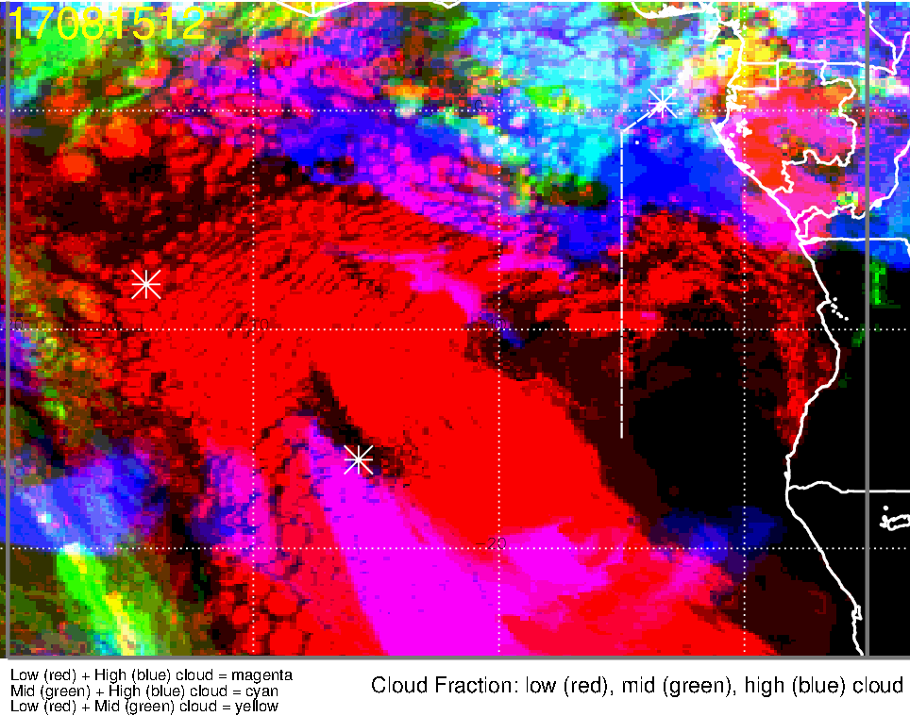
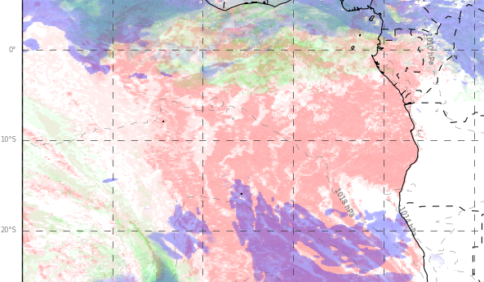
Low, middle, high cloud forecast for 8/15 Tue @ 12PM
ECMWF (72-hr)
UKMO (60-hr)
Mid + high clouds
Mid + high clouds
Model tendencies
Low cloud clearing south of TMS have increased
Middle and high clouds have increased (further south than yesterday’s forecast)

Slide 21
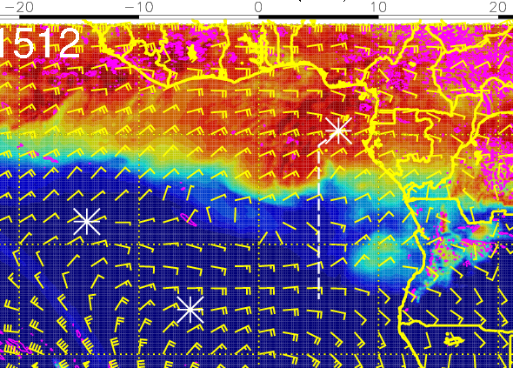
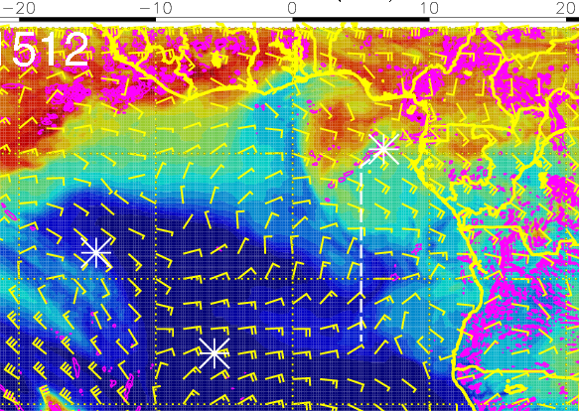
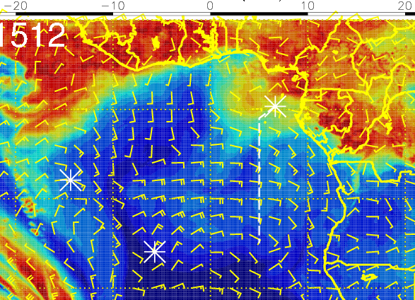
RH (color), winds, vert. velocity (pink) at 8/15 Tue @ 12PM
600 mb
700 mb
Moist air intrusion from the north over TMS is moving westward (faster than 96-hr forecasts)
Moist air north of 5S (mid-high clouds) influenced by moist convection
Air south of 10S (not as moist) suggests plume transport from dry convection
800 mb

Slide 22
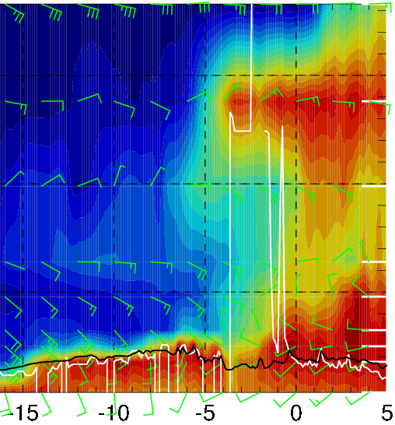
RH (color), wind, BL and cloud base heights along 5E, 8/15 Tue @ 12PM
20-35 knts
Wind shift
10-15 knts
5-15 knts
High RH at 600 and 700mb north of 5S (influenced by moist convection)
Easterly crosswinds above 5000ft, but winds shift from SE to NE across 5S along the flight track at 700mb ~10kft
Mid and high clouds north of ~4S

Slide 23
Tuesday 8/15
Given the large amounts of middle and high clouds in the morning (and the dependence of surface temperatures on cloud cover), takeoff temperatures should not be an issue
Low cloud clearing south of TMS leads to relatively sparse low clouds throughout the routine flight track (most dense near the middle of the flight track ~10S)
Abundant middle and high clouds north of ~4-5S
Moist air north of 5S (mid-high clouds) influenced by moist convection
Moist air south of ~10S suggests plume transport from dry convection
Wind shifts across 5S
SE to NE at 10 kft
WSW to S (SSE) below 2-3 kft

