Slide 1
ORACLES Forecast Briefing (Aerosols)
13 August 2017

Slide 2
Sunday update

Slide 3
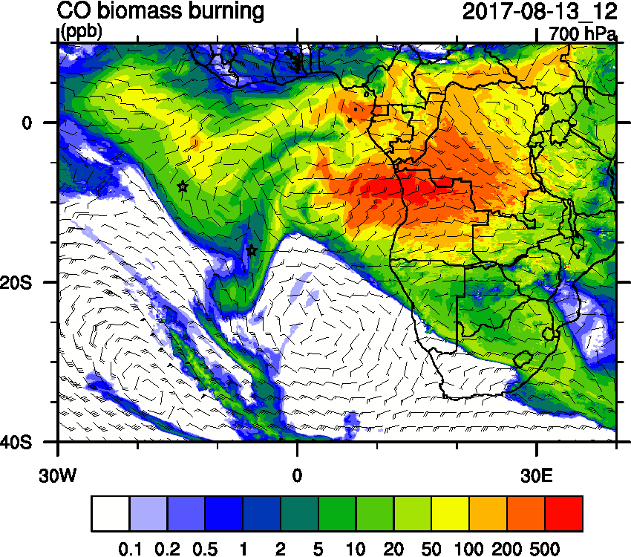
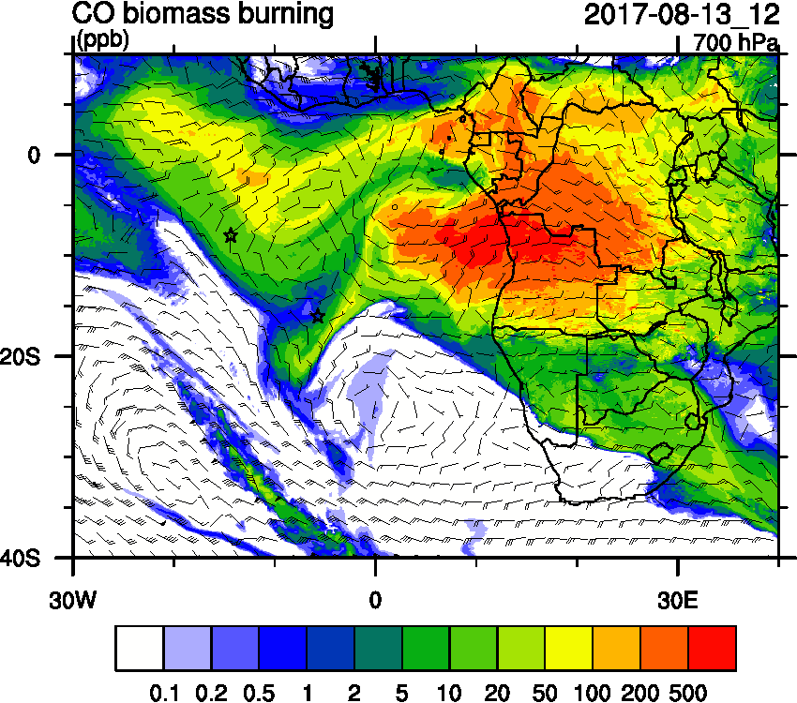
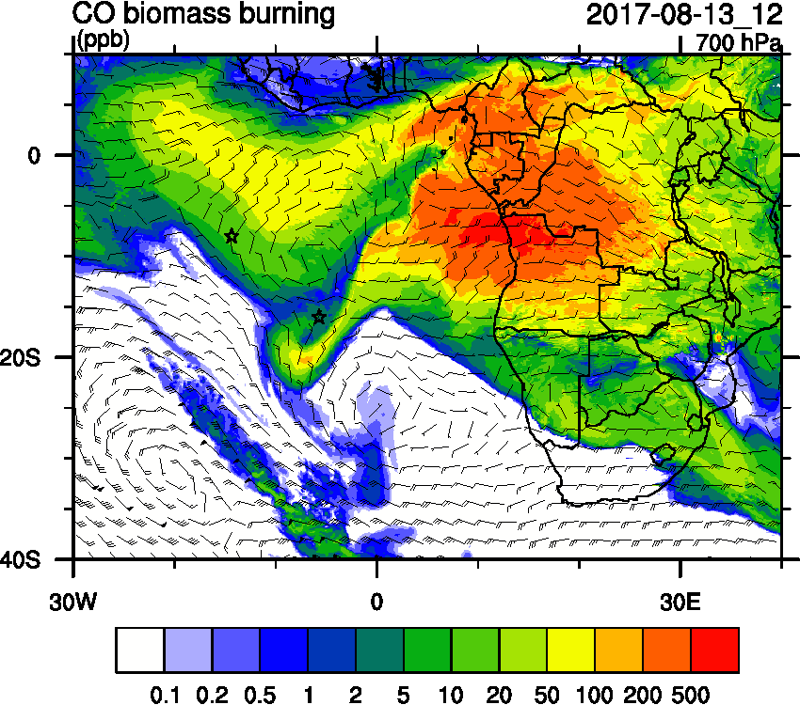
Sunday August 13 (12z) WRF-AAM
OLD
OLDest

Slide 4
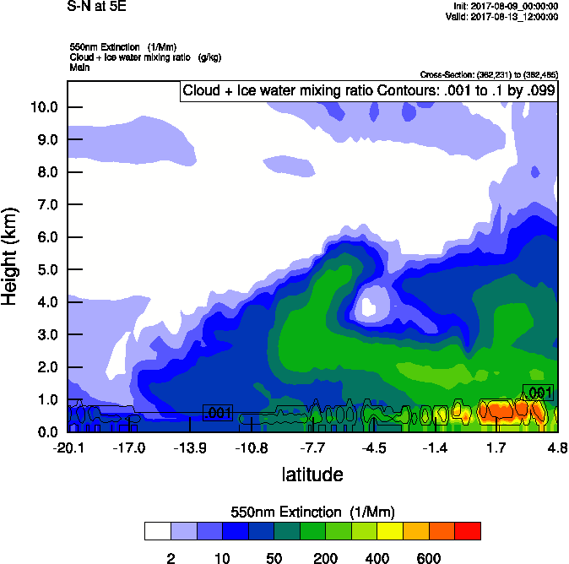
Sunday August 13 (12z) WRF-AAM flight day
OLD
OLDest

Slide 5
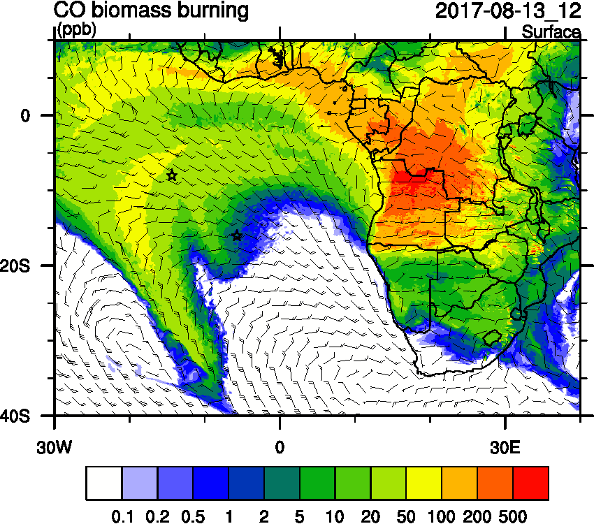
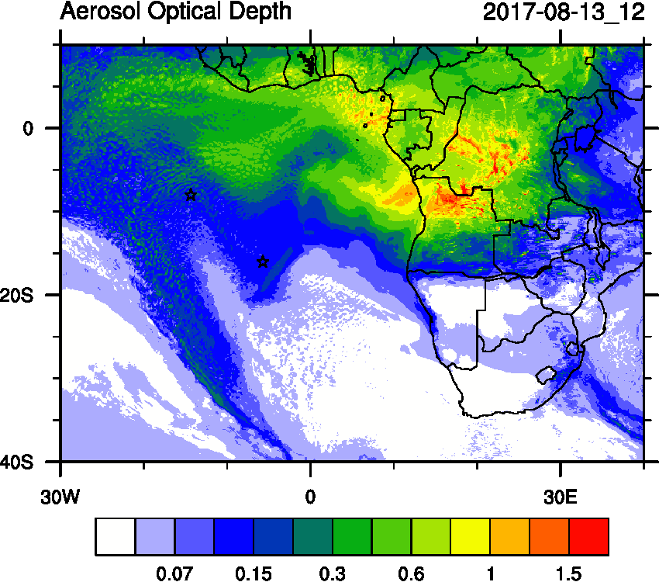
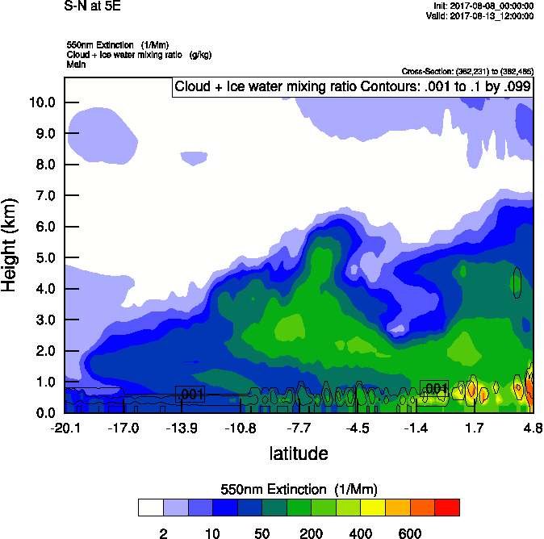
Sunday August 13 (12z) WRF-AAM OLD

Slide 6
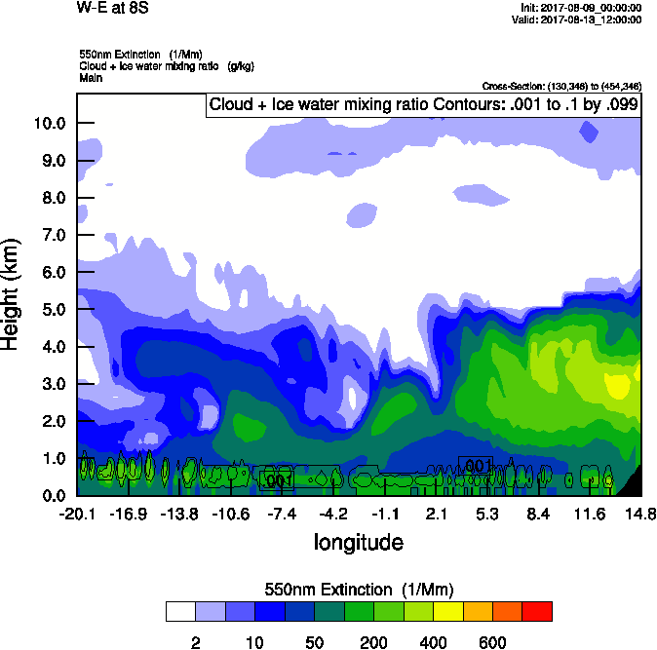
Sunday August 13 (12z) WRF-AAM flight day
OLD
8S
OLDest

Slide 7
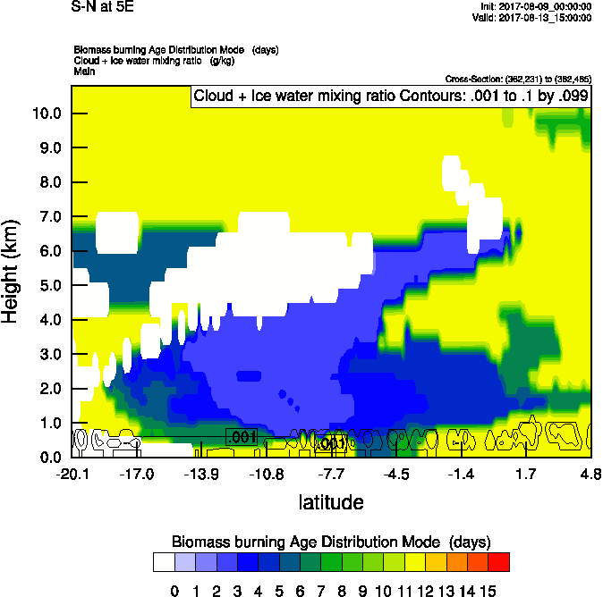
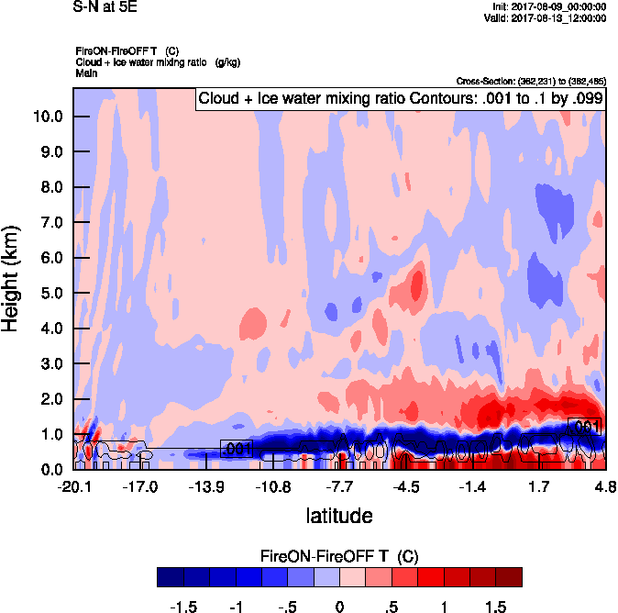
Sunday August 13 (12z) WRF-AAM flight day
OLD
OLDest

Slide 8
Sunday August 13 (12z) WRF-AAM flight day
OLD
OLDest

Slide 9
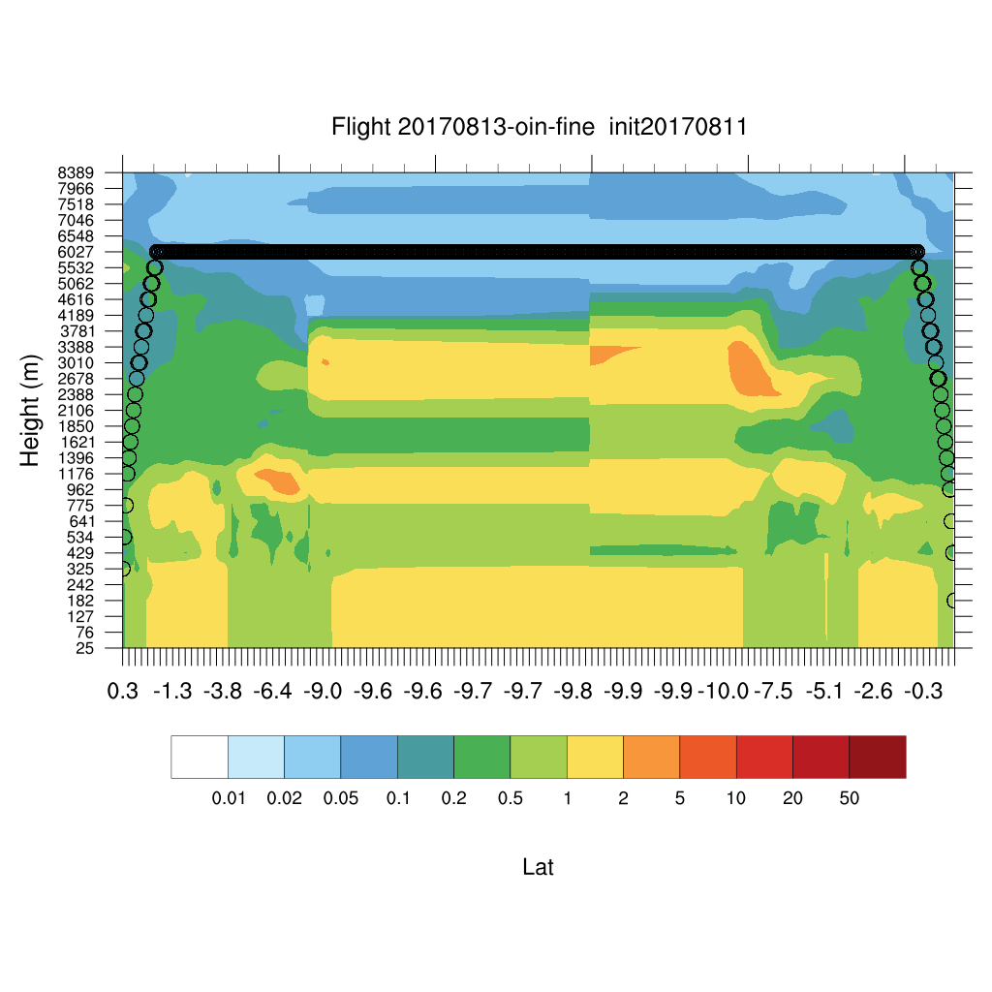
Sunday August 13 (12z) WRF-AAM

Slide 11
08/13 Sun (48h) 08/14 Mon(72h) 08/15 Tue(96h)
Sun - Tues August 13-15 12z GEOS-5
08/11 12Z
08/13 Sun (24h) 08/14 Mon(48h) 08/15 Tue(72h)
08/12 12Z

Slide 12
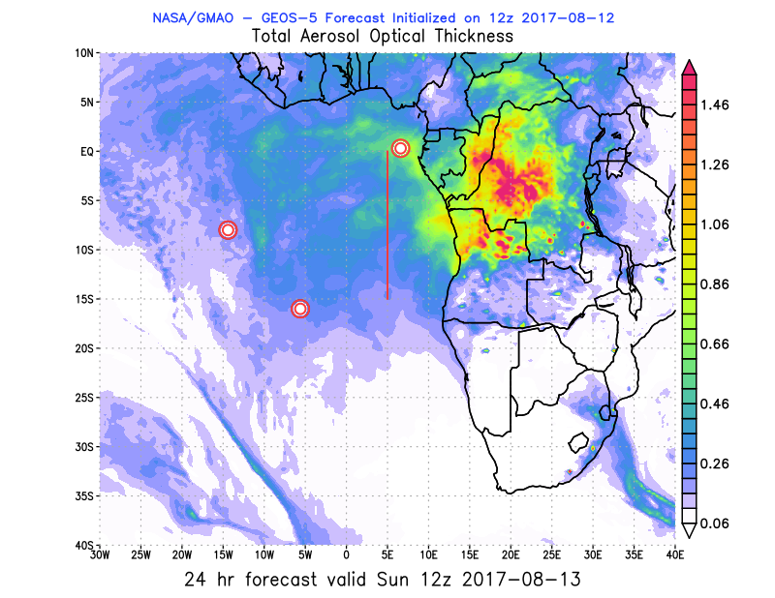
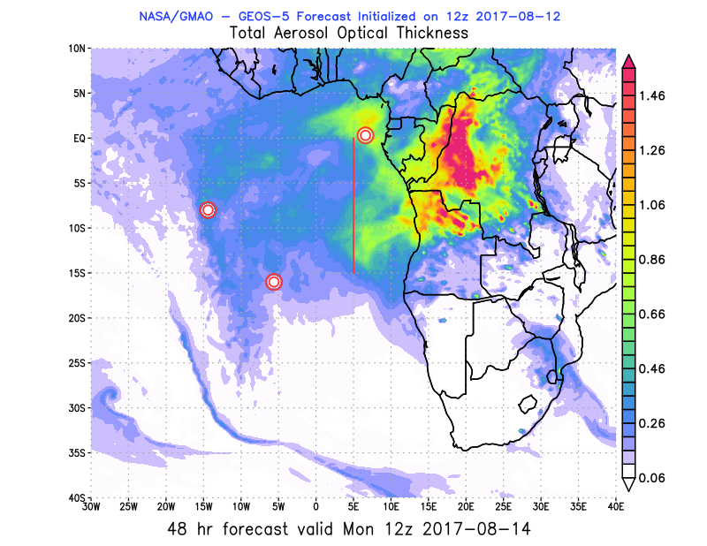
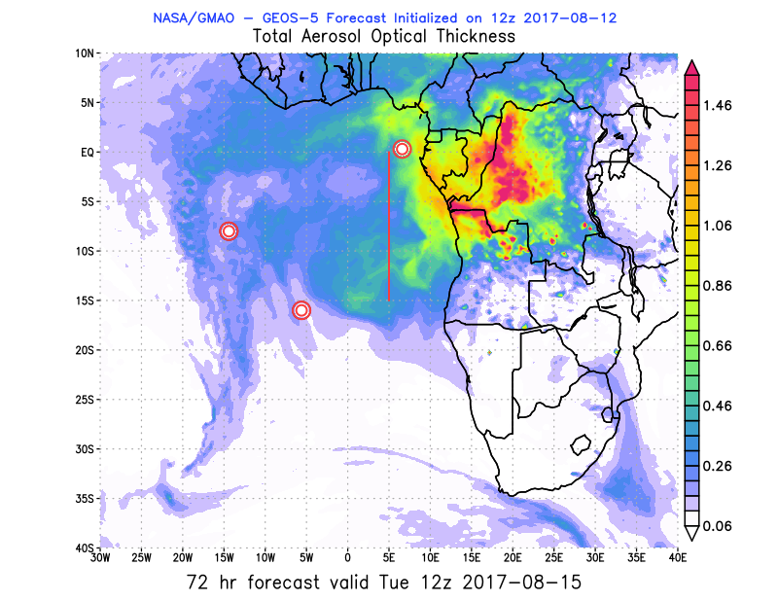
08/13 Sun (24h) 08/14 Mon(48h) 08/15 Tue(72h)
Sun - Tues August 13-15 12z GEOS-5/CAMS
08/12 12Z
08/13 Sun (36h) 08/14 Mon(60h) 08/15 Tue(84h)
08/12 00Z

Slide 13
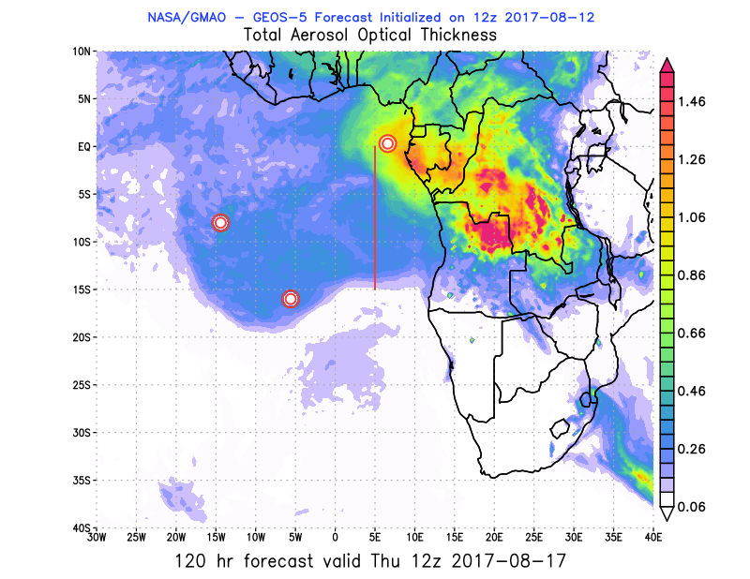
08/16 Wed (96h) 08/17 Thu(120h)
Wed-Thur August 16-17 12z GEOS-5/CAMS
08/12 12Z
08/16 Wed(108h)
08/12 00Z

Slide 14
08/11 12Z 08/13 Sun (48h) 08/14 Mon(72h) 08/15 Tue(96h)
Sun - Tues August 13-15 12z GEOS-5

Slide 15
08/12 12Z 08/13 Sun (24h) 08/14 Mon(48h) 08/15 Tue(72h)
Sun - Tues August 13-15 12z GEOS-5

Slide 16
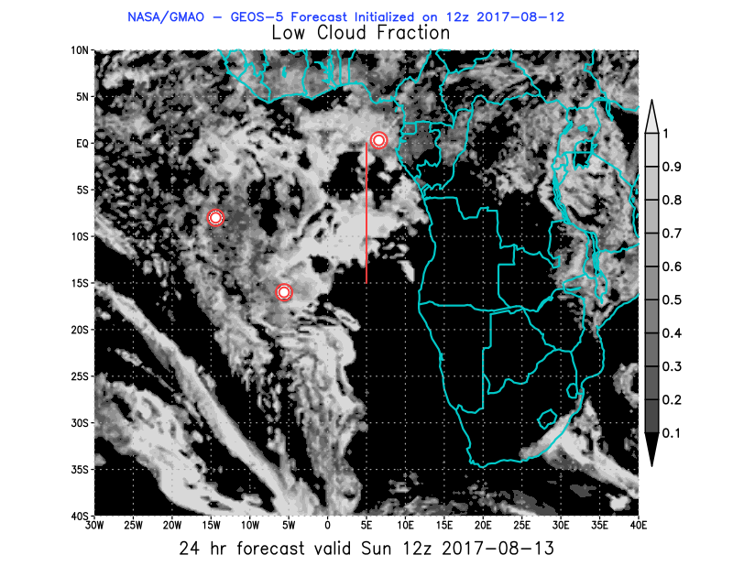
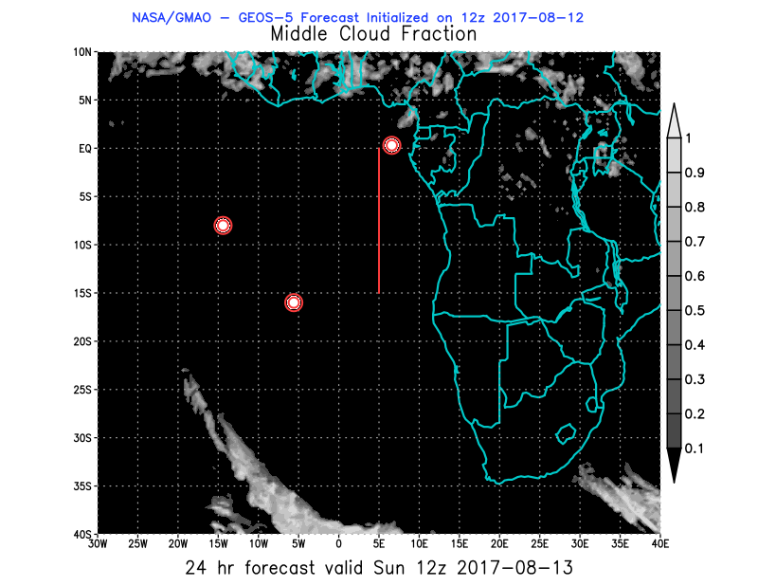
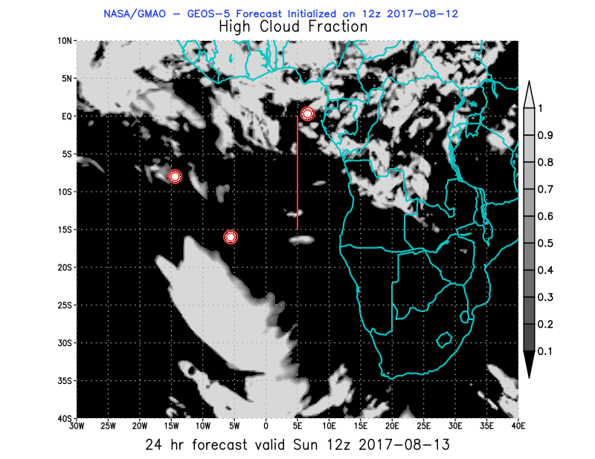
08/13 Sun (24h) GEOS-5 850 hPa 700hPa 600 hPa
08/12 12Z

Slide 17
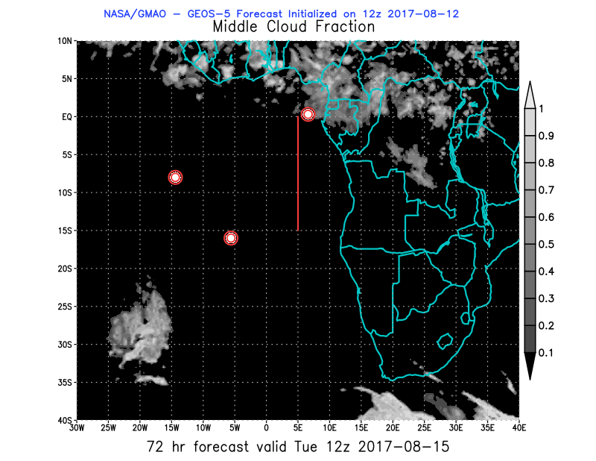
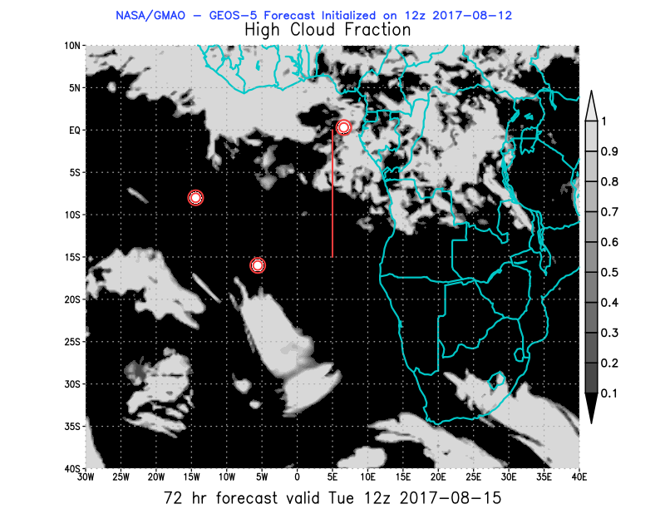
08/15 Tue (72h) GEOS-5 850 hPa 700hPa 600 hPa
08/12 12Z

Slide 18
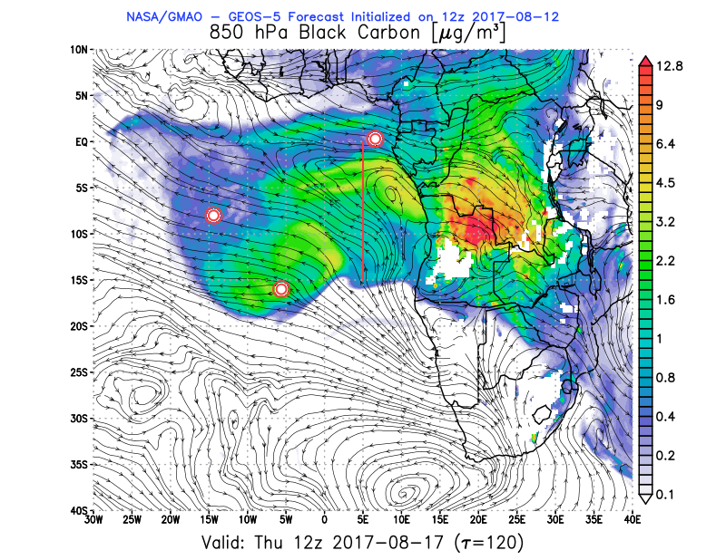
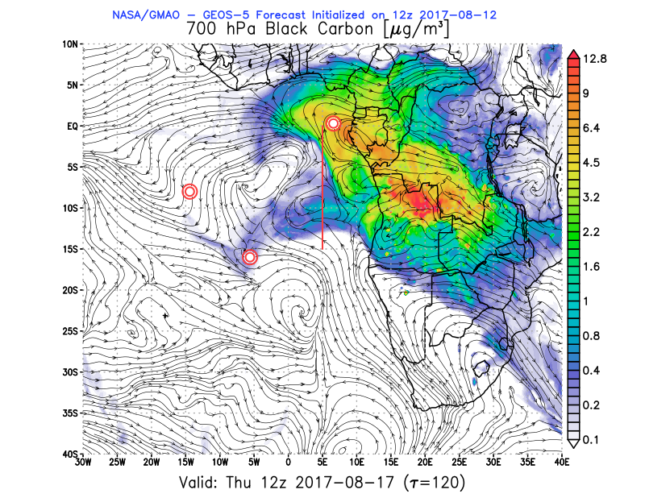
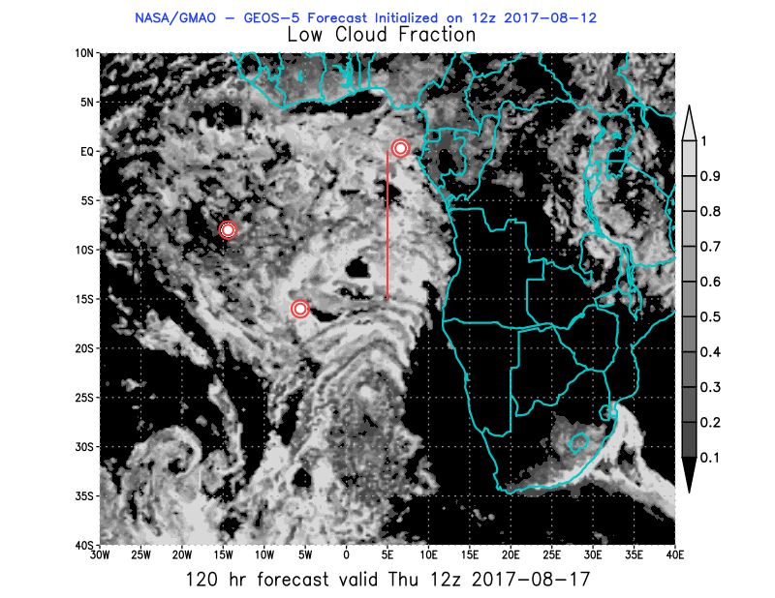
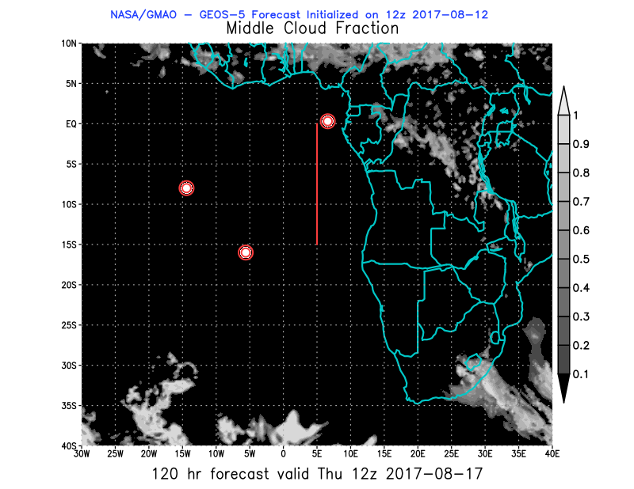
08/17 Thu (120h) GEOS-5 850 hPa 700hPa 600 hPa
08/12 12Z

Slide 19
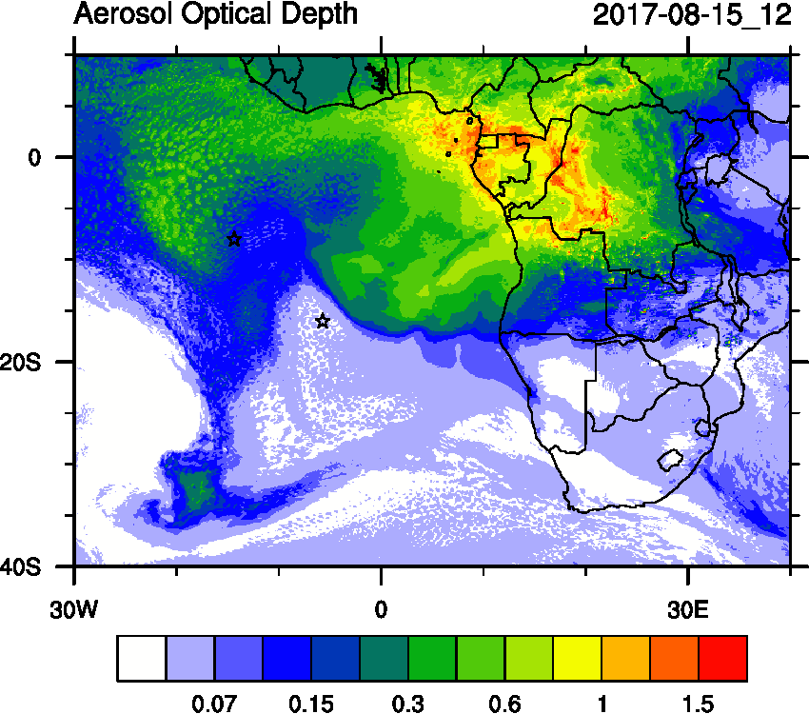
Tuesday August 15 12z

Slide 20
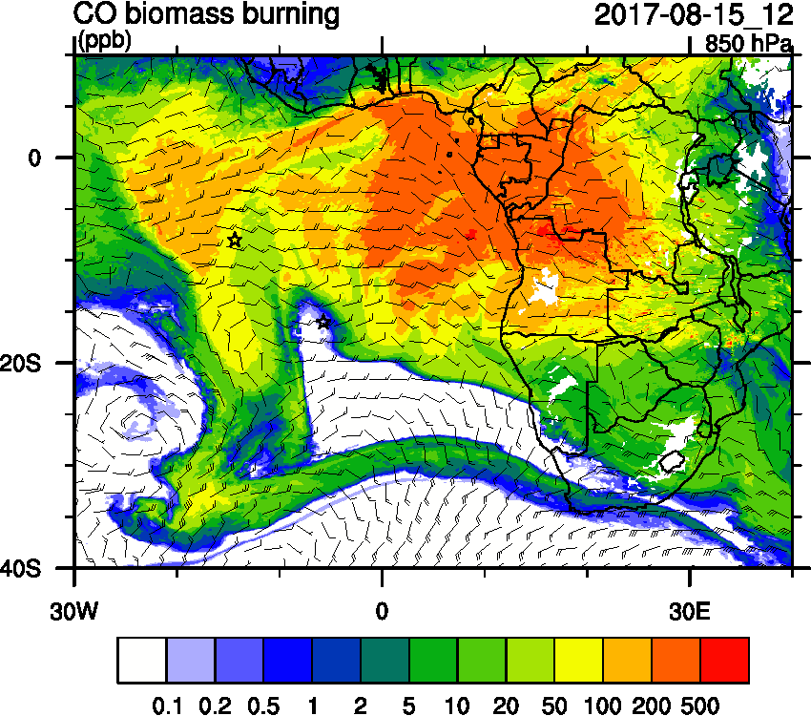
Tuesday August 15 12z WRF-AAM

Slide 21
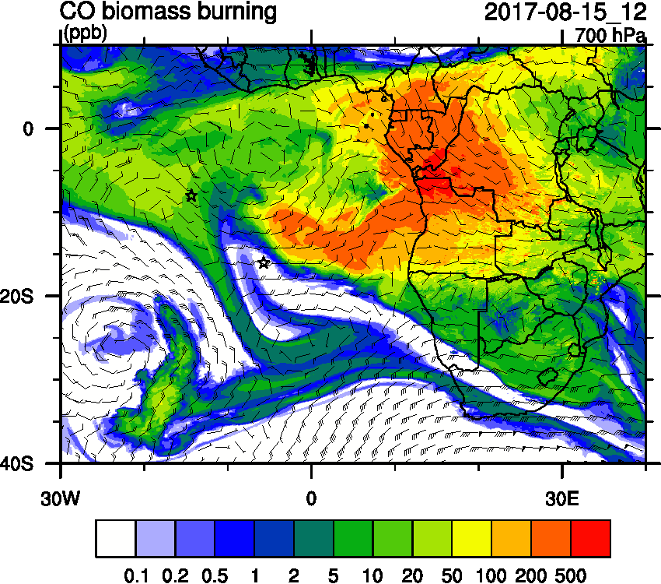
Tuesday August 15 12z WRF-AAM

Slide 22
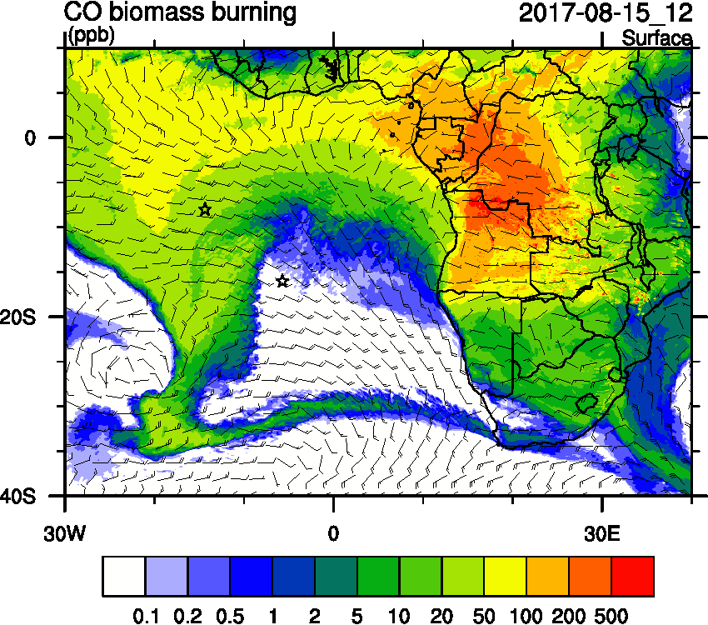
Tuesday August 15 12z WRF-AAM

Slide 23
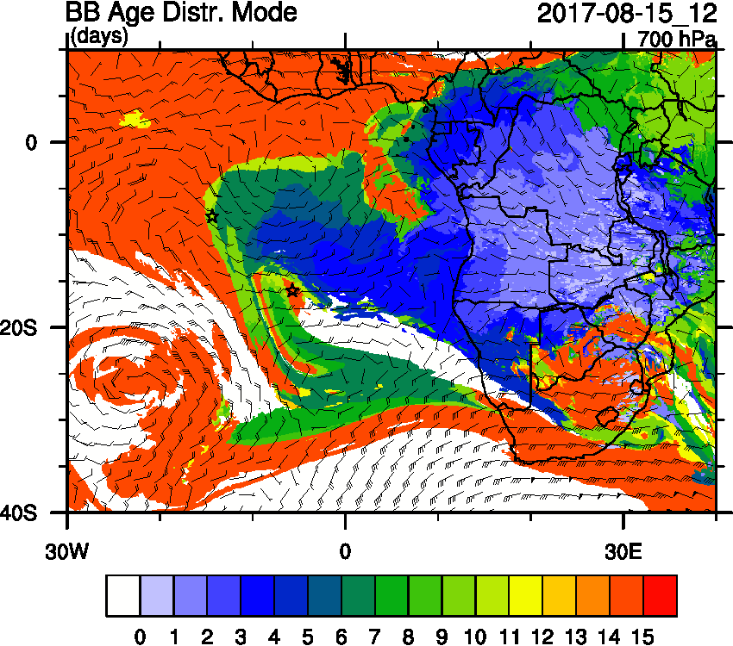
Tuesday August 15 12z WRF-AAM

Slide 24
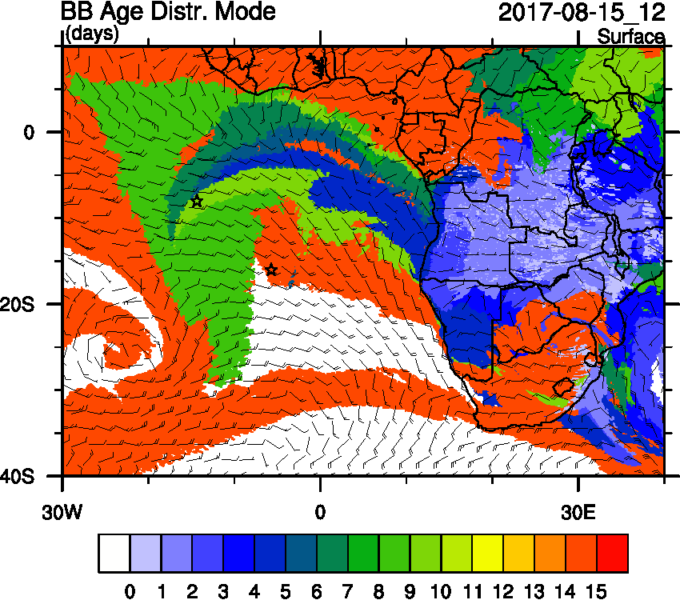
Tuesday August 15 12z WRF-AAM

Slide 25
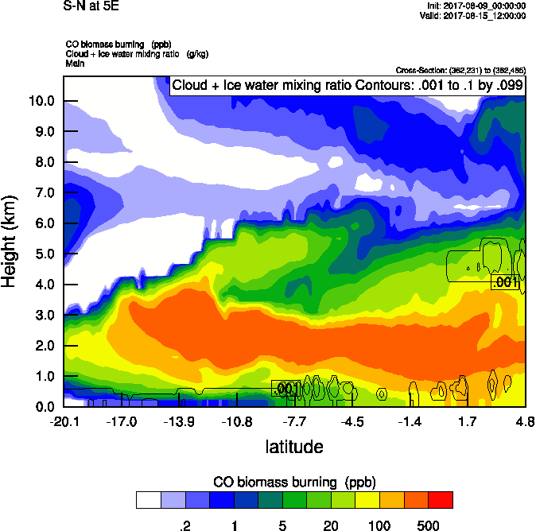
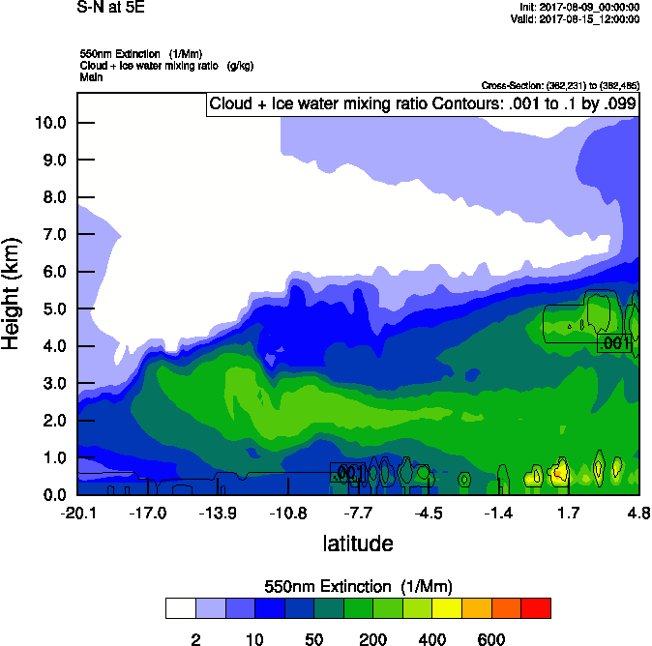
Tuesday August 15 12z WRF-AAM

Slide 26
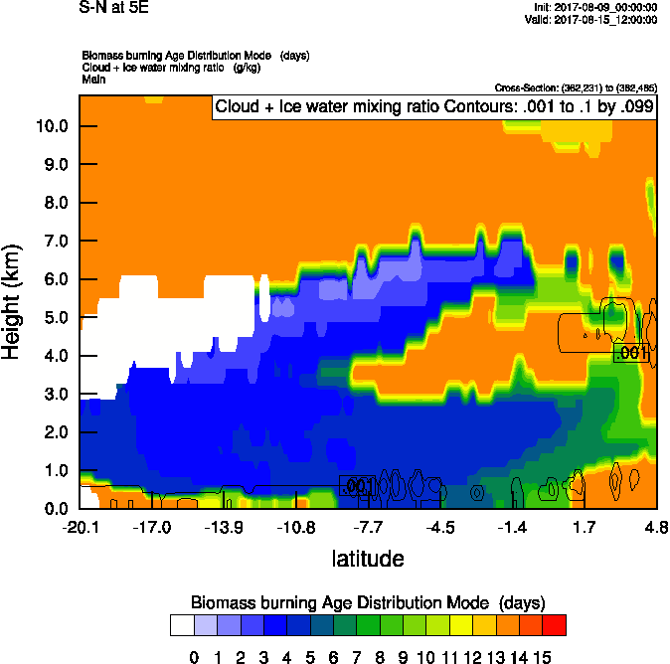
Tuesday August 15 12z WRF-AAM

Slide 27
Tuesday August 15 12z WRF-AAM

Slide 28
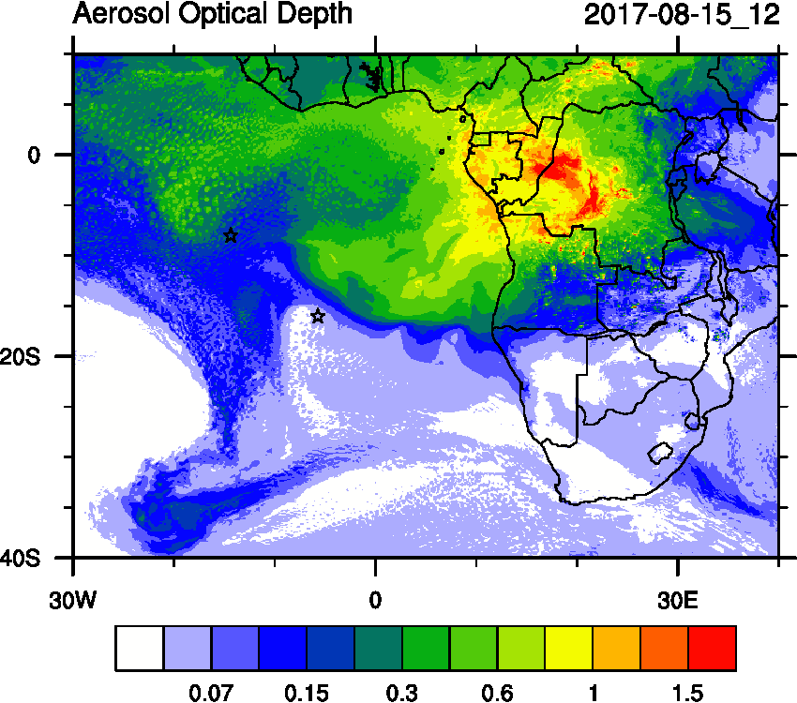
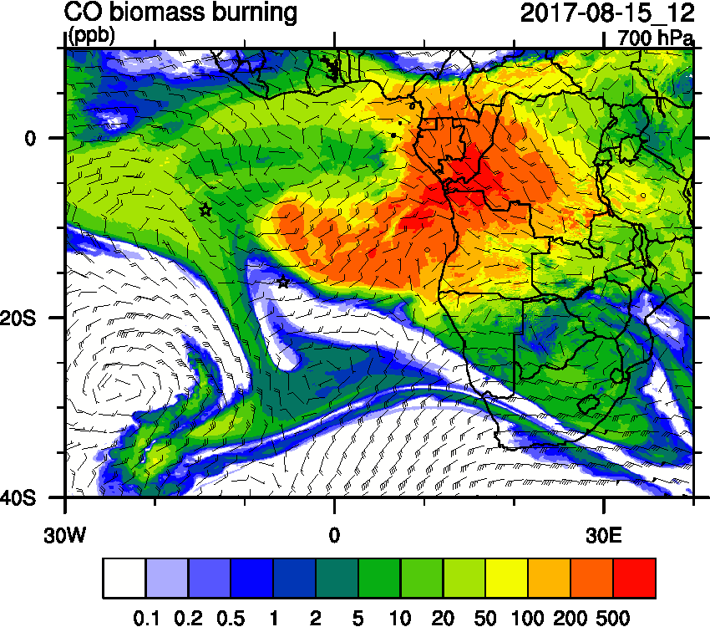
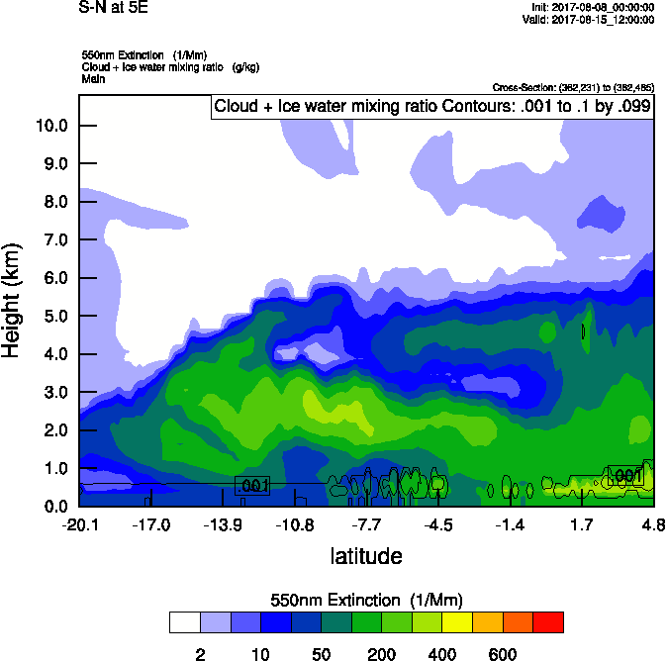
Tuesday August 15 (12z) WRF-AAM (OLD)

Slide 29
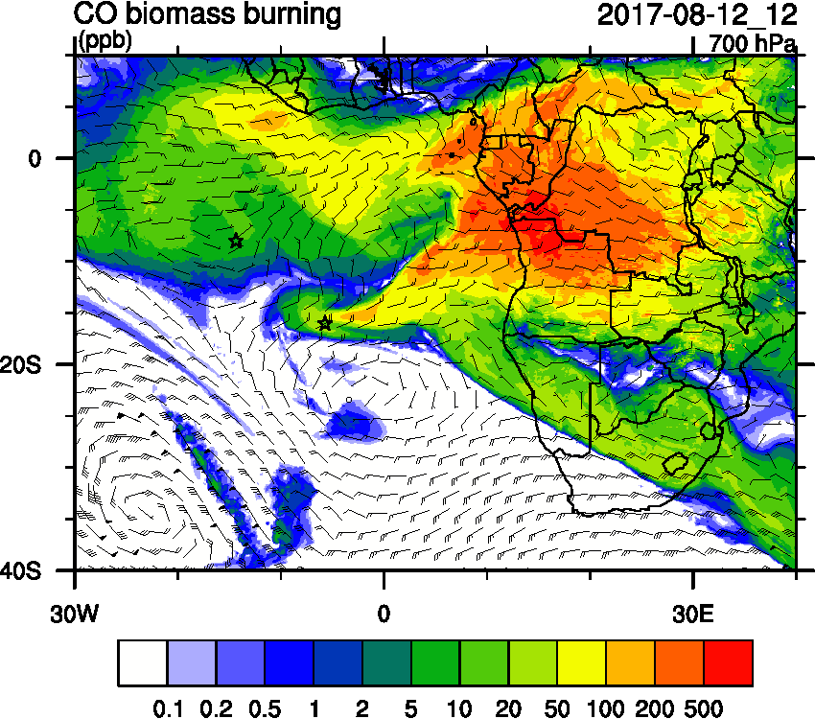
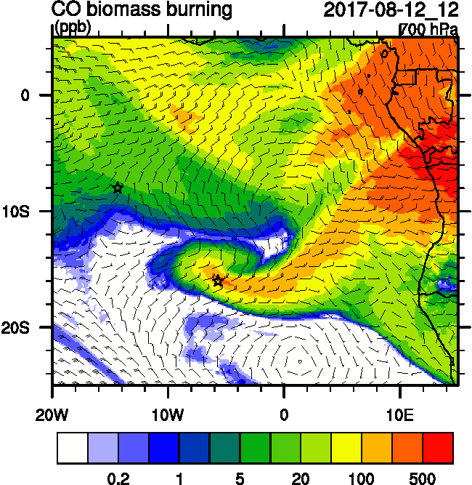
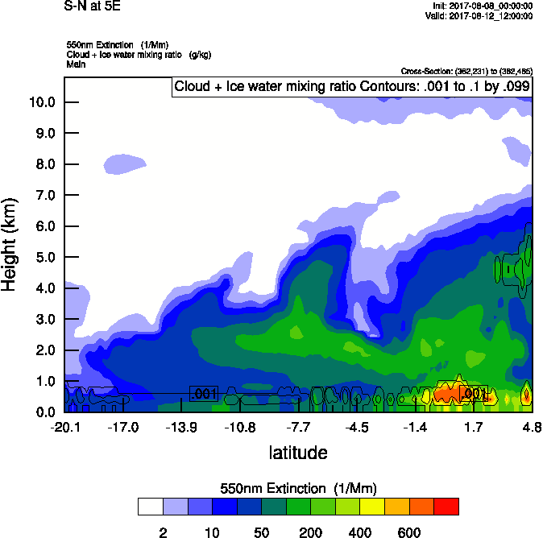
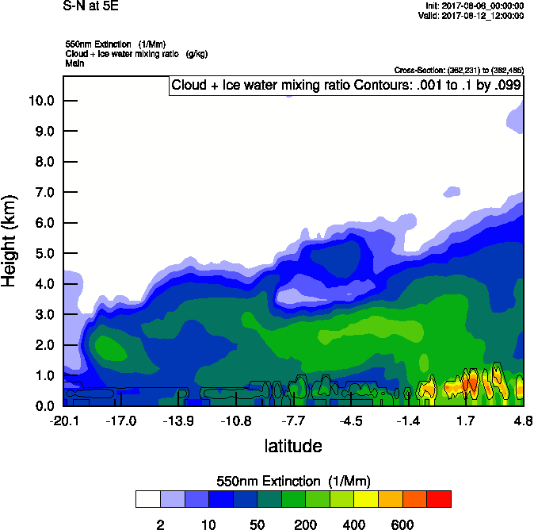
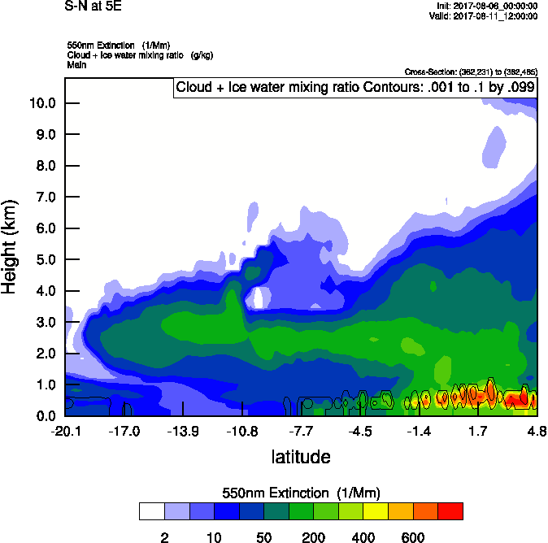
Saturday August 12 (12z) WRF-AAM

Slide 30
Sunday August 13 (12z) WRF-AAM

Slide 31
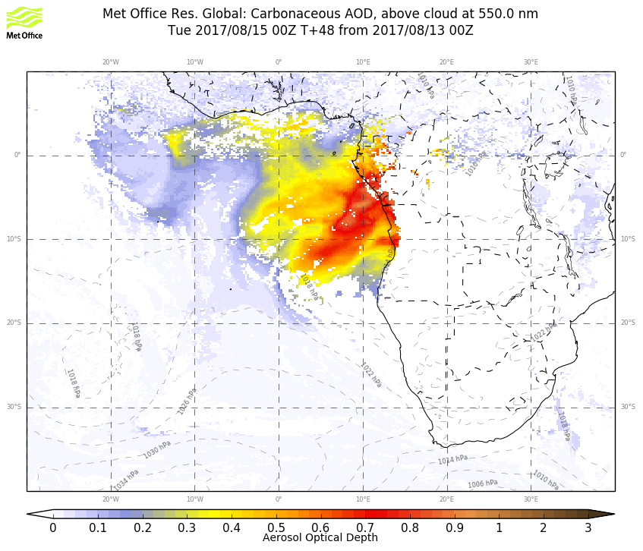
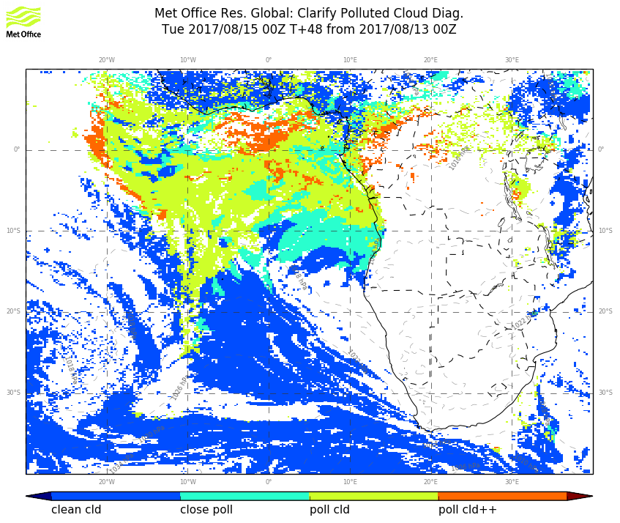
UKMO Tuesday August 15 12z

Slide 32
BC AOD 08/12-17

Slide 33
Ascension São Tomé e Príncipe Sta Helena

Slide 34
end

Slide 35
Tuesday August 15 12z

Slide 36
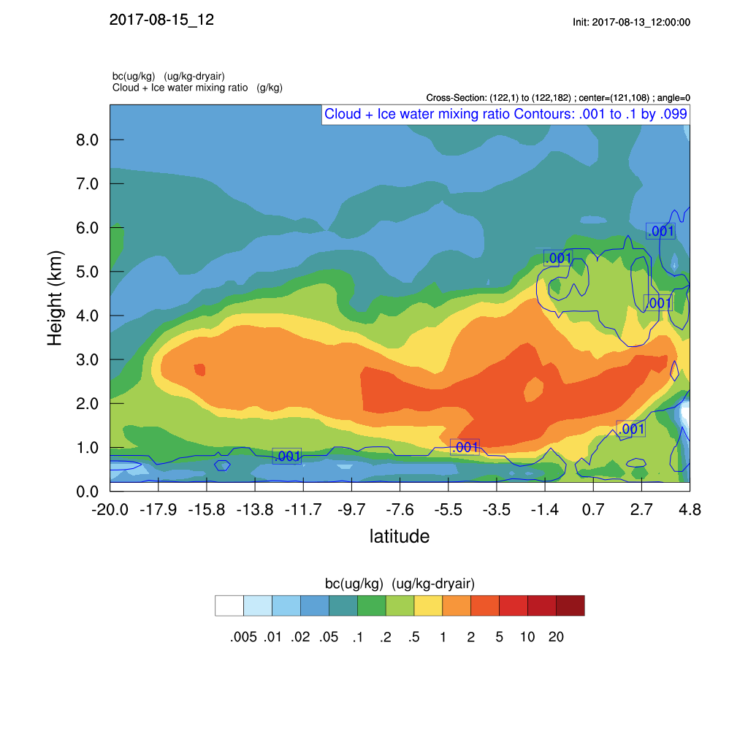
Tuesday August 15 12z

Slide 38
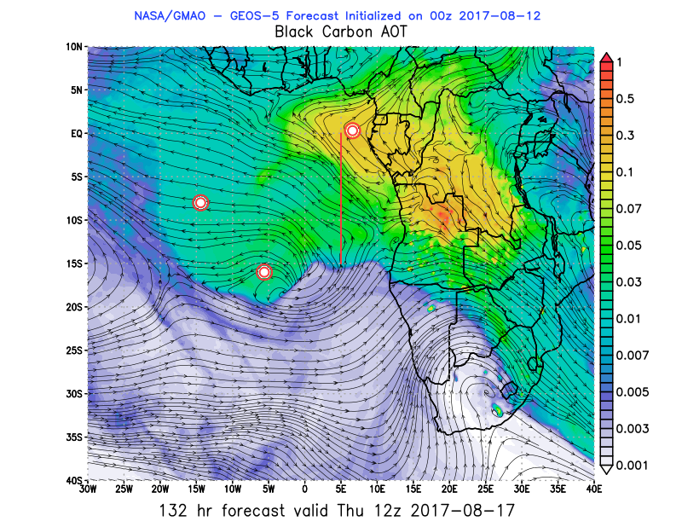
Tuesday Thursday, Fri, Sat 12z GEOS-5

Slide 39
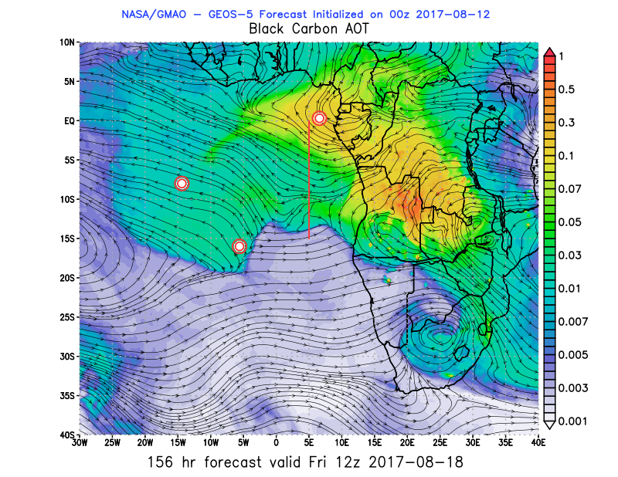
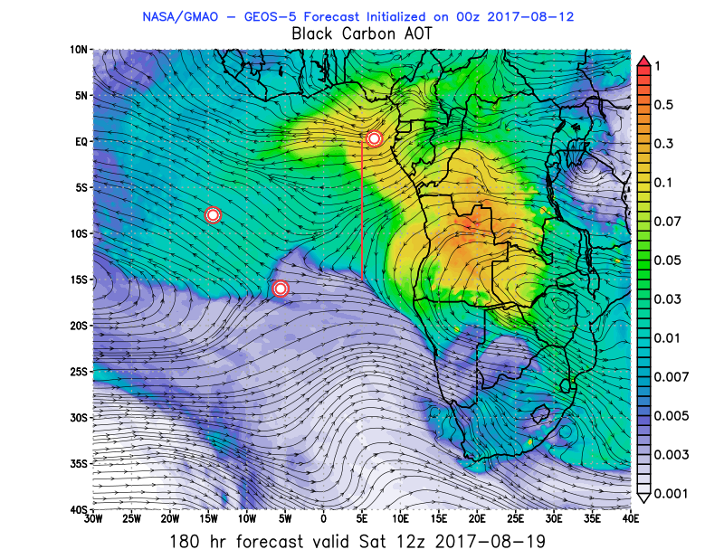
Tuesday Thursday, Fri, Sat 12z GEOS-5

