Slide 1
ORACLES weather briefing
12-Aug-2017
Lenny Pfister and Rei Ueyama

Slide 2
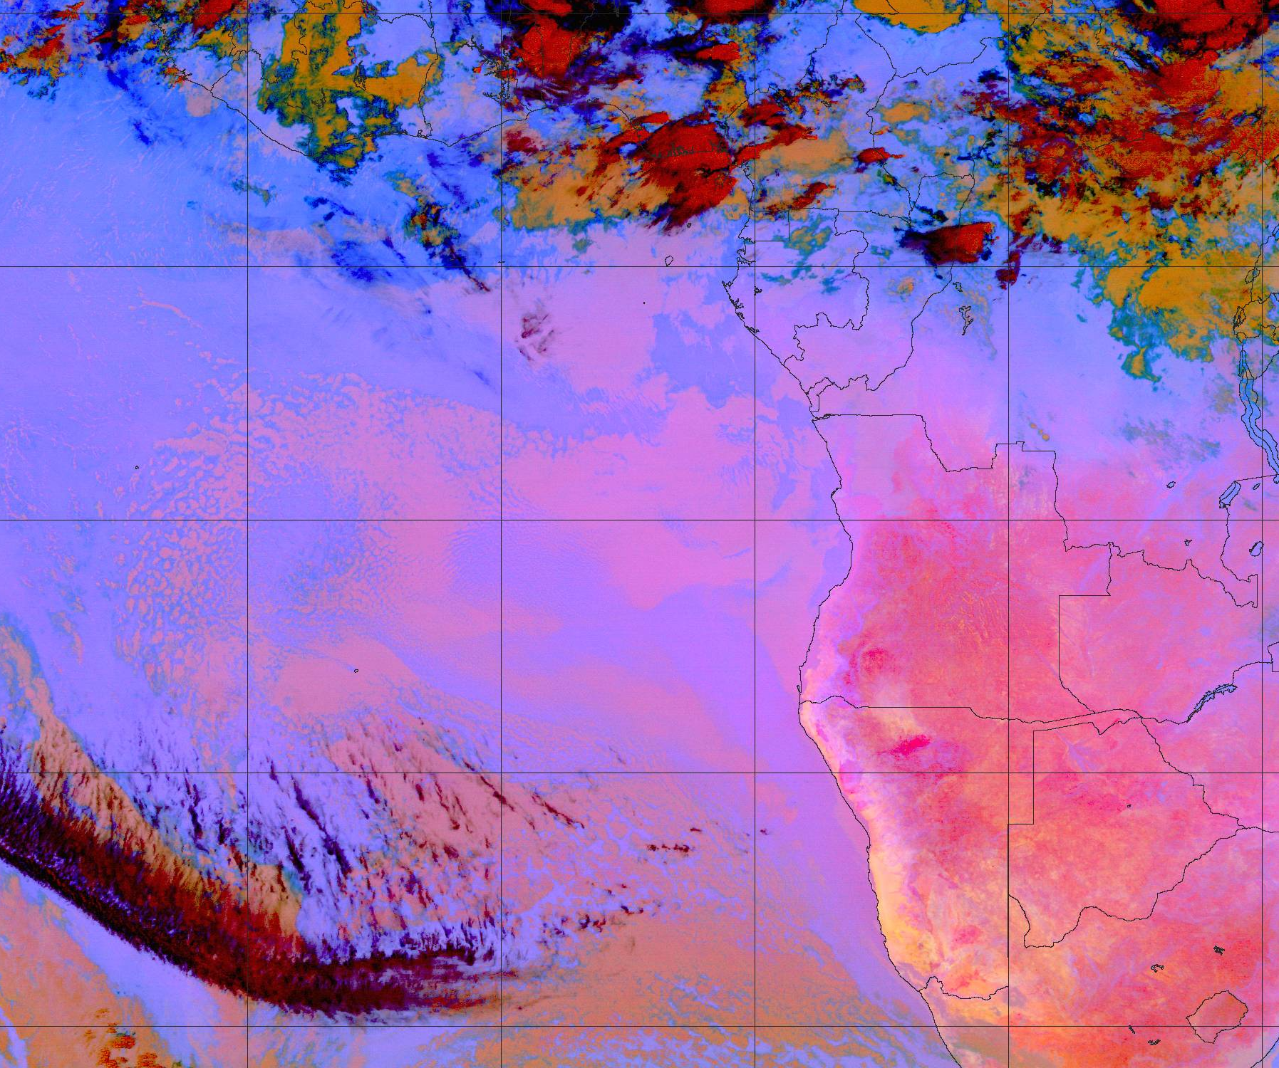
Satellite (enhanced IR) imagery on 8/12 Sat @ 5:15AM

Slide 3
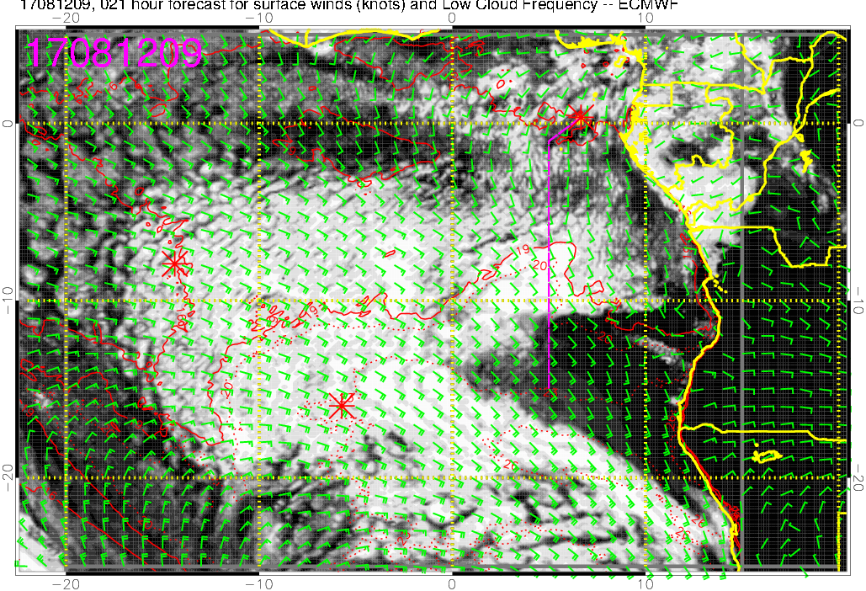
Low cloud forecast on 8/12 Sat @ 9AM
Some middle + high clouds (burn off during the day)
These “gaps” at 3AM were well simulated

Slide 4
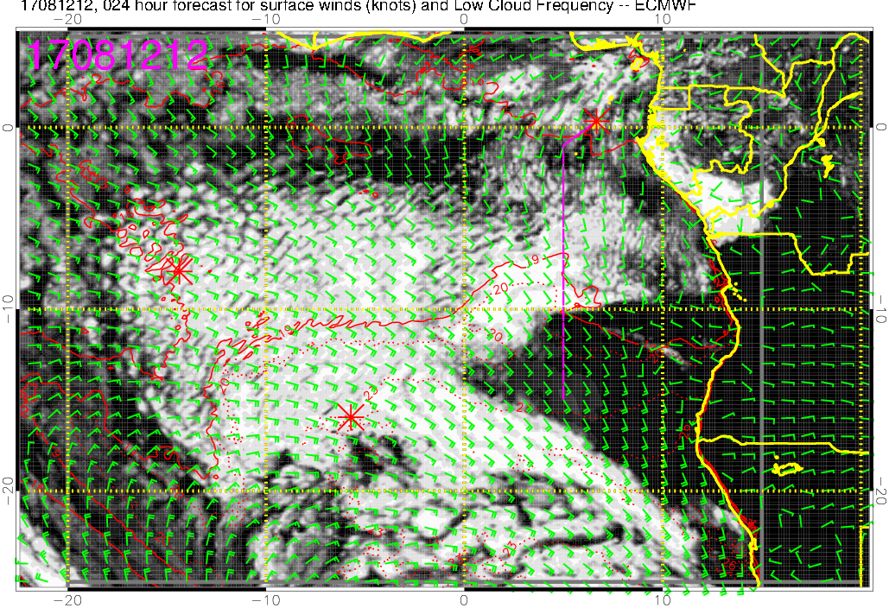
Low cloud forecast on 8/12 Sat @ 12PM
middle + high clouds north of TMS
Clouds burning off
Very thin high cloud “streamer” at 4S on our flight track (UKMO forecasts these at 9AM but not at 12PM)
this northern edge has moved (and continues to move) northward
** scattered low clouds TMS to 5S (may burn off faster than shown here)
** dense low clouds 5-10S

Slide 5
Saturday 8/12
TAF (until 6am tomorrow 8/13)
Winds: S 8 knots
Clouds: few 2000ft, scattered 4000ft, broken 11000ft
Low clouds expected down to 10S but scattered clouds from TMS to ~5S may burn off faster than forecasted (as happened yesterday)
Most dense low clouds 5-10S
High and middle clouds will likely NOT be a problem (mostly to the north of TMS)

