Slide 1
ORACLES weather briefing
12-Aug-2017
Lenny Pfister and Rei Ueyama

Slide 2
Sunday

Slide 3
Vis, noon yesterday
IR, noon yesterday
Forecast clearly underestimates cloud clearing we
had yesterday.
Fcast we had for noon yesterday at a Thursday brief

Slide 4
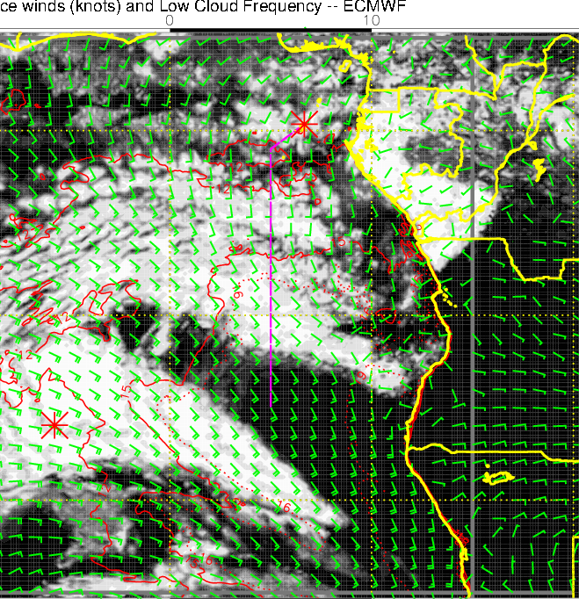
Vis, noon yesterday
IR, noon yesterday
More recent (24 hour) forecast is even worse
Fcast we had for noon yesterday at what would have been ystdy’s brief

Slide 5
Vis, noon yesterday
IR, noon yesterday
At least the 0 hour “forecast” gets it.
0 houe Forecast today

Slide 6
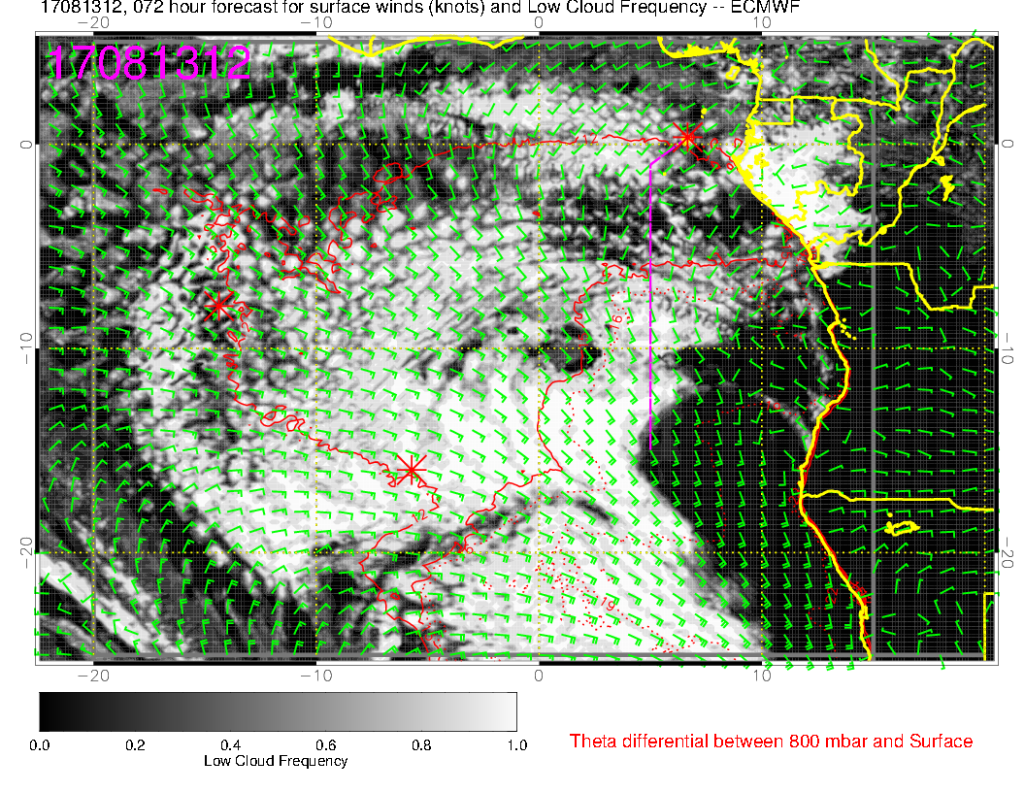
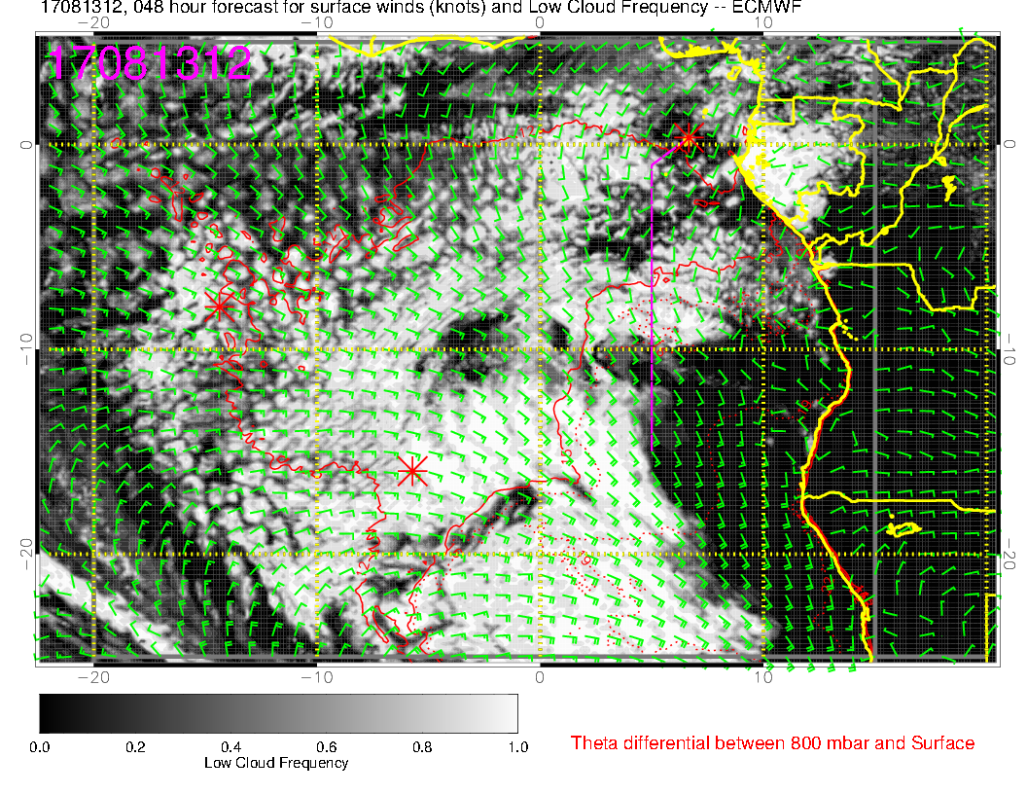
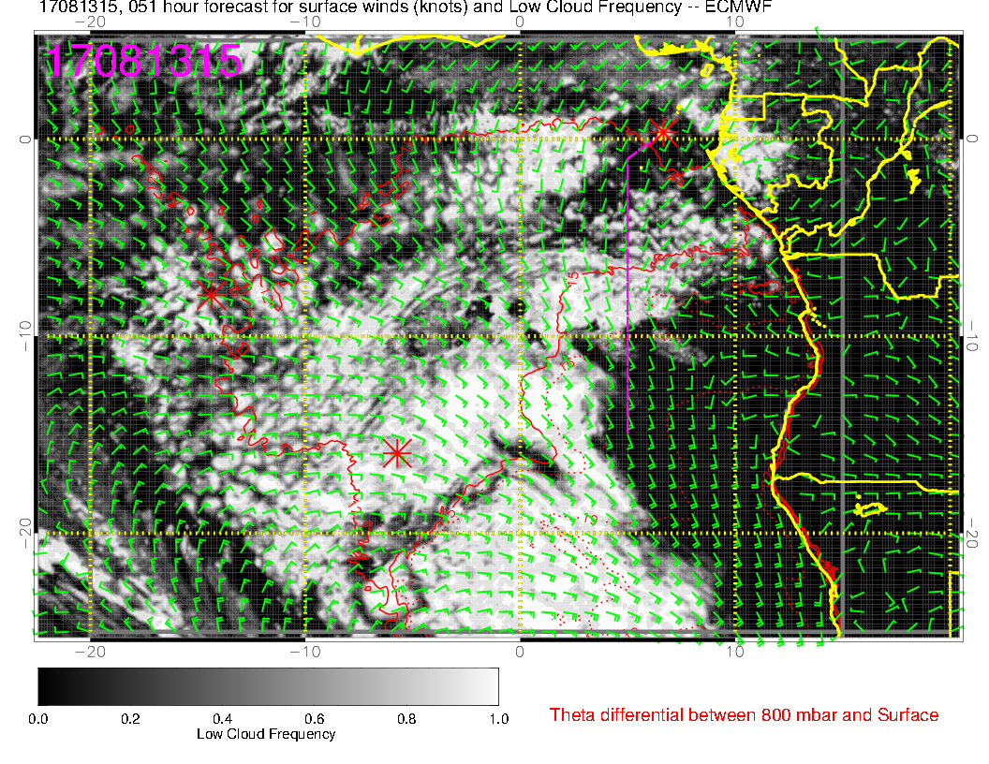
10S
SUNDAY, new, noon
Sunday, old, noon
The model is having trouble getting the rapid diurnal cloud clearing right. I think we will find reliable low cloud at the latitudes of TMS, and south of about 5-10. This is based on the diurnal cycle we have observed. The gap will be bigger than this forecast shows
SUNDAY, new, 3 PM

Slide 7
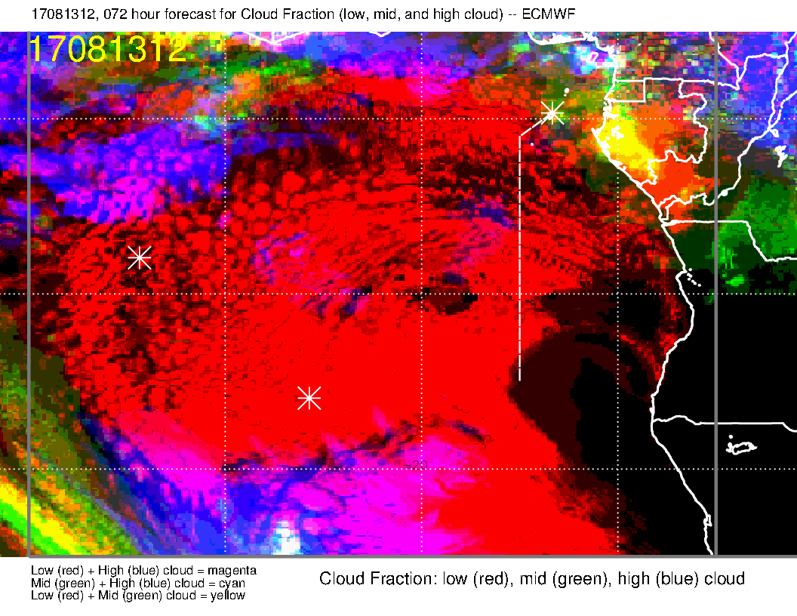
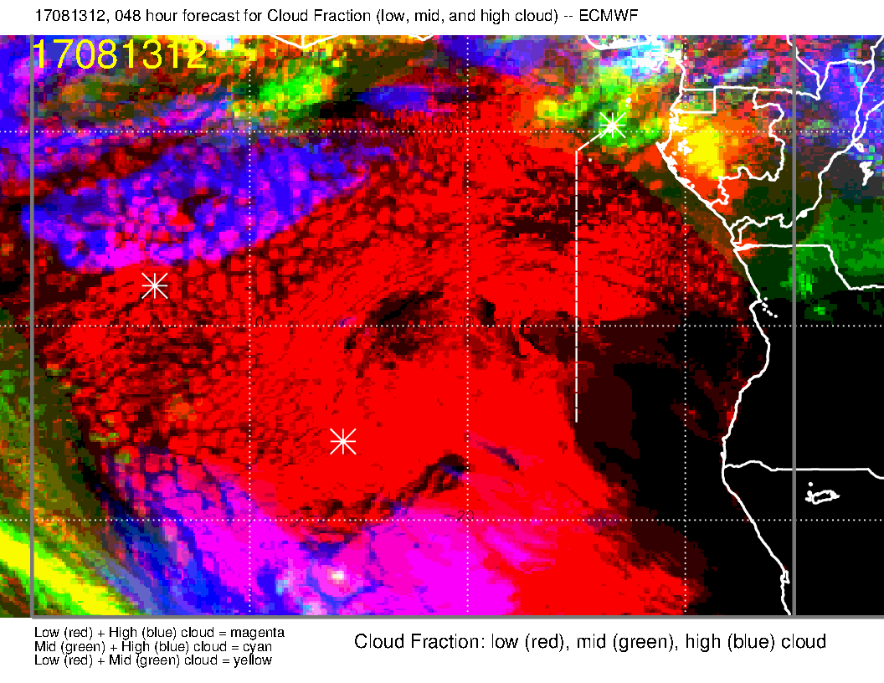
SUNDAY, very old
Sunday, old
We see middle cloud moving in from the northeast, more than previous forecast.
Sunday, latest
SUNDAY, old

Slide 8
Old forecast
Latest forecast
UKMO also shows more middle and high cloud, but
not in the same place.

Slide 9
SUNDAY, very old
Sunday, old
UKMO, Sunday
Unfortunately, the models disagree on the exact placement of the middle cloud. So, it is hard to guarantee that we can work the northern body of low cloud.
Sunday, latest
SUNDAY, old

Slide 10
900mb wind
Surface wind
925mb wind
Surface winds to south weaker than typical. At higher levels in the BL, they are desultory (technical term). To west pattern is more consistent with altitude

Slide 11
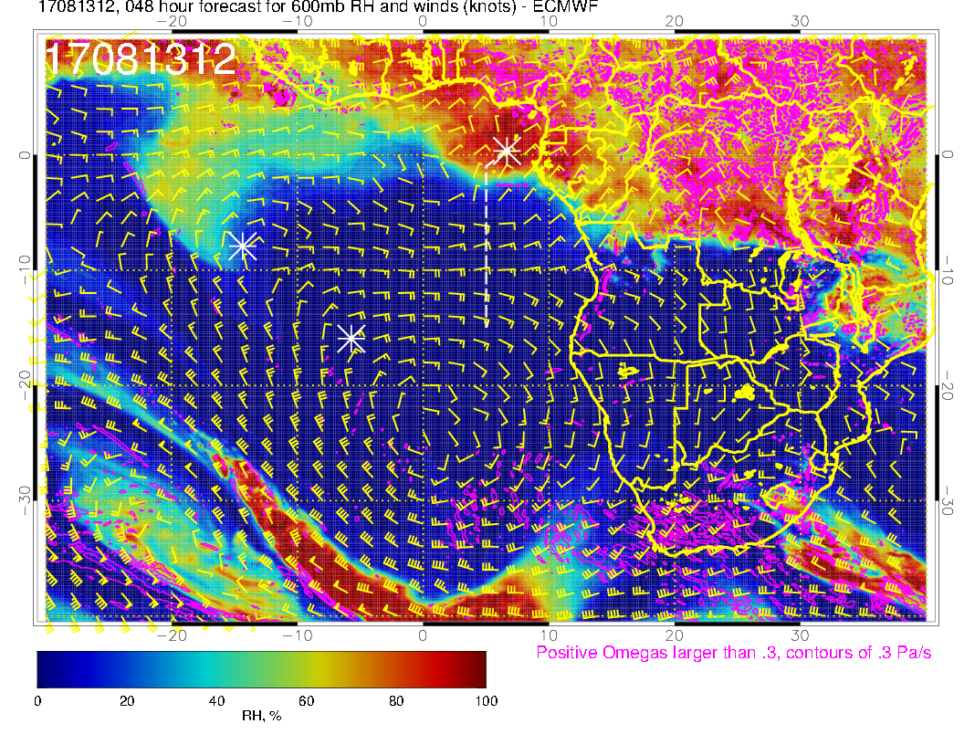
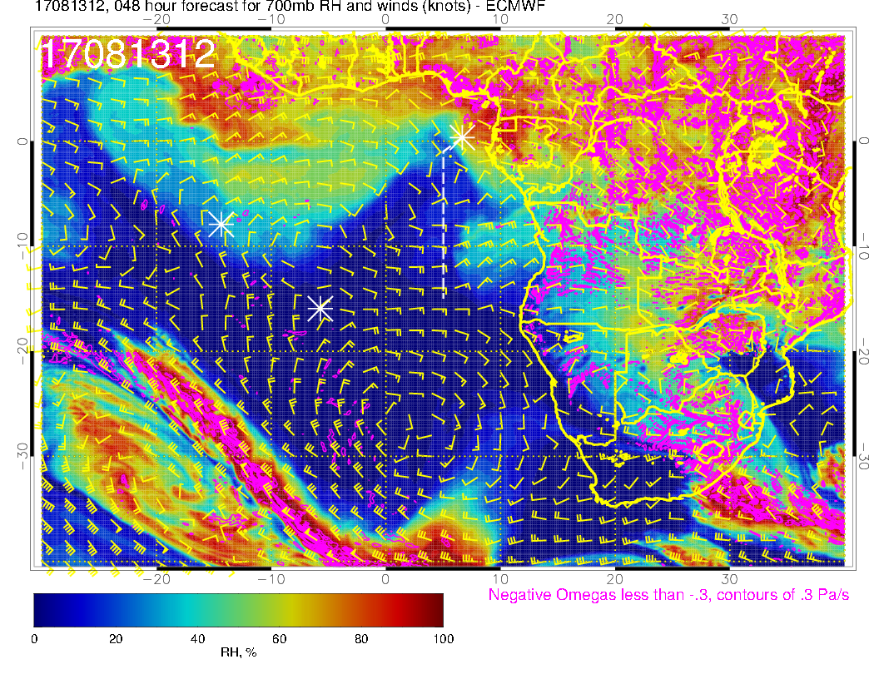
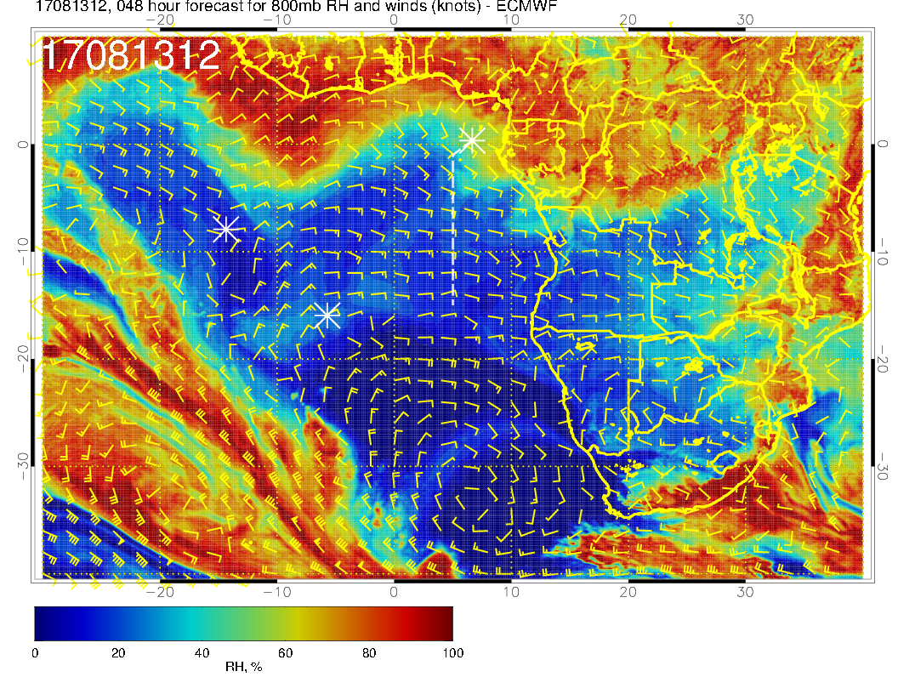
600 mb
700 mb
Important feature here is the surge of moisture coming in from the northeast at 600mb. This makes operating at TMS latitudes problematic.
800 mb

Slide 12
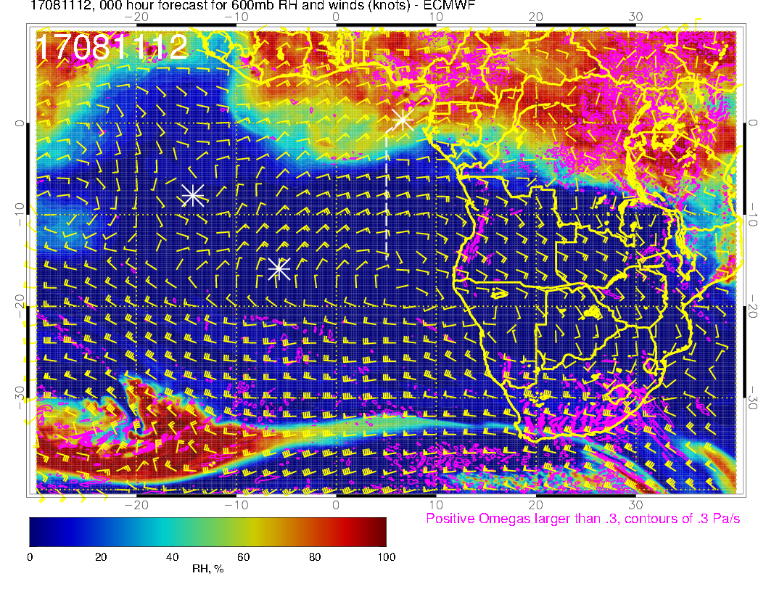
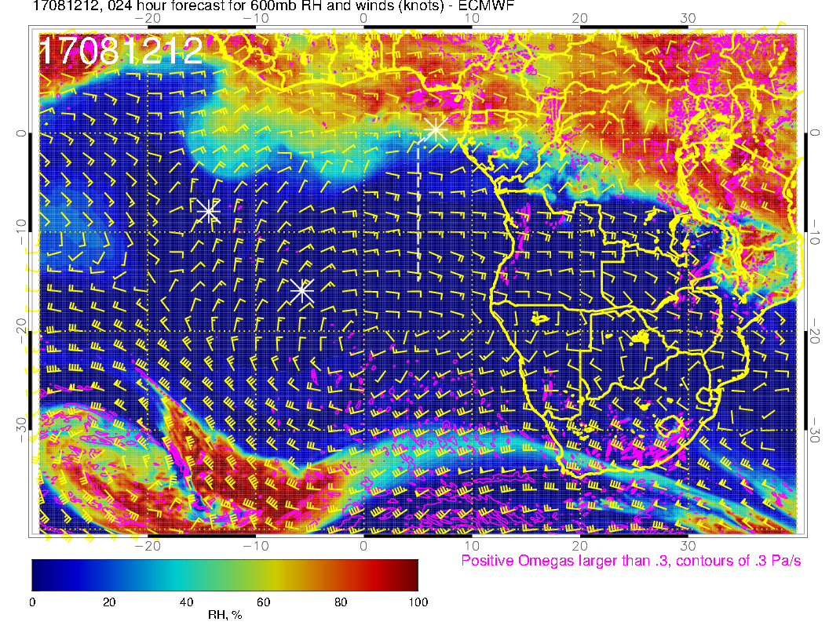
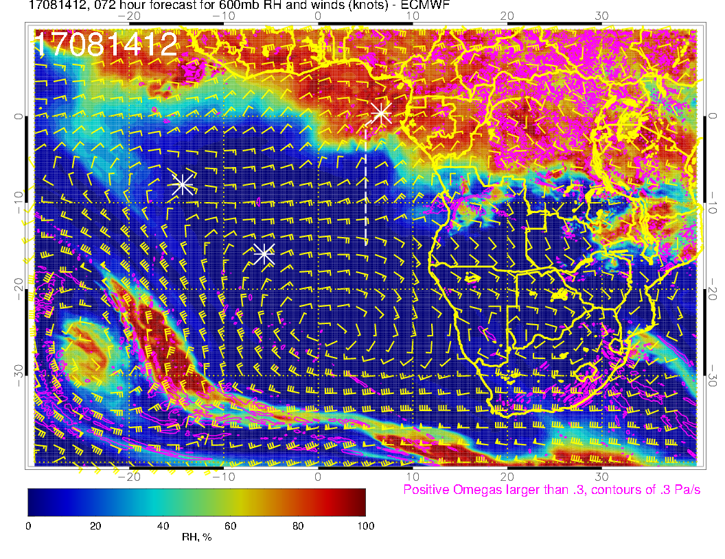
From yesterday to Monday every 24 hours

Slide 13
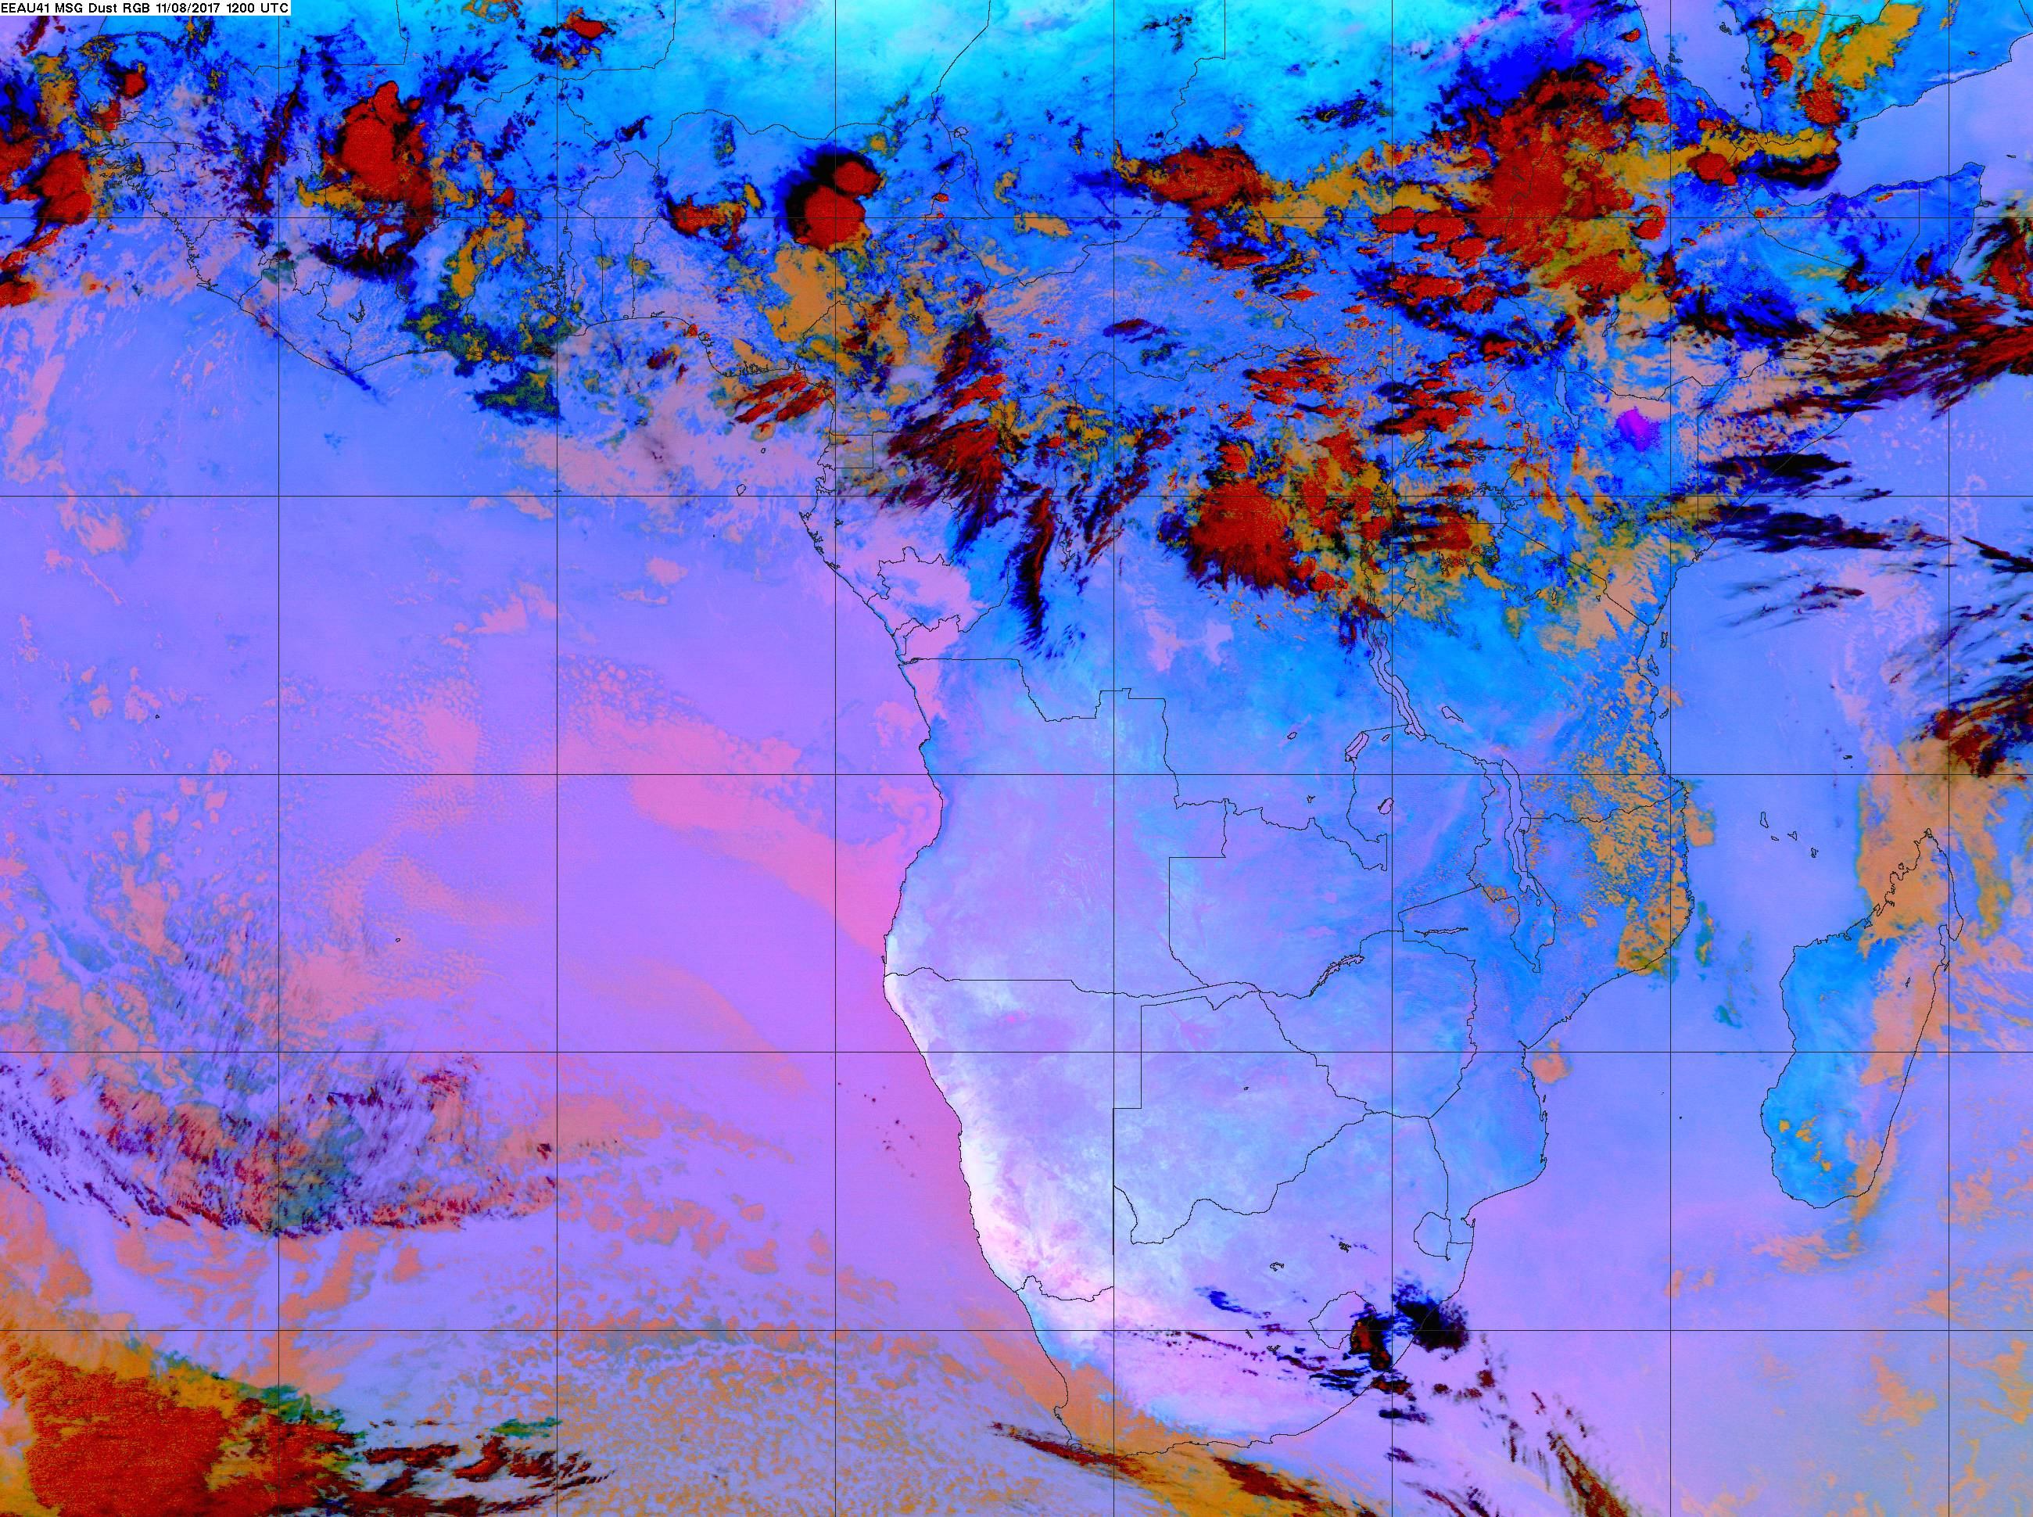
Use yesterday as an analogy based on quasi-similar midlevel moisture. Two bodies of low cloud. Can see some cirrus/mid level cloud to west. We shall see, but may want to work southern low cloud edge even though it is farther away

Slide 14
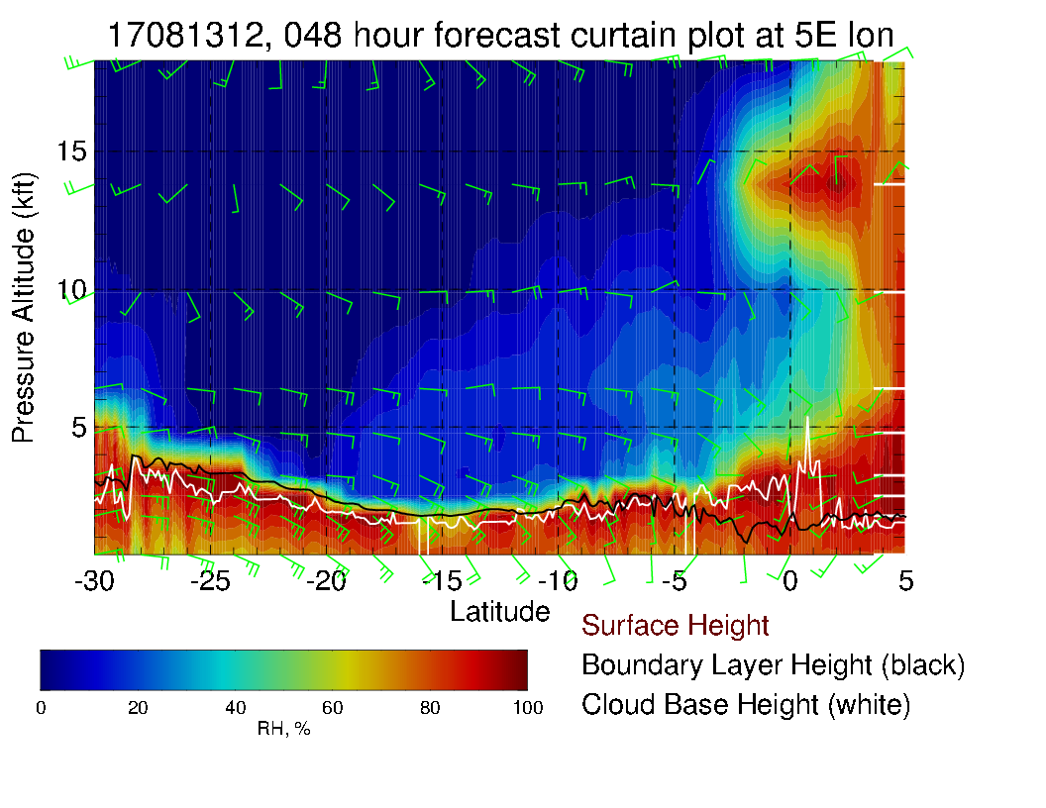
15 kft
10 kft
5 kft
-10
10
5E Xsect (left, func of lat); 0 Xsect (right, func of longitude) Message is that we need to be concerned about moisture intrusion and possible mid level clouds.

Slide 15
Summary for Sunday
EC model has trouble capturing the diurnal cycle and extensive cloud clearing. Gap in low clouds (by noon) is likely to be larger than forecasts show. Expect cloud boundary somewhere north of 10S by noon.
High and middle clouds are more extensive than previous forecasts, but still north of equator only.
Intrusion of 700mb moisture (no cloud) near 10S. 600mb moisture surge reaching to equator in the north.
Precip is stable with evolution of forecasts.
Surface conditions. With greater middle cloud than previous forecasts, expect T (8 AM) <= 26C

Slide 16
Monday

Slide 17
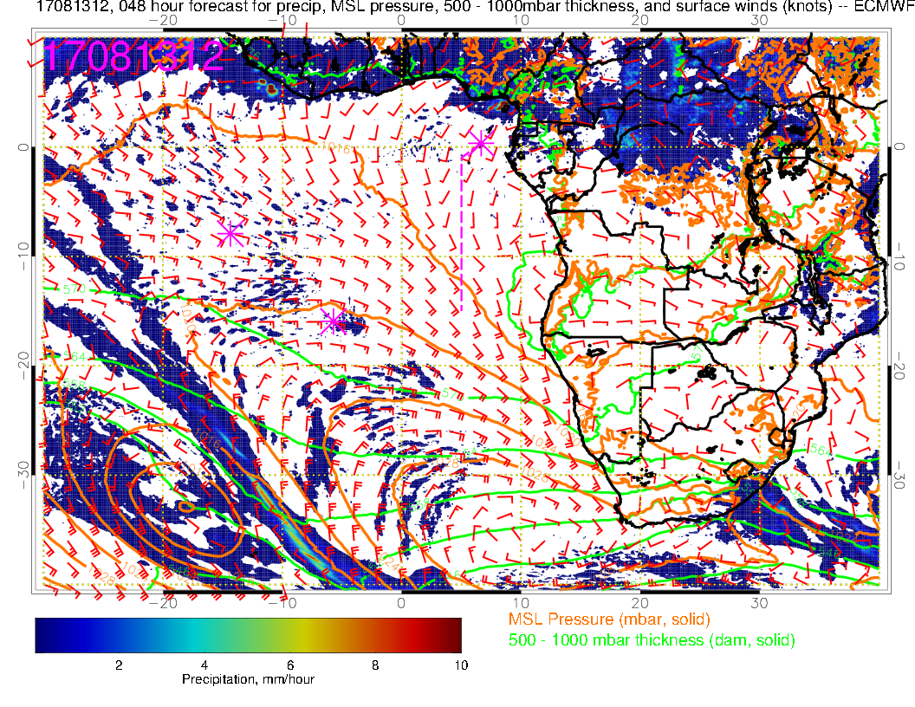
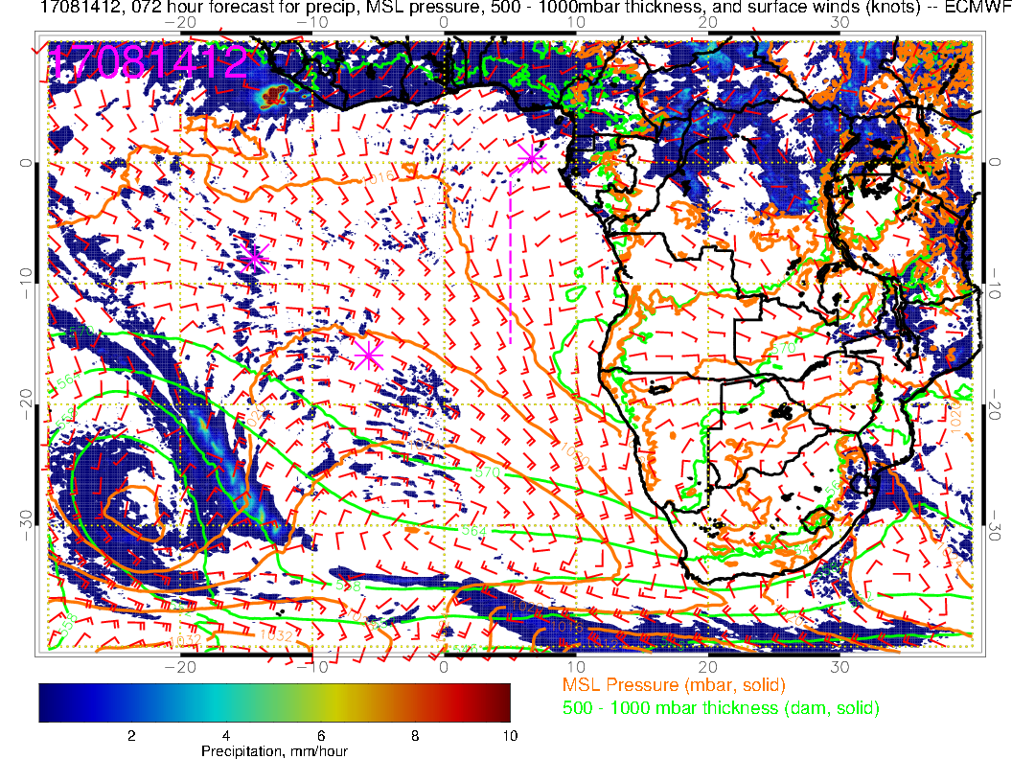
L
H
Low retrogrades, high moves around and weakens in response to higher latitude low pressure system. Winds more westerly in Angola bight. Not an obvious response to convection (if it is a response to convection)
L
H

Slide 18
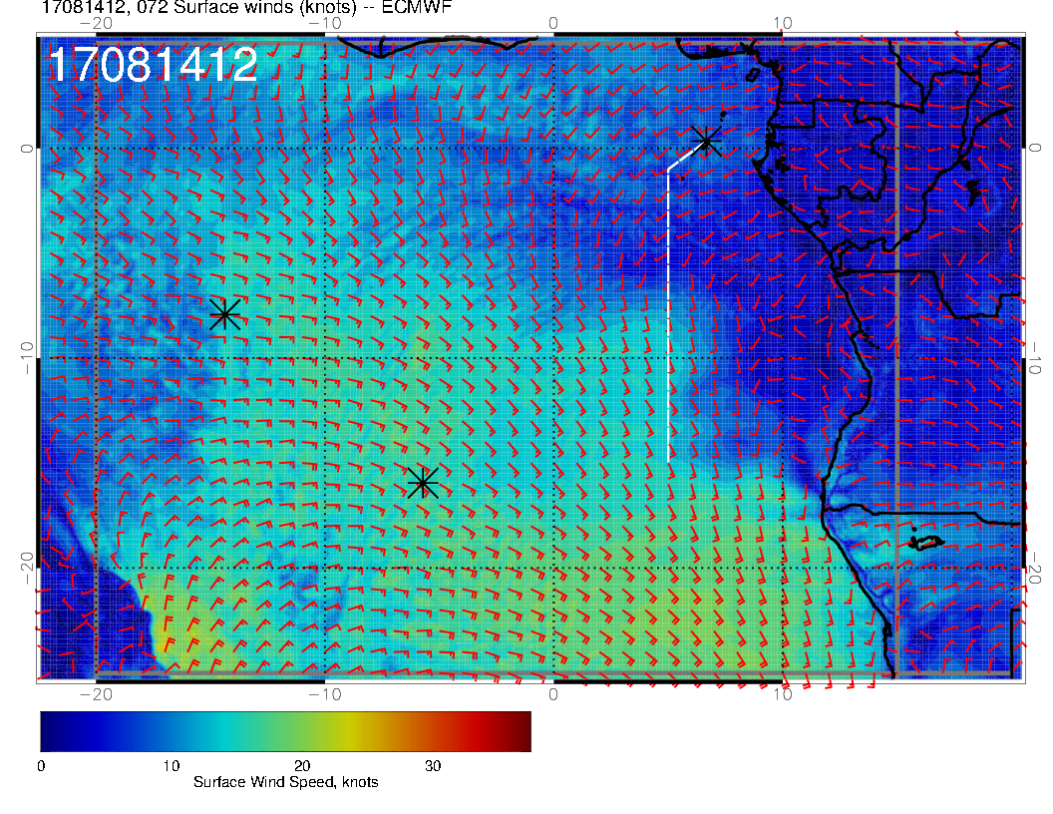
Sunday
SUNDAY
L
H
Sunday (above), Monday (right). Surface wind speeds similar for both days. In our region, there is a stronger westerly component. Weaker SH high leads to weaker winds off of Namibian coast.
MONDAY
Monday
L
L

Slide 19
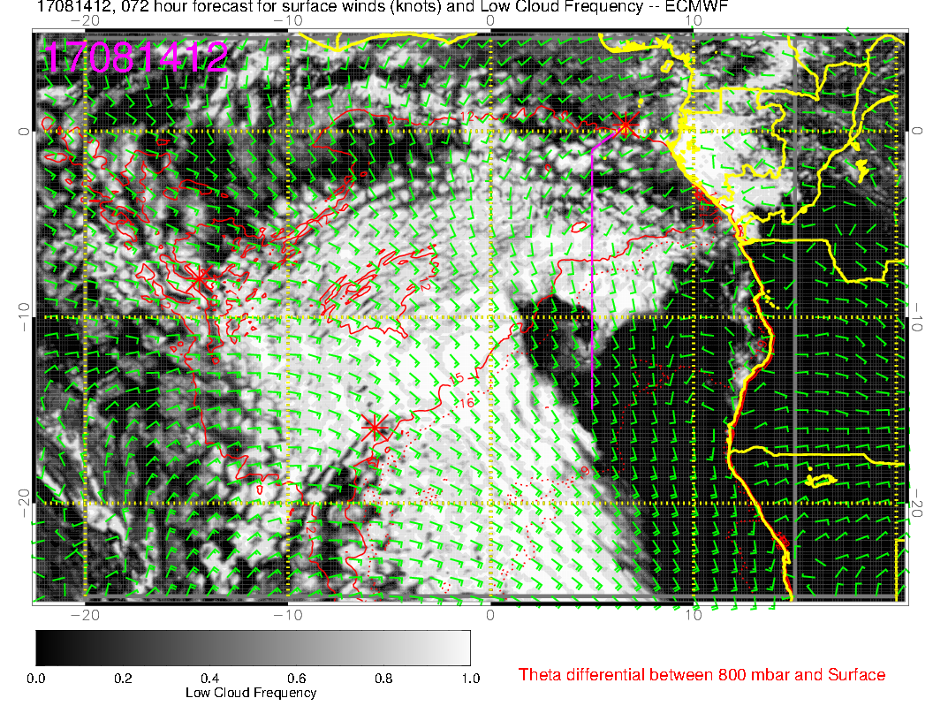
SUNDAY
Region of lowest clouds extends westward. Trend is for less low cloud in the latitudes north of TMS.
MONDAY

Slide 20
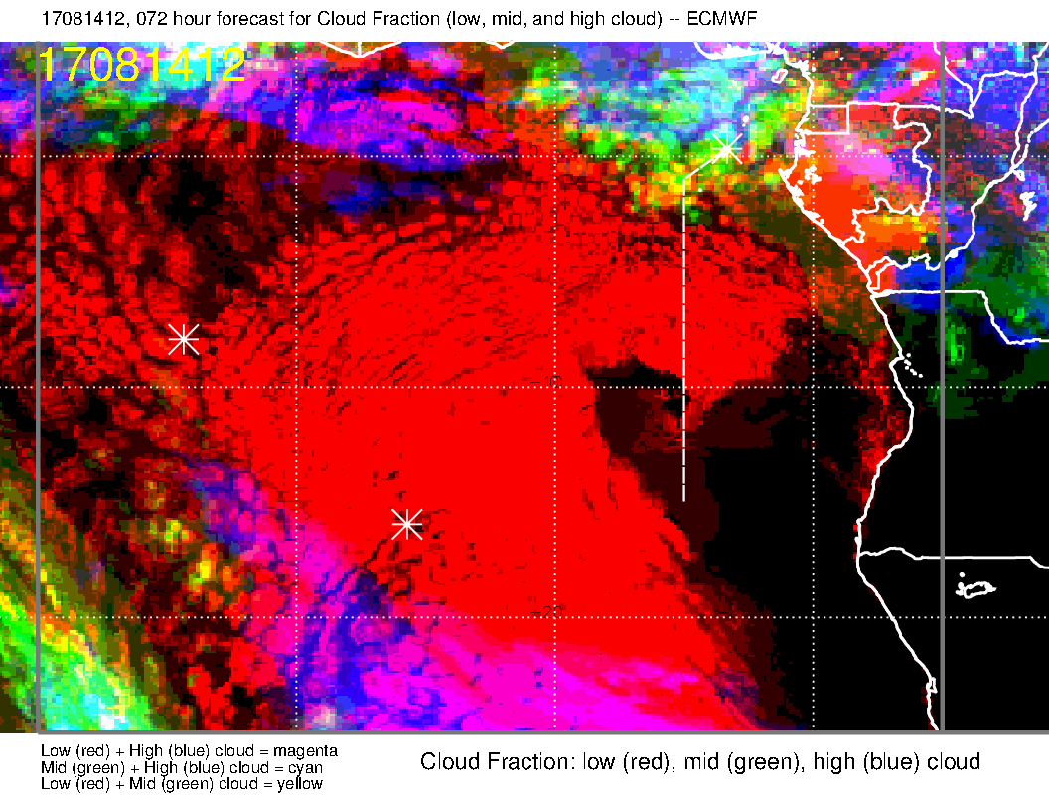
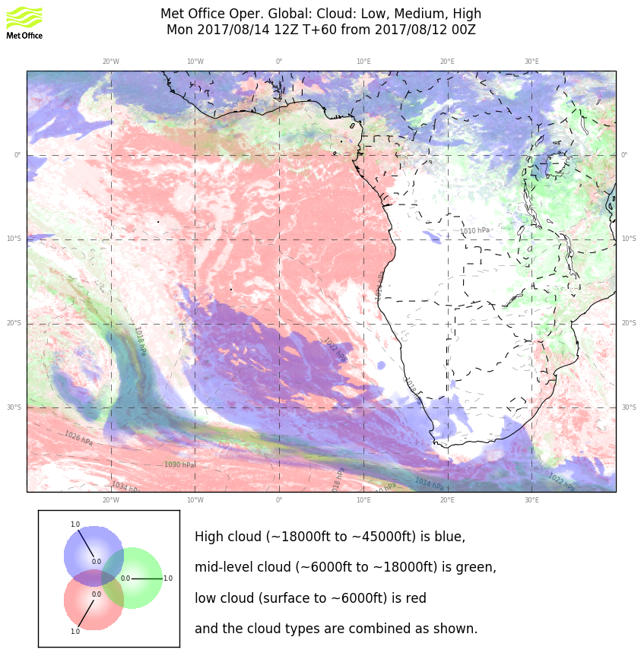
EC
UKMO
UKMO
It’s just as well, because both models (consistent with yesterday’s forecast) indicate more high and middle cloud at latitudes near TMS, so not a great place to work

Slide 21
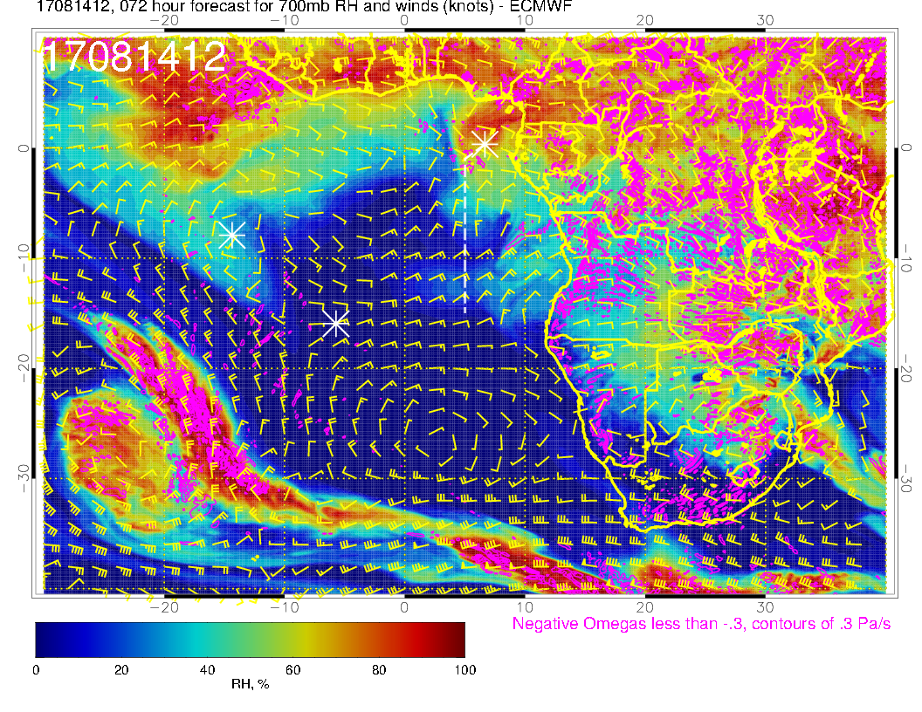
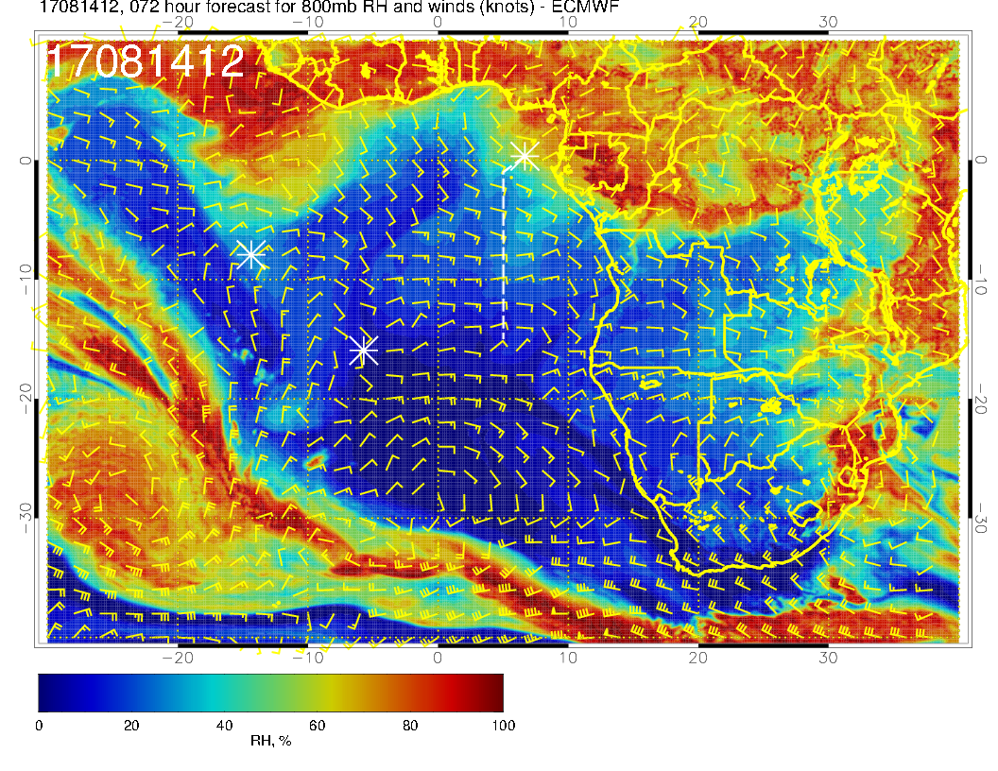
600 mb
700 mb
Can see the moisture intrusion from the continent at 600mb consistent with middle cloud forecast. 700mb moisture plume near 10S is like yesterday’s forecast. The theme here is that, above 800mb, we are getting northwest flow from the convective region.
800 mb

Slide 22
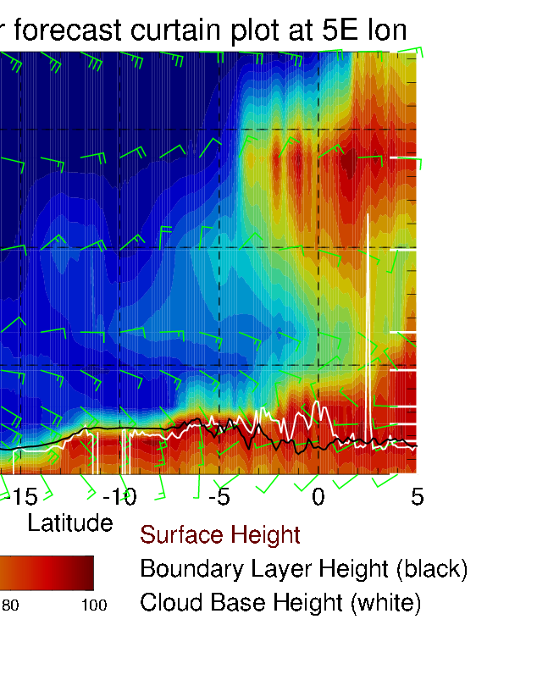
15kft
Monday
Sunday
5kft
Routine track. Lowest cloud region (left) has moved onto the routine track latitude, and midlevel moisture plume (mostly 600mb) has moved further south.

Slide 23
15kft
Monday
Sunday
5kft
5S Xsect (both are 20 degrees wide). 700mb moisture plume on Sunday to west has moved westward, new 700mb plume moves in on Monday.

Slide 24
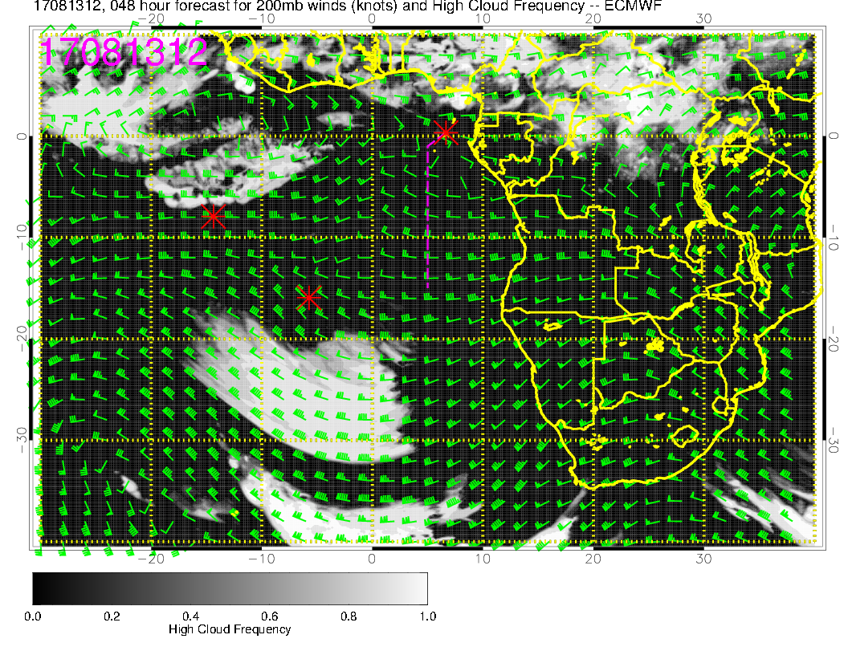
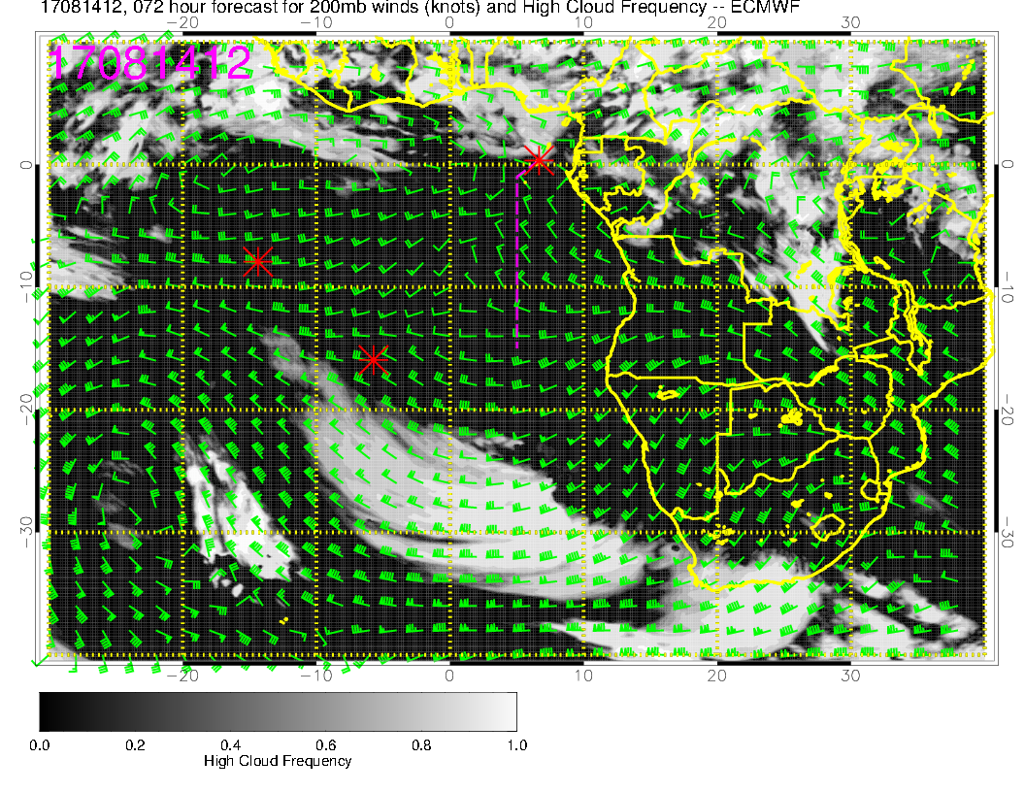
SUNDAY
MONDAY

Slide 25
Summary for Monday
Less low cloud north of equator than Sunday. Expect low cloud boundary (southern edge of gap) to be a bit further north than Sunday
High and middle clouds start to intrude into our region, especially near TMS. More mid and high cloud extending perhaps to 2S.
700mb moisture plume crosses routine flight track at 10S – of interest but no cloud associated with it. Continued moisture surge (and mid – level cloud) from the north getting to ~2 S.
Takeoff temperatures even less of a concern than Sunday because of increased mid cloud cover.

Slide 26
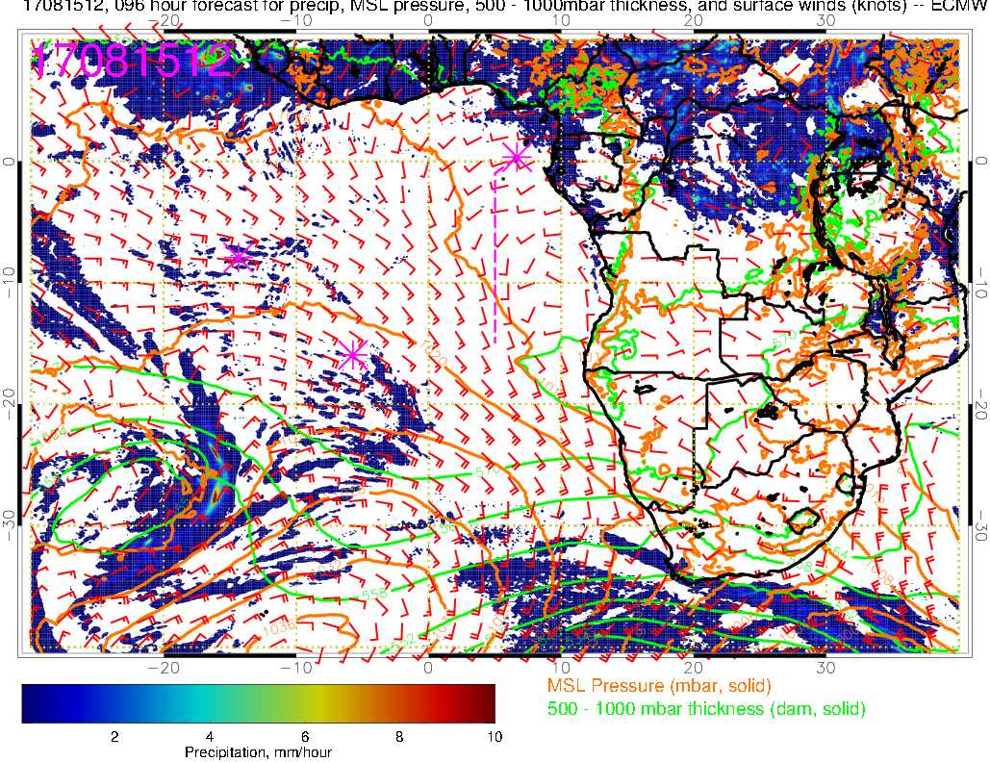
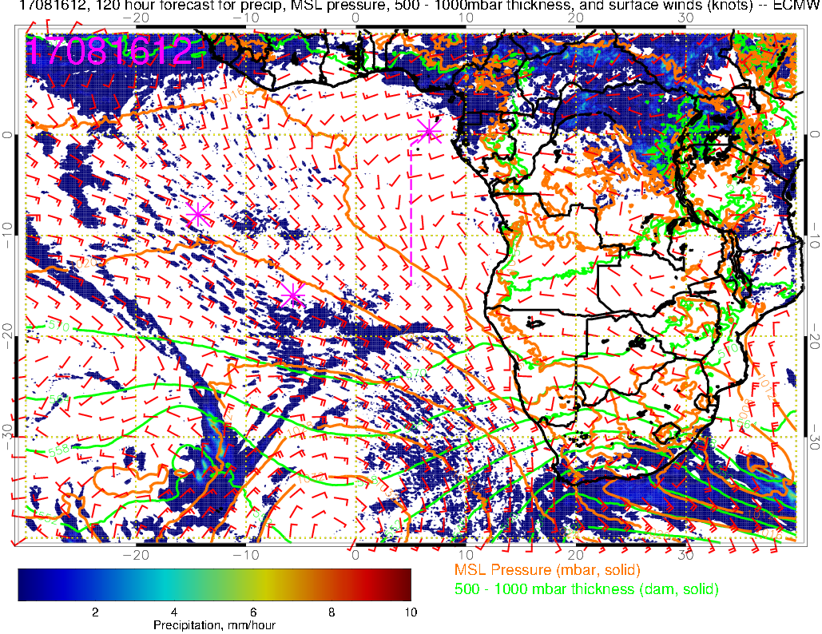
Precip, surface winds, 500-1000mb thickness for 8/15-16 @ 12PM
8/15 Tue
Precip (convection) over a large region east of TMS -> increase in high clouds
L
8/16 Wed
H
Winds have become westerly (WSW, normally SSW) over TMS and south to about 5S along the routine flight track
Northerly winds off Angola coast (normally SW)
L
H

Slide 27
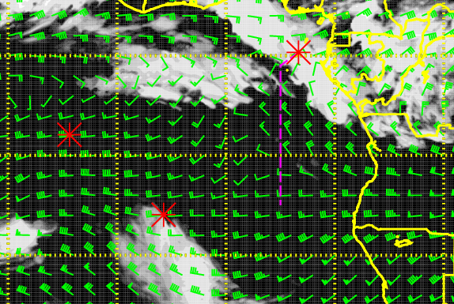
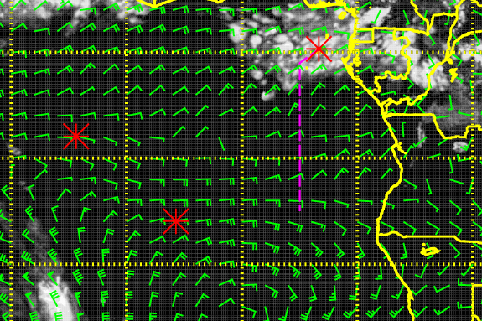
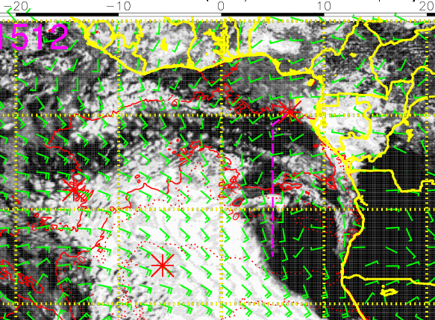
Mid (600mb)
High (200mb)
Cloud forecast for 8/15 Tue @ 12PM
Abundant middle and high clouds north of ~3S in our flight region
Low clouds are relatively sparse along the routine flight track
most dense in the middle of the flight track in this forecast (but filling in from the S-SE so could be more low clouds towards the end of the flight track than shown here)
Low (sfc)

Slide 28
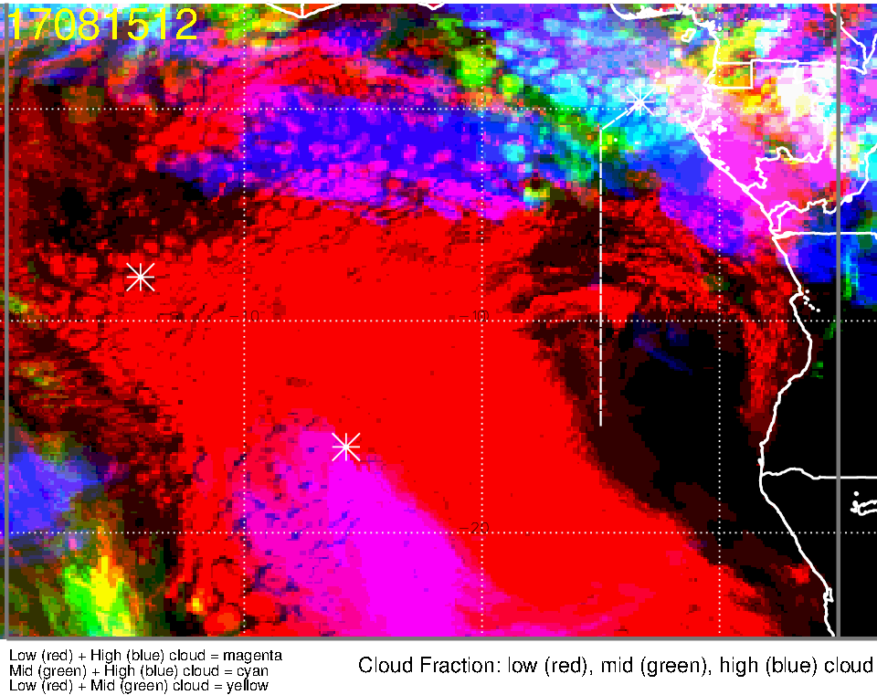
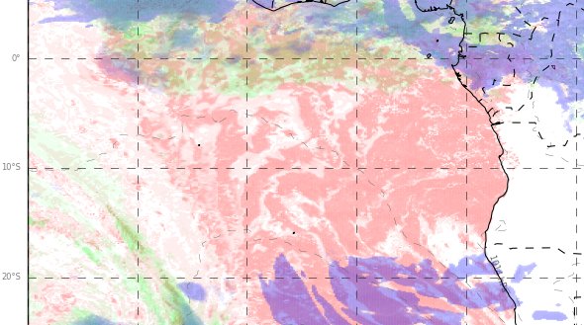
Low, middle, high cloud forecast for 8/15 Tue @ 12PM
ECMWF (96-hr)
UKMO (84-hr)
Mid + high clouds
Mid + high clouds
Less (more scattered) low clouds in our flight region compared to 8/14 in both models
Middle and high clouds are moving in from the NE, expect some over TMS down to ~2-3S along the flight track

Slide 29
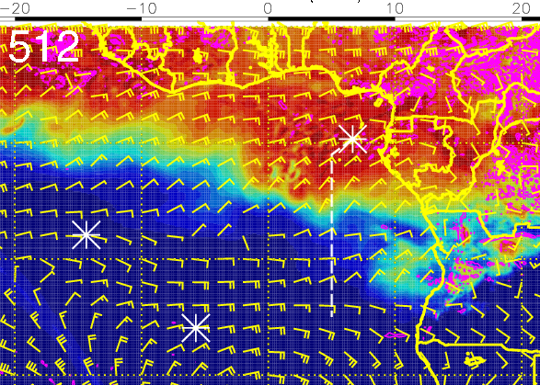
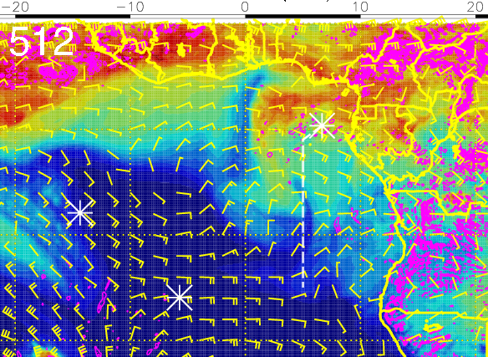
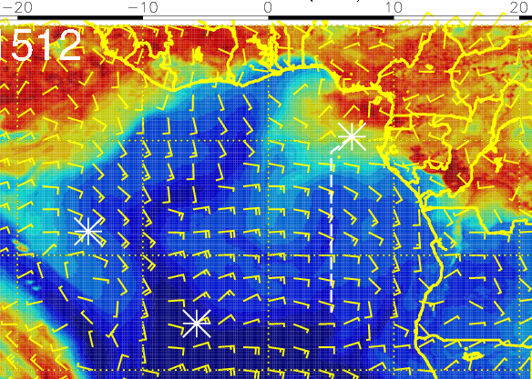
RH (color), winds, vert. velocity (pink) at 8/15 Tue @ 12PM
600 mb
700 mb
Increasing RH at 600-700mb
Moist air north of 5S (mid-high clouds) heavily influenced by moist convection
Moist air south of 8S suggests plume transport from dry convection
800mb wind: (1) Ely over Angola have weakened significantly; (2) Ely crosswinds along flight track
800 mb

Slide 30
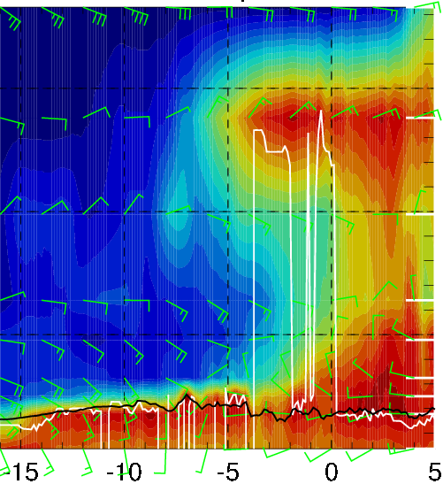
RH (color), wind, BL and cloud base heights along 5E, 8/15 Tue @ 12PM
20-35 knts
Moist convection
5-15 knts
5-15 knts
Dry convection
High RH at 600 and 700mb
Easterly cross winds along flight track above ~5000 ft
Winds below ~2-3000 ft: shift from westerlies north of 5S to southerlies south of 5S

Slide 31
Tuesday 8/15
Given the large amounts of middle and high clouds in the morning (and the dependence of surface temperatures on cloud cover), takeoff temperatures should not be an issue
Low cloud clearing leads to relatively sparse low clouds throughout the routine flight track
Abundant middle and high clouds north of ~3S
Moist air north of 5S (mid-high clouds) heavily influenced by moist convection
Moist air south of 8S suggests plume transport from dry convection

Slide 32
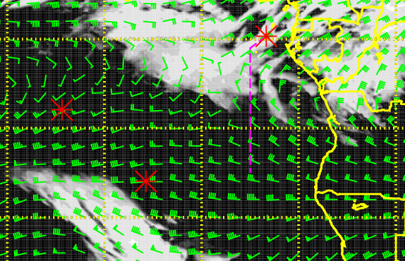
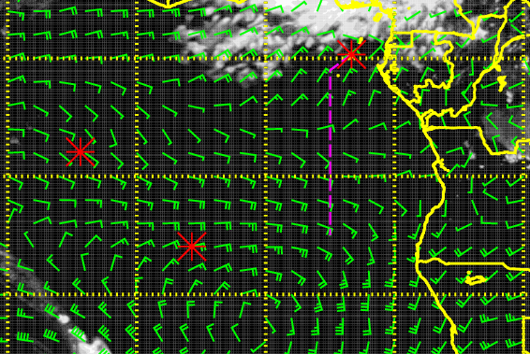
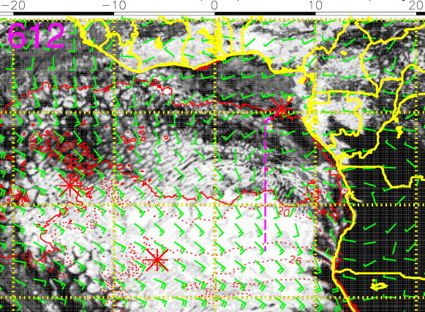
Mid (600mb)
High (200mb)
Cloud forecast for 8/16 Wed @ 12PM
Middle clouds have retreated to the north, but still abundant high clouds north of 5S
Low clouds have filled in from the south (StratCu deck)
Scattered low clouds from TMS to ~9S and more dense clouds south of ~9S
Low (sfc)

Slide 33
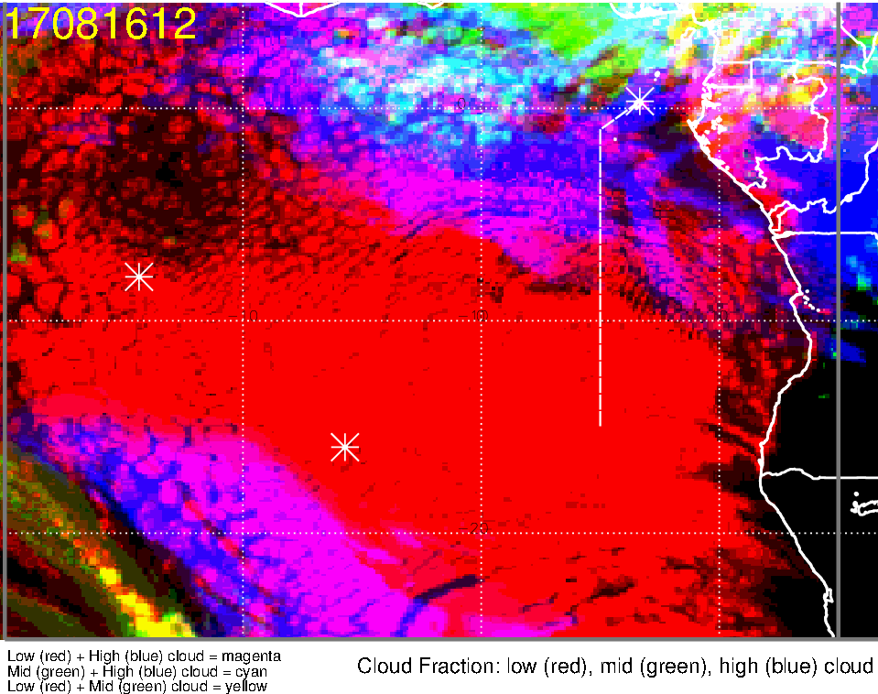
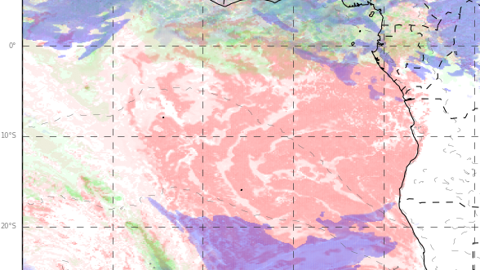
Low, middle, high cloud forecast for 8/16 Wed @ 12PM
ECMWF (120-hr)
UKMO (108-hr)
Mid + high clouds
Mid + high clouds
Expansive Strat Cu deck (clear-sky region off Namibia coast have largely disappeared)
Abundant low clouds along the flight track (most dense clouds south of ~9S)
Abundant middle and high clouds north of ~5S

Slide 34
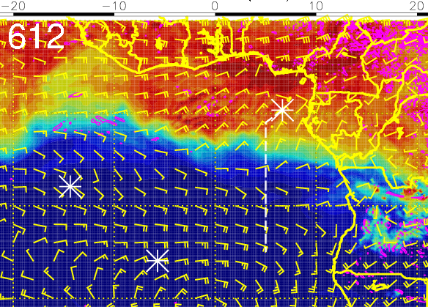
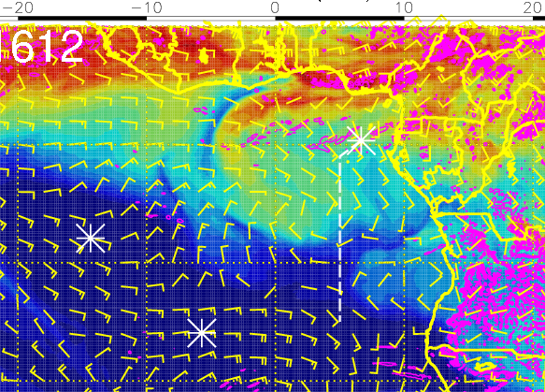
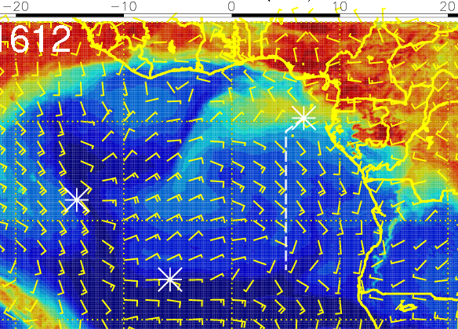
RH (color), winds, vert. velocity (pink) at 8/16 Wed @ 12PM
600 mb
700 mb
Moisture retreating northward
Moist air wraps around towards the flight track from the NW at 700mb
Moist air south of ~10S suggests plume transport from dry convection
800mb wind: (1) switched to Wly over Angola; (2) more Sly along the flight track(dry air from the south?)
800 mb

Slide 35
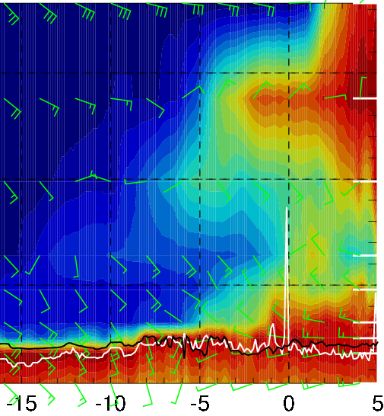
RH (color), wind, BL and cloud base heights along 5E, 8/16 Wed @ 12PM
20-30 knts
Moist air transported from the NW
10-20 knts
5-15 knts
Dry convection
High RH at 600mb has retreated northward
Westerly crosswinds at 700mb between 6-10S along the flight track due to transport of moist air (influenced by moist convection) from the NW
Winds below ~3000 ft: shift from westerlies north of 5S to southerlies south of 5S

Slide 36
Wednesday 8/16
Given the large amounts of middle and high clouds in the morning (and the dependence of surface temperatures on cloud cover), takeoff temperatures should not be an issue
Low clouds filling in from the south (StratCu deck expands with narrow clearing off Namibia coast)
Abundant middle to high clouds north of ~5S
Westerly crosswinds at 700mb between 6-10S along the flight track due to transport of moist air (influenced by moist convection) from the NW
Moist air south of ~10S suggests plume transport from dry convection

