Slide 1
ORACLES Forecast Briefing (Aerosols)
12 August 2017
Morning

Slide 2
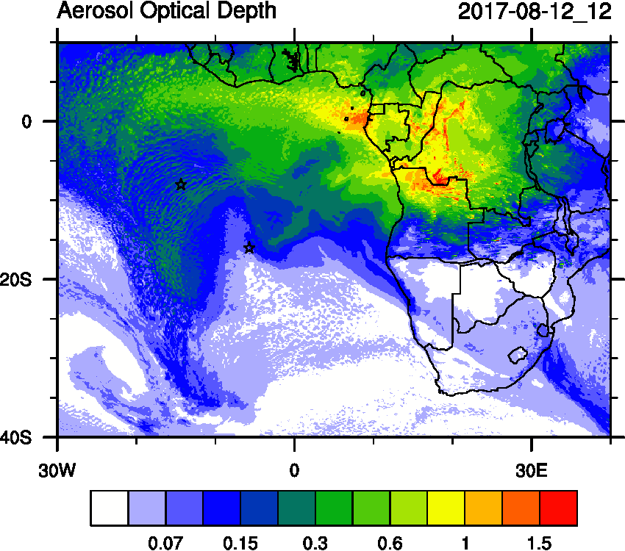
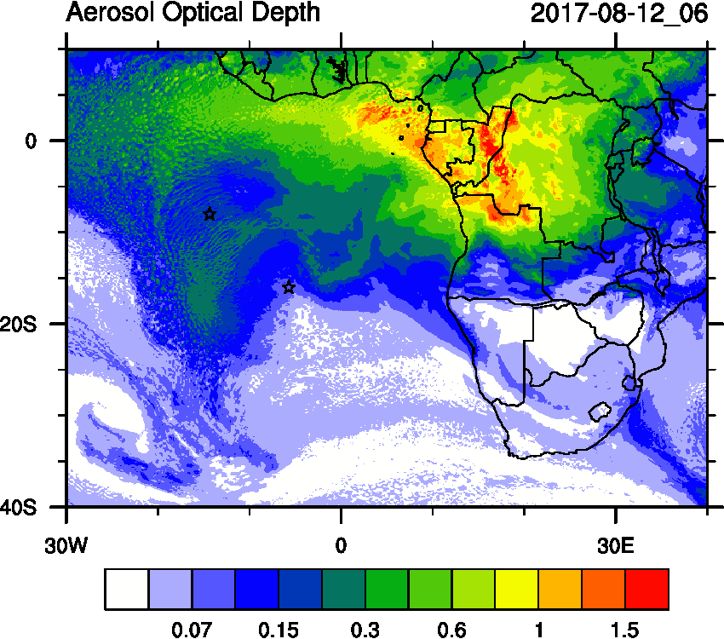
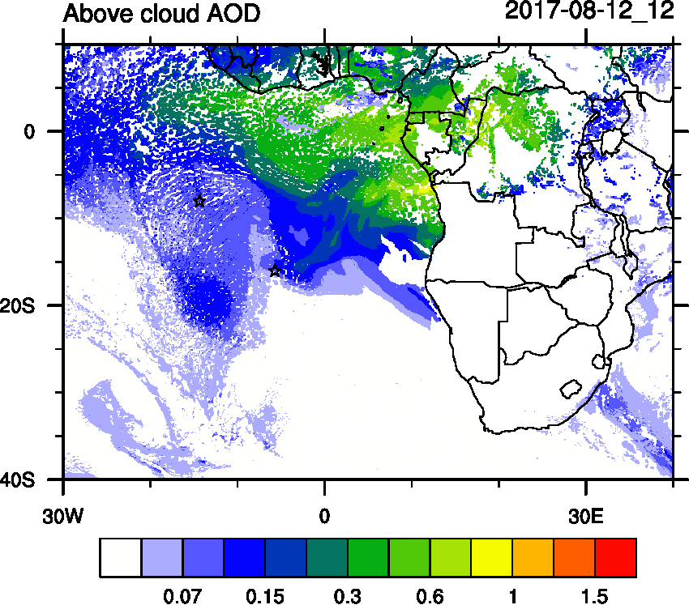
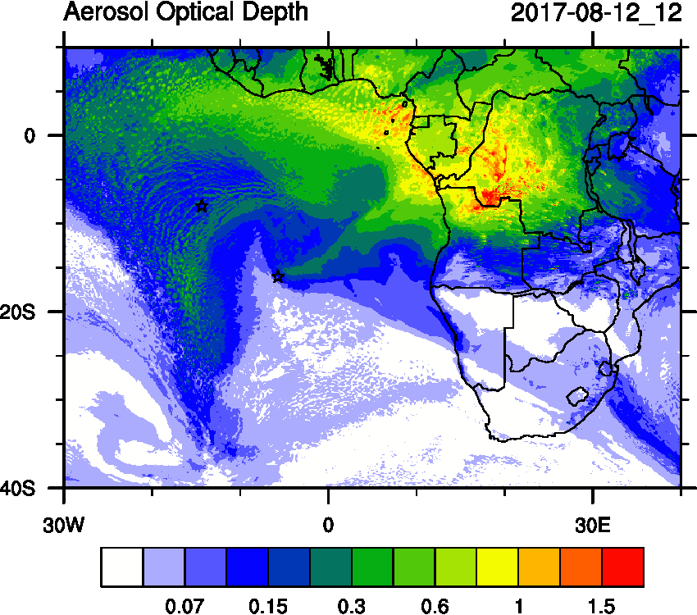
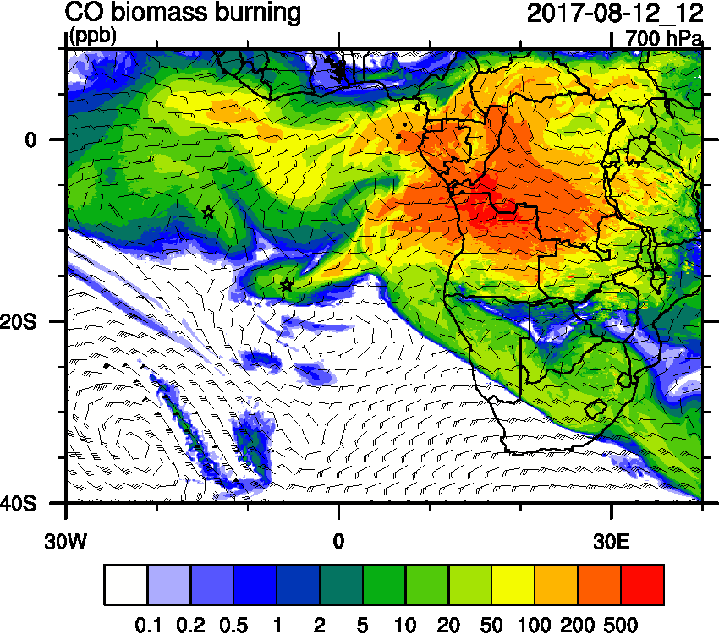
Saturday August 12 (12z) WRF-AAM today

Slide 3
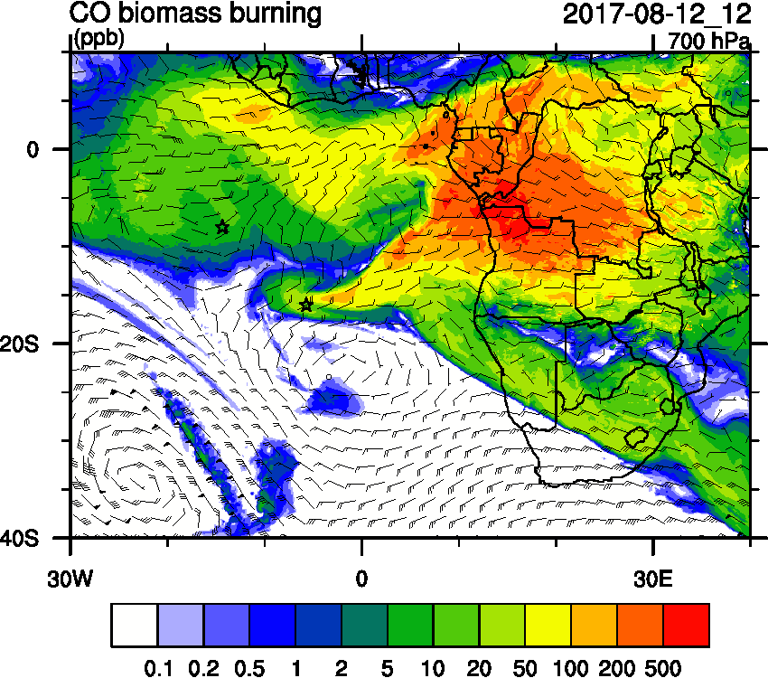
Saturday August 12 (12z) WRF-AAM (Old)

Slide 4
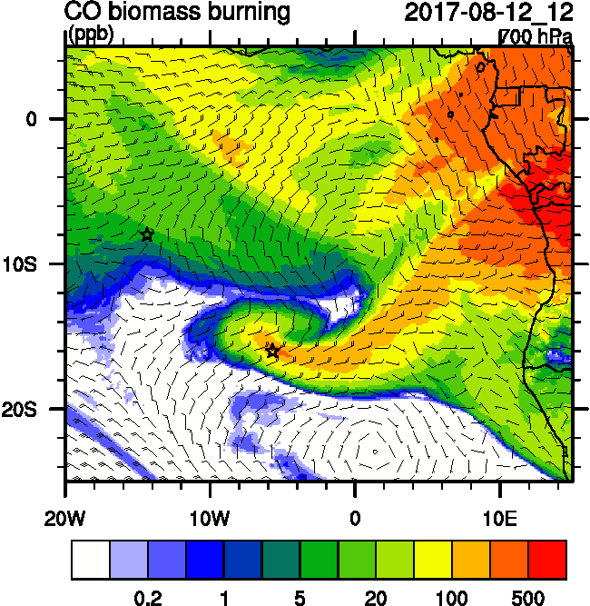
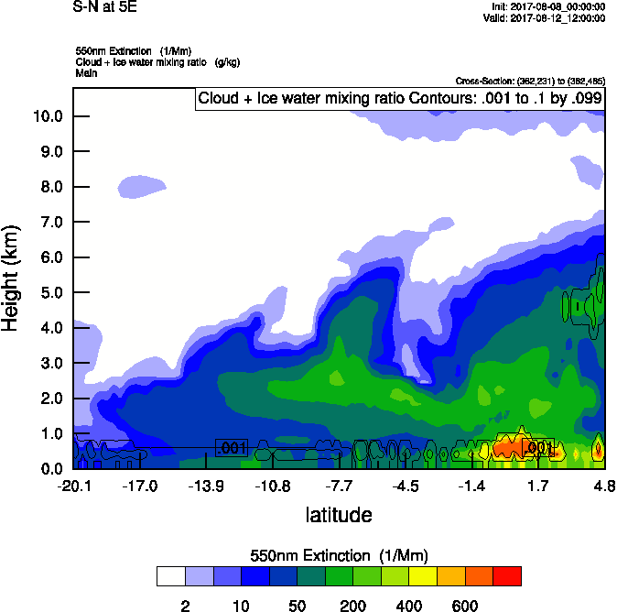
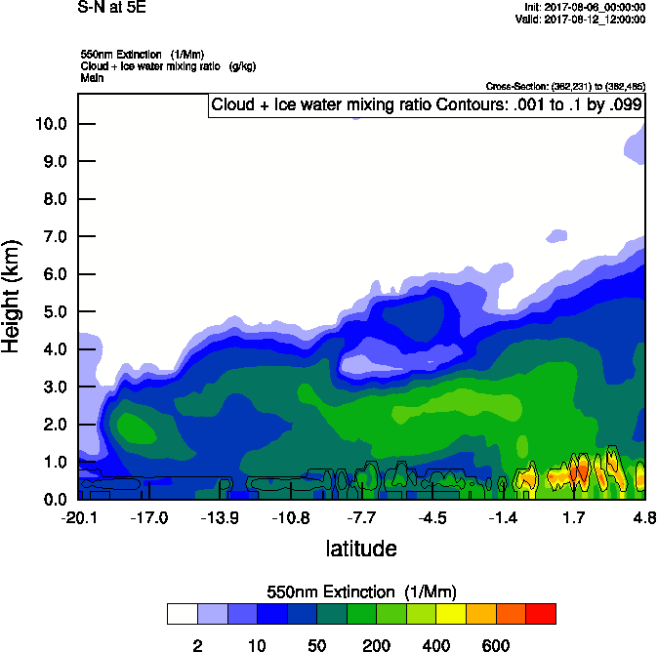
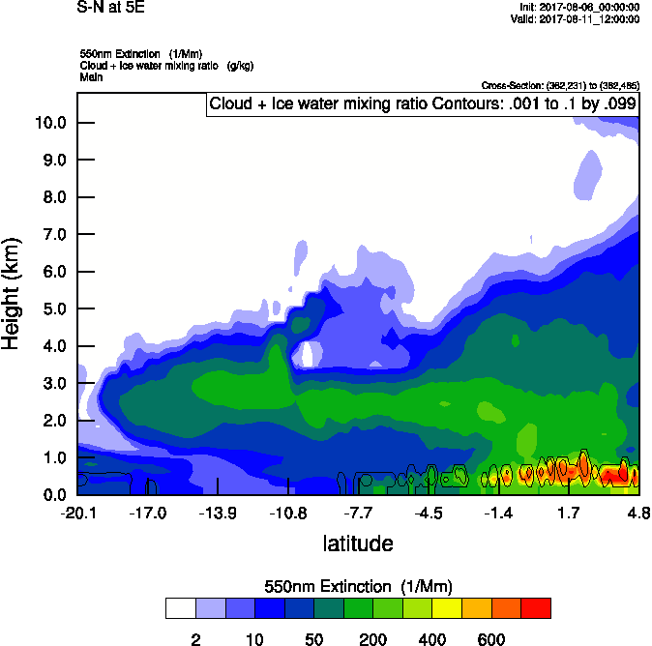
Saturday August 12 (12z) newest

Slide 5
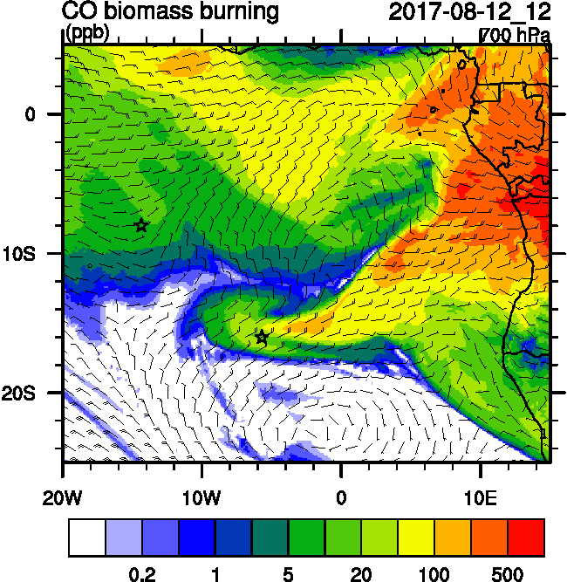
Saturday August 12 (12z) OLD

Slide 6
Saturday August 12 (12z) (Old)

Slide 7
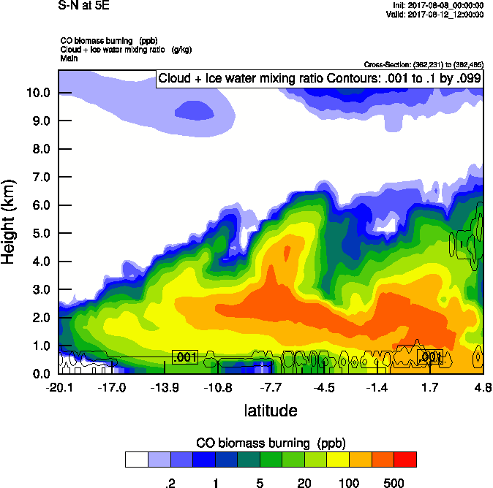
Saturday August 12 (12z) newest

Slide 8
Saturday August 12 (12z) newest

Slide 9
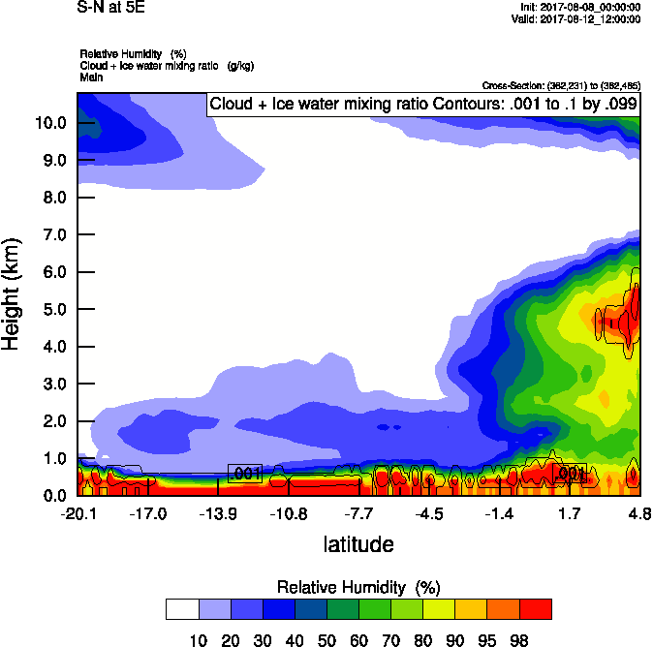
Saturday August 12 (12z) newest

Slide 10
Saturday August 12 (12z) newest

Slide 11
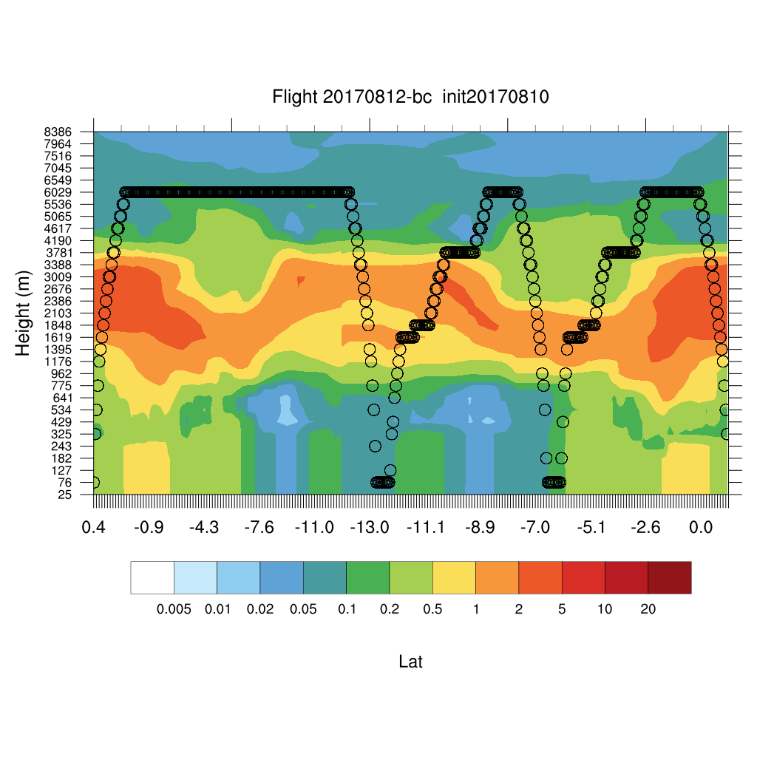
Saturday August 12 (12z) newest

Slide 12
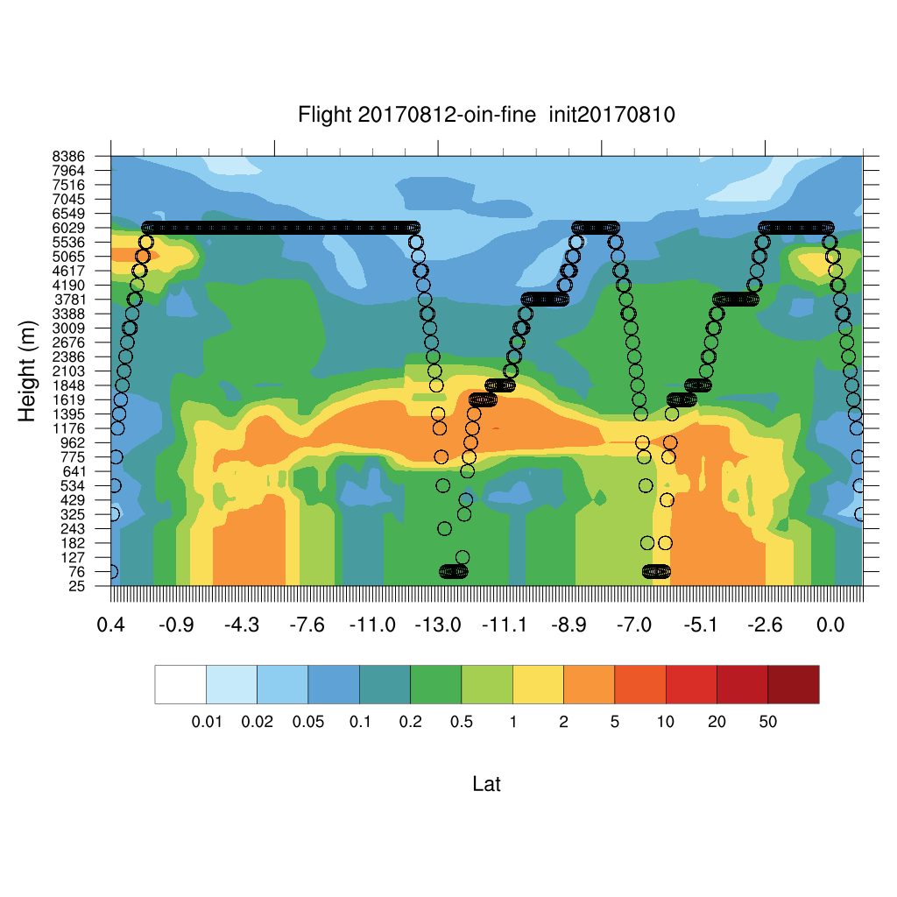
Saturday August 12 (12z) newest

Slide 13
ORACLES Forecast Briefing (Aerosols)
12 August 2017
Morning

Slide 14
08/13 Sun (48h) 08/14 Mon(72h) 08/15 Tue(96h)
Sunday - Tuesday (12z)
08/11 12Z
GEOS-5
08/13 Sun (60h) 08/14 Mon(84h) 08/15 Tue(108h)
08/11 00Z
CAMS

Slide 15
08/13 Sun (48h) 08/14 Mon(72h) 08/15 Tue(96h)
Sunday - Tuesday (12z) GEOS-5

Slide 16
SUNDAY August 13

Slide 17
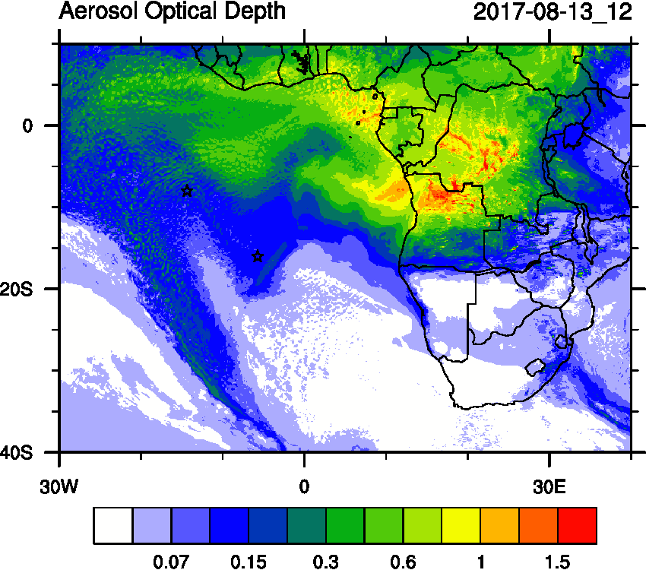
Sunday August 13 (12z)

Slide 18
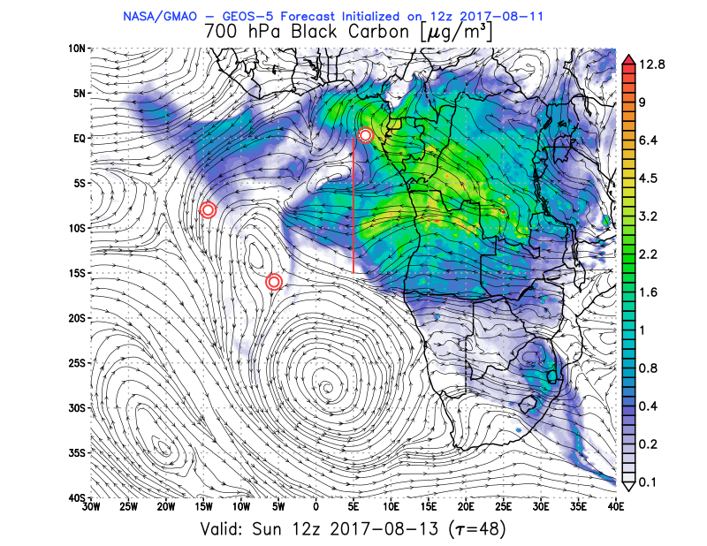
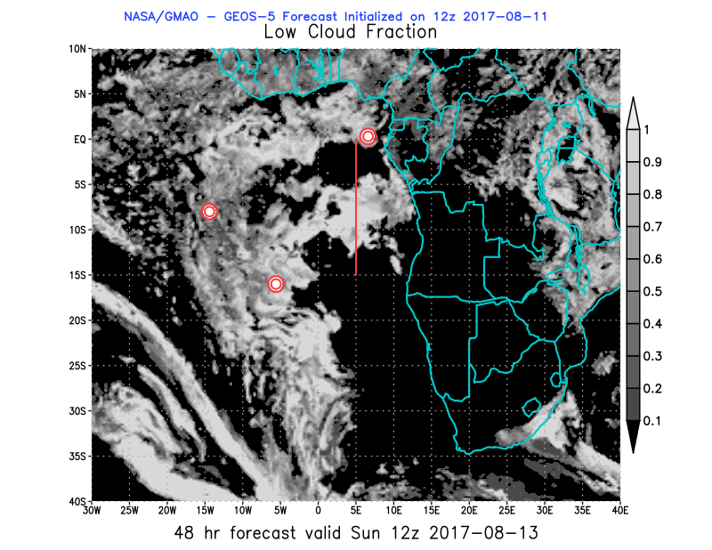
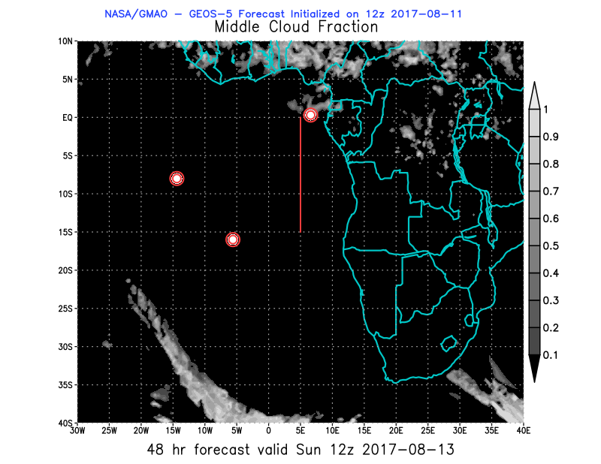
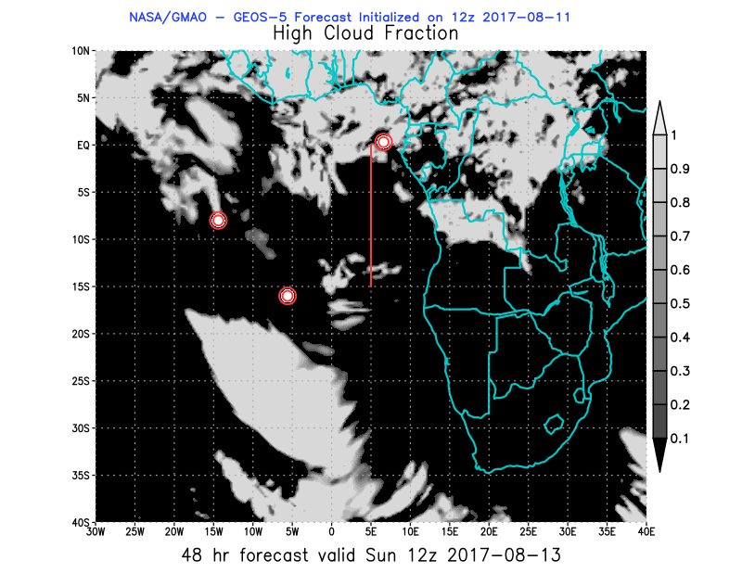
08/13 Sun (48h) GEOS-5 850 hPa 700hPa 600 hPa
08/11 12Z

Slide 19
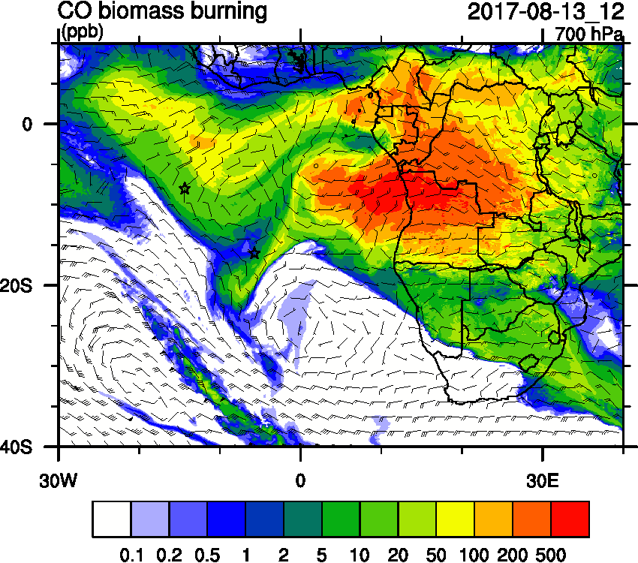
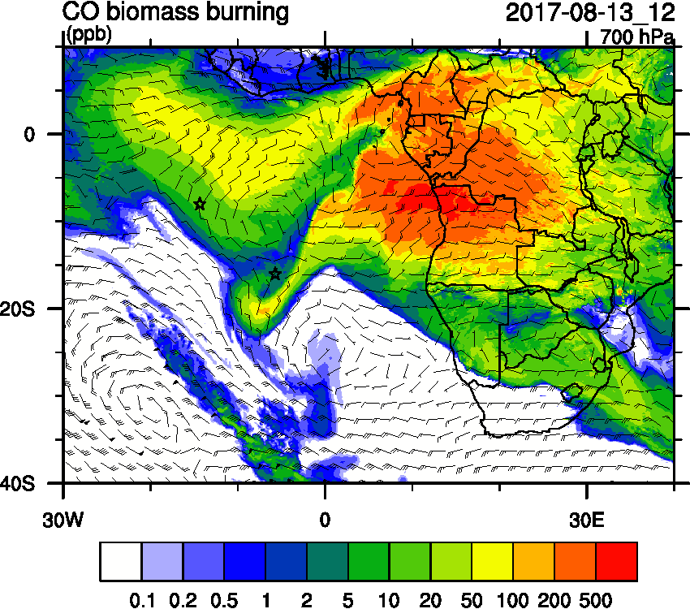
Sunday August 13 (12z) WRF-AAM

Slide 20
Sunday August 13 (12z) WRF-AAM
OLD

Slide 21
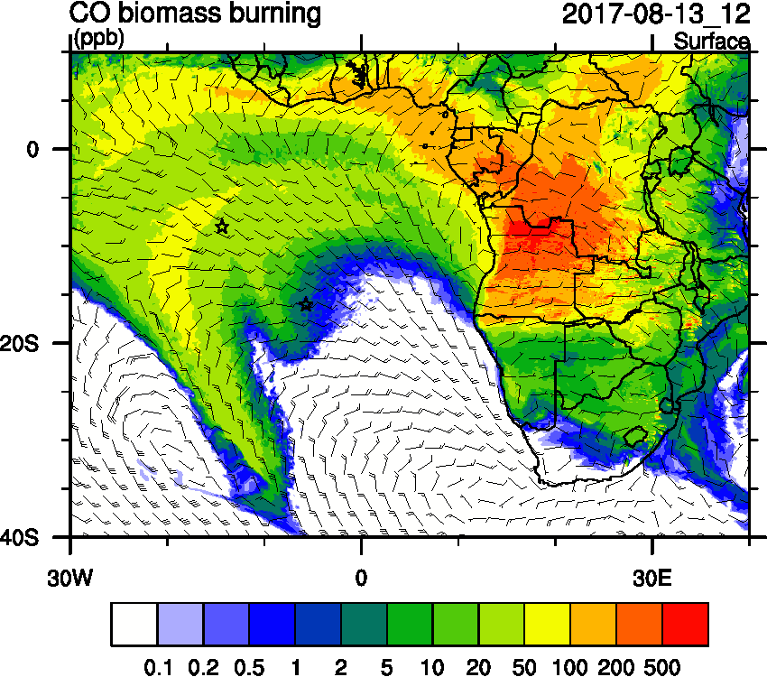
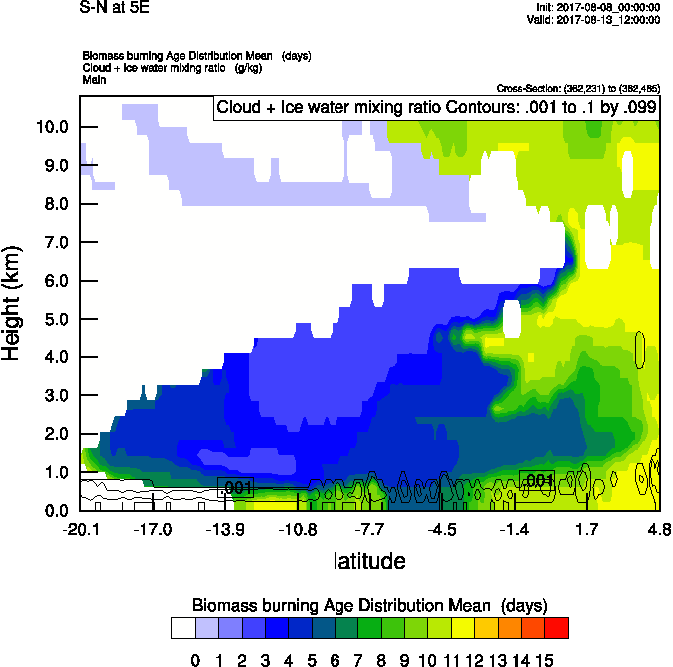
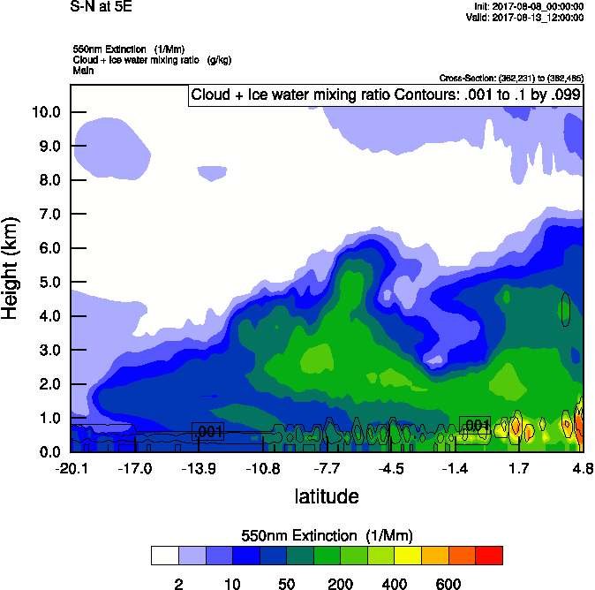
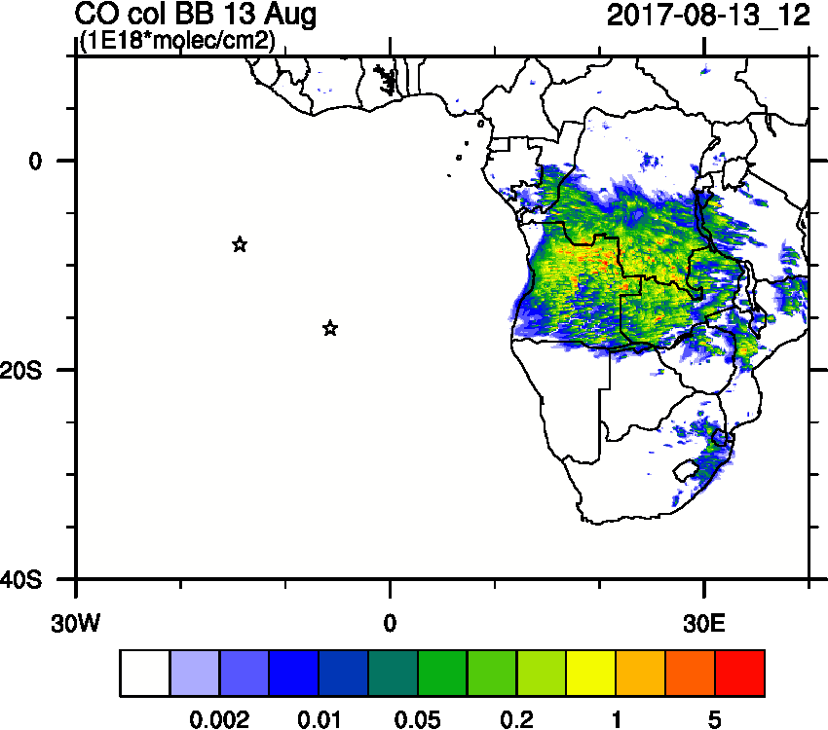
Sunday August 13 (12z) WRF-AAM

Slide 22
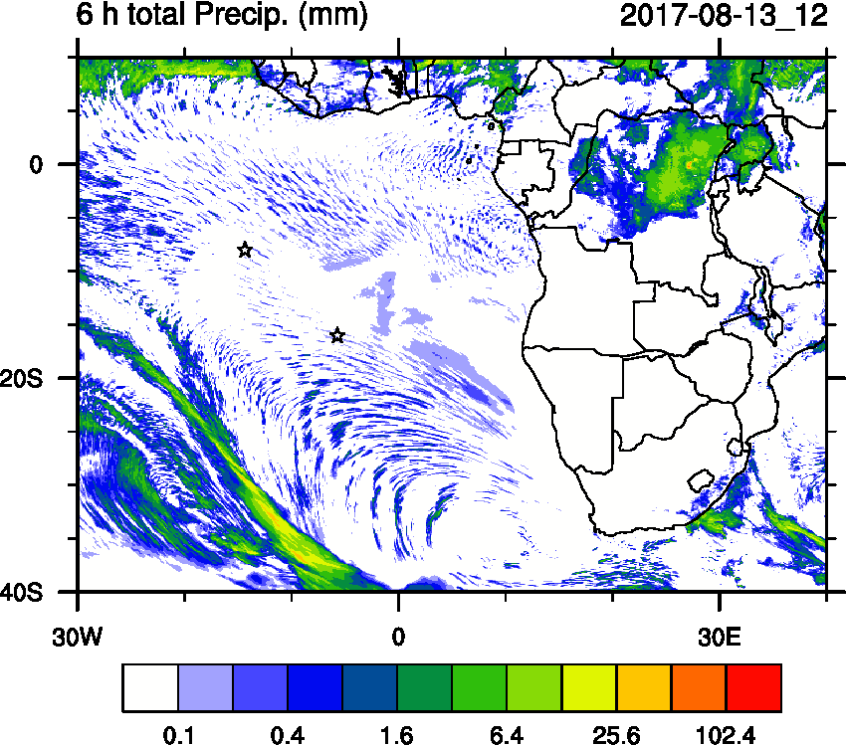
Sunday August 13 (12z) WRF-AAM

Slide 23
Sunday August 13 (12z) WRF-AAM

Slide 24
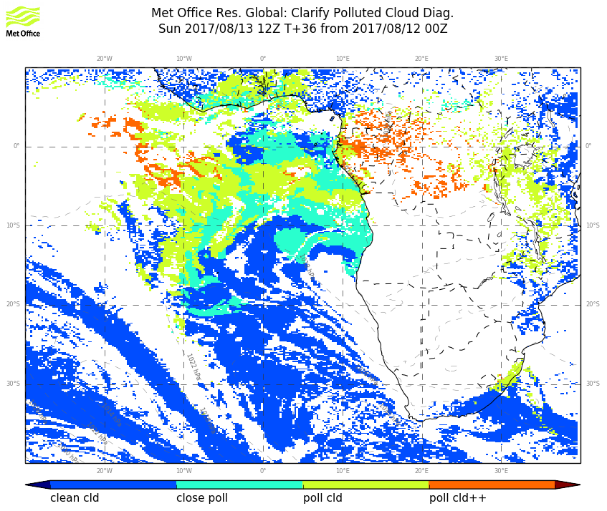
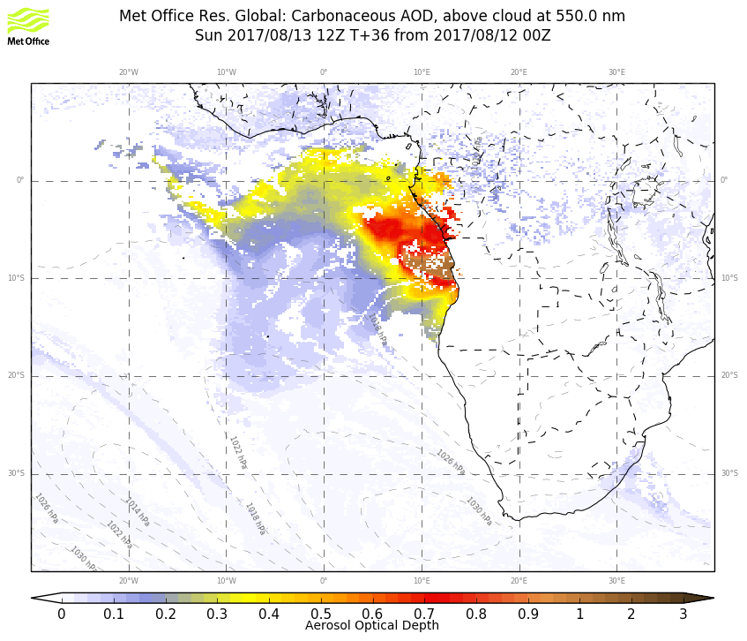
UKMO – Sunday 12z

Slide 25
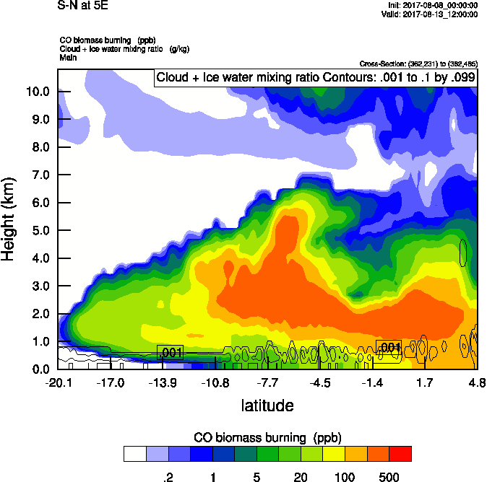
Sunday August 13 (12z) WRF-AAM

Slide 26
Sunday August 13 (12z) WRF-AAM

Slide 27
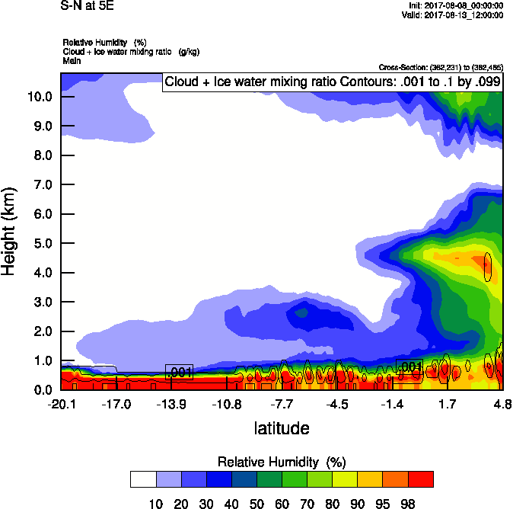
Sunday August 13 (12z) WRF-AAM

Slide 28
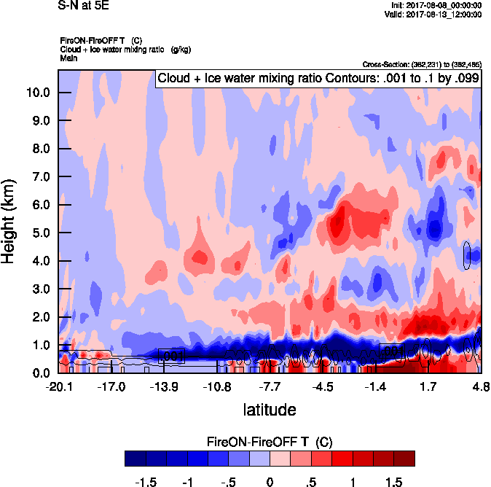
Sunday August 13 (12z) WRF-AAM

Slide 29
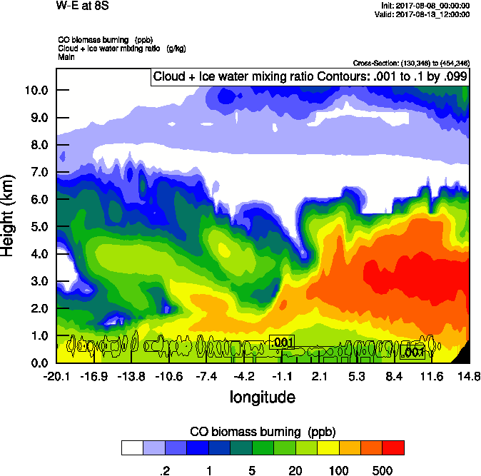
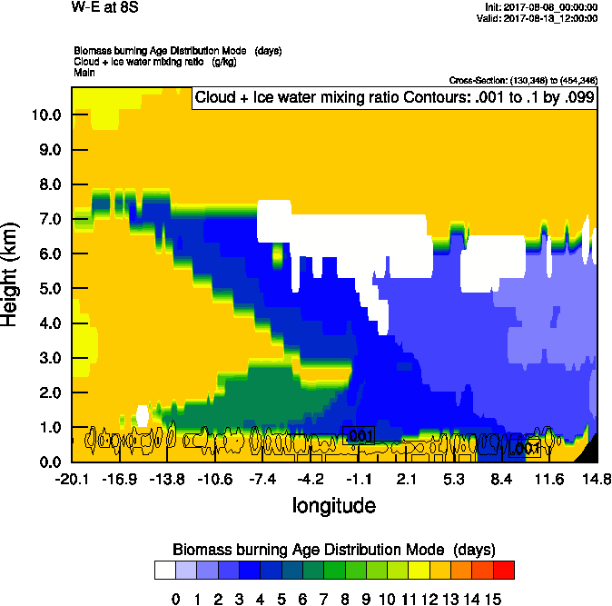
Sunday August 13 (12z) WRF-AAM
(W-E 8S)

Slide 30
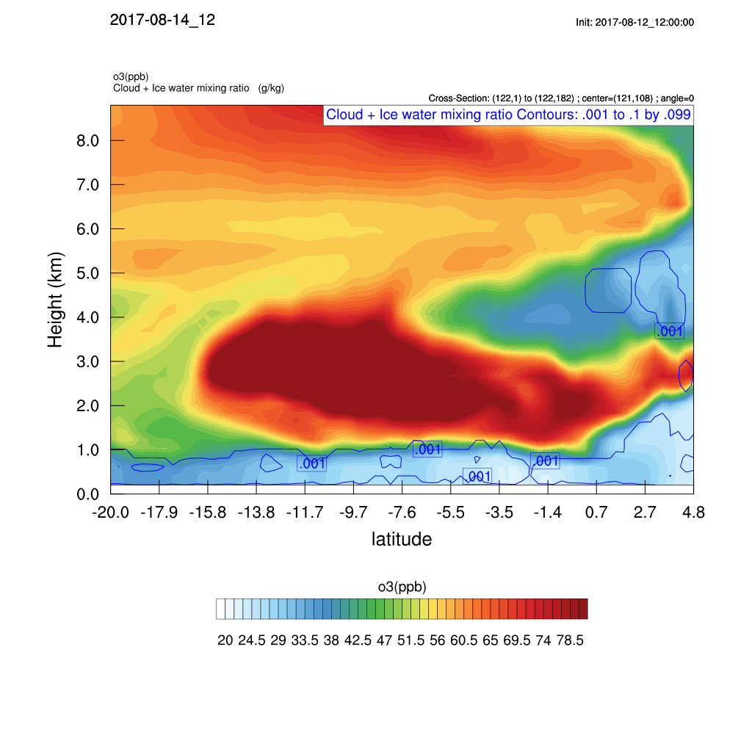
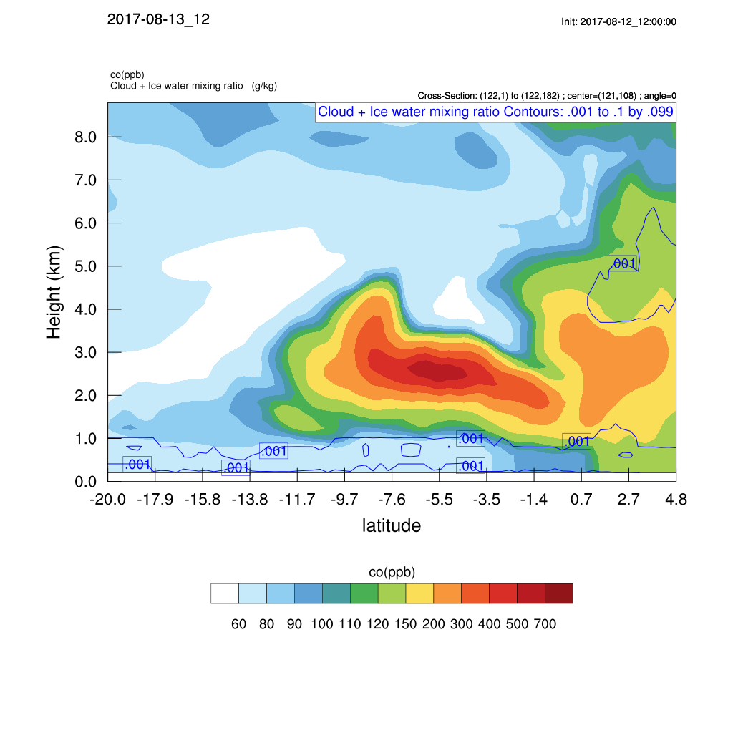
Sunday August 13 (12z) WRF-CAM5

Slide 31
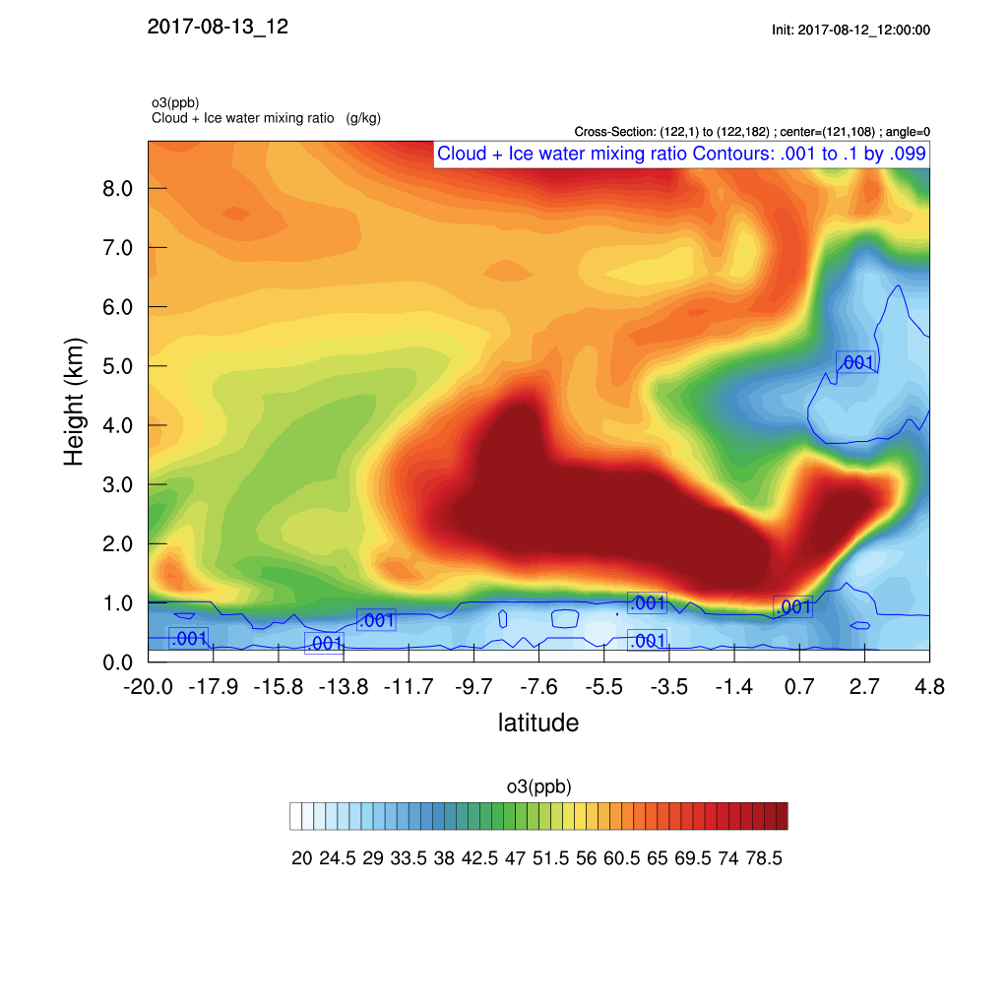
Sunday August 13 (12z) WRF-CAM5

Slide 32
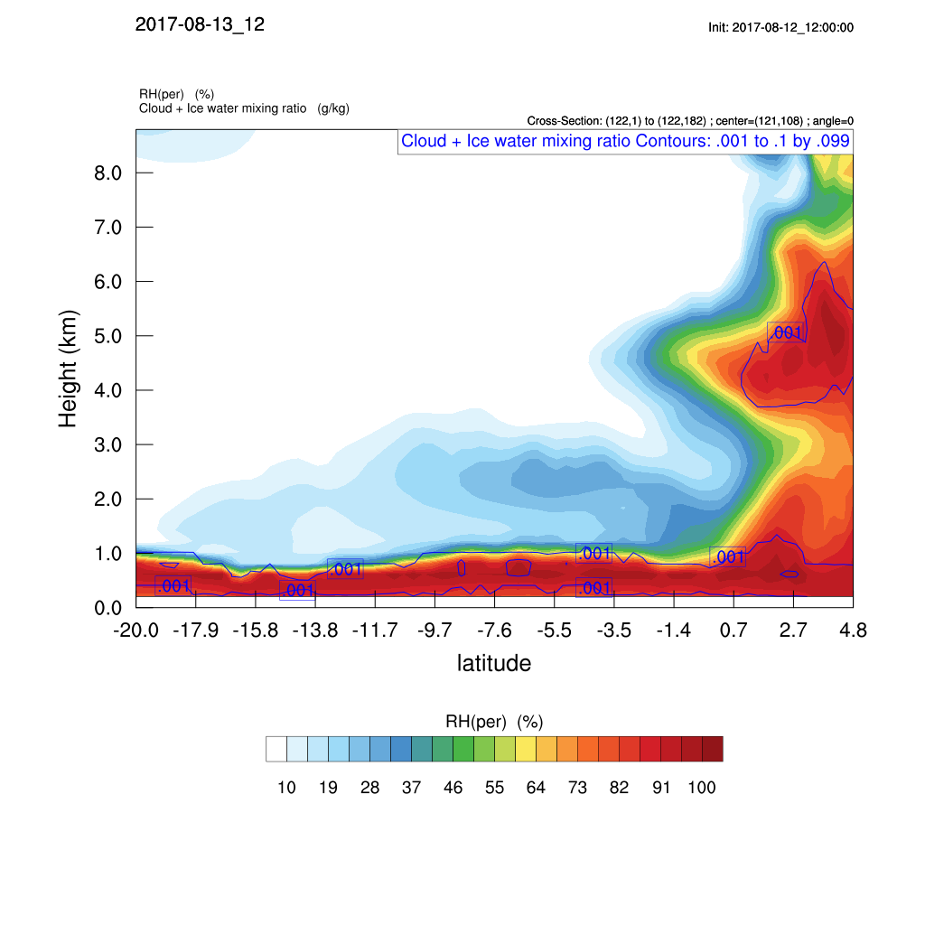
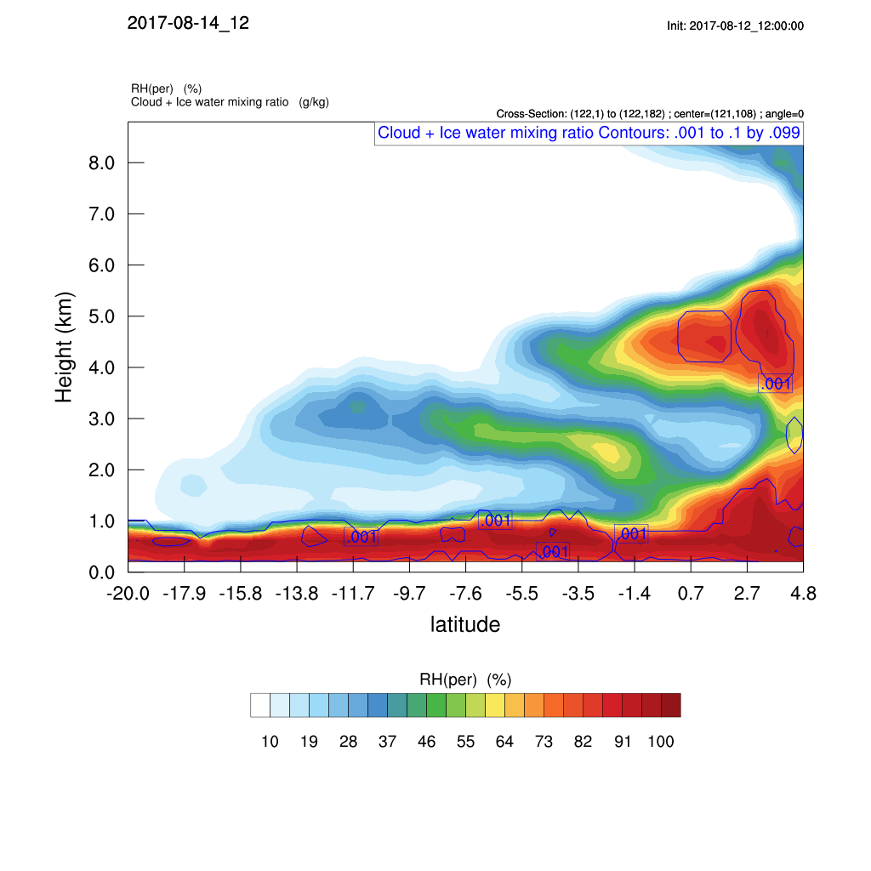
Sunday August 13 (12z) WRF-CAM5

Slide 33
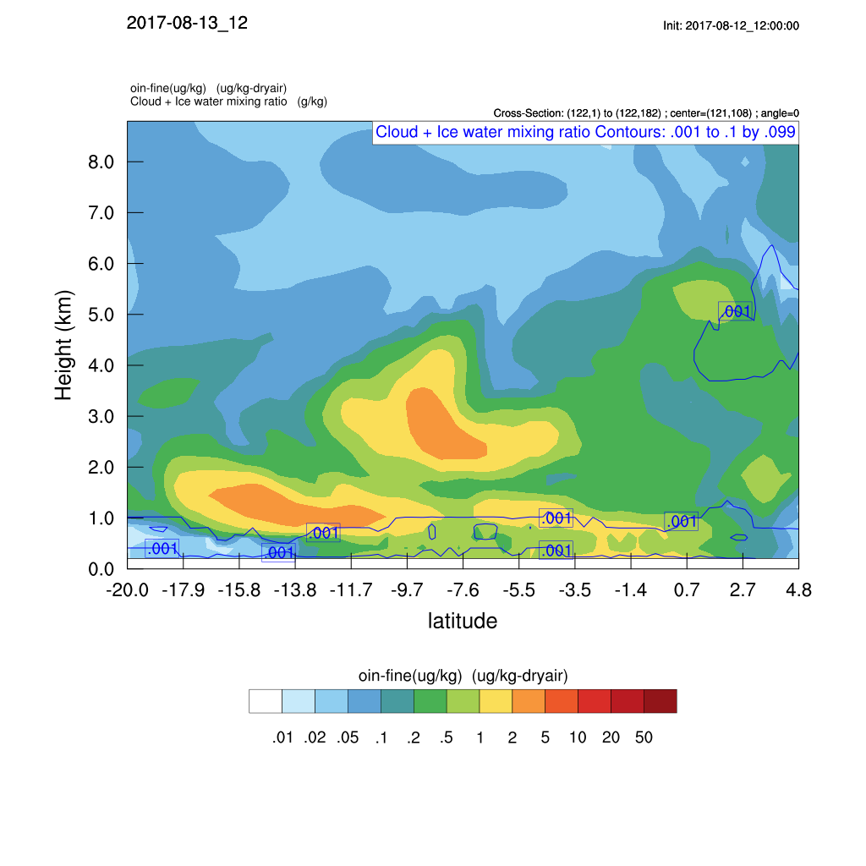
Sunday August 13 (12z) WRF-CAM5

Slide 34
Sunday August 13 (12z) WRF-CAM5

Slide 35
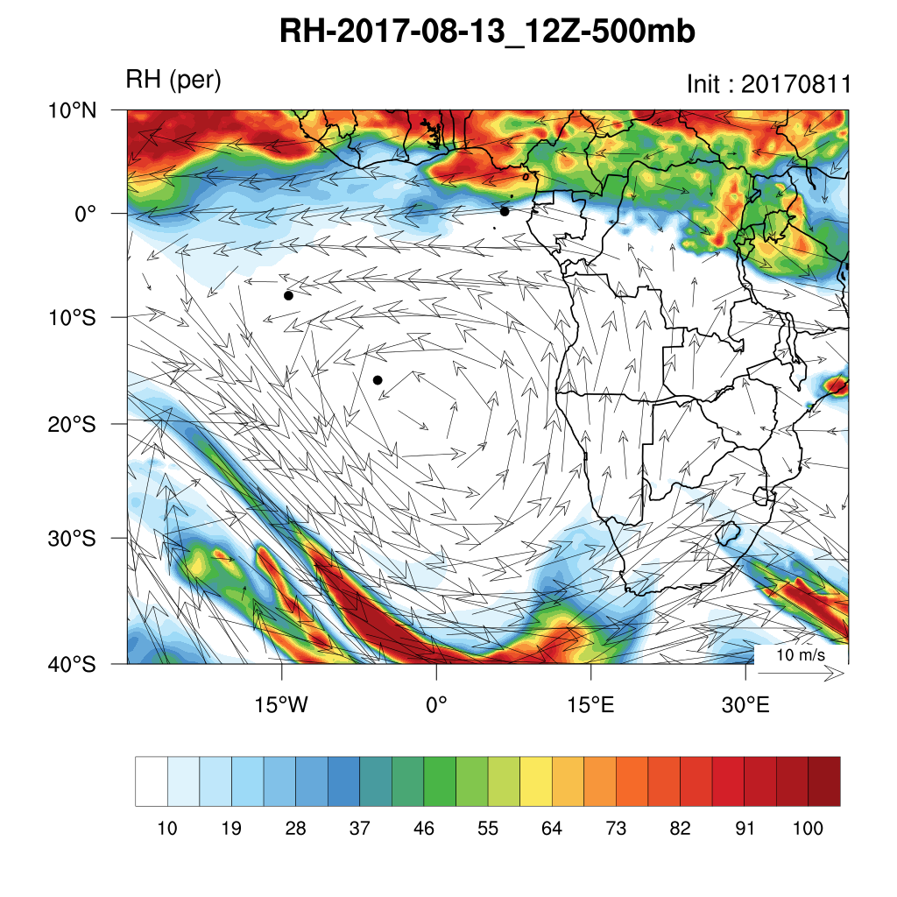
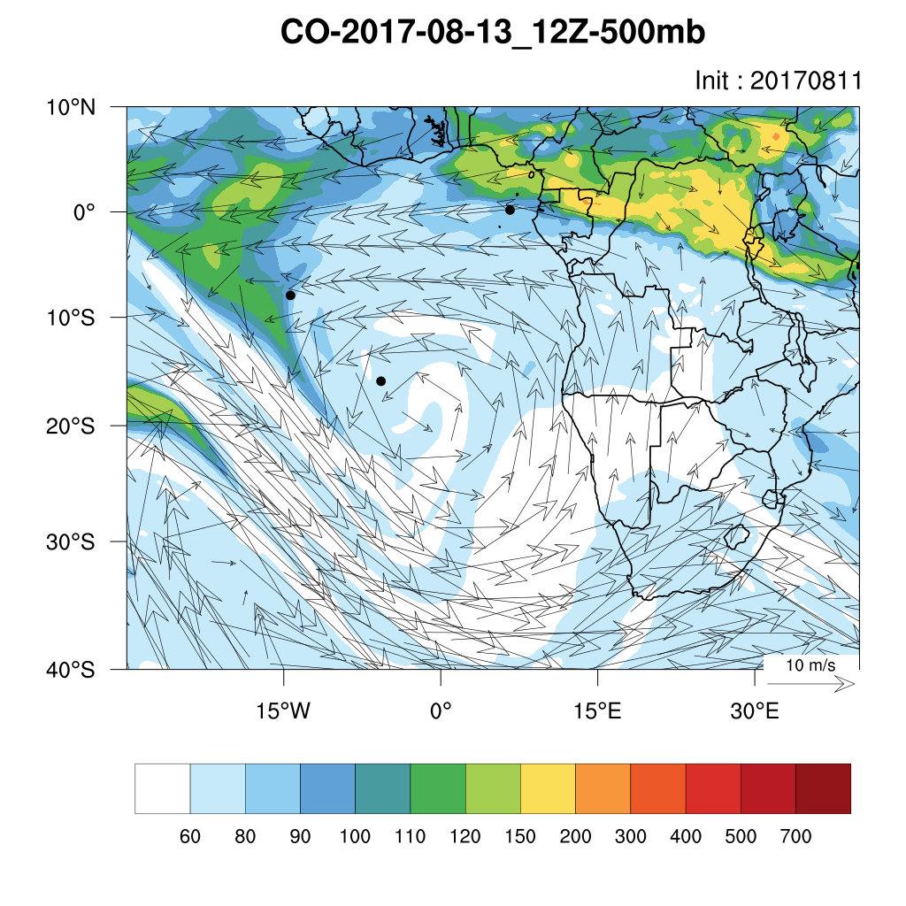
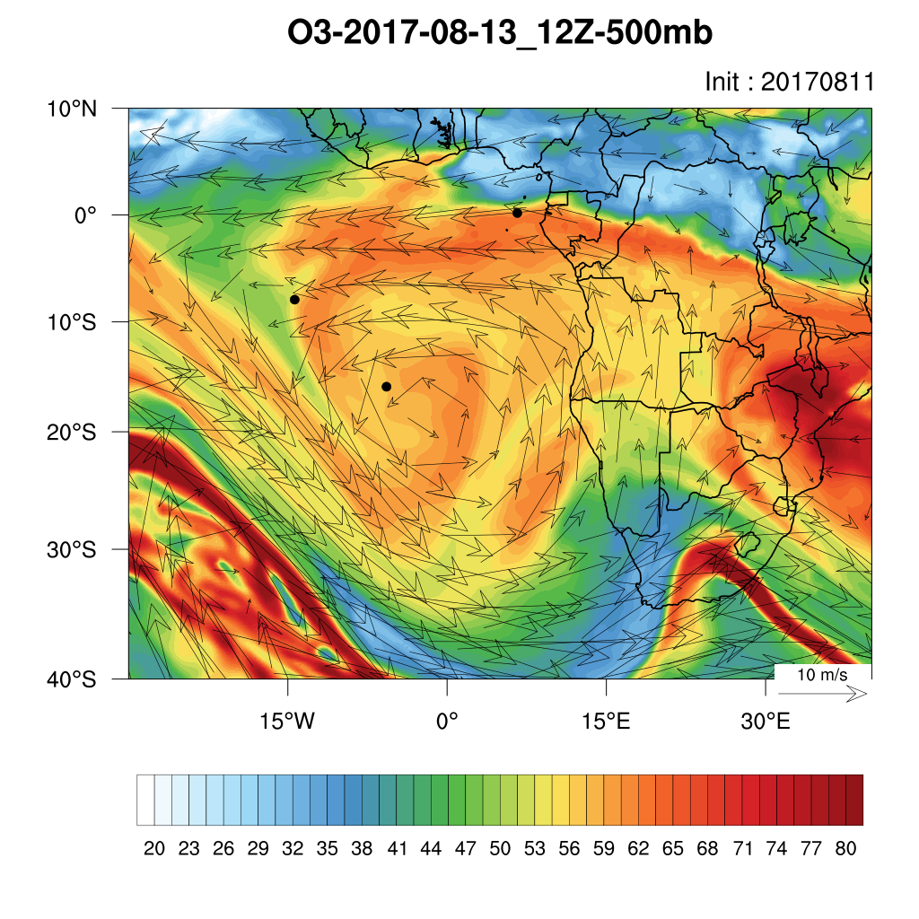
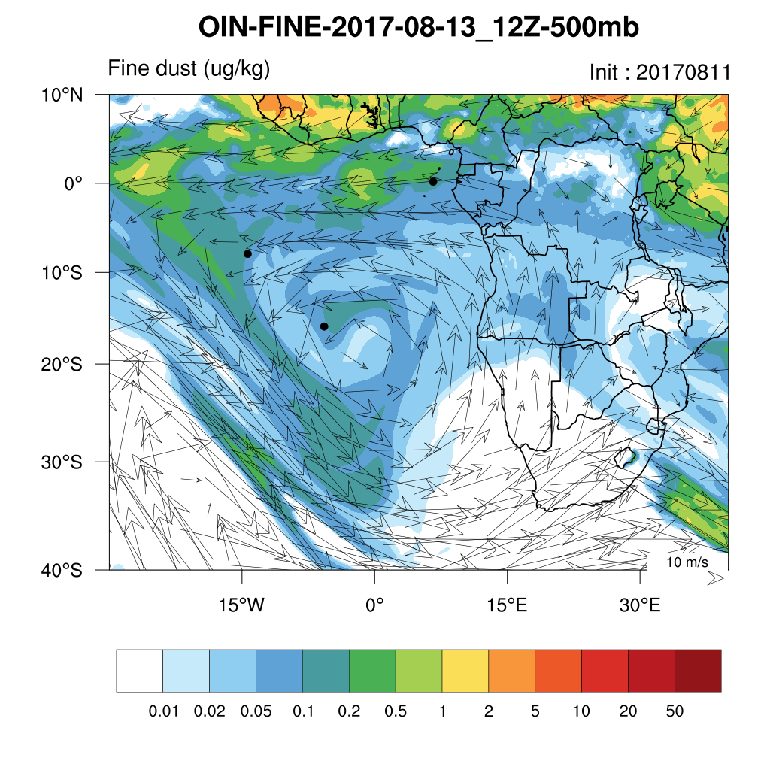
Sunday August 13 (12z) WRF-CAM5 (500hPa)

Slide 36
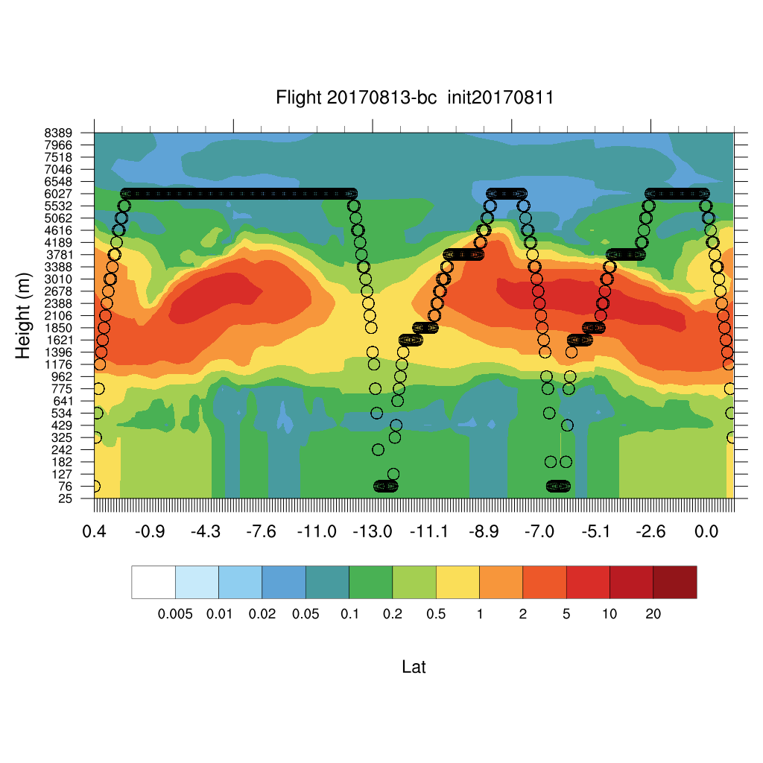
Sunday August 13 (12z) WRF-CAM5

Slide 37
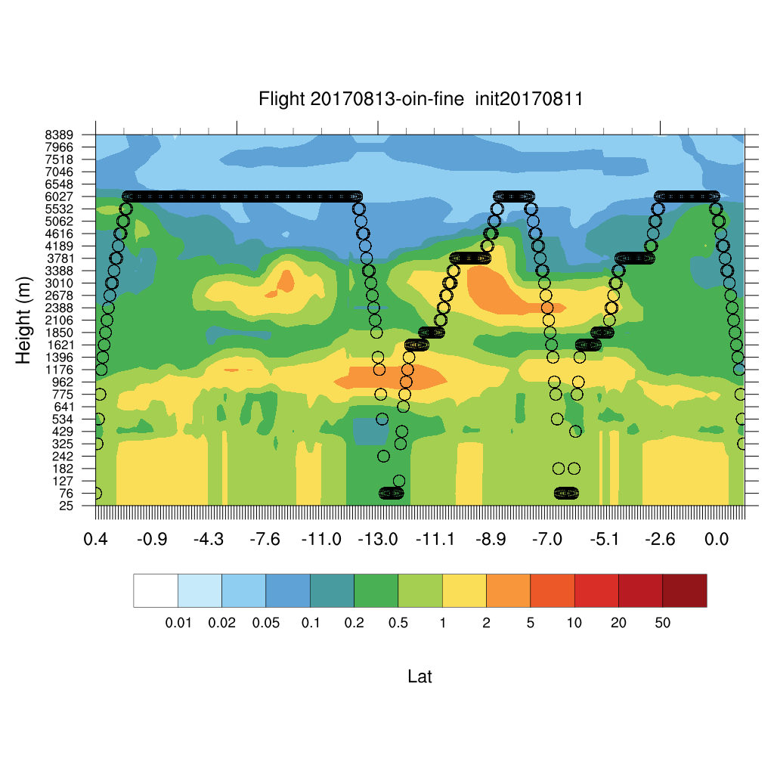
Sunday August 13 (12z) WRF-CAM5

Slide 38
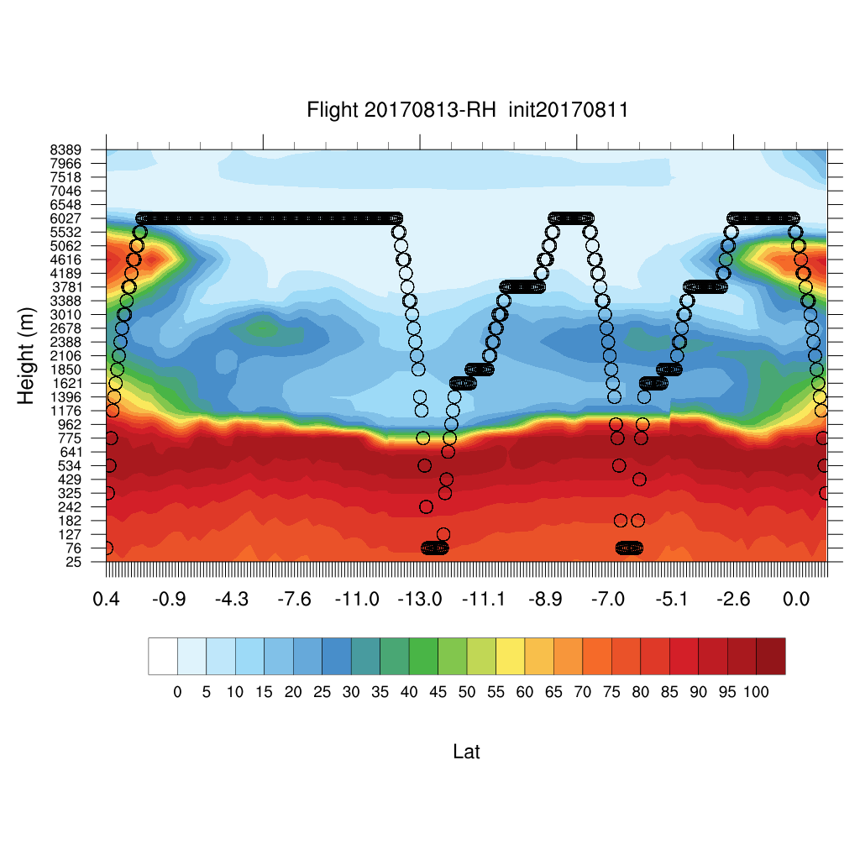
Sunday August 13 (12z) WRF-CAM5

Slide 39
Tuesday August 15

Slide 40
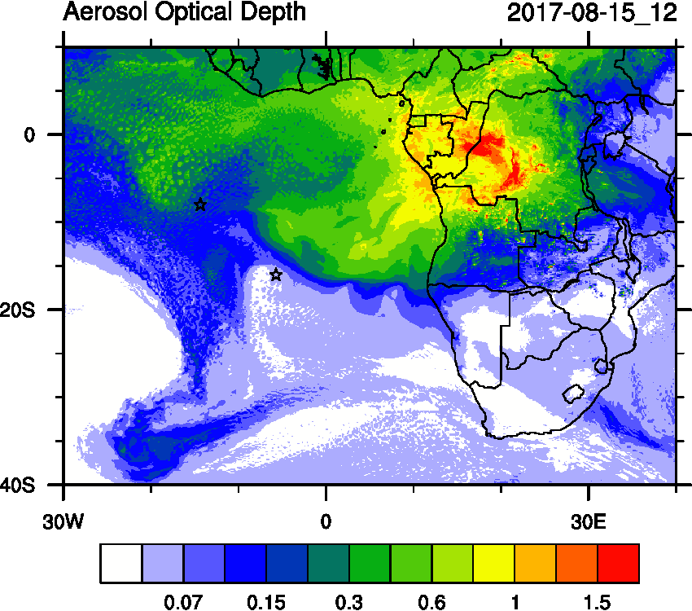
Tuesday August 15 (12z)
WRF-AAM
GEOS-5

Slide 41
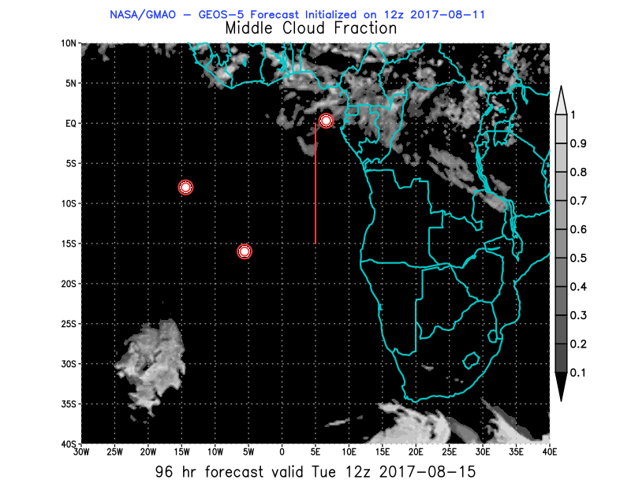
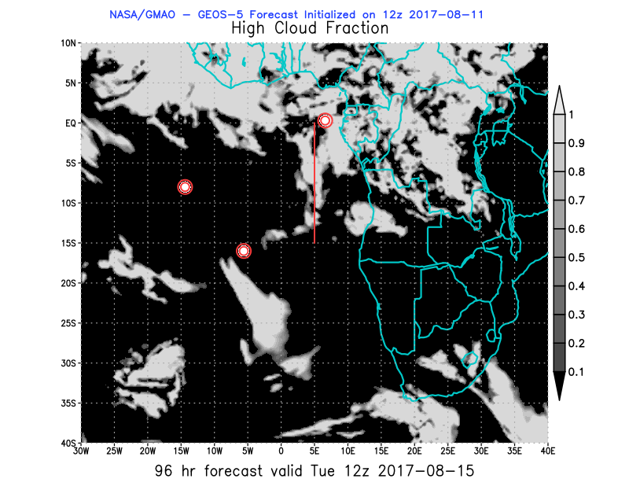
08/15 Tue (96h) 850 hPa 700hPa 600 hPa
08/11 12Z

Slide 42
Tuesday August 15 (12z) WRF-AAM

Slide 43
Saturday August 12 (12z) WRF-AAM

Slide 44
Sunday August 13 (12z) WRF-AAM

Slide 45
August 10
Meloe, CATS curtain on August 10 is indeed nice,

Slide 46
BC AOD 08/11-16

Slide 47
Ascension São Tomé e Príncipe Sta Helena
Sat-Wed August 12-16 GEOS-5

