Slide 1
ORACLES Forecast Briefing (Aerosols)
12 August 2017
Morning

Slide 2
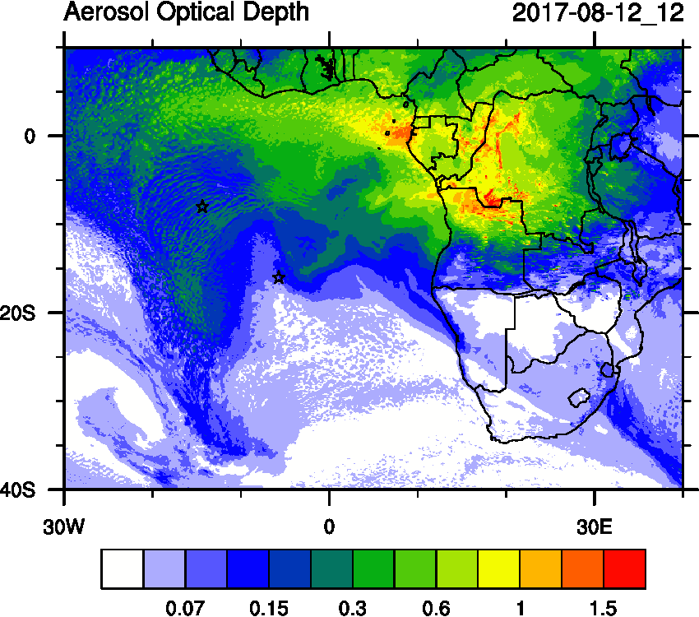
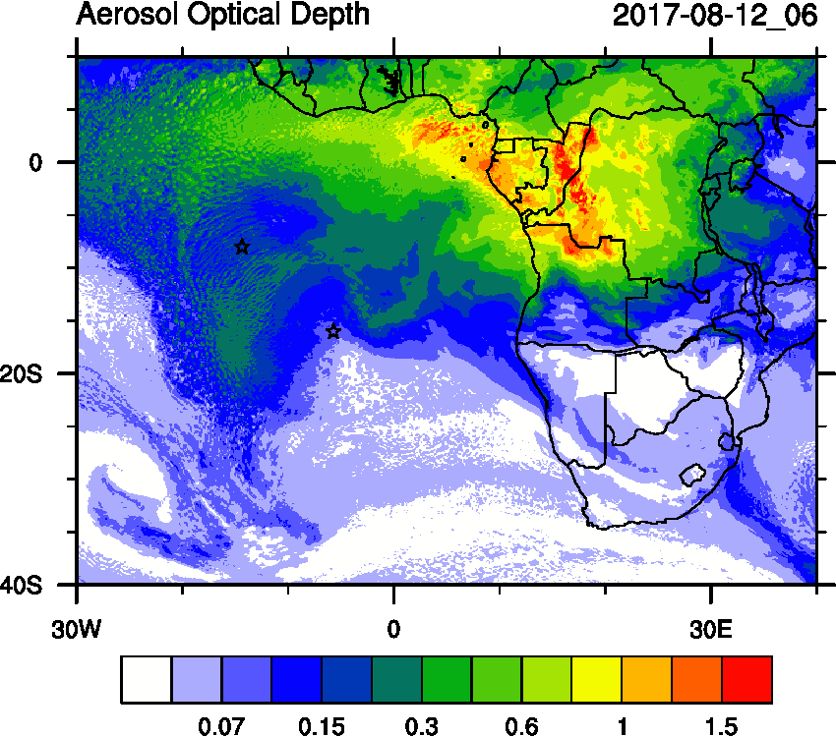
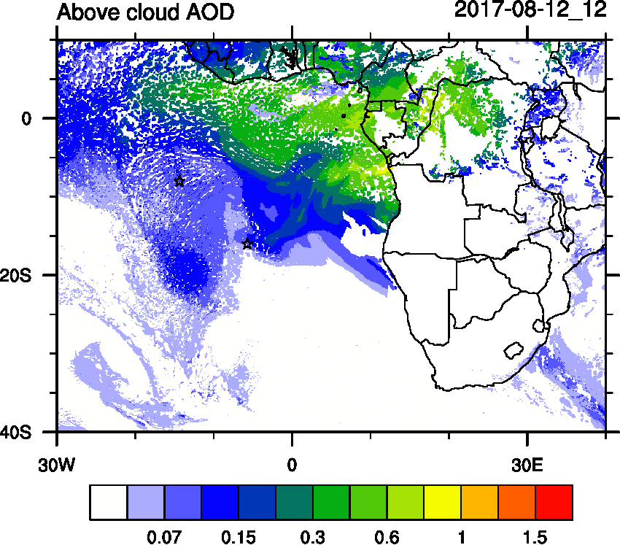
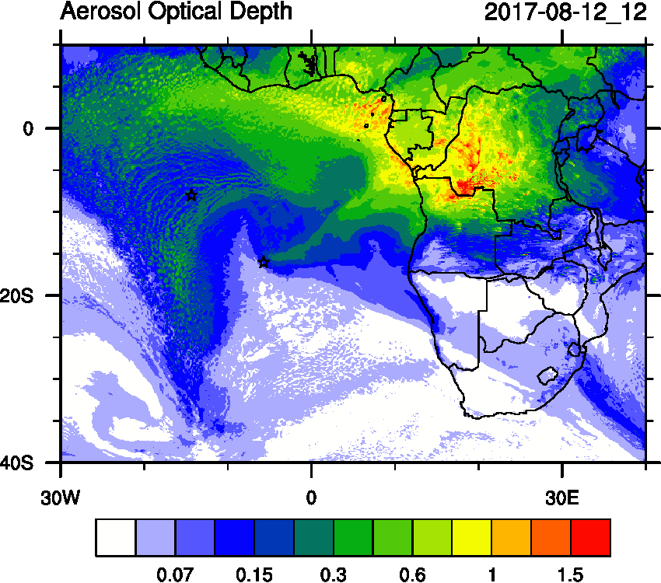
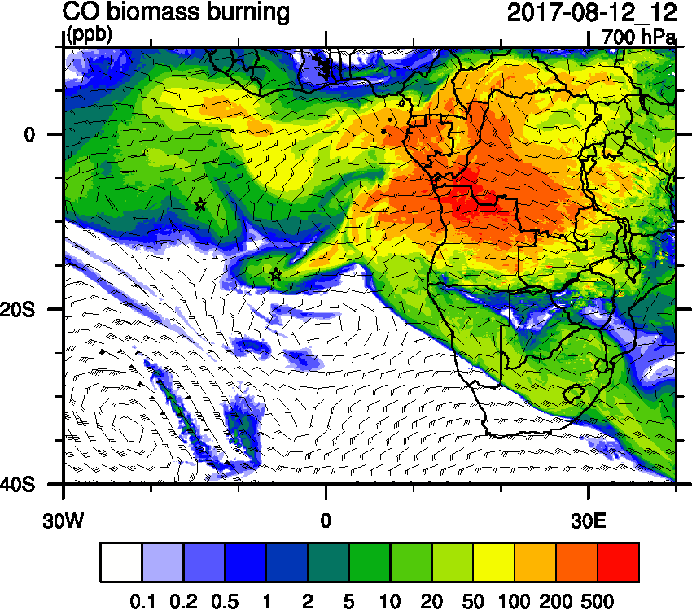
Saturday August 12 (12z) WRF-AAM today

Slide 3
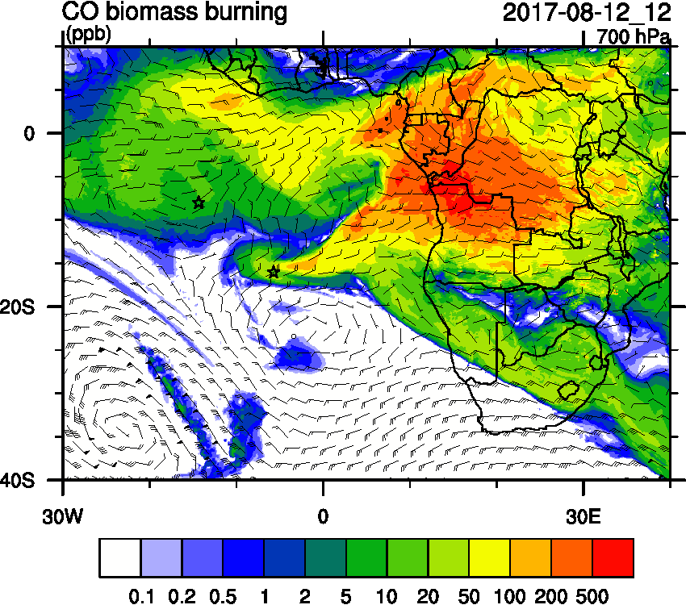
Saturday August 12 (12z) WRF-AAM

Slide 4
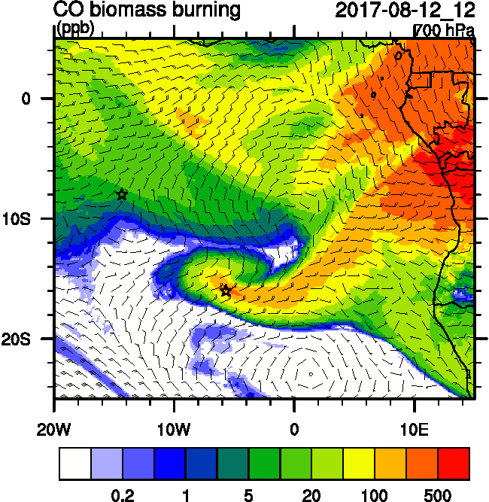
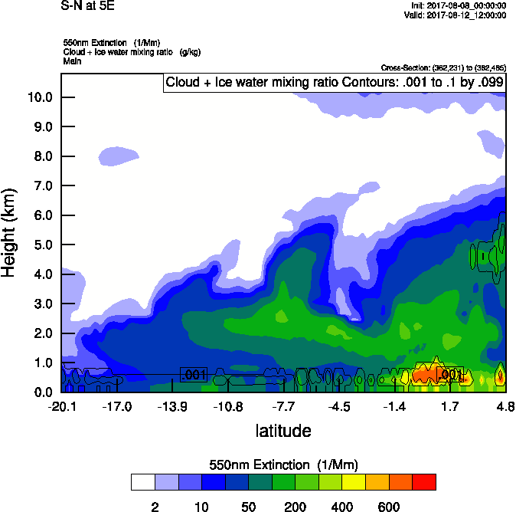
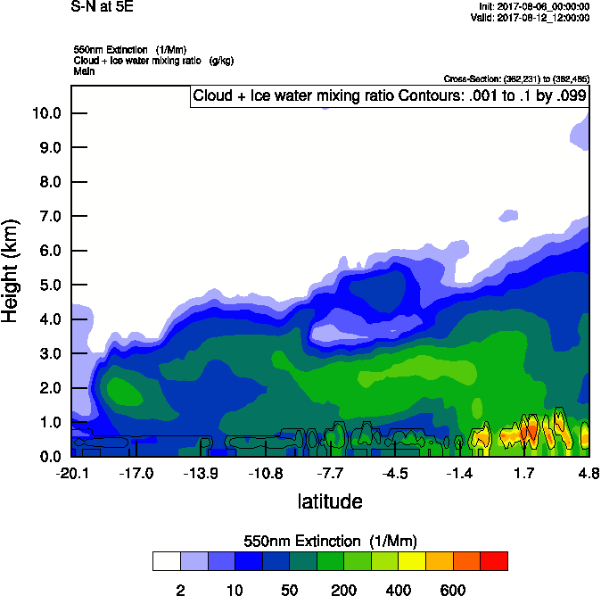
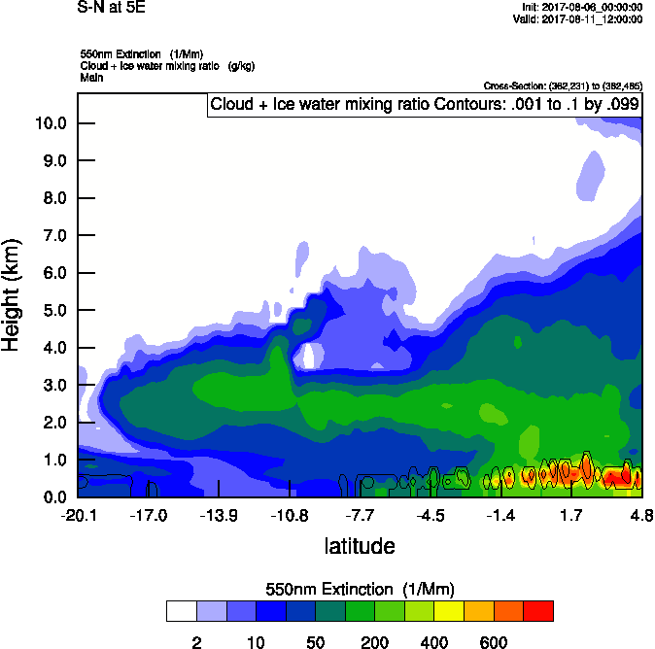
Saturday August 12 (12z) newest

Slide 5
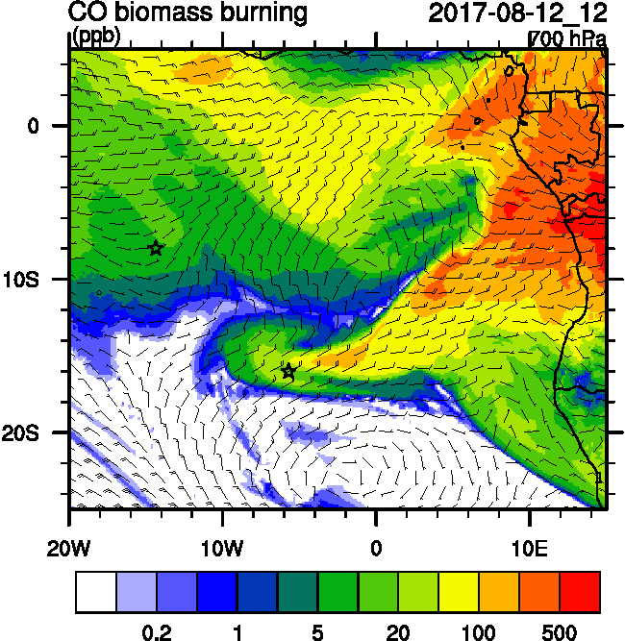
Saturday August 12 (12z)

Slide 6
Saturday August 12 (12z)

Slide 7
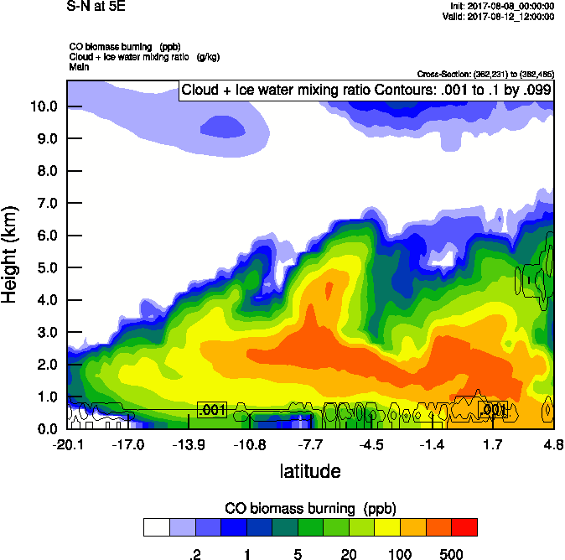
Saturday August 12 (12z) newest

Slide 8
Saturday August 12 (12z) newest

Slide 9
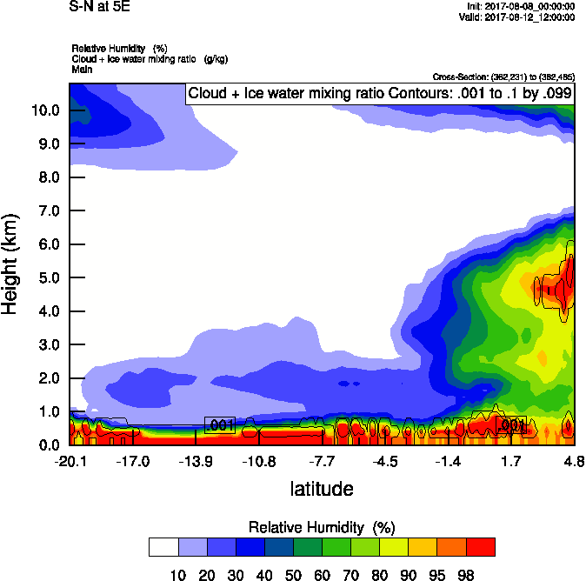
Saturday August 12 (12z) newest

Slide 10
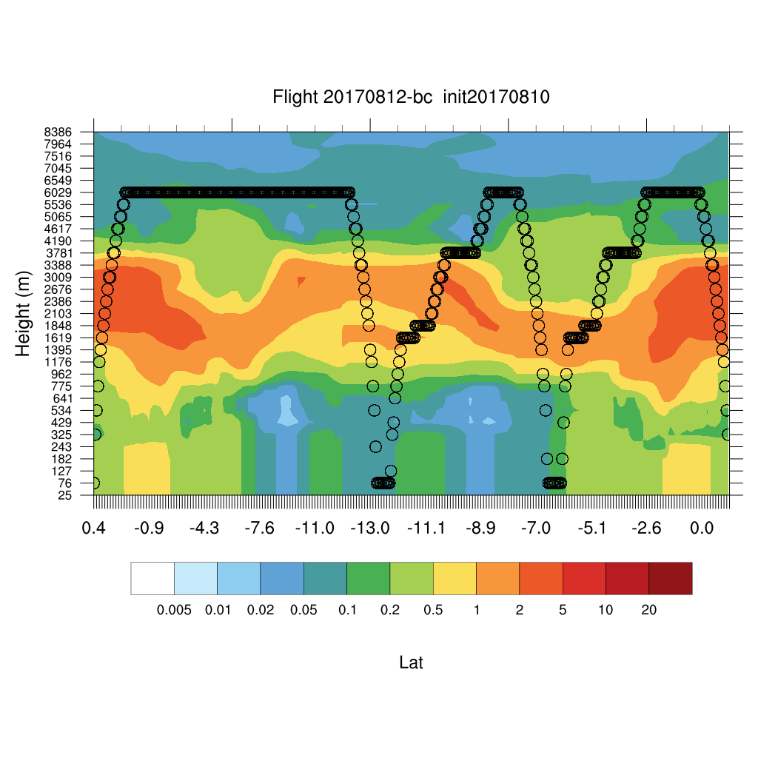
Saturday August 12 (12z) newest

