Slide 1
ORACLES weather briefing
11-Aug-2017
Lenny Pfister and Rei Ueyama

Slide 2
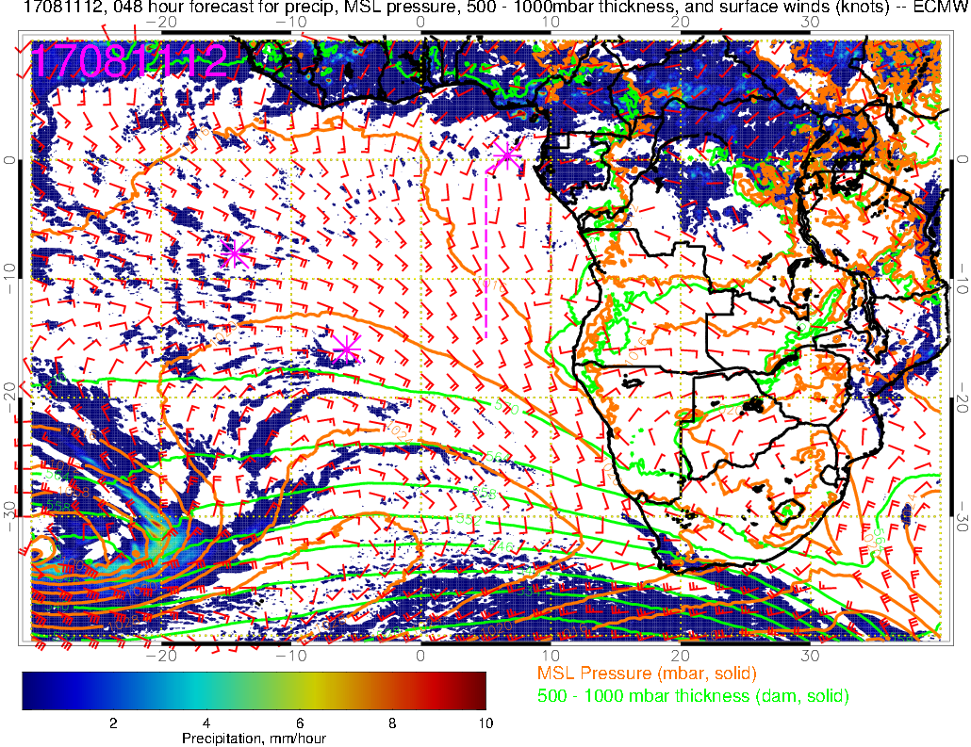
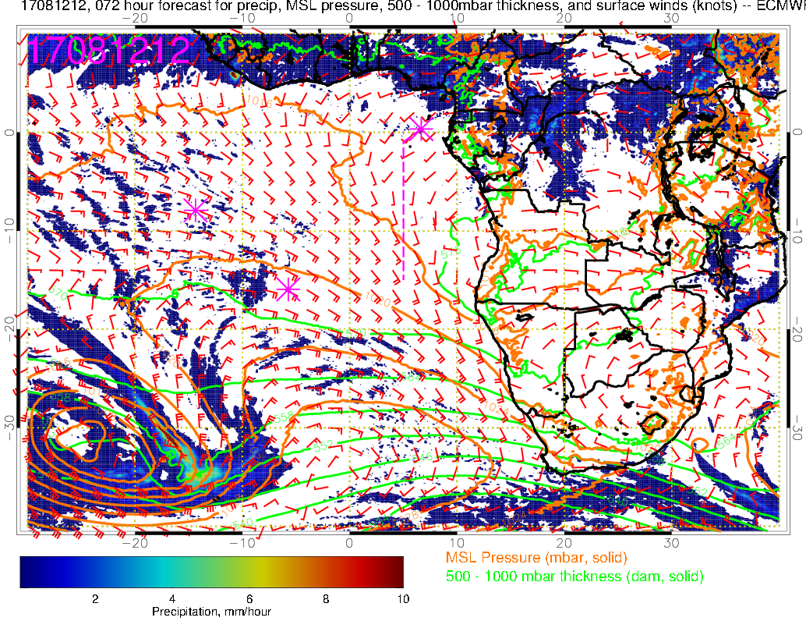
Precip, surface winds, 500-1000mb thickness for 8/11-12 @ 12PM
8/11 Friday
Yesterday’s 48 and 72 hour forecasts
8/12 Saturday
L
H
L
H

Slide 3
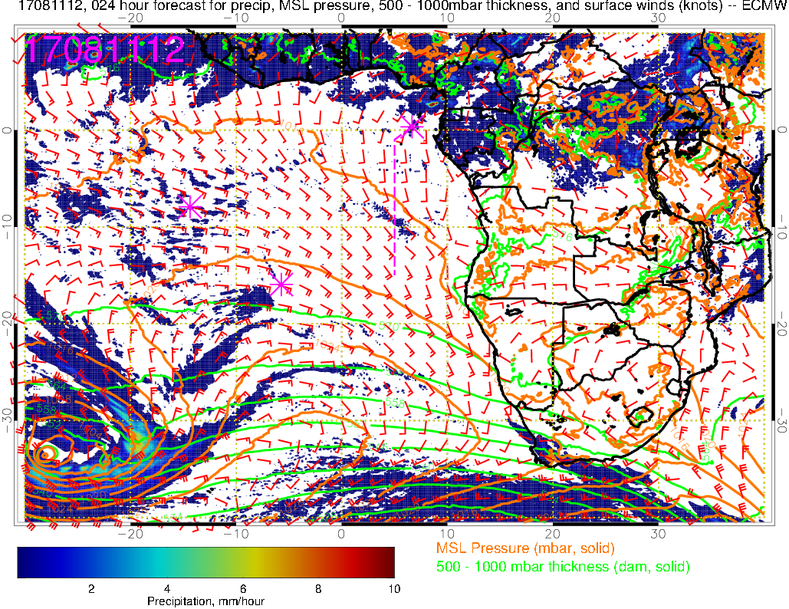
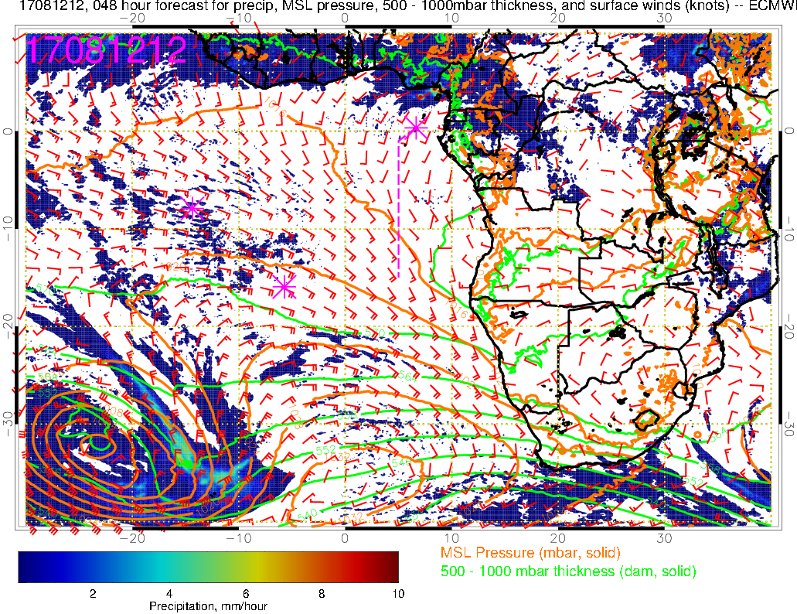
Precip, surface winds, 500-1000mb thickness for 8/11-12 @ 12PM
8/11 Friday
Surface Low and High are moving eastward faster than yesterday’s forecasts
8/12 Saturday
L
H
- Winds turning S to SSW near TMS (close to W by Tue)
- Similar (or slightly stronger) winds Sat than Fri with similar mid-high cloud conditions so temperature at 8am takeoff probably similar to (or less than) today (i.e., 25-26C)
L
H

Slide 4
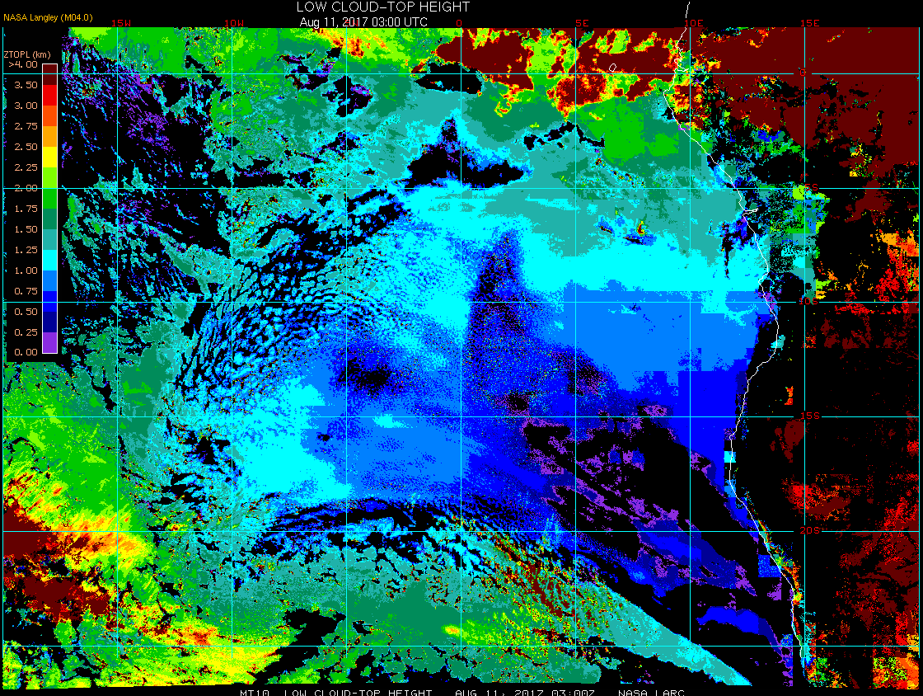
Low cloud top heights at 8/11 Fri @ 3AM
15W
10W
5W
0
5E
mid clouds (tops 5-6 km) over TMS this morning
5S
10S
High clouds
Clear-sky region SW of TMS
15S

Slide 5
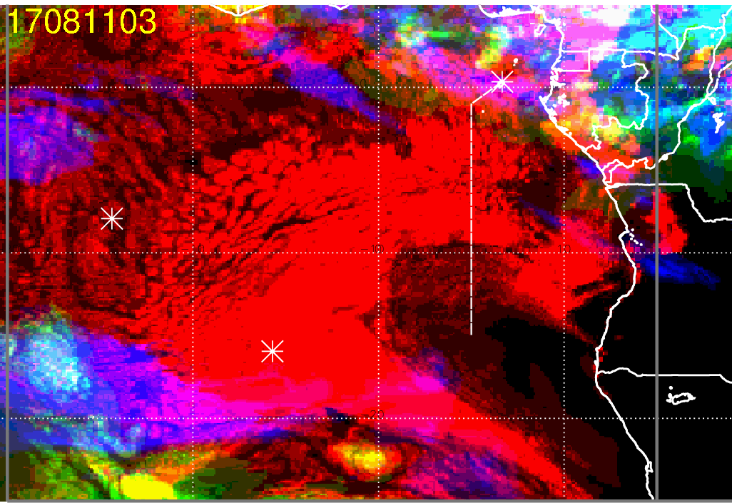
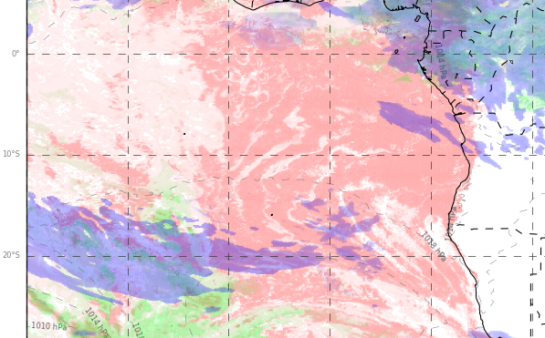
ECMWF (39-hr)
Clouds at 8/11 Fri @ 3AM
SW “gap” somewhat there in ECMWF, but SE “gap” is not evident in observations; UKMO has no gap in low clouds
Clear-sky region off Namibia coast not too bad in both models (UKMO a bit much)
mid and high clouds are overestimated
UKMO (39-hr)

Slide 6
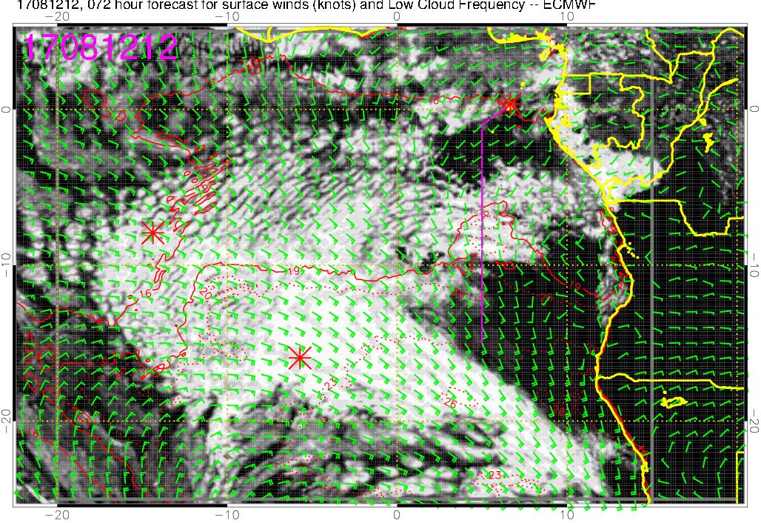
Low cloud forecast on 8/12 Sat @ 12PM - yesterday’s 72-hr forecast

Slide 7
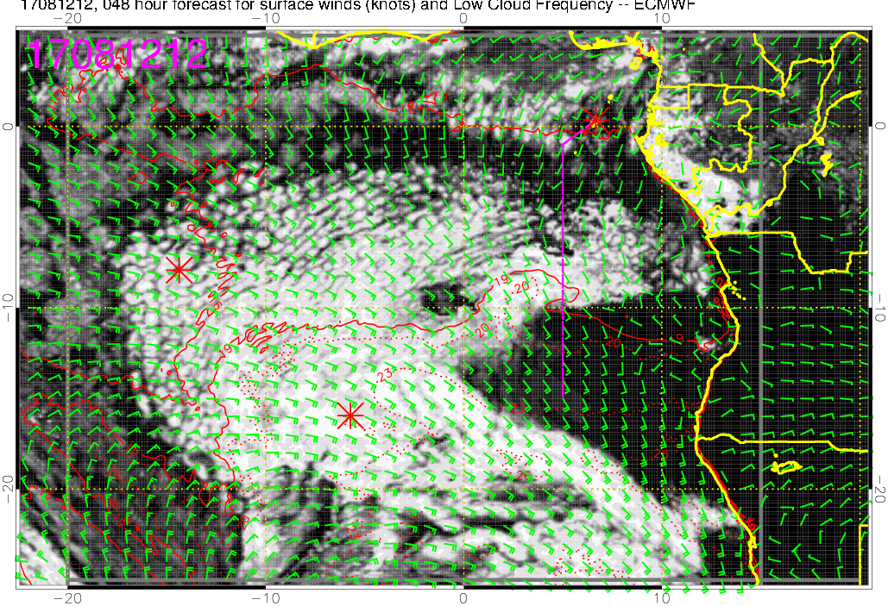
Low cloud forecast on 8/12 Sat @ 12PM
A larger “gap” than yesterday’s forecast (but not entirely cloud free)
Clouds retreating since yesterday’s forecast (same tendency in UKMO)
Most dense low clouds will be between 8-10S along the flight track

Slide 8
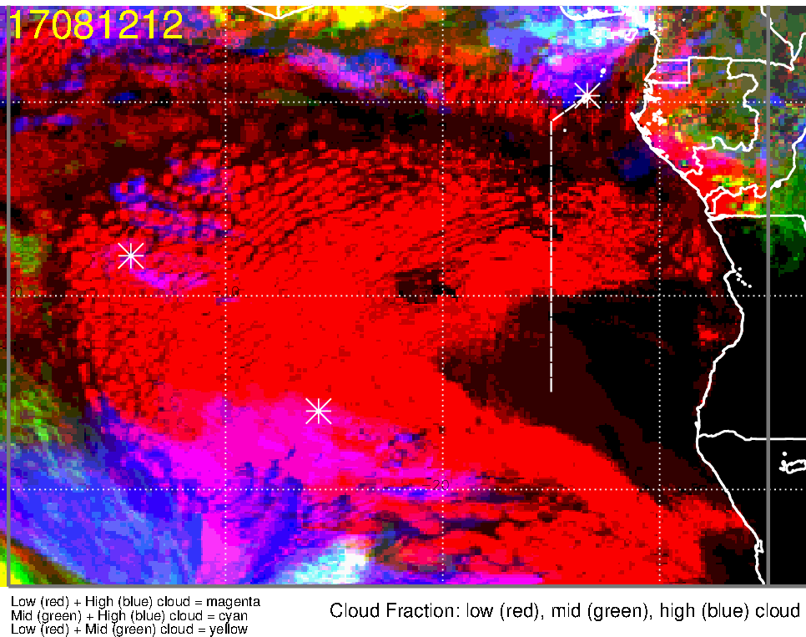
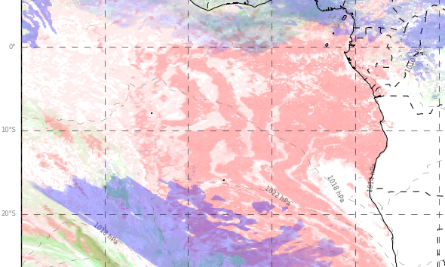
Low, middle, high cloud forecast for 8/12 Sat @ 12PM
ECMWF (48-hr)
UKMO (48-hr)
High clouds
High clouds
Most abundant low clouds 8-10S
Middle and high clouds should not be an issue (north of TMS)
Both models forecasting less high clouds NE of TMS compared to yesterday’s forecast

Slide 9
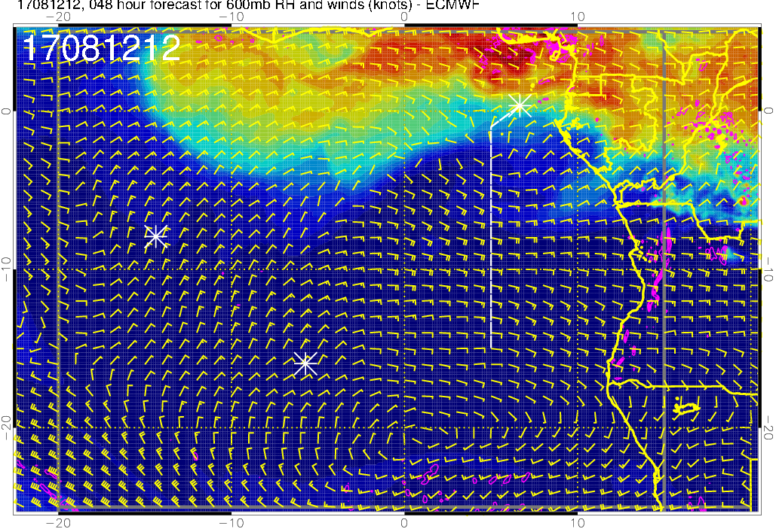
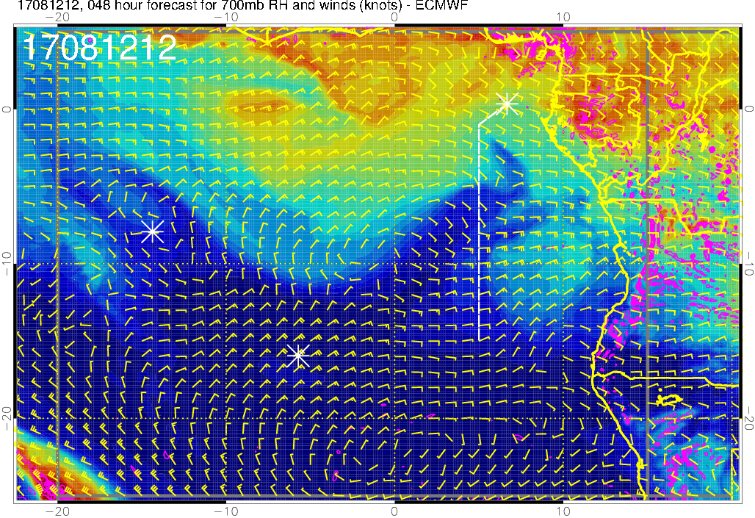
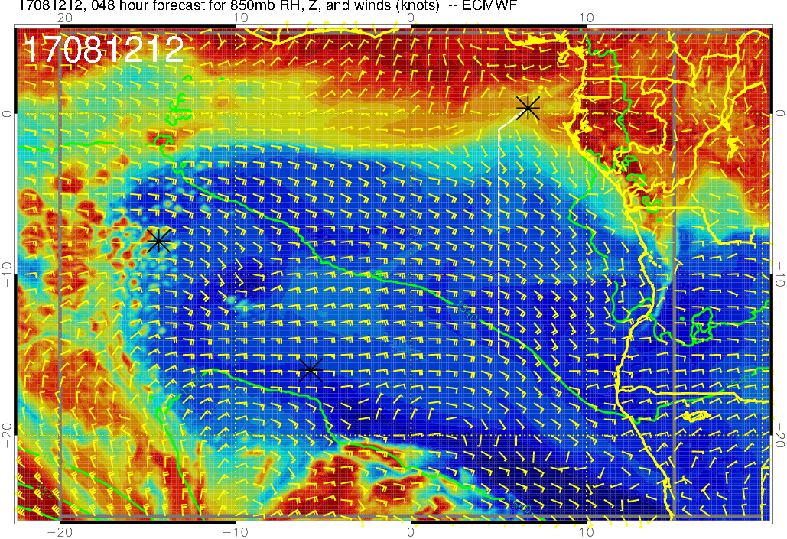
RH (color), winds, vert. velocity (pink) at 8/12 Sat @ 12PM
600 mb
700 mb
Mid-levels are dry
Moisture (influenced by moist convection) is at Sao Tome and northward
850 mb

Slide 10
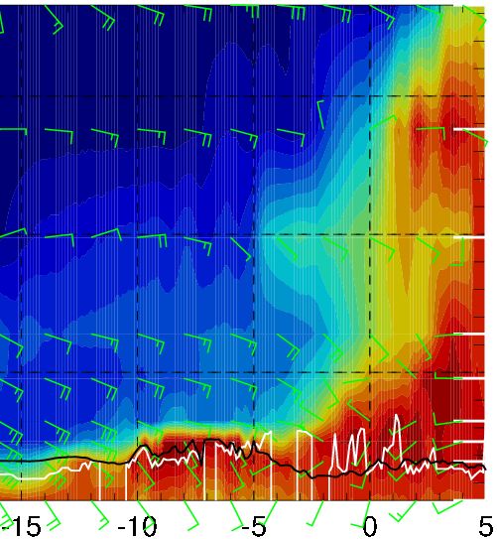
RH forecasts for 8/12 Sat @ 12PM
RH (color), wind, BL and cloud base heights along 5E
700mb RH, winds
15-25 knts
10-20 knts
Plume transport from dry convection (700mb, 10kft) not quite reaching the flight track (but more so in today’s forecast)
Cross winds (Ely) above 3kft, SW winds shifting to SE winds at surface ~5S
5-20 knts
10-20 knts
SE (south of 5S)
SW (north of 5S)

Slide 11
Saturday 8/12
Takeoff temperatures similar to today (25-26C) based on winds and mid-high cloud cover
Low clouds expected 5-10S with most dense clouds 8-10S
High and middle clouds will likely NOT be a problem (mostly to the north)
Mid levels are dry; don’t expect much plume transport from dry convection reaching our flight track
~10-20 knot crosswinds in the 5-15 kft layer along the N-S leg

Slide 12
Sunday

Slide 13
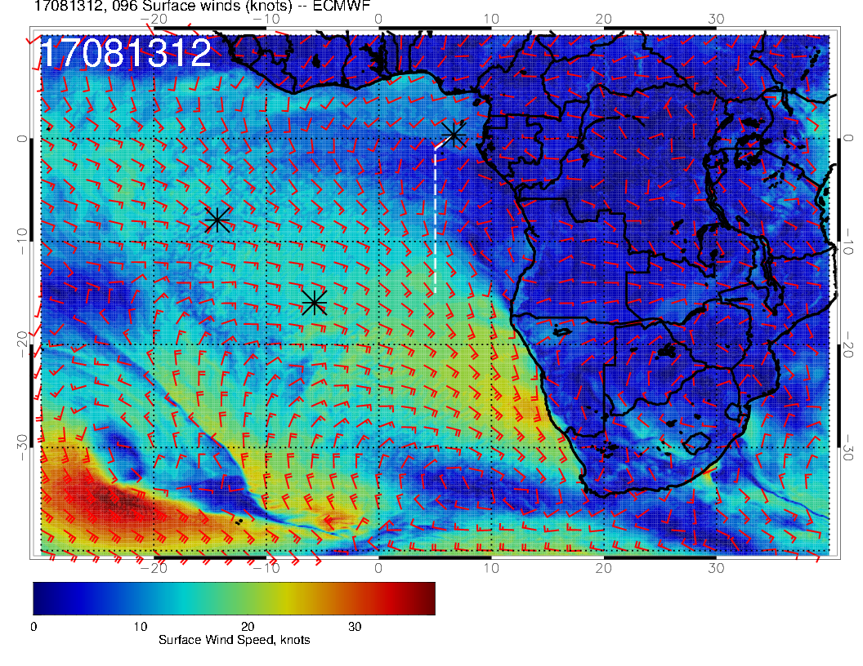
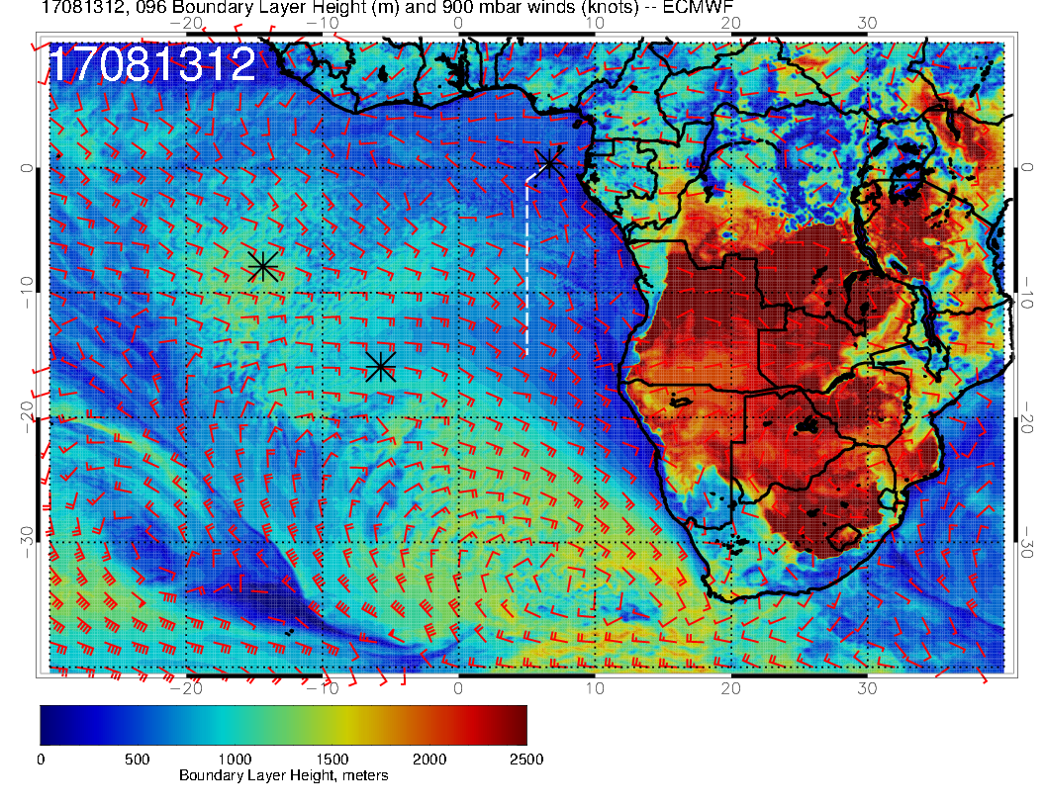
OLD FORECAST
SUNDAY SURFACE WINDS
L
H
L
SUNDAY BL HEIGHTS

Slide 14
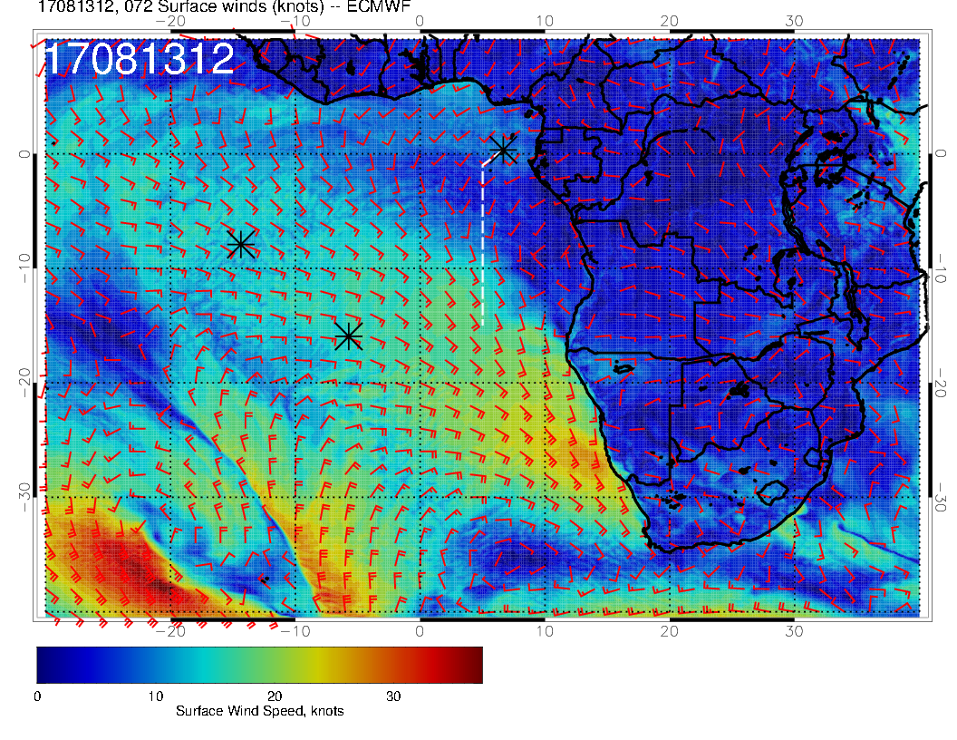
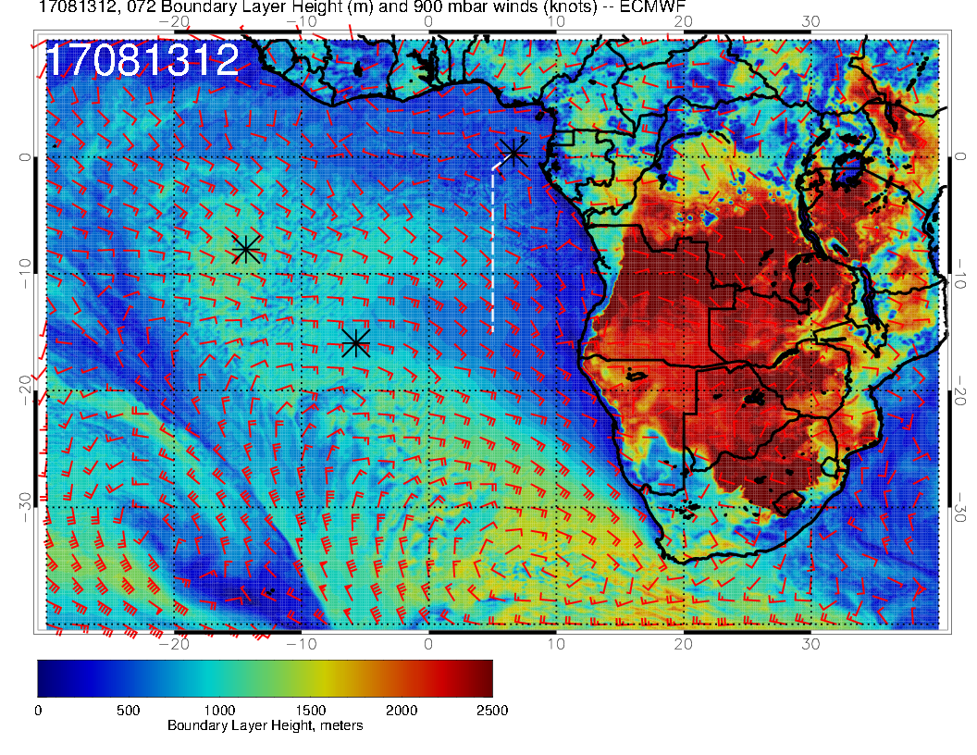
NEW FORECAST
SUNDAY SURFACE WINDS
SUNDAY SURFACE WINDS
L
L
H
H
L
Little change from yesterday’s forecast. Low pressure system to west is NOT progressing. Wind direction south of TMS more southwesterly.
SUNDAY BL HEIGHTS
SUNDAY BL HEIGHTS

Slide 15
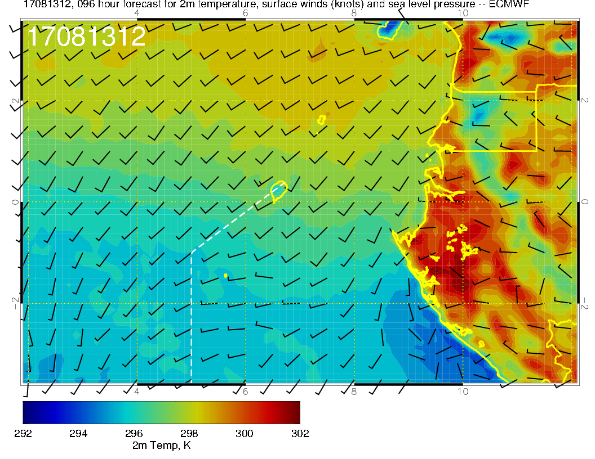
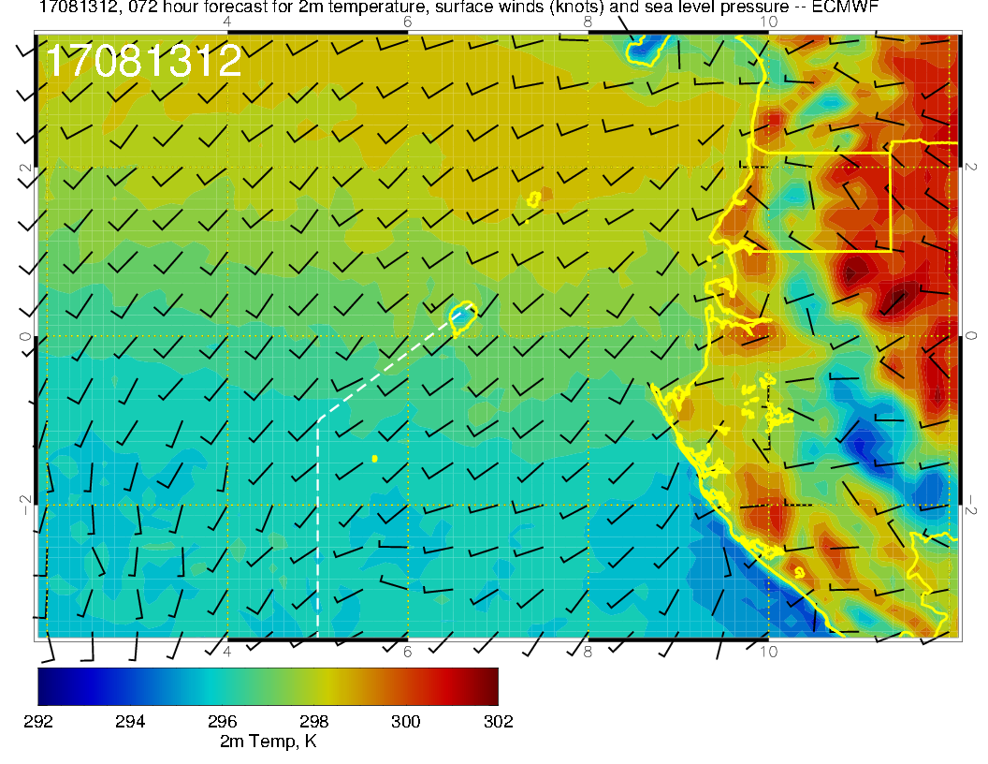
Not much change in pattern over the island with the old (above) and new (right) forecasts. Westerlies to the south are less extensive.

Slide 16
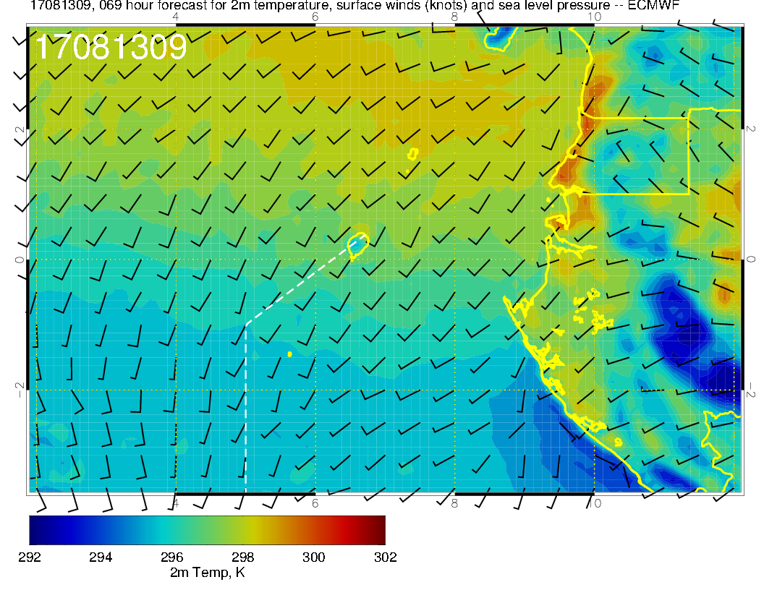
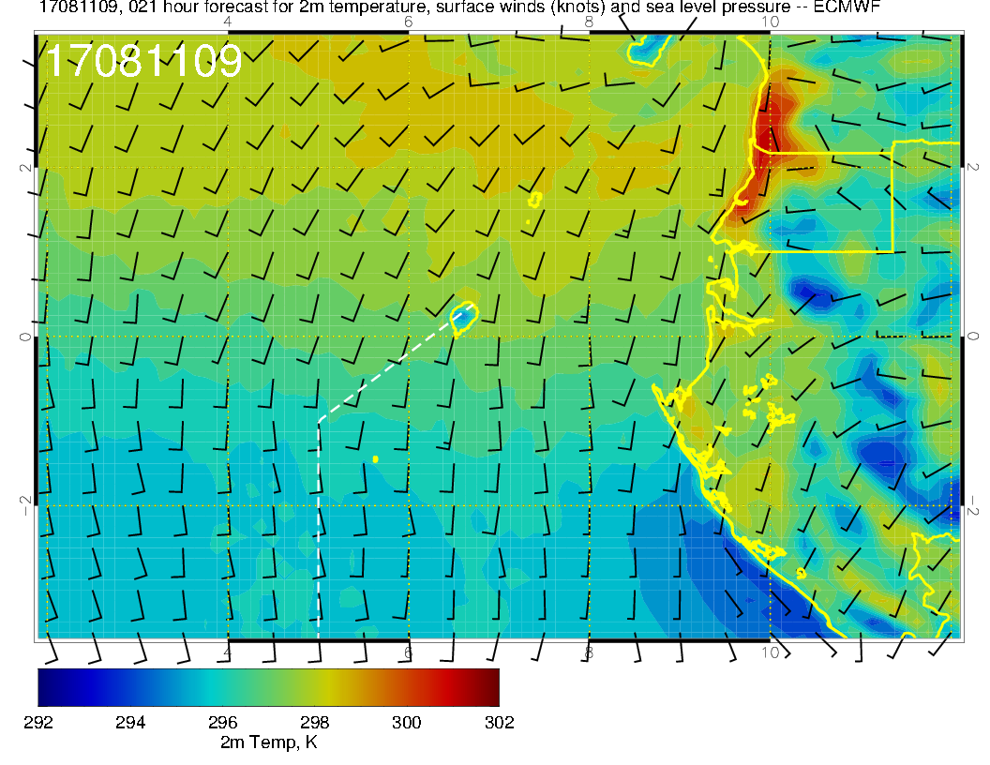
Surface conditions forecast for Sunday TO (above), and this morning (right) TO time. Winds are more westerly on Sunday, so might expect warmer T. Middle cloud cover should be about the same, with less low cloud forecast for Sunday. Expect it to be warmer than today.

Slide 17
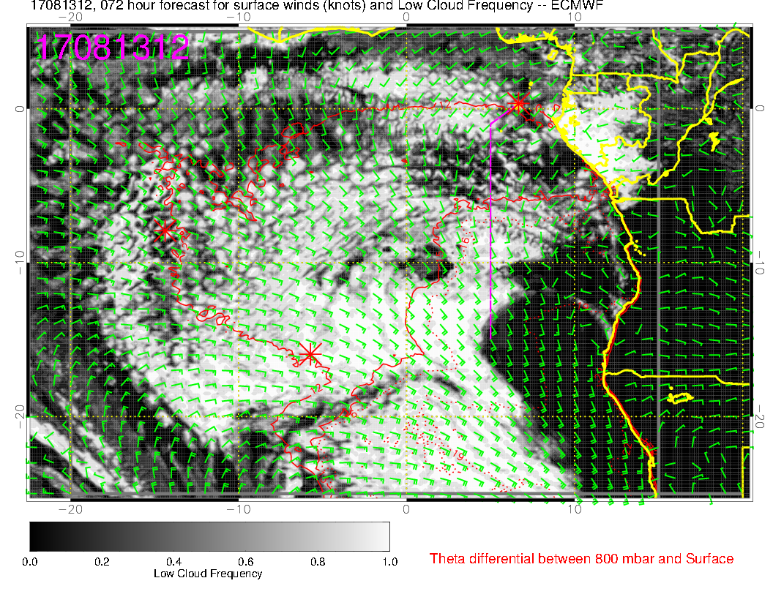
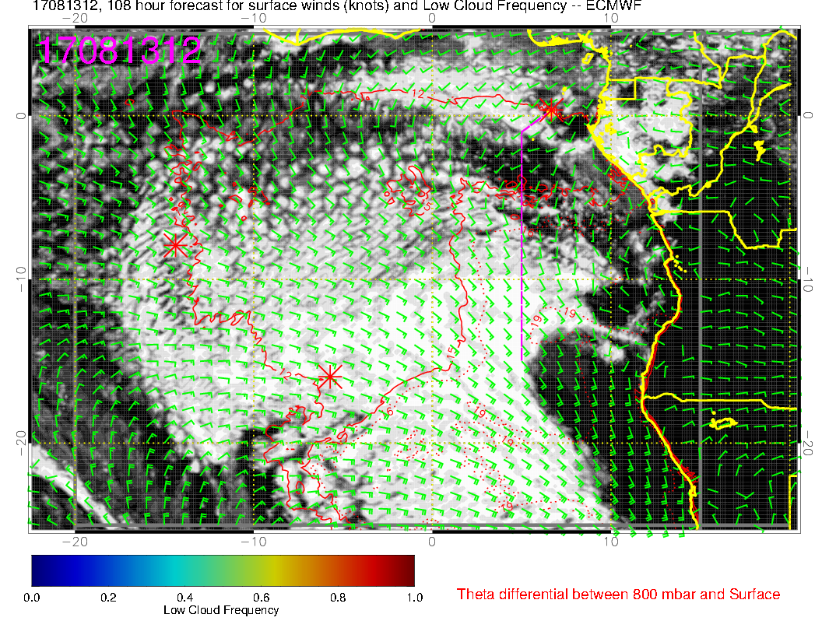
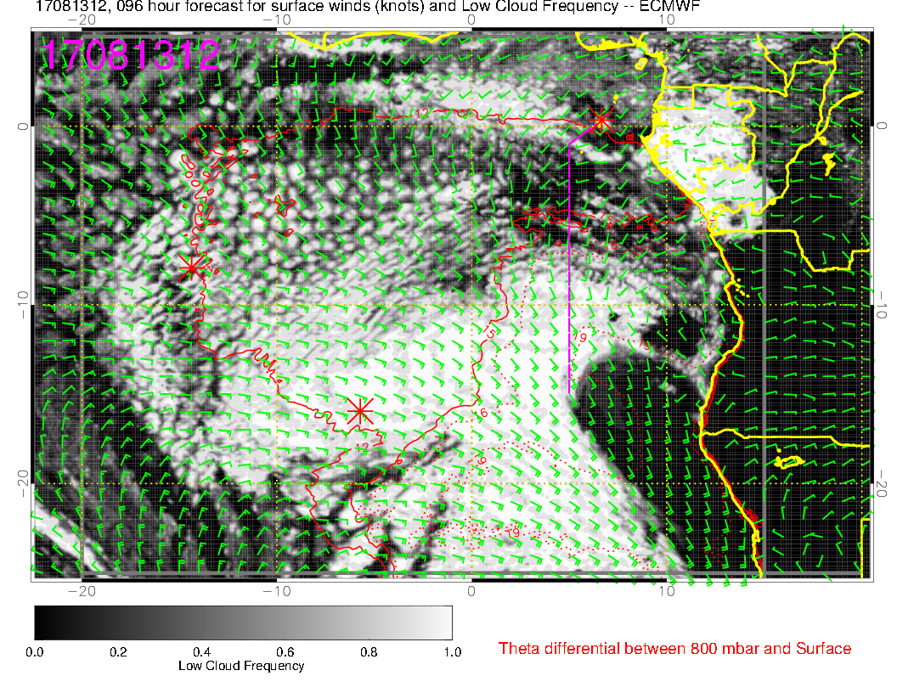
10S
SUNDAY, very old
Sunday, new fcst
Forecast is fairly stable. Newer fcsts enlarge the coastal clearing in Angola and Namibia, and “thin out” a bit in northwestern areas. The “gap” is becoming less pronounced (there isn’t any this morning)
T
SUNDAY, old

Slide 18
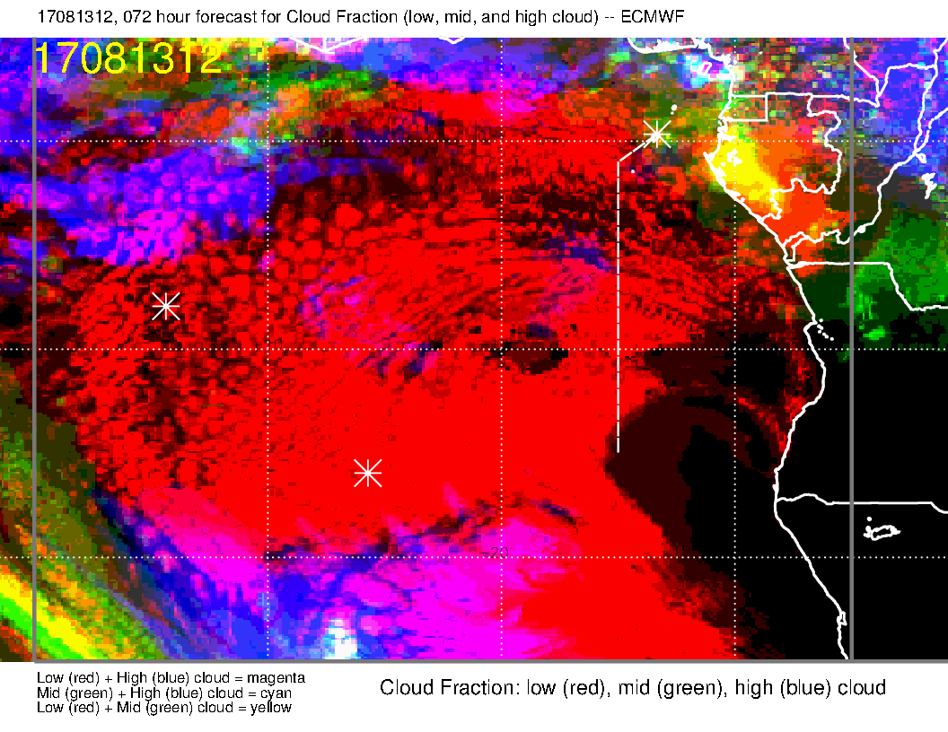
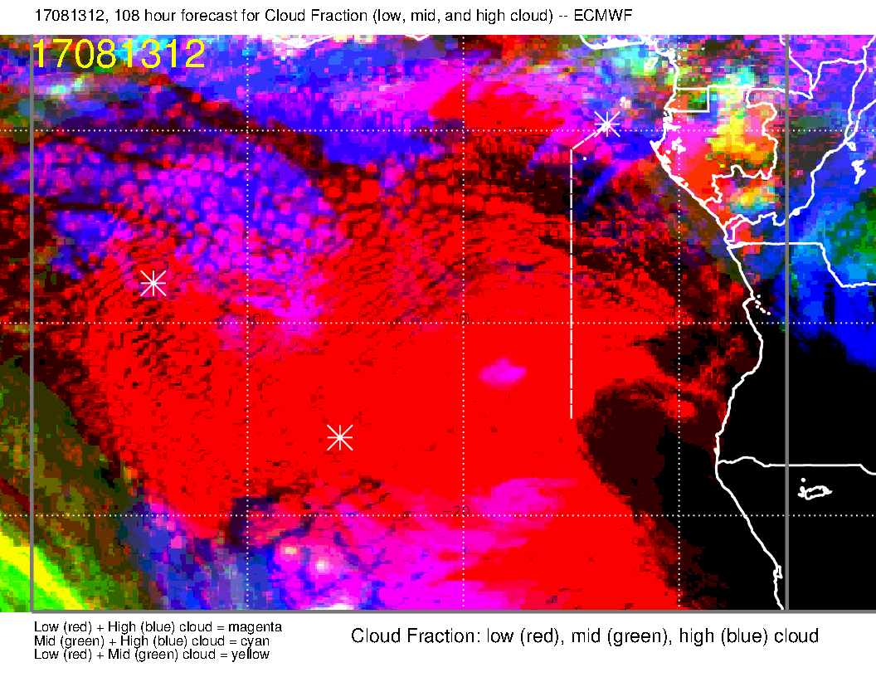
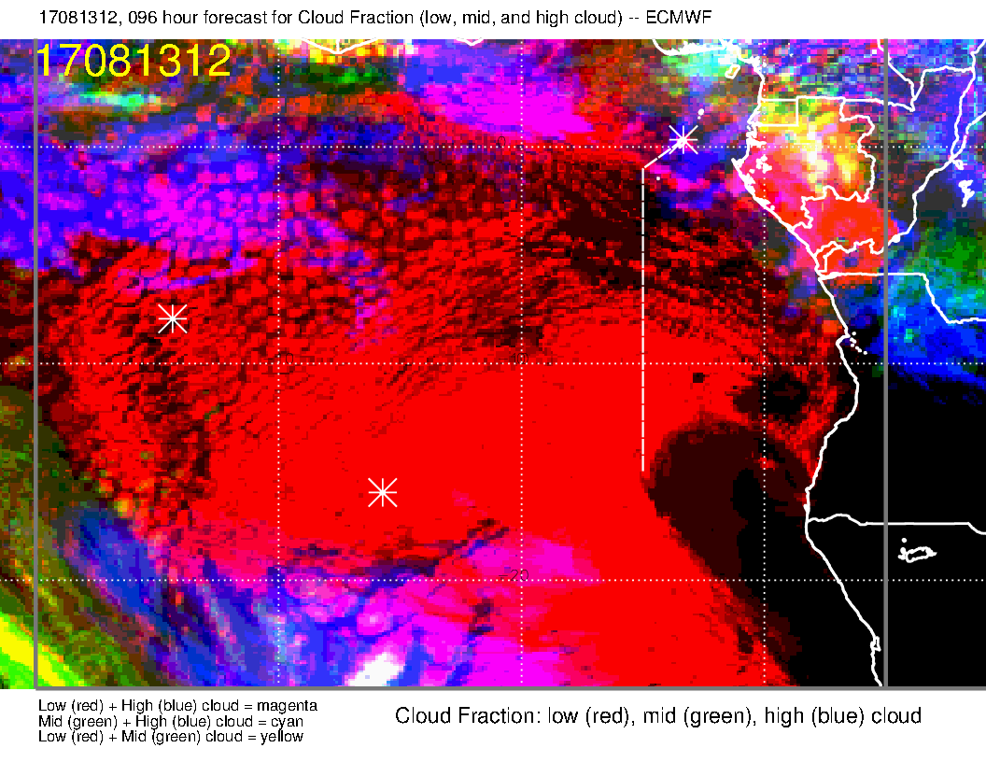
SUNDAY, very old
Sunday, new fcst
Forecast progression continues retreat of
high clouds.
SUNDAY, old

Slide 19
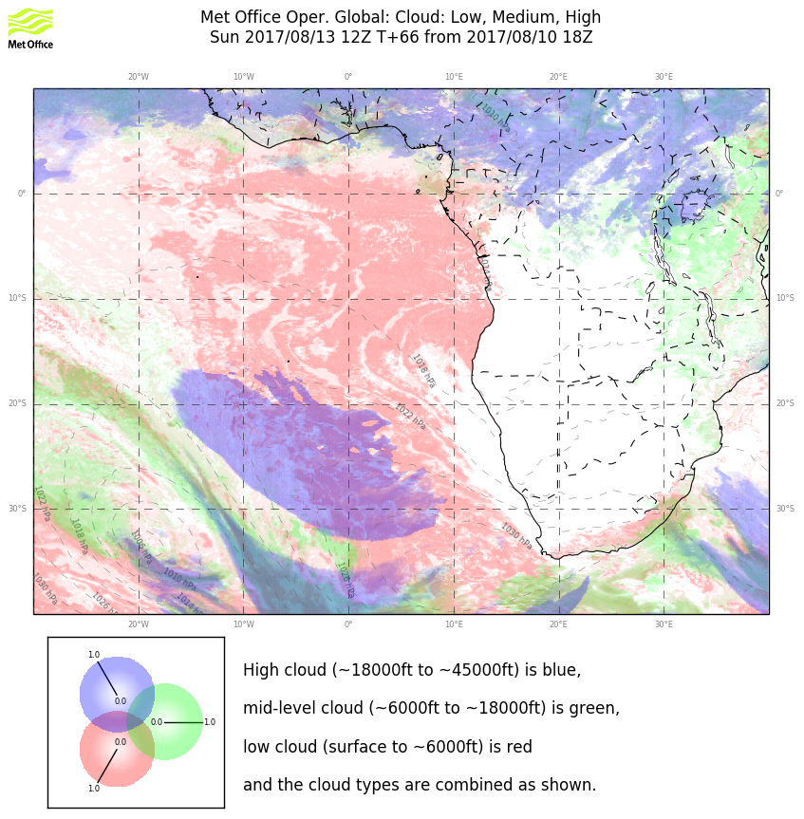
The bit of high cloud does not appear in previous fcsts. It is transient, and derives from moisture to the north traveling counterclockwise across the equator at about 5W. Does not appear in UKMO
Both models concur on the cloud near TMS. EC has more Gabon coastal middle cloud.

Slide 20
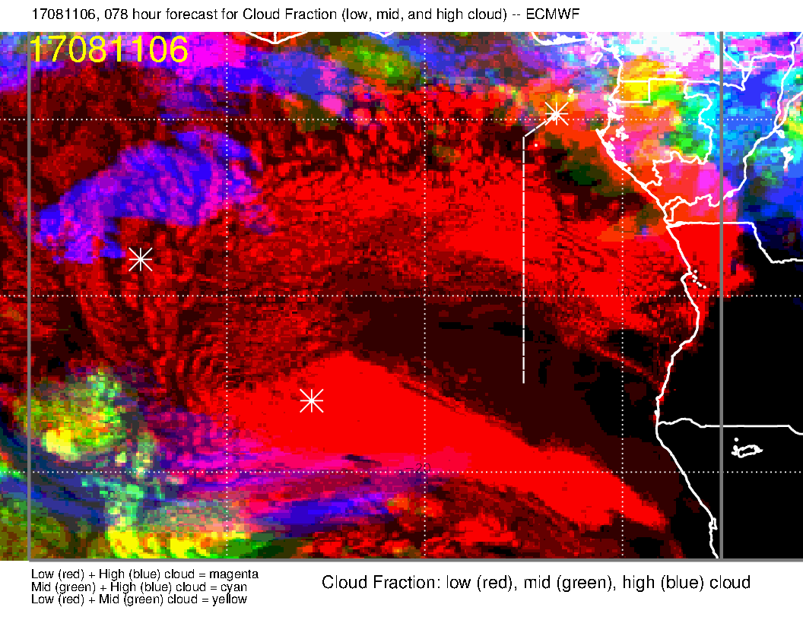
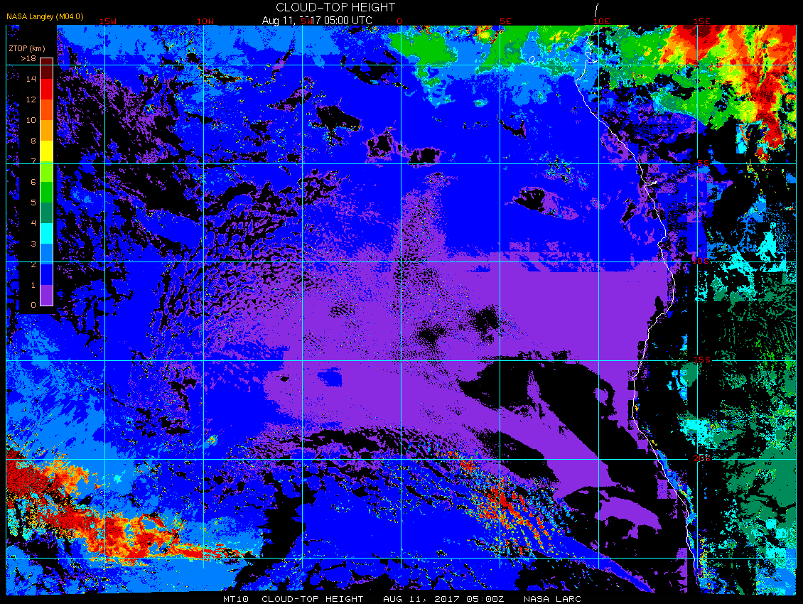
Quick verification on a 78 hour fcst. Model overpredicts middle cloud off of Gabon coast. Gap is “sealed” (not fcst, though the gap is smaller than usual in the fcst. The high clouds that come from convectively generated moisture over West Africa in the model are overdone.
5 AM this morning
78 hour forecast, 6Z
Cloud Top height, 5Z

Slide 21
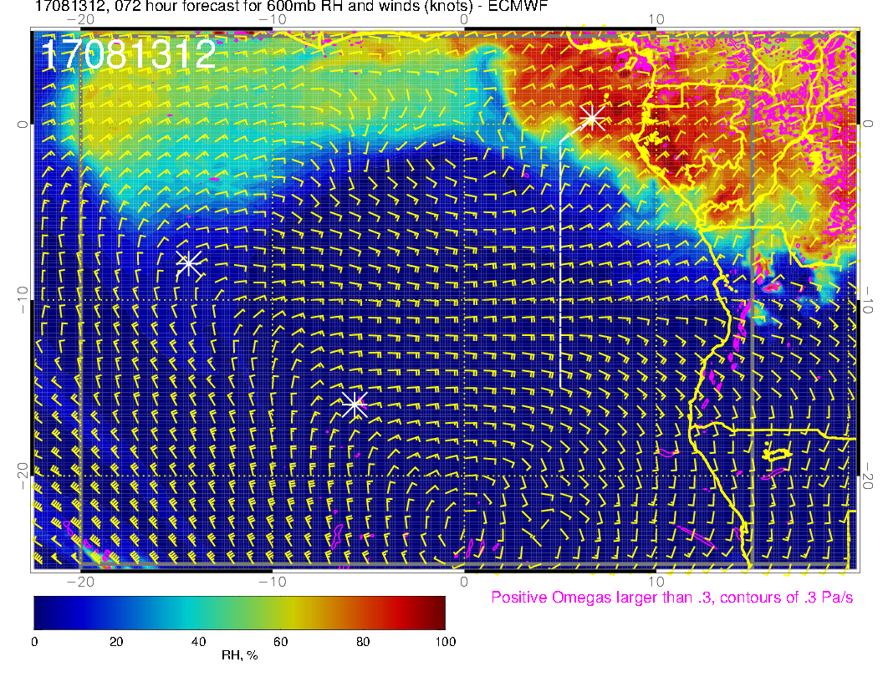
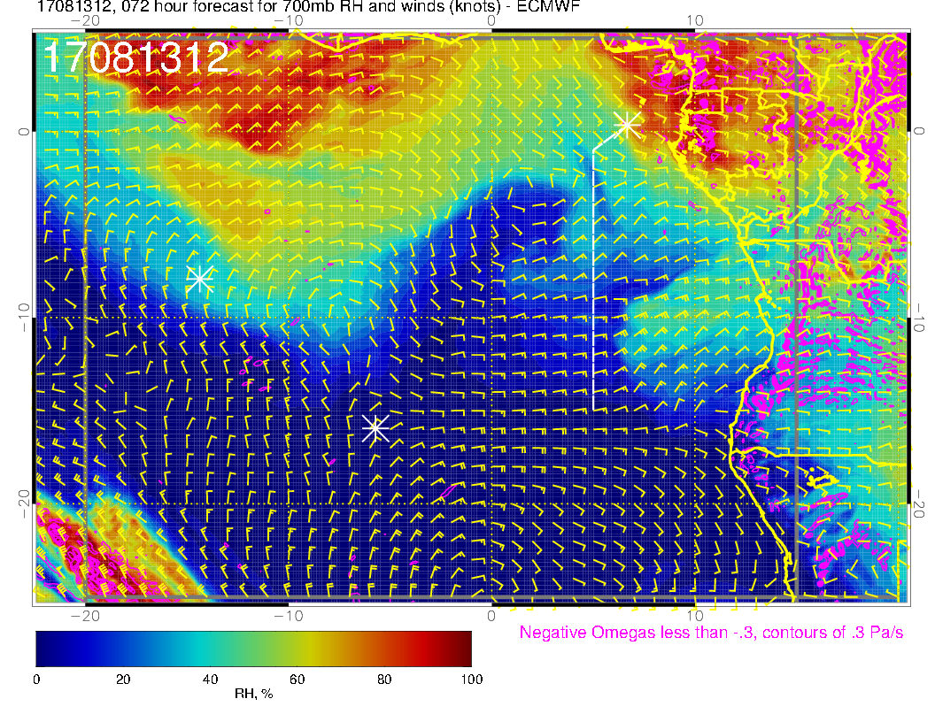
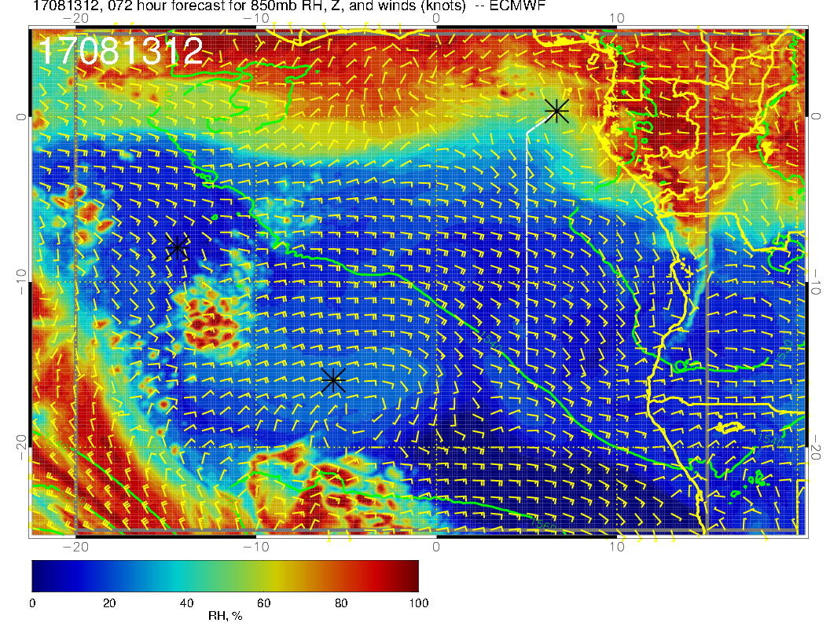
600 mb
700 mb
As in yesterday’s forecast, it is quite dry. At 850mb, see a northwestward flow; at 600mb, a surge of moisture that is clearly moving southwestward in the forecast progression. As usual, 700mb is the wettest, with a plume coming in.
850 mb

Slide 22
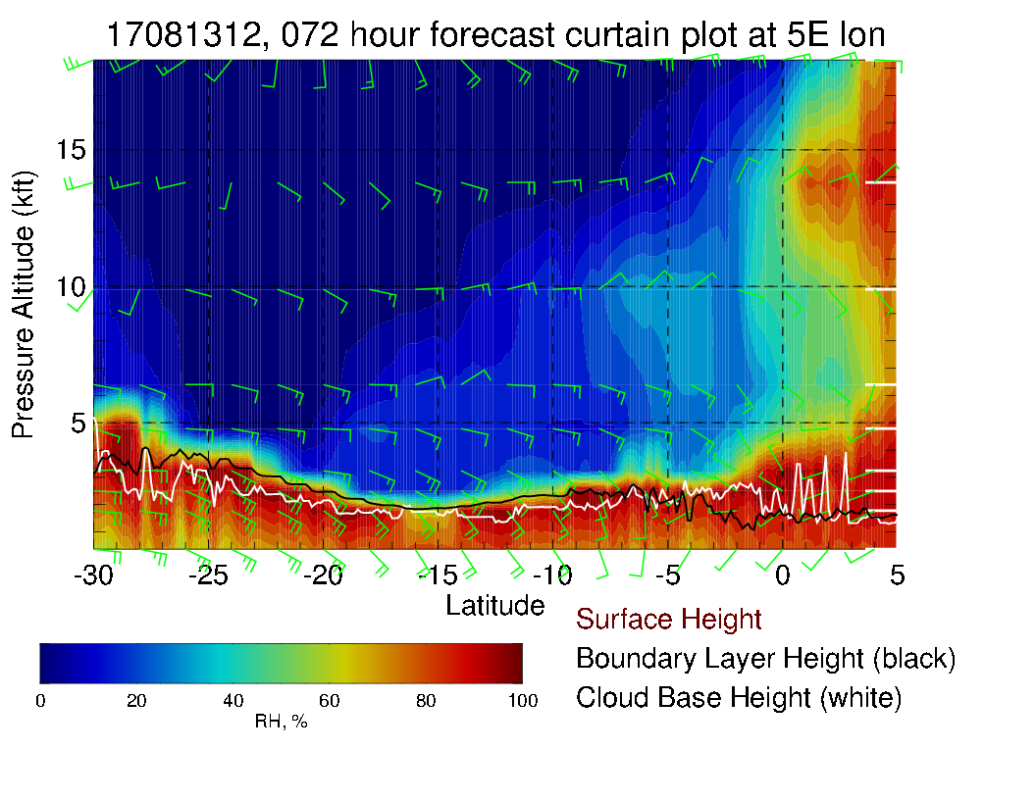
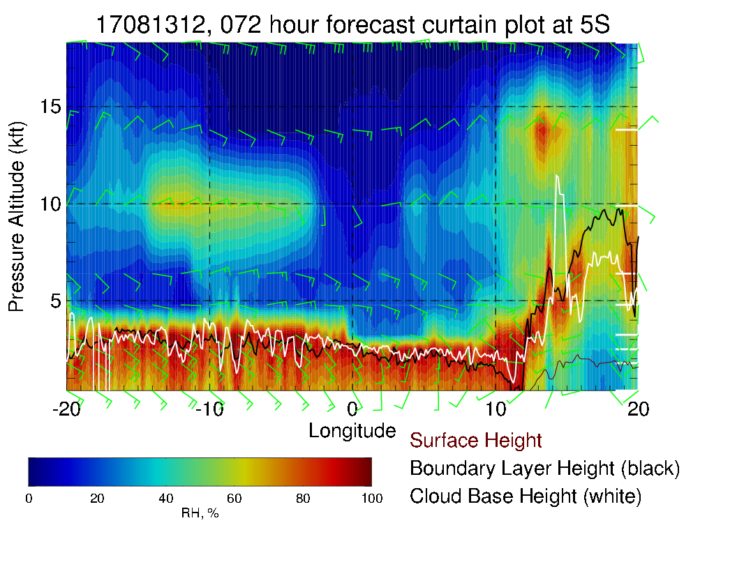
Cross sections along routine track (top) and at 5S (right). Note here that reported BL height north of 5S may be a bit deceptive (decoupling?). Note change in winds from surface layer (SSE) to midlevels (E)

Slide 23
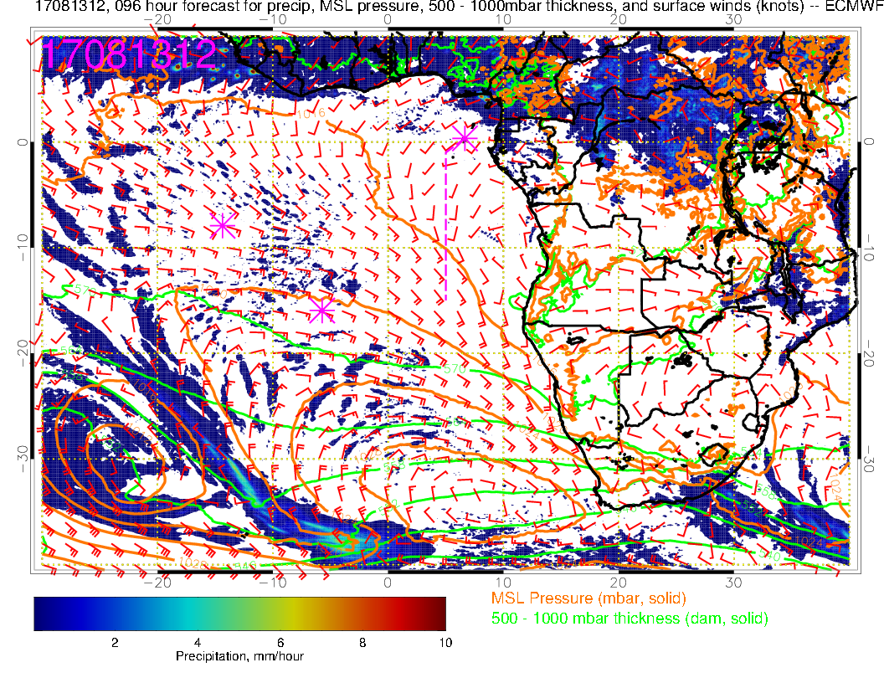
Old forecast for precip.

Slide 24
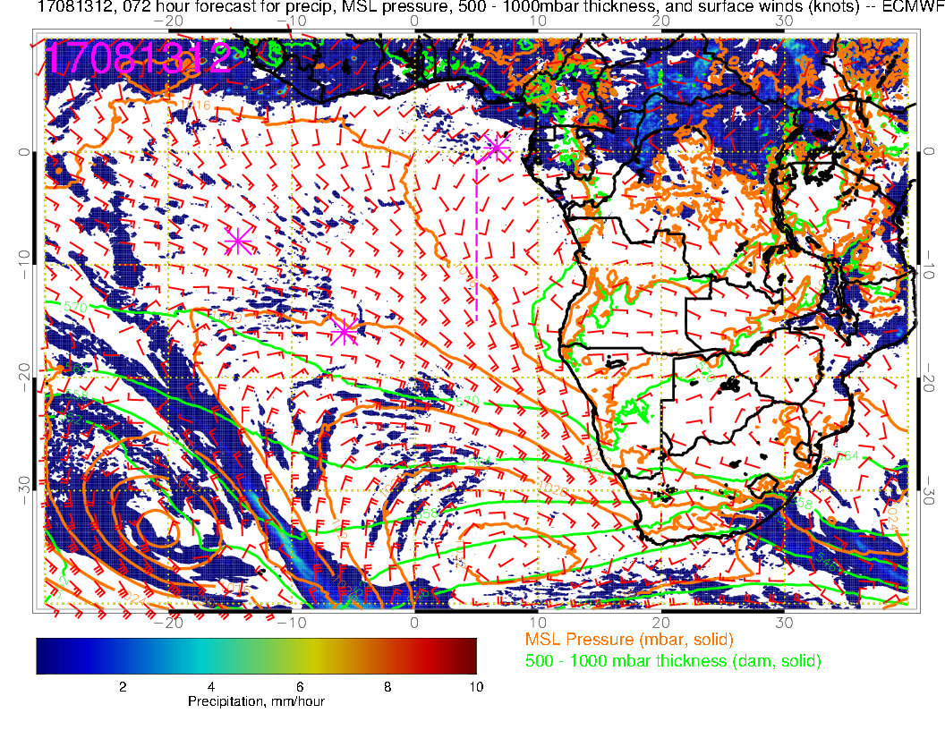
New forecast for precip. Basic pattern is not bad (in agreement). Trend is to have precip further north in the new forecast

Slide 25
Summary for Sunday
Sunday low cloud forecast little changed, “gap” boundary at about 5-8S. Gap is shrinking with later forecasts.
High and middle clouds minimal – “shrinking” high cloud with later forecasts.
Mid levels continue dry, with some intrusions at 700mb from the continent
Precip is stable with evolution of forecasts.
Surface conditions. Probably warmer than today on TO.

Slide 26
Monday

Slide 27
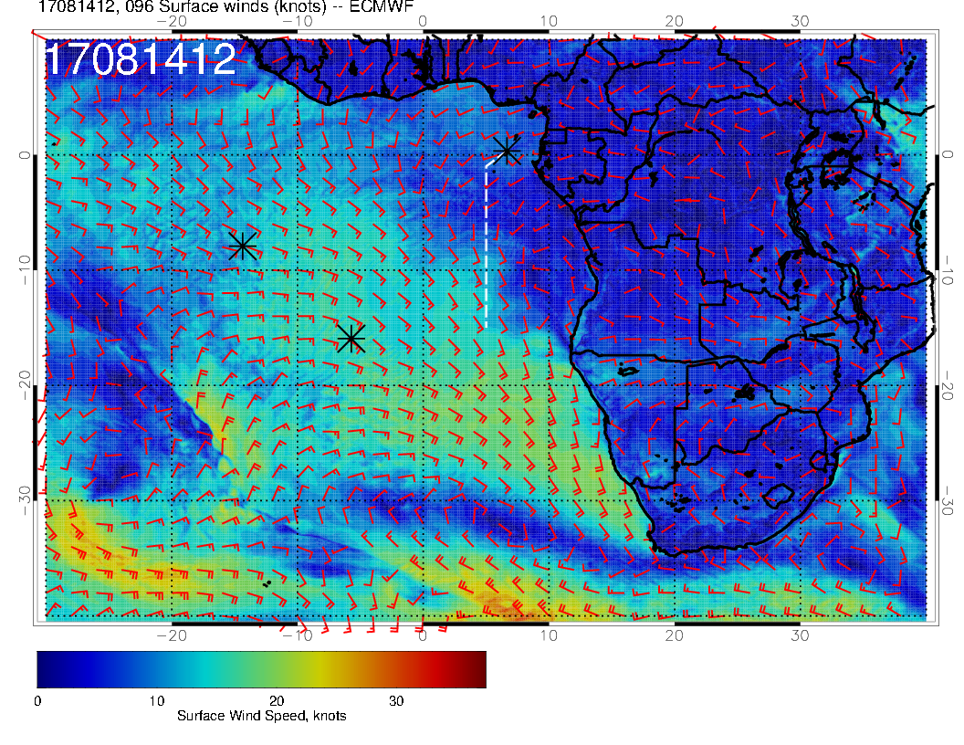
Sunday
SUNDAY
L
H
Low has effectively stalled, high is moving slowly eastward and weakening as it is being scrunched by a high latitude system, surface winds in our area are very similar to Sunday
MONDAY
Monday
L
H
L

Slide 28
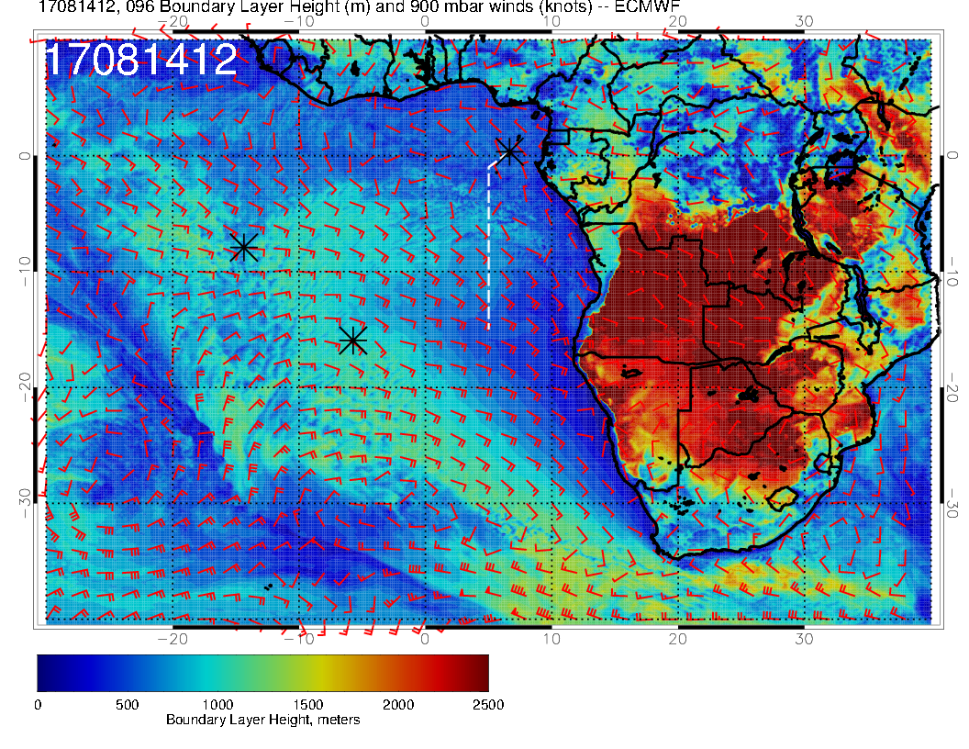
SUNDAY
SUNDAY
Higher BL heights pushed northward slightly on Monday relative to Sunday.
MONDAY
MONDAY

Slide 29
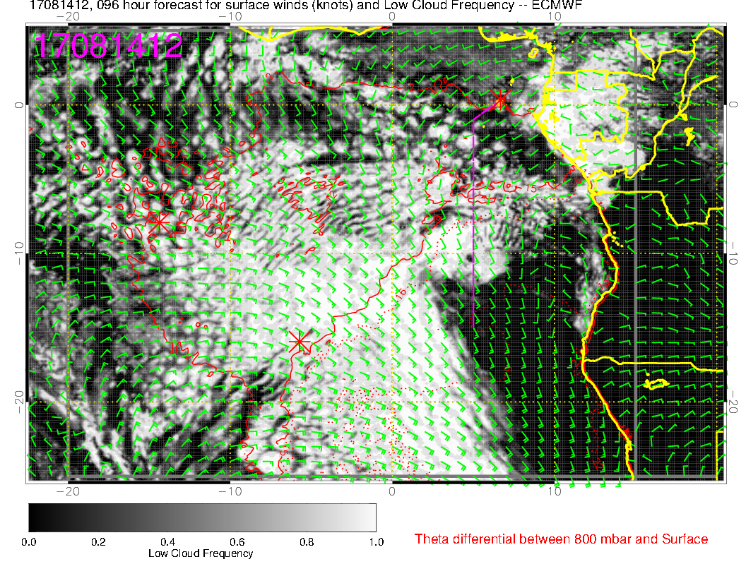
SUNDAY
Trends are similar to yesterday’s forecast, with higher boundary layer heights pushing northward, gap pushing northward (and perhaps filling).
MONDAY

Slide 30
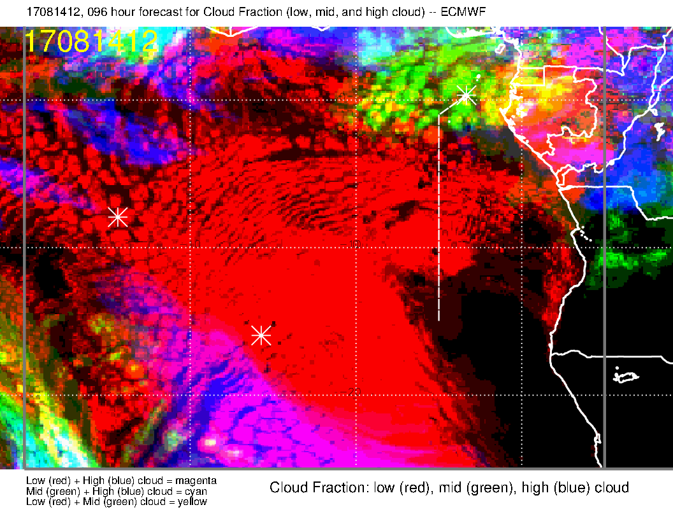
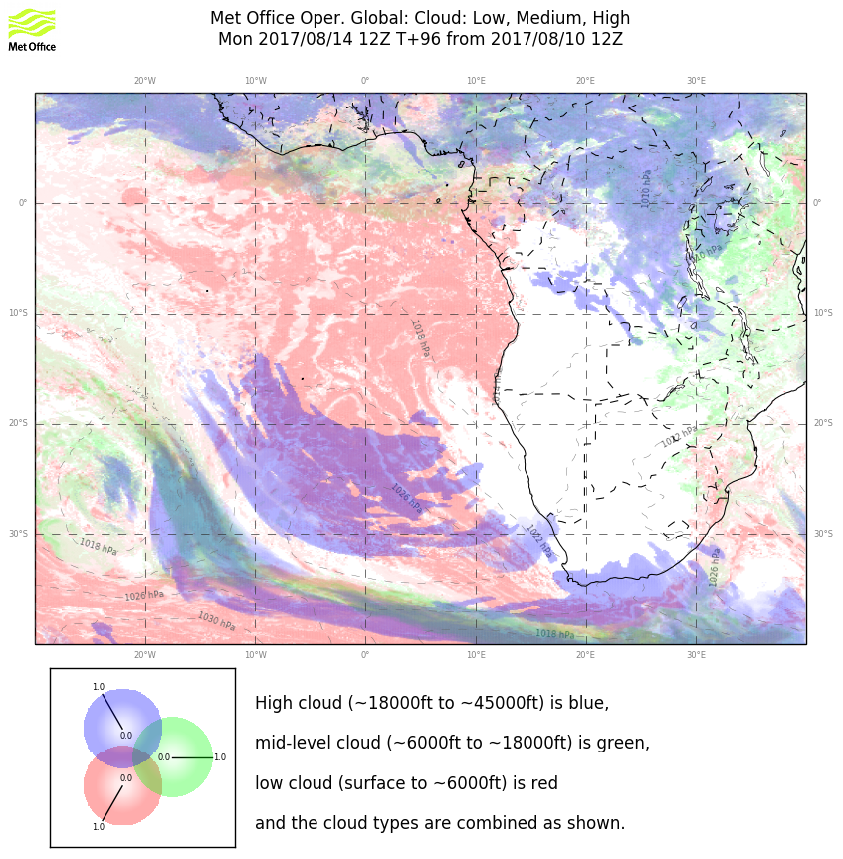
EC
UKMO
Big change in forecast is the intrusion of middle cloud to points south of TMS. Have seen this before. UKMO shows it too (kind of). The high cloud in the EC has retreated from previous forecast (typical).

Slide 31
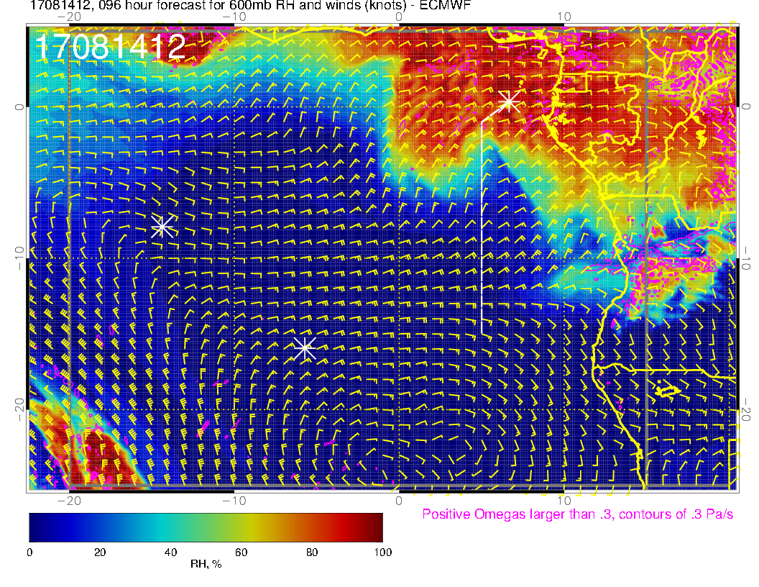
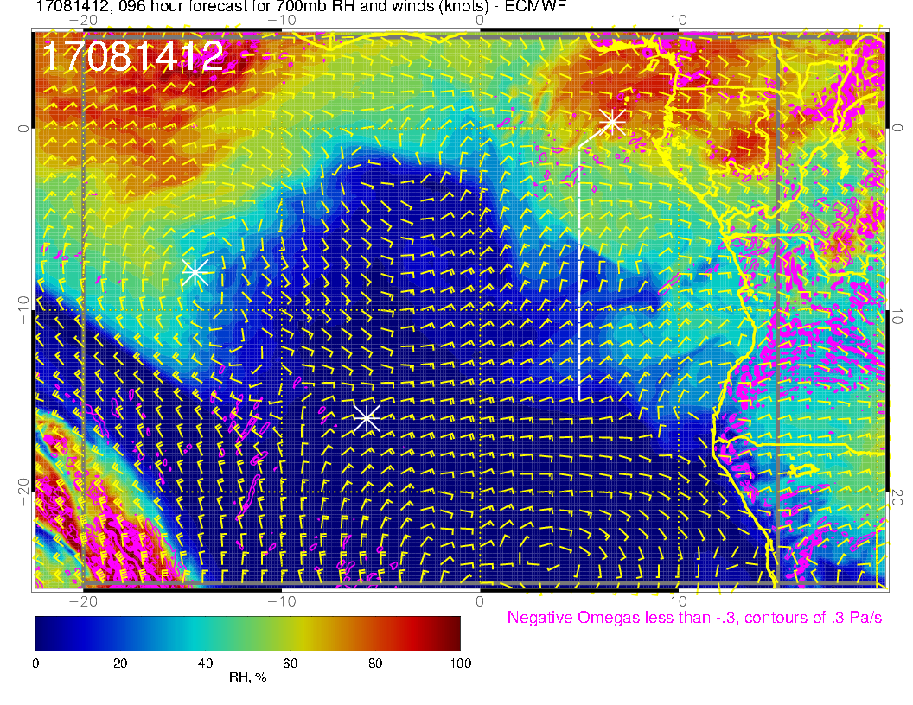
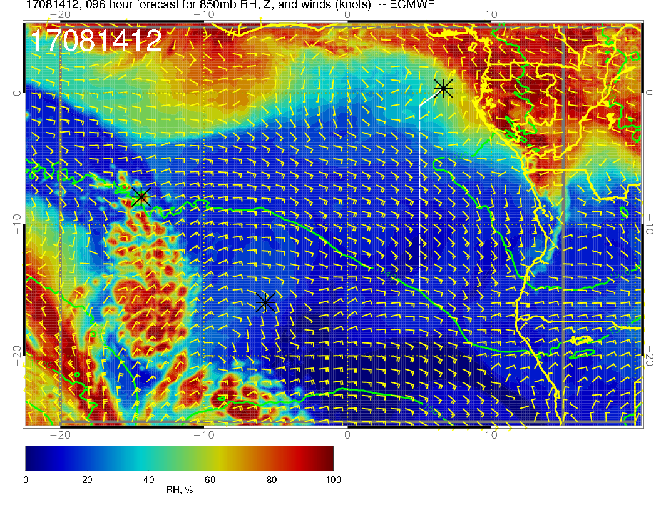
600 mb
700 mb
Can see the moisture intrusion from the continent at 600mb consistent with middle cloud forecast. 700mb moisture plume near 10S is less strong than in yesterday’s forecast. 850mb continues dry.
850 mb

Slide 32
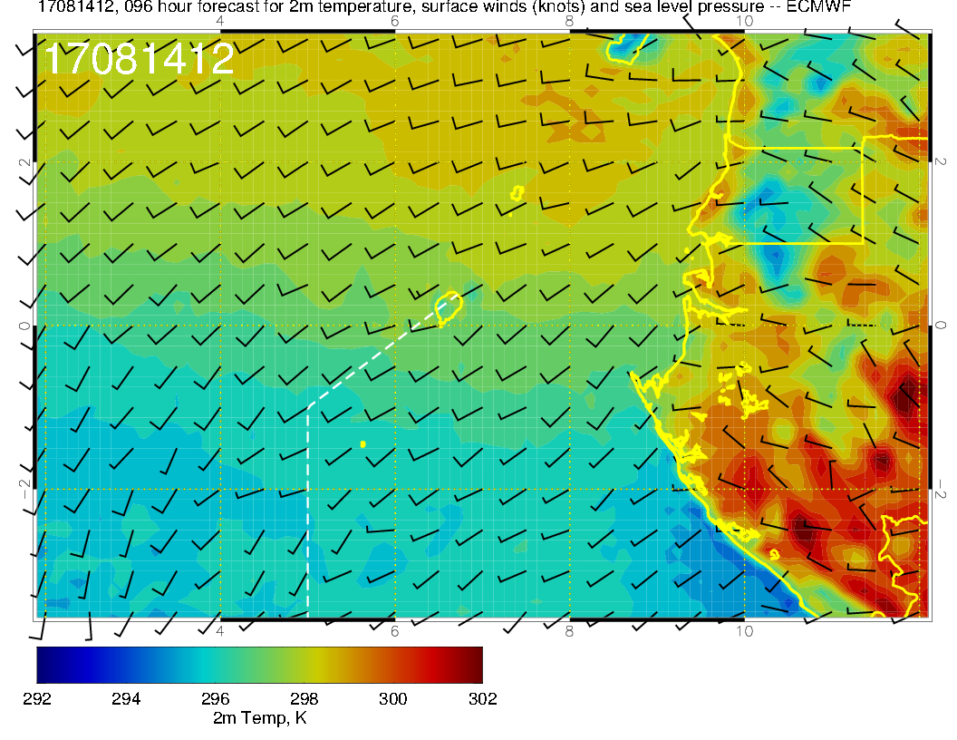
SUNDAY
Winds more westerly on Monday. Guess on morning temperature is that the forecast middle cloud cover should keep things cooler than Sunday.
MONDAY

Slide 33
Summary for Monday
Low clouds, and higher BL heights, move northward in the forecast. Actual “gap” may disappear.
High and middle clouds start to intrude into our region, especially near TMS.
700mb moisture minimal (less than previous forecasts) and more moisture than previous forecasts at 600mb (near TMS). 850mb continues dry.
Takeoff temperatures less of a concern than Sunday because of increased mid cloud cover.

Slide 34
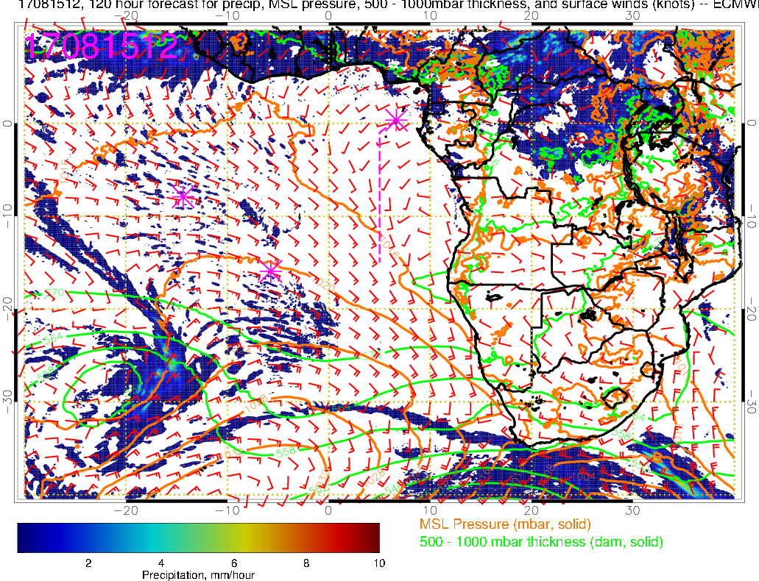
Precip, surface winds, 500-1000mb thickness for 8/15 Tue @ 12PM
Weak WSW winds at TMS
Can’t say much about takeoff temperature with any certainty this far out, but WSW wind from the ocean combined with mid and high clouds suggest takeoff temperatures won’t be any higher than what we’ve been experiencing
L
H

Slide 35
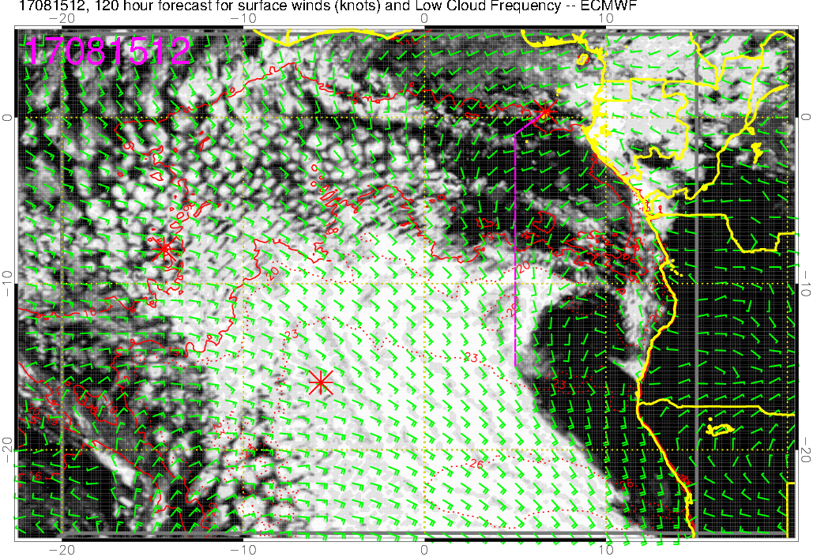
Low cloud forecast on 8/15 Tue @ 12PM
Another rather large “gap” south of TMS (down to 8S)
Most of the low clouds will be south of 8S along the flight track

Slide 36
Low, middle, high cloud forecast for 8/15 Tue @ 12PM
ECMWF (120-hr)
UKMO (120-hr)
Mid + high clouds
Mid + high clouds
Most abundant low clouds south of 8S
Both models are forecasting abundant middle and high clouds over TMS (but these are 120-hr forecasts…)
wouldn’t put much weight on the high clouds near the routine flight track ~8-10S at this time

Slide 37
RH (color), winds, vert. velocity (pink) at 8/15 Tue @ 12PM
600 mb
700 mb
Increased moisture at 600 and 700mb levels (influenced by moist convection), thus mid and high clouds
Perturbed flow east of flight track at 700mb so transport from dry convection is ambiguous in this plot
850 mb

Slide 38
RH (color), wind, BL and cloud base heights along 5E, 8/15 Tue @ 12PM
20-30 knts
Moist air 10-15 kft from TMS to 8S
5-15 knts
5-20 knts
Cloud top heights ~2-3000 ft at 5S decreasing with latitude

Slide 39
Tuesday 8/15
Takeoff temperatures will probably not be an issue
SW winds becoming WSW, weakening
Low clouds south of 8S along the routine flight track
Abundant middle and high clouds over TMS but highly uncertain (120-hr) forecasts
Mid levels (600-700mb) are becoming more moist
We’d likely be sampling air influenced by moist convection down to ~8S

