Slide 1
ORACLES Forecast Briefing (Aerosols)
11 August 2017
Morning

Slide 2
BC AOD 08/10-15

Slide 3
08/12 Sat(48h) 08/13 Sun(72h)
AOD Comparison Sat & Sun (12z)
GEOS-5
WRF-AAM
Saturday August 12 (12z)
CAMS

Slide 4
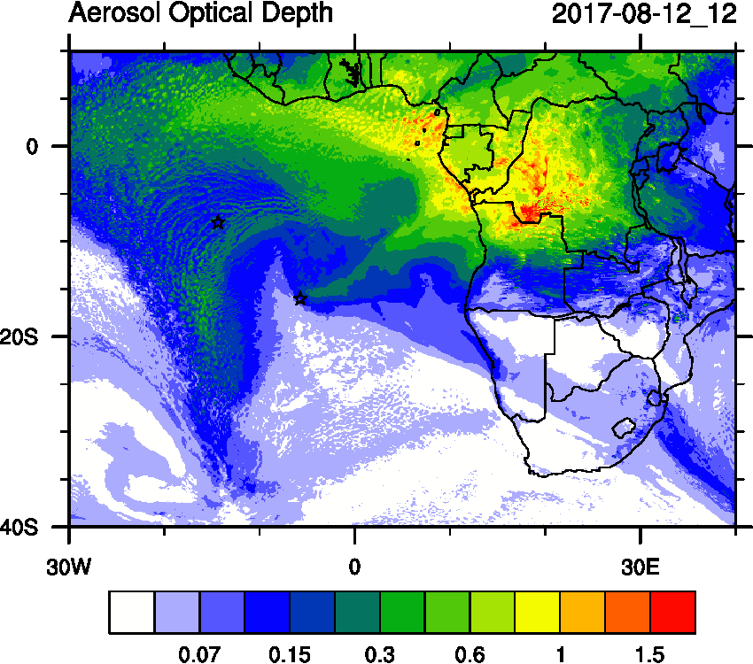
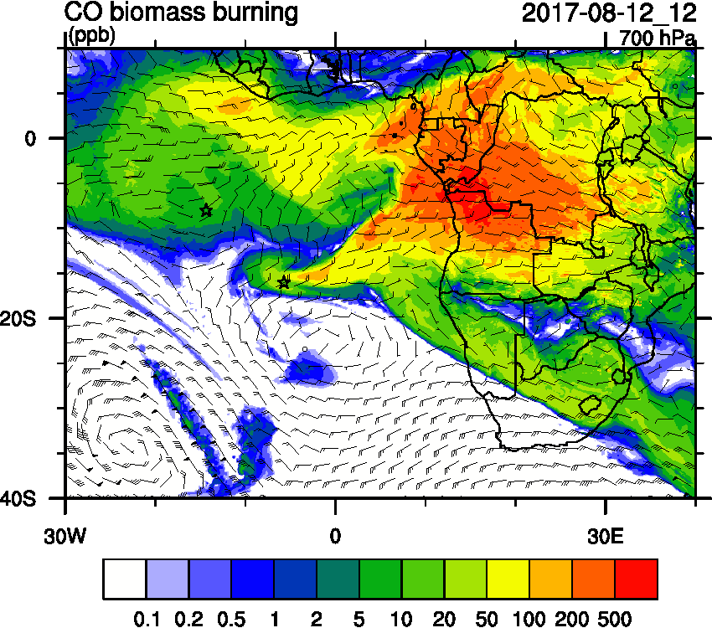
Saturday August 12 (12z) WRF-AAM

Slide 5
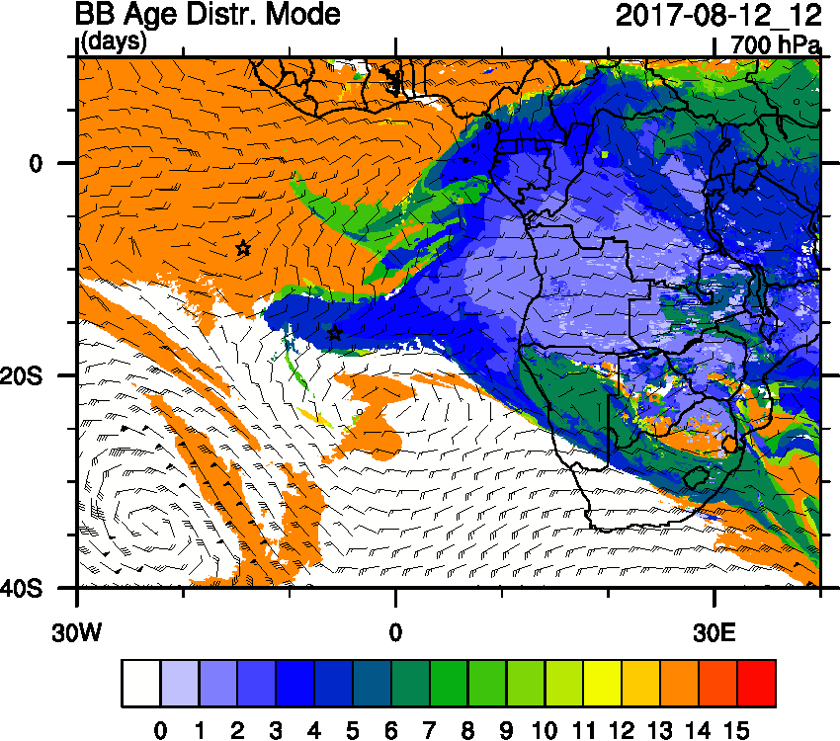
Saturday August 12 (12z)

Slide 6
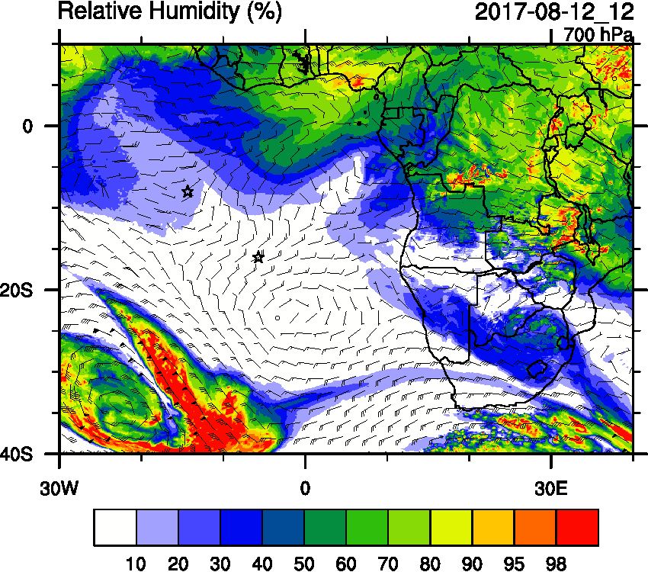
Saturday August 12 (12z)

Slide 7
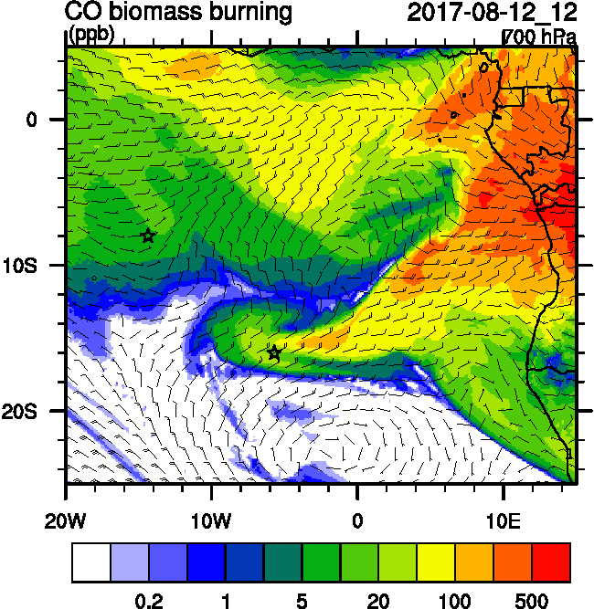
Saturday August 12 (12z)

Slide 8
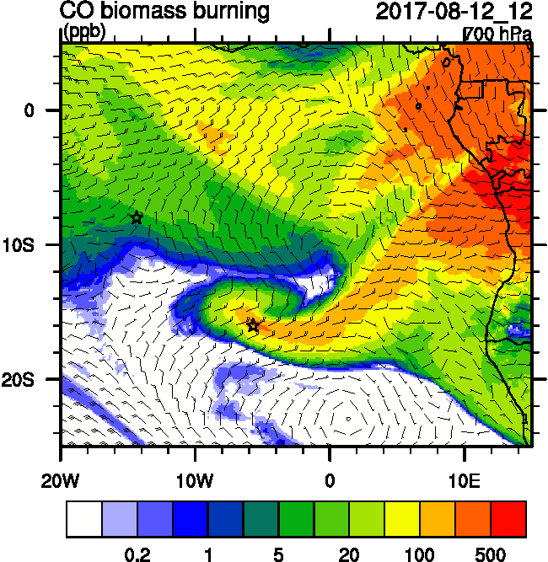
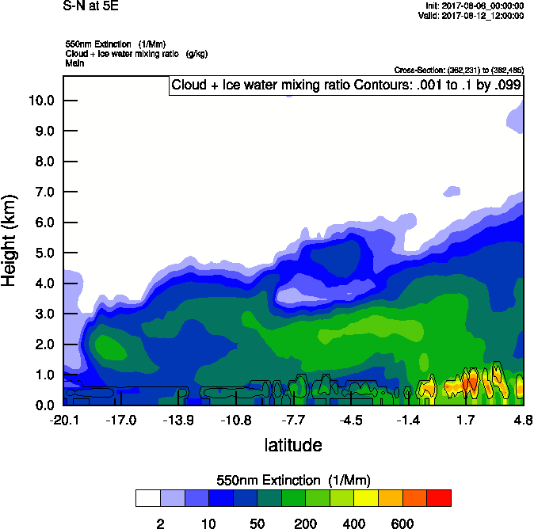
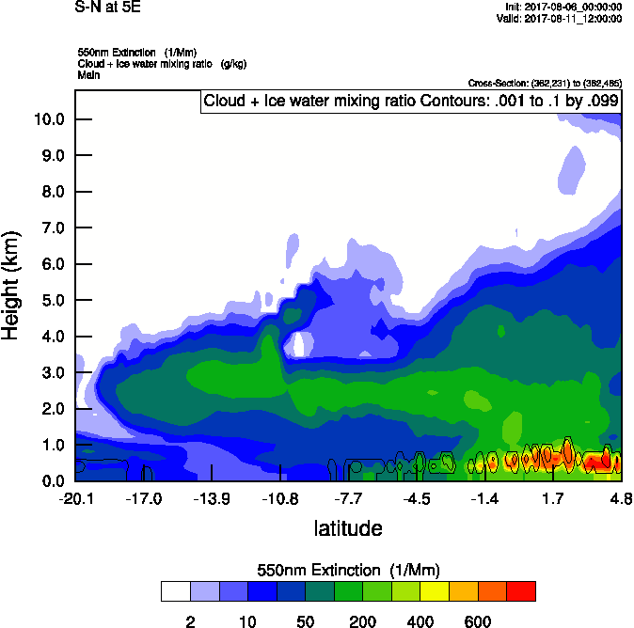
Saturday August 12 (12z) 72 hr forecast

Slide 9
Saturday August 12 (12z)

Slide 10
Saturday August 12 (12z)

Slide 11
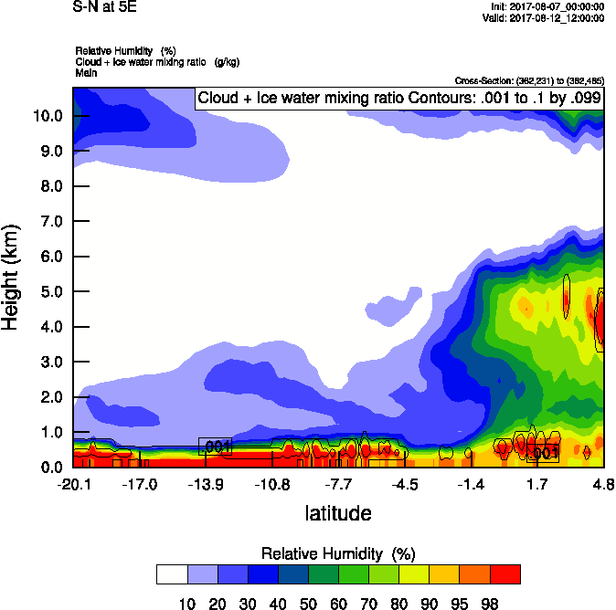
Saturday August 12 (12z)

Slide 12
Saturday August 12 (12z)
WRF-CAM5

Slide 13
Saturday August 12 (12z)
WRF-CAM5

Slide 14
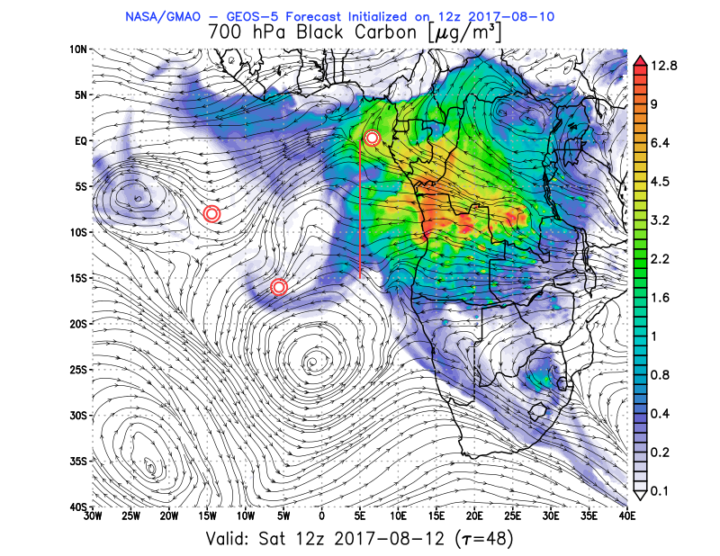
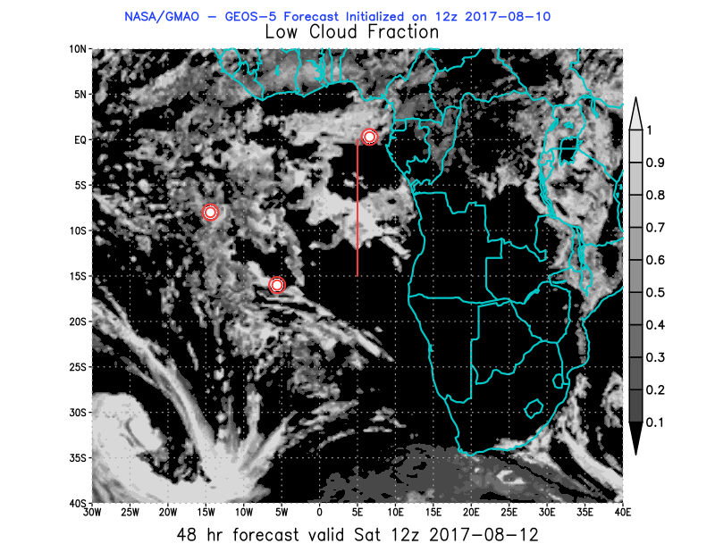
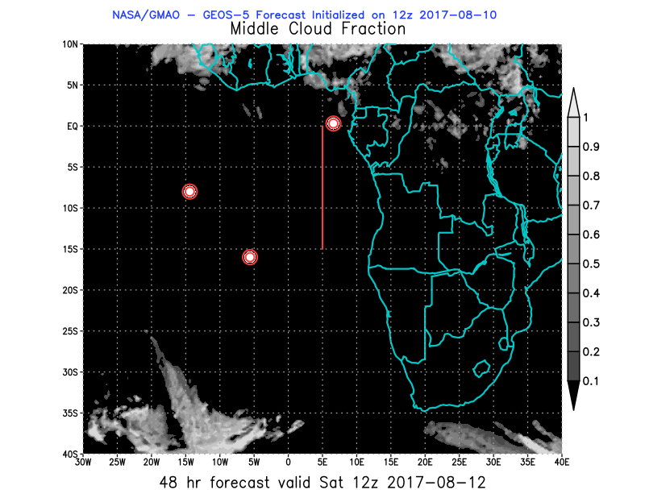
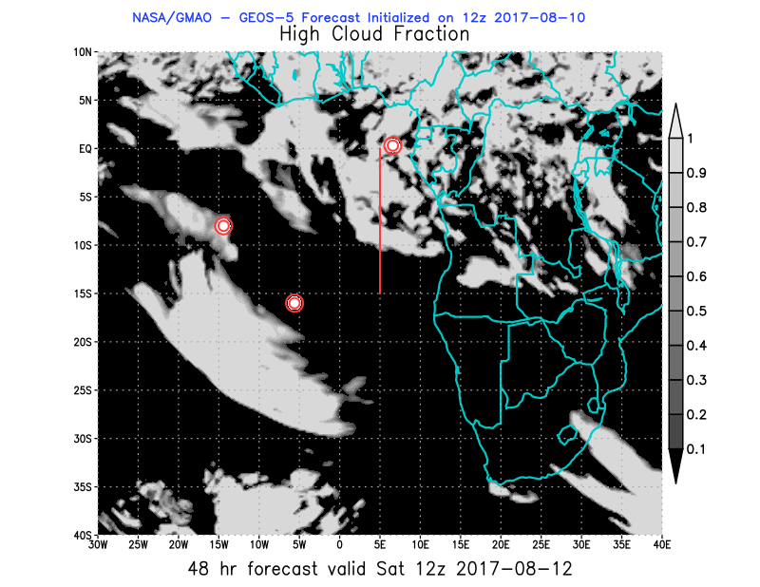
850 hPa 700hPa 600 hPa
Saturday August 12 (12z) GEOS-5

Slide 15
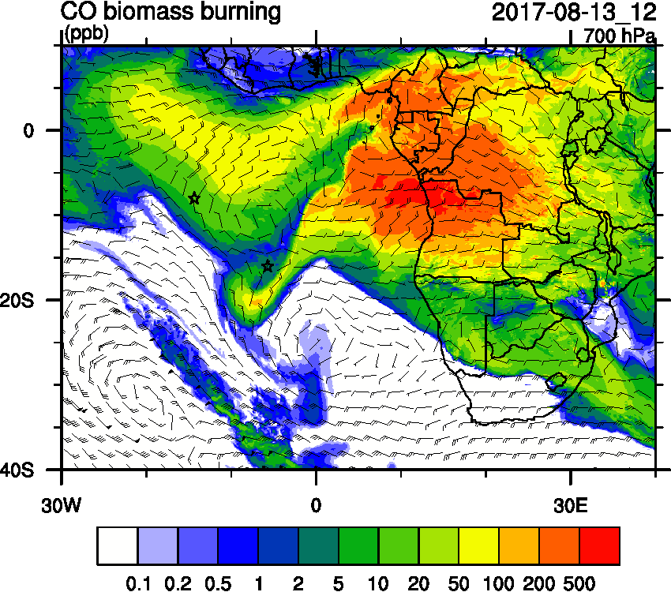
Sunday August 13 (12z) WRF-AAM

Slide 16
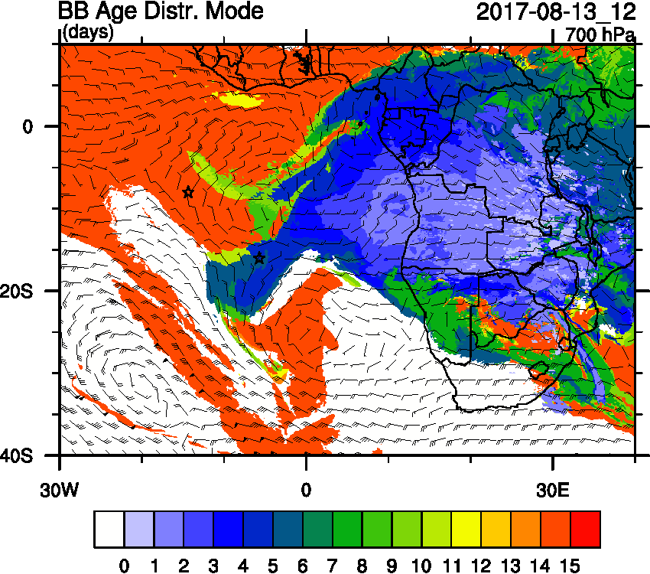
Sunday August 13 (12z)

Slide 17
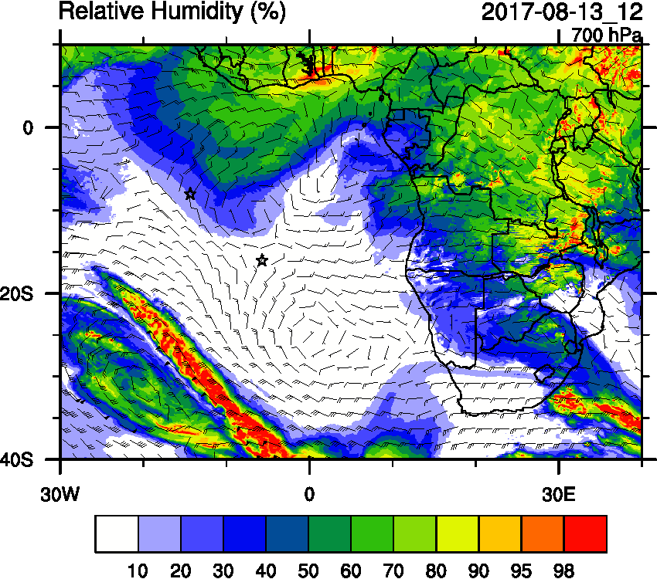
Sunday August 13 (12z)

Slide 18
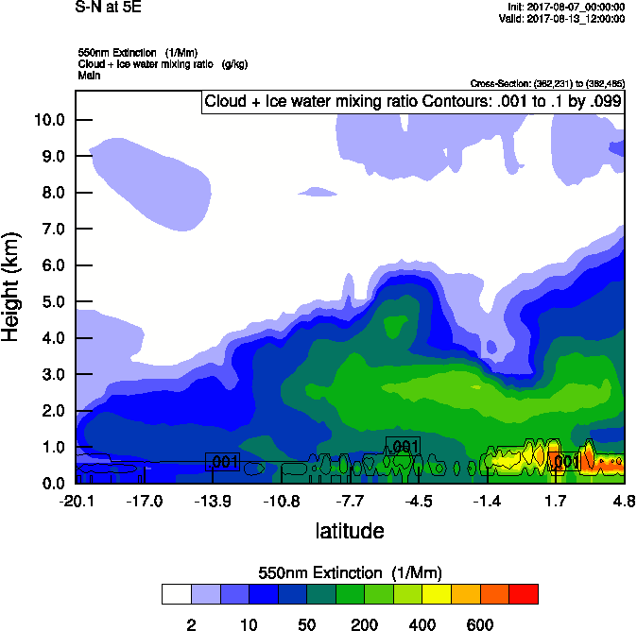
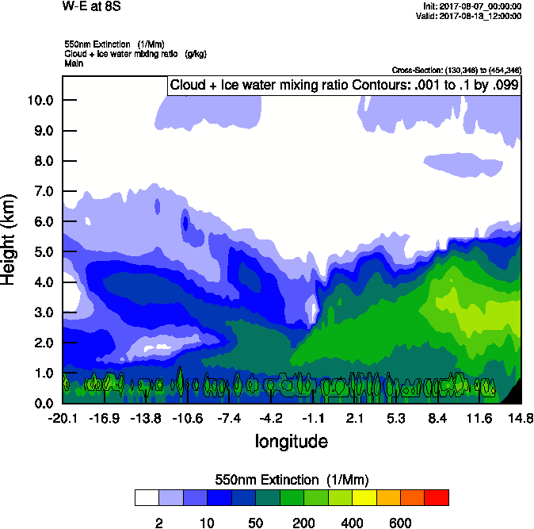
Sunday August 13 (12z)

Slide 19
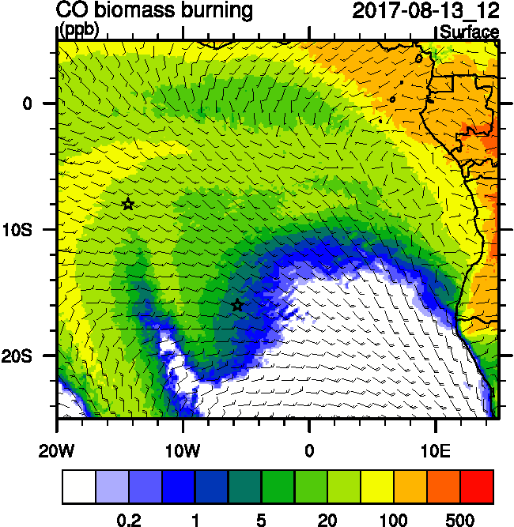
Sunday August 13 (12z)
surface

Slide 20
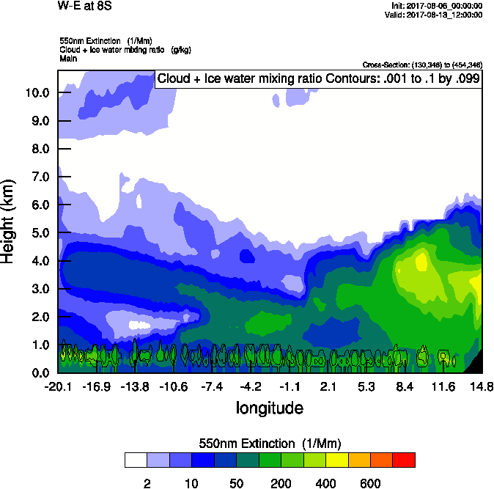
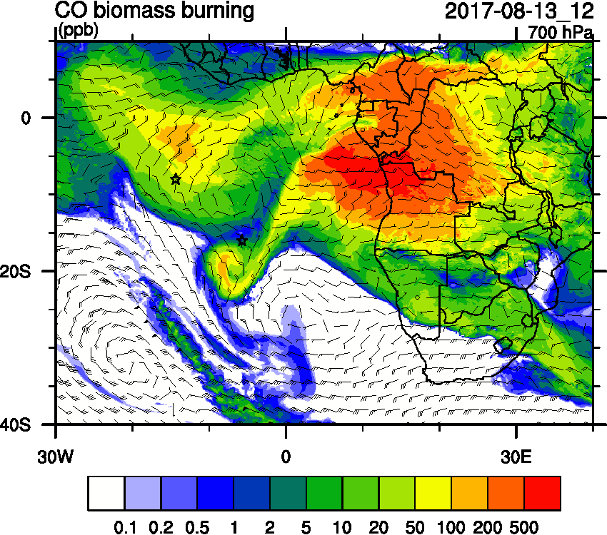
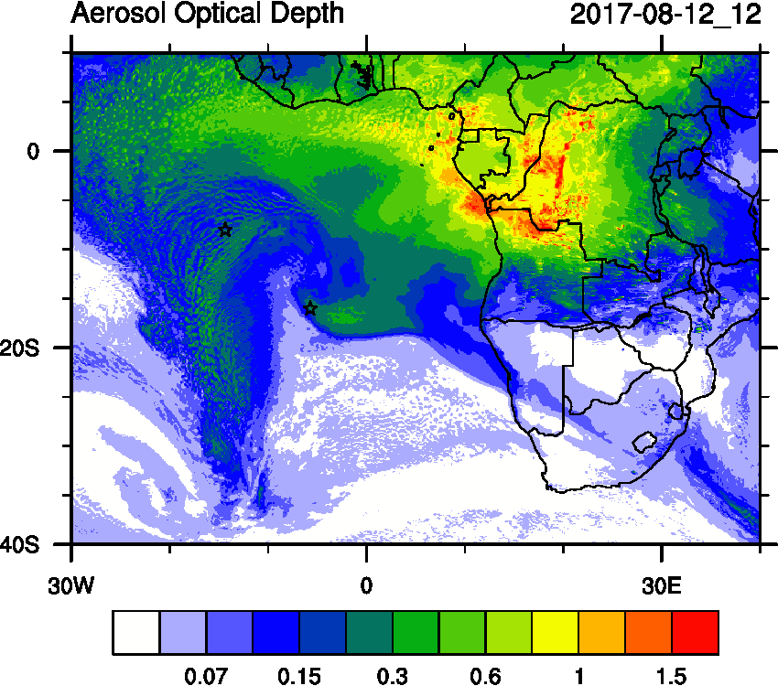
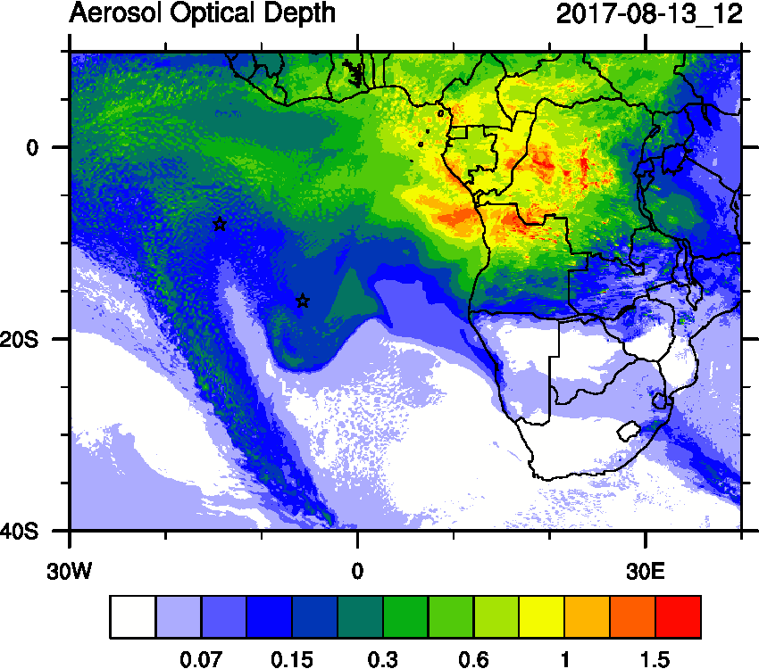
Sunday August 13 (12z) 72 hr forecast

Slide 21
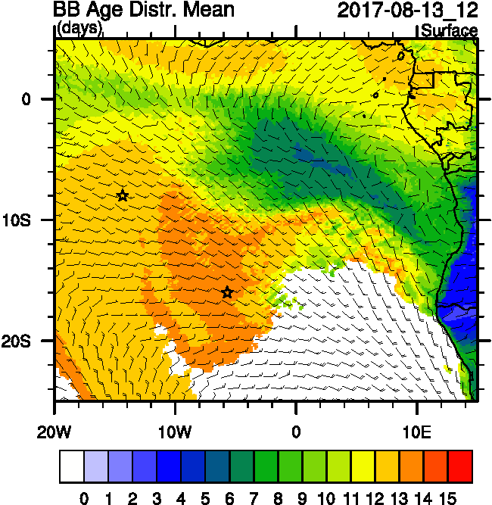
Sunday August 13 (12z)
surface

Slide 22
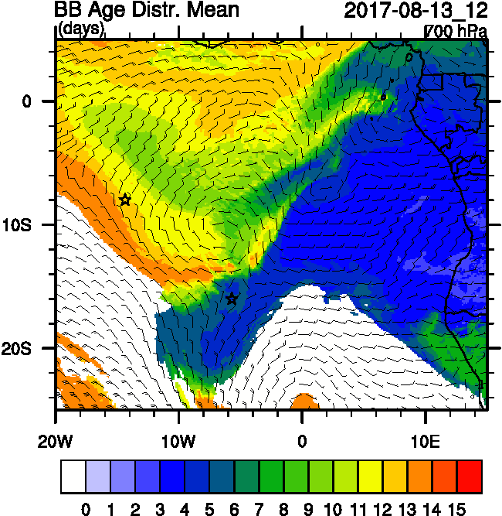
Sunday August 13 (12z)
surface

Slide 23
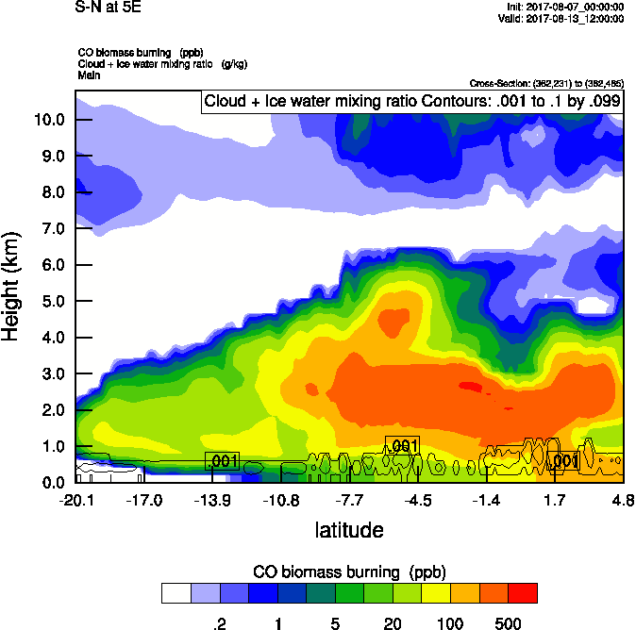
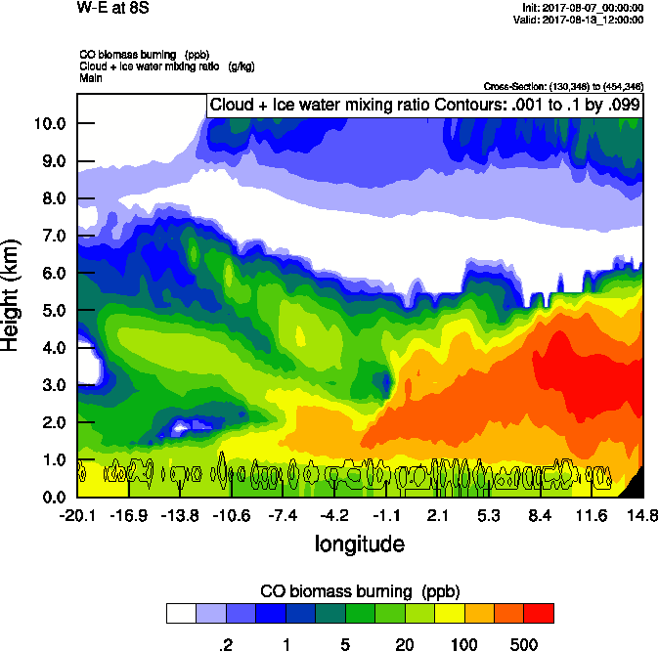
Sunday August 13 (12z)

Slide 24
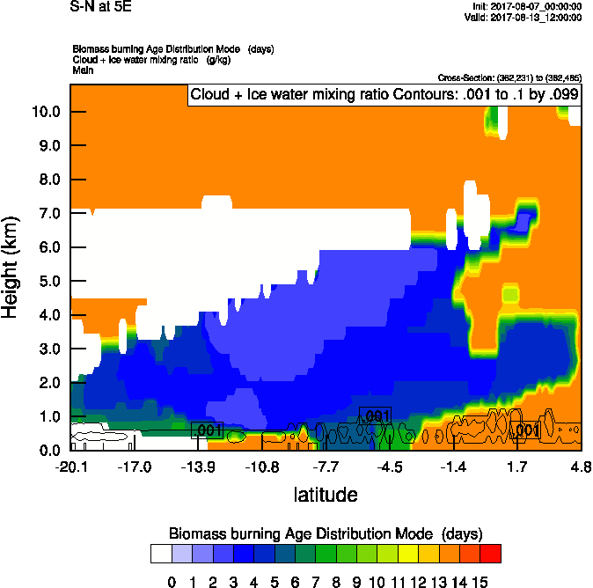
Sunday August 13 (12z)

Slide 25
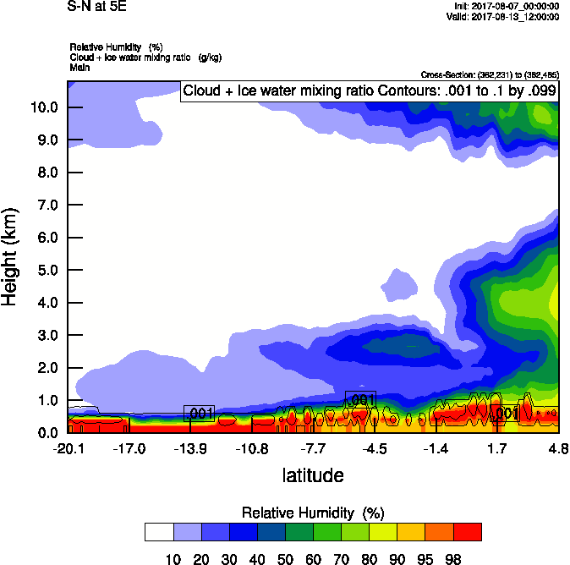
Sunday August 13 (12z)

Slide 26
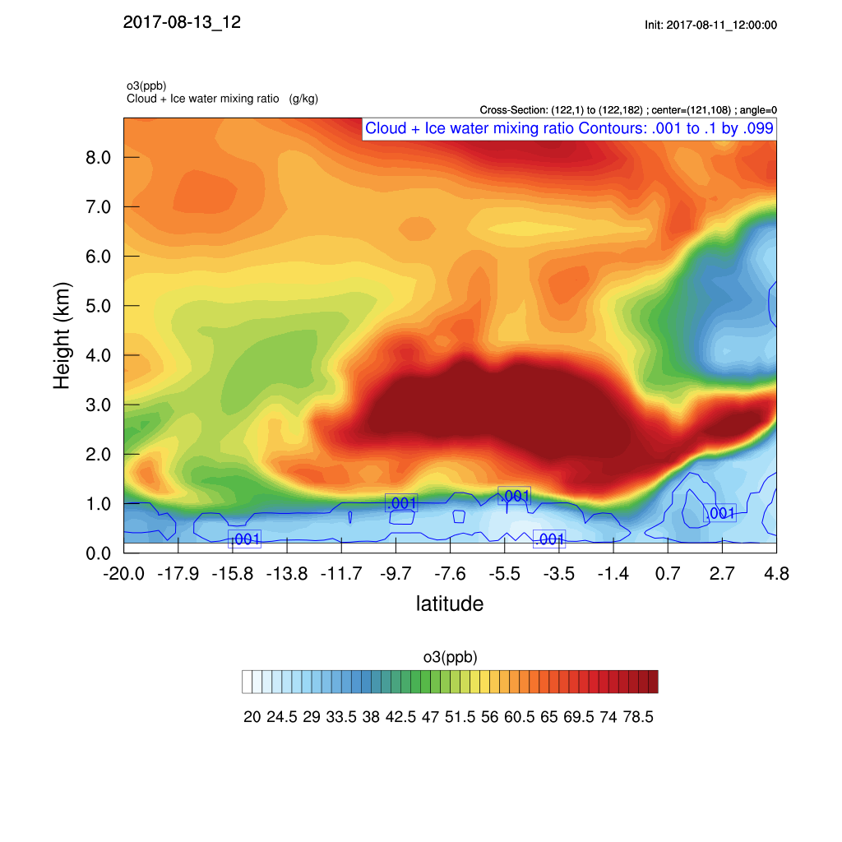
Sunday August 13 (12z)

Slide 27
Sunday August 13 (12z)

Slide 28
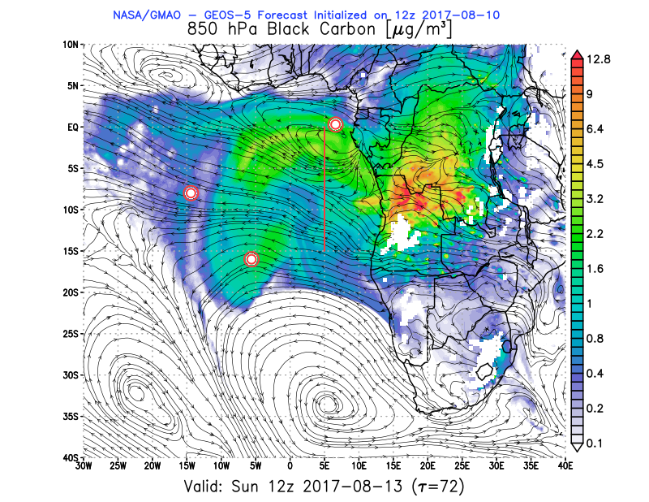
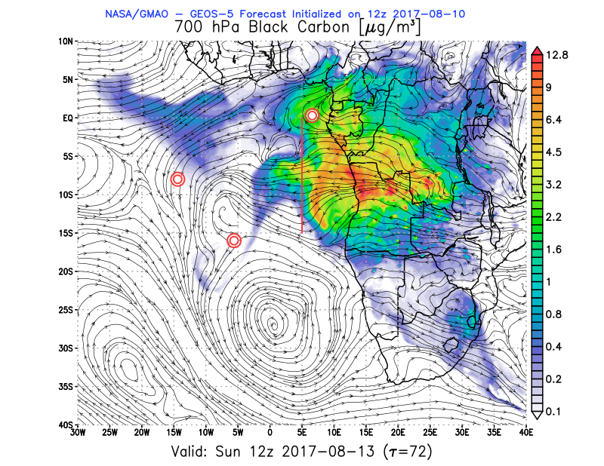
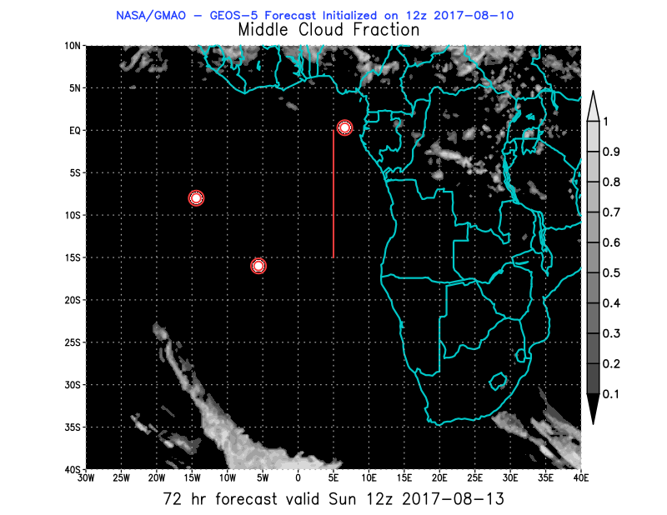
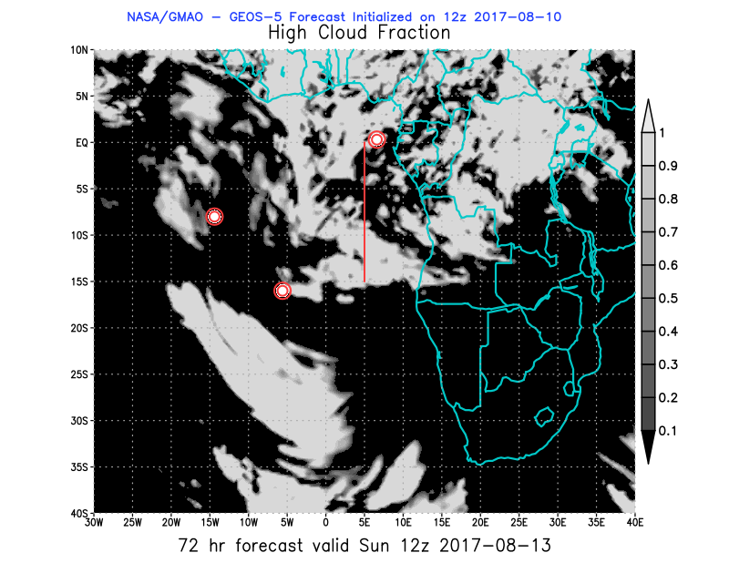
08/13 Sun (72h) 850 hPa 700hPa 600 hPa

Slide 29
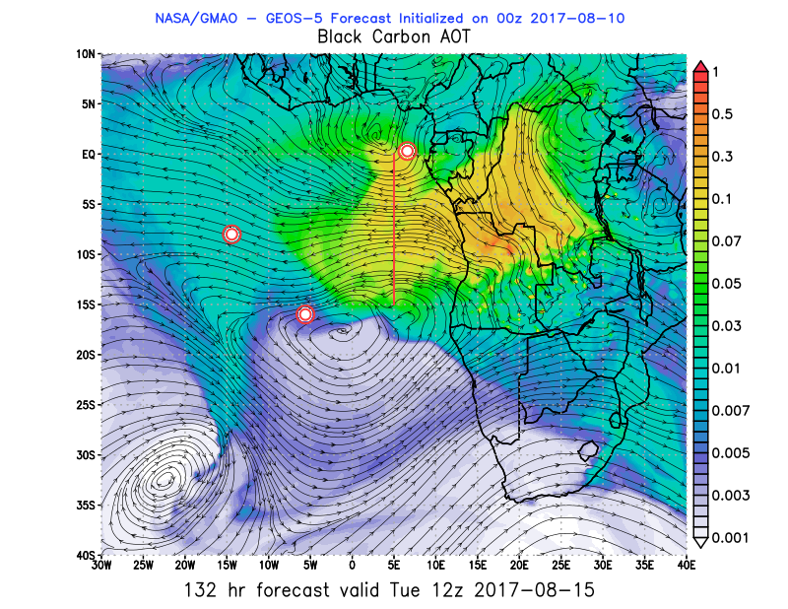
Tuesday August 15 (12z)

Slide 30
Tuesday August 15 (12z)

Slide 31
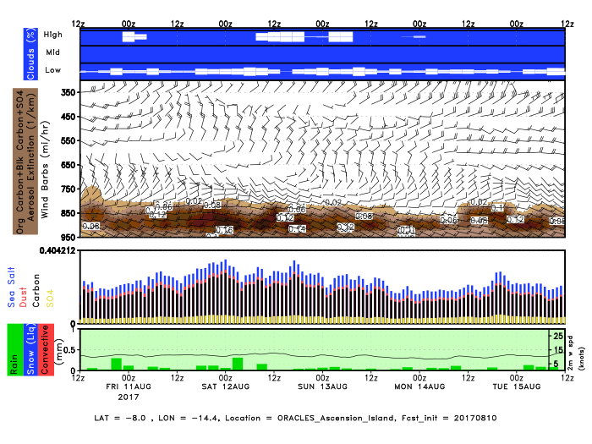
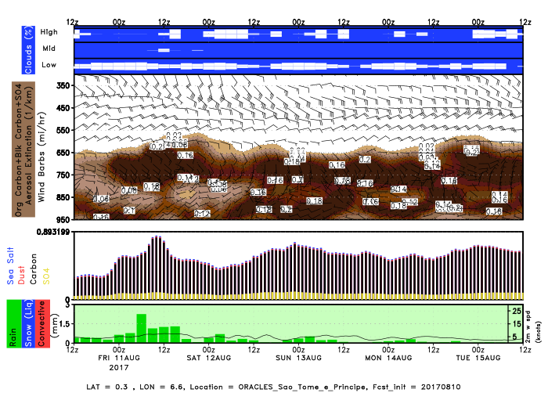
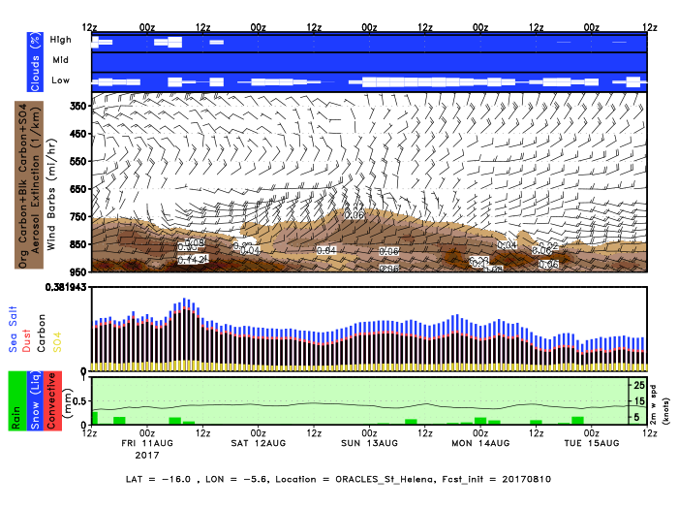
Ascension São Tomé e Príncipe Sta Helena

Slide 32
Outlook Through Sunday August 20
https://portal.nccs.nasa.gov/cgi-mission/mission_2d_chem.cgi?region=oracles_lg&dtg=2017081000&prod=3bcaot&model=f516_fp&tau=240&&region_old=oracles_lg&dtg_old=2017081000&prod_old=3bcaot&model_old=f516_fp&tau_old=000&&loop=1

Slide 34
BC AOD 08-18/Aug

