Slide 1


mid-level (700 & 600mb) wind field over southeast Atlantic for ORACLES
10-Aug-2017
Rei Ueyama and Lenny Pfister

Slide 2
700mb RH and flow
July 1979-2010
10W
0
10E
20E
0
0
10S
10S
20S
H
20S

Slide 3
700mb RH and flow
Aug 1979-2010
10W
0
10E
20E
0
0
10S
10S
20S
H
20S

Slide 4
700mb RH and flow
Sep 1979-2010
10W
0
10E
20E
0
0
10S
10S
20S
H
20S

Slide 5
700mb RH and flow
Oct 1979-2010
10W
0
10E
20E
0
0
10S
10S
20S
H
20S

Slide 6
0
10E
700mb RH and wind
(late Jul – early Aug)
0
Band of high RH (north of TMS) shifted southward
Stronger meridional (southerly) component of the winds south of TMS from the coast
10S
20S
0
10E
0
20-yr climatological mean
vs.
this year (2017)
10S
20S

Slide 7
Summary of climatological mean circulation at 700mb level
Position of the high (center of the anticyclonic circulation over Africa) does not vary much from July through October
  onshore / offshore wind direction along the coast does not change, around latitude of Angola/Namibia border
The anticyclonic circulation stretches zonally (westward extension) from July to September, shrinks back in October
Winds become more zonal and stronger near Sao Tome from August through October
This year, early July – late Aug winds are southerly from the coast (north of 8S) towards Sao Tome; climatological mean winds are more zonal with small northerly component

Slide 8
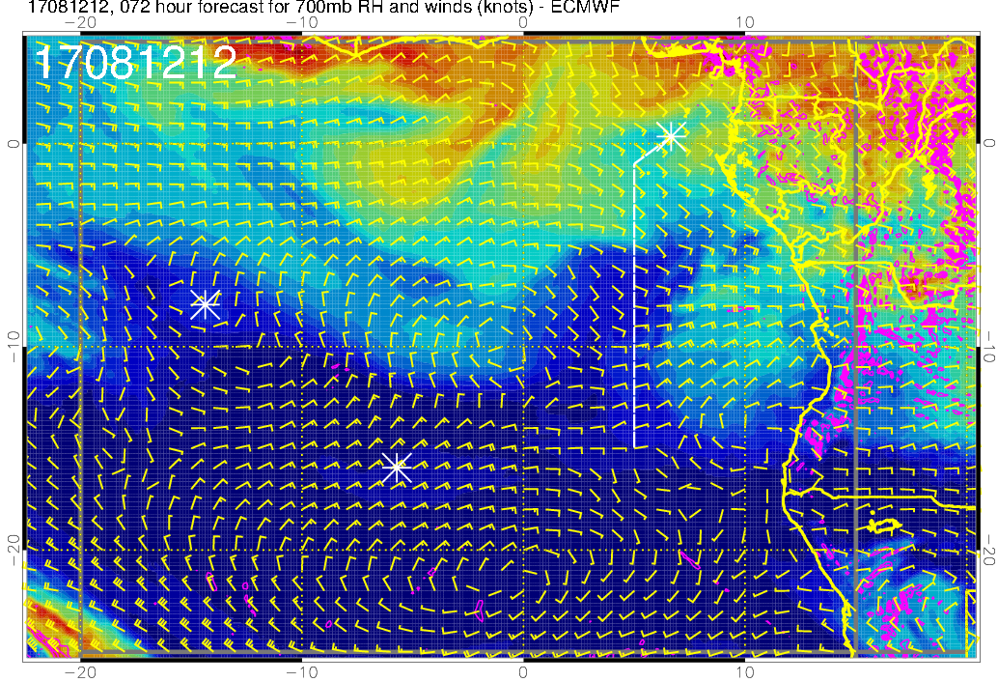
700mb RH (color), winds, vert. velocity (pink) at 8/12 Sat @ 12PM
H
H

Slide 9
600mb RH and flow
July 1979-2010
10W
0
10E
20E
0
H
0
10S
10S
20S
20S

Slide 10
600mb RH and flow
Aug 1979-2010
10W
0
10E
20E
0
0
10S
10S
H
20S
20S

Slide 11
600mb RH and flow
Sep 1979-2010
10W
0
10E
20E
0
0
10S
10S
H
20S
20S

Slide 12
600mb RH and flow
Oct 1979-2010
10W
0
10E
20E
0
0
10S
10S
H
20S
20S

Slide 13
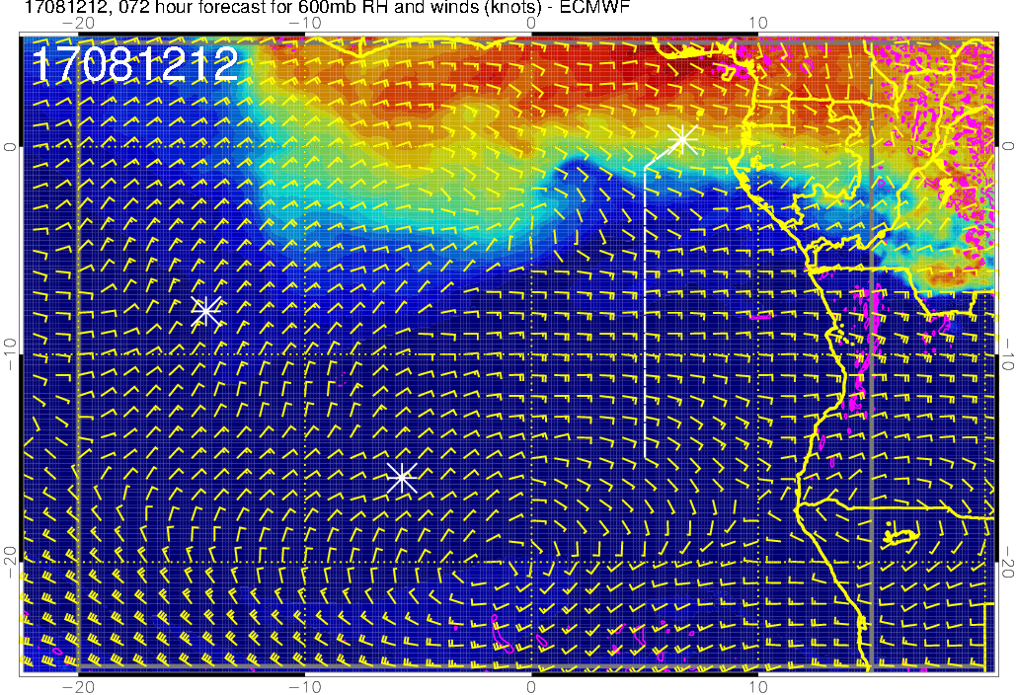
600mb RH (color), winds, vert. velocity (pink) at 8/12 Sat @ 12PM
H
H

Slide 14
Summary of climatological mean circulation at 600mb level
Position of the high shifts southward from Jul to Aug
The latitude of the wind shift (easterly vs. westerly) migrates southward from Jul to Sep

