Slide 1
ORACLES weather briefing
10-Aug-2017
Lenny Pfister and Rei Ueyama

Slide 2
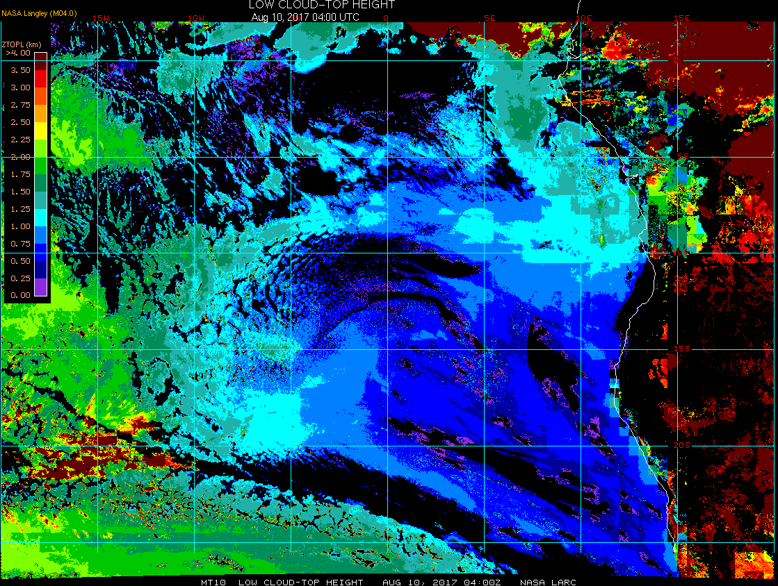
Low cloud top heights at 8/10 Thu @ 4AM
15W
10W
5W
0
5E
mid to high clouds over TMS this morning (as forecasted)
5S
10S
A bigger “gap” existed in the models
15S

Slide 3
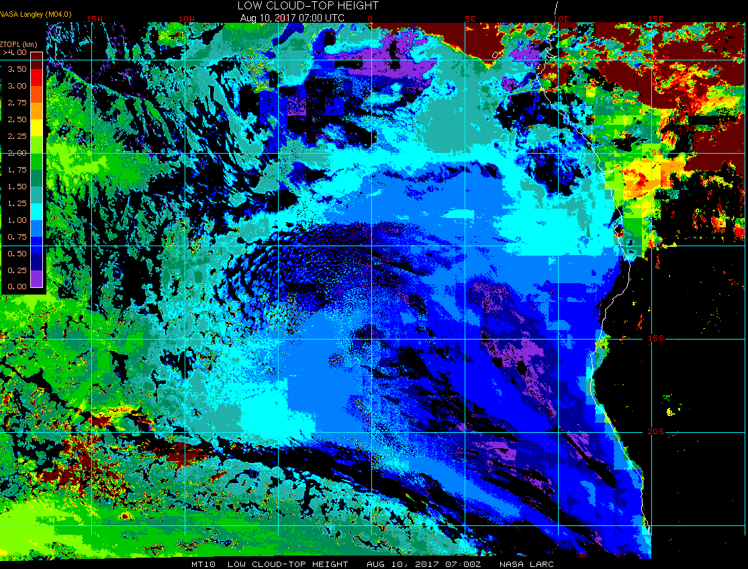
Low cloud top heights at 8/10 Thu @ 7AM
15W
10W
5W
0
5E
mid to high clouds (tops 10-12 km) over TMS this morning
5S
10S
EC model did very well with the mid-high clouds to the NW and the gap south of TMS; UKMO not as well
15S
TMS weather at 7am:
25C (was 24C at 7am yesterday)
S 6 knot winds (haven’t increased much yet since early morning as they have been in the past several days)

Slide 4
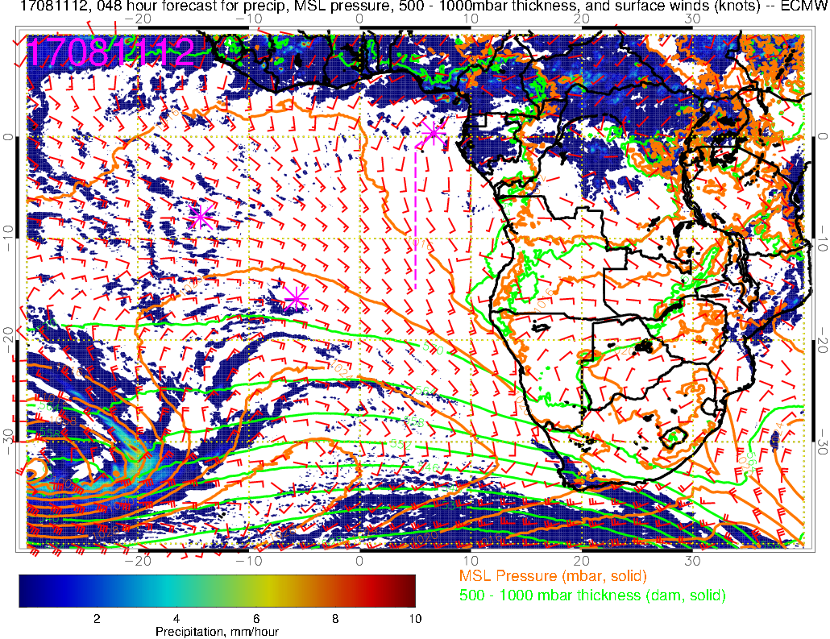
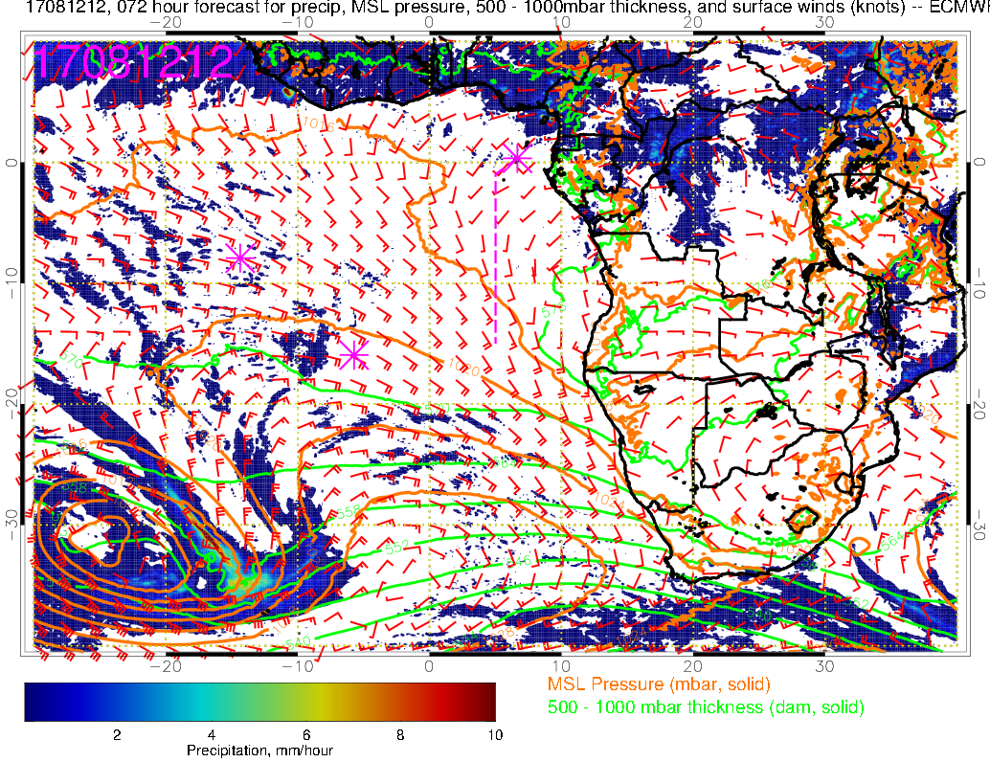
Precip, surface winds, 500-1000mb thickness for 8/11-12 @ 12PM
8/11 Friday
H
8/12 Saturday
L
H
L
current position of the surface high
H

Slide 5
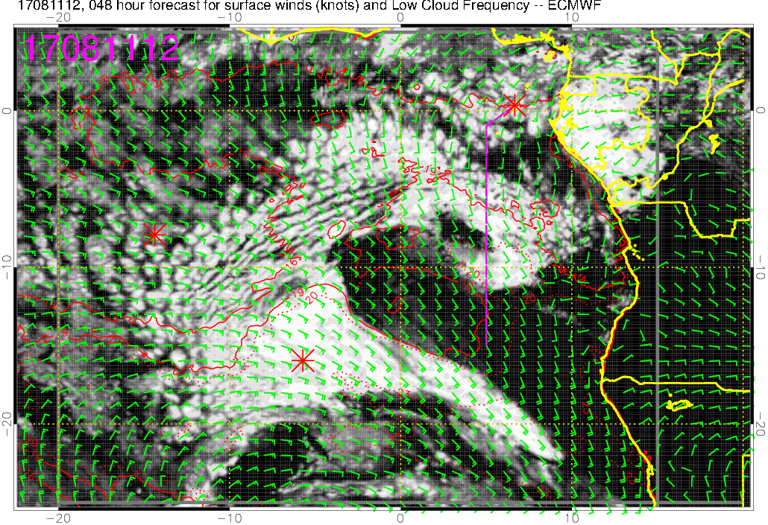
Low cloud forecast on 8/11 Fri @ 12PM
Low clouds throughout most of the flight
(more low clouds compared to yesterday’s 60-hr forecast)

Slide 6
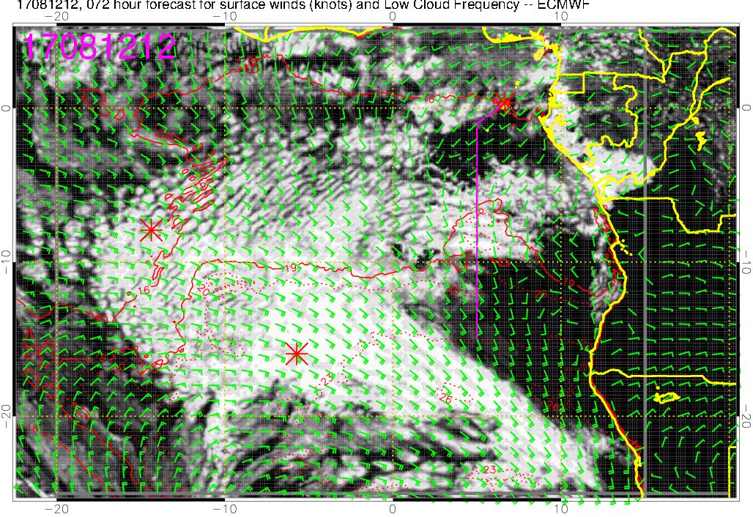
Low cloud forecast on 8/12 Sat @ 12PM
A larger “gap” south of TMS than 8/11 (but EC model overestimated its extent this morning)
Most of the low clouds in the middle of the flight (5-10S)

Slide 7
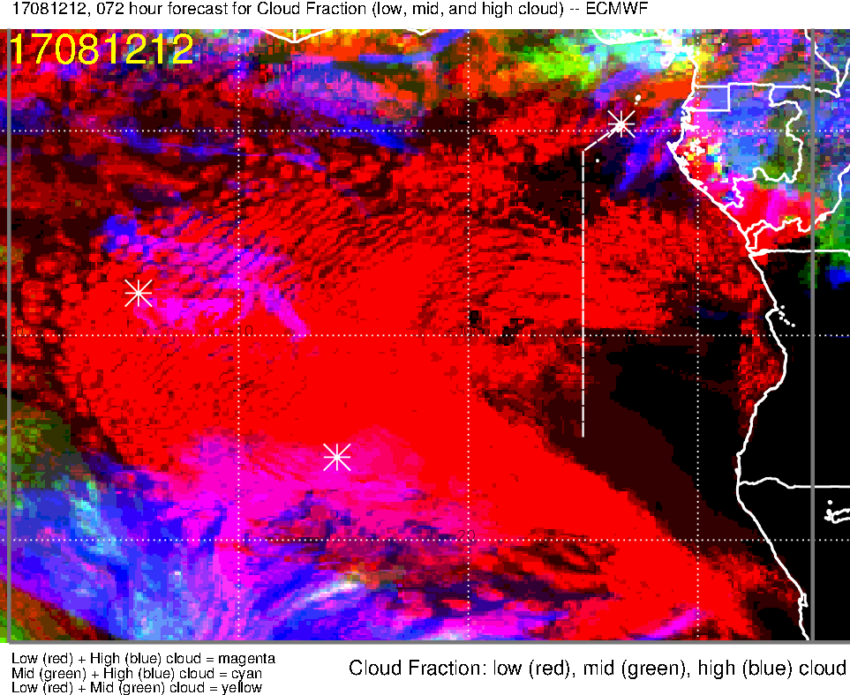
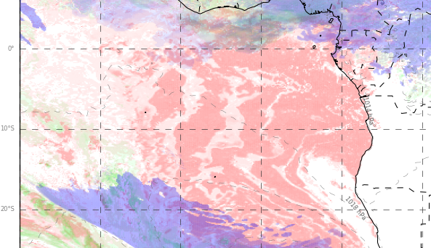
Low, middle, high cloud forecast for 8/12 Sat @ 12PM
ECMWF (72-hr)
UKMO (60-hr)
High clouds
High clouds
Most abundant low clouds expected in the middle of the flight, less south of 10S (based on ECMWF…UKMO likely overestimating low cloud cover along the flight track, small gap south of TMS is evident)
Both models show high clouds to the N and E of TMS, probably not an issue for us

Slide 8
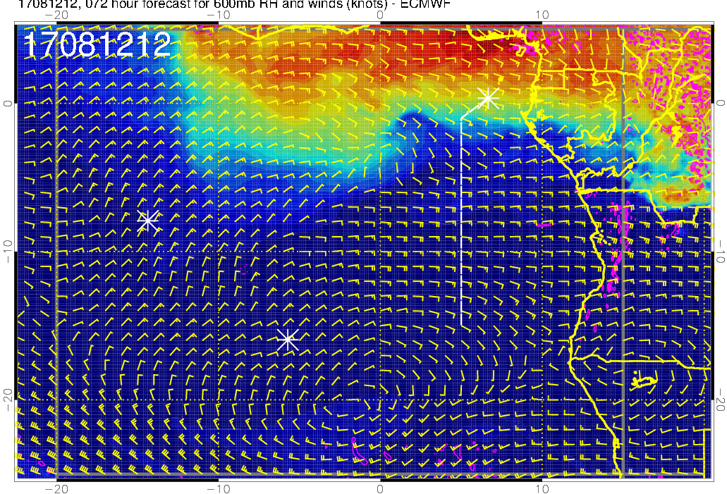
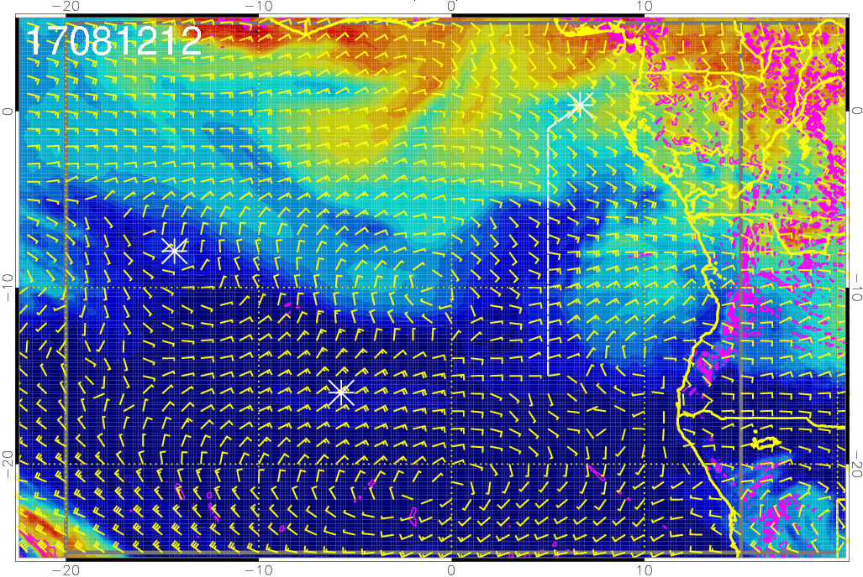
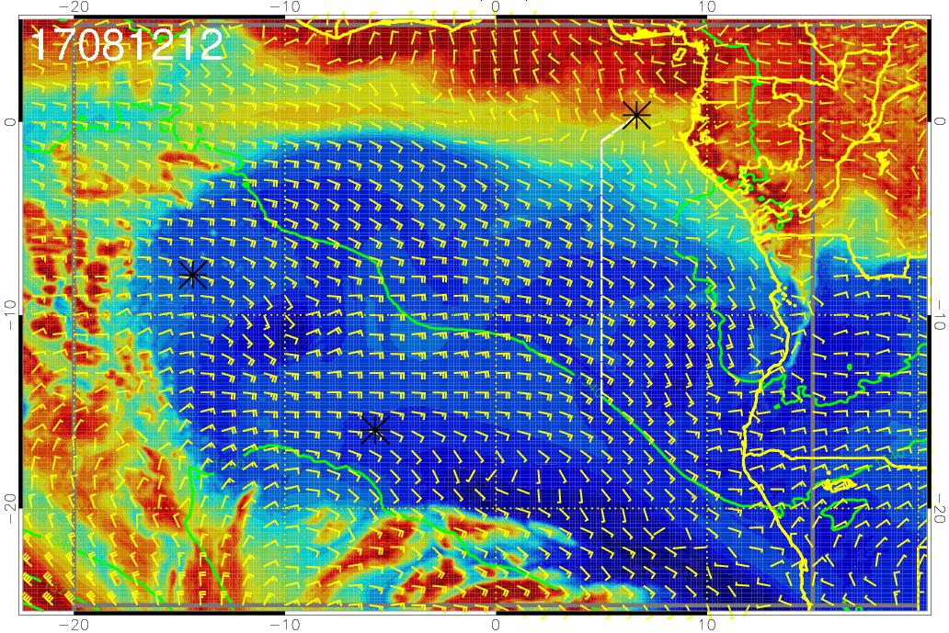
RH (color), winds, vert. velocity (pink) at 8/12 Sat @ 12PM
600 mb
700 mb
Mid-levels are dry
Moisture (influenced by moist convection) is at Sao Tome and northward
850 mb

Slide 9
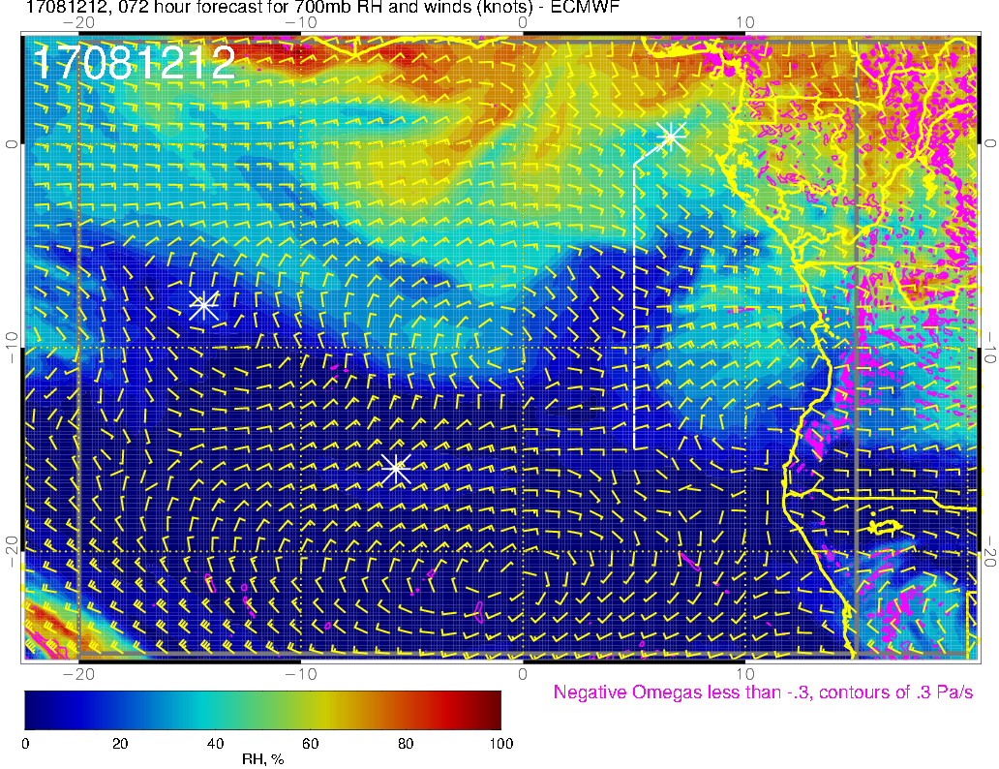
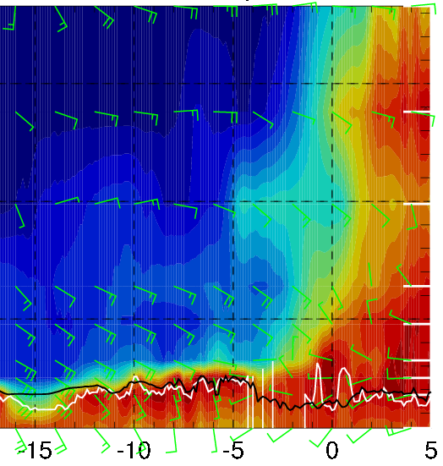
RH forecasts for 8/12 Sat @ 12PM
RH (color), wind, BL and cloud base heights along 5E
700mb RH, winds
15-25 knts
10-20 knts
Plume transport from dry convection (700mb, 10kft) not quite reaching the flight track
Cross winds (Ely) at 3-15 kft altitudes during most of the flight
5-15 knts
10-20 knts

Slide 10
Summary
Routine flight: Saturday 8/12
Low clouds expected mostly in the middle of the flight
High and middle cloud cover will most likely NOT be a problem, except near TMS (primarily to the north)
Mid levels are dry; don’t expect much plume transport from dry convection reaching our flight track

Slide 11
Sunday

Slide 12
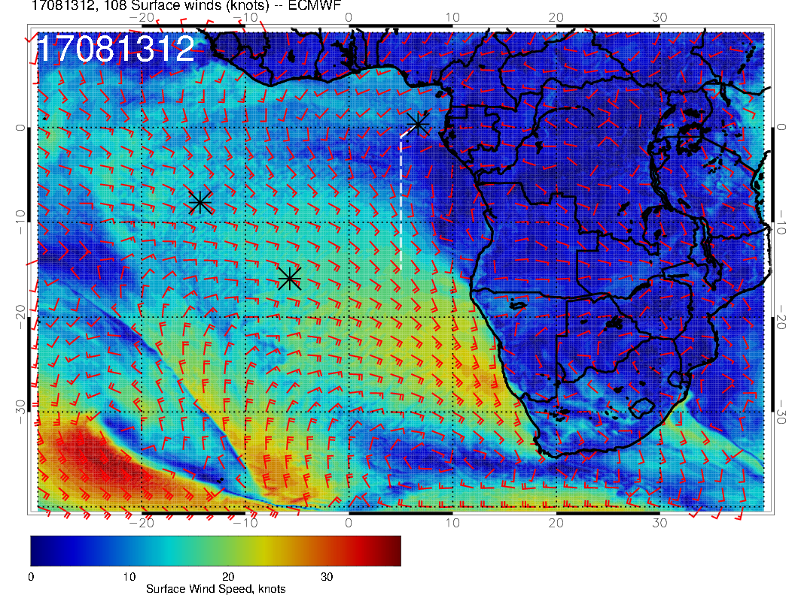
H
Surface winds weaken in northern SC region, but still stronger than at
start. Still westerly winds near TMS.

Slide 13
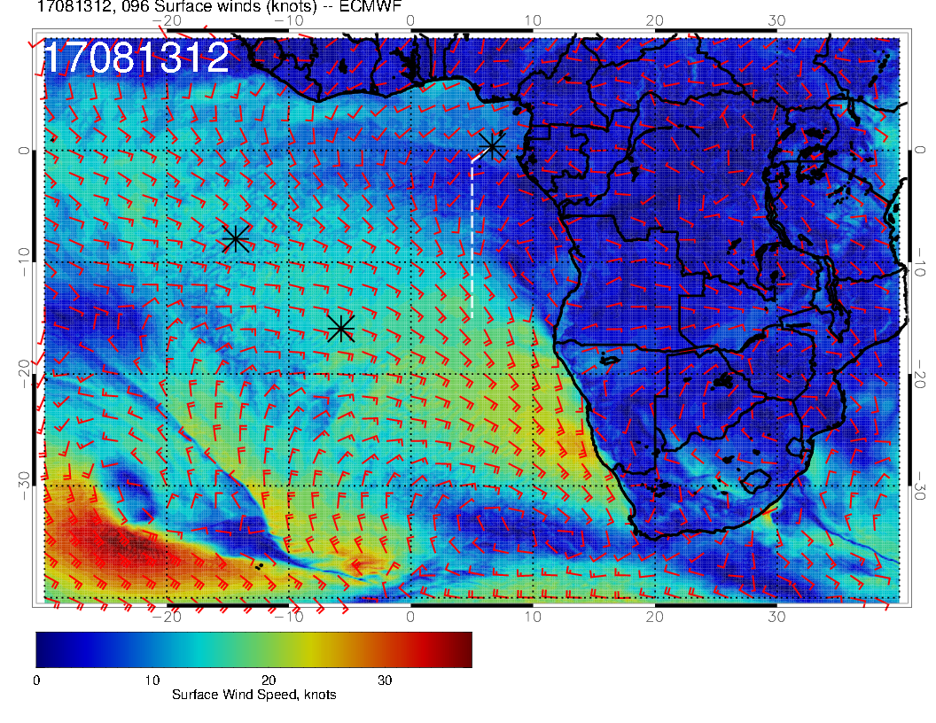
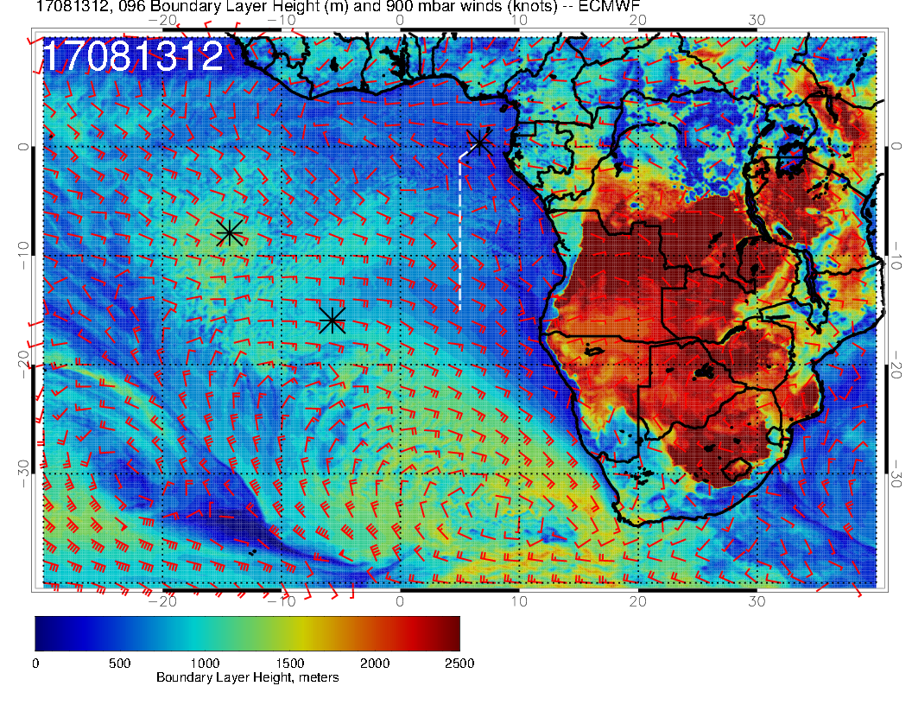
SUNDAY SURFACE WINDS
L
H
L
Little change from yesterday’s forecast. Low pressure system to west is NOT progressing. Winds weak and near westerly just south of TMS.
SUNDAY BL HEIGHTS

Slide 14
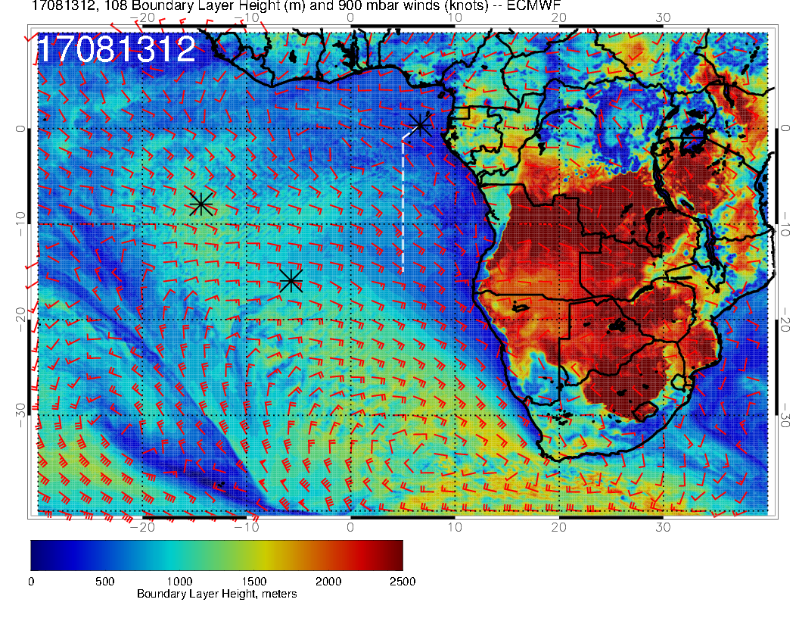
H
Slightly less elevated BL heights than on August 12, but still greater than at start of forecast period.

Slide 15
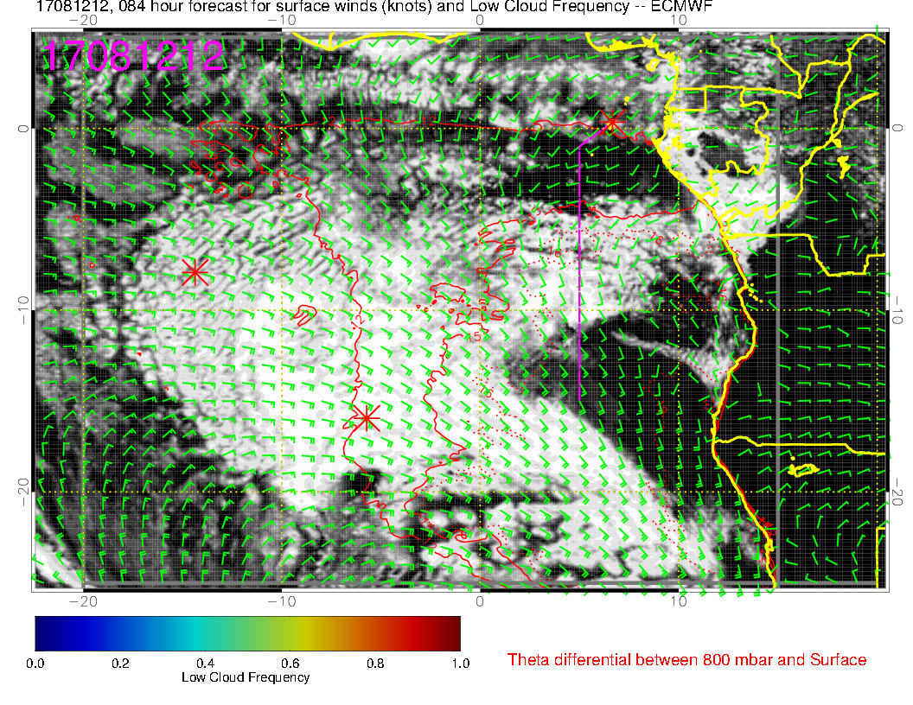
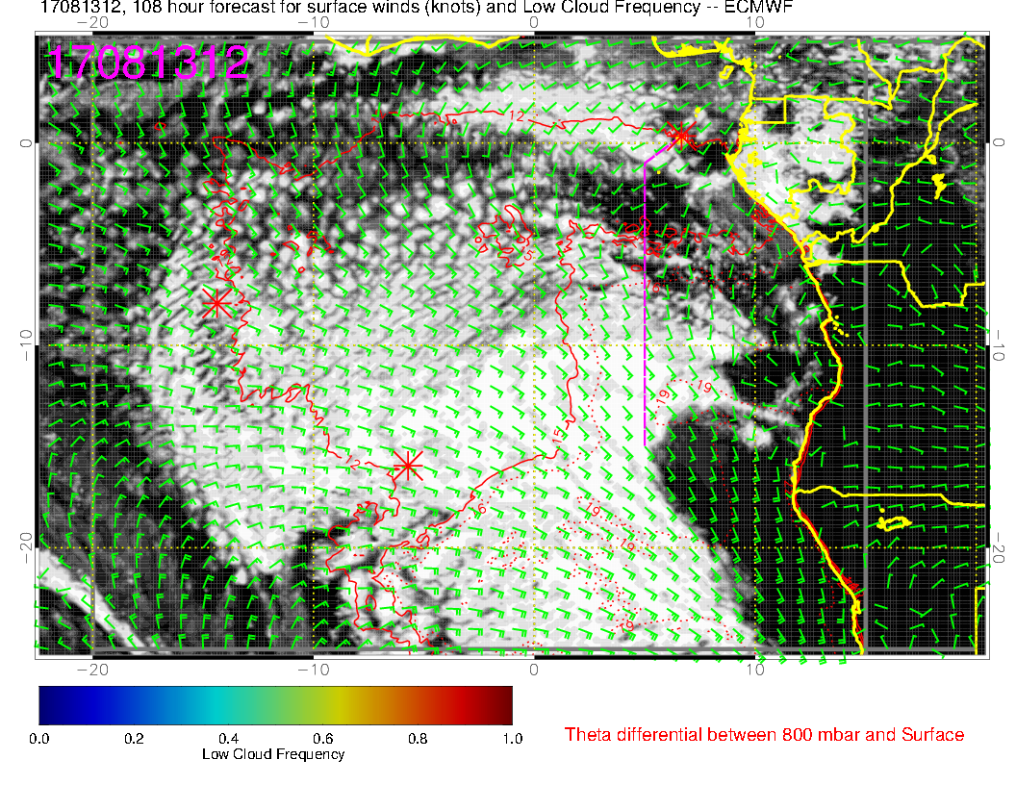
SATURDAY
This far out, can say that we should have ample low cloud south of us if we don’t go too far east. Both days are similar
SUNDAY
T

Slide 16
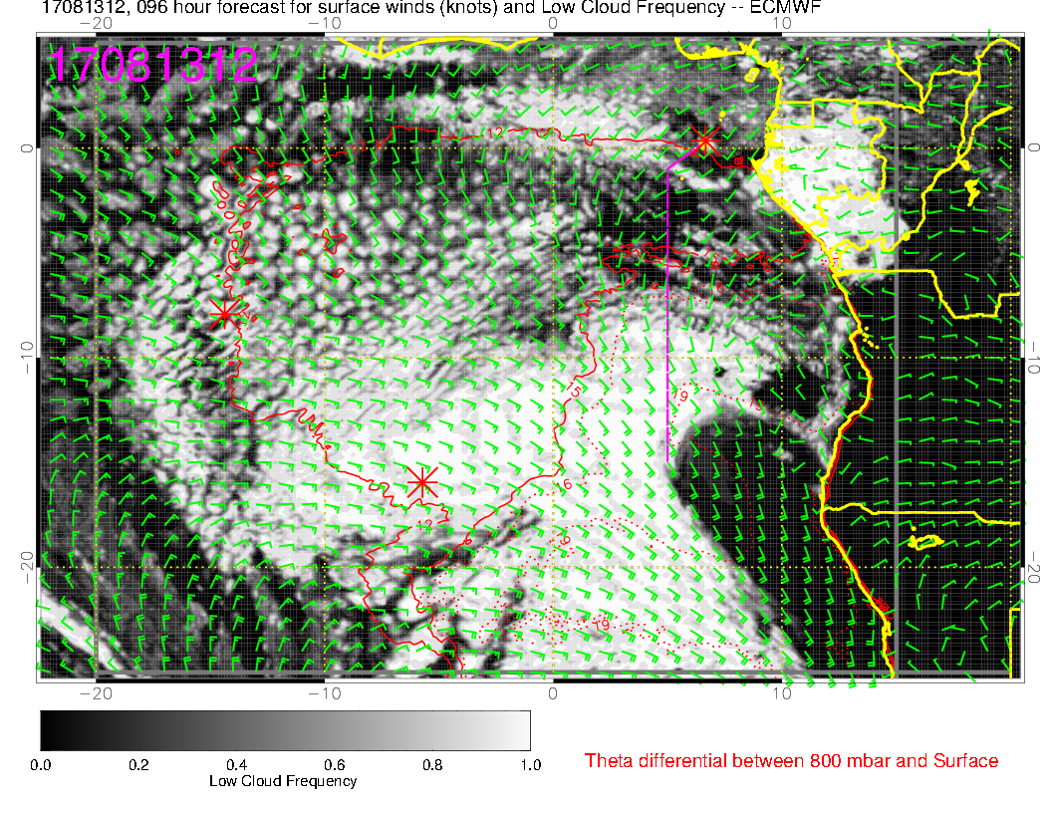
SUNDAY, OLD
Subtle changes in the forecast for
low clouds, “gap” extends further
south
SUNDAY, NEW

Slide 17
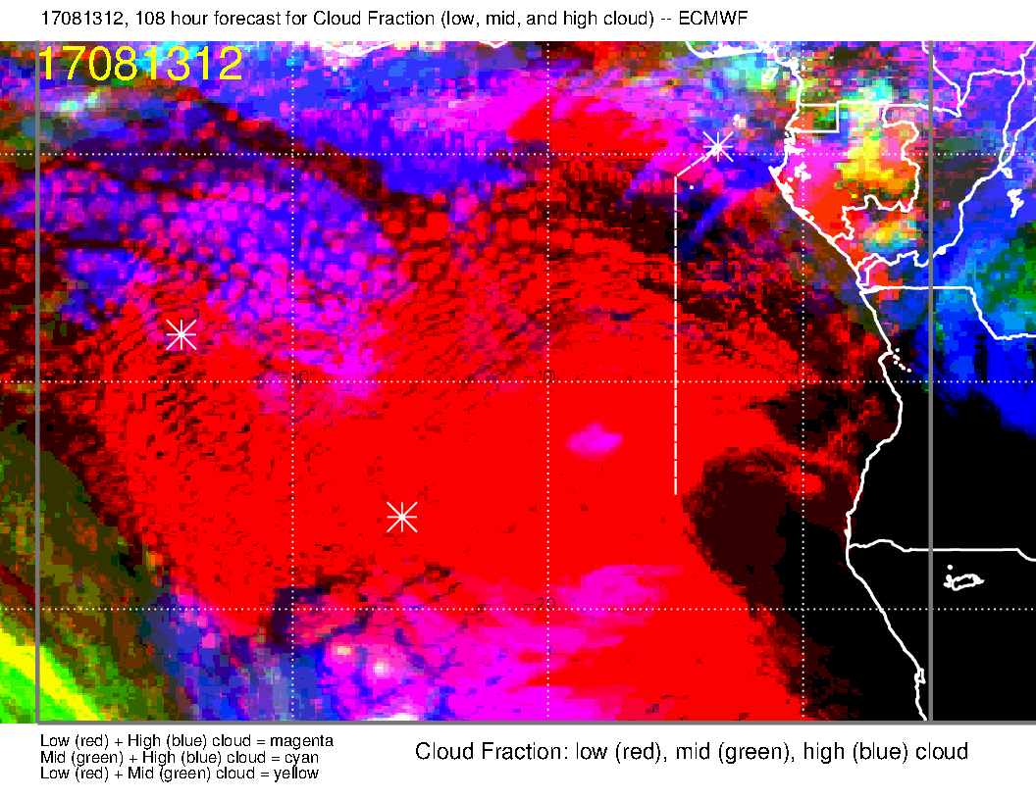
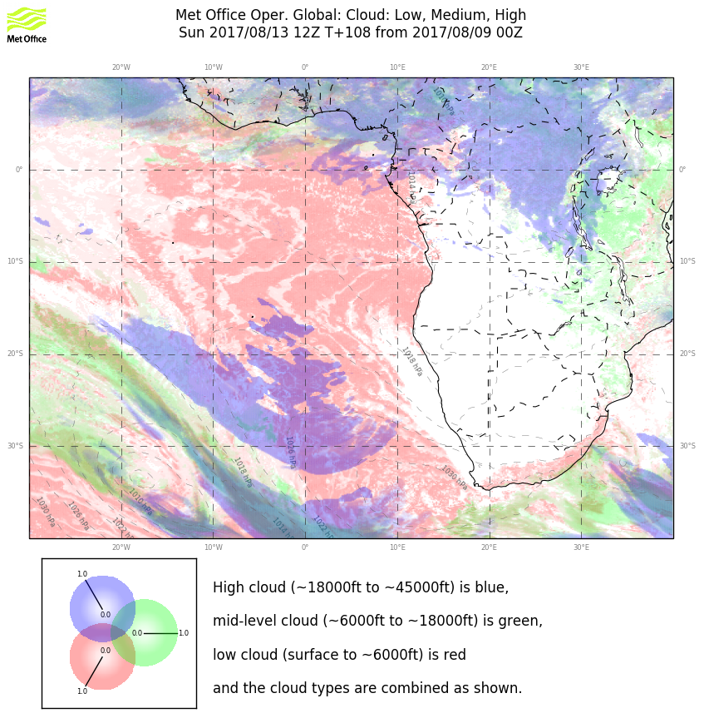
Old forecast for overall clouds for Sunday

Slide 18
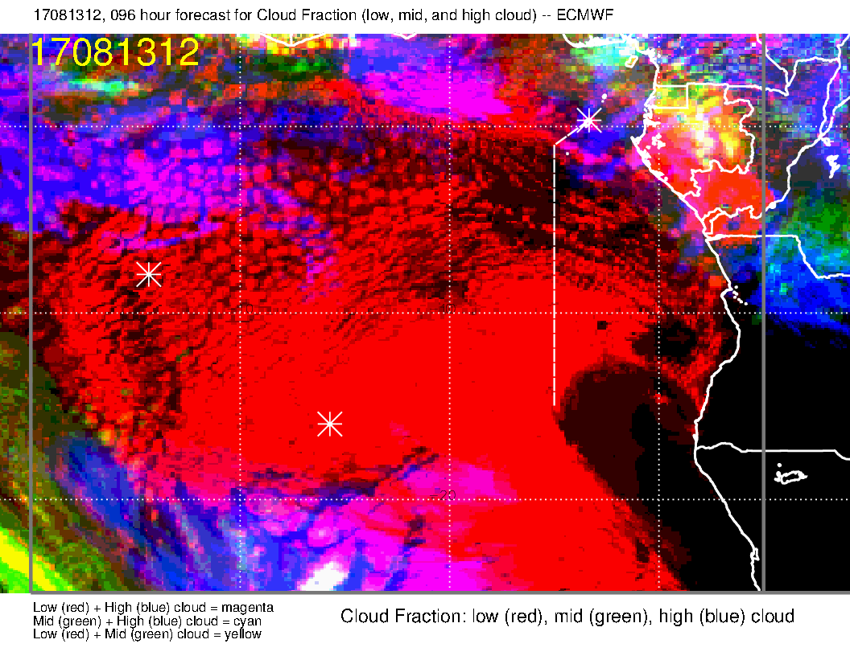
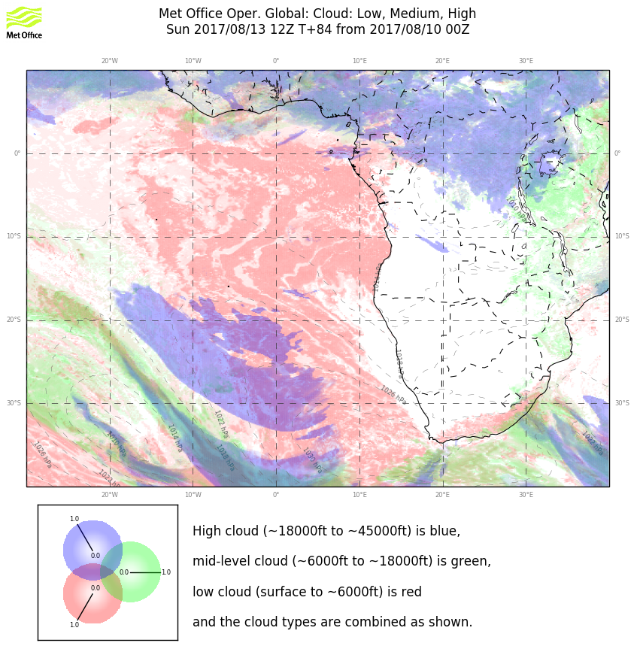
Both models have the high cloud “retreating” from yesterday’s forecast in the TMS region.

Slide 19
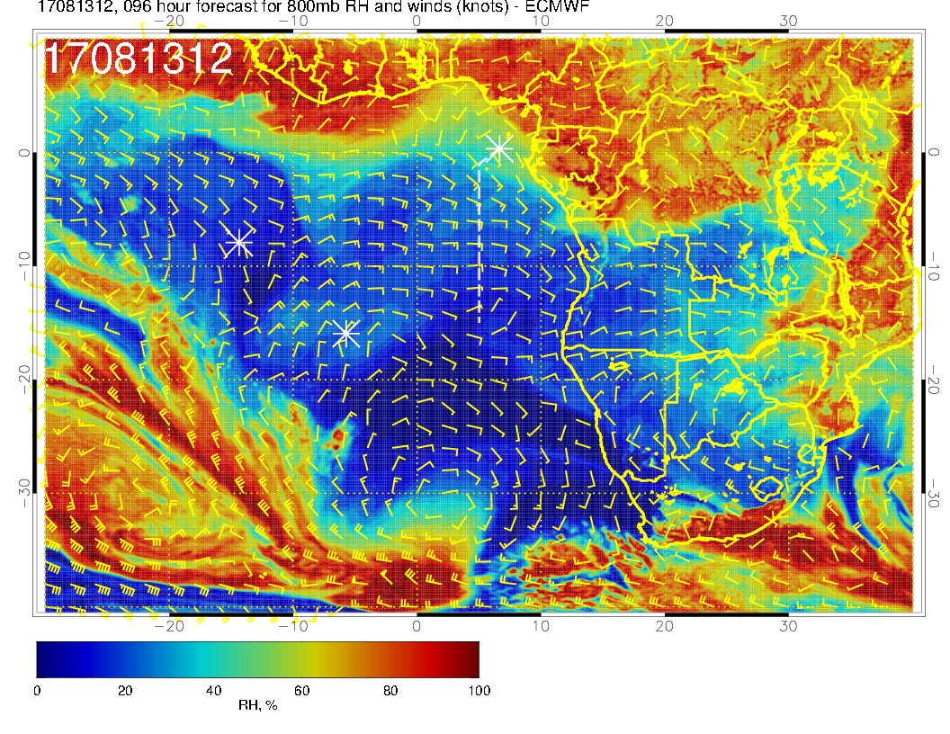
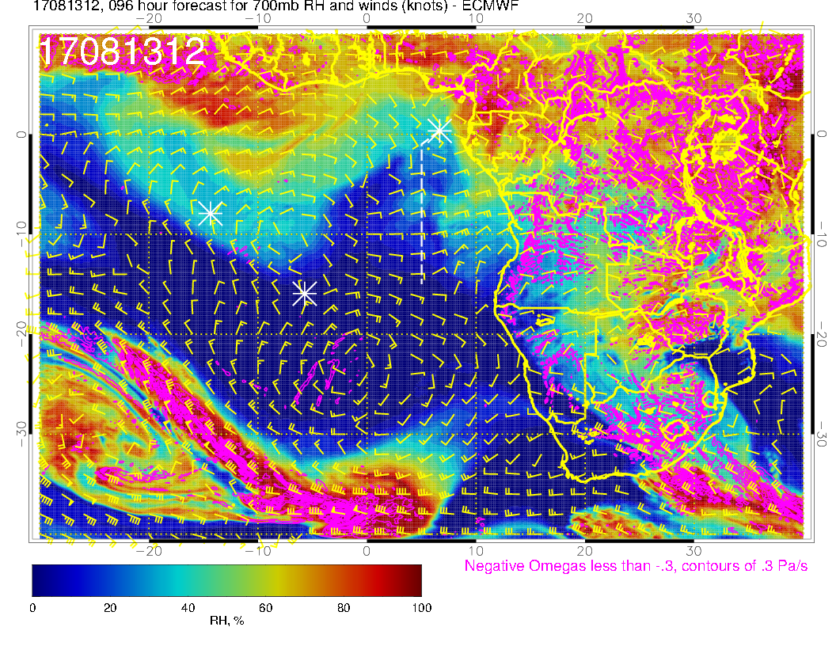
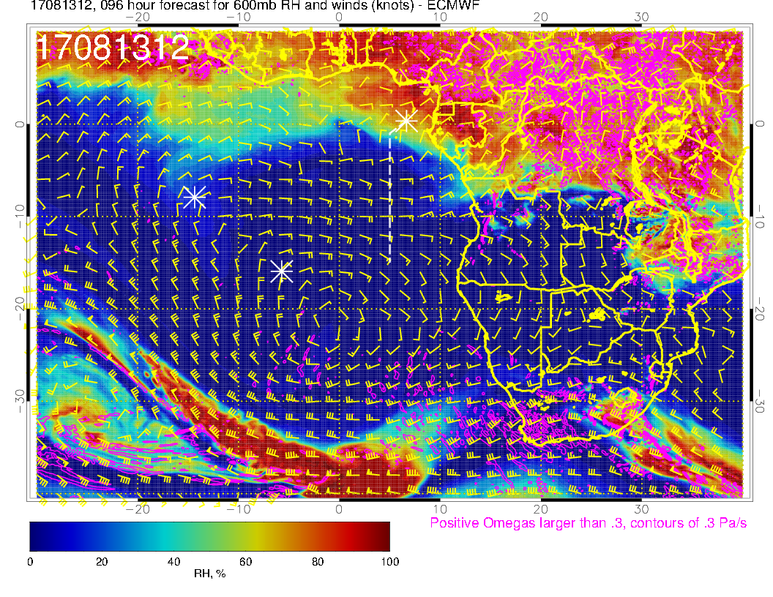
800 mb
700 mb
As in yesterday’s forecast, it is quite dry. At 800mb, see a northwestward flow; at 600mb, I think we have sufficient descent over the ocean to keep the RH down. 700mb is a bit moister than yesterday’s fcst. Starting to get some northeasterlies that bring moisture in (but not Sunday)
600 mb

Slide 20
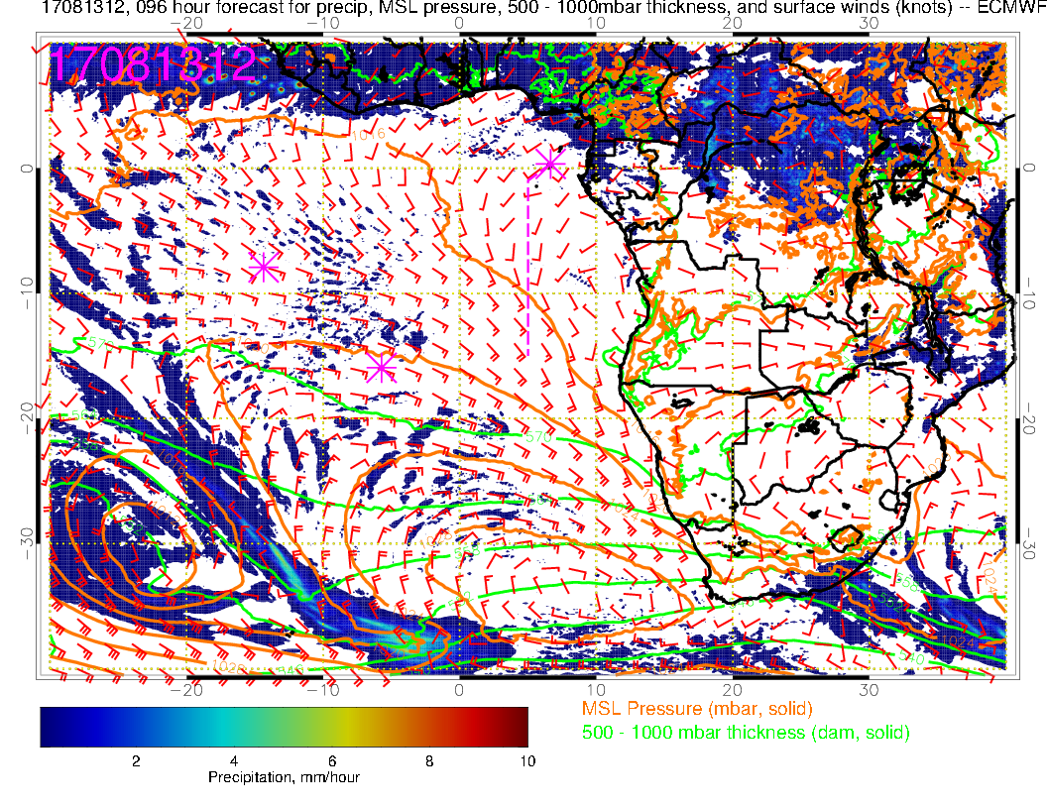
A note on precipitation. Model precip beyond about 48 hours is marginally trustworthy. However, the EC model is putting continental precip more northward than earlier in the month. Almost nothing south of the latitude of Kinshasha

Slide 21
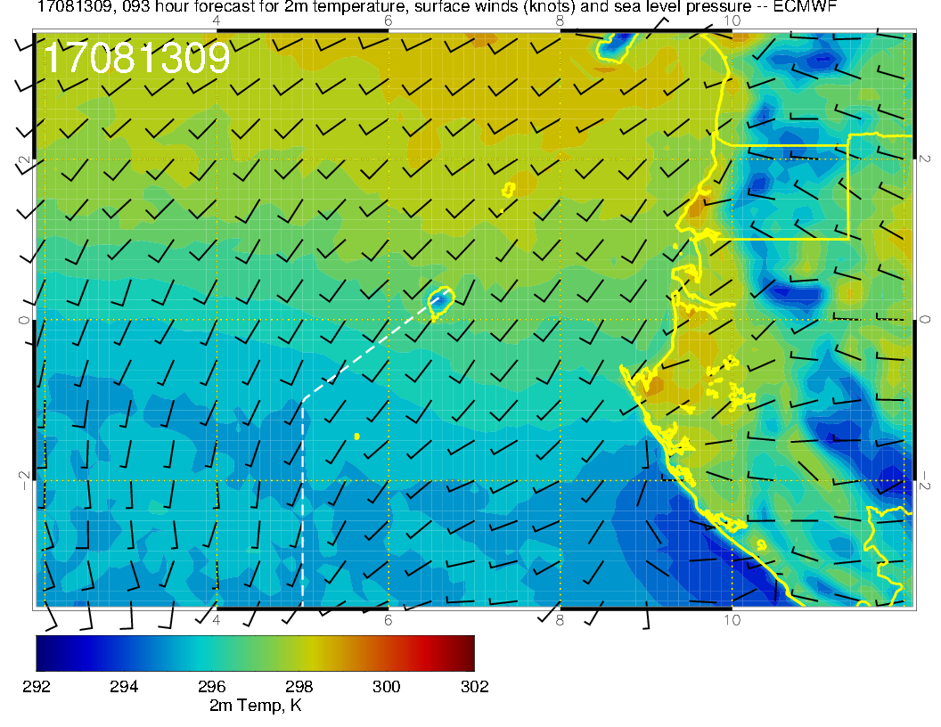
Surface winds overall are weaker than typical. If we have minimal middle cloud, things could heat up more quickly than normal. Yesterday temps at 8 AM were 25C (it was sunny).

Slide 22
Summary for Sunday
Sunday low cloud forecast little changed, “gap” boundary at about 5-8S.
Low BL height region with thin clouds is smaller than usual and near 15S.
Weak surface winds (even westerlies) south of TMS (0-5S)
High and middle clouds minimal – forecast has changed for the “better”
Mid levels continue dry, with some intrusions at 700mb from the continent
Need to watch takeoff temperatures

Slide 23
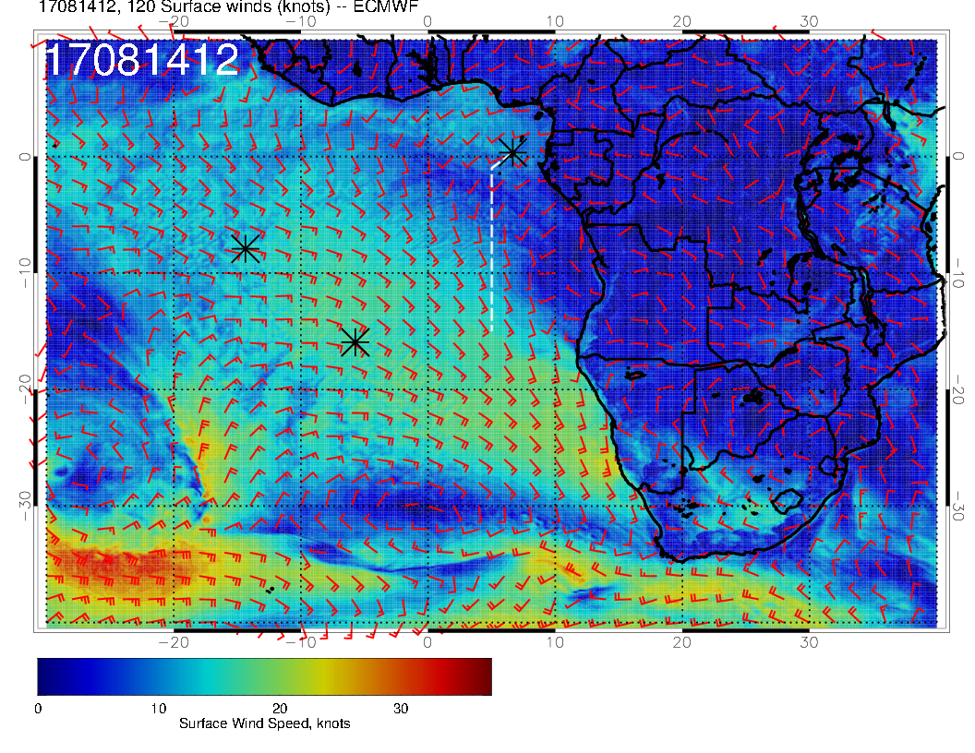
MONDAY SURFACE WINDS
L
H
This actually looks close to climo. SH high near mean position. Low is stationary. Surface winds south of TMS are southwesterly again.

Slide 24
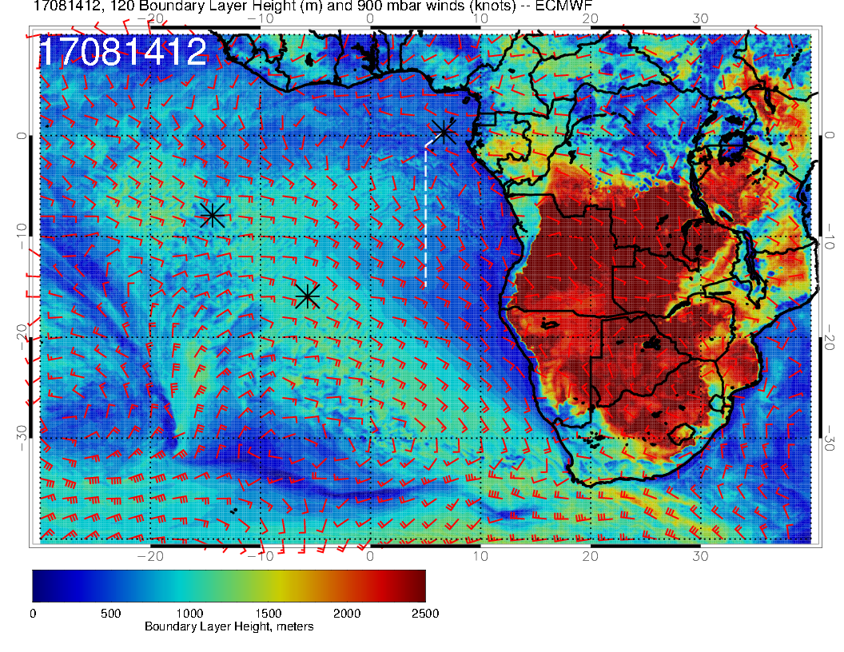
SUNDAY
Boundary layer heights similar to Sunday, with higher heights pushed further northward.
MONDAY

Slide 25
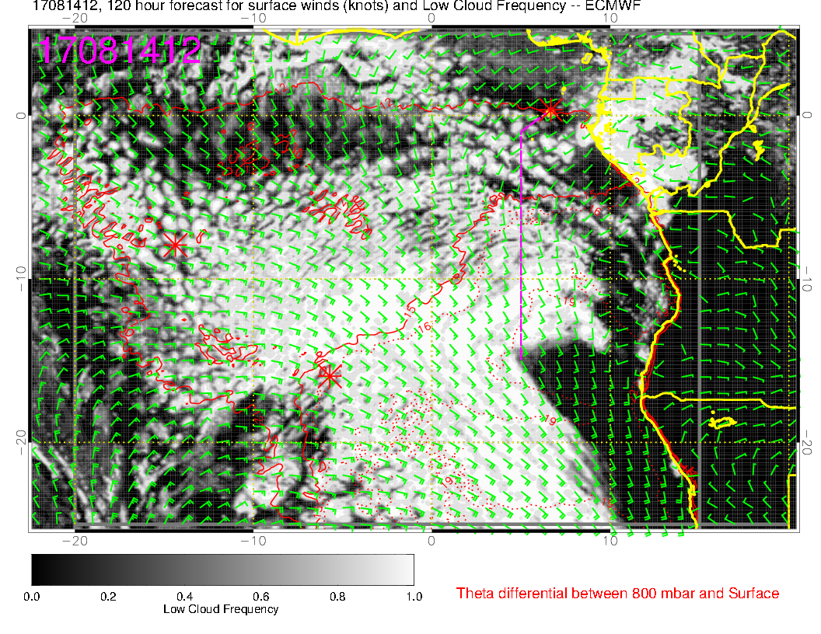
SUNDAY
Forecast for Monday (right) suggests some filling in of the gap, consistent with northward push of higher BL heights. Otherwise, persistence (from Monday) is a reasonable forecast
MONDAY

Slide 26
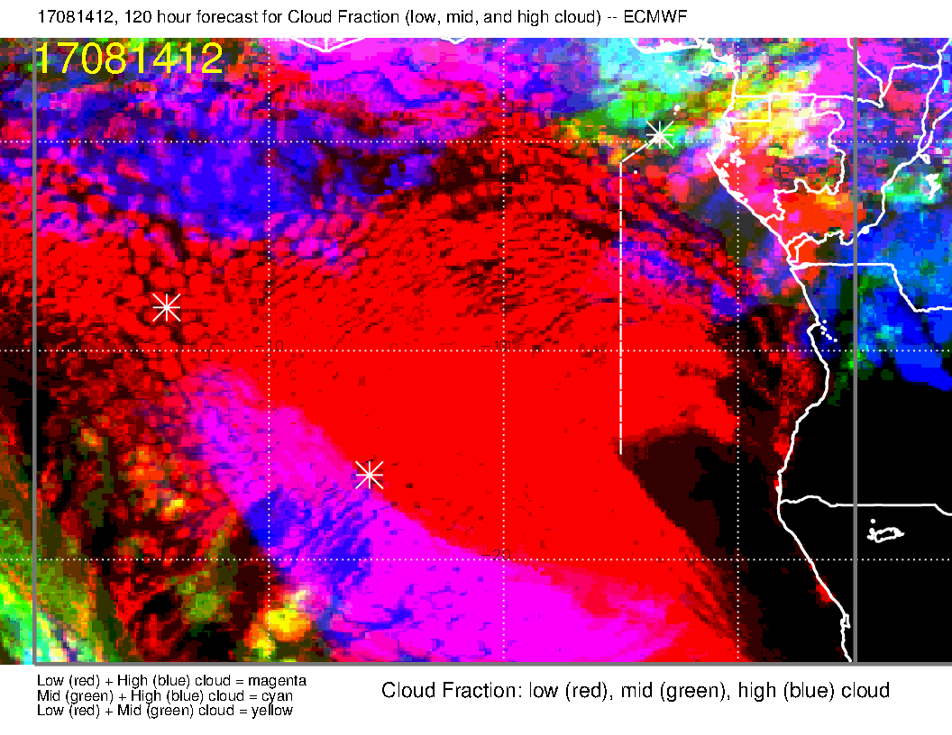
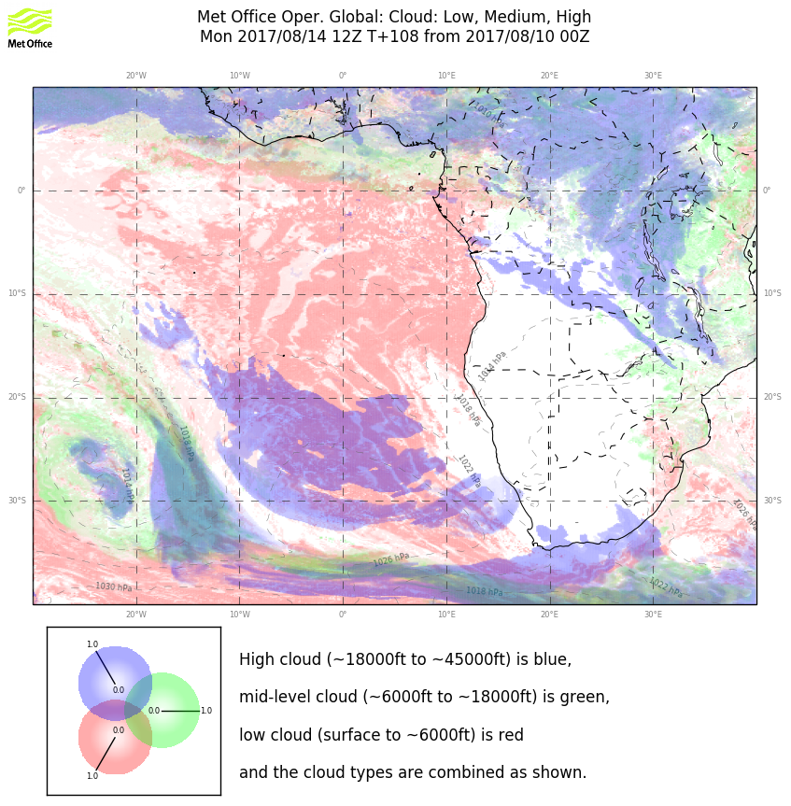
EC
UKMO
We have more high clouds in both than Sunday near TMS. The patch on the routine flight track in the EC is related to a flow field “disturbance”. Will watch to see if it materializes. There is a northeasterly flow (from the convective regions) prevailing, so some high and middle cloud from convectively detrained moisture is always a possibility.

Slide 27
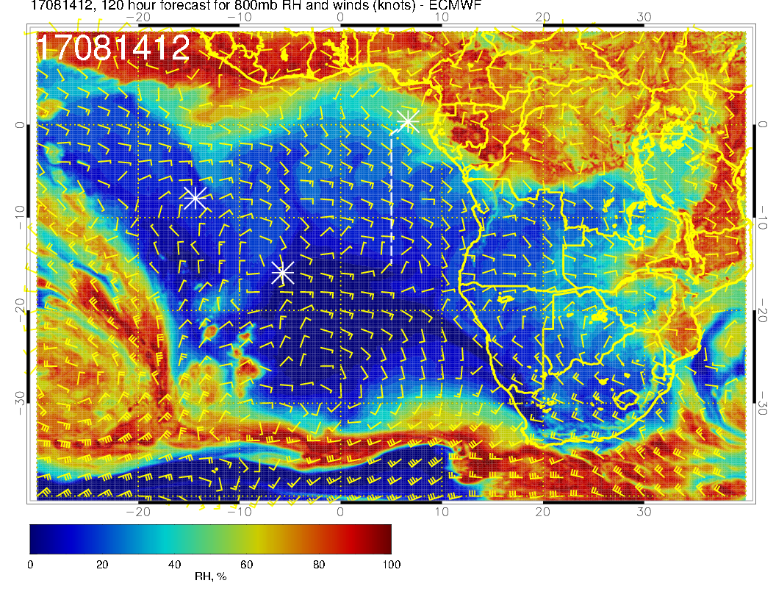
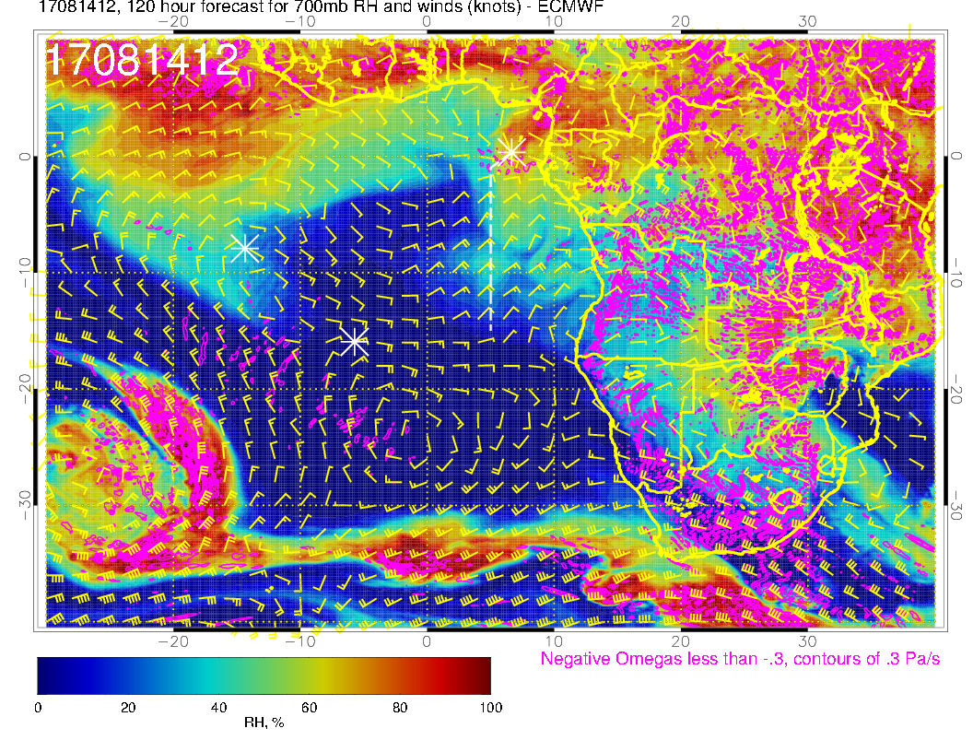
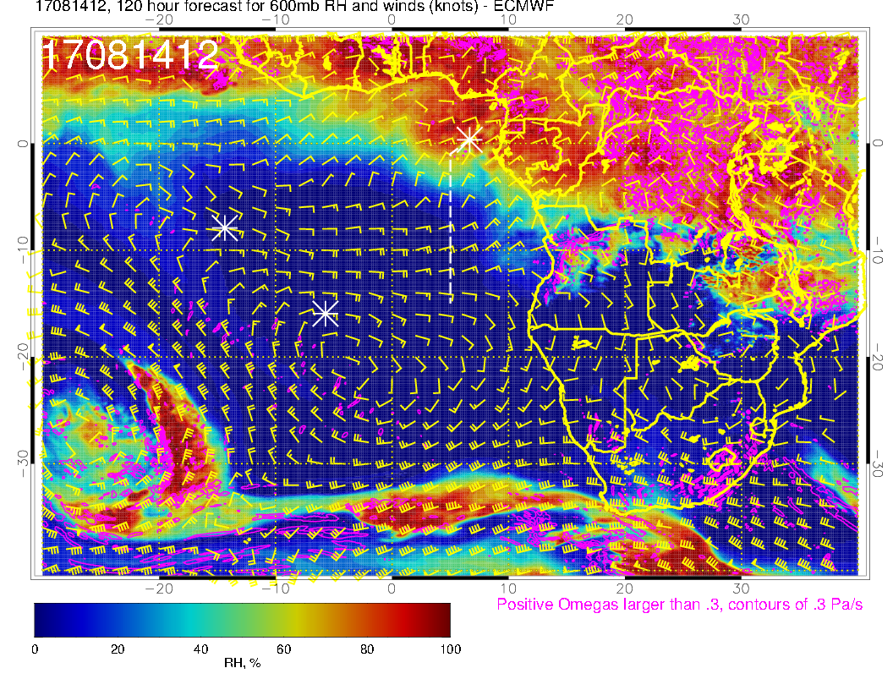
800 mb
700 mb
Northeasterlies at 700mb are starting to have their effect on the moisture at 700mb. 600mb is also moister near TMS than Sunday. 800mb continues dry with winds from the southeast (dry regions).
600 mb

Slide 28
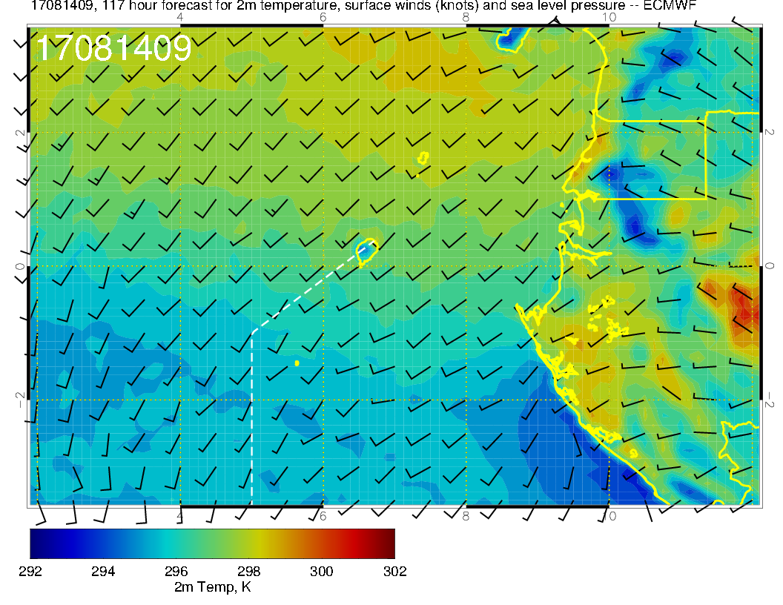
Situation for Monday. Winds a little stronger, more middle cloud forecast. Perhaps less of a concern for takeoff temperatures.

Slide 29
Summary for Monday
Low clouds, and higher BL heights, move northward in the forecast. Actual “gap” may disappear
Surface winds just south of TMS are stronger and southwesterly
High and middle clouds start to intrude into our region, especially near TMS.
Slight surge of moisture at 700mb, and more moisture than previous at 600mb (near TMS). 800mb continues dry.
Takeoff temperatures less of a concern than Sunday

Slide 30
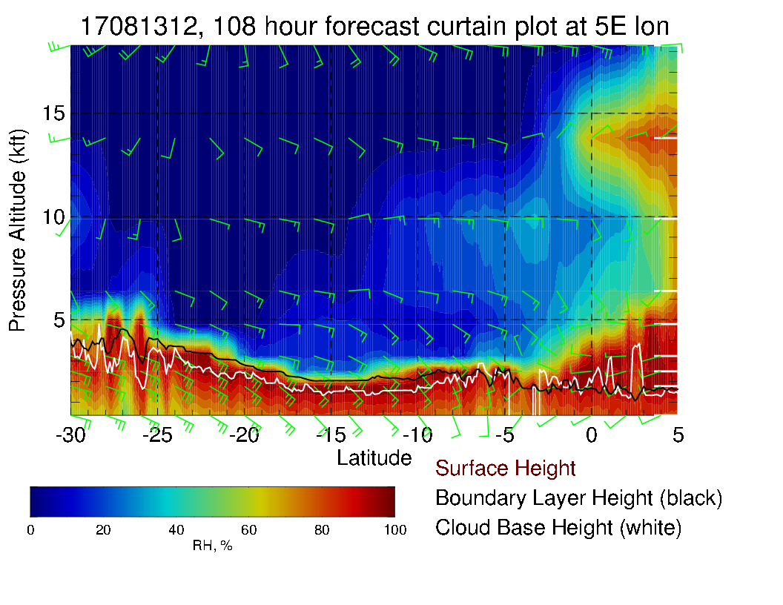
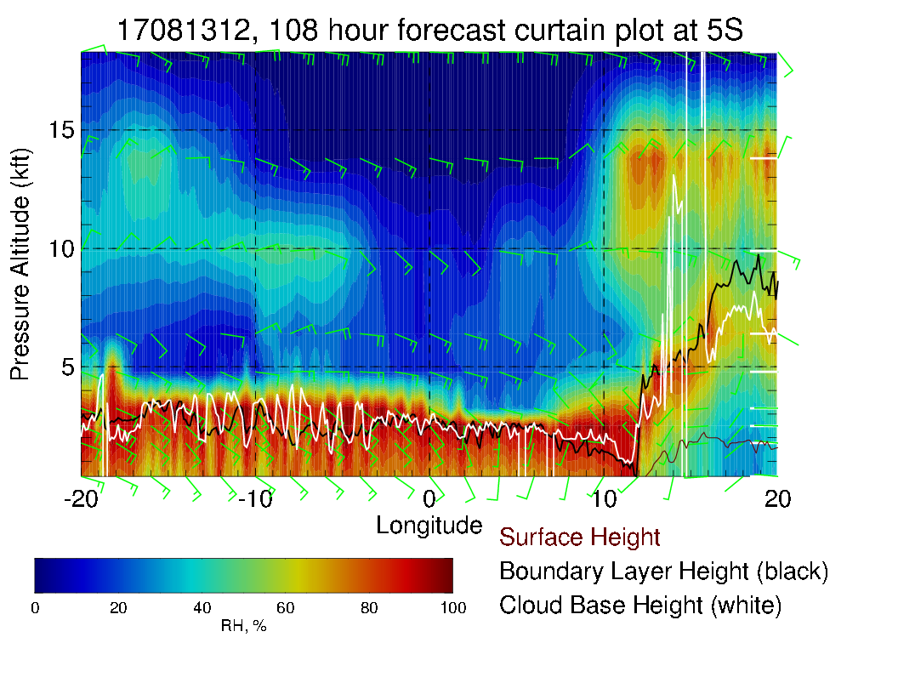
N/S (above) and E/W (right) cross sections. Cloud top heights about .8 km near extensive low cloud band at 5-10 S, somewhat lower (not as low as August 12) between 10 and 15S.

Slide 31
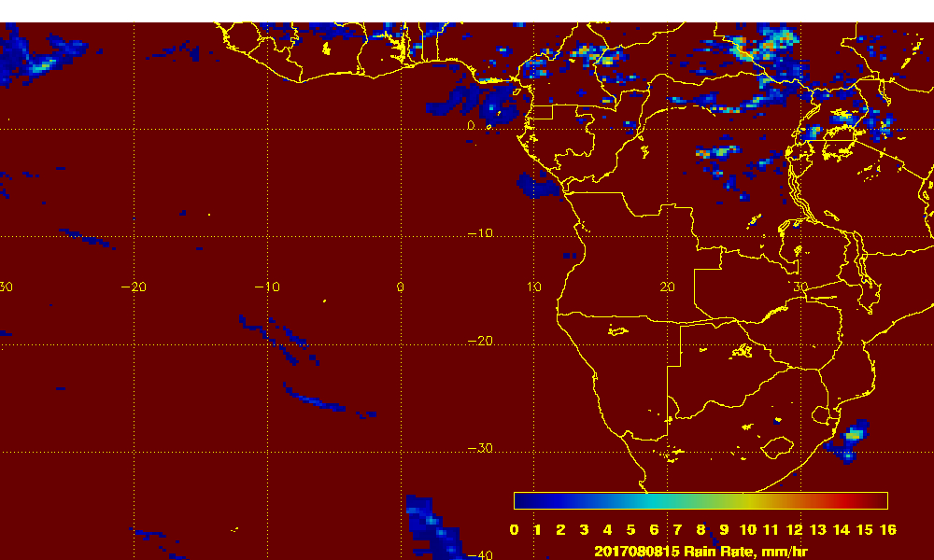
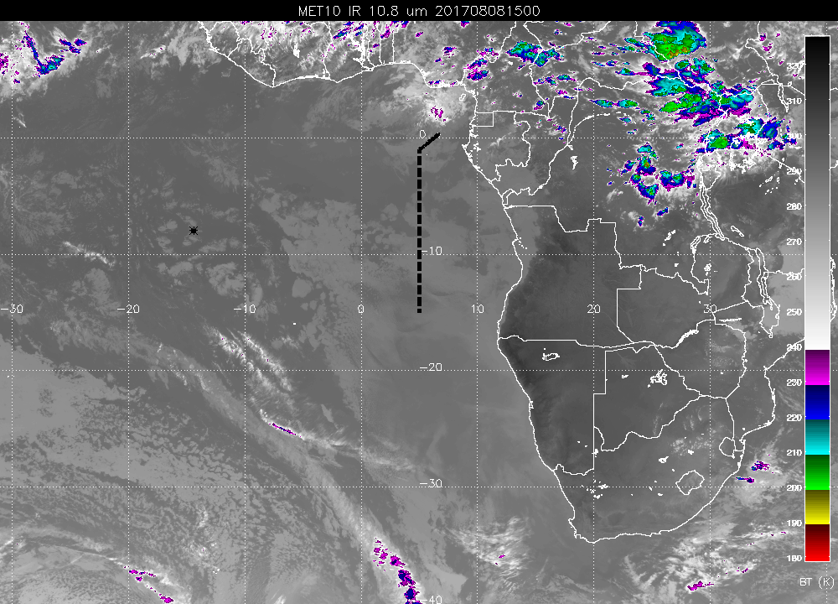

Slide 32
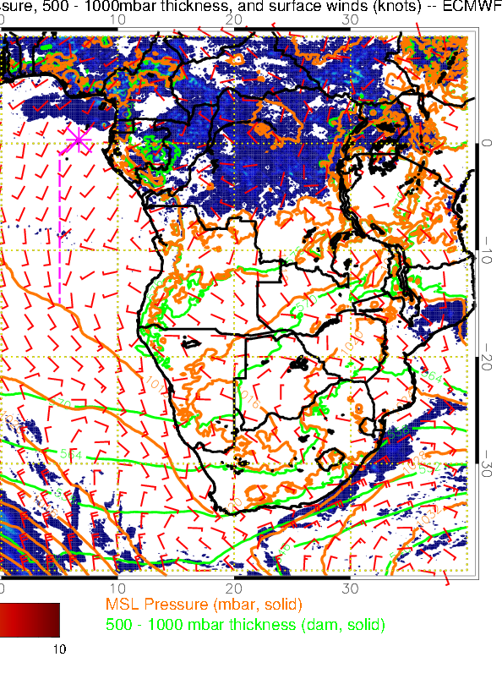
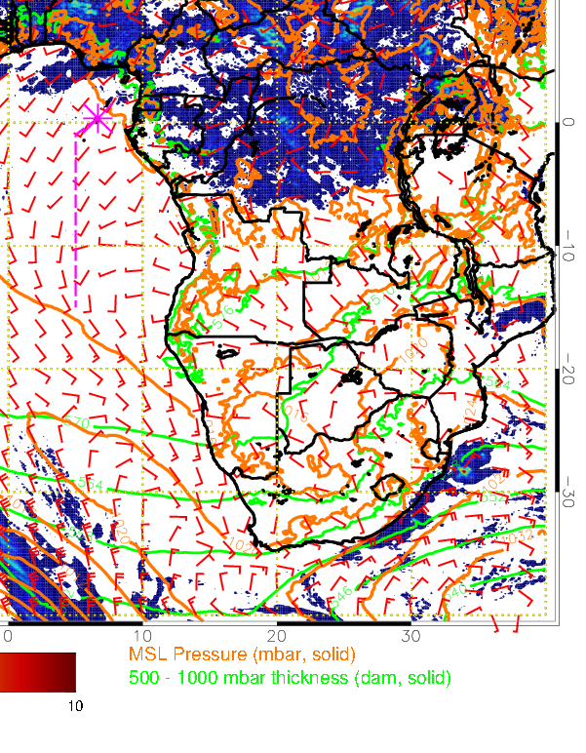
27 hour fcst
51 hour fcst

Slide 33
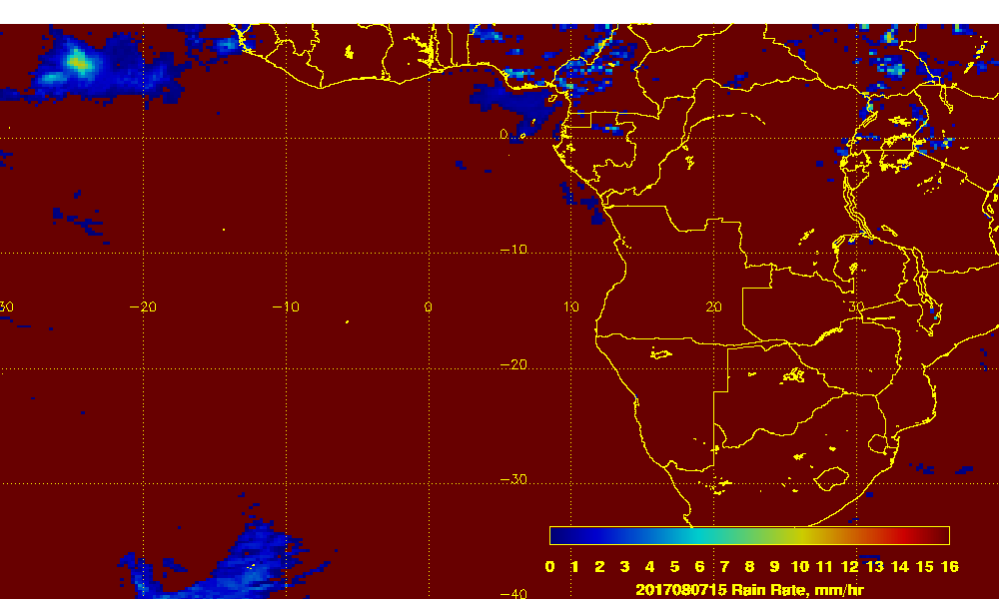
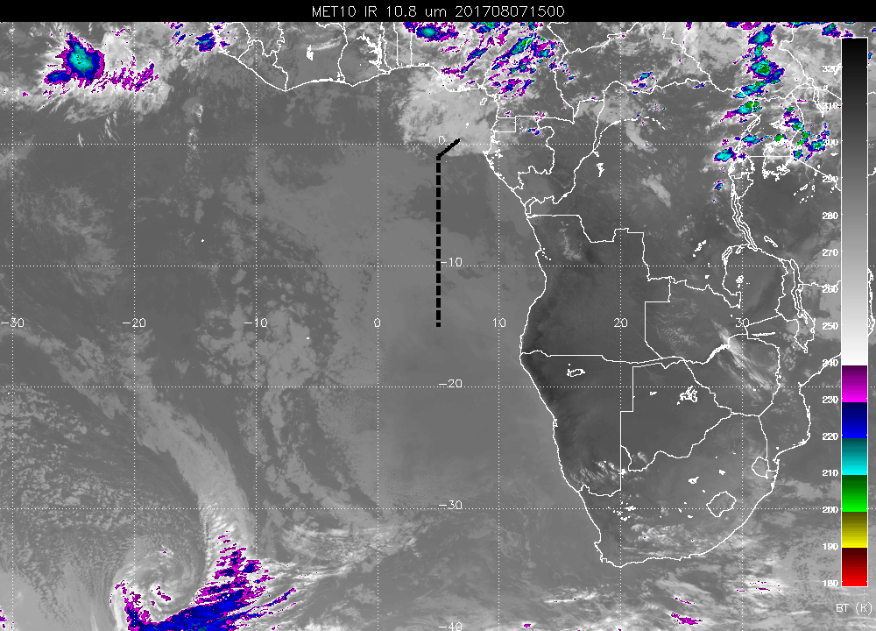
Precip on August 7 at 15Z.

Slide 34
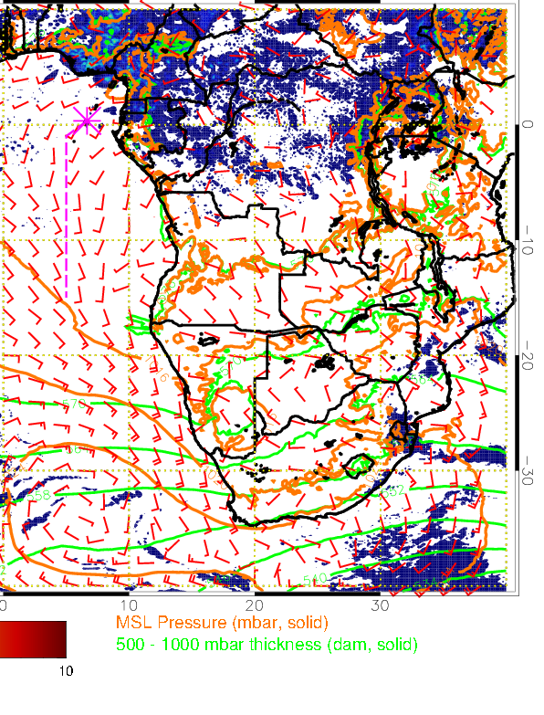
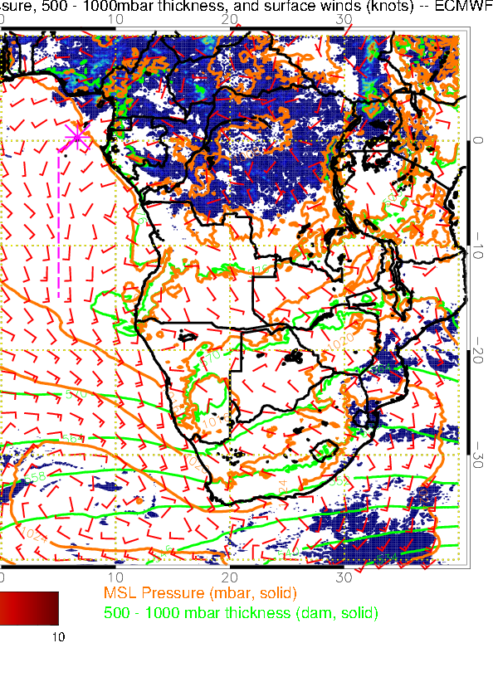
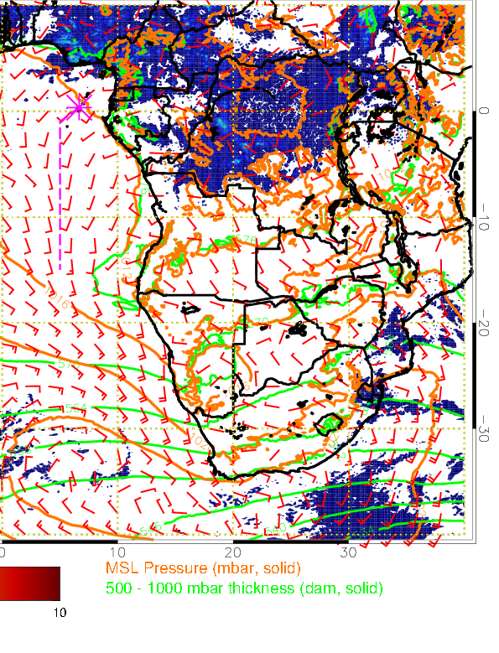
27 hour fcst
51 hour fcst
75 hour fcst

